Slide 1
Lesson 58
The Restoration Part 2

Slide 2
Great Apostasy
Restoration

Slide 3
The First Vision
Del Parsons

Slide 4
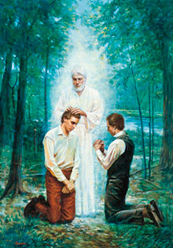
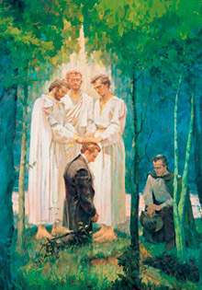
The Aaronic Priesthood
The Melchizedek Priesthood
The Latter-day Restoration of the Gospel

Slide 5
With the Bible, the Book of Mormon testifies of Jesus Christ and contains the fulness of the gospel.
Grant Heaton

Slide 6
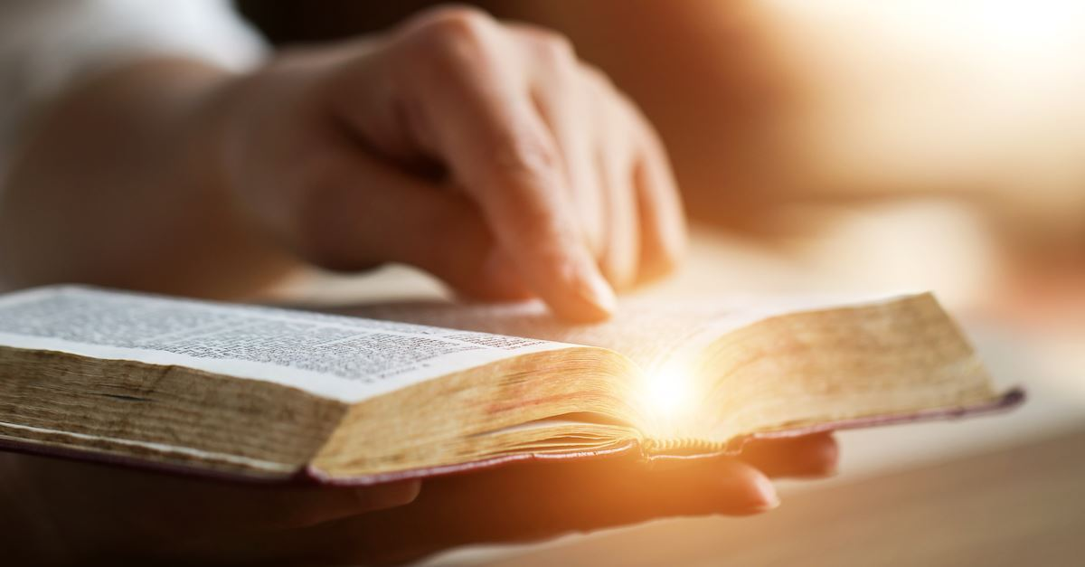
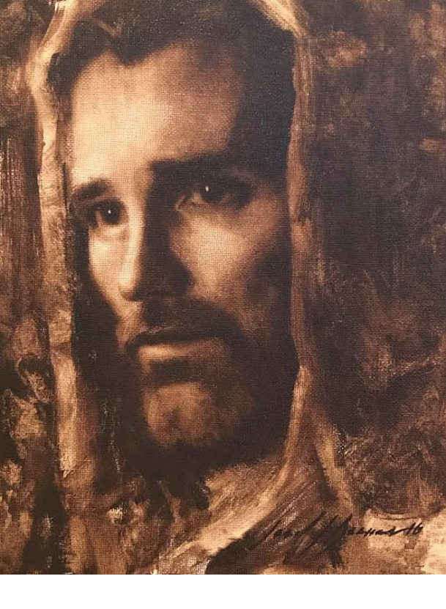
“The Bible and the Book of Mormon are both witnesses of Jesus Christ.
They teach that He is the Son of God, that He lived an exemplary life, that He atoned for all mankind, that He died upon the cross and rose again as the resurrected Lord.
They teach that He is the Savior of the world. …
“Love for the Book of Mormon expands one’s love for the Bible and vice versa.
Scriptures of the Restoration do not compete with the Bible; they complement the Bible” (1)

Slide 7
Book of Mormon and Bible Work Together
How do the Bible and the Book of Mormon work together to testify of Jesus Christ?
Why is it helpful to have multiple witnesses of Jesus Christ?

Slide 8
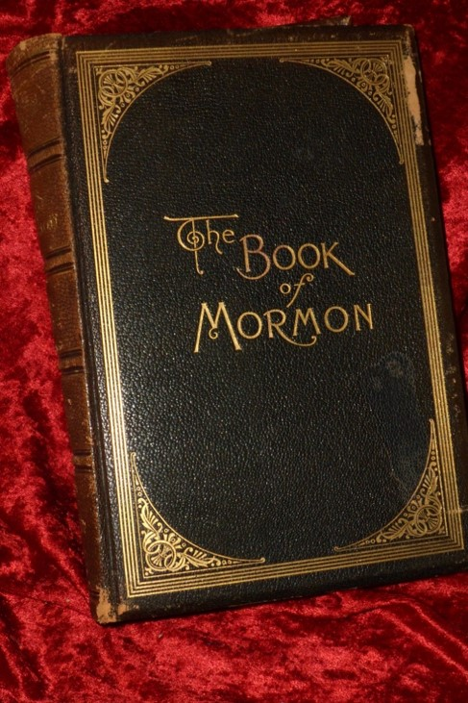
“The Lord Himself has stated that the Book of Mormon contains the ‘fulness of the gospel of Jesus Christ.
That does not mean it contains every teaching, every doctrine ever revealed. Rather, it means that in the Book of Mormon we will find the fulness of those doctrines required for our salvation.
And they are taught plainly and simply so that even children can learn the ways of salvation and exaltation” (2)
D&C 20:9

Slide 9
15 ¶ The word of the Lord came again unto me, saying,
16 Moreover, thou son of man, take thee one stick, and write upon it, For Judah, and for the children of Israel his companions: then take another stick, and write upon it, For Joseph, the stick of Ephraim, and for all the house of Israel his companions:
17 And join them one to another into one stick; and they shall become one in thine hand. Ezekiel 37:15-17
The Bible and the Book of Mormon testifies of Jesus Christ and contains the fulness of the gospel.

Slide 10
The Stick of Judah
The Stick of Ephraim
Holy Bible
The
Book
of
Mormon
ANOTHER TESTAMENT
OF JESUS CHRIST
Written predominantly by members of the tribes of Ephraim and Manasseh, who were the sons of Joseph.
Written predominantly by members of the tribe of Judah,

Slide 11
Sources:
Russell M. Nelson, “Scriptural Witnesses,” Ensign or Liahona, Nov. 2007, 43
” (Ezra Taft Benson, “The Book of Mormon—Keystone of Our Religion,” Ensign, Nov. 1986, 6).

