Slide 1
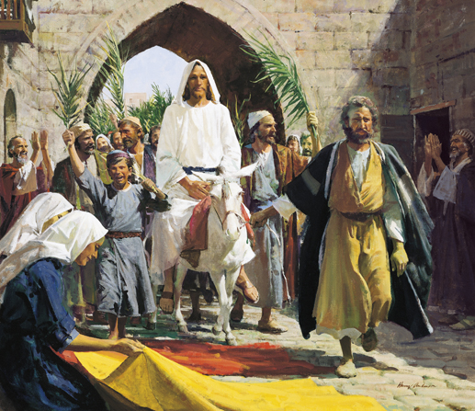
The Triumphal Entry
Luke 19:30-35

Slide 2
“A colt tied, whereon yet never man sat”
Zechariah 9:9
Matthew 21:2-7
Mark 11:2-7
John 12:14-15

Slide 3
“They spread their clothes in the way”
Luke 19:36
Matthew 21:8
Mark 1:8

Slide 4
“Took branches of palm trees, and went forth to meet him”
John 12:13
Matthew 21:8
Mark 11:8

Slide 5
Hosanna
Hosanna to the Son of David: Blessed is he that cometh in the name of the Lord”
Matthew 21:9
Mark 11:9-10
Luke 19:38
John 12:13

Slide 6
“If these should hold their peace, the stones, would immediately cry out”
Luke 19:40
John 12:19

