Slide 1
What Happened Between
?
Old Testament
New Testament
And are built upon the foundation of the apostles and prophets, Jesus Christ himself being the chief corner stone; Ephesians 2:20

Slide 2
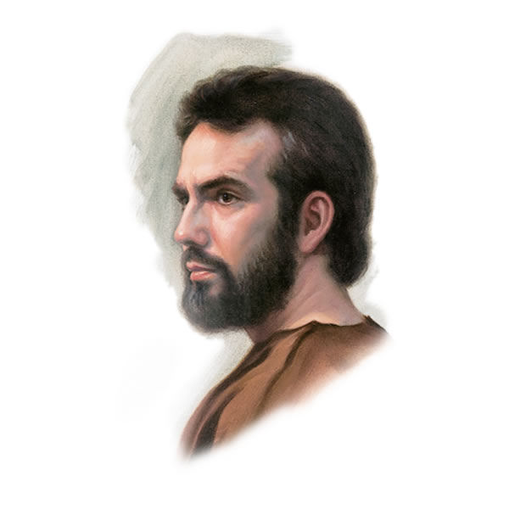
Lost 500 Years
When the prophet Malachi stepped off the earthly stage around 450 B.C., no genuine prophetic voice was heard again for about 500 years. We know this period as the intertestamental period—the gap between dispensations in the Old and New Testaments.
Without a prophet, people in the land began to divide into parties and groups, each claiming the right to interpret the scriptures and lead the people. The true understanding of Jehovah diminished among these groups.
(1)

Slide 3
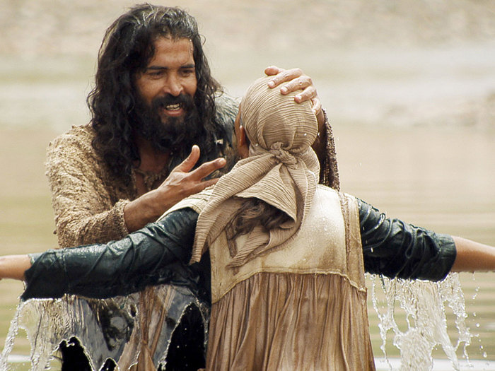
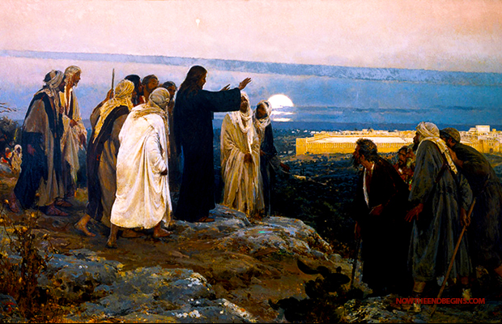
God Sends a New Prophet, John the Baptist
But even with John the Baptist and the Savior teaching the people, many were unable to overcome the traditions and beliefs
As we understand these 500 years and the confusion that accompanied them, we can understand more about the Savior’s ministry and renew our commitment to follow Him.
(1)

Slide 4
Timeline
Before 600 B.C.
600 B.C.
587 B.C.
515 B.C.
400 B.C.
332 B.C.
Babylon invaded Judah
Jerusalem rebuilt and became the center of Jewish worship
Alexander the Great conquered the region– a long period of Greek Rule--Hellenization
Prophets warned Jerusalem that the temple would be destroyed
Jerusalem fell, and a few who remained in and around Jerusalem, including the Samaritans eventually intermarried with non-Israelites
The Jews rejected the Samaritan’s and their offer to help reconstruct the temple…so the Samaritans built an alternate temple on Mount Gerizim 40 miles north of Jerusalem.
They offered competing claims to the priesthood
After Malachi: Behold, the days come, saith the Lord God, that I will send a famine in the land, not a famine of bread, nor athirst for water, but of hearing the words of the Lord:
Amos 8:11
(1)

Slide 5
Timeline
200 B.C
200 B.C.
168 B.C.
162 B.C.
63 B.C
60 B.C.
37 B.C.
Birth of Jesus.
Split between liberal Jews and conservative Jews
Pompeii conquered the Seleucids and made Judea a part of the Roman province of Syria.
Septuagint=
a translation of the Hebrew Bible and some related texts into Koine Greek. As the primary Greek translation of the Old Testament, it is also called the Greek Old Testament.
One group waiting for the Messiah was the Essenes, which formed during the Maccabean conflict.
See DEAD SEA SCROLLS *
Simon Maccabee took Judea out of the hands of Alexander's successors (the Seleucids), and began his own dynasty.
Nationalistic Jews in league with Parthian invaders, revolted. The Romans had appointed Herod ("the Great") as King of the Jews two years earlier, and he repelled the invaders and eliminated their Jewish supporters. He ruled the area until 4 B.C.
The Pharisees were an independent religious group that came into being soon after the Maccabean War.
(1)

Slide 6
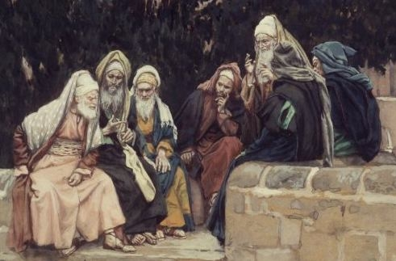
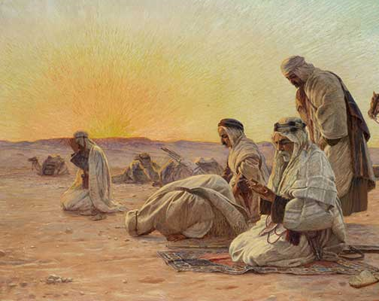
Without A Prophet To Guide The Jews
The Jews debated the meaning of the scriptures and about who the Messiah would be.
While most people waited for a Davidic Messiah (one descended from King David), others championed a Messiah who was the son of Aaron—a priestly Messiah.
Still others did not expect the Messiah to come.
For John came unto you in the way of righteousness, and ye believed him not—Matthew 21:32
None of the groups—scribes, Pharisees, Essenes, or Sadducees—accepted John the Baptist as a prophet or Jesus as the Messiah.
Some members of these groups became the primary adversaries of John and Jesus during their ministries
Read Matthew 21:23-46
(1)

Slide 7
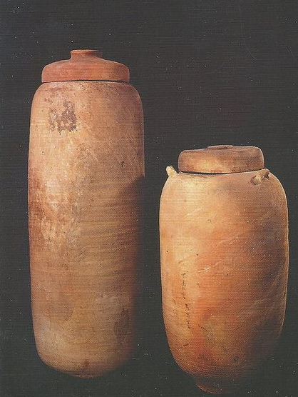
The Dead Sea Scrolls
In early 1947, three shepherds belonging to the Ta‘amireh Bedouin were searching for a stray animal. One of them threw a rock into a cave and heard an earthen jar break. When they entered the cave, they saw it contained several large clay jars, some of which held scrolls.* In the ensuing years, Bedouin and archaeologists found several hundred scrolls in 11 caves on the northwest shore of the Dead Sea.
Many scholars believe that the Dead Sea Scrolls are the greatest archaeological discovery of the 20th century. The scrolls provide an ancient library of more than 900 texts, most of them written in the original Hebrew of the Old Testament.
About 225 of the scrolls contain the oldest copy of the Old Testament (except for the book of Esther), which is more than 1,000 years older than the copies used during the Middle Ages. Most of the scrolls date between 150 B.C. and A.D. 68, although some texts date as far back as the third century B.C.
(1)

Slide 8
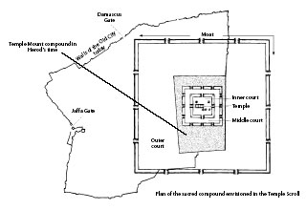
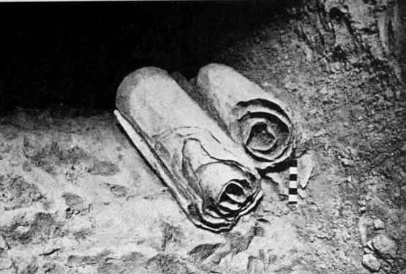
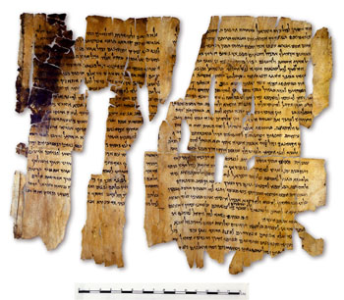
The Temple Scrolls
In addition to traditional biblical texts, the Dead Sea Scrolls also include the Temple Scroll (describing a temple to be built in Jerusalem and the ideal covenant society), the War Scroll (describing the end-of-days conflict), and texts parallel to the Bible (such as the books of Enoch, Noah, Melchizedek, and the testaments of Jacob, Judah, and Levi).
Little is known about Enoch in the Bible, but in the scrolls, Enoch is a major character—a mighty prophet with special gifts.
Most of the scrolls are severely fragmented because of age and exposure to the elements, but scholars have been able to glean a wealth of information about the scribal practices.
The scribes’ careful and meticulous work indicates a high level of professionalism and competence as they copied and transmitted sacred texts from one generation to the next. Those of us who love and appreciate the holy scriptures owe a great debt to these scribes for their careful work.
* Accounts of how the scrolls were discovered vary because the shepherds relied on their memories to recount the story years later.
(1)

Slide 9
Sources:
1. The Lost 500 Years: From Malachi to John the Baptist
By S. Kent Brown, Professor Emeritus of Ancient Scripture, and Richard Neitzel Holzapfel, Professor of Church History and Doctrine at Brigham Young University
Other Sources To Read:
Looking beyond the Mark: Why Many Did Not Accept the Messiah By Robert L. Millet Ensign July 1987
The Reality of the Resurrection By Richard D. Draper Ensign April 1994
There are also from Slides 12-23 which include some historical world dates…for the historian buff

Slide 10
Slide 5: The Pharisees became very influential in Jewish society by introducing a narrow focus on food laws and on ritual purity, aspects that were rooted primarily in their oral traditions, not scripture. In their homes, they tried to behave as if they were living in the temple.
The Sadducees, on the other hand, whose origins remain unknown, rejected any appeal to oral tradition and held strictly to the five books of Moses, turning their backs on the writings of other prophets. This group consisted mostly of the elite in Jerusalem society. By the time Jesus was born, they had expanded their power by asserting control over the Jerusalem temple.
Each of these religious groups preserved traditions and doctrines that they believed were essential to lives of devotion. But because they lacked the guidance of a true prophet, they were left to their own interpretations. (1)
Slide 5: The Essenes believed that the temple priests in Jerusalem were corrupt and the temple was in need of serious reform. In their view, the coming of the Messiah was near. They believed He would join with them to throw off the oppressive yoke of Rome, whose rulers had conquered Palestine some 60 years before the birth of Jesus. (1)
*Slide 5: The Dead Sea Scrolls:
This time had a remarkable production of religious literature, including the translation of the Hebrew Bible into Greek and the beginning of the creation of the Dead Sea Scrolls and the Apocrypha. During this time the ideas about angels, resurrection, and the concepts of heaven and hell became developed and refined.

Slide 11
Slide 5: The development of a Hellenized Jewish community in Alexandria (Egypt) led to a split between those liberal Jews and the more conservative Jews of Palestine. Also, the Samaritans, who inhabited what was originally Israel, broke ranks with the Jews of Judea (Judah), keeping only the original Torah as their scripture.
A Brief History of Judaism
Dr. C. George Boeree
http://webspace.ship.edu/cgboer/judaism.html
Slide 5: Palestine probably had a population of about two and one half million at this time, with some 100,000 people in Jerusalem. Three sects became influential among the Jews:
The Sadducees were a conservative, highly nationalistic group. They did not believe in immortality.
The Pharisees believed in strict application of the Law, and added an oral tradition. They did believe in immortality, and were more conciliatory towards the Romans.
The Essenes were an extremist monastic tradition, possibly influenced by Buddhist monastics. They believed that a Messiah would establish the Kingdom of Heaven, to which only the "pure" would be admitted.
Palestine is the name that the Romans gave to the area. It comes from their name for the Philistines, the people who once occupied the coast, and who may have been Greeks from Crete or Cyprus.
The earliest name for Palestine was Canaan, and today, of course, we call most of it Israel.
The Hebrews, the Canaanites, and the Phoenicians were ethnically the same people. Their languages were merely dialects of each other, and they shared in the use of the first alphabet.
Over time, the government of Palestine – mostly Roman-appointed Jews – would degenerate into incompetence and corruption. Groups of Zealots (fanatics) arose who swore to kill all disloyal Jews. They killed quite a few, and many Gentiles as well. The Gentiles of the area responded in kind. Emperor Vespasian sent his son Titus with Roman legions to Palestine and Titus offered the Jews a lenient settlement. The Zealots turned him down, so the legionnaires slaughtered them.In 70 ad, Titus ordered the Temple destroyed and the Jews dispersed – the Diaspora. Millions of Jews spread throughout the Empire, which already contained some seven million Jews – roughly 7 % of the Empire's population. With the Diaspora, the Sadducees disappeared and the Pharisees, by means of their teachers (rabbis) kept the flame alive by preaching the Law in thousands of synagogues.
Around 132 ad, there was another uprising by Jews in the Near East. The Emperor Hadrian outlawed teaching of the Law, and destroyed most of Judea. Many Jews went to Babylon, where they were fairly well treated and did quite well. In around 500 ad, they completed the Babylonian Talmud, a collection of commentaries on and explanations of the Law.
Within the Roman Empire, the Jews were granted citizenship (like everyone else) in 212 ad. They were, however, greatly disliked by other Roman citizens: They insisted on dressing differently, celebrating different holidays, eating different foods. Even more annoying was their exclusivity, their firm conviction that they were better than everyone else, and their disdain for anyone else's gods. The increasing popularity of one Jewish messianic sect – Christianity – only made things worse.
In 417 ad, Constantine, the first Christian emperor, lowered the Jew's status to secondary citizens of the Empire. They remained in that precarious position for the next 1400 years or so.

Slide 12
399 Spartan Dercylidas gained control of Troad. 399 Socrates tried and executed in Athens. 398 Sparta made truces with Pharnabazus and Tissaphernes. 396 Egypt aided Sparta in war on Persia. 396 Himilco abandoned Syracuse. North Africa 396 Spartan king Agesilaus invaded Phrygia. 396 Roman soldiers paid by the state. 395-380 Agesipolis I co-ruled Sparta. c. 395 Defense of Socrates by Plato. 394 Persian navy defeated Spartan navy off Cnidus. 394 Sparta defeated Athenian-Theban coalition at Corinth. 393 Mo-zi advised Prince Wen of Lu Yang. 393 Conon helped Athenians rebuild their long walls. Spartan Hegemony c. 393 Defense of Socrates by Xenophon. 392 Lysias gave patriotic funeral oration in Athens. Spartan Hegemony 392 Dionysius defeated Carthaginians led by Mago. 392 The Ecclesiazusae produced by Aristophanes. 391 Athenians rejected treaty, banished Andocides. Spartan Hegemony c. 390 Memoirs of Socrates written by Xenophon. c. 390 Charmides, Protagoras, Laches, Euthydemus written by Plato. 390 Gauls captured Rome, besieged citadel. 388 Athenians Thrasybulus and Conon died overseas. Spartan Hegemony 388 Lysias speech at Olympics criticized Greek wars. Spartan Hegemony 388 Plutus produced by Aristophanes. 387 Athenians supported revolt of Euagoras at Cyprus. Spartan Hegemony 387 Plato founded Academy in Athens. 386 Peace of Antalcidas between Greeks and Persia. 385 Roman dictator Camillus defeated Volscians. 384 Aristotle born in Stagira. 384 Demosthenes born in Attica. 382 Spartans seized citadel at Thebes. 380 Spartans defeated at Olynthus; Agesipolis killed. 380 Persia defeated Egypt and Euagoras. 380 Isocrates wrote Panegyric oration. c. 380 Meno, Gorgias, Phaedrus, Symposium, Phaedo by Plato.
World Chronology
399 B.C. to Birth of Jesus
380-371 Cleombrotus I co-ruled Sparta. 379 Syracuse defeated Carthage again; Mago killed. North Africa 378 Carthaginians beat Syracuse at Cronion, made treaty. 378 Spartans expelled from Theban citadel. 378 Spartan Sphodrias raided Piraeus. 378 Athens allied with Thebes against Sparta. 378-377 Spartan king Agesilaus invaded Boeotia. 377 Athens formed league with 70 cities, added tax. Spartan Hegemony 377-353 Mausolus ruled Caria. Persia 377-366 Tribunes Licinius and Sextius agitated for reform. Rome 376 Jin territory divided by Zhao, Wei, and Han. Warring States 376 Athenian Chabrias defeated Lacedaemonians at Naxos. Spartan Hegemony 374 Short peace between Athens and Sparta. 373 Athenians led by Iphicrates defeated Sparta at Corcyra. 373 Isocrates speech asked aid for Plataeans. 371 Athenians made peace with Sparta. 371 Thebes defeated Spartans at Leuctra. 371-289 Mencius taught Confucian philosophy in China. 371-287 Theophrastus studied with and succeeded Aristotle. 370 Jason of Pherae assassinated. Theban Hegemony 370-319 Hui ruled Liang advised by Mencius. Warring States 370-309 Cleomenes II co-ruled Sparta. Greece c. 370-295 Zhuang-zi wrote Daoist musings in Song. 370 Arcadian union built Megalopolis. Theban Hegemony 370 Boeotians led by Epaminondas invaded Lacedaemonia. Theban Hegemony c. 370 Republic written by Plato. 368 Ptolemy murdered Alexander II of Macedonia. Theban Hegemony 368 Iphicrates intervened in Macedonia. Theban Hegemony 368 Pelopidas, who helped Thessaly form union, captured. Theban Hegemony 368 Dionysius I defeated by Carthaginians at Lilybaeum. 368 Theaetetus written by Plato. 368 Isocrates wrote to Dionysius I of Syracuse. 367 Ariobarzanes revolted from Persia. 367 Persia recognized independence of Messenia.
Bolded sections have to do with background information into the study of the New Testament Times and Syria—where the lost ten tribes were scattered.
http://www.san.beck.org/AB-Chronology.html

Slide 13
367 Athens executed envoy Timagoras. Theban Hegemony 367 Plato visited Dionysius II in Syracuse. 367 Licinian law limited land ownership by Romans. 367-357 Dionysius II ruled Syracuse. 367-347 Aristotle studied in Plato's Academy. 366 Thebans seized Oropus. 366 Athens allied with Arcadia. Theban Hegemony 366 Lycomedes killed by Mantinean exiles. Theban Hegemony 366 Isocrates wrote oration for Spartan Archidamus. 366 Sextius first plebeian elected consul in Rome. 366 Roman patricians created new office of praetor. 365 Macedonian regent Ptolemy assassinated. Theban Hegemony 365 Athens led by Timotheus conquered and settled Samos. Theban Hegemony 364 Pelopidas killed attacking Alexander at Pherae. Theban Hegemony 364 Olympic games disrupted by Arcadian invasion of Elis. Theban Hegemony 364 Demosthenes sued trustees of his estate. 364 Etruscan dance and music used in Rome during a plague. 362 Epaminondas killed in battle at Mantinea. Theban Hegemony 362 Ariobarzanes crucified by Persia in satrap revolt. 361 Agesilaus mercenary in Egypt's revolt from Persia. 361 Corcyra oligarchs left Athenian league. Theban Hegemony c. 360 Hellenica history of Greece 411-362 by Xenophon. c. 360 Laws written by Plato. 360 Plato visited Syracuse again. 360-338 Archidamus co-ruled Sparta. Macedonian Expansion c. 360-270 Pyrrho of Elis founded Skeptical school of philosophy. 359 Qin duke Xiao instituted reforms of ShangYang. 359 Cotys of Thrace and Alexander of Pherae killed. Macedonian Expansion 359 Macedonian king Perdiccas killed.
359-336 Philip II ruled Macedonia. 358 Macedonian Philip defeated Paeonians and Illyrians. 358 Rome outlawed bribery and reduced interest rates. 357 Philip II's army captured Amphipolis.
357 Chios, Rhodes, and Cos seceded from Athenian league. Macedonian Expansion 357 Chian fleet killed Chabrias and blockaded Samos. Macedonian Expansion 357 Dion led revolution in Syracuse. 356 Caria, Rhodes, Chios, Cos, and Byzantium confederated. Macedonian Expansion 356 Philip's army captured Pydna and Potidaea. 356 Isocrates wrote letter to Spartan king Archidamus. 356 Phocians seized treasury of Delphi. Wars 356 Alexander III born in Macedonia. 356 Rutulus first plebeian appointed dictator of Rome. 355 Athenians acquitted Iphicrates and fined Timotheus. Wars 355 Chares supported Artabazus rebellion against Persia. Wars 355 Athens made peace with Chios, Rhodes, Cos, Byzantium. Wars 355 On the Peace written by Isocrates. 355 Demosthenes spoke against Leptines and Androtion. c. 355 Ways and Means written by Xenophon. 354 Thebans defeated Phocians, killed Philomelus. Wars 354 Areopagiticus written by Isocrates. 354 Samnites allied with Rome. 354 Dion murdered in Syracuse. 354-353 Callippus ruled Syracuse. Sicily 354-350 Eubulus administered Theoric fund in Athens. Wars 353-351 Hipparinus ruled Syracuse. Sicily 353 Philip's Macedonian army captured Methone. 353 Phocians led by Onomarchus captured Coroneia. Wars 353 Demosthenes spoke against Aristocrates. 352 Macedonians defeated Phocian army. 352-337 Han reformed by prime minister Shen Bu-hai. Warring States 351 First Philippic oration by Demosthenes. 351-346 Nysaeus ruled Syracuse. Sicily c. 350 Nyaya Sutras by Gautama. c. 350 Mimamsa Sutra by Jaimini. c. 350 Vedanta Sutra by Badarayana. c. 350 Jataka tales told in India.
http://www.san.beck.org/AB-Chronology.html

Slide 14
349 Thirty-two cities of Chalcide submitted to Philip. 349 Three Olynthiac orations by Demosthenes. 348 Philip's forces captured Olynthus. 348 Rome renewed treaty with Carthage. 348 Roman taxes, interest, and conscription reduced. 347 Plato died in Athens. 347 Athenian embassy led by Philocrates to Philip. 347-339 Speusippus headed Academy in Athens. Aristotle 346 Athens made treaty with Macedonia. 346 Philip allied with Thebes defeated Phocis. 346 Isocrates wrote to Macedonian king Philip. 346-344 Dionysius II ruled Syracuse. 345 Aeschines prosecuted Timarchus. 345-343 Persia invaded Egypt. 344 Demosthenes made speeches in the Peloponnese. 344 Second Philippic oration by Demosthenes. 344 Timoleon defeated Hicetas at Hadranum. 343-338 Spartan king Archidamus II fought in Italy. 343 Philocrates and Aeschines impeached in Athens. 343 Antiphon executed for treason by Athens. Wars 343 Demosthenes and Aeschines spoke on the treaty. 343 Roman senate declared war on Samnites. 343-341 Athenians formed various alliances. Wars 342-341 Philip's Macedonian army invaded Thrace. 342-336 Aristotle tutored Alexander in Macedonia. 342-292 Menander wrote more than a hundred comedies. 341 Third Philippic and On the Chersonese by Demosthenes. 341-325 Rome observed truce with Samnites. 341-270 Epicurus founded Hedonist school of philosophy. 340 Qin attacked state of Wei. Warring States c. 340 Lie-zi told Daoist tales in Zheng. 340 Amphictyonic Council conflicts. Wars 340 Philip appointed Alexander regent in Macedonia. 340, 338 Athenians crowned Demosthenes. 339 Amphictyons asked Philip to lead sacred war. 339 Timoleon's army defeated Carthaginians at Crimisus.
339-329 King Wei ruled Chu. Zhuang-zi 339-314 Xenocrates headed Academy in Athens. 338 ShangYang executed in Qin. 338 Macedonian army captured Amphissa and Chaeronea. 338 Timoleon liberated Sicily, instituted democracy. 338-326 Lycurgus administered Athenian finances. Demosthenes 338-318 Sicily ruled by democracy. 337-333 Demosthenes administered Athenian Theoric fund. 336 Philip sent force to secure the Hellespont. 336 Philip murdered; Alexander made king of Macedonia. 336 Alexander elected general by the Greeks. 336 Aristotle founded Lyceum in Athens. 336-330 Darius III ruled Persian empire. 335 Macedonian army attacked Ionian coast. Alexander 335 Alexander invaded Thrace and Illyria. 335 Alexander's Macedonians destroyed Thebes. 335-323 Aristotle lectured on logic, metaphysics, nature. 335-323 Aristotle lectured on Ethics, Politics, and Rhetoric. 334 Yue taken over by Chu. Warring States 334-323 Alexander's Macedonian army conquered Persian empire. 334-263 Latins settled in 19 colonies in Italy. 334 Alexander's Macedonian army conquered Lydia. 334 Alexander of Epirus defeated Brettian league in Italy. 333 Alexander's Macedonian army conquered Cilicia. 332 Alexander's army conquered Phoenicia, Judea, and Egypt. c. 332-260 Zeno founded Stoic school of philosophy. 331 Samaritans killed Alexander's governor Andromachos. Jews
331 Alexandria founded in Egypt. Alexander 331 Macedonian army defeated Persians at Gaugamela. Alexander 331 Revolt led by Spartan king Agis defeated at Megalopolis. Alexander 330 Alexander's Macedonian army destroyed Persepolis. 330 Alexander of Epirus killed in battle at Pandosia. Alexander 330 Aeschines spoke against Ctesiphon and Demosthenes. 330 Demosthenes defended himself in On the Crown. 329 Alexander’s Macedonian army conquered Arachosia. 329 Romans defeated Privernum.
http://www.san.beck.org/AB-Chronology.html

Slide 15
328 Zhang Yi made prime minister of Qin. Warring States 328 Demosthenes became Athenian wheat commissioner. 328-308 Nastasen ruled Kushites using Meroitic script. Africa 328-302 Second Roman-Samnite war. 328-299 Huai ruled Chu. Warring States 327 Alexander's Macedonian army conquered Sogdiana. 326 Alexander's Invasion of India. 325 Hui proclaimed king of Qin. Warring States 324 Alexander and 80 officers wed Persians. 324 Demosthenes convicted and exiled from Athens. 324-300 Chandragupta founded Mauryan dynasty. 323 Zhang Yi made prime minister of Wei. Warring States 323 Hephaestion and Alexander died of possible poisoning. 323 Aristotle, accused of impiety, fled Athens. 323-283 Ptolemy I Soter ruled Egypt. Alexander's Successors 322 Aristotle died in Chalcis. 322 Demosthenes poisoned himself. 322 Antipater's Macedonians put down Athenian revolt. Alexander's Successors 322-307 Macedonian garrison in Athens. Alexander's Successors 321 Ptolemy's forces defeated and killed Perdiccas in Egypt. Alexander's Successors 321 20,000 Roman soldiers surrendered to Samnites. 321-301 Antigonus I ruled Asia Minor area. Alexander's Successors 320-c. 310 Mencius advised Qi king Xuan. c. 320 Qin army killed 80,000 in Han. Warring States c. 320 Su Qin formed alliance against Qin. Warring Stats c. 320-300 Ju Yuan diplomat in Chu, Qi, and Qin. Songs of Chu c. 320-232 Cleanthes studied and taught Stoic philosophy. 319 Antipater died in Macedonia, succeeded by Cassander. Alexander's Successors 317 Zhang Yi made prime minister of Qin again. Warring States 317 Eudemus left India. Mauryan Empire 317-289 Agathocles ruled Syracuse. Alexander's Successors 316 Cassander executed Olympias, mother of Alexander. Alexander's Successors
316 Cassander executed Olympias, mother of Alexander. Alexander's Successors 316 Dyskolos by Menander won a prize at Athens. 315 Yen king abdicated, caused revolt; Qi invaded Yen. Warring States 315 Romans captured 7,000 Samnite soldiers at Luceria. 315-281 Lysimachus ruled Thrace area. Alexander's Successors 315-241 Arcesilaus founded Middle Academy in Athens. Pyrrho 314 Qin attacked Wei. Warring States 314-260 Zeno taught Stoic philosophy in Athens. 313 Qin king Hui-wen sent Zhang Yi to Chu with gifts. Warring States 312 Ptolemy I defeated Demetrius at Gaza. Alexander's Successors 312 Censor Appius Claudius started highway and aqueduct. Rome 312-280 Seleucus I ruled Mesopotamia area. Alexander's Successors c. 310 Qi and Qin defeated Chu, killing 80,000. Warring States 310 Agathocles' Syracusan army attacked Carthage. Alexander's Successors 310 Roman army defeated Etruscans. c. 310-240 Callimachus wrote poetry in Alexandria. c. 310-250 Theocritus wrote poetry in Alexandria and Syracuse. 310-212 Xun-zi taught Confucian philosophy in China. 309-265 Areus I co-ruled Sparta. Greece 307 Macedonian Demetrius liberated Athens. Alexander's Successors 306-270 Epicurus taught hedonistic philosophy in Athens. 306 Rome's treaty with Carthage renewed. 305 Treaty made by India's Chandragupta and Seleucus. Alexander's Successors 305 Macedonian Demetrius captured Rhodes. Alexander's Successors c. 302 Qi king Xuan founded Ji-Xia academy. Warring States 302 Rome intervened for aristocratic class at Arretium. 301 Antigonus defeated and killed at Ipsus. Alexander's Successors 301 Ptolemy I claimed Syria. Alexander's Successors 301-281 Lysimachus ruled Anatolia area. Alexander's Successors 301-266 Mithridates I ruled Pontus. Alexander's Successors.
c. 300 Ju Yuan composed Songs of Chu. c. 300 Kautilya wrote Artha Shastra. c. 300 Euclid taught geometry, wrote Elements in Alexandria. c. 300 Sacred History written by Euhemerus. Greece
http://www.san.beck.org/AB-Chronology.html

Slide 16
298 Cassander died in Macedonia. Alexander's Successors 298 Agathocles' army captured Corcyra from Macedonia. Alexander's Successors 298-290 Third Roman-Samnite war. 297-279 Zipoetes I ruled Bithynia. Seleucid Empire 297-272 Pyrrhus I ruled Epirus. Alexander's Successors 296 Rome intervened for aristocratic class at Lucania. c. 295-215 Apollonius of Rhodes wrote the Argonautica. Alexandrian Poetry 294 Demetrius of Phalerum organized museum in Alexandria. 294-288 Demetrius ruled Macedonia. Alexander's Successors 293 Qin army attacked Han and Wei, killing 240,000. Warring States 292 Qin army invaded Chu. Warring States 290 Aetolian League took over Delphi. Alexander's Successors 289-280 Hicetas ruled Syracuse. Alexander's Successors 288 Qin king Zhao proclaimed Western Emperor in China. Warring States 288 Qi king proclaimed Eastern Emperor in China. Warring States 288 Pyrrhus and Lysimachus conquered Macedonia. Alexander's Successors 287 Ptolemy I married Berenice. Egypt 287 Hortensius Roman dictator; plebiscites (type of voting) made law. 286 Qi took over Song. Warring States c. 286-206 Chrysippus studied and taught Stoic philosophy. 284 Yen, Qin, Wei, and Zhao invaded Qi. Warring States 284 Xun-zi and scholars fled Ji-Xia academy. 284-276 Xun-zi taught Confucian philosophy in Chu. 283 Gauls invaded Etruria; Romans destroyed Senones. 283-246 Ptolemy II Philadelphus ruled Egypt. 282 Tarentines destroyed Roman fleet. 281 Lysimachus defeated by Seleucus and killed in Lydia. Alexander's Successors 281 Seleucus assassinated by Ptolemy Ceraunus. Alexander's Successors c. 280 Qin devastated Zhao, Wei and Han. Warring States c. 280 Han prince Han Fei-zi born. 280 Ptolemy II's army took Damascus from Seleucids. 280-274 Pyrrhus' army invaded Italy and Sicily. 280-261 Antiochus I ruled Seleucid empire.
279 Gauls invaded Macedonia, killed Ceraunus. 279 Aetolian League defeated Gauls at Delphi. Greece 279-250 Nicomedes I ruled Bithynia. Seleucid Empire 278 Qin army invaded Chu. Warring States c. 277 Poet Ju Yuan drowned. Songs of Chu 277 Antigonus II defeated invading Gauls at Lysimacheia. 277-239 Antigonus Gonatas ruled Macedonia. 276 Gauls invaded Anatolia and settled Galatia. Seleucid Empire 276-265 Xun-zi taught at Ji-Xia academy in Qi. 275 Antiochus I defeated Galatians in Anatolia. Seleucid Empire 275 Ptolemy II Philadelphus married his sister Arsinoe. 274 Antiochus I invaded lower Syria. Seleucid Empire 273 Latin colony settled in Cosa. Italy c. 273-236 Ashoka ruled India. 272 Pyrrhus invaded Peloponnesus and was killed. Greece 270-215 Hiero II ruled Syracuse. Rome 268 Latin colony settled in Ariminum. Italy 268 Roman silver coin denarius (day's wage) minted. 267-261 Chremonidean War between Athens and Macedonia. 265-259 Xun-zi taught in Qin and Zhao. 264 Latin colony settled in Firnum. Italy 264 Rome intervened for aristocratic class at Volsinii. 264 First gladiatorial contests held in Rome. 264-241 Carthage fought first Punic war against Rome. North Africa 263-241 Eumenes I ruled Pergamum. Seleucid Empire 261 Ashoka converted to Buddhism. 261-246 Antiochus II ruled Seleucid empire. 260 Qin army defeated Zhao at Chang-ping, killing 400,000. Warring States 260 Ephesians revolted against Egypt. Seleucid Empire c. 260 Apollonius of Rhodes became librarian at Alexandria. 260 Roman navy defeated Carthaginians at Mylae. 259 Antigonus Gonatas defeated Egyptians off Cos. Macedonia 256 Qin army attacked Han, killing 40,000. Warring States 256 Roman navy captured 64 Carthaginian ships.
http://www.san.beck.org/AB-Chronology.html

Slide 17
255 Ptolemy II ceded Ionia and Cilicia to Antiochus II. 255 Ariarathes III began ruling Cappadocia. Seleucid Empire 255 Spartan general Xanthippus defeated Rome's Regulus. c. 254-184 Plautus produced comedies for Rome. 253 Roman fleet wrecked by storm off Palinurus. 252 Antiochus II married Ptolemy's daughter Berenice. c. 250 Xun-zi magistrate of Lan-ling in Chu. c. 250 Guan-zi and Book of ShangYang Legalist texts. c. 250 Bactria led by Diodotus became independent. Seleucid Empire 250 Romans besieged Lilybaeum. 249 Qin army defeated and ended Zhou dynasty. Warring States 249 Sicyon joined Achaean League. Greece 249 Carthaginians captured 93 Roman ships at Drepana. 247 Li Si left Xun-zi and gained an office in Qin. Warring States c. 247 Ashoka prohibited killing animals for sport. 247-207 Devanampiyatissa ruled Ceylon. India 246 Zheng became king of Qin. Warring States 246-226 Seleucus II ruled Seleucid empire. 246-221 Ptolemy III Euergetes ruled Egypt. 245 Aratus elected general of Achaean League. Greece 245 Aetolian League defeated Boeotians. Greece 244-241 Agis IV co-ruled Sparta. Greece 243 Achaeans led by Aratus captured Corinth. Greece 242 Rebuilt Roman navy defeated Carthaginians. c. 241 Ptolemy III signed peace treaty in Palestine. 241 Rome annexed Sicily. 241-238 Mercenary revolt crushed in Carthage. 241-235 Leonidas II ruled Sparta. Greece 241-219 Phoenician coast ruled by Ptolemies. 241-197 Attalus I ruled Pergamum. Seleucid Empire c. 240 Livius Andronicus adapted Greek plays in Rome. Plautus 239-229 Demetrius II ruled Macedonia. 239-169 Quintius Ennius adapted Greek tragedies in Rome. Plautus
238 Seleucus II defeated Antiochus the Hawk near Ancyra. Seleucid Empire 238-225 Rome invaded and annexed Sardinia and Corsica. 238-229 Carthage's Hamilcar conquered Iberia (Spain).
237 Li Si succeeded Lu Bu-wei as Qin prime minister. Warring States 235 Achaeans declared war on Lacedaemonians. Greece 235-222 Cleomenes III co-ruled Sparta. Greece 234 Qin army attacked Han. Warring States 234 Han king An sent Legalist Han Fei-zi as his envoy to Qin. 233 Legalist Han Fei-zi died of poison in Qin. 231 Federal republic established in Epirus. Greece 230 Qin annexed Han. Warring States 230 Seleucus II invaded Parthia. Seleucid Empire 230-228 Roman army intervened in Illyria. 230-182 Prusias I ruled Bithynia. Seleucid Empire 229 Argos joined Achaean League. Greece 228 Qin annexed Zhao. Warring States 228 Athens paid off Macedonian garrisons. 227 Achaeans defeated by Spartan forces at Elis. Greece 227 Cleomenes III reformed Sparta. Greece 227 Colossus of Rhodes destroyed in earthquake. Greece 226 Roman-Carthaginian treaty in Spain. 226-223 Seleucus III ruled Seleucid empire. 225 Qin annexed Wei. Warring States 225 Roman army defeated invading Gauls. 224 Macedonia allied with Achaeans, Thessaly, Epirus, etc. 223 Qin annexed Chu. Warring States 223-187 Antiochus III ruled Seleucid empire. 222 Qin annexed Yen. Warring States 222 Macedonian alliance defeated Sparta at Sellasia. 222 Insubres Gauls submitted to Rome. 221 Qin annexed Qi. Warring States 221 Qin king Zheng proclaimed August Emperor (Huang-di). 221 Hasdrubal assassinated and replaced by Hannibal. Carthage 221-206 Qin dynasty united China. 221-179 Philip V ruled Macedonia. 221-204 Ptolemy IV Philopator ruled Egypt. 220-219 Antiochus III's army put down revolt in Babylon. Seleucid Empire 220-210 Great wall construction continued in China. Qin Empire
http://www.san.beck.org/AB-Chronology.html

Slide 18
219 Li Si made a high minister of Qin empire. 219 Roman navy defeated piratical Demetrius of Pharos. 219 Hannibal captured Saguntum in Spain. Carthage 219-217 Antiochus III's Seleucids invaded Phoenicia. 218 Attempted assassination of Qin emperor. 218 Lex Claudia barred Roman patricians from commerce. 218 Hannibal crossed Alps and invaded Italy. Carthage 218-201 Carthage fought 2nd Punic war against Rome. North Africa 217 Egyptians defeated Antiochus III at Raphia. Seleucid Empire 217 Philip V made a treaty with Aetolians. Greece 217 Roman navy defeated Hasdrubal off the Ebro. 217 Hannibal defeated Roman army at Lake Trasimene. 216 Carthaginian army defeated Roman forces at Cannae. c. 215 The Menaechmi by Plautus performed in Rome. 214 500,000 "criminals" sent to invade Luliang in China. Qin Empire 214 Antiochus III besieged Achaeus at Sardis. Seleucid Empire 214 Romans led by Fabius Maximus devastated Caudini. 213 Qin emperor ordered books burned. 213 Li Si made chancellor of Qin empire. 213-211 Syracuse besieged by Marcellus and Romans. 213-129 Carneades headed New Academy in Athens. Pyrrho 212 700,000 forced to build Qin emperor's palaces. 212 Roman army up to 25 legions. 212-211 Capua starved into surrender by Romans. 212-204 Antiochus III invaded Parthia and Bactria. Seleucid Empire 211 Meteor landed and inscribed in China. Qin Empire 211 Archimedes killed as Syracuse is captured by Romans. 210 First Qin emperor died. 210 12 Latin colonies refused to support Roman war. 209 Chen She began revolt against Qin dynasty. 209 Scipio's Roman army captured New Carthage in Spain. 208 Zhao Gao appointed Chancellor of Qin empire. 208 Philopoemen's Achaeans defeated Sparta at Mantinea. Greece
207 Second Qin emperor killed. 207 Nabis instituted radical policies in Sparta. Greece 207 Rome's Scipio defeated Hasdrubal at Metaurus in Spain. 206 King Zi-ying surrendered, ending Qin dynasty. 206 Xiang Yu declared Protector king of Western Chu. Han Dynasty 206 Liu Bang (governor of Pei) appointed king of Han. Han Dynasty 206-8 CE Western Han dynasty ruled China.
205 Xiang Yu defeated king of Han. Han Dynasty 205 The Swaggering Soldier produced by Plautus. 205 Carthaginian army surrendered Spain at Gades. 204 Asian cult of mother goddess Cybele brought to Rome. 203 Rome's Scipio defeated Syphax's Numidians in Africa. 203-181 Ptolemy V Epiphanes ruled Egypt. 203-187 Nubians controlled Thebes. Africa 202 Xiang Yu defeated committed suicide. Han Dynasty 202-195 King of Han named Emperor Gao-zu ruled China. Han Dynasty 202 Rome's Scipio defeated Hannibal at Zama near Carthage. 201 Rome made treaty with Carthage and Masinissa. 201-169 Jia Yi wrote "Faults of Qin." Han Dynasty 200 Gao-zu established Chinese capital at Chang-an. Han Dynasty c. 200 Daoist Lu Jia wrote New Discourses. Han Dynasty c. 200 Yoga Sutras written by Patanjali. Yoga 200 Seleucid army defeated Egyptians at Panium. 200 Insubres destroyed Placentia. Rome 200 Rome declared war on Philip's Macedonia. 200 Stichus produced by Plautus. 199 Aetolians joined Roman alliance against Philip. Greece 198 Achaeans and Boeotians joined Roman alliance. Greece 198 Carthaginian captives and slaves revolt crushed. Rome 197 Roman army defeated Macedonian army in Thessaly. 197 Roman army defeated Insubres and Hamilcar. 197 Romans defeated Macedonian phalanx at Cynocephalae. 197 Rome made peace treaty with Macedonia's Philip V. 197-160 Eumenes II ruled Pergamum. Seleucid Empire
http://www.san.beck.org/AB-Chronology.html

Slide 19
196 Edict promoting men of virtue in China. Han Dynasty 196 Flamininus proclaimed Greek liberty at Corinth. Rome 196 Slave rebellion in Etruria put down. Rome 195 Lex Oppia restricting women's luxuries repealed. Rome 195 Rome declared war on Spartan tyrant Nabis. 195-188 Hui-di ruled China. Han Dynasty 194 Romans withdrew garrisons from Greece. 194-185 Cao Can Daoist prime minister in Qi. Han Dynasty 192 Antiochus III's Seleucid army invaded Greece. 192-189 Rome at war with Seleucid Antiochus III. 191 Romans defeated Seleucids at Thermopylae and Corycus. 191 Pseudolus produced by Plautus. 190 Scipio's army defeated Seleucid army at Magnesia. Rome 189 Roman forces punished Galatia for raids. 188 Seleucids lost Anatolia in treaty of Apamea. 188 Achaean League led by Philopoemen captured Sparta. Greece 188-180 Empress Lu ruled China as regent. Han Dynasty c. 187 Brihadratha's death ended Mauryan dynasty in India. 187 Scipio brothers charged with peculation in Rome. 187-175 Seleucus IV ruled Seleucid empire. c. 187-151 Pushyamitra ruled in India.
186 Bacchic cult suppressed in Rome. 186 Amphitryo produced by Plautus. c. 185 Terence born a slave in Carthage. 184 Elder Cato elected censor in Rome. 183 Pontic king Pharnaces I invaded Galatia. Seleucid empire 182 Messenia revolted; Philopoemen poisoned. Greece 181 Philip's son Demetrius killed by poison. Greece 181-173 Cleopatra I ruled Egypt as regent. c. 180 Wisdom of Jesus the Son of Sirach written. Judea 180-157 Wen-di ruled China. Han Dynasty
179-167 Perseus ruled Macedonia. c. 179-105 Confucian Dong Zhong-shu founded Yin Yang school. 177 Xiong-nu invaded Honan. Han Dynasty 177 Sempronius Gracchus defeated Sardinians. Rome 175-163 Antiochus IV Epiphanes ruled Seleucid empire.
175 Bactrians invaded northern Mauryan empire.
174 Mao-Dun, founder of Xiong-nu empire, died. Han Dynasty 173 Roman consul Popillius Laenas subjugated Statielli. 173-145 Ptolemy VI Philometor ruled Egypt and Cypress. 172 Menelaus appointed high priest in Jerusalem. Judea 172 Rome declared war on Macedonia. 171-168 Roman army invaded Greece. c. 171-155 Eucratides I ruled Bactria. Seleucid Empire 171-138 Mithridates I ruled Parthia. Seleucid Empire c. 170 Bactrian king Demetrius II conquered northwest India. Seleucid Empire 169 Seleucid army invaded Bactria. 169 Antiochus IV captured Ptolemy VI at Memphis. Seleucid Empire 169-116 Ptolemy VII ruled Cyrene. 168 Antiochus IV seized Jerusalem treasury. Seleucid Empire Judea 168 Rome's envoy Popillius forced Antiochus out of Egypt. 168 Romans defeated Macedonian army at Pydna. 167 Mutilation removed from Chinese penal code. Han Dynasty 167 Antiochus IV Epiphanes Hellenized Jerusalem temple. Seleucid Empire 167-150 1000 Achaeans including Polybius held in Rome. Greece 166 The Woman of Andros produced by Terence in Rome. 165 Civil service exams began in China. Han Dynasty 165 The Mother-In-Law produced by Terence. 164 Maccabees rededicated Jerusalem temple. Judea c. 164 Daniel written in Judea. (speculation) 163 The Self-Tormentor produced by Terence. 162 China's Wen-di made peace with Xiong-nu king. Han Dynasty 162-150 Demetrius I ruled Seleucid kingdom. 161 Alcimus appointed high priest in Jerusalem. Judea 161 The Eunuch and Phormio produced by Terence. 160 Judas killed in Maccabean revolt. Judea 160 The Brothers produced by Terence. c. 160 On Agriculture written by the elder Cato. Rome 157-141 Jing-di ruled China. Han Dynasty
155 Athenian philosopher diplomats dismissed from. Rome c. 155-130 Menander ruled Bactria. Seleucid Empire
There are various additions to the book of Daniel not included in the present canon, some of which are found in the Apocrypha, that is, the Song of the Three Children, the History of Susanna, and Bel and the Dragon.-- Bible Dictionary
http://www.san.beck.org/AB-Chronology.html

Slide 20
154 Chao Cuo executed for seizing territory in China. Han Dynasty 154 Rome made Bithynia's Prusias II pay war damages. 154-138 Rome at war with Lusitanians in Spain. 152-142 Jonathan high priest in Jerusalem. Judea 151 Roman men resisted conscription. Rome c. 150 Laws of Manu written. c. 150 Panchatantra tales written down. c. 150 Books found in house of Confucius. Confucian Works c. 150 Steel and paper manufactured in China. Han Dynasty 150 Achaean League attacked Sparta. Greece 150-146 Third Punic war of Rome with Carthage. 150-145 Balas ruled Syria. Seleucid Empire c. 150-120 Mithridates V ruled Pontus. Seleucid Empire 149 Andriscus raised an army and ravaged Thessaly. Greece 149 Lex Calpurnia established extortion court in Rome. 149-146 Carthage fought 3rd Punic war against Rome. North Africa 147-145 Egypt's Ptolemy VI Philometor invaded Syria. 146 Carthage destroyed by Romans 146 Romans defeated Achaean army, destroyed Corinth. Greece 145-140 Demetrius II ruled Syria. Seleucid Empire 145-116 Ptolemy VII (Euergetes II) ruled Egypt. 145-101 Elara ruled Sri Lanka (Ceylon). India c. 145-90 Sima Qian wrote biographies and history of China. Wu-di's Reign 144 Xiong-nu invaded Shanxi. Han Dynasty 142-135 Simon Maccabeus ruled Judea. 141-87 Wu-di ruled China. 140 Mithridates I captured Seleucid king Demetrius II. 140-129 Antiochus VII ruled Syria. Seleucid Empire 139 Huai-nan-zi presented to Wu-di. 139 Astrologers and Jews expelled from Rome. 138-133 Attalus III ruled Pergamum. Rome 136 Dong Zhong-shu founded imperial university in China. Wu-di's Reign 135 Empress Dowager Dou died in China. Wu-di's Reign 135-131 Chancellor Tian Fen promoted Confucians. Wu-di's Reign 135-132 Slave revolt in Sicily led by Syrian Eunus. Rome c. 135-50 Poseidonius taught philosophy at Rhodes. Stoics
133 Attalus III willed Pergamum to Rome. 133 Roman army destroyed Numantia in Spain. 133 Roman tribune Tiberius Gracchus proposed land reform. 133 Senators killed Tiberius Gracchus in Rome. 133-119 Wu-di warred against Xiong-nu. 131-126 Ptolemy VII exiled from Egypt by Cleopatra II. c. 130 Luxuriant Gems of the Annals written by Dong Zhong-shu. Confucian Works 129 Roman province of Asia organized. Reforms 129-104 John Hyrcanus I ruled Judea. 128 China invaded Manchuria and Korea. Wu-di's Reign 125 Consul Fulvius Flaccus proposed Italian citizenship. Reforms 123 Gaius Gracchus elected tribune and proposed reforms. 123- 86 Mithridates II ruled Parthia. Seleucid Empire 122 Huai-nan king's rebellion failed. Wu-di's Reign 121 China invaded Mongolia. Wu-di's Reign 121 Gaius Gracchus killed in Rome riots. 121 120,000 Gauls were killed by Roman army. Reforms 120 700,000 disaster victims moved to Shanxi. Wu-di's Reign c. 120-63 Mithridates VI ruled Pontus. Rome 119 Imperial monopolies of salt and iron began in China. Wu-di's Reign 118 Numidian king Micipsa died; kingdom divided. Marius 116-108 Cleopatra III and Ptolemy VIII co-ruled Egypt. 114 Wu-di's travel caused two governors' suicides. 114 Last religious human sacrifice in Rome. Marius 113-112 Numidian Jugurtha besieged Adherbal at Cirta. Marius 112 China used criminals in army and construction. Wu-di's Reign 112 Rome declared war on Numidia's Jugurtha. Marius 110 Wu-di broke with Confucians over sacrifices. 110 Sang Hung-yang began Chinese standards bureau. Wu-di's Reign 109 China invaded south to Vietnam. Wu-di's Reign 108 China established four commanderies in Korea. Wu-di's Reign 108-101 Cleopatra III and Ptolemy IX co-ruled Egypt. 107 Marius elected consul and replaced Metellus in Africa.
http://www.san.beck.org/AB-Chronology.html

Slide 21
106 Cicero and Pompey born in Italy. 106 Sulla captured Jugurtha in Africa. 105 Chinese envoys reached Seleucia. Wu-di's Reign 105 Teutons and Cimbri defeated Romans at the Arausio. Marius 104 Mithridates VI occupied Galatia and Cappadocia. Marius 104 Jugurtha executed in Rome. Marius 104 Slaves revolted in Sicily. Marius 103-90 China war with Xiong-nu killed many. Wu-di's Reign 103-76 Alexander Janneus ruled Judea. 102 Marius' proletarian Roman army defeated Ambrones. 101 Chinese sailors using compass reached India. Wu-di's Reign 101-88 Ptolemy IX and Berenice co-ruled Egypt. 101-77 Dutthagamani ruled and unified Sri Lanka (Ceylon). India c. 100 Li Ji compiled by Dai De and Dai Sheng. Li (Propriety) c. 100 "Sir Fantasy" poem written by Sima Xiang-ru. Wu-di's Reign c. 100 Bhagavad-Gita written. 100 Marius served sixth consecutive Roman consulate. 100 Reforming tribune Saturninus killed in Rome. Marius 100 Julius Caesar born in Rome. 99 Du Zhou prosecuted many in China. Wu-di's Reign 99 Historian Sima Qian arrested and castrated. Wu-di's Reign 97 Scaevola established judicial tribunals in Asia. Marius 97 Rome banned human sacrifice. Marius 94-74 Nicomedes IV ruled Bithynia. Sulla 93-87 Pharisee revolt put down in Judea. 92 Rutilius Rufus convicted of extortion by Romans. Marius 91 Many executed for sorcery in China. Wu-di's Reign 91 Tribune Drusus assassinated in Rome. Marius 91-88 Rome war with Marsi and other Italians. Marius 89 Asiello murdered by creditors in Rome. Marius
88 Mithridates VI invaded Bithynia and Asia Minor. Marius 88 Sulla's Roman legions besieged and captured Athens. 88 Sulla marched on Rome; tribune Sulpicius killed. 88-81 Ptolemy VIII ruled Egypt. 87-84 Consul Cinna ruled Rome. Sulla
87-68 Ho Guang ruled China for Zhao-di and Xuan-di. Confucian China 87-30 BC 86 Flaccus' and Fimbria's soldiers deserted to Sulla. 86 Marius died of illness during 7th consulate.
84 Cinna killed by troops mutinying at Ancona. Sulla 83 Armenian king Tigranes I conquered Syria. Sulla 83 Sulla's forces returned to Italy, aided by Pompey. 83-66 Tigranes I ruled Armenia. Pompey 82 Sulla won Roman civil war, proscribed enemies. 81 Japanese emperor Sujin ordered shipbuilding. Confucian China 87-30 BC 81 Salt and iron monopolies debated in China. Confucian China 87-30 BC 81-79 Dictator Sulla reformed Rome's laws. 80 Cicero defended Sextus Roscius on murder charge. 80-51 Ptolemy XI king of Egypt. 79-78 Sulla retired and died of illness. 78 Roman Consul Lepidus proposed reforms. Pompey 78-75 Servilius attacked pirates in Lycia and Cilicia. Pompey 77 Catulus defeated Lepidus; Pompey sent to Spain. 77-59 Saddhatissa ruled Sri Lanka. India 77-6 Liu Xian added to Songs of Chu. 76-67 Salome Alexandra ruled Judea. 75 Cicero served as quaestor in western Sicily. c. 75-30 Kanvas dynasty ruled in India. 74 Nicomedes IV bequeathed Bithynia to Rome. Pompey 74 Armenian Tigranes I invaded Cappadocia. Pompey 74 Mithridates VI invaded Bithynia; Rome sent Lucullus. Pompey 74 Rome annexed Cyrene. Pompey 73-71 Spartacus led slave revolt in Italy crushed by Crassus. 72 Perperna murdered Sertorius in Spain. Pompey 70 Consuls Crassus and Pompey reformed Sullan laws. 70 Cicero prosecuted Verres for governing Sicily corruptly. 70-19 Virgil wrote poetry in Italy. 69 Roman army led by Lucullus invaded Armenia. Pompey 69-63 Judea civil war between Hyrcanus II and Aristobolus II. 68-48 Xuan-di ruled China. 67 Pompey cleared pirates out of the Mediterranean. 67 Rome annexed Crete. Pompey
http://www.san.beck.org/AB-Chronology.html

Slide 22
66 Lucullus replaced by Pompey in Mithridatic war. 66 Cicero praetor and defended Cluentius. 65 Julius Caesar aedile and Crassus censor in Rome. 63 Pompey made Judea a Roman province. 63 Julius Caesar elected pontifex maximus and praetor. 63 Cicero defended Rabirius on murder charge. 63 Cicero defended Murena on bribery charge. 63 Consul Cicero executed 5 Catiline conspirators. 62 Pompey organized Syria as a Roman province. 62 Catiline and Manlius defeated and killed fleeing Italy. Cicero 62 Pompey given the largest triumph in Rome. 61-60 Caesar became rich governing farther Spain. 60 Caesar elected consul allied with Pompey and Crassus. 59-56 Ptolemy XI exiled from Egypt. 59-50 Caesar' governed and conquered Gaul. 58-56 Rome sent Cato to annex Cypress. 58 Tribune Clodius passed law distributing free grain. Cicero 58 Caesar's army defeated Helvetii and Ariovistus. 58-57 Cicero exiled from Rome in Greece. 57 Caesar's army defeated Belgae and Nervii. 57-37 Orodes ruled Parthia. Crassus 56 Cicero opposed Caesar's land law. 56 Pompey, Crassus, and 120 senators met Caesar at Luca. 55 Second consulship of Pompey and Crassus. 55 Pompey sent Syrian governor Gabinius to occupy Egypt. 55 Caesar's army invaded Germans and Britain. 55 Cicero wrote on Oratory. c. 55 Lucretius, who wrote poem On the Nature of Things, died. 54 Julia, Caesar's daughter and Pompey's wife, died. c. 54 Catulls, who wrote erotic poetry, died at the age of 30.
53 Crassus took 10,000 talents from Jerusalem temple. 53 Crassus was killed invading Parthia. 52 Clodius attacked Milo and was killed. Cicero 52 Caesar's army defeated revolt led by Vercingetorix. 51 Confucian classics formalized by Xuan-di. c. 51 Cicero wrote his Republic. 51-48 Ptolemy XII and Cleopatra VII co-ruled Egypt.
c. 50 Mayans used hieroglyphics. 50 Pompey mobilized his forces. 49 Pompey fled; Caesar made dictator in Rome. 49 Caesar's army won battle at Ilerda in Spain. 49 Curio's army destroyed by Juba's Numidians. Caesar 48 Caesar's army defeated Pompey's at Pharsalus. 48 Pompey killed in Egypt; Caesar fought Alexandria. 48-33 Yuan-di ruled China by Confucian principles. 48-30 Cleopatra VII ruled Egypt. 47-44 Julius Caesar ruled Roman empire as dictator. 46 Caesar's army victorious at Thapsus in Africa. c. 46 Laws by Cicero. 45 Julian calendar inaugurated by Caesar. 45 Caesar's army victorious at Munda in Spain. 45-43 Cicero wrote books on philosophy and ethics. 44.3.15 Caesar assassinated by Casca, Cassius, Brutus, et al. 44 Conspirators fled Rome; Octavian returned to Rome. 44 Mark Antony assigned to Gaul. 44-43 Cicero's "Philippics" criticized Antony. 43 Octavian defeated Antony at Mutina. 43 Rhodes devastated by Cassius. Brutu 43.8.19 Roman senate elected Octavian consul. 43.8.27 Octavian, Antony, and Lepidus formed triumvirate. 43 Proscriptions killed Cicero and many others. Antony 42 Antony defeated Cassius and Brutus at Philippi. 42-36 Sextus Pompey controlled Sicily. Octavian 41 Antony visited Cleopatra in Alexandria. 40 Antony and Octavian divided Roman empire. 40 Virgil wrote pastoral Eclogues. 38 Octavian divorced wife and married Livia in Rome. 37 Roman triumvirate renewed for five years. Octavian 37-4 Herod I ruled Judea. 36 Agrippa defeated Sextus Pompey in naval battle. Octavian 36 Antony retreated from Armenia. 34 Antony invaded Armenia, donated kingdoms.
http://www.san.beck.org/AB-Chronology.html

Slide 23
34 Antony invaded Armenia, donated kingdoms. 33-7 Cheng-di ruled China. 32 Antony divorced Octavia; his will read in Rome. 31 Octavian defeated Antony and Cleopatra at Actium. 30 Antony and Cleopatra committed suicide at Alexandria. 30 Octavian made tribune for life in Rome. 30 Virgil wrote Georgics.
29 Propertius published poems. 29-17 Vattagamani ruled island of Lanka. India 29 Herod had his wife Mariamme executed. 28 Bastarnae, Moesians and Thracians conquered by Rome. 27 Octavian given the name Augustus. 26 Romans secured sea trade to Somalia and India. 25 Romans sold Salassi tribe into slavery. Rome 24 Herod bought Egyptian grain to relieve famine. 23 Augustus consolidated power as imperator and tribune. 23 Roman army led by Petronius plundered Napata. Nubia 23 Horace published Odes. 22 Revolts by slaves in Chinese imperial iron works. China 22 Marcus Primus tried for making war on Thrace. Rome c. 20 Buddhist Tripitaka was written in Pali. India 20 Rome made peace with the Parthians. 20 Herod began rebuilding temple at Jerusalem. 16 Rome annexed by force Noricum and Raetia. 14 Peasants revolted in China. c. 13 Horace published Art of Poetry. 12 Augustus became chief priest in Rome. 10 New city Caesarea completed in Judea. 10 Tiberius married Augustus' daughter Julia. 9 Drusus died returning from Germany. Rome 7 Herod executed Aristobolus and Alexander. c. 6 Jesus born to Mary in Bethlehem. 4 King Herod executed Antipater and died. 4 BC-6 CE Archelaus ruled Judea for Rome.
http://www.san.beck.org/AB-Chronology.html

