Slide 1
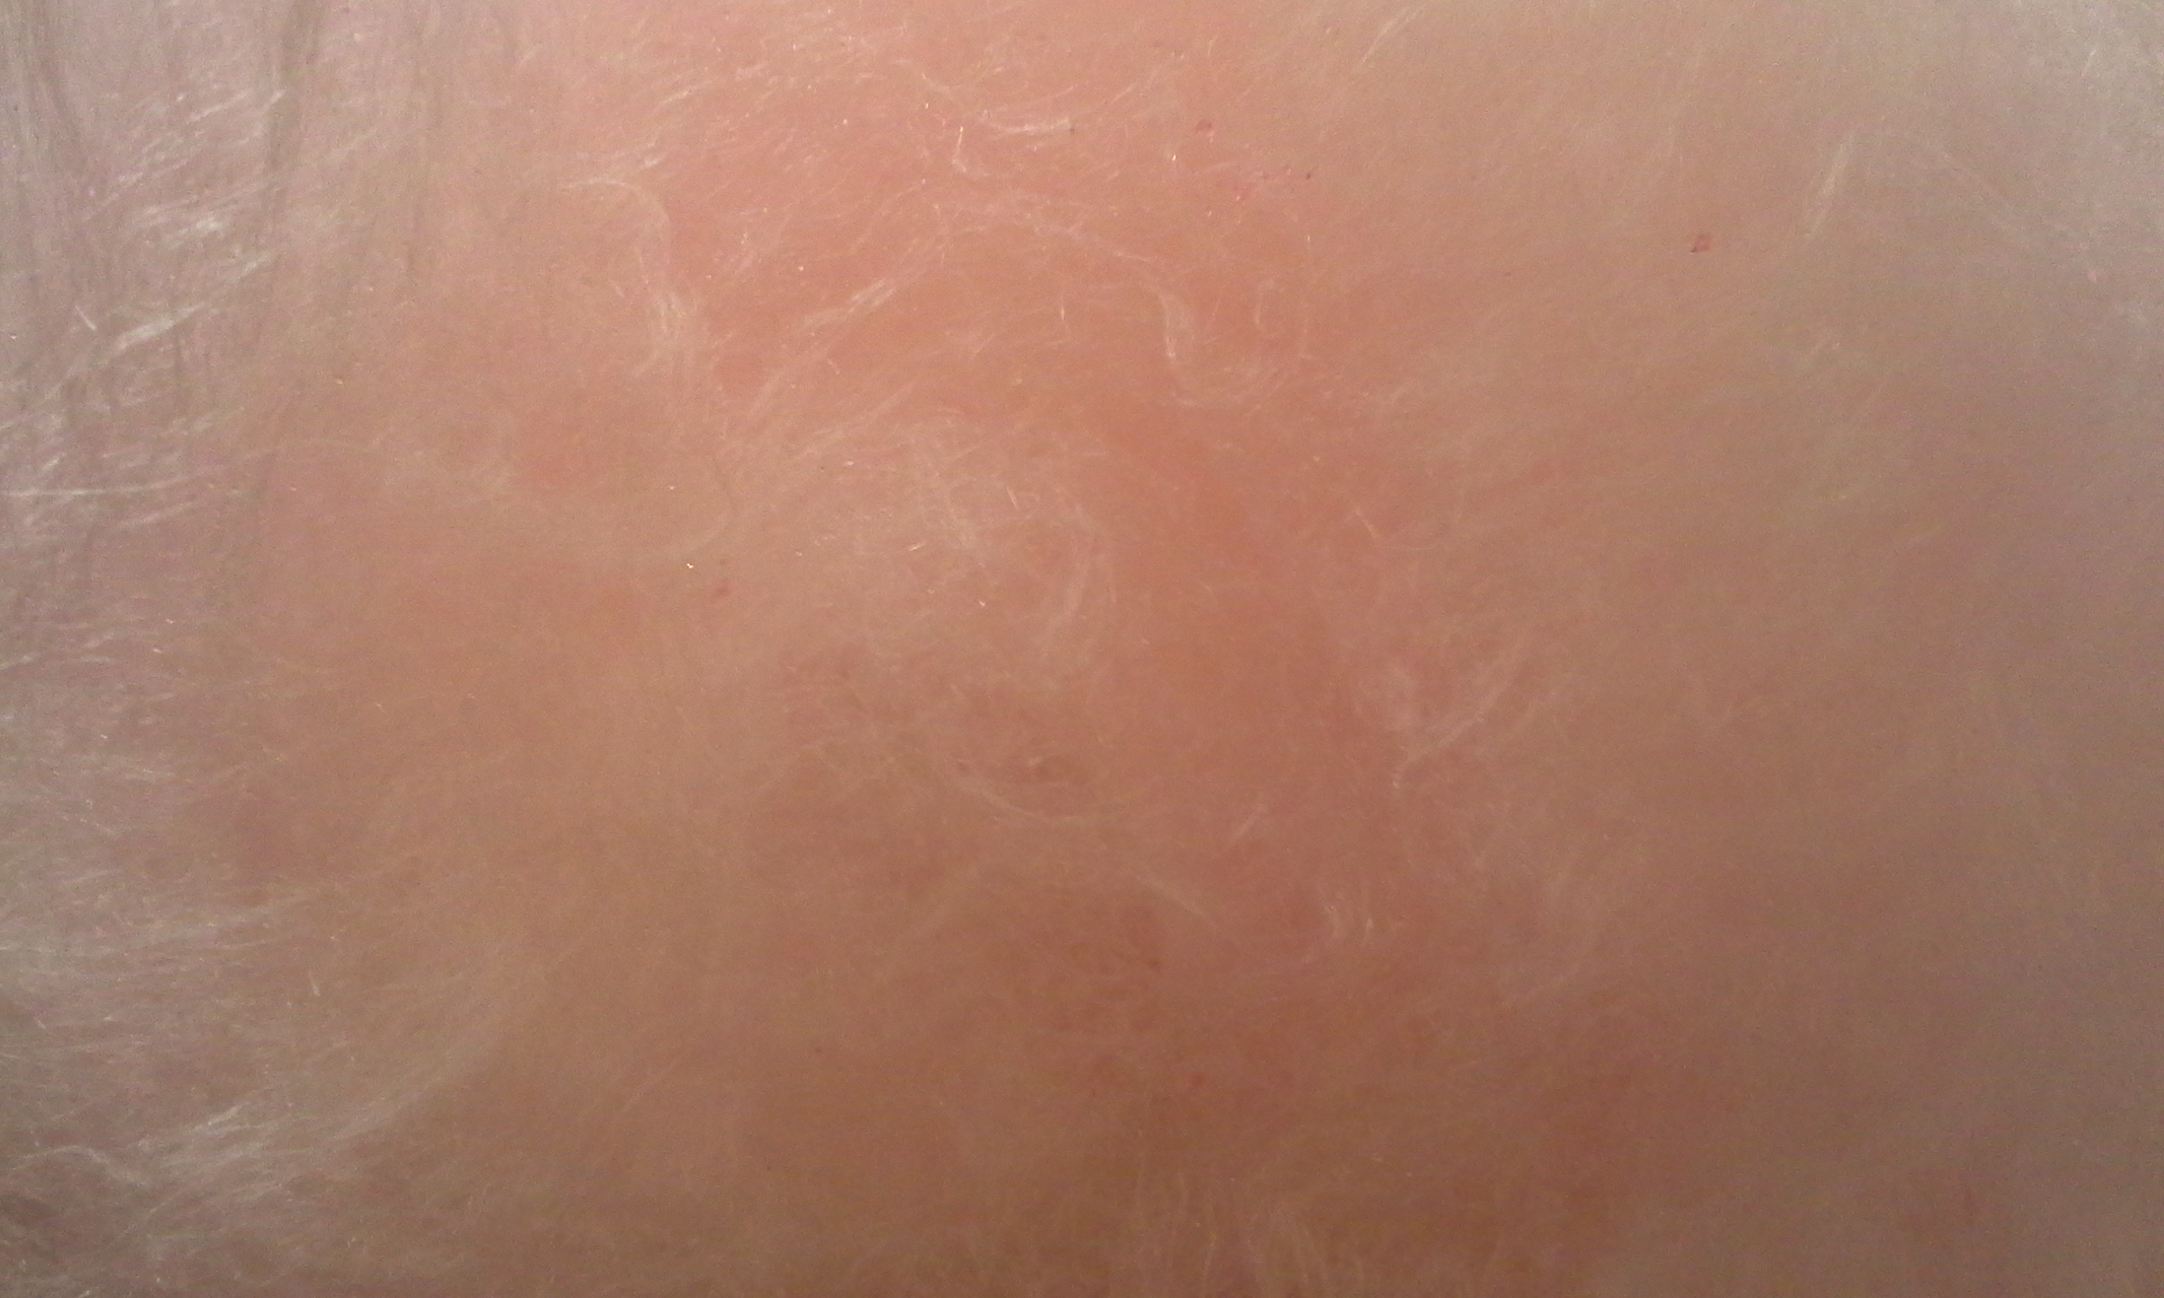
Lesson 140 Part 2
Sorrow, Remorse, and Consequences of Sin
Lamentations
Presentation by ©http://fashionsbylynda.com/blog/

Slide 2
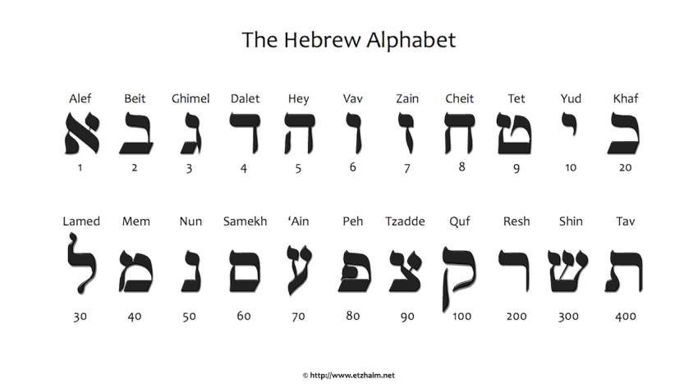
Lamentations
The Book of Lamentations was written by Jeremiah 586 B.C.
This book is perhaps the saddest book in the Bible and written after the fall of Jerusalem
Lamentation describes the funeral of the city, once proud and noble, now reduced to rubble
The entire book of Lamentations is written in carefully constructed poetry.
An acrostic is a poetic form in which the first letters of each line or verse form a meaningful sequence. Lamentation 1-4
It was customary in ancient Judah to compose and sing lamentations about departed friends or relatives. (1)

Slide 3
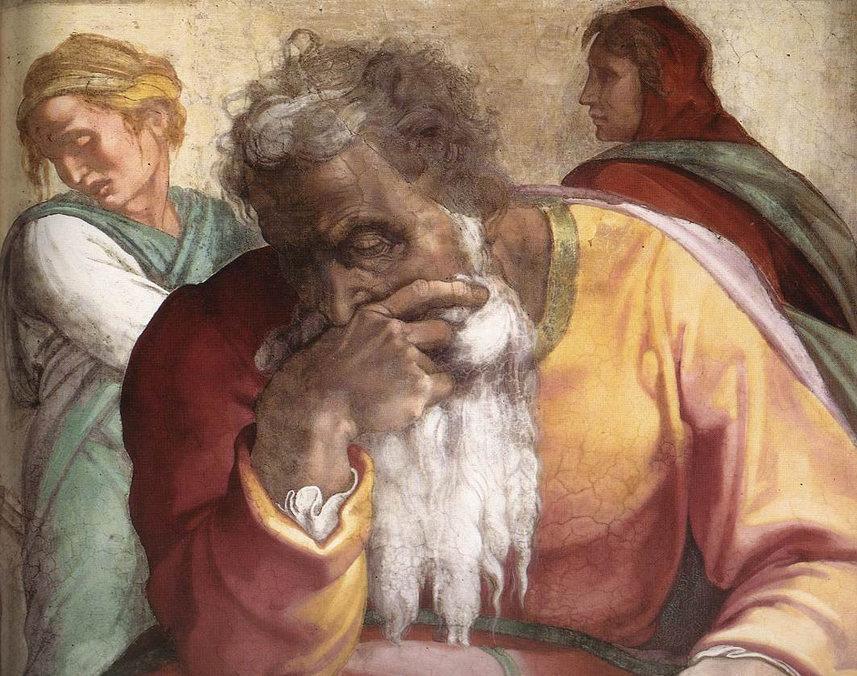
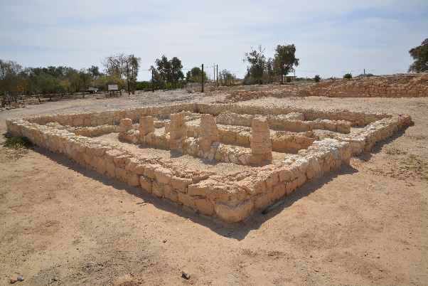
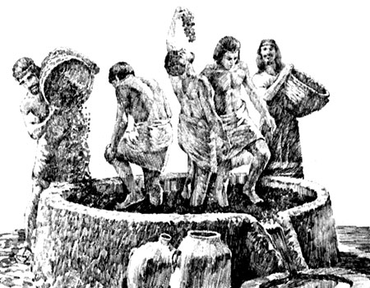
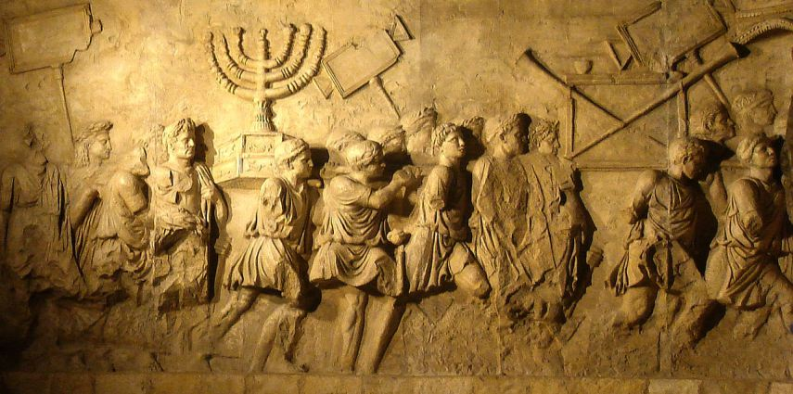
Lamentations 1
Destruction of Jerusalem
Lamentations 1
The Mourning City
The Grief
1:1
1:2
1:3
Jeremiah laments the desolate state of Jerusalem following its destruction by the Babylonians
Because the people of Judah chose to ignore the warnings of Jeremiah and other prophets and disobey their teachings, choosing wickedness instead, the Babylonians destroyed Jerusalem.
Abandoned Jerusalem:
Widow
Lovers—false gods
Mocked her Sabbath—forsook
Pleasant things—the things that were taken out of Jerusalem
Fire in her bones
A yoke around the neck
The crushing of grapes in a winepress.

Slide 4
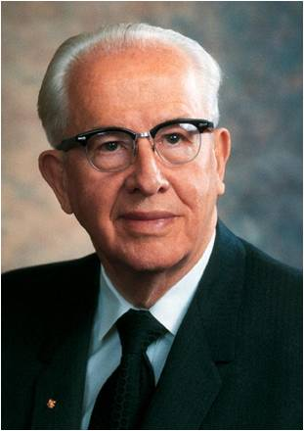
“You cannot do wrong and feel right. It is impossible! Years of happiness can be lost in the foolish gratification of a momentary desire for pleasure.
Satan would have you believe that happiness comes only as you surrender to his enticements, but one only needs to look at the shattered lives of those who violate God’s laws to know why Satan is called the Father of Lies” (2)

Slide 5
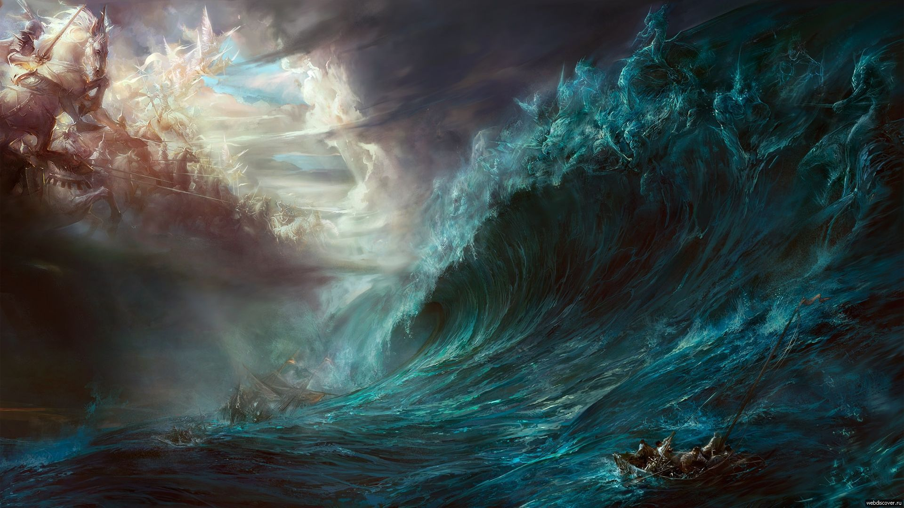
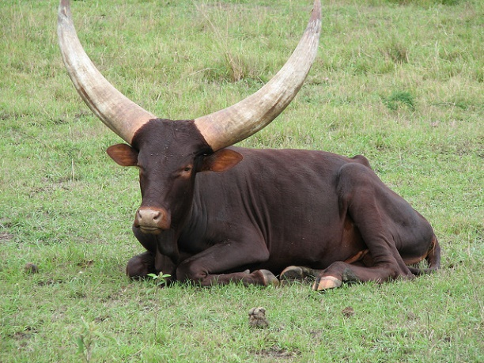
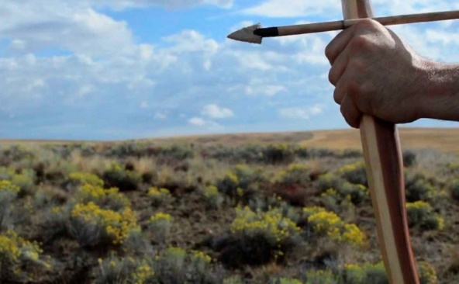
Lamentations 2
Anger of Jehovah
Lamentations 2
A Broken People
The Cause
Jeremiah acknowledges that Jerusalem was destroyed because the people rebelled against the commandments of the Lord.
1:1
1:2
1:3
Verse 2: Swallowed Up –The Lord has permitted Jerusalem to be destroyed
Verse 7: a noise in the house = Instead of trumpets all that is heard is warlike sounds
Verse 3: Horn of Israel = The principle strength for cattle is in their horns
Verse 8: Stretched out a line = a line of devastation making what is pulled down is destroyed
Verse 9: Gates are sunk = neglected
Verse 4: Bent his bow = the archer. He first bends his bow; then sets his arrow upon the string; and, lastly, placing his right hand on the lower end of the arrow, in connection with the string, takes his aim, and prepares to let fly.
Verse 11: Swoon in the streets = famine
Verse 13: Breach like the sea = flood of afflictions, sea of troubles, an ocean of misery
(3)

Slide 6
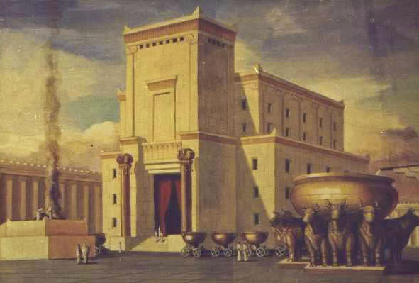
Lamentations 2
Verse 16: This is the day we look for = many surrounding nations were anxious for Jerusalem to fall
Verse 15: Perfection of beauty = the temple was a structure of beauty while Jerusalem city was not
Verse 18: Wall of thy daughter = lament, tears
Verse 19: Cry out in the night = a fervent prayer
Verse 20: Consider to whom thou hast done this = The priests and prophets had been slain. They had brought it on themselves
(3)

Slide 7
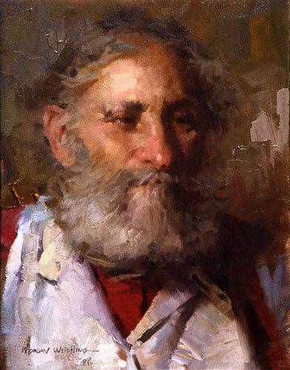
Lamentations 3
Prayer for Mercy
Lamentations 3
A Suffering Prophet
The Hope
3:1-3
3:4-6
Jeremiah prays for Judah’s deliverance and expresses hope in the Lord, whose mercy is upon those who trust in Him.
In their sinful state the people felt that the Lord had abandoned them.
In reality, the people had moved away from God.
Morgan Weistling

Slide 8
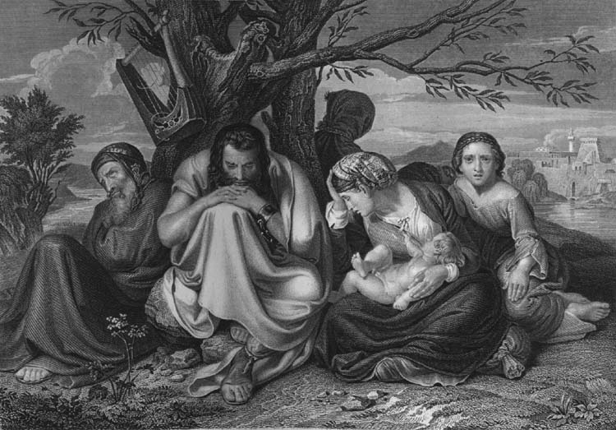
Lamentations 4
Siege of Jerusalem
Lamentations 4
A Ruined Kingdom
The Repentance
1:1
1:2
1:3
Jeremiah compares the conditions of the Jews before and after the destruction of Jerusalem. He sorrows as he considers the pitiful state of the people and acknowledges that these conditions are the result of sin.
Who was responsible for the suffering?
First, the “sons of Zion” once “comparable to fine gold” had become inferior vessels like those made of earthen clay.
The mothers of Judah, unlike the monsters (whales and other large fish) of the sea who feed their young properly, had neglected their children. Wickedness was everywhere.
The bitter hunger experienced during the siege of Jerusalem, led some to eat their own children. (vv. 8-10)
(1)

Slide 9
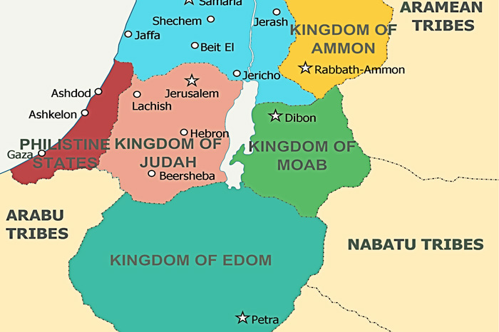
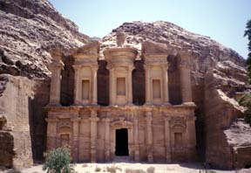
Lamentations 4
Edom, at the time of Jerusalem’s capture, had sought to enrich herself through Judah’s tragedy, and her actions at that time were bitterly resented by the Jews.
But the Jews could console themselves with the thought that whereas their own punishment was now accomplished, that of Edom was still to come: “The cup also shall pass through unto thee.”
Remember: Edom would not allow the Israelites to use their roads on their way to Canaan (Numbers 20:17-21),
Obadiah 1:10-16; Ezekiel 25:12-14; Psalm 137:7-9
(1)

Slide 10
Lamentations 5
Prayer for Restoration
Lamentations 5
A Repentant Nation
The Prayer
Jeremiah prays for those who survived the destruction of Jerusalem, pleading for God to notice their desolation, forgive them, and allow them to return to the Lord and be restored as a people.
Verse 2: Our inheritance is turned to strangers =
The greater part of the Jews were either slain or carried away captive; and even those who were left under Gedaliah were not free, for they were vassals to the Chaldeans.
Jeremiah pled that the Lord would forgive the people and make them clean, as they had been in former times.

Slide 11
Sources:
Suggested Hymn: #129 Where Can I Turn For Peace
Video: LDS Addiction Recovery Program: Meet Karen (4:11)
Old Testament Institute Manual The Babylonian Captivity Chapter 24
President Ezra Taft Benson (“A Message to the Rising Generation,” Ensign, Nov. 1977, 30).
Adam Clarke Bible Commentary
Presentation by ©http://fashionsbylynda.com/blog/

Slide 12
Destruction of Jerusalem | Anger of Jehovah | Prayer for Mercy | Siege of Jerusalem | Prayer for Restoration
Lamentations 1 | Lamentations 2 | Lamentations 3 | Lamentations 4 | Lamentations 5
The Mourning City | A Broken People | A Suffering Prophet | A Ruined Kingdom | A Repentant Nation
The Grief | The Cause | The Hope | The Repentance | The Prayer
Grief and Sorrow Comes from Sin:
“The prophecies and lamentations of Jeremiah are important to Latter-day Saints. Jeremiah and the Jerusalem of his day are the backdrop to the beginning chapters in the Book of Mormon. Jeremiah was a contemporary of the prophet Lehi [see 1 Nephi 5:13; 7:14]. …
“We learn valuable lessons from this tragic period. We should do everything within our power to avoid the sin and rebellion that lead to bondage [see D&C 84:49–50]. …
“Bondage, subjugation, addictions, and servitude come in many forms. They can be literal physical enslavement but can also be loss or impairment of moral agency that can impede our progress. Jeremiah is clear that unrighteousness and rebellion were the main reasons for the destruction of Jerusalem and captivity in Babylon. …
“Our challenge is to avoid bondage of any kind, help the Lord gather His elect, and sacrifice for the rising generation. We must always remember that we do not save ourselves. We are liberated by the love, grace, and atoning sacrifice of the Savior. … If we are true to His light, follow His commandments, and rely on His merits, we will avoid spiritual, physical, and intellectual bondage as well as the lamentation of wandering in our own wilderness, for He is mighty to save” Elder Quentin L. Cook (“Lamentations of Jeremiah: Beware of Bondage.” Ensign or Liahona, Nov. 2013, 88, 89, 91).

Slide 13
Lamentations 3 (Source 3)
Verse 2 | Darkness | Often expressed for calamity, sorrow or distress
Verse 7 | Hedged me about | The lines drawn round the city during the siege. Captivity, an oppressed and distressed state
Verse 9 | Hewn stone | Obstacles in the way
Verse 13 | Arrows of the quiver | The sons, or posterity
Verse 16 | Broken teeth with gravel stones | A painful experience
Verse 16 | Cover me with ashes | The idea of suffocation
Verse 22 | It is of the Lord’s mercies that we are not consumed | Any sinner that is kept out of hell; it is because God’s compassion faileth not
Verse 26-27 | Hope, and bear the yoke | Hope is essentially necessary to faith; he that hopes not, cannot believe
Verse 28 | He sitteth alone | Lesson in independence
Verse 29 | He putteth his mouth in the dust | Lives in a state of deep humility
Verse 29 | If so be there may be hope | There is room for hope

Slide 14
Lamentations 3 continued (Source 3)
Verse 30 | He giveth his cheek to him that smiteth | He has that love that is not provoked. He is not quarrelsome, nor apt to resent injuries; he suffers long and is kind. Or, it may be rendered, "let him give his cheek.“
Verse 30 | He is filled full with reproach | Though all this take place, yet let his "trust be in God, who will not cast off for ever." God will take his part, and bring him safely through all hardships.
Verse 33 | For he doth not afflict willingly | It is no pleasure to God to afflict men. He takes no delight in our pain and misery: yet, like a tender and intelligent parent, he uses the rod; not to gratify himself, but to profit and save us.
Verse 34 | All the prisoners of the earth | Those insolvent debtors who were put in prison, and there obliged to work out the debt. Yet this is mercy in comparison with those who put them in prison, and keep them there, when they know that it is impossible, from the state of the laws, to lessen the debt by their confinement.
Verse 36 | To subvert a man in his cause | To prevent his having justice done him in a lawsuit, etc., by undue interference, as by suborning false witnesses, or exerting any kind of influence in opposition to truth and right.
Verse 40 | Let us search | Let us examine our lives and our relationship with the Lord
Verse 48 | Mine eye runneth down | I weep incessantly
Verse 51 | Mine eye affecteth mine heart | What I see I feel, I see nothing but misery, and I feel in consequence nothing but pain
Verse 51 | Daughters of my city | Villages about Jerusalem
Verse 56 | Hide not thine ear at my breathing | He dared not even to complain, nor to cry, nor to pray aloud; he was obliged to whisper his prayer to God
Verse 65 | Give them sorrow of heart | They shall have a callous heart. The former is their state, the latter their fate. This is the consequence of their hardening their hearts from thy fear.

Slide 15
Lamentations 4 (Source 3)
Verse 1 | How is the gold become dim | native gold from the mine, which, contrary to its nature, is become dim, is tarnished; and even the fine, the sterling gold
Verse 1 | The stones of the sanctuary | the holy stones; the Jewish godly men, who were even then the living stones of which God built his Church.
Verse 2 | The precious sons of Zion | The Jewish priests and the Jewish believers
Verse 5 | Embrace dunghills | Lie on straw or rubbish, instead of the costly carpets and sofas on which they formerly stretched themselves
Verse 7 | Her Nazarites were purer than snow | nazir does not always signify a person separated under a religious vow
Verse 7 | The hands of the pitiful women have sodden their own children | Reference to mother’s eating their own children Lamentations 2:20
Verse 15 | When they fled away | The priests and prophets (from Lamentations 3:13) were so bad, that the very heathen did not like to permit them to sojourn among them. The prophet now resumes the history of the siege.
Verse 17 | We have watched for a nation | The Egyptians, who were their pretended allies, but were neither able nor wilting to help them against the Chaldeans.
Verse 18 | We cannot go in our streets | Supposed to refer to the darts and other missiles cast from the mounds which they raised on the outside of the walls, by which those who walked in the streets were grievously annoyed, and could not shield themselves
Verse 19 | They pursued us upon the mountains | They hunted down the poor Jews like wild beasts in every part of the country by their marauding parties, whilst the great army besieged Jerusalem. But this may apply to the pursuit of Zedekiah.
Verse 20 | The breath of our nostrils, the anointed of the Lord | Zedekiah the king, who was as the life or the city, was taken in his flight by the Chaldeans, and his eyes were put out; so that he was wholly unfit to perform any function of government; though they had fondly hoped that if they surrendered and should be led captives, yet they should be permitted to live under their own laws and king in the land of their bondage.
Verse 22 | The punishment of thine iniquity is accomplished, O daughter of Zion | For thy captivity will soon end; thy sufferings are nearly completed; thou shalt soon return to thy own land: but he will visit thy iniquity, O Edom; he will discover thy sins. When sin is pardoned it is said to be covered: here, God says he will not cover the sins of Edom - he will not pardon them; they shall drink the cup of wrath. The promise in this last verse may refer to Jerusalem under the Gospel. When they receive Christ crucified, they shall be gathered from all nations, become one with the Church among the Gentiles, be one flock under one and the same Shepherd, and shall be carried no more into captivity.

Slide 16
Lamentations 5 (Source 3)
Verse 2 | Our inheritance is turned to strangers | The greater part of the Jews were either slain or carried away captive; and even those who were left under Gedaliah were not free, for they were vassals to the Chaldeans.
Verse 4 | We have drunken our water for money | Suggesting everything was taxed by the Chaldeans, and kept under management in their own hands, so that wood and water were both sold. They were reduced to servitude and obliged to pay dearly for those things which formerly were common and of no price
Verse 5 | Our necks are under persecution | We feel the yoke of our bondage; we are driven to our work like the bullock, which has a yoke upon his neck.
Verse 6 | We have given the hand to the Egyptians | We have sought alliances both with the Egyptians and Assyrians, and made covenants with them in order to get the necessaries of life. Or, wherever we are now driven, we are obliged to submit to the people of the countries in order to the preservation of our lives.
Verse 8 | Servants have ruled over us | To be subject to such is the most painful and dishonorable bondage
Verse 9 | We gat our bread with the peril of our lives | They could not go into the wilderness to feed their cattle, or to get the necessaries of life, without being harassed and plundered by marauding parties, and by these were often exposed to the peril of their lives. This was predicted by Moses, Deuteronomy 28:31.
Verse 10 | Our skin was black - because of the terrible famine | Because of the searching winds that burnt up every green thing, destroying vegetation, and in consequence producing a famine.
Verse 11 | They ravished the women in Zion, and the maids in the cities of Judah | The evil mentioned here was predicted by Moses, Deuteronomy 28:30, Deuteronomy 28:32, and by Jeremiah, Jeremiah 6:12
Verse 12 | Princes are hanged up by their hand | It is very probable that this was a species of punishment. They were suspended from hooks in the wall by their hands till they died through torture and exhaustion. The body of Saul was fastened to the wall of Bethshan, probably in the same way; but his head had already been taken off. They were hung in this way that they might be devoured by the fowls of the air. It was a custom with the Persians after they had slain, strangled, or beheaded their enemies, to hang their bodies upon poles, or empale them.
Verse 13 | They took the young men to grind | This was the work of female slaves. See Isaiah 47:2.
Verse 14 | The elders have ceased from the gate | There is now no more justice administered to the people; they are under military law, or disposed of in every sense according to the caprice of their masters.

Slide 17
Lamentations 5 continued (Source 3)
Verse 16 | The crown is fallen from our head | At feasts, marriages, etc., they used to crown themselves with garlands of flowers; all festivity of this kind was now at an end. Or it may refer to their having lost all sovereignty, being made slaves.
Verse 18 | The foxes walk upon it | Foxes are very numerous in Palestine, see on Judges 15:4;. It was usual among the Hebrews to consider all desolated land to be the resort of wild beasts; which is, in fact, the case every where when the inhabitants are removed from a country.
Verse 21 | Renew our days as of old | Restore us to our former state. Let us regain our country, our temple, and all the Divine offices of our religion; but, more especially, thy favor. (Jeremiah pled that the Lord would forgive the people and make them clean, as they had been in former times). (OT Seminary teacher Manual)
Verse 22 | But thou hast utterly rejected us | The Hebrews were accustomed to make lamentations or mourning songs upon the death of great men, princes, and heroes, who had distinguished themselves in arms; and upon any occasion or public miseries and calamities. From this verse it is evident, that Jeremiah had composed a funeral elegy on Josiah: but, from the complexion of this Book, it is most evident that it was not composed on the death of Josiah, but upon the desolations of Jerusalem, etc., as has already been noted. His lamentation for Josiah is therefore lost. It appears also, that on particular occasions, perhaps anniversaries, these lamentations were sung by men and women singers, who performed their several parts; for these were all alternate or responsive songs.

Slide 18
Edom is the country that was established by the descendants of Esau, who was Jacob's brother. Edom means "red" and was a name by which Esau himself was called. The nation of Edom was often antagonistic towards the people of Israel. Edom ceased to exist as a definable people within a few centuries after the Romans suppressed uprisings for Jewish independence in the land of Israel about 2000 years ago.
Edom was near the land of Israel, to the east of Jerusalem, between the Dead Sea to the north and the Gulf of Aqaba to the south. It's most famous city was Petra, which featured many buildings that are carved into rock.
Petra, and the land that once was Edom, are now part of the country of Jordan.
Edom is mentioned in a list of Sethos I of about 1215 BC. It is also mentioned in the records of Rameses III. Edom would not allow the Israelites to use their roads on their way to Canaan (Numbers 20:17-21), and Aaron died on Mount Hor near the Edom border.
Although Edom and Israel were related through Esau and Jacob, there was constant warfare between the two countries. David was the first Israelite King to conquer Edom. Edom revolted in the days of King Joram, installing its own king. Years later, Amaziah re-conquered Edom, and it was not until the days of Ahaz that the country regained its independence. In the 6th century BC Edom was conquered by the Babylonians.
The years following its downfall, the country was overrun by nomadic tribes, which forced the Edomites westward into southern Judah, south of Hebron. The area became known as Idumea, and in 135 BC it was conquered by John Hyrcanus who converted them to Judaism. King Herod was an Idumean of Edomite origin. Edom was condemned by the prophets, especially Obadiah, who devoted his 21-verse Book to foretelling the eventual destruction of the country.
http://www.aboutbibleprophecy.com/s22.htm

