Slide 2
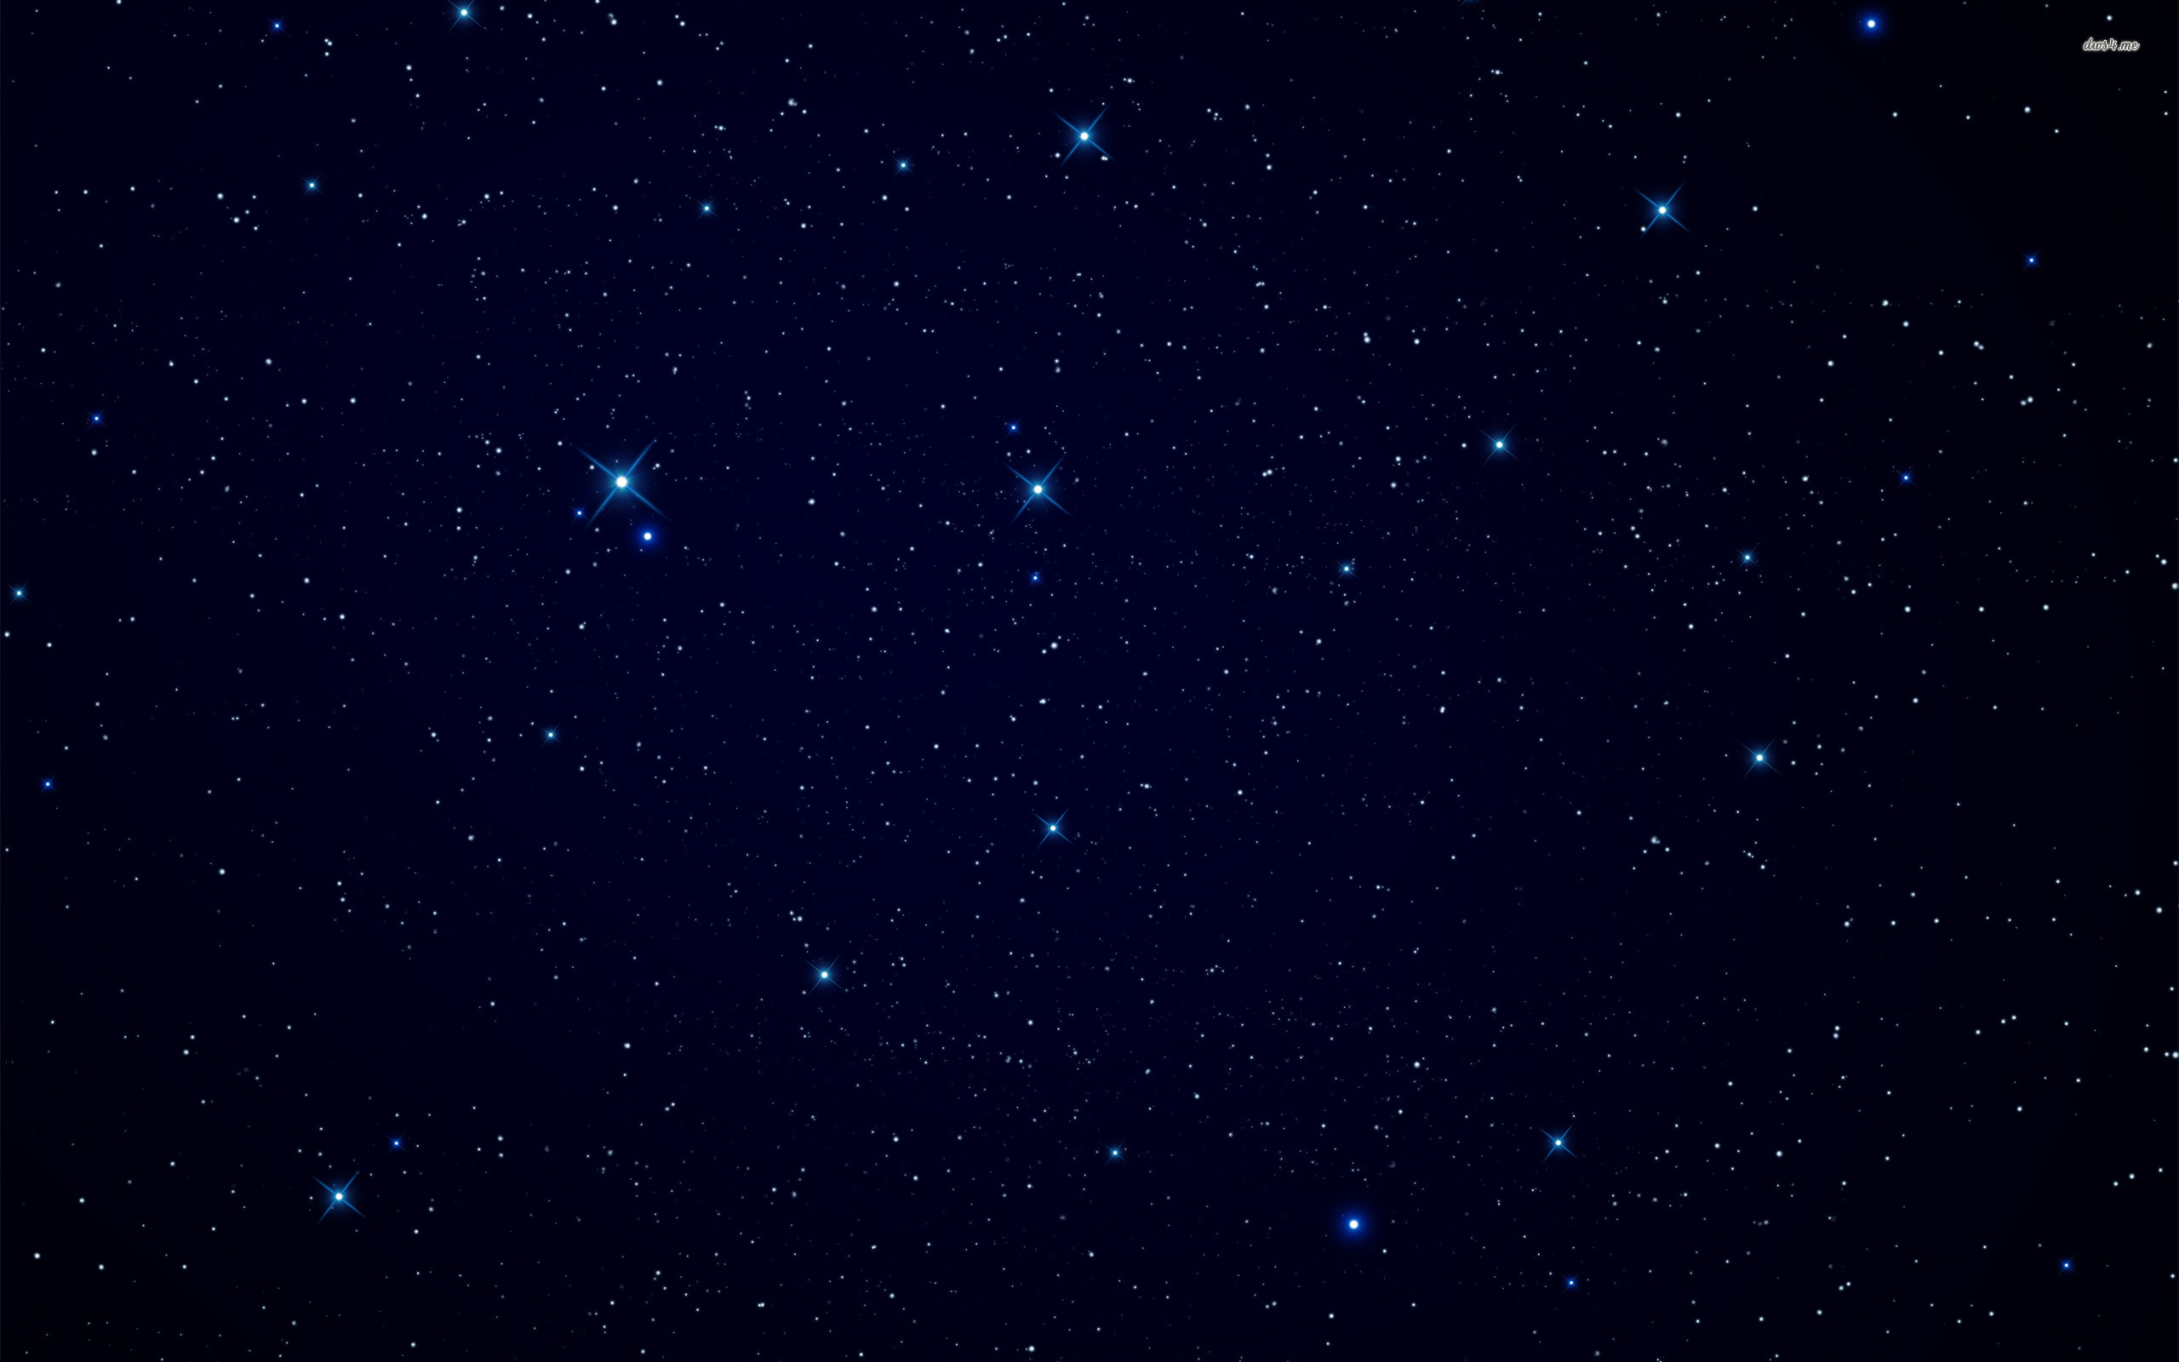
Celestial World
Those whose hands the Father has given all things
Those who are priests and kings, who have received of his fullness and glory
Those who are of the Church of the Firstborn
Those who are the order of Melchizedek
Those who are gods, even the sons of God
“These shall dwell in the presence of God and his Christ forever and ever.”
D&C 76:54-62

Slide 3
Those Who Dwell With God
They will accompany Christ when He comes again
They who shall be part of the first resurrection
They who will come forth in the resurrection of the just
They will go to Mount Zion and be accompanied by angels
They will have their names written in heaven
They are just and made perfect through Jesus Christ
“These are they whose bodies are celestial, whose glory is that of the sun, even the glory of God, the highest of all, whose glory the sun of the firmament is written of as being typical.”
D&C 76:63-70

Slide 4
Terrestrial World
Those who didn’t receive the testimony of Jesus, while on the earth but received, it afterwards
Those who were honorable but blinded by worldliness
Those who receive part of His glory, but not all
Those who are not valiant in the testimony of Jesus
Those who die without law
Those who are kept in prison
“Wherefore, they are bodies terrestrial, and not bodies celestial,”
D&C 76:72-79

Slide 5
Telestial World
Those who do not accept the gospel of Christ
Those who deny the Holy Spirit
Those who are thrust down to hell
Those who are redeemed from the devil
“These are they who receive not of his fulness in the eternal world, but of the Holy Spirit through the ministration of the terrestrial;
And the terrestrial through the ministration of the celestial.”
D&C 76:82-87

