Slide 1
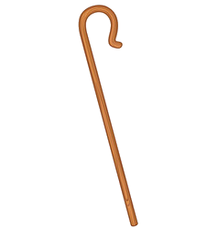
The
Good Shepherd
John 10:11-18

Slide 2
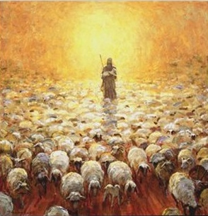
Who are the Sheep in the Scriptures?
All of God’s Children

Slide 3
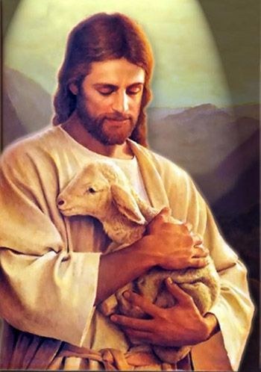
Sheep are Helpless

Slide 4
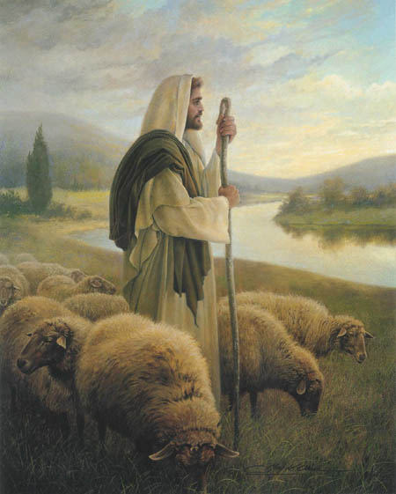
Sheep are mentioned over 1,000 times in the scriptures

Slide 5
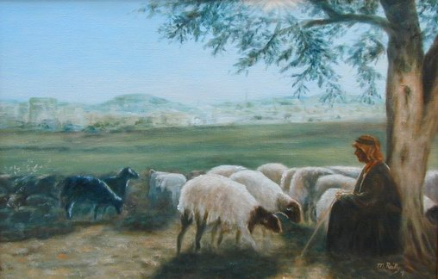
Sheep need full time supervision
Sheep are not easily trainable—they don’t learn well from mistakes

Slide 6
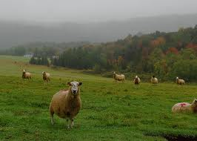
They go astray from the shepherd’s care and get into trouble
Sheep don’t remember well

Slide 7
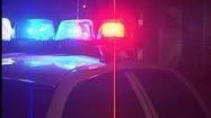
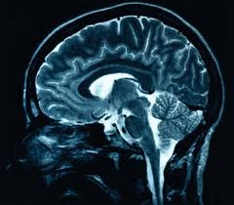
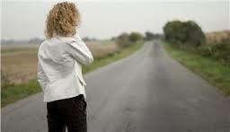
How well do you learn from mistakes?
Do you allow God to train you?

Slide 8
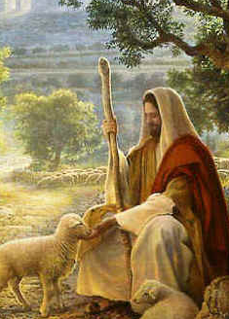
Sheep are Fragile and Defenseless
“Cast thy burden upon the Lord, and he shall sustain thee….” Psalms 55:22
Weak & Helpless

Slide 9
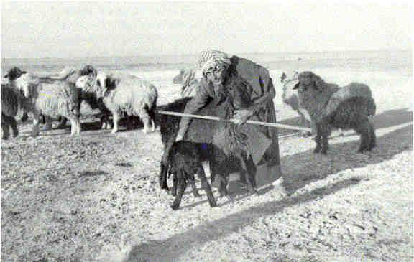
Their backs are weak
You will never see one hitched to a wagon or carrying a load on its back.

Slide 10
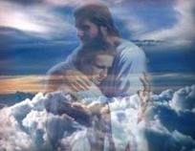
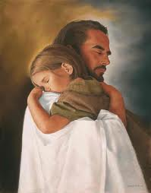
Sheep are not burden-bearing animals
“Cast thy burden upon the Lord, and he shall sustain thee….”
Psalms 55:22
“For my yoke is easy, and my burden is light” Matthew 11:30

Slide 11
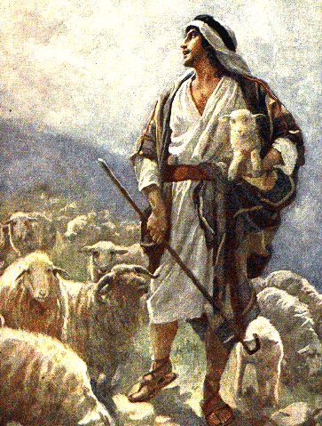
They are completely defenseless---
no claws or horns.
Sheep require constant help from the Shepherd.

Slide 12
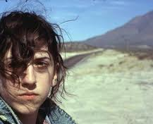
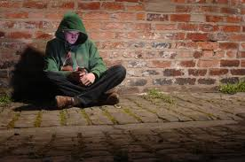
How helpless are you in the world?
Can you defend yourself on Satan’s turf without help?
Can you save yourself?

Slide 13
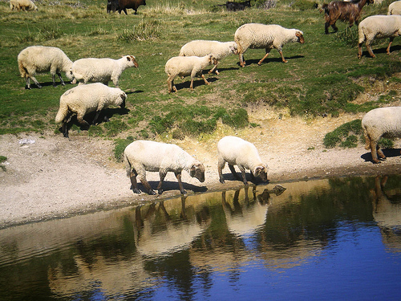
Sheep need “Living Water “
“….he leadeth me beside the still waters.”
Psalms 23:2
Sheep are afraid to drink from
running water

Slide 14
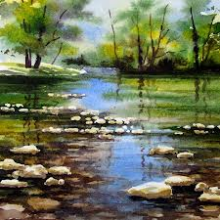
Sheep need still water, but fresh, pure water from a spring
Shepherds are concerned everyday with finding “still waters” from a natural spring or “living water.”

Slide 15
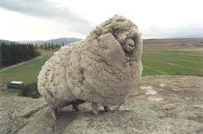
Hebrew word for ‘still waters’ –menuchot meaning motionless waters
Sheep know they cannot swim in a swift current because of their heavy fleece.

Slide 16
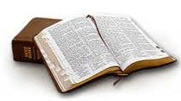
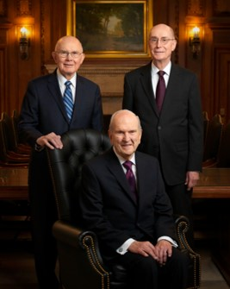
Waters---Revelation
Purest spiritual water---Scripture, “living prophets”

Slide 17
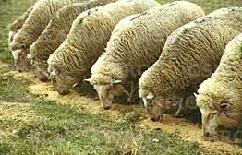
Sheep Ruminate = to ponder or meditate
Sheep eat
by chewing their cud
over and over again
"And I will give you [shepherds] according to mine heart,
which shall feed you with knowledge and understanding .”
Jeremiah 3:15

Slide 18
Do you read your scriptures or do you meditate?
Scriptures---spiritual food
The nourishment gained from our spiritual food will not obtained by one quick chewing but pondering and reading them over and over--everyday

Slide 19
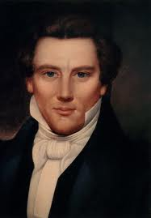
"This is good doctrine.
It tastes good. I can taste the principles of eternal life, and so can you .”
--Joseph Smith

Slide 20
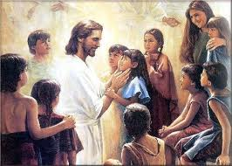
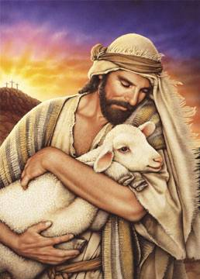
Sheep Need Daily Physical Touch
“And they brought young children to him…and he took them up in his arms.”
Mark 10:13,16

Slide 21
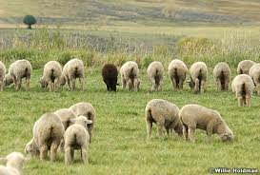
Early in the morning the sheep would form a grazing line and keep the same position throughout the day
At some point in time the sheep leave the line and search for shepherd.

Slide 22
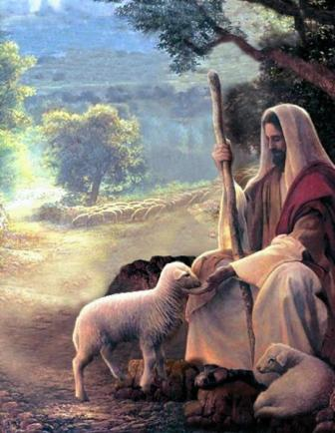
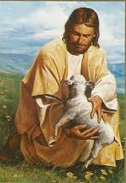
The shepherd receives the sheep with outstretch arms…
…The sheep would rub against the shepherd’s leg, or if the shepherd were seated, rub its cheek against His face.

Slide 23
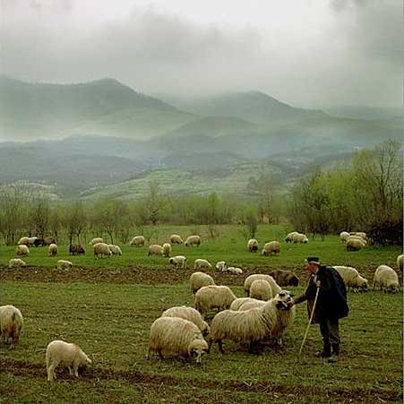
Meanwhile the shepherd would gently pat the sheep, rubbing its nose and ears and scratching its chin…
…After a brief period the sheep would return to its place in the grazing line.

Slide 24
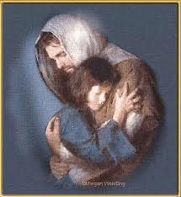
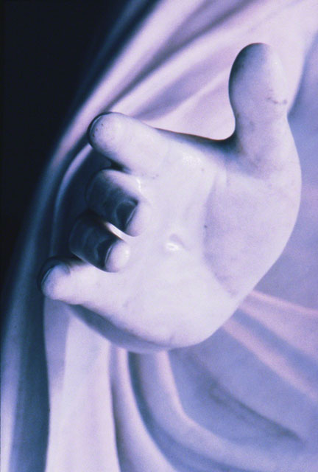
Christ touches you through the Holy Ghost. Are you keeping yourselves worthy to feel His touch every day?
Sometimes His touch can make us aware of the difference between who we are and who we should be.

Slide 25
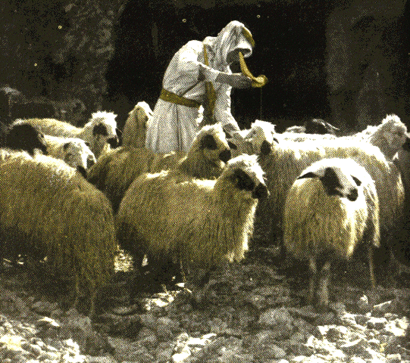
Sheep need to be Anointed
“…..thou anointest
my head with oil.”
Psalms 23:5
To preserve
and to heal and keep them from sunstroke

Slide 26
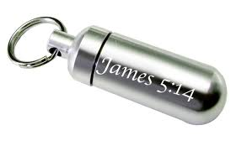
Anointed and blessed by Priesthood
God’s way to preserve as or set apart from the world or to heal us
Read James 5:14

Slide 27
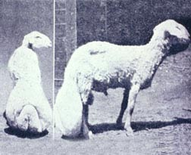
Fat-tailed Sheep
One type of sheep was raised for its tail, which is a delicacy.
“Woe unto them that draw iniquity with cords of vanity, and sin as it were with a cart rope.”
Isaiah 5:18

Slide 28
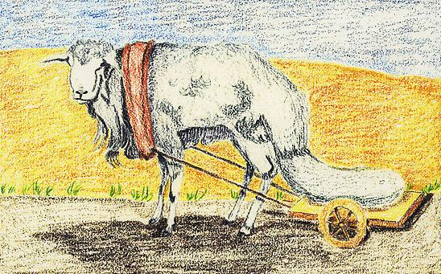
Sheep and Pride
“The wicked, through the pride of their countenance,
will not seek after God.”
Psalm 10:4
Shepherds fatten these sheep up and tie a cart on them so that their tails rest and gain about 30-40 lbs.

Slide 29
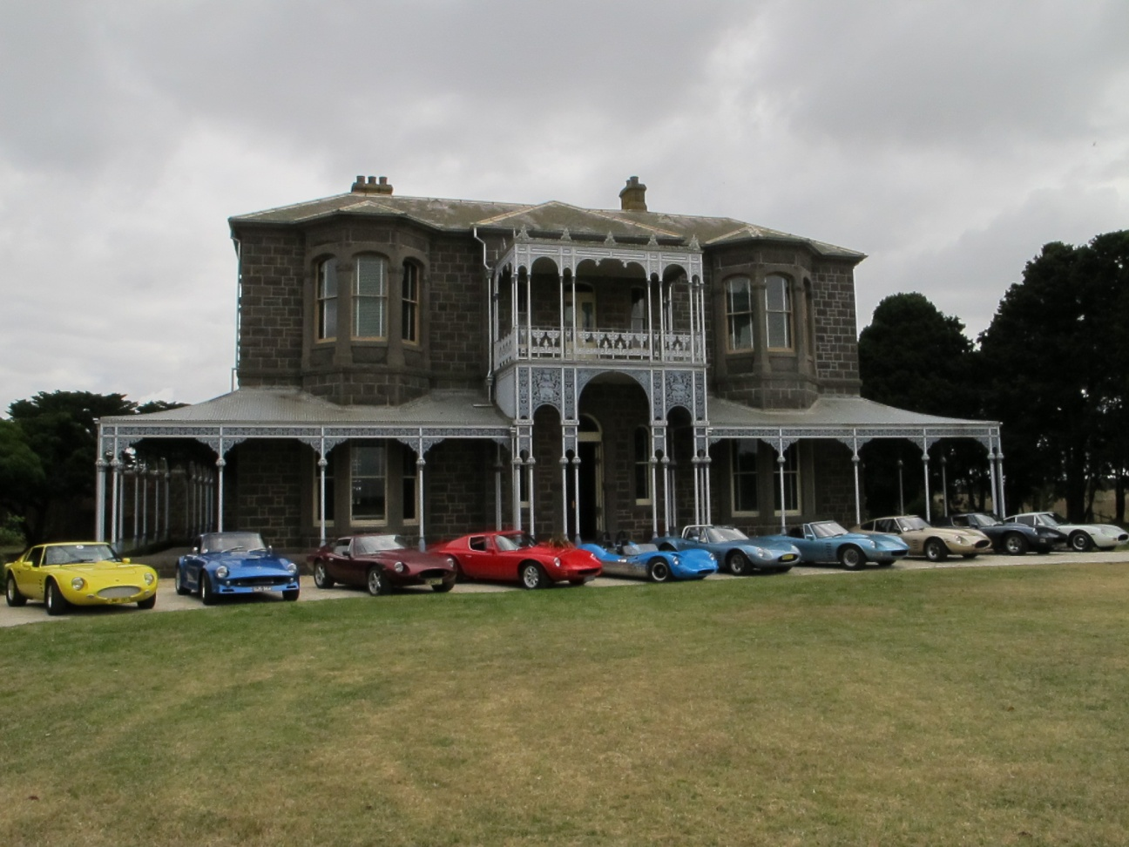
Pride—Carrying around burdens of sins or…
…thinking of what we want first.
Satan will use that to destroy us

Slide 30
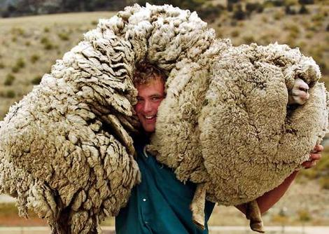
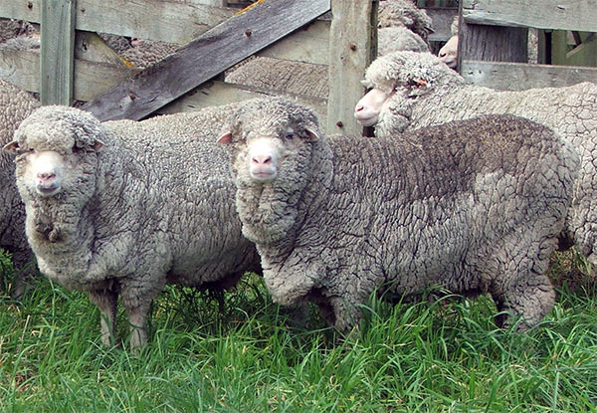
Sheep must be sheared
“….as a sheep
before her shearers
is dumb….”
Isaiah 53:7
Vision can be impaired if not sheared

Slide 31
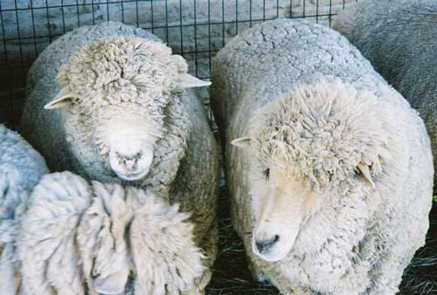
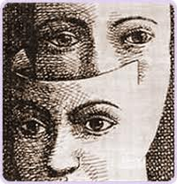
“Pulling the wool over our eyes”
Sin does the same to us.
It weighs us down, holds us back and blinds us to God.

Slide 32
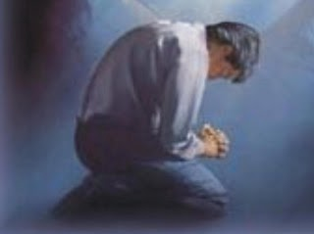
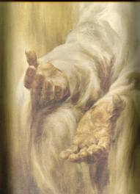
Submit to the Shearer
“Be thou humble; and the Lord thy God shall lead thee by the hand, and give thee answer to thy prayers.”
D&C 112:10s
“Be Thou Humble in Thy Weakness and the Lord Thy God shall lead thee…” Hymn 130

Slide 33
Sheep are Vulnerable
“I will not leave you comfortless: I will come to you.”
John 14:18
A Shepherd is careful to keep them warm and comforted.

Slide 34
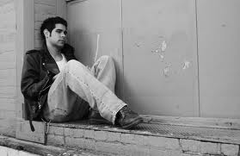
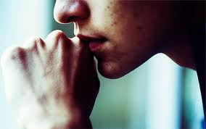
We are Vulnerable
Without alcohol an alcoholic feels afraid.
Without our boyfriend or girlfriend we might feel lonely.
Without pornography you might feel depressed.
When we repent and forsake our sins it is hard at first.
That is when we most need to have the comfort of the Holy Ghost.
He is always with us when we are humble.

Slide 35
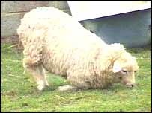
Sheep can be “Cast Down”
“He restoreth my soul….” Psalms 23:3
….Yea, though I walk
through the valley
of the shadow of death,
I will fear not evil:
for thou art with me.”
Psalms 23:4

Slide 36
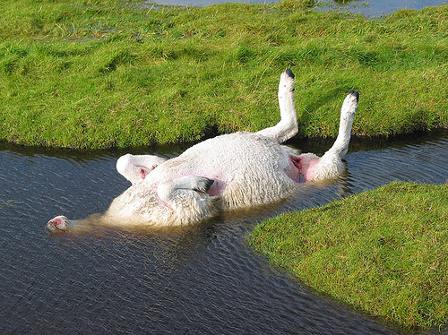
Helpless
If they get off balance they fall onto their backs (casting down) they are helpless.
“Their undersides are exposed to the sun—gas develops—swelling---cuts off air supply and then death.

Slide 37
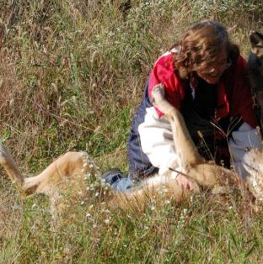
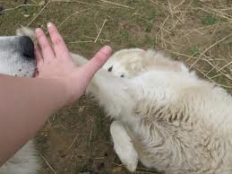
Restoring
To restore a cast-down sheep take time
The shepherd massages its tummy and legs.

Slide 38
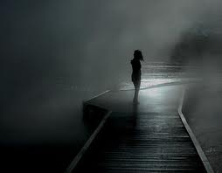
One foot on the path and the other in the great and spacious building?
If we try to live in the world we will get off balance and fall.
The world can cause spiritual death

Slide 39
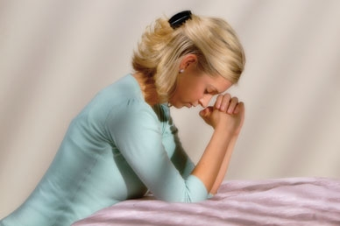
Calling on the Savior for help
He will be there to restore us
Restoration of a son or daughter of God is a process, but it is one of the most satisfying things the Savior does

Slide 40
He-Goats Represent the Priesthood
Horns are a symbol of Power
“Remove out of the midst
of Babylon,
and be as the
he -goats before the flock.”
Jeremiah 50:8

Slide 41
Helping us find our way
Worthy Priesthood holders:
Prophets
Stake Presidents
Bishops
Fathers

Slide 42
Pascal Lambs---Passover Shepherds
These are they that are there at the birth of the lambs to choose the firstborn male without blemish
“My son, God will provide himself
a lamb…..”
Genesis 22:8
Then taken into the shepherd’s homes to live with the family for days before their sacrifice

Slide 43
Sleep with the children and are feed by them, and named by them
They are then taken to the temple by shepherd and his family and ritually killed.
This taught the children the cost of sin—the life of innocence

Slide 44
Our sins caused the suffering and of Christ
Jesus has paid for all our sins and all our sins yet to be.
Even in the prexistence

Slide 45
Judas Sheep
“….he is brought as a lamb to the slaughter…so he openeth not his mouth.”
Isaiah 53:7
A large castrated male sheep is trained to lead the sheep up ramps to the “killing floor” of the slaughter house so they won’t be nervous.

Slide 46
The sheep are unaware and follow blindly. Once up the top, the trap door is opened for the “Judas Sheep,”and he trots away, and back down to the bottom pen area to lead another group of sheep to their destiny.

Slide 47
Allegiance—who leads your life?
Be careful who you follow
Many times we follow worldly friends or pop culture---who lead us to sin.

Slide 48
Definition of a Good Friend
Someone who helps you keep the standards of the Church—John Bytheway
Following the “he goats” (priesthood) instead of worldly friend.

Slide 49
Life and Death
At lambing time:
If sheep have a difficult labor they die.
Shepherds end up with Eves without lambs and lambs without mothers.
“Washed white through the
blood of the Lamb.”
Alma 13:11

Slide 50
Nurturing
A Ewe will not nurture another ewe’s baby. The Shepherd takes one of the lambs that died and cuts of their skin, making sure some of the blood is still on the skin.
He puts the skin on the motherless living lamb. The ewe accepts it as her baby because she recognizes the smell of the blood.

Slide 51
Alienated from God---
Spiritual death---because of sin
1 Nephi 15:34
“…and there cannot any unclean thing enter into the kingdom of God…”
Christ provided his flesh and blood to cover us symbolically so that God will symbolically recognize us as His lambs.

Slide 52
Hebrew word for Atonement---Kafar.
Meaning to protect, surround, and to cover.
Christ’s Atonement –his blood– symbolically covers our sins and we become clean again and acceptable to Heavenly Fahter.

Slide 53
What does it mean to be a Good Shepherd?

Slide 54
Pharisees Self-righteous Keepers of the Law
How did the Pharisees (the World) view Shepherds?
“He that entereth not by the Door
…but climbeth up some other way,
the same is a thief and a robber.”
John 10:1
They thought the Law could save them

Slide 55
World View of Priesthood leaders:
Misguided
uninformed
Old-fashioned
Controlling
Blind followers
To be a Good Shepherd you need to not worry what the World thinks of you

Slide 56
Shepherds are Peaceful
Sheep’s wool won’t grow
if they are stressed
Sensitive
Best profession to teach a man how to nurture others
Shepherdesses
Women were Shepherds too
Rachel and Rebekah

Slide 57
One with
their Sheep
A good shepherd always
smelled like his sheep
All Patriarchs were shepherds
for part
of their lives
Moses
Joseph
Great leadership
lessons learned
David

Slide 58
Receiving callings at age 12
Learning how to Shepherd a flock.

Slide 59
Sheepherders vs. Shepherds
“…the sheep follow him: for they know his voice.” John 10:4
Sheep recognize their Shepherd’s voice and not that of a stranger

Slide 60
What happens without a Shepherd?
“And a stranger will they not follow, but will flee from him:
for they know not the voice of strangers.” John 10:5

Slide 61
Shepherd’s Rod
“Thy rod and thy staff they
comfort me.”
Psalms 23:4
Used to defend sheep against predators.

Slide 62
God’s Rod
“The Rod…
was the word of God.”
1 Nephi 11:25
The Word of God is our greatest defense against our enemies

Slide 63
Shepherd’s Staff
More than 6 ft. tall—a lamb can see it.
At night the shepherd taps the rocks with his staff to assure them he is near.

Slide 64
“….thy staff be my stay.”
With a crook the shepherd will encircle the neck of the sheep, or the chest of a small sheep and lift to safety.

Slide 65
If sheep dropped over a cliff the shepherd turns the staff upside down and coos along the length in a quiet voice to calm them then pull them to safety with the crook.

Slide 66
Staff—Christ’s mercy and tender guidance toward us
We need to remember we worship a Savior whose greatest attribute is his deep love and mercy for us.

Slide 67
The Shepherd loves
his sheep individually
“One by one…” 3 Nephi 17:21

Slide 68
Courageous
“I will seek that which is lost….
neither shall the beast of the land devour them…
therefore I will save my flock.”
Ezekial 34:16,22,28

Slide 69
The Shepherd lays down His Life for His Sheep

Slide 70
God
Great Plan of Happiness
Christ
Christ’s Rehabilitation Program
Us

Slide 71
Sources:
Poway Institute by Becky Davies and Lesley Meacham

