Slide 2
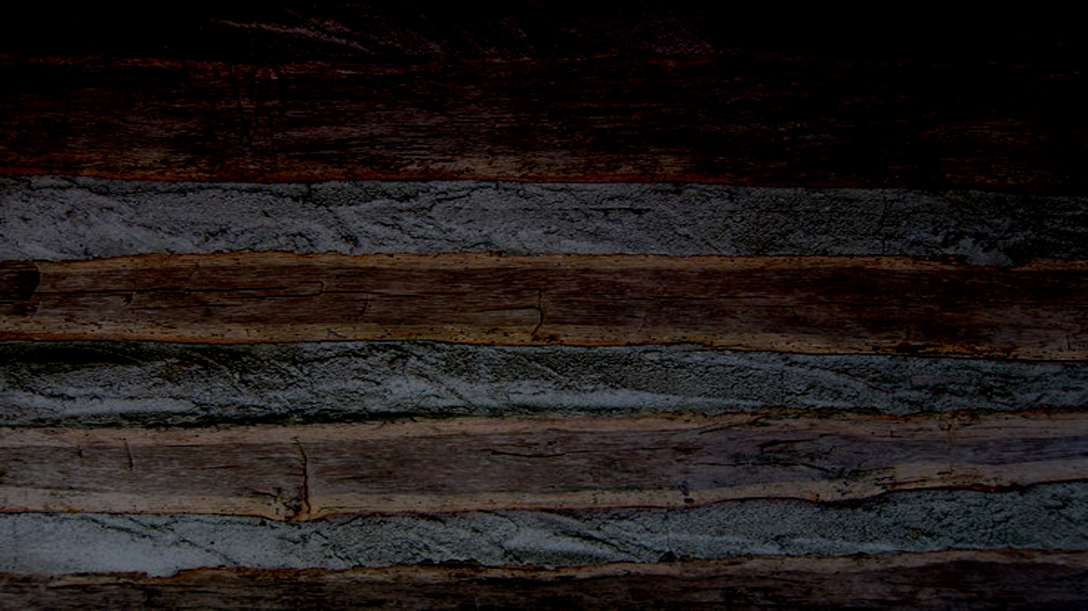
Joseph Prays For Forgiveness
Sept. 21, 1823
What are some experiences Joseph Smith had as a youth that you can relate to?
According to the end of Joseph Smith—History 1:28 what did Joseph say about the temptations and errors he fell into?
He was not guilty of any great sins, but he sometimes felt that he did not act as one who had been called of God should act.
What did Joseph Smith do about the guilt he felt for his sins?
He prayed for forgiveness and asked to know of his standing before God.
Joseph suffers persecution
Guilty of Levity--humor or frivolity, especially the treatment of a serious matter with humor or in a manner lacking due respect.
Joseph Smith—History 1:27-29

Slide 3
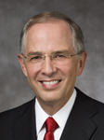
“[We can] humbly petition the Lord: ‘Father, what wouldst Thou have me do?’ The answers come. We feel the changes we need to make. The Lord tells us in our mind and in our heart”
Neil A. Anderson
As we recognize our sins and feel sorrow for them, we can pray to Heavenly Father for forgiveness.
We can pray to know of our standing before God.
Joseph Smith—History 1:27-29

Slide 4
Moroni
He was the son of Mormon around Ad 350 to AD421
He spent his last years protecting and adding to the ancient records given to him by his father, left alone for about 35 years. The civilizations he knew had been destroyed by their own doing
He buried them in a vault (stone) on the crest of the Hill Cumorah
He wrote the title page for the entire book (Book of Mormon)
He held the keys of restoring the divine message of hope and exaltation in the latter days
John the Revelator had a vision of him (Rev. 14:6-7)
His image can be found on the spires of the modern-day Temples of the Church
He was the angelic messenger who visited the young Joseph Smith for the first time on September 21, 1823
Who’s Who

Slide 5
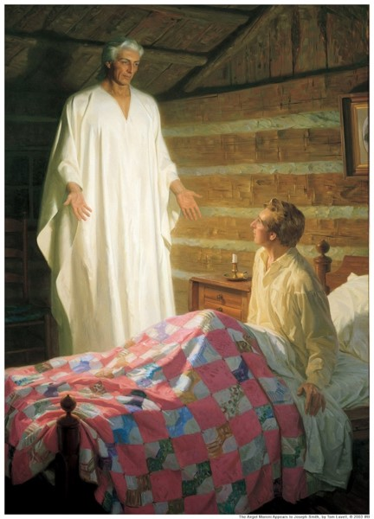
Angel Moroni
His loose robe was exceedingly white
His whole person was glorious beyond description
His countenance truly like lightning.
When I first looked upon him, I was afraid; but the fear soon left me.
He called me by name, and said unto me that he was a messenger sent from the presence of God to me, and that his name was Moroni; that God had a work for me to do; and that my name should be had for good and evil among all nations, kindreds, and tongues, or that it should be both good and evil spoken of among all people.
Joseph Smith—History 1:30-33

Slide 6
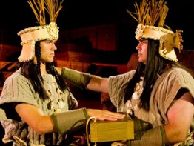
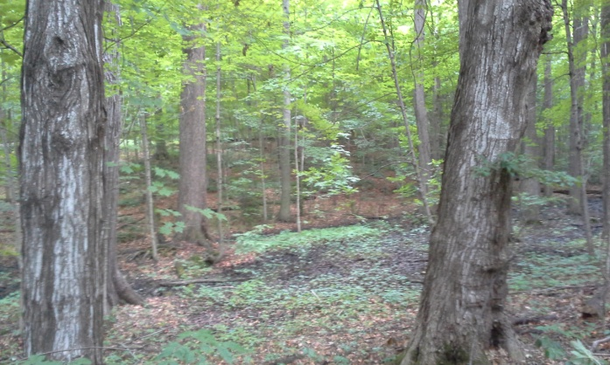
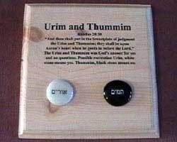
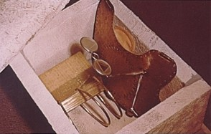
The Book
A Book of Gold Plates containing a history of former inhabitants of the land
There were two stones in silver bows—and these stones, fastened to a breastplate, constituted what is called the Urim and Thummim—deposited with the plates;
and the possession and use of these stones were what constituted “seers” in ancient or former times; and that God had prepared them for the purpose of translating the book.
Joseph Smith—History 1:34-35

Slide 7
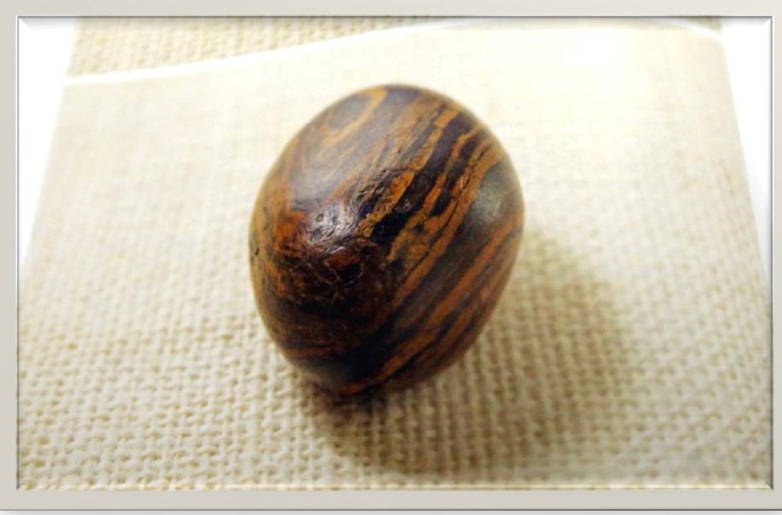
The Seer Stone
A picture of a smooth, brown, egg-sized rock is shown in the printer's manuscript of the Book of Mormon following a news conference Tuesday, Aug. 4, 2015, at The Church of Jesus Christ of Latter-day Saints Church History Library, in Salt Lake City. The Mormon church for the first time is publishing photos of a small sacred stone it believes founder Joseph Smith used to help translate the story that became the basis of the religion. The Mormon church is taking another step in its push to be more transparent, and is releasing more historical documents that shed light on how Joseph Smith formed the religion. (AP Photo/Rick Bowmer)

Slide 8
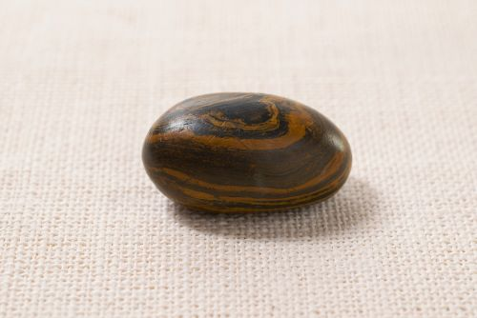
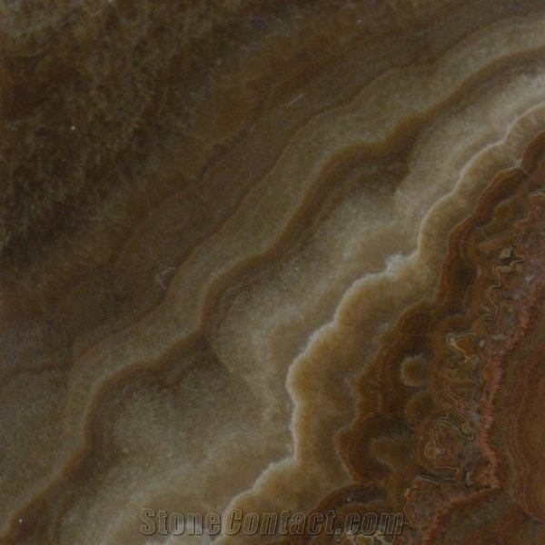
Urim and Thummim
Light and Protection
And thou shalt put in the breastplate of judgment the Urim and the Thummim; and they shall be upon Aaron’s heart, when he goeth in before the Lord: and Aaron shall bear the judgment of the children of Israel upon his heart before the Lord continually.
Seer Stone Belonging to Joseph Smith
An instrument prepared of God to assist man in obtaining revelation from the Lord and in translating languages.
The stone for the tribe of Joseph is an Onyx. It is described as a chocolate colored oval shape. This stone passed from Joseph Smith to Oliver Cowdery and then to the Church through Brigham Young and others.
Exodus 28:30

Slide 9
Malachi
He was the last of the Old Testament prophets
The Book of Malachi was written around 430 BC
He lived in the Holy Land about 170 years after Lehi and his family left Jerusalem
His purpose was to call the people to repentance and to prepare for the Second Coming and judgments of the Lord
Because his words were not written in the Brass plates Jesus had the Nephites write Malachi’s words in their records
His words included the truths about the law of tithing and the sealing commission of Elijah
He prophesied of “a messenger” speaking of John the Baptist, to prepare the way for the Savior
Moroni also cited the words of Malachi to Joseph Smith concerning the prophet Elijah
He is included among the elect whom President Joseph F. Smith beheld during his vision of the work of salvation going on in the spirit world (D&C 138:46)
Who’s Who

Slide 10
A Little Variation
“For behold, the day cometh that shall burn as an oven, and all the proud, yea, and all that do wickedly shall burn as stubble; for they that come shall burn them, saith the Lord of Hosts, that it shall leave them neither root nor branch.”
“For, behold, the day cometh, that shall burn as an oven; and all the proud, yea, and all that do wickedly, shall be stubble: and the day that cometh shall burn them up, saith the Lord of hosts, that it shall leave them neither root nor branch.”
Malachi 4:1
And he shall plant in the hearts of the children the promises made to the fathers, and the hearts of the children shall turn to their fathers. If it were not so, the whole earth would be utterly wasted at his coming.
“And he shall turn the heart of the fathers to the children, and the heart of the children to their fathers, lest I come and smite the earth with a curse.”
Malachi 4:6
Joseph Smith—History 1:36-39
Who’s Who

Slide 11
Elijah
Meaning: Jehovah is my God
He was a Tishbite in a long line of extraordinary prophets
He commenced his ministry around 926 BC among the northern tribes of Israel
Peter, James, and John witnessed Elijah (Elias) and Moses at the Mount of Transfiguration (Matthew 17:1-11)
He restored the keys of sealing power of the priesthood to Joseph Smith (D&C 110:13-16) in the Kirtland Temple on April 3, 1836
He taught the Doctrines of Salvation
He fasted 40 days and his successor Elisha received the priesthood power from him
He held the “keys of the power of turning the hearts of the fathers to the children, and the hearts of the children to the fathers…(D&C 27:9)
Who’s Who

Slide 12
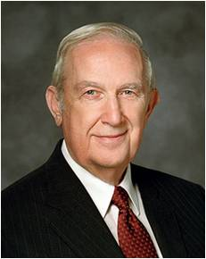
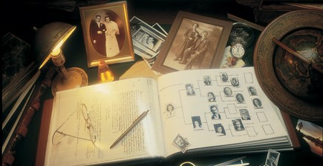
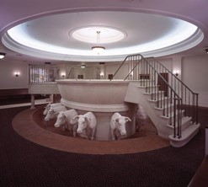
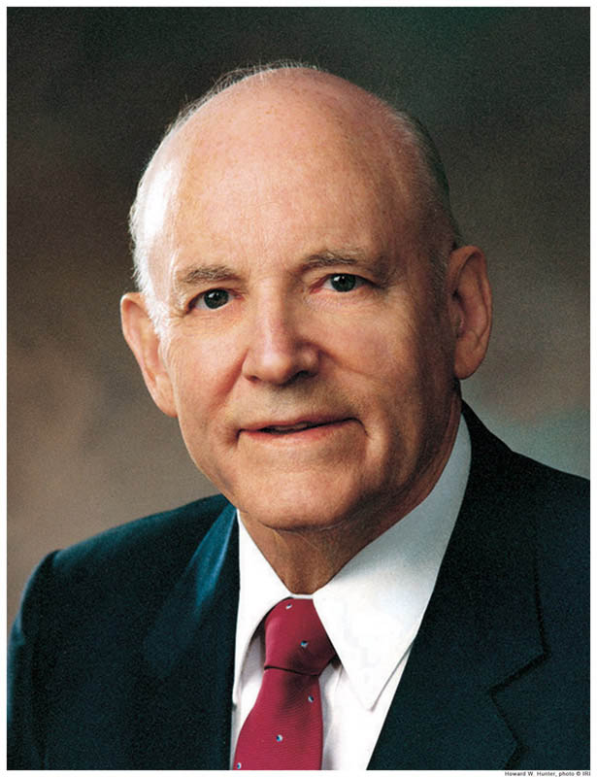
Turn the Hearts of the Children…
“Temple and family history work is one work divided into two parts. They are connected together like the ordinances of baptism and the gift of the Holy Ghost. Some members may not be able to do both works because of health or distances to temples.”
Elder Richard G. Scott
“We must accomplish the priesthood temple ordinance work necessary for our own exaltation; then we must do the necessary work for those who did not have the opportunity to accept the gospel in life. Doing work for others is accomplished in two steps: first, by family history research to ascertain our progenitors; and second, by performing the temple ordinances to give them the same opportunities afforded to the living.”
President Howard W. Hunter
D&C 2:1-3

Slide 13
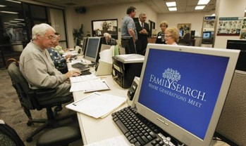
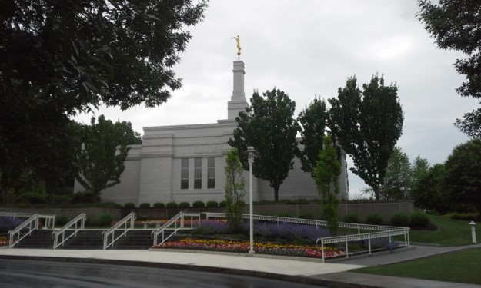
“There are many members of the Church who have only limited access to the temples. They do the best they can. They pursue family history research and have the temple ordinance work done by others. Conversely, there are some members who engage in temple work but fail to do family history research on their own family lines. Although they perform a divine service in assisting others, they lose a blessing by not seeking their own kindred dead as divinely directed by latter-day prophets. …
“I have learned that those who engage in family history research and then perform the temple ordinance work for those whose names they have found will know the additional joy of receiving both halves of the blessing.”
President Howard W. Hunter
D&C 2:1-3

Slide 14
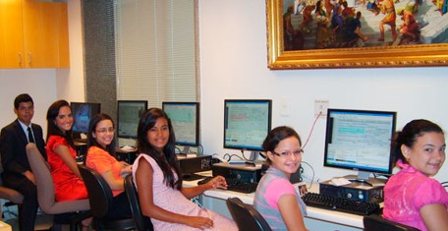
“Father in Heaven wants each of us to receive both parts of the blessing of this vital vicarious work. He has led others to show us how to qualify. It is up to you and me to claim those blessings.
“Any work you do in the temple is time well spent, but receiving ordinances vicariously for one of your own ancestors will make the time in the temple more sacred, and even greater blessings will be received. The First Presidency has declared, ‘Our preeminent obligation is to seek out and identify our own ancestors.’ [First Presidency letter, Feb. 29, 2012; emphasis added.]
“Do you young people want a sure way to eliminate the influence of the adversary in your life? Immerse yourself in searching for your ancestors, prepare their names for the sacred vicarious ordinances available in the temple, and then go to the temple to stand as
proxy for them to receive the ordinances of
baptism and the gift of the Holy Ghost.
As you grow older, you will be able to participate
in receiving the other ordinances as well. I can
think of no greater protection from the influence
of the adversary in your life.”
Elder Richard G. Scott
D&C 2:1-3

Slide 15
Isaiah
Isaiah played a profound role in the Book of Mormon. His words were upon the plates of brass obtained from Laban.
Isaiah lived in Jerusalem and wrote in the period 740 BC to 701 BC at a time when Israel had incurred the anger of the Lord through pride and idolatry
Isaiah’s language includes much symbolism, although he uses references of his own time with those of future times
The message from Isaiah is one of the mission of the Redeemer and the atoning power of the Father’s plan of salvation
Isaiah’s words are the bridge that unites the Old Testament, the New Testament, and the Book of Mormon
Isaiah is quoted in the Book of Mormon more than any other prophet—
Who’s Who

Slide 16
Isaiah and Acts
The stem of Jesse (Christ) will judge in righteousness—The knowledge about God will cover the earth in the Millennium—The Lord will raise an ensign and gather Israel
Isaiah 11
For Moses truly said unto the fathers, A prophet shall the Lord your God raise up unto you of your brethren, like unto me; him shall ye hear in all things whatsoever he shall say unto you.
And it shall come to pass, that every soul, which will not hear that prophet, shall be destroyed from among the people.
Acts 3:22-23
That Prophet--Christ
Joseph Smith—History 1:40

Slide 17
Joel
The Lord will pour out His Spirit upon all flesh.
There will be dreams and visions.
Wonders in Heaven and earth
Sun into darkness and moon into blood
The Coming of the Savior--Millennium
That whosoever shall call on the name of the Lord shall be delivered: for in mount Zion and in Jerusalem shall be deliverance, as the Lord hath said, and in the remnant whom the Lord shall call.’
Joel 2 :32
This is not yet fulfilled
Joseph Smith—History 1:41

Slide 18
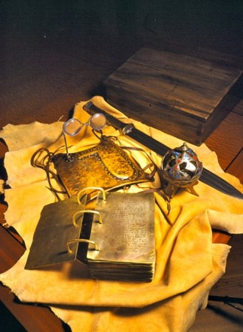
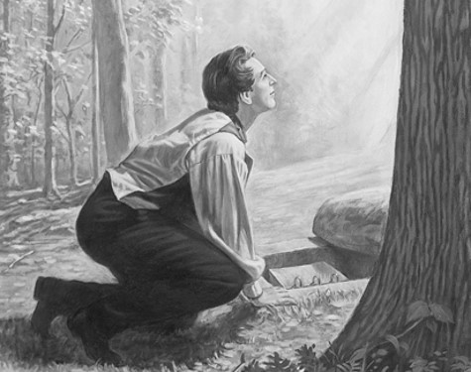
Conditions Given by Angel Moroni
Joseph should not show them to any person
Joseph should not show anyone the breastplate with the Urim and Thummin
If Joseph showed the plates to anyone the plates would be destroyed
Joseph had a clear vision of where the plates were
Joseph Smith—History 1:42

Slide 19
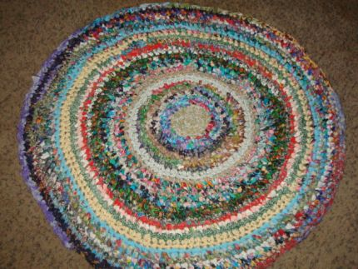
The Conduit
“After this communication, I saw the light in the room begin to gather immediately around the person of him who had been speaking to me, and it continued to do so until the room was again left dark, except just around him; when, instantly I saw, as it were, a conduit open right up into heaven, and he ascended till he entirely disappeared, and the room was left as it had been before this heavenly light had made its appearance.”
Joseph Smith—History 1:43

Slide 20
2 More Visits—Overwhelmed and Astonished
“After this third visit, he again ascended into heaven as before, and I was again left to ponder on the strangeness of what I had just experienced; when almost immediately after the heavenly messenger had ascended from me for the third time, the cock crowed, and I found that day was approaching, so that our interviews must have occupied the whole of that night..”
Joseph Smith—History 1:44-47

Slide 21
Joseph and His Father
Joseph obeyed Moroni’s command and told his father about his experience the previous night.
His father believed him and counseled him to do what Moroni had told him to do.
So Joseph went to the hill where the gold plates were buried.
“Having removed the earth, I obtained a lever, which I got fixed under the edge of the stone, and with a little exertion raised it up. I looked in, and there indeed did I behold the plates, the Urim and Thummim, and the breastplate, as stated by the messenger. The box in which they lay was formed by laying stones together in some kind of cement. In the bottom of the box were laid two stones crossways of the box, and on these stones lay the plates and the other things with them.”
Joseph Smith—History 1:50-52

Slide 22
Each Year
I made an attempt to take them out, but was forbidden by the messenger, and was again informed that the time for bringing them forth had not yet arrived, neither would it, until four years from that time; but he told me that I should come to that place precisely in one year from that time, and that he would there meet with me, and that I should continue to do so until the time should come for obtaining the plates.
“Accordingly, as I had been commanded, I went at the end of each year, and at each time I found the same messenger there, and received instruction and intelligence from him at each of our interviews, respecting what the Lord was going to do, and how and in what manner his kingdom was to be conducted in the last days.”
Joseph Smith—History 1:53-54

Slide 23
Sources:
Video:
Deciding How to Focus Repentance (0:39)
Neil A. Anderson(“Repent … That I May Heal You,” Ensign or Liahona, Nov. 2009, 41).
Who’s Who in the Book of Mormon by Ed. J. Pinegar and Richard J. Allen pg. 46, 69-72, 116-117, 126-129
Elder Richard G. Scott (“The Joy of Redeeming the Dead,” Ensign or Liahona, Nov. 2012, 93).
President Howard W. Hunter (“A Temple-Motivated People,” Ensign, Feb. 1995, 4

Slide 24
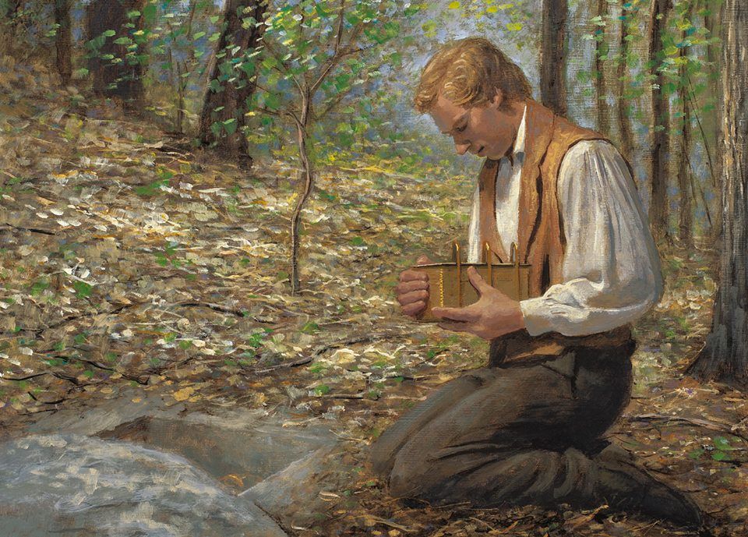
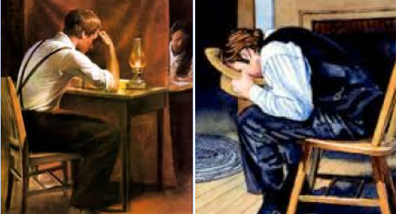
Urim and Thummim
Hebrew term that means “Lights and Perfections.” An instrument prepared of God to assist man in obtaining revelation from the Lord and in translating languages. See Ex. 28:30; Lev. 8:8; Num. 27:21; Deut. 33:8; 1 Sam. 28:6;Ezra 2:63; Neh. 7:65; JS—H 1:35.
Using a Urim and Thummim is the special prerogative of a seer, and it would seem reasonable that such instruments were used from the time of Adam. However, the earliest mention is in connection with the brother of Jared (Ether 3:21–28). Abraham used a Urim and Thummim (Abr. 3:1–4), as did Aaron and the priests of Israel, and also the prophets among the Nephites (Omni 1:20–21; Mosiah 8:13–19; 21:26–28; 28:11–20; Ether 4:1–7).
There is more than one Urim and Thummim, but we are informed that Joseph Smith had the one used by the brother of Jared (Ether 3:22–28; D&C 10:1; 17:1).
(See Seer.) A partial description is given in JS—H 1:35. Joseph Smith used it in translating the Book of Mormon and in obtaining other revelations.
This earth in its celestial condition will be a Urim and Thummim, and many within that kingdom will have an additional Urim and Thummim (D&C 130:6–11).
Bible Dictionary
A Treasured Testament
BY ELDER RUSSELL M. NELSON July 1993
“Joseph Smith would put the seer stone into a hat, and put his face in the hat, drawing it closely around his face to exclude the light; and in the darkness the spiritual light would shine. A piece of something resembling parchment would appear, and on that appeared the writing. One character at a time would appear, and under it was the interpretation in English. Brother Joseph would read off the English to Oliver Cowdery, who was his principal scribe, and when it was written down and repeated to Brother Joseph to see if it was correct, then it would disappear, and another character with the interpretation would appear. Thus the Book of Mormon was translated by the gift and power of God, and not by any power of man.” (David Whitmer, An Address to All Believers in Christ, Richmond, Mo.: n.p., 1887, p. 12.)

Slide 25
SEER STONE
In Joseph Smith’s day, some individuals claimed that they had a gift to “see,” or receive divine or supernatural messages, through seer stones. These beliefs came from the Bible and from European cultural traditions brought to early America by immigrants. Joseph Smith and his family accepted these beliefs, and Joseph occasionally used stones he located in the ground to help neighbors find missing objects or search for buried treasure.
When Joseph Smith received the golden plates in 1827, he also received a translation instrument with them, “two stones in silver bows” used by “‘seers’ in ancient or former times” (Joseph Smith—History 1:35). This instrument was referred to in the Book of Mormon as the “interpreters.” During the translation of the Book of Mormon, Joseph Smith apparently used both of these instruments—the interpreters and his seer stone—interchangeably. They worked in much the same way, and the early Saints sometimes used the term “Urim and Thummim” to refer to the seer stone as well as the interpreters. The Prophet also received several of the revelations found today in the Doctrine and Covenants by means of these instruments of revelation.³ As Joseph became more experienced in spiritual matters, he eventually started receiving revelation without these aids.
https://www.churchofjesuschrist.org/study/history/topics/seer-stones?lang=eng
Urim and Thummim
Hebrew term that means “Lights and Perfections.” An instrument prepared of God to assist man in obtaining revelation from the Lord and in translating languages. See Ex. 28:30; Lev. 8:8; Num. 27:21; Deut. 33:8; 1 Sam. 28:6; Ezra 2:63; Neh. 7:65; JS—H 1:35.
Using a Urim and Thummim is the special prerogative of a seer, and it would seem reasonable that such instruments were used from the time of Adam. However, the earliest mention is in connection with the brother of Jared (Ether 3:21–28). Abraham used a Urim and Thummim (Abr. 3:1–4), as did Aaron and the priests of Israel, and also the prophets among the Nephites (Omni 1:20–21; Mosiah 8:13–19; 21:26–28; 28:11–20; Ether 4:1–7). There is more than one Urim and Thummim, but we are informed that Joseph Smith had the one used by the brother of Jared (Ether 3:22–28; D&C 10:1; 17:1). (See Seer.) A partial description is given in JS—H 1:35. Joseph Smith used it in translating the Book of Mormon and in obtaining other revelations.
This earth in its celestial condition will be a Urim and Thummim, and many within that kingdom will have an additional Urim and Thummim (D&C 130:6–11)
Bible Dictionary.

Slide 26
Group 1 Doctrine and Covenants 2:1— Who is Elijah? What priesthood power did Moroni say Elijah would restore? | Group 2 Doctrine and Covenants 2:2— Who are the fathers and the children referred to in this verse? | Group 3 Doctrine and Covenants 2:3— Why would the earth be utterly wasted if the sealing power had not been restored?

Slide 27
Group 1 Doctrine and Covenants 2:1— Who is Elijah? What priesthood power did Moroni say Elijah would restore? | Group 2 Doctrine and Covenants 2:2— Who are the fathers and the children referred to in this verse? | Group 3 Doctrine and Covenants 2:3— Why would the earth be utterly wasted if the sealing power had not been restored?
Doctrine and Covenants 2:1— God would send Elijah to restore the sealing power to the earth before the Second Coming of Jesus Christ. | Doctrine and Covenants 2:2— Our hearts can be turned to our ancestors, and we can perform ordinances for them in temples. | Doctrine and Covenants 2:3— Without the power to unite families for eternity, the earth would be destroyed at Jesus Christ’s Second Coming.
“Elijah was a great prophet with great power given him by God. He held the greatest power God gives to His children: he held the sealing power, the power to bind on earth and have it bound in heaven” (President Henry B. Eyring, “Hearts Bound Together,” Ensign or Liahona, May 2005, 78). | In the prophecy that “he shall plant in the hearts of the children the promises made to the fathers,” the phrase “the fathers” refers to “Abraham, Isaac, and Jacob, to whom the promises were made. What are the promises? They are the promises of a continuation of the family unit in eternity” (Elder Bruce R. McConkie, Millennial Messiah [1982], 267). In the prophecy that “the hearts of the children shall turn to their fathers,” the phrase “their fathers” refers to “our dead ancestors who died without the privilege of receiving the gospel, but who received the promise that the time would come when that privilege would be granted them. The children are those now living who are preparing genealogical data and who are performing the vicarious ordinances in the temples” (President Joseph Fielding Smith, Doctrines of Salvation, ed. Bruce R. McConkie, 3 vols. [1954–56], 2:127). | “Why would the earth be wasted? Simply because if there is not a welding link between the fathers and the children—which is the work for the dead—then we will all stand rejected; the whole work of God will fail and be utterly wasted” (President Joseph Fielding Smith, Doctrines of Salvation, ed. Bruce R. McConkie, 3 vols. [1954–56], 2:122).

