Slide 1
Lesson 125
The Messiah: A Light Unto The Gentiles
Isaiah 42-47
That it might be fulfilled which was spoken by Esaiasthe prophet, saying,
Behold my servant, whom I have chosen; my beloved, in whom my soul is well pleased: I will put my spirit upon him, and he shall shew judgment to the Gentiles.
He shall not strive, nor cry; neither shall any man hear his voice in the streets.
A bruised reed shall he not break, and smoking flax shall he not quench, till he send forth judgment unto victory.
And in his name shall the Gentiles trust.
Matthew 12:17-21

Slide 2
Whom Can You Trust?
The children of Israel were faced with a decision concerning whom they would trust

Slide 3
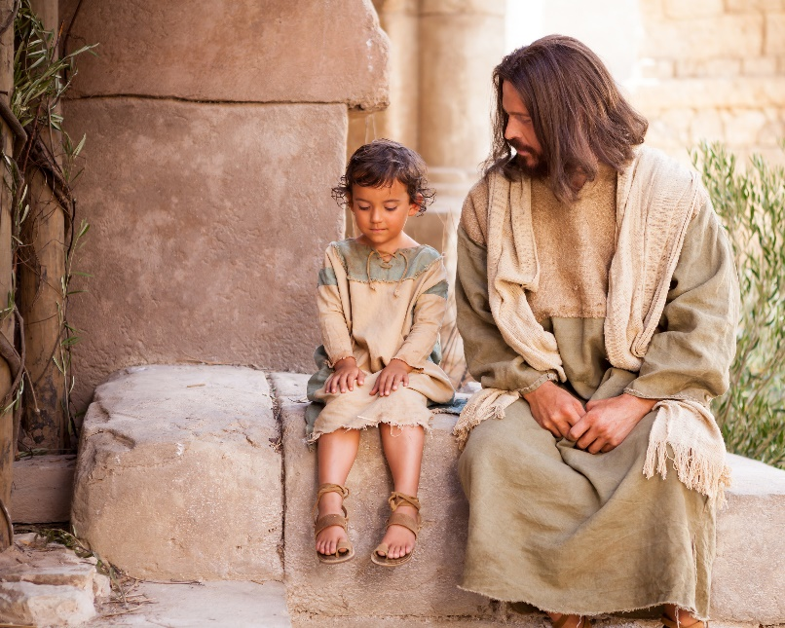
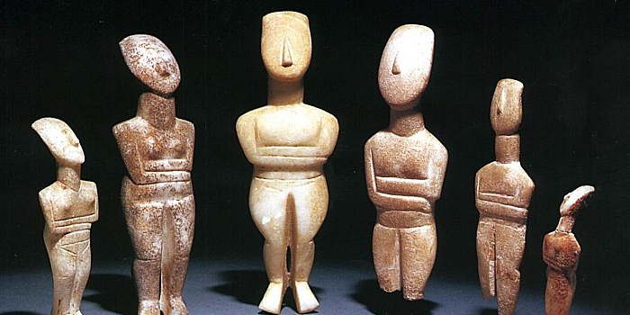
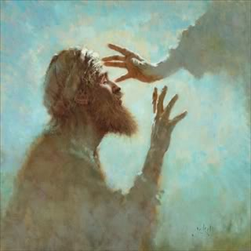
Whom Can You Trust?
Jesus Christ
False Gods

Slide 4
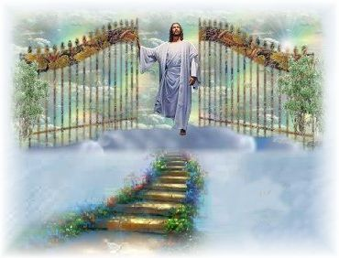
My Servant
Only one servant was given power of judgment
But why dost thou judge thy brother? or why dost thou set at nought thy brother? for we shall all stand before the judgment seat of Christ
Romans 14:10
O then, my beloved brethren, come unto the Lord, the Holy One. Remember that his paths are righteous. Behold, the way for man is narrow, but it lieth in a straight course before him, and the keeper of the gate is the Holy One of Israel; and he employeth no servant there; and there is none other way save it be by the gate; for he cannot be deceived, for the Lord God is his name.
2 Nephi 9:41
Isaiah 42:1-4

Slide 5
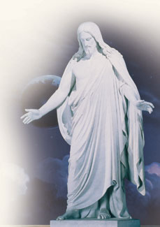
Messiah—The Anointed
An Aramaic and Hebrew word and occurs in Daniel 9:25-26 and John 1:41: 4:25 as Messias.
Used as the title of an office, it denotes the King and Deliverer whose coming the Jews were eagerly expecting.
In the New Testament the deliverer is called the Christ, which is the Greek equivalent of Messiah, and Jesus the Messiah is called Jesus the Christ, Jesus Christ, or Christ Jesus.
Throughout the Apocrypha there is no reference to the hope of the Messiah, though during the century before the birth of Christ the hope was steadily reviving.
Many Jews, as we learn from the Gospels, were looking only for a deliverer from the Roman power and for greater national prosperity; so when the Messiah came, the nation as a whole rejected Him.
Only the faithful were able to see in Jesus of Nazareth the true Suffering Servant of Isa. 53, as well as the true Prophet, Priest, and King of Israel.
Bible Dictionary

Slide 6
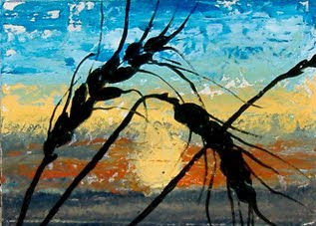
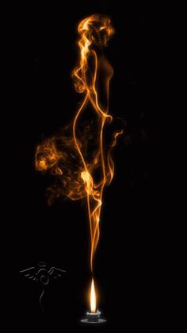
Judgement From the Servant
The spirit of judgment was to be withheld until the Day of Judgment, at which time Christ will claim victory as “King of kings, and Lord of lords”
Bruised reed and smoking flax = even though He comes in judgment, it is not to destroy souls but to save them.
“Smoking flax” translated a “glimmering wick.”
“…He does not completely break or extinguish.
Not only will He not destroy the life that is dying out, but He will actually save it; His course is not to destroy, but to save.” (1)
Isaiah 42:1-4

Slide 7
The Gospel Light Is Preached
When mortals who are blind because they lack gospel light embrace the gospel, they are as prisoners set free. (2)
By which also he went and preached unto the spirits in prison;
1 Peter 3:19
Isaiah 42:5-16

Slide 8
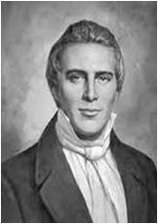
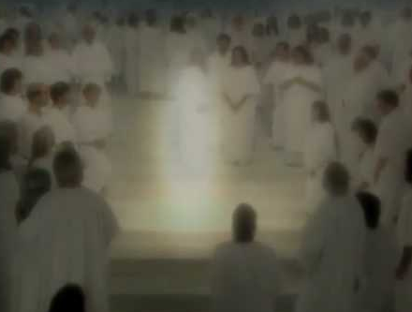
“Here then we have an account of our Savior preaching to the spirits in prison, to spirits that had been imprisoned from the days of Noah; and what did He preach to them? That they were to stay there? Certainly not! Let His own declaration testify.
It is very evident from this that He not only went to preach to them, but to deliver, or bring them out of the prison house. …
Thus we find that God will deal with all the human family equally, and that as the antediluvians [those who lived before the Flood] had their day of visitation, so will those characters referred to by Isaiah, have their time of visitation and deliverance, after having been many days in prison.” (4)
Isaiah 42:7 Luke 4:18

Slide 9
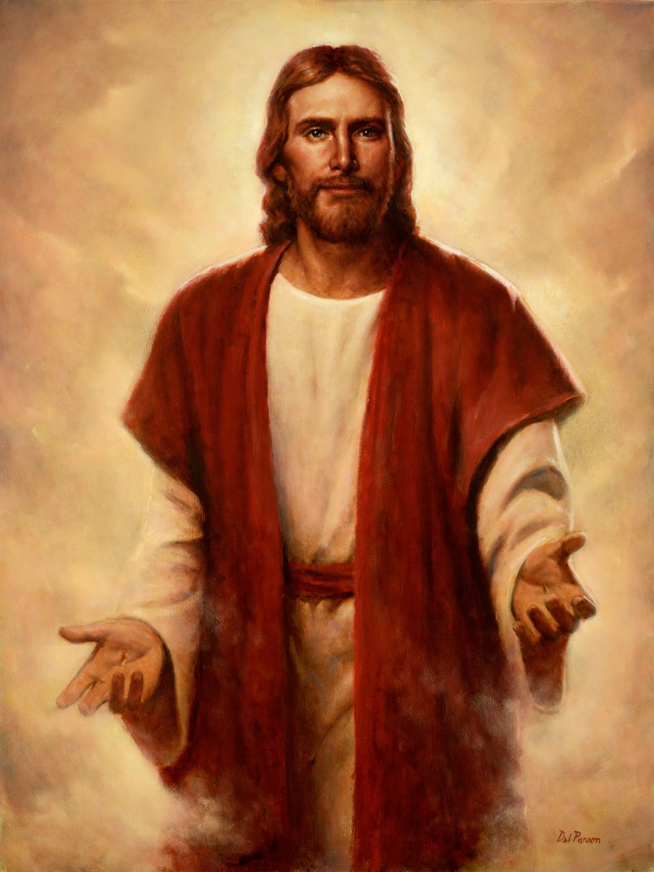
The Savior of the Gentiles
Everything centers in the Savior, Jesus Christ. He is the light of the world and “of the gentiles.”
His hand is extended to strengthen, support, and protect covenant Israel; but that is not all.
Every covenant person becomes a light to the world by holding up the light of the Savior through faithfully living His commandments. (3)
Therefore, hold up your light that it may shine unto the world. Behold I am the light which ye shall hold up—that which ye have seen me do. Behold ye see that I have prayed unto the Father, and ye all have witnessed.
3 Nephi 18:24
Isaiah 42:6 Acts 26:17-18

Slide 10
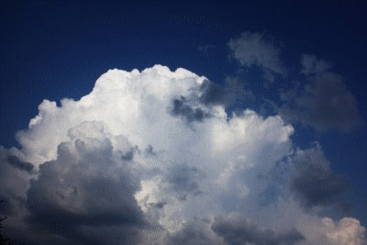
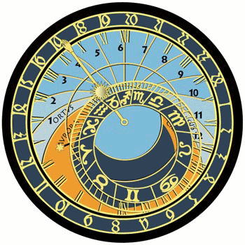
Waiting in Spirit Prison
But behold, from among the righteous, he organized his forces and appointed messengers, clothed with power and authority, and commissioned them to go forth and carry the light of the gospel to them that were in darkness, even to all the spirits of men; and thus was the gospel preached to the dead.
And the chosen messengers went forth to declare the acceptable day of the Lord and proclaim liberty to the captives who were bound, even unto all who would repent of their sins and receive the gospel.
D&C 138:30-31
While this vast multitude waited and conversed, rejoicing in the hour of their deliverance from the chains of death, the Son of God appeared, declaring liberty to the captives who had been faithful;
And there he preached to them the everlasting gospel, the doctrine of the resurrection and the redemption of mankind from the fall, and from individual sins on conditions of repentance.
D&C 138:18-19
Jesus Christ’s Atonement makes it possible for all, including those who have already died, to accept the gospel and become free from the captivity of sin.

Slide 11
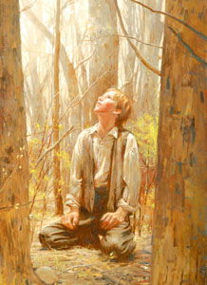
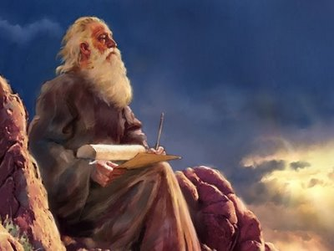
Restoration of the Gospel Foretold
The prophet Isaiah introduced the vision of the restoration of the gospel in the latter days by explaining that the truths and the keys of former days were to be restored. (3)
He also observed the restoration of new keys in the dispensation of the fulness of times.
Using the metaphor of childbirth he described the restoration of the earthly kingdom following a long period of apostasy, during which the heavens had been sealed. (3)
Isaiah 42:9-16

Slide 12
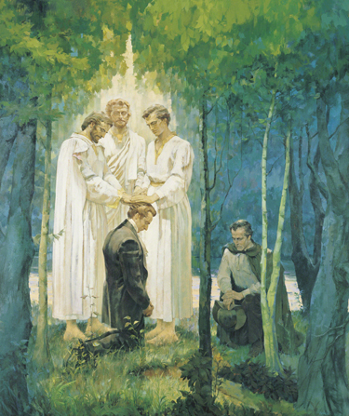
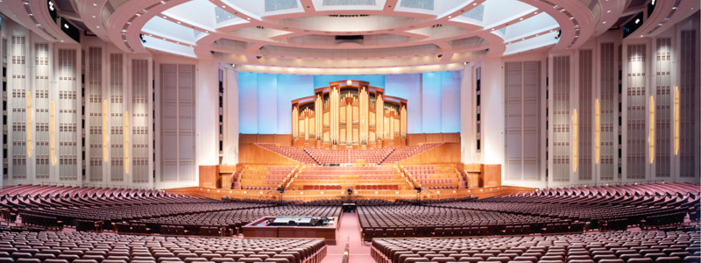
The Church Restored
The Church will be restored in the last days, before the destruction that will make the mountains as plains and dry up the waters, and before the return of the scattered tribes of Israel, when they will come on paths they have not known, and the light of the gospel will dispel the darkness they have so long endured
Isaiah 42:9-16

Slide 13
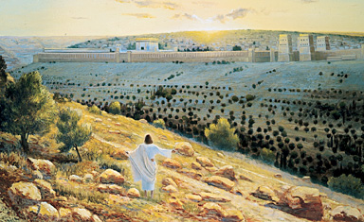
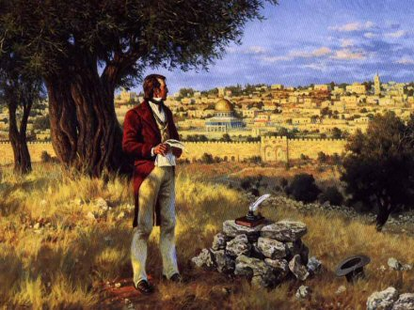
The Lord’s Promise
The restored gospel would not be taken again from the earth and that the Lord will not forsake His own.
And it shall come to pass in that day, that the Lord shall set his hand again the second time to recover the remnant of his people.
And he shall set up an ensign for the nations, and shall assemble the outcasts of Israel, and gather together the dispersed of Judah from the four corners of the earth.
Isaiah 42:9-16 Isaiah 11:11-12

Slide 14
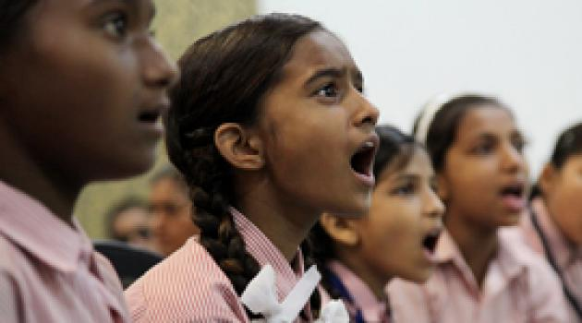
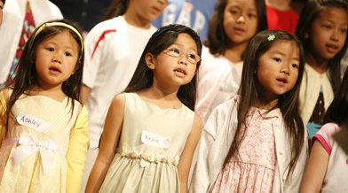
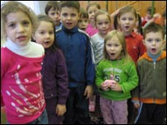
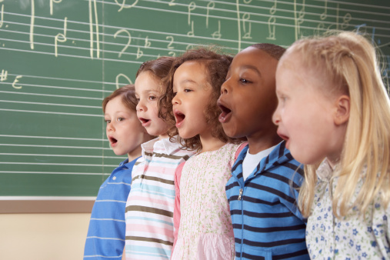
The New Song
And they sung as it were a new song before the throne.
Rev. 14:3
Isaiah recorded the singing of the “new song” after he recorded the restoration of the gospel. The song is unique in that only those who are sanctified are worthy to sing it.
The same spirit is reflected in Doctrine and Covenants 84:98–102.
In another instance, the song is simply called the “song of the Lamb.”
And the graves of the saints shall be opened; and they shall come forth and stand on the right hand of the Lamb, when he shall stand upon Mount Zion, and upon the holy city, the New Jerusalem; and they shall sing the song of the Lamb, day and night forever and ever.
D&C 133:56-57
Isaiah 42:10

Slide 15
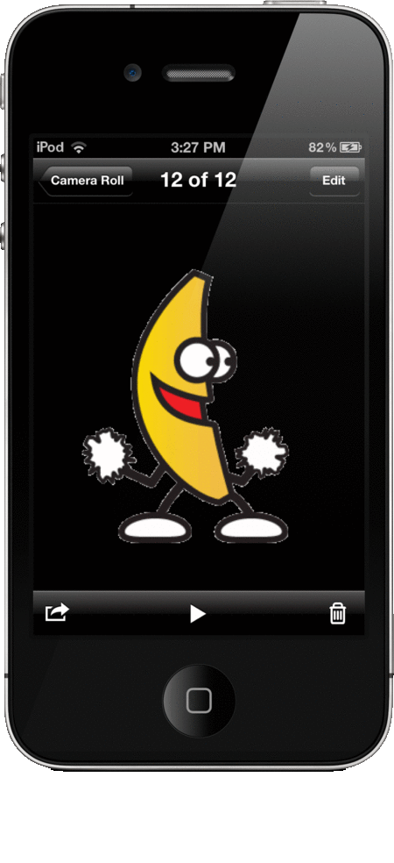
Spiritual Blindness and Deafness
Isaiah gave a clear reminder that all those, including wayward Israel, who pay homage at the feet of idols are deaf and blind to the message and light of the gospel
Why do we depend upon our False Gods?
Isaiah 42:19-23
Note: I am not saying that these items are bad…it is how we use them or how much that we depend on them that is our downfall

Slide 16
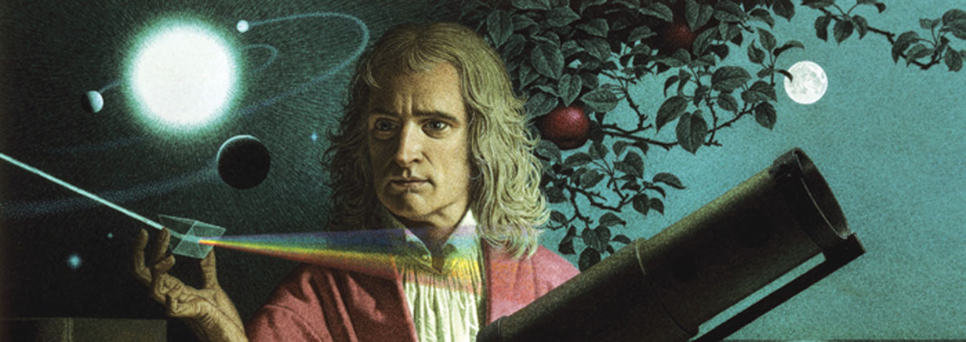
One Ray of Light
It is reported that on one occasion when Sir Isaac Newton was thinking seriously concerning the nature of light, he cut a hole in a window blind and a ray of light entered his room.
He held a triangular piece of glass in the range of the light, and there were reflected in great beauty all the colors of the rainbow.
And for the first time man learned that all of the glorious colors of the universe are locked up in a ray of white light. (5)
Isaiah 42:10

Slide 17
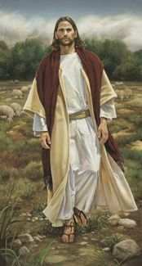
There Is No Other Savior
The Lord told the Israelites that they were witnesses of Him because of the great things He had done for them, and He emphasized that there is no Savior other than Him.
"Wherever 'Lord' appears in the Old Testament, we can substitute the name Jehovah.
"The language is clear. Jehovah is the only Savior. The reasoning is simple. If the Lord Jehovah is our only Savior, and Jesus Christ is our only Savior, then the Lord Jehovah must be Jesus Christ.
"Somehow, even before He obtained a mortal body, Jesus had become so like the Father that he was divinely invested with the power and authority to be Jehovah, the God of the Old Testament, who loved us enough to condescend from that position of power and authority to take upon Himself mortality and work the great and infinite Atonement." (7)
Isaiah 43:10

Slide 18
3 Phases of Gathering of Israel
The gathering of Israel to the land of Zion which is America, this land.
The return of the lost tribes, the ten lost tribes, from the land of the north
(see D&C 133).
That is under way and has been under way since the Church was established and our missions abroad were inaugurated.
The reestablishment of the Jews in Palestine as one of the events to precede the second coming of the Master.
From the four corners of the earth and they will be set in their own land, they will build the old wastes and repair the waste cities (6)
Isaiah 43:8-13 Isaiah 11:11-12 see Jeremiah 30:3

Slide 19
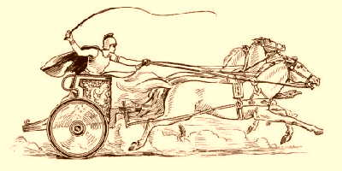
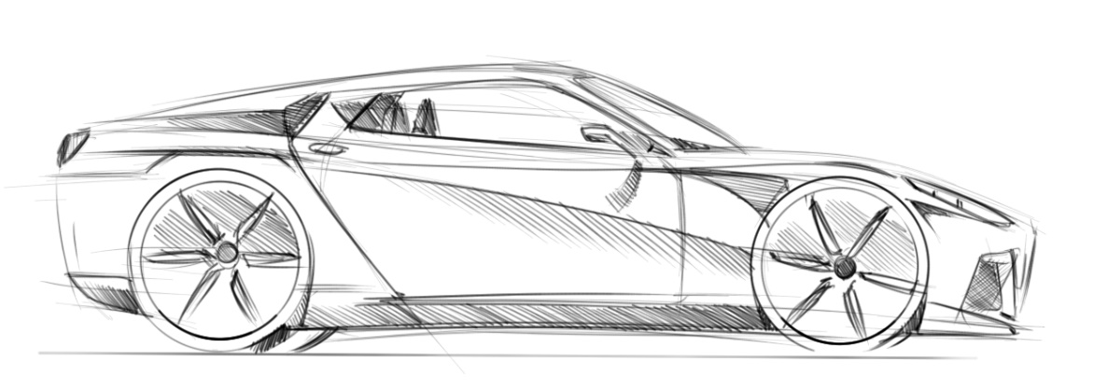
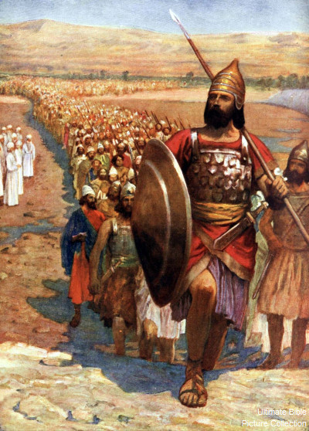
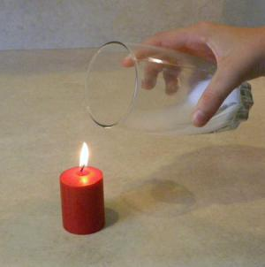
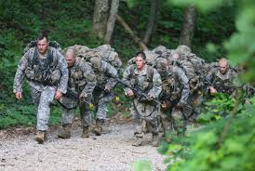
Yesterday and Today
Which bringeth forth the chariot and horse, the army and the power; they shall lie down together, they shall not rise: they are extinct, they are quenched as tow
The term, "quenched as tow" refers to the burning flax of a candle that is extinguished with water.
Isaiah 43:17

Slide 20
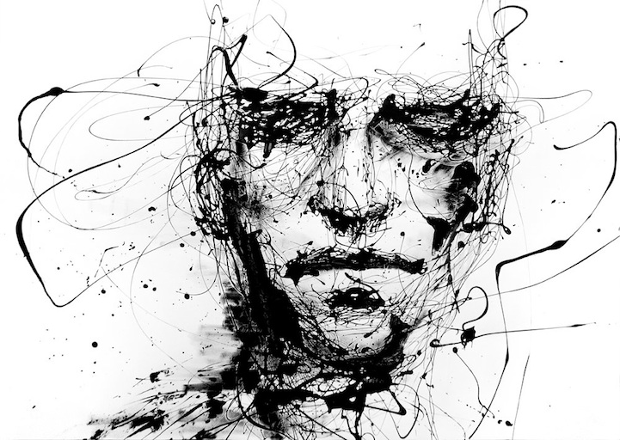
Blotteth Out
I, even I, am he that blotteth out thy transgressions for mine own sake, and will not remember thy sins.
Those who make one serious mistake tend to add another by assuming that it is then too late for them. It is never too late! Never!
(8)
Isaiah 43:25 See Alma 42

Slide 21
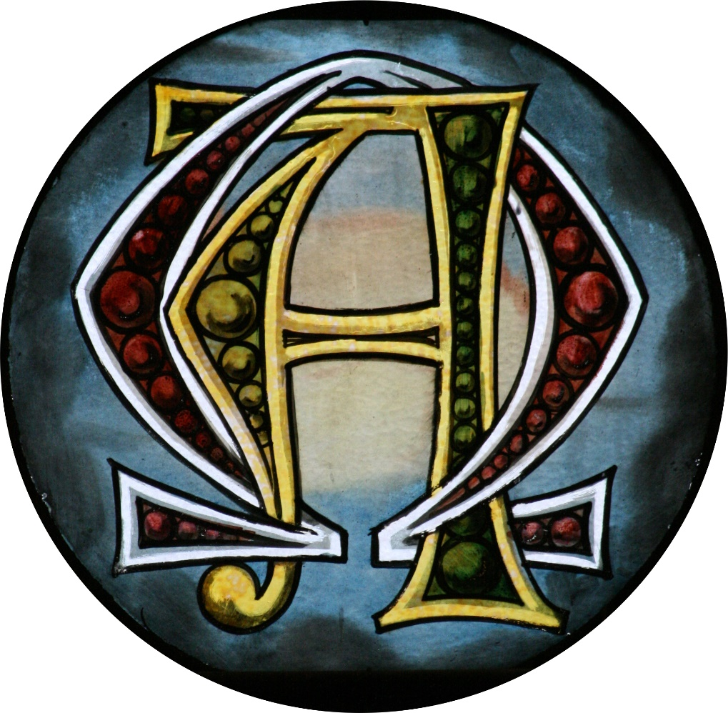
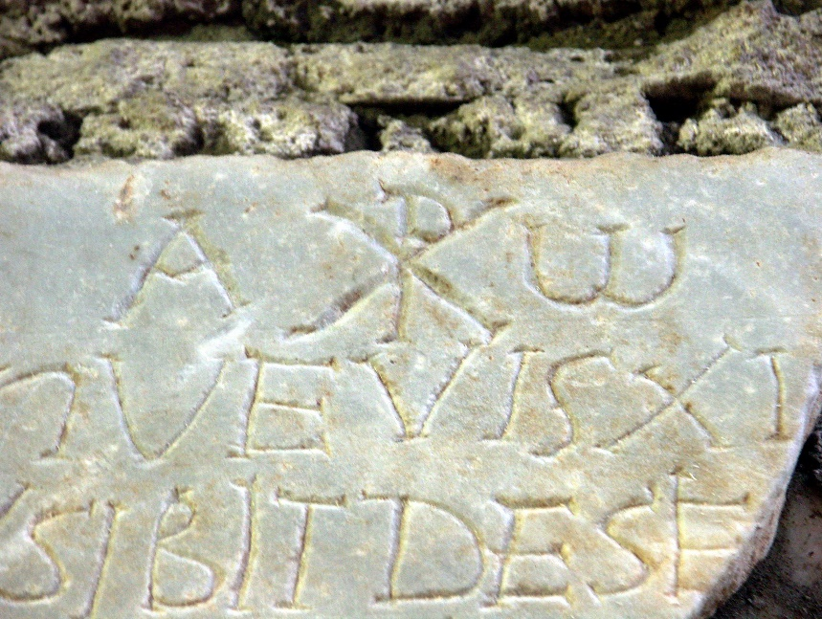
The First And The Last
Alpha and Omega
Beginning to End
Isaiah 44:6 see handout

Slide 22
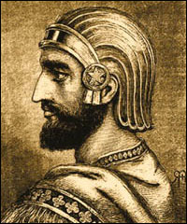
Cyrus—the Universal Ruler
One hundred years before Cyrus, the general who captured Babylon, was born, the Lord revealed to the Prophet Isaiah that Cyrus should be his servant and say unto Jerusalem that it should be rebuilt.
Babylon at that time was the greatest city in all the world, and was thought to be impregnable. Cyrus was not a Jew. Cyrus did not understand the old Testament, nor did he know of the part he was to play in the freeing of the captive Jews and rebuilding Jerusalem. (9)
“Cyrus is the only Gentile king who is called God’s ‘anointed.’ Since this is the translation of the Hebrew word which we spell in English as Messiah, Cyrus is in a sense a type of the Anointed One, the Lord Jesus Christ.
The only intended resemblance is in the fact that Cyrus was the anointed one who delivered the people of Israel from their captivity. As such he points us to the greater Anointed One who saves His people from their sins.” (10)
Isaiah 45

Slide 23
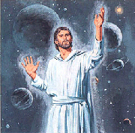
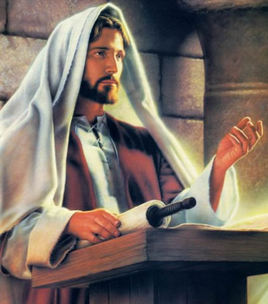
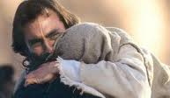
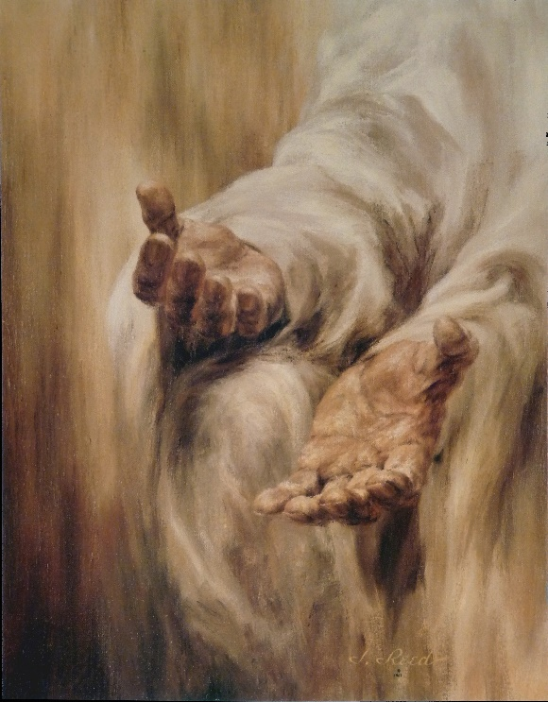
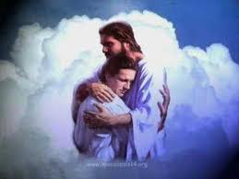
God of the Old Testament
Isaiah 45:15
He is the Messiah, the Savior of the World
Isaiah 45:17
He shall save Israel with an everlasting salvation
Isaiah 45:18
He is the Creator
Isaiah 45:21
He is just and is mighty to save
Isaiah 45 21-22
There is no other name given by which we may be saved
Isaiah 45:23
His words are truth and righteousness
Isaiah 45:23
Every knee shall bow and every tongue confess that Jesus is the Christ
Isaiah 45:24
He is the Mediator for all the seed of Israel
Isaiah 45:15-25

Slide 24
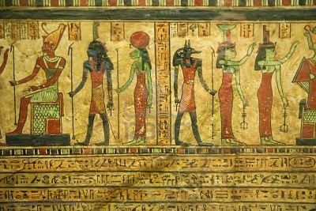
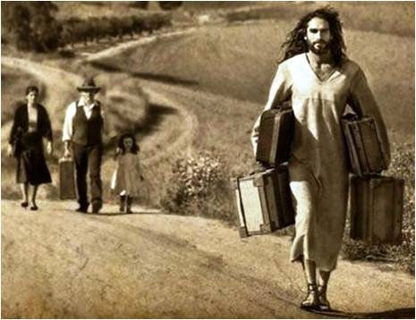
Idols Are Idols And A Burden
Does man make God or does God make man?
Should man be stronger than God or should God be stronger than man?
Should man or God have greater carrying capacity?
The questions are ridiculous, but so is the practice of making a god and then worshipping it.
The Lord will carry us if we will let him. Instead, sometimes we burden ourselves with our idolatry, when the Lord has promised
"Come unto me, all ye that labour and are heavy laden, and I will give you rest. Take my yoke upon you, and learn of me; for I am meek and lowly in heart: and ye shall find rest unto your souls. For my yoke is easy, and my burden is light." (Matt. 11:28-30)
Isaiah 46
(11)

Slide 25
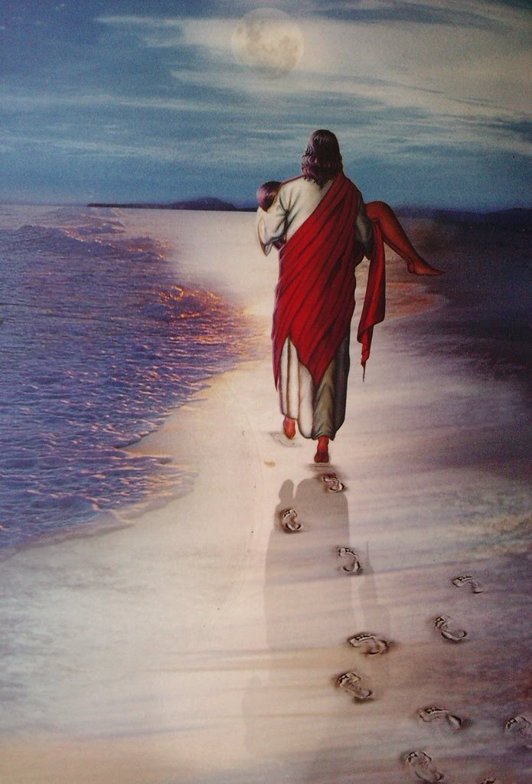
Footprints
One night I had a dream. I dreamed I was walking along the beach with the Lord, and across the sky flashed scenes from my life. For each scene I noticed two sets of footprints in the sand. One belonged to me and the other to the Lord.
When the last scene of my life flashed before me, I looked back at the footprints in the sand. I noticed that many times along the path of my life, there was only one set of footprints. I also noticed that it happened at the very lowest and saddest times in my life. This really bothered me, and I questioned the Lord about it.
"Lord, you said that once I decided to follow you, you would walk with me all the way, but I have noticed that during the most troublesome times in my life, there is only one set of footprints. I don't understand why in times when I needed you most, you should leave me."
The Lord replied, "My precious, precious child. I love you and I would never, never leave you during your times of trial and suffering. When you saw only one set of footprints, it was then that I carried you."
Isaiah 46:4

Slide 26
The Graven Images
Babylon of the Chaldees
Babylon or Spiritual Weakness
As society is attracted to a beautiful woman, so the children of men are attracted to the glitter and poser of spiritual Babylon
Isaiah 47:5—Called ‘the lady of kingdoms
Isaiah 47:6—Showed no mercy to covenant Israel, but laid great burden upon her
Through the wickedness of Babylon may appear attractive because it is easy or pleasurable, it only enslaves its subjects.
Isaiah 47:7—Boasted of being indestructible, but failed to see the judgment that would finally destroy her
In blindness, spiritual Babylon wreaks havoc upon the world, failing to see the self-destructive nature of her acts.
Isaiah 46
(3)

Slide 27
The Babylon of the world is enthroned triumphantly when men worship the lusts of the flesh. She becomes a counterfeit god. “They deny the power of God, the Holy One of Israel; and … say unto the people … there is no God” (2 Nephi 28:5), and “there is no hell”; thus the devil “grasps them with his awful chains from whence there is no deliverance” (2 Nephi 28:22).
Isaiah 47:8—Declared her pleasures to be the one and fulfillment of life’s dream, not merely the means to it
Isaiah 47:10--Through Babylon’s own wicked power subjected men to her will.
The Babylon of the world, through wicked covenants and deeds, binds a man’s loyalty to the prince of darkness by the promise of secret gain (Helaman 6:16–25).
Isaiah 47:10--So great had this “lady of the kingdoms” become that her rulers gloried in the thought that they were the center of knowledge and wisdom and forced their subjects to kneel to the king, and not to God
The Babylon of the world assumes expertise in all knowledge and decrees that men should worship at her door. As men embrace this hellish doctrine, they begin to believe that they knowwhere others do not, and they become self-appointed gods, even to the giving and taking of life (2 Nephi 9:20)
Isaiah 47
(3)

Slide 28
Sources:
Suggested Hymn: #63 Great King of Heaven
Videos:
Connect to the Spirit of God (0:21) Unplugging your devices
The Dead Awaited the Atonement (0:34)
The Power of Hope (2:11)
https://www.youtube.com/watch?v=c-eRRWDLdGo
C. F. Keil and F. Delitzsch (Commentary on the Old Testament, 7:2:176.)
Joseph Fielding Smith Doctrines of Salvation,1:269–70
Old Testament Student Manual Chapter 16 The God of Israel and the Nations
President Joseph Smith (History of the Church, 4:596–97.
Joseph Anderson Man’s Eternal Horizon April 1972 Gen. Conf.
Ezra Taft Benson A Message to Judah from Joseph December 1976 Ensign
Terry Ball and Nathan Winn, Making Sense of Isaiah, [SLC: Deseret Book, 2009], 124)
Boyd K. Packer "To Young Women and Men," Ensign, May 1989, 59)
George Albert Smith Conference Report, October 1948, pp. 180-190)
Alfred Martin Isaiah, the Salvation of Jehovah, pp. 77–78
Gospeldoctrine.com
Presentation by ©http://fashionsbylynda.com/blog/

Slide 29
Until all shall know me, who remain, even from the least unto the greatest, and shall be filled with the knowledge of the Lord, and shall see eye to eye, and shall lift up their voice, and with the voice together sing this new song, saying:
The Lord hath brought again Zion;
The Lord hath redeemed his people, Israel,
According to the election of grace,
Which was brought to pass by the faith
And covenant of their fathers.
The Lord hath redeemed his people;
And Satan is bound and time is no longer.
The Lord hath gathered all things in one.
The Lord hath brought down Zion from above.
The Lord hath brought up Zion from beneath.
The earth hath travailed and brought forth her strength;
And truth is established in her bowels;
And the heavens have smiled upon her;
And she is clothed with the glory of her God;
For he stands in the midst of his people.
Glory, and honor, and power, and might,
Be ascribed to our God; for he is full of mercy,
Justice, grace and truth, and peace,
Forever and ever, Amen.
D&C 84:98-102
Until all shall know me, who remain, even from the least unto the greatest, and shall be filled with the knowledge of the Lord, and shall see eye to eye, and shall lift up their voice, and with the voice together sing this new song, saying:
The Lord hath brought again Zion;
The Lord hath redeemed his people, Israel,
According to the election of grace,
Which was brought to pass by the faith
And covenant of their fathers.
The Lord hath redeemed his people;
And Satan is bound and time is no longer.
The Lord hath gathered all things in one.
The Lord hath brought down Zion from above.
The Lord hath brought up Zion from beneath.
The earth hath travailed and brought forth her strength;
And truth is established in her bowels;
And the heavens have smiled upon her;
And she is clothed with the glory of her God;
For he stands in the midst of his people.
Glory, and honor, and power, and might,
Be ascribed to our God; for he is full of mercy,
Justice, grace and truth, and peace,
Forever and ever, Amen.
D&C 84:98-102
The New Song
The New Song

Slide 30
Electronic Devices:
“You live in a world where technological advances occur at an astounding pace. It is difficult for many of my generation to keep up with the possibilities.
Depending on how technology is used, these advances can be a blessing or a deterrent. Technology, when understood and used for righteous purposes, need not be a threat but rather an enhancement to spiritual communication.
For example, many of us have a personal electronic device that fits into our pocket. We are seldom without its company; we may refer to it many times a day. Unfortunately, these devices can be a source of filth and wasted time. But, used with discipline, this technology can be a tool of protection from the worst of society.
Who could have imagined not very many years ago that the full standard works and years of general conference messages would fit into your pocket? Just having them in your pocket will not protect you, but studying, pondering, and listening to them during quiet moments of each day will enhance communication through the Spirit.
Be wise in how you embrace technology. Mark important scriptures on your device and refer back to them frequently. If you young people would review a verse of scripture as often as some of you send text messages, you could soon have hundreds of passages of scripture memorized. Those passages would prove to be a powerful source of inspiration and guidance by the Holy Ghost in times of need.”
Elder Richard G. Scott For Peace at Home
April 2013 Gen.Conf.
JST Isaiah 42:19-23 My Servant
“For I will send my servant unto you who are blind; yea, a messenger to open the eyes of the blind, and unstop the ears of the deaf;
“And they shall be made perfect notwithstanding their blindness, if they will hearken unto the messenger, the Lord’s servant.
“Thou art a people, seeing many things, but thou observest not; opening the ears to hear, but thou hearest not.
“The Lord is not well pleased with such a people, but for his righteousness’ sake he will magnify the law and make it honorable.
“Thou art a people robbed and spoiled; thine enemies, all of them, have snared thee in holes, and they have hid thee in prison houses; they have taken thee for a prey, and none delivereth; for a spoil, and none saith, Restore.”
it is not the servant who is blind, but scattered Israel, who have adopted the idols of their neighbors.
Isaiah 43:19: The mountains, the rivers, the deserts
I love the prophecies of Isaiah. It seems to me that he almost lived more in our day than when he was actually upon the earth. He saw so much of what would transpire in our day. He saw us settled here in these valleys of the mountains. He saw this desert, where we were once a thousand miles from transportation and supplies, made to blossom as a rose (see Isa. 35:1). He saw the rivers flow in the desert where we have built these great irrigation canals (see Isa. 43:19). He saw the water flow down from the high places where we have reservoired it in these mountain fastnesses for summer's use (see Isa. 41:18). He saw the redeemed of the Lord come up and sing in the heights of Zion (see Isa. 51:11). And where do you find anything in the world to fulfill that like the singing of the Tabernacle Choir for over fifty years without a break?
He saw the mountain of the Lord's house established in the top of the mountains in the latter days when all nations would flow unto it, and they would say, "Come ye, and let us go up to the mountain of the Lord, to the house of the God of Jacob; that he will teach us of his ways, and we will walk in his paths" (Isa. 2:3). LeGrand Richard("A Testimony," Ensign, Nov. 1980, 64)

Slide 31
Comparison of Exodus and Revelation
Isaiah 43:16-17
The Chariot and horse, the army and the Power…are quenched as tow.
The plagues brought upon Egypt by Moses are a type for the destruction of the wicked.
Gospeldoctrine.com

Slide 32
The First and the Last
Isaiah 41:4 | Who hath wrought and done it, calling the generations from the beginning? I the Lord, the first, and with the last; I am he.
Isaiah 48:12 | Hearken unto me, O Jacob and Israel, my called; I am he; I am the first, I also am the last.
Isaiah 44:6 | Thus saith the Lord the King of Israel, and his redeemer the Lord of hosts; I am the first, and I am the last; and beside me there is no God
Revelation 22:13 | I am Alpha and Omega, the beginning and the end, the first and the last.
Revelation 1:17 | And when I saw him, I fell at his feet as dead. And he laid his right hand upon me, saying unto me, Fear not; I am the first and the last:
Revelation 1:11 | Saying, I am Alpha and Omega, the first and the last:
1 Nephi 20:12 | Hearken unto me, O Jacob, and Israel my called, for I am he; I am the first, and I am also the last.
Alma 11:39 | And Amulek said unto him: Yea, he is the very Eternal Father of heaven and of earth, and all things which in them are; he is the beginning and the end, the first and the last;
D&C 110:4 | I am the first and the last; I am he who liveth, I am he who was slain; I am your advocate with the Father.
3 Nephi 9:18 | I am the light and the life of the world. I am Alpha and Omega, the beginning and the end.
Revelation 1:8 JST | For he saith, I am Alpha and Omega, the beginning and the ending, the Lord, who is, and who was, and who is to come, the Almighty.
D&C 19:1 | I am Alpha and Omega, Christ the Lord; yea, even I am he, the beginning and the end, the Redeemer of the world.
D&C 63:60 | Behold, I am Alpha and Omega, even Jesus Christ.

Slide 33
Isaiah 44:6 This scripture answers the question, "Was Christ a man that became God or a God that became man?"
This scripture proves it. Jehovah is "the first, and... the last." This is the same terminology used in John's revelation of Jesus Christ, "I am Alpha and Omega, the first and the last" (Rev. 1:11). To the Nephites, the resurrected Lord would declare, "Behold, I am he that gave the law, and I am he who covenanted with my people Israel" (3 Ne. 15:5). Can you imagine the uproar such a statement would have caused during Christ's mortal ministry? The detractors asked, "Art thou greater than our father Abraham, which is dead? and the prophets are dead: whom makest thou thyself?" (John 8:53) Jesus could have replied, "I am the Holy One of Israel, the God of Abraham, Isaac, and Jacob, the Jehovah that gave the Law to Moses on Sinai. I am the first and the last." How would that answer have been received by the scribes and Pharisees?
Cyrus:
"In 539 B.C., Cyrus, King of Persia, entered Babylon as a conquering hero and was acclaimed king of Babylon by the priests of the Babylonian god Marduk. Although Cyrus had become the king of the Persians already in 557 B.C., it was his entry into Babylon that marked the beginning of his reign as universal ruler, 'king of the four quarters of the earth.' We thus read in the book of Ezra, 'Now in the first year of Cyrus king of Persia, that the word of the Lord by the mouth of Jeremiah might be fulfilled, the Lord stirred up the spirit of Cyrus king of Persia, that he made a proclamation throughout all his kingdom.' (Ezra 1:1.) This 'first year' would have been 539 B.C., and the proclamation which follows in Ezra 1:2-4 charges the people of Judah to return from their Babylonian exile to their homeland, where they should build a temple to the Lord God of Israel in Jerusalem.
"Even though the decree quoted in the first chapter of Ezra is not found in the preserved royal inscriptions of Cyrus, the sentiment contained in that decree, that of returning exiled peoples to their homelands and to the worship of their own gods, is an authentic reflection of Cyrus's policy. The Cyrus Cylinder, which is an account in the Babylonian language of Cyrus's conquest of Babylon and his subsequent policy, states: 'I gathered all their former inhabitants and returned to them their habitations. Furthermore, I resettled upon the command of Marduk, the great lord, all the gods of Sumer and Akkad whom Nabonidus [the last king of Babylon, defeated by Cyrus] has brought into Babylon to the anger of the lord of the gods, unharmed, in their former chapels, the places which make them happy.' (James B. Pritchard, Ancient Near Eastern Texts Relating to the Old Testament, Princeton: Princeton University Press, 1955, p. 316).
"Cyrus thus reversed the policy of preceding rulers: instead of deporting conquered peoples, he restored them to their homelands. The Assyrians had deported the people of the kingdom of Israel in 721 B.C., and the Babylonians had deported the Jews in 587/6 B.C. But Cyrus was broad-minded in his dealings with conquered peoples and was detached enough in his adherence to his own religion that he was able to grant concessions to others. He established a remarkably farsighted and effective administrative system for the far-flung Persian Empire. The books of Ezra and Nehemiah give us a number of fascinating glimpses into the workings of this system. Cyrus, one of the most remarkable rulers in history, was thus able to carry out a mission that had been foreseen two hundred years earlier by the prophet Isaiah: 'Thus saith the Lord to his anointed, to Cyrus, whose right hand I have holden, to subdue nations before him; and I will loose the loins of kings, to open before him the two leaved gates; and the gates shall not be shut.' (Isa. 45:1.)" (John M. Lundquist, "Life in Ancient Biblical Lands," Ensign, Dec. 1981, 43)

Slide 34
The rest of the History of Cyrus:
One hundred years before Cyrus, the general who captured Babylon, was born, the Lord revealed to the Prophet Isaiah that Cyrus should be his servant and say unto Jerusalem that it should be rebuilt (Isa. 44:28; Isa. 45:1). Babylon at that time was the greatest city in all the world, and was thought to be impregnable. Cyrus was not a Jew. Cyrus did not understand the old Testament, nor did he know of the part he was to play in the freeing of the captive Jews and rebuilding Jerusalem.
While Cyrus was besieging the city of Babylon the great king, Belshazzar of Babylon and his associates were using the sacred vessels that had been taken from the house of the Lord in Jerusalem to drink from (Dan. 5:1-31). It was a great debauch, and suddenly in the midst of it was seen a hand writing on the wall these words, "Me-ne, Me-ne, Tekel, U-phar-sin," and they could not read it (Dan. 5:25).
The Queen said to the King, "There is a Hebrew prophet among us. He can tell you what it means."
And so they went out and brought Daniel in and when Daniel saw the handwriting on the wall he could read it. It was not difficult for him. He was the servant of the Lord. He had the priesthood and he had honored it in a most marvelous way all down through his life.
The king and others felt perfectly secure, feeling that with food and provisions, and a river of water running through the city, not anything could come in to disturb them, and yet on that wall were written the words which, when interpreted, read, "You have been weighed in the balance and found wanting, and your kingdom will be divided among the Medes and the Persians." At that very hour "my servant Cyrus" had diverted the river that went through the city from its channel and his army entered under the wall, which wall was so high that it could not be scaled or destroyed with any means or weapons that they had, and so wide that several chariots could ride abreast on the top.
When that gentile, if we may use that term, that alien to those that had had the priesthood and the blessings of the Lord, the descendants of Abraham, Isaac and Jacob, realized that the Lord had given him Babylon, he issued a proclamation freeing the Jewish captives and returning them to rebuild their city of Jerusalem. He not only took his own army and his own people but he gave them means to use in payment to the workers. George Albert Smith (Conference Report, October 1948, pp. 180-190)
Trust in the Lord:
“This life is an experience in profound trust—trust in Jesus Christ, trust in his teachings, trust in our capacity as led by the Holy Spirit to obey those teachings now and for a purposeful, supremely happy eternal existence. To trust means to obey willingly without knowing the end from the beginning (see Prov. 3:5–7). To produce fruit, your trust in the Lord must be more powerful and enduring than your confidence in your own personal feelings and experience” Elder Richard G. Scott (“Trust in the Lord,” Ensign, Nov. 1995, 17).
Christ is the Redeemer:
“Among the most significant of Jesus Christ’s descriptive titles is Redeemer. … The word redeem means to pay off an obligation or a debt. Redeem can also mean to rescue or set free as by paying a ransom. If someone commits a mistake and then corrects it or makes amends, we say he has redeemed himself. Each of these meanings suggests different facets of the great Redemption accomplished by Jesus Christ through His Atonement, which includes, in the words of the dictionary, ‘to deliver from sin and its penalties, as by a sacrifice made for the sinner’ [Webster’s New World College Dictionary, 3rd ed. (1988), ‘redeem’]” Elder D. Todd Christofferson (“Redemption,” Ensign or Liahona, May 2013, 109).

