Slide 1
Help in Power Point Presentations
Do Your Characters look green?
Presentation by http://fashionsbylynda.com/blog/

Slide 2
Because the Power Points were created on or in the year 2011.
Microsoft office color pallet was different.

Slide 3
To Solve the problem of green faces click on:
Design

Slide 4
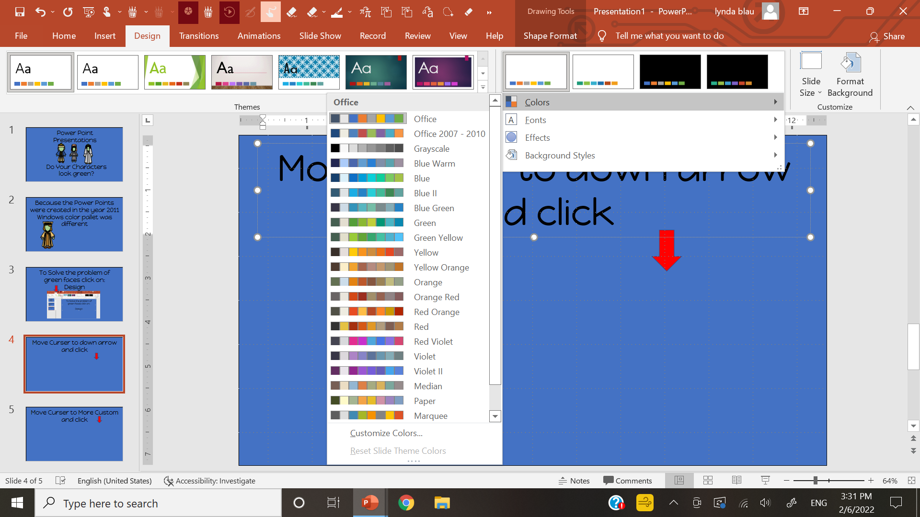
Move Curser to down arrow and click

Slide 5
A color pallet will appear and click on office 2007-2010

Slide 6
2007-2010 will change some of the other colors you will see in the background or on the
characters, but at least they will not be GREEN
Practice on this presentation. All the characters, and some backgrounds will change.

Slide 7
If you are looking at the PDF version you will not be able to make changes.
Power Point….make sure to enable presentation.

