Slide 2
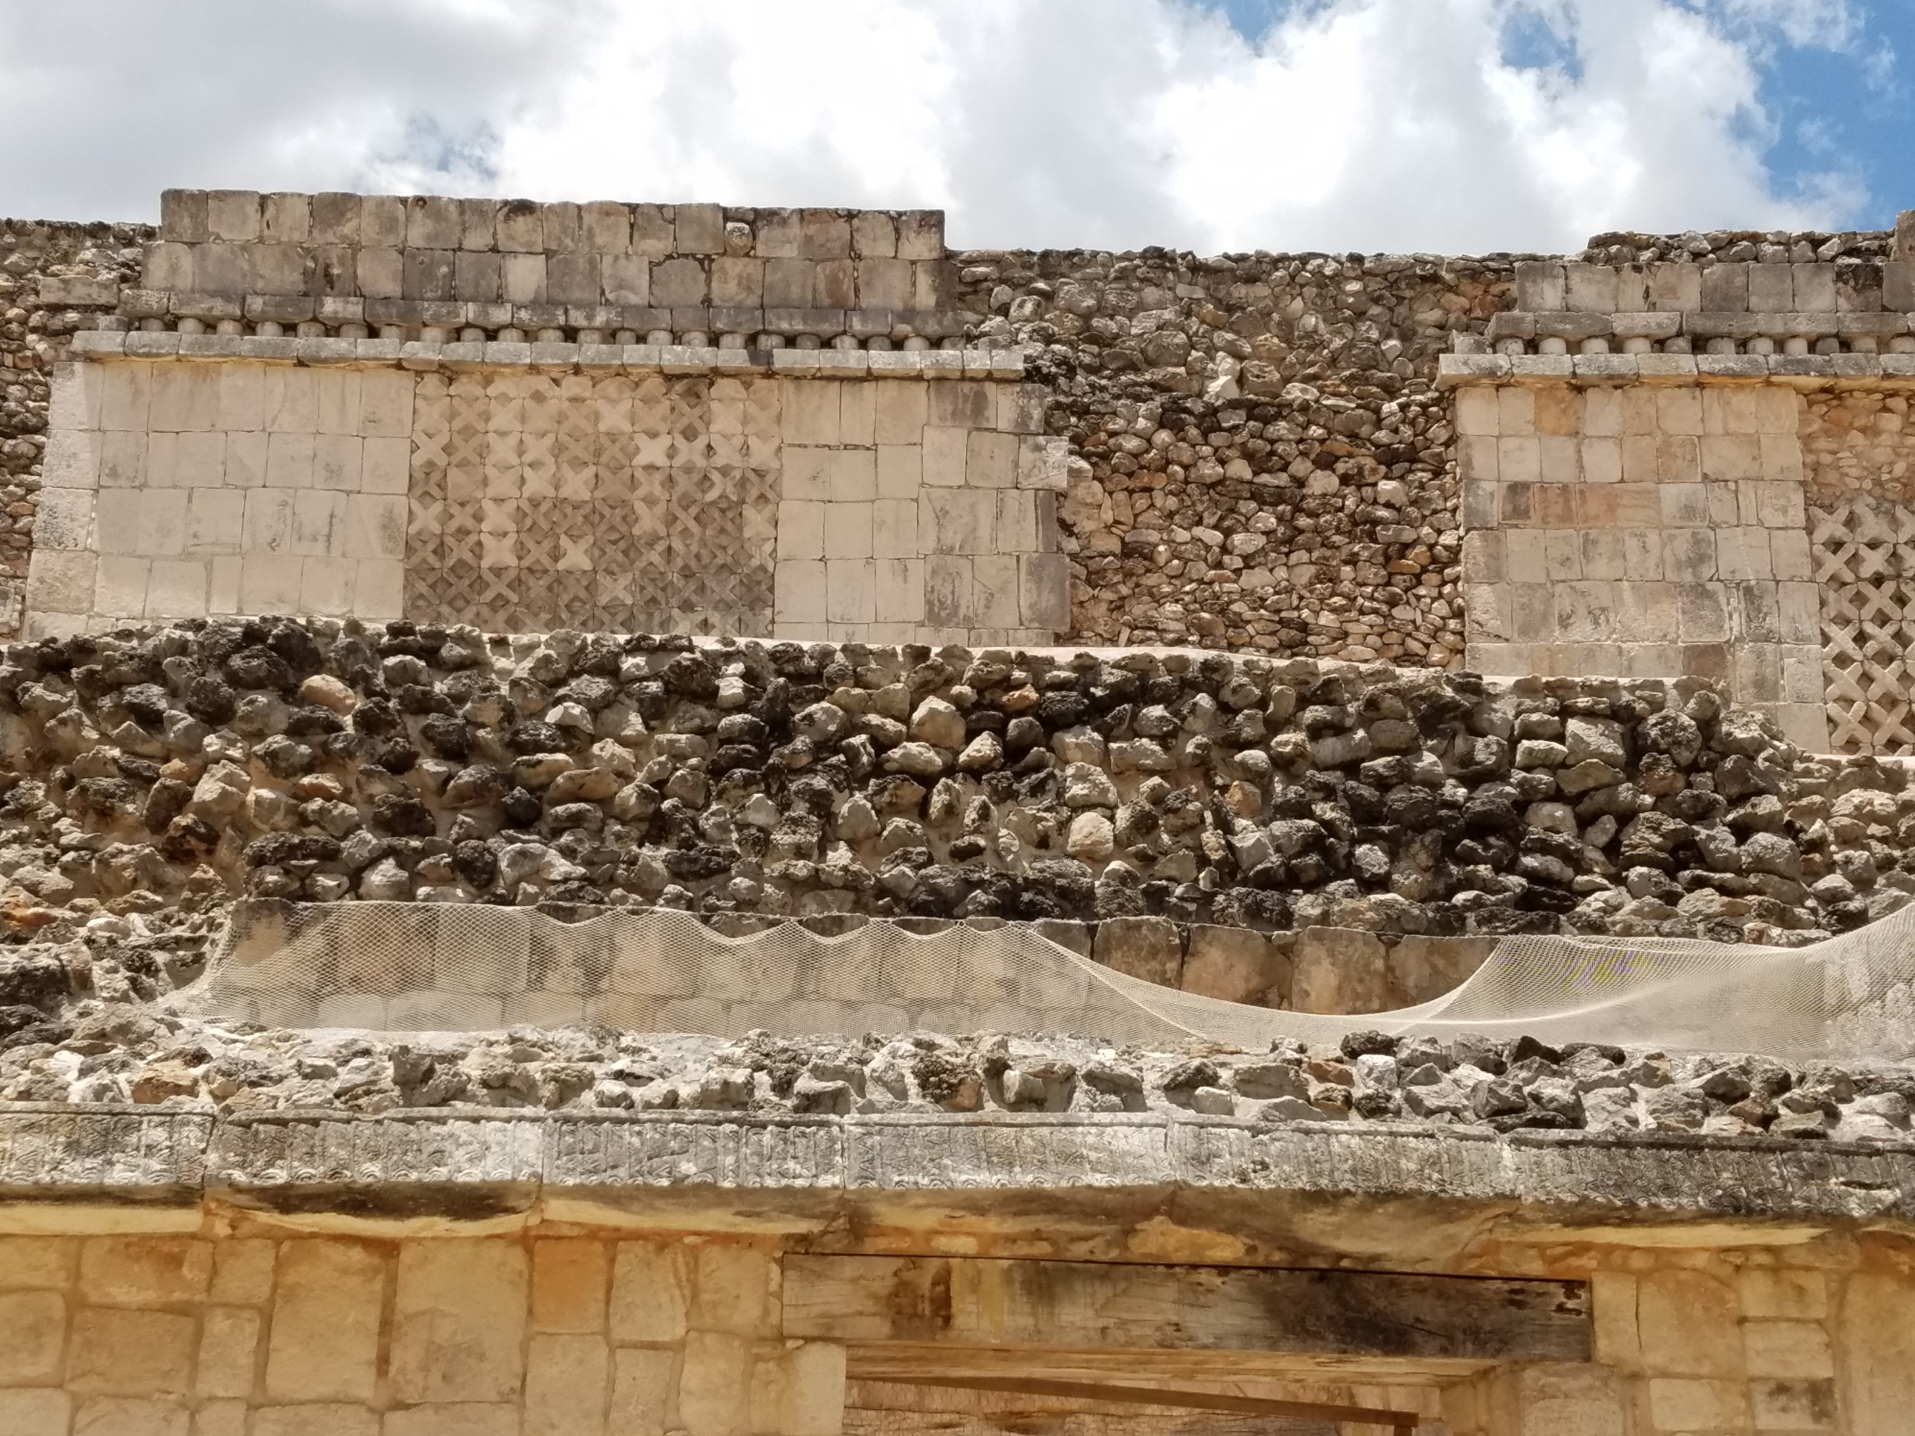
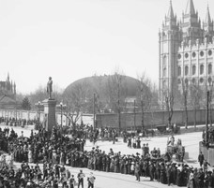
The Gathering
2,500 Nephite men, women and children
Why would the people gather around the temple?
Where would you gather if you had witnessed a miraculous event?
3 Nephi:1-3

Slide 3
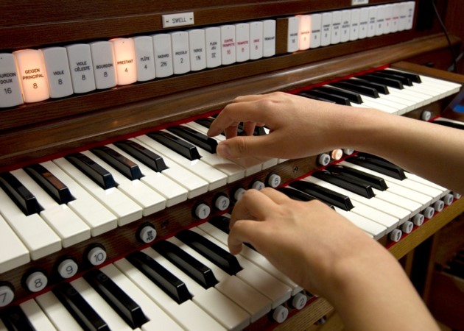
The Voice
What would be the message of the song before the starting of a sacrament meeting?
(Prelude Music)
How often do you listen to the music before a meeting?
What must a person do to hear and understand a soft voice?
3 Nephi 11:3-5

Slide 4
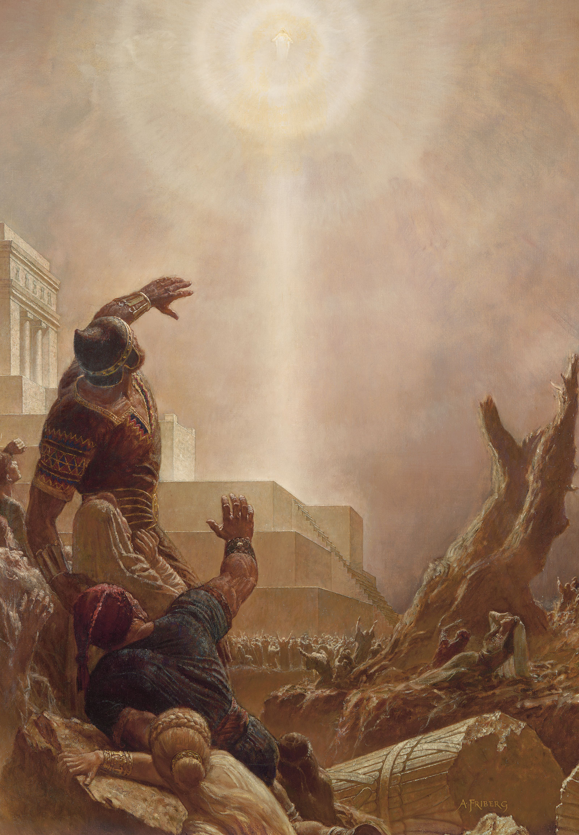
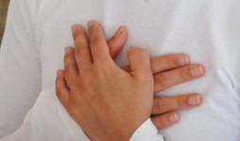
The Sound of the Voice
“And it came to pass when they heard this voice, and beheld that it was not a voice of thunder, neither was it a voice of a great tumultuous noise, but behold, it was a still voice of perfect mildness, as if it had been a whisper, and it did pierce even to the very soul—”
Helaman 5:30
Not a harsh voice, neither was it a loud voice
A small voice, piercing them that did hear to the center…their very soul…causing their heart to burn—a testimony
The Holy Ghost often speaks to us through our feelings
3 Nephi 11:3

Slide 5
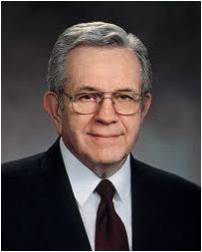
“The Spirit does not get our attention by shouting. It never shakes us with a heavy hand. The Spirit whispers. It caresses so gently, indeed, that if we are preoccupied, we can’t feel it at all.
“Occasionally, the Spirit will press just firmly enough or often enough for us to pay attention; but from my experience, most of the time, if we do not heed the gentle feeling, if we do not listen with those feelings, the Spirit will withdraw and wait until we come seeking and listening, in our manner and our expression.”
Boyd K. Packer
As we learn how to listen to the voice of the Lord through the Holy Ghost, we will be able to understand the communication He gives us

Slide 6
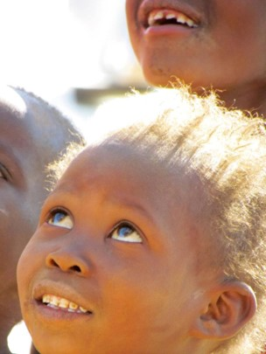
Looking to Heaven
The third time the voice came:
They did open their ears toward the sound
They did look toward where the sound came from
They did understand, this time, thinking what they saw was an angel.
Try this sometime:
In a crowded area look up, then look around and see how many look up also.
3 Nephi 11:5-8

Slide 7
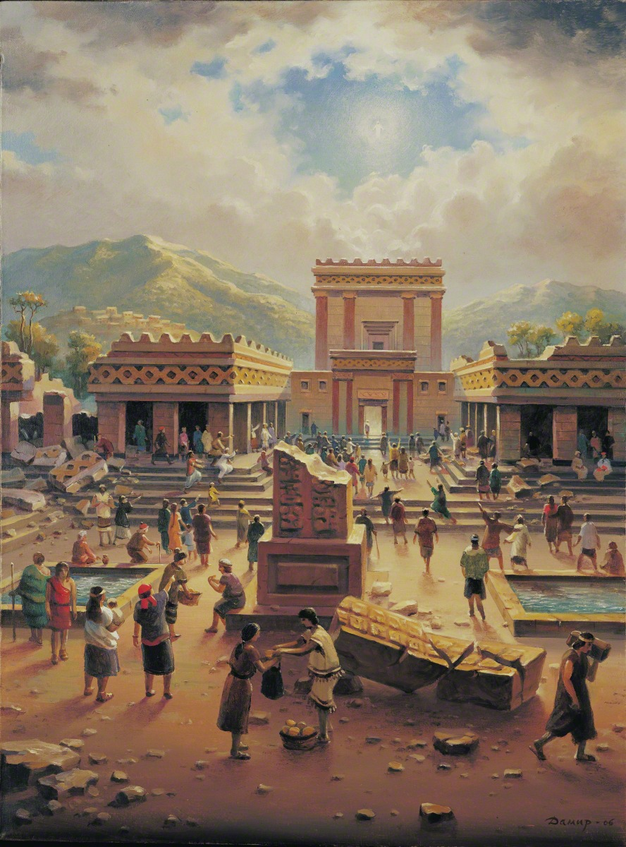
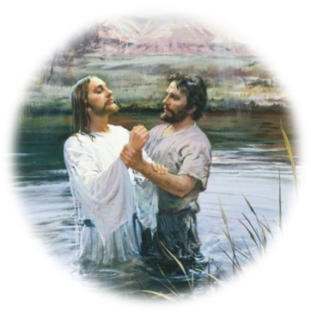
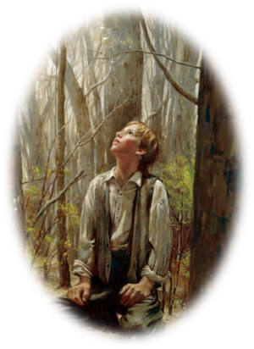
“Hear Him”
The voice of Heavenly Father announces His Son:
“Behold my Beloved son, in whom I am well please, in whom I have glorified my name—hear ye him.”
After Jesus was baptized:
“And lo a voice from heaven, saying, This is my beloved Son, in whom I am well pleased.”
Matthew 3:17
To Joseph Smith: “…One of them spake unto me, calling me by name and said, pointing to the other—This is My Beloved Son. Hear Him!”
Joseph Smith History 1:17
3 Nephi 11:7-8

Slide 8
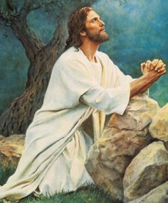
Glorified My Name
“…Christ’s fulfillment of the atoning sacrifice that makes immortality and eternal life possible for mankind—which is the “work and glory” of the Father.”
JFM and RLM
He is the Christ, the Messiah who every prophet had testified would come into the world:
“And I said unto him: Then ye do not understand them; for they truly testify of Christ. Behold, I say unto you that none of the prophets have written, nor prophesied, save they have spoken concerning this Christ.”
Jacob 7:11
“Yea, even six hundred years from the time that my father left Jerusalem, a prophet would the Lord God raise up among the Jews—even a Messiah, or, in other words, a Savior of the world.”
1 Nephi 10:4
“For behold, this is my work and my glory—to bring to pass the immortality and eternal life of man.”
Moses 1:39
3 Nephi 11:7

Slide 9
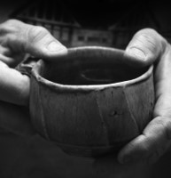
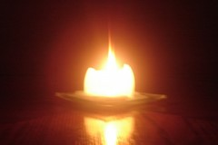
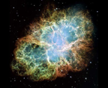
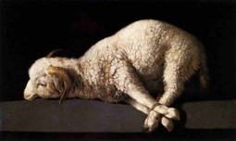
“I Am Jesus Christ”
I am the Light—the truth
I have drunk out of that bitter cup—The painful demands of justice that had to be met in order for the infinite and eternal sacrifice to be fulfilled
(see Matthew 26:36-46)
I have suffered the will of the Father in all things from the beginning—He has suffered for not only the repentant people but all the people from the beginning of Adam.
I have glorified the Father in taking upon the sins of the world—demonstrating His infinite love for every person.
3 Nephi 11:9-11

Slide 10
Doctrinal Mastery
Behold, I am Jesus Christ, whom the prophets testified shall come into the world.
And behold, I am the light and the life of the world; and I have drunk out of that bitter cup which the Father hath given me, and have glorified the Father in taking upon me the sins of the world, in the which I have suffered the will of the Father in all things from the beginning.
3 Nephi 11:10-11

Slide 11
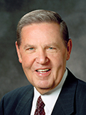
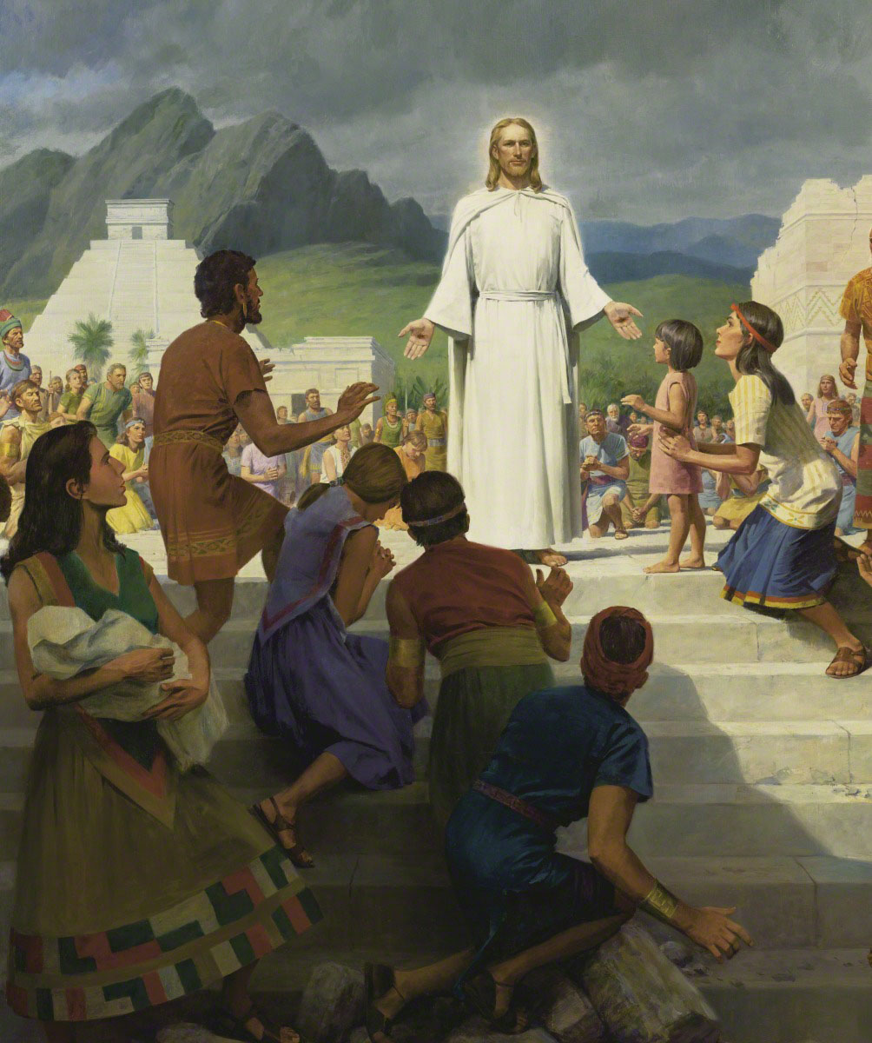
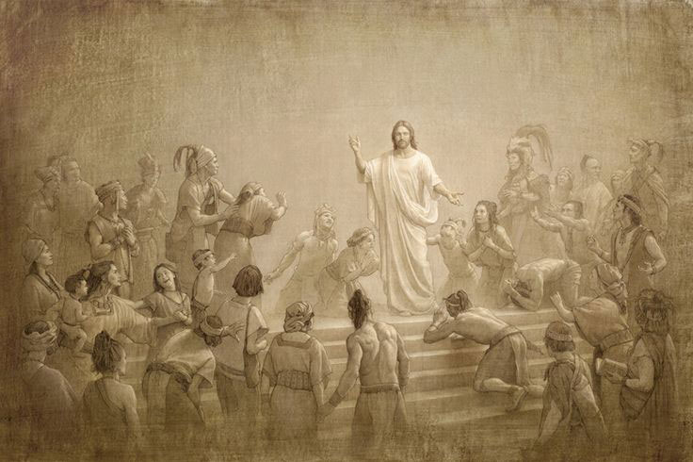
“Fall to the Earth”
“That appearance and that declaration constituted the focal point, the supreme moment, in the entire history of the Book of Mormon.
It was the manifestation and the decree that had informed and inspired every Nephite prophet for the previous six hundred years, to say nothing of their Israelite and Jaredite forefathers for thousands of years before that.
“Everyone had talked of him, sung of him, dreamed of him, and prayed for his appearance—but here he actually was. The day of days! The God who turns every dark night into morning light had arrived.”
Elder Jeffrey R. Holland
3 Nephi 11:12

Slide 12
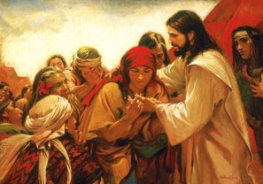
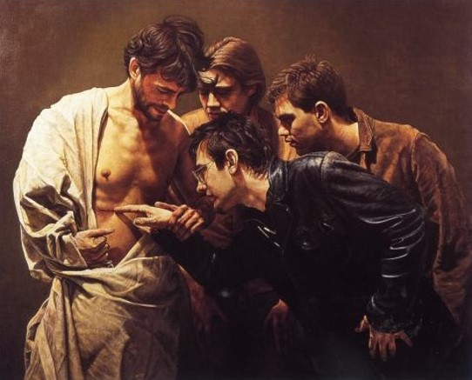
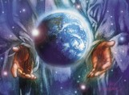
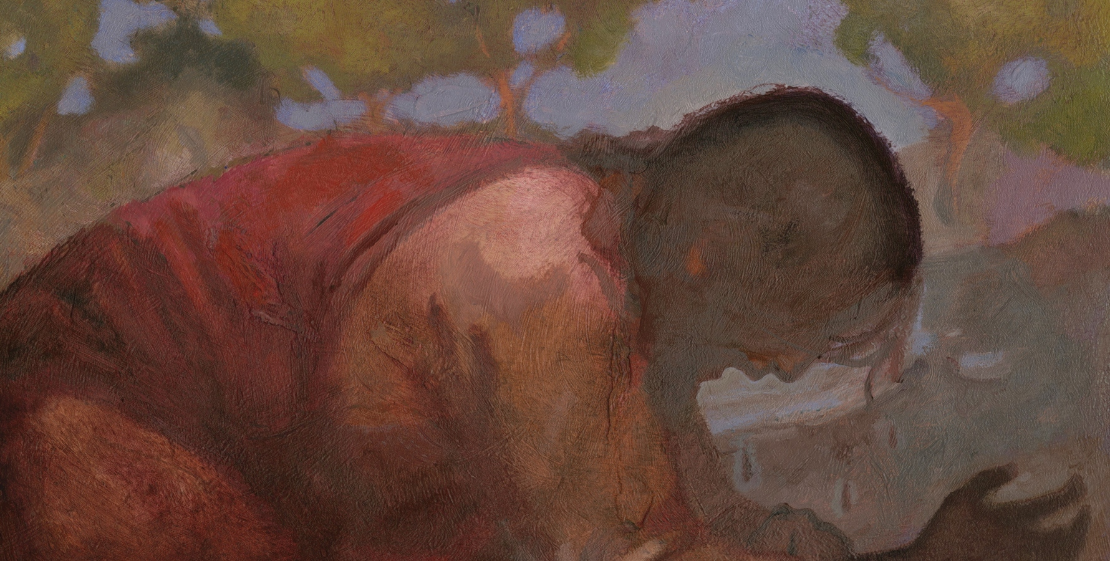
“Come Forth”
Feel my sides and see my hands…
I am the God of Israel – from Abinadi: “…come down among the children of men, and shall redeem his people.” Mosiah 15:1
I am the God of the whole earth.
I have been slain for the sins of the world.
J. Kirk Richards
3 Nephi 11:14-15

Slide 13
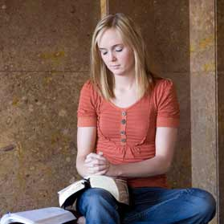
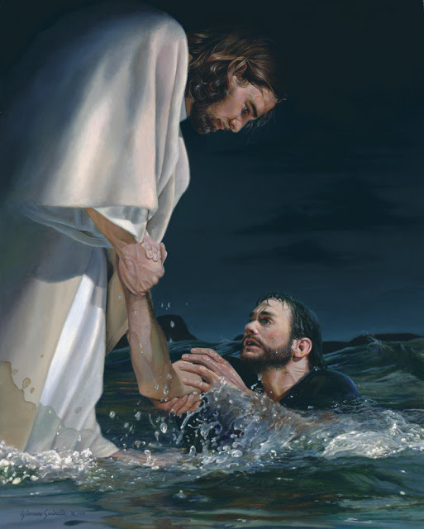
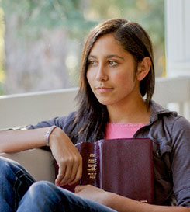
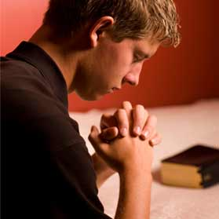
Inviting
Jesus Christ invites me to receive a personal testimony that He is my Savior.
3 Nephi 11:13-15

Slide 14
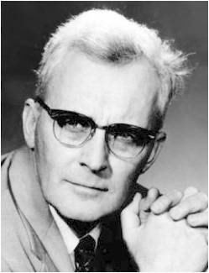
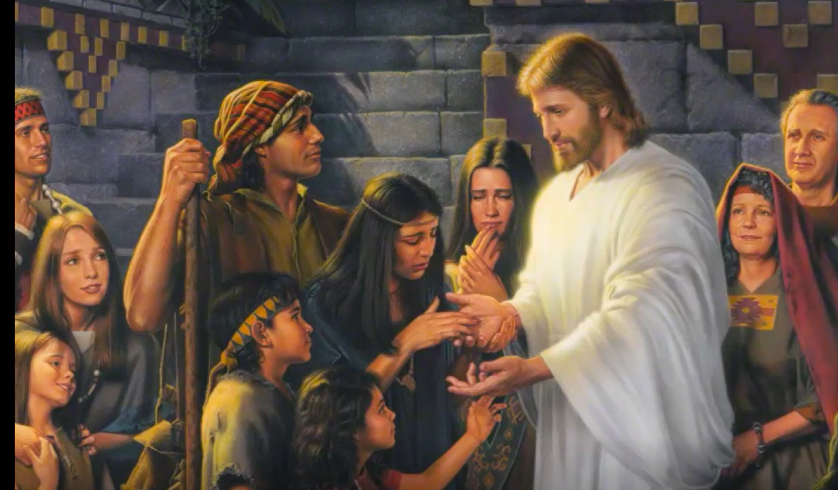
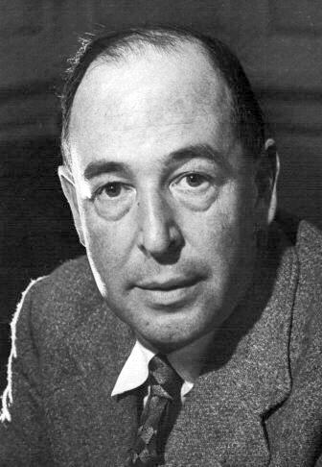
One By One
The sacrament is given individually
If each person took 10 seconds with the Savior It would have taken 7 hours
He greets them one by one, he gives them the signs and tokens one by one, he converses with them one by one, he blesses the children one by one. Hugh Nibley.
When Christ died, He died for you individually just as much as if you'd been the only man in the world. C.S. Lewis
3 Nephi 11:15

Slide 15
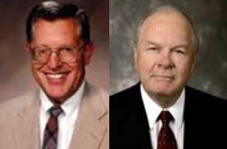
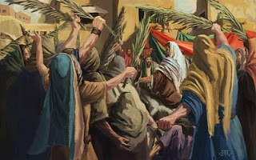
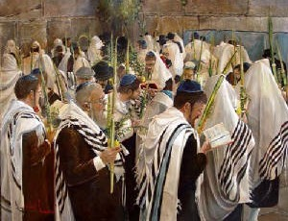
“Hosanna”
Meaning— “Save now, save we pray”
Deep reverence and worship
Psalm 118:25 “Save now, I beseech thee, O Lord: O Lord, I beseech thee, send now prosperity.”
“It was commonly used in ancient times in connection with the worship of Jehovah at the Feast of Tabernacles. Shouting Hosannas and waving palm branches was a means of worshipping the Messiah and acknowledging his saving power.” JFM and RLM
“And the multitudes that went before, and that followed, cried, saying, Hosanna to the Son of David: Blessed is he that cometh in the name of the Lord; Hosanna in the highest.”
Matthew 21:9
3 Nephi 11:17

Slide 16
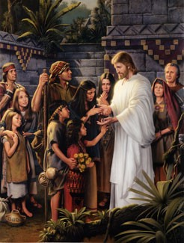
Personal Testimony
What did the people do after they had seen and felt the Savior’s wounds?
When we receive a personal testimony of Jesus Christ, it is our responsibility to bear record of Him
Why do we not need to see and touch the Savior to know that He lives?
And by the power of the Holy Ghost ye may know the truth of all things.
Mosiah 10:5

Slide 17
Sources:
Video: Feeling the Holy Ghost (3:17)
Joseph Fielding McConkie and Robert L. Millet Doctrinal Commentary on the Book of Mormon Vol. 4 pg. 52-53
Boyd K. Packer (“How Does the Spirit Speak to Us?” New Era, Feb. 2010, 3).
Jeffrey R. Holland, Christ and the New Covenant: The Messianic Message of the Book of Mormon [1997], 250–51.
Hugh Nibley “Book of Mormon Commentary” Volume 2
C.S. Lewis
Presentation by ©http://fashionsbylynda.com/blog/

Slide 18
“What is the Hosanna Shout?”
Answer/ Reed Durham
On March 27, 1836, the Kirtland Temple was dedicated, and at the close of the dedicatory services the pattern for giving the Hosanna Shout was given. The Prophet Joseph wrote: “President Rigdon then made a few appropriate closing remarks, and a short prayer, at the close of which we sealed the proceedings of the day by shouting hosanna, hosanna, hosanna to God and the Lamb, three times sealing it each time with amen, amen, and amen.” (Documentary History of the Church vol. 2, pp. 427–8.) This pattern of “hosanna,” to “God and the Lamb,” and “amen” repeated three times formed the basic pattern of the Hosanna Shout throughout all of Church history to the present.
From time to time some modifications were made upon the basic pattern, such as striking the right hand into the palm of the left hand at the end of each word, which was done on the occasion of the reorganization of the First Presidency with President Brigham Young on December 27, 1847. (“Journal of Norton Jacob,” Journal History, September 5, 1848, p. 4.)
On another occasion the Church members stood up on their feet while giving the shout (Millennial Star, vol. 24, p. 758); clapped hands while shouting; added the words “forever and ever, worlds without end” after the regular words “God and the Lamb” (B. H. Roberts, Life of John Taylor, p. 365); and often, especially since 1893, the Saints waved white handkerchiefs while shouting (James E. Talmage, House of the Lord, p. 150; Conference Report, April 1930, pp. 21–22).
Often after the shout the congregation or choirs sang a song (“America,” “The Spirit of God,” or the Evan Stephen “Hosanna Anthem.”) But with these different modifications made from time to time during Church history, the basic pattern, repeated three times while waving white handkerchiefs, has persisted until the present.
Today, the shout is conducted at temple dedications and at solemn assemblies. However, in the past several other occasions and events were honored with the congregational Hosanna Shout:
1. At the close of the famous Sidney Rigdon Salt Sermon at Missouri in 1838
2. By the twelve before leaving for their missions to England, 1838
3. Upon arrival on English soil, Brigham Young and the rest of the Twelve with him, April 6, 1840
4. At a secret council of fifty meeting in Nauvoo, March 11, 1844, and April 11, 1844
5. At the laying of the capstone of the Nauvoo Temple, May 24, 1845
6. Upon entering the Salt Lake Valley for the first time
7. At several general conferences—April 11, 1852; October 6, 1862; April 9, 1882
8. At a 24th of July celebration in Brigham City—July 24, 1875
9. Occasionally, at a ward or stake conference
Page 1

Slide 19
When the proper occasion arises for this spiritious congregational shout of praise and rejoicing (and it is now used only on rather special occasions), when the spirit guides the proper ecclesiastical authority, and when the congregation has been properly tutored and instructed in the sacredness and pattern of it, the Hosanna Shout is one of the most dramatic and impressive ceremonies in the Church.
“It is impossible to stand unmoved on such an occasion. It seems to fill the prairies or woodland, mountain wilderness or tabernacle, with mighty waves of sound; and the shout of men going into battle cannot be more stirring. It gives wonderful vent to religious emotions and is followed by a feeling of reverential awe—a sense of oneness of God.” (B. H. Roberts, Comprehensive History of the Church, vol. 3, p. 317.) The word hosannaas we know it originated from two Hebrew words found in Psalm 118:25, and roughly means “Save us, we beseech thee.” [Ps. 118:25] (See also 2 Sam. 14:4; Ps. 20:9.)
This psalm was recited by one of the priests every day during the procession around the altar during the seven-day holiday called the Feast of Tabernacles, when the people were commanded to “rejoice before the Lord. …” (Lev. 23:40). On the seventh day it was sung seven times, and when the priest reached verses 25 and 26, the trumpet sounded and all the people waved their branches of palms, myrtles, and willows (their lulab), and shouted the Hosanna many times. In fact, this seventh day of the feast was called the Great Hosanna.
The Feast of Tabernacles was a season of great rejoicing for the Jewish people, and hence the Hosanna, though supplicatory at first, came to be equated with rejoicing. It was apparently used in this way in the New Testament.
The Hosanna became an acclamation of the multitude on the occasion of Jesus’ triumphal entry into Jerusalem. It occurs six times in the Gospels. It is used alone in Mark 11:9 and John 12:13; it is twice followed by the dative “to the Son of David” in Matthew 21:9, 15 [Matt. 21:9, 15]; and it is used twice with the phrase “in the highest” in Matthew 21:9 [Matt 21:9] and in Mark 11:10. The element of rejoicing and praise even in an ejaculation or shout was present on this occasion as was the lulab or waving of branches or leaves.
The earliest actual use of the Hosanna Shout in the Church is not known. But it was most likely used from the very beginning. Indeed, the Lord commanded its use even before the Church was officially organized.
In March 1830 the Prophet received a revelation for Martin Harris in which the Lord commanded him to preach the gospel “even with a loud voice, with a sound of rejoicing, crying—Hosanna, hosanna, blessed be the name of the Lord God!” (D&C 19:37.) On several other occasions in the beginning years of the Church, the Lord commanded the use of the Hosanna Shout (D&C 36:3; D&C 39:19), and it is known that it was practiced. (Millennial Star, vol. 26, p. 504.) But in 1836 with the completing of the Kirtland Temple, the Hosanna Shout became well established in the Church. The Lord gave specific instructions pertaining to it for priesthood and general Church practice. (D&C 109:79–80;Documentary History of the Church vol. 2, pp. 381–92.)
Director of the Institute of Religion University of Utah
Page 2

Slide 20
The Hosanna Shout
In the Latter Day Saint movement, a hosanna shout is an organized ritual by a congregation of shouting hosanna. It was first performed as a ritual in the dedication of the Kirtland Temple, and was a part of the Kirtland Endowment ceremony. It continues to be practiced by some Latter Day Saint denominations, most notably The Church of Jesus Christ of Latter-day Saints (LDS Church), which practices the ritual at the dedication of each of its temples.
When the ordinance of the washing of feet was introduced at Kirtland, shouts of hosanna were viewed as a sealing benediction on both private and quorum prayer and then on the dedicatory prayer. At prayer meetings in the Kirtland Temple, the Saints sometimes used related phrases such as "Blessed is the name of the Most High God" and "Glory to God in the highest" (HC 2:386).
The Hosanna shout is intended to be whole-souled and given to the full limit of one's strength. The congregation stands and in unison shouts three times the words "Hosanna, Hosanna, Hosanna to God and the Lamb," then concludes with "Amen, Amen, and Amen." This is done while waving white handkerchiefs with uplifted hands.[The epithet "Lamb" relates to the condescension and Atonement of Jesus Christ.
The Hosanna shout memorializes the pre-earthly Council in Heaven, as "when ... all the sons of God shouted for joy" (Job 38:7). It also recalls the hosannas and the waving of palm branches accorded Jesus as he entered Jerusalem, and the hosannas that welcomed him as he appeared to the Nephites in the Book of Mormon. President of the LDS Church Lorenzo Snow taught that this shout will herald the Messiah when he comes in the glory of the Father (cf. 1 Thes. 4:16). The word Hosanna means "save, rescue" or "save", which concisely summarizes the purpose of the temple in Latter-day theology as a place where saving ordinances are performed for both the living and the dead.
http://en.wikipedia.org/wiki/Hosanna_shout

