Slide 1
Lesson 67
He That is Without Sin
John 8:1-30
Acknowledging our own imperfections can help us avoid condemning others.

Slide 2
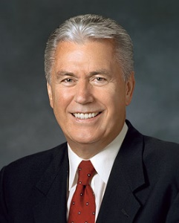
Who Are We To Judge?
What should we do in situations when we are with others whose appearance or behavior is not in harmony with the Lord’s standards?
How do we treat those whose behavior and appearance is not in harmony with the Lord’s standard?
When it comes to hating, gossiping, ignoring, ridiculing, holding grudges, or wanting to cause harm, please apply the following:
Stop it!
We simply have to stop judging others and replace judgmental thoughts and feelings with a heart full of love for God and His children.
“Don’t judge me because I sin differently than you.”
(2)

Slide 3
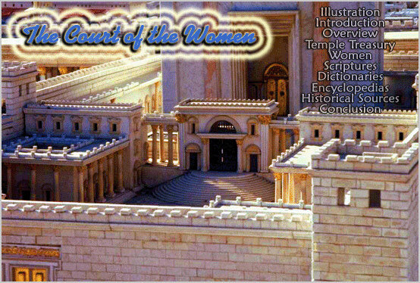
Early in the morning Jesus went to the temple
The usual public place to teach was in the Women’s Court

Slide 4
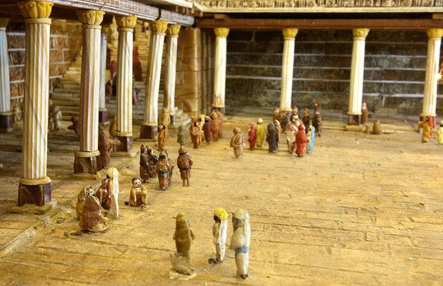
Gentile’s Court
Large and paved with stones of a variety of colors
Anyone can enter this court such as cattle dealers and money changers.

Slide 5
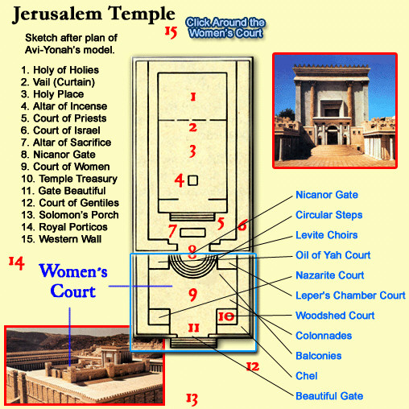
Herod’s Temple

Slide 6
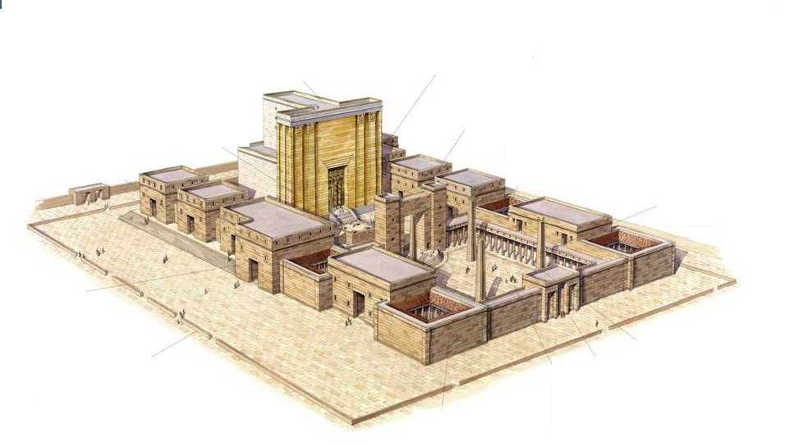
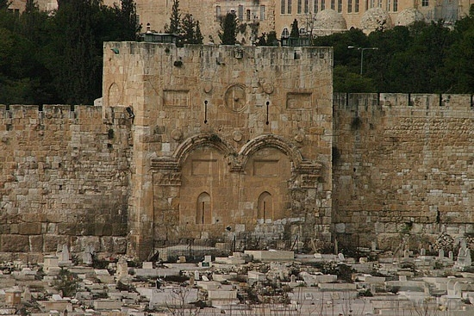
Gentile Court
Also called:
Outer Courts,
Lower Courts,
The Rabbi’s sometimes called it “The Mountain of the Lord’s House”
Outer court
Gate Beautiful
Acts 3:2, 10
Gate Beautiful sometimes called Gate Susan, for the sculpture relief of the City of Susa.
During morning and evening sacrifices this gate entrance was the place of public worship

Slide 7
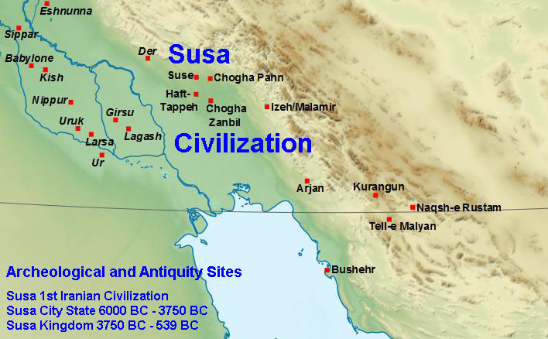
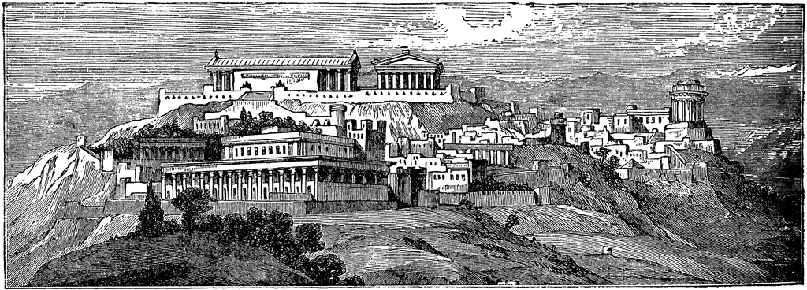
The scene of the Biblical book of Esther is laid in Susa, where king Ahasverus (Xerxes) resides.
Archaeologists have been able to identify several ruins with buildings mentioned by the author of Esther although the plot of the story is known to be fictional.
Ancient City of Susa

Slide 8
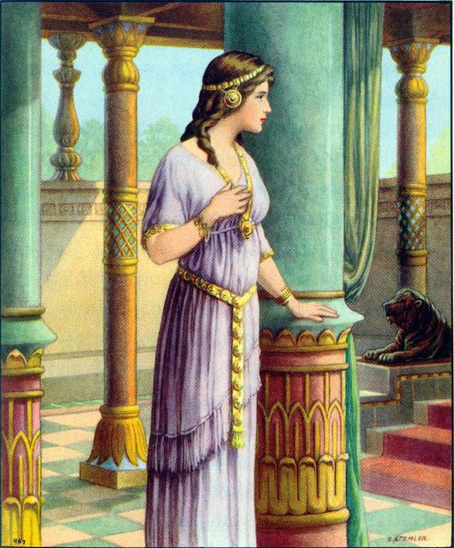
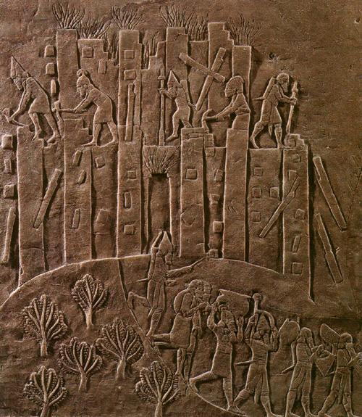
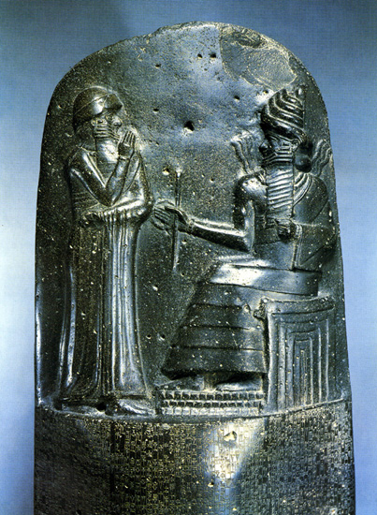
Esther
Sculpture reliefs from the City of Susa

Slide 9
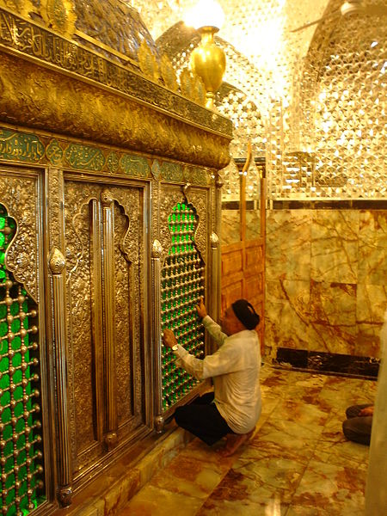
The city is also the reputed location of the tomb of the Prophet Daniel

Slide 10
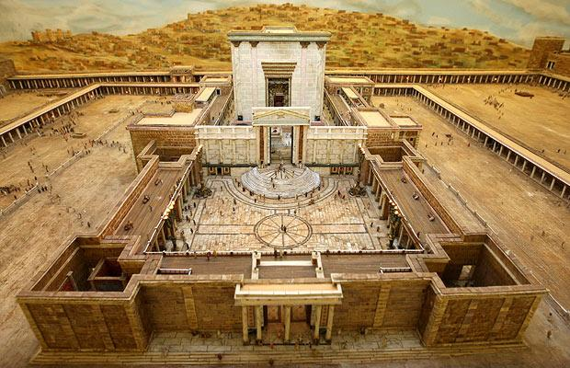
Through the gate is the court of women

Slide 11
Not just women were allowed in these courts, it is called this because women could not go any further into the temple.

Slide 12
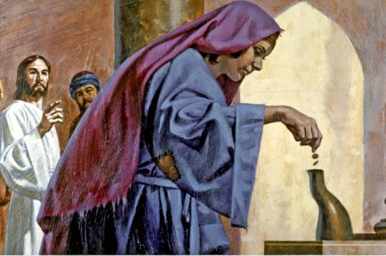
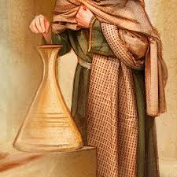
In front of the columns were eleven treasure chests for collecting money. Also two chests at the gate for collecting a half-shekel tax

Slide 13
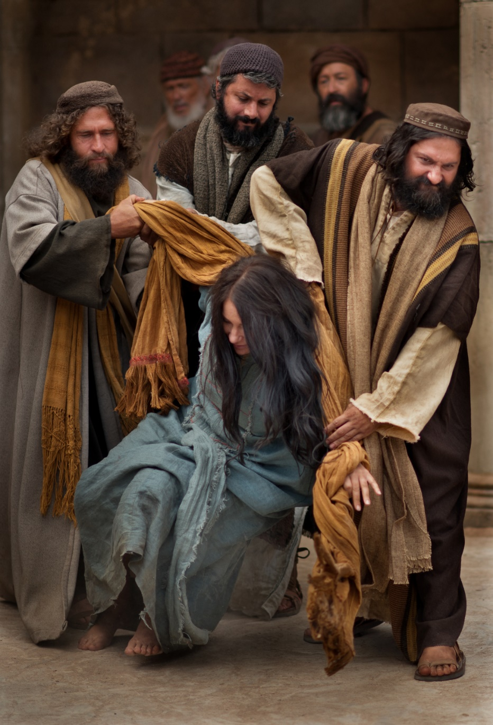
Taken in Adultery
Law of Moses:Stoning
Why did they not bring the man involved?
Where was her accuser?
And the man that committeth adultery with another man’s wife, even he that committeth adultery with his neighbour’s wife, the adulterer and the adulteress shall surely be put to death.
Leviticus 20:10

Slide 14
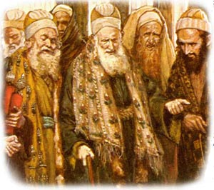
Scribes and Pharisees Tempt Jesus
Breaking the Roman law
Disrespect for the Law of Moses
While the law of Moses was death by stoning as a penalty for adultery, the extreme punishment had lapsed long before the time of Christ

Slide 15
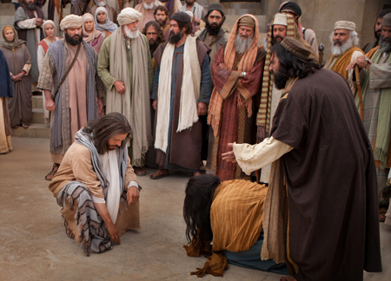
(1) If he agreed with Moses that she should be stoned, he would both
(a) arouse the ire of the people generally by seeming to advocate the reinstitution of a penalty which did not have popular support, and
(b) run counter to the prevailing civil law by prescribing what Rome [prohibited].
“In bringing this adulteress to Jesus, the scribes and Pharisees were laying this trap for the Master:
(2) If he disagreed with Moses and advocated anything less than death by stoning, he would be accused of perverting the law, and of advocating disrespect of and departure from the hallowed practices of the past.”
(3)

Slide 16
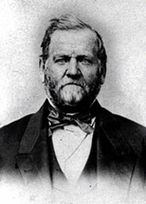
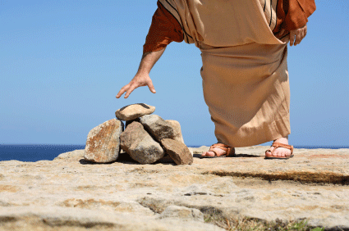
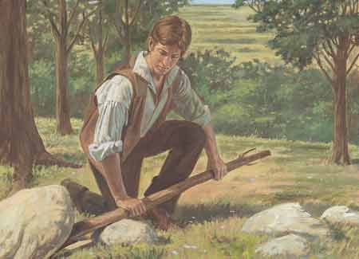
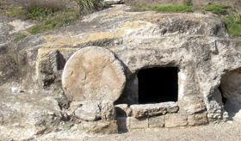
The letter of the law would have killed that woman then and there. But the Spirit of God, in the person of his Son, the living oracle, opened her way unto life.
It is the living oracles that lead the people of God. In them there is life; but in the letter of the law there is death.
The early commandments of God to his Church and the manner in which we were led at that time will not fit our case in all respects now. We must have teachings and revelations adapted to our present circumstances and condition."
(4)

Slide 17
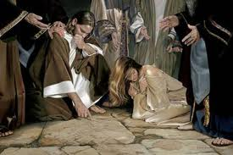
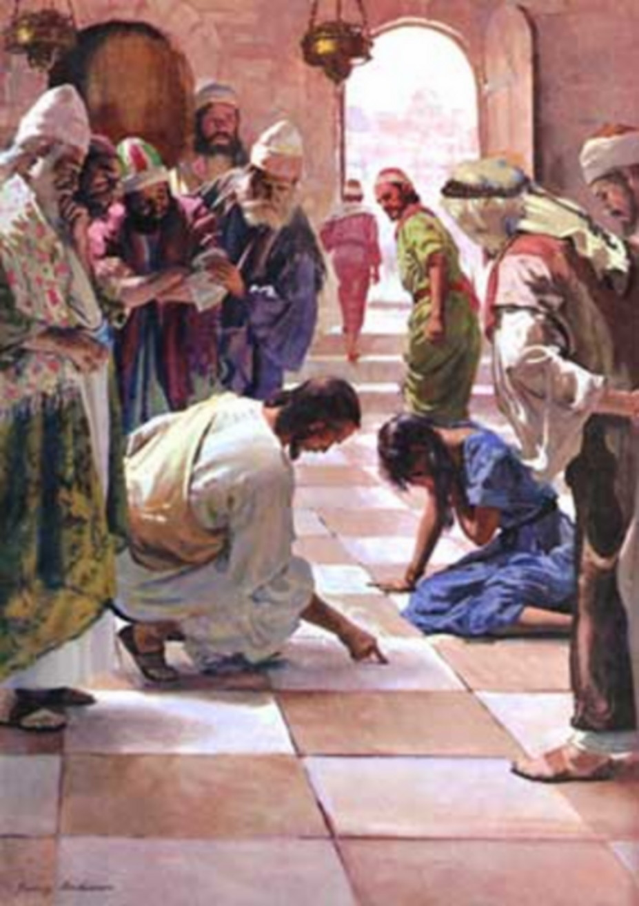
He Heard Them Not
Jesus stoops down, and writes on the ground
Jesus comes to her level;
Her level of suffering
John 8:6

Slide 18
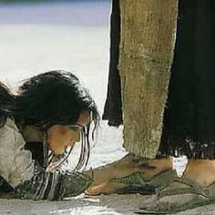
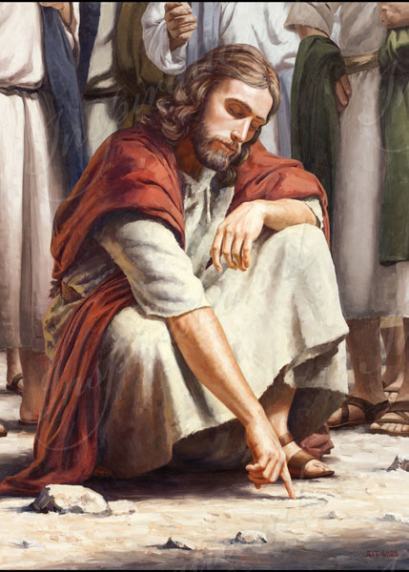
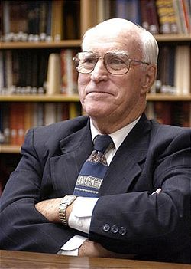
Jesus knows the hearts of every person
He wrote on the ground, writing so beautifully, enabling to relieve the stresses of the world; a small glimpse of how the Atonement works
"We do not know what Jesus wrote, but we know that he regarded many of the Pharisees as adulterers themselves. When he said that any in that crowd who was 'without sin' could cast a stone, he didn't mean just any sin, he meant anyone there who was not as guilty of adultery as she was." (5)

Slide 19
Christ was able to communicate specifically to her, his sister, a daughter of Heavenly Father.

Slide 20
He Rebukes the Accusers
James Tissot
“He that is without sin among you, let him first cast a stone at her”
Luke 8:7

Slide 21
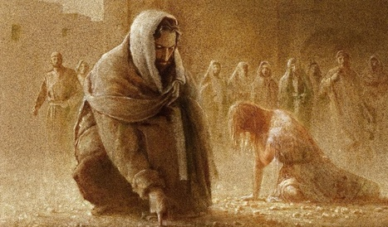
Jesus stooped down again and wrote on the ground
The Accusers leave one by one
Yongsung Kim
Luke 8:8-9

Slide 22
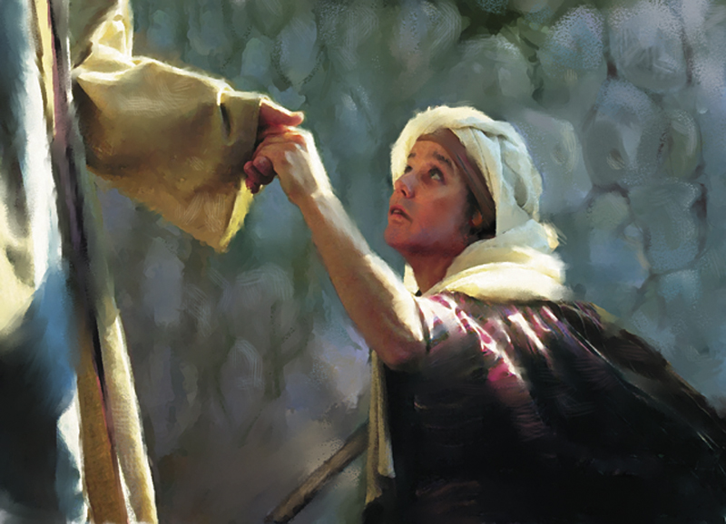
“…go, and sin no more.”
Luke:8:11
An invitation that is both a promise and a blessing.
Go and have a life that is closer to Him.
The Savior shows us mercy by giving us opportunities to repent

Slide 23
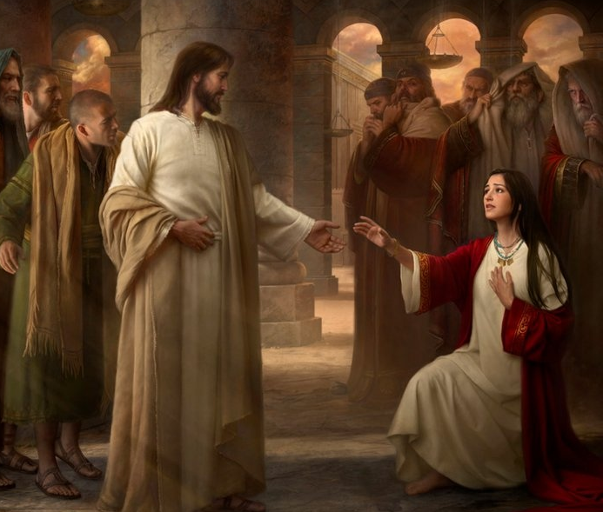
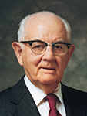
“His command to her was, ‘Go, and sin no more.’ He was directing the sinful woman to go her way, abandon her evil life, commit no more sin, transform her life.
He was saying, Go, woman, and start your repentance; and he was indicating to her the beginning step—to abandon her transgressions.”
(6)

Slide 24
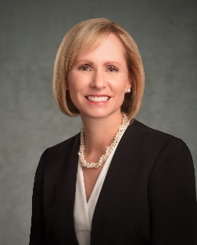
Go Forth and Change
“Another way to say “go, and sin no more” could be “go forth and change.”
The Savior was inviting her to repent: to change her behavior, her associations, the way she felt about herself, her heart.”
“Because of Christ, our decision to “go forth and change” can also allow us to “go forth and heal,” for He is the source of healing all that is broken in our lives.” (12)
John 8:11

Slide 25
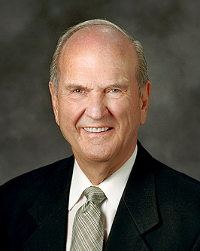
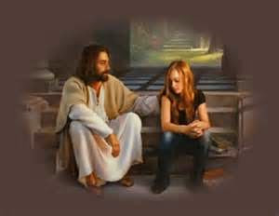
“…believe that ye must repent of your sins and forsake them, and humble yourselves before God; and ask in sincerity of heart that he would forgive you; and now, if you believe all these things see that ye do them.”
(8)

Slide 26
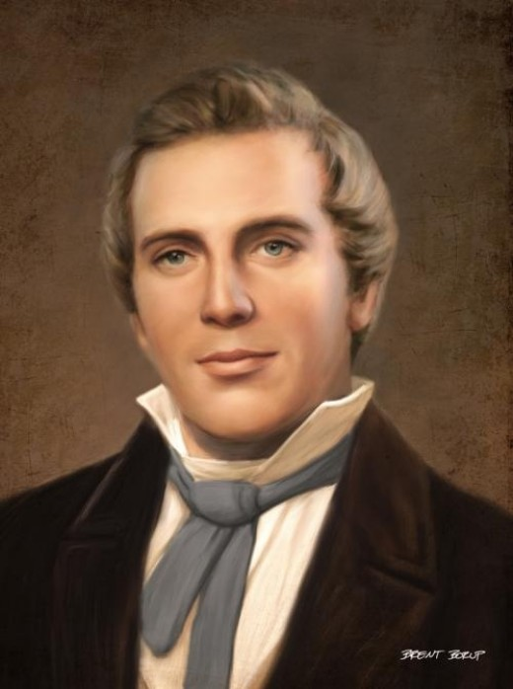
“And the woman glorified God from that hour, and believed on his name”
John 8:11
…for I, the Lord, forgive sins, and am merciful unto those who confess their sins with humble hearts…”
D&C 61:2

Slide 27
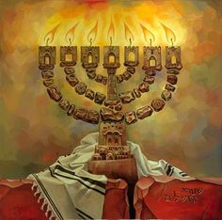
The Light of the World
“I am the light of the world: he that followeth me shall not walk in darkness, but shall have the light of life.”
The great lamps set up in the court as a feature of the joyful celebration just ended gave point to our Lord’s avowal of Himself as the Light of the World. It was another proclamation of His divinity as God and the Son of God.
Luke 8:12-
(1)

Slide 28
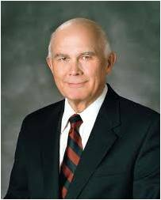
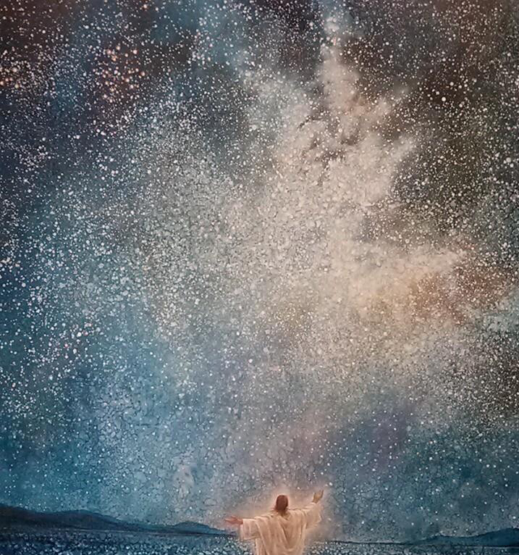
“Jesus Christ is the light of the world because he is the source of the light which ‘proceedeth forth from the presence of God to fill the immensity of space’ (D&C 88:12). …
“Jesus Christ is also the light of the world because his example and his teachings illuminate the path we should walk to return to the presence of our Father in Heaven. …
“Jesus Christ is also the light of the world because his power persuades us to do good.”
Yongsung Kim
Luke 8:12
(9)

Slide 29
Light and Salvation
If we follow the Savior, we will avoid spiritual darkness and be filled with His light
And he said, It is a light thing that thou shouldest be my servant to raise up the tribes of Jacob, and to restore the preserved of Israel: I will also give thee for a light to the Gentiles, that thou mayest be my salvation unto the end of the earth.
Isaiah 49:6
Arise, shine; for thy light is come, and the glory of the Lord is risen upon thee.
Isaiah 60:1

Slide 30
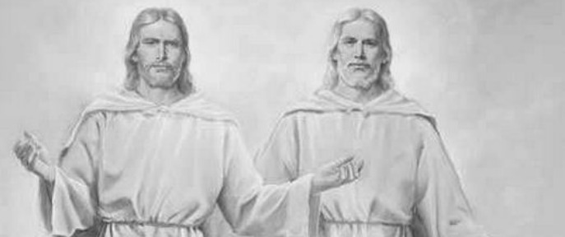
Testimony of Two Men
At the mouth of two witnesses, or three witnesses, shall he that is worthy of death be put to death; but at the mouth of one witness he shall not be put to death.
Deuteronomy 17:6
The Pharisees said that the law of Moses required the testimony of at least two men to establish truth.
I am one that bear witness of myself, and the Father that sent me beareth witness of me.
The Father and the Son are two separate beings.
John 8:17

Slide 31
“In all that Jesus came to say and do, including and especially in His atoning suffering and sacrifice, He was showing us who and what God our Eternal Father is like, how completely devoted He is to His children in every age and nation. In word and in deed Jesus was trying to reveal and make personal to us the true nature of His Father, our Father in Heaven. …
“So feeding the hungry, healing the sick, rebuking hypocrisy, pleading for faith—this was Christ showing us the way of the Father, He who is ‘merciful and gracious, slow to anger, long-suffering and full of goodness.’
In His life and especially in His death, Christ was declaring, ‘This is God’s compassion I am showing you, as well as that of my own.’” (11)
John 8:19

Slide 32
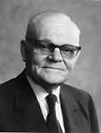
Coming Up Next…
The truths that can free us from our sins, guilt, false concepts, erroneous understanding, and unproductive habits and behavior are to be had only through the Holy Spirit.
T
R
U
T
H
"The central core of the Father's plan of salvation is that to obtain these truths and the peace, happiness, security, and freedom these truths bring to their righteous adherents, we must draw upon a source of knowledge that lies above and beyond the reach of ordinary learning processes.
"The road to this sure knowledge is a sincere and honest desire to obtain truth from God, seeking such truth through sustained prayer, through devoted study of God's scriptures, and through righteous, charitable behavior in our daily lives.“
Luke 8:30-32
(10)

Slide 33
Sources:
Suggested Hymn: #153 Lord, We Ask Thee Ere We Part Could be sung at end of class
Video:
Judging Others Stop It! (3:19)
The Merciful Obtain Mercy (2:33)
Go and Sin No More (3:22)
New Testament Institute Student Manual Chapter 24
President Dieter F. Uchtdorf The Merciful Obtain Mercy 2012 April. Gen. Conf.
Elder Bruce R. McConkie Doctrinal New Testament Commentary, 3 vols. [1965–73], 1:450–51, (Truth) 456-57
Elder Orson Hyde (Journal of Discourses, 26 vols. [London: Latter-day Saints' Book Depot, 1854-1886], 7: 151.)
(Robert J. Matthews, Behold the Messiah [Salt Lake City: Bookcraft, 1994], 197.)
President Spencer W. Kimball (The Miracle of Forgiveness [1969], 165).
Elder James E. Talmage Jesus the Christ p. 406
Elder Russell M. Nelson Thanks Be to God April 2012 Gen. Conf.
Elder Dallin H. Oaks (“The Light and Life of the World,” Ensign, Nov. 1987, 63–64).
Marion G. Romney ("Receiving and Applying Spiritual Truth," Ensign, Feb. 1984, 4)
Elder Jeffrey R. Holland (“The Grandeur of God,” Ensign or Liahona, Nov. 2003, 70, 72).
Amy A. Wright General Conference April 2022 Sunday Morning Session
Presentation by ©http://fashionsbylynda.com/blog/

Slide 34
The Self Test
“Do you harbor a grudge against someone else?
“Do you gossip, even when what you say may be true?
“Do you exclude, push away, or punish others because of something they have done?
“Do you secretly envy another?
“Do you wish to cause harm to someone?
“If you answered yes to any of these questions, you may want to apply the two-word sermon from earlier: stop it!
“In a world of accusations and unfriendliness, it is easy to gather and cast stones. But before we do so, let us remember the words of the One who is our Master and model: ‘He that is without sin among you, let him first cast a stone.’
“Brothers and sisters, let us put down our stones.”
President Dieter F. Uchtdorf (“The Merciful Obtain Mercy,”
Ensign or Liahona, May 2012, 76).

Slide 35
Event | Matthew | Mark | Luke | John
Woman Taken in Adultery (Casting the 1st Stone) |  |  |  | 8:1-11
Jesus Testifies of Himself |  |  |  | 8:12-30
Adultery, the Law of Moses: John 8:5:
It wasn't Moses who had commanded the stoning of adulterers; it was Jehovah. The words, 'the adulterer and the adulteress shall surely be put to death' (Lev. 20:10), came from Jesus when he communed with Moses and gave him the law (3 Ne. 15:5). Ironically, Christ is tempted to conform to the very law he gave to a previous generation. gospeldoctrine.com
At one time, when Israel was ruled by a righteous judge, i.e. Moses, when the Lord was trying to teach the people the difference between the holy and unholy (Lev. 10:10), and when deviance from the law could not be tolerated, Jehovah commanded that adulterers be put to death.
In the meridian of time, when Israel was ruled by wicked men, when the tempters motivation was not holiness but wickedness, when Christ's mission was a mission of mercy and not judgment (Jn. 3:17), the Lord's answer condemned the scribes and Pharisees, not the woman. And he did so without nullifying the law he had previously given. Christ knew that the woman's accusers were guilty of the very same crime (see Matt 12:38-39), they just hadn't been caught 'in the very act' (v. 4).
"Jesus, who knows the hearts of every person, knows the hearts of those Pharisees...When they continue to press him for an opinion, he says: 'He that is without sin among you, let him first cast a stone at her' (John 8:7), and he writes again on the ground. The Pharisees, each convicted by his own conscience, leave one by one.
(Robert J. Matthews, Behold the Messiah [Salt Lake City: Bookcraft, 1994], 197.)
The Lord Gives Us Time to Repent John 8:15:
Elder Oaks further explained that Jesus did not condone the woman’s sin, but He was allowing her time to repent and acknowledging that her final judgment would come later: “The Lord obviously did not justify the woman’s sin. He simply told her that He did not condemn her—that is, He would not pass final judgment on her at that time. This interpretation is confirmed by what He then said to the Pharisees: ‘Ye judge after the flesh; I judge no man’ (John 8:15). The woman taken in adultery was granted time to repent, time that would have been denied by those who wanted to stone her” (“‘Judge Not’ and Judging,” Ensign,Aug. 1999, 8).
Yongsung Kim is a Korean painter working in oil on canvas and with computer.

Slide 36
The Light John 8:12
"The light of life is divine light that permeates and radiates in the human soul and brings out the godlike qualities and attributes of godliness. The light of life is the gospel of Jesus Christ, the gospel of love. The light of life has within it the glorious promises from God of eternal life in his heavenly kingdom. The light of life will bring divine truth and happiness and peace into a troubled heart. The light of life brings divine light into the problems and troubles of this life and helps to turn life's problems into steppingstones to eternal progression and to developing a godlike character.
"Jesus also said: '... light is come into the world, and men loved darkness rather than light, because their deeds were evil. For every one that doeth evil hateth the light, neither cometh to the light, lest his deeds should be reproved. But he that doeth truth cometh to the light, that his deeds may be made manifest, that they are wrought in God.' (John 3:19-21.)
"To know God, you must walk in the light of life. To know God as a living child of God, we should know our relationship to him, our divine potential, and we should know that in knowing God there is great responsibility to respect and love and follow his counsel and his doctrines and his commandments and to grow as a child to become more godlike." Bernard P. Brockbank ("Knowing God," Ensign, July 1972, 122)
Freedom:
"Freedom is based on truth, and no man is completely free as long as any part of his belief is based on error, for the chains of error bind his mind. This is why it is so important for us to learn all the truth we can from all the sources we can. We need particularly to search the scriptures, for in them are the words which, if accepted and lived, will lead us to eternal life.“ N. Eldon Tanner ("Ye Shall Know the Truth,“ Ensign, May 1978, 14)
Some Can Not Come John 8:22-24
While the Savior invites all to come unto Him and eventually be where He is, some will decline the invitation and “die in [their] sins” (John 8:21, 24)—meaning they will not repent and be made clean through the Atonement. The Savior’s statement “Whither I go, ye cannot come” (John 8:22) applies to those who understand the invitation and the opportunity to accept the Savior but decline. (1)
Challenging the Lord John 8:18
The Pharisees challenged His testimony, declaring it of no worth because He bore record of Himself. Jesus admitted that He testified of Himself, but affirmed nevertheless that what He said was true, for He knew whereof He spoke, whence He came and whither He would go, while they spoke in ignorance. They thought, talked, and judged after the ways of men and the frailties of the flesh; He was not sitting in judgment, but should He choose to judge, then His judgment would be just, for He was guided by the Father who sent Him. Their law required the testimony of two witnesses for the legal determination of any question of fact; and Jesus cited Himself and His Father as witnesses in support of His affirmation. His opponents then asked with contemptuous or sarcastic intent, “Where is thy Father?” The reply was in lofty tone: “Ye neither know me, nor my Father: if ye had known me, ye should have known my Father also.” Enraged at their own discomfiture, the Pharisees would have seized Him, but found themselves impotent. “No man laid hands on him; for his hour was not yet come.” James E. Talmage Jesus the Christ

