Slide 1
Lesson 137
Suggested Hymn: #277 As I Search The Holy Scriptures
Mormon and the Sacred Records
Introduction and Mormon 1-2
Presentation by ©http://fashionsbylynda.com/blog/

Slide 2
Mormon and the Sacred Records
When Mormon was about 10 years old, the record keeper Ammaron charged him to take responsibility for the sacred records when he came of age.
He was to record everything he observed concerning the people.
At age 15, Mormon was “visited of the Lord, and tasted and knew of the goodness of Jesus”. In the same year, the Nephites appointed Mormon to lead their armies.
Obedient to Ammaron’s counsel, he later obtained the large plates of Nephi and began to make his record.
He also abridged the large plates of Nephi, which included writings from prophets and record keepers from Lehi through Ammaron, and inserted the small plates of Nephi into that abridgement.
The Large Plates of Nephi
The Small Plates of Nephi
Mormon wrote the first seven chapters of this book as a brief account of the wickedness and wars among the Nephites and Lamanites in his day.
He also made a full account of the events from his lifetime on the large plates of Nephi.
Mormon 1:4, 15; Mormon 2:1, 18; 5:9

Slide 4
To Be Stored in a Hill
Near the end of his life, Mormon deposited all the records in the Hill Cumorah, except for a few plates that he gave to his son Moroni.
He then led the Nephites in their last great battle against the Lamanites.
Before Mormon died, he directed Moroni to complete his record.
Moroni added the words that make up chapters 8–9 of this book.
Mormon 6:6

Slide 5
A Book For Us Today
Mormon wrote to Gentiles and members of the house of Israel in the latter days, desiring to “persuade all [the] ends of the earth to repent and prepare to stand before the judgment-seat of Christ”.
As Moroni concluded his father’s book, he directly addressed those who would read his words.
He warned them of the consequences of their sins and invited them to “come unto the Lord with all [their] heart”
Mormon 3:22; Mormon 9:27

Slide 6
Time Line of the Sacred Records
AD
320
321-327
345-401
401-402, 421
Feb. 1828
Ammaron
Hides records
Moroni
Chapter 8-9
Wandering for the safety of his life
Joseph Smith receives the Sacred Plates at Hill Cumorah Palmyra, New York
Ammaron finds Mormon at age 10
At age 24 he is to take the plates of Nephi
Mormon writes
Chapters 1-7
Finished after final battle at Cumorah
Mormon 2:15-17;8:5-6; 6:10-15

Slide 7
The Writings Include…
The fulfillment of prophecies by Nephi, Alma, Samuel the Lamanite, and Jesus Christ regarding the destruction of the Nephites
Mormon refers to some of his writings as “my record of the destruction of my people” (Mormon 6:1).
He showed that the downfall of the Nephites was a consequence of their wickedness
1 Nephi 12:19; Alma 45:9-14; Helaman 13:8-10; 3 Nephi 27:32
Mormon 4:12; 6:15-18

Slide 8
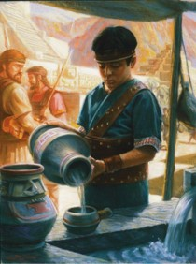
Young Mormon
At age 15, he was “visited of the Lord” desired to help the Nephites repent, but because of their willful rebellion he was forbidden by the Lord to preach to them.
At this young age, he was appointed to lead the Nephite army.
Although Mormon grew up in a time of great wickedness, he chose to be faithful.
Because of his faithfulness, he was told that he would be entrusted with the people’s sacred records later in his life.
Mormon 1:5-6, 15

Slide 9
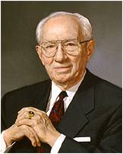
Calling You “Mormon”
How do you feel when people call you a Mormon?
“While I sometimes regret that people do not call this church by its proper name, I am happy that the nickname they use is one of great honor made so by a remarkable man and a book which gives an unmatched testimony concerning the Redeemer of the world.
“Anyone who comes to know the man Mormon, through the reading and pondering of his words, anyone who reads this precious trove of history which was assembled and preserved in large measure by him, will come to know that Mormon is not a word of disrepute, but that it represents the greatest good—that good which is of God”
President Gordon B. Hinckley
Mormon 1:5-6, 15

Slide 10
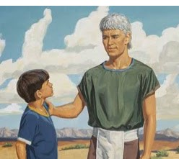
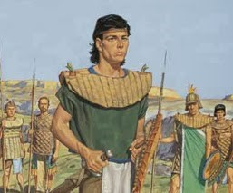
The Responsibility
Sober child--Trustworthy
Ammaron instructed Mormon to take the plates of Nephi when he became 24 years of age and record on them the things he observed among the people.
He was instructed to not only record the history but the workings of the Lord among the people.
Quick to observe—insightful, perceptive in recognizing what should be recorded to warn and bless the latter-day readers…us.
The father of Mormon, also named Mormon, ‘carried’ Mormon to the land southward, ‘even to the land of Zarahemla, that land being covered with buildings and many people.
Mormon 1:1-7

Slide 11
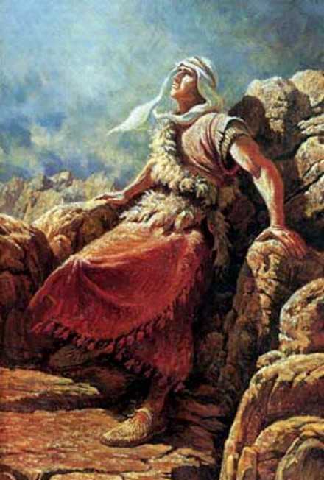
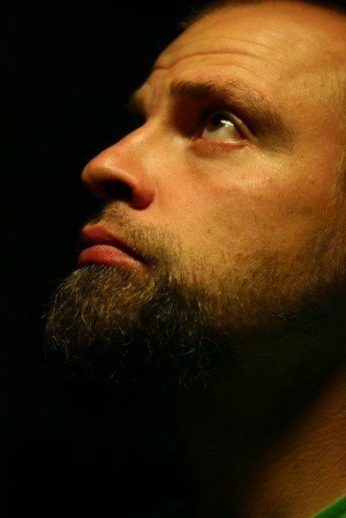
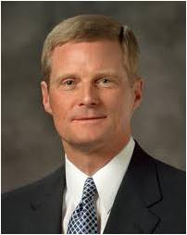
“When we are quick to observe, we promptly look or notice and obey. Both of these fundamental elements—looking and obeying—are essential to being quick to observe. And the prophet Mormon is an impressive example of this gift in action. …
“… The spiritual gift of being quick to observe is so vital for us in the world in which we do now and will yet live.”
Elder David A. Bednar

Slide 12
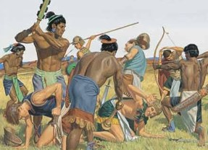
Wickedness Among the People
During the Savior’s visit there were no “ites” the people being united as one (4 Nephi 1:17)
Nephites:
Nephites
Jacobites
Jaephites
Zoramites
They gathered to fight at the borders of Zarahemla
Exceeding 30,000 who died in bloodshed
The Nephites beat the Lamanites and the Lamanites withdrew and there was peace for 4 years
Lamanites:
Lamanites
Lemuelites
Ishmaelites
Mormon 1:8-12

Slide 13
Consequences of Spiritual Darkness
The Lord removed ‘gifts’ from the Nephites
The Lord takes away the 3 Nephites
The spirit (Holy Ghost) was withdrawn
Miracles cease
Healings cease
Revelation and visions stopped
They cut themselves off from the companionship of the Holy Ghost
When people are wicked and unbelieving, they lose spiritual gifts from the Lord and the influence of the Holy Ghost
Mormon 1:13-14

Slide 14
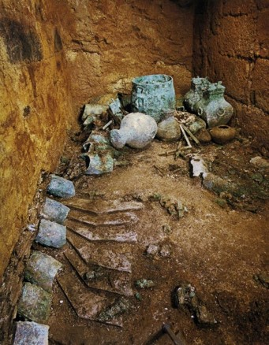
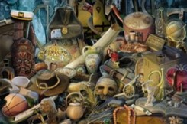
Abinadi and Samuel’s Prophecy Fulfilled
Gadianton robbers return among the Lamanites and infested the land
People began to hide up their treasures
The Lord cursed the land that their treasures they ‘could not hold them, nor retain them again’
Slippery—thievery and dishonesty of the Gadiantons and others with similar motives
The power of evil:
Sorcerers, witchcrafts, and magicians
“Oh My”
Mormon 1:18-19

Slide 15
Mormon -- Leader of Nephite Army
Mormon’s responsibility at age 16:
Head of the army against the Lamanites
Took possession of city of Angola
Fortified the city but the Lamanites drove them out to the city of David
Withstood a troop of 42,000 against the King Aaron of the Lamanites
Mormon 2:1-9

Slide 16
Aaron—King of the Lamanites
He was king of the Lamanites around AD 331
He brought an army of 44,000 against Mormon’s 42,000
Mormon defeated the Lamanites and they retreated
10 years later the king returned and sent an epistle to Mormon announcing an attack upon the Nephites
This attack was the battle at Hill Cumorah
The Nephites fled to the army of Aaron and became victims of brutal deaths which was the prophecy of Lehi some 1,000 years previous
(2 Nephi 1:9-10)
Who’s Who

Slide 17
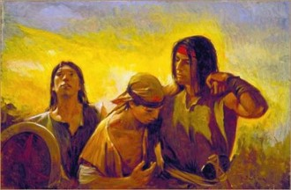
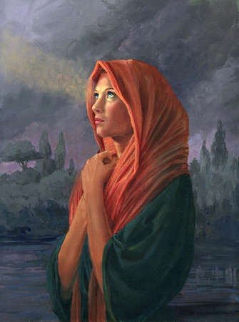
Sorrow
The Lamanites attacked the Nephite armies with such force that the Nephites were frightened and retreated.
The Lamanites drove them from one place to another until the Nephites gathered in one place.
They sorrowed because they were unable to keep their belongings. In other words, they sorrowed only because of the consequences of their sins, not because they regretted their actions
“sorrowing … unto repentance” and the “sorrowing of the damned,”
Those who sorrow unto repentance …
Those who sorrow only because of the consequences of sin …
Mormon 2:3-13

Slide 18
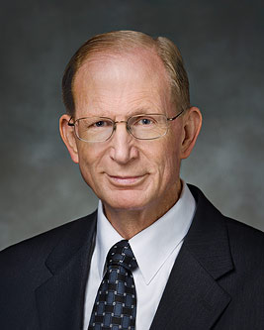
Those who sorrow unto repentance recognize the goodness of God and come unto Christ with humble hearts.
Those who sorrow only because of the consequences of sin continue to rebel against God.
“A broken heart and a contrite spirit mean to experience ‘godly sorrow [that] worketh repentance’ (2 Corinthians 7:10). This comes when our desire to be cleansed from sin is so consuming that our hearts ache with sorrow and we yearn to feel at peace with our Father in Heaven.
Those who have a broken heart and a contrite spirit are willing to do anything and everything that God asks of them, without resistance or resentment.
We cease doing things our way and learn to do them God’s way instead. In such a condition of submissiveness, the Atonement can take effect and true repentance can occur.
The penitent will then experience the sanctifying power of the Holy Ghost, which will fill them with peace of conscience and the joy of reconciliation with God.”
Elder Bruce D. Porter

Slide 19
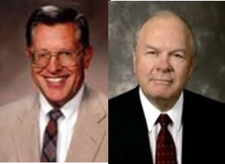
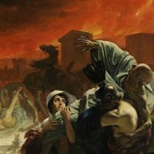
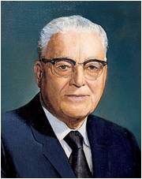
The Day of Grace Had Passed
“One of the greatest principles of the gospel of Jesus Christ is the principle of repentance.”
JFM and RLM
33 …do not procrastinate the day of your repentance until the end; for after this day of life, which is given us to prepare for eternity, behold, if we do not improve our time while in this life, then cometh the night of darkness wherein there can be no labor performed.
34 Ye cannot say… that I will repent, that I will return to my God. Nay, ye cannot say this; for that same spirit which doth possess your bodies at the time that ye go out of this life, that same spirit will have power to possess your body in that eternal world.
35 For behold, if ye have procrastinated the day of your repentance even until death, behold, ye have become subjected to the spirit of the devil, and he doth seal you his; therefore, the Spirit of the Lord hath withdrawn from you, and hath no place in you, and the devil hath all power over you; and this is the final state of the wicked.
Alma 34:33-35
“…if one has sinned so seriously and becomes habitually a sinner, the spirit of repentance leaves, and he may or may not be able to repent.”
President Harold B. Lee
Mormon 2:15

Slide 20
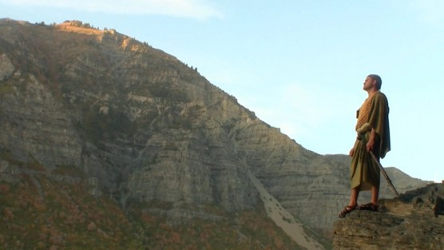
By the Hills of Shim
Mormon found himself near a hill called Shim, where Ammaron had hidden the Nephite records. He removed the plates of Nephi and began to record what he had observed among the people since the time he was a child.
Jashon
Hills of Shim
Land of Desolation
Land Bountiful
West Sea
Small Narrow Neck of Land
East Sea
River Sidon
Zarahemla
“And now, the city of Jashon was near the land where Ammaron had deposited the records unto the Lord, that they might not be destroyed. And behold I had gone according to the word of Ammaron, and taken the plates of Nephi, and did make a record according to the words of Ammaron.”
Jerusalem
Land of Nephi
Mormon 2:17-20

Slide 21
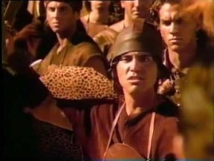
Choosing to Live Righteously in a Wicked Society
“To ensure that we do not disqualify ourselves from having the strength of the Lord we must live our lives in such a way as not to repel the Spirit. “
JFM and RLM
“Being righteous when we are surrounded by unrighteous influences is a challenge we all face. Given that reality, what can we do to prepare for—and pass—the test of living righteously in a wicked world?
Personal revelation often includes insights into specific ways we can more fully follow the Savior. These insights safeguard and guide us, help us master our thoughts and desires, and strengthen us to live in conformity with the commandments.
Today the word discriminate has been co-opted by those who would have us believe that discrimination is a bad thing. But we all discriminate on a daily basis whenever we make a choice.
Living righteously in a wicked world requires that we not be afraid to make right choices.”
Elder Charles Didier
We can choose to live righteously, even in a wicked society

Slide 22
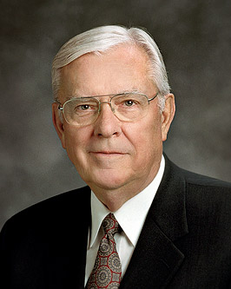
“In the Church, we often state the couplet: ‘Be in the world but not of the world.’ As we observe television shows that make profanity, violence, and infidelity commonplace and even glamorous, we often wish we could lock out the world in some way and isolate our families from it all. …
“Perhaps we should state the couplet … as two separate admonitions. First, ‘Be in the world.’ Be involved; be informed. Try to be understanding and tolerant and to appreciate diversity. Make meaningful contributions to society through service and involvement. Second, ‘Be not of the world.’ Do not follow wrong paths or bend to accommodate or accept what is not right.”
“We need to influence more than we are influenced. We should work to stem the tide of sin and evil instead of passively being swept along by it. We each need to help solve the problem rather than avoid or ignore it.”
I testify that as we seek personal revelation, keep our eye on the Lord’s anointed, hold fast to righteous standards, and strive to make a difference through our example and influence, we will find joy in this life and in the next.
“The word of God, as found in the scriptures, in the words of living prophets, and in personal revelation, has the power to fortify the Saints and arm them with the Spirit.”
Elder M. Russell Ballard

Slide 23
Mormon Highlights Major Problems That Lead to Their Downfall
1. Groups begin to break off.
2. Exceeding prosperity-costly clothing and adornments.

Slide 24
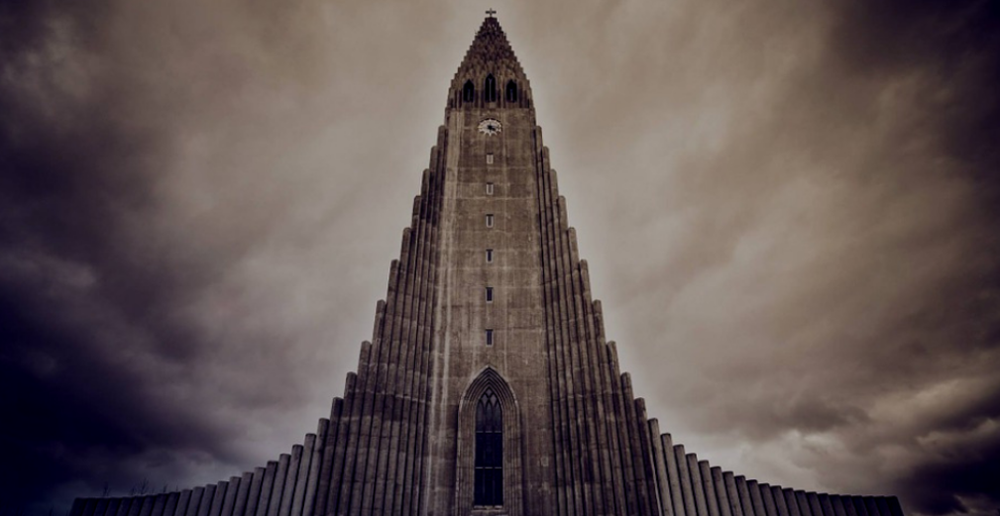
3. Divided into classes or tribes.
4. False churches getting gain.

Slide 25
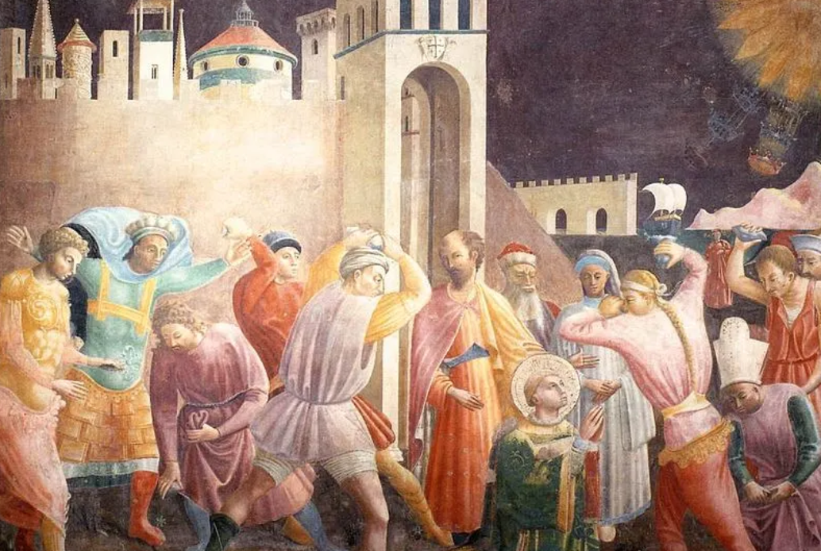
5. Persecution of believers.
6. Great division among the people.

Slide 26
7. Children taught to reject what is true.
8. Believers become as wicked as the others.

Slide 27
9. Secret society conspiracies overrun the whole land

Slide 28
Sources:
Sources:
President Gordon B. Hinckley(“Mormon Should Mean ‘More Good,’” Ensign, Nov. 1990, 52–53)
Elder David A. Bednar (“Quick to Observe,” Ensign, Dec. 2006, 34).
Joseph Fielding McConkie and Robert L. Millet Doctrinal Commentary on the Book of Mormon Vol. 4 pgs. 211-212, 219-220
The Book of Mormon Who’s Who by Ed J. Pinegar and Richard J. Allen pgs. 1-2
Elder Bruce D. Porter (“A Broken Heart and a Contrite Spirit,” Ensign or Liahona, Nov. 2007, 32).
President Harold B. Lee Church News March 3, 1973 p. 4
Elder Charles Didier Choosing Right When the World Is Wrong Feb. 2010 Ensign
Elder M. Russell Ballard, “The Effect of Television,” Ensign, May 1989, 80
Presentation by ©http://fashionsbylynda.com/blog/

Slide 29
Mormon 1
The following list highlights aspects of Mormon’s life and ministry:
1. His father was named Mormon (see Mormon 1:5).
2. He was named after the land of Mormon, where Alma established the Church (see 3 Nephi 5:12).
3. He named a son Moroni (see Mormon 6:6).
4. He was a pure descendant of Lehi (see 3 Nephi 5:20).
5. He was visited by the Savior (see Mormon 1:15).
6. He was a disciple of Jesus Christ (see 3 Nephi 5:13).
7. He was a commander of Nephite armies (see Mormon 2:1).
8. He wrote according to God’s will (see 3 Nephi 5:14).
9. He witnessed the downfall of the Nephites (see Mormon 2:18–19; 3:16; 6:8–22).
Mormon 1
The following list highlights aspects of Mormon’s life and ministry:
1. His father was named Mormon (see Mormon 1:5).
2. He was named after the land of Mormon, where Alma established the Church (see 3 Nephi 5:12).
3. He named a son Moroni (see Mormon 6:6).
4. He was a pure descendant of Lehi (see 3 Nephi 5:20).
5. He was visited by the Savior (see Mormon 1:15).
6. He was a disciple of Jesus Christ (see 3 Nephi 5:13).
7. He was a commander of Nephite armies (see Mormon 2:1).
8. He wrote according to God’s will (see 3 Nephi 5:14).
9. He witnessed the downfall of the Nephites (see Mormon 2:18–19; 3:16; 6:8–22).
Mormon 1
The following list highlights aspects of Mormon’s life and ministry:
1. His father was named Mormon (see Mormon 1:5).
2. He was named after the land of Mormon, where Alma established the Church (see 3 Nephi 5:12).
3. He named a son Moroni (see Mormon 6:6).
4. He was a pure descendant of Lehi (see 3 Nephi 5:20).
5. He was visited by the Savior (see Mormon 1:15).
6. He was a disciple of Jesus Christ (see 3 Nephi 5:13).
7. He was a commander of Nephite armies (see Mormon 2:1).
8. He wrote according to God’s will (see 3 Nephi 5:14).
9. He witnessed the downfall of the Nephites (see Mormon 2:18–19; 3:16; 6:8–22).
Mormon 1
The following list highlights aspects of Mormon’s life and ministry:
1. His father was named Mormon (see Mormon 1:5).
2. He was named after the land of Mormon, where Alma established the Church (see 3 Nephi 5:12).
3. He named a son Moroni (see Mormon 6:6).
4. He was a pure descendant of Lehi (see 3 Nephi 5:20).
5. He was visited by the Savior (see Mormon 1:15).
6. He was a disciple of Jesus Christ (see 3 Nephi 5:13).
7. He was a commander of Nephite armies (see Mormon 2:1).
8. He wrote according to God’s will (see 3 Nephi 5:14).
9. He witnessed the downfall of the Nephites (see Mormon 2:18–19; 3:16; 6:8–22).

Slide 30
The hill Shim is in the land of Antum (which is next to the land of Jashon). The hill Shim is eastward of the city of Boaz, northward of the narrow neck, southward of the hill Ramah/hill Cumorah, and westward of Ablom. The hill Shim is several days' travel from the lands of Nehor and Heth.
Commentaries .
IV NEPHI 1:57 [1:48]: And it came to pass that when three hundred and twenty years had passed away, Ammoron, being constrained by the Holy Ghost, did hide up the records which were sacred;
Commentary: This verse references the place of the hill Shim. Ammoron hid up the records in Hill Shim.
MORMON 1:2 [1:2]: And about the time that Ammoron hid up the records unto the Lord, he came unto me, (I being about ten years of age; and I began to be learned somewhat after the manner of the learning of my people,) and Ammoron said unto me, I perceive that thou art a sober child, and art quick to observe;
Commentary: This verse references the place of the hill Shim. Ammoron had hid up the records in Hill Shim. The term 'I' refers to Mormon.
MORMON 1:4 [1:3]: And when ye are of that age, go to the land of Antum, unto a hill, which shall be called Shim; and there have I deposited unto the Lord, all the sacred engravings concerning this people.
Commentary: This verse references the places of Antum and the hill Shim. In this verse, Ammoron is talking to Mormon. The hill Shim is located in the land of Antum.
MORMON 1:43 [2:17]: And now the city of Jashon was near the land where Ammoron had deposited the records unto the Lord, that they might not be destroyed.
Commentary: This verse references the places of Antum, the hill Shim, and Jashon. The hill Shim is where Ammoron deposited the records in the land of Antum. The phrase 'was near' means the land around the city of Jashon is next to the land of Antum.
MORMON 2:25 [4:23]: And now I, Mormon, seeing that the Lamanites were about to overthrow the land, therefore I did go to the hill Shim, and did take up all the records which Ammoron had hid up unto the Lord.
Commentary: This verse references the places of Antum, Boaz, the hill Shim, and the Sea West. Mormon went to the hill Shim (in the land of Antum) from the city Boaz. There is no indication how close the two were together. It may imply that the way to the hill Shim from the land of Boaz is through an area where there were few, if any, Lamanites. If the Lamanites were pursuing the Nephites generally northward from the land Desolation, the route from the city Boaz to the hill Shim would then have to be eastward (westward would be the Sea West). This would also imply that the hill Shim is northward of the narrow neck where Lamanites had control.
ETHER 4:3 [9:3]: And the Lord warned Omer in a dream that he should depart out of the land; wherefore Omer departed out of the land with his family, and traveled many days, and came over and passed by the hill of Shim,
Commentary: This verse references the places of Heth, hill Shim, Nehor, and a ridge between Heth and the hill Shim. Omer traveled many days from the land of Nehor and passed by the hill of Shim. To travel many days, the hill Shim is not very near the land of Nehor or the land of Heth. The phrase 'came over' means over a ridge before getting to the hill Shim (in order to pass by the hill Shim).
ETHER 4:4 [9:3]: And came over by the place where the Nephites were destroyed, and from thence eastward, and came to a place which was called Ablom, by the sea-shore, and there he pitched his tent, and also his sons and his daughters, and all his household, save it were Jared and his family.
Commentary: This verse references the places of the land of Ablom, hill Cumorah, hill Ramah, hill Shim, ridge between hill Shim and hill Cumorah, and the Sea East. 'He' refers to Omer. The phrase 'where the Nephites were destroyed' means the hill Cumorah. From Ether 6:83 [15:11], the hill Ramah is the same as the hill Cumorah. The term 'thence' indicates Ablom is outside the area around hill Cumorah. Traveling eastward to the sea indicates that Ablom is eastward from hill Ramah/hill Cumorah and on the Sea East shore. The phrase 'came over' means they traveled over elevated terrain from the hill Shim to get to the hill Cumorah. So, there is a ridge between the hill Shim and the hill Ramah/hill Cumorah. Hill Shim is south of the hill Ramah/Cumorah since they were traveling north when they passed the hill Shim and then turned east at the hill Ramah/Cumorah.
https://sites.google.com/site/bomgeography/internal-map/new-world-commentary/h/hill-shim

