Slide 1
Lesson 116
Proverbs—
A Library of Wisdom
The secret of happiness is not doing the things that you like but liking the things that you do.
- Unknown

Slide 2
Introduction
Written as poetry
The book of Proverbs is frequently quoted in the New Testament.
The book of Proverbs contains many brief but wise statements about how to live a godly life
Although the book was written in ancient Israel, its messages remain applicable in the modern world.

Slide 3
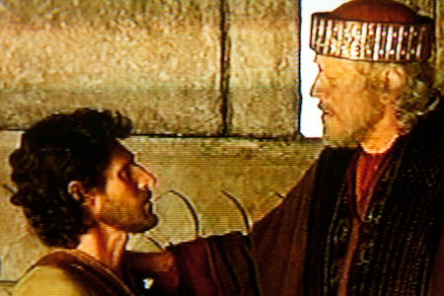
Who Wrote Proverbs?
These are also proverbs of Solomon, which the men of Hezekiah king of Judah copied out
Proverbs 25:1
Some of the book of Proverbs is attributed to “Solomon the son of David, the king of Israel”

Slide 4
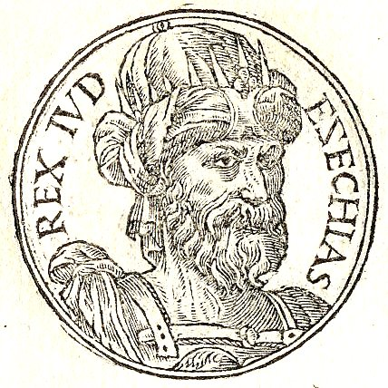
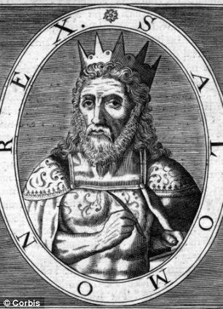
When Was Proverbs Written?
We do not know exactly when or where the book of Proverbs was written, but the initial compilation of Proverbs is traditionally thought to have taken place during the reign of King Solomon in Jerusalem, between 1015 and 975 B.C.
It is likely that many of the proverbs came from oral traditions that existed before Solomon’s time. Also, some proverbs were added after Solomon’s time: chapters 25–29 were added in the days of King Hezekiah of Judah.
It is unknown when the book reached its final form.

Slide 5
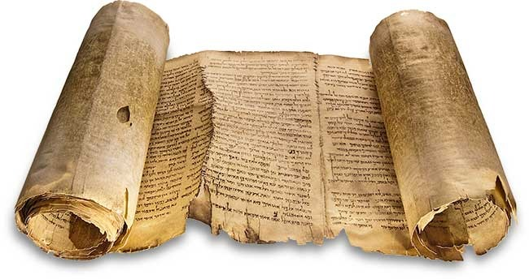
What Proverbs Contains
Chapters 1–9 contain an explanation of true wisdom.
Chapters 10–24 contain a collection of sayings about the right and wrong ways of living.
Chapters 25–29 contain the proverbs of Solomon that the men of Hezekiah, king of Judah, recorded.
Chapters 30–31 include a description of a virtuous woman.

Slide 6
“That’s What Its All About”
Proverbs 1:1-7
“A wise man will hear, and will increase in learning … but fools despise wisdom and instruction”
A wise person knows that there is something to be learned from everyone.
- Unknown
"You can tell whether a man is clever by his answers.
You can tell whether a man is wise by his questions."
- Naguib, Mahfouz—Egyptian writer

Slide 7
The Principle
Proverbs 1:1-7
If we have reverence for the Lord and His teachings, then He will bless us with knowledge and wisdom.

Slide 8
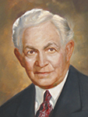
Reverence
“Fear the Lord”
“Reverence is profound respect mingled with love. …
[One writer] says it is ‘the highest of human feelings.’ …
“Reverence embraces regard, deference, honor, and esteem.” (1)

Slide 9
Gaining Knowledge
“Gaining knowledge is one thing, and applying it [is] quite another.
Wisdom is the right application of knowledge, and true education—the education for which the Church stands—is the application of knowledge to the development of a noble and Godlike character.” (1)

Slide 10
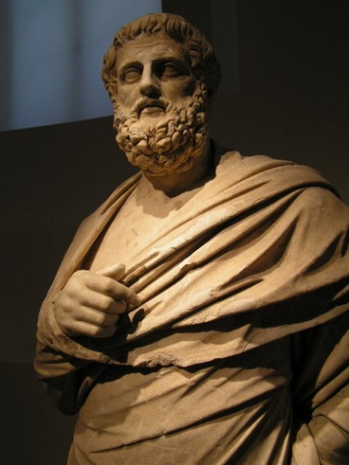
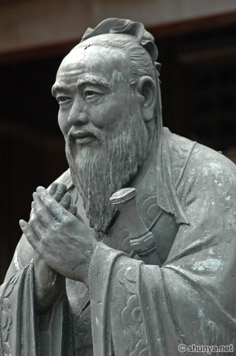
Finding Wisdom
Froward = to be wayward or to go in a direction opposite of what is expected.
deceitfulness, perverseness, and foolishness”
Proverbs 4:5-9
Proverbs 2:10-15
Wisdom is the daughter of experience.
LEONARDO DA VINCI
"To know that you know, and to know that you don't know - that is real wisdom."
- Confucius
Proverbs 3:13-18, 35
“Wisdom is the Supreme part of Happiness”--Sophocles

Slide 11
The Principle
Proverbs 2-4
Gaining wisdom and living righteously lead to happiness and peace

Slide 12
Doctrinal Mastery
Trust in the Lord with all thine heart; and lean not unto thine own understanding.
In all thy ways acknowledge him and he shall direct thy paths.
Proverbs
3:5-6

Slide 13
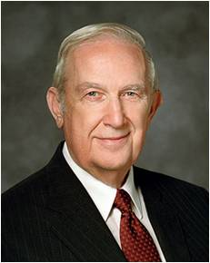
“Our Father in Heaven has invited you to express your needs, hopes, and desires unto Him.
That should not be done in a spirit of negotiation, but rather as a willingness to obey His will no matter what direction that takes. His invitation, ‘Ask, and ye shall receive’ (3 Ne. 27:29 ) does not assure that you will get what you want.
It does guarantee that, if worthy, you will get what you need, as judged by a Father that loves you perfectly, who wants your eternal happiness even more than do you” (2)

Slide 14
Proverbs 4
Proverbs 14-19
If you find yourself in a hole, the first thing to do is stop digging.
- Will Rogers
Proverbs 4:10
Proverbs 4:20-27
It requires wisdom to understand wisdom; the music is nothing if the audience is deaf.
- Walter Lippmann
God gave us mouths that close and ears that don’t—that should tell us something
--unknown

Slide 15
Proverbs 5
Proverbs 5:15-21
“A successful marriage requires falling in love many times, always with the same person.”
Mignon McLaughlin

Slide 16
Proverbs 6:16
“Seven is a number that symbolizes completeness; this list covers most abominable attitudes and acts, including pride, lying, murder, malicious thought, eagerness for evil, false testimony, and raising dissension. These generate most of the ills of society.” (4)

Slide 17
Proverbs 6:16-19
A Proud Look
Don't think less of yourself, think of yourself less
- Unknown
A Lying Tongue
The worst thing about being lied to is knowing you weren’t worth the truth.--unknown
Hands that shed innocent blood
“Thou shalt not kill does not apply to murder of one’s own kind only, but to all living beings; and this Commandment was inscribed in the human breast long before it was proclaimed from Sinai. –Leo Tolstoy
A heart that deviseth wicked imaginations
"You can fool all the people some of the time, and some of the people all the time, but you cannot fool all the people all the time."
- Abraham Lincoln
Feet that be swift in running to mischief
“I solemnly swear that I am up to no good.” J.K. Rowling
Rather fail with honor than succeed by fraud.
- Sophocles—Greek writer
A false witness

Slide 18
The Fool--Proverbs 9:6
A fool will learn nothing from a wise man, but a wise man will learn much from a fool
- Unknown
Who is more follish? The fool or the fool that follows it?
--Alec Guinness
Wise men don’t need advice.
Fools won’t take it.
--Benjamin Franklin

Slide 19
The Couch Potato
Proverb 10:4
Laziness may appear attractive, but work gives satisfaction
--Anne Frank
Proverb 12:24
Proverb 10:16
Work hard and become a leader, be lazy and become a slave.
--unknown
The good man labors that he may be able to support life; this is his first object: and then to have something to divide with the poor; this is his next object.
--Adam Clarke
Great things come out of being hungry and cold. Once you're pampered, you get lazy. Rob Zombie

Slide 20
Pride—Proverbs 11:2
Pride is concerned with who is right.
Humility is concerned with WHAT IS RIGHT
--Ezra T. Benson
Humility is not thinking less of yourself, but thinking of yourself less.
--C.S. Lewis

Slide 21
A Virtuous Woman
Proverbs 12:4
A handsome guy and a pretty girl will make a beautiful wedding, but a faithful man and a virtuous woman will make a beautiful marriage.
--KM II
Proverbs 31:10-31
Who Can Find a Virtuous woman? For her Price is far above rubies.

Slide 22
Virtue
“Virtue originates in your innermost thoughts and desires. It is a pattern of thought and behavior based on high moral standards. Since the Holy Ghost does not dwell in unclean tabernacles, virtue is prerequisite to receiving the Spirit’s guidance. What you choose to think and do when you are alone and you believe no one is watching is a strong measure of your virtue.
“Virtuous people are clean and pure spiritually. They focus on righteous, uplifting thoughts and put unworthy thoughts that lead to inappropriate actions out of their minds. They obey God’s commandments and follow the counsel of Church leaders. They pray for the strength to resist temptation and do what is right. They quickly repent of any sins or wrongdoings. They live worthy of a temple recommend” (3)

Slide 23
A Wise Man Feareth
Proverbs 14:16
When you realize God is all you have, you realize, God is all you needed in the first place.
--unknown
Proverbs 31:10
A wise man once said: An error does not become a mistake, until you refuse to correct it.
--President John F. Kennedy
by Rehahn Hoia

Slide 24
Sorrow of the Heart
Proverbs 15:13
You have to have a darkness for the dawn to come.
- Harrison Ford

Slide 25
Gossip
Proverbs 16:13 and Proverbs 21:23
The quieter you become, the more you can hear.
--unknown
Proverbs 16:28
Gossip is spread by wicked people. It stirs up trouble and breaks up friendships
--unknown
Proverbs 18:4
If you want to know how far gossip travels, do this - take a feather pillow up on a roof, slice it open, and let the feathers fly away on the wind. Then go and find every single feather and re-stuff the pillow. --Rebecca Pidgeon

Slide 26
Children’s Children
Proverbs 17:6
"Children are likely to live up to what you believe of them." Lady Bird Johnson, Former First Lady of the United States
Proverbs 23:24
Children must be taught how to think, not what to think." — Margaret Mead
Proverbs 22:6
"Children are great imitators. So give them something great to imitate." — Anonymous

Slide 27
Friends
Proverbs 18:24
Your truest friend are the ones who will stand by you in your darkest moments because they’re willing to brave the shadows with you.
And in your greatest moments because they’re not afraid to let you shine.
--Nicole Yatsonsky

Slide 28
Safety in the Lord—Proverbs 21:31
I can only show you the door. You're the one who has to walk through it.
- The Matrix ' Morpheous
When GOD leads you to the edge of a cliff, trust him fully. Only two things can happen; either He will catch you when you fall or He will teach you how to fly.
- Unknown

Slide 29
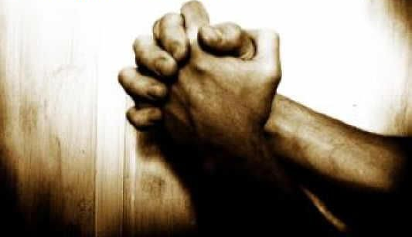
Patience—Proverbs 24:32-33
God gives you answers in three ways: he says yes and gives you want you want, he says no and gives you something better, or he says wait and gives you the best.
- Unknown

Slide 30
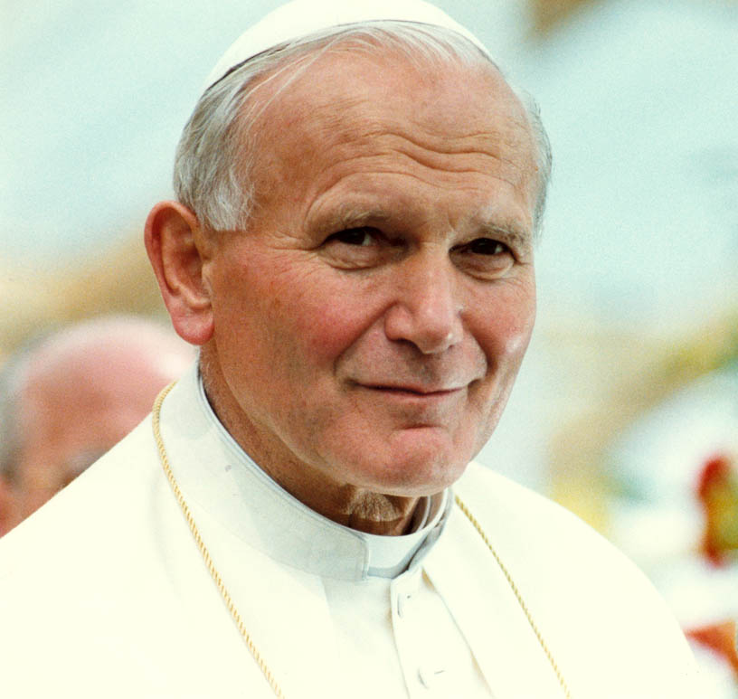
To the Poor—Proverbs 25:21
Nobody is so poor that he has nothing to give, and nobody is so rich that he has nothing to receive.
--Pope John Paul II

Slide 31
Trust in the Lord
He that trusteth in his own heart is a fool: but whoso walketh wisely, he shall be delivered. Proverbs 28:26
Every word of God is pure: he is a shield unto them that put their trust in him. Proverbs 30:5
“The secret of life, though, is to fall seven times and to get up eight times.” ― Paulo Coelho, The Alchemist

Slide 32
The Stage
“Your mind is like a stage in a theater; in the theater of your mind, however, only one actor can be on stage at a time. If the stage is left bare, thoughts of darkness and sin often enter the stage to tempt.
But these thoughts have no power if the stage of your mind is occupied by wholesome thoughts, such as a memorized hymn or verse of scripture that you can call upon in a moment of temptation.
By controlling the stage of your mind, you can successfully resist persistent urges to yield to temptation and indulge in sin. You can become pure and virtuous” (3)

Slide 33
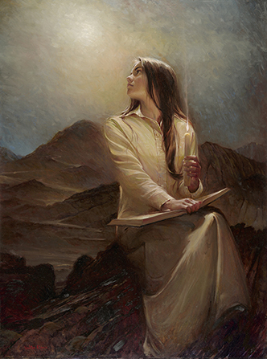
Sources:
Suggested Hymn: #79 With All the Power of Heart and Tongue
Videos: Trust in the Lord (0:39)
Return to Virtue (2:34)
A “Mother’s Heart” (2:51)
President David O. McKay (Teachings of Presidents of the Church: David O. McKay [2003], 30).
Conference Report, Apr. 1968, 93–94.
2. Elder Richard G. Scott (“Trust in the Lord,” Ensign, Nov. 1995, 17).
3. (Preach My Gospel [2004], 118–19).
4. Ellis T. Rasmussen, A Latter-day Saint Commentary on the Old Testament[1993], 474
Each Proverb means something different to each individual…
These were some of my impressions.
Presentation by ©http://fashionsbylynda.com/blog/
by Walter Rane

Slide 34
The Purpose of Proverbs | Proverbs 1:1-7
Proverbs of Solomon
Contrasting the Righteous and the Wicked | 10:1-15:33
Encouraging to Live Righteously | 16:1-22:16
Concerns of various situations | 22:17-24:34
Proverbs to the Youth
The Purpose of Proverbs | 1:1-7
Proverbs to the Youth | 1:8-9:18
Obeying parents | 1:8-9
Avoid Bad Company | 1:10-19
Seek Wisdom | 1:20-2:22
Benefits of Wisdom | 3:1-26
Be Kind to Others | 3:27-35
Acquire Wisdom | 4:1-13
Avoid the Wicked | 4:14-22
Keep Your Heart | 4:23-27
Do Not Commit Adultery | 5:1-14. 6:20-7:27
Faithfulness to Your Spouse | 5:15-23
Avoid Surety | 6:6-19
Do Not Be Lazy | 6:6-19
Praise of Wisdom | 8:1-9: 12
Foolish Woman | 9:13-18
Proverbs of Solomon copied by Hezekiah’s Men
Relationships with Others | 25:1-26:28
Relationships with Kings | 25:1-7
Relationships with Neighbors | 25:8-20
Relationships with Enemies | 25:21-24
Relationships with Yourself | 25:25-28
Relationships with Fools | 26:1-12
Relationships with Sluggards | 26:13-16
Relationships with Gossip | 26:17-28
Various Activities | 27:1-29:27
Outline of Proverbs
The Words of Agur 30:1-33
The Words of King Lemuel
Wisdom for Leaders and Wise Woman | 31:1-31

Slide 36
1. Faith - A Virtuous Woman serves God with all of her heart, mind, and soul. She seeks His will for her life and follows His ways. (Proverbs 31: 26, Proverbs 31: 29 – 31, Matthew 22: 37, John 14: 15, Psalm 119: 15 2. Marriage – A Virtuous Woman respects her husband. She does him good all the days of her life. She is trustworthy and a helpmeet. (Proverbs 31: 11- 12, Proverbs 31: 23, Proverbs 31: 28, 1 Peter 3, Ephesians 5, Genesis2: 18) 3. Mothering - A Virtuous Woman teaches her children the ways of her Father in heaven. She nurtures her children with the love of Christ, disciplines them with care and wisdom, and trains them in the way they should go. (Proverbs 31: 28,Proverbs 31: 26, Proverbs 22: 6, Deuteronomy 6, Luke 18: 16) 4. Health – A Virtuous Woman cares for her body. She prepares healthy food for her family. (Proverbs 31: 14 – 15, Proverbs 31: 17, 1 Corinthians 6: 19, Genesis 1: 29, Daniel 1, Leviticus 11)
5. Service - A Virtuous Woman serves her husband, her family, her friends, and her neighbors with a gentle and loving spirit. She is charitable. (Proverbs 31: 12,Proverbs 31: 15, Proverbs 31: 20, 1 Corinthians 13: 13) 6. Finances - A Virtuous Woman seeks her husband’s approval before making purchases and spends money wisely. She is careful to purchase quality items which her family needs. (Proverbs 31: 14, Proverbs 31: 16, Proverbs 31: 18, 1 Timothy 6: 10, Ephesians 5: 23, Deuteronomy 14: 22, Numbers 18: 26) 7. Industry – A Virtuous Woman works willingly with her hands. She sings praises to God and does not grumble while completing her tasks. (Proverbs 31: 13,Proverbs 31: 16, Proverbs 31: 24, Proverbs 31: 31, Philippians 2: 14) 8. Homemaking – A Virtuous Woman is a homemaker. She creates an inviting atmosphere of warmth and love for her family and guests. She uses hospitality to minister to those around her. (Proverbs 31: 15, Proverbs 31: 20 – 22, Proverbs 31: 27, Titus 2: 5, 1 Peter 4: 9, Hebrews 13: 2) 9. Time - A Virtuous Woman uses her time wisely. She works diligently to complete her daily tasks. She does not spend time dwelling on those things that do not please the Lord. (Proverbs 31: 13, Proverbs 31: 19, Proverbs 31: 27, Ecclesiastes 3, Proverbs 16: 9, Philippians 4:8 ) 10. Beauty – A Virtuous Woman is a woman of worth and beauty. She has the inner beauty that only comes from Christ. She uses her creativity and sense of style to create beauty in her life and the lives of her loved ones. (Proverbs 31: 10 Proverbs 31: 21 – 22, Proverbs 31: 24 -25, Isaiah 61: 10, 1 Timothy 2: 9, 1 Peter 3: 1 – 6)
A Virtuous Woman
Proverbs 31:10-31
Beyond Sunday School Blog

