Slide 1
Lesson 130
Guide Me To Thee
Isaiah 51-52

Slide 2
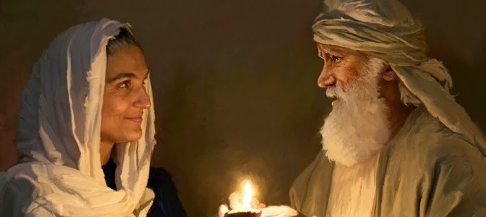
Look—The Rock
Abraham and Sarah were examples of solid, faithful followers of the Lord (1)
Jehovah promised that in him and in his seed all the nations of the earth should be blessed, as a pattern of piety, and as the great head of the Church.
Because of his faithfulness in keeping the commandments of Jehovah on earth, he drew from on high this great promise. (2)
Isaiah 51:1-2

Slide 3
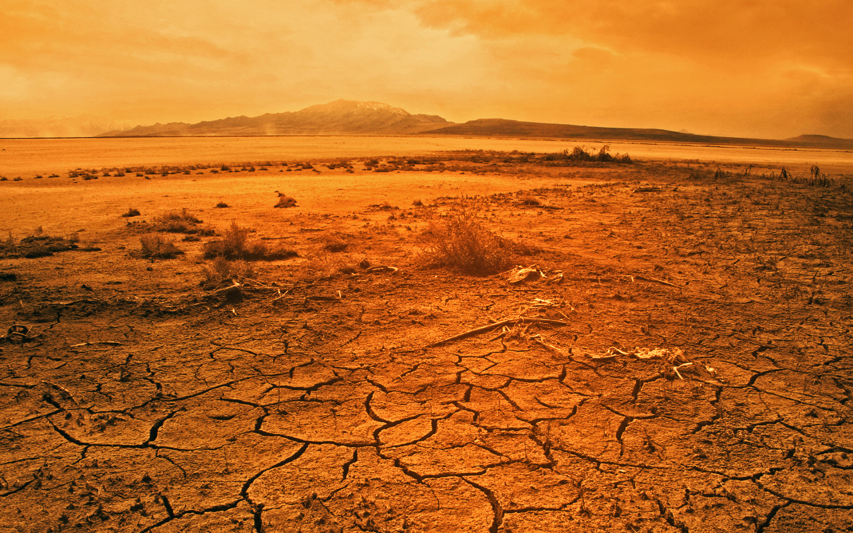
Waste Places
A wilderness turned into Eden?
A desert turned into a garden?
Isaiah 51:3

Slide 4
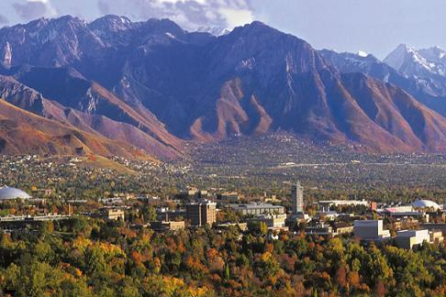
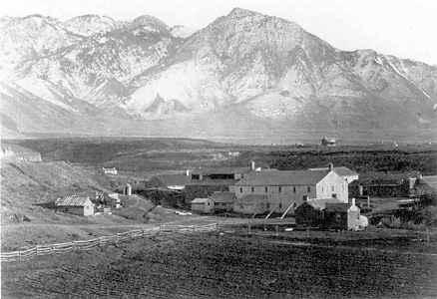
We can expect that the redemption of Zion to include a complete change in the landscape-the land will be made like the Garden of Eden.
But the Lord has made it clear that the blessings he plans to pour out upon the saints will occur wherever they go. While in Kirtland, the Lord said,
"Therefore, will I not make solitary places to bud and to blossom, and to bring forth in abundance? Saith the Lord. Is there not room enough on the mountains of Adam-ondi-Ahman?" (DC 117:7-8).
“The desert of the Great Basin in which the early pioneers settled blossomed as a rose in fulfillment of Isaiah's prophecy). Isaiah said,
"The wilderness and the solitary place shall be glad for them; and the desert shall rejoice, and blossom as the rose" (Isa 35:1).
The Lord will comfort the saints and make the wilderness beautiful wherever the pure in heart go.” (3)
As we remember our covenants and keep them, the Lord will bless us and comfort us
Isaiah 51:3
(4)

Slide 5
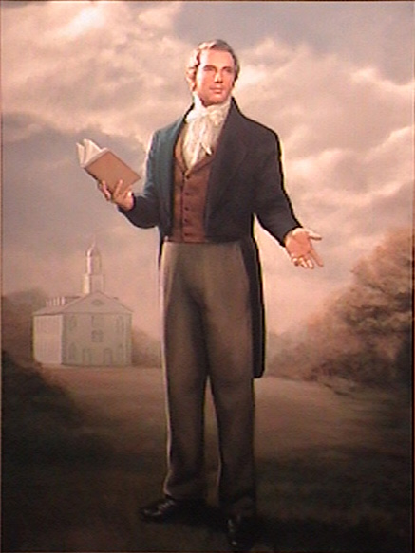
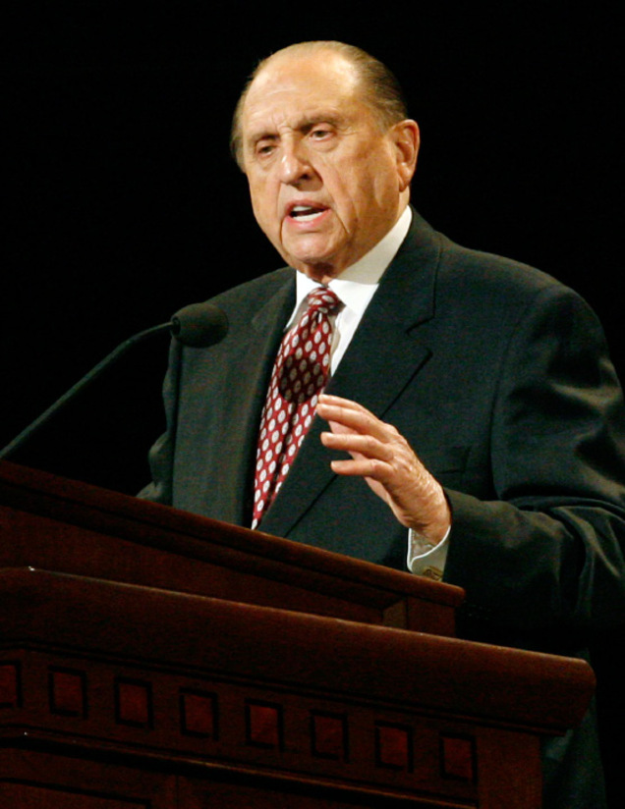
A Law Will Proceed
A prophecy of the restoration of the gospel law and covenant in the last days.
That law and covenant includes modern scripture and living prophets to reveal God’s will anew.
Isaiah 51:4

Slide 6
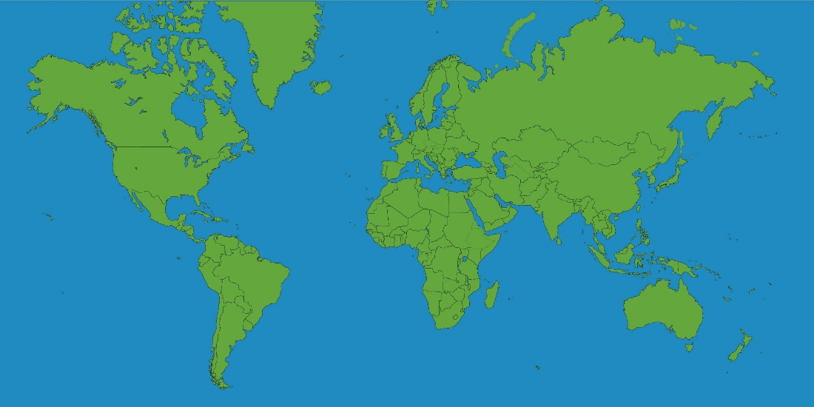
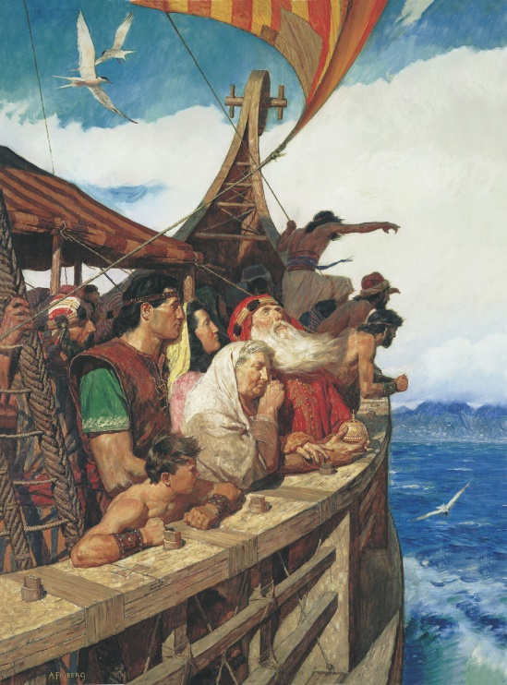
The Isles Shall Wait
"isles of the sea," is a term which Nephi and later Jacob use to refer to the land of promise.
This includes those who came to the American continent.
Those of the house of Israel who have been scattered all over the earth, including to the isles of the sea, will turn to the Lord before the Second Coming.
We think of the Americas as two great continents. However, it is completely natural for the prophets to refer to it as an isle of the sea
…we have been driven out of the land of our inheritance; but we have been led to a better land, for the Lord has made the sea our path, and we are upon an isle of the sea.
2 Nephi 10:20
Isaiah 51:4-5
(4)

Slide 7
“My and Mine”
My Nation
My People
My Judgement
My righteousness
My Salvation
Mine Arms
The Lord emphasized these things to stress His relationship with us.
He is our Creator,
He is our Judge,
He is our Savior, and He is our perfect Exemplar.
The qualities He claims for Himself will endure forever.
God is permanent, stable, upright, and dependable. (5)
Simon Dewey
Isaiah 51:4-6

Slide 8
The Earth Will Be Transformed
At the beginning of the Millennium, the earth will be transformed from a telestial state to a terrestrial one.
This will be similar to the paradise of the Garden of Eden before the fall of Adam.
The second transformation of the earth will occur at the end the little season (after the Millennium) when the earth will be transformed into a celestial sphere for those worthy of a celestial glory.
Isaiah 51:6
(4)

Slide 9
Reproach and Revilings= Rebukes or Mockery
Let us recognize that fear comes not of God, but rather that this gnawing, destructive element comes from the adversary of truth and righteousness. Fear is the antithesis of faith. It is corrosive in its effects, even deadly. (6)
If the Lord’s law is in our hearts, then we have no need to fear the mockery of others
The blessings of the Lord’s righteousness and salvation will endure forever, while those who revile against righteousness will no longer be able to hurt us in the next life.
Isaiah 51:7

Slide 10
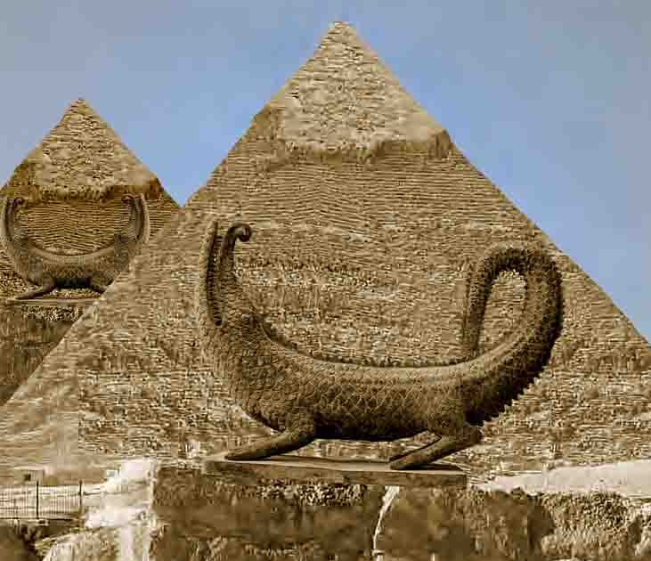
Zion is to Awake—Put on the Strength
Rahab and the wounded Dragon = Egypt
Rahab = Satan
Isaiah wrote that the Lord’s people were pleading with the Lord to awake (or use His power) to help them as He had done in the past and to fulfill His promises.
Isaiah 51:9-23

Slide 11
The Lord’s Wrath of Jerusalem
Drunken the dregs =
Covenant Israel had drunk the bitter judgments of the Lord, right down to the sediments at the bottom of the cup.
None to guide her = Israel has lost her prophetic leadership because of apostasy (2 Nephi 7:1-2)
Isaiah 51:17-25

Slide 12
“Thy sons have fainted, save these two…”
Because Israel has lost the gospel of Jesus Christ and its power to guide, direct, and save, God has sent two priesthood holders to assist and bless them. These two are the same “two witnesses” spoken of in Revelation 11:3. (7)
Isaiah 51:20

Slide 13
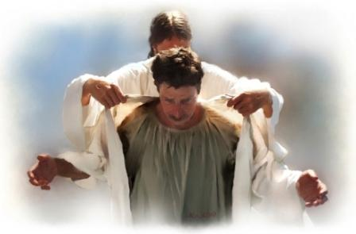
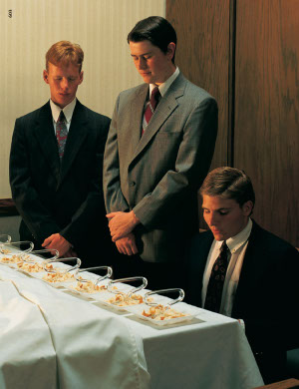
“Put on thy strength”
Put on the authority of the priesthood as one would put on a robe.
Isaiah showed that the beautiful garments symbolized the priesthood power restored to the house of Israel in the last days and that the loosing of the bands from her neck signified the removal of the curses of God. If Israel would return to God, new revelations would be given.
He had reference to those whom God should call in the last days, who should hold the power of priesthood to bring again Zion, and the redemption of Israel; and to put on her strength is to put on the authority of the priesthood, which she, Zion, has a right to by lineage; also to return to that power which she had lost.
D&C 113: 7-8
Isaiah 52:1-2 2 Nephi 8:24 3 Nephi 20:36-37
(7)

Slide 14
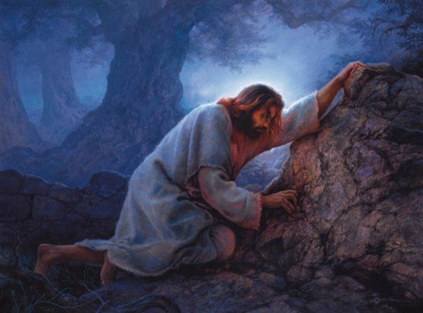
The Price Was Paid Without Money
Just because Isaiah says Israel is redeemed without money, we should not assume he is redeemed without price.
The Israelites sold themselves but there was no exchange of money.
When the Lord buys them back, no money is exchanged, but there was a price paid-indeed a very high price.
Instead of dollars, yen, or drachma, the price was paid drop by drop as the Savior suffered in Gethsemane and on Golgotha. Paul and Peter were clear on this point:
Forasmuch as ye know that ye were not redeemed with corruptible things, as silver and gold, from your vain conversation received by tradition from your fathers;
But with the precious blood of Christ, as of a lamb without blemish and without spot:
1 Peter 1:18-19
Isaiah 52:3
(4)

Slide 15
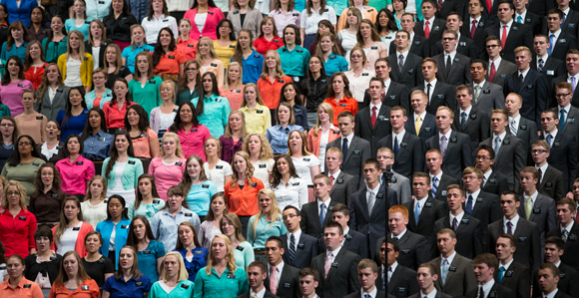
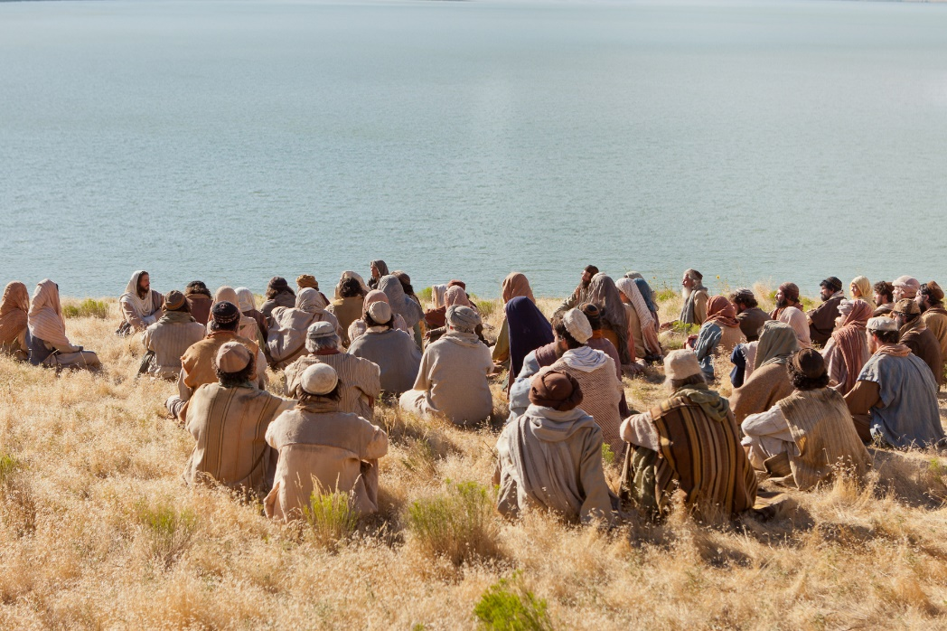
“How Beautiful Upon the Mountain”
Abinadi to the priests of Noah:
How beautiful upon the mountains are the feet of him that bringeth good tidings; that publisheth peace; that bringeth good tidings of good; that publisheth salvation; that saith unto Zion, Thy God reigneth;
Mosiah 12:21
The bringer of “good tidings” is Jesus Christ, the “founder of peace.” Those who publish that peace are the servants of the Lord who spread His word—Missionary Work
These people are the prophets of God - they who preach the gospel of the Prince of Peace, the Lord Jesus Christ. (8)
Isaiah 52:7 Mosiah 15:13-18

Slide 16
“Ultimately it is Christ who is beautiful upon the mountain.
And it is His merciful promise of ‘peace in this world,’ His good tidings of ‘eternal life in the world to come’ that make us fall at His feet and call His name blessed and give thanks for the restoration of His true and living Church.” (11)
Isaiah 52:7 Mosiah 15:13-18 D&C 59:23

Slide 17
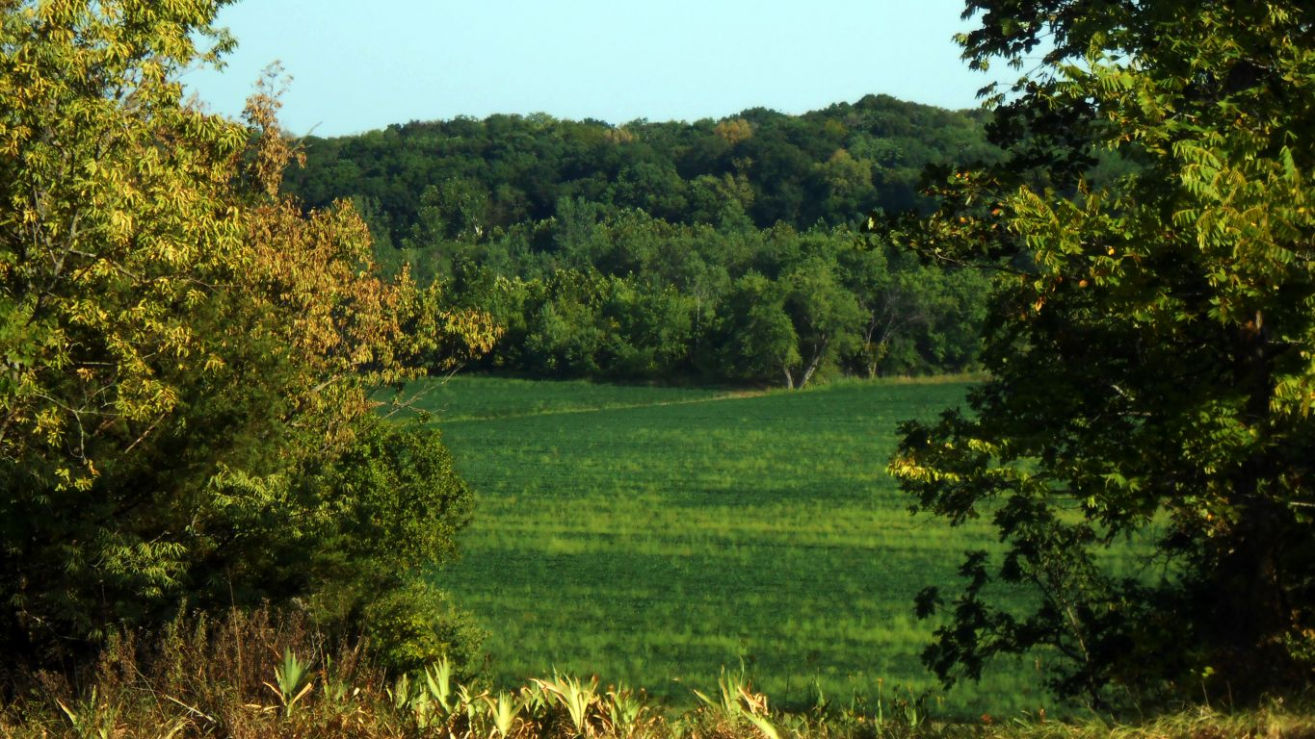
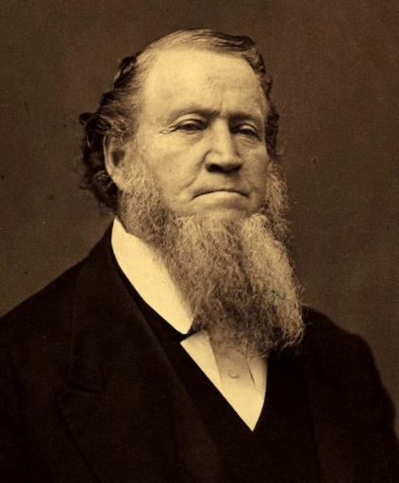
“Thy Watchmen”--Zion
“We talk and read about Zion, we contemplate upon it, and in our imaginations we reach forth to grasp something that is transcendent in heavenly beauty, excellency, and glory. But while contemplating the future greatness of Zion, do we realize that we are the pioneers of that future greatness and glory?
Do we realize that if we enjoy a Zion in time or in eternity, we must make it for ourselves? That all who have a Zion in the eternities of the gods organized, framed, consolidated, and perfected it themselves, and consequently are entitled to enjoy it.” (9)
Hearken, O ye elders of my church, saith the Lord your God, who have assembled yourselves together, according to my commandments, in this land, which is the land of Missouri, which is the land which I have appointed and consecrated for the gathering of the saints.
Wherefore, this is the land of promise, and the place for the city of Zion. D&C 57:1-2
Isaiah 52:8

Slide 18
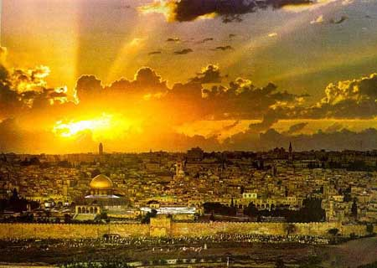
Jerusalem’s Watchmen
The ‘watchmen’ are those who preach the gospel,
If the Lord has begun gathering Israel, if the covenant has gone forth throughout the earth, if Jerusalem is already inhabited with the Lord's people, then certainly, the full redemption of Jerusalem and the millennial day cannot be far off. (4)
The song to be sung in Zion will be a new song, sung when all will know Christ (i.e., during the Millennium).
And now I say unto you that the time shall come that the salvation of the Lord shall be declared to every nation, kindred, tongue, and people.
Yea, Lord, thy watchmen shall lift up their voice; with the voice together shall they sing; for they shall see eye to eye, when the Lord shall bring again Zion.
Mosiah 15:28-29
Isaiah 52:9

Slide 19
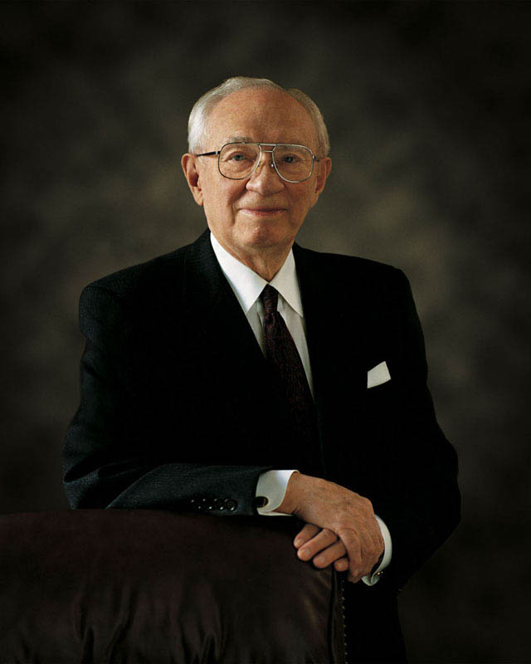
Depart Ye and Be Ye Clean
Your are a representative of the Lord
“Be clean. Be clean in your thoughts.
It is not easy in the environment in which you live. But if you work at it, you can do it.
You can shut out those influences which destroy your soul, your spirituality, and can destroy your very life.
The sleaze, the filth, the terrible pornography that is sweeping over the earth like a flood--stay away from it. Do not rent videos of a sleazy, filthy nature and sit around and look at them. They will destroy you.
Do not go to shows which will tear down your principles. Do not read literature which will destroy your high ideals.”
You are a son or daughter of God, and He expects marvelous things of you.” (10)
Isaiah 52:10-11

Slide 20
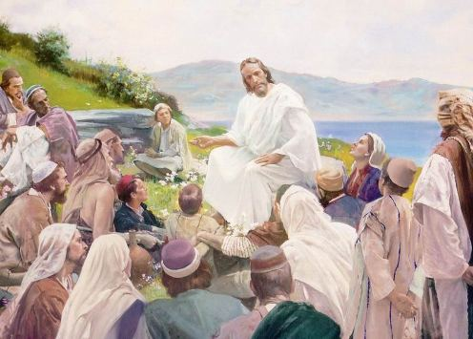
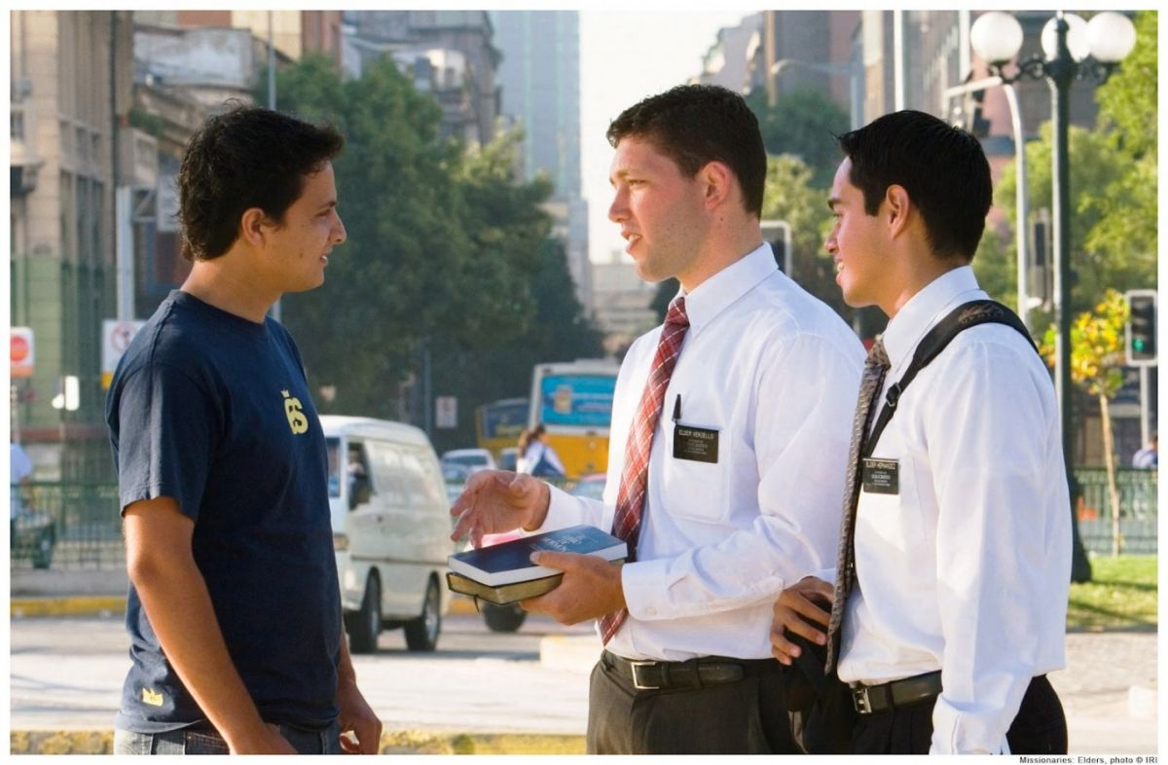
The Servant Will Have Knowledge
Exalted = an eternal destiny
Deal prudently = The knowledge of the servant will have insight and wisdom to understand exactly what the Lord wants him to do.
He will be successful by means of faithfulness in doing all that is asked of the Lord.
Progression in Christ’s mortality
Act wisely – Christ’s ministry
Raised – Crucifixion
Lifted up – Resurrection
Highly exalted – Ascension
Isaiah 52:13

Slide 21
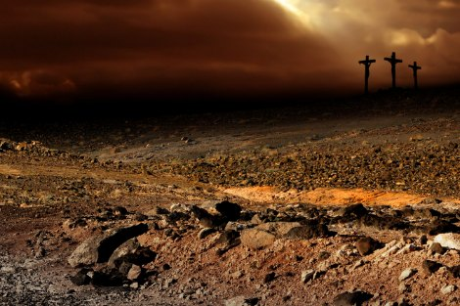
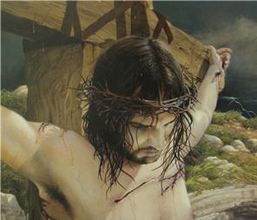
“Marred more than any man”
“In these words we see a triumphant millennial Christ -- one whose visage was marred and whose form was mangled when he dwelt among men -- we see him in glory and dominion, in whose presence kings remain silent and before whom their mouths are shut.
We see his cleansing blood sprinkle all nations, with devout men everywhere turning to the saving truths that they have not before heard and to the words of truth that they have not theretofore considered.” (12)
Isaiah 52:14

Slide 22
Sources:
Suggested Hymn: #101 Guide Me To Thee
Videos:
You Will Be Freed (2:55)
Live by Faith and Not by Fear(1:03)
I’ll Go Where You Want Me to Go(5:45)
Victor L. Ludlow Unlocking Isaiah in the Book of Mormon pp. 71
Orson Hyde [London: Latter-day Saints' Book Depot, 1854-1886], 2: 79)
Elder LeGrand Richards (see A Marvelous Work and a Wonder, pp. 233-4).
Gospeldoctrine.com
Old Testament Institute Manual The Gathering of Israel and the Coming of the Messiah Chapter 17
Gordon B. Hinckley (Commentaries on Isaiah in the Book of Mormon, ed. by K. Douglas Bassett, [American Fork, UT: Covenant Publishing Co., 2003], 39)
John Bythway Isaiah for Airheads p. 63
Mark E. Peterson LDS Church News, Deseret News, Mar 30, 1996)
President Brigham Young (Journal of Discourses, 9:282
(Eugene Oregon Regional Conference, September 15, 1996 as taken from Teachings of Gordon B. Hinckley, "Virtue")
Elder Jeffrey R. Holland (“Peaceable Things of the Kingdom,” Ensign, Nov. 1996, 82).
Elder Bruce R. McConkie (The Mortal Messiah, p. 344)
Presentation by ©http://fashionsbylynda.com/blog/

Slide 23
Isaiah 51 | 2 Nephi 8
1. Hearken to me, ye that follow after righteousness, ye that seek the Lord: look unto the rock whence ye are hewn, and to the hole of the pit whence ye are digged. | 1. Hearken unto me, ye that follow after righteousness. Look unto the rock from whence ye are hewn, and to the hole of the pit from whence ye are digged.
2. Look unto Abraham your father, and unto Sarah that bare you: for I called him alone, and blessed him, and increased him. | Look unto Abraham, your father, and unto Sarah, she that bare you; for I called him alone, and blessed him.
3. For the Lord shall comfort Zion: he will comfort all her waste places; and he will make her wilderness like Eden, and her desert like the garden of the Lord; joy and gladness shall be found therein, thanksgiving, and the voice of melody. | 3. For the Lord shall comfort Zion, he will comfort all her waste places; and he will make her wilderness like Eden, and her desert like the garden of the Lord. Joy and gladness shall be found therein, thanksgiving and the voice of melody
4. Hearken unto me, my people; and give ear unto me, O my nation: for a law shall proceed from me, and I will make my judgment to rest for a light of the people. | 4. Hearken unto me, my people; and give ear unto me, O my nation; for a law shall proceed from me, and I will make my judgment to rest for a light for the people.
5. My righteousness is near; my salvation is gone forth, and mine arms shall judge the people; the isles shall wait upon me, and on mine arm shall they trust. | 5. My righteousness is near; my salvation is gone forth, and mine arm shall judge the people. The isles shall wait upon me, and on mine arm shall they trust.

Slide 24
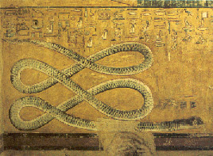
Abraham first received the gospel by baptism (which is the covenant of salvation). Then he had conferred upon him the higher priesthood, and he entered into celestial marriage (which is the covenant of exaltation), gaining assurance thereby that he would have eternal increase. Finally he received a promise that all of these blessings would be offered to all of his mortal posterity (D&C 132:29–50; Abr. 2:6–11). Included in the divine promises to Abraham were the assurances that (1) Christ would come through his lineage, and that (2) Abraham’s posterity would receive certain lands as an eternal inheritance (Gen. 17; 22:15–18; Gal. 3; Abr. 2). These promises taken together are called the “Abrahamic covenant.” It was renewed with Isaac (Gen. 26:1–4, 24) and again with Jacob (Gen. 28; 35:9–13; 48:3–4).
The portions of the covenant that pertain to personal salvation and eternal increase are renewed with each individual who receives the ordinance of celestial marriage (see D&C 132:29–33). Those of non-Israelite lineage, commonly known as Gentiles, are adopted into the house of Israel and become heirs of the covenant and the seed of Abraham through the ordinances of the gospel (Gal. 3:26–29)
.
Being an heir to the Abrahamic covenant does not make one a “chosen person” per se but does signify that such are chosen to responsibly carry the gospel to all the peoples of the earth. Abraham’s seed have carried out the missionary activity in all the nations since Abraham’s day. (Matt. 3:9; Abr. 2:9–11.)
To fulfill the covenant God made with Abraham—having particular reference to the fact that the literal seed of his body would be entitled to all of the blessings of the gospel (Abr. 2:10–11)—a number of specific and particular things must take place in the last days. The gospel must be restored, the priesthood must be conferred again upon man, the keys of the sealing power must be given again to mortals, Israel must be gathered, and the Holy Ghost must be poured out upon the Gentiles. All this has already taken place or is in process of fulfillment. Bible Dictionary
The Earth Transformed:
"The earth is utterly broken down, the earth is clean dissolved, the earth is moved exceedingly. The earth shall reel to and fro like a drunkard, and shall be removed like a cottage; and the transgression thereof shall be heavy upon it; and it shall fall, and not rise again." (Isa 24: 19-20) Again he declares: "Lift up your eyes to the heavens and look upon the earth beneath; for the heavens (i.e. the heavens surrounding the earth) shall vanish away like smoke, and the earth shall wax old like a garment, and they that dwell, therein shall die in like manner." (Isa 51:6.) Here we have predictions that the earth shall pass away, die, and all its inhabitants shall also die in like manner. This truth was not generally and correctly understood until the Lord made known in revelations to Joseph Smith that this should be the case. When Isaiah said the earth should "fall and not rise again," the interpretation is that it should not be restored to the same mortal or temporal condition. When the earth passes away and is dissolved it will pass through a similar condition which the human body does in death....The "new heavens and new earth" referred to in this scripture [Isa 65:17], and also in Section 101:23-31, had reference to the change which shall come to the earth and all upon it, at the beginning of the Millennial reign, as we declare in the tenth article of the Articles of Faith. This is the renewed earth when it shall receive its paradisiacal glory, or be restored as it was before the fall of man. (See Compendium, art, "Millennial Reign," p. 202.) "The new heaven and new earth" we are discussing in Section 29, is the final change, or resurrection, of the earth, after the "little season" which shall follow the Millennium." Joseph Fielding Smith (Church History and Modern Revelation, vol. 1, p. 132)
EGYPT's_ Apep: or Apophis was an evil god in ancient Egyptian religion depicted as a snake/serpent and a dragon, the deification of darkness and chaos, and thus opponent of light and Ma'at (order/truth), whose existence was believed from the 8th Dynasty on wards.

Slide 25
The two witnesses:
They will testify in Jerusalem for three and a half years, will be killed and left dead in the streets, and then will be resurrected and lifted up to meet Jesus Christ as he returns to make his appearance to the Jews. Book of Mormon Reference Companion 356
Elder Bruce R. McConkie has suggested that these two “sons” could be members of the council of the Twelve or the first Presidency (Millennial Messiah, 390)
Upon the Mountains:
These familiar passages, written first by Isaiah but spoken of and inspired by Jehovah himself, are often applied to anyone-especially missionaries-who bring the good tidings of the gospel and publish peace to the souls of men. There is nothing inappropriate about such an application, but it is important to realize-as the prophet Abinadi did-that in its purest form and original sense, this psalm of appreciation applies specifically to Christ. It is he and only he who ultimately brings the good tidings of salvation. Only through him is true, lasting peace published. To Zion, in both the old and new Jerusalem's, it is Christ who declares, "Thy God reigneth!" It is his feet upon the mountain of redemption that are beautiful. Jeffrey R. Holland (Christ And The New Covenant, p. 286 - 287)
Peace and good tidings; good tidings and peace. These are among the ultimate blessings that the gospel of Jesus Christ brings a troubled world and the troubled people who live in it, solutions to personal struggles and human sinfulness, a source of strength for days of weariness and hours of genuine despair. This entire general conference and The Church of Jesus Christ of Latter-day Saints which convenes it declare that it is the Only Begotten Son of God Himself who gives us this help and this hope. Such assurance is as "firm as the mountains around us.“
Ultimately it is Christ who is beautiful upon the mountain. And it is His merciful promise of "peace in this world," His good tidings of "eternal life in the world to come" that make us fall at His feet and call His name blessed and give thanks for the restoration of His true and living Church. Jeffrey R. Holland ("The Peaceable Things of the Kingdom," Ensign, Nov. 1996, 82)
Put on thy beautiful garments:
Here is Israel gathering together, being taught of the Lord, to learn of His ways and walk in His paths, that they may receive the blessing and be clothed upon with power, as the Prophet said: "Awake, awake; put, on thy strength, O Zion, put on thy beautiful garments, O Jerusalem." What are these beautiful garments? These beautiful garments are the clothing upon with the authority and power of the Holy Priesthood. It is that which makes people beautiful; it is that which makes people useful; it is that which causes the Saints to sing: "How beautiful upon the mountains are the feet of Him that bringeth good tidings, that publisheth peace; that bringeth good tidings of good, that publisheth salvation; that saith unto Zion, Thy God reigneth." It is that excellence of the knowledge of God that makes men and women beautiful, and makes their acts delightful when they are performed in righteousness in the name of the Lord Jesus Christ. I rejoice when I look around and contemplate this precious privilege-that there is scarcely an individual that has come to years of judgment and understanding but is a partaker of some measure of the Priesthood, if no more than the office of a Deacon that can administer blessing by attending to the door, wait upon the tables, and also by attending to other temporal duties from time to time as they may occur. Franklin D. Richards Journal of Discourses 26:100
[The millennial day will be] a day when the servants of God may bear the glad tidings to all people, nations, kindreds and tongues upon all the face of the earth, and there shall be none to molest them, or make them afraid. The truth will abound and light and understanding come to the people. It will be a day of great light in every corner of the land-the day spoken of by the Prophet Isaiah, wherein he says the knowledge of the Lord shall cover the earth as the waters cover the sea-the day when they shall teach no more every man his neighbor, and every man his brother, saying, know the Lord; for they shall all know Him from the least of them to the greatest of them-a day when "every man shall see eye to eye." Prophets and Saints have looked for such a period, have longed for it, have prayed for it, have sung about it, have prophesied of it, and they have spoken of the work that should bring it about. Are all these prophecies fallacious? Are all these hopes vain? Will all these expectations come to naught? Or are they to be fulfilled? With the Latter-day Saints there is but one answer to this question. The Lord has opened their understanding, has touched their eyes, has pricked them in the ear, has comforted them, and has given to them the Holy Ghost. They have been enabled to see and to discern the signs of the times, and to understand in a measure the age in which we live. It is a source of unbounded joy unto those who possess this testimony, and are living for the blessings promised to the faithful. Erastus Snow (Journal of Discourses, 25:69-70)
Loose thyself…bands of thy neck:
Since things are hung around the neck, it is often associated with slavery or bondage. The "yoke" upon the neck (see Isa. 10:27; Jer. 27:2) and the "bands of thy neck" (Isa. 52:2) provide clear and powerful imagery of spiritual, and sometimes literal, bondage. On the other hand, when Isaiah says, "thy neck is an iron sinew" (Isa. 48:4) and when Jeremiah notes the people "made their neck stiff that they may not hear, nor receive instruction" (Jer. 17:23) the image is that of stubborn pride. The reason for this is linked to another function of the neck. It holds the head and turns it. Since the bowing of the head is a sign of humility, to be stiff-necked is the symbol of pride. ("Understanding Scriptural Symbols," Ensign, Oct. 1986, 25)

Slide 26
3 Nephi 20 | Isaiah 52 | Today | Other references
Verses: 32-35 Watchmen works as Lord’s messengers to share the peace and joy that the gospel message brings. Bare His holy arm—power of God | Verses: 8-10 Watchmen-sing-give inheritance-bare His holy arm | These watchmen might be: Prophets, General Authorities, full-time missionaries, or local leaders and members. They all serve as Christ’s representatives as they take the joyous word to the world. Every member a missionary | D&C 18:15 D&C 65:2
Verses: 36-38 A joyful future of Israel when only the righteous and pure will dwell in Jerusalem. Put on the power and authority of the priesthood. Redemption through Christ | Verses: 1-3 Awake, shake off dust, put on thy strength. Loose bands, Redeemed without money.. | Both our clothing and our behavior reveal to others the principles we represent…Spiritual Attire Scattered Remnants of Israel return to the Lord---spiritual freeing through the Atonement of Christ…as sinners we are indebted to the Lord for His mercy | D&C 27:15 2 Nephi 9:14 D&C 113:9-10
Verses: 39-40 Standing on the Lord’s house to receive instruction | Verses: 6-7 I am—mountains of thy feet—brings good tidings | Going to the temple of the Lord. Receiving instruction from the General Authorities and leaders at conference | 2 Nephi 12:2 Isaiah 2:2
Verses: 41-45 They are called to repent after they receive the gospel blessing—if they refuse they will face God’s judgment | Verses: 11-15 Be clean (repent)—God will be your rearward (prudent in judgment)—sprinkle many nations | The need to be clean and pure, virtuous in all things “We counsel you not to pollute your minds with degrading matter…” Ezra Taft Benson Turn away from filth We will be judged upon our actions with Jesus is our mediator | 2 Timothy 2:20-22 Revelation 18:4 D&C 101:94

Slide 27
The New Song: D&C 84:99-102
99 The Lord hath brought again Zion; The Lord hath redeemed his people, Israel, According to the election of grace, Which was brought to pass by the faith And covenant of their fathers.
100 The Lord hath redeemed his people; And Satan is bound and time is no longer. The Lord hath gathered all things in one. The Lord hath brought down Zion from above. The Lord hath brought up Zion from beneath.
101 The earth hath travailed and brought forth her strength; And truth is established in her bowels; And the heavens have smiled upon her; And she is clothed with the glory of her God; For he stands in the midst of his people.
102 Glory, and honor, and power, and might, Be ascribed to our God; for he is full of mercy, Justice, grace and truth, and peace, Forever and ever, Amen.
Jerusalem:
When we get through warning the Gentiles, the proclamation which the Lord has given us, shall be delivered to Israel in the islands of the sea and among the various nations; and they shall gather home to the land of their inheritance. Then Jerusalem shall be redeemed and a temple established upon its former foundation in the holy land. Then the nations of the earth will see a fulfillment of our words. We have told them for the last forty-nine years that the Lord God had commenced a work to prepare the way before the face of his coming, to prepare a people to endure his presence, to gather his people from the four quarters of the earth into one, in order that they might be prepared against the day when the veil of eternity shall be rent, and the voice of the Lord shall be heard unto the ends of the earth. Then they shall behold a fulfillment of our words, they shall then know of a surety, if they do not before, that there is a God in this work, that he has commenced a proclamation and message for the last time, to prepare the way before the face of the coming of his Son from the heavens. Orson Pratt (Journal of Discourses, 20:148)

