Slide 1

Lesson 135
Preparing For The Millennium
Isaiah 59-66
For it is written, As I live, saith the Lord, every knee shall bow to me, and every tongue shall confess to God.
Romans 14:11

Slide 2

Spiritual Death = Separation From God
“the Lord’s hand is not shortened” = the Lord’s power to save has not decreased.
Two sources of spiritual death:
The first source is the Fall
The second is our own disobedience.
Yea, behold, this death bringeth to pass the resurrection, and redeemeth all mankind from the first death—that spiritual death; for all mankind, by the fall of Adam being cut off from the presence of the Lord, are considered as dead, both as to things temporal and to things spiritual. Helaman 14:16
Yea, and it bringeth to pass the condition of repentance, that whosoever repenteth the same is not hewn down and cast into the fire; but whosoever repenteth not is hewn down and cast into the fire; and there cometh upon them again a spiritual death, yea, a second death, for they are cut off again as to things pertaining to righteousness.
Helaman 14:18
Spiritual death can be overcome through the Atonement of Jesus Christ and by obedience to His gospel. (Topics)
Isaiah 59:1-5

Slide 3
What sins had the people committed?
Why do you think committing these sins would separate someone from God?
Which of these sins are prevalent in our day?
Isaiah 59:3-8

Slide 4
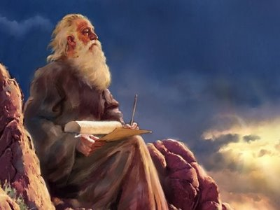
Iniquities
A cockatrice is a mythical creature that does not exist. It was supposedly a serpent produced from a cock's egg = "viper" and "adder" and "poisonous snake,
They are eager to do evil with whatever gets in their way and they have no peace among them
All their web of lies and deceit can not cover them in their sins
Isaiah 59:3-8

Slide 5
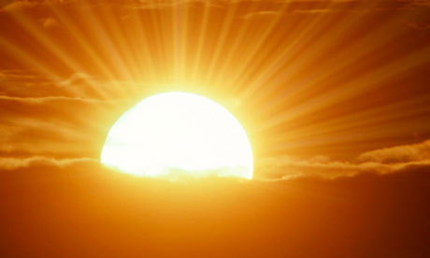
They were blindly groping or searching in the darkness for anything to help guide them, like a wall or a fence.
Isaiah 59:8

Slide 6
Salvation Was Far From Them
Their sins testified against them, and by sinning they had departed from God.
Apostasy occurs whenever people turn away from the Lord.
Isaiah:59:9-15

Slide 7
An Intercessor
Someone who intervenes to help settle differences between two people or groups. When we sin, we disrupt our relationship with God, and a penalty must be paid to restore harmony and balance to the relationship. However, we are unable to pay the penalty ourselves and need someone to intercede on our behalf to satisfy the demands of God’s justice.
If we repent of our sins, then the Lord will intercede for us and redeem us.
Isaiah:59:16-21

Slide 8
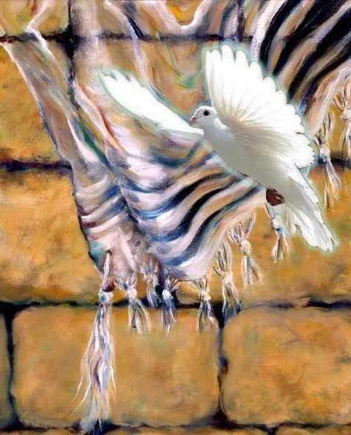
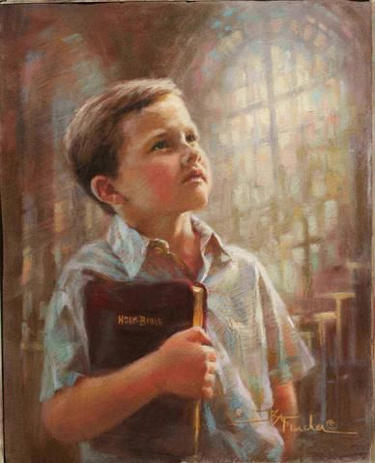
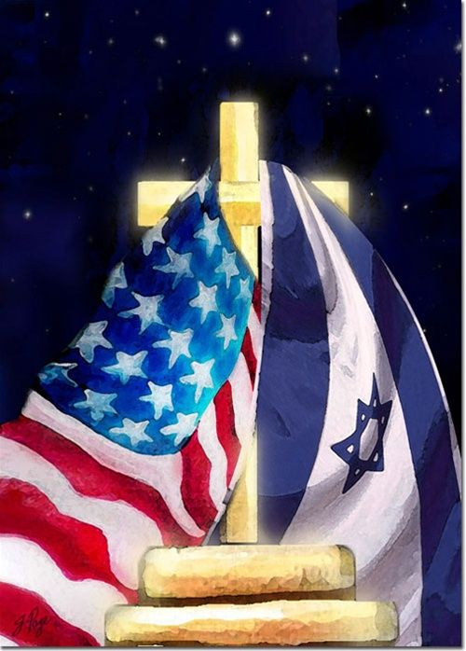
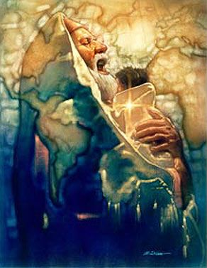
Prophecies of the Last Days
The gentile peoples will join with and serve Israel
Israel will rise again as a mighty nation
Finally, Israel will dwell in celestial splendor
Zion will be established
Isaiah 60

Slide 9
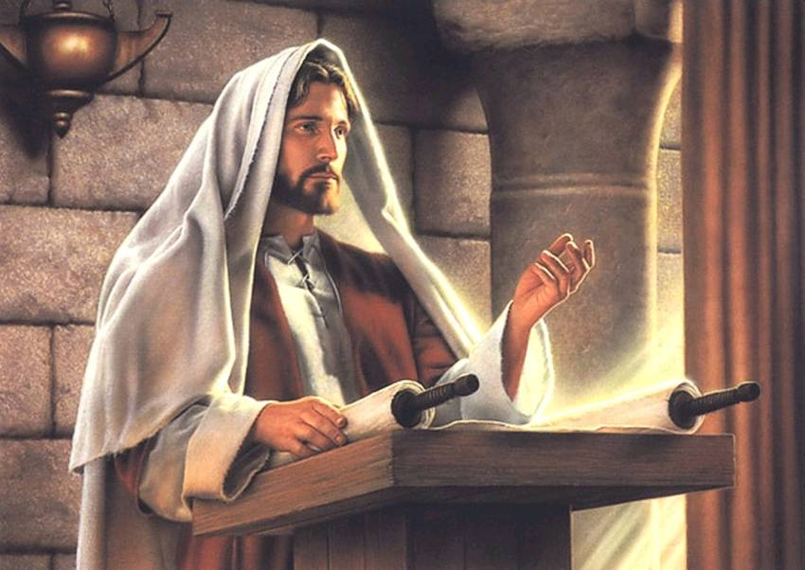
Prophecy of the Savior’s Mission
And he came to Nazareth, where he had been brought up: and, as his custom was, he went into the synagogue on the sabbath day, and stood up for to read.
Luke 4
Isaiah 61
18. The Spirit of the Lord is upon me, because he hath anointed me to preach the gospel to the poor; he hath sent me to heal the brokenhearted, to preach deliverance to the captives, and recovering of sight to the blind, to set at liberty them that are bruised, | 1. The Spirit of the Lord God is upon me; because the Lord hath anointed me to preach good tidings unto the meek; he hath sent me to bind up the brokenhearted, to proclaim liberty to the captives, and the opening of the prison to them that are bound;
19. To preach the acceptable year of the Lord. | 2. To proclaim the acceptable year of the Lord, and the day of vengeance of our God; to comfort all that mourn;
And he closed the book, and he gave it again to the minister, and sat down. And the eyes of all them that were in the synagogue were fastened on him.
And he began to say unto them, This day is this scripture fulfilled in your ears.
Isaiah 61 Luke 4:16-21

Slide 10
For Those Who Mourn
To appoint unto them that mourn in Zion, to give unto them beauty for ashes, the oil of joy for mourning, the garment of praise for the spirit of heaviness; that they might be called trees of righteousness, the planting of the Lord, that he might be glorified.
Beauty for ashes = crown of beauty instead of ashes
Oil of Joy = Israelite custom to anoint oneself with oil for festivals and prosperity. (not used in times of mourning
Garment of Praise = Our Sunday Best. Sackcloth was worn by those in mourning
Spirit of heaviness = depressed, discouraged, weak
Trees = often symbolize man. They are healthy because they have submitted and are planted “of the Lord” (TREE OF LIFE)
As the promised Messiah, Jesus Christ preaches hope, heals, liberates, and comforts.
Isaiah 61:3

Slide 11
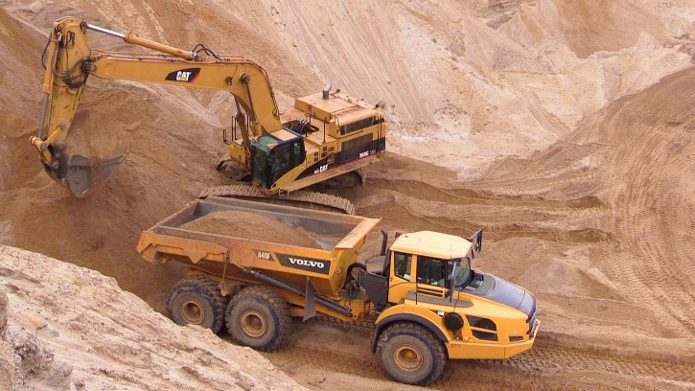
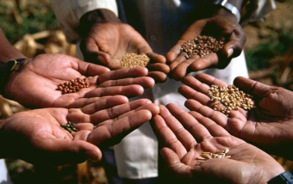
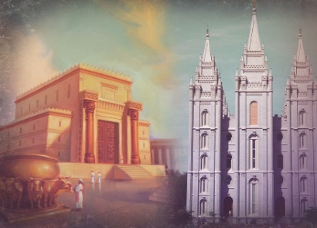
Zion Will Be Built in the Last Days
Build and repair = In the last days Israel is gathered and will build and repair the Holy Land (literal) and Israel as a people will be built and healed (spiritually)
Strangers/sons of the alien = Gentiles will feed and assist Israel in rebuilding
Priest/minister = Anciently only the High Pries could go into the Holy of Holies. Today all worthy adults can enter the temples…We have become a “nation of priests.”
Eat the riches of Gentile = Just as the ancient priests were supported by the people through their offering, Zion in our day will receive glory and wealth for God to help build his kingdom on earth.
Isaiah 61:4-6
(1)

Slide 12
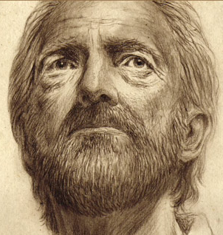

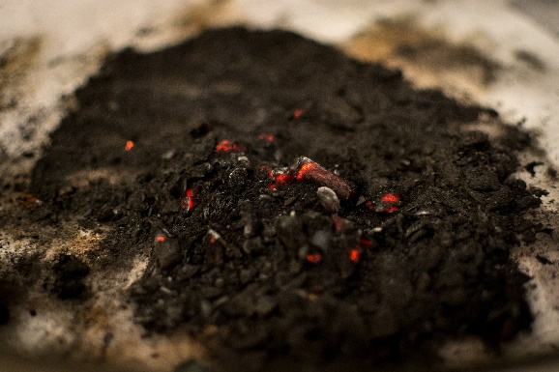
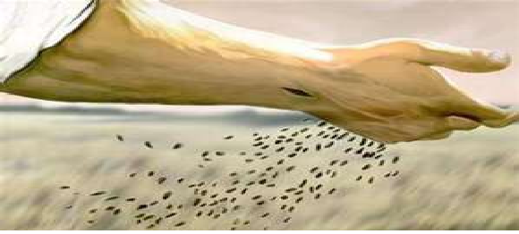
Shame/Rejoice
Instead of shame they will receive a double portion and instead of disgrace they will rejoice in their inheritance.
Just like Job who lost all but was blessed doubly.
Robbery for burnt offering = Burnt offerings were sacrificed entirely – Nothing was held back
I will direct their work = Christ directs the work of His church and kingdom
Seed shall be known = a renewal of the Abrahamic promise –his posterity will have the Priesthood and will be chosen servants of the Lord in the last days.
Isaiah 61:7-9
(1)

Slide 13
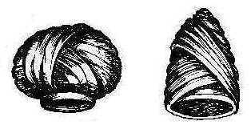
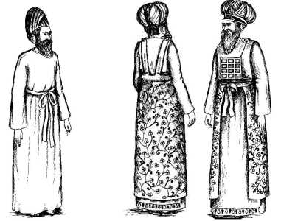
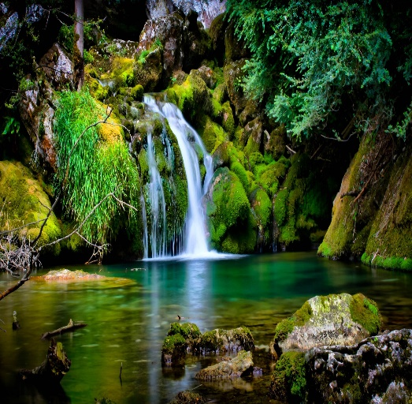
The Coming Marriage Between Jehovah and His Bride, The Church
They wear the garments of the holy priesthood, robes, and wedding attire.
Israel and the Lord are ready to enter into their marriage covenant.
Robes of Righteousness = Turban or ornaments = priestly mitre or cap
Righteousness is symbolized by the ornaments and jewels they wear
The earth has become a glorious garden of paradise
Isaiah 61:10-11
(1)

Slide 14
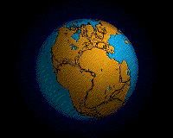
Hephzi-bah and Beulah
Isaiah describing the latter-day condition of Zion
Beulah = “union”
A marriage is once again the symbol of unity, but this time the marriage is not of the people and God but of the land and God.
Hephzi-bah = “delightful” in Hebrew and may refer to Jerusalem and Zion’s latter-day righteousness.
הפזיבה
ביולה
And the land of Jerusalem and the land of Zion shall be turned back into their own place, and the earth shall be like as it was in the days before it was divided. D&C 133:24
In the days of Peleg the earth was divided into continents, but before that time it was all united in one land mass.
The joining of the continents once again can be likened to a union or a marriage that is both hephzi-bah and beulah,that is, delightful and united. The lands, like a man and woman in holy wedlock, will be sealed by the authority of the one officiating.
Isaiah 62:4-5 Genesis 10:25 See JST Isaiah 62:4-5
(2)

Slide 15
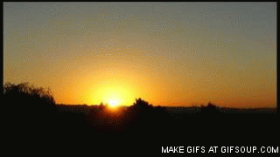
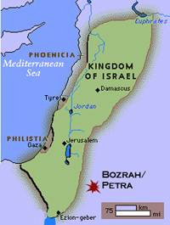
Out of the East—The Morning Son
Bozrah was a city in the land of Edom. Both were east of the Judah's inheritance in Canaan.
The language is teaching us that Christ will come from the East. (3)
For as the lightning cometh out of the east, and shineth even unto the west; so shall also the coming of the Son of man be.
Matthew 24:27
Isaiah 63:1
(2)

Slide 16
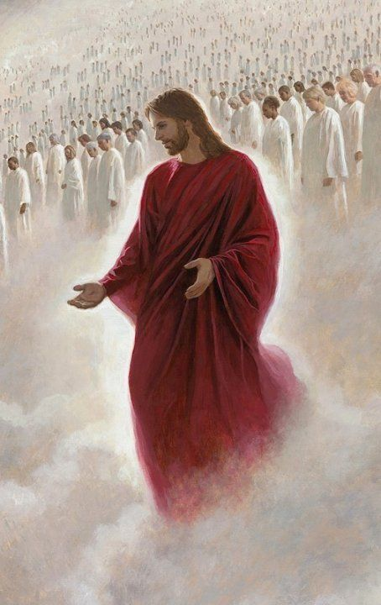
When the Savior Returns
And it shall be said: Who is this that cometh down from God in heaven with dyed garments; yea, from the regions which are not known, clothed in his glorious apparel, traveling in the greatness of his strength?
And he shall say: I am he who spake in righteousness, mighty to save.
And the Lord shall be red in his apparel, and his garments like him that treadeth in the wine-vat.
D&C 133:46-48
Red = Blood, mortality and sin
And he was clothed with a vesture dipped in blood: and his name is called The Word of God. Rev. 19:13
A reminder of the righteous of the blood Jesus shed on our behalf
Isaiah 63:2

Slide 17
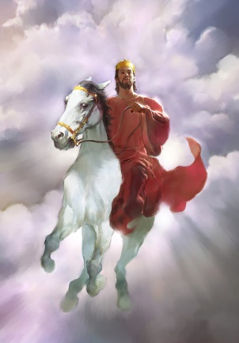
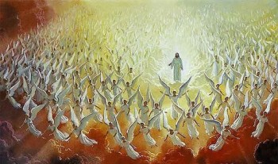
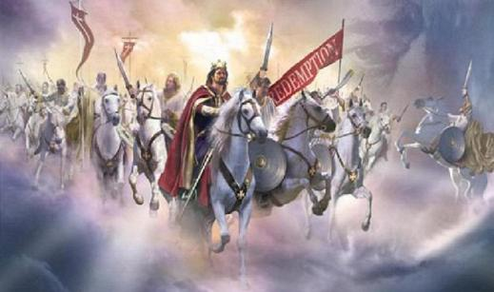
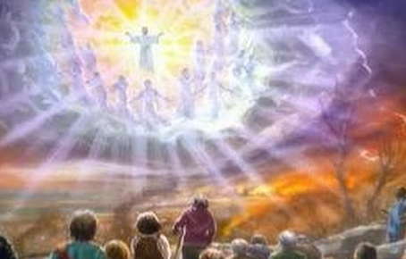
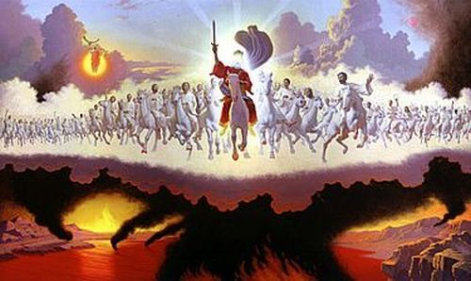
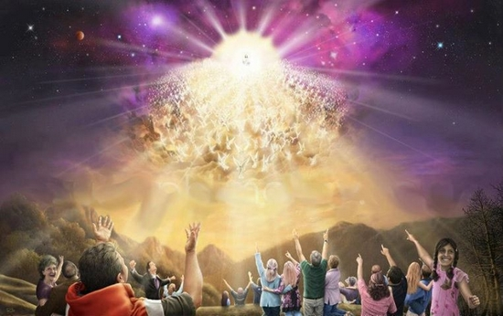
A Picture Paints A Thousand Words
However, a picture can paint a thousand words incorrectly and leave a thousand false impressions.
Such is the case with almost all artwork depicting the Second Coming of Christ.
Almost never does the artwork represent the picture painted by John the Revelator and Isaiah, with Christ in battle array, dressed in red, riding a white horse, surrounded by angelic cavalry, appearing to save Jerusalem in might and power.
Instead, we get the impression the Savior comes dressed in white to the empty deserts of central Utah surrounded by female angels playing trumpets. (3)
The following painting, a non-Mormon rendition, may not be more esthetically pleasing but it is more scripturally accurate
Isaiah 63:2 Revelation 19:11-16

Slide 18
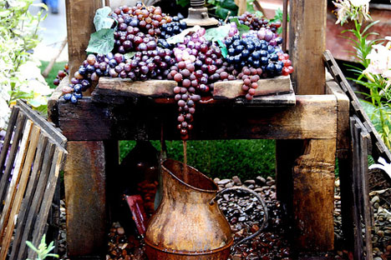
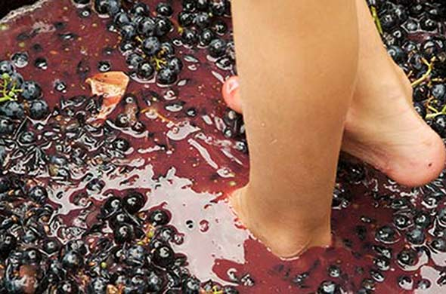
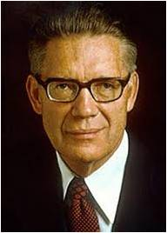
I Have Trodden the Wine Press Alone
When the grapes are finally harvested, they are placed in a receptacle, or winevat, and trampled to express the juice. This was an arduous way to make grape juice and was usually attended to by a group of men rather than a single individual. Those familiar with the process would have realized that this was not a task done by one person. (3)
”The wine is trampled from the grapes in great vats, staining the garments of the laborers as though with blood. But in this case the second coming of Christ is involved, the one harvesting the crop is the Lord himself, and the winepress is full of the wrath of God.” (4)
Isaiah 63:3

Slide 19
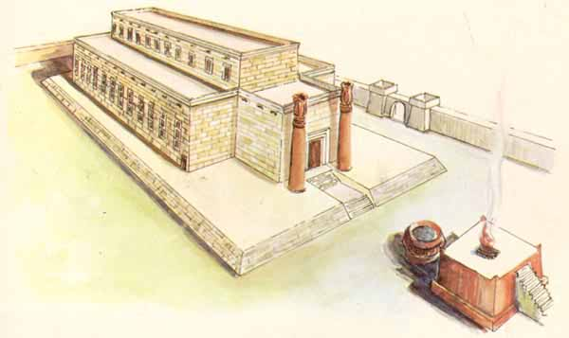
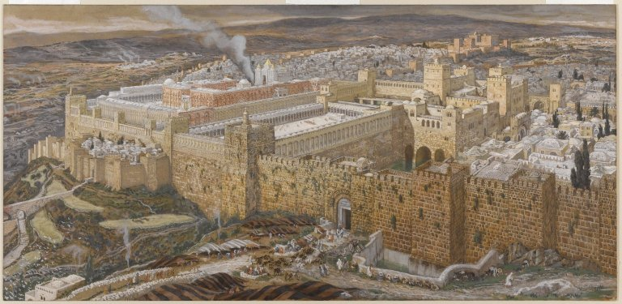
Adversaries Have Trodden Down Thy Sanctuary
About 589 BC, the Temple of Solomon was trampled by the Babylonians.
The temple reared after the captivity, the Temple of Zerubbabel, was desecrated by Syrian King Antiochus IV when he erected "an altar to the Greek god Zeus" in about 168 BC. (5)
In 70 AD, the temple of Herod was burned by the Romans such that there was not left one stone upon another.
(Matt. 24:2).
The Babylonians, Syrians, and Romans have all taken their turn fulfilling Isaiah's prophecy. Just prior to the Second Coming, "all nations" will siege Jerusalem and desecrate the temple one more time.
Then will the Lord come and execute vengeance. It will be his third and most impressive cleansing of the temple. (3)
Isaiah 63:18 Zech. 12:1; Daniel 8:13-14

Slide 20
Isaiah Quoted in Doctrine and Covenants
A Prayer
Isaiah 64 | Doctrine and Covenants 133
1. Oh that thou wouldest rend the heavens, that thou wouldest come down, that the mountains might flow down at thy presence | 40. Calling upon the name of the Lord day and night, saying: O that thou wouldst rend the heavens, that thou wouldst come down, that the mountains might flow down at thy presence.
2 As when the melting fire burneth, the fire causeth the waters to boil, to make thy name known to thine adversaries, that the nations may tremble at thy presence! | 41 And it shall be answered upon their heads; for the presence of the Lord shall be as the melting fire that burneth, and as the fire which causeth the waters to boil.
3 When thou didst terrible things which we looked not for, thou camest down, the mountains flowed down at thy presence. | 42. O Lord, thou shalt come down to make thy name known to thine adversaries, and all nations shall tremble at thy presence—
4. For since the beginning of the world men have not heard, nor perceived by the ear, neither hath the eye seen, O God, beside thee, what he hath prepared for him that waiteth for him. | 44 Yea, when thou comest down, and the mountains flow down at thy presence, thou shalt meet him who rejoiceth and worketh righteousness, who remembereth thee in thy ways.
5. Thou meetest him that rejoiceth and worketh righteousness, those that remember thee in thy ways: behold, thou art wroth; for we have sinned: in those is continuance, and we shall be saved. | 45 For since the beginning of the world have not men heard nor perceived by the ear, neither hath any eye seen, O God, besides thee, how great things thou hast preparedfor him that waiteth for thee.
The description of the mountains flowing down at God’s presence is probably a reference to the tremendous physical changes that will attend the Savior’s Second Coming in glory. (2)

Slide 21

Millennium Begins Following the Second Coming
The New Heaven = The earth will go through a transformation and will be “renewed and receive its paradisiacal glory.”
Former shall not be remembered = The changes in the earth will be so significant and blissful that they will remove all though of the pre-millennial world
People raised during the Millennium will have trouble understanding what life was like when selfishness, wickedness, wars, disease and other problems prevailed.
The changes will not be just physical, but the social order and spirituality of the people will dramatically change.
Isaiah 65:17-19
(1)

Slide 22
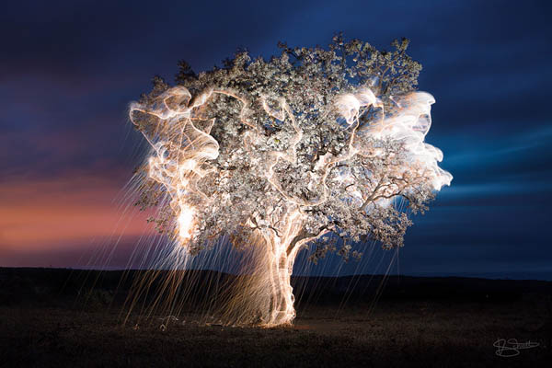
During the Millennium
Satan will be bound—no temptations
There will be agency and some will choose the terrestrial rather than the celestial way of life. Some will sin against the greater light and will becomes sons of perdition
We will receive everything we ask for
All things will be revealed
There will be no death
All old and young will live out their lives completely and live to 100 years old when they will be changed from mortality to immortality “in the twinkling of an eye.”
Isaiah 65:17-20 D&C 101:27-32
(1)

Slide 23
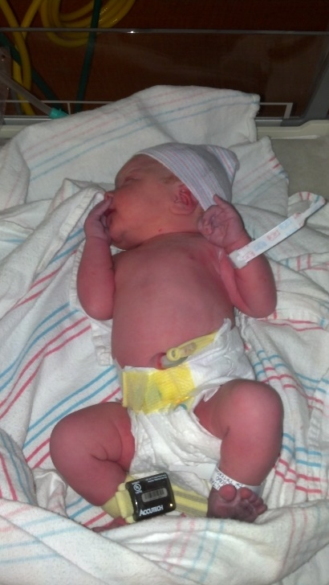

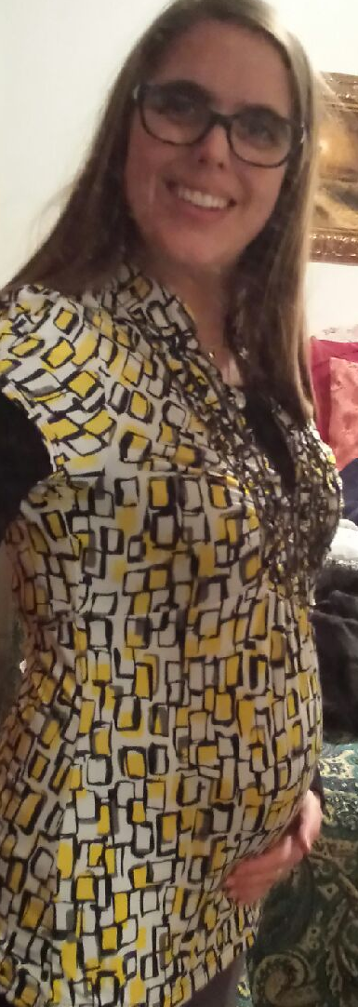

Before…
Before she travailed = before labor
Before a baby is born there are signs and contractions to give warning and to prepare the mother for delivery.
Zion will give birth to an ideal millennial society before the labor pains come.
Shortly after Zion is established in Jackson County great numbers of unexpected people will join with Zion to prepare for the Millennium
ZION WILL GROW RAPIDLY
Isaiah 66:7-9
(1)

Slide 24
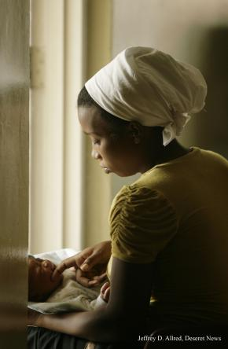
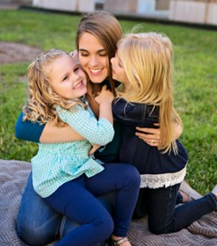
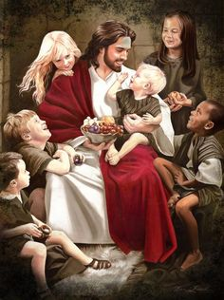
During…
Nurse = imagery of a mother and her children, conveying God’s tender love for his children
Isaiah 66:7-9
(1)

Slide 25
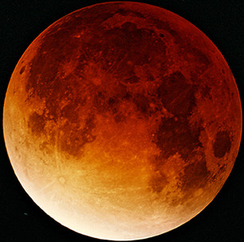
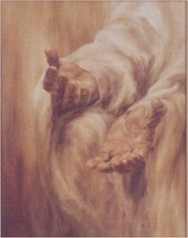
After…
Your seed and your name remain = The seed (eternal increase) and the name (in Book of Life) will continue forever to those who gain exaltation
New Moon = Ancient Israel corrupted the feasts and holy days. The Feasts were all yearly rehearsals for events in the future that deal with the Meridian of Times, or Christ’s Second Coming.
The Sabbath observance was a weekly holy day. The Israelites had corrupted the symbols and purposes. In the millennial Zion this feat will regain their intended respect and be kept perfectly.
…That unto me every knee shall bow, every tongue shall swear.
Isaiah 45:23
For it is written, As I live, saith the Lord, every knee shall bow to me, and every tongue shall confess to God. Romans 14:11
All will worship =
The Millennial people will all worship God and Christ. Every knee will bow and every tongue confess that Jesus is the Christ.
Isaiah 66:22-23
(1)

Slide 26
Sources:
Suggested Hymn: #40 Arise, O Glorious Zion
Video: https://vimeo.com/bookofmormoncentral/review/156376942/ad24640f20
Poway Institute Handout—Becky Davies and Lesley Meacham
Old Testament Institute Manual
Gospeldoctrine.com
Elder Bruce R. McConkie (The Millennial Messiah: The Second Coming of the Son of Man [Salt Lake City: Deseret Book Co., 1982], 503)
(Galbraith, DB, Ogden, DK, Skinner, AC, Jerusalem: The Eternal City [SLC: Deseret Book, 1996], 142).
Presentation by ©http://fashionsbylynda.com/blog/

Slide 27
Temple Ceremonies found in Isaiah 61 and 62
Scripture | Concept | Temple Meaning | Other sources
Isaiah 61:2 | Freedom to those in spirit prison | The vicarious work for the dead | Malachi 4:5-6; D&C:2, 138; 1 Peter 3:18-20
Isaiah 61:2 | Comfort the mourners | A common practice in temple prayers is to exercise faith on behalf of the sick, afflicted, and others who mourn
Isaiah 61:4 | Rebuilding ancient ruins | Building temples or restoring eternal family ties and keys | D&C 110
Isaiah 61:8 | Everlasting Covenant | The new and everlasting covenant of marriage | D&C 131:104; 132
Isaiah 61:9 | Children | Promise of eternal increase to those in the highest degree of celestial glory | “The gift promised to those who receive this covenant of marriage and remain faithful to the end, that they shall ‘have no end,’ means that they shall have the power of eternal increase. Joseph Fielding Smith, The Way to Perfection, 247
Isaiah 62:2 | New Name | A new name is given to those who are to enter the celestial kingdom | D&C 130:11
Isaiah 62:4,5 | Marriage | Eternal marriages are performed in temple | D&C 131:2; 132:19
Isaiah 62:9 | Sacred Courts | Only worthy people are allowed in God’s house | Matthew 10:38; Moroni 9:29; D&C 136:31; Psalms 24:3-5
Isaiah 62:10 | Gates | Certain requirements are necessary to pass by Heavenly Father’s servants in order to enter His presence | D&C 97:16; D&C 132:22-23
(1)

Slide 28
The Savior Comes again in Red:
In Revelation 19:13, [John] describes Christ at his second coming, mentioning that "he was clothed with a vesture dipped in blood." This may puzzle those who picture him clothed in glorious white. Nevertheless, it is in perfect agreement with other scriptures that tell us that the Savior's apparel will be red at his coming. (See Gen. 49:11; Isa. 63:2; D&C 133:48.) Gerald N. Lund
(Ensign, Dec. 1987, 49)
Isaiah 64:
At that time, valleys shall be “exalted” and mountains “made low” (D&C 49:23). God’s voice “shall break down the mountains,” so that “the valleys shall not be found” (D&C 133:22)
Jesus Christ is a celestial being. Since the sun is typical of the glory of the celestial kingdom (see D&C 76:70), the imagery of burning and fire that describes the Second Coming could actually be caused by the glory of Christ’s person. Elder Charles W. Penrose, writing of this day, said: “He comes! The earth shakes, and the tall mountains tremble; the mighty deep rolls back to the north as in fear, and the rent skies glow like molten brass. He comes! The dead Saints burst forth from their tombs, and ‘those who are alive and remain’ are ‘caught up’ with them to meet him [see 1 Thessalonians 4:17]. The ungodly rush to hide themselves from his presence, and call upon the quivering rocks to cover them. He comes! with all the hosts of the righteous glorified. The breath of his lips strikes death to the wicked. His glory is a consuming fire. The proud and rebellious are as stubble; they are burned and ‘left neither root nor branch’ [see Malachi 4:1]. He sweeps the earth ‘as with the besom of destruction.’ [Isaiah 14:23]. He deluges the earth with the fiery floods of his wrath, and the filthiness and abominations of the world are consumed. Satan and his dark hosts are taken and bound—the prince of power of the air has lost his dominion, for He whose right it is to reign has come, and ‘the kingdoms of this world have become the kingdoms of our Lord and of his Christ.’” (“The Second Advent,” in Millennial Star, 10 Sept. 1859, p. 583.).
When Jesus comes in overwhelming majesty and power, in at least one of His appearances He will come in red attire, reminding us that He shed His blood to atone for our sins (see D&C 133:48; Isa. 63:1). His voice will be heard to declare, again, how alone He once was: "I have trodden the wine-press alone ... and none were with me" (D&C 133:50).
The more we know of Jesus' Atonement, the more we will humbly and gladly glorify Him, His Atonement, and His character. We will never tire of paying tribute to His goodness and loving-kindness. How long will we so speak of our gratitude for His Atonement? The scriptures advise "forever and ever"! (See D&C 133:52.)
Praise be to God for the harvest of such bounteous blessings from the Restoration which, truly, are running over. I humbly exclaim with Jacob, "O how great the plan of our God" (2 Ne. 9:13).
Praise be to Jesus for His great Atonement, the central act of all human history! Elder Neal A. Maxwell (Ensign, Apr. 1997, 10)
Life and Death During the Millennium: Isaiah 65-66
“When the Lord comes to rule on the earth in his own right, and all kingdoms become subject unto him, and the earth is renewed and again receives its paradisiacal glory, death shall be removed as far as it possibly can be removed before the resurrection, and while mortality remains. During the Millennium the earth will be transformed into a ‘new earth’ with a new heaven, as Isaiah has declared. It will no longer be a telestial earth, but will become a terrestrial earth. Infants will not die until they become old and then death shall be the transition to the immortal from the mortal state in the twinkling of an eye. This day is near at hand, ‘speaking after the manner of the Lord,’ and then shall come the time of the entire separation of the wicked from the righteous” President Joseph Fielding Smith (Church History and Modern Revelation, 2 vols. [1953], 1:232–33).
The Lord a source of Light: Isaiah 60
“Zion will [not] need the sun when the Lord is there, and all the city is lighted up by the glory of his presence. When the whole heavens above are illuminated by the presence of his glory we shall not need those bright luminaries of heaven to give light, so far as the city of Zion is concerned. But there will be a great people round about, dwelling in other cities that will still have need of the light of the sun and the moon; but the great capital city where the Lord will establish one of his thrones—for his throne is not to be in Jerusalem alone, it will also be in Zion, as you will find in numerous places in this Bible. When, therefore, he shall establish his throne in Zion and shall light up the habitations thereof with the glory of his presence, they will not need this light which comes from the bright luminaries that shine forth in yonder heavens, but they will be clothed upon with the glory of their God” Elder Orson Pratt (“Discourse,” Deseret News, Mar. 20, 1872, 79).

Slide 29
Isaiah 64:11 The Beautiful House is Burned
When Titus perceived that his endeavors to spare a foreign temple turned to the damage of his soldiers, and then be killed, he gave order to set the gates on fire...
So Titus retired into the tower of Antonia, and resolved to storm the temple the next day, early in the morning, with his whole army, and to encamp round about the holy house. But as for that house, God had, for certain, long ago doomed it to the fire; and now that fatal day was come, according to the revolution of ages; it was the tenth day of the month Lous, [Ab,] upon which it was formerly burnt by the king of Babylon... As the flames went upward, the Jews made a great clamor, such as so mighty an affliction required, and ran together to prevent it; and now they spared not their lives any longer, nor suffered any thing to restrain their force, since that holy house was perishing, for whose sake it was that they kept such a guard about it.
[Those that came to save the temple] were every where slain, and every where beaten; and as for a great part of the people, they were weak and without arms, and had their throats cut wherever they were caught. Now round about the altar lay dead bodies heaped one upon another, as at the steps going up to it ran a great quantity of their blood, whither also the dead bodies that were slain above [on the altar] fell down...
WHILE the holy house was on fire, every thing was plundered that came to hand, and ten thousand of those that were caught were slain; nor was there a commiseration of any age, or any reverence of gravity, but children, and old men, and profane persons, and priests were all slain in the same manner... The flame was also carried a long way, and made an echo, together with the groans of those that were slain; and because this hill was high, and the works at the temple were very great, one would have thought the whole city had been on fire... for one would have thought that the hill itself, on which the temple stood, was seething hot, as full of fire on every part of it, that the blood was larger in quantity than the fire, and those that were slain more in number than those that slew them; for the ground did no where appear visible, for the dead bodies that lay on it; but the soldiers went over heaps of those bodies, as they ran upon such as fled from them. Josephus (Josephus, Wars of the Jews, Book VI, 4:1-6; 5:1)
The New Heavens: Isaiah 65:17
The new heavens and new earth spoken of by Isaiah and in [D&C] section 101, have no reference to the new heavens and earths which will come after the close of the Millennium when the earth shall become as a sea of glass. The new heavens and earth here spoken of will come at the beginning of the Millennium. It is the change spoken of in the tenth Article of Faith. The Lord definitely fixes the time when this change will come and all corruptible things be removed. It is in the day when enmity shall cease on the earth and love shall take the place of hate even among the beasts and fowl as well as with mankind. It shall be a day when there shall be no sorrow for there shall be no death. Men on the earth will still be mortal, but a change shall come over them so that they will have power over sickness, disease and death. Death shall all but be banished from the earth, for men shall live until they are the age of a tree or one hundred years old, (See Sec. 63:50-51), and then shall die at the age of man, but this death shall come in the twinkling of an eye and mortality shall give way to immortality suddenly. There shall be no graves, and the righteous shall be caught up to a glorious resurrection. In that day the resurrected Saints will work hand in hand with the mortal Saints on the earth. It is the purpose of the Lord during that thousand years to have the ordinance work performed for all the dead who are entitled to receive it. It is the time of restoration and perfection, when all things pertaining to the Salvation of man will be fulfilled. Mortals must perform in the Temples the ordinance work which pertains to this mortal life. All who are raised in the resurrection also belong to another life, and therefore cannot be baptized, confirmed, ordained, endowed, or sealed for themselves, since all of these ordinances belong to this mortal sphere. Those who have passed through the resurrection will come with the needed records so that those in the flesh, or mortality, can perform the work for their dead. Joseph Fielding Smith (Church History and Modern Revelation, 4 vols. [Salt Lake City: The Church of Jesus Christ of Latter-day Saints, 1946-1949], 2: 216 - 217)

