Slide 1
Lesson 45 Part 1
Priesthood and John the Baptist
Luke 3
Includes Jesus’ Genealogy
He shall be great, and shall be called the Son of the Highest: and the Lord God shall give unto him the throne of his father David: Luke 3:32

Slide 2
High Priesthood
Under the law of Moses, the high priest functioned as the presiding officer of the Aaronic Priesthood and political head of the nation of Israel.
"Tetrarch. The word originally meant the ruler of the fourth part of a country, but was also used when the part governed was some other fraction of the whole. (2)
Galilee
Jewish High Priests
Jerusalem
Judea
However, by the time of the Savior’s ministry, the office of high priest had become corrupted. Rather than being selected by God, high priests were chosen by men such as Herod and other Roman officials
Luke 3:1-2

Slide 3
Annas
He was appointed high priest in A.D. 7 by the Roman legate Quirinius and deposed in A.D. 15 by Valerius Gratus.
From A.D. 18–36 his son-in-law (John 18:13) Joseph Caiaphas was high priest, and during this time Annas was a person of great influence in the Sanhedrin.
Jesus, when arrested, was first brought to him (John 18:13.)
He also took a leading part in the trial of the Apostles (Acts 4:6).
In accordance with Jewish custom he kept the title “high priest” after he was deposed from office.
Luke 3:2
(2)

Slide 4
Joseph Caiaphas
He was the High priest from A.D. 18 to A.D. 36 during the ministry of Jesus
He was the son-in-law of Annas
He belonged to the Sadducee party and took an active part in the attack made upon our Lord and His disciples
When Jesus was taken captive He was led to Caiaphas who condemned Jesus for blasphemy and referred Him to Pontius Pilate
Luke 3:2
(2,3)

Slide 5
High Priest
An office in the Melchizedek Priesthood. Adam and all the patriarchs were high priests.
Under the law of Moses the presiding officer of the Aaronic Priesthood was called the high priest. The office was hereditary and came through the firstborn among the family of Aaron, Aaron himself being the first high priest of the Aaronic order.
Three years previous to the death of Adam, he called Seth, Enos, Cainan, Mahalaleel, Jared, Enoch, and Methuselah, who were all high priests, with the residue of his posterity who were righteous, into the valley of Adam-ondi-Ahman, and there bestowed upon them his last blessing.
D&C 107:53
The Aaronic Priesthood still operated among the Jews prior to John. (1)
Wherefore, it must needs be that one be appointed of the High Priesthood to preside over the priesthood, and he shall be called President of the High Priesthood of the Church D&C107:65
(2,3)

Slide 6
The Word of the Lord
The Word of the Lord came to John, the Baptist instead of the High Priests
In John’s day some people believed that because they were descendants of Abraham, they were better or more loved by God than non-Israelites.
“John, at that time, was the only legal administrator in the affairs of the kingdom there was then on the earth, and holding the keys of power. The Jews had to obey his instructions or be damned, by their own law. … The son of Zacharias wrested the keys, the kingdom, the power, the glory from the Jews, by the holy anointing and decree of heaven” (4)
“fruit” is a symbol of the results of the choices we make
Luke 3:5-9
(1)

Slide 7
Isaiah 40:3-5
“For behold, and lo, he shall come, as it is written in the book of the prophets, to take away the sins of the world, and to bring salvation unto the heathen nations, to gather together those who are lost, who are of the sheepfold of Israel;
“Yea, even the dispersed and afflicted; and also to prepare the way, and make possible the preaching of the gospel unto the Gentiles;
“And to be a light unto all who sit in darkness, unto the uttermost parts of the earth; to bring to pass the resurrection from the dead, and to ascend up on high, to dwell on the right hand of the Father,
“Until the fullness of time, and the law and the testimony shall be sealed, and the keys of the kingdom shall be delivered up again unto the Father”
Luke 3:5-8
(9)

Slide 8
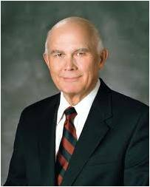
Two Coats
'when the Lord sent prophets to call Israel back from apostasy, in almost every instance, one of the first charges made was that the poor had been neglected.'
Thus, part of John the Baptist's message of repentance was, 'He that hath two coats, let him impart to him that hath none; and he that hath meat, let him do likewise.' (5)
"The prophets of the Book of Mormon taught that the care of the poor was the only way we could obtain essential blessings.
The prophet/king Benjamin declared that we must impart of our substance to the poor, 'such as feeding the hungry, clothing the naked, visiting the sick and administering to their relief' for the sake of 'retaining a remission of [our] sins from day to day, that [we] may walk guiltless before God.'
Luke 3:11
(6)

Slide 9
Exact No More
"Roman tax collectors or tax farmers. Imperial Rome sold to the highest bidder the right to collect taxes in a given area.
Publicans purchasing this power for large areas often resold it to numerous others who did the actual assessing and collecting in smaller areas.
Exorbitant profits were often made by all through whose hands the taxes passed. Cases of exorbitant collections, bordering on extortion, were not uncommon.”
Luke 3:13
(7)

Slide 10
Who is This John?
"The people generally were greatly concerned over the identity of John; and as the real import of the voice dawned upon them, their concern deepened into fear.
The ever recurring question was, Who is this new prophet?
Then the Jews, by which expression we may understand the rulers of the people, sent a delegation of priests and Levites of the Pharisaic party to personally question him.
He answered without evasion, 'I am not the Christ,' (John 1:20)
Luke 3:16
(8)

Slide 11
Baptism By Fire
John declared that he would baptize with water but that Jesus would baptize “with the Holy Ghost and with fire.”
This refers to the purifying and sanctifying effect of receiving the Holy Spirit.
“I have repented of my sins, and have been redeemed of the Lord; behold I am born of the Spirit.” He then taught that “all mankind … must be born again; yea, born of God, changed from their carnal and fallen state, to a state of righteousness, being redeemed of God, becoming his sons and daughters; and thus they become new creatures; and unless they do this, they can in nowise inherit the kingdom of God.”
Luke 3:16
(8)

Slide 12
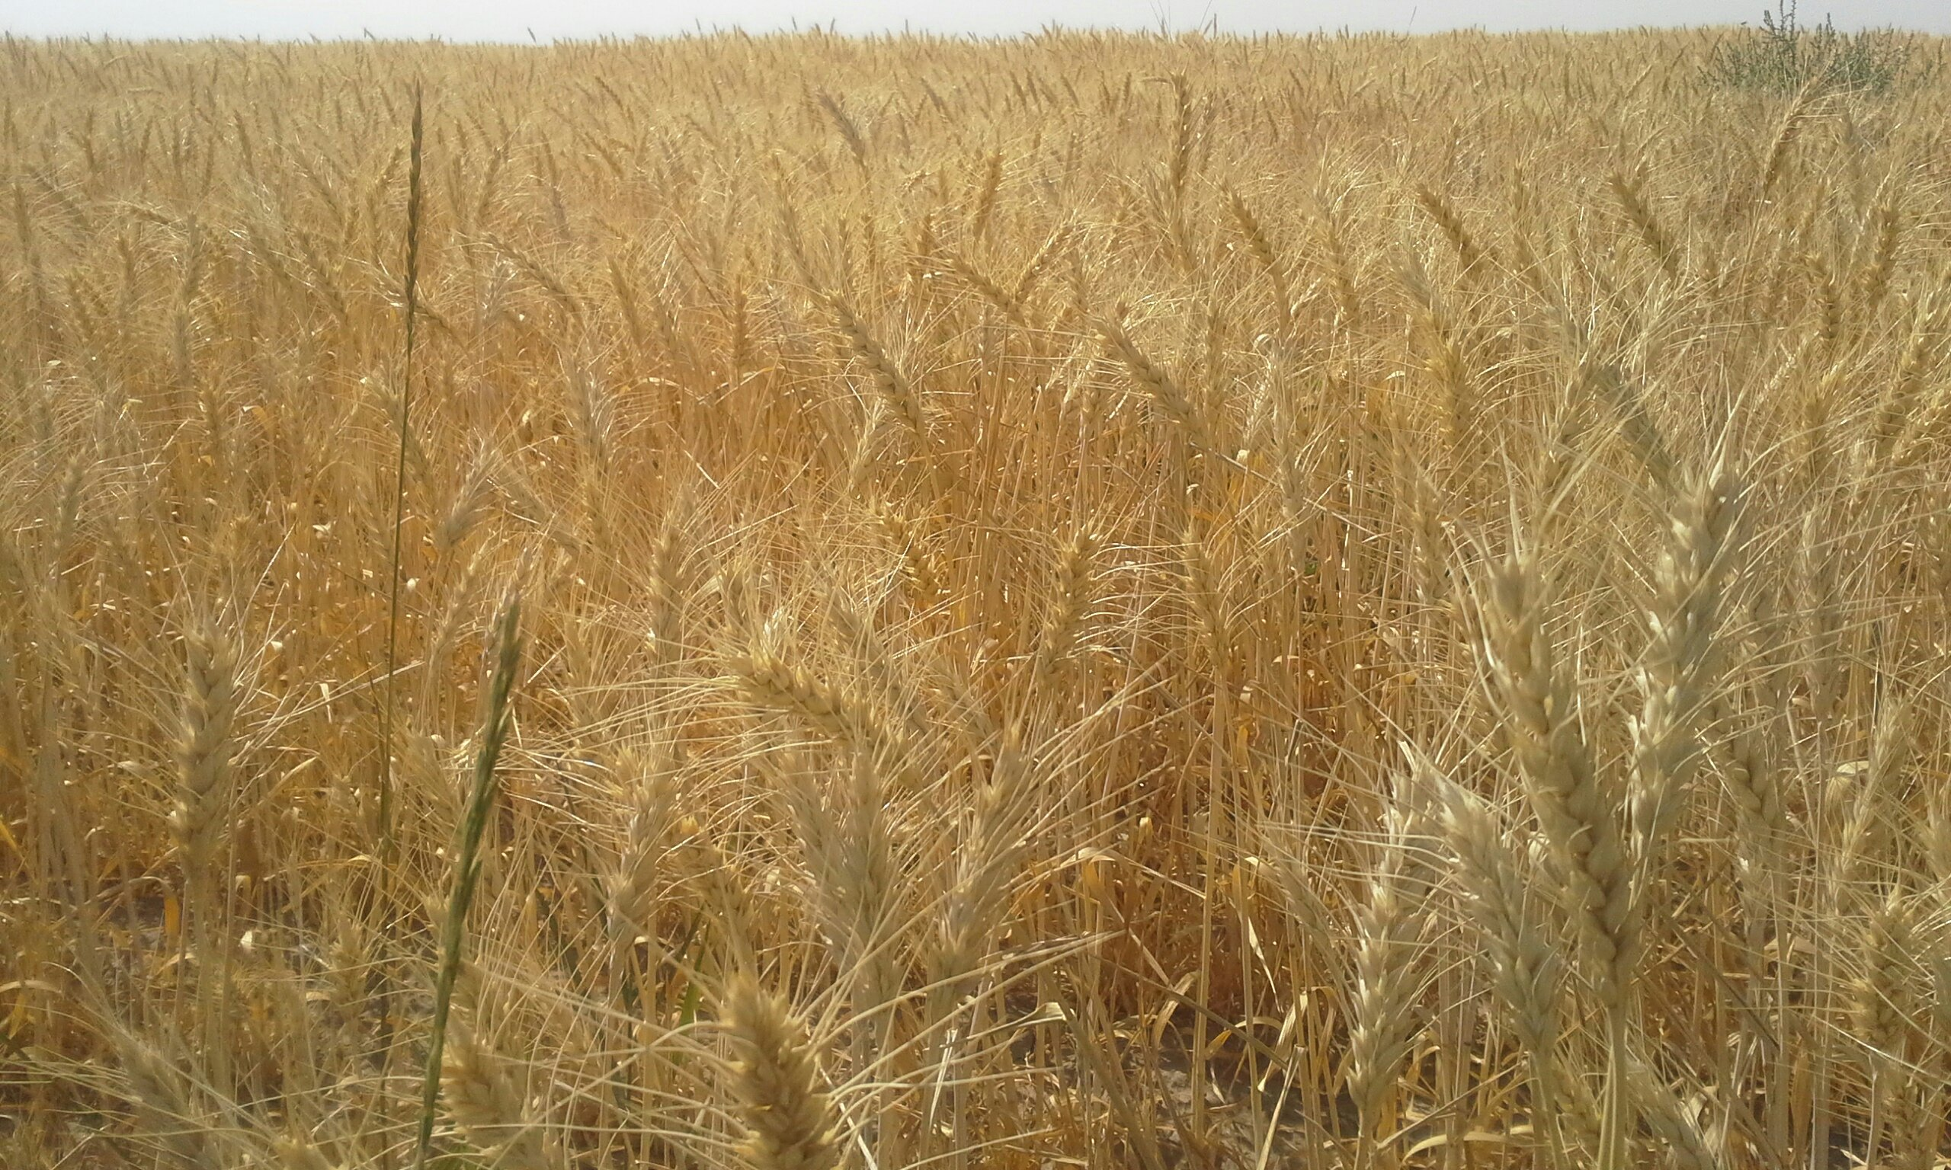
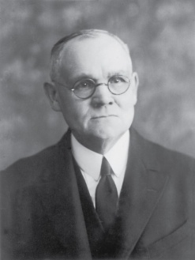
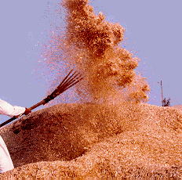
Winnowing
After wheat was harvested and threshed (when the grain was separated from the rest of the plant), the grain would be winnowed.
Winnowing is an ancient method used to separate wheat kernels from the chaff (the outer shell) and the husk.
A winnower would use a large shovel or wooden fork (translated in the scriptures as “fan”) to throw the threshed wheat into the air.
The breeze would then carry away the lighter, undesirable chaff, and the heavier wheat kernels would fall in a pile on the threshing floor.
Jesus Christ separates the righteous from the wicked
The final separation of the righteous from the wicked will take place at the Day of Judgment
Luke 3:17
(8)

Slide 13
Jesus is Baptized
John the Baptist is the one who saw the person of the Holy Ghost.
'the Holy Ghost descended in a bodily shape . . . upon him.' Because the Holy Ghost is a spirit man, the only 'bodily shape' John could have seen was that of a spirit personage.
'like a dove,' clearly meaning that the Spirit came with the calmness, serenity, and peace of which the dove is a symbol.
John 'saw the heavens opened, and the Spirit like a dove descending upon him.' oly Ghost descended in a bodily shape . . . upon him.' Because the Holy Ghost is a spirit man, the only 'bodily shape' John could have seen was that of a spirit personage.
Luke 3:18-22; Mark 1:10; Matthew 3:16
(7)

Slide 14
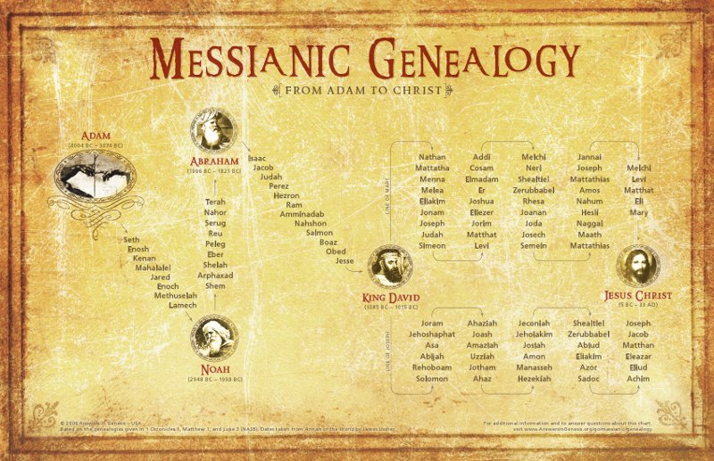
Genealogies of Jesus
There is no way from a historical standpoint to search out the generation of Christ.
One of the Biblical accounts may be the genealogy of Mary, the other of Joseph;
one may assay to set forth kingly descent, the other give the lineal ancestry.
We do not know. The only point upon which there is surety is the fact that Mary was his mother and God was his Father.”
Luke 3:23-38
(7)

Slide 15
Sources:
Suggested Song: Baptism Children’s Songbook p. 100
Video: Fan (0:56)
New Testament Institute Student Manual Chapter 15 and 16
Bible Dictionary
Who’s Who in the New Testament by Richard J. Allen p. 23
Joseph Smith (Teachings: Joseph Smith, 81–82).
Elder Russell M. Nelson quoted by Dallin H. Oaks (The Lord's Way [Salt Lake City: Deseret Book Co., 1991], 103.)
Elder Dallin H. Oaks (The Lord's Way [Salt Lake City: Deseret Book Co., 1991], 103.)
Elder Bruce R. McConkie (Doctrinal New Testament Commentary, 3 vols. [Salt Lake City: Bookcraft, 1965-1973], 1: 120.) A New Witness for the Articles of Faith [Salt Lake City: Deseret Book Co., 1985], 255.) (The Promised Messiah: The First Coming of Christ [Salt Lake City: Deseret Book Co., 1978], 471.)
James E. Talmage Jesus the Christ p. 128, 130
(Joseph Smith Translation, Luke 3:5–8 [in the Bible appendix])
Presentation by ©http://fashionsbylynda.com/blog/

Slide 16
Event | Matthew | Mark | Luke | John
Time and Background of John’s Ministry |  |  | 3:1, 2
John and His Message | 3:1-12 | 1:2-8 | 3:3-18
Jesus is Baptized by John | 3:13-17 | 1:9-11 | 3:21-23
Fast and Temptation of Jesus | 4:1-11 | 1:12, 13 | 4:1-13
Time and Background of John’s Ministry |  |  | 3:1, 2
John the Baptist Imprisoned by Herod | 14:3-5 | 6:17-20 | 3:19,20
Jesus Leaves Judea for Galilee | 4:12 | 1:14 | 4:14 | 4:1-3
Jesus Enters Galilee |  |  | 4:15 | 4:43-45
Jesus is Rejected at Nazareth |  |  | 4:16-30
Jesus Teaches with Power and Authority |  | 1:21,22 | 4:31,32
Jesus Teaches with Power and Authority |  | 1:21,22 | 4:31,32
Jesus Casts Out Unclean Spirit |  | 1:23-28 | 4:33-37
Jesus Heals Peter’s Mother-in-Law and Others | 8:14-17 | 1:29-34 | 4:38-41
Jesus Preaches and Heals in Galilee | 4:23-25 | 1:35-39 | 4:42-44

Slide 17
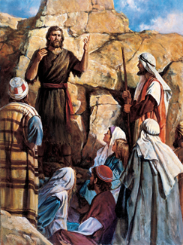
What Happened to the High Priesthood? Luke 3:2
Following the children of Israel’s rejection of the Lord at Mount Sinai, the Lord had removed the Melchizedek Priesthood from the people. Therefore, until the time of Jesus Christ, under the law of Moses a high priest was the presiding priest in the Aaronic Priesthood and presided over all other priests in their functions and ordinances, particularly in those of the temple. However, the presiding office of high priest had become corrupted. For years, Herod and other Roman officials had appointed high priests based on political expediency or bribery.
The Jews lacked a divinely authorized priesthood leader and, as a nation, they were in need of spiritual rebirth. Because John had been chosen by God and properly ordained to be God’s representative, the children of Israel could again turn to the Lord through the authorized channels of repentance and baptism. (1)
"The genealogy of the Savior as provided in Luke calls Adam a son of God. (Luke 3:38Luke 3:38.) So does the revelation given to Joseph Smith: 'And this is the genealogy of the sons of Adam, who was the son of God, with whom God, himself, conversed. And they were preachers of righteousness, and spake and prophesied, and called upon all men, everywhere, to repent; and faith was taught unto the children of men.' (Moses 6:22Moses 6:23Moses 6:22-23.)
"We need to understand the true concept of the first man, Adam. He was next to Christ in authority in the creation; he still is. He directs all dispensations of the gospel ever given to mankind, as the Prophet Joseph Smith taught." Mark E. Peterson (Adam: Who Is He? [Salt Lake City: Deseret Book Co., 1976], 60.)
John the Baptist Luke 3:16:
"...this was the way by which the Baptist declared his inferiority to the Mightier One, who was to succeed and supersede him; and a more effective illustration would be difficult to frame. To loosen the shoe latchet or sandal thong, or to carry the shoes of another, 'was a menial office betokening great inferiority on the part of the person performing it.' (Smith's Dict. of the Bible.) A passage in the Talmud (Tract. Kidduschin xxii: 2) requires a disciple to do for his teacher whatever a servant might be required to do for his master, except the loosing of his sandal thong.
Some teachers urged that a disciple should carry his humility even to the extreme of carrying his master's shoes. The humility of the Baptist, in view of the widespread interest his call aroused, is impressive." James E. Talmage (Jesus the Christ, 128)
Sign of the Dove Luke 3:18-22
"By way of interpretation, the Prophet Joseph Smith said that 'the sign of the dove' was given as a witness that the baptism had divine approval. 'The sign of the dove was instituted before the creation of the world, a witness for the Holy Ghost, and the devil cannot come in the sign of a dove,' he said. 'The Holy Ghost is a personage, and is in the form of a personage. . . . The Holy Ghost cannot be transformed into a dove; but the sign of a dove was given to John to signify the truth of the deed, as the dove is an emblem or token of truth and innocence.' (History of the Church 5:261.)" (Elder Bruce R. McConkie A New Witness for the Articles of Faith [Salt Lake City: Deseret Book Co., 1985], 255.)

