Slide 1
Matthew 2 and Luke 2
Presentation by http://fashionsbylynda.com/blog/

Slide 2
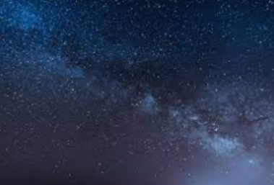
Unto Us a Child is Born
Luke 2:1-14

Slide 3
Taxes to Be Paid
Caesar Augustus was a capable and energetic Roman ruler whose reign—from 31 B.C. to A.D. 14—was marked by order and lawfulness.
The “taxing” was actually an enrollment of persons for future taxation purposes, an enrollment that required the taxpayer to personally submit required information.
Because both Joseph and Mary were descendants of King David, they were required to make the journey to Bethlehem, which was King David’s hometown.
It is also possible that Joseph owned property in Bethlehem, further mandating him to register in Bethlehem.
Ancient prophets had testified that the Messiah would be born in Bethlehem, in the land of Jerusalem.
But thou, Beth-lehem Ephratah, though thou be little among the thousands of Judah, yet out of thee shall he come forth unto me that is to be ruler in Israel; whose goings forth have been from of old, from everlasting. Micah 5:2
Luke 2:2

Slide 4
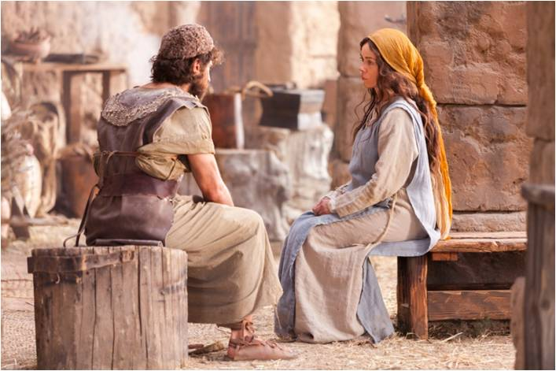
Espoused Wife
When Mary was found to be with child, Joseph, knowing he was not the father, had several options.
First, he could have subjected Mary to a public divorce and perhaps even execution, for people would have presumed that Mary was guilty of adultery—a crime punishable by death under the law of Moses.
Second, Joseph could have had his betrothal to Mary privately annulled before two witnesses.
A third option was to proceed with the marriage. Joseph was inclined to show mercy to Mary by quietly annulling the betrothal agreement.
However, when assured by an angel that Mary’s child was the Son of God, Joseph elected to marry her, though doing so could have brought upon him public shame and ridicule.
Read Matthew 1:19-25
Luke 2:5; Leviticus 20:10; John 8:5
(1)

Slide 5
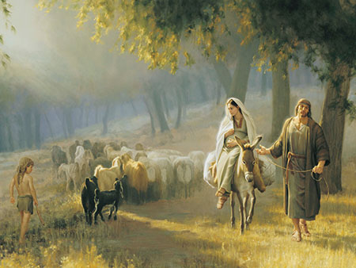
Bethlehem
Bethlehem lay approximately 85–90 miles (137–145 kilometers) south of Nazareth, a trek of at least four to five walking days, perhaps longer considering Mary’s condition.
Nazareth
Jerusalem
Bethlehem
Travelers typically stayed at quarters known as caravansaries, which were rectangular structures with open rooms overlooking a central courtyard, where the travelers’ animals were kept.
Luke 2:1-6
(1)

Slide 6
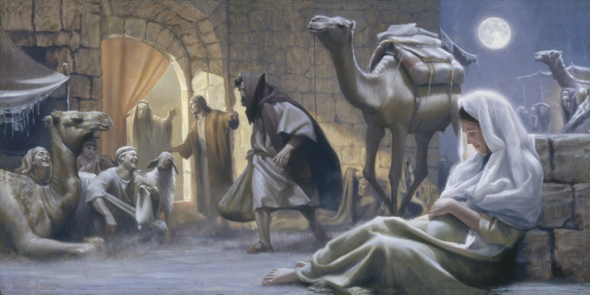
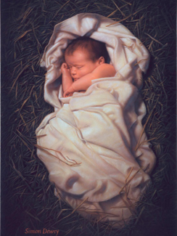
No Room At the Inn
The Joseph Smith Translation indicates there was no room for Mary and Joseph in the “inns” at Bethlehem.
Swaddling clothes were generally blankets or strips of cloth wrapped tightly around tiny infants. To swaddle = to “wrap snugly.”
It is therefore likely that there were no openings in the rooms of the caravansaries, and on the night of the Savior’s birth, the couple was required to stay in the crowded courtyard of a caravansary—where the travelers’ animals, including donkeys, dogs, oxen, and camels, were kept.
Simon Dewey
Luke 2:7
(1)

Slide 7
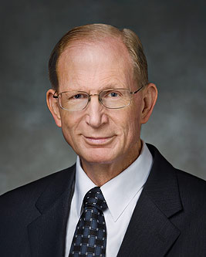
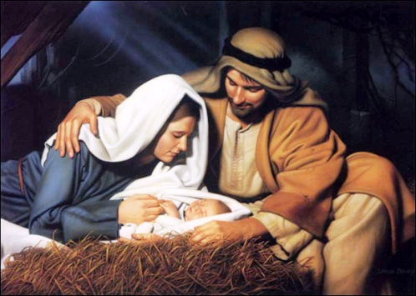
Of Humble Birth
“His birth, like his life, teaches us that there is nothing wrong with humble origins, with poverty, simplicity, and obscurity.
There is nothing to be ashamed of in being outcast from society, in being forced to dwell apart from the world, literally or figuratively.
Poverty is no disgrace, and a shelter for animals may be a temple of God’s spirit as surely as any more elegant dwelling. …
Christ’s birth and simple upbringing are a reminder to us that we must never look down on anyone because of their origins or worldly status. If we scorn the humble, we may unwittingly scorn the chosen of God’s children on the earth.”
Luke 2:7
(2)

Slide 8
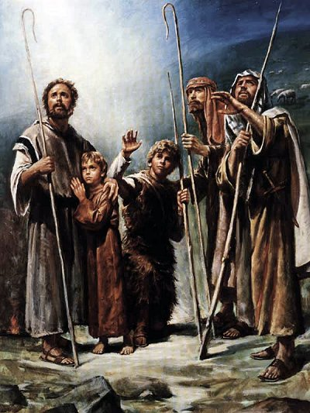
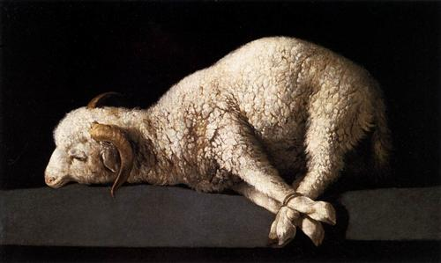
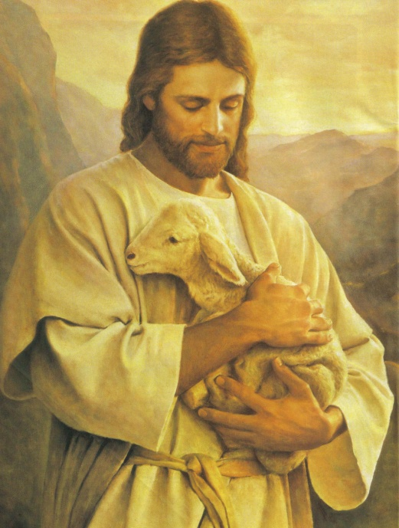
Shepherds in the Field
"The fields surrounding Bethlehem were home to numerous flocks of sheep, and the month of April was a traditional birthing season for the ewes of the flock, with lambs born almost every night. In their awkward role of midwives to the animals, the shepherds would have stayed up most of the night laboring beneath the crystal sky of the desert plateau; hence, the angels who heralded his birth would not have needed to wake them.
"The boy child who arrived that birthing season was known as 'the Lamb of God.' It is a title of deep significance, for he arrived with the lambs and would someday be 'brought as a lamb to the slaughter'.
Yet paradoxically, he was also the Good Shepherd, one who cares for the lambs....He was the greatest, who made himself least; the heavenly Shepherd who became a lamb...
Luke 2:8; Isaiah 53:7
(2)

Slide 9
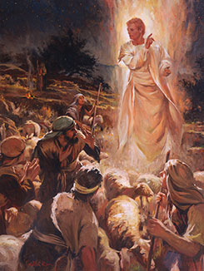
Angels Appear to Shepherds
"The shepherds to whom the angels appeared were the keepers of the temple flocks.”
And, lo, the angel of the Lord came upon them, and the glory of the Lord shone round about them: and they were sore afraid.
Fear not: for, behold, I bring you good tidings of great joy, which shall be to all people.
Luke 2:8-15

Slide 10
Luke 2:10-12
10 And the angel said unto them, Fear not: for, behold, I bring you good tidings of great joy, which shall be to all people.
11 For unto you is born this day in the city of David a Saviour, which is Christ the Lord.
12 And this shall be a sign unto you; Ye shall find the babe wrapped in swaddling clothes, lying in a manger.
Doctrinal Mastery
Luke 2:10-12

Slide 11
Witness of the Savior
Luke 2:1-39, Matthew 2:1-12

Slide 12
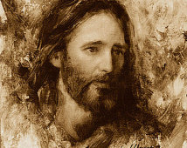
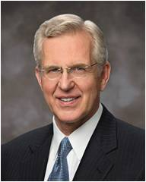
First Title: Christ the Lord
Savior = deliverer or preserver.
Jesus Christ is the Savior of the world.
Jared Barnes
A while ago, a person who has been a member of the Church for many years asked me, “Why do I need Jesus Christ? I keep the commandments; I’m a good person. Why do I need a Savior?” I must say that this member’s failure to understand this most fundamental part of our doctrine, this foundational element of the plan of salvation, took my breath away.
(6)

Slide 13
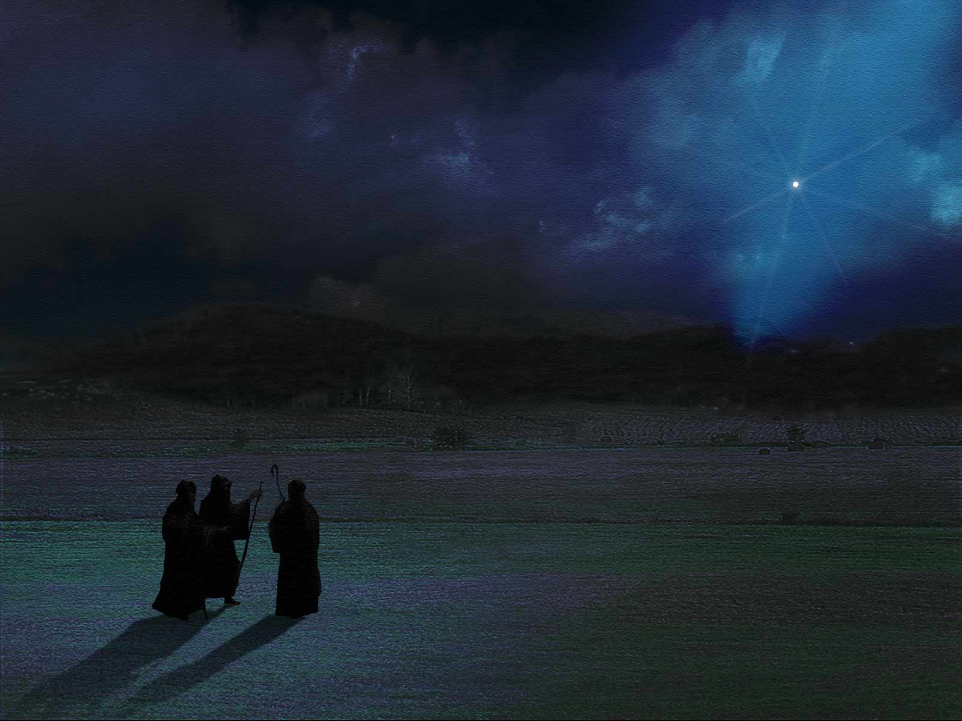
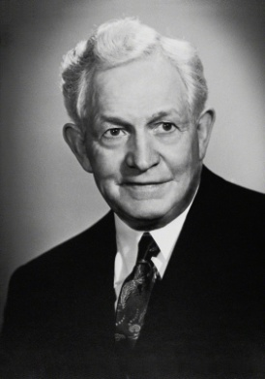
“Let Us Now Go”
They came with haste
"The shepherds did not say, 'I wonder if this be true.' They did not say, 'Let us go and see if this thing be true'; they said, 'Let us go and see this thing which is come to pass which the Lord hath made known unto us'-an assurance that God had revealed his Son, that the angels had given to the world the message that he who should be King of kings and Lord of lords had come as a mere babe in the humblest part of that little Judean town.
"What would you give-you who may not have that assurance-to have in your hearts that same confidence that Christ is born, that Christ lives, that God had heralded his birth by angels in heaven? All doubt would be banished, all worry concerning our purpose here in life would cease.
That is what such a testimony means.”
Luke 2:15
(3)

Slide 14
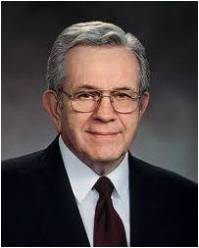
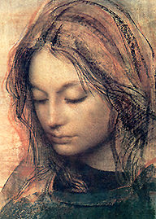
Pondered In Her Heart
Treasuring sacred experiences
Luke recorded that after the shepherds’ visit and after finding the 12-year-old Jesus in the temple, Mary pondered the events and sayings, and she kept them “in her heart”
“It is not wise to continually talk of unusual spiritual experiences. They are to be guarded with care and shared only when the Spirit itself prompts you to use them to the blessing of others. …
“I heard President Marion G. Romney once counsel mission presidents and their wives … , ‘I found out that if I talked too lightly of sacred things, thereafter the Lord would not trust me.’
“We are, I believe, to keep these things and ponder them in our hearts, as Luke said Mary did of the supernal events that surrounded the birth of Jesus.”
Luke 2:19
(1,4)

Slide 15
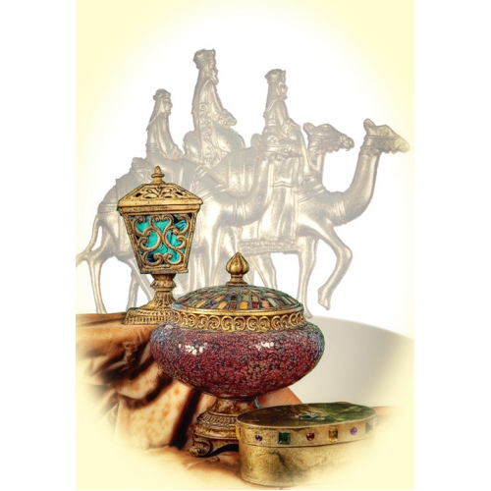
Gifts
The Gospel of Matthew is the only Gospel to include an account of the Wise Men--magoi, which originally referred to religious wise men from Persia or Babylon, but by Matthew’s day the word encompassed a variety of religious practitioners. (3)
1. How did the Wise Men know the Messiah had been born?
2. Why did the Wise Men want to find the Messiah?
3. How did the chief priests and scribes know where the Messiah would be born?
4. What did Herod want the Wise Men to do after they found Jesus?
5. What did the Wise Men do instead?
6. Were there just 3 Wise Men?
The Bible Doesn’t Say
Matthew 2:1-12

Slide 16
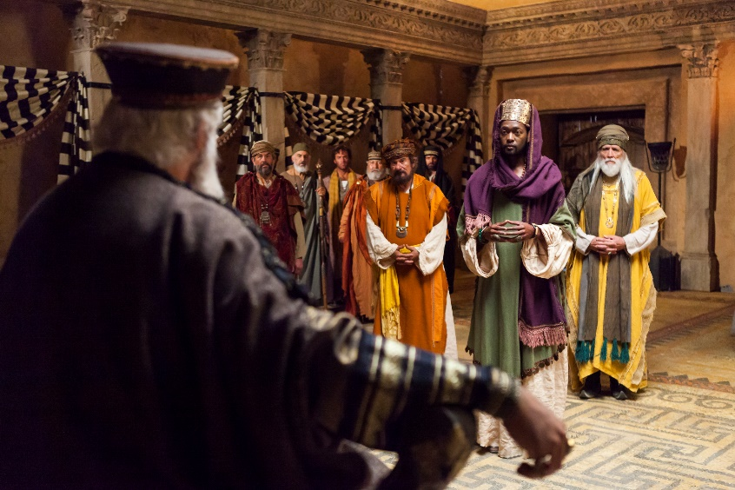
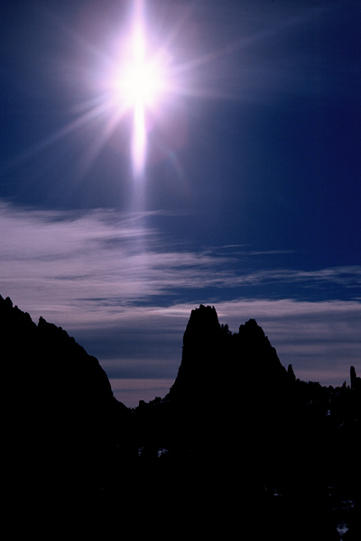
The Star in the East
The Sign of the Messiah
Saying, Where is he that is born King of the Jews? for we have seen his star in the east, and are come to worship him.
JST Matthew 2;2
But thou, Beth-lehem Ephratah, though thou be little among the thousands of Judah, yet out of thee shall he come forth unto me that is to be ruler in Israel; whose goings forth have been from of old, from everlasting.
Micah 5:2
Bethlehem = “house of bread,” was the place where the “Bread of Life” would be born.
And behold, there shall a new star arise, such an one as ye never have beheld; and this also shall be a sign unto you.
Helaman 14:4
Matthew 2:2, 6

Slide 17
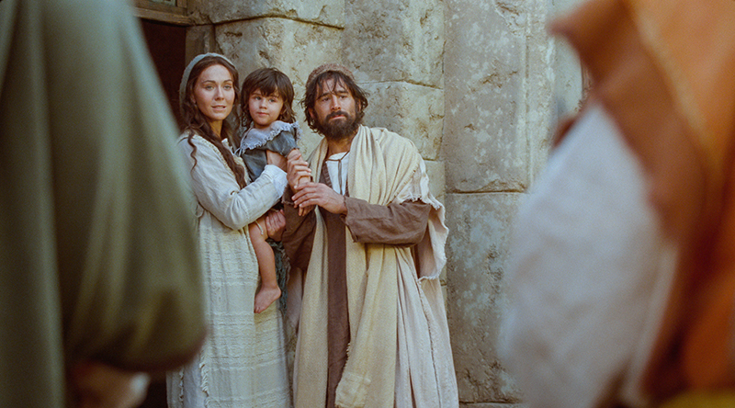
Seeking the Lord
Regardless of who the Wise Men were or where they came from, their visit shows that those who should have been aware of the signs accompanying the birth of Jesus Christ failed to recognize them, while righteous people from other lands, directed by the Holy Ghost, not only noticed the signs but acted upon them.
The exact time of the Wise Men’s visit is unknown; however, Matthew 2:11 suggests that some time had passed since the birth of Jesus Christ, for the Wise Men found Jesus in a “house,” not a manger, and He was a “young child,” not a baby.
Matthew 2:2-11
(1)

Slide 18
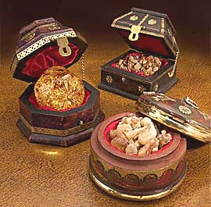
Gold = King
Incorruptible, pure, valuable, eternal
Frankincense = Priest
Temple incense, sacrifice, prayer, resurrection
Myrrh = Healer
Balm, healing, death, atonement
Matthew 2:11
(1)

Slide 19
“In ancient times when people wanted to worship the Lord and seek His blessings, they often brought a gift. …
“Is there something in you or in your life that is impure or unworthy?
When you get rid of it, that is a gift to the Savior. Is there a good habit or quality that is lacking in your life?
When you adopt it and make it part of your character, you are giving a gift to the Lord.
Sometimes this is hard to do, but would your gifts of repentance and obedience be worthy gifts if they cost you nothing?”
Matthew 2:13
(5)

Slide 20
Simeon and Anna
It was revealed to him that he would see the Lord Jesus Christ before he died.
He was a righteous man of senior years in Jerusalem who was inspired to come to the temple on the day Joseph and Mary brought their babe to the holy place, in keeping with Mosaic practice.
He was a prophet and he pronounced a prophetic blessing upon the family.
Her name means Grace.
She had been married only 7 short years.
She was a widow of some 84 years who served in the temple at Jerusalem might and day all her life.
She happened to arrive at the temple during the time Joseph and Mary were there to present their new child at the temple.
She was a prophetess from the tribe of Asher(Luke 2:36-38)
Luke 2:24-25, 36-38
(7,8)

Slide 21
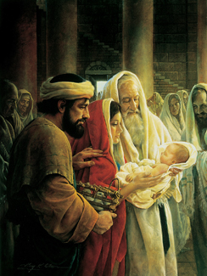
Presented At The Temple
If a woman have conceived seed, and born a man child: then she shall be unclean seven days; according to the days of the separation for her infirmity shall she be unclean.
And in the eighth day the flesh of his foreskin shall be circumcised.
And when the days of her purifying are fulfilled, for a son, or for a daughter, she shall bring a lamb of the first year for a burnt offering, and a young pigeon, or a turtledove, for a sin offering, unto the door of the tabernacle of the congregation, unto the priest:
Greg K. Olsen
Who shall offer it before the Lord, and make an atonement for her; and she shall be cleansed from the issue of her blood. This is the law for her that hath born a male or a female.
And if she be not able to bring a lamb, then she shall bring two turtles, or two young pigeons; the one for the burnt offering, and the other for a sin offering: and the priest shall make an atonement for her, and she shall be clean.
Leviticus 12:2-3, 6-8

Slide 22
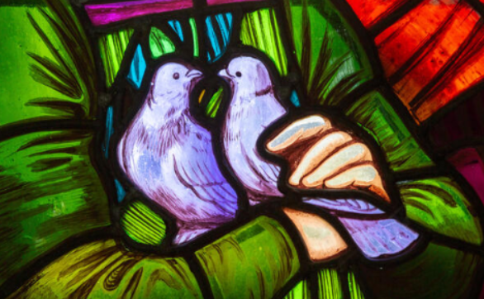
Turtle Doves
The law of Moses declared women to be ceremonially unclean after giving birth. To become clean, a new mother had to present a lamb at the temple for a burnt offering, and a pigeon or turtledove for a sin offering.
“And if she be not able to bring a lamb, then she shall bring two turtles [turtledoves], or two young pigeons”.
That Mary presented turtledoves or pigeons instead of a lamb is evidence Jesus Christ was born to a mother of little material means.
Leviticus 12:2-3, 6-8; Leviticus 12:5-6; Leviticus 12:8

Slide 23
Being Warned of God
Matthew 2:11-23
Warning

Slide 24
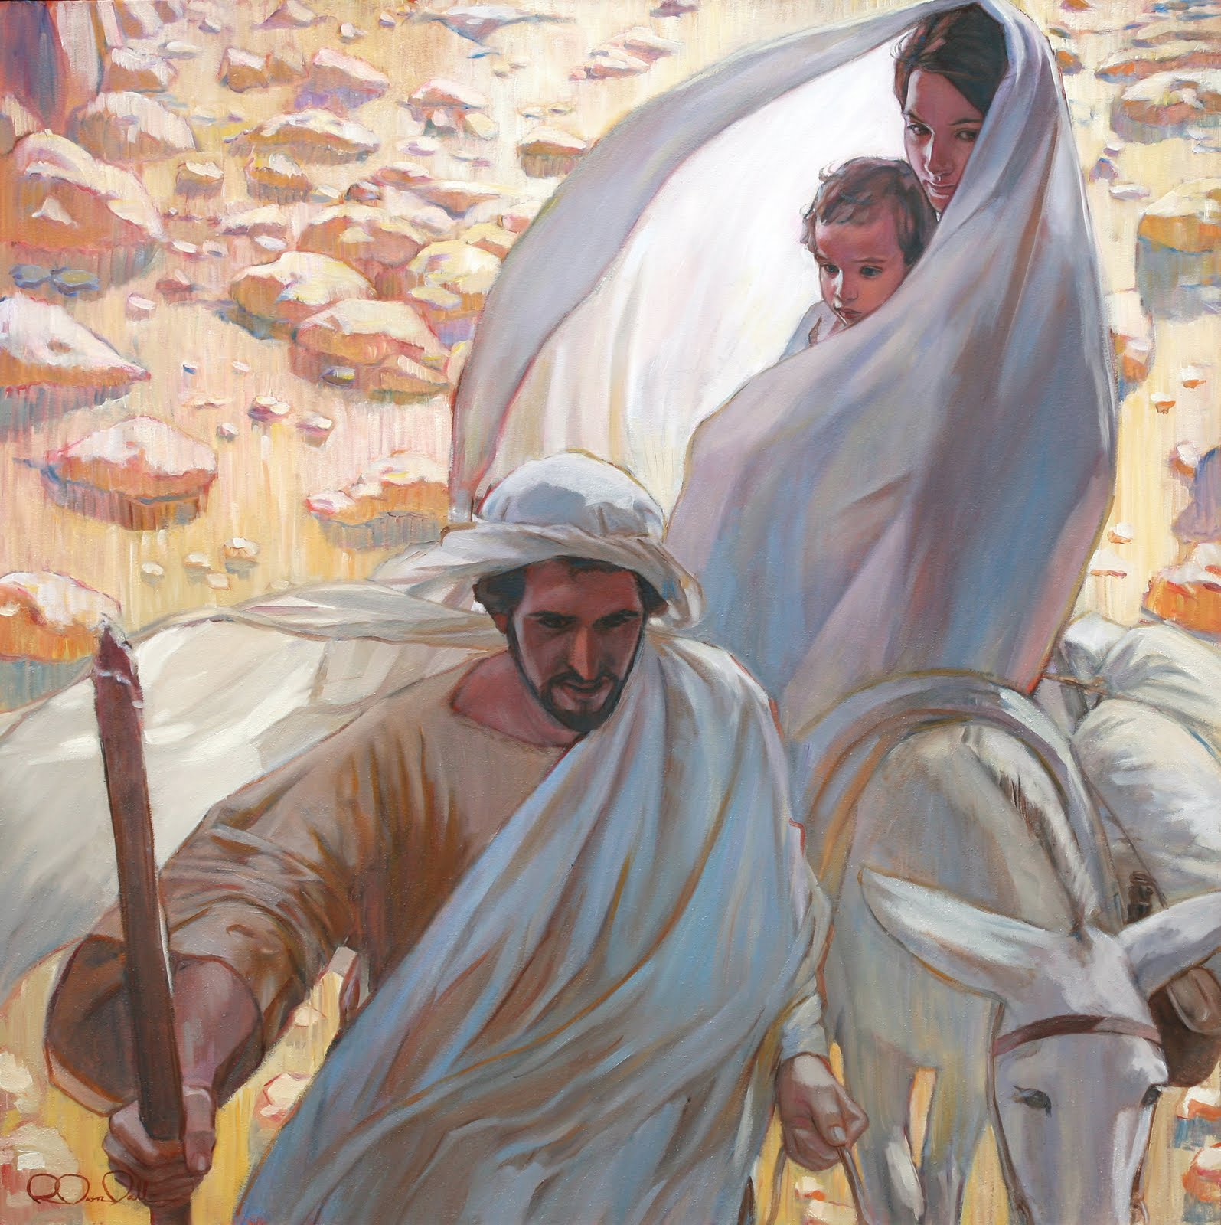
Escape to Egypt
Herod became angry after the Wise Men “departed into their own country” without telling him where the Messiah was.
Hoping to kill the Messiah, he ordered that all children two years old and younger in Bethlehem and the surrounding area be killed.
Matthew 2:13-23

Slide 25
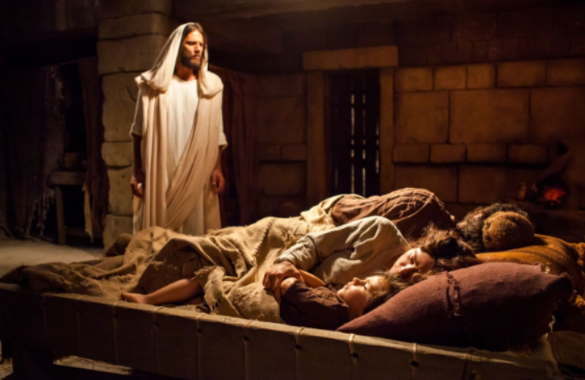
Joseph, Mary, and Jesus stayed in Egypt until Herod died.
God instructed Joseph through dreams to take his family back to Israel, and they settled in the city of Nazareth.

Slide 26
Warning
Signs
It is not expected that you go through life without making mistakes, but you will not make a major mistake without first being warned by the promptings of the Spirit. This promise applies to all members of the Church.
(12)

Slide 27
Jesus Grew, and Waxed Strong in Spirit
Luke 2:40-52

Slide 28
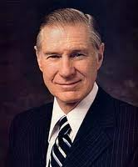
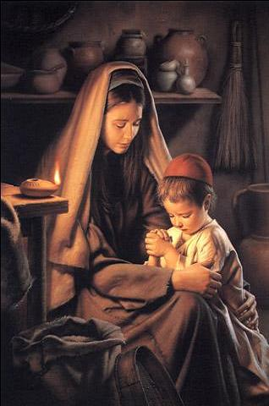
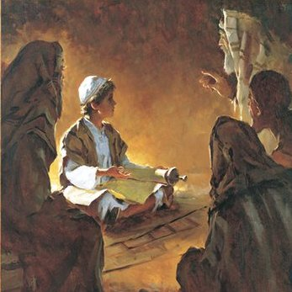
Jesus’ Childhood
Though the scriptures contain little information regarding the youth of Jesus Christ, he more than likely grew up with the Jewish traditions of the family
“It was in the temple that Jesus received much of his early education. It was there he revealed the spiritual insight he had received to be about his Father’s business. In the temple the Savior announced his Messianic mission. Simeon came by the Spirit to the temple and there had fulfilled for him the promise by the Holy Ghost that he would not die until he had seen ‘the Lord’s Christ.”
Luke 2:40
(9)

Slide 29
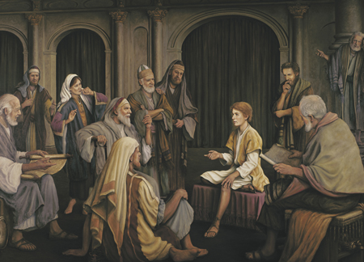
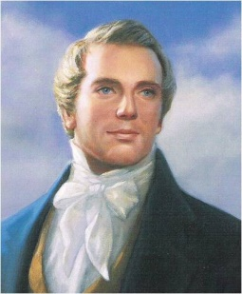
“When still a boy He had all the intelligence necessary to enable Him to rule and govern the kingdom of the Jews, and could reason with the wisest and most profound doctors of law and divinity, and make their theories and practice to appear like folly compared with the wisdom He possessed.”
Grant R. Clawson
Luke 2:46-47; John 8:25-30
(8)

Slide 30
What Does it Mean to…
To increase in wisdom?
Develop wisdom
To increase in “favour with God”?
Develop spiritually
To increase in “favour with … man”?
Develop socially
To increase in “stature”?
Develop physically
We can follow Jesus’s example by gaining wisdom and by growing physically, spiritually, and socially
Luke 2:51-52
(7)

Slide 31
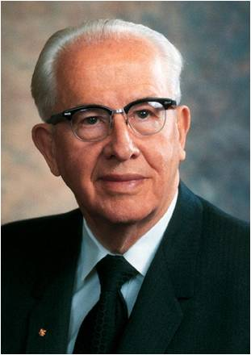
Jesus Increased in Wisdom and Stature
“From modern-day revelation we learn that Jesus ‘received not of the fulness at first, but continued from grace to grace … , until he received a fulness.’
“What manner of man was Jesus during those thirty years when He was personally preparing Himself for His three-year public ministry?
“We, too, should be moving from grace to grace in wisdom and stature and in favor with God and man. … May we all follow our leader, Jesus Christ, and increase in stature mentally, physically, spiritually, and socially.”
Luke 2:52
(11)

Slide 32
Goals
In what ways will developing in this area help you become more like the Savior?
What would you like to improve on in this area of your life? Why?
How will you seek Heavenly Father’s help and guidance?
What obstacles might you face?

Slide 33
We start with a little bit at a time.
Walking on the covenant path really is just placing one foot in front of the other.
Make one goal. Start simply.
The guidebooks for youth and children will give us a wonderful pattern to follow. …
This is an amazing opportunity to grow as the Savior did! If we’re wondering, “What do I focus on?” we can remember that we are already doing many things to become like Him.
Gospel learning is happening in many homes and at church. We’re serving and participating in activities.
This new effort is simply a way for us to be intentional and accountable about acting on what we are learning—and to focus that growth in the four areas that the Savior grew: spiritually, socially, physically, and intellectually.
This will bring joy, peace, and lasting happiness to us all as we follow the Savior!
(11)
(Luke 2:52)

Slide 34
Sources:
New Testament Institute Student Manual Chapter 15
Elder Bruce D. Porter (The King of Kings [2000], 26). And Latter-day Commentary on the New Testament: The Four Gospels, by Pinegar, Bassett, and Earl, p. 20-21)
President Boyd K. Packer (“The Candle of the Lord,” Ensign, Jan. 1983, 53).
Elder D. Todd Christofferson (“When Thou Art Converted,” Ensign or Liahona, May 2004, 12
D. Todd Christofferson, “Why We Need Jesus Christ,” Ensign, Dec. 2020, 19–20
Who’s Who in the New Testament by Richard J. Allen p. 9, 178-179
Bible Dictionary
James P. Bell, In the Strength of the Lord: The Life and Teachings of James E. Faust [1999], 444–45
Joseph Smith (in History of the Church, 6:608
President Ezra Taft Benson “In His Steps” Ensign, Sept. 1988, 4, 6
Bonnie H. Cordon, in “Children and Youth: Starting Strong,” Ensign, Jan. 2020, 54, 55
Boyd K. Packer, “Counsel to Youth,” Ensign or Liahona, Nov. 2011, 18

Slide 35
Event | Matthew | Mark | Luke | John
Birth of Jesus the Christ |  |  | 2:1-7
Shepherds Witness the Babe and make known His birth |  |  | 2:8-20
Circumcision and Naming of Jesus | 1:25 |  | 2:21
Jesus presented at the temple |  |  | 2:22-39
Flight to Egypt and Return to Nazareth | 2:13-23 |  | 2:39
Childhood of Jesus and age twelve at the temple |  |  | 2:40-52

Slide 36
Joseph
“Matthew tells us that [Joseph] was of the lineage of King David, that he was a just and considerate man, that in a dream an angel told him who Jesus would be, that he was obedient, and that he gave Jesus his name, which means savior. (See Matt. 1.) We know that he took Mary to Bethlehem, where Jesus was born. (See Luke 2:4–6.) Less than two years later, Joseph took his family into Egypt to escape Herod, after being warned in a dream. In Egypt, a dream again told him when to return, and another dream told him to go to Galilee. (See Matt. 2:13–15, 19–22.) Four dreams from God! Joseph must have been an exceptionally visionary and spiritually sensitive man” Gerald N. Lund (Jesus Christ, Key to the Plan of Salvation [1991], 51–52).
No Room Luke 2:7:
"Even in our day, although two thousand years have passed, there are many who say the same thing that was said on that night in Bethlehem. 'There is no room, no room' (see Luke 2:7). We make room for the gifts, but sometimes no room is made for the giver. We have room for the commercialism of Christmas and even pleasure-seeking on the Sabbath day, but there are times when there is not room for worship. Our thoughts are filled with other things-there is no room." Howard W. Hunter (The Teachings of Howard W. Hunter, edited by Clyde J. Williams [Salt Lake City: Bookcraft, 1997], 42.)
The City of David Luke 1:4
"Bethlehem. The city of David. Ancient homeland of Israel's greatest king. In Hebrew it is called Beth Lechem. Literally, Beth Lechem means 'The House of Bread.' How perfect that He who was to take the throne of David and become Israel's ultimate king should come to earth in the city of His illustrious ancestor! How fitting that He who would be known as the 'Bread of Life' should enter mortality in the tiny village called 'The House of Bread.' (See John 6:35.)" Gerald N. Lund (Jesus Christ, Key to the Plan of Salvation [Salt Lake City: Deseret Book Co., 1991], 12 - 13.)
The City of David Luke 1:4
"Bethlehem. The city of David. Ancient homeland of Israel's greatest king. In Hebrew it is called Beth Lechem. Literally, Beth Lechem means 'The House of Bread.' How perfect that He who was to take the throne of David and become Israel's ultimate king should come to earth in the city of His illustrious ancestor! How fitting that He who would be known as the 'Bread of Life' should enter mortality in the tiny village called 'The House of Bread.' (See John 6:35.)" Gerald N. Lund (Jesus Christ, Key to the Plan of Salvation [Salt Lake City: Deseret Book Co., 1991], 12 - 13.)
Of Royal Blood: Luke 1:4
"Since Jesus was not begotten by mortal man, his descent from David would, by necessity, be through his mother. Thus, when Mary came to earth she was born into that royal lineage so that she could transmit it to her son Jesus. That Mary was of Davidic descent is plainly set forth in the scriptures. Jesus was frequently addressed as 'Son of David.' He did not disclaim that title.
"Paul made it clear that Jesus was of royal blood in his earthly lineage. To the Roman Saints he wrote: 'Jesus Christ our Lord... was made of the seed of David according to the flesh' (Rom. 1:3). And to Timothy he said: 'Remember that Jesus Christ of the seed of David was raised from the dead' (2 Tim. 2:8; see also Acts 13:22-23; 2:30).
"Mary's husband, Joseph, also was 'of the house and lineage of David' (Luke 2:4; see also Luke 1:27; Matt. 1:16, 20; Luke 3:23-31). So Jesus, though not a blood descendant of Joseph, inherited legal status as a son of David through him.
"At that time the Jews were ruled by Rome, and the rights of the royal Davidic family were not recognized. Herod, king of the Jews by Roman appointment, was not even an Israelite, and certainly not of David's line. Gospel Doctrine.com
"Elder James E. Talmage explained: 'Had Judah been a free and independent nation, ruled by her rightful sovereign, Joseph the carpenter would have been her crowned king; and his lawful successor to the throne would have been Jesus of Nazareth, the King of the Jews' (Jesus the Christ [Salt Lake City: Deseret Book Co., 1948], p. 87)." (Robert J. Matthews, Behold the Messiah [Salt Lake City: Bookcraft, 1994], 78-79.)
Shepherds—Keepers of the temple flocks Luke 2:9:
"The shepherds to whom the angels appeared were the keepers of the temple flocks, a conjecture based on an ancient Jewish tradition that the Messiah would be revealed from Migdal Eder, 'the tower of the flock.' The Jewish interpretive text of the Mishnahsuggests that this could mean none other than the special flocks consecrated to the temple. If this is so, then lambs born years later into those same flocks may have been among those offered in the temple at the time of Christ's Passover sacrifice on the cross. Whether this is so or not, it is certainly the case that his atoning sacrifice was portended even in his birth. An ancient Hebrew tradition held that the Messiah would be born on the Passover. And from astronomical calculation we know that April 6 in the meridian of time was indeed the day of the Passover Feast, that sacred Jewish commemoration of Israel's salvation from the destroying angel that meant death for the firstborn sons of Egypt. It was a salvation granted to each Israelite family that sacrificed a lamb and smeared its blood on the wooden doorposts of their dwelling." (Bruce D. Porter, The King of Kings, 21, 23 as taken from Latter-day Commentary on the New Testament: The Four Gospels, by Pinegar, Bassett, and Earl, p. 20-21)

Slide 37
Day of Jesus’ Birth Luke 2:11:The Latter-day saints have long believed that Jesus was born in the spring and not on December 25. The traditional celebration of his birth in December is a remnant of an old Roman holiday which celebrated the birth of the sun after the winter solstice. There are many evidences suggesting that this could not have been the correct date.
"It has been pointed out that the 6 April 1 B.C. date also explains certain aspects of the New Testament account. For example, the date is during the short lambing season, which would explain why the shepherds were 'keeping watch over their flock by night.' (Luke 2:8.) Moreover, the fact that 'there was no room for them in the inn' (Luke 2:7) suggests that the birth probably occurred at the time of one of the three feasts, such as Passover, at which Jews were required to be in Jerusalem. That proposal is also consistent with the 6 April date." (John P. Pratt, "Passover-Was It Symbolic of His Coming?" Ensign, Jan. 1994, 44)
Testimonies of the Birth of Jesus Luke 2:17:
"'It will be observed that the testimonies concerning the birth of the Messiah are from two extremes, the lowly shepherds in the Judean field, and the learned magi from the far east. We cannot think this is the result of mere chance, but that in it may be discerned the purpose and wisdom of God...there were classes of people among the Jews whom these lowly shepherd witnesses could not reach, and had they been able to reach them, the story of the angel's visit, and the concourse of angels singing the magnificent song of Peace on earth, good will to men would doubtless have been accounted an idle tale of superstitious folk, deceived by their own over-wrought imaginations or idle dreams. Hence God raised up another class of witnesses-the wise men from the east-witnesses that could enter the royal palace of proud King Herod and boldly ask: Where is he that is born king of the Jews? for we have seen his star in the east, and are come to worship him.'" James E. Talmage (quoted in Jesus the Christ, 108-109)
Matthew 2:1-12 The Identity of the Wise Men:
“It would appear they were true prophets, righteous persons like Simeon, Anna, and the shepherds, to whom Deity revealed that the promised Messiah had been born among men. Obviously they were in possession of ancient prophecies telling of the rise of a new star at his birth. That they did receive revelation for their personal guidance is seen from the inspired dream in which they were warned not to return to Herod after they had found and worshiped the Son of Mary” (Doctrinal New Testament Commentary, 3 vols. [1965–73], 1:103).
Regardless of who the Wise Men were or where they came from, their visit shows that those who should have been aware of the signs accompanying the birth of Jesus Christ failed to recognize them, while righteous people from other lands, directed by the Holy Ghost, not only noticed the signs but acted upon them.

