Slide 1
Lesson 22
The Sanctity of Marriage
Matthew 19-20
“Therefore, if a man marry him a wife in the world, and he marry her not by me nor by my word, and he covenant with her so long as he is in the world and she with him, their covenant and marriage are not of force when they are dead, and when they are out of the world; therefore, they are not bound by any law when they are out of the world”
D&C 132:15.

Slide 2
Worldly Marriage VS Eternal Marriage
The Lord’s doctrine concerning marriage and divorce differs from many of the world’s beliefs.
“marriage between a man and a woman is ordained of God and that the family is central to the Creator's plan for the eternal destiny of His children.” When a man and woman are married in the temple, their family can be together forever. This is a common goal of Latter-day Saints.
Life is eternal. Death does not terminate the existence of man (or woman) (3)
That union is not merely between husband and wife; it embraces a partnership with God.” (2)
Salt Lake Sealing Room

Slide 3
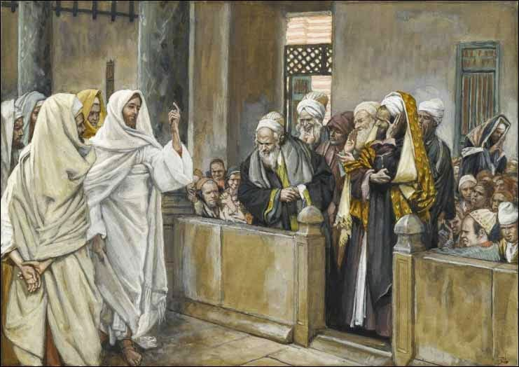
Divorce
During the time of the Savior’s mortal ministry, divorce was a vexing issue, debated without resolution among rabbis.
For many people, divorce was justified even for trivial reasons. The Pharisees sought to involve Jesus in the controversy by asking His opinion about divorce.
In response, the Savior emphasized the sanctity of marriage by referring to Adam and Eve, who provided the ideal of marital unity and permanence.
Therefore shall a man leave his father and his mother, and shall cleave unto his wife: and they shall be one flesh
Genesis 2:24
Matthew 19:3

Slide 4
Bill of Divorcement—’Get’
When a man hath taken a wife, and married her, and it come to pass that she find no favour in his eyes, because he hath found some uncleanness in her: then let him write her a bill of divorcement, and give it in her hand, and send her out of his house. Deuteronomy 24:1
Document "On the __________ day of the week, the __________ day of the month of __________ in the year __________ from the creation of the world according to the calendar reckoning we are accustomed to count here, in the city __________, which is located on the river __________, and situated near wells of water, I, __________, the son of __________, who today am present in the city __________, which is located on the river __________, and situated near wells of water, do willingly consent, being under no restraint, to release, to set free and put aside thee, my wife __________, daughter of __________, who art today in the city of __________, which is located on the river __________, and situated near wells of water, who has been my wife from before. Thus do I set free, release thee, and put thee aside, in order that thou may have permission and the authority over thy self to go and marry any man thou may desire. No person may hinder thee from this day onward, and thou are permitted to every man. This shall be for thee from me a bill of dismissal, a letter of release, and a document of freedom, in accordance with the law of Moses and the Sages Israel."
According to the Old Testament, a Jewish marriage is ended when the husband gives his wife a document, a 'get'. This get is written by a scribe and presented in the presence of a rabbinic court and qualified witnesses. (4)
Why did Moses allow divorce among the Israelites?
Because of the hardness of the people’s hearts
Matthew 19:8-9
English Translation of the GET Document

Slide 5
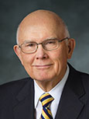
“The kind of marriage required for exaltation—eternal in duration and godlike in quality—does not contemplate divorce. In the temples of the Lord, couples are married for all eternity. But some marriages do not progress toward that ideal.
“Because ‘of the hardness of [our] hearts’, the Lord does not currently enforce the consequences of the celestial standard. He permits divorced persons to marry again without the stain of immorality specified in the higher law” (5)
Matthew 19:8

Slide 6
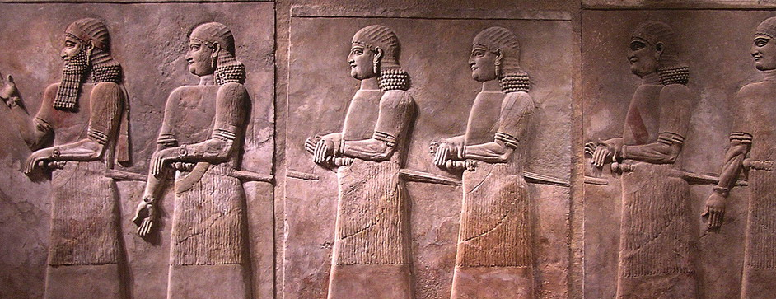
Eunuchs
There are several developmental disorders which result in boys being born with ambiguous genitalia or as hermaphrodites. As adults, they are unable to father children and were classed as eunuchs.
Another group of eunuchs were "a class of emasculated men attached to the courts of eastern rulers. They were employed to watch of the harems, and also were often given positions as trusted officials." (6)
“…the full meaning of the law of celestial marriage, it is better not to marry at all than to make the mistake of violating the covenants of your first marriage in marrying another. For example, there have been men who understood this doctrine and made themselves eunuchs rather than take the risk of violating this holy law." This response was not meant to justify the mutilating act required to become a eunuch nor to condone a celibate lifestyle but to acknowledge their understanding of the supreme solemnity of the covenant of celestial marriage.” (7,8)
Matthew 19:12

Slide 7
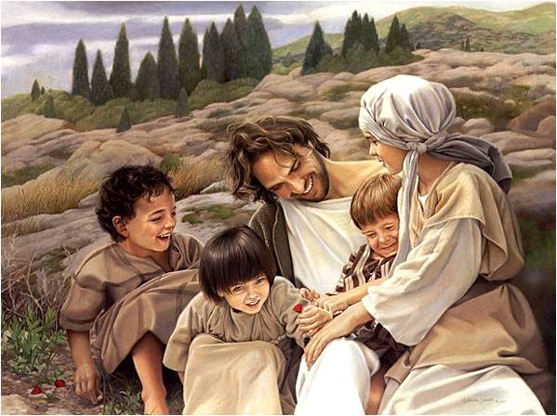
Suffer Little Children To Come Unto Me
If little children are qualified for the kingdom of heaven, then they are in no need of any external ordinances or sacraments to get there.
During Christ's entire ministry, the only individuals who were clean and pure enough to deserve the privilege of his presence were these little children. (8)
And he that saith that little children need baptism denieth the mercies of Christ, and setteth at naught theatonement of him and the power of his redemption.
For behold that all little children are alive in Christ, and also all they that are without the law.
Moroni 8:20,22
Baby Dean July 6, 2016
Matthew 19:13-15

Slide 8
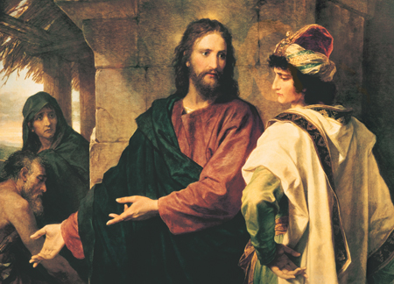
Seek Eternal Life
The Savior asked him to give up his earthly possessions and follow Him, but riches had gained such a powerful hold on the young man that he went away grieved, unwilling to make the sacrifices necessary to inherit eternal life. This account shows the power of material possessions to obscure what should be our real goal in mortality.
Because their hearts are set so much upon the things of this world, and aspire to the honors of men, that they do not learn this one lesson— D&C 121:35
However, we are not told that the young man’s decision was final—we do not know that he absolutely refused to comply with Jesus’ instruction.
Matthew 19:16-30

Slide 9
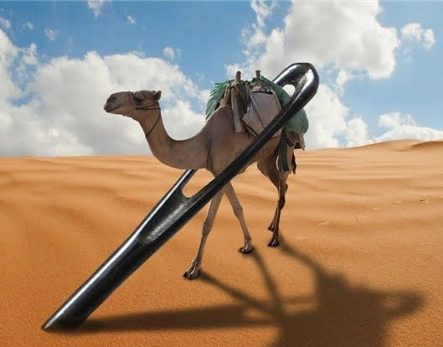
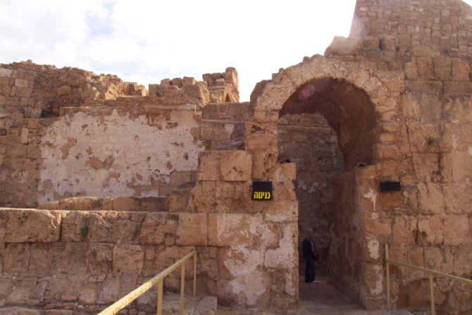
Camel Through the Eye of a Needle
Some have asserted that the eye of the needle was a small door in the Jerusalem city wall, requiring a camel to be stripped of its load in order to enter. There is no evidence that such a door ever existed.
Others have proposed that altering one letter in the Greek text would change the scripture to mean that a rope, not a camel, would have to pass through the eye of a needle
In any event it is clear that riches add to the difficulty of gaining salvation. (9, 10)
Matthew 19:24

Slide 10
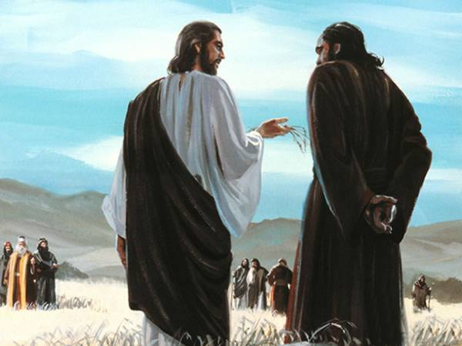
What shall we have therefore?
Because we have been faithful and followed thee—what is our reward?
Jesus teaches a lesson to Peter about the Kingdom of God
Matthew 19:30

Slide 11
Parable:
Laborers in the vineyard
Matthew 20:1-16

Slide 12
Scarcity Mentality VS Abundance Mentality
Some people think of success as slices of a single pizza.
If you take a slice, there is less pizza for me.
Therefore, I would be hurt by your success
Success is not a limited commodity.
Therefore we can rejoice for the success of others. Their success doesn’t take away for ours.
When our hearts are right, we rejoice when others are rewarded. We’re not prone to comparisons.
When Alma the Younger saw his brethren’s missionary success, was he envious? Did he say in his heart, ‘Wow, I feel rotten because you guys did so well”….No, Alma rejoiced
Matthew 19:24
(11,12)

Slide 13
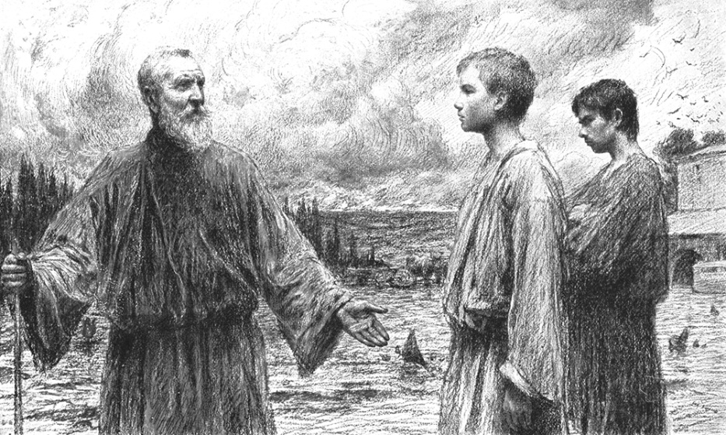
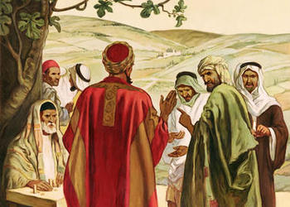
Message in the Parable
“…the focus is not how long or how well they worked, but the focus is that they come and participate.”
"By reason of their willingness and their loyalty to their master, by the end of the day the laborers hired in the eleventh hour had become as much-had qualified as completely-as those who had served the entire period. The master's rewards were not given for the time served or for any other external measure.
His rewards were for the ultimate and comprehensive internal measure-what the workers had become within themselves as a result of their service."
Matthew 19:24
(12, 13)

Slide 14
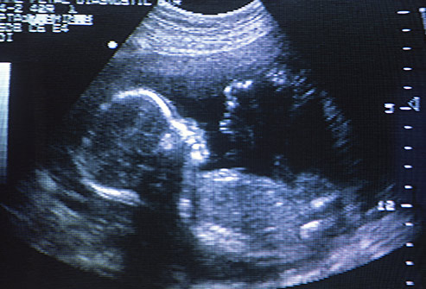
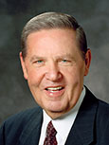
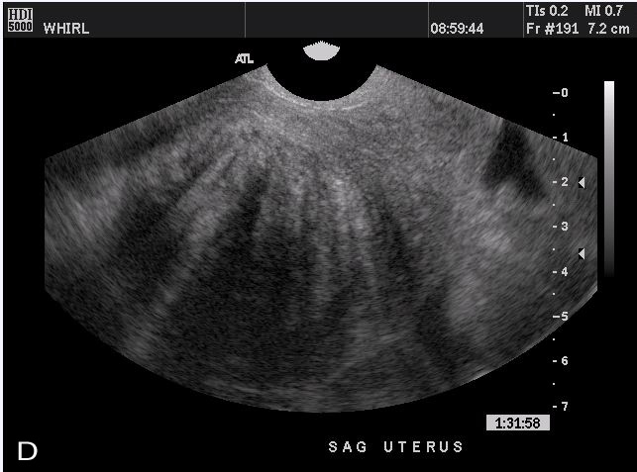
God gives eternal life to all people who choose to make and keep sacred covenants with Him
“There are going to be times in our lives when someone else gets an unexpected blessing or receives some special recognition.
May I plead with us not to be hurt—and certainly not to feel envious—when good fortune comes to another person?
We are not diminished when someone else is added upon.
We are not in a race against each other to see who is the wealthiest or the most talented or the most beautiful or even the most blessed. The race we are really in is the race against sin. …
infertile
“… Coveting, pouting, or tearing others down does not elevate your standing, nor does demeaning someone else improve your self-image. So be kind, and be grateful that God is kind. It is a happy way to live”
(14)

Slide 15
Sources:
Suggested Hymn: #217 Come, Let Us Anew
LDS Topics “marriage” The Family: A Proclamation to the World”).
Elder Russell M. Nelson “Nurturing Marriage,” Ensign, May 2006, 36
President Spencer W. Kimball Temple and Eternal Marriage Ensign Feb. 1995
Rev. William F. Luck Sr. Termination of Marriage in the Mosaic Law bible.org
Elder Dallin H. Oaks (“Divorce,” Ensign or Liahona, May 2007, 70).
Bible Dictionary
Joseph Smith Teachings 276
Gospeldoctrine.com
Elder Bruce R. McConkie Doctrinal New Testament Commentary p. 556
New Testament Institute Student Manual Chapter 7
Stephen R. Covey 7 Habits p. 219-220
John Bytheway Of Pigs, Pearls & Prodigals p. 64 Sister Camille Fronk Olson (The Parables)
Dallin H. Oaks Pure in Heart p. 138
Elder Jeffrey R. Holland (“Laborers in the Vineyard,” 31, 32).
You Tube Labor in the Vineyard (4:33) https://www.youtube.com/watch?v=OgUw5FWWG8c
Presentation by ©http://fashionsbylynda.com/blog/

Slide 16
Marriage:
Elder Bruce R. McConkie (1915–85) of the Quorum of the Twelve Apostles counseled, “The most important single thing that any Latter-day Saint ever does in this world is to marry the right person, in the right place, by the right authority.”
“Eternal marriage is a principle which was established before the foundation of the world and was instituted on this earth before death came into it. Adam and Eve were given to each other by God in the Garden of Eden before the Fall. The scripture says, ‘In the day that God created man, in the likeness of God made he him; Male and female created he them; and blessed them’ (Gen. 5:1–2; emphasis added).
“The prophets have uniformly taught that the consummate and culminating element of God’s great plan for the blessing of His children is eternal marriage” (“Eternal Marriage,” Ensign orLiahona, May 2003, 92).
Civil marriage is an earthly contract, dissolved by the death of either party. Eternal celestial marriage is a sacred covenant between man and woman, consecrated in the holy temple by servants of God who hold authoritative keys. It bridges death; it includes both time and eternity.
Though relatively few people in this world understand it, the new and everlasting covenant is the marriage ordinance performed in the holy temple by the properly constituted officiators who have the genuine, authoritative power to perform them. This glorious blessing is available to men and women on this earth.
Marriages that are made only “so long as you both shall live” or “until death do you part” are terminated when the mortal breath is no more.
A civil marriage may be performed by any of the numerous people approved by laws of the respective countries, but eternal marriage must be solemnized by one properly authorized. (3)
Divorce:
“There are many good Church members who have been divorced. … We know that many of you are innocent victims—members whose former spouses persistently betrayed sacred covenants or abandoned or refused to perform marriage responsibilities for an extended period. …
“… All who have been through divorce know the pain and need the healing power and hope that come from the Atonement. That healing power and that hope are there for them and also for their children. …
“… We cannot control and we are not responsible for the choices of others, even when they impact us so painfully. …
“Whatever the outcome and no matter how difficult your experiences, you have the promise that you will not be denied the blessings of eternal family relationships if you love the Lord, keep His commandments, and just do the best you can” Dallin H. Oaks (“Divorce,” Ensign or Liahona, May 2007, 70–71, 73).
“Divorce is not part of the gospel plan no matter what kind of marriage is involved. But because men in practice do not always live in harmony with gospel standards, the lord permits divorce for one reason or another, depending upon the spiritual stability of the people involved. …In this day divorces are permitted in accordance with civil statutes, and the divorced persons are permitted by the church to marry again without the stain of immorality which under a higher system would attend such a course.” Elder Bruce R. McConkie Doctrinal New Testament Commentary p. 547
Eternal Families:
“We know that in the great premortal conflict we sided with our Savior, Jesus Christ, to preserve our potential to belong to eternal families. … We believe in the formation of eternal families. That means we believe in getting married” Sister Julie B. Beck (“What Latter-day Saint Women Do Best: Stand Strong and Immovable,” Ensign or Liahona, Nov. 2007, 110).
Eucuchs Matthew 19:10-12:
“Apparently those who made themselves eunuchs were men who in false pagan worship had deliberately mutilated themselves with the expectancy that such would further their salvation. It is clear that such was not a true gospel requirement of any sort. There is no such thing in the gospel as willful emasculation; such a notion violates true principles of procreation and celestial marriage” Elder Bruce R. McConkie (Mormon Doctrine, 2nd ed. [1966], 241).

Slide 17
Children Saved Through the Atonement Matthew 19:13-15
“The fact is that little children are saved through the atonement without any action on their part or on the part of any person for them
Moses 6:54 The Son of God hat atoned for original guilt, wherein the sins of the parents cannot be answered upon the heads of the children, for they are whole from the foundation of the world.” Elder Bruce R. McConkie Doctrinal New Testament Commentary p. 550
Joseph Smith received revelation January 21, 1836 “And I also beheld that all children who die before they arrive at the years of accountability, are saved in the celestial kingdom of heaven. (Teachings p. 107)
Parable of the Laborers in the Vineyard Matthew 20:1-16:
It was customary for landowners to hire temporary, seasonal workers to help with the tasks on their farms. Potential laborers would gather in a central place hoping to be hired for the day. They would contract to work for one day at a time—or a part of the day. Their work lacked the security of an ongoing job, but they were anxious to obtain whatever work they could. The day’s work typically lasted 12 hours, from 6:00 A.M. to 6:00 P.M., and the standard pay for such labor was one penny, or one denarius.” Jay A. and Donald W. Parry Understanding the Parable p. 185
The Rich Man: Matthew 19:16-30
To Gain eternal life a man must do 5 things:
1. Have faith in Christ, a true and living faith.
2. Repent and forsake the world
3 Submit to baptism under the hands of a legal administrator.
4. Receive the gift of the Holy ghost by the laying on of hands by one having authority so to act.
5. Endure in faith, devotion, and obedience to the whole gospel law to the end of life. Included in this requirement is entrance into the order of celestial marriage and conformity to the whole program of the Church.
The rich young ruler was commanded to forsake his worldly possessions,…”
Elder Bruce R. McConkie Doctrinal New Testament Commentary p. 554
Rejoice for Blessings of Others Matthew 20:1-16:
“I’ve met a few young people who have worked in the vineyard all day (were born in the chruch0 who have felt a tinge of envy toward those who joined the Church later in life because those friends were able to sample a lot of the world’s sinful pleasures. The first group need to be reminded that “wickedness never was happiness” (Alma 41:10), and that while they were laboring in the heat of the day,” they were also enjoying the gift of the Holy Ghost and the joy and peace of being in covenant with Jesus Christ. So while the spiritually immature may speak of what they “missed out on” by being in the Church all their lives, others often speak of all the goodness and spirit and understanding that they “missed out on” during all those ears without the gospel. (12)
Camel through the eye of a needle: Matthew 19:24
We are told that the apostles were amazed beyond measure when he told them that. They didn't know about any postern gates through which a camel comes. That's an invention of modern-day criticism. There is no evidence anywhere at all that there was a gate called 'The Eye of the Needle.' No, Jesus really meant it: It's impossible. You've got to get rid of your treasures." Hugh Nibley (Approaching Zion, 315.)

Slide 18
Something of Interest
Judaism and Divorce Judaism looks with disfavor upon divorce; however, it is not prohibited and even encouraged in certain cases. The rabbis of the Talmud considered marriage a holy contract, and the dissolution of marriage an unholy act. They quote the prophet Malachi, “…the Lord has been witness between you and your wife of your youth against whom you have dealt treacherously, though she is your companion, the wife of your covenant” (2:14). They add in Sanhedrin (22a), “Even God shares tears when anyone divorces his wife.” In biblical law a husband has the right to divorce his wife, but a wife cannot initiate a divorce. About 1,000 years ago, Rebbeinu Gershom ben Yehuda (965- 1028) decreed that a husband could no longer divorce his wife without her consent. This decision was accepted as binding by European Jewry.
Why is a ‘Get’ needed:
According to Jewish law, neither person can remarry until the wife accepts a 'get' from her husband. Without the 'Get', any children borne by the woman would be considered illegitimate and do not get the status of children born to a Jewish mother. This stigma would mean that the child, often called mamzerim, could not marry another Jew unless that Jew is also in the same situation, i.e. a mamzer. Traditional Jewish law (Halacha) and traditional Judaism i.e. Orthodox and Conservative rabbis may require a 'Get' for the dissolution of a marriage before either couple can remarry. The government of the State of Israel also requires a 'get' as formal dissolution of a marriage between two Jewish people. When a Jewish couple marries in a Jewish wedding ceremony, two distinct legal systems recognize the marriage: (1) American civil law; and (2) Jewish law. If a marital relationship dissolves and one or both parties want a divorce, American civil law requires that the moving party bring an action into an American court of law. Assuming proper grounds exist for a divorce, the court will order a divorce and American civil law will consider the marriage terminated. Case closed, right? Wrong. A secular, or civil, divorce has no religious validity in dissolving the marital ties of the Jewish couple. In other words, a civilly divorced couple is still married according to Jewish law until a Jewish divorce has been granted; that is, Jewish law will consider the parties still married until such time as distinct Jewish religious legal proceedings are performed. In order for a divorce to be complete, thus severing all marital ties of a couple, a Jewish husband must issue his wife a GET.
GET is the Hebrew word for divorce document. Since a Jewish marriage is entered into by the issuance of a legal contract between husband and wife, it can be terminated only by the issuance of a legal writ nullifying the original contract. According to Jewish law, a marriage is not dissolved until a bill of divorce, GET, is exchanged between husband and wife. A competent Rabbi will not officiate at a wedding if either party has been divorced without a GET. A Jewish Divorce is similar to many present day legal transactions. A divorce contract is drawn up under rabbinical supervision and signed by witnesses. The husband and wife are NOT subject to personal questions. If they choose to, they need not be present together. A Jewish divorce usually takes an hour or two, during which time the GET is prepared and executed. The parties are expected to provide proof of identification, and will be asked some formal questions to make it clear that the GET is being executed on their behalf without coercion. Since the writing of a GET is a complex and delicate matter, a Jewish divorce must be conducted by experts. "Those [rabbis] who are not well-versed in the intricacies of marriage and divorce may not participate in divorce proceedings" (Kiddushin 6a).
Based upon the statement in Deuteronomy (24:1), which states that when a man wants to divorce his wife, "then let him write her a bill of divorcement," the Rabbis conclude that a GET must be handwritten by a scribe for the occasion. The document is written in aramaic as this was the vernacular during the mishnaic and talmudic periods. Proper witnesses must be present at the time of the writing of the document and at its delivery.

Slide 19
Something of Interest continued
‘Get’ Process:
Under the direction of a Rabbi, the husband authorizes the scribe to draw up the divorce document ('Get') in front of two witnesses who then signs it and the husband presents it to the wife at which point the divorce takes effect.
(1) The parties appear before a rabbi learned in the laws of divorce, a scribe, and two witnesses; (2) The husband requests that the scribe write the GET for his wife, which the scribe then proceeds to do using a special quill pen; (3) The husband declares that he is giving the GET of his own free will, and a similar declaration is made by the wife concerning its receipt; (4) At this point, the GET is then signed by the two witnesses; (5) The parties are again questioned as to whether they are giving and accepting the GET voluntarily. (6) the husband takes the GET and drops it directly into his wife’s cupped hands, stating: "This is your GET and accept this as your GET, you shall therewith be divorced from me, you are untied free and permitted to any man"; (7) She then places the GET under her arm and symbolically leaves by turning and moving several steps away; (8) the divorcée then returns and the GET is taken from her by the officiating rabbi who tears the GET crosswise; and (9) finally, the divorced woman is given a Divorce Certificate to prove her divorced status, and the process is over. From the Jewish religious standpoint, once a husband issues his wife a GET, it completely severs his marital relationship, even if they are not civilly divorced. This is a rather simple process. Regardless of ones personal convictions or practices, or one's affiliation, if you are Jewish, obtaining a GET is important. This simple procedure does more than just assure the couple that they will be free to remarry should they so desire. It also prevents a tragic problem; a child born to a Jewish woman whose previous marriage did not terminate with a GET may be considered illegitimate. Any Jew, whether observant or nonobservant, needs to share in the concern for Jewish unity and in providing their children with a clean slate for the future.
New Testament By the time of Christ, there was a split in the Jewish community over the issue of divorce. One view held that a Jew could divorce his wife at any time and for any reason what so ever. This led to the practice of people divorcing their wife for an evening so that they could have relations with another woman and not have it be considered adultery. The second view was that divorce could only be for good cause, and a temporary divorce for the purpose of a new sexual relationship, was still adultery. The Pharisees used this argument to try and trap Jesus. Whichever side of this Jewish argument Jesus would take, he would upset and alienate the other side. Jesus did not fall for it. Rather, he responded by pointing out that God does not want us to divorce at all. Moses allowed it due to the hardness of man’s heart. God was not condoning divorce, but rather Moses was establishing Jewish law structured to protect us from the results of our own sinful actions by regulating a process of divorce, as wrong as the divorce itself was.
Updated language of Matthew 19:3-7
3 Some Pharisees came to him to test him. They asked, "Is it lawful for a man to divorce his wife for any and every reason?"
4 "Haven't you read," he replied, "that at the beginning the Creator 'made them male and female,
5 and said, 'For this reason a man will leave his father and mother and be united to his wife, and the two will become one flesh'?
6 So they are no longer two, but one. Therefore what God has joined together, let man not separate."
7 "Why then," they asked, "did Moses command that a man give his wife a certificate of divorce and send her away?" 8 Jesus replied, "Moses permitted you to divorce your wives because your hearts were hard. But it was not this way from the beginning. 9 I tell you that anyone who divorces his wife, except for marital unfaithfulness, and marries another woman commits adultery.“
http://www.christiandivorceservices.com/Documents/The%20Old%20Testament%20and%20Jewish%20Laws%20of%20Divorce.pdf

Slide 20
What is Out There in the World About Divorce in the New Testament:
First, in order for a divorce to be granted, there had to be a problem related to “indecency.” Verse 1 reads, “If then she finds no favor in his eyes because he has found some indecency in her . . .” (ESV). The Hebrew phrase used here was generally a reference to sexual indecency such as adultery (Leviticus 18:6–18) or indecent exposure (Deuteronomy 23:14). Jewish leaders would long debate what was considered “indecent,” but the original wording clearly referred to indecent sexual behavior. Second, a formal divorce certificate was required: “He writes her a certificate of divorce [and] gives it to her” (verse 1). A husband could not simply express his desire to be divorced and move on with his life. He was required to provide a written legal certificate, which would have required witnesses to the event. Third, the divorced couple was no longer to live together: the husband “sends her from his house” (verse 1). Living together as an unmarried couple was not acceptable, and a divorced couple was considered unmarried. Fourth, the divorced woman could remarry another man: “After she leaves his house she becomes the wife of another man” (verse 2). The text does not explicitly teach the woman must remarry, but neither does it prohibit a divorced woman from doing so. In that society, a single woman would have had few other options than to seek another husband or to return to her father’s household.
Fifth, the divorced spouse could not later remarry the first partner, if that partner had remarried: “Her first husband, who divorced her, is not allowed to marry her again” (verse 4). The New Testament teachings regarding divorce offer additional insight into this topic. Jesus reminded the religious leaders that God never intended divorce: “Moses permitted you to divorce your wives because your hearts were hard. But it was not this way from the beginning” (Matthew 19:8). The “beginning” refers to Adam and Eve as one man and one woman in lifelong marriage—God’s original design. Jesus also taught that sexual immorality was one legitimate reason for divorce: “I tell you that anyone who divorces his wife, except for sexual immorality, makes her the victim of adultery” (Matthew 5:31). The apostle Paul added, “A wife must not separate from her husband. But if she does, she must remain unmarried or else be reconciled to her husband. And a husband must not divorce his wife” (1 Corinthians 7:10–11). Another instruction is also provided for Christians with an unbelieving spouse: “If the unbeliever leaves, let it be so. The brother or the sister is not bound in such circumstances” (1 Corinthians 7:15). Though divorce was not part of God’s original plan for marriage, sinful humanity demanded it, and the Mosaic Law addressed occasions when it was permissible. Jesus and the New Testament teachings affirm the original intent of marriage as being a lifelong relationship between a man and woman while specifying limited occasions when divorce is acceptable.
Got Questions.org

Slide 21
Event | Matthew | Mark | Luke | John
Jesus Travels from Galilee to Judea | 19:1, 2 | 10:1
Jesus Teaches About Marriage and Divorce | 19:3-12 | 10:2-12
Jesus Blesses the Little Children | 19:13-15 | 10:13-16 | 18:15-17
Jesus Teaches a Rich Young Ruler | 19:16-26 | 10:17-27 | 18:18-27
Results of Following Jesus | 19:27-30 | 10:28-31 | 18:28-30
Parable of Laborers in the Vineyard | 20:1-16
Jesus Foretells his Death and Resurrection in Jerusalem | 20:17-19 | 10:32-34 | 18:31-34
Seeking Greatness in the Kingdom | 20:20-28 | 10:35-45
Blind Bartimaeus and Another Healed Near Jericho | 20:29-34 | 10:46-52 | 18:35-43

