Slide 1
Lesson 78
“I Am He”
John 18-19
Including:
Jesus is Arrested and Tried
The Crucifixion
Jesus is Buried

Slide 2
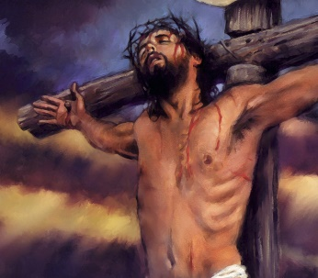
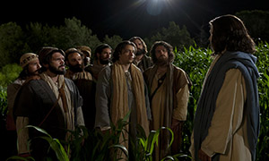
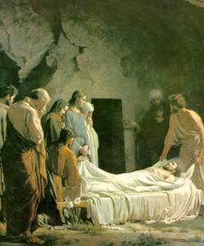
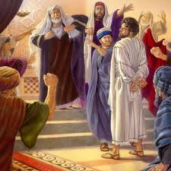
The Savior was crucified at Golgotha
Jesus Christ offered the great Intercessory Prayer
The body of Jesus Christ was placed in a tomb by Joseph of Arimathea and Nicodemus
He was betrayed, arrested, and tried before Annas, Caiaphas, and Pilate

Slide 3
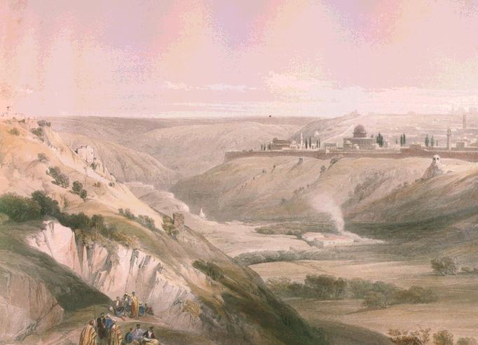
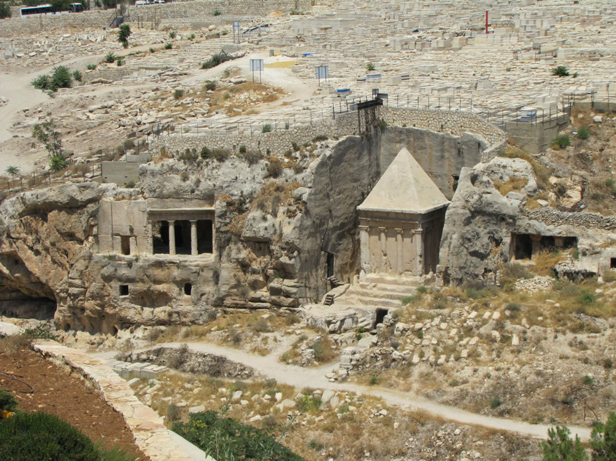
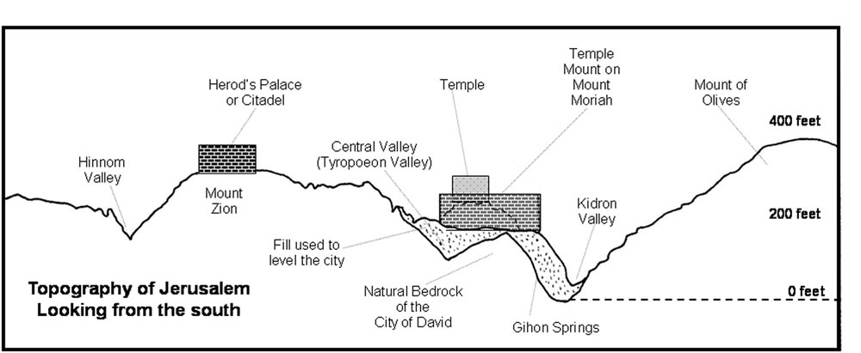
The Cedron Valley
Yea, though I walk through the valley of the shadow of death,...Psalm 23:4
The Kidron Valley contained tombs in Jesus' time, as it does today. The walk Jesus and His disciples would have taken through this area the night before He died. (1)
Looking down into the Kidron Valley from the base of the southeast corner of the Temple Mount at 2000 year old tombs cut into the west side of the Mount of Olives. (4)
John 18:1

Slide 4
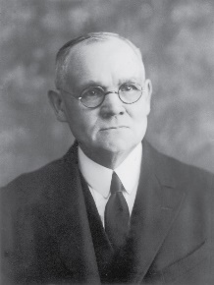
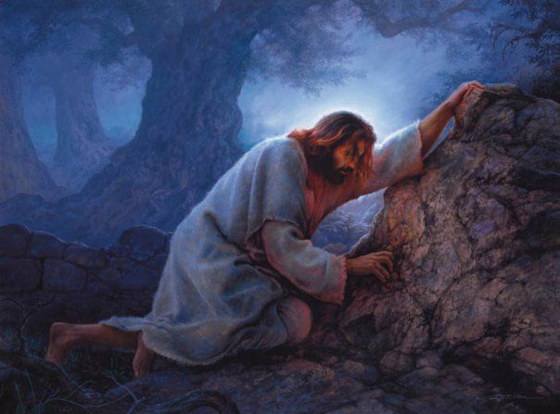
The Suffering
“Christ’s agony in the garden is unfathomable to the finite mind, both as to intensity and cause. The thought that He suffered through fear of death is untenable.
Death to Him was preliminary to resurrection and triumphal return to the Father from whom He had come, and to a state of glory even beyond what He had before possessed; and, moreover, it was within His power to lay down His life voluntarily.”
In some manner, actual and terribly real, though to man incomprehensible, the Savior took upon Himself the burden of the sins of mankind from Adam to the end of the world.”
Greg Olsen
John 18:1; Matthew 26:36-46; Mark 14:32-42; Luke 22:40-46
(2)

Slide 5
“The Savior’s physical suffering guarantees that through his mercy and grace every member of the human family shall be freed from the bonds of death and be resurrected triumphantly from the grave. Of course the time of that resurrection and the degree of exaltation it leads to are based upon our faithfulness.”
Wherefore, how great the importance to make these things known unto the inhabitants of the earth, that they may know that there is no flesh that can dwell in the presence of God, save it be through the merits, and mercy, and grace of the Holy Messiah, who layeth down his life according to the flesh, and taketh it again by the power of the Spirit, that he may bring to pass the resurrection of the dead, being the first that should rise. 2 Nephi 2:8
The Savior’s spiritual suffering and the shedding of his innocent blood, so lovingly and freely given, paid the debt for what the scriptures call the “original guilt” of Adam’s transgression. Furthermore, Christ suffered for the sins and sorrows and pains of all the rest of the human family, providing remission for all of our sins as well, upon conditions of obedience to the principles and ordinances of the gospel he taught
(3)

Slide 6
The Betrayal
After Jesus' suffering in the garden, Judas, along with “a band of men and officers from the chief priests and Pharisees” found Jesus in the garden.
Jesus, “knowing all things that should come upon him,” stepped forward and asked, “Whom seek ye?”
Jesus was not a passive participant in His own arrest.
When the men asked for Jesus of Nazareth, Jesus answered, “I am he”
These words are translated from the Greek phrase egō eimi, used in many other places in John in reference to the divinity of Jesus Christ.
John 18:3-8
(1)

Slide 7
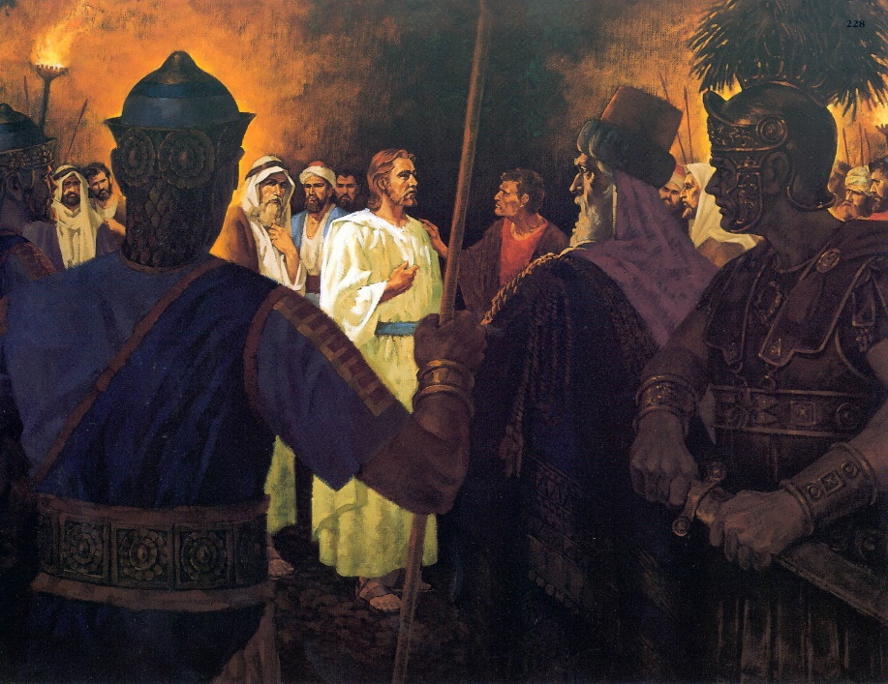
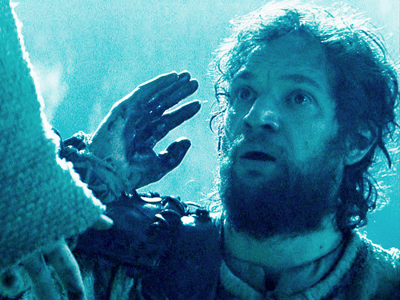
Jesus’ Concerns
Protecting His Apostles; healing the servant’s (Malchus) ear and doing Heavenly Father’s will
Jesus Christ offered Himself to His enemies if they would let His disciples go free.
This ensured the immediate physical safety of the Apostles, who would become the leaders of the Church following Jesus' death.
This small detail is a reflection of the larger event that was then taking place, a mirror of the Atonement of Christ. The Savior gave Himself so all of us could be set free from the eternal enemies of sin and death. (1)
John 18:8-9

Slide 8
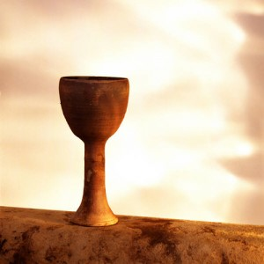
The Cup
“drink of the cup” was “a metaphorical expression meaning,
‘To do the things which my lot in life requires of me.’”
He explained that the phrase “be baptized with the baptism that I am baptized with” means “to follow my course, suffer persecution, be rejected of men, and finally be slain for the truth’s sake” (5)
The Savior refocused the attention of James and John on carrying out the Father’s will, rather than on receiving glory and honor. (1)
John 18:11; Mark 10:38

Slide 9
Jesus Allowed the Officers to Arrest Him
After Caiaphas questioned Jesus, the Jewish leaders took Jesus to Pilate, the Roman provincial governor of Judea, to be tried and sentenced.
They took Him to Annas, one of the Jewish leaders
And then to Caiaphas, the high priest who sought to condemn Jesus to death
The trial may have taken place at Antonia Fortress near the temple.
Peter and another disciple followed Jesus. When three different people asked Peter whether he was one of Jesus' disciples, Peter denied knowing Him each time.
Only the Romans had the authority to carry out a death sentence in Jerusalem.
John 18:12-32

Slide 10
Did Peter know who he was?
I am not one of the man’s disciples
I am not one of the disciples
I was not in the garden with him
John 18:17, 25-27

Slide 11
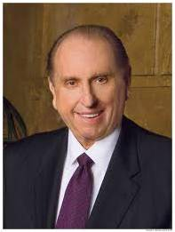
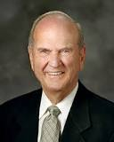
Who Am I?
“We must remember who we are and what God expects us to become.” (6)
“As you continue to face many challenging choices in life, remember, there is great protection when you know who you are, why you are here, and where you are going.” (7)

Slide 12
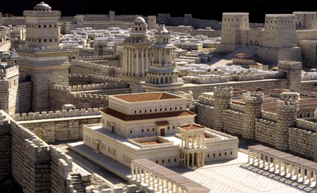
Jesus to Pilate
The hypocrisy of the Jewish leaders was put on display when they led Jesus to Pilate to be judged.
They would not enter into the hall of judgment, which was a Gentile structure, because doing so would make them ritually unclean and they desired to eat the Passover meal the next day.
Yet at the same time, they were willing to falsely accuse Jesus before Pilate and seek His death. (1)
This model of first-century Jerusalem depicts the palace (foreground) that was probably “the hall of judgment” (John 18:28) where Pilate questioned Jesus. It also depicts the Antonia Fortress (background on right), another possible site of the trial before Pilate.
John 18:28-36

Slide 13
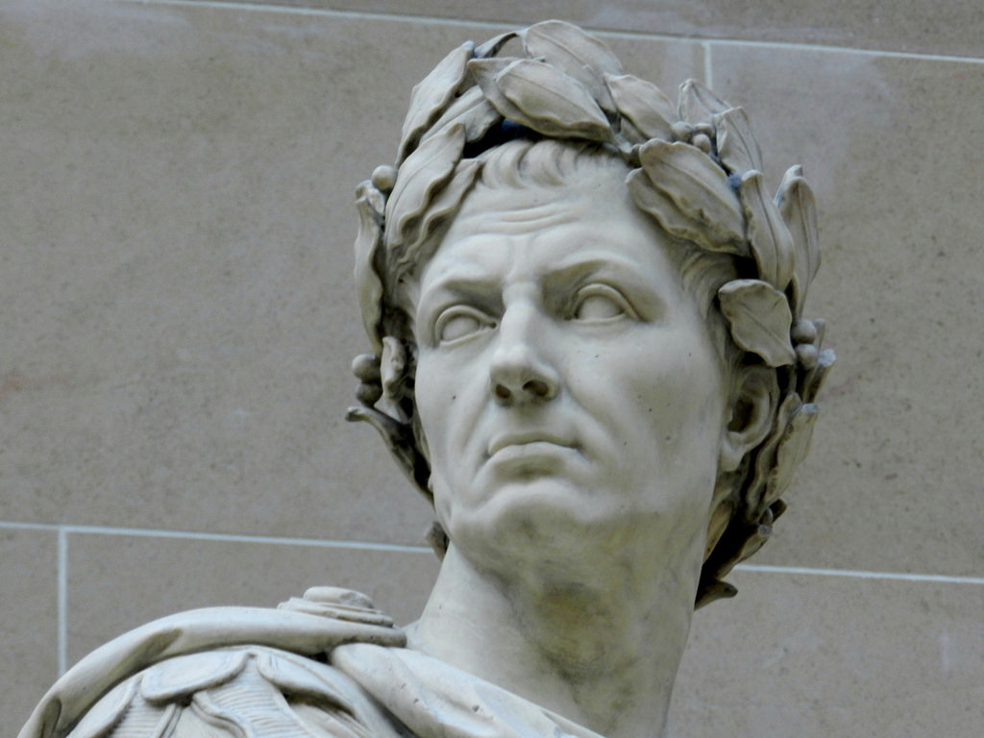
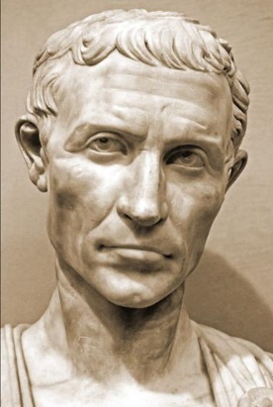
Who Was Pontius Pilate
Caesar was the Roman emperor who had granted Pilate his position as Judea’s governor.
On several previous occasions, Pilate had ordered Roman soldiers to slaughter Jews, and he had defiled some of their sacred religious traditions.
Pilate’s actions had been reported to Caesar, and Caesar had rebuked Pilate.

Slide 14
Tried Before Pilate
My kingdom is not of this world: if my kingdom were of this world, then would my servants fight, that I should not be delivered to the Jews: but now is my kingdom not from hence.
Art thou the King of the Jews?
Sayest thou this thing of thyself, or did others tell it thee of me?
Art thou a king then?
Thou sayest that I am a king. To this end was I born, and for this cause came I into the world, that I should bear witness unto the truth.
Am I a Jew Thine own nation and the chief priests have delivered thee unto me; what hast thou done?
Every one that is of the truth heareth my voice.
John 18:33-37

Slide 15
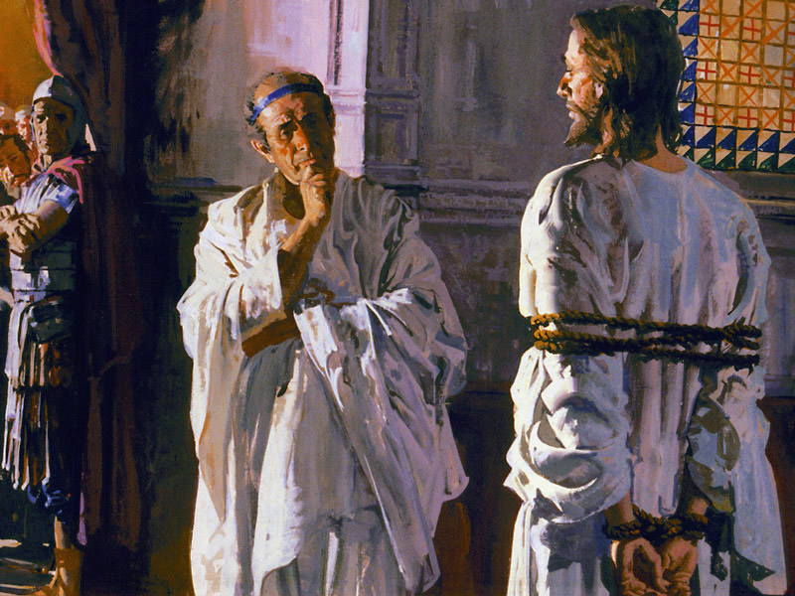
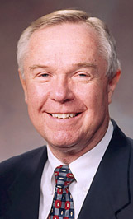
“My Kingdom is Not of this World”
Jesus’ statements are consistent with His refusal throughout His ministry to present Himself as an earthly king, while openly declaring that He was the Messiah.
When Jesus therefore perceived that they would come and take him by force, to make him a king, he departed again into a mountain himself alone. John 6:15
“With these few words, Jesus declares His kingdom independent and distinct from this world. The Savior’s teachings, doctrine, and personal example lift all who truly believe in Him to a
divine standard that requires
both eye and mind be single to
the glory of God.” (8)
John 18:28-36

Slide 16
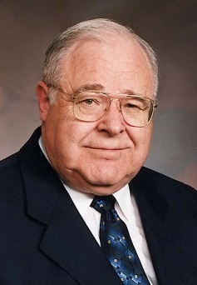
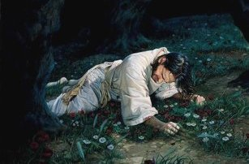
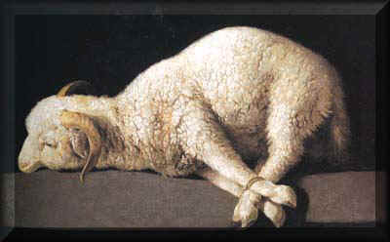
Bare Witness of the Truth
But with the precious blood of Christ, as of a lamb without blemish and without spot: 1 Peter 1:19
“Love for all of God’s children that led Jesus, unique in His sinless perfection, to offer Himself as ransom for the sins of others.
This, then, was the consummate cause which brought Jesus to earth to ‘suffer, bleed, and die for man.’ (9)
He came as ‘a lamb without blemish and without spot’ to atone for our sins, that He, being raised on the cross, might draw all men unto Him.
3 Ne. 27:14
John 18:37

Slide 17
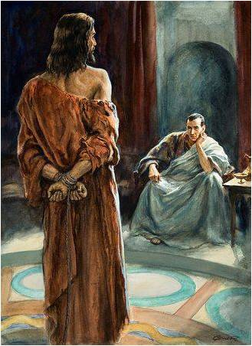
What is Truth?
Perhaps, afraid to learn the truth, Pilate left before Jesus responded. Most likely, Pilate did not want to face the truth.
"'What is truth?' From the time Pilate asked this in the New Testament until the heavens were opened again in the day of the Restoration, the scriptures are silent on the Lord's response to that question.
"We don't know if Pilate waited to hear the Savior's reply. We are told only that, after he asked his question, Pilate 'went out again unto the Jews, and saith unto them, I find in him no fault at all.'
'Ye were also in the beginning with the Father; that which is Spirit, even the Spirit of truth;
And truth is knowledge of things as they are, and as they were, and as they are to come;
And whatsoever is more or less than this is the spirit of that wicked one who was a liar from the beginning.
The Spirit of truth is of God. I am the Spirit of truth, and John bore record of me, saying: He received a fulness of truth, yea, even of all truth...' (D&C 93:23-30.)
John 18:37-39
(10)

Slide 18
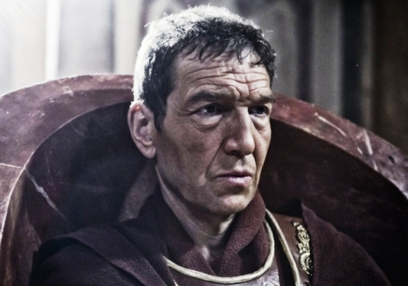
Finding No Fault
The Jewish leaders accused Jesus of claiming to be the king of the Jews because if Jesus claimed to be a king, He could be charged with sedition, or treason, against the Roman government, a crime that was punishable by death.
Pilate initially resisted the entreaty of Jewish leaders to get involved with the case against Jesus and thereafter sought repeatedly to release Jesus.
Pilate had a troubled history with the Jewish population he governed during an 11-year appointment in Judea—which included several violent clashes with the Jewish people and an official reprimand from the emperor. So his eventual capitulation to the crowd is no surprise.
To quell a possible riot and avoid allegations of political disloyalty Pilate consented to crucify Jesus of Nazareth. For additional insights about Pontius Pilate.
John 18:38; John 19:12; Matthew 27:24
(1)

Slide 19
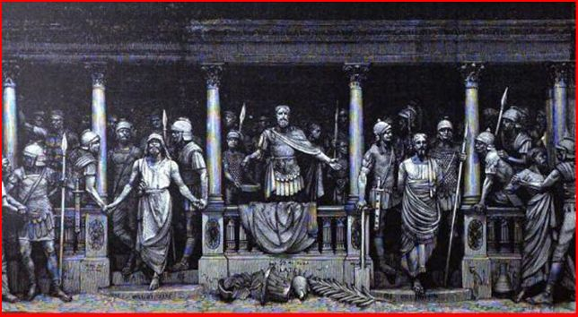
Not This Man, But Barabbas
Ecclesiastical and political rejection became more personal when the citizenry in the street turned against Jesus as well.
It is one of the ironies of history that sitting with Jesus in prison was a real blasphemer, a murderer and revolutionary known as Barabbas, a name or title in Aramaic meaning "son of the father."
Free to release one prisoner in the spirit of the Passover tradition, Pilate asked the people, "Whether of the twain will ye that I release unto you?"
They said, "Barabbas."
So one godless "son of the father" was set free while a truly divine Son of His Heavenly Father moved on to crucifixion.
John 18:40, Matthew 27:21
(3)

Slide 20
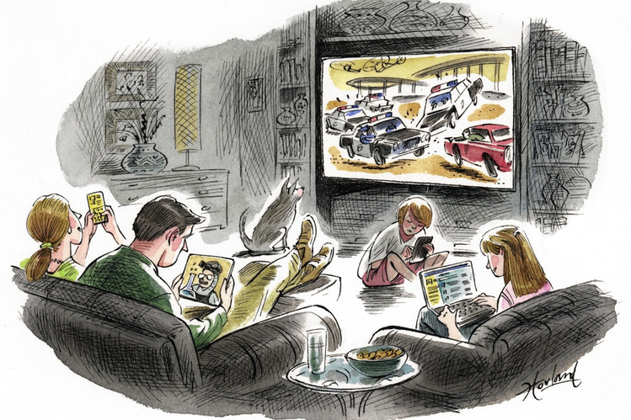
Pilate’s Concerns
himself; his position and power.
Placing our own interests ahead of doing what is right will lead us to sin
What are some situations in which we might be tempted to place our own interests ahead of doing what is right?
What can we do to overcome the temptation to place our own interests ahead of doing what is right?
John 18:40
(3)

Slide 21
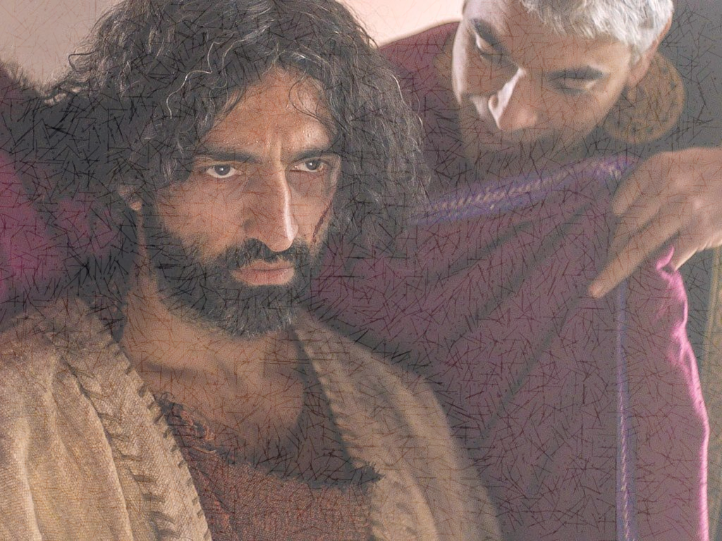
Delivering The Lamb
“Pilate delivered the Lamb of God to be crucified at the same time Paschal lambs nearby were being prepared for sacrifice”
At the very hour when the Passover lambs were being sacrificed, the “Lamb of God” began His journey to the cross to make the ultimate sacrifice for all mankind.”
John 19:1-16
(1,7)

Slide 22
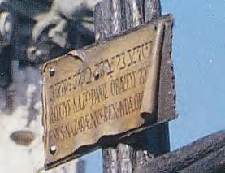
“What I Have Written I Have Written”
“In Hebrew, Greek, and Latin—as though to symbolize the fact that here was a message for all nations and tongues—Pilate bore a written testimony of the divine Sonship of our Lord, a testimony which he obdurately refused to change, a testimony which is true and so stands everlastingly.”
Pilate wrote a title and put it on the cross
“Jesus of Nazareth the King of the Jews”
John 19:17-22
(5)

Slide 23
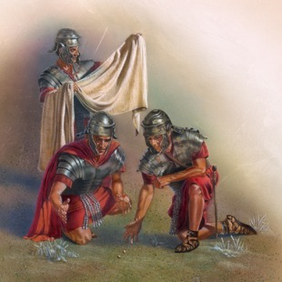
The Saviors Clothes Divided
The Savior’s clothing was divided among the soldiers.
Jewish men usually wore five articles of clothing—headdress, shoes, inner garment, outer cloak, and girdle or belt—which, according to Roman custom, became the property of the soldiers who performed crucifixions.
In Jesus' case, all of His clothing besides His coat was divided between the four soldiers at the cross. But His coat was seamless and too valuable to be cut up, so the soldiers cast lots to see who would get it.
This episode fulfilled prophecy:
They part my garments among them, and cast lots upon my vesture. Psalm 22:18
John 19:23-24
(1)

Slide 24
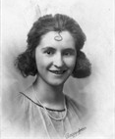
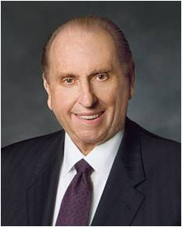
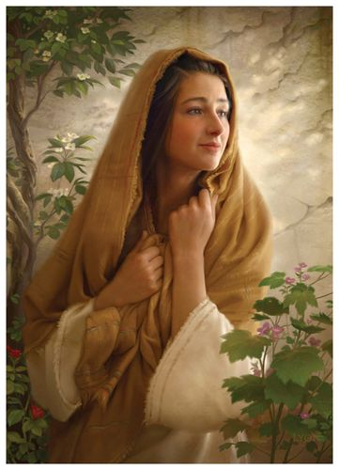
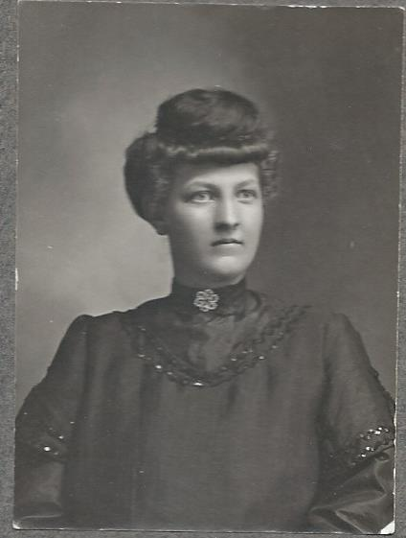
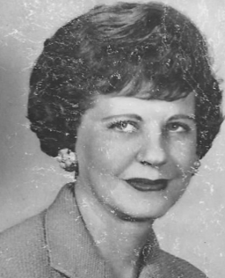
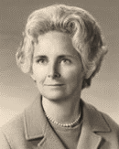
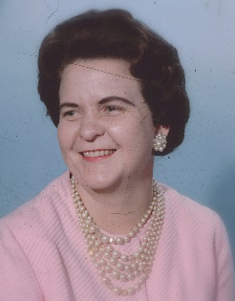
“Woman, Behold Thy Son”
"As we truly listen to that gentle command and with gladness obey its intent, gone forever will be the vast legions of 'mothers forgotten.'
Everywhere present will be 'mothers remembered,' 'mothers blessed,' and 'mothers loved'; and, as in the beginning, God will once again survey the workmanship of his own hand and be led to say, 'It is very good.‘
"May each of us treasure this truth: 'One cannot forget mother and remember God. One cannot remember mother and forget God.' Why? Because these two sacred persons, God and mother, partners in creation, in love, in sacrifice, in service, are as one."
Gladys Condie Monson (1902-1973)
(mother of Pres. Thomas S. Monson)
John 19:25-27
(6)

Slide 25
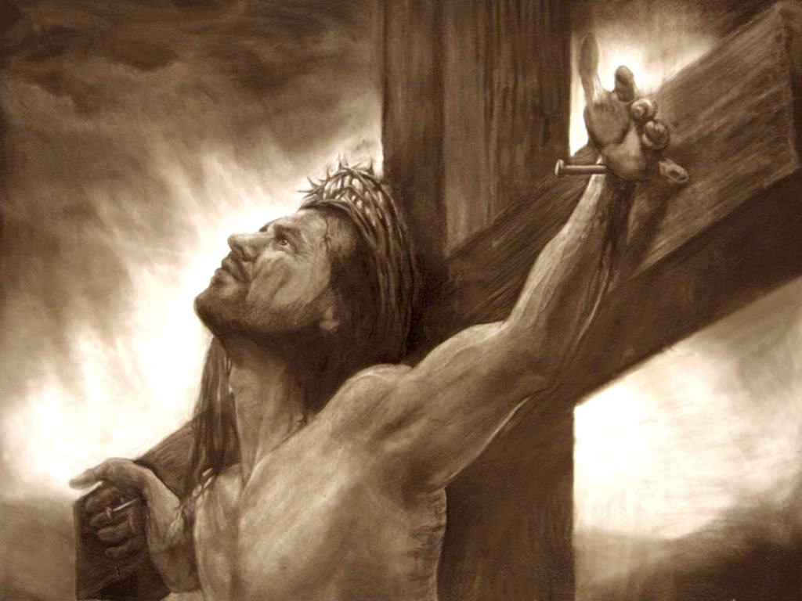
I Thirst
Jesus taught that He offers “living water” to quench forever the spiritual thirst of all who follow Him.
But now, on the cross, Jesus declared His own thirst and was offered only vinegar, fulfilling ancient prophecy:
They gave me also gall for my meat; and in my thirst they gave me vinegar to drink. Psalm 69:21
“John affirms that Christ uttered the exclamation, ‘I thirst,’ only when He knew ‘that all things were now accomplished’; and the apostle saw in the incident a fulfillment of prophecy”
John 19:28-29
(2)

Slide 26
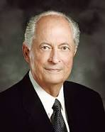
Jesus Fulfills His Divine Mission
“From before the foundation of the world to the final moments on the cross, the Savior had been about His Father’s business. He completed the work He had been sent to do.”
“Jesus when he had cried again with a loud voice, saying, Father, it is finished, thy will is done, yielded up the ghost” (12)
Therefore, we do not wonder to whom He was talking when, upon the cross, ‘he said, It is finished,’ and ‘cried with a loud voice, … Father, into thy hands I commend my spirit: and having said thus, he gave up the ghost’.
We know He was praying to His Heavenly Father.”
John 19:30; Luke 23:46
(11)

Slide 27
The Burial
Matthew 27:57-66
Mark 15:42-47 Mark 16:1
Luke 23:50-56
John 19:38-42

Slide 28
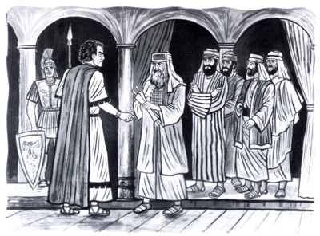
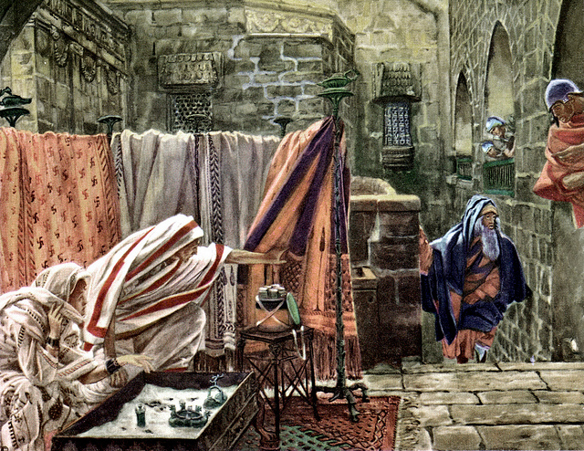
“…begged…”
Luke 23:52
“…Joseph of Arimathaea, being a disciple of Jesus…
…besought Pilate that he might take away the body of Jesus…”
John 19:38

Slide 29
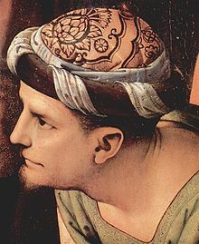
Joseph of Arimathaea:
Honorable disciple
A man of wealth
Fearful of the Jews
Property owner of burial place
John 19:38

Slide 30
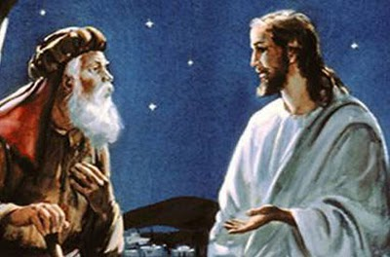
“…also Nicodemus, which at the first came to Jesus by night,…
…and brought a mixture of myrrh and aloes…”
John 19:39

Slide 31
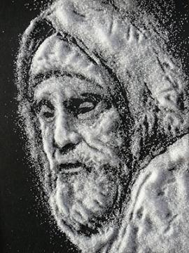
Nicodemus:
Was with Jesus three years earlier
Protested unlawful condemnation of Jesus without a hearing
John 19:39

Slide 32
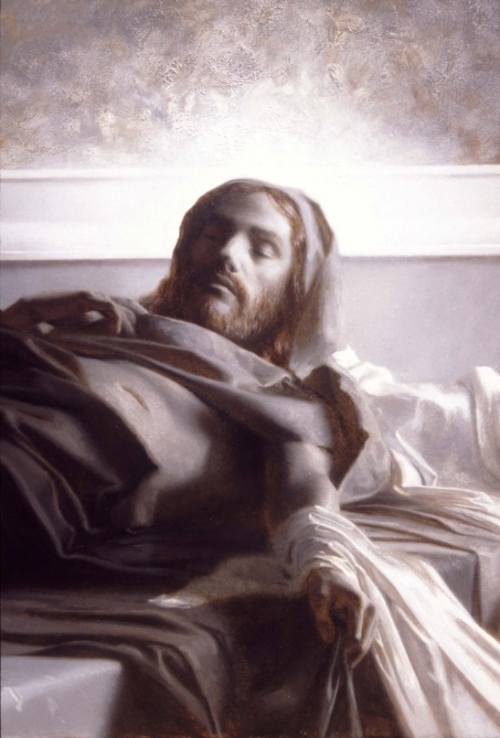
“Then took they the body of Jesus, and wound it in linen clothes with the spices…
“And laid it in his own tomb, which was hewn out in the rock; and he rolled a great stone to the door of the sepulchre, and departed.
John 19:40; Matthew 27:60

Slide 33
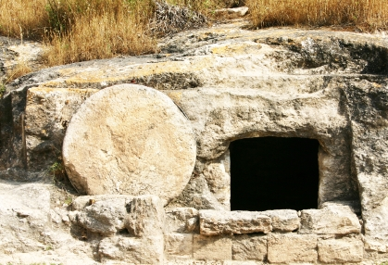
“Now in the place where he was crucified there was a garden;…
…and in the garden a new sepulchre, wherein was never man yet laid.”
John 19:40

Slide 34
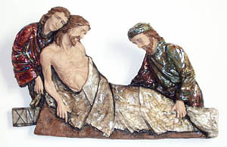
“There laid they Jesus therefore because of the Jews’ preparation day, for the sepulchre was nigh at hand.”
Because of the nearness of the Sabbath the internment had to be made with haste.
John 19:40

Slide 35
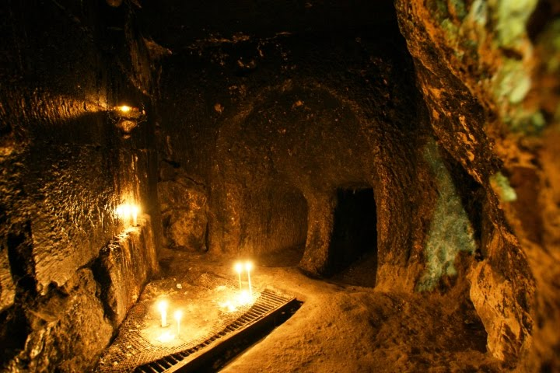
The preparation day extended from sunset on Thursday to the beginning of the Sabbath at sunset on Friday.

Slide 36
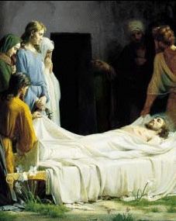
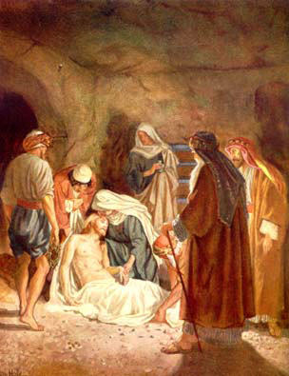
“And the women also, which came with him from Galilee, followed after,…
“And they returned, and prepared spices and ointments; and rested the sabbath day according to the commandments.”
Luke 23:55-56

Slide 37
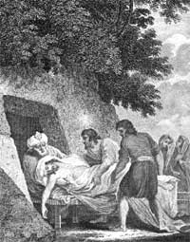
“Mary Magdalene and Mary the mother of Jeses beheld where he laid.”
These women watched the entombment from a distance, and when it was completed they returned with prepared spices and ointments, then rested the Sabbath day.
Mark 15:47; Luke 23:56

Slide 38
It is evident that Pilate and others remembered Jesus’ predictions of an assured resurrection on the third day after His death.
They went to see the sealed door.
He placed guards so that his disciples could not steal the body.
Matthew 27:60-66

Slide 39
“So they went, and made the sepulcher sure, sealing the stone, and setting the watch.”
Matthew 27:60-66

Slide 40
“And when the Sabbath was past, Mary Magdalene, and Mary the mother of James and Salome, had bought sweet spices, that they might come and anoint him.”
Mark 16:1

Slide 41
The True Character of Jesus Christ
“Character is revealed … in the power to discern the suffering of other people when we ourselves are suffering; in the ability to detect the hunger of others when we are hungry; and in the power to reach out and extend compassion for the spiritual agony of others when we are in the midst of our own spiritual distress.
Thus, character is demonstrated by looking and reaching outward when the natural and instinctive response is to be self-absorbed and turn inward.
If such a capacity is indeed the ultimate criterion of moral character, then the Savior of the world is the perfect example of such a consistent and charitable character.”
We can follow the Savior’s example by choosing to help others even when we are in need ourselves
(13)

Slide 42
Sources:
Suggested Hymn: #194 There is a Green Hill Far Away
Video: To This End Was I Born (27:12)
God Will Lift Us Up (4:59)
New Testament Institute Student Manual Chapter 27
Elder James E. Talmage (Jesus the Christ, p. 613, 648-649; 661.)
Elder Jeffrey R. Holland This Do In Remembrance of Me Oct. 1995 Gen. Conf. And ("None Were with Him" Ensign, May 2009, 86)
Generationword.com Jerusalem 101 (Kidron Valley)
Elder Bruce R. McConkie (Doctrinal New Testament Commentary, 1:566; 1:817).
President Thomas S. Monson May 1994 Gen. Conf. and Mothers: (Pathways to Perfection [Salt Lake City: Deseret Book Co., 1973], 230.)
Elder Russell M. Nelson Conf. Report Oct 1990 and (“Why This Holy Land?” Ensign, Dec. 1989, 18).
Elder Dennis B. Neuenschwander (“Holy Place, Sacred Space,” Ensign or Liahona, May 2003, 71).
Elder Alexander B. Morrison (“For This Cause Came I into the World,” Ensign, Nov. 1999, 25–26).
What Is Truth?, LDS Church News, 1996, 09/21/96.
Elder Robert D. Hales (“Gaining a Testimony of God the Father; His Son, Jesus Christ; and the Holy Ghost,” Ensign or Liahona, May 2008, 31).
Joseph Smith Translation, Matthew 27:54 [in Matthew 27:50, footnote a
Elder David A. Bednar (“The Character of Christ”[Brigham Young University–Idaho Religion Symposium, Jan. 25, 2003], 2–3).
Presentation by ©http://fashionsbylynda.com/blog/

Slide 43
Event | Matthew | Mark | Luke | John
Prayer and Agony of Gethsemane | 26:36-46 | 14:32-42 | 22:40-46 | 18:1
The Betrayal by Judas | 26:47, 50 | 14:43-45 | 22:47, 48 | 18:2-9
Peter Rebuked for Trying to Stop the Arrest | 26:51-55 | 14:47-49 | 22:49-53 | 18:10, 11
The Arrest and the Apostles Flee | 26:50, 56 | 14:46, 50-52 |  | 18:12
Taken to the Palace of Annas and Caiaphas Followed by Peter and John | 26:57, 58 | 14:53, 54 | 22:54, 55 | 18:13-16, 18
Questioned by Annas |  |  |  | 18:19-24
Peter Denies Knowing Jesus | 26:69-75 | 14:66-72 | 22:56-62 | 18:17, 25-27
First Appearance Before Pilate | 27:2, 11-14 | 15:1-5 | 23:1-7 | 18:28-38
Scourging and Mocking of Jesus | 27:27-30 | 15:16-19 |  | 19:1-3
Pilate Pleads for Jesus | 27:23 | 15:14 | 23:23 | 19:4-15
Pilate Preleases Barabbas and Delivers Jesus to Be Crucified | 27:24-26 | 15:5 | 23:24, 25 | 19:16
Jesus Mocked and led to Golgotha and Crucified | 27:31-34, 38 | 15:20-23, 25, 27, 28 | 23:26-33 | 19:16-18
Superscription: “This Is Jesus The King of the Jews” | 27:37 | 15:26 | 23:38 | 19:19-22
Soldiers Cast lots for His Garments | 27:35, 36 | 15:24 | 23:34b | 19:23, 24
Jesus Speaks to His Mother |  |  |  | 19:25-27
Final Words and Death of Jesus | 27:46-50 | 15:34-37 | 23:47 | 19:28-30
Jesus’ Side is Pierced |  |  |  | 19:31-37
The Burial of Jesus | 27:57-61 | 15:42-47 | 23:50-56 | 19:38-42

Slide 44
“I AM” Statements
REFERENCE IN JOHN | “I AM” STATEMENT | FULFILLMENT
6:35, 48, 51 | “I am the bread of life.” | Jesus Christ gave Himself for us in the Atonement. He feeds us spiritually.
8:12; 9:5 | “I am the light of the world.” | Jesus Christ is the source of all truth. If we follow His words and example, we will not stumble or walk in spiritual darkness.
8:58 | “Before Abraham was, I am.” | Jesus Christ is Jehovah of the Old Testament.
10:7, 9 | “I am the door of the sheep.” | Jesus Christ protects us like a shepherd at the door of a sheep enclosure. No one can enter His kingdom except through Him.
10:11, 14 | “I am the good shepherd.” | Jesus Christ leads us. He gave His life for us. He knows each of us individually.
10:36 | “I am the Son of God.” | Jesus Christ is the Firstborn of the Father’s spirit children (see D&C 93:21) and His Only Begotten in the flesh (see John 1:14).
11:25 | “I am the resurrection, and the life.” | Through the Atonement of Jesus Christ we can overcome physical and spiritual death. Jesus Christ gave us the gift of resurrection.
14:6 | “I am the way, the truth, and the life.” | Jesus Christ is the only way to the Father, and He is the source of all truth. Because of His Atonement, we will all be resurrected and through our faithfulness may inherit eternal life.
15:1, 5 | “I am the true vine.” | We depend on Jesus Christ for life. Only by abiding by His teachings will we be able to bear the fruit of righteousness.
New Testament Seminary Teacher Manual

Slide 45
Jesus Christ made seven statements from the cross that are recorded in the Gospels
SCRIPTURE REFERENCE | Statements
Luke 23:34 | “Father, forgive them; for they know not what they do.”
Luke 23:43 | “To day shalt thou be with me in paradise.”
John 19:26–27 | “Woman, behold thy son! … Behold thy mother!”
Matthew 27:46; Mark 15:34 | “My God, my God, why hast thou forsaken me?”
John 19:28 | “I thirst.”
John 19:30 | “It is finished.”
Luke 23:46 | “Father, into thy hands I commend my spirit.”

Slide 46
John Does not write about the suffering of Christ John 18:1
Ironically, John was the only of the Gospel writers who was closer than a stone's throw of Christ's suffering in Gethsemane, yet his record lacks any mention of the event. We cannot suppose from this notable absence that John thought it unimportant. Rather, as other evidence indicates, John seems to be writing his gospel with a full knowledge of what is contained in the other testimonies. His record seems to be designed specifically to fill in the gaps. With regard to the events in the Garden, we may assume that the synoptic authors were comprehensive. Matthew, Mark, and Luke all spoke of the great sacrifice in Gethsemane while John seems to have had nothing more to add.
As we know, John had slept through portions of that monumental moment. Possibly, the narrative silence represents his grief about his own weak and slumbering flesh which could not remain awake despite the Master's specific request (Matt. 26:38-43). Meanwhile, the Master was suffering 'according to the flesh' even 'the pains of every living creature, both men, women, and children, who belong to the family of Adam' (Matt. 26:41, Alma 7:13, 2 Ne. 9:21). Certainly, the heaviness of John's eyelids can hardly be compared to the heaviness of Christ's burden on that fateful night. Such is the contrast between even great men and the Master!
Gospeldoctrine.com
John 18:12-13:
"John alone informs us that the Lord was taken first to Annas, who sent Him, still bound to Caiaphas, the high priest; the synoptists record the arraignment before Caiaphas only. No details of the interview with Annas are of record; and the bringing of Jesus before him at all was as truly irregular and illegal, according to Hebrew law, as were all the subsequent proceedings of that night. Annas, who was father-in-law to Caiaphas, had been deposed from the high-priestly office over twenty years before; but throughout this period he had exerted a potent influence in all the affairs of the hierarchy." Elder James E. Talmage (Jesus the Christ, 576)
Who was the Other Disciple? John 18:16
How John, the son of Zebedee and a Galilean fisherman, knew the high priest is entirely unclear. Not only did he know the high priest, but he knew his servant Malchus by name (v. 10). He may even have known the woman that kept the door. The whole incident proves that even in Jesus time, it's not what you know but who you know. Instructively, we learn that the disciple had no qualms about using his "in" with the high priest so he could witness the unfolding drama. Sometimes it is appropriate to play the games of the world when performing the Lord's work. John seemed to understand the Lord's meaning when he said, 'I send you forth as sheep in the midst of wolves: be ye therefore wise as serpents, and harmless as doves' (Matt 10:16).
Gospeldoctrine.com
The Arrest John 18:3-8:
"One cannot help but be struck with the tremendous difference between Christ's behavior during those terrible hours and the actions of those around him. Throughout, it becomes clear that Jesus was the only one who was not thrown off balance by the passions of that night and the following day. Judas betrayed him, then committed suicide, apparently in a great overflowing feeling of guilty remorse. The armed party sent out to arrest him fell back in fright when he told them he was Jesus. Peter vowed perfect support and then failed miserably as fear washed out his determination. The high priest was thrown into a rage by the calm demeanor of the accused. Pilate, symbol and wielder of Roman might, became a frightened vacillating man when faced with the King of the Jews. Even the hardened Roman soldier was awed by Christ's manner of dying. Throughout, it becomes clear that Jesus was not the victim but the Master.“ Elder Gerald Lund (Selected Writings of Gerald N. Lund: Gospel Scholars Series [Salt Lake City: Deseret Book Co., 1999], 308.)
Peter Denies Jesus John 18:15-18, 25-27:
“My heart goes out to Peter. So many of us are so much like him. We pledge our loyalty; we affirm our determination to be of good courage; we declare, sometimes even publicly, that come what may we will do the right thing, that we will stand for the right cause, that we will be true to ourselves and to others.
“Then the pressures begin to build. Sometimes these are social pressures. Sometimes they are personal appetites. Sometimes they are false ambitions. There is a weakening of the will. There is a softening of discipline. There is capitulation. And then there is remorse, followed by self-accusation and bitter tears of regret. …
“Now, if there be those throughout the Church who by word or act have denied the faith, I pray that you may draw comfort and resolution from the example of Peter, who, though he had walked daily with Jesus, in an hour of extremity momentarily denied the Lord and also the testimony which he carried in his own heart. But he rose above this and became a mighty defender and a powerful advocate. So, too, there is a way for any person to turn about and add his or her strength and faith to the strength and faith of others in building the kingdom of God.” President Gordon B. Hinckley (“And Peter Went Out and Wept Bitterly,” Ensign, Mar. 1995, 2, 4, 6). For more insight on Peter’s denials, see the commentary for Matthew 26:69–75.
In the Bible, Malchus is the servant of the Jewish High Priest Caiaphas who participated in the arrest of Jesus. According to the Bible, one of the disciples, Simon Peter, being armed with a sword, cut off the servant's ear in an attempt to prevent the arrest of Jesus.
Simon cutting off Malchus' ear is related in all four canonical gospels, in Matthew 26:51, Mark 14:47, Luke 22:50-51, and John 18:10–11, but Simon and Malchus are named only in the Gospel of John. Also, Luke is the only gospel that says Jesus healed the servant's ear. This was Jesus' last recorded miracle prior to His resurrection. Wikipedia

Slide 47
“My heart goes out to Peter. So many of us are so much like him. We pledge our loyalty; we affirm our determination to be of good courage; we declare, sometimes even publicly, that come what may we will do the right thing, that we will stand for the right cause, that we will be true to ourselves and to others.
“Then the pressures begin to build. Sometimes these are social pressures. Sometimes they are personal appetites. Sometimes they are false ambitions. There is a weakening of the will. There is a softening of discipline. There is capitulation. And then there is remorse, followed by self-accusation and bitter tears of regret. …
“Now, if there be those throughout the Church who by word or act have denied the faith, I pray that you may draw comfort and resolution from the example of Peter, who, though he had walked daily with Jesus, in an hour of extremity momentarily denied the Lord and also the testimony which he carried in his own heart. But he rose above this and became a mighty defender and a powerful advocate. So, too, there is a way for any person to turn about and add his or her strength and faith to the strength and faith of others in building the kingdom of God.” President Gordon B. Hinckley (“And Peter Went Out and Wept Bitterly,” Ensign, Mar. 1995, 2, 4, 6). For more insight on Peter’s denials, see the commentary for Matthew 26:69–75.
John 18:12-13:
"John alone informs us that the Lord was taken first to Annas, who sent Him, still bound to Caiaphas, the high priest; the synoptists record the arraignment before Caiaphas only. No details of the interview with Annas are of record; and the bringing of Jesus before him at all was as truly irregular and illegal, according to Hebrew law, as were all the subsequent proceedings of that night. Annas, who was father-in-law to Caiaphas, had been deposed from the high-priestly office over twenty years before; but throughout this period he had exerted a potent influence in all the affairs of the hierarchy." Elder James E. Talmage (Jesus the Christ, 576)
Who was the Other Disciple? John 18:16
How John, the son of Zebedee and a Galilean fisherman, knew the high priest is entirely unclear. Not only did he know the high priest, but he knew his servant Malchus by name (v. 10). He may even have known the woman that kept the door. The whole incident proves that even in Jesus time, it's not what you know but who you know. Instructively, we learn that the disciple had no qualms about using his "in" with the high priest so he could witness the unfolding drama. Sometimes it is appropriate to play the games of the world when performing the Lord's work. John seemed to understand the Lord's meaning when he said, 'I send you forth as sheep in the midst of wolves: be ye therefore wise as serpents, and harmless as doves' (Matt 10:16).
Gospeldoctrine.com
The Arrest John 18:3-8:
"One cannot help but be struck with the tremendous difference between Christ's behavior during those terrible hours and the actions of those around him. Throughout, it becomes clear that Jesus was the only one who was not thrown off balance by the passions of that night and the following day. Judas betrayed him, then committed suicide, apparently in a great overflowing feeling of guilty remorse. The armed party sent out to arrest him fell back in fright when he told them he was Jesus. Peter vowed perfect support and then failed miserably as fear washed out his determination. The high priest was thrown into a rage by the calm demeanor of the accused. Pilate, symbol and wielder of Roman might, became a frightened vacillating man when faced with the King of the Jews. Even the hardened Roman soldier was awed by Christ's manner of dying. Throughout, it becomes clear that Jesus was not the victim but the Master.“ Elder Gerald Lund (Selected Writings of Gerald N. Lund: Gospel Scholars Series [Salt Lake City: Deseret Book Co., 1999], 308.)
Pilates Error on Truth John 18:37-39:
"Simply put, truth is eternal. When all else has passed away, truth will remain. Man might try to turn his back on it, close his eyes to it, refuse to hear it, or cover it up, but he cannot make truth go away.
"Truth and error have always been, and always will be, at opposite ends of the spectrum.
"The biblical account of Pilate's brief pursuit of truth gives a glimpse of a major flaw in his character. He claimed that he sought the truth. Yet, he obviously wanted to find the most expedient solution to a difficult situation-what to do with this man, Jesus of Nazareth, in whom he found no fault but whose life the mob demanded. Pilate bowed before custom as he conceded to the will of the throng that Barabbas, a robber, should be released rather than Jesus. (See John 18:39-40.)" (What Is Truth?, LDS Church News, 1996, 09/21/96 .)
In the Bible, Malchus is the servant of the Jewish High Priest Caiaphas who participated in the arrest of Jesus. According to the Bible, one of the disciples, Simon Peter, being armed with a sword, cut off the servant's ear in an attempt to prevent the arrest of Jesus.
Simon cutting off Malchus' ear is related in all four canonical gospels, in Matthew 26:51, Mark 14:47, Luke 22:50-51, and John 18:10–11, but Simon and Malchus are named only in the Gospel of John. Also, Luke is the only gospel that says Jesus healed the servant's ear. This was Jesus' last recorded miracle prior to His resurrection. Wikipedia

Slide 48
Pilate:
Pilate knew what was right but lacked the moral courage to do it. He was afraid of the Jews, and more afraid of hostile influence at Rome. He was afraid of his conscience, but more afraid of losing his official position. It was the policy of Rome to be gracious and conciliatory in dealing with the religions and social customs of conquered nations. Pontius Pilate had violated this liberal policy from the early days of his procuratorship. In utter disregard of the Hebrew antipathy against images and heathen insignia, he had the legionnaires enter Jerusalem at night, carrying their eagles and standards decorated with the effigy of the emperor. To the Jews this act was a defilement of the Holy City. In vast multitudes they gathered at Cæsarea, and petitioned the procurator that the standards and other images be removed from Jerusalem.
For five days the people demanded and Pilate refused. He threatened a general slaughter, and was amazed to see the people offer themselves as victims of the sword rather than relinquish their demands. Pilate had to yield (Josephus, Antiquities, xviii, chap. 3:1; also Wars, ii, chap. 9:2, 3). Again he gave offense in forcibly appropriating the Corban, or sacred funds of the temple, to the construction of an aqueduct for supplying Jerusalem with water from the pools of Solomon. Anticipating the public protest of the people, he had caused Roman soldiers to disguise themselves as Jews; and with weapons concealed to mingle with the crowds. At a given signal these assassins plied their weapons and great numbers of defenseless Jews were killed or wounded (Josephus, Antiquities, xviii, chap. 3:2; and Wars, ii. chap. 9:3, 4).
On another occasion, Pilate had grossly offended the people by setting up in his official residence at Jerusalem, shields that had been dedicated to Tiberius, and this “less for the honor of Tiberius than for the annoyance of the Jewish people.” A petition signed by the ecclesiastical officials of the nation, and by others of influence, including four Herodian princes, was sent to the emperor, who reprimanded Pilate and directed that the shields be removed from Jerusalem to Cæsarea (Philo. De Legatione ad Caium; sec. 38).
These outrages on national feeling, and many minor acts of violence, extortion and cruelty, the Jews held against the procurator. He realized that his tenure was insecure, and he dreaded exposure. Such wrongs had he wrought that when he would have done good, he was deterred through cowardly fear of the accusing past.
James E. Talmage 648-649 Notes #7
Barabbas Matthew 27:26 and John 18:40:
The name Barabbas ironically means “son of the father.” The crowd, most of whom were stirred up by the chief priests and elders, called for the release of Barabbas while rejecting the true Son of the Father. In one sense, we are all like Barabbas—we are the sinful sons set free because the true Son of the Father was condemned to death. According to the Greek text of Matthew 27:26, Barabbas’s first name was Jesus. Jesus Barabbas was a thief, murderer, and traitor, while Jesus the Christ was perfect. Those who condemned the Savior to death were presented with a clear choice, and they chose evil.
The Scapegoat Leviticus 16:8-10
The law of Moses provided a foreshadowing of Barabbas’s release centuries before it happened. The law of Moses taught that once a year, on the Day of Atonement, the high priest selected two goats. One goat became the scapegoat and was released alive into the wilderness, while the other was “for the Lord” and was killed as an offering for the sins of the people (see Leviticus 16:8–10). The high priest then took blood from the slain goat into the Holy of Holies of the tabernacle. He sprinkled it on the lid of the ark of the covenant (called the mercy seat), symbolically making atonement for the sins of Israel.
New Testament Institute Manual Chapter 10
Scourging John 19:1:
"Flogging was a preliminary to every Roman execution, and only women and Roman senators or soldiers (except in cases of desertion) were exempt. The usual instrument was a short whip (flagrum or flagellum) with several single or braided leather thongs of variable lengths, in which small iron balls or sharp pieces of sheep bones were tied at intervals. Occasionally, staves also were used. For scourging, the man was stripped of his clothing, and his hands were tied to an upright post...As the Roman soldiers repeatedly struck the victim's back with full force, the iron balls would cause deep contusions, and the leather thongs and sheep bones would cut into the skin and subcutaneous tissues. Then as the flogging continued, the lacerations would tear into the underlying skeletal muscles and produce quivering ribbons of bleeding flesh. Pain and blood loss generally set the stage for circulatory shock. The extent of blood loss may well have determined how long the victim would survive on the cross.
"At the Praetorium, Jesus was severely whipped...The Roman soldiers, amused that this weakened man had claimed to be a king, began to mock him by placing a robe on his shoulders, a crown of thorns on his head, and a wooden staff as a scepter in his right hand. Next, they spat on Jesus and struck him on the head with a wooden staff. Moreover, when the soldiers tore the robe from Jesus back, they probably reopened the scourging wounds.
"The severe scourging, with its intense pain and appreciable blood loss, most probably left Jesus in a preshock state. Moreover, hematidrosis (bleeding from the pores of the skin) had rendered his skin particularly tender. The physical and mental abuse meted out by the Jews and the Romans, as well as the lack of food, water, and sleep, also contributed to his generally weakened state. Therefore, even before the actual crucifixion, Jesus' physical condition was at least serious and possibly critical." (Edwards, et al, "On the Physical Death of Jesus Christ," Journal of the American Medical Association, Mar. 21, 1986, Vol. 255, No. 11, pp. 1457-58)

Slide 49
Jesus Remains Submissive John 19:11:
"During all of the taunting, the abuse, the scourging, and the final torture of crucifixion, the Lord remained silent and submissive. Except, that is, for one moment of intense drama which reveals the very essence of Christian doctrine. That moment came during the trial. Pilate, now afraid, said to Jesus: 'Speakest thou not unto me? knowest thou not that I have power to crucify thee, and have power to release thee?' (John 19:10).
"One can only imagine the quiet majesty when the Lord spoke. 'Thou couldest have no power at all against me, except it were given thee from above' (John 19:11).
"What happened thereafter did not come because Pilate had power to impose it, but because the Lord had the will to accept it.
"'I lay down my life,' the Lord said, 'that I might take it again. No man taketh it from me, but I lay it down of myself. I have power to lay it down, and I have power to take it again' (John 10:17-18).
"Before the Crucifixion and afterward, many men have willingly given their lives in selfless acts of heroism. But none faced what the Christ endured." Boyd K. Packer ("Atonement, Agency, Accountability," Ensign, May 1988, 69)
It is Finished John 19:30:
“Jesus chose not to be released from this world until He had endured to the end and completed the mission He had been sent to accomplish for mankind. Upon the cross of Calvary, Jesus commended His spirit to His Father with a simple statement, ‘It is finished’ (John 19:30). Having endured to the end, He was released from mortality.
“We, too, must endure to the end. The Book of Mormon teaches, ‘Unless a man shall endure to the end, in following the example of the Son of the living God, he cannot be saved’ (2 Ne. 31:16)” Elder Robert D. Hales (“The Covenant of Baptism: To Be in the Kingdom and of the Kingdom,” Ensign, Nov. 2000, 6).
Two Messianic Prophecies Fulfilled John 19:31-37
While Matthew and Mark pointed out that the Savior’s death fulfilled certain prophecies (see Matthew 27:35; Mark 15:28), John mentioned two details that other Gospel writers did not:
First, not one of Jesus' bones was broken. Soldiers sometimes broke the leg bones of crucifixion victims to hasten death, but they did not do this with Jesus. Without realizing it, they fulfilled an important part of the symbolism of Passover, for the Lord had instructed that the Passover lamb—which symbolized the Savior—was not to have any broken bones (see Exodus 12:46; Numbers 9:12). This also fulfilled the messianic prophecy found in Psalm 34:20: “He keepeth all his bones: not one of them is broken.”
Second, Jesus Christ’s side was pierced with a spear. This fulfilled the prophecy of Zechariah: “They shall look upon me whom they have pierced, and they shall mourn for him, as one mourneth for his only son, and shall be in bitterness for him, as one that is in bitterness for his firstborn” (Zechariah 12:10). (1)
Preparation for Passover John 19:14:
John's chronology is different than the synoptic gospels. He wrote that the Last supper was "before the feast of the passover" (John 13:1-2). That means Christ was crucified the day the Jews were preparing the passover feast-that he was crucified at the same time the Jews were slaughtering their unblemished, male lambs. (See commentary for John 13:1-2).
Secondly, the sixth hour is mid-day or noon. The timing here is also different than Matthew, Mark and Luke's. Matthew has Christ on the cross by the sixth hour and dead just after the ninth, "Now from the sixth hour there was darkness over all the land unto the ninth hour" (Matt. 28:45).
"The law of Moses 'was our schoolmaster to bring us unto Christ' (Gal. 3:24), wrote the Apostle Paul, offering 'a shadow of good things to come' (Heb. 10:1). How? One example is the actual sacrificing of the Passover lamb, which was in similitude of the death of Jesus. (See 1 Cor. 5:7.) It appears that the symbolism also included the timing of the Savior's death: the Passover lamb was killed between 3:00 and 5:00 P.M. on the afternoon of the fourteenth day of the spring month specified in the law of Moses (see Ex. 12:1-6), which was when the Lamb of God actually died as a sacrifice (see John 19:14; Matt. 27:46)." (John P. Pratt, "Passover-Was It Symbolic of His Coming?" Ensign, Jan. 1994, 38)
The Sign John 19:20:
The sign was read by many people because the Crucifixion took place “nigh to the city”.
Crucifixion in the Roman Empire was for punishment and also for deterrence of crime. The Roman writer, Marcus Quintilian, explained why crucifixions took place where many people could see them: “Whenever we crucify the guilty, the most crowded roads are chosen, where the most people can see and be moved by this fear. For penalties relate not so much to retribution as to their exemplary effect” (cited in The Anchor Bible Dictionary [1992], “Crucifixion”).

Slide 50
In Chandler’s excellent work (vol. 1, “The Hebrew Trial”), the record of fact in the case, and the Hebrew criminal law bearing thereon are exhaustively considered. Then follows an elaborate “Brief,” in which the following points are set forth in order.
“Point 1: The arrest of Jesus was illegal,” since it was effected by night, and through the treachery of Judas, an accomplice, both of which features were expressly forbidden in the Jewish law of that day.
“Point 2: The private examination of Jesus before Annas or Caiaphas was illegal”;—for (1) it was made by night; (2) the hearing of any cause by a ‘sole judge’ was expressly forbidden; (3) as quoted from Salvador, ‘A principle perpetually reproduced in the Hebrew scriptures relates to the two conditions of publicity and liberty.’
“Point 3.—The indictment against Jesus was, in form, illegal. ‘The entire criminal procedure of the Mosaic code rests upon four rules: certainty in the indictment; publicity in the discussion; full freedom granted to the accused; and assurance against all dangers or errors of testimony’—Salvador, p. 365. ‘The Sanhedrin did not and could not originate charges; it only investigated those brought before it.’—Edersheim, vol. 1, p. 309. ‘The evidence of the leading witnesses constituted the charge. There was no other charge; no more formal indictment. Until they spoke and spoke in the public assembly, the prisoner was scarcely an accused man.’—Innes, p. 41. ‘The only prosecutors known to Talmudic criminal jurisprudence are the witnesses to the crime. Their duty is to bring the matter to the cognizance of the court, and to bear witness against the criminal. In capital cases they are the legal executioners also. Of an official accuser or prosecutor there is nowhere any trace in the laws of the ancient Hebrews.’—Mendelsohn, p. 110.
“Point 4: The proceedings of the Sanhedrin against Jesus were illegal because they were conducted at night. ‘Let a capital offense be tried during the day, but suspend it at night.’—Mishna, Sanhedrin 4:1. ‘Criminal cases can be acted upon by the various courts during daytime only, by the Lesser Sanhedrions from the close of the morning service till noon, and by the Great Sanhedrion till evening.’—Mendelsohn, p. 112.
“Point 5: The proceedings of the Sanhedrin against Jesus were illegal because the court convened before the offering of the morning sacrifice. ‘The Sanhedrin sat from the close of the morning sacrifice to the time of the evening sacrifice.’—Talmud, Jeremiah San. 1:19. ‘No session of the court could take place before the offering of the morning sacrifice.’—MM. Lemann, p. 109. ‘Since the morning sacrifice was offered at the dawn of day, it was hardly possible for the Sanhedrin to assemble until the hour after that time.’—Mishna, Tamid, ch. 3.
“Point 6: The proceedings against Jesus were illegal because they were conducted on the day preceding a Jewish Sabbath; also on the first day of unleavened bread and the eve of the Passover.—‘They shall not judge on the eve of the Sabbath nor on that of any festival.’—Mishna, San. 4:1. ‘No court of justice in Israel was permitted to hold sessions on the Sabbath or any of the seven Biblical holidays. In cases of capital crime, no trial could be commenced on Friday or the day previous to any holiday, because it was not lawful either to adjourn such cases longer than over night, or to continue them on the Sabbath or holiday.’—Rabbi Wise, ‘Martyrdom of Jesus,’ p. 67.
“Point 7: The trial of Jesus was illegal because it was concluded within one day. ‘A criminal case resulting in the acquittal of the accused may terminate the same day on which the trial began. But if a sentence of death is to be pronounced, it cannot be concluded before the following day.’—Mishna, San. 4:1.
“Point 8: The sentence of condemnation pronounced against Jesus by the Sanhedrin was illegal because it was founded upon His uncorroborated confession. ‘We have it as a fundamental principle of our jurisprudence that no one can bring an accusation against himself. Should a man make confession of guilt before a legally constituted tribunal, such confession is not to be used against him unless properly attested by two other witnesses.’—Maimonides, 4:2. ‘Not only is self-condemnation never extorted from the defendant by means of torture, but no attempt is ever made to lead him on to self-incrimination. Moreover, a voluntary confession on his part is not admitted in evidence, and therefore not competent to convict him, unless a legal number of witnesses minutely corroborate his self-accusation.’—Mendelsohn, p. 133.
“Point 9: The condemnation of Jesus was illegal because the verdict of the Sanhedrin was unanimous. ‘A simultaneous and unanimous verdict of guilt rendered on the day of the trial has the effect of an acquittal.’—Mendelsohn, p. 141. ‘If none of the judges defend the culprit, i.e., all pronounce him guilty, having no defender in the court, the verdict of guilty was invalid and the sentence of death could not be executed.’—Rabbi Wise, ‘Martyrdom of Jesus,’ p. 74.
“Point 10: The proceedings against Jesus were illegal in that: (1) The sentence of condemnation was pronounced in a place forbidden by law; (2) The high priest rent his clothes; (3) The balloting was irregular. ‘After leaving the hall Gazith no sentence of death can be passed upon any one soever.’—Talmud, Bab. ‘Of Idolatry’ 1:8. ‘A sentence of death can be pronounced only so long as the Sanhedrin holds its sessions in the appointed place.’—Maimonides, 14. See further Levit. 21:10; compare 10:6. ‘Let the judges each in his turn absolve or condemn.’—Mishna, San. 15:5. ‘The members of the Sanhedrin were seated in the form of a semi-circle, at the extremity of which a secretary was placed, whose business it was to record the votes. One of these secretaries recorded the votes in favor of the accused, the other those against him.’—Mishna, San. 4:3. ‘In ordinary cases the judges voted according to seniority, the oldest commencing; in a capital case the reverse order was followed.’—Benny, p. 73.
“Point 11: The members of the Great Sanhedrin were legally disqualified to try Jesus. ‘Nor must there be on the judicial bench either a relation or a particular friend, or an enemy of either the accused or of the accuser.’—Mendelsohn, p. 108. ‘Nor under any circumstances was a man known to be at enmity with the accused person permitted to occupy a position among the judges.’—Benny, p. 37.
“Point 12: The condemnation of Jesus was illegal because the merits of the defense were not considered. ‘Then shalt thou enquire, and make search, and ask diligently.’—Deut. 13:14. ‘The judges shall weigh the matter in the sincerity of their conscience.’—Mishna, San. 4:5. ‘The primary object of the Hebrew judicial system was to render the conviction of an innocent person impossible. All the ingenuity of the Jewish legists was directed to the attainment of this end.’—Benny, p. 56.”
Walter M. Chandler’s masterly statements of fact and his arguments on each of the foregoing points are commended to the investigator. The author tersely avers: “The pages of human history present no stronger case of judicial murder than the trial and crucifixion of Jesus of Nazareth, for the simple reason that all forms of law were outraged and trampled under foot in the proceedings instituted against Him.” (p. 216.) The Trial of Jesus from a lawyer’s Standpoint
From James E. Talmage’s Jesus the Christ pp. 645-648

Slide 51
The Trial of Jesus from a lawyer’s Standpoint
Walter M. Chandler’s
Found in James E. Talmage’s
Jesus the Christ pp. 645-648
Online Reading Chapter 34

Slide 52
Point 1
The arrest of Jesus was illegal,” since it was effected by night, and through the treachery of Judas, an accomplice, both of which features were expressly forbidden in the Jewish law of that day.

Slide 53
Point 2
The private examination of Jesus before Annas or Caiaphas was illegal”;—for (1) it was made by night;
(2) the hearing of any cause by a ‘sole judge’ was expressly forbidden;
(3) as quoted from Salvador, ‘A principle perpetually reproduced in the Hebrew scriptures relates to the two conditions of publicity and liberty.’

Slide 54
Point 3
The indictment against Jesus was, in form, illegal. ‘The entire criminal procedure of the Mosaic code rests upon four rules: certainty in the indictment; publicity in the discussion; full freedom granted to the accused; and assurance against all dangers or errors of testimony’—Salvador, p. 365.
‘The Sanhedrin did not and could not originate charges; it only investigated those brought before it.’—Edersheim, vol. 1, p. 309.
‘The only prosecutors known to Talmudic criminal jurisprudence are the witnesses to the crime. Their duty is to bring the matter to the cognizance of the court, and to bear witness against the criminal. In capital cases they are the legal executioners also. Of an official accuser or prosecutor there is nowhere any trace in the laws of the ancient Hebrews.’—Mendelsohn, p. 110.
‘The evidence of the leading witnesses constituted the charge. There was no other charge; no more formal indictment. Until they spoke and spoke in the public assembly, the prisoner was scarcely an accused man.’—Innes, p. 41.

Slide 55
Point 4
The proceedings of the Sanhedrin against Jesus were illegal because they were conducted at night. ‘Let a capital offense be tried during the day, but suspend it at night.’—Mishna, Sanhedrin 4:1.
‘Criminal cases can be acted upon by the various courts during daytime only, by the Lesser Sanhedrions from the close of the morning service till noon, and by the Great Sanhedrion till evening.’—Mendelsohn, p. 112.

Slide 56
Point 5
‘No session of the court could take place before the offering of the morning sacrifice.’—MM. Lemann, p. 109.
The proceedings of the Sanhedrin against Jesus were illegal because the court convened before the offering of the morning sacrifice. ‘The Sanhedrin sat from the close of the morning sacrifice to the time of the evening sacrifice.’—Talmud, Jeremiah San. 1:19.
‘Since the morning sacrifice was offered at the dawn of day, it was hardly possible for the Sanhedrin to assemble until the hour after that time.’—Mishna, Tamid, ch. 3.

Slide 57
Point 6
The proceedings against Jesus were illegal because they were conducted on the day preceding a Jewish Sabbath; also on the first day of unleavened bread and the eve of the Passover.—‘They shall not judge on the eve of the Sabbath nor on that of any festival.’—Mishna, San. 4:1.
‘No court of justice in Israel was permitted to hold sessions on the Sabbath or any of the seven Biblical holidays. In cases of capital crime, no trial could be commenced on Friday or the day previous to any holiday, because it was not lawful either to adjourn such cases longer than over night, or to continue them on the Sabbath or holiday.’—Rabbi Wise, ‘Martyrdom of Jesus,’ p. 67.

Slide 58
Point 7
The trial of Jesus was illegal because it was concluded within one day. ‘A criminal case resulting in the acquittal of the accused may terminate the same day on which the trial began.
But if a sentence of death is to be pronounced, it cannot be concluded before the following day.’—Mishna, San. 4:1.

Slide 59
Point 8
The sentence of condemnation pronounced against Jesus by the Sanhedrin was illegal because it was founded upon His uncorroborated confession. ‘We have it as a fundamental principle of our jurisprudence that no one can bring an accusation against himself. Should a man make confession of guilt before a legally constituted tribunal, such confession is not to be used against him unless properly attested by two other witnesses.’—Maimonides, 4:2.
‘Not only is self-condemnation never extorted from the defendant by means of torture, but no attempt is ever made to lead him on to self-incrimination. Moreover, a voluntary confession on his part is not admitted in evidence, and therefore not competent to convict him, unless a legal number of witnesses minutely corroborate his self-accusation.’—Mendelsohn, p. 133.

Slide 60
Point 9
The condemnation of Jesus was illegal because the verdict of the Sanhedrin was unanimous. ‘A simultaneous and unanimous verdict of guilt rendered on the day of the trial has the effect of an acquittal.’—Mendelsohn, p. 141.
‘If none of the judges defend the culprit, i.e., all pronounce him guilty, having no defender in the court, the verdict of guilty was invalid and the sentence of death could not be executed.’—Rabbi Wise, ‘Martyrdom of Jesus,’ p. 74.

Slide 61
Point 10
The proceedings against Jesus were illegal in that:
(1) The sentence of condemnation was pronounced in a place forbidden by law;
(2) The high priest rent his clothes; (3) The balloting was irregular.
‘After leaving the hall Gazith no sentence of death can be passed upon any one so ever.’—Talmud, Bab. ‘Of Idolatry’ 1:8.
‘A sentence of death can be pronounced only so long as the Sanhedrin holds its sessions in the appointed place.’—Maimonides, 14. See further Levit. 21:10; compare 10:6. ‘Let the judges each in his turn absolve or condemn.’—Mishna, San. 15:5.
‘The members of the Sanhedrin were seated in the form of a semi-circle, at the extremity of which a secretary was placed, whose business it was to record the votes. One of these secretaries recorded the votes in favor of the accused, the other those against him.’—Mishna, San. 4:3. ‘In ordinary cases the judges voted according to seniority, the oldest commencing; in a capital case the reverse order was followed.’—Benny, p. 73.

Slide 62
Point 11
The members of the Great Sanhedrin were legally disqualified to try Jesus. ‘Nor must there be on the judicial bench either a relation or a particular friend, or an enemy of either the accused or of the accuser.’—Mendelsohn, p. 108.
Tissot
‘Nor under any circumstances was a man known to be at enmity with the accused person permitted to occupy a position among the judges.’—Benny, p. 37.

Slide 63
Point 12
The condemnation of Jesus was illegal because the merits of the defense were not considered. ‘Then shalt thou enquire, and make search, and ask diligently.’—Deut. 13:14.
‘The judges shall weigh the matter in the sincerity of their conscience.’—Mishna, San. 4:5.
‘The primary object of the Hebrew judicial system was to render the conviction of an innocent person impossible. All the ingenuity of the Jewish legists was directed to the attainment of this end.’—Benny, p. 56.”

Slide 64
The Authors
Samuel James Andrews, Life of Our Lord
Samuel James Andrews (July 31, 1817 in Danbury, Connecticut– October 11, 1906 in Hartford, Connecticut) was an Irvingite divine. He graduated from Williams College in 1839 and practiced law for some years, but turned his attention to theology, and was a Congregational clergyman from 1848 to 1855. In 1856 he became pastor of the Catholic and Apostolic Church (Irvingite) at Hartford, Connecticut.
Alfred Edersheim,
;
(7 March 1825 – 16 March 1889) was a Jewish convert to Christianity and a Biblical scholar known especially for his book The Life and Times of Jesus the Messiah (1883).
Edersheim was born in Vienna of Jewish parents of culture and wealth. English was spoken in their home, and he became fluent at an early age. He was educated at a local gymnasium and also in the Talmud and Torah at a Hebrew school, and in 1841 he entered the University of Vienna. His father suffered illness and financial reversals before Alfred could complete his university education, and he had to support himself.
M. Dupin The Trial of Jesus Before Caiaphas and Pilate
Online Reading
https://archive.org/details/trialofjesusbefo00dupi

Slide 65
The Authors
Alexander Taylor Innes (1833–1912)
The Trial of Jesus Christ
He was a lawyer, writer, biographer and church historian
Online Reading
https://archive.org/details/trialjesuschris00innegoog
Joseph Salvador (1779–1873) was a scholar from a Sephardi Jewish family in the south of France. Salvador was born in Montpellier. His family had fled to Southern France from Spain in the 15th century in the wake of the Spanish Inquistion where they acculturated to life in France. Salvador's mother was a Roman Catholic. At his personal request, he was buried in the Protestant cemetery of Le Vigan, near Montpellier. Wrote Institutions of Moses
Benny, Philip Berger. The Criminal Code of the Jews, According to the Talmud. Originally published: London: Smith, Elder, & Co. 1880. 133 pp. Reprinted 2006 by The Lawbook Exchange
This study goes beyond the statutes of the Mosaic Pentateuch to the jurisprudence of the Talmud to create a nuanced description of Jewish criminal law. Beginning with a history of the Mosaic code and an overview of the prescriptions of the Talmud, this study goes on to examine the constitution of the courts, procedure, rules of evidence, perjury, methods of punishment and execution, the treatment of murder, adultery and idolatry and cities of refuge.
Samuel Mendelsohn, Criminal Jurisprudence of the Ancient Hebrews
(1850-1922)
Online reading
https://archive.org/details/criminaljurispru00mend

Slide 66
The Author
Moshe ben Maimon (Hebrew: משה בן מימון‎‎ Moshe ben Maymon), or Mūsā bin Maymūn ("Rabbeinu Moshe Ben Maimon", "Our Rabbi/Teacher Moses Son of Maimon"), and Graecized (and subsequently Latinized) Moses Maimonides), a preeminent medieval Sephardic Jewish philosopher and astronomer,]became one of the most prolific and influential Torah scholars and physicians of the Middle Ages. Born in Cordova, Almoravid Empire (present-day Spain) on Passover Eve, 1135 or 1138, he died in Egypt on December 12, 1204, whence his body was taken to the lower Galilee and buried in Tiberias, He worked as a rabbi, physician, and philosopher in Morocco and Egypt.
During his lifetime, most Jews greeted Maimonides' writings on Jewish law and ethics with acclaim and gratitude, even as far away as Iraq and Yemen, and although Maimonides rose to become the revered head of the Jewish community in Egypt, there were also vociferous critics of some of his writings, particularly in Spain. Nonetheless, he was posthumously acknowledged as among the foremost rabbinical arbiters and philosophers in Jewish history, and his copious work comprises a cornerstone of Jewish scholarship. His fourteen-volume Mishneh Torah still carries significant canonical authority as a codification of Talmudic law. He is sometimes known as "ha Nesher ha Gadol" (the great eagle) in recognition of his outstanding status as a bona fide exponent of the Oral Torah.
Aside from being revered by Jewish historians, Maimonides also figures very prominently in the history of Islamic and Arab sciences and is mentioned extensively in studies. Influenced by Al-Farabi (ca. 872–950/951), Avicenna (c. 980 – 1037), and his contemporary Averroes (1126–1198), he in his turn influenced other prominent Arab and Muslim philosophers and scientists. He became a prominent philosopher and polymath in both the Jewish and Islamic worlds.
Moshe ben Maimon ("Maimonides")
Sanhedrin; MM. Lemann, Jesus before the Sanhedrin
1135

Slide 67
The Author
Born on December 8, 1867 near Yazoo City, Mississippi, Chandler attended public schools, the University of Virginia at Charlottesville, and the University of Mississippi at Oxford. He taught school for a time and then graduated from the University of Michigan at Ann Arbor in 1897. He studied history and jurisprudence at the University of Berlin and the University of Heidelberg in Germany.
He established his law practice in Dallas, Texas, and three years later moved to New York City, where he continued the practice of law and engaged in writing and lecturing.
In 1912, Chandler was elected to Congress to the first of two terms as a Progressive. In 1916, he was elected to a third term to Congress as a Republican. He was an unsuccessful candidate for reelection in the heavily Republican year of 1918.
In 1920, Chandler was elected to a fourth nonconsecutive term as a Republican to the Sixty-seventh Congress (March 4, 1921 – March 3, 1923). He was an unsuccessful candidate for reelection in 1922 and thereafter unsuccessfully contested the election of Sol Bloom to fill a congressional vacancy. He was again an unsuccessful candidate in 1924, even as U.S. President Calvin Coolidge won the electors of New York State.
He served as member of the faculty and lecturer at the American Expeditionary Force University at Beaune, France, during World War I.
After he left Congress early in 1923, he resumed the practice of law in New York City, where he died twelve years later.
He died on March 16, 1935. Chandler was interred in the West Evergreen Cemetery in Jacksonville, Florida.
Walter M. Chandler, of the New York Bar, The Trial of Jesus from a Lawyer’s Standpoint

