Slide 2
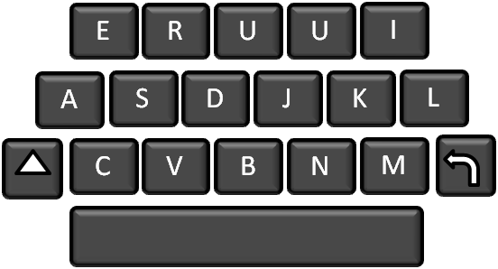
Defending Our Faith
Your friends ask your opinion about a social issue that is generally popular and supported but is contrary to the teachings of the Church.
A friend posts something untrue about the Church on social media.
A coach schedules a tournament that requires your team to play on Sunday.
What are the challenges we face?

Slide 3
Peter and John Arrested
Sanhedrin:
The Jewish senate and the highest native court in both civil and ecclesiastical matters. Under the presidency of the high priest it regulated the whole internal affairs of the Jewish nation. (3)
After healing the lame man at the temple Peter and John were arrested and taken before the Jewish governing council called the Sanhedrin.
Annas was a Jewish high priest (a Sanhedrin) during the time of Jesus’ crucifixion and Peter and John’s imprisonment. Five of his sons served as high priests.
Joseph Caiaphas was his son-in-law and also a high priest during the reign of the emperor Tiberius. Peter and John appeared before him. Caiaphas served 18 years. (2)
Acts 4:1-6

Slide 4
Judgement
By what power, or by what name, have ye done this?
This is the stone which was set at nought of you builders, which is become the head of the corner.
Ye rulers of the people, and elders of Israel,
Neither is there salvation in any other: for there is none other name under heaven given among men, whereby we must be saved.
If we this day be examined of the good deed done to the impotent man, by what means he is made whole;
Be it known unto you all, and to all the people of Israel, that by the name of Jesus Christ of Nazareth, whom ye crucified, whom God raised from the dead, even by him doth this man stand here before you whole.
Acts 4:7-12

Slide 5
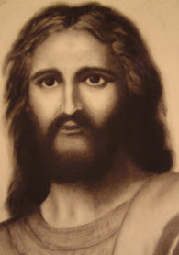
‘None Other Name’
The name of Jesus Christ is the only name through which we can receive salvation
“This is more than just a name we deal with. This relates to spiritual authority and power and lies at the very center of Christian doctrine.
Therefore, whatsoever ye shall do, ye shall do it in my name; therefore ye shall call the church in my name; and ye shall call upon the Father in my name that he will bless the church for my sake.
3 Nephi 27:7
Nathan Buhler
“In the Church that Jesus Christ established, all things are done in his name. Prayers are said, children are blessed, testimonies borne, sermons preached, ordinances performed, sacrament administered, the infirm anointed, graves dedicated.”
Acts 4:12
(4)

Slide 6
Unlearned But Not Ignorant
…by means to bring about his great and eternal purposes; and by very small means the Lord doth confound the wise and bringeth about the salvation of many souls.
Alma 37:7
These “unlearned” fishermen are examples showing that:
and that:
But God hath chosen the foolish things of the world to confound the wise; and God hath chosen the weak things of the world to confound the things which are mighty;
1 Corinthians 1:27
Acts 4:13
(1)

Slide 7
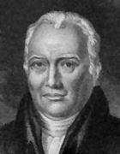
Marveled Yet Concerned
What Shall We Do With These Men?
…that it spread no further among the people, let us straitly threaten them, that they speak henceforth to no man in this name.
Not the news of the miraculous healing of the lame man, but the doctrine and influence which these men preach and exert. More than a thousand people had already professed faith in Christ in consequence of this miracle, and if this teaching should be permitted to go on, probably accompanied with similar miracles, they had reason to believe that all Jerusalem (themselves excepted, who had steeled their hearts against all good) should be converted to the religion of him whom they had lately crucified. (5)
And they called them [Peter and John], and commanded them not to speak at all nor teach in the name of Jesus.
Acts 4:16-18

Slide 8
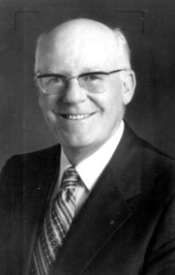
Boldness and Conviction
'all filled with the Holy Ghost, and they spake the word of God with boldness.'
"The Apostles who there stood with the Son of God responded to this call with faith, boldness, and power.
They had seen a resurrected being, had eaten with him, had felt his hands and feet. They knew, and knowing, they testified:
"Does that commission extend to us as his disciples?
Perhaps we have not seen, in person, the risen Lord.
'For we cannot but speak the things which we have seen and heard.'
As we are filled with the Holy Ghost, we can share the gospel with boldness
Acts 4:20,31
(6)

Slide 9
We Know, We Can Testify
“But the testimony of his chosen witnesses is etched into our hearts by the Holy Spirit. We know, and knowing, we too must testify.
Is there any question in the mind of any of us that this is one of the chief responsibilities we enjoy by reason of our membership in his Church?”
'I have been called of him to declare his word among his people, that they might have everlasting life.' (3 Ne. 5:13.)
Such is the calling of each of us."
Acts 4:20, 31
(6)

Slide 10
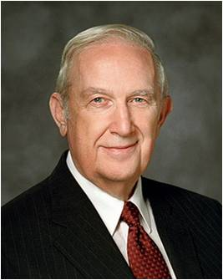
Looking Up Instead of Looking Down
“Do what is right even though it seems you will be alone in so doing, that you are going to lose friends, that you will be criticized.
What you will find is that by doing what is right, after a period of testing, the finest friends will be discovered and you can mutually support each other in your resolve to be obedient to all of the commandments of the Lord.”
You will learn that truth.
You will also discover that when you have taken a determined stand for right, when you have established personal standards and made covenants to keep them, when temptations come and you act according to your standards, you will be reinforced and given strength beyond your own capacity, if that is needed.”
Acts 4:19
(7)

Slide 11
Peter and John Are Released
After Peter and John were released, they gathered with other believers and prayed with them.
All Things In Common:
Members of the Church in Jerusalem attempted to live the law of consecration.
They used their excess resources to care for the poor and needy among them.
Acts 4:23-28; 32-35

Slide 12
Barnabas
And Joses, who by the apostles was surnamed Barnabas, (which is, being interpreted, The son of consolation,) a Levite, and of the country of Cyprus,
Having land, sold it, and brought the money, and laid it at the apostles’ feet.
He was a Levite from Cyprus, He was a convert to the church and sold his land to the church
He was one of Paul’s companions
It was he that the disciples sent to Antioch to counsel the Saints and convert there
Paul and Barnabas tarried a year in Antioch, where the disciples were first called “Christians” (Acts 11:26)
Paul and Barnabas separated in their journey when Paul declined to accept John Mark (nephew or cousin of Barnabas) into their circle.
Though Barnabas is not referred to in the New Testament as a member of the Twelve, he is identified by Paul as an Apostle (Acts 14:4, 14; 1 Corinthians 9:6)
Acts 4:36-37
(13)

Slide 13
“We Believe in Being Honest”
Acts 5:1-12

Slide 14
Striving for discipleship
Keeping commitments
Keeping the Law of Chastity
Avoiding Obscenity
Pray once in awhile
Paying a full tithe
Honorable People
Love and service
Only reading scriptures in class
Slacking in discipleship:
Occasional attendance at church
Little to no paying of tithing
Skipping Temple Trips

Slide 15
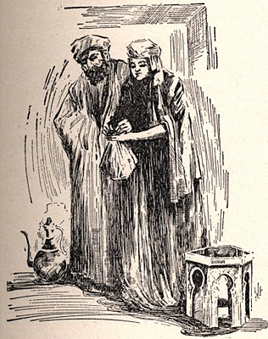
“But a certain man named Ananias, with Sapphira his wife…
…Sold a possession”
Acts 5:1

Slide 16
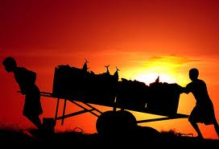
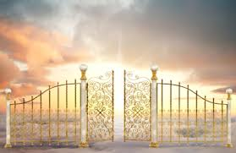
These people were righteous people and disciples of Christ.
They probably promised to give all that they had for the building up of the Kingdom of God

Slide 17
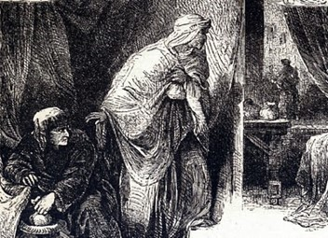
“And kept back part of the price, his wife also being privy to it…
…and brought a certain part, and laid it at the apostles’ feet.”
Acts 5:2

Slide 18
Keeping back a portion:
Halfhearted---half obedience
Incomplete testimony
Not fully committed
Don’t care
Uniformed---untaught

Slide 19
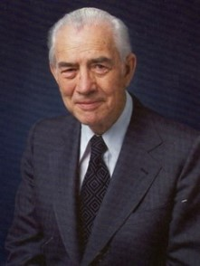
“Half obedience will be rejected as readily as full violation…for half rejection and half acceptance is but a sham, an admission of lack of character, a lack of love for Him.
It is actually an effort to live on both sides of the line.”
(8)

Slide 20
“No man can serve two masters”

Slide 21
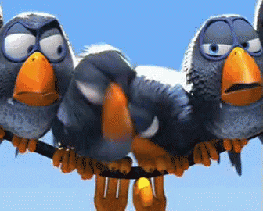
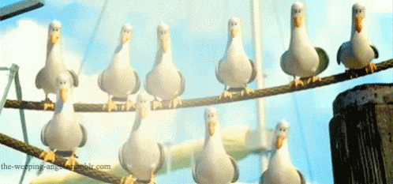
Afraid:
Losing our friends
Losing our places in the world
Selfishness
Being alone

Slide 22
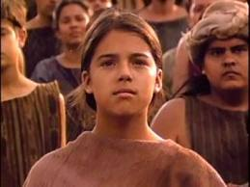
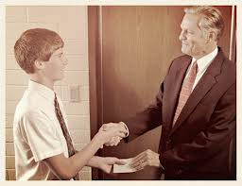
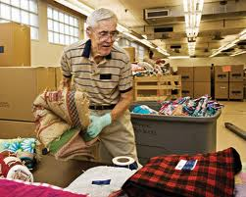
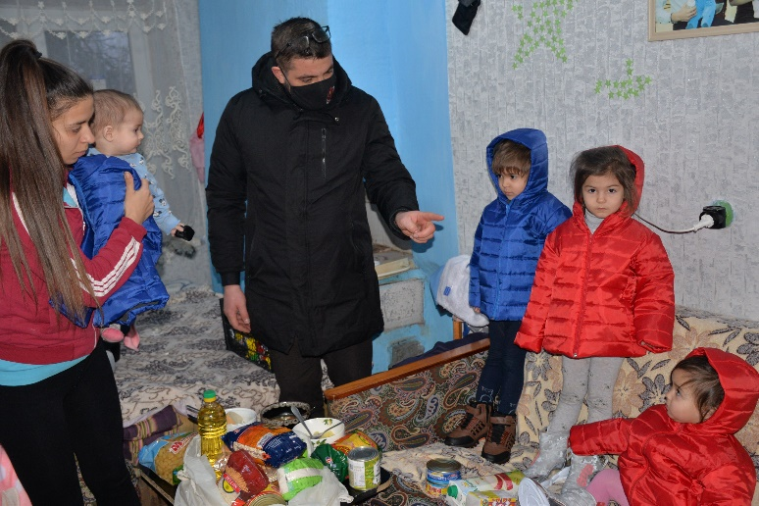
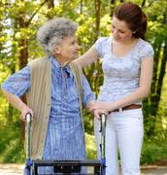
Law of Consecration:
Dedication
Giving your all
Not holding back
Charity
Love

Slide 23
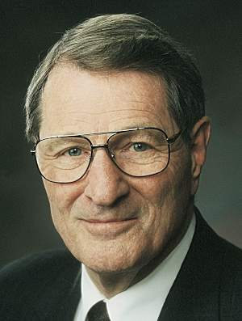
“Increased consecration is not so much a demand for more hours of Church work as it is for more awareness of whose work this really is!
For now, consecration may not require giving up worldly possessions so much as being
less possessed by them.”
(9)

Slide 24
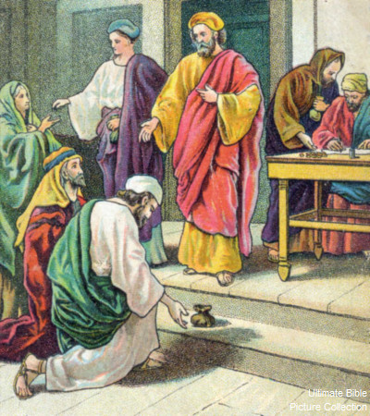
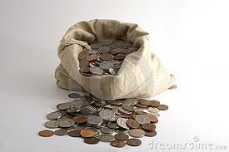
“But Peter said, Ananias, why hath Satan filled thine heart to lie to the Holy Ghost
…and to keep back part of the price of the land?”
Acts 5:3

Slide 25
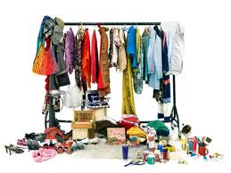
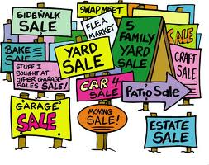
“Whiles it remained, was it not thine own?
…and after it was sold, was it not in thine own power?
Acts 5:4

Slide 26
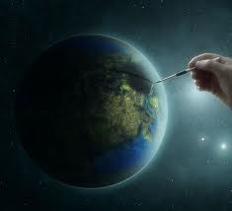
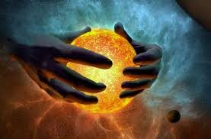
Heavenly Father has given to us all our possessions
“All things were made by him; and without him was not any thing made that was made.”
John 1:3

Slide 27
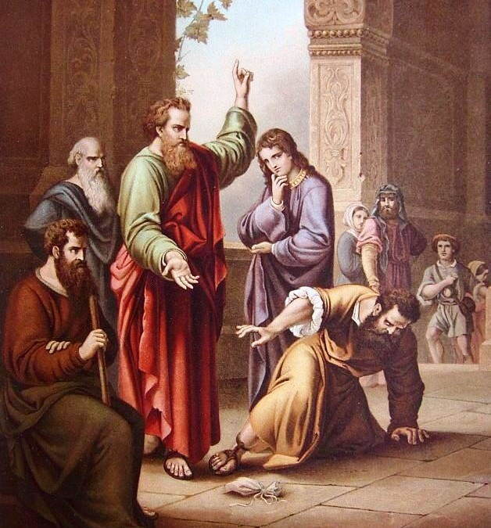
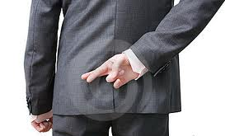
“Why hast thou conceived this thing in thine heart?
…thou hast not lied unto men, but unto God.”
Acts 5:4

Slide 28
These six things doth the Lord hate:
Proverbs 6:16-19
A lying tongue
Hands that shed innocent blood
A proud look
Making mischief
False witness, speaking lies against another
A wicked heart

Slide 29
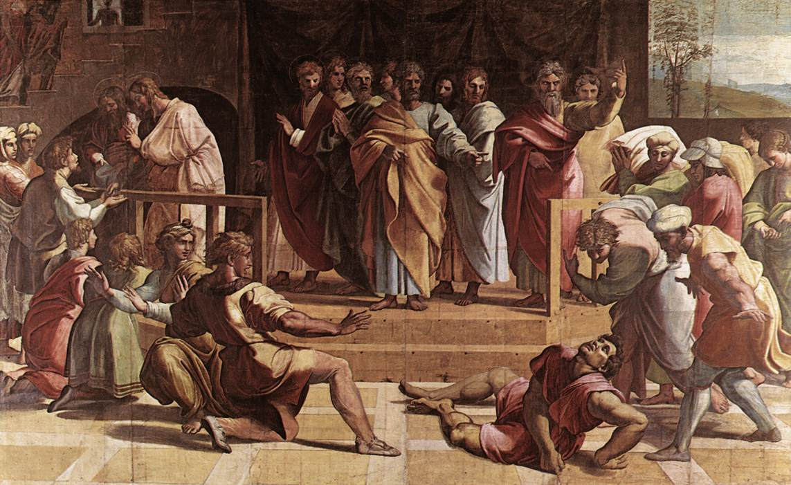
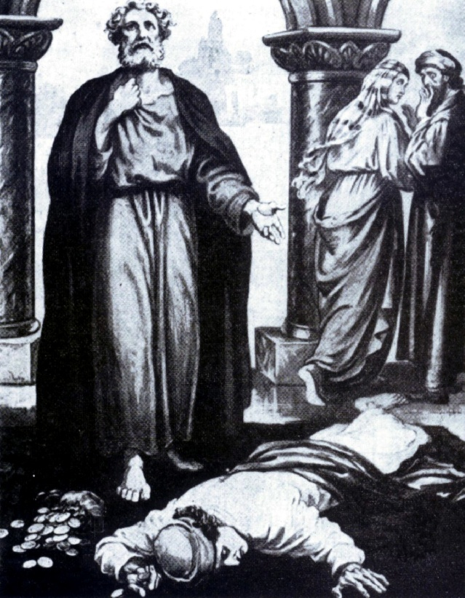
“And Ananias hearing these words fell down…
…and gave up the ghost:”
Acts 5:5

Slide 30
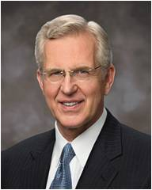
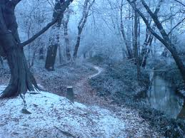
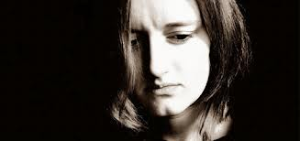
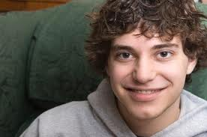
“…I have seen some who have spent a long winter of guilt and spiritual starvation…
…emerge into the morning of forgiveness:”
(10)

Slide 31
“Behold, he who has repented of his sins, the same is forgiven, and I, the Lord, remember them no more”
(D&C 58:42)
Unfortunately, Ananias did not have time to repent.

Slide 32
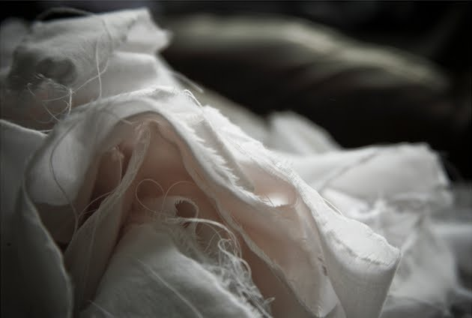
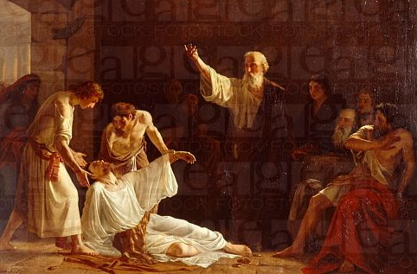
“And great fear came on all them that heard these things.”
“And the young men arose, wound him up, and carried him out, and buried him.”
Kharlamov, Alexei Alexeyevich
Acts 5:5-6

Slide 33
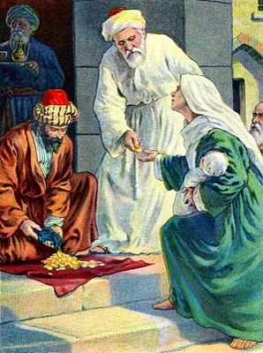
“And it was about the space of three hours after…
…when his wife, not knowing what was done, came in.”
Acts 5:7

Slide 34
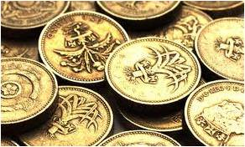
“And Peter answered unto her, Tell me whether ye sold the land for so much?
louis glanzman
…And she said, Yea, for so much.”
Acts 5:8

Slide 35
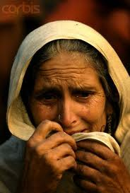
“Then Peter said unto her, How is it that ye have agreed together to tempt the Spirit of the Lord?
…behold, the feet of them which have buried thy husband are at the door, and shall carry thee out.”
Acts 5:9

Slide 36
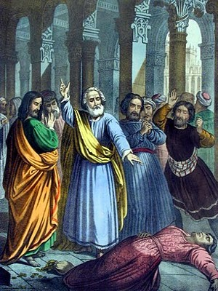
“Then fell she down straightway at his feet, and yielded up the ghost…
…and the young men came in, and found her dead, and, carrying her forth, buried her by her husband.”
Acts 5:10

Slide 37
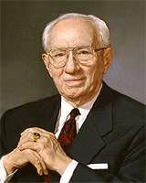
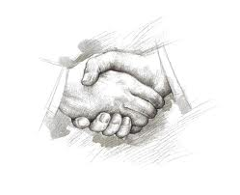
“Once it was said among our people that a man’s word was as good as his bond.”
(11)

Slide 38
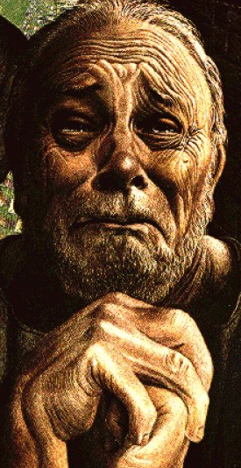
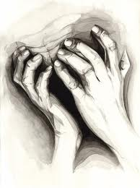
“In our time those found in dishonesty do not die as did Ananias and Sapphira, but something within them dies:
Conscience chokes
Character withers
Self-respect vanishes
Integrity dies.
Sandy Freckleton Gagan
(11)

Slide 39
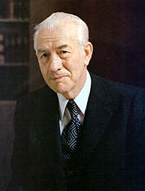
“If we who have the gift of the Holy Ghost shall lie or cheat or in other ways resort to dishonesty…we contaminate
ourselves and our relationship
with our Heavenly Father.”
(8)

Slide 40
“And great fear came upon all the church…
…and upon as many as heard these things.”
Acts 5:12

Slide 41
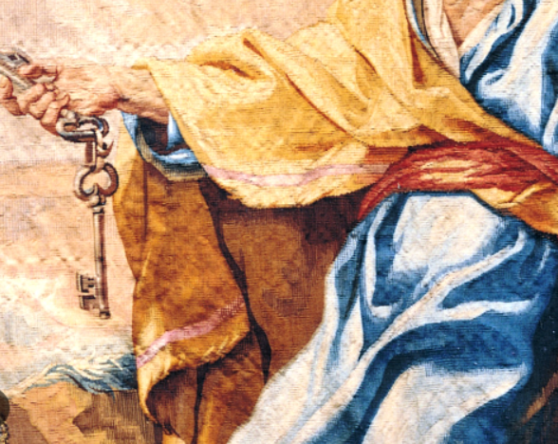
Peter Blesses With Authority
“Faith in Peter’s faith brought the sick into the streets on their beds of affliction ‘that at the least the shadow of Peter passing by might overshadow some of them.’
One wonders if there is a single written line in any other record that stands as a greater monument to the faith and power of one mortal man bearing the holy priesthood of God. …
“With his own sense of urgency, Peter aggressively defied the injunction not to teach in the name of Christ and he returned again and again to the temple, where his safety was never secure.”
Acts 5:12-16
(12)

Slide 42
Put in Prison Again By Sadducees
Sanhedrin-The Jewish senate and the highest native court in both civil and ecclesiastical matters. Under the presidency of the high priest it regulated the whole internal affairs of the Jewish nation.
A party or caste among the Jews. The name is probably derived from Zadok, the high priest in Solomon’s time. The party consisted of old high-priestly families who came to the front during the Maccabean war. They formed the Jewish aristocracy and were powerful, though quite small in numbers.
In their treatment of religious questions they held to the letter of the Mosaic revelation and denied the authority of ancient tradition; they taught complete freedom of the will in moral action; they were opposed to the Pharisees as to the belief in angels and spirits; they refused also to accept the doctrine of immortality as a necessary part of the Jewish faith. It was through their influence that Greek culture spread in Israel.
They opposed the work of the Apostles because they preached the Resurrection. (3)
Acts 5:17

Slide 43
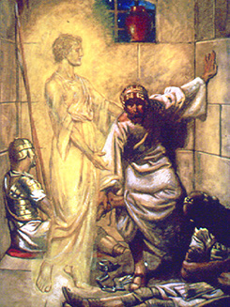
Angel Opens Door
As the Apostles ministered with the power of God and multitudes of people joined the Church, the Jewish leaders once again tried to stop the Church’s progress by putting Peter and John in prison.
With this imprisonment and the earlier arrest of Peter and John following the healing of the lame man, we see a fulfillment of the Savior’s prophecy that His Apostles would be persecuted by those who thought they were serving God.
An angel of the Lord opened the prison doors and let Peter and John go free. (1)
Acts 5:19-20

Slide 44
Gamaliel
He was the grandson of the famous rabbi Hillel.
He was a member of the Sanhedrin and a distinguished scholar of Jewish law.
Paul was tutored by this famous master of the law.
Gamaliel had a reputation for being tolerant and kind, relaxing the standards of the Sabbath observance so they were not so rigorous and encouraging more humane treatment of women in divorce laws.
His wise counsel likely saved the lives of the Apostles, who had been brought again before the Jewish council after being released from prison by an angel.
Acts 5:34-39
(13)

Slide 45
Sources:
Suggested Hymn: #272 Oh, Say What is Truth
Video:
Peter and John Are Judged (2:51)
Message from Elder L. Tom Perry (3:08)
“Peter and John Continue Preaching the Gospel” (5:38)
New Testament Institute Student Manual Chapter 30
Life and Teachings of Jesus and His Apostles section 7, Chapter 29, pp. 244-245
Bible Dictionary under “Sanhedrin”
President Boyd K. Packer (in Conference Report, Oct. 1967, 128).
Adam Clarke Commentary
Robert L. Backman ("Jesus the Christ," Ensign, Nov. 1991, 8)
Elder Richard G. Scott (“Do What Is Right” [address given at Brigham Young University, Mar. 3, 1996], 5; speeches.byu.edu)
Elder Mark E. Peterson “We Believe in Being Honest” Apr. 1982 General Conference
Elder Neal A. Maxwell “Settle This in Your Hearts” Oct. 1992 General Conference
D. Todd Christofferson “The Divine Gift of Repentance” Oct. 2011 General Conference
11. Elder Gordon B. Hinckley “An Honest Man…” Apr. 1976 General Conference
12. Elder Jeffrey R. Holland “The Lengthening Shadow of Peter,” Ensign, Sept. 1975, 35.
13. Who’s Who in the New Testament by Richard J. Allen pp. 18-19
Presentation by ©http://fashionsbylynda.com/blog/

Slide 46
Event | Acts
Kingdom to Be Restored to Israel | 1:1–8
Mount of Olives: Christ Ascends to Heaven | 1:9–14
Jerusalem: Apostles Choose Successor to Judas | 1:15–26
The Holy Ghost and the Day of Pentecost | 2:1–21
Peter Testifies of Jesus’ Resurrection | 2:22–36
How to Gain Salvation | 2:37–40
All Things in Common | 2:41–47
Peter Heals Man Lame from Birth | 3:1–16
Age of Restoration Is Prior to Christ’s Second Coming | 3:17–24
The Children of the Covenant | 3:25, 26
Salvation Comes Only Through Christ | 4:1–12
Sadducees Seek to Silence Apostles | 4:13–22
Saints Glory in Testimony of Jesus | 4:23–31
Saints Practice United Order | 4:32–37
Fate of Deceivers | 5:1–11
Event | Acts
Apostles Continue Miracles of Jesus | 5:12–16
Angels Deliver Apostles from Prison | 5:17–26
Apostles Testify of Christ | 5:27–32
Persecution Is Not of God | 5:33–42
Seven Chosen to Assist Apostles | 6:1–6
Stephen Transfigured Before the Sanhedrin | 6:7–15
Stephen Preaches about Israel | 7:1–36
Moses—A Prototype of Christ | 7:37–40
Stephen Testifies of Apostasy in Israel | 7:41–53
Stephen Sees the Father and the Son | 7:54–60; 8:1
Saul Persecutes the Church | 8:1–4
Samaria: Philip Works Miracles, Converts Simon | 8:5–13
Apostles Confer Gift of the Holy Ghost | 8:14–17
Simon Seeks to Buy Gift of the Holy Ghost | 8:18–25
Toward Gaza: Philip Preaches Christ, Baptizes Eunuch | 8:26–40
The Acts of The Apostles, Written by Luke to Theophilus, 61-63 AD
The Events That Occurred 33-36 AD (1-8)
Life and Times of Jesus Christ Section 7 Chapter 29

Slide 47
The Stone Acts 4:11:
In this reference, the building up of the kingdom of God is likened unto the building of a house which should have been built up by the ecclesiastical authorities of the day. They had the most experience, training, and knowledge. In laying the foundation, they should have been able to look amongst all the rocks and boulders and select a rock of supreme quality. They would need a perfect stone, one that could support all the weight of the building, one that would make a 'sure foundation' (Jacob 4:16).
Ironically, as they surveyed the scene, they missed this most important stone 'because of their blindness, which blindness came by looking beyond the mark' (Jacob 4:14). Instead of making it their chief cornerstone, they stumbled over it as Isaiah prophesied they would (Isa 8:14). They tripped on it and fell flat on their faces. Angered by their own bruised elbows and scuffed up knees, they cursed and kicked and 'set at naught' this 'rock of offence'. With this blunder of eternal proportions, God himself had to step in to finish the work. God himself would have to take over the construction project. These blind and wounded contractors were fired and the Father placed Christ in his rightful position as the 'head stone of the corner' (Ps. 118:22). We are left to conclude with the psalmist, 'This is the Lord's doing; it is marvelous in our eyes' (Ps 118:23). Gospeldoctrine.com
Honesty Acts 5:1-10
“Honesty is the basis of a true Christian life. For Latter-day Saints, honesty is an important requirement for entering the Lord’s holy temple. Honesty is embedded in the covenants that we make in the temple. Each Sunday as we partake of the holy emblems of the Savior’s flesh and blood, we again renew our basic and sacred covenants—which encompass honesty. … Honesty should be among the most fundamental values that govern our everyday living.” Bishop Richard C. Edgley (“Three Towels and a 25-Cent Newspaper,” Ensign or Liahona, Nov. 2006, 74).
Gamaliel Acts 5:34-39
In his speech before the Jewish leaders, Gamaliel referred to two historical situations that showed how a movement would fail if the Lord was not with it.
The first was a Jewish uprising against the Romans that was led by a man called Theudas, who had gained about 400 followers before he was slain and his followers were scattered. The second occurred in about A.D. 6, when Judas of Galilee and a band of followers revolted against Roman taxation; in the ensuing violence, Judas died and his followers were dispersed.
In effect, Gamaliel’s counsel was, “Let nature take its course. If this movement of Jesus’s followers is of men, it will fail, as did the uprisings of Theudas and Judas. But if it is of God, you cannot overthrow it” (see Acts 5:35–39). (1)
Boldness in Peter Acts 4:13:
"We stand in awe before the great Peter, who had so completely received his total assurances and who had so graciously donned the robe of leadership and the mantle of authority and the courage of the inspired and assured. What strength he had come to have as he led the saints and faced the world with all its persecutors, unbelievers, and difficulties. And, as he rehearsed over and over his absolute knowledge, we glory in his stamina as he faced mobs and prelates, officials who could take his life, and as he boldly proclaimed the resurrected Lord, the Prince of Peace, the Holy One and the Just, the Prince of Life, the Prince and Savior. Peter certainly now was sure, impregnable, never to falter. We should gain much sureness by his certainty." Spencer W. Kimball (Conference Report, April 1969, Afternoon Meeting 28.)
Stand Firm, Be Bold: “The world is constantly crowding in on us. From all sides we feel the pressure to soften our stance, to give in here a little and there a little.
“We must never lose sight of our objective. We must ever keep before us the goal which the Lord has set for us. …
“We must stand firm. We must hold back the world. If we do so, the Almighty will be our strength and our protector, our guide and our revelator. We shall have the comfort of knowing that we are doing what He would have us do.” Pres. Gordon B. Hinckley (“An Ensign to the Nations, a Light to the World,” Ensign or Liahona, Nov. 2003, 82–83).

