Slide 1
Lesson 93
The Promptings of the Spirit
Acts 16
And the Spirit giveth light to every man that cometh into the world; and the Spirit enlighteneth every man through the world, that hearkeneth to the voice of the Spirit. D&C 84:46

Slide 2
A prompting refers to feelings or impressions we receive from the Holy Ghost to say or do something.

Slide 3
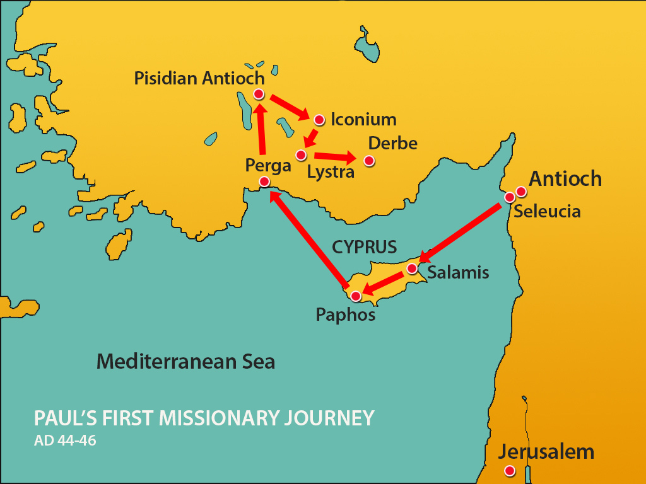
Previously…
Paul’s Companions
First Mission
John Mark
Acts 12:25
Barnabas Acts 11:30

Slide 4
Paul’s Companions—2nd Mission
Paul is inspired to return to the cities he taught on his first mission
While in Derbe and Lystra they met Timothy
Macedonia
Black Sea
Philippi
Troas
Galatia
Mysia
Blithynia
Phrygia
Asia
Antioch
Iconium
Lystra
Derbe
Cilicia
Antioch
Cyprus
Syria
Timotheus (Timothy)
Acts 16:1-4
Mother Jewish, Father Greek
Mediterranean Sea
Israel
Silas
Acts 15:40
Jerusalem
Acts 16:1-8

Slide 5
Forbidden to Preach in Asia
"Here the Lord commands his missionaries not to preach the gospel in Asia or Bithynia, but instead to go to Macedonia.
Why? It is simply a matter of sending missionaries where there are more receptive people.
Of course those in Asia and elsewhere were entitled to hear the truth; all men are; but every man in his day and time and season.
The Lord establishes his own system of priorities and since the laborers are few and cannot be everywhere, they are sent, by revelation, to those peoples who in God's wisdom deserve to hear the truth first."
Macedonia
Black Sea
Philippi
Blithynia
Asia
Cilicia
Cyprus
Syria
Mediterranean Sea
Israel
Jerusalem
Acts 16:6
(2)

Slide 6
Paul’s Vision
While in Troas the Lord calls them to preach in Macedonia
The beloved physician herein becomes one of Paul's associates, making him an eyewitness to most of the rest of the story.
At this point, the missionary entourage is made up of a foursome: Paul, Silas, Timothy, and Luke.
Acts 16:9-15

Slide 7
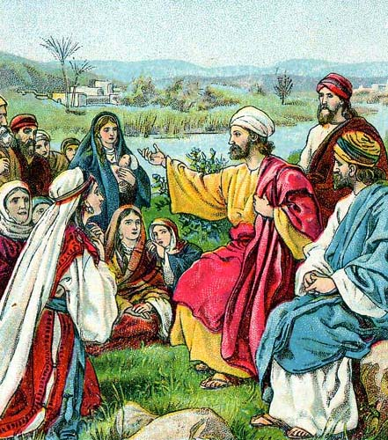
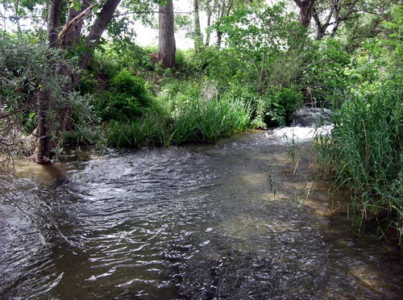
Sabbath Day—no synagogue
"Philippi was named for its refounder Philip, the father of Alexander the Great, the world conqueror.
But a different world conqueror came when Paul arrived with his small missionary group in obedience to the vision of the pleading man of Macedonia... 'Colony' was a technical term for Romans settled outside Rome.
That Philippi was a colony implies that it had civic rights of Rome and the honor of modeling its local government after that of the mother city.
The old Roman virtues were loyalty and reliability. These qualities certainly summarize the remarkable faithfulness of the Philippian Christians." (3)
They went to the river side and sat down and spoke to the women
Acts 16:11-13

Slide 8
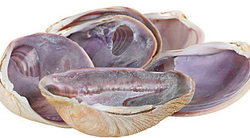
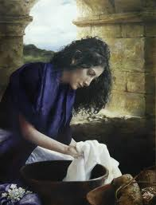
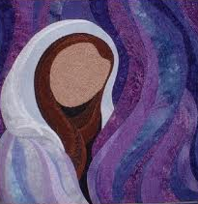
Lydia—a seller of Purple
Dyer of purple cloth
While Paul and his companions were ministering in Philippi, they met a woman named Lydia from Thyatira, a city that was famous for its purple textiles. The best natural purple dye was extracted from the shells of mollusks, and the process was very expensive.
The Lord had opened her heart
Therefore in ancient times, the color purple became associated with royalty or saintliness
She has the distinction of being Paul’s first known European convert and also the first person mentioned by name who joined the Church as a result of Paul’s second mission. She appears to have been a wealthy woman who owned her own house and had servants, who were part of “her household”
Acts 16:12-15
(1)

Slide 9
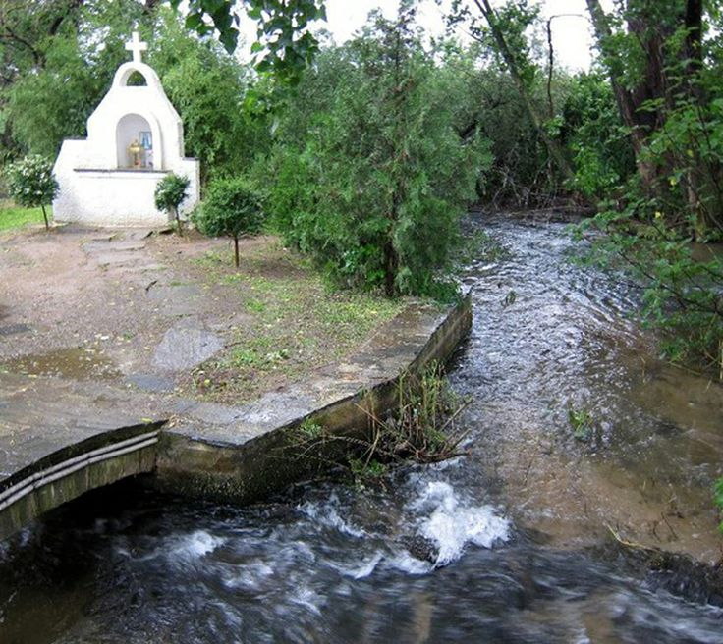
Lydia—a seller of Purple
Lydia and her household were converted and baptized and invites the missionaries to stay in her household.
As we follow revelation from God, we can be guided to those who are ready to receive the gospel
Traditional site of where Lydia was baptized as of today
Later, believers gathered at her home for worship and instruction
Acts 16:15

Slide 10
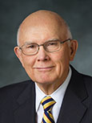
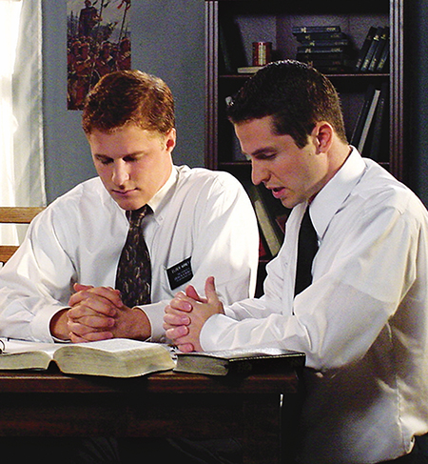
“We must pray for the Lord’s help and directions so we can be instruments in His hands for one who is now ready—one He would have us help today.
Then, we must be alert to hear and heed the promptings of His Spirit in how we proceed.
“Those promptings will come.
We know from countless personal testimonies that in His own way and His own time the Lord is preparing persons to accept His gospel.
Such persons are searching, and when we are seeking to identify them the Lord will answer their prayers through answering ours.
He will prompt and guide those who desire and who sincerely seek guidance in how, where, when, and with whom to share His gospel.”
Greg Olsen
(5)

Slide 11
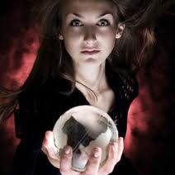
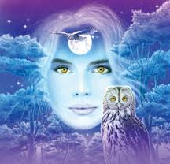
“Spirit of Divination”
Divination is the act of foretelling, or pretending to foretell, the future by using occult practices. Divination, which is also called soothsaying, was and is forbidden to the Lord’s people.
She foretold of “These men” being servants of the most high God.
She told a truth.
The missionaries encounter a “certain damsel possessed”
She brought her masters much gain by “soothsaying”
Acts 16:16-17; Deuteronomy 18:9-14; Joshua 13:22

Slide 12
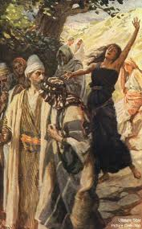
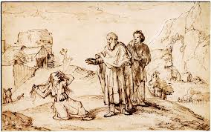
Truth From the Wrong Source
Paul recognized that she had a truth but it came from the wrong source.
“The testimony of the devil-led damsel was true. Paul and Silas were prophets; they had the words and power of salvation. But true testimony from Satan’s servants does not lead to salvation.
In effect the damsel was saying: ‘Go ahead and believe in Paul and Silas and this Jesus whom they preach. I agree they and their Master are of God; and since we are now united on that point, you can also continue to follow me and enjoy the fruits of my divination.’
And how many other practitioners of false religions there are who give lip service to Jesus and his doctrines so that people will the more readily follow them and their special brand of ‘saving’ grace. It was for the very reason here involved that Jesus himself forbade the devils whom he cast out to testify that he was the Son of God (Luke 4:41.)” (2)
“…But Paul, being grieved, turned and said to the spirit, I command thee in the name of Jesus Christ to come out of her.”
Acts 16:18

Slide 13
Why Cast Out Her Gift?
It is important for us to understand why this woman's actions grieved Paul so.
This spirit claimed to know certain truths of God and to "prophecy" about them, but it was the wrong spirit.
Someone can say something that is true, but still be demonically inspired.
Paul was able to discern the spirit operating behind those words. This is why God tells us to test the spirits (I John 4:1).
Even truths spoken in the wrong spirit is not the “Way of the Lord”
1 John 4:1
“Beloved, believe not every spirit, but try the spirits whether they are of God: because many false prophets are gone out into the world.”

Slide 14
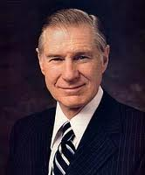
“It is not good practice to become intrigued by Satan and his mysteries.
No good can come from getting close to evil.
The only safe course is to keep well distanced from him and any of his wicked activities or nefarious practices.
The mischief of devil worship, sorcery, casting spells, witchcraft, voodooism, black magic, and all other forms of demonism should be avoided like the plague.”
(4)

Slide 15
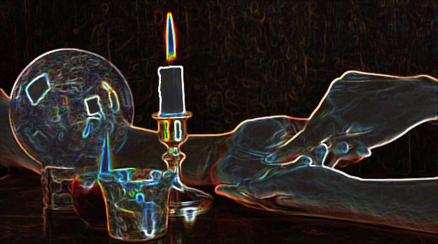
“These days we really need to be careful about everything we see and hear. It can seem spiritual, knowledgeable, and even mention an actual truth we are sure of. But, that does not mean it is leading us in God’s truths.
The only way we will ever be able to figure out if we’re being misled is to actually become grounded in God’s word.” (6)
“For I say unto you that whatsoever is good cometh from God, and whatsoever is evil cometh from the devil.”
Alma 5:40

Slide 16
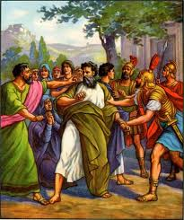
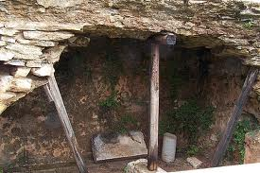
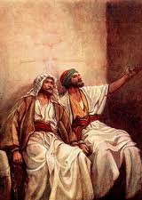
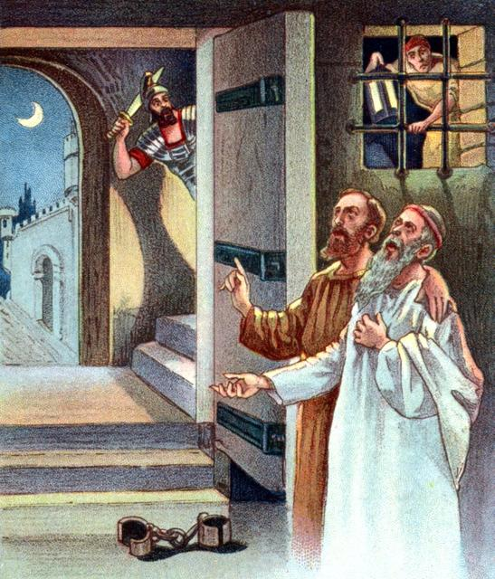
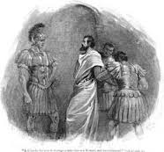
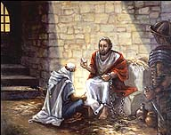
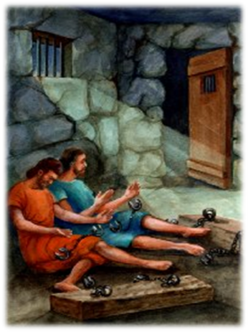
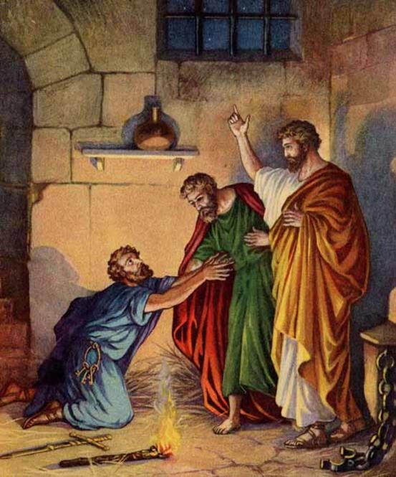
Paul and Silas are Thrown in Prison
They are taken before the rulers and beaten
A jailor is put in charge of them and “made feet fast in the stocks.”
Acts 16:25
Acts 16:26
Acts 16:27-28
Acts 16:29-30
Acts 16:31-32
Acts 16:33-34
Paul washed their wounds and he was baptized and his household

Slide 17
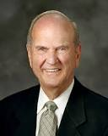
Salvation
“What must I do to be saved?”
Salvation requires believing in Jesus Christ, and we manifest our belief in Him by being baptized.
“To be saved—or to gain salvation—means to be saved from physical and spiritual death. Because of the Resurrection of Jesus Christ, all people will be resurrected and saved from physical death. People may also be saved from individual spiritual death through the Atonement of Jesus Christ, by their faith in Him, by living in obedience to the laws and ordinances of His gospel, and by serving Him.
Salvation is an individual matter.”
For ye are all the children of God by faith in Christ Jesus.
For as many of you as have been baptized into Christ have put on Christ. Galatians 3:26-27
(6)

Slide 18
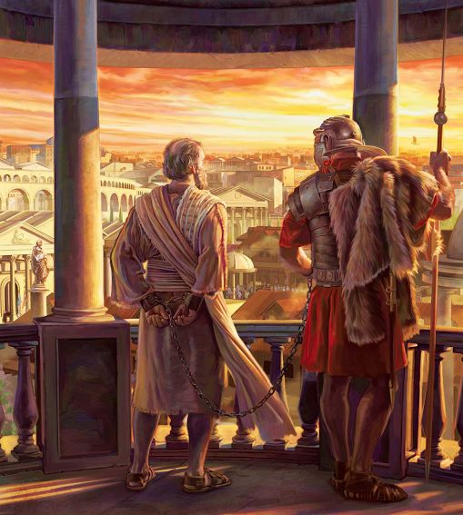
Paul’s Release
Magistrates sent word to the prison guard to let Paul and Silas go. Paul refused to go because he knew his rights as a Roman citizen and knew that their treatment of him was unjust. It was unlawful to beat a Roman citizen without first holding a trial.
When the magistrates found out that Paul and Silas were Romans, they were frightened because they knew that if their superiors discovered they had treated a Roman citizen as they did, they could be punished, even with death. The magistrates came to the prison, released Paul and Silas, and asked them to leave the city.
Paul’s second missionary journey lasted about three years and covered about 3,000 miles. This journey began in Antioch in Syria.
Paul likely wrote both epistles to the Thessalonians after he arrived in Corinth.
Acts 16:27-34

Slide 19
Missionaries in Prison
Acts 16:23-40
Paul and Silas
Praising and Singing
Other prisoners hear
Earthquake
Foundation falters and Bands loosened
Jailor and household converted
Alma 14:17-29
Alma and Amulek
Judged and questioned
Broke free of cords with strength from the Lord
Earthquake
Walls rent in twain and fell to earth
All slain except Alma and Amulek
Fear came and people fled
Missionaries continued their mission and baptized Zeezrom in the next city
Helaman 5:21-52
Nephi and Lehi
Crying repentance
Other prisoners hear
Pillar of fire surrounds them
Earthquakes and darkness
Wall falls
Aminadab recognizes the Spirit
About 300 “Convinced”

Slide 20
Sources:
Suggested Hymn: #143 Let The Holy Spirit Guide
Video:
Preparation of Thomas S. Monson: Always Follow the Promptings of the Spirit (2:40)
New Testament Institute Student Manual Chapter 33
Bruce R. McConkie (Doctrinal New Testament Commentary, 2: 147, 149.
Richard Lloyd Anderson, Understanding Paul [Salt Lake City: Deseret Book Co., 1983], 291
James E. Faust: “The Great Imitator” General Conference 1987 Oct.
Elder Dallin H. Oaks (“Sharing the Gospel,” Ensign, Nov. 2001, 8).
Spirit of divination 2: http://123hallelujah.wordpress.com/2010/10/25/a-spirit-of-divination/
Elder Russell M. Nelson Salvation and Exaltation April 2008 Gen. Conf.
Presentation by ©http://fashionsbylynda.com/blog/

Slide 21
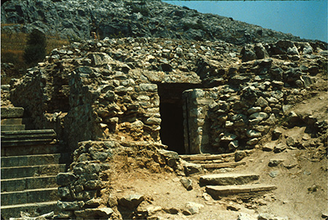
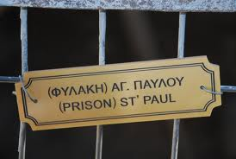
THE ACTS OF THE APOSTLES—EVENTS OCCURRED CA. A.D. 45–51 (13:6–18:23) PAUL’S FIRST AND SECOND MISSIONARY JOURNEYS
The Holy Ghost Directs Paul’s Labors | 16:1–15
Thyatira, Asia An Evil Spirit Cast Out | 16:16–18
Philip, a Jailor, Receives Christ | 16:19–40
Life and Teachings of Jesus and His Apostles Section 7 Chapter 32
Timothy and Circumcision Acts 16:1-3:
"Although Paul was opposed to circumcision as essential for salvation and he emphatically declared that it was not needful for Titus to be circumcised (Gal. 2:1-3), soon after the Jerusalem council Paul circumcised the young Timothy before taking him as a companion on the second mission (Acts 16:1-3). This action provides an insight into Paul's thinking. He saw a difference between necessity and convenience. With Titus, the question was whether or not circumcision was essential for salvation; thus, Paul opposed it. With Timothy it was a matter of rendering him acceptable to the non-Christian Jews where he would do missionary work. Paul was willing to allow circumcision as a concession, but not as a requirement, so that the Jews would be willing to listen to Timothy teach the gospel. This distinction reveals something of Paul's mind and method." (Robert J. Matthews, Studies in Scripture, Vol. 6: Acts to Revelation, edited by Robert L. Millet, [Salt Lake City: Deseret Book Co., 1987], 41.)
Ruins of what may have been the jail in Philippi where Paul and Silas were kept

Slide 22
Spirit of Divination:
"The Shaker will whirl around on his heel, impelled by a supernatural agency or spirit, and think that he is governed by the Spirit of God; and the Jumper will jump and enter into all kinds of extravagances. A Primitive Methodist will shout under the influence of that spirit, until he will rend the heavens with his cries; while the Quakers (or Friends) moved as they think, by the Spirit of God, will sit still and say nothing. Is God the author of all this? If not of all of it, which does He recognize? Surely, such a heterogeneous mass of confusion never can enter into the kingdom of heaven.
"Every one of these professes to be competent to try his neighbor's spirit, but no one can try his own, and what is the reason? Because they have not a key to unlock, no rule wherewith to measure, and no criterion whereby they can test it...If Satan should appear as one in glory, who can tell his color, his signs, his appearance, his glory, or what is the manner of his manifestation? Who can detect the spirit of the French prophets with their revelations and their visions, and power of manifestations? Or who can point out the spirit of the Irvingites, with their apostles and prophets, and visions and tongues, and interpretations, etc. Or who can drag into daylight and develop the hidden mysteries of the false spirits that so frequently are made manifest among the Latter-day Saints?
We answer that no man can do this without the Priesthood, and having a knowledge of the laws by which spirits are governed; for as no man knows the things of God, but by the Spirit of God, so no man knows the spirit of the devil, and his power and influence, but by possessing intelligence which is more than human, and having unfolded through the medium of the Priesthood the mysterious operations of his devices; without knowing the angelic form, the sanctified look and gesture, and the zeal that is frequently manifested by him for the glory of God, together with the prophetic spirit, the gracious influence, the godly appearance, and the holy garb, which are so characteristic of his proceedings and his mysterious windings.
"A man must have the discerning of spirits before he can drag into daylight this hellish influence and unfold it unto the world in all its soul-destroying, diabolical, and horrid colors; for nothing is a greater injury to the children of men than to be under the influence of a false spirit when they think they have the Spirit of God." (Teachings of the Prophet Joseph Smith, 204-5.)
Not Rooted in the Revelations of Heaven Acts 16:19:
"Why, we ask, would a woman possessed with an evil spirit bear a positive testimony of the gospel message and the servants commissioned to bear it? Because that testimony would eventually give her credibility among believers, thus placing her in a position to do much harm. Her testimony was not rooted in the revelations of heaven, and no other source for the testimony of Christ is acceptable." (Joseph Fielding McConkie, Watch and Be Ready: Preparing for the Second Coming of the Lord [Salt Lake City: Deseret Book Co., 1994], 60)
Paul—A Roman Citizen:
Paul never wearied of using his Roman citizenship to his advantage (see Acts 22:22-30; 25:11). He has no qualms about embarrassing those who were responsible for his scabbing and weeping wounds. To his oppressors Paul appeared to be a Jew, but he had Roman citizenship by virtue of his birth in Tarsus. This entitled him to due process under Roman law. Gospeldoctrine.com
This means that the freedom of Rome (which ruled all those countries at that time) had been given to the freemen of Tarsus. This freedom had been granted because the men of Tarsus had defended two emperors of Rome during a rebellion against them. Thus, Saul, though a Jew, was a freeborn Roman citizen." (Ancient Apostles [Salt Lake City: Deseret Book Co., 1964], 144)
Salvation Acts 16:30:
"Is belief alone enough to bring salvation to the contrite soul? Assuredly yes, if by belief is meant the ringing declaration of him who, baptizing our Lord, then testified: 'He that believeth on the Son hath everlasting life' (John 3:36); or if by belief is meant the pronouncement of Jesus: 'He that believeth on me, the works that I do shall he do also; and greater works than these shall he do' (John 14:12); or if by belief is meant that pure, perfect faith in Christ which presupposes and in fact cannot exist without the works of righteousness. (Mormon Doctrine, 2nd ed., pp. 78-80; See Heb. 11:1-3.) But belief alone is scarcely the beginning of that course leading to a celestial inheritance if it is isolated as a thing apart, if it is supposed that it does not embrace within its folds both baptism and a subsequent course of enduring to the end. (2 Ne. 31:15-21.) And in the very case at hand, Paul and Silas teach the gospel to the whole group, baptize them, and without question give them the gift of the Holy Ghost, thus starting them out in the direction of salvation. Elder Bruce R. McConkie (Doctrinal New Testament Commentary, 2:151.)

Slide 23
Places During Paul’s 2nd Mission
City | Description | Scripture | More About…
Derbe | A city in the Roman province of Galatia in Asia Minor, and in the ethnic region of Lycaonia | Acts 14:6, 20 Acts 16:1. | In Roman times it struck its own coins, of which a few are extant. The apostles Paul and Barnabas came to Derbe after escaping a disturbance and attempted stoning in Iconium, about 60 miles away, and successfully evangelized there. Paul and Barnabas returned there after being stoned again in Lystra. On these experiences, Paul commented, "We must through many tribulations enter the kingdom of God." He and Silas later visited Derbe again.
Lystra | A city in central Anatolia, now part of present-day Turkey. It is mentioned five times in the New Testament. | Acts 14:6,8,21 Acts 16:1-2 2 Timothy 3:11 | Lystra was visited several times by the Apostle Paul, along with Barnabas or Silas. There Paul met a young disciple, Timothy, whose parents lived there. The Roman Empire made Lystra a colony in 6 BC. Lystra apparently had no synagogue, although Timothy and his mother were Jewish
Iconium | Iconium—latin name A district in the center of Asia Minor, inhabited by tribes from Gaul who settled there in the 3rd century B.C. (Galatia was also the Greek name for Gallia, or Gaul.) | Acts 13;51 Acts 14:1-5 Acts 14:21 Acts 16:6 Acts 18:23 | Excavations have shown that the region was inhabited during the Late Copper Age, around 3000 BC. The city came under the influence of the Hittites around 1500 BC. These were overtaken by the Sea Peoples around 1200 BC. The apostles Paul and Barnabas preached in Iconium during their first Missionary Journey in about 47–48 and It was visited by Paul on his second and third journeys (Acts 16:6; 18:23). Konya, was known in classical antiquity. It is the center of the largest province, and is among the largest cities in the country. It is the seventh most populated city in Turkey today.
Phrygia | It was a kingdom in the west central part of Anatolia, in what is now Turkey, centered on the Sakarya River | Acts 2:10 Acts 16:6 Acts 18:23 Col. 1:1, 7 Col. 4:12-13 | The town of Phrygia, in the valley of the Lycus, near Laodicea and Hierapolis, and close to the great road that led from Ephesus to the Euphrates. When Paul wrote his epistle to the Colossians he had probably not yet visited the place. Epaphras and perhaps Timothy were its first Christian teachers.
Mysia | A region in the northwest of ancient Asia Minor or Anatolia (part of modern Turkey) A district forming the northern part of the Roman province of Asia. | Acts 16:7,8 | In ancient times it was inhabited by the Mysians, Phrygians, Aeolian Greeks, and other groups. The apostles Paul, Silas and Timothy came to (or passed by) Mysia during Paul's second missionary journey. The narrative suggests that they were uncertain where to travel during this part of the journey, being 'forbidden by the Holy Spirit to preach the word in Asia'. Shortly afterwards Paul had a vision of a 'man of Macedonia' who invited the apostles to travel westwards to Macedonia.
Troas | Alexandria Troas, southwest of Troy on the seacoast, a Roman colony. There is circuit of the old walls that can still be traced today. | Acts 16:8,11 Acts 20:5-6 2 Cor. 2:18 2 Timothy 4:13 | A lad at Troas who fell from a window and was restored by Paul. . Paul sailed for Europe for the first time from Alexandria Troas and returned there from Europe (it was there that the episode of the raising of Eutychus later occurred). Ignatius of Antioch also paused at this city before continuing to his martyrdom at Rome

