Slide 1
Matthew 1 and Luke1
Presentation by http://fashionsbylynda.com/blog/

Slide 2
Overview
Matthew, also known as Levi, is the author of the first Gospel of the New Testament.
One of his purposes in writing was to show that Jesus fulfilled Old Testament prophecies about the Messiah (1)
Luke was written before Acts, probably between A.D. 57-79.
Luke was a physician and presented Jesus Christ as the Son of God.
He did not witness the events of the Savior’s life, but became acquainted with them through others and testified of His birth. (2)

Slide 3
Who is Jesus Christ?
Why is He important to you?
What do you know about Heavenly Father and Jesus Christ that helps you put your trust in Them?

Slide 4
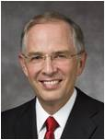
Faith does not fall upon us by chance or stay with us by birthright. …
Faith in Jesus Christ is a gift from heaven that comes as we choose to believe and as we seek it and hold on to it. …
The future of your faith is not by chance, but by choice. …
(3)

Slide 5
Faith never demands an answer to every question but seeks the assurance and courage to move forward, sometimes acknowledging, “I don’t know everything, but I do know enough to continue on the path of discipleship.”
(3)

Slide 6
Immersing oneself in persistent doubt, fueled by answers from the faithless and the unfaithful, weakens one’s faith in Jesus Christ and the Restoration.
“The natural man receiveth not the things of the Spirit of God: for they are foolishness unto him” [1 Corinthians 2:14]. …
Although your beginning fire of faith may be small, righteous choices bring greater confidence in God, and your faith grows. (3)

Slide 7
Sources:
Teacher Manual Overview
New Testament Institute Manual
Neil L. Andersen, “Faith Is Not by Chance, but by Choice,” Ensign or Liahona, Nov. 2015, 65–67
Handout https://www.churchofjesuschrist.org/study/manual/new-testament-seminary-teacher-manual-2023/acquiring-spiritual-knowledge-part-1?lang=eng

Slide 8
Jesus is the Promised Messiah
Matthew 1:1-17
Presentation by http://fashionsbylynda.com/blog/

Slide 9
Matthew
He was the son of Aphaeus, but was known as Levi before his conversion
His name means “Gift of God”
He lived in Capernaum and was a tax collector (publican)
He communicated with both Romans and Jews
He was one of original 12 Apostles (eyewitness)
He was well versed in Old Testament and uses many quotes in his gospel from the Old Testament
His gospel was for the Jewish persons in Palestine
His chief object was to show that Jesus was the Messiah of whom the prophets spoke. He also emphasizes that Jesus is the King and Judge of men
His Gospel was probably written in Aramaic but is known to us by a Greek translation
His later life is not know for certain
A tradition asserts that he died a martyr’s death
Tax
collector
(1)

Slide 10
The Book was likely written in the second half of the first century A.D.
*The only gospel to refer to wise men
*The only gospel to refer to the star in the east
*The only gospel of Herod’s killing of children in Bethlehem
*Has 10 different parables than other Gospels.
*Has the most compiled record of the “Sermon on the Mount”
*Refers to bodies slept/arose and came out of grave referring to the resurrection
*Refers to Jesus as the “Son of David” 12 times
*The book traces Abraham’s lineage to Jesus
Book
of
Matthew
*Background during Matthew’s time: Jews wanted deliverance from Roman oppression. Many saw Jesus as deliverer, but realized He would not deliver them out of Roman hands.
*As a writer: He appeals to Jewish audience and uses events and principles in testimonies, and talks of the prophecy of Jesus.

Slide 11
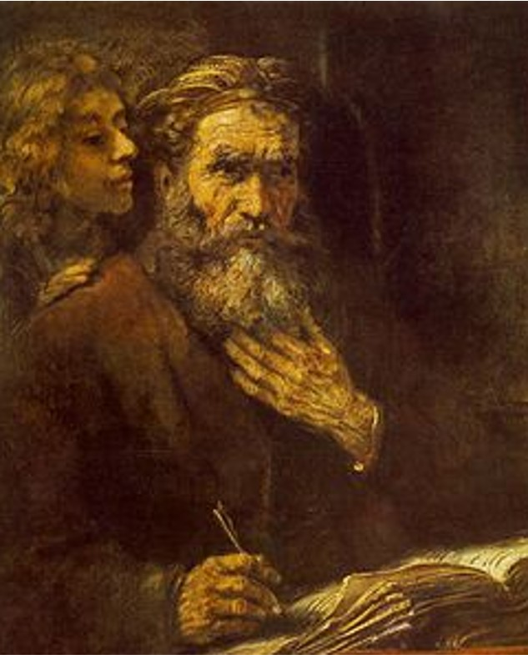
Matthew wrote the Gospel of Matthew to help people, especially the Jews who did not believe in the Savior, recognize Jesus Christ for who He was.
Matthew specifically emphasized the truth that Jesus Christ is the promised Messiah by frequently referring to ancient prophecies about the Messiah that Jesus Christ fulfilled.
(2)
When Jesus visited His hometown of Nazareth, He attended the synagogue (church) and read from the book of Isaiah a prophecy about the divine mission of the Messiah. After reading, Jesus proclaimed that He was the Messiah by stating that Isaiah’s prophecy was now fulfilled.
Luke 4:16-21
Rembrandt

Slide 12
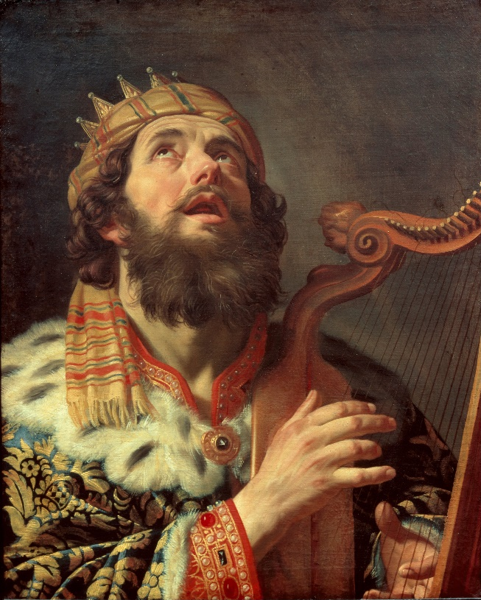
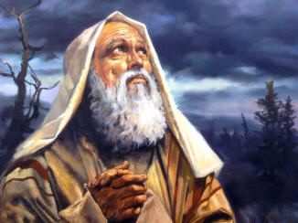
The Prophecies
The Messiah would be a descendant of David
An offspring of Abraham would bless “all the nations of the earth”
Jesus Christ was a descendant of David and of Abraham
2 Samuel 7:12–13; Isaiah 9:6–7; Jeremiah 23:5–6; Genesis 22:18; Abraham 2:11

Slide 13
Jesus Is The Promised Messiah
Jesus was the rightful heir to the throne of David
Matthew 1:1-17

Slide 14
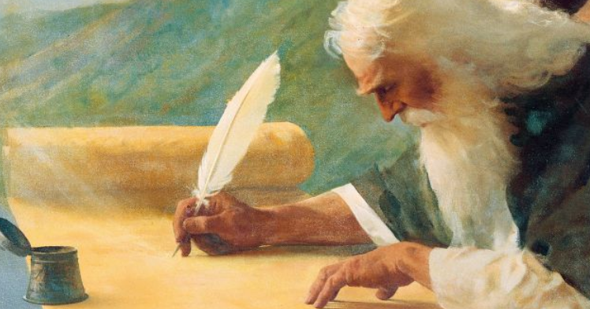
Prophecy of Isaiah
The Spirit of the Lord God is upon me; because the Lord hath anointed me to preach good tidings unto the meek; he hath sent me to bind up the brokenhearted, to proclaim liberty to the captives, and the opening of the prison to them that are bound;
To proclaim the acceptable year of the Lord, and the day of vengeance of our God; to comfort all that mourn;
Isaiah 61:1-2
Matthew 1:1-17

Slide 15
The Anointed One
Christ is the Greek form of the Aramaic word Messiah, which means “the anointed.”
Jesus was anointed by Heavenly Father to be our “Prophet, Priest, King, and Deliverer”
He was to be Heavenly Father’s representative in all things pertaining to the salvation of mankind.
Matthew 1:1-17
(1)

Slide 16
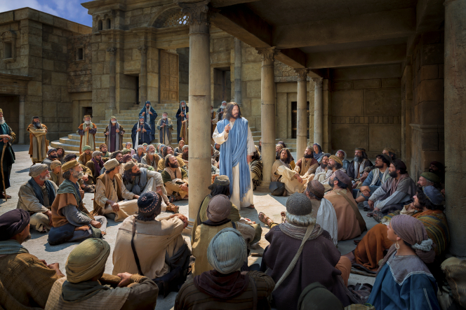
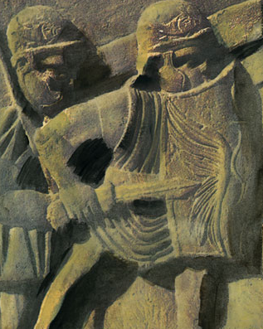
Looking For a Deliverer
Surely he hath borne our griefs, and carried our sorrows: yet we did esteem him stricken, smitten of God, and afflicted. Isaiah 53:4
Many Jews were looking only for a deliverer from the Roman power and for a greater national prosperity; thus, when the Messiah came, the leaders and many others rejected him.
Only the humble and faithful were able to see in Jesus of Nazareth the true Christ
Matt. 16:16; John 4:25–26
(1)

Slide 17
What do you learn about Jesus Christ from these prophecies about the Messiah and their fulfillment?
What did Jesus Christ come to earth to do? Why is it important to understand His mission?
Why is Jesus Christ important to you?

Slide 18
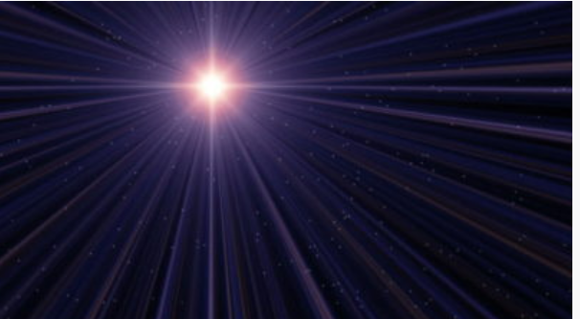
Like a guiding star in a clear, dark sky, Jesus Christ lights our way. He came to earth in a humble stable. He lived a perfect life.
He healed the sick and raised the dead.
He was a friend to the forgotten.
He taught us to do good, to obey, and to love one another.
He was crucified on a cross, rising majestically three days later, allowing us and those we love to live beyond the grave.
With His incomparable mercy and grace, He took upon Himself our sins and our suffering, bringing forgiveness as we repent and peace in the storms of life.
We love Him. We worship Him. We follow Him. He is the anchor of our souls.
(3)

Slide 19
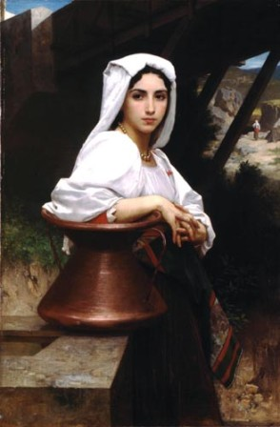
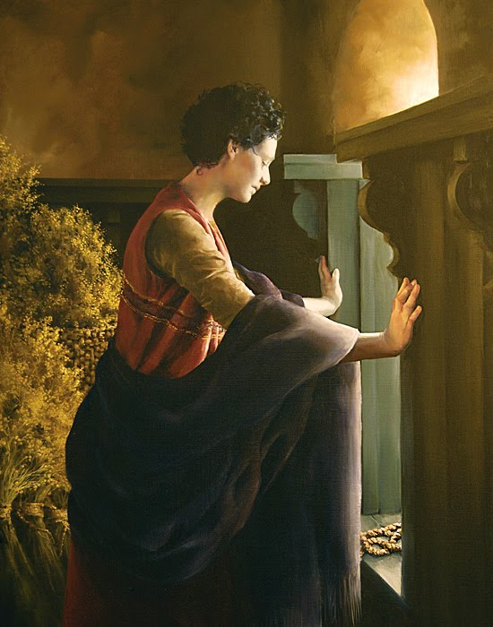
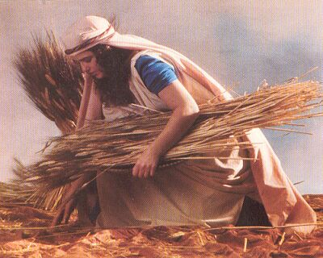
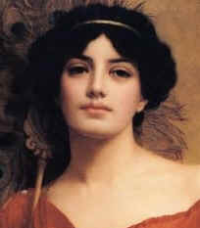
The Women in Jesus’ Line
Ruth was a Moabitess before converting to Judaism
Ruth 1:4
Rahab was a Canaanite of Jericho
Joshua 2:1–7
Bathsheba was the wife of Uriah, a Hittite
2 Samuel 11:3
Tamar was from Adullam in Canaanite territory
Genesis 38
All four were either non-Israelites or associated with non-Israelites.
Matthew 1:1-17
(3)

Slide 20
Sources:
Bible Dictionary
Teacher Seminary Manual
Neil L. Andersen, “We Talk of Christ,” Ensign or Liahona, Nov. 2020, 88

Slide 21
Old Testament Prophecies of the Messiah | Fulfillment through Jesus Christ
The Messiah would be a descendant of Abraham and of David (see Jeremiah 23:5–6 ; Genesis 22:18). | Matthew 1:1, 6, 17
The Messiah would be born of a virgin (see Isaiah 7:14 ; Alma 7:10). | Matthew 1:21–23
The Messiah would be born in Bethlehem (see Micah 5:2). | Matthew 2:4–6
The Messiah would come from Nazareth (see 1 Nephi 11:13). | Matthew 2:23
The Messiah would heal the sick (see Isaiah 53:4 ; Mosiah 3:5). | Matthew 8:16–17
The Messiah would teach using parables (see Psalm 78:2). | Matthew 13:35
The Messiah would enter Jerusalem riding on a donkey (see Zechariah 9:9). | Matthew 21:1–7
Messiah | Related Scriptures
The Messiah shall have the Spirit, preach the gospel, and proclaim liberty | Isa. 61:1–3; Luke 4:18–21
We have found the Messias, which is, being interpreted, the Christ | John 1:41 John 4:25–26
God raised up among the Jews a Messiah, or, in other words, a Savior | 1 Ne. 10:4
The Son of God was the Messiah who should come | 1 Ne. 10:17
Redemption cometh in and through the holy Messiah | 2 Ne. 2:6
The Messiah cometh in the fulness of time | 2 Ne. 2:26
The Messiah shall rise from the dead | 2 Ne. 25:14
In the name of Messiah I confer the Priesthood of Aaron | D&C 13:1
The Lord said, I am Messiah, the King of Zion | Moses 7:53

Slide 22
Notes or handouts Matthew 1:1-17
Matthew 1:1-17 The Genealogy of Jesus:
“Jesus was not Joseph’s son, but Joseph’s genealogy is essentially Mary’s genealogy, for they were cousins; Jesus inherited from his mother, Mary, the blood of David and therefore the right to David’s throne. Jesus was born in the royal line, and as Elder James E. Talmage has explained, ‘Had Judah been a free and independent nation, ruled by her rightful sovereign, Joseph the carpenter would have been her crowned king; and his lawful successor to the throne would have been Jesus of Nazareth, the King of the Jews’ [Jesus the Christ, 3rd ed. (1916), 87; see also Jesus the Christ, 83–86, 89–90; Bruce R. McConkie, Doctrinal New Testament Commentary, 3 vols. (1965–73), 1:94–95]” (The Life and Teachings of Jesus and His Apostles, 2nd ed. [Church Educational System manual, 1979], 22).
Matthew 1–4 Matthew sets forth the genealogy and birth of Jesus Christ. Wise men seek the King of the Jews. Guided by dreams, Joseph takes Mary and the child Jesus to Egypt and later to Nazareth. John the Baptist preaches the gospel of repentance and baptizes Jesus Christ. The Savior is tempted in the wilderness. He begins His mortal ministry by teaching and healing.
Matthew 1:1-17 The Royal Linage:
“The consensus of judgment on the part of investigators is that Matthew’s account is that of the royal lineage, establishing the order of sequence among the legal successors to the throne of David, while the account given by Luke is a personal pedigree, demonstrating descent from David without adherence to the line of legal succession to the throne through primogeniture or nearness of kin. Luke’s record is regarded by many, however, as the pedigree of Mary, while Matthew’s is accepted as that of Joseph. The all important fact to be remembered is that the Child promised by Gabriel to Mary, the virginal bride of Joseph, would be born in the royal line” James E. Talmage (Jesus the Christ,3rd ed. [1916], 86).
Though both Matthew’s and Luke’s accounts are correct, the most important aspect of Jesus Christ’s genealogy has been made clear on several occasions by God the Father: “This is my beloved Son, in whom I am well pleased; hear ye him”
Old Testament Institute Student Manual
Descendant of David:
No single concept was more firmly lodged in the minds of the Jews in Jesus’ day than the universal belief that their Messiah would be the Son of David. … They looked for a temporal deliverer who would throw off the yoke of Roman bondage and make Israel free again. They sought a ruler who would restore that glory and worldwide influence and prestige which was enjoyed when the Son of Jesse sat on Israel’s throne.
(Bruce R. McConkie, The Promised Messiah [1978], 188)
Who are the women Matthew included in Christ’s genealogy?
“Tamar was from Adullam in Canaanite territory (see Genesis 38); Rahab was a Canaanite of Jericho (see Joshua 2:1–7); Ruth was a Moabitess before converting to Judaism (see Ruth 1:4); and Bathsheba was the wife of Uriah, a Hittite (see 2 Samuel 11:3). Thus, all four [women] were either non-Israelites or associated with non-Israelites” (New Testament Student Manual [2018], 13). The inclusion of these women in the genealogy of Jesus Christ can teach us that God works with all people and through unexpected ways.
It is also proof that “personal righteousness is not dependent on possessing the ‘perfect’ lineage, since Jesus Christ’s lineage was not perfect. [And] the inclusion of women in the Savior’s [family history] reflects the important truth that men and women are equal in the eyes of God” (New Testament Student Manual, 13).
Matthew 1:3,5,6 The non-Israelite women in Jesus’ Genealogy:
First, it demonstrates that God had worked through Gentiles in the past, thus preparing Matthew’s readers to appreciate the commission to “teach all nations” that would come at the end of his Gospel (Matthew 28:19).
Second, the mention of these particular women, each of whom figured in a controversy of some sort in the Old Testament, shows that in Israel’s past, God had worked through people and situations that the Jews would not have expected, thus preparing Matthew’s readers for the account that is immediately to follow—Mary and the virgin birth.
Third, it shows all of us today that personal righteousness is not dependent on possessing the “perfect” lineage, since Jesus Christ’s lineage was not perfect. Finally, the inclusion of women in the Savior’s pedigree reflects the important truth that men and women are equal in the eyes of God.
Old Testament Institute Student Manual

Slide 23
With God Nothing Shall Be Impossible
Luke 1:1-38
The Holy Ghost shall come upon thee, and the power of the Highest shall overshadow thee: therefore also that holy thing which shall be born of thee shall be called the Son of God.
Luke 1:35
Presentation by http://fashionsbylynda.com/blog/

Slide 24
Luke
He was a Gentile by birth
He was a physician (Colossian 4:14)
He was called to be a “messenger of Jesus Christ” (JST Luke 1:1)
He was well educated in Greek, culture and language
He did not witness the events of the Savior’s life, but became acquainted with them through others
He was one of Paul’s missionary companions at various times, during Paul's 2nd and 3rd journeys
He was the author of Acts
His audience included the Gentiles
His gospel contains the traditional Christmas narrative
(1)

Slide 25
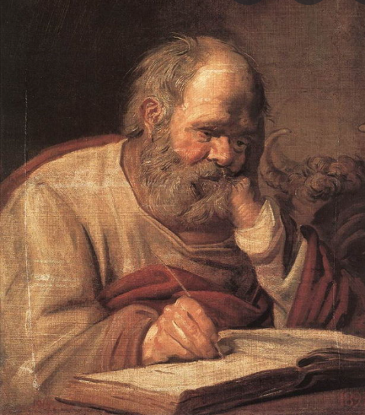
The Book of Luke
Book
Of
Luke
Luke was written before Acts, probably between A.D. 57-79
*As a writer: He wanted the Gentiles to come to the same knowledge of the truth he had.
(Luke writes this testimony so his friend Theophilus, probably also a Greek convert, would know the truth about Jesus Christ).
It is the longest Book in the New Testament.
He was not a Jew, but gives meanings to Hebrew words.
He presented Jesus as the Son of God.
He narrated events of the humanity of Christ.
He added the genealogy back to Adam.
He added a detailed account of the life of Jesus’ mother, Mary, and His childhood.
The only Gospel writer to record that the Savior shed His blood in Gethsemane and that an angel ministered to Him
Much of his writings focused on women, the poor, and the lower class.
He provided a hope through the life and atoning sacrifice of Jesus Christ to all the people.
He was especially concerned with the mission to the Gentiles.
(2)

Slide 26
Zacharias and Elisabeth
He was a Judean priest, from the family of Aaron, in the days of king Herod and husband to Elizabeth
They had no children and both were ‘stricken in years’
He was visited by the angel Gabriel (Noah) and was told that his wife would have a son .
Not convinced, Zacharias was struck dumb (not able to speak) until after the birth of their son, John (the Baptist)
He was slain between the temple and the alter
________________________________________________________________
She was the wife of Zacharias, the priest, and mother to John the Baptist
She belonged to the priestly family of Aaron
She was a kinswoman to Mary, mother of Jesus
(1)

Slide 27
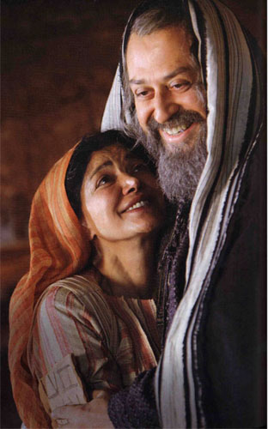
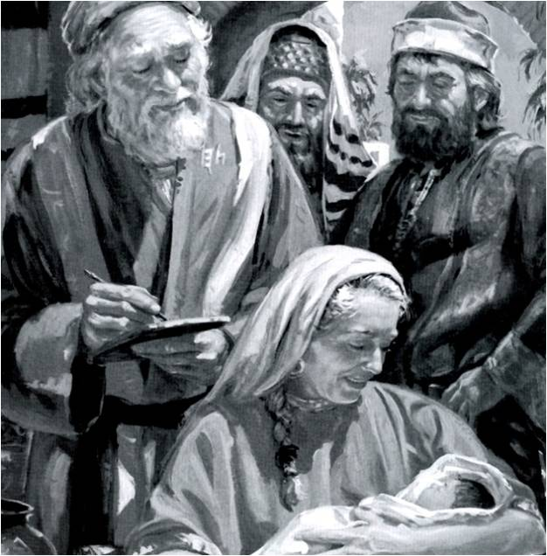
Joy and Gladness
Zacharias and Elisabeth had prayed for the opportunity to become parents.
Zacharias had no posterity through whom his priesthood line could continue, and Elisabeth later remarked that her barrenness had been viewed with “reproach among men”
Prophecy of John, the forerunner, the Elias, of the Son of God
Fear not, Zacharias: for thy prayer is heard; and thy wife Elisabeth shall bear thee a son, and thou shalt call his name John.
Luke 1:14-17, 25
(1)

Slide 28
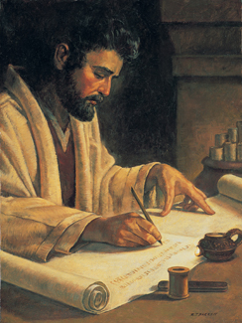
Theophilus—Friend of God
The name or honorary title of the person to whom the Gospel of Luke and the Acts.
The person to whom Luke addressed his Gospel and the Acts. The use of the title “most excellent” seems to show that he was a real personage.
One possibility…
"...This Theophilus was probably a native of Italy and perhaps an inhabitant of Rome, in tracing St. Paul's journey to Rome, places which an Italian might be supposed not to know are described minutely, Acts 27:8, 12, 16; but when he comes to Sicily and Italy this is neglected.
Hence it would appear that the person for whom Luke wrote in the first instance was a Gentile reader; and accordingly we find traces in the Gospel of a leaning toward Gentile rather than Jewish converts." (2)
Luke 1:3

Slide 29
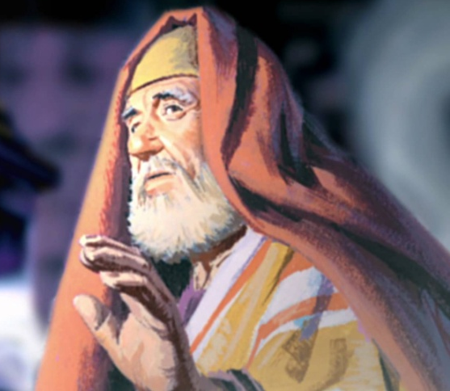
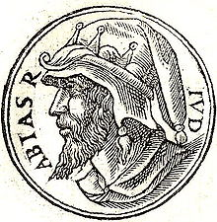
The Course of Abia
Zacharias belonged to the course of priests named after Abijah, and known in later time as the course of Abia.
This was the eighth in the order of the twenty-four courses established by David the king, each course being appointed to serve in turn a week at the sanctuary.
Centuries before the birth of Jesus, King David had divided the priests of Israel into 24 families (called “courses”), each of which was called to serve in the temple twice a year for one week each time.
Zacharias belonged to the priestly family of Abia (also called Abijah;).
Joseph Smith Translation, Luke 1:8 replaces the word course with priesthood.
The priests drew lots to determine who among them would receive the high honor of offering incense within the temple.
Because of the large number of priests, the opportunity to burn incense was a rare privilege, one that would have been a high point in Zacharias’s life of service as a priest. (2)
According to the Hebrew Bible, the fourth king of the House of David and the second of the Kingdom of Judah. He was the son of Rehoboam, the grandson of Solomon and the great-grandson of David. The Chronicler refers to him as Abijah. Wikipedia
Luke 1:5; 1 Chronicles 23:1-6; 24:1-19

Slide 30
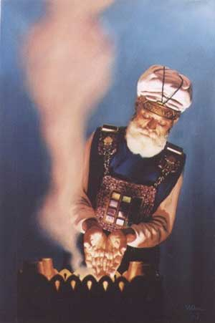
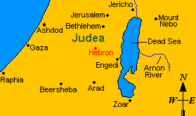
Zacharias Priestly Duty
Appointed to burn incense in the Jerusalem temple
"Twice each year, in April and October, the priests of the course of Abia, named for Abijah, traveled from their village homes to the House of the Lord in Jerusalem, there to take their week-long turns at performing those sacred rites and ordinances which for fifteen hundred years had been the center of Israel's worship.” (3)
Zacharias and Elisabeth dwelt in a village in the hill country of Judea, believed to be Hebron.
Luke 1:9

Slide 31
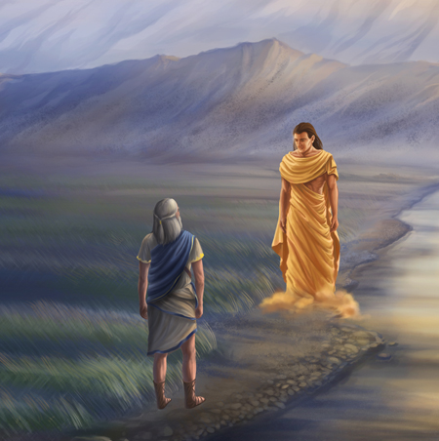
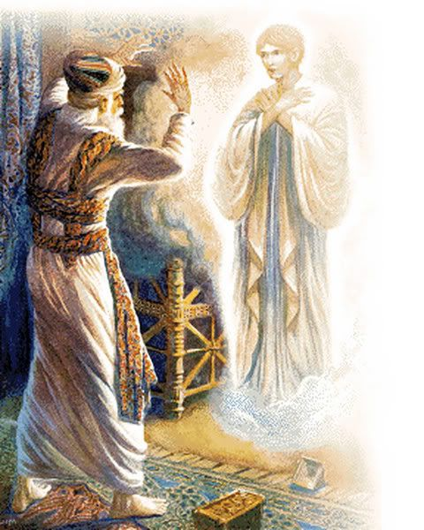
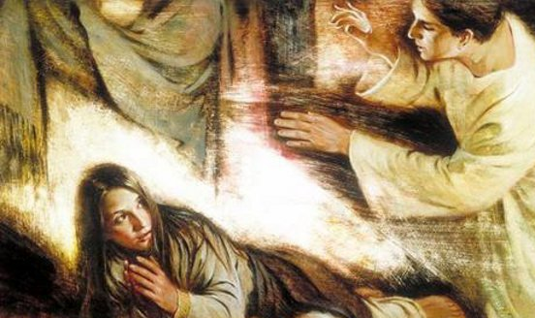
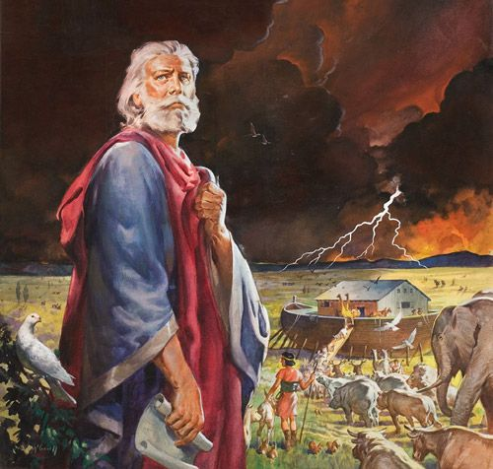
Angel Gabriel—Man of God
The name of an angel sent:
To Daniel
To Zacharias
To Mary
“Noah … is Gabriel; he stands next in authority to Adam in the Priesthood; he was called of God to this office, and was the father of all living in his day, and to him was given the dominion.” (4)
Luke 1:11-19; 26-38 ; Daniel 8:16; 9:21 HC3:386
(1)

Slide 32
With God Nothing is Impossible
“You will be asked to accept challenging assignments and become an instrument in the Lord’s hands. And He will enable you to accomplish the impossible.”
(5)

Slide 33
“How will you accomplish the impossible? By doing whatever it takes to strengthen your faith in Jesus Christ by increasing your understanding of the doctrine taught in His restored Church and by relentlessly seeking truth. …
When you are asked to do impossible things, you will be able to step forward with faith and dogged persistence and cheerfully do all that lies in your power to fulfill the purposes of the Lord.
You will have days when you will be thoroughly discouraged. So, pray for courage not to give up!
(5)

Slide 34
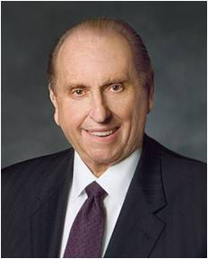
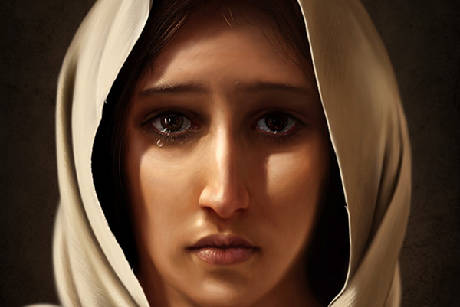
Mary of Nazareth—Handmaid of the Lord
"In our selection of heroes, let us nominate also heroines...I speak of Mary of Nazareth, espoused to Joseph, destined to become the mother of the only truly perfect man to walk the earth. Her acceptance of this sacred and historic role is a hallmark of humility.
"Could we ask, What makes of these men heroes and these women heroines?
I answer: Unwavering trust in an all-wise Heavenly Father and an abiding testimony concerning the mission of a divine Savior. This knowledge is like a golden thread woven through the tapestry of their lives.“
Dean Packwood
Luke 1:38
(6)

Slide 35
Sources:
Bible Dictionary
New Testament Institute Manual Chapter 15
Elder Bruce R. McConkie (The Mortal Messiah: From Bethlehem to Calvary, 4 vols. [Salt Lake City: Deseret Book Co., 1979-1981], 1: 306-307.) and (Doctrinal New Testament Commentary, 1:89).
Teachings of Presidents of the Church: Joseph Smith[2007], 104).
(Russell M. Nelson, “Becoming True Millennials” [worldwide devotional for young adults, Jan. 10, 2016], broadcasts.ChurchofJesusChrist.org)
President Thomas S. Monson (Be Your Best Self [Salt Lake City: Deseret Book Co., 1979], 40.
(9)

Slide 37
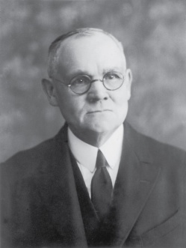
Zacharias:
About fifteen months prior to the Savior’s birth, Zacharias, a priest of the Aaronic order, was officiating in the functions of his office in the temple at Jerusalem. His wife, Elisabeth, was also of a priestly family; being numbered among the descendants of Aaron. The couple had never been blessed with children; and at the time of which we speak they were both well stricken in years and had sorrowfully given up hope of posterity. Zacharias belonged to the course of priests named after Abijah, and known in later time as the course of Abia. This was the eighth in the order of the twenty-four courses established by David the king, each course being appointed to serve in turn a week at the sanctuary. It will be remembered that on the return of the people from Babylon only four of the courses were represented; but of these four each averaged over fourteen hundred men.
During his week of service each priest was required to maintain scrupulously a state of ceremonial cleanliness of person; he had to abstain from wine, and from food except that specifically prescribed; he had to bathe frequently; he lived within the temple precincts and thus was cut off from family association; he was not allowed to come near the dead, nor to mourn in the formal manner if death should rob him of even his nearest and dearest of kin. We learn that the daily selection of the priest who should enter the Holy Place, and there burn incense on the golden altar, was determined by lot; and furthermore we gather, from non-scriptural history, that because of the great number of priests the honor of so officiating seldom fell twice to the same person.
On this day the lot had fallen to Zacharias. It was a very solemn occasion in the life of the humble Judean priest—this one day in his life on which the special and particularly sacred service was required of him. Within the Holy Place he was separated by the veil of the temple only from the Oracle or Holy of Holies—the inner sanctuary into which none but the high priest might enter, and he only on the Day of Atonement, after long ceremonial preparation. The place and the time were conducive to the highest and most reverential feelings. As Zacharias ministered within the Holy Place, the people without bowed themselves in prayer, watching for the clouds of incense smoke to appear above the great partition which formed the barrier between the place of general assembly and the Holy Place, and awaiting the reappearance of the priest and his pronouncement of the benediction.
Before the astonished gaze of Zacharias, at this supreme moment of his priestly service, there appeared, standing on the right of the golden altar of incense, an angel of the Lord. Many generations had passed in Jewry since any visible presence other than mortal had been manifest within the temple, either in the Holy Place or the Holy of Holies; the people regarded personal visitations of heavenly beings as occurrences of the past; they had come almost to believe that there were no longer prophets in Israel. Nevertheless, there was always a feeling of anxiety, akin to that of troubled expectancy, whenever a priest approached the inner sanctuary, which was regarded as the particular abode of Jehovah should He ever again condescend to visit His people. In view of these conditions we read without surprise that this angelic presence troubled Zacharias and caused fear to fall upon him. The words of the heavenly visitant, however, were comforting though of startling import, embodying as they did the unqualified assurance that the man’s prayers had been heard, and that his wife should bear him a son, who must be named John. The promise went even further, specifying that the child to be born of Elisabeth would be a blessing to the people; many would rejoice at his birth; he would be great in the sight of the Lord, and must be guarded against wine and strong drink; he would be filled with the Holy Ghost, would be the means of turning many souls to God, and would go before to make ready a people prepared to receive the Messiah.
…In due time the child was born, there in the hill country of Judea^{i} where Zacharias and Elisabeth had their home; and, on the eighth day following the birth the family assembled in accordance with custom and Mosaic requirement, to name the babe in connection with the rite of circumcision.^{j} All suggestions that he be called after his father were overruled by Zacharias, who wrote with decisive finality: “His name is John.” Thereupon the dumb priest’s tongue was loosed, and being filled with the Holy Ghost he burst forth in prophecy, praise and song;
Elisabeth must have known that the approaching birth of her son would soon be followed by that of the Messiah, and that therefore the day for which Israel had waited and prayed through the long dark centuries was about to dawn. When Mary’s salutation fell upon her ears, the Holy Ghost bore witness that the chosen mother of the Lord stood before her in the person of her cousin; and as she experienced the physical thrill incident to the quickening spirit of her own blessed conception, she returned the greeting of her visitor with reverence: “Blessed art thou among women, and blessed is the fruit of thy womb. And whence is this to me, that the mother of my Lord should come to me?”
Jesus the Christ by James E. Talmage
Chapter 7 pgs. 75-78

Slide 38
Abijam (Abia) from Guillaume Rouillé's Promptuarii Iconum Insigniorum, 1553
Reign | 913 to 911 BC
Predecessor | Rehoboam, his father
Successor | Asa, his son
Died | 911 BC possibly Jerusalem
Burial | Jerusalem
Spouse | 14 wives
Issue | 22 sons and 16 daughters
Hebrew name | אבים בן-רחבעם ’Aviyam ben Rehav’am
House | House of David
Father | Rehoboam
Mother | Maacah, or Micaiah, daughter of Uriel of Gibeah, and granddaughter of Absalom (Abishalom)
‘Why were angels so prominent at the Savior’s birth? And why were they such an important part of His life and ministry?’
The answers are twofold. The first pertains to the nature and mission of the personage whom they were heralding—a divine Being, the Son of God, the Only Begotten in the flesh who came to earth to save all of God’s children. The second concerns the ushering in of a new dispensation, a period of time when the gospel would be restored in its fulness. The ministry of angels is to assist in the ushering in of dispensations.
“The last prophet of the Old Testament was Malachi, who lived 400 years before the birth of Christ. At that time Israel in large part had turned away from the covenants made with Jehovah. Consequently, they were in apostasy. Although the Aaronic Priesthood was on earth when Jesus was born, the Melchizedek Priesthood had been taken from the earth. Therefore, there was a need for the priesthood and the gospel to be restored in their fulness. …
“At the beginning of a new dispensation following a period of apostasy, there is no one with priesthood authority to administer the covenants in their fulness. Consequently, the Lord sends messengers from the other side of the veil to return priesthood keys and the gospel plan to the earth.
“It is not surprising then that an angel visited Zacharias and instructed him with regard to the mission of his son” Elder Merrill J. Bateman(“A Season for Angels,” Ensign, Dec. 2007, 10, 14).
Forerunner: Luke 1:17
“Being the forerunner was neither a simple task nor an honorary title. Difficult and dangerous work needed to be done. … John, a mere mortal—armed with the Aaronic Priesthood, a divine commission, personal righteousness, the truth of God, and a huge amount of courage—was launched on his ministry to prepare the way for the Son of God. What John was called to do placed his life in jeopardy.
“The term forerunner is descriptive. Forerunners anciently would run before the chariot of the king and clear the path of rocks or other obstacles, and loudly proclaim the coming of the ruler. … John was both a forerunner and a proclaimer of Jesus. He was the divinely appointed herald” (Robert J. Matthews, Behold the Messiah [1994], 46).
Event | Matthew | Mark | Luke | John
Annunciation to Zacharias |  |  | 1:5-25
Annunciation to Mary |  |  | 1:26-38
Mary Visits Elizabeth |  |  | 1:39-55
Birth of John the Baptist |  |  | 1:57-64
Prophecy of Zacharias |  |  | 1:67-79, 65,66
Mary Returns to Nazareth |  |  | 1:56
Wikipedia

Slide 39
Acquiring Spiritual Knowledge
Part 1
Presentation by http://fashionsbylynda.com/blog/

Slide 40
A young man has a lot of questions about the Church’s policies and begins to wonder if the Church is really true.
A young woman sees a post on social media that questions a doctrine of the Church. Now she begins to wonder about that doctrine herself.
A young woman wonders if prayers are really answered after her brother suffered and died from a terminal illness, despite prayers and blessings offered in his behalf.
1

Slide 41
What are some questions or challenges you have (or that other people you know have) that are not easy to resolve?
Why do you think Heavenly Father allows us to have unresolved questions rather than always giving us the answers?
1

Slide 42
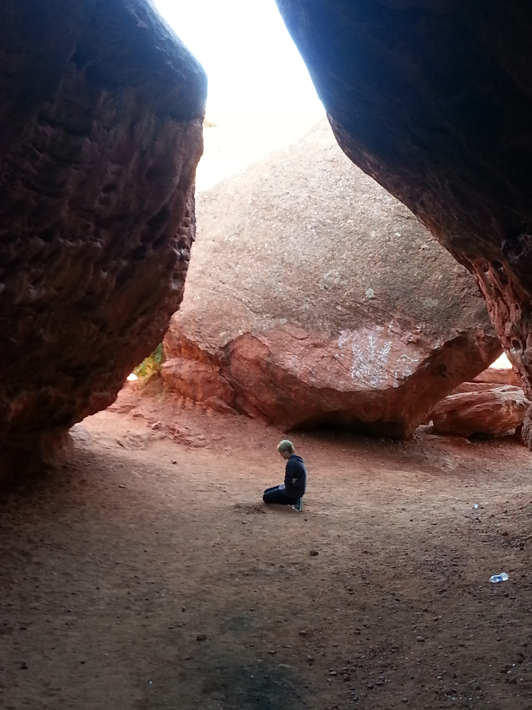
Ask, and it shall be given you; seek, and ye shall find; knock, and it shall be opened unto you:
For every one that asketh receiveth; and he that seeketh findeth; and to him that knocketh it shall be opened.
Matthew 7:7-8
If any of you lack wisdom, let him ask of God, that giveth to all men liberally, and upbraideth not; and it shall be given him.
But let him ask in faith, nothing wavering. For he that wavereth is like a wave of the sea driven with the wind and tossed.
James 1:5-6

Slide 43
Learn the Truth
Asking questions and seeking answers is a vital part of our effort to learn truth,
Followed by:
applying and living what we have learned in our quest to become more like the Savior and our Heavenly Father.
Dorina Castras
1

Slide 44
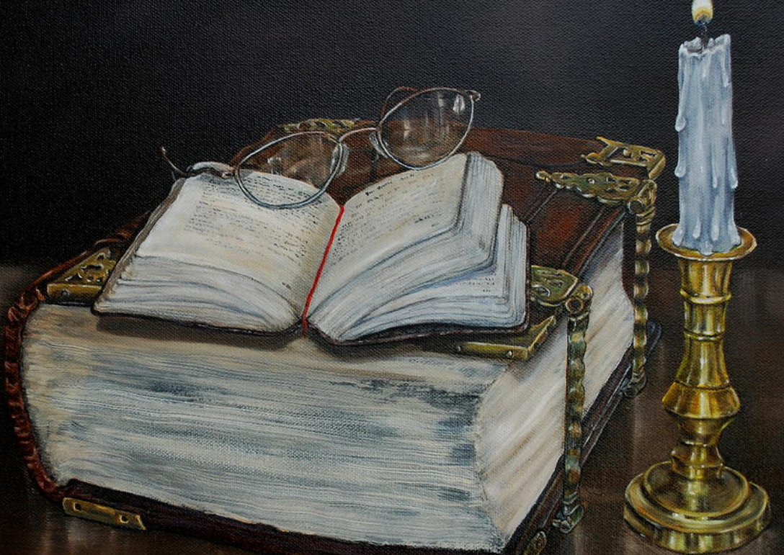
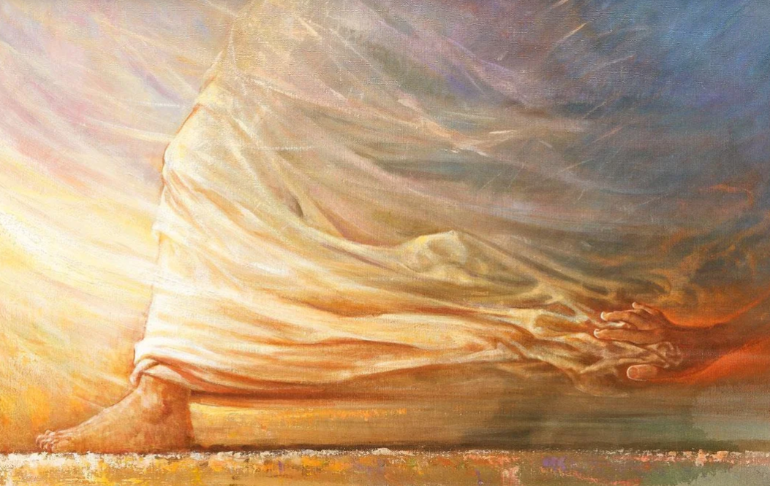
Understanding Eternal Truth
Act in faith
Examine concepts and questions with an eternal perspective
Yongsung Kim
Arvil Brand
Seek further understanding through divinely appointed sources
1

Slide 45
Act In Faith
Faith does not fall upon us by chance or stay with us by birthright. … Faith in Jesus Christ is a gift from heaven that comes as we choose to believe and as we seek it and hold on to it. … The future of your faith is not by chance, but by choice. …
Faith never demands an answer to every question but seeks the assurance and courage to move forward, sometimes acknowledging, “I don’t know everything, but I do know enough to continue on the path of discipleship.”
Immersing oneself in persistent doubt, fueled by answers from the faithless and the unfaithful, weakens one’s faith in Jesus Christ and the Restoration. “The natural man receiveth not the things of the Spirit of God: for they are foolishness unto him” [1 Corinthians 2:14]. …
Although your beginning fire of faith may be small, righteous choices bring greater confidence in God, and your faith grows. (2)
1

Slide 46
What characteristics and attributes of Heavenly Father and Jesus Christ increase your confidence and trust in Them?
How can knowing or believing these things about Heavenly Father and Jesus Christ help you to act in faith?
What are some actions you might take as you strive to act in faith when facing difficult questions or challenges?
Are there other resources you are aware of that could help someone else learn how to act in faith?
1

Slide 47
It’s natural to have questions—the acorn of honest inquiry has often sprouted and matured into a great oak of understanding. There are few members of the Church who, at one time or another, have not wrestled with serious or sensitive questions.
One of the purposes of the Church is to nurture and cultivate the seed of faith—even in the sometimes sandy soil of doubt and uncertainty. Faith is to hope for things which are not seen but which are true.
Therefore, my dear brothers and sisters—my dear friends—please, first doubt your doubts before you doubt your faith. We must never allow doubt to hold us prisoner and keep us from the divine love, peace, and gifts that come through faith in the Lord Jesus Christ.
(3)
1

Slide 48
Our faith increases every time we exercise our faith in Him. That is what learning by faith means.
For example, each time we have the faith to be obedient to God’s laws—even when popular opinions belittle us—or each time we resist entertainment or ideologies that celebrate covenant-breaking, we are exercising our faith, which in turn increases our faith.
(4)
1

Slide 49
Sources:
1. Teacher Manual New Testament
2. Neil L. Andersen, “Faith Is Not by Chance, but by Choice,” Ensign or Liahona, Nov. 2015, 65–67
3. Dieter F. Uchtdorf, “Come, Join with Us,” Ensign or Liahona, Nov. 2013, 23
4. Russell M. Nelson, “Embrace the Future with Faith,” Ensign or Liahona, Nov. 2020, 75

Slide 50
Jesus Christ, Son of God and Mary
Matthew 1:18–25; Luke 1:26–35
Presentation by http://fashionsbylynda.com/blog/

Slide 51
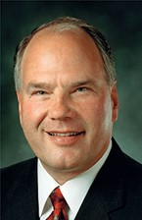
What are some of the most common challenges you face today?
?
What could you turn to as you try to deal with these challenges?
?
Jesus Christ is always the answer. In understanding His mission and His gospel, our love for Him and our belief in and reliance on Him give us strength.
(1)

Slide 52
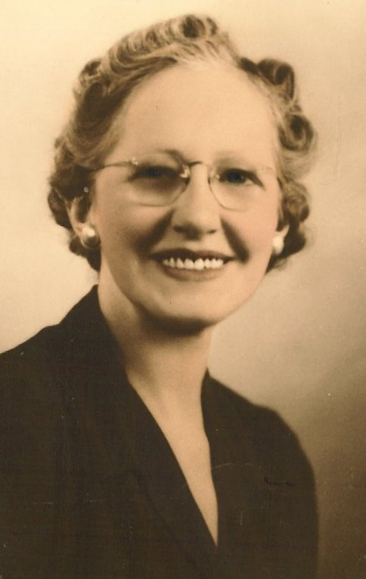
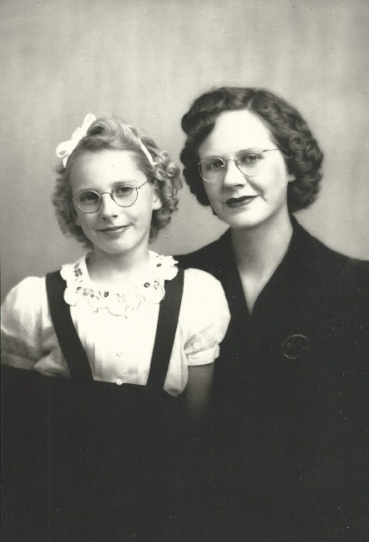
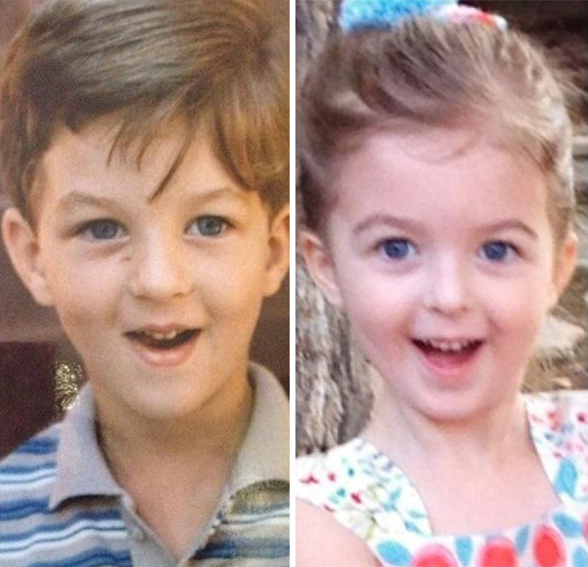
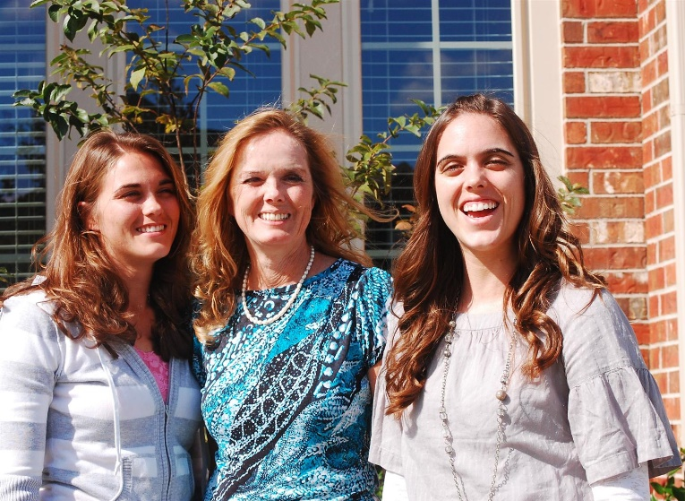
Inherited Traits
2014 and 1977
Both 20 years old
Three Generations
Father and Daughter
Mother and Son
Mother and Daughters

Slide 53
Joseph
He was the Son of Heli (Luke 3:23) and husband of the virgin Mary and a “Just Man”
His descent could be traced from David by a double line (Matt. 1:1–16; Luke 3:23–38).
He lived at Nazareth and espoused Mary, possibly the daughter of his uncle Jacob.
Joseph worked the trade of Tekton, meaning not just a joiner or carpenter, but a master builder, somebody who worked on the various materials needed for the construction work, including timber and iron, but most frequently stone (2)
It was shortly before the marriage that Mary received the visit from the angel Gabriel.
The birth of the child, Jesus, was miraculous, His mother being His only earthly parent; but Joseph was naturally regarded in Nazareth as His father, and the holy child treated him as such (Luke 2:48, 51).
It is probable that Joseph died before the Crucifixion (and probably before our Lord’s baptism), as otherwise Mary would hardly have been committed by our Lord to the keeping of John (John 19:26–27).
(2)

Slide 54
Mary
Tradition tells us she was the daughter Joachim and Hannah (Anna) named Miriam or Mary and the firstborn female
She was from Nazareth
Anna prayed in her garden to have a child and like Hannah, Samuel’s mother, she promised to have their child raised in the Temple as a holy vessel of God
Her cousin was Elisabeth, wife of Zacharias the priest, and mother of John, the Baptist
She was a virgin and mentioned in the Book of Mormon in Alma 7:10 and Mosiah 3:8
She was betrothed to Joseph at about the age of 12
She received ‘an Annunciation’ when the angel Gabriel appeared to her and announced her divine selection to be the mother of Jesus She was at the death of her son
According to Apocryphal writings, at some time soon after her death, her incorrupt body was assumed directly into Heaven, to be reunited with her soul, and the apostles thereupon found the tomb empty
(2,3)

Slide 55
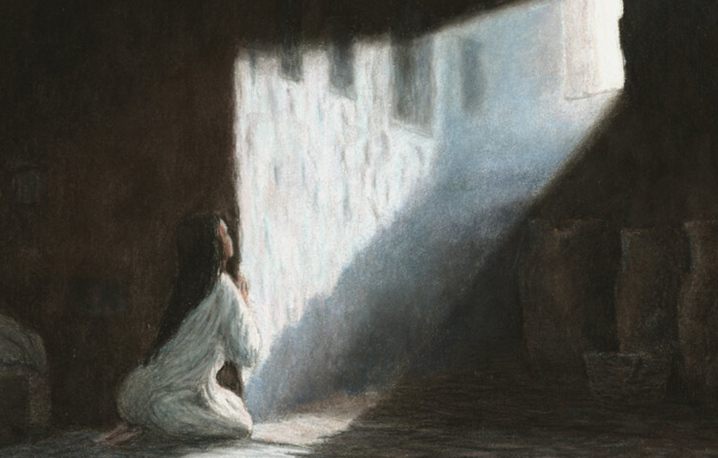
Gabriel and Mary
Fear not, Mary: for thou hast found favour with God.
Hail, thou that art highly favoured, the Lord is with thee: blessed art thou among women.
See also: Alma 7-10
Luke 1:26-38
(3)
Rosa Tuffney

Slide 56
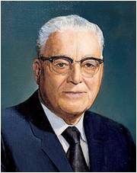
“I Know Not A Man”
The Holy Ghost shall come upon thee, and the power of the Highest shall overshadow thee: therefore also that holy thing which shall be born of thee shall be called the Son of God.
Luke 1:35
Now the birth of Jesus Christ was on this wise: When as his mother Mary was espoused to Joseph, before they came together, she was found with child of the Holy Ghost.
Matthew 1:18
And behold, he shall be born of Mary, at Jerusalem which is the land of our forefathers, she being a virgin, a precious and chosen vessel, who shall be overshadowed and conceive by the power of the Holy Ghost, and bring forth a son, yea, even the Son of God.
Alma 7:10
And it came to pass that I beheld that she was carried away in the Spirit;
1 Nephi 11:19
For my thoughts are not your thoughts, neither are your ways my ways, saith the Lord. For as the heavens are higher than the earth, so are my ways higher than your ways, and my thoughts than your thoughts.
Isaiah 55:8-9
“Let the Lord rest His case with this declaration and wait until He sees fit to tell us more.” (8)
Luke 1:34

Slide 57
Behold, a virgin shall be with child, and shall bring forth a son, and they shall call his name Emmanuel,
Joseph’s Dream
Joseph, thou son of David, fear not to take unto thee Mary thy wife
Matthew 1:18-23
Joseph Brickey

Slide 58
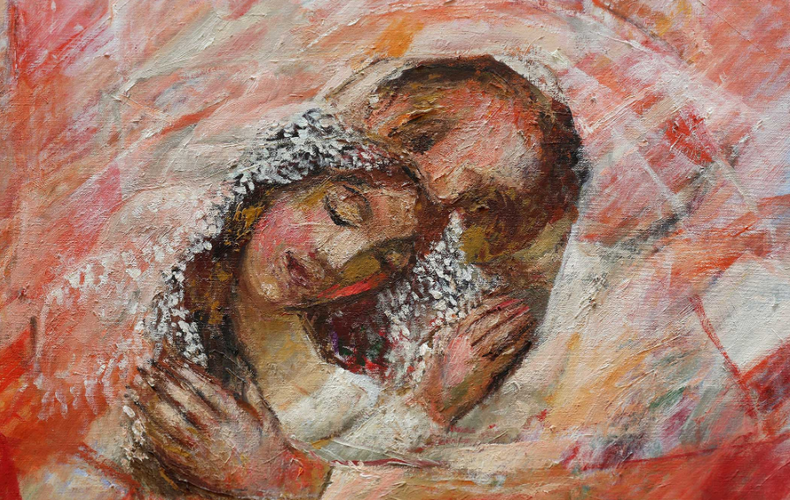
Joseph: Knew Her Not
The term know or knew in the Bible can refer to sexual relations.
Joseph did not have sexual relations with Mary before Jesus was born.
This detail reinforces the fact that he could not have been the father of Jesus and that Jesus’s conception was miraculous.
Sieger Koder
Matthew 1:25, Genesis 4:1
(9)

Slide 59
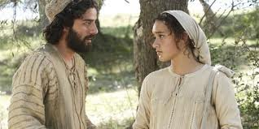
Three Possible Actions
By Jewish law, to break a betrothal required a bill of divorcement. Deuteronomy 22:13-21, 25-27
First, he could have subjected Mary to a public divorce and perhaps even execution (stoning), for people would have presumed that Mary was guilty of adultery—a crime punishable by death under the law of Moses.
Second, Joseph could have had his betrothal to Mary privately annulled before two witnesses.
A third option was to proceed with the marriage. Joseph was inclined to show mercy to Mary by quietly annulling the betrothal agreement
“to put her away privily” = Joseph planned to cancel the engagement privately without forcing Mary to face public humiliation or the possible penalty of stoning
Matthew 1:19: Leviticus 20:10; John 8:5; Matthew 1:20-25; Luke 3:23
(3)

Slide 60
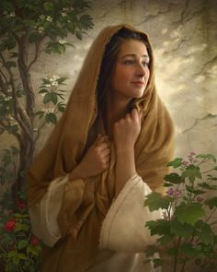
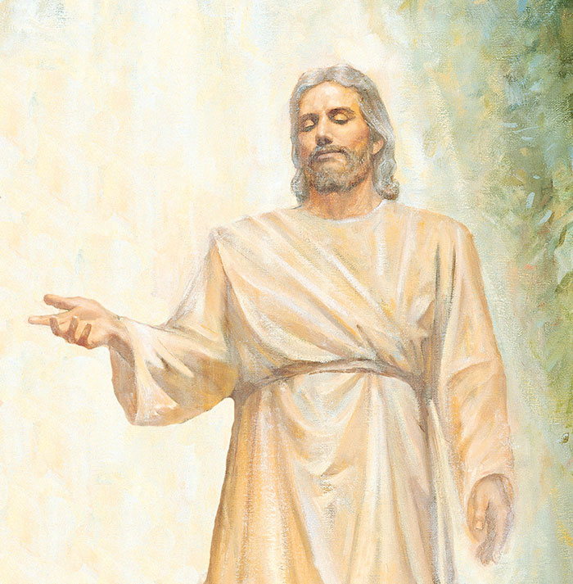
Jesus Christ is the divine Son of God the Father and of Mary
Mortality=Through Jesus’s mortal mother, Mary, He inherited the ability to “lay down His life voluntarily.”
Howard Lyon
Immortality= Capacity to live forever through resurrection.
From His Heavenly Father, Jesus inherited the ability to endure suffering during His atoning sacrifice “such as no other being who has lived on earth might even conceive as possible.”
Luke 1:32-33
(4)

Slide 61
From His immortal Father, Jesus inherited the power to live forever.
From His mortal mother He inherited the fate of physical death.
Those unique attributes were essential for His mission to atone for the sins of all mankind.
Thus Jesus the Christ was born to die (see 3 Nephi 27:13–15).
He died that we might live. He was born that all humankind could live beyond the grave. (6)

Slide 62
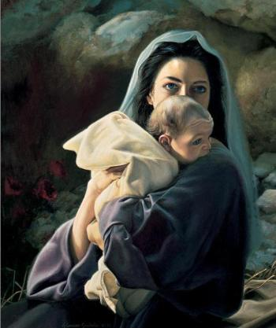
The Name
And he shall be called Jesus Christ, the Son of God, the Father of heaven and earth, the Creator of all things from the beginning; and his mother shall be called Mary. Mosiah 3:8
“Son of the Highest” = Jesus Christ is the Son of God
“That Child to be born of Mary … was of right to be called the ‘Son of the Highest.’ In His nature would be combined the powers of Godhood with the capacity and possibilities of mortality. … The Child Jesus was to inherit the physical, mental, and spiritual traits, tendencies, and powers that characterized His parents—one immortal and glorified—God, the other human—woman.” (6)
'The Lord himself shall give you a sign; Behold, a virgin shall conceive, and bear a son, and shall call his name Immanuel.' (Isaiah 7:14)
Liz Lemon
Luke 1:32
(2)

Slide 63
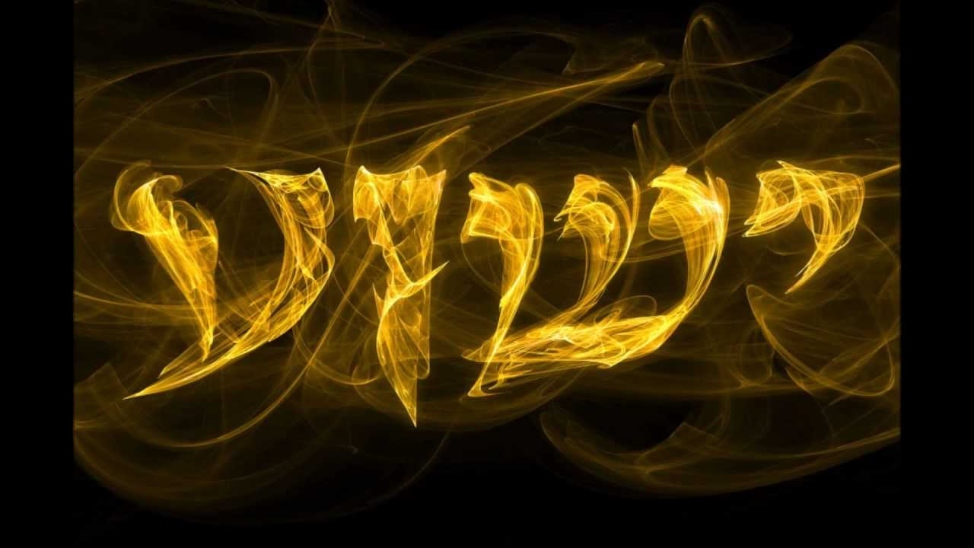
To Save
The name Jesus comes from Iēsous, a Greek form of the Hebrew name Yeshua (Joshua in English).
Yeshua means “Jehovah saves,” and the long form of the name,
Yehoshua, means “Jehovah is salvation.”
Both forms of the name bear witness of the identity and mission of Jesus Christ, who was Jehovah in the premortal life.
Matthew described the Savior’s mission of salvation by declaring, “He shall save his people from their sins.”
…for he said unto him that the Lord surely should come to redeem his people, but that he should not come to redeem them in their sins, but to redeem them from their sins. Helaman 5:10
Matthew 1:21
(3)

Slide 64
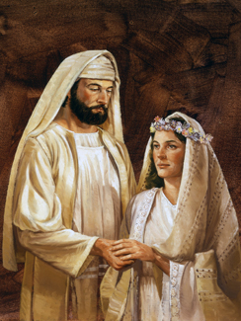
Betrothed
Marriage between a young man and a young woman was arranged and agreed to by the heads of the respective families—usually the fathers.
Once the marriage was agreed upon, the wedding consisted of two stages: betrothal (also called espousal) and a wedding ceremony.
Though betrothed couples were legally regarded as husband and wife, between the time of betrothal and the wedding ceremony, a strict code of chastity was enforced.
At the time of betrothal the young man took legal possession of the young woman, but not physical possession.
Painting by Lyle Beddes
Matthew 1:18, 25; Deuteronomy 22:23-24
(5)

Slide 65
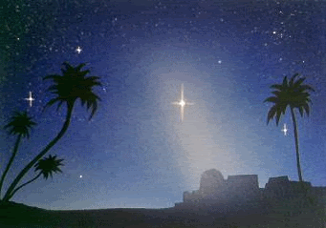
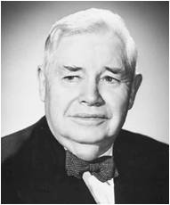
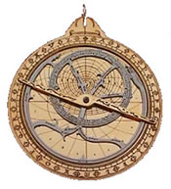
The Year of His Birth
Concerning the year in which Jesus Christ was born, “the Church has made no official declaration on the matter” (7)
The calendar currently used throughout most of the world was created many centuries after Jesus Christ lived, and experts disagree about how to use existing historical information to calculate the year of His birth. (2)
“This is not a settled issue. Perhaps also it does not matter too much as long as we have an accepted framework of time within which to relate the actual events of [Christ’s] life” (5)
Matthew 1:25

Slide 66
Sources:
Ronald A. Rasband, “Jesus Christ Is the Answer,” [evening with a General Authority, Feb. 8, 2019], broadcasts.ChurchofJesusChrist.org
Bible Dictionary
New Testament Institute Student Manual
James E. Talmage Jesus the Christ, 81, 613
Elder Bruce R. McConkie (The Mortal Messiah: From Bethlehem to Calvary, 4 vols. [Salt Lake City: Deseret Book Co., 1979-1981], 1: 306-307.) and (Doctrinal New Testament Commentary, 1:89).
Russell M. Nelson, “Christ the Savior Is Born,” New Era, Dec. 2006, 5
J. Reuben Clark Jr., Our Lord of the Gospels[1954], vi.
The Teachings of Harold B. Lee, ed. Clyde J. Williams [1996], 14
New Testament Teacher Manual

Slide 67
Matthew 1:1-17 The Royal Linage:
“The consensus of judgment on the part of investigators is that Matthew’s account is that of the royal lineage, establishing the order of sequence among the legal successors to the throne of David, while the account given by Luke is a personal pedigree, demonstrating descent from David without adherence to the line of legal succession to the throne through primogeniture or nearness of kin. Luke’s record is regarded by many, however, as the pedigree of Mary, while Matthew’s is accepted as that of Joseph. The all important fact to be remembered is that the Child promised by Gabriel to Mary, the virginal bride of Joseph, would be born in the royal line” James E. Talmage (Jesus the Christ,3rd ed. [1916], 86).
Though both Matthew’s and Luke’s accounts are correct, the most important aspect of Jesus Christ’s genealogy has been made clear on several occasions by God the Father: “This is my beloved Son, in whom I am well pleased; hear ye him”
Old Testament Institute Student Manual
The Dreams of Joseph
“Gerald N. Lund, who later became a member of the Seventy, discussed Joseph’s visions and spiritual sensitivity: ‘Matthew tells us that [Joseph] was of the lineage of King David, that he was a just and considerate man, that in a dream an angel told him who Jesus would be, that he was obedient, and that he gave Jesus his name, which means savior. (See Matt. 1.) We know that he took Mary to Bethlehem, where Jesus was born. (See Luke 2:4–6.) Less than two years later, Joseph took his family into Egypt to escape Herod, after being warned in a dream. In Egypt, a dream again told him when to return, and another dream told him to go to Galilee. (See Matt. 2:13–15, 19–22.) Four dreams from God! Joseph must have been an exceptionally visionary and spiritually sensitive man’ (Jesus Christ, Key to the Plan of Salvation [1991], 51–52)” (New Testament Student Manual [Church Educational System manual, 2014], 13–14).
Forerunner: Luke 1:17
“Being the forerunner was neither a simple task nor an honorary title. Difficult and dangerous work needed to be done. … John, a mere mortal—armed with the Aaronic Priesthood, a divine commission, personal righteousness, the truth of God, and a huge amount of courage—was launched on his ministry to prepare the way for the Son of God. What John was called to do placed his life in jeopardy.
“The term forerunner is descriptive. Forerunners anciently would run before the chariot of the king and clear the path of rocks or other obstacles, and loudly proclaim the coming of the ruler. … John was both a forerunner and a proclaimer of Jesus. He was the divinely appointed herald” (Robert J. Matthews, Behold the Messiah [1994], 46).
Matthew 1:1-17 The Genealogy of Jesus:
“Jesus was not Joseph’s son, but Joseph’s genealogy is essentially Mary’s genealogy, for they were cousins; Jesus inherited from his mother, Mary, the blood of David and therefore the right to David’s throne. Jesus was born in the royal line, and as Elder James E. Talmage has explained, ‘Had Judah been a free and independent nation, ruled by her rightful sovereign, Joseph the carpenter would have been her crowned king; and his lawful successor to the throne would have been Jesus of Nazareth, the King of the Jews’ [Jesus the Christ, 3rd ed. (1916), 87; see also Jesus the Christ, 83–86, 89–90; Bruce R. McConkie, Doctrinal New Testament Commentary, 3 vols. (1965–73), 1:94–95]” (The Life and Teachings of Jesus and His Apostles, 2nd ed. [Church Educational System manual, 1979], 22).
Jesus is the Son of God Luke 1:35
President Ezra Taft Benson taught: “the testimonies of appointed witnesses leave no question as to the paternity of Jesus Christ. God was the Father of His fleshly tabernacle, and Mary, a mortal woman, was His mother. … He was not the son of Joseph, nor was He begotten by the Holy Ghost. He is the Son of the Eternal Father!” (“Five Marks of the Divinity of Jesus Christ,” Ensign, Dec. 2001, 10–11).
“[Jesus Christ] was the Only Begotten Son of our Heavenly Father in the flesh—the only child whose mortal body was begotten by our Heavenly Father. His mortal mother, Mary, was called a virgin, both before and after she gave birth. (See 1 Ne. 11:20.)” (“Joy in Christ,” Ensign, Mar. 1986, 3–4).
Matthew 1:19: Betrothal
A betrothal was not like our idea of engagement. It was a very serious covenant – legally binding – could not break without a divorce. During a betrothal they were as if legally married but not yet consummated. Adultery during this period was seen as worse than after the wedding. (Mary and Joseph) Choosing a companion was not the prerogative of the bride – only the groom. She could only accept or reject.
Inherited Luke 1:32-33:
“From His immortal Father, Jesus inherited the power to live forever. From His mortal mother He inherited the fate of physical death. Those unique attributes were essential for His mission to atone for the sins of all mankind. Thus Jesus the Christ was born to die (see 3 Nephi 27:13–15). He died that we might live. He was born that all humankind could live beyond the grave.” Elder Russell M. Nelson (“Christ the Savior Is Born,” New Era, Dec. 2006, 5).

Slide 68
Inheritance: “Just as Jesus is literally the Son of Mary, so he is the personal and literal offspring of God the Eternal Father. … Matthew’s statement, ‘she was found with child of the Holy Ghost,’ properly translated should say, ‘she was found with child by the power of the Holy Ghost.’
… Alma perfectly describes our Lord’s conception and birth by prophesying: Christ ‘shall be born of Mary, … she being a virgin, a precious and chosen vessel, who shall be overshadowed and conceive by the power of the Holy Ghost, and bring forth a son, yea, even the Son of God.’ (Alma 7:10)”
Elder Bruce R. McConkie (Doctrinal New Testament Commentary, 3 vols. [1965–73], 1:82). The Mortal Messiah: From Bethlehem to Calvary, 4 vols. [1979–81], 1:350
Mary’s Faith, The Angel Departed From Her Luke 1:38:
"Mary's example teaches us much about giving the answer of faith when things happen that we don't understand, about trusting in the Lord when things happen that try us and challenge our faith, about having confidence in his goodness at seasons of loss and sorrow.
"We are so used to thinking of the annunciation as the beginning of the joyous celebration of Christmas that we focus on Mary's joy, which I'm sure she felt, and on the great gladness of the Savior's birth. We are not used to thinking of this season as a time of loss for Mary. But it was a loss. She was a righteous young woman, but she was bound to lose her reputation among her family and friends and those who knew her in Nazareth. What else could they think, when they saw her pregnant, but that she had been unchaste? The last line in the annunciation is, 'And the angel departed from her' (v. 38). In other words, the angel didn't take the rabbi aside for a quiet chat about this very special young woman he had in town. He didn't whisper to the chief merchants that Mary was going to be remembered till the end of time, while their names would barely survive their own generation. The angel was not there at the well when Mary went for water, after she came back from visiting Elisabeth, her body already rounded with a sixth-month pregnancy. He didn't explain to the other women, shocked and scandalized and whispering to each other behind their hands, that Mary was the chosen vessel of the Lord. Nobody explained to the girls younger than Mary that she was the living embodiment of faith.
"Furthermore, Mary didn't explain it either. She obviously didn't explain it even to Joseph, because Joseph was the one person to whom the angel did come, to tell him that his faith in Mary was not misplaced. So, yes, I think we have to admit that despite the joy this was also a season of loss and mourning." Chieko N. Okazaki (Disciples [Salt Lake City: Deseret Book Co., 1998], 165 - 166.)
“That Child to be born of Mary was begotten of Elohim, the Eternal Father. … In His nature would be combined the powers of Godhood with the capacity and possibilities of mortality. … The Child Jesus was to inherit the physical, mental, and spiritual traits, tendencies, and powers that characterized His parents—one immortal and glorified—God, the other human—woman.” Because Jesus was the Son of an immortal Father and a mortal mother, He had the capacity to live eternally if He chose, as well as the ability to die. This divine nature uniquely qualified Him to be able to suffer for our sins, die on the cross, and be resurrected. James E. Talmage (Jesus the Christ, 3rd ed. [1916], 81).
Jesus Born of Mortal and Immortal Luke 1:31-35
if Jesus Christ had been born of two mortal parents, He could not have endured the infinite pain and suffering of the Atonement or overcome death. If He had been born of two immortal parents, He would not have been subject to physical suffering and death. Because Jesus was born of one divine parent and one mortal parent, He had the ability to suffer infinitely, to allow Himself to die, and then to overcome death through His Resurrection.)
Paternity of Jesus Christ: Matthew 1:18 The testimonies of appointed witnesses leave no question as to the paternity of Jesus Christ. God was the Father of His fleshly tabernacle, and Mary, a mortal woman, was His mother. …
… He was not the son of Joseph, nor was He begotten by the Holy Ghost. He is the Son of the Eternal Father!
(Ezra Taft Benson, “Five Marks of the Divinity of Jesus Christ,” Ensign, Dec. 2001, 10, 11)

Slide 69
Rejoice and Praise God
Luke 1:39–79
Presentation by ©http://fashionsbylynda.com/blog/

Slide 70
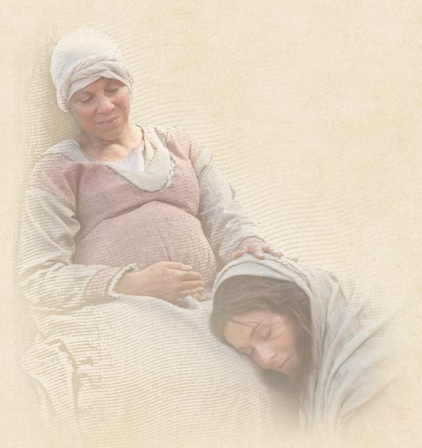
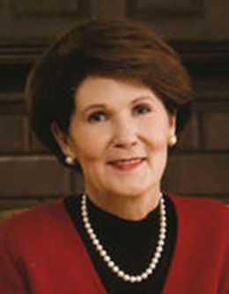
Mary and Elisabeth
“… her singular time of confusion and wonder and awe, Mary went to another woman. She knew she could go to Elisabeth.
Mary was very young-probably in her mid-teens at most-and Elisabeth was well beyond her childbearing years.
The scripture says she was 'well stricken' in years. Yet these two women came together, greeting one another in a bond that only women can know.
…And in the special roles they were destined to play, these two beloved women-representing both personally and dispensationally the old and the new-sang to each other even as the babe in the womb of one leapt in recognition of the divinity of the other.”
Luke 1:38-41
(1)

Slide 71
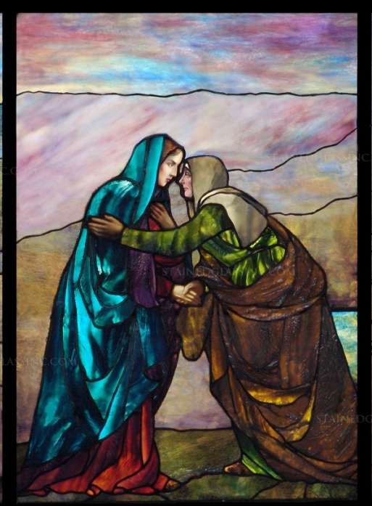
Song of Mary
Magnificat = which in Latin means “magnifies”
Elisabeth recognized Mary’s remarkable mission and, filled with the Holy Ghost, spoke words of praise and testimony
When Zacharias’s tongue was loosed at the time his son, John, was circumcised and named, Zacharias, also filled with the Holy Ghost, spoke beautiful words of praise, testifying of the mission of the Savior.
Zacharias’s hymn of praise is known as the Benedictus (which in Latin means “blessed”.
Luke 1:41-55, 67-80
(5)

Slide 72
Hymns of Praise in the Bible
Old Testament
Exodus 15:1-21
1 Samuel 1:11, 28
Judges 5:1-31
1 Samuel 2:1-10
1 Chronicles 16:7-36
Mary’s song closely resembles the song of Hannah. Hannah was a handmaid of the Lord who, through faith, miraculously conceived Samuel and dedicated him to God’s service .
The Song of Mary associates the birth of Jesus Christ with Israel’s sacred past and celebrates the Lord’s mercy in once again reaching out to bless and honor His people—particularly those of “low degree”.
Luke 1:46-55
(5)

Slide 73
Humility and Revernance
God knows and loves His children regardless of their circumstances.
Howard Lyon
Howard Lyon

Slide 74
We can rejoice in knowing that we have a Savior
Luke 1:47
The Lord is mighty and can do great things
Luke 1:49
God fulfills His promises
Luke 1:54
God is merciful to those who honor and obey Him
Luke 1:50
Truths
When we hunger spiritually,
the Lord can
fill us
Luke 1:53
God humbles the proud and lifts the humble
Luke 1:52

Slide 75
“As I have reflected on gifts from our Heavenly Father and from Jesus Christ, I have come to know of Their infinite love and Their incomprehensible compassion for all Heavenly Father’s children.
This knowledge has changed me, and it will change you too.”
(2)
2 Nephi 26:33

Slide 76
What are some blessings from Heavenly Father that you are most grateful for?
What do these blessings help you understand about Heavenly Father and Jesus Christ?
When have you felt joy because of recognizing God’s blessings for you or someone you know?
What scripture story or verse helps you want to praise God?

Slide 77
HYMNS
How Can I Praise God?

Slide 78
I pray this morning that all who are hungering and thirsting, and sometimes wandering, will hear this invitation from Him who is the Bread of Life, the Fountain of Living Water, the Good Shepherd of us all, the Son of God: “Come unto me, all ye that labour and are heavy laden, … and ye shall find rest unto your souls”
Truly He does fill “the hungry with good things,” as His own mother Mary testified. Come, and feast at the table of the Lord in what I testify to be His true and living Church, led by a true and living prophet.
(4)
Luke 1:53 ; Mathew 11:28-29

Slide 79
The Eighth Day
John is born of Zacharias and Elisabeth
“Naming of children and circumcision of male members of the house of Israel took place on [the eighth] day. In the case of John, he ‘was ordained by the angel of God at the time he was eight days old’—not to the Aaronic Priesthood, for such would come later, after his baptism and other preparation.
That is, at this solemn eighth day ceremony, an angel … gave the Lord’s Elias [John] the divine commission to serve as the greatest forerunner of all the ages”
For he was baptized while he was yet in his childhood, and was ordained by the angel of God at the time he was eight days old unto this power, to overthrow the kingdom of the Jews, and to make straight the way of the Lord before the face of his people, to prepare them for the coming of the Lord, in whose hand is given all power. D&C 84:28
Luke 1:59
(3)

Slide 80
Horn of Salvation
The God of my rock; in him will I trust: he is my shield, and the horn of my salvation, my high tower, and my refuge, my saviour; thou savest me from violence. 2 Samuel 22:3
When John’s father, Zacharias, was released by God from his inability to speak, he praised God and prophesied of John’s mission.
He mentioned that God had raised up a “horn of salvation,” which is a messianic title that refers to Jesus Christ.
The Lord is my rock, and my fortress, and my deliverer; my God, my strength, in whom I will trust; my buckler, and the horn of my salvation, and my high tower. Psalm 18:2
The horn was a symbol of power—an allusion to the strength of horned animals indigenous to the Near.
Luke 1:69
(3)

Slide 81
Sources:
Jeffrey R. Holland and Patricia T. Holland, On Earth As It Is in Heaven [Salt Lake City: Deseret Book Co., 1989], 33.)
Dale G. Renlund, “Consider the Goodness and Greatness of God,” Ensign or Liahona, May 2020, 44
Elder Bruce R. McConkie (The Mortal Messiah: From Bethlehem to Calvary, 4 vols. [Salt Lake City: Deseret Book Co., 1979-1981], 1: 306-307.) and (Doctrinal New Testament Commentary, 1:89).
Jeffrey R. Holland, “He Hath Filled the Hungry with Good Things,” Ensign, Nov. 1997, 66
New Testament Institute Manual Chapter 15

Slide 82
Mary and Elisabeth Luke 1:39-40:
"For the next three months, Mary remained with Elizabeth. From Mary, in her youth and with a special mission few others could comprehend, there was surely understanding and support. And from Elizabeth, there surely came wisdom shared from the experiences of a long life. Women the world over appreciate the closeness Mary and Elizabeth felt and the strength they each gained together.
"This account allows us to see clearly that sisterhood may be both individual and shared. As the Savior would later say, 'My mother and my brethren [and we may add sisters], are these which hear the word of God, and do it.' (Luke 8:21.) In that sense, Mary, as well as Elizabeth, enjoyed a sisterhood that had to do with personally qualifying through faithfulness to be counted among the followers of righteousness-the sons and daughters of God." Barbara B. Smith ("The Bonds of Sisterhood," Ensign, Mar. 1983, 22)
O Come, O Come, Emmanuel – full lyrics
O come, O come, Emmanuel, And ransom captive Israel, That mourns in lonely exile here, Until the Son of God appear. Rejoice! Rejoice! Emmanuel Shall come to thee, O Israel.
O come, Thou Rod of Jesse, free Thine own from Satan's tyranny; From depths of hell Thy people save, And give them victory o'er the grave. Rejoice! Rejoice! Emmanuel Shall come to thee, O Israel.
O come, Thou Dayspring, from on high, And cheer us by Thy drawing nigh; Disperse the gloomy clouds of night, And death's dark shadows put to flight. Rejoice! Rejoice! Emmanuel Shall come to thee, O Israel.
O come, Thou Key of David, come And open wide our heav'nly home; Make safe the way that leads on high, And close the path to misery. Rejoice! Rejoice! Emmanuel Shall come to thee, O Israel.
O come, Adonai, Lord of might, Who to Thy tribes, on Sinai's height, In ancient times didst give the law In cloud and majesty and awe. Rejoice! Rejoice! Emmanuel Shall come to thee, O Israel.
Recognizing Blessings:
Every day, but especially on the Sabbath day, we have the extraordinary opportunity to experience the wonder and awe of heaven and offer our praises to God for His blessed goodness and overwhelming mercy. …
When we worship, our hearts are drawn out in praise to our blessed God morning, noon, and night.
We hallow and honor Him continually—in our meetinghouses, homes, temples, and all our labors.
When we worship, we open our hearts to the healing power of the Atonement of Jesus Christ.
Our lives become the token and expression of our worship.
(Dean M. Davies, “The Blessings of Worship,” Ensign or Liahona, Nov. 2016, 94–95)

