Slide 1
Matthew 3, Mark 1, Luke 3
Presentation by http://fashionsbylynda.com/blog/

Slide 2
Matthew 3:1–12; Mark 1:1–8
Prepare the Way of the Lord

Slide 3
Mark
He was also called John Mark, son of Mary from Jerusalem and a cousin or nephew of Barnabas from Jerusalem
After the death of James the Apostle, at the hands of Herod Agrippa I, Peter found his way to the house of Mary the mother of John…whose surname was Mark
Mark journeyed with Paul and Barnabas on their first mission, but at Perga he declined to continue with them and later went with Barnabas to Cyprus. He was also with Paul in Rome at a later time
He was with Peter for a time and also spent time with Timothy at Ephesus
He was too young to be associated with Jesus and His ministry, but thought to be mentored by Peter.
Peter referred to him as “Marcus my son”
Mark likely wrote his Gospel in Rome between A.D. 64 and A.D. 70, perhaps shortly after the Apostle Peter suffered martyrdom in about A.D. 64
Tradition states after Peter’s death, Mark visited Egypt, founded the Church of Alexandria, and died a martyrdom
He provided cultural and geographical explanations that appealed to the gentiles (non-Jewish) audience and one-third of Mark’s Gospel recounts the Savior’s teachings and experiences during the last week of His life
(2,3)

Slide 4
Gospel of Mark
Mark’s account of the Savior’s life is different from Matthew’s.
It begins suddenly and is fast-paced, emphasizing the Savior’s divinity by focusing on His works and miracles.
Mark likely wrote his account based on what he learned from the Apostle Peter.

Slide 5
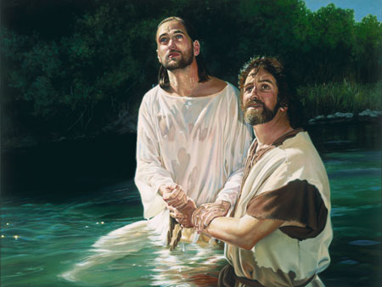
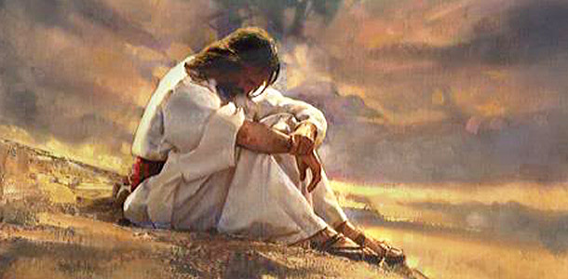
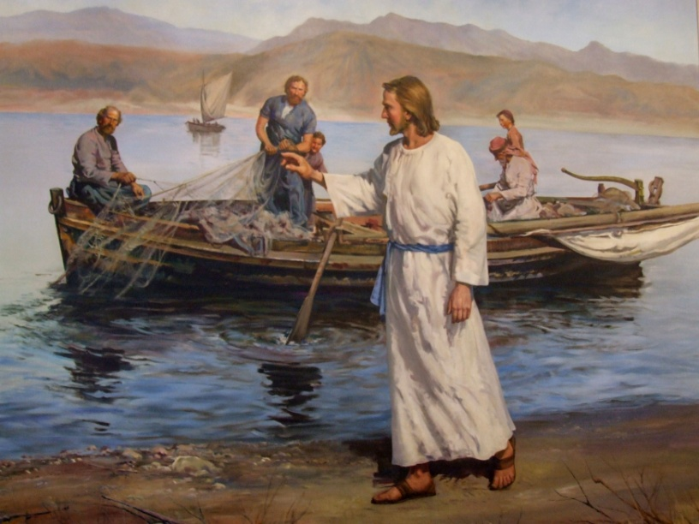
More Insight From Mark
Jesus is baptized by John and Jesus preached the baptism of repentance and the remission of sins
After Jesus fasted for 40 days, He was tempted by the devil.
He also preached repentance in Galilee and called disciples to follow Him.
Mark 1:12-20; Matthew 4

Slide 6
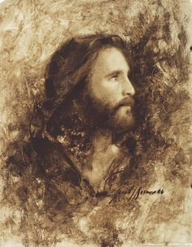
Special Attention to Jesus Christ’s Identity
“The beginning of the gospel of Jesus Christ, the Son of God.”
Mark emphasizes the importance that Jesus is the Son of God
And there came a voice from heaven, saying, Thou art my beloved Son, in whom I am well pleased.
Mark 1:11
And he healed many that were sick of divers diseases, and cast out many devils; and suffered not the devils to speak, because they knew him.
Mark 1:34
And they were astonished at his doctrine: for he taught them as one that had authority,.
Mark 1:22
I know thee who thou art, the Holy One of God.
Mark 1:24
…for with authority commandeth he even the unclean spirits, and they do obey him
Mark 1:27
Mark 1:1

Slide 7
High Priesthood
Under the law of Moses, the high priest functioned as the presiding officer of the Aaronic Priesthood and political head of the nation of Israel.
"Tetrarch. The word originally meant the ruler of the fourth part of a country, but was also used when the part governed was some other fraction of the whole. (2)
Galilee
Jewish High Priests
Jerusalem
Judea
However, by the time of the Savior’s ministry, the office of high priest had become corrupted. Rather than being selected by God, high priests were chosen by men such as Herod and other Roman officials
Luke 3:1-2

Slide 8
Annas
He was appointed high priest in A.D. 7 by the Roman legate Quirinius and deposed in A.D. 15 by Valerius Gratus.
From A.D. 18–36 his son-in-law (John 18:13) Joseph Caiaphas was high priest, and during this time Annas was a person of great influence in the Sanhedrin.
Jesus, when arrested, was first brought to Annas (John 18:13.)
He also took a leading part in the trial of the Apostles (Acts 4:6).
In accordance with Jewish custom he kept the title “high priest” after he was deposed from office.
Luke 3:2
(1)

Slide 9
Joseph Caiaphas
He was the High priest from A.D. 18 to A.D. 36 during the ministry of Jesus
He was the son-in-law of Annas
He belonged to the Sadducee party and took an active part in the attack made upon our Lord and His disciples
When Jesus was taken captive He was led to Caiaphas who condemned Jesus for blasphemy and referred Him to Pontius Pilate
Luke 3:2
(1,2)

Slide 10
High Priest
An office in the Melchizedek Priesthood. Adam and all the patriarchs were high priests.
Under the law of Moses the presiding officer of the Aaronic Priesthood was called the high priest. The office was hereditary and came through the firstborn among the family of Aaron, Aaron himself being the first high priest of the Aaronic order.
Three years previous to the death of Adam, he called Seth, Enos, Cainan, Mahalaleel, Jared, Enoch, and Methuselah, who were all high priests, with the residue of his posterity who were righteous, into the valley of Adam-ondi-Ahman, and there bestowed upon them his last blessing.
D&C 107:53
The Aaronic Priesthood still operated among the Jews prior to John. (1)
Wherefore, it must needs be that one be appointed of the High Priesthood to preside over the priesthood, and he shall be called President of the High Priesthood of the Church D&C107:65
(1.2)

Slide 11
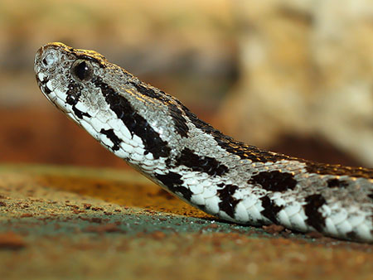
Pharisees VS Sadducees
Generation of Vipers
The Pharisees were a religious group of Jews whose name suggests being separate or apart. They took pride in strictly observing the law of Moses and believed that man-made additions to it, known as the oral law, were as important as the law of Moses itself.
The Sadducees were a small but politically powerful group of Jews who believed in obeying the letter of the law of Moses. They did not believe in the doctrine of resurrection or eternal life.
Palestinian Viper
Matthew 3:7
(1)

Slide 12
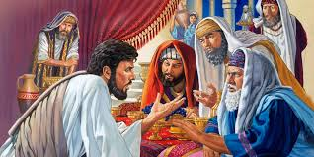
Threatened-Publicans
The Pharisees and Sadducees felt threatened by John, as he drew many people away from their evil influence and false teachings.
34 Why is it that ye receive not the preaching of him whom God hath sent? If ye receive not this in your hearts, ye receive not me; and if ye receive not me, ye receive not him of whom I am sent to bear record; and for your sins ye have no cloak.
35 Repent, therefore, and bring forth fruits meet for repentance;
36 And think not to say within yourselves, We are the children of Abraham, and we only have power to bring seed unto our father Abraham; for I say unto you that God is able of these stones to raise up children into Abraham.
JST Matthew 3:34-36
If the Pharisees and Sadducees rejected John’s word, they would also rejected Jesus
Matthew 3:7 Luke 3:10-14
(1)

Slide 13
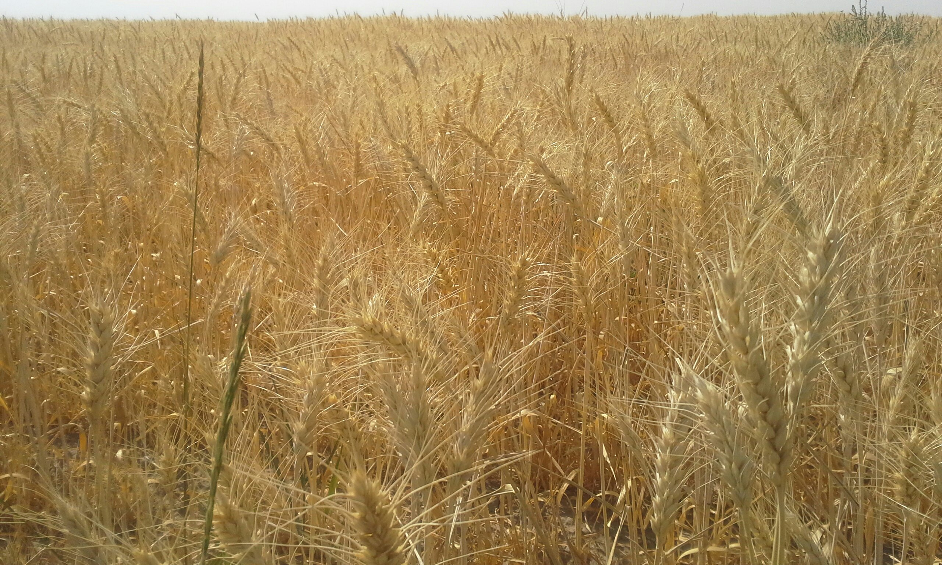
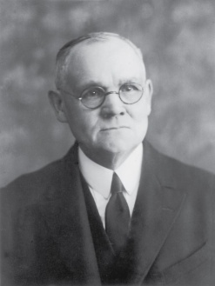
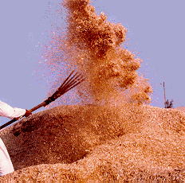
Winnowing
After wheat was harvested and threshed (when the grain was separated from the rest of the plant), the grain would be winnowed.
Winnowing is an ancient method used to separate wheat kernels from the chaff (the outer shell) and the husk.
A winnower would use a large shovel or wooden fork (translated in the scriptures as “fan”) to throw the threshed wheat into the air.
The breeze would then carry away the lighter, undesirable chaff, and the heavier wheat kernels would fall in a pile on the threshing floor.
Jesus Christ separates the righteous from the wicked
The final separation of the righteous from the wicked will take place at the Day of Judgment
Luke 3:17
(8)

Slide 14
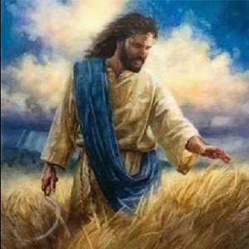
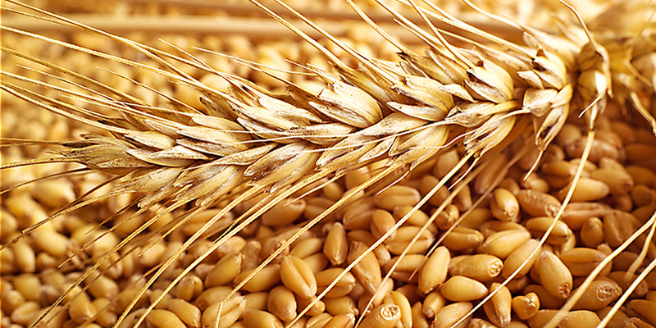
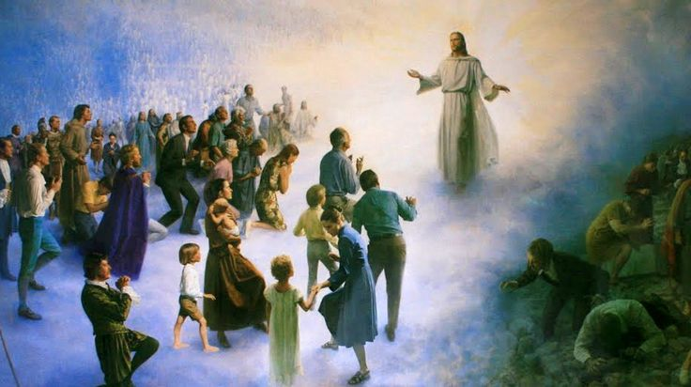
Separating Believers from Non-believers
“fan” = is a winnowing fan that was used to toss wheat into the air
Garner = storehouse
The righteous who accept Jesus Christ (the wheat) and to the wicked who reject Him (the chaff).
Matthew 3:12

Slide 15
Luke 3:7–14
The Joy of Repentance

Slide 16
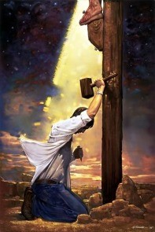
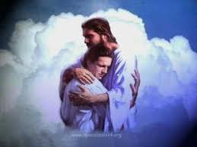
Invitation to Repent
“Repentance is one of the first principles of the gospel.
It is essential to your happiness in this life and throughout eternity. Repentance is much more than just acknowledging wrongdoings.
It is a change of mind and heart that gives you a fresh view about God, about yourself, and about the world.
It includes turning away from sin and turning to God for forgiveness”
Mark 1:4-5, 15; Matthew 3:1-3
(12)

Slide 17
Turning Away From Sin
When we choose to repent, we choose to change!
We allow the Savior to transform us into the best version of ourselves.
We choose to grow spiritually and receive joy—the joy of redemption in Him.
﻿
Matthew 3:1-3
(13)

Slide 18
How do I repent?
How can I find more joy in repentance?
How can I overcome the fear of repentance?
What might a regular, daily focus on repentance involve, or what might it look like in my life?

Slide 19
Bring Forth Fruits
Meet = worthy of—truly repentant
In the scriptures people are sometimes symbolized by trees that produce either good fruit or bad fruit
Matthew 3:7-8 footnote b

Slide 20
Two Coats
'when the Lord sent prophets to call Israel back from apostasy, in almost every instance, one of the first charges made was that the poor had been neglected.'
Thus, part of John the Baptist's message of repentance was, 'He that hath two coats, let him impart to him that hath none; and he that hath meat, let him do likewise.’ (7)
"The prophets of the Book of Mormon taught that the care of the poor was the only way we could obtain essential blessings.
The prophet/King Benjamin declared that we must impart of our substance to the poor, 'such as feeding the hungry, clothing the naked, visiting the sick and administering to their relief' for the sake of 'retaining a remission of [our] sins from day to day, that [we] may walk guiltless before God.'
Luke 3:11
(6)

Slide 21
Exact No More
"Roman tax collectors or tax farmers. Imperial Rome sold to the highest bidder the right to collect taxes in a given area.
Publicans purchasing this power for large areas often resold it to numerous others who did the actual assessing and collecting in smaller areas.
Exorbitant profits were often made by all through whose hands the taxes passed. Cases of exorbitant collections, bordering on extortion, were not uncommon.”
Luke 3:13
(7)

Slide 22
Matthew 3:13-17 Part 1
Jesus Christ Was Baptized By John the Baptist

Slide 23
Isaiah 40:3-5
“For behold, and lo, he shall come, as it is written in the book of the prophets, to take away the sins of the world, and to bring salvation unto the heathen nations, to gather together those who are lost, who are of the sheepfold of Israel;
“Yea, even the dispersed and afflicted; and also to prepare the way, and make possible the preaching of the gospel unto the Gentiles;
“And to be a light unto all who sit in darkness, unto the uttermost parts of the earth; to bring to pass the resurrection from the dead, and to ascend up on high, to dwell on the right hand of the Father,
“Until the fullness of time, and the law and the testimony shall be sealed, and the keys of the kingdom shall be delivered up again unto the Father”
Luke 3:5-8
(4)

Slide 24
The Forerunner
Written about 700 Years Before: Isaiah
“The voice of him that crieth in the wilderness, Prepare ye the way of the Lord, make straight in the desert a highway for our God.”
Isa. 40:3
Written about 400 Years Before: Malachi
Behold, I will send my messenger, and he shall prepare the way before me: and the Lord, whom ye seek, shall suddenly come to his temple, even the messenger of the covenant, whom ye delight in: behold, he shall come, saith the Lord of hosts.
Malachi 3:1
Written about 600-595 BC: Nephi
And he spake also concerning a prophet who should come before the Messiah, to prepare the way of the Lord
1 Nephi 10:7
Written about 559-545 BC: Nephi
And the Lamb of God went forth and was baptized of him; and after he was baptized, I beheld the heavens open, and the Holy Ghost come down out of heaven and abide upon him in the form of a dove.
1 Nephi 11:27
Wherefore, I would that ye should remember that I have spoken unto you concerning that prophet which the Lord showed unto me, that should baptize the Lamb of God, which should take away the sins of the world.
2 Nephi 31:4
Matthew 11:10; John 7:27

Slide 25
John the Baptist
His forthcoming birth and the nature of his ministry were announced to John’s father by the angel Gabriel. He was an “Elias”
He was the son of Zacharias and Elisabeth. He was born 6 months before Jesus and he was ordained at the age of 8 days old (D&C 84:28)
He was the child of promise, with prophecies of his mission given by Isaiah and Malachi
He grew up in the desert until the time arrived for his ministry. He preached in Judaea
He was the embodiment of the law of Moses, designed to prepare the way for the Messiah and make ready for the people to receive Him
The sign of the dove was an emblem for the Holy Ghost and a signal which John recognized that he had baptized the Son of God. John also saw and heard the voice of the Father
He preached and baptized several months before he baptized Jesus
John, the Beloved, and his brother Andrew were baptized by John before they met Jesus
He was the forerunner in two gospel dispensations
He criticized Herod’s marriage and was shut in prison, then later he was beheaded by the hand of Herodias, Herod’s wife
(1)

Slide 26
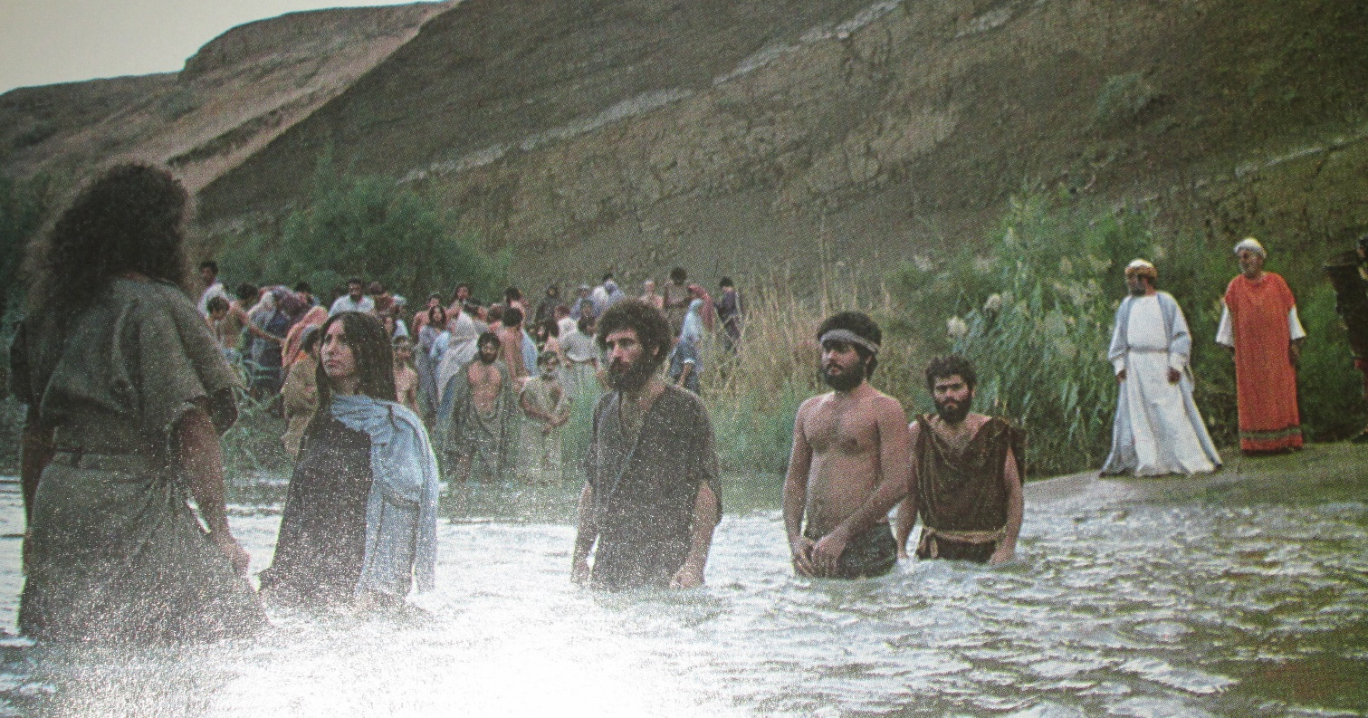
John Preaches
The people whom John taught were willing to confess their sins and be baptized
Being willing to confess one’s sins to Heavenly Father and, when necessary, to designated priesthood leaders is essential to repentance
Matthew 3:5-6

Slide 27
Who is This John?
"The people generally were greatly concerned over the identity of John; and as the real import of the voice dawned upon them, their concern deepened into fear.
The ever recurring question was, Who is this new prophet?
Then the Jews, by which expression we may understand the rulers of the people, sent a delegation of priests and Levites of the Pharisaic party to personally question him.
He answered without evasion, 'I am not the Christ,' (John 1:20)
Luke 3:16
(8)

Slide 28
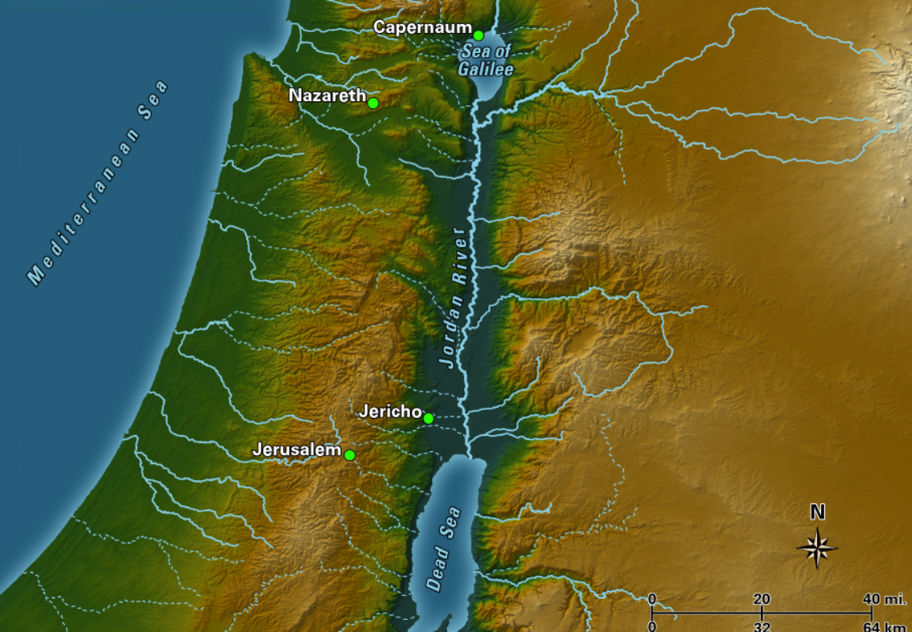
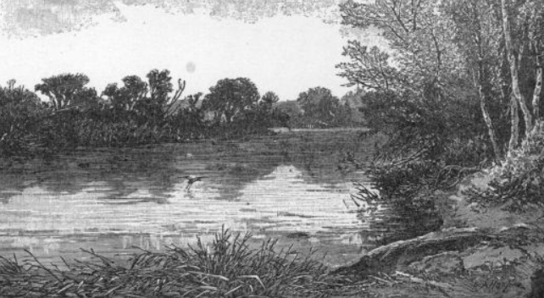
Jesus traveled from Galilee to Bethabara, likely on foot, to be baptized by John the Baptist
Bethabara
Matthew 3:13; John 1:28

Slide 29
The Word of the Lord
The Word of the Lord came to John, the Baptist instead of the High Priests
In John’s day some people believed that because they were descendants of Abraham, they were better or more loved by God than non-Israelites.
“John, at that time, was the only legal administrator in the affairs of the kingdom there was then on the earth, and holding the keys of power. The Jews had to obey his instructions or be damned, by their own law. … The son of Zacharias wrested the keys, the kingdom, the power, the glory from the Jews, by the holy anointing and decree of heaven” (16)
“fruit” is a symbol of the results of the choices we make
Luke 3:5-9
(1)

Slide 30
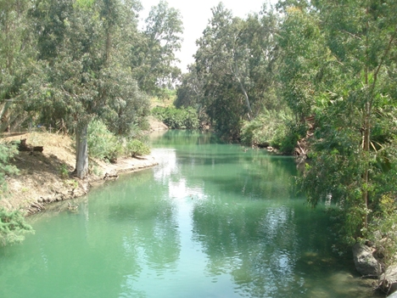
Baptism of Jesus
By Whom?
How?
Why?
John the Baptist
“out of the water” =
By Immersion
“To fulfil all righteousness”
Receiving the ordinances of salvation is a requirement to return to live with Heavenly Father again. By being baptized Jesus set an example by demonstrating humility and obeying the commandments of His Father, and receiving the ordinance necessary to attain eternal life
By Proper Authority
He was covered completely by the water.
Matthew 3:13-17

Slide 31
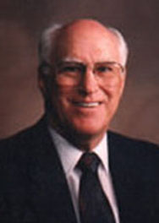
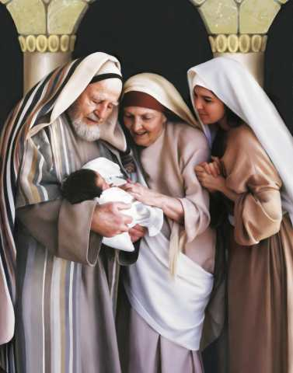
The Aaronic Priesthood
“For he [John] was baptized while he was yet in his childhood, and was ordained by the angel of God at the time he was eight days old unto this power, to overthrow the kingdom of the Jews, and to make straight the way of the Lord before the face of his people, to prepare them for the coming of the Lord, in whose hand is given all power.”
D&C 84:28
The identity of the angel mentioned in the foregoing statement is not revealed. Although John’s father, Zacharias, had the Aaronic Priesthood, he may not have held the proper keys of authority to ordain his son to this particular calling.
Therefore this special authority had to be conferred by this heavenly messenger, who was duly authorized and sent to confer it. John’s ordination was not merely the bestowal of the Aaronic Priesthood, which his father held, but also the conferring of certain essential powers peculiar to the time among which was the authority to overthrow the kingdom of the Jews and ‘to make straight the way of the Lord.’ ”
“The reason Zacharias could not ordain John is because of the fact that John received certain keys of authority which his father Zacharias did not possess.
(3)

Slide 32
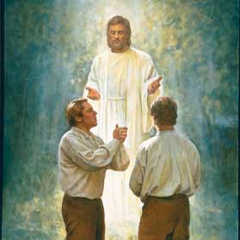
The Aaronic Priesthood Restored
Upon you my fellow servants, in the name of Messiah I confer the Priesthood of Aaron, which holds the keys of the ministering of angels, and of the gospel of repentance, and of baptism by immersion for the remission of sins; and this shall never be taken again from the earth, until the sons of Levi do offer again an offering unto the Lord in righteousness. D&C 13:1
The messenger who visited us on this occasion and conferred this Priesthood upon us, said that his name was John, the same that is called John the Baptist in the New Testament, and that he acted under the direction of Peter, James and John, who held the keys of the Priesthood of Melchizedek, which Priesthood, he said, would in due time be conferred on us, and that I should be called the first Elder of the Church, and he (Oliver Cowdery) the second. It was on the fifteenth day of May, 1829, that we were ordained under the hand of this messenger, and baptized. (JS—H 1:72)

Slide 33
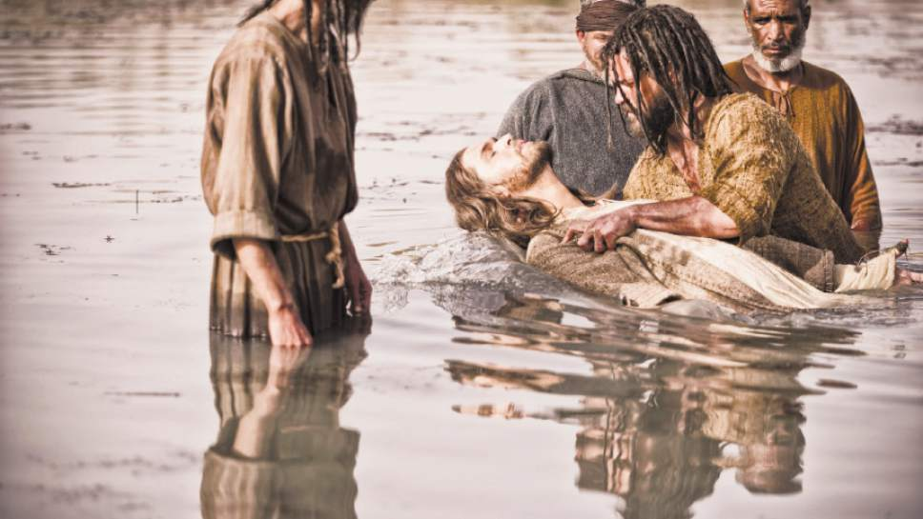
Mightier Than I
Baptism by immersion by one holding authority is essential for salvation.
Cast into fire
Unrepentant individuals lose the influence of the Spirit of God and eventually forfeit the blessings of the celestial kingdom.
The person who is called of God and has authority from Jesus Christ to baptize, shall go down into the water with the person who has presented himself or herself for baptism, and shall say, calling him or her by name: Having been commissioned of Jesus Christ, I baptize you in the name of the Father, and of the Son, and of the Holy Ghost. Amen.
Then shall he immerse him or her in the water, and come forth again out of the water.
D&C 20:73-74
Matthew 3:11
Matthew 3:16

Slide 34
The Holy Ghost
John the Baptist is the one who saw the person of the Holy Ghost.
'the Holy Ghost descended in a bodily shape . . . upon him.' Because the Holy Ghost is a spirit man, the only 'bodily shape' John could have seen was that of a spirit personage.
'like a dove,' clearly meaning that the Spirit came with the calmness, serenity, and peace of which the dove is a symbol.
John 'saw the heavens opened, and the Spirit like a dove descending upon him.’ Holy Ghost descended in a bodily shape . . . upon him.' Because the Holy Ghost is a spirit man, the only 'bodily shape' John could have seen was that of a spirit personage.
Luke 3:18-22; Mark 1:10; Matthew 3:16
(7)

Slide 35
Baptism By Water
John declared that he would baptize with water but that Jesus would baptize “with the Holy Ghost and with fire.”
This refers to the purifying and sanctifying effect of receiving the Holy Spirit.
“I have repented of my sins, and have been redeemed of the Lord; behold I am born of the Spirit.” He then taught that “all mankind … must be born again; yea, born of God, changed from their carnal and fallen state, to a state of righteousness, being redeemed of God, becoming his sons and daughters; and thus they become new creatures; and unless they do this, they can in nowise inherit the kingdom of God.”
Luke 3:16
(8)

Slide 36
Matthew 3:13-17 Part 2
Heavenly Father, Jesus, and the Holy Ghost

Slide 37
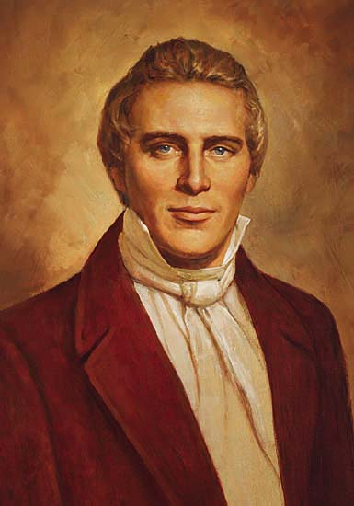
Repent of all your sins, and be baptized in water for the remission of them, in the name of the Father, and of the Son, and of the Holy Ghost, and receive the ordinance of the laying on of the hands of him who is ordained and sealed unto this power, that ye may receive the Holy Spirit of God; and this is according to the Holy Scriptures, and the Book of Mormon; and the only way that man can enter into the celestial kingdom.
(14)

Slide 38
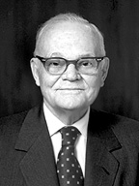
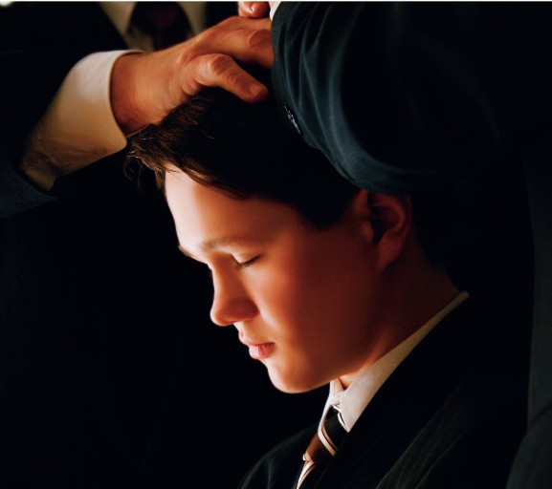
Baptism by Fire
Baptism of fire by the Holy Ghost ‘converts [us] from carnality to spirituality. It cleanses, heals, and purifies the soul. …
Faith in the Lord Jesus Christ, repentance, and water baptism are all preliminary and prerequisite to it, but [the baptism of fire] is the consummation.
To receive [this baptism of fire] is to have one’s garments washed in the atoning blood of Jesus Christ’.
John was referring to receiving the gift of the Holy Ghost, the second half of the covenant and ordinance of baptism.
The Holy Ghost sanctifies and refines our souls as if by fire
Matthew 3:11
(9)

Slide 39
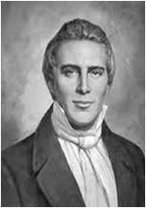
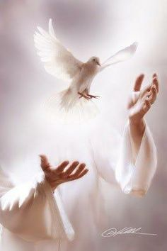
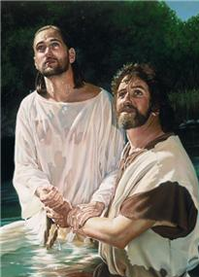
Descending Like a Dove
This is my beloved Son, in whom I am well pleased.
“The sign of the dove was instituted before the creation of the world, a witness for the Holy Ghost, and the devil cannot come in the sign of a dove.
The Holy Ghost is a personage, and is in the form of a personage.
It does not confine itself to the form of the dove, but in sign of the dove.
The Holy Ghost cannot be transformed into a dove; but the sign of a dove was given to John to signify the truth of the deed, as the dove is an emblem or token of truth and innocence” (10)
Liz Lemon Swindle
Matthew 3:16-17

Slide 40
A [news] article had the title “Mormon teens cope best: Study finds they top peers at handling adolescence.”
This article concluded that “Mormons fared best at avoiding risky behaviors, doing well in school and having a positive attitude about the future.”
One of the researchers in the study, who interviewed most of our youth, said, “Across almost every category we looked at, there was a clear pattern: Mormons were first.”
President Dallin H. Oaks feels the youth of The Church of Jesus Christ of Latter-day Saints are so prepared to face challenges because of their understanding of the plan of salvation and their knowledge of their relationship with God
(15)

Slide 41
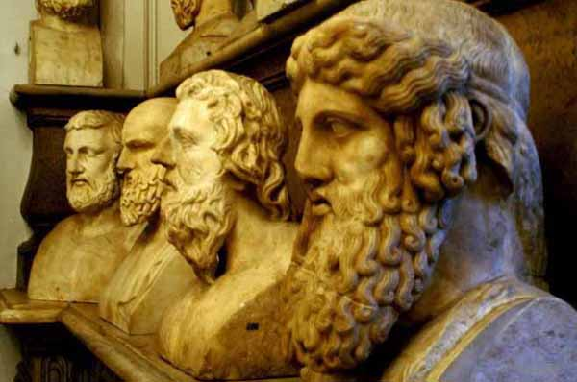
Three distinct and Separate Persons
We believe in God, the Eternal Father, and in His Son, Jesus Christ, and in the Holy Ghost
“We believe these three divine persons constituting a single Godhead are united in purpose, in manner, in testimony, in mission. … I think it is accurate to say we believe They are one in every significant and eternal aspect imaginable except believing Them to be three persons combined in one substance, a Trinitarian notion never set forth in the scriptures because it is not true.”
One of the reasons for confusion about the nature of the Godhead is that during the Great Apostasy, “churchmen, philosophers, and ecclesiastical dignitaries” debated the nature of the Godhead and ultimately decided that God was unknowable and incomprehensible
Matthew 3:17
(11)

Slide 42
We believe these three divine persons constituting a single Godhead are united in purpose, in manner, in testimony, in mission.
We believe Them to be filled with the same godly sense of mercy and love, justice and grace, patience, forgiveness, and redemption.
I think it is accurate to say we believe They are one in every significant and eternal aspect imaginable except believing Them to be three persons combined in one substance, a Trinitarian notion never set forth in the scriptures because it is not true. …
We declare it is self-evident from the scriptures that the Father, the Son, and the Holy Ghost are separate persons, three divine beings, noting such unequivocal illustrations…
John 17; Matthew 3:13-17; Mark 1:9-11; Luke 3:21-22; Acts 7:55-56
(11)

Slide 43
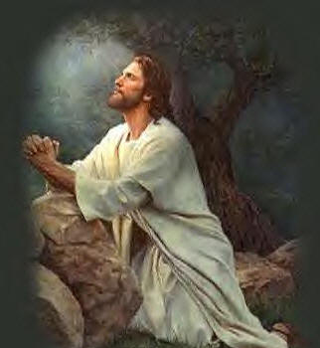
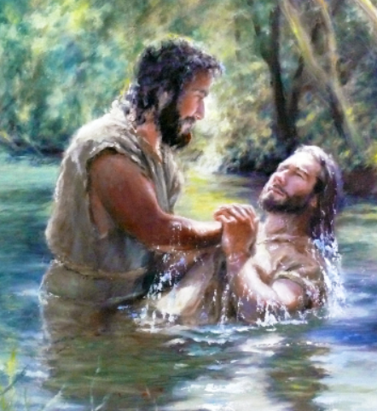
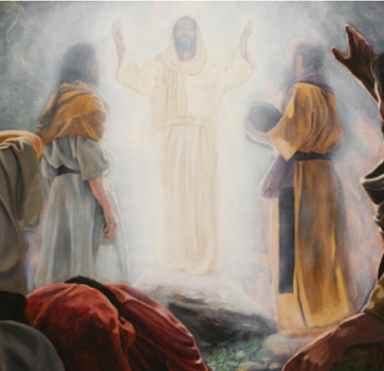
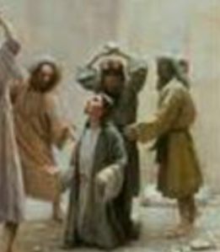
…the Savior’s great Intercessory Prayer …,
His baptism at the hands of John,
the experience on the Mount of Transfiguration,
and the martyrdom of Stephen ﻿
—to name just four.
(11)

Slide 44
The Rest of Mark 1:21-45
Preaching, Casting Out Devils, and Healing Lepers

Slide 45
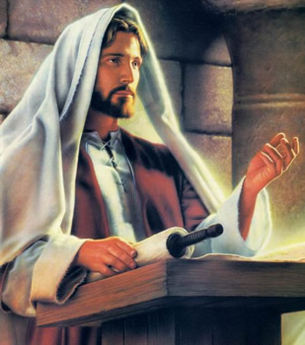
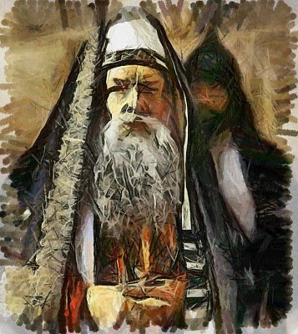
Teaching With Authority
Jesus went to Capernaum and taught in the synagogue
Scribes were considered experts in the legal aspects of the law of Moses.
When preaching and interpreting the law, they typically added greater weight and authority to their teaching by appealing to former authorities and experts. In contrast, Jesus spoke with the authority of the Lawgiver, for He was the giver of the law of Moses.
Mark 1:21-22
(4)

Slide 46
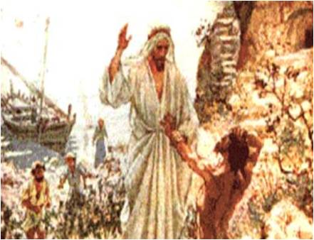
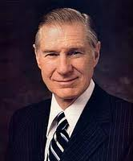
Unclean Spirits
The evil spirits that seek to possess physical bodies are Lucifer’s followers. They dwelt in the presence of Heavenly Father and Jesus Christ before being cast out of heaven
And he shall cast out devils, or the evil spirits which dwell in the hearts of the children of men. Mosiah 3:6
And because of the righteousness of his people, Satan has no power; wherefore, he cannot be loosed for the space of many years; for he hath no power over the hearts of the people, for they dwell in righteousness, and the Holy One of Israel reigneth.
1 Nephi 22:26
“We need not become paralyzed with fear of Satan’s power. He can have no power over us unless we permit it. He is really a coward, and if we stand firm, he will retreat. The Apostle James counseled: ‘Submit yourselves therefore to God.
Resist the devil, and he will flee from you’.
He cannot know our thoughts unless we speak them.
And Nephi states that ‘he hath no power over the hearts’
of people who are righteous.”
Mark 1:23-26
(17)

Slide 47
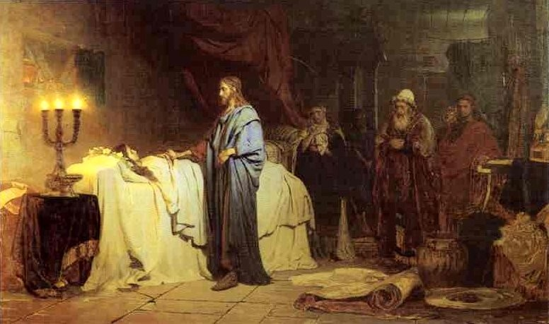
Healing Peter’s Mother-in-law
The Savior healed Simon Peter’s mother-in-law of a fever, healed many others who were sick, and cast out many devils. Jesus continued to preach in Galilee.
And in the morning, rising up a great while before day, he went out, and departed into a solitary place, and there prayed.
Mark 1:29-39
(17)

Slide 48
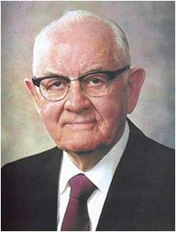
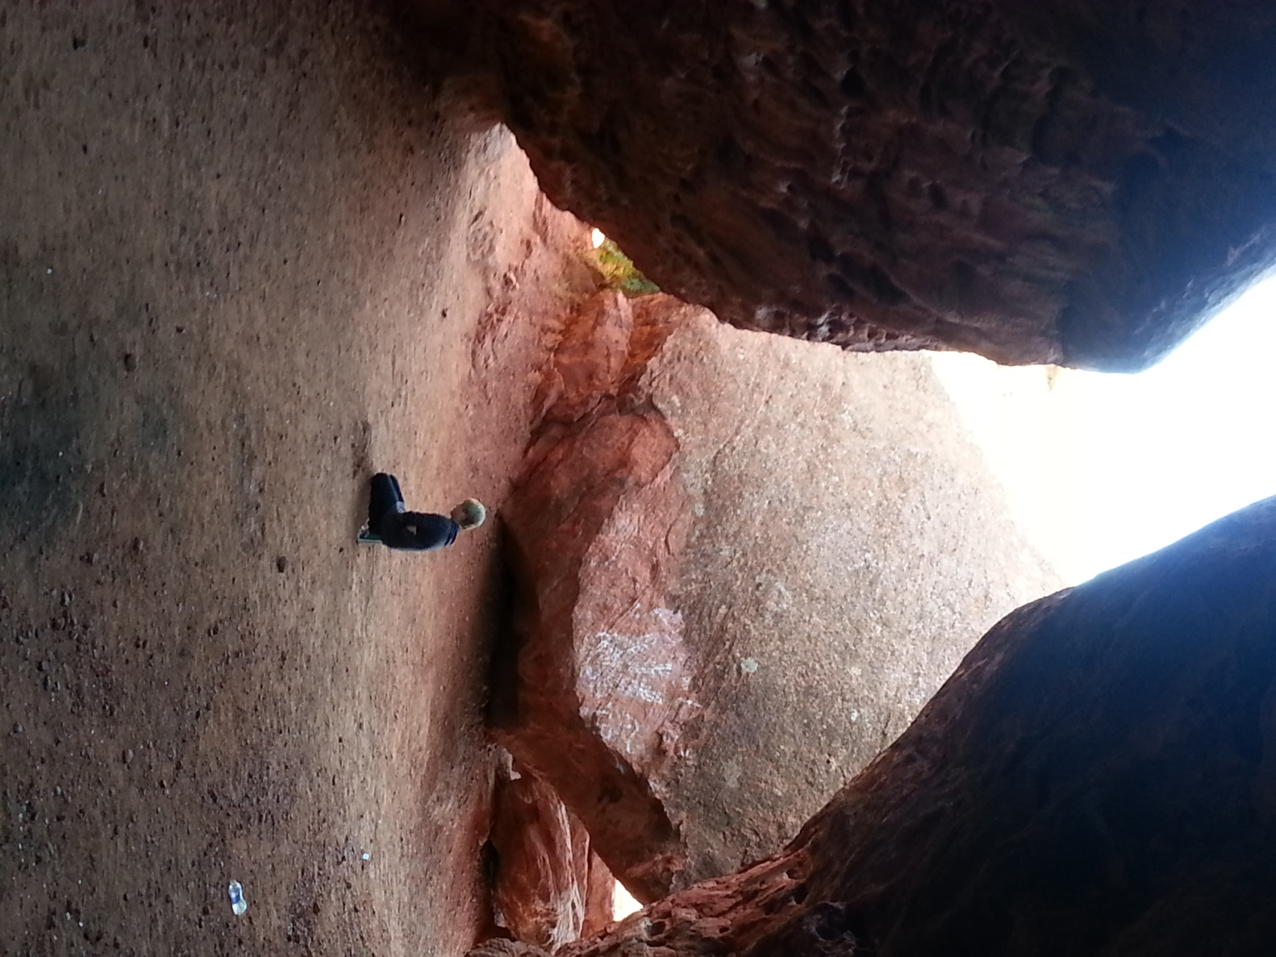
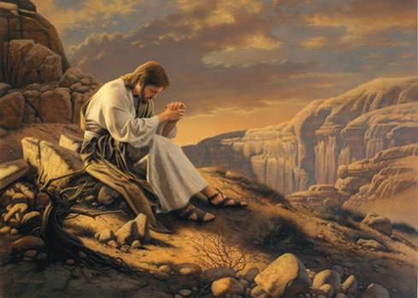
Seeking Solitude
“Solitude is rich and profitable. When we Pray alone with God, we shed all sham and pretense, all hypocrisy and arrogance…
Mark 1:35
(18)

Slide 49
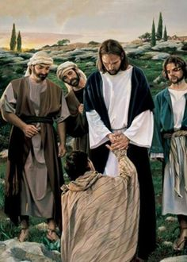
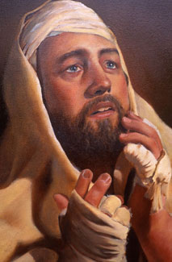
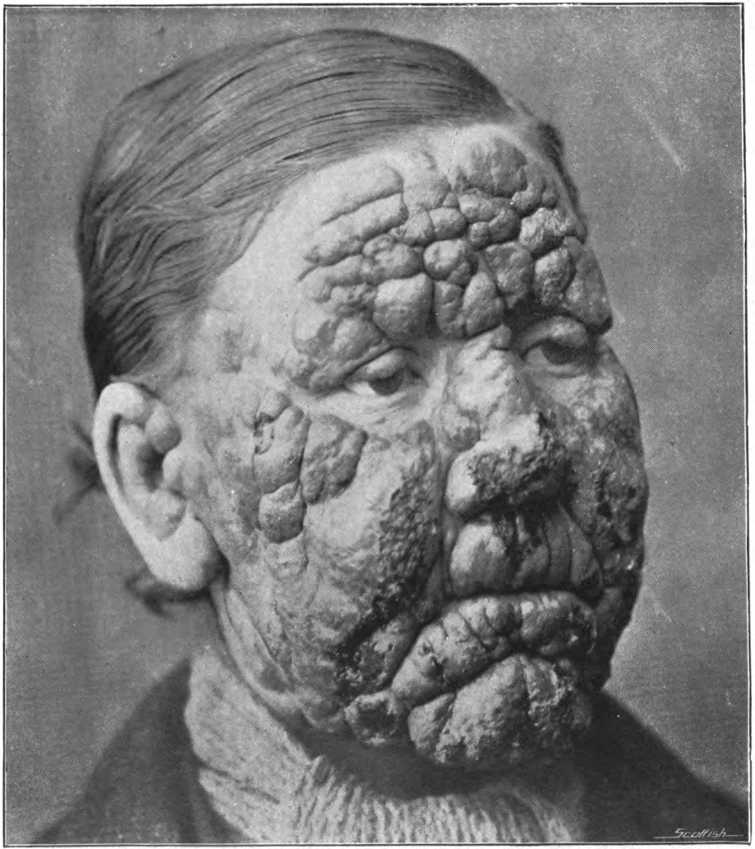
Healing a Leper
Leprosy is a chronic disease that attacks skin, nerves, eyes, bones, and limbs. Left untreated, it leads to a painful death. In ancient times, it was believed that anyone who came in contact with lepers would contract the disease.
Beseeching = begging
It is remarkable that Jesus touched this leper while healing him. (1)
After healing the man, the Savior commanded him to obey the Mosaic commandment that healed lepers present themselves to a priest, offer sacrifice, and undergo a purification ritual.
He also told him to tell no one, but word spread anyway and Jesus had to leave the city.
People still came to Him in the desert.
To protect a community’s health and well-being, lepers were forced to live outside the town. The law required them to call out “Unclean!” to warn anyone approaching them
Kyle Vincent
Mark 1:40-45; Leviticus 13:44–46
(1)

Slide 50
Sources:
Bible Dictionary
Who’s Who in the New Testament by Richard J. Allen p. 23
Robert J. Matthews John the Baptist: A Burning and a Shining Light September 1972 Ensign
New Testament Institute manual Chapter 15 and 16
(Joseph Smith Translation, Luke 3:5–8 [in the Bible appendix])
Elder Dallin H. Oaks (The Lord's Way [Salt Lake City: Deseret Book Co., 1991], 103.)
Elder Russell M. Nelson quoted by Dallin H. Oaks (The Lord's Way [Salt Lake City: Deseret Book Co., 1991], 103.)
James E. Talmage Jesus the Christ p. 128, 130
Marion G. Romney Learning for the Eternities, comp. George J.
Prophet Joseph Smith (Teachings of Presidents of the Church: Joseph Smith [2007], 81).
Elder Jeffrey R. Holland (“The Only True God and Jesus Christ Whom He Hath Sent,” Ensign or Liahona, Nov. 2007, 40)
True to the Faith: A Gospel Reference [2004], 132
Russell M. Nelson, “We Can Do Better and Be Better,” Ensign or Liahona, May 2019, 67
Teachings of Presidents of the Church: Joseph Smith [2007], 154
Dallin H. Oaks, “Parents and Children,” Ensign or Liahona, Nov. 2018, 62
Joseph Smith (Teachings: Joseph Smith, 81–82).
James E. Faust (“The Great Imitator,” Ensign, Nov. 1987, 35).
President Spencer W. Kimball Faith Precedes the Miracle

Slide 51
John’s Ordination:
“The reason Zacharias could not ordain John is because of the fact that John received certain keys of authority which his father Zacharias did not possess. Therefore this special authority had to be conferred by this heavenly messenger, who was duly authorized and sent to confer it. John’s ordination was not merely the bestowal of the Aaronic Priesthood, which his father held, but also the conferring of certain essential powers peculiar to the time among which was the authority to overthrow the kingdom of the Jews and ‘to make straight the way of the Lord.’ Moreover, it was to prepare the Jews and other Israelites for the coming of the Son of God. This great authority required a special ordination beyond the delegated power that had been given to Zacharias or any other priest who went before him, so the angel of the Lord was sent to John in his childhood to confer it.” Joseph Fielding Smith Answers to Gospel Questions, vol. 5, p. 2.
Matthew 3
Authority to Baptize:
John, at that time, was the only legal administrator in the affairs of the kingdom there was then on the earth, and holding the keys of power. The Jews had to obey his instructions or be damned, by their own law. … The son of Zacharias wrested the keys, the kingdom, the power, the glory from the Jews, by the holy anointing and decree of heaven.
(Teachings of Presidents of the Church: Joseph Smith [2007], 81–82; see also Doctrine and Covenants 84:23–28)
Matthew 3:7 Viper::
It is the most common poisonous snake in Israel. Vipers are active at night and typically hunt by hiding and then sneaking up on their prey. When they feel threatened, vipers will coil their body, hiss, and strike at their opponents..
Ordinance of Baptism:
"Those who seek to follow the Savior will understand the importance of the ordinance of baptism. The Lamb without Blemish saw fit to submit himself to baptism by one holding the authority of the priesthood in order to 'fulfil all righteousness.' How much more each of us has need of the cleansing and saving power of this ordinance and the other ordinances of the gospel." Elder Dallin H. Oaks ("Always Remember Him," Ensign, May 1988, 31)
Matthew 3:12 Fan::
“The ‘fan’ is a winnowing fan that was used to toss wheat into the air. This allowed the wheat to be separated from the chaff. Wheat kernels would fall back to the ground while the wind blew the lighter chaff away. The wheat was then gathered into a garner, or storehouse, and the chaff was burned with fire. John the Baptist taught that the Savior, who would come after him, would separate believers from nonbelievers in the same way that wheat was separated from chaff (New Testament Student Manual [Church Educational System manual, 2014], 17).
Repentance: It is not repentance per se that saves man. It is the blood of Jesus Christ that saves us. It is not by our sincere and honest change of behavior alone that we are saved, but “by grace that we are saved, after all we can do” ( 2 Nephi 25:23). True repentance, however, is the condition required so that God’s forgiveness can come into our lives. True repentance makes “a brilliant day [out] of the darkest night” (Spencer W. Kimball, The Miracle of Forgiveness [1969], 362).
(Dieter F. Uchtdorf, “Point of Safe Return,” Ensign or Liahona, May 2007, 100)

Slide 52
What Happened to the High Priesthood? Luke 3:2
Following the children of Israel’s rejection of the Lord at Mount Sinai, the Lord had removed the Melchizedek Priesthood from the people. Therefore, until the time of Jesus Christ, under the law of Moses a high priest was the presiding priest in the Aaronic Priesthood and presided over all other priests in their functions and ordinances, particularly in those of the temple. However, the presiding office of high priest had become corrupted. For years, Herod and other Roman officials had appointed high priests based on political expediency or bribery.
The Jews lacked a divinely authorized priesthood leader and, as a nation, they were in need of spiritual rebirth. Because John had been chosen by God and properly ordained to be God’s representative, the children of Israel could again turn to the Lord through the authorized channels of repentance and baptism. (1)
The Book of Mormon and Baptism:
Again and again the Book of Mormon acts as a confirming, clarifying, unifying witness of the doctrines taught in the Bible so that there is only “one Lord, one faith, one baptism.” …
There exist various modes of baptisms in the world today even though the Bible tells us the manner in which the Savior, our great Exemplar, was baptized: “[He] went up straightway out of the water” ( Matthew 3:16). Could He have come up out of the water unless He first went down into the water? Lest there be any discord on this subject, the Book of Mormon dispels it with this straightforward statement of doctrine as to the proper manner of baptism: “And then shall ye immerse them in the water” ( 3 Nephi 11:26).
(Tad R. Callister, “The Book of Mormon—a Book from God,” Ensign or Liahona, Nov. 2011, 75–76)
Repentance: Luke 3:7-14
Too many people consider repentance as punishment﻿—something to be avoided except in the most serious circumstances. But this feeling of being penalized is engendered by Satan. He tries to block us from looking to Jesus Christ, who stands with open arms, hoping and willing to heal, forgive, cleanse, strengthen, purify, and sanctify us.
The word for repentance in the Greek New Testament is metanoeo. The prefix meta- means “change.” The suffix -noeo is related to Greek words that mean “mind,” “knowledge,” “spirit,” and “breath.”
Thus, when Jesus asks you and me to “repent” [ Luke 13:3, 5 ], He is inviting us to change our mind, our knowledge, our spirit﻿—even the way we breathe. He is asking us to change the way we love, think, serve, spend our time, treat our wives, teach our children, and even care for our bodies.
Nothing is more liberating, more ennobling, or more crucial to our individual progression than is a regular, daily focus on repentance. Repentance is not an event; it is a process. It is the key to happiness and peace of mind. When coupled with faith, repentance opens our access to the power of the Atonement of Jesus Christ.
Whether you are diligently moving along the covenant path, have slipped or stepped from the covenant path, or can’t even see the path from where you are now, I plead with you to repent. Experience the strengthening power of daily repentance—of doing and being a little better each day.
﻿(Russell M. Nelson, “We Can Do Better and Be Better,” Ensign or Liahona, May 2019, 67)
Luke 3
Sign of the Dove Luke 3:18-22
"By way of interpretation, the Prophet Joseph Smith said that 'the sign of the dove' was given as a witness that the baptism had divine approval. 'The sign of the dove was instituted before the creation of the world, a witness for the Holy Ghost, and the devil cannot come in the sign of a dove,' he said. 'The Holy Ghost is a personage, and is in the form of a personage. . . . The Holy Ghost cannot be transformed into a dove; but the sign of a dove was given to John to signify the truth of the deed, as the dove is an emblem or token of truth and innocence.' (History of the Church 5:261.)" (Elder Bruce R. McConkie A New Witness for the Articles of Faith [Salt Lake City: Deseret Book Co., 1985], 255.)
John the Baptist Luke 3:16:
"...this was the way by which the Baptist declared his inferiority to the Mightier One, who was to succeed and supersede him; and a more effective illustration would be difficult to frame. To loosen the shoe latchet or sandal thong, or to carry the shoes of another, 'was a menial office betokening great inferiority on the part of the person performing it.' (Smith's Dict. of the Bible.) A passage in the Talmud (Tract. Kidduschin xxii: 2) requires a disciple to do for his teacher whatever a servant might be required to do for his master, except the loosing of his sandal thong.
Some teachers urged that a disciple should carry his humility even to the extreme of carrying his master's shoes. The humility of the Baptist, in view of the widespread interest his call aroused, is impressive." James E. Talmage (Jesus the Christ, 128)

Slide 53
Sign of the Dove Mark 1:10:
"The sign of the dove was instituted before the creation of the world, a witness for the Holy Ghost, and the devil cannot come in the sign of a dove. The Holy Ghost is a personage, and is in the form of a personage. It does not confine itself to the form of the dove; but in sign of the dove. The Holy Ghost cannot be transformed into a dove; but the sign of a dove was given to John to signify the truth of the deed, as the dove is an emblem or token of truth and innocence." Joseph Smith (Teachings, pp. 275-276.)
Mark 1
John and James Mark 1:19-20:
To be a ship-owner with hired servants suggests that James and John were men of some means. Interestingly, John also had political connections. John's personal relationship with the high priest allowed him to gain access to the council of the Sanhedrin at the time of Christ's trial-eventually allowing Peter access as well (John 18:15-16). How a Galilean fisherman like John became an acquaintance of the high priest is unknown. gospeldoctrine.com
My Beloved Son. Hear Him Mark 1:11:
"Each time the Father has introduced the Son, he has declared the Sonship of the Only Begotten. As John the Baptist baptized Jesus while others stood on the river bank, the Father declared to Jesus: 'Thou art my beloved Son, in whom I am well pleased.' At the transfiguration, the Father said to Peter, James, and John: 'This is my beloved Son, in whom I am well pleased; hear ye him.' And to the people on this hemisphere, the Father proclaimed: 'Behold my Beloved Son, in whom I am well pleased, in whom I have glorified my name-hear ye him.'
"[And again to Joseph Smith], praying in the woods on that bright spring morning, the Father, calling the youth by name, pointed to the Son, and said: 'This is My Beloved Son. Hear Him!'" J. Rueben Clark Jr. (On the Way to Immortality and Eternal Life [Salt Lake City: Deseret Book Co., 1949], 115.)
Repent Origin :
“When Jesus said ‘repent,’ His disciples recorded that command in the Greek language with the verb metanoeo. This powerful word has great significance. In this word, the prefix meta means ‘change.’ The suffix relates to four important Greek terms: nous, meaning ‘the mind’; gnosis, meaning ‘knowledge’; pneuma, meaning ‘spirit’; and pnoe, meaning ‘breath.’
“Thus, when Jesus said ‘repent,’ He asked us to change—to change our mind, knowledge, and spirit” Elder Russell M. Nelson(“Repentance and Conversion,” Ensign or Liahona, May 2007, 103).
With Wild Beasts and Angels Mark 1:13:
"Meditation is one of the most secret, most sacred doors through which we pass into the presence of the Lord. Jesus set the example for us. As soon as he was baptized...Jesus repaired to what is now known as the mount of temptation. I like to think of it as the mount of meditation where, during the forty days of fasting, he communed with himself and his Father, and contemplated upon the responsibility of his great mission.“David O. McKay (Conference Report, April 1946, p. 113.)
Unclean Spirits Mark 1:23
“[Joseph Smith] stated, ‘Wicked spirits have their bounds, limits, and laws by which they are governed’ [in History of the Church,4:576]. So Satan and his angels are not all-powerful. …
“… Satan’s efforts can be thwarted by all who come unto Christ by obedience to the covenants and ordinances of the gospel.” President James E. Faust (“Serving the Lord and Resisting the Devil,” Ensign, Sept. 1995, 6, 7).
Kingdom of God Mark 1:15:
"Some say the kingdom of God was not set up on the earth until the day of Pentecost, and that John did not preach the baptism of repentance for the remission of sins. But I say, in the name of the Lord, that the kingdom of God was set up on the earth from the days of Adam to the present time, whenever there has been a righteous man on earth unto whom God revealed His word and gave power and authority to administer in His name. And where there is a priest of God-a minister who has power and authority from God to administer in the ordinances of the gospel and officiate in the priesthood of God-there is the kingdom of God." (Teachings of the Prophet Joseph Smith, 271)
Solitary Place Mark 1:35:
"[Jesus] communed constantly with his Father through prayer. This he did not only to learn the will of his Father but also to obtain the strength to do his Father's will. He fasted and prayed forty days and forty nights at the beginning of his ministry. (Matthew 4:2; Mark 1:13; Luke 4:2.) He prayed all night just before choosing his twelve apostles. (Luke 6:12-13.) He prayed in the Garden of Gethsemane. (Matthew 26:39.) It would seem that during his earthly ministry he never made a major decision or met a crisis without praying." (Come unto Christ [Salt Lake City: Deseret Book Co., 1983], 44.)

Slide 54
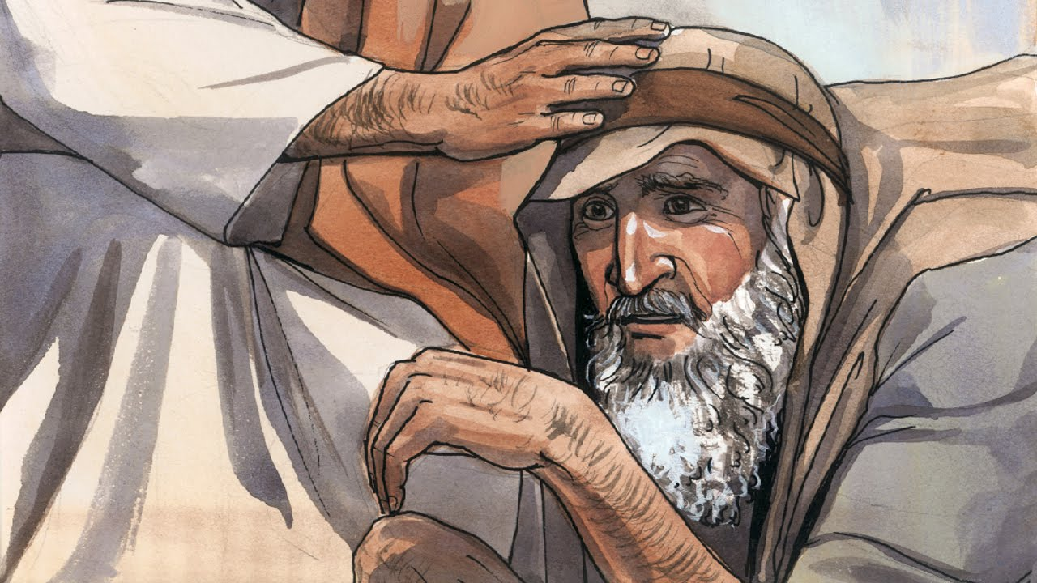
In ancient times the cry “Unclean!”
Would warn of lepers near.
“Unclean! Unclean!” the words rang out;
Then all drew back in fear,
Lest by the touch of lepers’ hands
They, too, would lepers be.
There was no cure in ancient times,
Just hopeless agony.
· · · · · · · · · · · · · · · · · · ·
But there was One, the record shows,
Whose touch could make them pure;
Could ease their awful suffering,
Their rotting flesh restore.
· · · · · · · · · · · · · · · · · · ·
The day He made ten lepers whole,
The day He made them clean,
Well symbolized His ministry
And what His life would mean.
However great that miracle,
This was not why He came.
He came to rescue every soul
From death, from sin, from shame.
· · · · · · · · · · · · · · · · · · ·
What must be done to make us clean
We cannot do alone.
The law, to be a law, requires
A pure one must atone.
He taught that justice will be stayed
Till mercy’s claim be heard
If we repent and are baptized
And live by every word.
· · · · · · · · · · · · · · · · · · ·
If we could only understand
All we have heard and seen,
We’d know there is no greater gift
Than those two words—“Washed clean!”
Mark 1:40
President Boyd K. Packer wrote a poem likening the Savior’s healing of lepers to the forgiveness that is available through repentance and the Atonement of Jesus Christ:
“Washed Clean,” Ensign, May 1997, 10–11

