Slide 1
Matthew 4, Luke 4-5, John 3:1-8

Slide 2
Jesus Christ Resisted Satan’s Temptations
Matthew 4:1-11
Part 1
Jesus Christ Resisted Satan’s Temptations

Slide 3
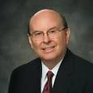
Focus
“Distractions and opposition to righteousness are not just on the Internet; they are everywhere.
They affect not just the youth but all of us.
We live in a world that is literally in commotion.”
“We are surrounded by obsessive portrayals of “fun and games” and immoral and dysfunctional lives.
[Some of] these are presented as normal conduct in much of the media.”
Were you able to focus on the words or the picture?
(1)

Slide 4
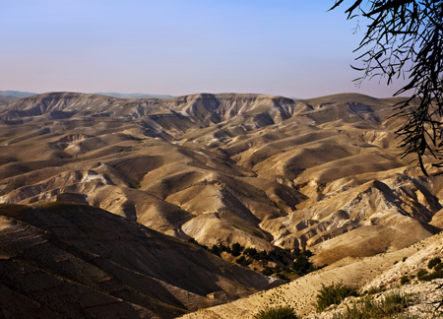
Forty Days and Forty Nights
To Be = To be with God
Then was Jesus led up of the Spirit into the wilderness to be tempted of the devil.
Then Jesus was taken up into the holy city, and the Spirit setteth him on the pinnacle of the temple.
JST Matthew 4:5
And again, Jesus was in the Spirit, and it taketh him … JST Matthew 4:8
Matthew 4:1-5
(1)

Slide 5
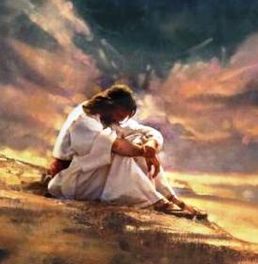
“Jesus did not go into the wilderness to be tempted of the devil; righteous men do not seek out temptation.
He went ‘to be with God.’ Probably he was visited by the Father; without question he received transcendent spiritual manifestations.
The temptations came after he ‘had communed with God,’ ‘after forty days’
Greg Olsen
Matthew 4:1-5
(2)

Slide 6
 | What Satan Tempted Jesus to Do | How Jesus Responded to the temptation
Matthew 4:3-4 | Turn the stones into bread | Physical = Hunger Man shall not live (mortality) by bread alone, but by every word (revelation) that proceedeth out of the mouth of God.
Mathew 4:5-7 | Jump ---Satan tempted Jesus to tempt the Father | Thou shalt not tempt the Lord thy God.
Matthew 4:8-11 | If you worship me you can have all | Spiritual --Thou shalt worship the Lord thy God, and him only shalt thou serve.
Matthew 4:3-11

Slide 7
Satan
Satan tries to appeal to our desires to satisfy our physical appetites
Satan promised rewards that were not his to give and that he could not provide
Satan targets our weakest or most vulnerable areas and repeatedly tempts us
(3)

Slide 8
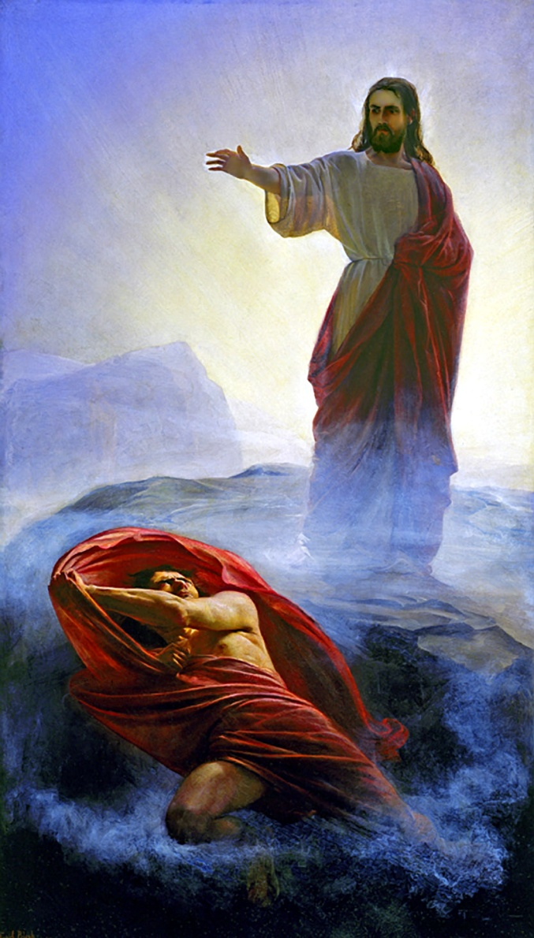
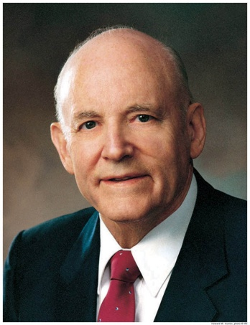
Fasting 40 Days
Satan tempted Jesus to use His power for selfish reasons—to save Himself, not all mankind. Satan continued to tempt the Savior in this way even at the end of His life.
Satan also offered the Savior all the kingdoms, power, and glory of the world if He would worship him. However, these were not Satan’s to give. Jesus Christ, as the Creator, already held dominion over this earth, under the direction of His Father.
“The surest way to lose the blessings of time or eternity is to accept them on Satan’s terms” (3)
Luke 4:1-11

Slide 9
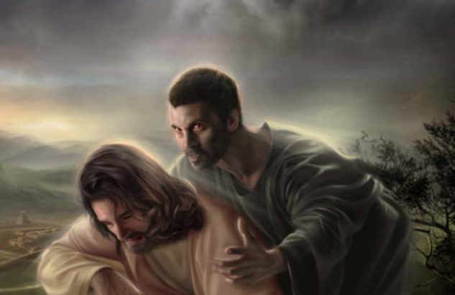
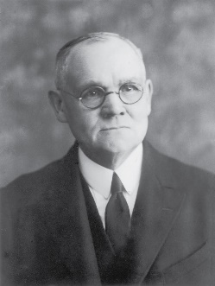
And when the devil had ended all the temptation, he departed from him for a season.
Luke 4:13
“This victory over the devil and his wiles, this triumph over the cravings of the flesh, the harassing doubts of the mind, the suggested reaching out for fame and material wealth, were great but not final successes in the struggle between Jesus, the embodied God, and Satan, the fallen angel of light.”
Matthew 4:1-11
(4)

Slide 10
Following the Savior’s Example of Resisting Temptation
Matthew 4:1-11
Part 2

Slide 11
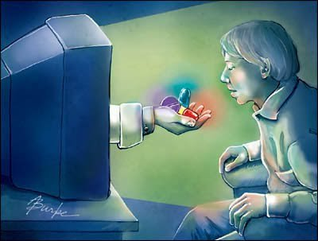
“Whatever else Satan may do, he will certainly appeal to our appetites. Far better to play on natural, acknowledged needs than struggle to plant in us artificial ones.
Here Jesus experiences the real and very understandable hunger for food by which he must sustain his mortal life.
….Why not simply turn the stones to bread and eat?
“The temptation is not in the eating. He has eaten before, he will soon eat again, he must eat for the rest of his mortal life.
…But Christ will not ask selfishly for unearned bread. He will postpone gratification, indefinitely if necessary, rather than appease appetite—even ravenous appetite—with what is not his.
“Salvation comes only through discipline and sacrifice.”
(4)

Slide 12
How do the scripture passages the Savior quoted relate to the temptations He overcame?
How often do you turn to the Lord through the scriptures to help you resist temptation? Why?
What experiences have you had with turning to the Lord through the scriptures to help you resist temptation?
Draw on the Lord’s Power by recalling and applying truths from the scriptures
Matthew 4:1-11

Slide 13
Memorize
Ponder and Write
Receiving strength from the scriptures
Write a social media or blog post that could help others increase their desire to study the scriptures.
Write in a way that could help them seek the Lord’s power to help them resist temptation.
Include at least one scripture reference you identified today.
Read it several times to yourself, looking at the scripture less and less each time.
Write down the passage or phrase.
Erase or cross out words as you memorize them and repeat until all the words are erased or crossed out and you can repeat the whole thing from memory.

Slide 14
My dear brothers and sisters, I promise that as you prayerfully study the Book of Mormon every day, you will make better decisions—every day.
I promise that as you ponder what you study, the windows of heaven will open, and you will receive answers to your own questions and direction for your own life.
I promise that as you daily immerse yourself in the Book of Mormon, you can be immunized against the evils of the day, even the gripping plague of pornography and other mind-numbing addictions. (5)

Slide 15
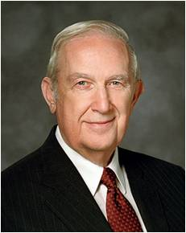
Be wise in how you embrace technology. Mark important scriptures on your device and refer back to them frequently.
If you young people would review a verse of scripture as often as some of you send text messages, you could soon have hundreds of passages of scripture memorized.
Those passages would prove to be a powerful source of inspiration and guidance by the Holy Ghost in times of need.
(6)

Slide 16
The Rest of Matthew
Matthew 4:12-25
Including an introduction to Peter, James, John and Andrew, the Apostles of Jesus

Slide 17
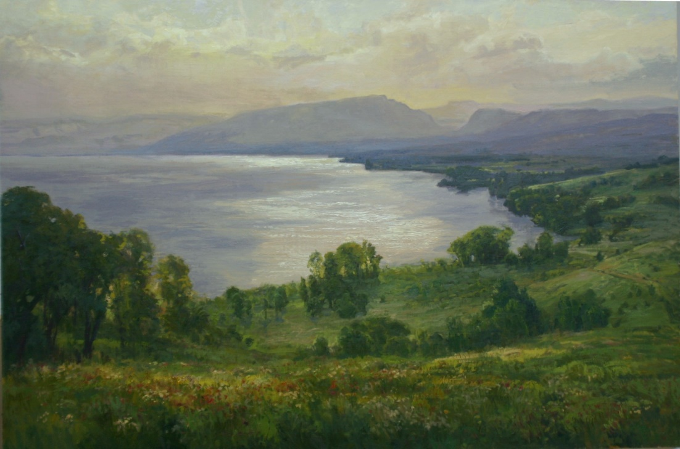
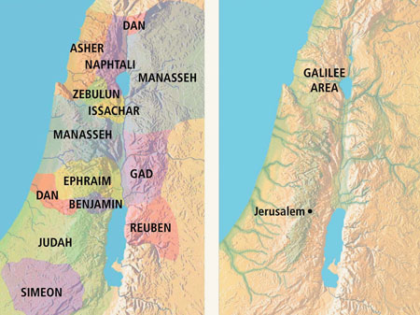
Jesus in Galilee
City of Capernaum—by the sea
Nevertheless the dimness shall not be such as was in her vexation, when at the first he lightly afflicted the land of Zebulun and the land of Naphtali, and afterward did more grievously afflict her by the way of the sea, beyond Jordan, in Galilee of the nations.
The people that walked in darkness have seen a great light: they that dwell in the land of the shadow of death, upon them hath the light shined.
The Old Testament lands of Zebulun and Naphtali became the land of Galilee in New Testament times
Matthew 4:12-17; Isaiah 9:1-2

Slide 18
Jesus Christ spent the majority of His life and ministry in the villages of Galilee—places like Capernaum, Nain, Nazareth, and Bethsaida
Jesus Christ brings light into the lives of those who are in darkness
The Savior began to preach repentance in preparation for the kingdom of heaven being established among the people.
Matthew 4:16

Slide 19
Fishers of Men
Matthew 4:19
“…Follow me and I will make you fishers of men.”
Mark 1:17
“…Come ye after me, and I will make you to become fishers of men.
Luke 5:7
“…Fear not; from henceforth thou shalt catch men.”
Matthew 4:18-22

Slide 20
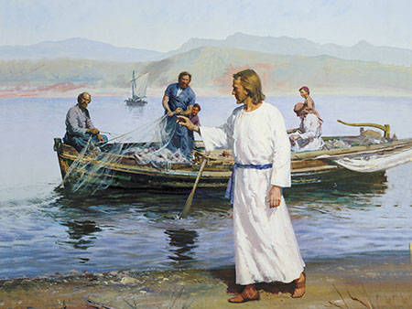
The Calling
What did the Savior call Peter, Andrew, James, and John to do?
When we choose to follow Jesus Christ, He can help us understand and achieve greater purpose for our lives.
What would these men be sacrificing to follow the Savior and assist in His work?
Matthew 4:18-22

Slide 21
Peter
He was the son of Jonah and the brother of Andrew, and his name means “Rock”. He was also known as Simon. His Aramaic name, Cephas, of which Peter is the Greek equivalent, was given him by the Lord
He was originally a fisherman on the coast of Galilee
He was present at miraculous occasions and the Transfiguration
He was acting first presidency of the church in their day. However, he denied Christ three times
He was in Jerusalem at Pentecost and in prison with Cornelius and has a vision to take the gospel to the gentiles
He held the keys of the kingdom
Tradition says Peter probably died by crucifixion in Rome. (About AD 64) Head downward. (10)
In the latter days Peter, with James and John, came from heaven and literally conferred the Melchizedek Priesthood and the keys thereof upon Joseph Smith and Oliver Cowdery. This took place in May or June 1829, near Harmony, Pennsylvania.
(9)

Slide 22
James
He was the son of Zebedee, one of the Twelve, and brother of John (however there are several persons of this name)
He is also known as Jacob (Hebrew)
He was called with the other fishermen to follow Jesus.
He was given the name of Boanerges Meaning “son of Thunder”
He was baptized by John the Baptist
He was one of the three chosen to be with the Lord during special occasions: The raising of the daughter of Jairus, at the transfiguration, and at Gethsemane
He was killed by Herod in about AD 44 (Acts 12:2)
He was the first apostle martyred in early church times
(9)

Slide 23
John
He was the son of Zebedee, along with his brother James
He was one of the original 12 Apostles and a special witness to the acts and teaching of Jesus
Like Peter, he was a fisherman when Jesus called him.
He and James were two of the apostles Jesus appointed “To take the keys of Presidency.”
He was acting first presidency of the church in their day.
From Jesus he received the name Boanerges, “a son of thunder”
He was present at the raising of Jairus‘ daughter, at the Transfiguration, and present at Gethsemane.
He was banished to Patmos; there he wrote Revelation.
John did not die but has been allowed to remain on the earth as a ministering servant until the time of the Lord’s Second Coming (D&C 7; 3 Nephi 28:6)
(9)

Slide 24
Andrew
He was the son of Jonah and the elder brother of Simon Peter
He was a disciple of John the Baptist and Peter followed him 60 miles to hear the gospel
He was a fisherman along with his brother
He was one of the earliest called to be a disciple of Jesus Christ and was one of the Twelve
Andrew literally brought a young boy to Jesus, and Jesus multiplied the fish and bread to feed the multitude
Philip and Andrew went together to take the inquiring gentiles to Jesus just after the Triumphal Entry and Jesus’ end of His mortal ministry
Tradition says that Andrew was crucified at Patras, in Achaia about AD 70
(9)

Slide 25
“Men and women who turn their lives over to God will discover that He can make a lot more out of their lives than they can.
He will deepen their joys, expand their vision, quicken their minds, strengthen their muscles, lift their spirits, multiply their blessings, increase their opportunities, comfort their souls, raise up friends, and pour out peace.
Whoever will lose his life in the service of God will find eternal life.”
Matthew 4:18-22
(8)

Slide 26
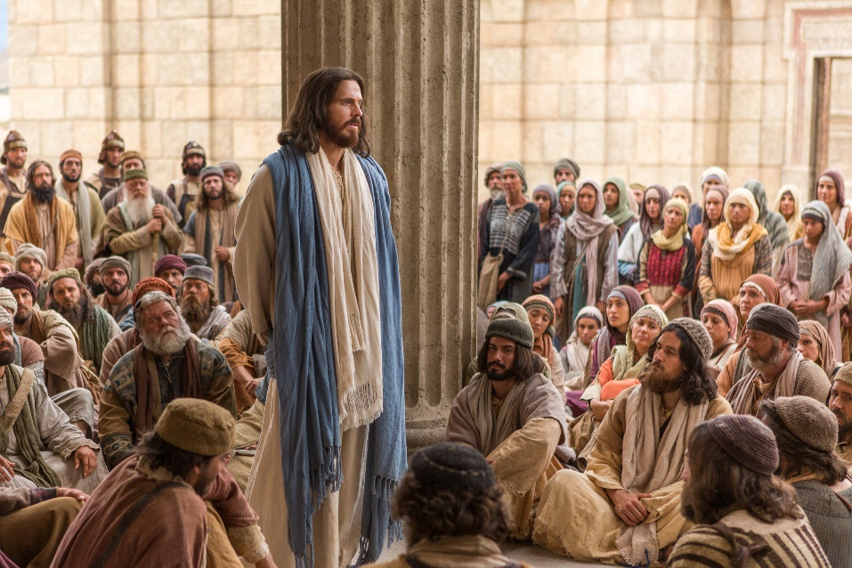
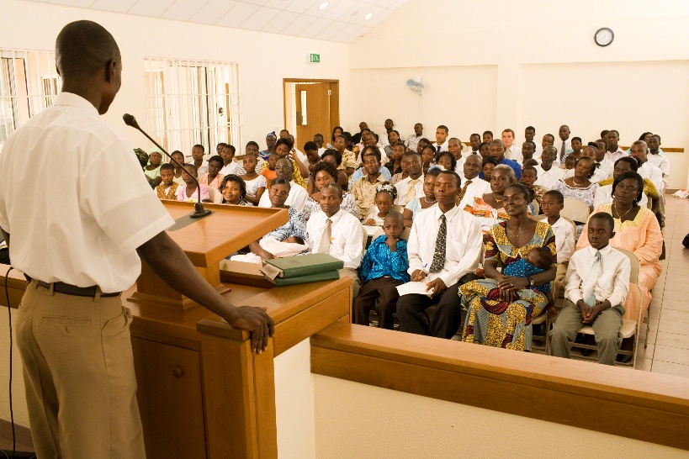
Teaching, Preaching, and Healing
“…from this earliest beginning, from the first hour, healing is mentioned almost as if it were a synonym for teaching and preaching. At least there is a clear relationship among the three. In fact, the passage that follows says more about the healing than the teaching or the preaching. …
“…our teaching can lead to healing of the spiritual kind. … As with the Master, wouldn’t it be wonderful to measure the success of our teaching by the healing that takes place in the lives of others?
(7)
Matthew 4:23-25

Slide 27
Sources:
Elder Quentin L. Cook Choose Wisely October 2014 General Conference
Elder Bruce R. McConkie (Doctrinal New Testament Commentary, 1:128). Joseph Smith Translation, Matthew 4:1–2; Luke 4:2]”
President Howard W. Hunter (“The Temptations of Christ,” Ensign, Nov. 1976, 18
James E. Talmage Jesus the Christ Chapter 10
Russell M. Nelson, “The Book of Mormon: What Would Your Life Be Like without It?,” Ensign or Liahona, Nov. 2017, 62–63
Richard G. Scott, “For Peace at Home,” Ensign or Liahona, May 2013, 30
Jeffrey R. Holland, “The Inconvenient Messiah,” Ensign, Feb. 1984, 68–73.
“Teaching, Preaching, Healing,” Ensign, Jan. 2003, 33–34, 37.
8. President Ezra Taft Benson (“Jesus Christ—Gifts and Expectations,” Ensign, Dec. 1988, 4).
9. Bible Dictionary
10.Commentary on Genesis, cit. Eusebius, History 3:1 from Simon Peter By Dr. Richard Lloyd Anderson Ensign Feb. 1975
Presentation by ©http://fashionsbylynda.com/blog/

Slide 28
Opening Events in Jesus’ Ministry
Event | Matthew | Mark | Luke | John
Fast and Temptation of Jesus | 4:1-11 | 1:12, 13 | 4:1-13
Jesus Leaves Judea for Galilee | 4:12 | 1:14 | 4:14 | 4:1-3
Jesus Leaves Judea for Galilee | 4:12 | 1:14 | 4:14 | 4:1-3
Goes to Capernaum | 4:13-17 | 1:15
Fishers of Men: Peter, Andrew, James, and John | 4:18-22 | 1:16-20 | 5:1-11
Jesus Preaches and Heals in Galilee | 4:23-25 | 1:35-39 | 4:42-44
Source: Horizontal Harmony of the Four Gospels by Thomas M. Mumford
Peter
John
James
https://www.lds.org/ensign/1975/02/simon-peter?lang=eng
https://www.lds.org/ensign/1999/10/as-flaming-fire-and-a-ministering-angel?lang=eng
https://www.lds.org/ensign/1975/09/i-have-a-question?lang=eng

Slide 29
Matthew 4:1 Communion with God
The circumstances attending this time of exile and test must have been related by Jesus Himself, for of other human witnesses there were none. The recorded narratives deal principally with events marking the close of the forty-day period, but considered in their entirety they place beyond doubt the fact that the season was one of fasting and prayer. Christ’s realization that He was the chosen and foreordained Messiah came to Him gradually. As shown by His words to His mother on the occasion of the memorable interview with the doctors in the temple courts, He knew, when but a Boy of twelve years, that in a particular and personal sense He was the Son of God; yet it is evident that a comprehension of the full purport of His earthly mission developed within Him only as He progressed step by step in wisdom. His acknowledgment by the Father, and the continued companionship of the Holy Ghost, opened His soul to the glorious fact of His divinity. He had much to think about, much that demanded prayer and the communion with God that prayer alone could insure. Throughout the period of retirement, he ate not, but chose to fast, that His mortal body might the more completely be subjected to His divine spirit. James E Talmage Jesus the Christ Chapter 10
Fasting:
“Fasting, coupled with mighty prayer, is powerful. It can fill our minds with the revelations of the Spirit. It can strengthen us against times of temptation. Fasting and prayer can help develop within us courage and confidence. They can strengthen our character and build self-restraint and discipline. Often when we fast, our righteous prayers and petitions have greater power. Testimonies grow. We mature spiritually and emotionally and sanctify our souls. Each time we fast, we gain a little more control over our worldly appetites and passions” Elder Joseph B. Wirthlin (“The Law of the Fast,” Ensign, May 2001, 73).
Temptation:
“It is extremely difficult, if not impossible, for the devil to enter a door that is closed. He seems to have no keys for locked doors. But if a door is slightly ajar, he gets his toe in, and soon this is followed by his foot, then by his leg and his body and his head, and finally he is in all the way” (Teachings of Presidents of the Church: Spencer W. Kimball [2006], 106–7).
Matthew 4:16 Galilee:
Jesus Christ spent the majority of His life and ministry in the villages of Galilee—places like Capernaum, Nain, Nazareth, and Bethsaida. During Old Testament times this area was the inheritance of the tribes of Zebulun and Naphtali. Over the centuries, numerous battles were waged to secure control over this strategic region. Some have suggested that because so many people lost their lives in battle here, Isaiah referred to the people of this region as “them which sat in the region and shadow of death” (Matthew 4:16). Isaiah prophesied that in this death-stricken land a “great light” would spring up (Isaiah 9:2). That light is Jesus Christ, the Light of the World. Matthew wanted his readers to know that the Savior’s ministry in the land of Galilee was a fulfillment of this messianic prophecy. New Testament Student Manual Institute Chapter 2
Was Jesus Capable of Sinning?
The question as to whether He was capable of sinning. Had there been no possibility of His yielding to the lures of Satan, there would have been no real test in the temptations, no genuine victory in the result. Our Lord was sinless yet peccable (capable);
He had the capacity, the ability to sin had He willed so to do. Had He been bereft of the faculty to sin, He would have been shorn of His free agency; and it was to safeguard and ensure the agency of man that He had offered Himself, before the world was, as a redeeming sacrifice. To say that He could not sin because He was the embodiment of righteousness is no denial of His agency of choice between evil and good. A thoroughly truthful man cannot culpably lie; nevertheless his insurance against falsehood is not that of external compulsion, but of internal restraint due to his cultivated companionship of the spirit of truth. A really honest man will neither take nor covet his neighbor’s goods, indeed it may be said that he cannot steal; yet he is capable of stealing should he so elect. His honesty is an armor against temptation; but the coat of mail, the helmet, the breastplate, and the greaves, are but an outward covering; the man within may be vulnerable if he can be reached.. James E Talmage Jesus the Christ Chapter 10

Slide 30
 | What Satan Tempted Jesus to Do | How Jesus Responded to the Temptation
Matthew 4:3-4
Mathew 4:5-7
Matthew 4:8-11
 | What Satan Tempted Jesus to Do | How Jesus Responded to the Temptation
Matthew 4:3-4
Mathew 4:5-7
Matthew 4:8-11
 | What Satan Tempted Jesus to Do | How Jesus Responded to the Temptation
Matthew 4:3-4
Mathew 4:5-7
Matthew 4:8-11

Slide 31
Jesus Teaches in the Synagogue
Luke 4

Slide 32
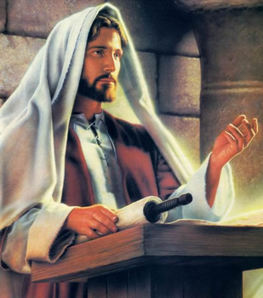
Jesus is the Messiah
He began to preach in the synagogues in Galilee. Soon, He returned to His hometown of Nazareth. While there, He stood in a synagogue and read from the book of Isaiah.
Jesus is the Messiah who was sent to heal the brokenhearted and deliver those who are spiritually captive
Luke 4:14-21
(1)

Slide 33
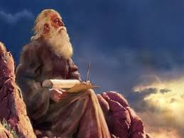
Quoting Isaiah
The Spirit of the Lord is upon me because he hath anointed me
To preach the gospel to the poor in spirit;
He hath sent me to heal those with a broken heart and contrite spirit
To preach deliverance to the captives in spirit prison
And recovering of sight to the spiritually blind,
To set at liberty them that are bruised and battered in spiritual bondage.
Luke 4:14-21; Isaiah 61:1-2

Slide 34
Summary of His Earthly Mission and Atoning Sacrifice
Anointed = The Messiah
His atoning sacrifice would save those who offer the sacrifice of a broken heart and contrite spirit.
“heal the brokenhearted”
And ye shall offer for a sacrifice unto me a broken heart and a contrite spirit. And whoso cometh unto me with a broken heart and a contrite spirit, him will I baptize with fire and with the Holy Ghost…
3 Nephi 9:20
Thou shalt offer a sacrifice unto the Lord thy God in righteousness, even that of a broken heart and a contrite spirit.
D&C 59:8
Luke 4:14-21; Isaiah 61:1-2
(1)

Slide 35
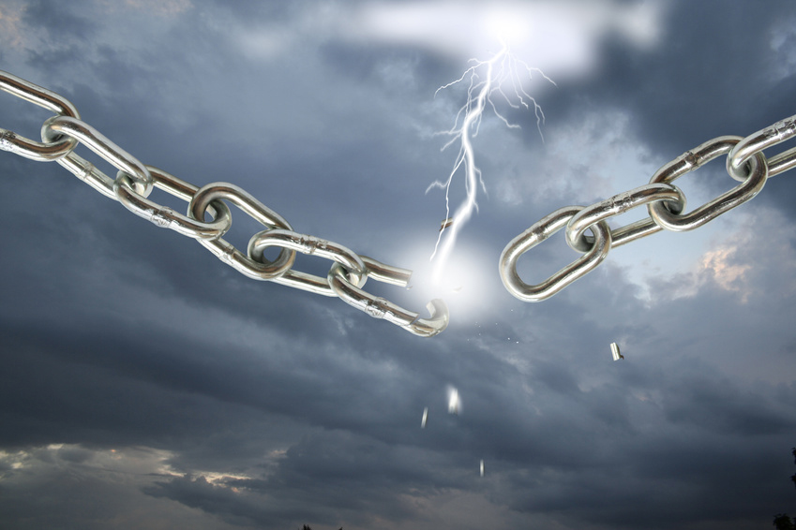
Summary of His Earthly Mission and Atoning Sacrifice
His gospel would deliver those in spirit prison as well as those in spiritual bondage.
“preach deliverance to the captives”
For Christ also hath once suffered for sins, the just for the unjust,…By which also he went and preached unto the spirits in prison; 1 Peter 3:18-19
…the Son of God appeared, declaring liberty to the captives who had been faithful;
Those who rejected = Where these were, darkness reigned, but among the righteous there was peace; D&C 138:18-22
Luke 4:14-21; Isaiah 61:1-2
(1)

Slide 36
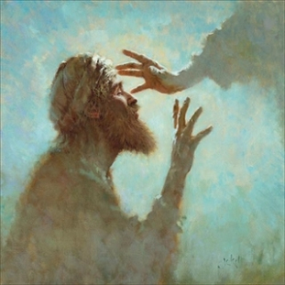
Summary of His Earthly Mission and Atoning Sacrifice
He would miraculously restore physical and spiritual sight. had!
Provide “sight to the blind”
Then was brought unto him one possessed with a devil, blind, and dumb: and he healed him, insomuch that theblind and dumb both spake and saw. Matthew 12:22
Luke 4:14-21; Isaiah 61:1-2
(1)

Slide 37
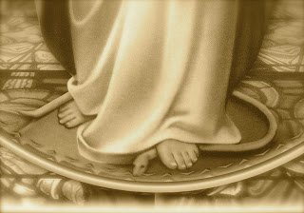
Summary of His Earthly Mission and Atoning Sacrifice
Fulfilling the promise to Mother Eve that her posterity, whose heels were bruised by the serpent, would have power to crush the serpent’s head
“set at liberty them that are bruised”
And I will put enmity between thee and the woman, and between thy seed and her seed; it shall bruise thy head, and thou shalt bruise his heel.
Luke 4:14-21; Isaiah 61:1-2
(1)

Slide 38
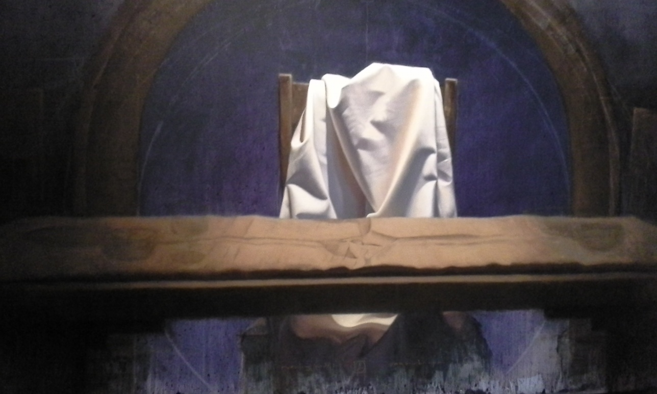
Summary of His Earthly Mission and Atoning Sacrifice
To preach that the Lord had begun His ministry, which He had!
“preach the acceptable year of the Lord”
An "acceptable year," or "year of acceptance," is a space of time during which God would be pleased to accept such as repented and turned to him. (BibleHub)
To proclaim the acceptable year of the Lord, and the day of vengeance of our God; Isaiah 61:2
Luke 4:14-21; Isaiah 61:1-2
(1)

Slide 39
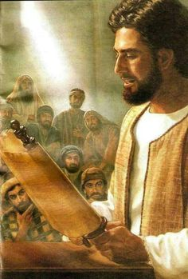
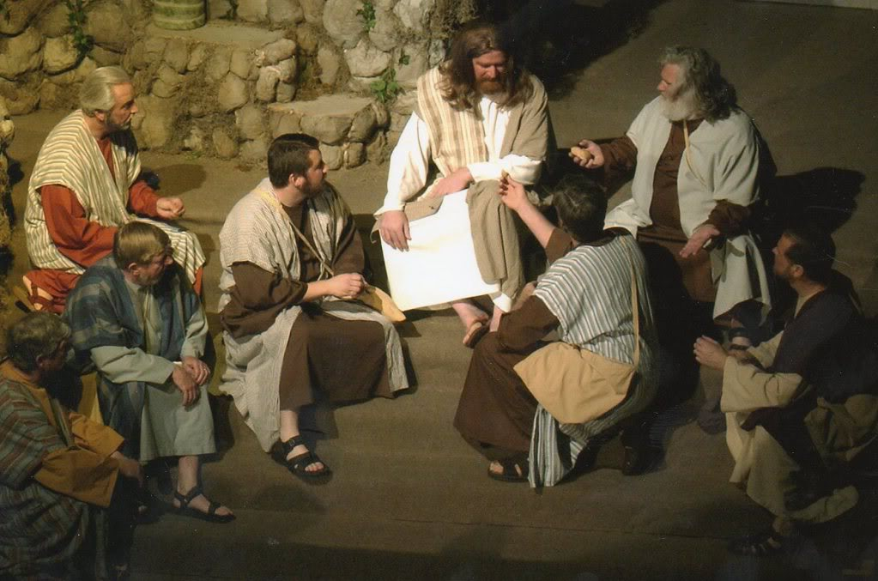
Teaching
After reading the scripture, Jesus Christ sat down to comment.
In Jesus' era, it was customary to stand while reading but to sit while teaching
Luke 4:14-21; Isaiah 61:1-2
(1)

Slide 40
Do We Need Proof?
Require not miracles, except I shall command you, except casting out devils, healing the sick, and against poisonous serpents, and against deadly poisons;
D&C 24:13
Jesus knew that the people in Nazareth would challenge Him to prove He was the Messiah by repeating the miracles He had performed in Capernaum.
And he that seeketh signs shall see signs, but not unto salvation.
Verily, I say unto you, there are those among you who seek signs, and there have been such even from the beginning;
But, behold, faith cometh not by signs, but signs follow those that believe. D&C 63:7-9
Wherefore, I, the Lord, am not pleased with those among you who have sought after signs and wonders for faith, and not for the good of men unto my glory. D&C 63:12
Miracles occur to bless the faithful, not to convert skeptics.
Luke 4:22
(1)

Slide 41
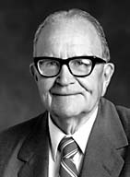
"Thus Jesus Christ was rejected by the people because he told them what saving work he would do for the captives then confined to a spiritual prison and for those who had been bruised in their souls through iniquity.
Instead of rejoicing in this liberation, the people hated Jesus for being so presumptuous as to tell them that he had been anointed to open the prison doors.
Even his very life was threatened. Nevertheless, he continued to preach this doctrine even more clearly, in the hopes that people would understand him and the importance of the work he had been called to do.“
Luke 4:22-30
(3)

Slide 42
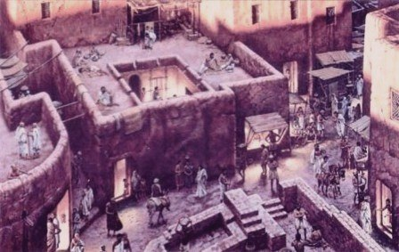
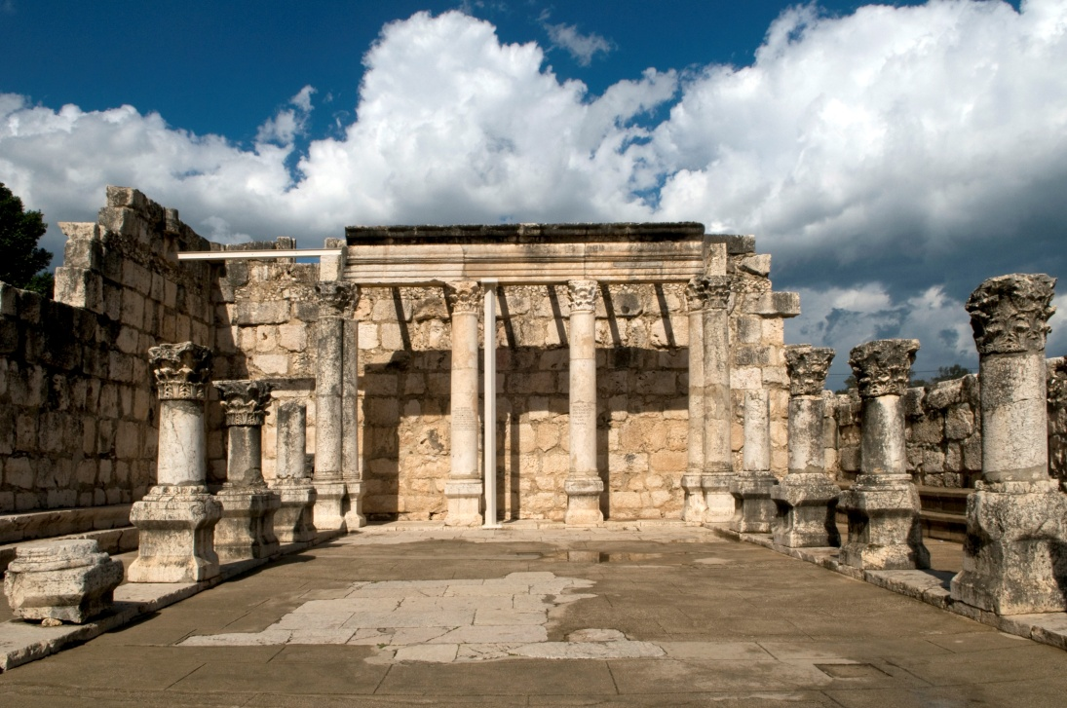
Those Who Sought Him
In contrast to the people of Nazareth who rejected the Savior, many in Capernaum sought Him out and pleaded
Nazareth
This may have been one of the reasons why Capernaum came to be known as Jesus' “own city” and as Church headquarters for His ministry.
Ancient Capernaum
Luke 4:31-44; Matthew 9:1
(1)

Slide 43
“Where there is faith, there is the miracle; where there is no faith, no miracle is wrought. And if the prophets of old went outside the fold of Israel to find those worthy of their ministry, so Jesus would go outside Nazareth to find receptive souls who would believe in him and receive the blessings that he came to bestow.
Should the people of Nazareth desire to see the wondrous works done elsewhere, then let them accept Him who now preached in their synagogue, and they too would receive the blessings of heaven.”
Luke 4:31-44
(4)

Slide 44
"We are amazed that everywhere he went the forces of evil went before him and that they knew him from the beginning, even if mortals did not.
"We stand all amazed as these forces of evil were cast out and defeated, even as the lame were made to walk, the blind to see, the deaf to hear, the infirm to stand.
Indeed we are all amazed at every movement and moment-as every generation from Adam to the end of the world must be.“
Luke 4:31-44
(5)

Slide 45
Sources:
New Testament Institute Student Manual Chapter 16
Gospeldoctrine.com
Elder Theodore M. Burton (Conference Report, October 1970, Afternoon Meeting 34.)
Elder Bruce R. McConkie (The Mortal Messiah, 4 vols. [1979–81], 2:26).
Elder Jeffrey R. Holland ("I Stand All Amazed," Ensign, Aug. 1986, 68)

Slide 46
Event | Matthew | Mark | Luke | John
Fast and Temptation of Jesus | 4:1-11 | 1:12, 13 | 4:1-13
Jesus Leaves Judea for Galilee | 4:12 | 1:14 | 4:14 | 4:1-3
Jesus Enters Galilee |  |  | 4:15 | 4:43-45
Jesus is Rejected at Nazareth |  |  | 4:16-30
Jesus Teaches with Power and Authority |  | 1:21,22 | 4:31,32
Jesus Teaches with Power and Authority |  | 1:21,22 | 4:31,32
Jesus Casts Out Unclean Spirit |  | 1:23-28 | 4:33-37
Jesus Heals Peter’s Mother-in-Law and Others | 8:14-17 | 1:29-34 | 4:38-41
Jesus Preaches and Heals in Galilee | 4:23-25 | 1:35-39 | 4:42-44

Slide 47
To the High Mountain Luke 4:5,9:
Joseph Smith’s inspired translation of Luke 4:5, 9 makes clear that it was the Spirit, not the devil, who took Jesus Christ to a high mountain and brought Him to Jerusalem, and then afterward Satan came to tempt Him (see Joseph Smith Translation, Luke 4:5 [in Luke 4:5, footnote a]
He Hath Appointed Me Luke 4:18:
The title of Christ literally means "the anointed one." We might ask, "what was Jesus anointed with?" Or, "who performed this anointing?" The answer comes from Peter, 'God anointed Jesus of Nazareth with the Holy Ghost and with power' (Acts 10:38). Therefore, when Isaiah declares, 'the spirit of the Lord is upon me, because he hath anointed me,' it means just what it says: Jesus was filled with the Spirit because he was anointed by the Father. Our own anointings symbolize this same outpouring of the Spirit. The pure olive oil is anointed in priesthood administrations to symbolize the sanctification of the Spirit. The Holy Ghost is the Sanctifier.'" (Joseph Fielding McConkie, Gospel Symbolism [Salt Lake City: Bookcraft, 1999], 115.)
Teaching in the Synagogue Luke 18-19:
“Many times as boy and man He had sat in that house of worship [the synagogue], listening to the reading of the law and the prophets and to the commentaries … , as delivered by appointed readers; but now, as a recognized teacher of legal age He was eligible to take the reader’s place. On this occasion He stood up to read, when the service had reached the stage at which extracts from the prophetical books were to be read to the congregation. The minister in charge handed Him the roll, or book, of Isaiah; He turned to the part known to us as the beginning of the sixty-first chapter, and read: [Luke 4:18–19]. … The scripture He had quoted was one recognized by all classes as specifically referring to the Messiah, for whose coming the nation waited” James E. Talmage (Jesus the Christ, 3rd ed. [1916], 179).
People of Nazareth Reject Jesus’ Words Luke 4:22-30:
“In their hearts the people were eager for a sign, a wonder, a miracle. They knew that Jesus had wrought such in Cana, and a boy in Capernaum had been healed by His word; at Jerusalem too He had astonished the people with mighty works. Were they, His townsmen, to be slighted? Why would He not treat them to some entertaining exhibition of His powers?
He continued His address, reminding them that in the days of Elijah, when for three years and a half no rain had fallen, and famine had reigned, the prophet had been sent to but one of the many widows, and she a woman of Sarepta in Sidon, a Gentile, not a daughter of Israel. And again, though there had been many lepers in Israel in the days of Elisha, [only] one leper, and he a Syrian, not an Israelite, had been cleansed through the prophet’s ministration, for Naaman alone had manifested the requisite faith.
“Then great was their wrath. Did He dare to class them with Gentiles and lepers? Were they to be likened unto despised unbelievers, and that too by the son of the village carpenter, who had grown from childhood in their community? Victims of diabolical rage, they seized the Lord and took Him to the brow of the hill on the slopes of which the town was built, determined to avenge their wounded feelings by hurling Him from the rocky cliffs” James E. Talmage (Jesus the Christ, 180).

Slide 48
Following the Lord and Achieving Our Divine Purposes
Luke 5:1-11

Slide 49
When have you been asked to do something without knowing all the reasons for doing it?
Why Follow the Lord?

Slide 50
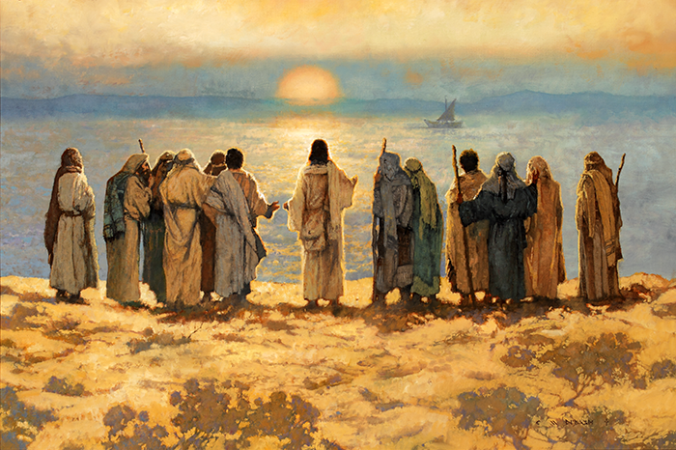
Lake of Gennesaret=Sea of Galilee
let down your nets for a draught = a catch or haul of fish
Capernaum
Besaida
Gennesaret
Sea of Galilee
Tiberias
Michael Dudash
Luke 5:1-4

Slide 51
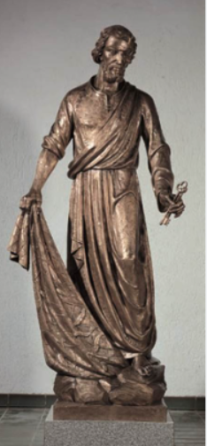
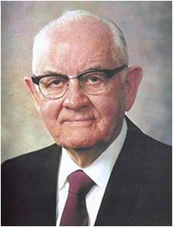
Diamond in the Rough
Simon Peter was working as a successful fisherman who, with his partners, owned at least two ships. Yet Peter was willing to forsake everything to follow Jesus Christ.
“Peter was, in President [Spencer W.] Kimball’s words, ‘a diamond in the rough—a diamond that would need to be cut, trimmed, and polished by correction, chastisement, and trials—but nevertheless a diamond of real quality.”
Luke 5:1-4
(2)

Slide 52
“A Sinful Man”
When Peter first met the Savior and witnessed His miraculous power, Peter recognized that he was “a sinful man” in great need of the Savior’s redeeming power.
Peter’s words illustrate that as we draw near to God, we become aware of our sinfulness and unworthiness and desire His help in becoming more like Him.
Luke 5:8
(1)

Slide 53
[Those] who turn their lives over to God will discover that He can make a lot more out of their lives than they can.
He will deepen their joys, expand their vision, quicken their minds, strengthen their muscles, lift their spirits, multiply their blessings, increase their opportunities, comfort their souls, raise up friends, and pour out peace.
Whoever will lose his life in the service of God will find eternal life.
(7)

Slide 54
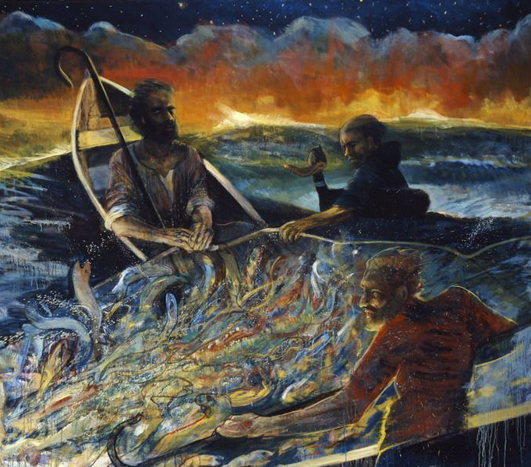
Deep In the Heart of the Sea
After an unsuccessful night of effort, Peter’s expert judgment told him a final effort was useless. But this was a man of genuinely childlike faith, and he lowered the net.
The number of fish taken in that single attempt strained the strings until they began to break and filled two boats until they began to sink.
In that small ship Peter kneeled, stunned, at the feet of the Master. Jesus said lovingly, ‘Henceforth thou shalt catch men.’ (1)
Luke 5:1-11
(2)

Slide 55
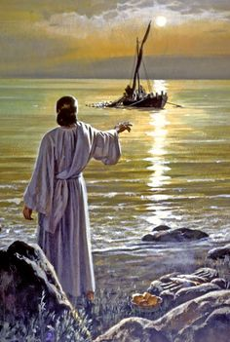
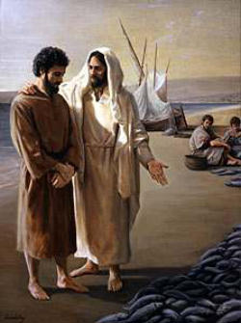
Giving It Up to Follow Jesus
Peter could not have known the ever-widening circles that single command would make in the stream of his plain and simple life. He was launching out into the expanse of godliness, into the eternal possibilities of redeemed and celestial life. He would be learning the mysteries of the kingdom.
He would be hearing unspeakable things. To launch out into that limitless sea of the gospel of Jesus Christ, Peter brought his craft to shore, turned his back on the most spectacular single catch ever taken from Galilee, ‘forsook all, and followed him.’
Luke 5:1-11
(2)

Slide 56
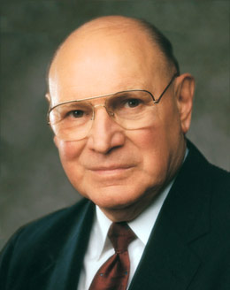
We might define a net as anything that entices or prevents us from following the call of Jesus Christ, the Son of the living God.
Nets in this context can be our work, our hobbies, our pleasures, and, above all else, our temptations and sins. In short, a net can be anything that pulls us away from our relationship with our Heavenly Father or from His restored Church.
Let me give you a modern example. A computer can be a useful and indispensable tool. But if we allow it to devour our time with vain, unproductive, and sometimes destructive pursuits, it becomes an entangling net.
(8)

Slide 57
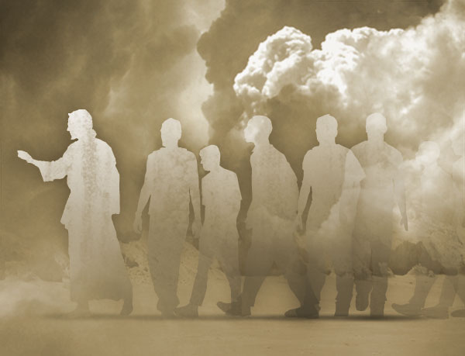
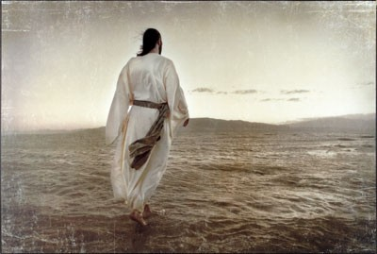
Disciple = Followers of Jesus
The word for disciple and the word for discipline both come from the same Latin root—discipulus, which means pupil.
It emphasizes practice or exercise. Self-discipline and self-control are consistent and permanent characteristics of the followers of Jesus, as exemplified by Peter, James, and John, who indeed ‘forsook all, and followed him.’
If we do what the Lord asks even when we do not understand why, He can provide greater blessings than we could have anticipated
Luke 5:1-11
(4)

Slide 58
To Trust and Obey
“This life is an experience in profound trust—trust in Jesus Christ, trust in His teachings, trust in our capacity as led by the Holy Spirit to obey those teachings for happiness now and for a purposeful, supremely happy eternal existence.
To trust means to obey willingly without knowing the end from the beginning.
To produce fruit, your trust in the Lord must be more powerful and enduring than your confidence in your own personal feelings and experience.”
Luke 5:1-11
(5)

Slide 59
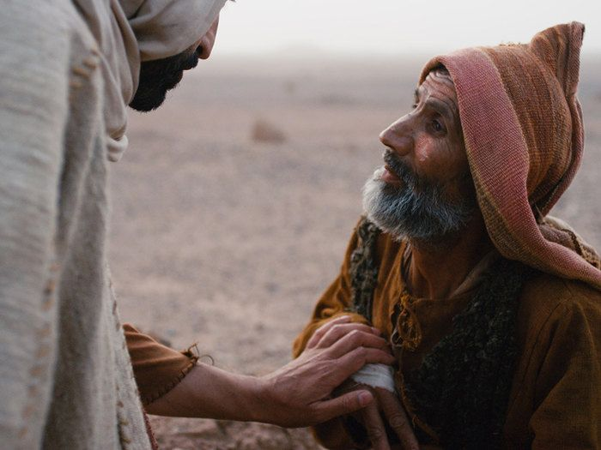
Faithful Personal Healing
Luke 5
12-15
Leprosy
The man seeks for Jesus
Jesus touches him
Jesus asks him to tell no one
Jesus asks him to present himself to the priest
A Personal Faith
The one who seeks for Jesus Christ was healed because of his faith.
His healing was immediate and his sins removed through obedience.
As we exercise faith and come to the Savior, He can heal us.
Luke 5:12-25

Slide 60
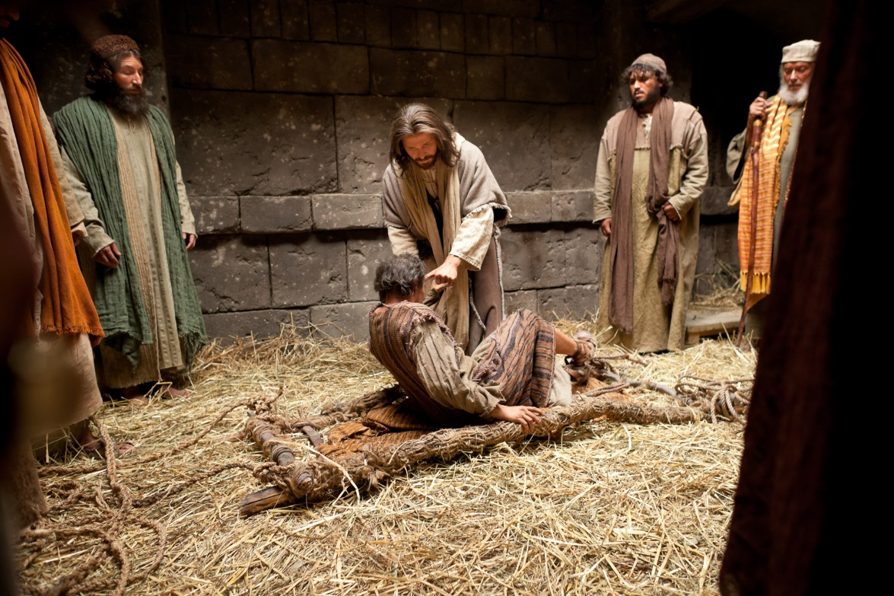
Faithful Public Healing
Luke 5
18-25
Palsy = paralyzed
Others brought him to see Jesus
Jesus see their faith and forgives the man
Jesus performs the miracle in front of many
The man is immediately healed
Faith of Others
Those who seek Jesus and those who are forgiven of their sins will be forgiven.
His healing was immediate with others to witness the miracle.
We can help others come to the Savior so they can be healed.
Luke 5:12-25

Slide 61
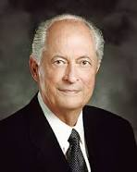
Lifting Burdens
…and now, as ye are desirous to come into the fold of God, and to be called his people, and are willing to bear one another’s burdens, that they may be light;
Mosiah 18:8
Once we receive a witness of the Spirit, our testimony is strengthened through study, prayer, and living the gospel.
Our growing testimony brings us increased faith in Jesus Christ and His plan of happiness.
We are motivated to repent and obey the commandments, which, with a mighty change of heart, leads to our conversion. And our conversion brings divine forgiveness, healing, joy, and the desire to bear our witness to others. (6)
Luke 5:12-25

Slide 62
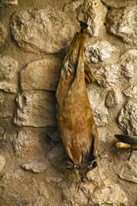
New Wine in Old Bottles
Have you ever tried jam that was canned in an old pickle jar?
How does it taste?
As new wine fermented in leather bags, gases would build up inside and stretch the leather. Once a wineskin had already been stretched in this way, attempting to ferment new wine in it again would risk bursting it.
The new wine = the Savior’s teachings and the fulness of the everlasting gospel.
The old wine = the practices, traditions, and beliefs of the Pharisees under the law of Moses.
Luke 5:36-39

Slide 63
Willing to Change
Just as old bottles are too inflexible to hold new wine, the scribes and Pharisees were hard-hearted and unwilling to change to accept the Savior and His teachings.
New Bottles
Those people who are humble and willing to change to accept the Savior and His teachings
Luke 5:36-39

Slide 64
Sources:
New Testament Institute Student Manual Chapter 16 and New Tesament Student Manual (2018)
President Spencer W. Kimball and Elder Jeffrey R. Holland ‘Peter, My Brother,’ Brigham Young University Speeches of the Year (July 13, 1971), 2 (“The Lengthening Shadow of Peter,” Ensign, Sept. 1975, 32).
Peter the fisherman statue located Catholic Church of Oriental, North Carolina.
President James E. Faust (“Discipleship,” Ensign or Liahona, Nov. 2006, 20, 22).
Elder Richard G. Scott (“Trust in the Lord,” Ensign, Nov. 1995, 17).
Elder Robert D. Hales Receiving a Testimony of the Restored Gospel of Jesus Christ Liahona November 2003
Ezra Taft Benson, “Jesus Christ—Gifts and Expectations,” Ensign, Dec. 1988, 4
Joseph B. Wirthlin, “Follow Me,” Ensign, May 2002, 15
Presentation by ©http://fashionsbylynda.com/blog/

Slide 65
Event | Matthew | Mark | Luke | John
Jesus Cleanses a Leper | 8:2-4 | 1:40-45 | 5:12-16
Jesus Heals a Man with Palsy | 9:2-8 | 2:1-12 | 5:17-26
Matthew Follows Jesus | 9:9 | 2:13-14 | 5:27, 28
Jesus Came to Call Sinners to Repentance | 9:10-13 | 2:15-17 | 5:29-32
Jesus is the New law | 9:14-17 | 2:18-22 | 5:33-39
Miracles:
“The greatest miracles I see today are not necessarily the healing of sick bodies, but the greatest miracles I see are the healing of sick souls, those who are sick in soul and spirit and are downhearted and distraught, on the verge of nervous breakdowns. We are reaching out to all such, because they are precious in the sight of the Lord, and we want no one to feel that they are forgotten” President Harold B. Lee (“Stand Ye in Holy Places” Ensign, July 1973, 123).
New wine in Old bottles Luke 5:36-39
"In such wise did our Lord proclaim the newness and completeness of His gospel. It was in no sense a patching up of Judaism. He had not come to mend old and torn garments; the cloth He provided was new, and to sew it on the old would be but to tear afresh the threadbare fabric and leave a more unsightly rent than at first. Or to change the figure, new wine could not safely be entrusted to old bottles. The bottles here referred to were really bags, made of the skins of animals, and of course they deteriorated with age. Just as old leather splits or tears under even slight strain, so the old bottle-skins would burst from the pressure of fermenting juice, and the good wine would be lost.
The gospel taught by Christ was a new revelation, superseding the past, and marking the fulfillment of the law; it was no mere addendum, nor was it a reenactment of past requirements; it embodied a new and an everlasting covenant. Attempts to patch the Judaistic robe of traditionalism with the new fabric of the covenant could result in nothing more sightly than a rending of the fabric. The new wine of the gospel could not be held in the old time-worn containers of Mosaic libations. Judaism would be belittled and Christianity perverted by any such incongruous association." James E. Talmage (Jesus the Christ, 184)
Four Men of Faith: Luke 5:18-25:
“Who were those people that Jesus mentioned? They could well include the four who carried the man with palsy, the man himself, the people who had prayed for him, and all those who were there listening to the preaching of Jesus and cheering quietly in their hearts for the soon-to-come miracle. They could also include a spouse, a parent, a son or a daughter, a missionary, a quorum president, a Relief Society president, a bishop, and a faraway friend. We can all help one another. We should always be anxiously engaged in seeking to rescue those in need” (“Rescue in Unity,” Ensign or Liahona, Nov. 2014, 16).perverted by any such incongruous association." James E. Talmage (Jesus the Christ, 184)

Slide 66
“Ye Must be born again”
John 3:1-8
For the natural man is an enemy to God, and has been from the fall of Adam, and will be, forever and ever, unless he yields to the enticings of the Holy Spirit, and putteth off the natural man and becometh a saint through the atonement of Christ the Lord, and becometh as a child, submissive, meek, humble, patient, full of love, willing to submit to all things which the Lord seeth fit to inflict upon him, even as a child doth submit to his father.
Mosiah 3:19

Slide 67
Nicodemus
He was a Pharisee, a ruler of the Jews
He was a member of the Sanhedrin. The Sanhedrin was a governing council made up of Pharisees and Sadducees that directed many of the civil and religious affairs of the Jewish people
He came in secret to Jesus during the night hour to learn more of His teaching
Jesus taught him the fundamental doctrines of the gospel
He later defended the Savior to his Pharisee associates who were intent on destroying the Christian cause
He asked Pilate if he and Joseph of Arimathaea could have the body of Jesus and helped prepare Him for burial
(2)

Slide 68
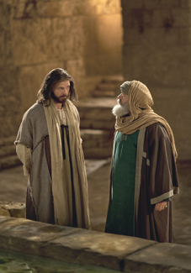
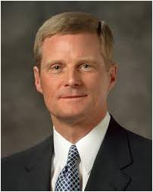
To Be Born Again
True or False?
As long as I am a good person, I can go to heaven.
“We begin the process of being born again through exercising faith in Christ, repenting of our sins, and being baptized by immersion for the remission of sins by one having priesthood authority. … Total immersion in and saturation with the Savior’s gospel are essential steps in the process of being born again.”
(3)

Slide 69
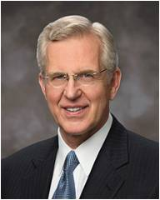
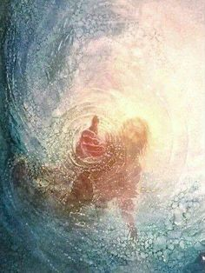
Our Own Effort
To be born again requires both our own effort and “divine power,” and for most of us, this happens over time rather than all at once.
“It was Jesus who stated that entry into the kingdom of God requires that one be born again—born of water and of the Spirit.
His teaching about a physical and a spiritual baptism helps us understand that both our own action and the intervention of divine power are needed for this transformative rebirth—for the change from natural man to saint…
John 3:3-5; Mosiah 3:19
(4)

Slide 70
Physical Birth
Our mortal life begins
We inherit physical and mental traits and material things from our parents.
In many cultures we receive our father’s name.
We can become like our parents.
Spiritual Birth
We begin a new life in Christ
Christ becomes our Father and we receive a spiritual inheritance from Him.
We receive the name of Christ.
We begin our progression towards becoming like our Father in Heaven.

Slide 71
Alma 5:14
“And now behold, I ask of you, my brethren of the church,
Have ye spiritually been born of God?
Have ye received his image in your countenances?
Have ye experienced this mighty change in your hearts?”
We must be born of water and of the Spirit to enter the kingdom of God.

Slide 72
Doctrinal Mastery
John 3;5
Jesus answered, Verily, verily, I say unto thee, Except a man be born of water and of the Spirit, he cannot enter into the kingdom of God.

Slide 73
What do you think this person could do to seek the Savior’s help in changing? Why do you think those actions will help?
How can the ordinances of baptism, confirmation, and partaking of the emblems of the sacrament help this person change and be born again?
What have you learned about Jesus Christ as you have experienced the process of being born again or have seen this process in others?

Slide 74
Sources:
New Testament Institute Student Manual Chapter 22
Who’s Who in the New Testament by Richard J. Allen p. 128-129
Elder David A. Bednar (“Ye Must Be Born Again,” Ensign or Liahona, May 2007, 21).
Elder D. Todd Christofferson (“Born Again,” Ensign or Liahona, May 2008, 77–78).
Presentation by ©http://fashionsbylynda.com/blog/

Slide 75
Born Again John 3:3-5:
“We were born again when we entered into a covenant relationship with our Savior by being born of water and of the Spirit and by taking upon us the name of Jesus Christ. …
“Latter-day Saints affirm that those who have been born again in this way are spiritually begotten sons and daughters of Jesus Christ (see Mosiah 5:7; 15:9–13;27:25). Nevertheless, in order to realize the intended blessings of this born-again status, we must still keep our covenants and endure to the end. In the meantime, through the grace of God, we have been born again as new creatures with new spiritual parentage and the prospects of a glorious inheritance” Dallin H. Oaks “Have You Been Saved?” Ensign, May 1998, 56).
“When we are baptized by immersion by one with the proper priesthood authority and choose to follow our Savior, we then are in His kingdom and of His kingdom. …
“At baptism we make a covenant with our Heavenly Father that we are willing to come into His kingdom and keep His commandments from that time forward, even though we still live in the world. …
“When we understand our baptismal covenant and the gift of the Holy Ghost, it will change our lives and will establish our total allegiance to the kingdom of God. When temptations come our way, if we will listen, the Holy Ghost will remind us that we have promised to remember our Savior and obey the commandments of God. …
“By choosing to be in His kingdom, we separate—not isolate—ourselves from the world. Our dress will be modest, our thoughts pure, our language clean. The movies and television we watch, the music we listen to, the books, magazines, and newspapers we read will be uplifting. We will choose friends who encourage our eternal goals, and we will treat others with kindness. We will shun the vices of immorality, gambling, tobacco, liquor, and illicit drugs. Our Sunday activities will reflect the commandment of God to remember the Sabbath day and keep it holy. We will follow the example of Jesus Christ in the way we treat others. We will live to be worthy to enter the house of the Lord” Elder Robert D. Hales(“The Covenant of Baptism: To Be in the Kingdom and of the Kingdom,” Ensign, Nov. 2000, 7–8).

