Slide 1
Snakes and Symbols relating to Jesus Christ
John 3:14-17

Slide 2
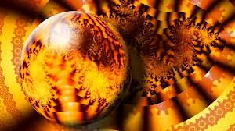
“Whosoever believeth in Him…”
John 3:14-17
During the time of Moses, the Lord sent poisonous serpents in consequence of the Israelites sinning against God. The Israelites were poisoned when the serpents bit them.
The Lord directed Moses to raise up a brass serpent on a pole and promised that any Israelite who looked at the serpent on the pole would be healed.

Slide 3
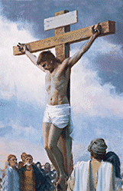
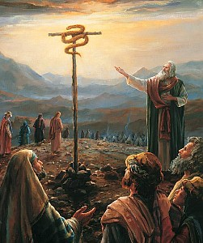
“And as Moses lifted up the serpent in the wilderness…
…even so must the Son of man be lifted up:”
John 3:14

Slide 4
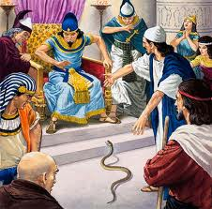
Aaron’s rod becomes a serpent
(Exodus 7:9-10)
Prove yourselves by performing a miracle.
Miracle---sign seeker

Slide 5
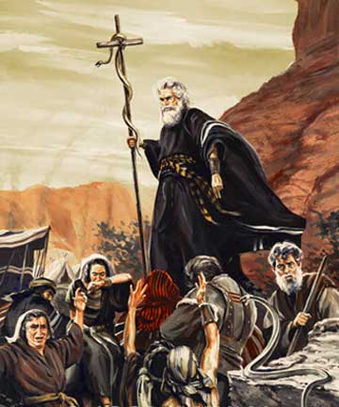
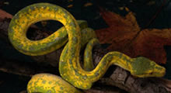
Moses tests Children of Israel in the wilderness
“…wherein were fiery serpents, and scorpions, and drought, where there was no water…”
(Deuteronomy 8:15)
John 3:14

Slide 6
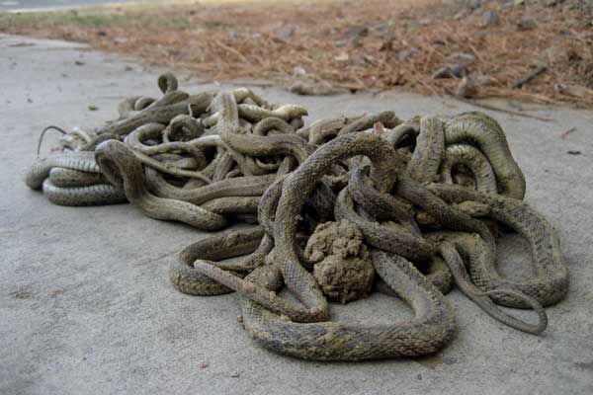
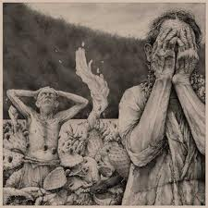
The Lord tests the Jaradites
“And there came forth poisonous serpents also upon the face of the land, and did poison many people…” (Ether 9:31-33)

Slide 7
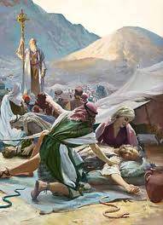
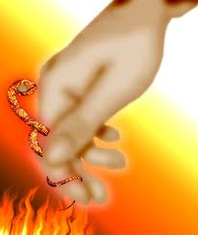
Children of Moses bitten by poisonous serpents
(Numbers 21:6)
Those who looked…were healed (Numbers 21:8)
John 3:14 ; 1 Nephi 17:41

Slide 8
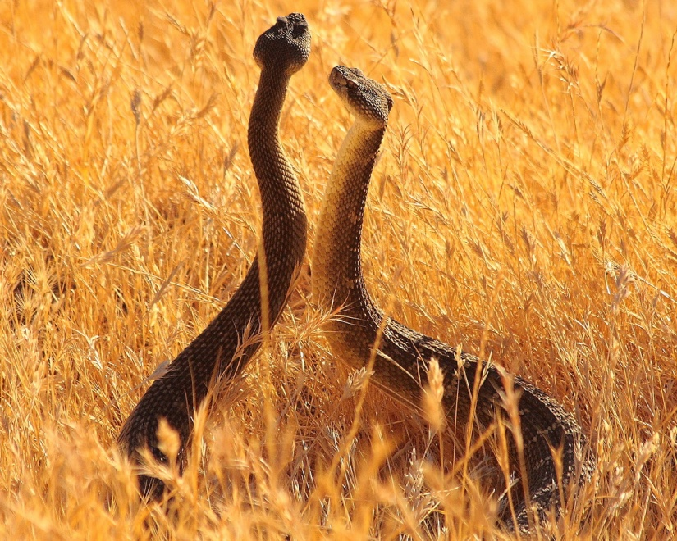
Fiery Serpents
Snakes marked with flame-like spots, or whose bite caused acute inflammation (Num. 21:6)
The Lord sent these upon the children of Israel to “straiten them,” and he prepared a way that those who were bitten might be healed by looking at the serpent of brass that Moses raised up before them, which was a symbol of the Redeemer being lifted upon the cross.
Bible Dictionary; (Num. 21:6, 8-9.)

Slide 9
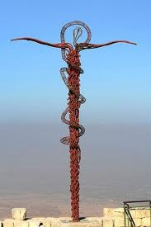
Symbolism of Jesus Christ
“…and behold a type was raised up in the wilderness…” (Alma 33:19)

Slide 10
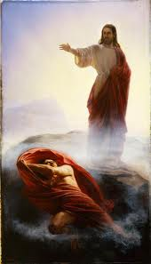
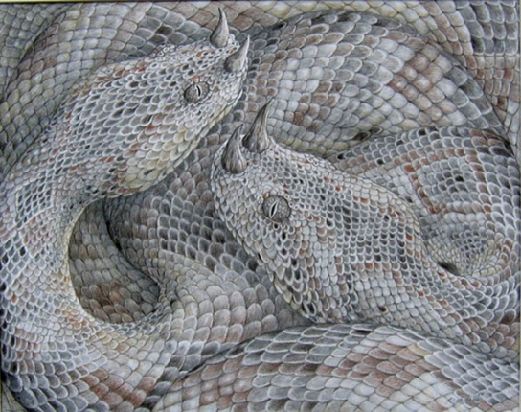
One Lifted and One Cast Out
Referring to war in heaven
“And the great dragon was cast out, that old serpent, called the Devil, and Satan, which deceiveth the whole world; he was cast out into earth, and his angels were cast out with him.” (Revelations 12:9)
John 3:14

Slide 11
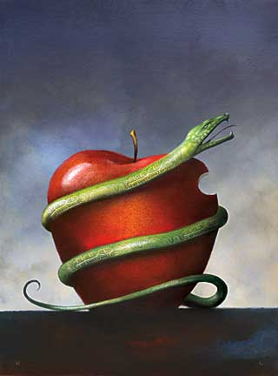
Eve’s Snake
“…The serpent beguiled me, and I did eat.”
Genesis 3:13

Slide 12
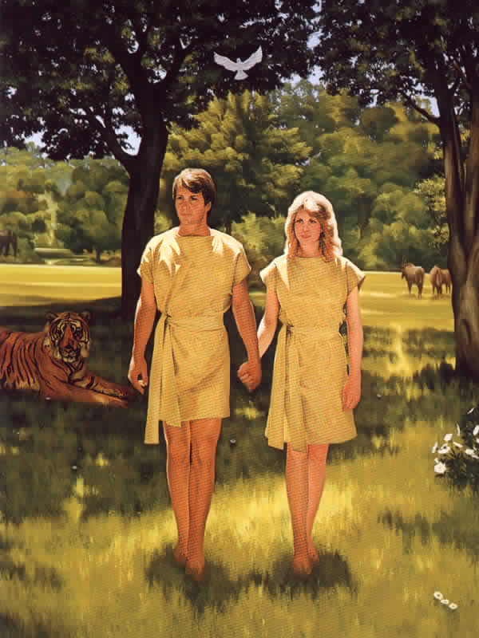
“…being who beguiled our first parents, who transformeth himself nigh unto an angel of light, and stirreth up the children of men…”
(2 Nephi 9:9)
J. Kirk Richards

Slide 13
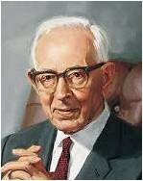
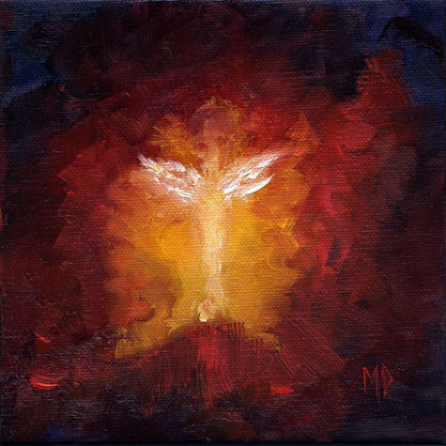
“Satan can and will appear as an angel of light. By revelation we have been given the keys by which the true and false messengers can be detected.”
And no marvel; for Satan himself is transformed into an angel of light.
2 Corinthians 11:14
Marina Petro
Joseph Fielding Smith (Answers to Gospel Questions, 5 vols. [Salt Lake City: Deseret Book Co., 1957-1966], 1: 178.)

Slide 14
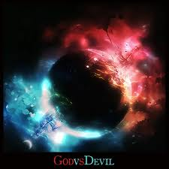
How Can you tell God from Satan?
Messengers of God:
Angel as a resurrected person
Just men made perfect who are not resurrected, a spirit
Messenger of Satan:
Can appear as angel of light
Has no body

Slide 15
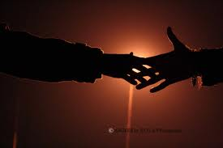
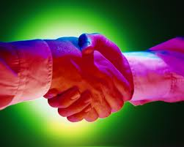
“If he be an angel he will do so, and you will feel his hand. If he be the spirit of a just man made perfect he will come in his glory; for that is the only way he can appear--
“Ask him to shake hands with you, but he will not move, because it is contrary to the order of heaven for a just man to deceive; but he will still deliver his message.
But If it be the devil as an angel of light, when you ask him to shake hands he will offer you his hand, and you will not feel anything; you may therefore detect him.”
D&C 129:5-8

Slide 16
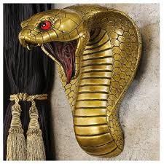
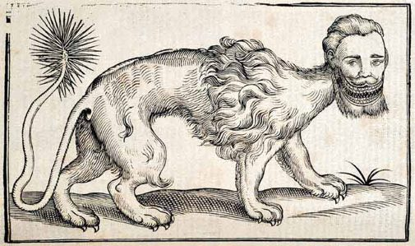
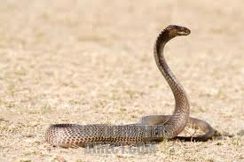
Egyptians:
fallen serpent—Sebau—Satan,
whose arms are “bound in chains”
or “hewn off” and whose legs are “hacked off” and whose joints are “cut asunder.”

Slide 17
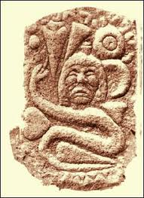
Muslims:
Their Gospel of Barnabas
When Satan was cast out of Paradise he was to have his “legs cut off by the angel Michael with the sword of God.”
(6)

Slide 18
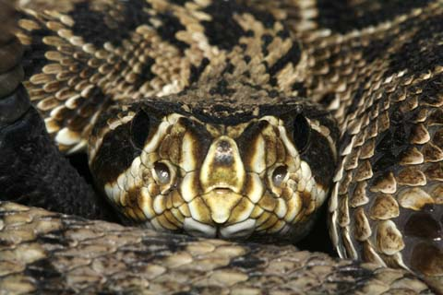
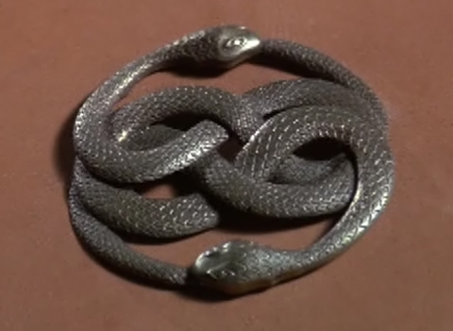
India according to Josephus:
The serpent once possessed the power of human speech, but had been deprived of it.
(6)

Slide 19
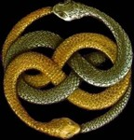
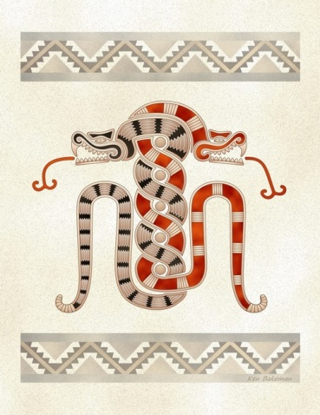
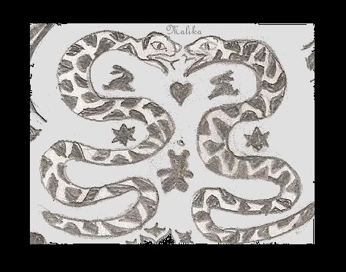
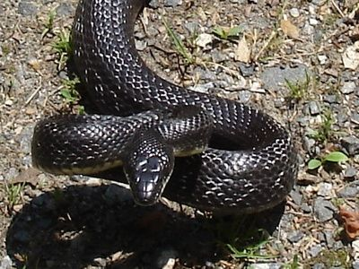
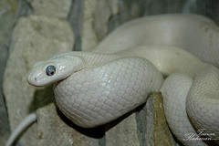
Two Serpent Motif
Mirrored twins
(6)

Slide 20
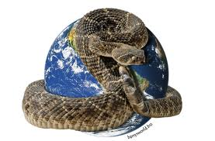
Snake—belly to the ground
Represents earthly or worldly things. A symbol of earth.

Slide 21
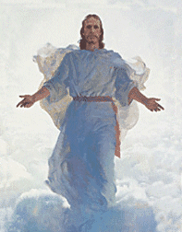
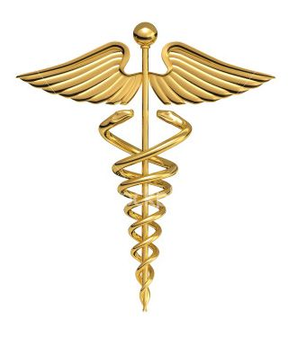
Healer of Nations
The Hippocratic Oath is an oath historically taken by physicians. It is one of the most widely known of Greek medical texts. In its original form, it requires a new physician to swear, by a number of healing gods, to uphold specific ethical standards.
Of historic and traditional value, the oath is considered a rite of passage for practitioners of medicine in many countries, although nowadays various modernized versions are often used.
The original Hippocratic Oath began with the invocation "I swear by Apollo the Physician and by Asclepius and by Hygieia and Panacea and by all the gods ..." The serpent and the staff appear to have been separate symbols that were combined at some point in the development of the Asclepian cult.
Represents a “type” of Christ who was lifted up and resurrected

Slide 22
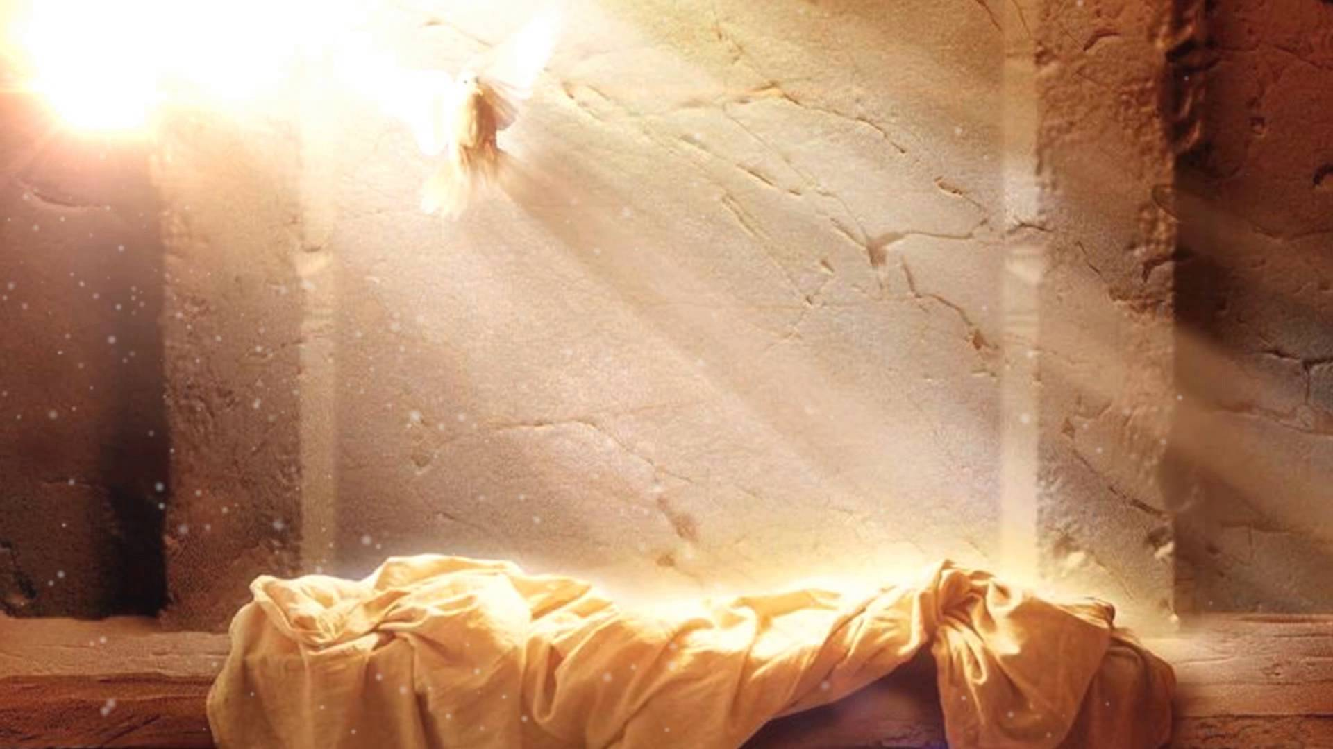
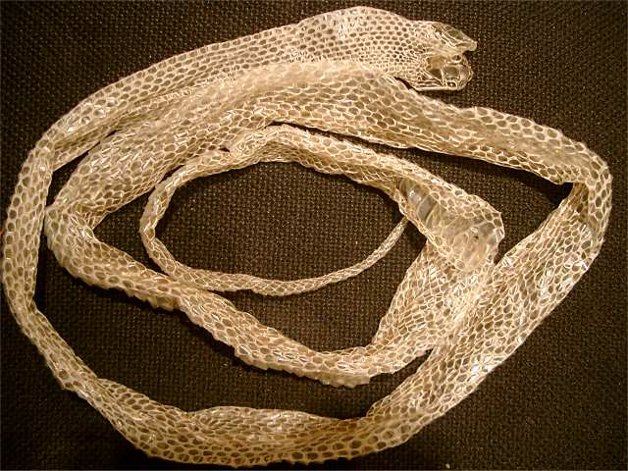
Symbols of Resurrection
A Snake will shed its skin and a new one will become the protector.
Jesus Christ’s Blood was shed for us; He is our protector

