Slide 1
Lesson 109
Esther
Go, gather together all the Jews that are present in Shushan, and fast ye for me, and neither eat nor drink three days, night or day: I also and my maidens will fast likewise; and so will I go in unto the king, which is not according to the law: and if I perish, I perish.
Esther 4:16
Presentation by ©http://fashionsbylynda.com/blog/

Slide 2
Esther
She was the cousin of Mordecia, a Jew, who worked at the palace of King Ahasuerus in Persia
Her name is Persia means “a star”
Mordecai raised her as his own daughter
After King Ahasuerus divorced his wife Vashti, Esther gained favor of the king and he married Esther
After Mordecai refused to bow down to Haman, the chief officer of the court, Haman developed a plan to exterminate all the Jews
Esther came before the king and announced that she was Jewish, unbeknownst to him
She alerted the king of a plot against the lives of the Jewish people
Through her courage the decree was reversed by saving the Jewish people from extinction.
(1)

Slide 3
1 Chronicles
Judges
2 Kings
2 Chronicles
Joshua
Ruth
1 Kings
2 Samuel
1 Samuel
Nehemiah
Ezra
Esther
The book of Esther provides an excellent illustration of the power and influence for good that one person can have.
As an exiled Jew in Persia, Esther rose to the position of the queen of Persia and then faced the possibility of being executed along with the rest of her people.
We do not know who wrote the book of Esther.
The events of this book occurred while many of the Jews were living in Persia after being deported from Jerusalem. “Most scholars place the events recorded in the book of Esther between about 482 B.C. and 478 B.C.”
(2)

Slide 4
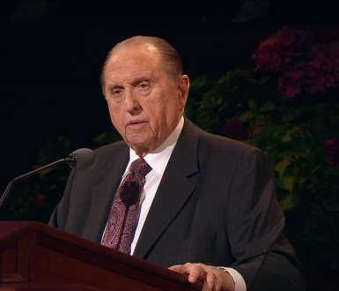
Most of you are familiar with the Old Testament account of Esther. It is a very interesting and inspiring record of a beautiful young Jewish girl whose parents had died, leaving her to be raised by an older cousin, Mordecai, and his wife.
Esther 2:5
(1)

Slide 5
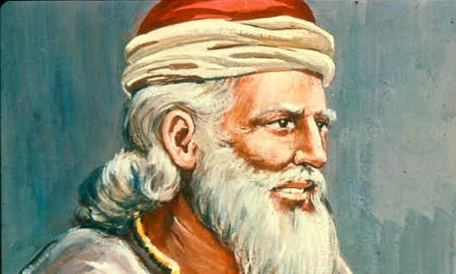
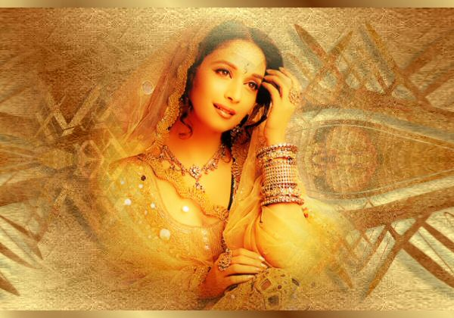
Mordecai worked for the king of Persia, and when the king was looking for a queen, Mordecai took Esther to the palace and presented her as a candidate, advising her not to reveal that she was Jewish.
The king was pleased with Esther above all the others and made Esther his queen.
Esther 2:5
(1)

Slide 6
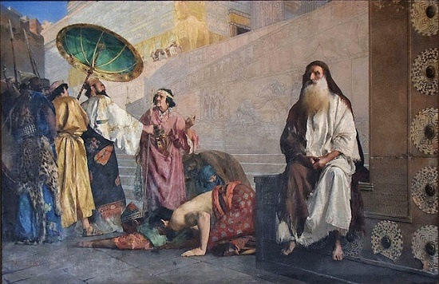
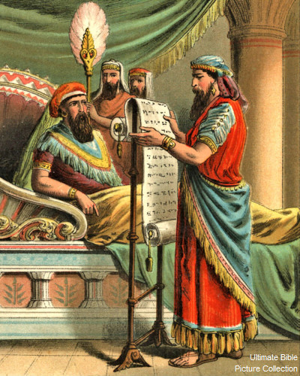
Haman, the chief prince in the king’s court, became increasingly angry with Mordecai because Mordecai would not bow down and pay homage to him.
In retribution, Haman convinced the king—in a rather devious manner—that there were “certain people” in all 127 provinces of the kingdom whose laws were different from others’ and that they would not obey the king’s laws and should be destroyed.
Without naming these people to the king, Haman was, of course, referring to the Jews, including Mordecai.
Esther 3–5
(1)

Slide 7
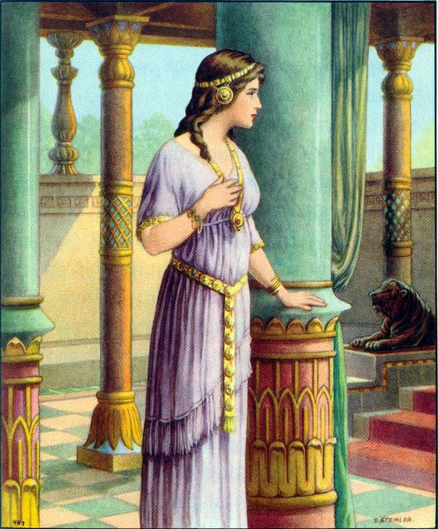
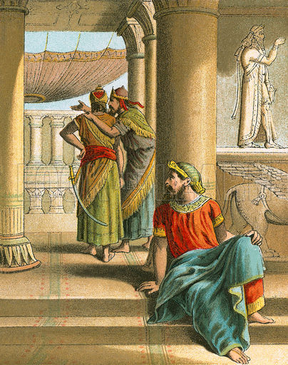
With the king’s permission to handle the matter, Haman sent letters to the governors of all of the provinces, instructing them “to destroy, to kill, and to cause to perish, all Jews, both young and old, little children and women, … [on] the thirteenth day of the twelfth month.”
Through a servant, Mordecai sent word to Esther concerning the decree against the Jews, requesting that she go in to the king to plead for her people. Esther was at first reluctant, reminding Mordecai that it was against the law for anyone to go unbidden into the inner court of the king. Punishment by death would be the result—unless the king were to hold out his golden scepter, allowing the person to live.
Esther 3–5
(1)

Slide 8
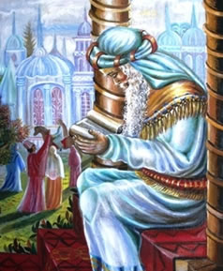
Mordecai’s response to Esther’s hesitation was to the point. He replied to her thus:
“Think not … that thou shalt escape in the king’s house, more than all the Jews.
“For if thou altogether holdest thy peace at this time, … thou and thy father’s house shall be destroyed.”
And then he added this searching question: “Who knoweth whether thou art come to the kingdom for such a time as this?”
Ahuva Klein
Esther 3–5
(1)

Slide 9
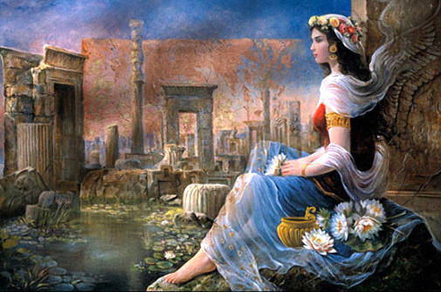
In response, Esther asked Mordecai to gather all the Jews he could and to ask them to fast three days for her and said that she and her handmaids would do the same.
She declared, “I [will] go in unto the king, which is not according to the law: and if I perish, I perish.” Esther had gathered her courage and would stand firm and immovable for that which was right.
Esther 3–5
(1)

Slide 10
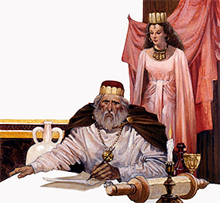
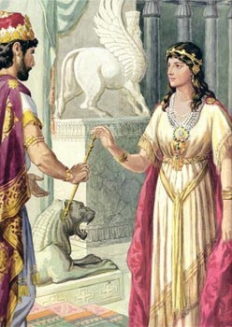
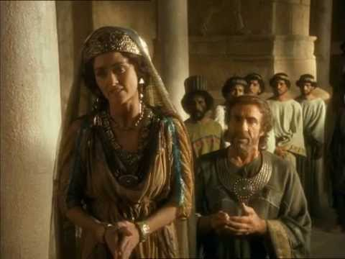
Physically, emotionally, and spiritually prepared, Esther stood in the inner court of the king’s house. When the king saw her, he held out his golden scepter, telling her that he would grant whatever request she had.
She invited the king to a feast she had arranged, and during the feast she revealed that she was a Jew.
She also exposed Haman’s underhanded plot to exterminate all of the Jews in the kingdom. Esther’s plea to save herself and her people was granted.
Esther 6-8
(1)

Slide 11
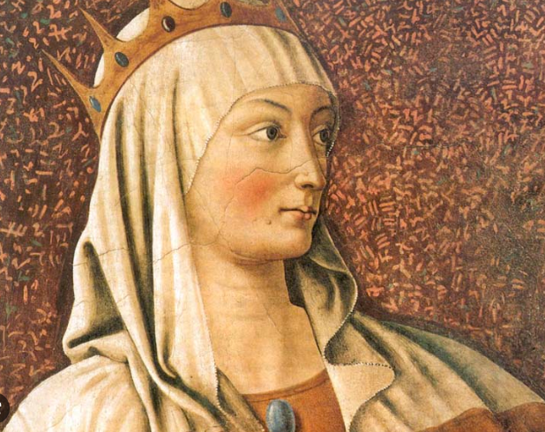
Esther, through fasting, faith, and courage, had saved a nation.
(1)

Slide 12
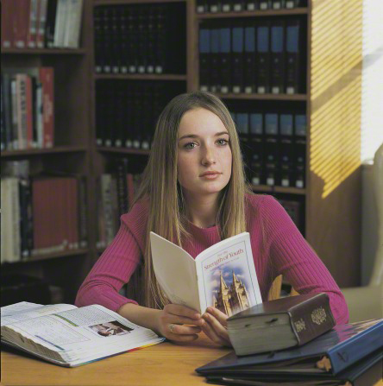
You will probably not be called upon to put your life on the line, as did Esther, for that which you believe. You will, however, most likely find yourself in situations where great courage will be required as you stand firm for truth and righteousness.
…although there have always been challenges in the world, many of those which you face are unique to this time. But you are some of our Heavenly Father’s strongest children, and He has saved you to come to the earth “for such a time as this.”
With His help, you will have the courage to face whatever comes. Though the world may at times appear dark, you have the light of the gospel, which will be as a beacon to guide your way.
(1)

Slide 13
My earnest prayer is that you will have the courage required to refrain from judging others, the courage to be chaste and virtuous, and the courage to stand firm for truth and righteousness.
As you do so, you will be “an example of the believers,”…
(1)

Slide 14
Sources:
Suggested Hymn: #138 Bless Our Fast, We Pray
Video: For Such a Time as This (13:44)
1. President Thomas S. Monson May You Have Courage May 2009 Gen. Conf.
2. Who’s Who in the Old Testament by Ed J. Pinegar and Richard J. Allen p. 54
Notes to the teacher: I found the article from President Monson and was impressed to use his words for the lesson
Presentation by ©http://fashionsbylynda.com/blog/

Slide 15
Feast of Purim to commemorate their miraculous deliverance from Haman’s plan.
Purim (Feast of Esther) is celebrated on the fourteenth day of the Hebrew month Adar, or exactly four weeks before Passover. It is held in honor of Esther, a beautiful Jewish queen. Esther was encouraged by her cousin Mordecai to go to her husband the king when his wicked adviser, Haman, had persuaded him to kill all of her people. After fasting and praying, Esther did go before her husband and pled for all of the Jews to be saved. Her desire was granted (See story in Friend, July 1972, p. 32).
On Taanit Esther, the day before Purim, many people fast in remembrance of the fasting of Queen Esther. A little verse boys and girls in Israel learn and recite at this time is:
Mordecai, the Just,
On his horse is riding,
And the wicked Haman
From the tree is hanging.
On Purim Day we send
Nice gifts to each other,
And all the happy children
Dress up in fancy costumes.
A sweet bread called hamanstaschen is usually served in all the homes at the time of Purim.
Esther 9:31
“Purim is the nearest thing Judaism has to a carnival. It is another full-moon celebration, falling on the fourteenth of Adar, usually in February or March. Old Testament Institute Manual
Vashti—Queen of Persia
About 500 B.C. Persia was a vast empire consisting of 127 provinces, and the king, Ahasuerus, had prepared a great feast in the palace gardens for the province princes. On the seventh day of the feast when the king was merry with wine, he commanded his chamberlains to bring Vashti, the queen, before him, wearing her royal apparel so the princes could see her beauty.
The queen refused to come. An embarrassment to King Ahasuerus, the incident filled him with anger. He called to him seven of his wisest princes who knew law and judgment and asked them, “What shall we do unto the queen Vashti according to law, because she hath not performed the commandment of the king … ?”
One of the princes answered, “Vashti the queen hath not done wrong to the king only, but also to all the princes, and to all the people that are in all the provinces of the king Ahasuerus.
“For this deed of the queen shall come abroad unto all women, so that they shall despise their husbands. …
“If it please the king, let there go a royal commandment from him, and let it be written among the laws of the Persians and the Medes, that it be not altered, That Vashti come no more before king Ahasuerus; and let the king give her royal estate unto another that is better than she.
“And when the king’s decree which he shall make shall be published throughout all his empire, (for it is great,) all the wives shall give to their husbands honour. …” (Esth. 1:15–17, 19–20.)
The saying pleased the king and the princes. Ahasuerus had letters sent to every province that each man should “bear rule” in his own house and his word should be law to his wife.
It is true that customs have changed, giving women more freedom than they had anciently. But God has not changed. Men and women are both his creations, sons and daughters of God whom he loves and always has loved. Woman’s stewardship, while different, is as important and soul-satisfying as is the one given man.
Lessons in Womanhood: Insights for Latter-day Saint Women from the Lives of Vashti, Miriam, Ruth, Hannah, Jezebel, and Esther
By Arta M. Hale October 1973 Lesson Manual
Why did the Jews stay in Babylon?
Having Mordecai near the king undoubtedly relieved the Jews of much oppression and gave them a favorable place in the empire. This good treatment may have been the reason most Jews elected to remain in Babylon rather than return to Judea when the opportunity came. Old Testament Institute Manual

Slide 16
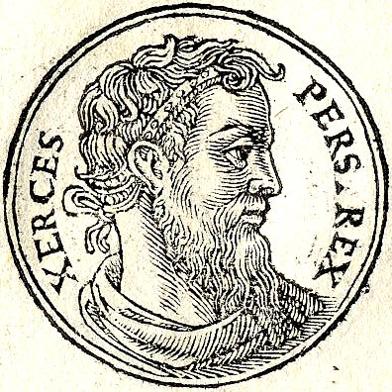
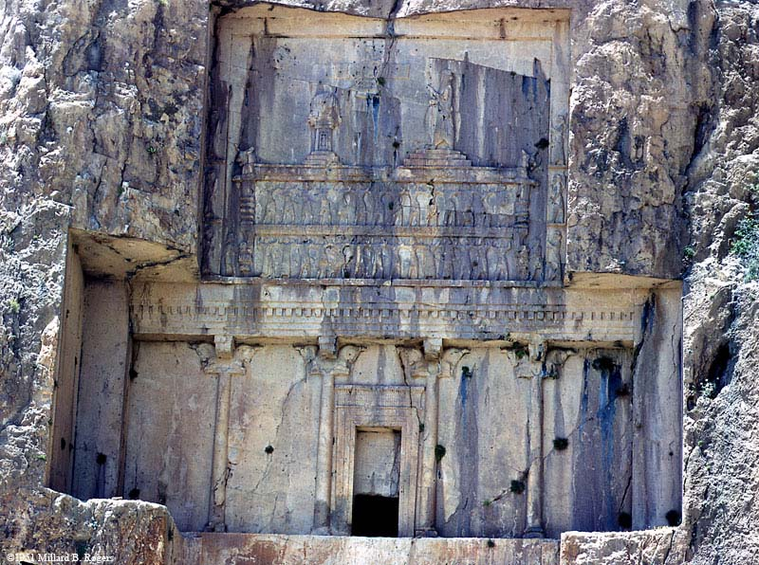
Xerxes or Artaxerxes?
Editor
On page 62 of the October Ensign Dr. Cyrus Gordon said that it was Xerxes, the Medo-Persian King, who married Esther, referring to the book of Esther in which Ahasuerus was the king who married Esther. Was it not Artaxerxes as mentioned in Josephus who married Esther? W. Cleon Skousen also calls Ahasuerus “Xerxes.”
Josephus copied his account of Esther and Artaxerxes from the library temple records at Jerusalem and was most accurate. Now the question arises: Where did Dr. Gordon get the information that Esther married Xerxes? Some clarification is needed because the book of Esther is history and not scripture.
Skousen, on page 773 of his Fourth Thousand Years, has said that Cyrus was killed in battle with the Scythians, but Herodotus says that Cyrus was killed in battle with Queen Tomyris, Queen of the Masagatae tribes. These tribes were Germanic in origin and not Scythic. These are the discrepancies.
Dr. Gordon replies: “For the historic setting of the book of Esther, in strict conformity with the scriptural evidence, see my Ancient Near East (New York: W. W. Norton Company, 1965). The king in the book of Esther is Ahasuerus (in Hebrew, Ahashwerisg). This name corresponds exactly to the Old Persian name, Xerxes. Artaxerxes in Hebrew is Artahshast. To summarize, the king’s name in the book of Esther can only be Xerxes and definitely not Artaxerxes. This is a matter of phonetics, not of interpretation.”
E. R. Pierce Ozark, Arkansas
Our Readers Write: April 1972 Ensign
Ahasuerus is given as the name of the King of Persia in the Book of Esther. 19th century Bible commentaries generally identified him with Xerxes I of Persia. The Greek version (Septuagint) of the Book of Esther refers to him as Artaxerxes, and the historian Josephus relates that this was the name by which he was known to the Greeks. Jewish Encyclopedia and Wikipedia
The book of Esther opens with the description of a grand banquet in the opulent courts of Susa (called Shushan in v. 2), palace of the great Persian Emperor Ahasuerus. This name is a Hebrew transliteration of the Persian Khsyayarsha, better known in history as Xerxes (the Greek form of the name). Most scholars place the events recorded in the book of Esther between about 482 B.C. and 478 B.C.
Old Testament Institute manual
Xerxes Tomb

