Slide 1
Lesson 15
The City of Enoch
Moses 7
And Enoch and all his people walked with God, and he dwelt in the midst of Zion; and it came to pass that Zion was not, for God received it up into his own bosom; and from thence went forth the saying, Zion is Fled.
Moses 7:69
Presentation by http://fashionsbylynda.com/blog/

Slide 2
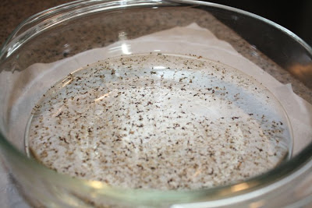
Surrounded By Wickedness
Enoch lived in a world full of wickedness.
Wicked influences

Slide 3
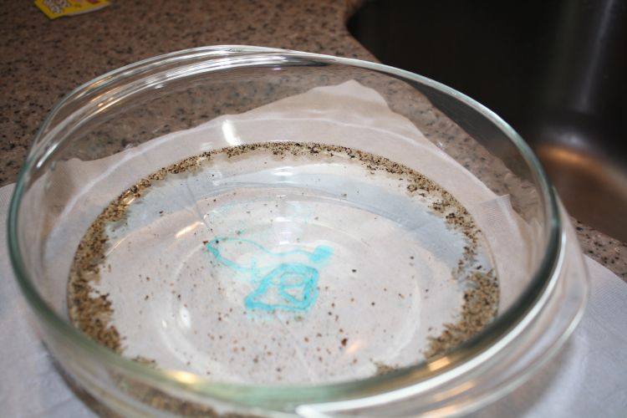
Dispersed By the Truth
Enoch’s
Teachings
As Enoch preached the gospel the people began to disperse.

Slide 4
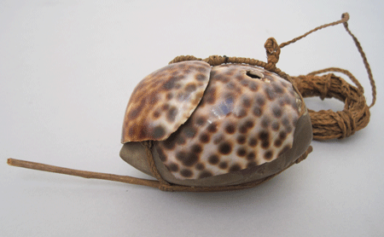
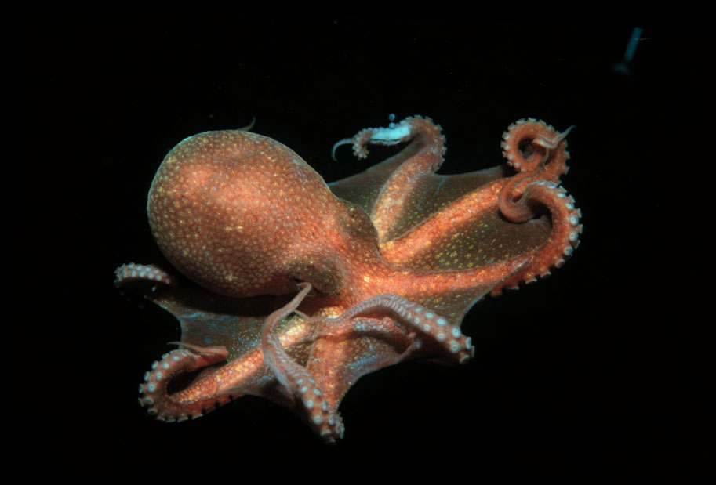
Maka-Fekes
To lure and to trap
Today we are surrounded by the maka-fekes which the evil one dangles before us and with which he attempts to entice us and then to ensnare us. Once grasped, such maka-fekes are ever so difficult—and sometimes nearly impossible—to relinquish.
To be safe, we must recognize them for what they are and then be unwavering in our determination to avoid them.
President Thomas S. Monson

Slide 5
Puppets On A String
Our culture tends to determine what foods we like, how we dress, what constitutes polite behavior, what sports we should follow, what our taste in music should be, the importance of education, and our attitudes toward honesty.
It also influences men as to the importance of recreation or religion, influences women about the priority of career or childbearing, and has a powerful effect on how we approach procreation and moral issues. All too often, we are like puppets on a string, as our culture determines what is “cool.”
David R. Stone

Slide 6
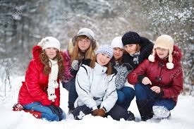
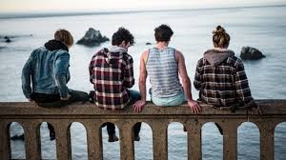
Clothed With Glory
Greek word=endowment
The purpose of clothing
To protect us from the elements
To provide us with comfort
To express our identity
God wants to protect us also to provide identity
Moses 7:3

Slide 7
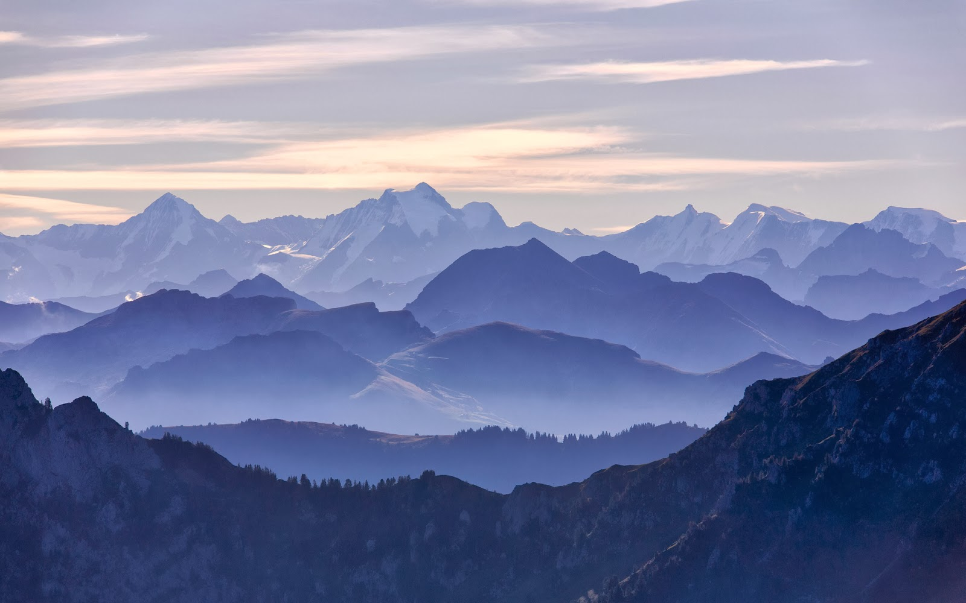
Mahujah—Mount Simeon
The Hebrew equivalent of Simeon is Shimʼon, which means “hearing.”
Enoch Has Two Major Visions
Vision 1
He sees peoples and places of his time
Valley of Shum and People of Canaan battle
He was to go to the Land of Sharon, Enoch, Omner, Heni, Shem, Haner, and Hanannihah and preach repentance and perform baptisms
Moses 7:4-12

Slide 8
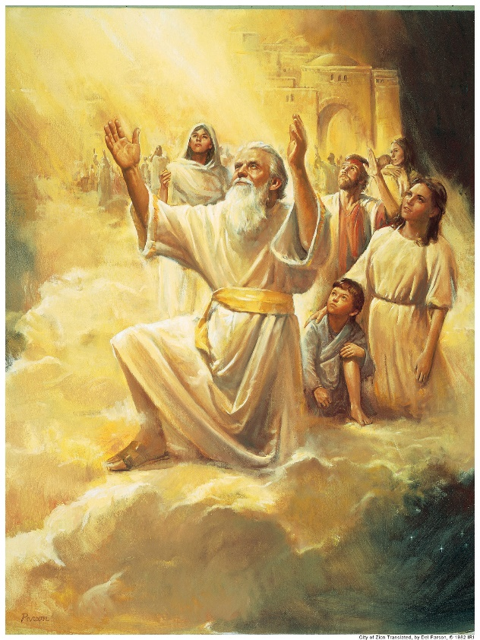
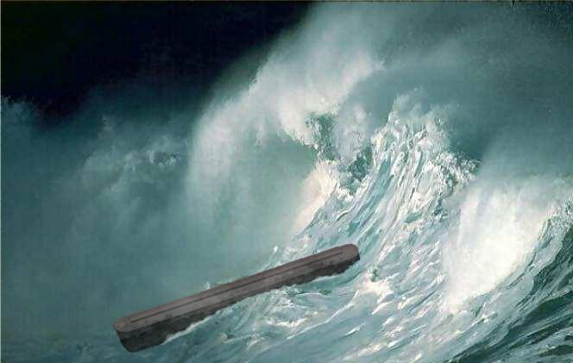
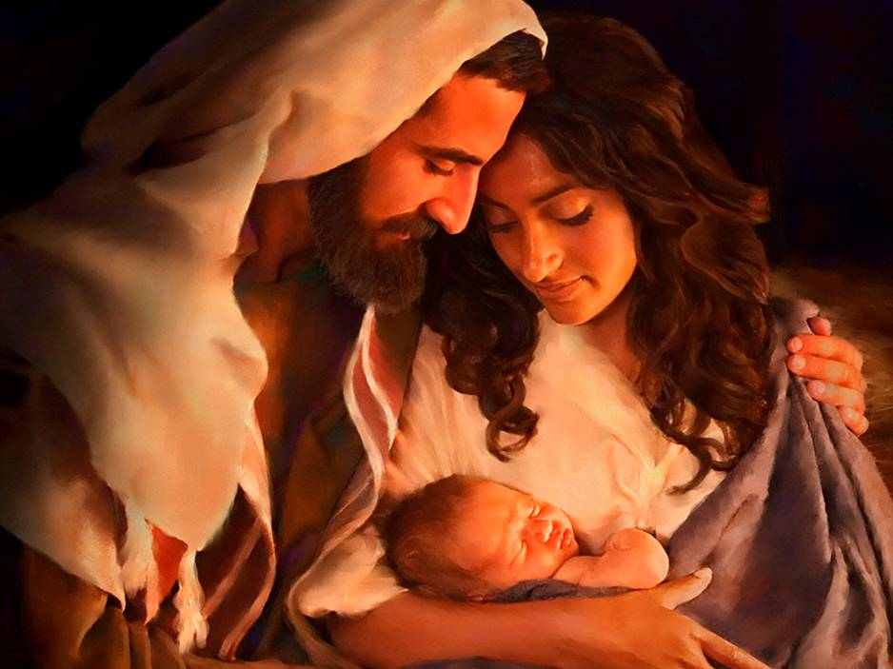
Vision 2
He sees the grand vision of “all the inhabitants of the earth” until “the endo of the world”
He sees the City of Zion taken to heaven
He sees the Flood
He sees the coming of the Son of God and Jesus lifted on the cross
Moses 7:21, 23-25, 28, 34, 47, 67

Slide 9
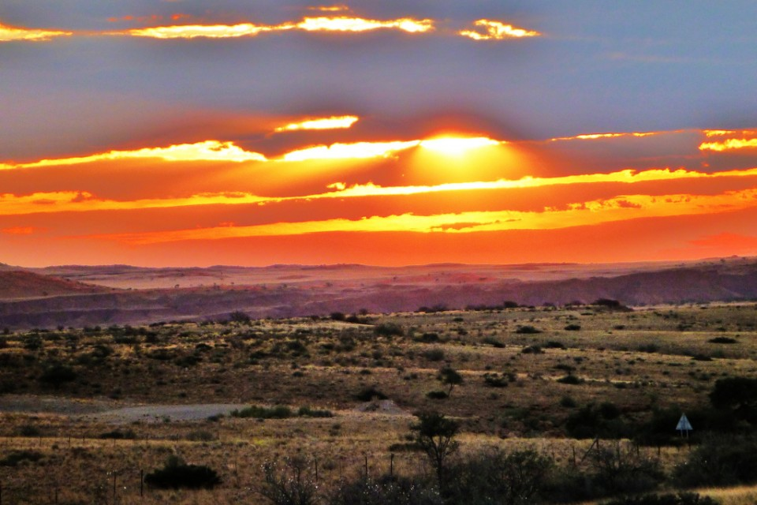
Blessings of the People of Enoch
The Lord came and dwelt with the people
The land was blessed
High Places—Mountains—Sanctuaries—a place to receive revelations and perform sacred ordinations
Moses 7:16-17

Slide 10
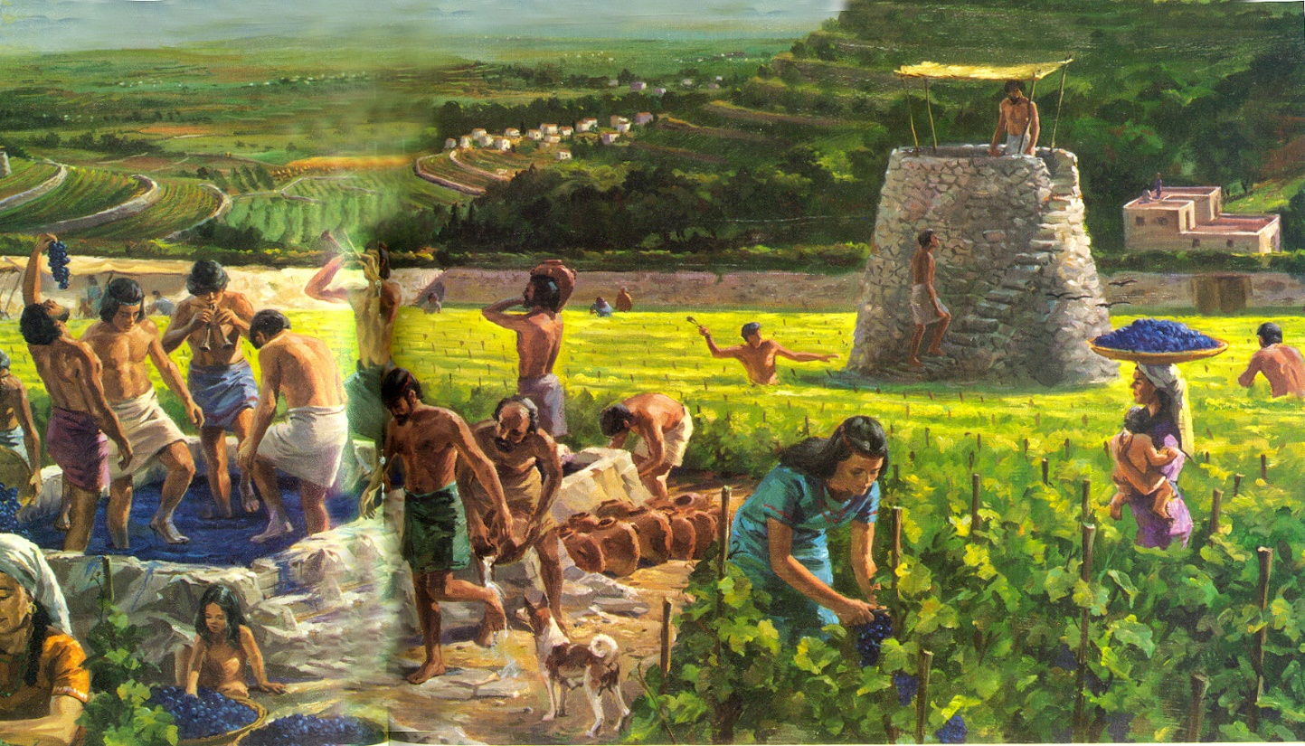
Zion—One Heart—One Mind
The name points to a people…not a place
The Lord will call His people Zion when they are of one heart and one mind, live righteously, and care for one another
Moses 7:18

Slide 11
Scripture Mastery
Old Testament
Moses 7:18
And the Lord called his people Zion, because they were of one heart and one mind, and dwelt in righteousness; and there was no poor among them.
Moses 7:18

Slide 12
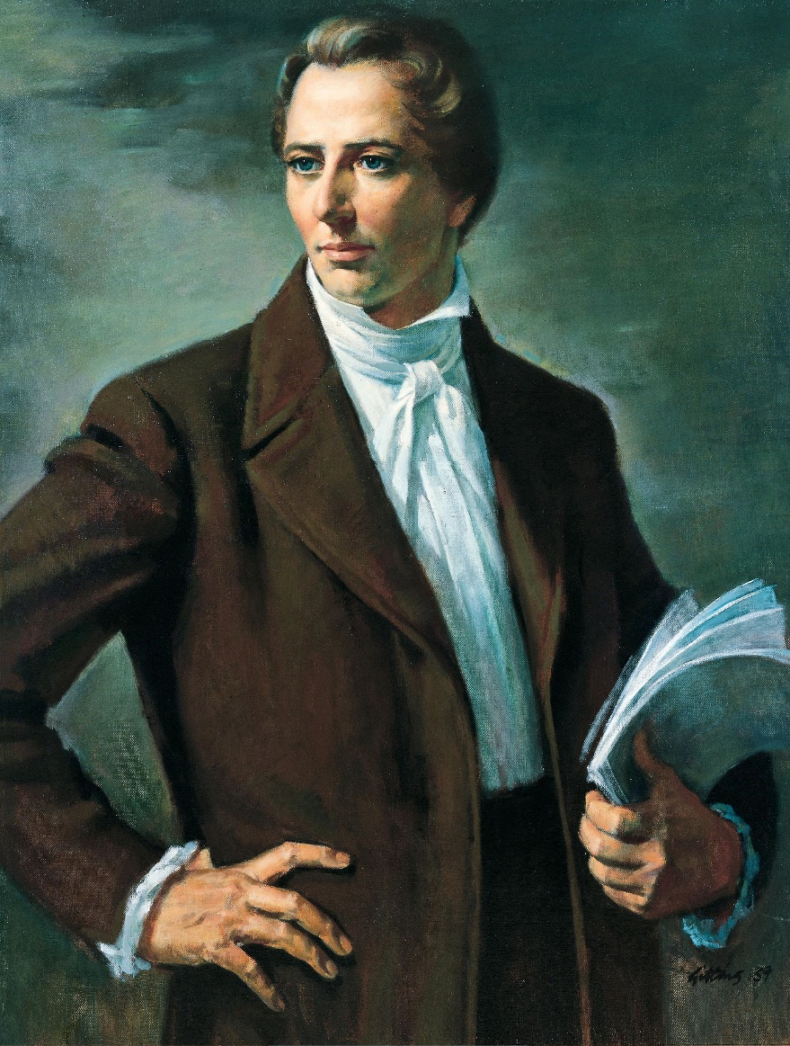
Joseph Smith
“The building up of Zion is a cause that has interested the people of God in every age; it is a theme upon which prophets, priests and kings have dwelt with peculiar delight; they have looked forward with joyful anticipation to the day in which we live; and fired with heavenly and joyful anticipations they have sung and written and prophesied of this our day; but they died without the sight; we are the favored people that God has made choice of to bring about the Latter-day glory.”

Slide 13
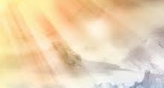
A Translated City
Enoch saw in a vision that the city would eventually be taken up to heaven because of the righteousness of his people.
Enoch and his people were translated—in other words, their bodies were changed so they would be free of physical pain and would not experience death until the time of their resurrection.
Enoch’s city had two names, Zion and City of Holiness. The second name becomes more meaningful when we remember that Heavenly Father’s name in the language of Adam is Man of Holiness
Institute Manual
Moses 7:19-21

Slide 14
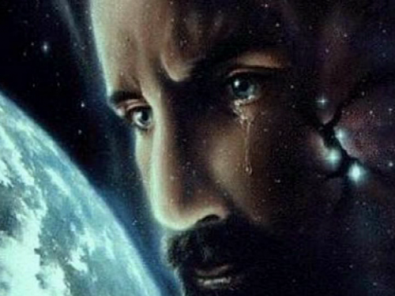
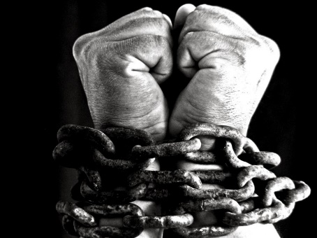
Chains of Darkness
What did Enoch learn about Satan?
What do you think the “great chain in his hand” represents?
Why do you think Satan and his followers laughed and rejoiced?
Satan promotes works of darkness and seeks to bind, captivate, and destroy mankind.
God does not work in darkness, and He seeks to save mankind.
Furthermore, in stark contrast to Satan and his angels, who laughed at the wickedness of mankind, tells us that God wept over the wickedness of His children.
Moses 7:26

Slide 15
Caught Up
“After those in the City of Holiness were translated and taken up into heaven without tasting death, so that Zion as a people and a congregation had fled from the battle-scarred surface of the earth, the Lord sought others among men who would serve him.
From the days of Enoch to the flood, new converts and true believers, except those needed to carry out the Lord’s purposes among mortals, were translated.”
Elder Bruce R. McConkie
Moses 7:27

Slide 16
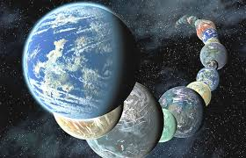
Caught Up
God has created worlds without number, yet He is aware of and cares about us.
“The God we worship is more powerful than we can comprehend. The Father, through His Son, not only created the heavens and the earth but also is the power that sustains those creations. Speaking of the Savior and the light, or power, by which He creates and governs.”
R. Val Johnson
Moses 7:28-30

Slide 17
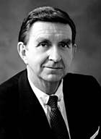
Sorrow
Heavenly Father feels sorrow when we choose to commit sin
“God, from whom all blessings come, asked of his children only that they should love each other and choose him, their Father.
“But as in our day, many neither sought the Lord nor had love for each other, and when God foresaw the suffering that would inevitably follow this self-willed, rebellious course of sin, he wept. That, he told Enoch, was what he had to cry about.”
Elder Marion D. Hanks
Moses 7:32-40

Slide 18
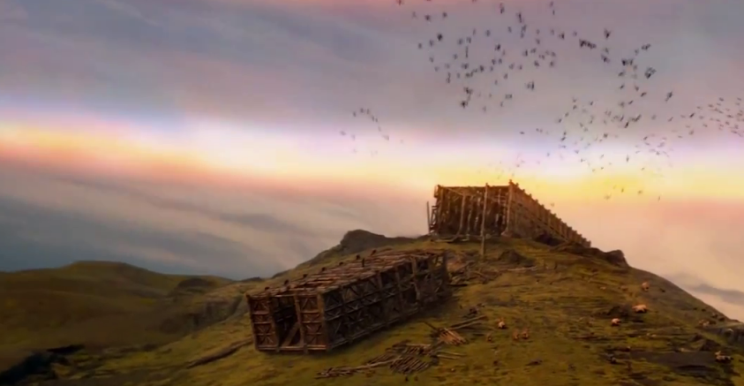
Enoch Learns of the Plan of Salvation
Enoch wept again when he heard the earth mourn because of the wickedness of the people.
Enoch prayed and asked God if he would have compassion on the earth and bless the children of Noah.
The Lord promised Enoch that He would never again flood the earth.
The Lord also promised that He would “call upon the children of Noah,” which means that He would invite them to accept the gospel.
The Lord also taught Enoch that those who build their lives upon the Savior would never fall
Moses 7:41-44

Slide 19
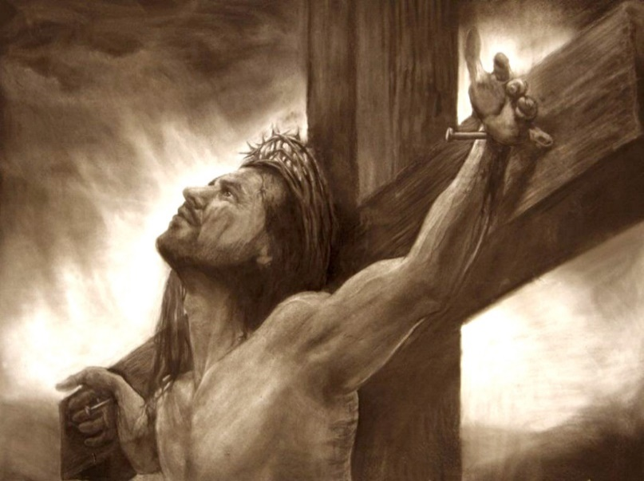
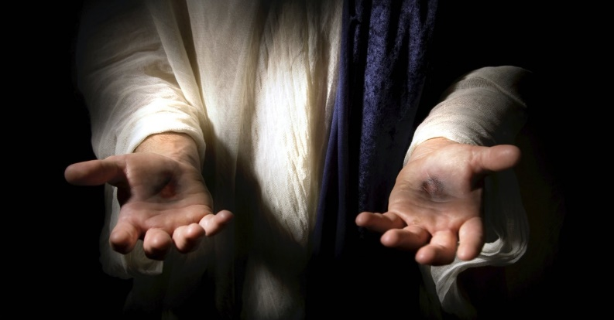
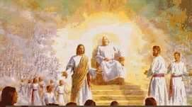
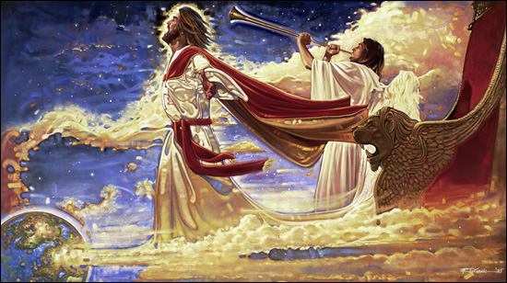
Enoch Sees the Rest of The Plan of Salvation
Enoch saw the resurrection of Jesus Christ
Enoch wept when he saw the Savior lifted on the cross, and the heavens groaned, and the rocks were rent.
Enoch saw the earth rest and the Second Coming of Christ
Enoch saw the spirits in heaven who stood on the right hand of God
And the righteous sent down to earth to testify of the Savior
Moses 7:55-62

Slide 20
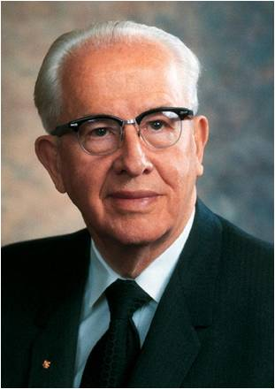
“The Lord promised that “righteousness would come from heaven and truth out of the earth. We have seen the marvelous fulfillment of that prophecy in our generation.
The Book of Mormon has come forth out of the earth, filled with truth, serving as the very ‘keystone of our religion’.
God has also sent down righteousness from heaven. The Father Himself appeared with His Son to the Prophet Joseph Smith.
The angel Moroni, John the Baptist, Peter, James, and numerous other angels were directed by heaven to restore the necessary powers to the kingdom.
Further, the Prophet Joseph Smith received revelation after revelation from the heavens during those first critical years of the Church’s growth.
These revelations have been preserved for us in the Doctrine and Covenants”
President Ezra Taft Benson

Slide 21
Enoch and the City of Zion Walk With God
Moses 7:67-69

Slide 22
Sources:
Sharon G. Larsen Standing in Holy Places April 2002 Gen. Conf.
http://michellesjournalcorner.blogspot.com/2010/07/preschool-science-pepper-and-dish-soap.html
President Thomas S. Monson True to the Faith April 2006 Gen. Conf.
https://www.youtube.com/watch?v=d2HCF8_g4ss
David R. Stone Zion in the Midst of Babylon April 2006 Gen. Conf.
(Teachings of Presidents of the Church: Joseph Smith [Melchizedek Priesthood and Relief Society course of study, 2007], 186).
Institute Manual. Pearl of Great Price
Elder Bruce R. McConkie (The Millennial Messiah, 284).
R. Val Johnson Worlds without Number August 2013 Ensign
https://www.lds.org/ensign/2013/08/worlds-without-number?lang=eng
Elder Marion D. Hanks(in Conference Report, Apr. 1980, 40–41; or Ensign, May 1980, 29).
” President Ezra Taft Benson (“The Gift of Modern Revelation,” Ensign, Nov. 1986, 79–80)

Slide 23
Surrounding Yourself With Those That Are Making Right Choices
“It is possible the loneliest times are when we are surrounded by people, even friends, who are making wrong choices, and we have to stand alone. There are some places it would not be safe for you to go even to help someone in need. The Lord said to stand in holy places. There are places where the Spirit would never be. You know where those places are. Stay away from them. Do not encourage a curiosity that ought to be stopped. Pay attention to what you are feeling so you will know when you are feeling unsure or uneasy.”
Sharon G. Larsen Standing in Holy Places April 2002 Gen. Conf.
The People of Canaan and Shum
“The Valley of Shum: Here is an early instance of a place and a tribe that share the same name…it is probable that these people carried the name of an ancestor and then transferred that name to the valley. ..it is important for understanding how the names in Moses 7:9 became attached to certain lands or regions. Shum: the name is likely a variant of Shem.
Geographically, both “the place Mahujah” and “the mount Simeon” lay to the south of the homeland of the “the people of Canaan, which dwelt in tents” (Moses 7:2,6)
The People of Canaan: This people is not the same as “the seed of Cain” (Moses 7:22)
Although both groups were ostracized largely because of skin pigmentation (Moses 7:8, 22), their tribal names are of different origin.
One of the results of the war of extermination against the people of Shum was that the people of Canaan came into possession of the entire desert region, which they had evidently shared with the people of Shum. The people of Canaan would not receive the call to repent from Enoch.”
The people of Shum were exterminated by the people of Canaan thus resulting in the land to be cursed. Enoch had that knowledge before hand, establishing himself as a prophet.
Richard D. Draper, S. Kent Brown, Michael D. Rhodes The Pearl of Great Price Verse by Verse Commentary pp. 115-117
Coincidence in a name:
A giant or a Watcher called Mahujah or Mahijah. But far more than a coincidence when taken in its context. The only thing the Mahijah in the Book of Moses is remarkable for is his putting of bold direct questions to Enoch, thus giving the patriarch an opening for calling upon the people to repent, referring them to the book of remembrance, and telling them of the plan of salvation. And this is exactly the role, and the only role, that the Aramaic Mahujah plays in the story. The name is found in none of the other Enoch texts and neither is the story: it is peculiar to the version Joseph Smith gave us and the oldest known Enoch manuscripts. The following translation is from Milik and Black, lest the writer be charged with forcing the text.
As the grandfather of Enoch, transliterated in the King James Bible as Mehuja-el, which name also appears in the Greek Septuagint as Mai-el and in the Latin Vulgate as Mavia-el, showing that Mahujah and Mahijah were the same name.
Could this be the same name?
A Strange Thing in the Land: The Return of the Book of Enoch, Part 13
By Hugh Nibley August 1977 Ensign
Translated Beings:
President Joseph Fielding Smith explained: “Translated beings are still mortal and will have to pass through the experience of death, or the separation of the spirit and the body, although this will be instantaneous, for the people of the City of Enoch, Elijah, and others who received this great blessing in ancient times, before the coming of our Lord, could not have received the resurrection, or the change from mortality to immortality, because our Lord had not [yet] paid the debt which frees us from mortality and grants to us the resurrection” (Answers to Gospel Questions, 1:165).
Translated Beings:
The Prophet Joseph Smith said: “Many have supposed that the doctrine of translation was a doctrine whereby men were taken immediately into the presence of God, and into an eternal fullness, but this is a mistaken idea. Their place of habitation is that of the terrestrial order, and a place prepared for such characters He held in reserve to be ministering angels unto many planets, and who as yet have not entered into so great a fullness as those who are resurrected from the dead” (Teachings of the Prophet Joseph Smith, 170).

