Slide 1
John 2-4

Slide 2
Jesus Turns Water to Wine
John 2

Slide 3
Commitment
When you make a commitment, you build hope.
When you keep a commitment, you build trust.

Slide 4
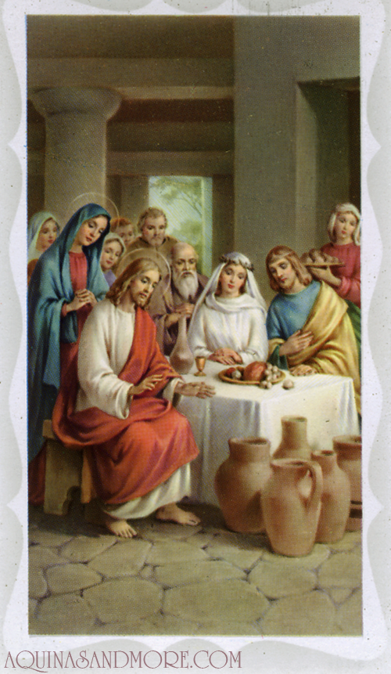
Water into Wine
The First Public Recorded Miracle of
Jesus Christ

Slide 5
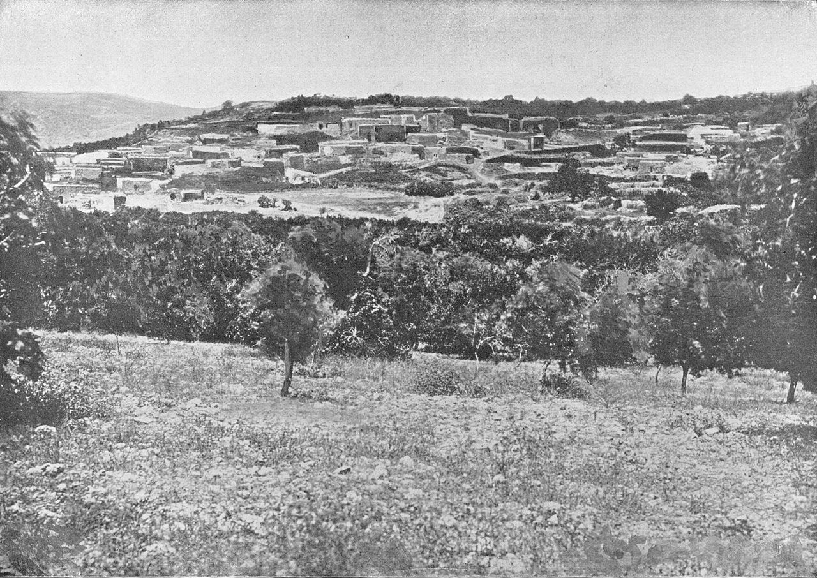
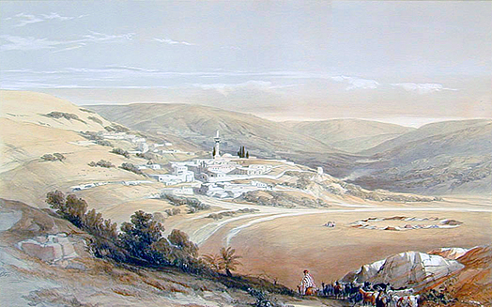
Cana
North of Nazareth - Galilean hills. Mary there as host. The wedding happened on the "third day of the week."
In ancient Jewish tradition, weddings were performed on Tuesdays, the third day of the week, because the word "good" was used twice in the creation account for the third day.
Important events were decided or celebrated on the third day because it would call for a "double" blessing from God. (2)
Daniel B. Shepp
Capernaum
Cana
Sea of Galilee
Nazareth
David Roberts
JST John 2:1

Slide 6
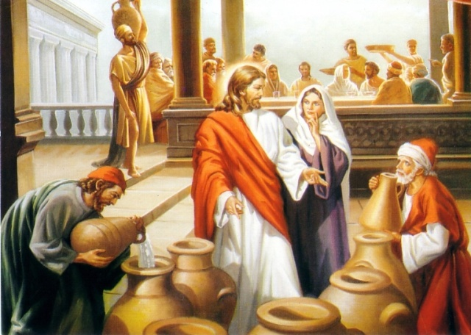
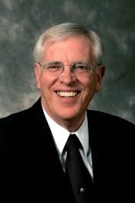
The Wedding Feast
A short time after Jesus was baptized, He and His disciples attended a wedding feast in Cana, a village near Jesus’ hometown of Nazareth.
Jesus Christ’s attendance at the wedding feast shows that He was not a social recluse; He participated in the normal social interactions of His day. His presence at a wedding demonstrates that He approved of marriage. (1)
Philip = Andrew’s friend
Nathanael = Phillip’s friend
They were not yet called to be apostles, but they believed that He was the Messiah. The miracle performed here was doubtless to increase their faith in the Messiahship of Jesus.
"Weddings were held at the home of the bride and were as elaborate as the budget of the house would allow, running from one day to a whole week.” (3)
COUSINS
John 2:2

Slide 7
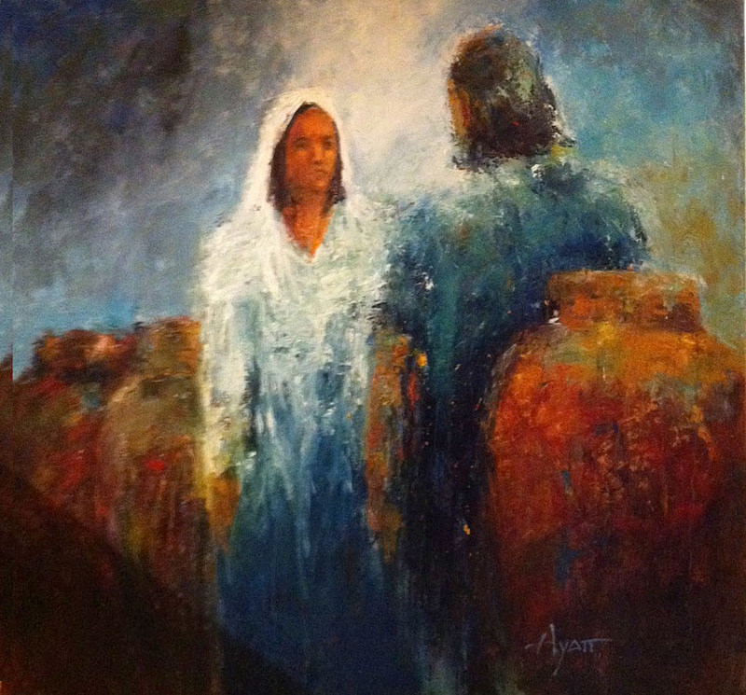
Mary Hosts the Wedding
with Jesus as the Birthright Son
“The hosts felt a strong obligation to provide lavish hospitality, and failing to do so would embarrass the family and mortify the newly wedded couple.
Mary may have been aware of this as she told her son that the wine had run out. We don't know Mary's function at the wedding, but the fact that she was concerned about the wine and was able to command the servants suggests that a close relative was being married." (3)

Slide 8
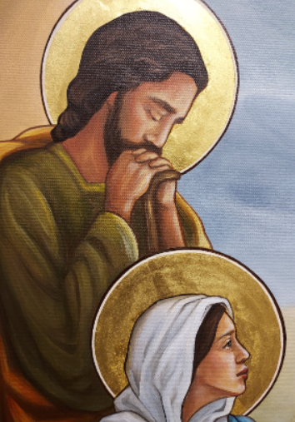
[Mary] knew more about [Jesus Christ] than anyone else on earth. She knew the truth of His miraculous birth. She knew that He was sinless and that He “spake not as other men, neither could he be taught; for he needed not that any man should teach him.
Mary knew of His extraordinary capacity to solve problems, including one as personal as providing wine for a wedding feast. She had unshakable confidence in Him and in His divine power.
Her simple, straightforward instruction to the servants had no caveats, no qualifications, no limitations: “Whatsoever he saith unto you, do it.”
(11)
Joseph Smith Translation, Matthew 3:25 (in the Bible appendix

Slide 9
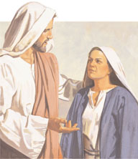
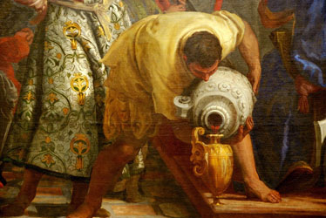
Woman,
what have I to do with thee?”
Mary knew he had great power, and she wanted him to use it. "We cannot avoid the conclusion that between Jesus' twelfth and thirtieth years there were many marvelous and miraculous things of which Mary knew." (4)
Mary tells the servants to do whatever her Son says because she already knows he will grant her request. She doesn't need to plead with him; she doesn't need to argue. She knows that the God of Israel will do what she wants because she is his mother-if for no other reason. And he does! (5)
John 2:3-4

Slide 10
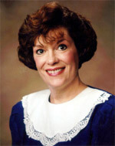
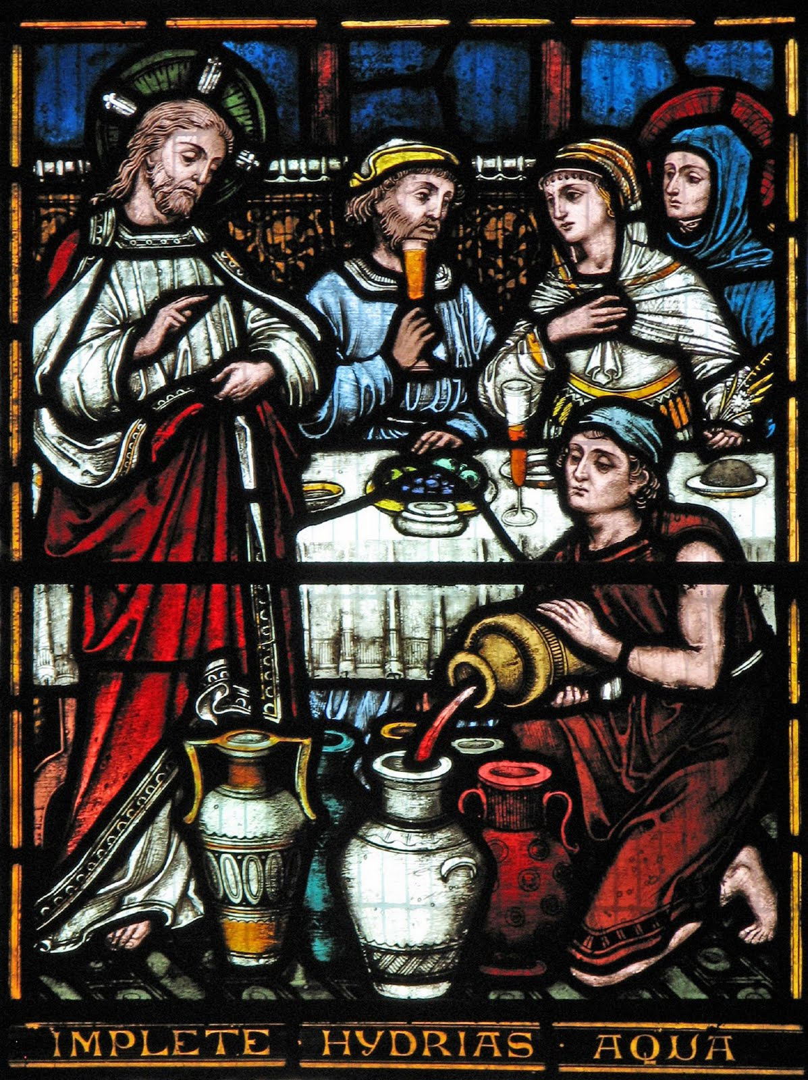
“Mine hour is not yet come.”
"Christ's mission to glorify his Heavenly Father and extend salvation to each of us did not prevent him from showing his profound love and respect for his mother.
Indeed, the scriptures make it clear that even during the agony of his crucifixion at Calvary, his mother's welfare was not far from his thoughts. John records that 'there stood by the cross of Jesus his mother.'
When Jesus saw his mother, standing by his disciple John, he said, 'Woman, behold thy son! Then saith he to the disciple, Behold thy mother! And from that hour that disciple took her unto his own home.’" (6)
John 2:5; John 19:25-27

Slide 11
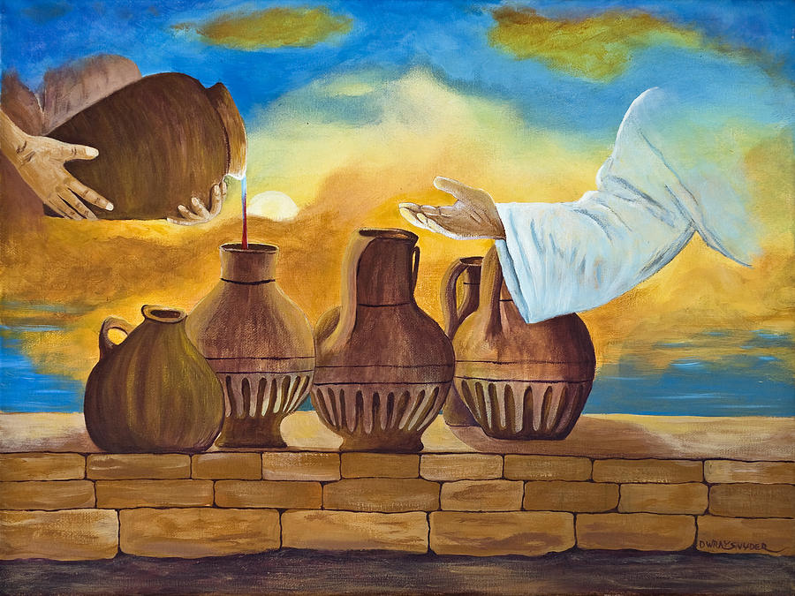
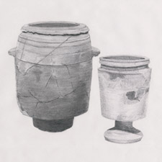
Six Water Pots
Wine was a customary drink at a wedding feast. Sometimes the wedding feast would continue for multiple days. To run out of wine would have been embarrassing for the hosts of the feast.
Life size Pots
1 Firkin = 9 gallons
2 Firkins = 18 gallons
3 Firkins = 27 gallons
100-160 gallons total
Limestone pots from the New Testament era in Israel
John 2:6
(4)

Slide 12
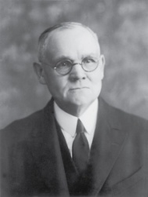
Water
for Religious Purposes
The Jews had a practice under the Pharisees to wash their hands for purification purposes before and after eating.
They also had rituals that required pure water that was dedicated to religious purposes.
The detailed regulations were set in the Talmud. Every home would have very large stone pots with this special dedicated water.
They would have been ceremonially cleansed (Kosher type cleansing today).
Stone vessels had special status because they could not become ritually impure. (8)
Used only for water
Dedicated for purification & rituals
Susan-Angelo DeBay
John 2:7

Slide 13
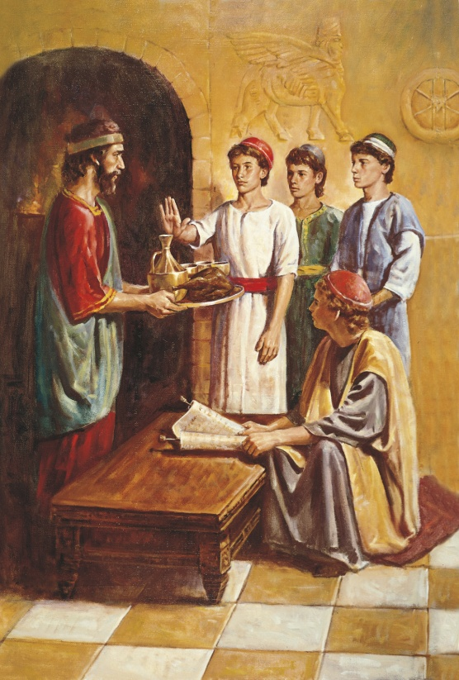
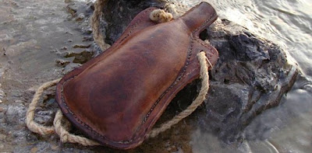
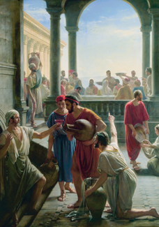
Good VS Bad Wine
There are many references in the Bible to the evils of drunkenness and strong drink.
These verses do not specifically forbid the use of alcohol, but they do condemn overindulgence and drunkenness.
In our day, the Lord has revealed the Word of Wisdom, which does forbid consumption of alcoholic beverages.
We should avoid judging the people of earlier dispensations by the commandments the Lord has given us in our day.
Carl H. Bloch
(1)
John 2:7; Proverbs 23:20–21; Isaiah 5:11–12; Ephesians 5:18; D&C 89:4-7

Slide 14
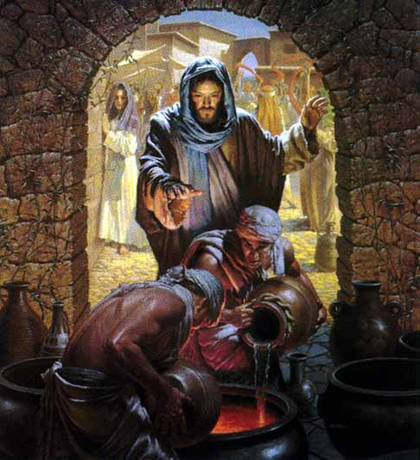
Water from a
Living Spring
Filled 1-2 gallons
at a time
to the brim
Christ who is the fountain
We don't go to him just once, but over and over until we are filled to the brim.
How do we go to Him?
By Prayer and Scriptures
John 2:7

Slide 15
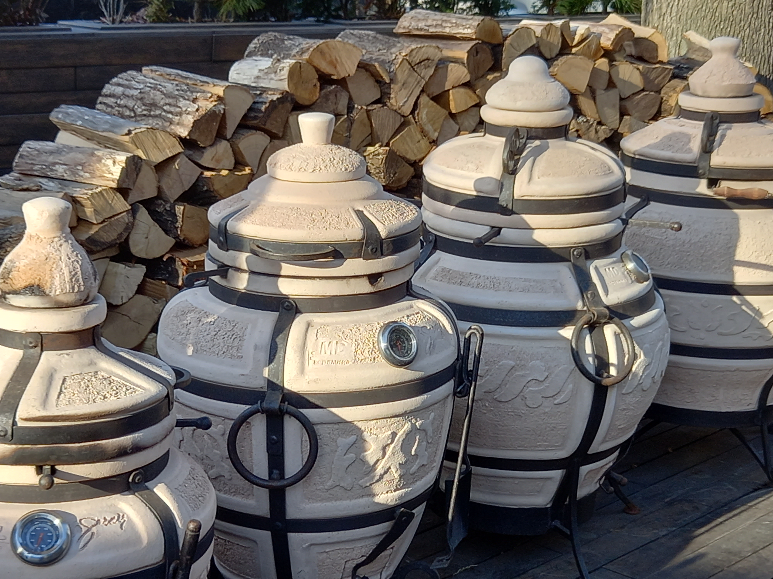
Water Pot Symbol
6= Imperfection
We are the Pot
Made from the elements of earth
Dedicated & cleansed to
hold living water

Slide 16
Water Symbolism
Living Water = Revelation
Source = God is the font
of living water
We are filled slowly…
…but to the brim
John 2:7

Slide 17
“Draw out now
& bare unto the Governor.”
Servants = Prophets
Vessels = US
Wine = Our character transformed through the Atonement
Governor = God the Father
John 2:8

Slide 18
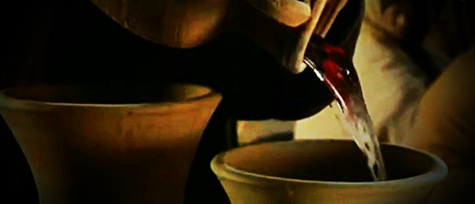
“Thou hast kept the good wine until now.”
The best wine was often used at the beginning of the feast and lesser-quality wine was used later into the feast
Jesus Christ has power over physical elements. The Savior knew He had a divine mission to fulfill. The Messiah manifested His divine power through miracles. The Son of God loved and respected His mother.
They were then instructed to draw out the water and take it to the "governor" (JST changes from ruler to governor) of the feast who tasted it.
He would have been the "Master of Ceremonies" for the wedding feast. He declared that what is normally done at weddings is that the host will bring forth the best wine, implying the more expensive, at the beginning of the 7 days of feasting to impress the guests and later, after the guests have been eating and drinking for a few days, to bring out the cheaper, lesser, or watered down wine, in the hopes that the guests don't notice. (7)
"[Christ], but a few days before had revolted at Satan's suggestion that He provide bread for His impoverished body --- now used His power to supply a luxury for others." (8)
John 2:9-10

Slide 19
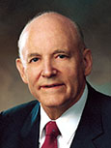
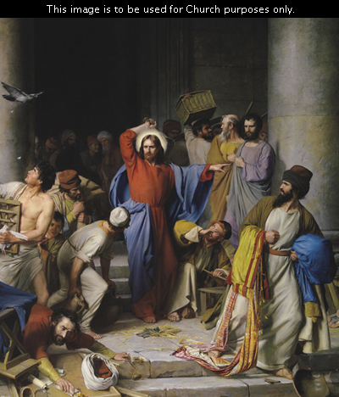
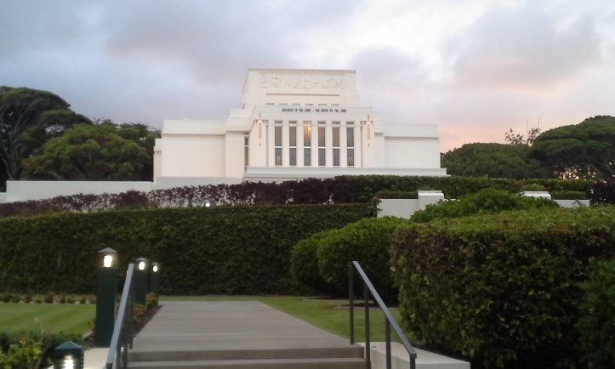
The Temple is a House of God
“Love of money had warped the hearts of many of Jesus’ countrymen. They cared more for gain than they did for God. Caring nothing for God, why should they care for his temple? They converted the temple courts into a marketplace and drowned out the prayers and psalms of the faithful with their greedy exchange of money and the bleating of innocent sheep. Never did Jesus show a greater tempest of emotion than in the cleansing of the temple. …
“The reason for the tempest lies in just three words: ‘My Father’s house.’ It was not an ordinary house; it was the house of God.
It was erected for God’s worship. It was a home for the reverent heart. It was intended to be a place of solace for men’s woes and troubles, the very gate of heaven. ‘Take these things hence;’ he said, ‘make not my Father’s house an house of merchandise.’
His devotion to the Most High kindled a fire in his soul and gave his words the force that pierced the offenders like a dagger.”
Carl Heinrich Bloch
John 2:12-25
(9)

Slide 20
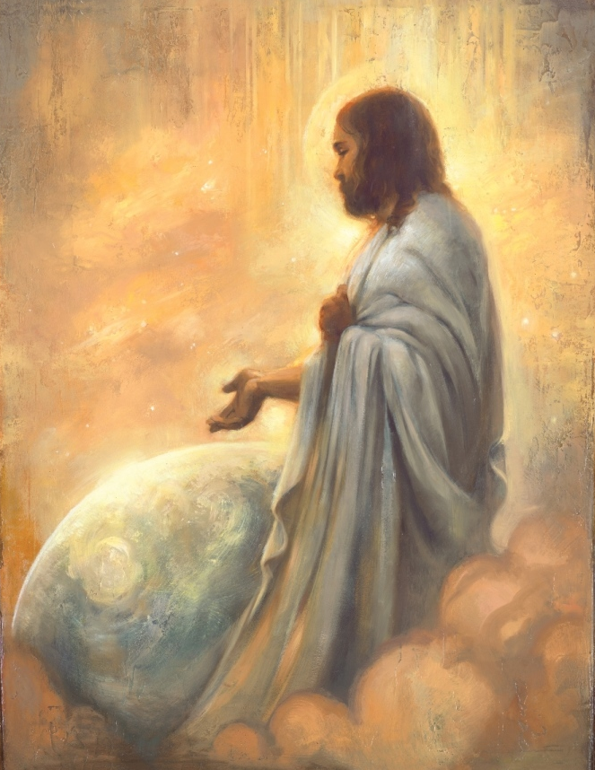
The Temple – His Body
“This great priesthood power of resurrection is vested in the Lord of this world. He taught that ‘all power is given unto me in heaven and in earth’
“‘Destroy this temple, and in three days I will raise it up. … But he spake of the temple of his body’
“The keys of the Resurrection repose securely with our Lord and Master.
Annie Hendri
“‘I am the resurrection, and the life: he that believeth in me, though he were dead, yet shall he live.’”
John 2:12-25; Matthew 28:18; John 11:25
(10)

Slide 21
Sources:
New Testament Institute Student Manual Chapter 22 and 2018 New Testament Student Manual
(Ogden & Skinner, The Four Gospels, p. 107-108)
Richard D. Draper, "Home Life at the Time of Christ," Ensign, Sept. 1987, 58
Bruce R. McConkie, The Mortal Messiah: From Bethlehem to Calvary, 1: 451 Pot size: Doctrinal New Testament Commentary, 3 vols. [Salt Lake City: Bookcraft, 1965-1973], 1: 136.
Gospeldoctrine.com
Susan Easton Black, "Mary, His Mother," Ensign, Jan. 1991, 12
Becky Davies and Lesley Meacham Poway Institute
James E. Talmage, Jesus the Christ, p. 138
President Howard W. Hunter (“Hallowed Be Thy Name,” Ensign, Nov. 1977, 52–53).
Elder Russell M. Nelson (“Life after Life,” Ensign, May 1987, 10).
L. Whitney Clayton, “Whatsoever He Saith unto You, Do It,” Ensign or Liahona, May 2017, 97
Presentation by ©http://fashionsbylynda.com/blog/

Slide 22
Event | Matthew | Mark | Luke | John
First Miracle: Water to Wine at Marriage in Cana |  |  |  | 2:1-11
Jesus Visits Capernaum |  |  |  | 2:12
Jesus Attends Passover and Cleanses Temple |  |  |  | 2:13-25
Who’s Wedding: John 1:2
"There is no way of knowing from the text whose wedding was being celebrated (there are numerous reasons why it could not have been Jesus' own wedding, as some have suggested), but it was apparently a grand affair lasting for many days. (C. Wilfred Griggs, Studies in Scripture, Vol. 5: The Gospels, ed. by Kent P. Jackson and Robert L. Millet, [Salt Lake City: Deseret Book Co., 1986], 126.)
"Weddings were held at the home of the bride and were as elaborate as the budget of the house would allow, running from one day to a whole week. The hosts felt a strong obligation to provide lavish hospitality, and failing to do so would embarrass the family and mortify the newly wedded couple. Mary may have been aware of this as she told her son that the wine had run out. We don't know Mary's function at the wedding, but the fact that she was concerned about the wine and was able to command the servants suggests that a close relative was being married." (Richard D. Draper, "Home Life at the Time of Christ," Ensign, Sept. 1987, 58)
Woman John 2:4:
This expression from the Savior has prompted some discussion. In English, it sounds like a harsh reproof. Accordingly, the Joseph Smith translation softens the phrase, but it also changes the meaning. To me, the expression is more meaningful as it stands-with the understanding that Jesus was not being rude to his mother, "for the word translated [for] mother is technically woman, but is more polite than the English word suggests." (Jackson and Millet, Studies in Scripture, Vol. 5: The Gospels, 126)
Woman John 2:4
The noun of address, “Woman,” as applied by a son to his mother may sound to our ears somewhat harsh, if not disrespectful; but its use was really an expression of opposite import. … When, in the last dread scenes of His mortal experience, Christ hung in dying agony upon the cross, He looked down upon the weeping Mary, His mother, and commended her to the care of the beloved apostle John, with the words: “Woman, behold thy son!” [ John 19:26 ]. Can it be thought that in this supreme moment, our Lord’s concern for the mother from whom He was about to be separated by death was associated with any emotion other than that of honor, tenderness and love?
(James E. Talmage, Jesus the Christ [1916], 144–45).
Most likely the marriage was of one of Jesus' half-siblings. Jesus' attendance also puts a divine stamp of approval on marriage itself.
Jesus himself was 30 years of age and would probably have married as was customary for Jewish men to do in their late teens:
At five years old one is ready for the scripture, at ten years for the Mishnah, at thirteen for the commandments, at fifteen for Talmud, at eighteen for marriage, at twenty for pursuit of righteousness, at thirty for full strength." (Ogden/Skinner, The Four Gospels, p. 108)
Observation: Had Jesus not been married we probably would have read of accusation after accusation against him, because marriage was number one of the commandments God had given from the beginning. There are none. Poway Institute
Water into Wine John 2:9:
"Every hour of every day somewhere on earth the Lord turns water into wine. By his power, pursuant to the laws he has ordained, men prepare the soil and plant the vine; from the good earth, from the rains that fall, and from the light of the sun, the vine takes nutrient, grows, and bears fruit; men dung it and dig about it and prune it, and the fruit matures and ripens: they harvest the crop and process it in the wine vat; and it comes out as wine on the lees well refined. It is a miracle...the Lord Jesus, turned water into wine, in an instant, suddenly as it were, by laws known to him but unknown to us. It was a miracle, the first of his public miracles." (The Mortal Messiah: From Bethlehem to Calvary, 4 vols. [Salt Lake City: Deseret Book Co., 1979-1981], 1: 450.)

Slide 23
Passover John 2:13:
"...it appears that Christ began his public ministry on the celebration day of the Passover feast. If so...it would have also been on his birthday. But which birthday? It would have been near his thirtieth because he was 'beginning to be about thirty' at his baptism shortly before (Luke 3:23). Let us also consider law of Moses symbolism to help answer this question.
"...The Savior cleansed the temple just before Passover both at the beginning of his ministry (see John 2:13-16) and at the end (see Matt. 21:12-3). In terms of our having a fuller understanding of Passover, note that the cleansing of the temple also fits the pattern of Passover. That is, part of the prescribed actions at Passover include searching the house for any leaven and putting it entirely outside the house. (See Ex. 12:15.) It would seem that leaven could symbolize false teachings (see Matt. 16:12), hypocrisy (see Luke 12:1), or wickedness (see 1 Cor. 5:7-8), which the Savior put out of his Father's house, the temple, by 'cleansing' it of those who defiled it." (John P. Pratt, "Passover-Was It Symbolic of His Coming?" Ensign, Jan. 1994, 42)
Something of Interest
Jesus’ cousins with James and John:
1. In the Gospel of Matthew, James and John are identified as the sons of Zebedee.
“And going on from thence, he saw other two brethren, James the son of Zebedee, and John his brother, in a ship with Zebedee their father” (Matthew 4:21).
2. Standing among the women near the cross with Jesus’ mother Mary was the mother of Zebedee’s children as identified by the Gospel of Matthew.
“Among which was Mary Magdalene, and Mary the mother of James and Joses, and the mother of Zebedee’s children (Matthew 27:56).
3. Standing among the women near the cross with Jesus’ mother Mary was Salome as identified by the Gospel of Mark.
“There were also women looking on afar off: among whom was Mary Magdalene, and Mary the mother of James the less and of Joses, and Salome“ (Mark 15:40).
4. Salome was Jesus’ mother’s sister as the apostle John himself states, about his own mother. Mark’s Gospel account refers to her by name. John’s Gospel account refers to her by her relationship to Mary.
“Now there stood by the cross of Jesus his mother, and his mother’s sister, Mary the wife of Cleophas, and Mary Magdalene” (John 19:25).
From Matthew’s account we know that James and John were the sons of Zebedee. By comparing Matthew and Mark we discover that Salome was the name of wife of the wife of Zebedee and the mother of James and John. From John we see that Salome was Mary’s sister.
I first thought that there could be other women in the account as well, but the order of the names and the similarity of the language in the accounts leads me to be almost certain that Jesus’ mother’s sister is Salome, the wife of Zebedee and the mother of James and John. Therefore, James and John were Jesus’ first cousins.
The implications of this are enormous when we consider how the various books of the New Testament were compiled and the roles that James and John, and also the “brothers of the Lord” James and Jude, had in writing and compiling the New Testament canon.
Forerunner.com by Jay Rogers Aug. 2007
Entering the Temple:
“Before entering the temple, you will be interviewed by your bishop and stake president for your temple recommend. Be honest and candid with them. That interview is not a test to be passed but an important step to confirm that you have the maturity and spirituality to receive the supernal ordinances and make and keep the edifying covenants offered in the house of the Lord. Personal worthiness is an essential requirement to enjoy the blessings of the temple. Anyone foolish enough to enter the temple unworthily will receive condemnation” Elder Richard G. Scott (“Receive the Temple Blessings,” Ensign, May 1999, 25).
Sacred Temple:
“The first sacred temple of Jerusalem was constructed on Mount Moriah. At that site, Jesus attended the remodeled second temple. Initially He called it 'my Father's house.' There He accomplished the first cleansing of the temple by driving out the money-changers.
"At the time of the second cleansing, He called it 'my house.' And He said unto them, 'It is written, My house shall be called the house of prayer; but ye have made it a den of thieves.' (Matt 21:13)
"Finally and sadly, He called it 'your house' when He said in desperation, 'Behold, your house is left unto you desolate,' (Matt. 23:38) and predicted the destruction of Jerusalem and the temple, of which one stone would not be left upon the other." Elder Russell M. Nelson (Perfection Pending, and Other Favorite Discourses [Salt Lake City: Deseret Book Co., 1998], 179.)

Slide 24
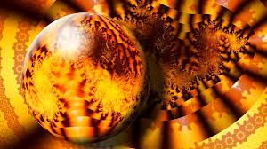
“Whosoever believeth in Him…”
John 3:14-17
During the time of Moses the Lord sent poisonous serpents in consequence of the Israelites sinning against God. The Israelites were poisoned when the serpents bit them.
The Lord directed Moses to raise up a brass serpent on a pole and promised that any Israelite who looked at the serpent on the pole would be healed.

Slide 25
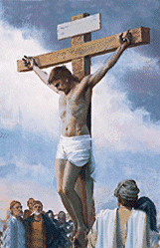
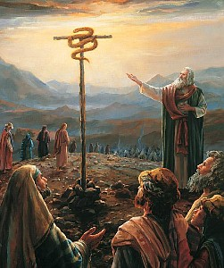
“And as Moses lifted up the serpent in the wilderness…
…even so must the Son of man be lifted up:”
John 3:14

Slide 26
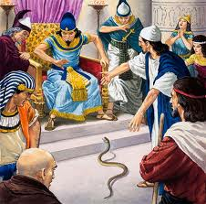
Aaron’s rod becomes a serpent
(Exodus 7:9-10)
Prove yourselves by performing a miracle.
Miracle---sign seeker

Slide 27
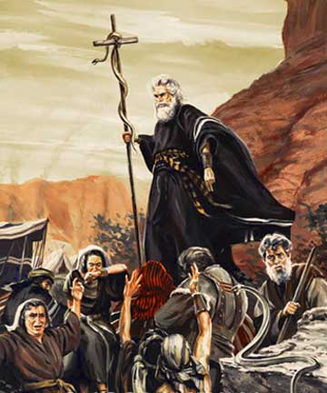
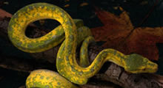
Moses tests Children of Israel in the wilderness
“…wherein were fiery serpents, and scorpions, and drought, where there was no water…”
(Deuteronomy 8:15)
John 3:14

Slide 28
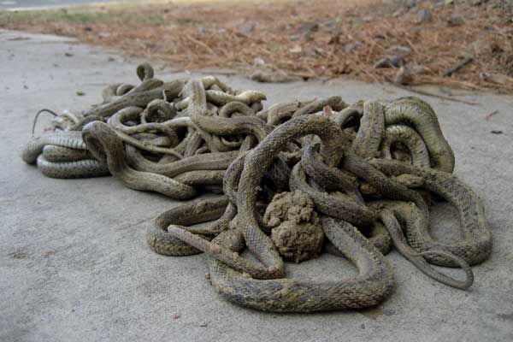
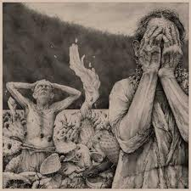
The Lord tests the Jaradites
“And there came forth poisonous serpents also upon the face of the land, and did poison many people…” (Ether 9:31-33)

Slide 29
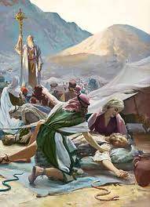
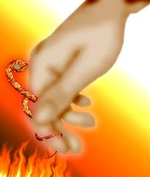
Children of Moses bitten by poisonous serpents
(Numbers 21:6)
Those who looked…were healed (Numbers 21:8)
John 3:14 ; 1 Nephi 17:41

Slide 30
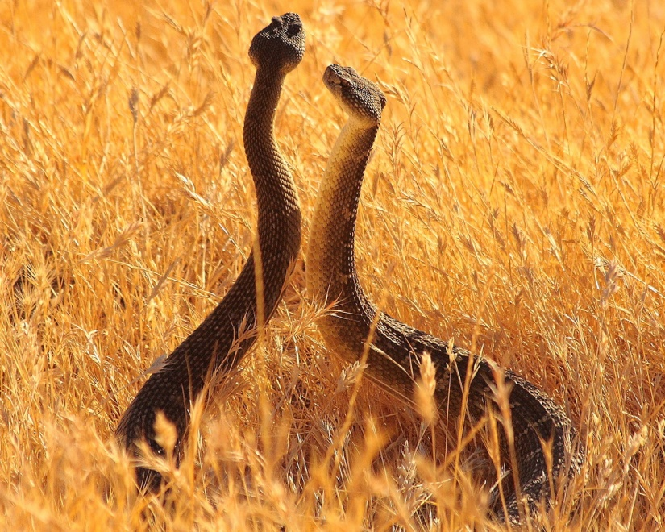
Fiery Serpents
Snakes marked with flame-like spots, or whose bite caused acute inflammation (Num. 21:6)
The Lord sent these upon the children of Israel to “straiten them,” and he prepared a way that those who were bitten might be healed by looking at the serpent of brass that Moses raised up before them, which was a symbol of the Redeemer being lifted upon the cross.
Bible Dictionary; (Num. 21:6, 8-9.)

Slide 31
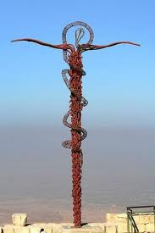
Symbolism of Jesus Christ
“…and behold a type was raised up in the wilderness…” (Alma 33:19)

Slide 32
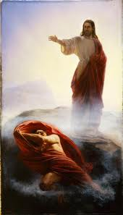
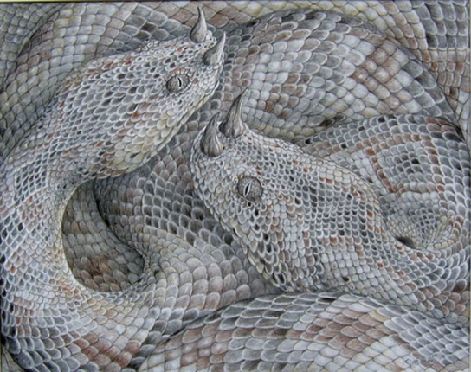
One Lifted and One Cast Out
Referring to war in heaven
“And the great dragon was cast out, that old serpent, called the Devil, and Satan, which deceiveth the whole world; he was cast out into earth, and his angels were cast out with him.” (Revelations 12:9)
John 3:14

Slide 33
Doctrinal Mastery
John 3:16
For God so loved the world, that he gave his only begotten Son, that whosoever believeth in him should not perish, but have everlasting life.
For God sent not his Son into the world to condemn the world; but that the world through him might be saved.

Slide 34
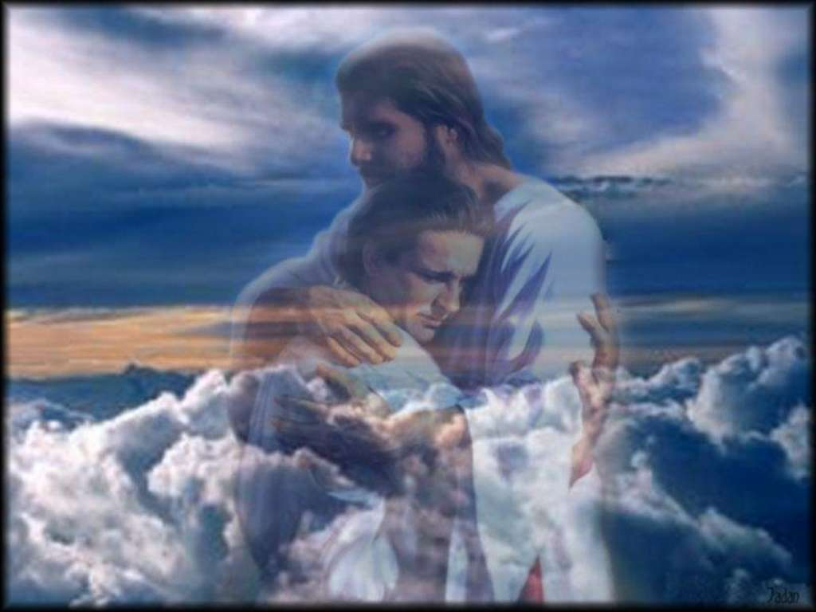
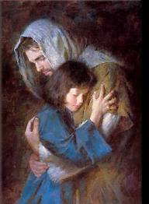
Heavenly Father loves His children so much that He sent His Only Begotten Son to atone for us.
John 3:16

Slide 35
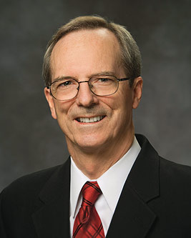
What then is the Atonement of Jesus Christ?
In one sense, it is a series of divine events that commenced in the Garden of Gethsemane, continued on the cross, and culminated with the Savior’s Resurrection from the tomb.
It was motivated by an incomprehensible love for each of us. It required a being who was sinless; who had infinite power over the elements—even death; who possessed a boundless capacity to suffer the consequences of all our sins and ailments; and who, in fact, descended beneath it all.
This was the mission of Jesus Christ—this was His Atonement.
What then was its purpose? It was to make it possible for us to return to God’s presence, become more like Him, and have a fulness of joy.
(1)
This was done by overcoming four obstacles:
Physical death
2. Spiritual death caused by Adam and by our sins
3. Our afflictions and infirmities
4. Our weaknesses and imperfections
John 3:16; Doctrine and Covenants 88:6

Slide 36
“There is no greater evidence of the infinite power and perfection of God’s love than is declared by the Apostle John…
Think how it must have grieved our Heavenly Father to send His Son to endure incomprehensible suffering for our sins. That is the greatest evidence of His love for each of us!”
(3)

Slide 37
As Latter-day Saints, we refer to His mission as the Atonement of Jesus Christ, which made resurrection a reality for all and made eternal life possible for those who repent of their sins and receive and keep essential ordinances and covenants. …
… Our covenants bind us to Him and give us godly power. As faithful disciples, we repent and follow Him into the waters of baptism. We walk along the covenant path to receive other essential ordinances. …
Covenant-keeping men and women seek for ways to keep themselves unspotted from the world so there will be nothing blocking their access to the Savior’s power.
(2)

Slide 38
John’s Gospel Continued
John 3:22-35

Slide 39
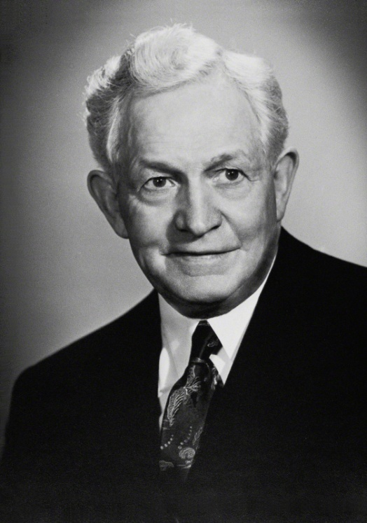
Jesus is the Christ
“Every person who lives in this world wields an influence, whether for good or for evil.
“The effect of our words and acts is tremendous in this world. Every moment of life you are changing to a degree the lives of the whole world.”
John 3:22-36
(4)

Slide 40
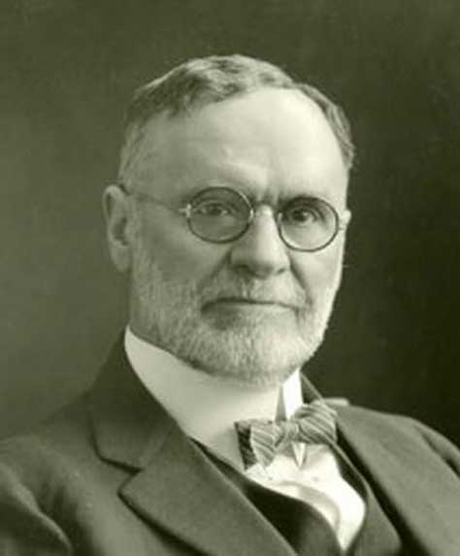
Baptized By Immersion
"'Born of water' means to come out of the water, and coming out of the water, presupposes going into the water.
This is why we are baptized by immersion, which means sinking, dipping, burying, plunging. Immersion is the only mode of baptism that symbolizes a birth. Jesus was baptized by immersion. He must have gone down into the water, for when he was baptized he 'went up straightway out of the water'.
When Philip baptized the Eunuch, 'they went down both into the water.' John baptized 'in Anon, near to Salim, because there was much water there,' a proof presumptive of baptism by immersion, that being the only mode requiring 'much water' for its performance.”
John 3:23; Matthew 3:16
(7)

Slide 41
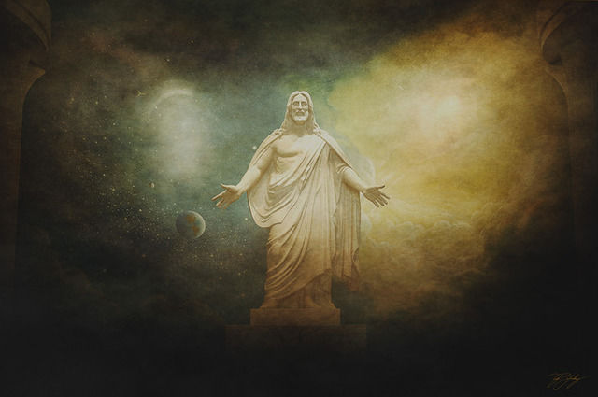
Given in Portions
God giveth not the Spirit by measure unto him. The Father...hath given all things into his hand
Even Apostles and Prophets are not given a full measure of the Spirit of God.
To all of us, the Spirit is given in portions depending on our stewardship and faithfulness.
In contrast to even the greatest prophets, Jesus received the Spirit in full measure for the Father had 'given all things into his hand,' in that 'he received all power, both in heaven and on earth‘…
And he received all power, both in heaven and on earth, and the glory of the Father was with him, for he dwelt in him.
D&C 93:17
John 3:34-35
(8)

Slide 42
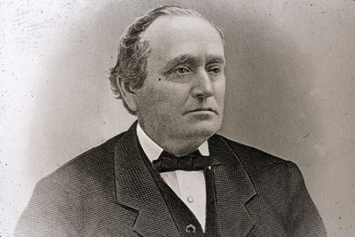
"[The Spirit] is measured out to you and me in the providence of the Lord; but for him there was a storehouse to draw upon, as it were, without measure.
He could continue to heal the sick and raise the dead and perform great and marvelous things, and yet the supply of vitality was not in the least abated.”
John 3:34-35
(8)

Slide 43
Sources:
Tad R. Callister, “The Atonement of Jesus Christ,” Ensign or Liahona, May 2019, 85
Russell M. Nelson, “Drawing the Power of Jesus Christ into Our Lives,” Ensign or Liahona, May 2017, 40, 41
Elder Dallin H. Oaks (“Love and Law,” Ensign or Liahona, Nov. 2009, 26).
(Teachings of Presidents of the Church: David O. McKay [2003], 227
Orson F. Whitney(Gospel Themes, 58.)
Elder Erastus Snow (Journal of Discourses, 26 vols. [London: Latter-day Saints' Book Depot, 1854-1886], 21: 26.)

Slide 44
Event | Matthew | Mark | Luke | John
Nicodemus, a Pharisee and Ruler Taught by Jesus |  |  |  | 3:1-21
John Further Testifies of Jesus |  |  |  | 3:22-36
Born Again John 3:3-5:
“We were born again when we entered into a covenant relationship with our Savior by being born of water and of the Spirit and by taking upon us the name of Jesus Christ. …
“Latter-day Saints affirm that those who have been born again in this way are spiritually begotten sons and daughters of Jesus Christ (see Mosiah 5:7; 15:9–13;27:25). Nevertheless, in order to realize the intended blessings of this born-again status, we must still keep our covenants and endure to the end. In the meantime, through the grace of God, we have been born again as new creatures with new spiritual parentage and the prospects of a glorious inheritance” Dallin H. Oaks “Have You Been Saved?” Ensign, May 1998, 56).
“When we are baptized by immersion by one with the proper priesthood authority and choose to follow our Savior, we then are in His kingdom and of His kingdom. …
“At baptism we make a covenant with our Heavenly Father that we are willing to come into His kingdom and keep His commandments from that time forward, even though we still live in the world. …
“When we understand our baptismal covenant and the gift of the Holy Ghost, it will change our lives and will establish our total allegiance to the kingdom of God. When temptations come our way, if we will listen, the Holy Ghost will remind us that we have promised to remember our Savior and obey the commandments of God. …
“By choosing to be in His kingdom, we separate—not isolate—ourselves from the world. Our dress will be modest, our thoughts pure, our language clean. The movies and television we watch, the music we listen to, the books, magazines, and newspapers we read will be uplifting. We will choose friends who encourage our eternal goals, and we will treat others with kindness. We will shun the vices of immorality, gambling, tobacco, liquor, and illicit drugs. Our Sunday activities will reflect the commandment of God to remember the Sabbath day and keep it holy. We will follow the example of Jesus Christ in the way we treat others. We will live to be worthy to enter the house of the Lord” Elder Robert D. Hales(“The Covenant of Baptism: To Be in the Kingdom and of the Kingdom,” Ensign, Nov. 2000, 7–8).
Moses and the Serpent John 3;14:
"The whole episode points toward the need to look upon Jesus Christ as our Lord, likewise a simple but unwaivable requirement. How plain and precious in any age! Yet believing in Jesus is sometimes regarded as foolishness. One can imagine the scoffing comments of some in Moses' time concerning the illogicality and foolishness of looking upon a brass pole in order to be healed and saved." Elder Neal A. Maxwell (Plain and Precious Things [Salt Lake City: Deseret Book Co., 1983], 21.)
John 3:16:
Elder Bruce R. McConkie (1915–85) of the Quorum of the Twelve Apostles taught that John 3:16 “summarizes the whole plan of salvation, tying together the Father, the Son, his atoning sacrifice, that belief in him which presupposes righteous works, and ultimate eternal exaltation for the faithful” (Doctrinal New Testament Commentary, 1:144).
All Men Come to Him John 3:26:
"John's supporters were concerned at the success of One whom they regarded in some measure as a rival to their beloved teacher...John's reply to his ardent followers constitutes a sublime instance of self-abnegation....In such a reply, under the existent conditions, is to be found the spirit of true greatness, and of a humility that could rest only on a conviction of divine assurance to the Baptist as to himself and the Christ. In more than one sense was John great among all who are born of women. He had entered upon his work when sent of God so to do; he realized that his work had been in a measure superseded, and he patiently awaited his release, in the meantime continuing in the ministry, directing souls to his Master. The beginning of the end was near. He was soon seized and thrown into a dungeon; where, as shall be shown, he was beheaded to sate the vengeance of a corrupt woman whose sins he had boldly denounced." Elder James E. Talmage (Jesus the Christ, 164-165)

Slide 45
Baptism John 3:22 Did Jesus Perform Baptisms?:
"In the King James Version John 3:22 we read that Jesus came with his disciples into the land of Judea, 'and there he tarried with them, and baptized.' The passage seems to say that Jesus himself performed some of the baptisms. However, a little later we find: 'When therefore the Lord knew how the Pharisees had heard that Jesus made and baptized more disciples than John, (though Jesus himself baptized not, but his disciples,) he left Judea, and departed again into Galilee' (John 4:1-3).
"This passage denies that Jesus performed baptisms himself, contradicting the passage in John 3. The matter is resolved by the Prophet's translation, which brings into harmony the various statements about Jesus performing baptisms: 'When therefore the Pharisees had heard that Jesus made and baptized more disciples than John, they sought more diligently some means that they might put him to death; for many received John as a prophet, but they believed not on Jesus. Now the Lord knew this, though he himself baptized not so many as his disciples; for he suffered them for an example, preferring one another. And he left Judea, and departed again into Galilee.' ([Joseph Smith Translation of the Bible]. The Holy Scriptures: Inspired Version. Independence, Mo.: Herald Publishing House, 1970 John 4:1-5.)
"Not only does the Joseph Smith Translation clearly state that Jesus performed baptisms (see also [Joseph Smith Translation of the Bible]. The Holy Scriptures: Inspired Version. Independence, Mo.: Herald Publishing House, 1970 Mark 1:6 and John 1:28) but it also explains why Jesus left the area. The King James Version leaves us dangling because it mentions the Pharisees but doesn't say what they have to do with the story. The Joseph Smith Translation explains that they wanted to kill Jesus because of his popularity, and therefore he left Judea and went into Galilee." (Robert J. Matthews, Behold the Messiah [Salt Lake City: Bookcraft, 1994], 191-192.)

Slide 46
The Woman at the Well
John 4 Part 1
Therefore, O my son, whosoever will come may come and partake of the waters of life freely; and whosoever will not come the same is not compelled to come; but in the last day it shall be restored unto him according to his deeds.
Alma 42:27
Presentation by ©http://fashionsbylynda.com/blog/

Slide 47
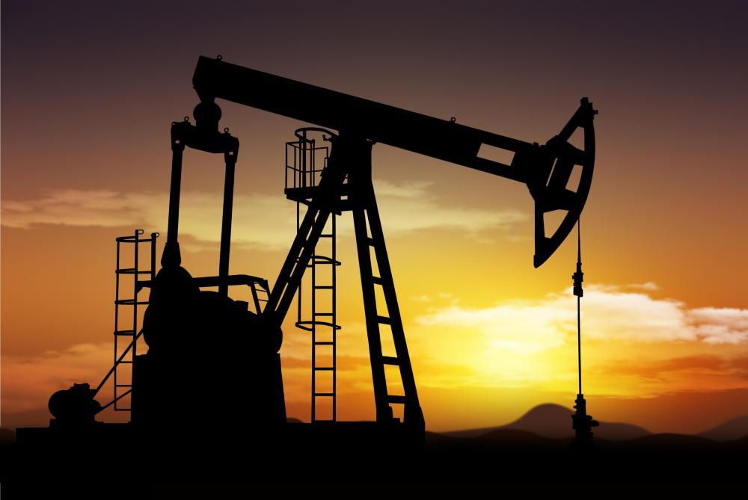
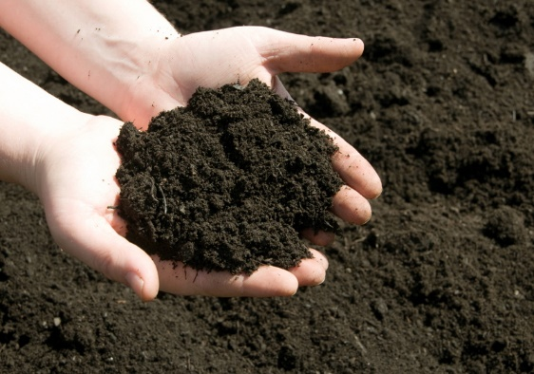
What is the most valuable natural resource on the earth?

Slide 48
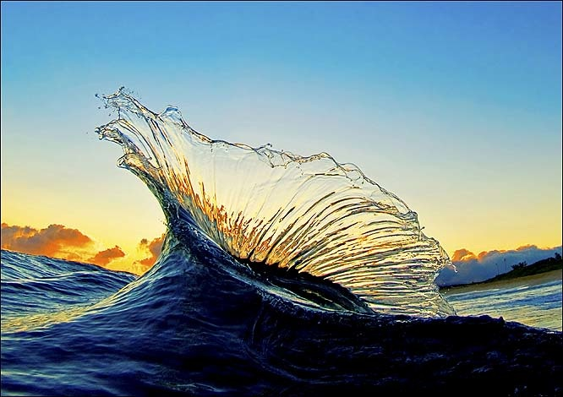
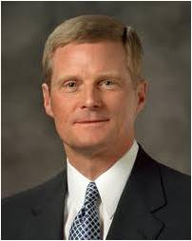
“We might initially think that gold, oil, or diamonds have the greatest worth. But of all the minerals, metals, gems, and solvents found on and in the earth, the most valuable is water.”
(2)

Slide 49
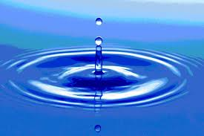
The Living Water
John 4:1-30
For my people have committed two evils; they have forsaken me the fountain of living waters, and hewed them out cisterns, broken cisterns, that can hold no water.
Jeremiah 2:13
And it shall be in that day, that living waters shall go out from Jerusalem; half of them toward the former sea, and half of them toward the hinder sea: in summer and in winter shall it be.
Zechariah 14:8
And he said unto me, It is done. I am Alpha and Omega, the beginning and the end. I will give unto him that is athirst of the fountain of the water of life freely.
Revelation 21:6
But unto him that keepeth my commandments I will give the mysteries of my kingdom, and the same shall be in him a well of living water, springing up unto everlasting life.
D&C 63:23

Slide 50
Ezekiel sees in a vision a “spring of pure water” forming a river and flowing through the dry wilderness of Judaea
Ezekiel 47:1

Slide 51
Ezekiel saw that wherever the river flowed life came to the barren desert

Slide 52
“Water from the river does two things:
It gives life and it heals.
The life it produces will not “fade”, and that which it heals will live forever. “
Ezekiel 47:9
Excerpt from Michael Wilcox “House of Glory”

Slide 53
Jesus leaves Judaea for Galilee and goes through Samaria
John 4:3-4

Slide 54
Samaritan Territory
Because of increased persecution in Jerusalem from the chief priests and Pharisees, Jesus left Judea for Galilee, traveling through Samaria to a city called Sychar. Being tired and thirsty, he sat down on Jacob’s well at “about the sixth hour.” (1)
John 4:6

Slide 55
Samaritan Woman
The Samaritan woman who went to the well and spoke with Jesus may have come at this unusual time to avoid the women of the village, who may have shunned her as a sinner.
Jews customarily had no contact with Samaritans and rabbis did not ordinarily talk to single women.
John 4:6
(1)

Slide 56
Near the city Sychar in Samaria Jesus and his disciples stop for the night. The disciples leave to find food in the nearby city.
John 4:8

Slide 57
Being weary, Jesus sits at Jacob’s Well near the parcel of ground that Jacob gave to his son Joseph
John 4:5-6

Slide 58
A woman of Samaria comes to draw water from the well.
John 4:7

Slide 59
Jesus asks for a drink
John 4:7

Slide 60
The woman wonders why he would accept a drink from a Samaritan
John 4:9

Slide 61
“…if thou knewest the gift of God, and who it is that saith to thee, Give me to drink; thou wouldest have asked of him, and he would have given thee living water.”
John 4:9

Slide 62
The woman does not understand about the living water
John 4:11

Slide 63
She understands that Jacob and his family used the well.
John 4:12

Slide 64
Jacob’s well
“Therefore with joy shall ye draw water out of the wells of salvation”
Isaiah 12:3
Jacob’s well was on the land that Jacob, the father of the twelve tribes of Israel, had settled after he returned from working for Laban in Padan-aram in Mesopotamia. Jacob bequeathed this land to his son Joseph. (1)
Genesis 33:18

Slide 65
“…Whosoever drinketh of this water shall thirst again:
…but whosoever drinketh of the water that I shall give him shall never thirst…”
John 4:13-14

Slide 66
…but the water that I shall give him shall be in him a well of water springing up into everlasting life.”
John 4:14

Slide 67
If any man thirst, let him come unto me, and drink.
The Living water is the gospel of Jesus Christ; its communicator is the Holy Ghost.
The living water also nourishes. He gives us rest. He sustains us when we are weary.
Matthew 11:28
John 7:37-38

Slide 68
Feast Upon That Which Perish Not
“Come, my brethren, every one that thirsteth, come ye to the waters; and he that hath no money, come buy and eat; yea, come buy wine and milk without money and without price.” (Isaiah 55:1-2)
2 Nephi 9:50-51

Slide 69
His Soul Shall Never Hunger
The Living waters can bring peace and joy even when the wellspring within us seems to have dried.
3 Nephi 20:8-9

Slide 70
“The living water referred to in this episode is a representation of the Lord Jesus Christ and His gospel.
And as water is necessary to sustain physical life, so the Savior and His doctrines, principles, and ordinances are essential for eternal life.
You and I need His living water daily and in ample supply to sustain our ongoing spiritual growth and development.”
If we come unto Jesus Christ and earnestly partake of His gospel, then we will receive eternal life.
(2)

Slide 71
What is the living water offered by Jesus Christ?
Why do we need the Savior’s living water?
What can we do to receive living water from the Savior?
How does knowing that the Savior wants everyone to partake of His living water affect how you feel about Him?

Slide 72
The Samaritan woman, once she recognized Him, listened to His words. Then she was able to be humble enough to drink of the water and be healed.
John 4:24-26
(4)

Slide 73
Believing, the woman took her pot and went to tell her people about the “Messias” who had come.
John 4:24-28

Slide 74
Everlasting Life
“…the gospel of Jesus Christ heals broken hearts, infuses meaning into lives, binds loved ones together with ties that transcend mortality, and bring to life a sublime joy. “
(3)

Slide 75
Faith Of Our Father
“The faith of our Father in Heaven has been consistent since the beginning of time, even from before the foundation of this world. John the Revelator described a great war in heaven.
The issue was moral agency, as it is today.
All who have ever lived on this earth were among those who fought against Satan and stood with the Son and the Father.
Therefore, do we not owe our allegiance to God, our Heavenly Father? …
God desires that all of His children receive it, irrespective of their background, culture, or tradition.
True religion should not originate from what pleases men or the traditions of ancestors, but rather from what pleases God, our Eternal Father” (5)
Revelation 12:7-9

Slide 76
Is God a Spirit?
The Greek phrase can also be understood to mean “God is spirit,” or “God is spiritual.” …
From latter-day revelation, we know that “the Father has a body of flesh and bones as tangible as man’s; the Son also; but the Holy Ghost has not a body of flesh and bones, but is a personage of Spirit”
John 4:24; D&C 130:22

Slide 77
I Am
“I that speak unto thee am he,”
Jesus was declaring that He is Jehovah.
John 4:25-26

Slide 78
A Desire to Share
As we gain a testimony of Jesus Christ, we are filled with a desire to share it with others
“When the crowd of curious Samaritans arrived to see and hear the man who had proclaimed himself to be the Messiah, … their initial curiosity matured into testimony.
They declared, ‘We have heard him ourselves, and know that this is indeed the Christ, the Saviour of the world.’” (3)
John 4:28-42

Slide 79
Fields Are White and Ready to Harvest
His harvest is humble people who have been searching for answers to their questions about life and death and who are ready to hear the gospel of Jesus Christ.
John 4:35; D&C 4:4

Slide 80
A Nobleman’s Son
The nobleman manifested significant faith in the Savior in at least two ways.
First, although his home, Capernaum, was about 20 miles (32 kilometers) away from Cana, he made the journey to implore the Savior for His help.
Second, when the Savior assured him that his son would live, the nobleman “went his way,” trusting the Savior’s word. (1)
As we believe in Jesus Christ without needing signs, the Lord will confirm our belief
John 4:46-54

Slide 81
Sources:
New Testament Institute Student Manual Chapter 22
Elder David A. Bednar (“A Reservoir of Living Water” [Church Educational System fireside for young adults, Feb. 4, 2007], 1,lds.org/broadcasts).
Elder Joseph B. Wirthlin The Abundant Life 2006 April Gen. Conf. and “Living Water to Quench Spiritual Thirst,” Ensign, May 1995, 18–19).
Kathleen H. Hughes “Blessed by Living Water 2003 April General Conference
President Dieter F. Uchtdorf (“Faith of Our Father,” Ensign orLiahona, May 2008, 75).
Presentation by ©http://fashionsbylynda.com/blog/

Slide 82
Event | Matthew | Mark | Luke | John
Jesus Leaves Judea for Galilee | 4:12 | 1:14 | 4:14 | 4:1-3
Samarian Woman at Jacob’s Well |  |  |  | 4:4-42
Jesus Enters Galilee |  |  | 4:15 | 4:43-45
Jesus Heals a Nobleman’s son |  |  |  | 4:46-54
Living Water John 4:1-30:
“Fully understood and embraced, the gospel of Jesus Christ heals broken hearts, infuses meaning into lives, binds loved ones together with ties that transcend mortality, and brings to life a sublime joy. …
“The abundant life is a spiritual life. Too many sit at the banquet table of the gospel of Jesus Christ and merely nibble at the feast placed before them. They go through the motions—attending their meetings perhaps, glancing at scriptures, repeating familiar prayers—but their hearts are far away. If they are honest, they would admit to being more interested in the latest neighborhood rumors, stock market trends, and their favorite TV show than they are in the supernal wonders and sweet ministerings of the Holy Spirit.
“Do you wish to partake of this living water and experience that divine well springing up within you to everlasting life?
“Then be not afraid. Believe with all your hearts. Develop an unshakable faith in the Son of God. Let your hearts reach out in earnest prayer. Fill your minds with knowledge of Him. Forsake your weaknesses. Walk in holiness and harmony with the commandments” Elder Joseph B. Wirthlin(“The Abundant Life,” Ensign or Liahona, May 2006, 100).
Samaritan History: John 4:19-24:
Toward the end of the sixth century B.C., the Jews rejected the Samaritans’ offer to help rebuild the temple in Jerusalem (see Ezra 4:1–10). Shortly thereafter, Manasseh, a priest from Jerusalem who had married the daughter of Sanballat, the Gentile governor of Samaria, was expelled from the priesthood. He then built a rival temple on Mount Gerizim in Samaria. This was the mountain referred to by the woman at the well (see Bible Dictionary, “Gerizim and Ebal”). During the Hasmonean (Jewish) revolt against the Seleucids in the late second century B.C., the Samaritans refused to aid the Jewish cause. Perhaps as retaliation for this lack of solidarity, John Hyrcanus, a leader of the Hasmonean Jews, destroyed the Samaritan temple on Mount Gerizim, and it was never rebuilt. The destruction of this temple added to the animosity that already existed between the Samaritans and Jews.
When the Samaritan woman came to understand that Jesus was indeed a prophet, she desired to know how she could worship. The Samaritan temple had been destroyed, Samaritans were not welcome in the temple in Jerusalem, and she did not know where she could worship (1)
Worshipping John 4:24:
“There is no salvation in worshiping a false god. It does not matter one particle how sincerely someone may believe that God is a golden calf, or that he is an immaterial, uncreated power that is in all things; the worship of such a being or concept has no saving power. Men may believe with all their souls that images or powers or laws are God, but no amount of devotion to these concepts will ever give the power that leads toimmortality and eternal life. …
“But if he worships the true and living God, in spirit and in truth, then God Almighty will pour out his Spirit upon him, and he will have power to raise the dead, move mountains, entertain angels, and walk in celestial streets” Elder Bruce R. McConkie (“How to Worship,” Ensign, Dec. 1971, 129).
Nobleman’s son John 4:50:
“Though he was in Cana, Jesus gave the command and the nobleman’s son, some twenty miles away in Capernaum, was healed. By the power of faith the sick are healed regardless of their geographical location. God is God of the universe; his power is everywhere manifest” Elder Bruce R. McConkie (Doctrinal New Testament Commentary, 1:159).

