Slide 1
Matthew 5, Luke 6

Slide 2
The Beatitudes
Matthew 5:1-12

Slide 3
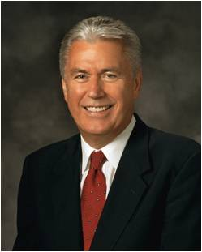
“So often we get caught up in the illusion that there is something just beyond our reach that would bring us happiness: a better family situation, a better financial situation, or the end of a challenging trial.
“… External circumstances don’t really matter or determine our happiness.
“… We determine our happiness.”
Are you happy?
(1)

Slide 4
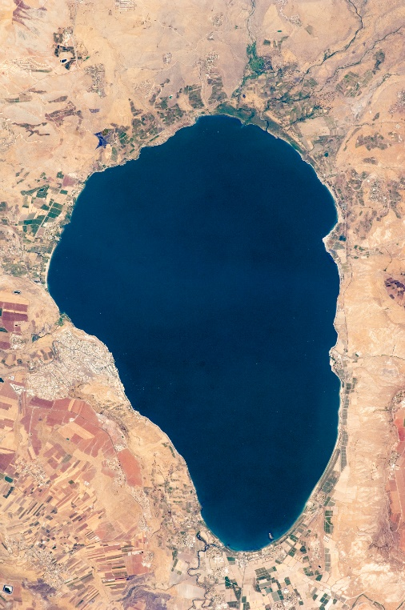
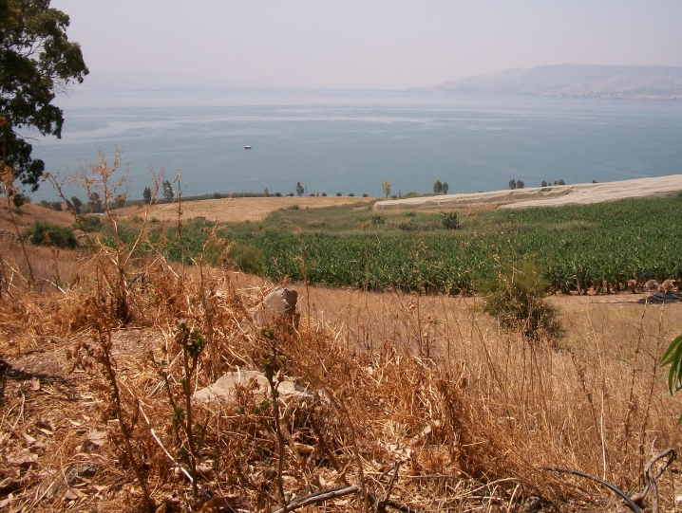
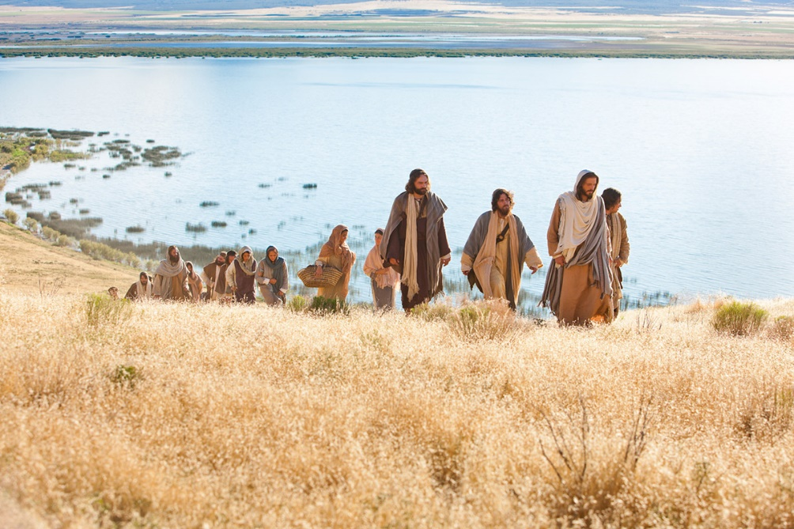
Sermon on the Mount
Beatitude=Blessed or Happy
As the Savior began His ministry, He gave a sermon near the Sea of Galilee
The Savior explained what we can do to be truly happy, regardless of our external circumstances.

Slide 5
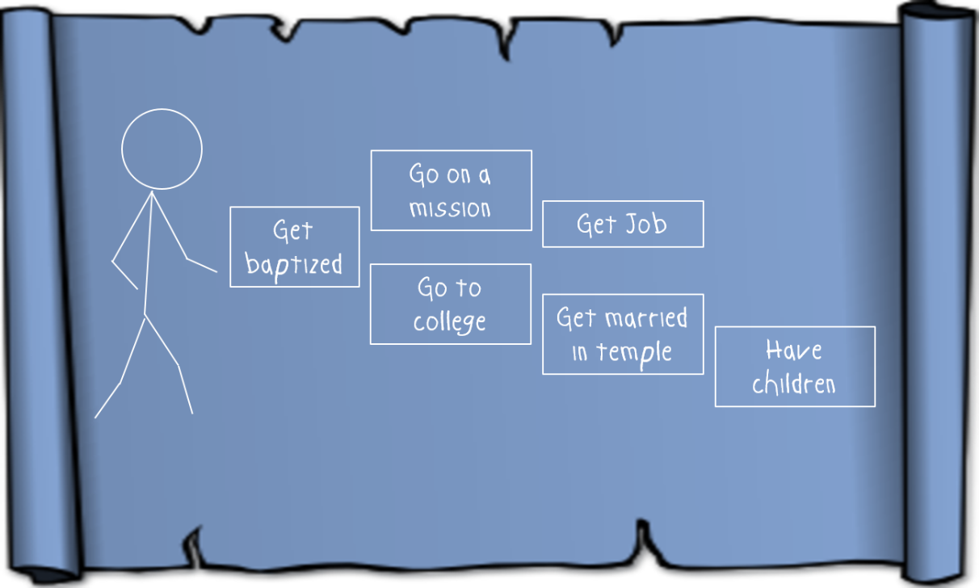
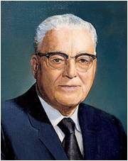
“In his Sermon on the Mount the Master has given us somewhat of a revelation of his own character, which was perfect, … and in so doing has given us a blueprint for our own lives. …
In that matchless Sermon on the Mount, Jesus has given us eight distinct ways by which we might receive [real] joy. Each of his declarations is begun by the word ‘Blessed.’ …
“These declarations of the Master are known in the literature of the Christian world as the Beatitudes. … They embody in fact the constitution for a perfect life.”
(1)

Slide 6
Blessed Are the Poor in Spirit
To be humble and “to recognize gratefully [our] dependence on the Lord—to understand that [we] have constant need for His support.
Humility is an acknowledgment that [our] talents and abilities are gifts from God.” (3)
3 Nephi 12:3
Matthew 5:3

Slide 7
Blessed Are They That Mourn
To feel or express sorrow.
A person may mourn over the difficulties and trials of mortality, including the death of loved ones.
Likewise, a person may also mourn because of sorrow for sin.
And again, more blessed are they who shall believe in your words because that ye shall testify that ye have seen me, and that ye know that I am. Yea, blessed are they who shall believe in your words, and come down into the depths of humility and be baptized, for they shall be visited with fire and with the Holy Ghost, and shall receive a remission of their sins.
3 Nephi 12:2
Yea, and are willing to mourn with those that mourn; yea, and comfort those that stand in need of comfort, and to stand as witnesses of God at all times and in all things, and in all places that ye may be in, even until death, that ye may be redeemed of God, and be numbered with those of the first resurrection, that ye may have eternal life—Mosiah 18:9
3 Nephi 12:4
Matthew 5:4

Slide 8
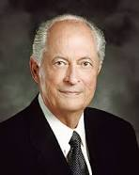
Blessed Are the Meek
“To be meek, as defined in Webster’s dictionary, is ‘manifesting patience and longsuffering: enduring injury without resentment’ (4)
To be “meek” means to be “God fearing, righteous, humble, teachable, and patient under suffering. The meek are willing to follow gospel teachings” (9)
Meekness is not weakness. It is a badge of Christian courage” (5)
But the meek shall inherit the earth; and shall delight themselves in the abundance of peace. Psalms 37:11
3 Nephi 12:5
Matthew 5:5

Slide 9
Blessed are They which do Hunger and Thirst
The Lord will feed them spiritually until they are completely satisfied.
The account of the sermon in 3 Nephi adds:
To hunger and thirst after righteousness implies a great desire to know and do the will of God.
…for they shall be filled with the Holy Ghost.
3 Nephi 12:6
Matthew 5:6

Slide 10
Blessed Are the Merciful
The Savior taught that the way we treat others affects how God will treat us
“Mercy is the compassionate treatment of a person greater than what is deserved” (6)
We are able to receive Heavenly Father’s mercy because of the Atonement of Jesus Christ.
And thou didst hear me because of mine afflictions and my sincerity; and it is because of thy Son that thou hast been thus merciful unto me, therefore I will cry unto thee in all mine afflictions, for in thee is my joy; for thou hast turned thy judgments away from me, because of thy Son.
Alma 33:11
3 Nephi 12:7
Matthew 5:7

Slide 11
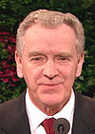
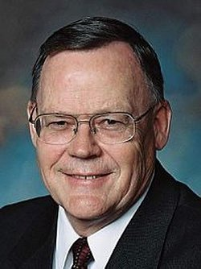
Blessed are the Pure in Heart
The pure in heart are those who love the Lord, who seek to follow Him and keep His commandments, who are striving to live virtuous lives and endure faithfully to the end.
The pure in heart are those who control their thoughts to keep themselves free from immoral fantasies and deeds” (7)
“If something is pure, it is not polluted or tainted by things which do not belong to it. Purity of heart is certainly one of the most important qualifications for receiving inspiration from God.
While none of our hearts are perfect, the more diligently we strive to eliminate impurity, or push out things which do not belong there, the more we open our hearts to the Holy Spirit” (10)
3 Nephi 12:8
Matthew 5:8

Slide 12
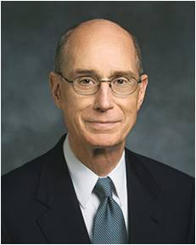
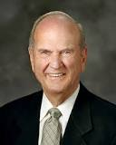
Blessed Are the Peacemakers
As a Church, we must “renounce war and proclaim peace.” As individuals, we should “follow after the things which make for peace.”
We should be personal peacemakers. We should live peacefully—as couples, families, and neighbors.(11)
“[Peacemaking] is the gift to help people find common ground when others are seeing differences” (8)
But I say unto you, Love your enemies, bless them that curse you, do good to them that hate you, and pray for them which despitefully use you, and persecute you;
Matthew 5:44
Yes
No
3 Nephi 12:9
Matthew 5:9

Slide 13
Blessed Are they which are persecuted for righteousness’ sake
Our choice to heed those who mock sacred things will distance us from the saving and life-giving light of the Savior. John 8:12 recorded: “Then spake Jesus again unto them, saying, I am the light of the world: he that followeth me shall not walk in darkness, but shall have the light of life.”
Remember, those who truly love us can help us build our faith. (14)
To be “persecuted for righteousness’ sake” means to be willing to obey and defend Jesus Christ and His teachings, even when we may be mocked or mistreated for doing so.
For those who have been persecuted by others:
I, the Lord, will forgive whom I will forgive, but of you it is required to forgive all men. D&C 64:10
3 Nephi 12:10-12
Matthew 5:10-12

Slide 14
As we develop Christlike attributes, we will find increased happiness

Slide 15
Christlike attributes are gifts from God. They cannot be developed without His help.
The one help we all need is given to us freely through the Atonement of Jesus Christ. Having faith in Jesus Christ and in His Atonement means relying completely on Him—trusting in His infinite power, intelligence, and love. Christlike attributes come into our lives as we exercise our agency righteously. Faith in Jesus Christ leads to action.
When we have faith in Christ, we trust the Lord enough to follow His commandments—even when we do not completely understand the reasons for them.
In seeking to become more like the Savior, we need to reevaluate our lives regularly and rely, through the path of true repentance, upon the merits of Jesus Christ and the blessings of His Atonement.
(1)

Slide 16
Ye Are The Light Of the World
Matthew 5:13-16

Slide 17
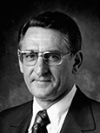
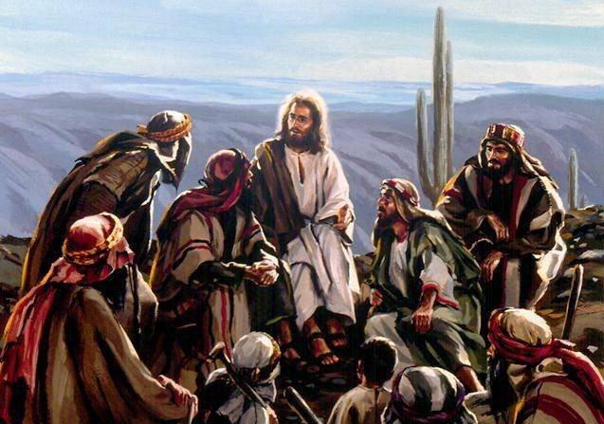
Setting a Righteous Example
Salt of the Earth = salt was added to sacrificial offerings under the law of Moses. Thus salt was associated with joy, permanence, and covenant making.
To whom did the Savior liken salt?
His disciples
“[Good salt] … is clean, pure, uncontaminated, and useful. In this state or condition, salt will preserve, flavor, heal, and perform other useful functions.”(12)
Matthew 5:13

Slide 18
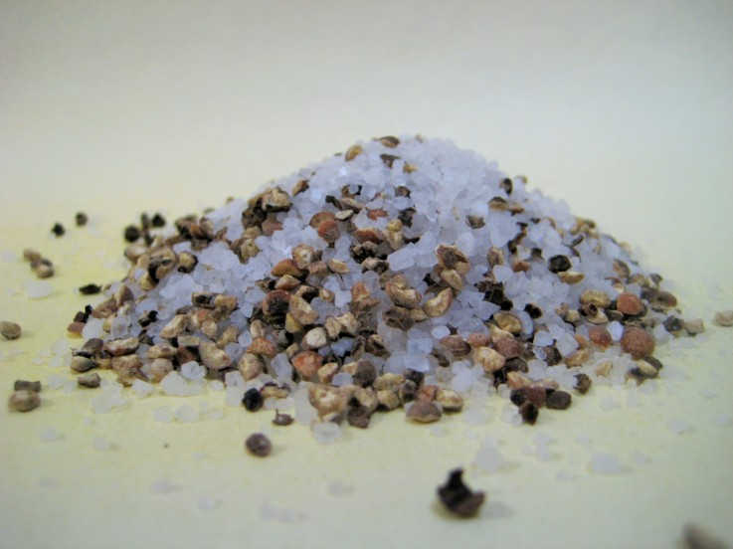
What Causes Salt to Lose Its Savor?
Salt loses its savor when it mixes with other materials and becomes contaminated.
How useful is salt when it is mixed with other materials?
Becoming contaminated by the sins of the world can prevent us from being a blessing to others.
Matthew 5:13

Slide 19
The Light of the World
What are Christ’s disciples asked to do with their light?
What does it mean to let your light shine?
Therefore, hold up your light that it may shine unto the world. Behold I am the light which ye shall hold up—that which ye have seen me do. Behold ye see that I have prayed unto the Father, and ye all have witnessed. 3 Nephi 18:24
“to glorify your Father which is in Heaven” = to give praise and honor to God through word or action.
Our righteous example can encourage others to draw nearer to Heavenly Father.
What will our good works lead others to do?
Matthew 5:14-16

Slide 20
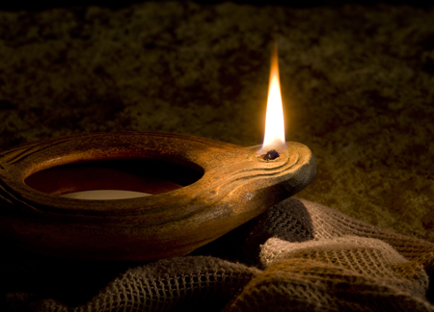
“Wouldn’t it be pleasing to Jesus if we could let our light so shine that those who followed us would be following the Savior? …
“Have you ever stopped to think that perhaps you are the light sent by Heavenly Father to lead another safely home or to be a beacon from a distance to show the way back to the straight and narrow path that leads to eternal life?
Your light is a beacon and should never stop burning or mislead those who are looking for a way home.” (13)
The “candle” in Matthew 5:15 refers to a ceramic oil lamp; the “candlestick” refers to a lamp stand.
Matthew 5:14-16

Slide 21
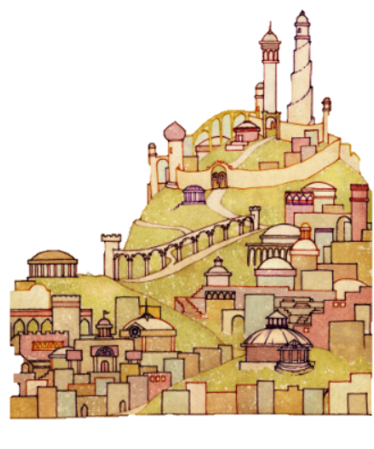
City on a Hill
Anciently, cities were built on hilltops to provide protection from potential attacks.
How can living the gospel boldly provide protection from bad influences?
Matthew 5:14

Slide 22
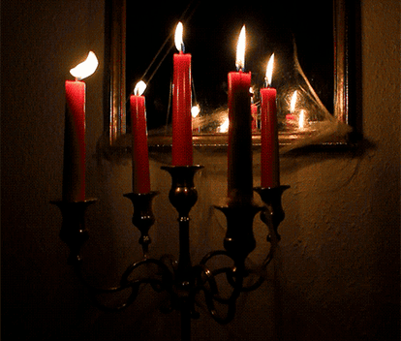
Candlestick
What might cause some people to hide under a basket (bushel) the light God gives them?
Every time you turn your hearts to God in humble prayer, you experience His light. Every time you seek His word and will in the scriptures, the light grows in brightness.
Every time you notice someone in need and sacrifice your own comfort to reach out in love, the light expands and swells.
Every time you reject temptation and choose purity, every time you seek or extend forgiveness, every time you courageously testify of truth, the light chases away darkness and attracts others who are also seeking light and truth.
(1)
Matthew 5:14-16

Slide 23
Doctrinal Mastery
Ye are the light of the world. A city that is set on an hill cannot be hid.
Neither do men light a candle, and put it under a bushel, but on a candlestick; and it giveth light unto all that are in the house.
Let your light so shine before men, that they may see your good works, and glorify your Father which is in heaven.
Matthew 5:14-16

Slide 24
Sources:
President Dieter F. Uchtdorf (“Of Regrets and Resolutions,” Ensign or Liahona, Nov. 2012, 23). (Dieter F. Uchtdorf, “Christlike Attributes—the Wind beneath Our Wings,” Ensign or Liahona, Nov. 2005, 102–3.; Dieter F. Uchtdorf, “Bearers of Heavenly Light,” Ensign or Liahona, Nov. 2017, 80
Teachings of Presidents of the Church: Harold B. Lee [2000], 200).
True to the Faith: A Gospel Reference [2004], 86.
[Webster’s Third New International Dictionary (1976 ‘meek,’ 1403].
Robert D. Hales, “Christian Courage: The Price of Discipleship,” Ensign or Liahona, Nov. 2008, 73
(Gospel Topics, “Mercy,” lds.org/topics).
(Sheldon F. Child, “Words of Jesus: Chastity,” Ensign, Jan. 2003, 44).
(Henry B. Eyring, “Learning in the Priesthood,” Ensign or Liahona, May 2011, 63).
Guide to the Scriptures “Meek”
Elder Gerald N. Lund “Opening Our Hearts,” Ensign or Liahona, May 2008, 33.
11. Russell M. Nelson “Blessed Are the Peacemakers” Oct. 2002 Gen. Conf.
12. Elder Carlos E. Asay (“Salt of the Earth: Savor of Men and Saviors of Men,” Ensign, May 1980, 42).
13. Elder Robert D. Hales (“That Ye May Be the Children of Light” [Brigham Young University fireside, Nov. 3, 1996], 8–9;speeches.byu.edu).
14. New Testament Student Institute Manual
15. Teachings of Presidents of the Church: Harold B. Lee [2000], 200).
For further study of the Beatitudes, you may want to refer to an article by Elder Robert E. Wells of the Seventy titled “The Beatitudes: Pattern for Coming unto Christ,” (Ensign, Dec. 1987, 8–11).
Presentation by ©http://fashionsbylynda.com/blog/

Slide 25
Mourn:
“‘And again, blessed are all they that mourn’ (3 Nephi 12:4; see also Matthew 5:4). … He is talking about repentance. He is talking about the promise that will come to whom? All who would ‘come down into the depths of humility’ and have been baptized and have received the gift of the Holy Ghost (see 3 Nephi 12:2)” (The Teachings of Harold B. Lee, ed. Clyde J. Williams [1996], 112).
Event | Matthew | Mark | Luke | John
The Sermon on the Mount | 5, 6, 7 |  | 6:17-49
Source: Horizontal Harmony of the Four Gospels by Thomas M. Mumford
Salt of the Earth- Matthew 5:13
Spiritual nutrients, which keep us spiritually healthy, can lose their potency and strength if we do not live worthy of the divine guidance we need. … We need to keep our minds and bodies clean from all forms of addiction and pollution. We would never choose to eat spoiled or contaminated food. In the same selective way, we should be careful not to read or view anything that is not in good taste. Much of the spiritual pollution that comes into our lives comes through the Internet, computer games, television shows and movies that are highly suggestive of or graphically portray humanity’s baser attributes. Because we live in such an environment, we need to increase our spiritual strength.
(James E. Faust, “Spiritual Nutrients,” Ensign or Liahona, Nov. 2006, 55)
Meek:
When Jesus promised that the meek would inherit the earth, He was quoting from Psalm 37:11. To “inherit the earth” (Matthew 5:5) means to inherit the celestial kingdom. This earth will one day be “sanctified from all unrighteousness, that it may be prepared for the celestial glory” (D&C 88:18), and “the meek of the earth shall inherit it” (D&C 88:17). Bishop H. David Burton (“More Holiness Give Me,” Ensign or Liahona, Nov. 2004, 99
Merciful and Forgiveness:
“I plead for a stronger spirit of compassion in all of our relationships, a stronger element of mercy, for if we are merciful we shall obtain mercy from the Ultimate Judge. … It is impressive to watch those who with a compelling spirit of kindness reach out to those in distress, to help and assist, to feed and provide for, to nurture and to bless. As these extend mercy, I am confident that the God of Heaven will bless them, and their posterity after them, with His own mercy. … One cannot be merciful to others without receiving a harvest of mercy in return [see Matthew 5:7]” President Gordon B. Hinckley (Standing for Something [2000], 75, 77).
Prophet Joseph Smith Said: “Ever keep in exercise the principle of mercy, and be ready to forgive our brother on the first intimations of repentance, and asking forgiveness; and should we even forgive our brother, or even our enemy, before he repent or ask forgiveness, our heavenly Father would be equally as merciful unto us” (Teachings of Presidents of the Church: Joseph Smith [2007], 392–93).
Increasing your Light: Matthew 3:14
Each time you choose to try to live more like the Savior, you will have your testimony strengthened. You will come in time to know for yourself that He is the Light of the World. You will come to feel light growing in your life. It will not come without effort. But it will come as your testimony grows and you choose to nurture it. Here is the sure promise from the Doctrine and Covenants: “That which is of God is light; and he that receiveth light, and continueth in God, receiveth more light; and that light groweth brighter and brighter until the perfect day” [Doctrine and Covenants 50:24]. You will be a light to the world as you share your testimony with others. You will reflect to others the Light of Christ in your life. The Lord will find ways for that light to touch those you love.
(Henry B. Eyring, “A Living Testimony,” Ensign or Liahona, May 2011, 128 )
“Purity of heart is a figure for purity of soul. They are the ones who received a remission of their sins in the waters of baptism; who, after baptism, have so lived as to retain a remission of sins; who have had their sins burned out of their souls as though by fire by the power of the Holy Ghost. They are God-fearing and righteous souls; and being pure, they qualify to see and associate with other pure beings, the chief of whom is the Lord of Purity” Elder Bruce R. McConkie(A New Witness for the Articles of Faith [1985], 492).

Slide 26
Something of Interest
Those who are persecuted: I have a question June 1994 Ensign
Am I in error to avoid all contact with a family member who has seriously wronged me and continues to emotionally abuse me? I harbor no bitterness toward this person, yet my spouse wonders if I am nevertheless being unforgiving.
Maxine Murdock, retired member of the Brigham Young University Psychology Department. Emotional abuse and mistreatment that occur over an extended period of time can be devastating. Those so wronged have the right and responsibility to protect themselves.
If a perpetrator is not a family member, avoiding all contact might be easy. But terminating contact with an abusive family member is difficult, particularly for Latter-day Saints, because of the emphasis we place on the importance of family ties. Nevertheless, victims of abuse must protect themselves from family members and others who freely choose to mistreat them.
Avoiding contact, for a while at least, may sometimes be the only way to achieve that end. When the time is right and if a perpetrator has repented and abandoned abusive behavior, minimal contact might be initiated, perhaps through cards or letters on holidays. Later, a phone call might be appropriate. It may help to make such contact impersonal at first. When renewing personal visits, those who have been wronged should consider doing so in group situations that provide a safe atmosphere and an opportunity to gauge the offender’s behavior and reaction toward renewed contact.
Visits should be brief at first. One of the best ways to determine how, when, and whether to proceed is to appeal for heavenly help through prayer. Those who have been abused, not their well-meaning friends or relatives, must determine when to reinitiate contact.
The ability to discard bitterness is a big step toward reconciliation and forgiveness. Many individuals who have been abused express frustration over their inability to grant forgiveness. The offended often receive great pressure from others to forgive their offender. They are told, “You can’t heal until you forgive.”
Forgiveness is a personal and often lengthy process. Condemning those who have difficulty forgiving places an additional burden on them. Sometimes, under pressure, they will say, “Yes, I forgive,” while deep inside, the hurt not only remains but is compounded by guilt because they do not really believe their own words. On the other hand, those who have been abused should remember that forgiveness is a gospel principle that eventually brings peace of mind. Forgiveness is not only possible but is an essential part of healing, though in some cases it may take years to forgive.
“You cannot erase what has been done, but you can forgive,” said Elder Richard G. Scott of the Quorum of the Twelve. “Forgiveness heals terrible, tragic wounds, for it allows the love of God to purge your heart and mind of the poison of hate. It cleanses your consciousness of the desire for revenge. It makes place for the purifying, healing, restoring love of the Lord” (Ensign, May 1992, p. 33).
The Savior said, “Love your enemies, bless them that curse you, do good to them that hate you, and pray for them which despitefully use you, and persecute you; that ye may be the children of your Father which is in heaven” (Matt. 5:44–45). Although we do not have the same degree of knowledge that the Lord has, we do have his counsel. While he will forgive whom he will forgive, it is required of us, no matter how arduous the task, “to forgive all men” (D&C 64:10).
Small offenses may be fairly easy to forgive—especially those resulting from accidents, carelessness, or insensitivity. But offenses that are long lasting or that cause deep wounds to the soul are much more difficult to forgive, particularly when an offender does not care, feel sorry, apologize, or even recognize the offense.
Elder Scott further taught, “Forgiveness … can be hard to understand, even more difficult to give. Begin by withholding judgment. … Leave the handling of aggressors to others. As you experience an easing of your own pain, full forgiveness will come more easily” (Ensign, May 1992, pp. 32–33).
True forgiveness often develops slowly, a little at a time, perhaps even unconsciously at first. No one can predict how long it should take to forgive. As friends, family, priesthood leaders, or professional helpers, we must be patient with those seeking to forgive. Few of us can see or feel the invisible wounds they have suffered.
Forgiveness does not require acceptance of abuse or acceptance of an abusive person. But when hurt has healed, when victims have realized that the abuse is not something they caused or deserved, when they have tried sincerely to understand the offender, and when they have prayed for charity and spiritual guidance, then peace of mind and true forgiveness will come.

Slide 27
A Greater Perspective
A Higher Law
“Be ye therefore perfect, even as your Father which is in heaven is perfect. Matthew 5:48

Slide 28
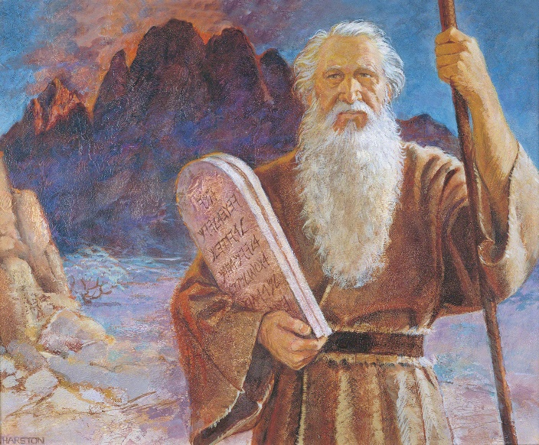
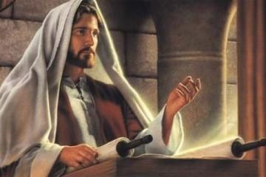
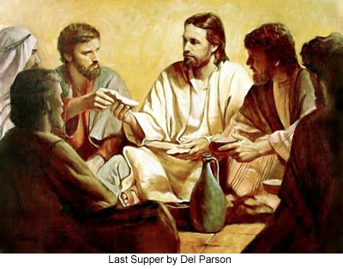
To Fulfill the Law of Moses
Jesus came to fulfill the law of Moses, not to destroy, or do away with, any of the eternal truths in the law of Moses.
Jesus Christ restored the fulness of the gospel that had been lost due to wickedness and apostasy, corrected false teachings, and fulfilled the prophecies made by Old Testament prophets.
Eventually, as part of the Restoration of the fulness of the gospel, some aspects of the law of Moses were discontinued, such as circumcision and animal sacrifice.
Matthew 5:17-20
Del Parson

Slide 29
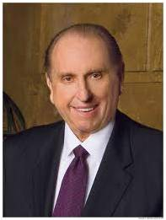
True Meaning of the laws
A higher way of righteousness.
Members of His kingdom must live this higher law. These higher laws provided guidance to help disciples of Jesus Christ avoid breaking God’s commandments.
“To be angry is to yield to the influence of Satan. No one can make us angry. It is our choice. If we desire to have a proper spirit with us at all times, we must choose to refrain from becoming angry. I testify that such is possible. …
“… We are all susceptible to those feelings which, if left unchecked, can lead to anger. We experience displeasure or irritation or antagonism, and if we so choose, we lose our temper and become angry with others. Ironically, those others are often members of our own families—the people we really love the most. …
“May we make a conscious decision, each time such a decision must be made, to refrain from anger.” (2)
Illuminate Anger
Matthew 5:22

Slide 30
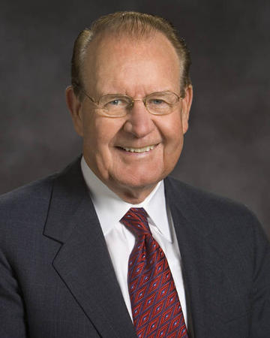
Agreeing with one’s adversary means working out disagreements before they lead to a worse situation.
Work out disagreements
“… commanding us to resolve our differences early on, lest the passions of the moment escalate into physical or emotional cruelty, and we fall captive to our anger. Nowhere does this principle apply more than in our families.” (3)
Illuminate Anger
Matthew 5:25

Slide 31
“Why is lust such a deadly sin? Well, in addition to the completely Spirit-destroying impact it has upon our souls, I think it is a sin because it defiles the highest and holiest relationship God gives us in mortality—the love that a man and a woman have for each other and the desire that couple has to bring children into a family intended to be forever. …
Do Not Lust After Others
Work out disagreements
Love makes us instinctively reach out to God and other people. Lust, on the other hand, is anything but godly and celebrates self-indulgence.
Love comes with open hands and open heart; lust comes with only an open appetite.” (4)
Illuminate Anger
Matthew 5:27-28

Slide 32
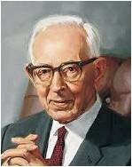
The Joseph Smith Translation makes it clear that the Savior did not encourage His followers to literally cut or disfigure themselves.
Remove yourself from sin
Do Not Lust After Others
Work out disagreements
“…close friends or relatives who [endeavor] to lead us from the path of rectitude and humble obedience to the divine commandments we receive from the Lord. If any friend or relative endeavors to lead a person away from the commandments, it is better to dispense with his friendship and association than to follow him in evil practices to destruction.” (5)
Illuminate Anger
Matthew 5:29-30

Slide 33
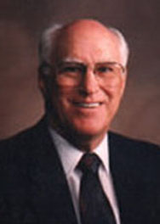
Thou shalt not avenge, nor bear any grudge against the children of thy people, but thou shalt love thy neighbour as thyself: I am the Lord.
Leviticus 19:18
Love Thy Neighbors
Remove yourself from sin
Do Not Lust After Others
Work out disagreements
“A man [or woman] who loves his [her] neighbor will not only avoid doing wrong to him, but will deliberately help him…
…Not only are we to help in time of trouble, but we are actually obligated to take steps to prevent physical harm from coming to a neighbor…
…one’s neighbor is anyone who is in need; he [she] also shows that neighborliness consists of ministering to that need.” (6)
Illuminate Anger
Matthew 5:43-47

Slide 34
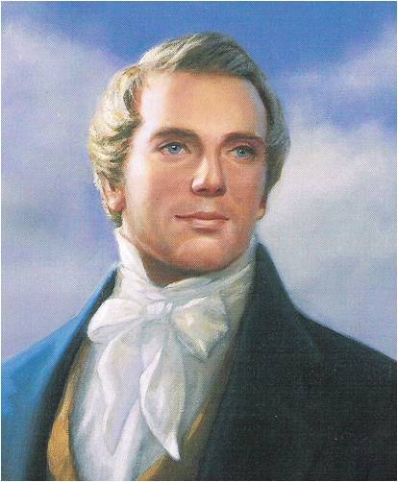
“When you climb up a ladder, you must begin at the bottom, and ascend step by step, until you arrive at the top; and so it is with the principles of the gospel—you must begin with the first, and go on until you learn all the principles of exaltation.
But it will be a great while after you have passed through the veil before you will have learned them. It is not all to be comprehended in this world; it will be a great work to learn our salvation and exaltation even beyond the grave’” (7)
Jesus Christ commanded us to be perfect like Heavenly Father

Slide 35
As always, Christ is our exemplar. In His teachings as in His life, He showed us the way.
He forgave the wicked, the vulgar, and those who sought to hurt and to do Him harm.
Jesus said it is easy to love those who love us; even the wicked can do that.
But Jesus Christ taught a higher law. His words echo through the centuries and are meant for us today. They are meant for all who desire to be His disciples.
They are meant for you and me: “Love your enemies, bless them that curse you, do good to them that hate you, and pray for them which despitefully use you, and persecute you”.
When our hearts are filled with the love of God, we become “kind one to another, tenderhearted, forgiving [each other], even as God for Christ’s sake [forgave us]”.
(8)
Matthew 5:43-47; Ephesians 4:32

Slide 36
Which Commandment is the Most Difficult to Keep?
Be ye therefore perfect, even as your Father which is in heaven is perfect.
Be: JST Matt. 5:50 Ye are therefore commanded to be perfect …
Perfect = complete, finished, fully developed.
Father = Elohim.
Perfect = Perfection of God
Sources:
To become complete or fully developed means to become like Heavenly Father.
Matthew 5:48
“Be ye therefore perfect, even as your Father which is in heaven is perfect. Matthew 5:48

Slide 37
“The term perfect was translated from the Greek teleios, which means ‘complete.’ …
The infinitive form of the verb is teleiono, which means ‘to reach a distant end, to be fully developed, to consummate, or to finish.’
Please note that the word does not imply freedom from error; it implies achieving a distant objective. …
“We need not be dismayed if our earnest efforts toward perfection now seem so arduous and endless.
Perfection is pending. It can come in full only after the Resurrection and only through the Lord. It awaits all who love him and keep his commandments.”
“We all need to remember: men are that they might have joy—not guilt trips!
We also need to remember that the Lord gives no commandments that are impossible to obey. But sometimes we fail to comprehend them fully.”
(1)

Slide 38
Sources:
Suggested Hymn: #308 As I Have Loved You
Videos: The Sermon on the Mount: The Higher Law (2:19)
The Healing Power of Forgiveness (1:45)
Elder Russell M. Nelson (“Perfection Pending,” Ensign, Nov. 1995, 86, 88).
President Thomas S. Monson (“School Thy Feelings, O My Brother”), Ensign or Liahona, Nov. 2009, 68–69).
Elder David E. Sorensen (“Forgiveness Will Change Bitterness to Love,” Ensign or Liahona, May 2003, 11).
Elder Jeffrey R. Holland (“Place No More for the Enemy of My Soul,” Ensign or Liahona, May 2010, 44–45).
President Joseph Fielding Smith (Answers to Gospel Questions, 5 vols. [1957–66], 5:79).
Robert J. Matthews What “Loving Your Neighbor” Really Means Oct. 1975 General Conf.
Teachings: Joseph Smith, 268.
Dieter F. Uchtdorf, “The Merciful Obtain Mercy,” Ensign or Liahona, May 2012, 76)
Presentation by ©http://fashionsbylynda.com/blog/

Slide 39
Matthew 5:22 The word raca comes from an Aramaic word meaning “imbecile, fool, or empty-headed person.”
“Profane and vulgar expressions vary from nation to nation and age to age, but the intent of this passage is to condemn any language which conveys improper feelings about another.” Elder Bruce R. McConkie(Doctrinal New Testament Commentary, 3 vols. [1965–73], 1:222).
What are jots and tittles? Matthew 5:18
A jot is the smallest letter in the Hebrew alphabet. A tittle is a small marking indicating different pronunciation of words in written language. The Savior referred to these elements of writing to indicate that He would fulfill every part of the law of Moses down to the smallest detail.
Matthew 5:22 Anger
“A cunning part of [Satan’s] strategy is to dissociate anger from agency, making us believe that we are victims of an emotion that we cannot control. … The Lord expects us to make the choice not to become angry. … When the Lord eliminates the phrase ‘without a cause,’ He leaves us without an excuse. …
“Anger is a yielding to Satan’s influence by surrendering our self-control. It is the thought-sin that leads to hostile feelings or behavior. … Understanding the connection between agency and anger is the first step in eliminating it from our lives” Elder Lynn G. Robbins(“Agency and Anger,” Ensign, May 1998, 80–81).
Matthew 5:27-28 Lust/Pornography
Elder Dallin H. Oaks of the Quorum of the Twelve Apostles spoke about the effects of pornography—a prevalent cause and promoter of lust—on those who view it: “Pornography impairs one’s ability to enjoy a normal emotional, romantic, and spiritual relationship with a person of the opposite sex. It erodes the moral barriers that stand against inappropriate, abnormal, or illegal behavior. As conscience is desensitized, patrons of pornography are led to act out what they have witnessed, regardless of its effects on their life and the lives of others” (“Pornography,” Ensign or Liahona, May 2005, 89).
Matthew 5:43 Love Your Neighbors
The commandment “Love thy neighbour” is found in Leviticus 19:18, but no scripture in the Old Testament commands us to hate thine enemy. It appears the Savior was referring to a saying common in His day. The discovery of the Dead Sea Scrolls in 1946 may reveal that some Jews at the time of Christ did in fact teach that they should love fellow members of their community but hate outsiders (see Dana M. Pike, “Is the Plan of Salvation Attested in the Dead Sea Scrolls?” in Donald W. Parry and Dana M. Pike, eds., LDS Perspectives on the Dead Sea Scrolls [1997], 93, note 19).

Slide 40
Sermon on the Plain
Luke 6
Presentation by ©http://fashionsbylynda.com/blog/

Slide 41
Who Will Serve?
Announcement during Church meeting on Sunday:
A service project for a family that lives nearby.
“That family has been through a lot lately. I am happy to help in any way that I can
“I don’t really want to go, but I could use some help next week with a project that I’m organizing, so I should probably help out now.”
There had better be refreshments afterward, because if there aren’t, I’m not going.
If my friend is going, I will go

Slide 42
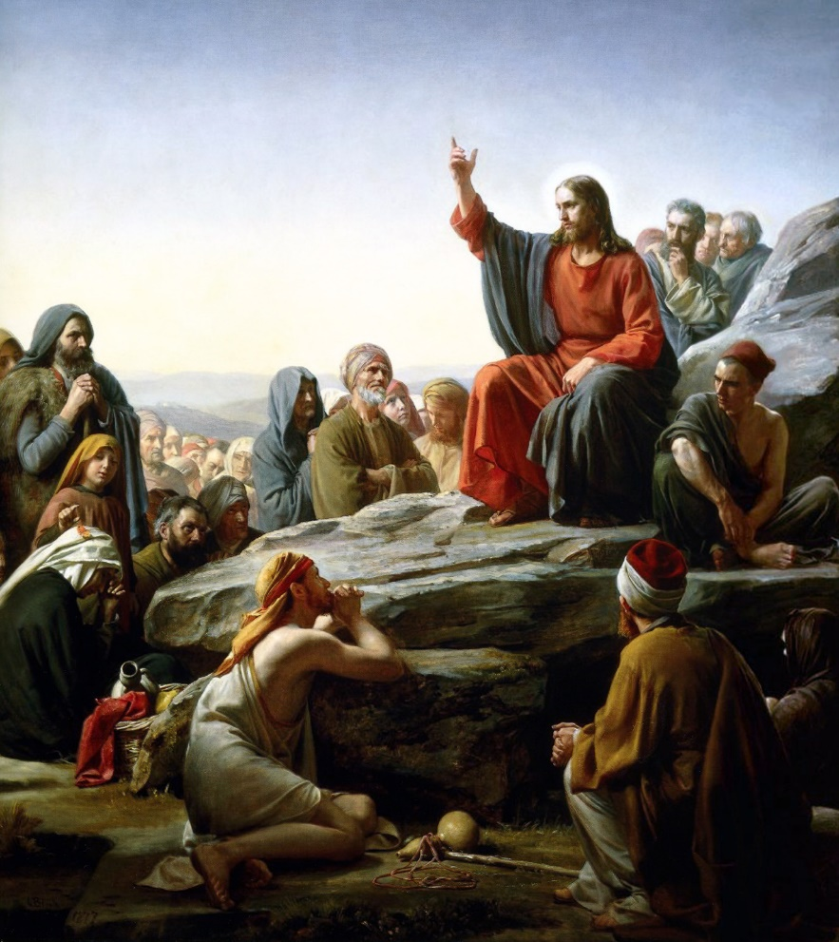
Jesus in Galilee
Capernaum
Besaida
Gennesaret
While Jesus was in Galilee early in His ministry, He healed a man’s withered hand on the Sabbath, spent a night in prayer, and called the Twelve Apostles. Jesus then began to teach them and “a great multitude of people” how to receive heavenly rewards.
Galilee
Sea of Galilee
Luke 6:17

Slide 43
Matthew 5-7
“Came down from the mountain”
Luke 6-7
Stood on the plain
It is unclear whether “the plain” refers to a low place apart from the mountain or a plateau within the mount.
Because of this uncertainty, there are varying views regarding whether the Sermon on the Mount recorded by Matthew and the Sermon on the Plain recorded by Luke were the same or different events. However, the chronological placement and the context of Luke’s record seem to indicate that the same sermon is being recorded in Luke 6 and Matthew 5–7.
(1)

Slide 44
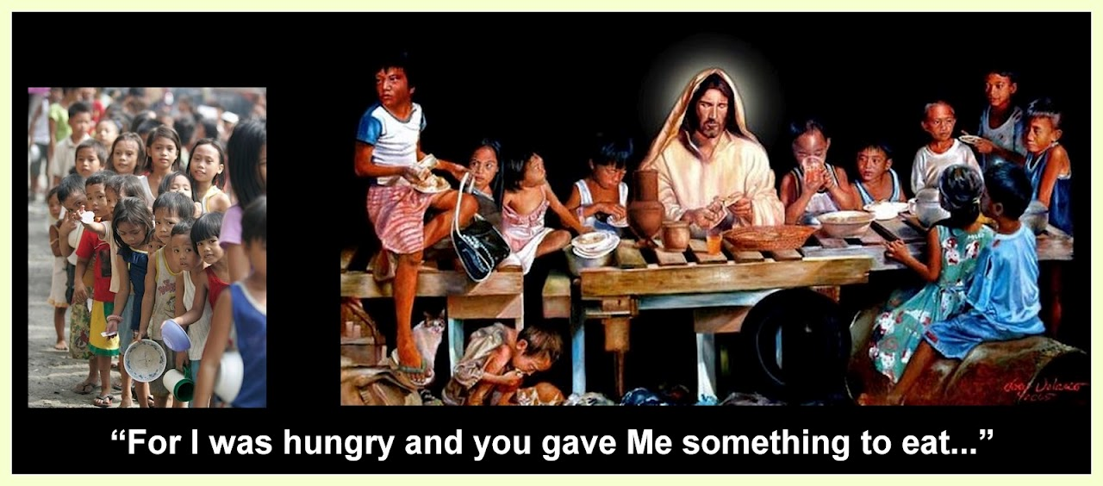
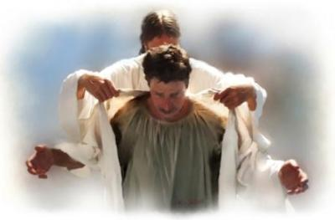
Blessings—Luke 6:20-23
Blessed be ye the poor
Blessed are ye that hunger now
Blessed are ye that weep now
Blessed are ye, when men shall hate you…
For yours is the Kingdom of God
For ye shall be filled
For ye shall laugh
Your reward is great in heaven
Greg Olsen

Slide 45
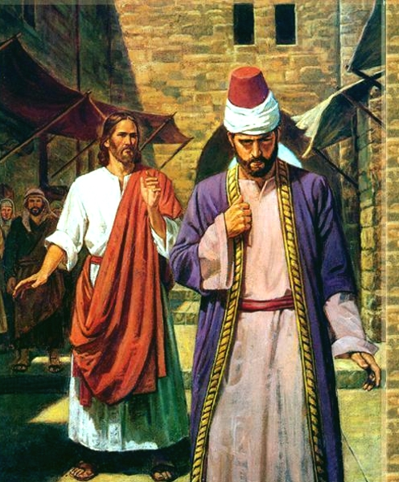
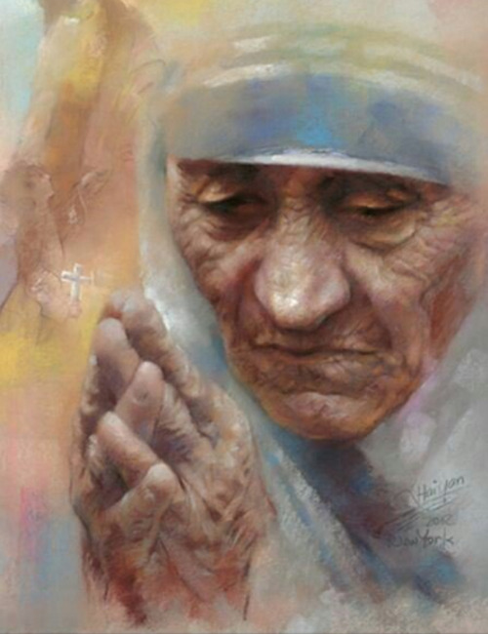
Woes—Luke 6:24-26
Woe unto you that are rich
Woe unto you that are full
Woe unto you that laugh now
Woe unto you, when men shall speak ill of you
For ye have received your consolation
For ye shall hunger
For ye shall mourn and weep
For so did their fathers to the false prophet

Slide 46
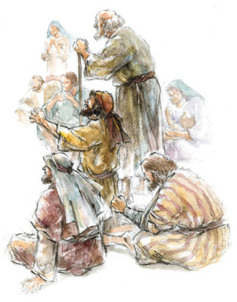
The Higher Law—Luke 6:31-35
Love your enemies
Him that taketh away thy cloak forbid not to take thy coat also
Pray for them which despitefully use you
Do good to them which hate you
Unto him that smiteth thee on the one cheek offer also the other
Give to every man that asketh of thee
As ye would that men should do to you, do ye also to them likewise.
If we do good to others without expecting anything in return, our reward will be great and we will be the children of the Highest

Slide 47
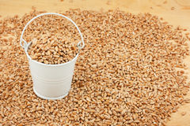
The Harvest Bucket
“Pressed Down, and Shaken Together, and Running Over”
A harvest basket that has been filled with produce beyond the specified amount.
Then the contents of the basket have been “pressed down” and “shaken together” so that even more produce can be added—until the basket is “running over.”
Those give in abundance will in turn receive from others the same measure of generosity.
(1)

Slide 48
Sources:
New Testament Institute Student Manual Chapter 16
Presentation by ©http://fashionsbylynda.com/blog/

Slide 49
Event | Matthew | Mark | Luke | John
Jesus is Lord of the Sabbath | 12:1-8 | 2:23-28 | 6:1-5
Jesus Heals Man With Withered Hand on the Sabbath | 12:9-14 | 3:1-6 | 6:6-11
Call and Ordination of the Twelve Apostles | 10:2-4 | 3:13-19 | 6:12-16
The Sermon on the Mount | 5, 6, 7 |  | 6:17-49
Sermon on the Plain: Luke 6
"In his sixth chapter Luke records an event similar to the 'Sermon on the Mount' but places it on the plain after Jesus had come down from the mountain, having just ordained the Twelve (Luke 6:10-17). There is a question whether these are two different sermons or two accounts of one sermon. It has been noted that Matthew's account is to disciples only, whereas Luke's account seems to include a multitude as well as the disciples (see Luke 6:17-20). It is possible that Jesus gave instructions on the mount to the Twelve and then came down with the Twelve and delivered portions to the multitude on the plain. The specific instruction that was given only to the disciples about not having a preoccupation with food and clothing (as in Matt. 6:25, 34, noted earlier), and the references to the 'salt of the earth' and the 'light of the world' are not found in Luke's account, which would be proper if the Sermon on the Plain was directed to the multitude generally and not to the Twelve specifically. Although the Twelve were present, there would be no need to repeat that which he had spoken specifically to them on the mount a few hours before." (Robert J. Matthews, Behold the Messiah [Salt Lake City: Bookcraft, 1994], 122.)
List of Woes: Luke 6: 24-26:
Absent from the Matthew account of the beatitudes, is this short list of "woes for the wicked." They contain the universal truth that those who have been blessed temporally while ignoring the things of the spirit will suffer the inevitable consequences. Hence, "there is a law, irrevocably decreed in heaven before the foundations of this world, upon which all cursings are predicated-And when we obtain any cursing from God, it is by disobedience to that law upon which it is predicated" (see DC 130:20-21). Thus, the man who was rich as to temporal things will find himself the poorest of all on judgment day. Those whose stomachs were always full will finally feel hunger-only to realize that spiritual hunger pangs are even more acute than physical ones. Those whose mortal lives were filled with fun and laughter will mourn and weep when they realize they have wasted away 'the days of [their] probation' (2 Ne. 9:27). Gospel doctrine.com

