Slide 1
Matthew 6 and 7

Slide 2
Matthew 6:1-18
The Savior Teaches His Disciples to Do Righteous Works

Slide 3
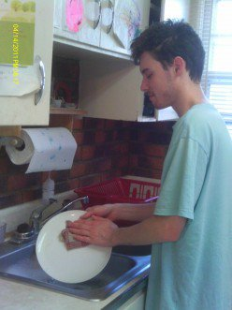
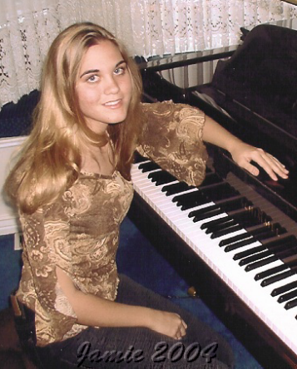
What do We do to Get Rewards?
Getting good grades?
Hugging mom?
Helping at home?
Cleaning your room?
Practicing an art?

Slide 4
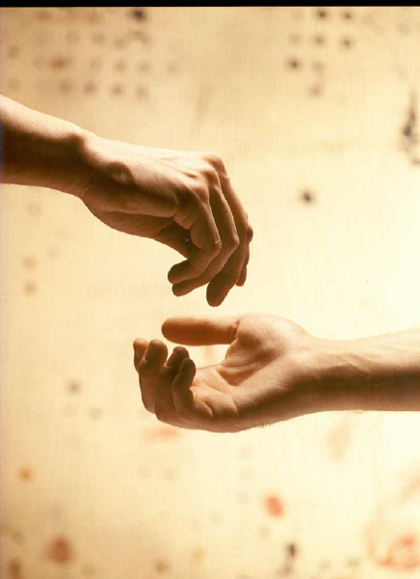
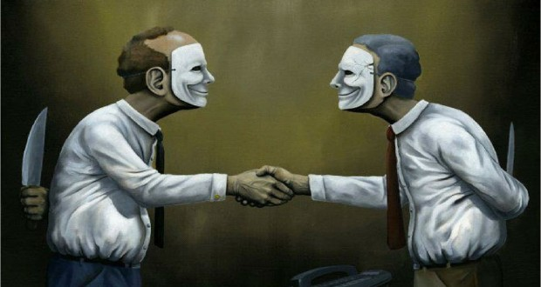
Improper Motives For a Reward
And it came to pass that, as Jesus taught his disciples, he said unto them, Take heed that ye do not your alms before men, to be seen of them: otherwise ye have no reward of your Father which is in heaven.
Alms = righteousness, acts of religious devotion.
Hypocrite = pretenders; the Greek word means “a play actor,” or “one who feigns, represents dramatically, or exaggerates a part.
Calling attention to oneself while they are performing a service or an act

Slide 5
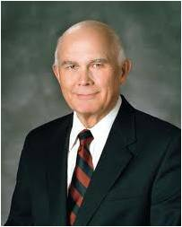
“Some may serve for hope of earthly reward. Such a man or woman might serve in Church positions or in private acts of mercy in an effort to achieve prominence or cultivate contacts that would increase income or aid in acquiring wealth. Others might serve in order to obtain worldly honors, prominence, or power. …
“In contrast, those who serve quietly, even ‘in secret,’ qualify for the Savior’s promise that ‘thy Father, who seeth in secret, shall reward thee openly.’
“‘Charity is the pure love of Christ.’ The Book of Mormon teaches us that this virtue is ‘the greatest of all.’
If we perform righteous acts to please Heavenly Father, then He will reward us openly. If we perform righteous acts to be seen of others, we will not receive heavenly blessings for our efforts.
“If our service is to be most efficacious, it must be accomplished for the love of God and the love of his children. …
“I know that God expects us to work to purify our hearts and our thoughts so that we may serve one another for the highest and best reason, the pure love of Christ.”
Matthew 6:1-6, 16,18; Moroni 7:46-47; 3 Nephi 13:18
(2)

Slide 6
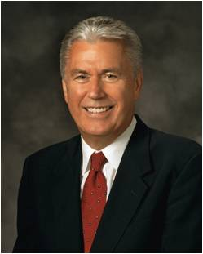
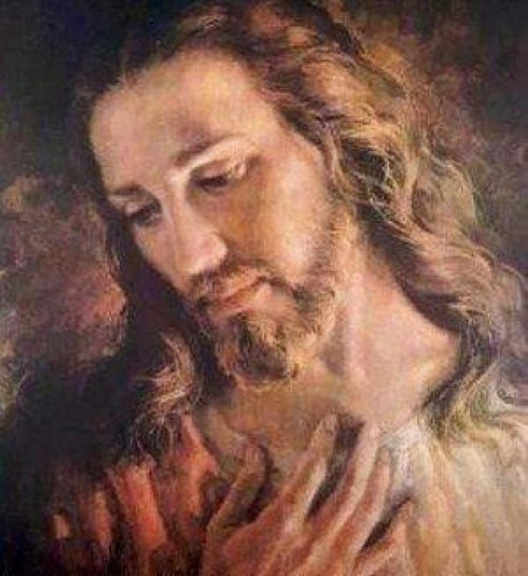
Why Do We Serve?
The greatest, most capable, most accomplished man who ever walked this earth was also the most humble.
He performed some of His most impressive service in private moments, with only a few observers, whom He asked to “tell no man” what He had done.
When someone called Him “good,” He quickly deflected the compliment, insisting that only God is truly good.
Clearly the praise of the world meant nothing to Him; His single purpose was to serve His Father and “do always those things that please him”.
We would do well to follow the example of our Master.
(19)
Luke 8:56; Mark 10:17-18; John 8:29

Slide 7
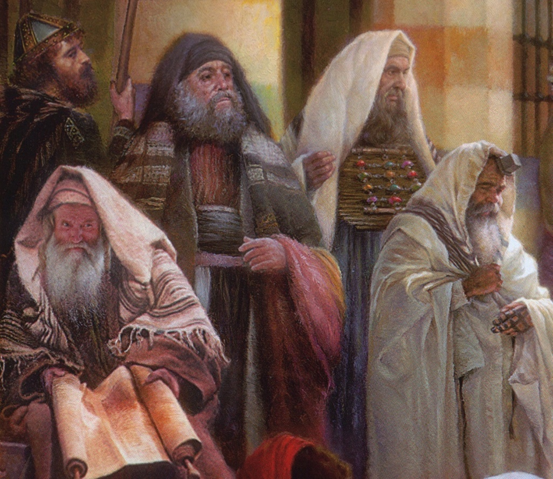
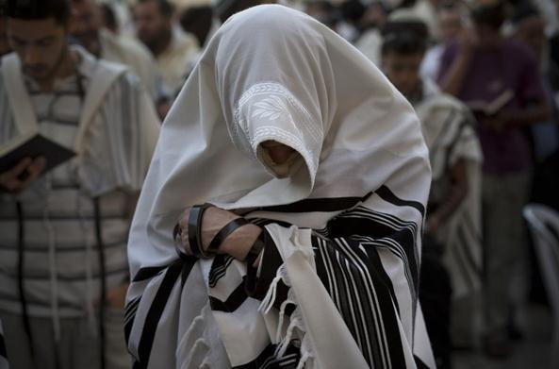
Prayer Practices
“Devout Jews, at set times, faced Jerusalem, covered their heads, cast their eyes downward, and ostentatiously went through the ritual of prayer.
If the hour of prayer found them in the streets, so much the better, for all men would see their devoutness!
“To attract attention by saying one’s own prayers aloud in the synagogue was not uncommon. Such were among the practices of the day.”
Matthew 6:4-6
(3)

Slide 8
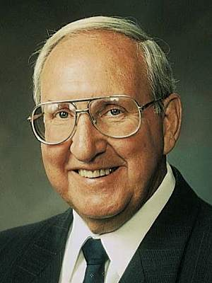
Pray in Your Closets
“…What happens to us when we pray in secret?
First, our faith is put to the test.
When we pray alone, there is no one to impress….
We take problems that no one else, not another living soul, can help us with.
We become like little children…
We do not have to worry about embarrassment if our prayers are not answered the way we think they should be, because only we and God know for what we pray.
We can be totally honest, knowing that we cannot lie to or deceive the Spirit or God.
When we have personal problems or struggles, we can pray and know that these things are kept totally confidential.
We can discuss our weaknesses, our sins, our frustrations, our needs, and know that He will listen and respond."
If we perform acts of devotion to please Heavenly Father rather than to seek the attention of others, then He will reward us openly
Matthew 6:6
(4)

Slide 9
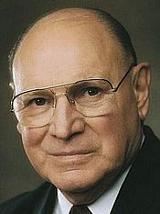
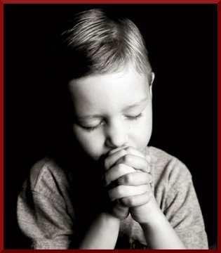
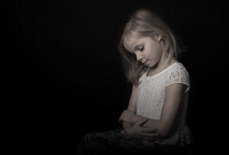
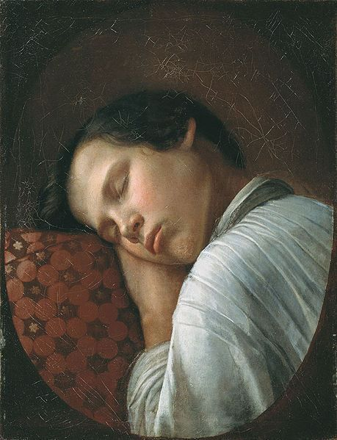
Vain Repetitions
“Our prayers become hollow when we say similar words in similar ways over and over so often that the words become more of a recitation than a communication.
This is what the Savior described as ‘vain repetitions’. …
“Do your prayers at times sound and feel the same?
Have you ever said a prayer mechanically, the words pouring forth as though cut from a machine?
Do you sometimes bore yourself as you pray?
Matthew 6:7
(5)

Slide 10
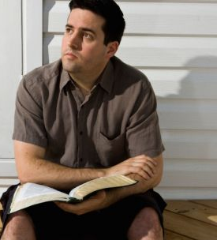
Improving Our Prayers
“Will prayers that do not demand much of your thought merit much attention from our Heavenly Father?
When you find yourself getting into a routine with your prayers, step back and think. Meditate for a while on the things for which you really are grateful. Look for them. They don’t have to be grand or glorious. …
“Think of those things you truly need.
Bring your goals and your hopes and your dreams to the Lord and set them before Him. Heavenly Father wants us to approach Him and ask for His divine aid.”
Matthew 6:7
(5)

Slide 11
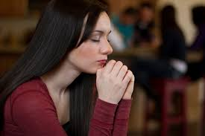
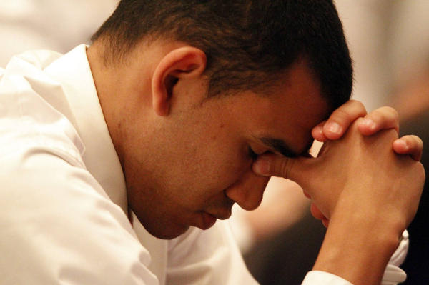
Your Father Knoweth
Some people might ask what purpose is served in asking for blessings if Heavenly Father already knows what we need.
Through prayer we acknowledge our dependence on the Lord, exercise our faith in His ability to bestow desired blessings, and acknowledge that ultimately all blessings come from Him.
Approached properly, prayer helps us evaluate our lives and align with the will of God.
Matthew 6:8
(6)

Slide 12
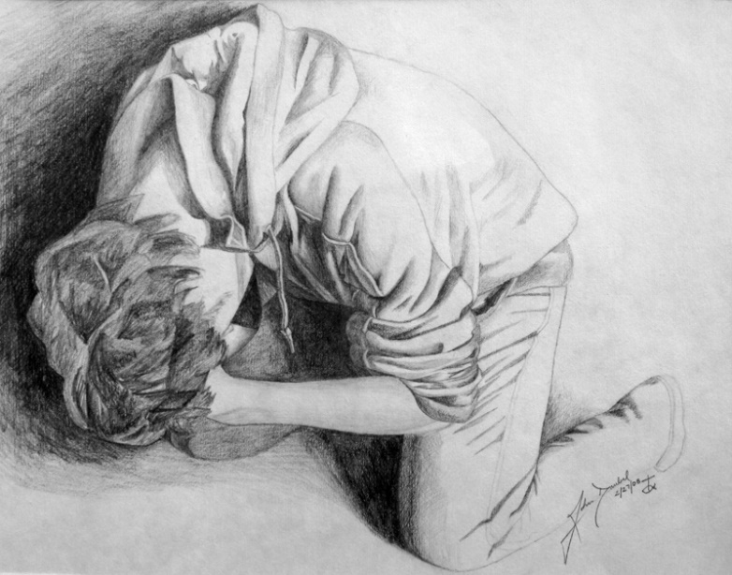
Prayer
“Prayer is the act by which the will of the Father and the will of the child are brought into correspondence with each other.
The object of prayer is not to change the will of God but to secure for ourselves and for others blessings that God is already willing to grant but that are made conditional on our asking for them.
Blessings require some work or effort on our part before we can obtain them. Prayer is a form of work and is an appointed means for obtaining the highest of all blessings”
Rick Moore
(7)

Slide 13
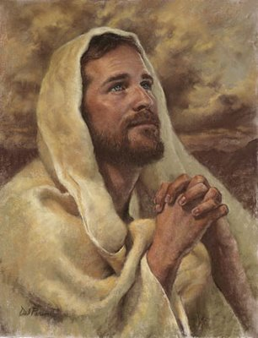
After This Manner Therefore Pray Ye
“The Lord’s Prayer serves as a pattern to follow and not as a piece to memorize and recite repetitively.” (8)
How can we enrich our own prayers and our own witness of the truth of Jesus’ message?

Slide 14
Hallowed Be Thy Name
“When we go to worship in a temple or a church, we put aside our working clothes and dress ourselves in something better.
This change of clothing is a mark of respect.
Similarly, when we address our Heavenly Father, we should put aside our working words and clothe our prayers in special language of reverence and respect.
In offering prayers in the English language, members of our church do not address our Heavenly Father with the same words we use in speaking to a fellow worker, to an employee or employer, or to a merchant in the marketplace.
We use special words that have been sanctified by use in inspired communications, words that have been recommended to us and modeled for us by those we sustain as prophets and inspired teachers.
Thee
Thou
Thy
Thine
“The special language of prayer follows different forms in different languages, but the principle is always the same.
We should address prayers to our Heavenly Father in words which speakers of that language associate with love and respect and reverence and closeness.”
Matthew 6:9
(2)

Slide 15
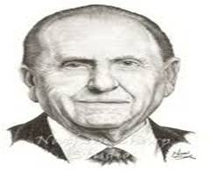
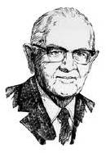
Thy Kingdom Come
“The Church is steadily growing; it has since its organization over 178 years ago. …
There remain, however, areas of the world where our influence is limited and where we are not allowed to share the gospel freely.
As did President Spencer W. Kimball over 32 years ago, I urge you to pray for the opening of those areas, that we might share with them the joy of the gospel. As we prayed then in response to President Kimball’s pleadings, we saw miracles unfold as country after country, formerly closed to the Church, was opened. Such will transpire again as we pray with faith.”
Matthew 6:10
(9)

Slide 16
Thy Will Be Done—on Earth—In Heaven
Praying for His will to be done and then not trying to live it, gives you a negative answer at once.
If we pray for the success of some cause or enterprise, manifestly we are in sympathy with it. It is the height of disloyalty to pray for God's will to be done, and then fail to conform our lives to that will.” (10)
Our thoughts should be brought to that point upon every occasion when we approach the Lord, that his will in us may be done as it is done in heaven.” (11)
Matthew 6:10

Slide 17
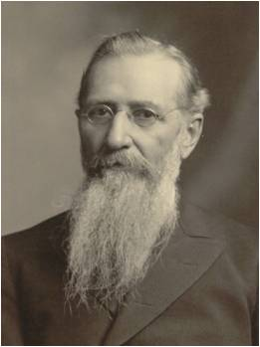
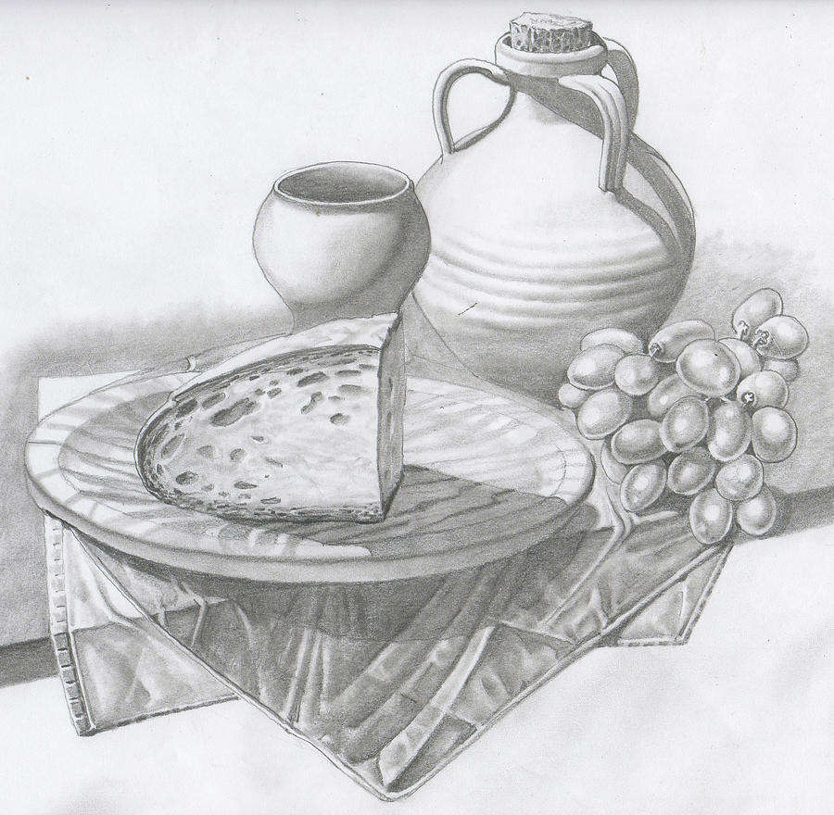
Daily Bread—The Lord Will Feed
Are we to sit in perpetual idleness and ask the Lord to give us our daily bread?
Are we to think that our food is His responsibility, that if we are hungry, it is His fault?
As with all blessings, those of temporal prosperity come only after diligence and obedience.
“We thank Him for the blessings that we enjoy, and we acknowledge His goodness and mercy in bestowing upon us the blessings that we possess.
But we do not have to repeat the Lord's prayer, every day, which was given to His ministry, the apostles in ancient times when they were sent out like lambs in the midst of wolves, and He taught them that they were not to take thought of what they should eat or what they should drink, or wherewithal they should be clothed; that the Lord would feed them; that the Lord would open the hearts of those they ministered unto, to provide for their necessities.” (12)
Matthew 6:11

Slide 18
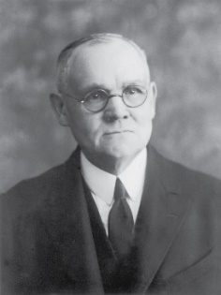
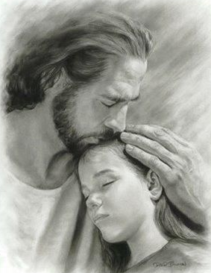
forgiveness
"Forgiveness is too precious a pearl to be cast at the feet of the unforgiving; and, without the sincerity that springs from a contrite heart, no man may justly claim mercy.
If others owe us, either in actual money or goods as suggested by debts and debtors, or through some infringement upon our rights included under the broader designation as a trespass, our mode of dealing with them will be taken into righteous account in the judgment of our own offenses." (1)
I, the Lord, will forgive whom I will forgive, but of you it is required to forgive all men. D&C 64:10
Matthew 6:12, 14

Slide 19
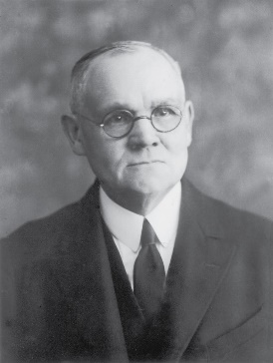
Lead Us Not Into Temptation
The Joseph Smith Translation clarifies that the Lord does not lead us into temptation:
“And suffer us not to be led into temptation, but deliver us from evil” (JST Matthew 6:14)
“We are not to understand that God would ever lead a man into temptation except, perhaps, by way of wise permission, to test and prove him, thereby affording him opportunity of overcoming and so of gaining spiritual strength ...
The intent of the supplication appears to be that we be preserved from temptation beyond our weak powers to withstand;
Can such souls as these be other than hypocrites in asking God to deliver them from the evils they have sought?
Temptation will fall in our way without our seeking, and evil will present itself even when we desire most to do right; …”
Click Here!
Matthew 6:13
(1)

Slide 20
Seek Ye First the Kingdom of God
Matthew 6:19-37
… but that ye may do these things to lay up for yourselves a treasure in heaven, yea, which is eternal, and which fadeth not away; yea, that ye may have that precious gift of eternal life, which we have reason to suppose hath been given to our fathers.
Helaman 8:5

Slide 21
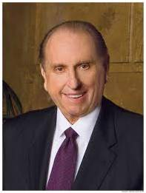
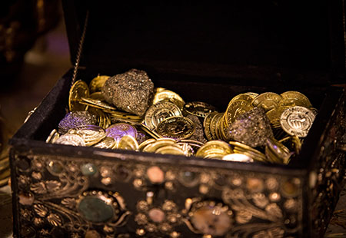
Treasures in Heaven
Treasures to mean what we value greatly,
Where is your treasure?
How much time is spent?
How much money is spent?
How much devotion is put into it?
“The promised reward was not a treasure of ivory, gold, or silver. Neither did it consist of acres of land or a portfolio of stocks and bonds.
The Master spoke of riches within the grasp of all—even joy unspeakable here and eternal happiness hereafter.”
Matthew 6:19-21
(9)

Slide 22
If Therefore Thine Eye Be Single
Single = sound, healthy, simple, sincere
Giving alms, praying, and fasting should all be done with a simple and sincere focus on our Father in Heaven or on the recipient.
And if your eye be single to my glory, your whole bodies shall be filled with light, and there shall be no darkness in you; and that body which is filled with light comprehendeth all things. D&C 88:67
When I give to the poor, do I hope to bring glory to God or to myself?
When I serve the Lord, am I doing so to receive approval from the Lord or from men?
When I pray in public, am I addressing God or those in the congregation?
Matthew 6:22-23
(6)

Slide 23
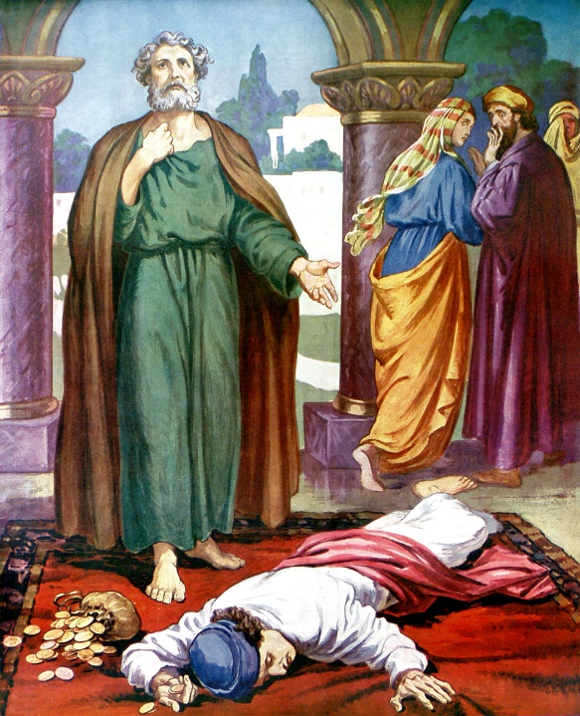
No man can serve two masters
'Some would never sell Jesus for thirty pieces, but they would not give Him their all either! Unfortunately, we tend to think of consecration only in terms of property and money. But there are so many ways of keeping back part.
One might be giving of money and time and yet hold back a significant portion of himself...
One might accept a Church calling but have his heart more set on maintaining a certain role in the world...
Each of us is an innkeeper who decides if there is room for Jesus! Consecration is the only surrender which is also a victory. It brings release from...selfishness and emancipation from the dark prison of pride...
Consecration may not require giving up worldly possessions so much as being less possessed by them...”
See Acts 5:1-11
Matthew 6:24
(13)

Slide 24
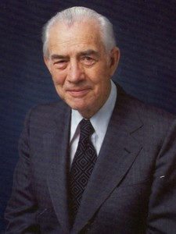
Mammon comes from an Aramaic term meaning “worldly riches” or “wealth.” (6)
We cannot serve both God and mammon
“Must we not recognize now that we cannot serve two masters? If we should try, the Lord will reject us. He will never be found in tandem with Lucifer, so let us not try to put Him there.”
Mammon = To set our hearts on worldly things in a way leads us away from God.
God
Mammon
Matthew 6:24
(14)

Slide 25
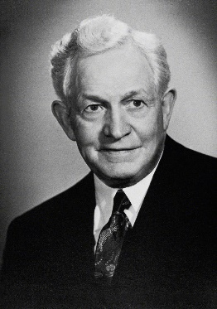
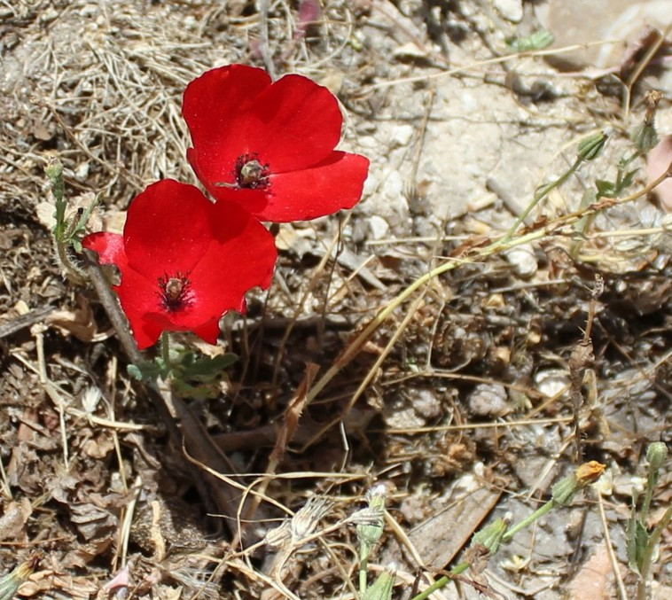
Consider the Lilies of the Field
“Let us consider the lily in the field.
It is buried in the ground with a root, which strikes out in the darkness to receive strength and moisture from the soil; and soon a stalk pushes its way through the earth, and pushes it up and up until finally the lily blooms in the sunshine and produces its kind.”
Mount of Olives May 2016
Matthew 6:28-29
(16)

Slide 26
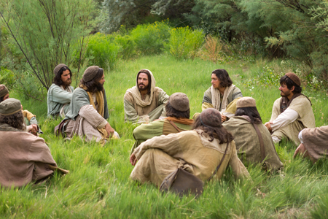
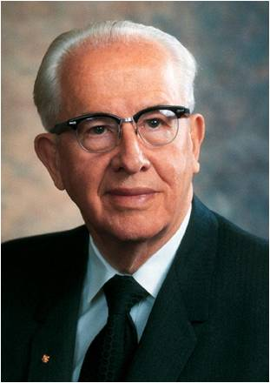
Seek the Kingdom First
No Thought = anxious concern
The Savior instructed His disciples to not be excessively anxious about providing for their basic needs.
The Lord is teaching all of us that we are not to let worldly concerns cause us to lose trust in our Father in Heaven or become diverted from seeking His kingdom. (6)
“We must put God in the forefront of everything else in our lives. …
“When we put God first, all other things fall into their proper place or drop out of our lives. Our love of the Lord will govern the claims for our affection, the demands on our time, the interests we pursue, and the order of our priorities.
“We should put God ahead of everyone else in our lives”
Matthew 6:25-34
(15)

Slide 27
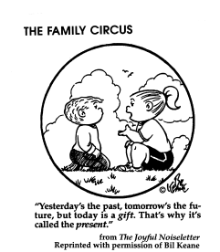
Sufficient unto the day is the evil thereof
Evil = is used in this phrase to mean the troublesome, annoying, problems of everyday life.
In the Matthew version, it reads, sufficient unto the day is the evil thereof.
In other words, every day brings enough problems that we don't need to waste our time worrying about the problems of tomorrow or the next day.
We should live in the present and concern ourselves with today's issues. Within reason, we are to live life one day at a time.
Matthew 6:25-34
(17)

Slide 28
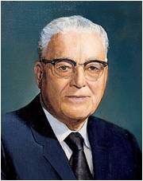
Yesterday
"...the only day you have to worry about is today.
There is nothing you can do about yesterday except repent. That means if you made mistakes yesterday, don't be making them today.
Don't worry about tomorrow, because you may have no tomorrows. This is the masterpiece you ought to be thinking about today.
And if you can always witness honestly that whatever you did, you did to the best of your ability, and next day try improvement on that, when your life's end comes, of you it can be said in truth, his was a successful life because he lived to the best that was in him.
Today
Tomorrow
That's all the Lord expects of any one of His children. We are all born with different capacities, some to do one thing, some to do the other, and all He asks is that we do our best; and that's the measure by which we'll be judged when that time comes."
Matthew 6:34
(18)

Slide 29
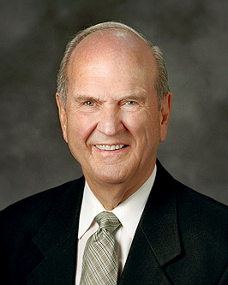
Are you willing to let God be the most important influence in your life? …
Consider how such willingness could bless you. …
If you have sincere questions about the gospel or the Church, as you choose to let God prevail, you will be led to find and understand the absolute, eternal truths that will guide your life and help you stay firmly on the covenant path.
When you are faced with temptation—even if the temptation comes when you are exhausted or feeling alone or misunderstood—imagine the courage you can muster as you choose to let God prevail in your life and as you plead with Him to strengthen you. …
… As you choose to let God prevail in your lives, you will experience for yourselves that our God is “a God of miracles.
(20)
Mormon 9:11

Slide 30
Sources:
James E. Talmage (Jesus the Christ, p. 224-225, 237)
Elder Dallin H. Oaks(“Why Do We Serve?” Ensign, Nov. 1984, 13–15).
(“The Language of Prayer,” Ensign, May 1993, 15–16)
Elder Bruce R. McConkie (The Mortal Messiah: From Bethlehem to Calvary, 4 vols. [1979–81], 2:147).
Excerpts from Vaugh J. Featherstone (The Incomparable Christ: Our Master and Model, 60 - 61.)
Elder Joseph B. Wirthlin (“Improving Our Prayers,” Ensign, Mar. 2004, 24, 26).
New Testament Institute Student Manual
Bible Dictionary
Elder Russell M. Nelson “Lessons from the Lord’s Prayers,” Ensign or Liahona, May 2009, 46.
President Thomas S. Monson (“Welcome to Conference,” Ensign or Liahona, Nov. 2008, 6).
In Search of Treasure Ensign or Liahona, May 2003, 19
President David O. McKay (Pathways to Happiness [Salt Lake City: Bookcraft, 1957], 226.)
Frances M. Lyman (Collected Discourses 1886-1898, ed. by Brian Stuy, vol. 2, Francis M. Lyman, Oct. 6, 1895)
Joseph F. Smith Conference Report, April 1912, 7 – 8
Neal A. Maxwell (Ensign, Nov. 1992, pp. 66-67 as taken from Latter-day Commentary on the Book of Mormon compiled by K. Douglas Bassett, p. 424
Mark E. Peterson “We Believe in Being Honest” April 1982 Gen. Conf.
President Ezra Taft Benson “The Great Commandment—Love the Lord,” Ensign, May 1988, 4).
President David O. McKay Man May Know for Himself: Teachings of President David O. McKay, compiled by Clare Middlemiss, 104.)
Gospeldoctrine.com
President Harold B. Lee (The Teachings of Harold B. Lee, p. 64-5)
Dieter F. Uchtdorf, “On Being Genuine,” Ensign or Liahona, May 2015, 83
Russell M. Nelson, “Let God Prevail,” Ensign or Liahona, Nov. 2020, 94, 95
Presentation by ©http://fashionsbylynda.com/blog/

Slide 31
Alms "The tossing of alms to a beggar, the pouring of offerings into the temple treasure chests, to be seen of men, and similar displays of affected liberality, were fashionable among certain classes in the time of Christ; and the same Spirit is manifest today. Some there be now who cause a trumpet to be sounded, through the columns of the press perchance, or by other means of publicity, to call attention to their giving, that they may have glory of men -- to win political favor, to increase their trade or influence, to get what in their estimation is worth more than that from which they part. With logical incisiveness the Master demonstrated that such givers have their reward. They have received what they bid for; what more can such men demand or consistently expect?" (Jesus the Christ, p. 237)
“Take no thought for your life” and “Take therefore no thought for the morrow”? (Matthew 6:25, 34)
“The Greek phrase that translated to ‘take no thought’ in Matthew 6:25, 34 of the King James Version means to not be overly anxious or worried” (New Testament Student Manual [Church Educational System manual, 2014], 29).
Beware of false teachings: Matthew 7:15-20
“Satan is anxious to confuse our thinking or to lead us astray on important matters. … The Savior … gave us this test to help us choose the truth from among different teachings that might confuse us: “Ye shall know them by their fruits,” He taught ( 3 Nephi 14:16). … Therefore, we should look to the results—“the fruits”—of principles that are taught and the persons who teach them. That is the best answer to many of the objections we hear against the Church and its doctrines and policies and leadership. Follow the test the Savior taught. Look to the fruits—the results.
(Dallin H. Oaks, “The Melchizedek Priesthood and the Keys,” Ensign or Liahona, May 2020, 71).
"The Lord's Prayer is more than just a way of getting through life, a code of morals or a pattern of behavior. It is an appeal to a Father we have known before and hope to dwell with hereafter. It asks for help in carrying out the first and greatest commandment. In this very short prayer, God, man as the child of God, and fellowman are all put in their proper relationship, which is the closest possible family association, approaching identity. The Tempter and his methods are introduced without which the statement of the Gospel plan would be incomplete; for the prayer by its very nature is an appeal from those in distress who are supplicating for something much better than what they have.
"What we want is to dwell in the Father's Kingdom under the sole dominion of his divine will by his power and in his glory forever and ever." Hugh Nibley (Of All Things: Classic Quotations from Hugh Nibley, 2nd ed., edited by Gary P. Gillum [FARMS], 180.)
Matthew 6:34 Sufficient:
"It's basic to realize that we don't run things. We are not in control. We can't make people do anything, and so we have nothing to lose. So don't get flustered and don't worry. Your Heavenly Father is in control." Brigham Young (Brother Brigham challenges the Saints, p. 462)
“Sufficient unto the day is the evil thereof”? (Matthew 6:34)
This phrase means “Don’t borrow trouble from tomorrow—you have enough to deal with today” (New Testament Student Manual, 29).
cubit? (Matthew 6:27)
A cubit was “the ordinary unit of length among the Hebrews; originally the distance from the elbow to the tip of the fingers … [about] 21½ inches in the time of our Lord” (Bible Dictionary, “ Cubit ”).

Slide 32
The Lord’s Prayer Comparison
Matthew 6:9-17 | Luke 11:2-4
Our father which art in heaven | Our Father which art in heaven
Hallowed be thy name | Hallowed be thy name
Thy kingdom come | Thy kingdom come
Thy will be done | Thy will be done
In earth, as it is in heaven. | as in heaven, so in earth.
Give us this day our daily bread, | Give us day by day our daily bread.
And forgive us our debts, | And forgive us our sins;
as we forgive our debtors. | for we also forgive every one that is indebted to us
And lead us not into temptation, | And lead us not into temptation;
But deliver us from evil | But deliver us from evil
For thine is the kingdom, And the power, and the glory, for ever. Amen

Slide 33
Something of Interest --The Three Daily Prayers by Nissan Mindel
Jewish Law makes it our duty to pray three times daily: in the morning, in the afternoon and at nightfall. These prayers are called morning prayer (shacharit), afternoon prayer (minchah) and evening prayer (arvith or maariv ).
Our Sages tell us that the custom of praying three times a day was originally introduced by our Patriarchs, Abraham, Isaac and Jacob. Abraham introduced prayer in the morning, Isaac—in the afternoon, and Jacob added one at night.
When the Torah was given to us at Mount Sinai, our way of life was set out for us by G‑d. Torah means "teaching," "instruction," "guidance"; for the Torah teaches us our way of life in every detail of our daily life. The Torah contains 613 commandments. Among them is the command to "serve G‑d with all our heart and all our soul."⁴ How do we serve G‑d with our heart? By praying to Him. In doing so, we fulfill not only the commandment of praying to G‑d, but also other commandments, such as to love G‑d and to fear Him, which are separate commandments.
During the first one thousand years, or so, since the time of Moses, there was no set order of prayer. Each individual was duty-bound to pray to G‑d every day, but the form of prayer and how many times a day to pray was left to the individual.
There was, however, a set order of service in the The Holy Temple in Jerusalem, known as the Beit Hamikdosh, in connection with the daily sacrifices, morning and evening, while the evening sacrifice extended into the night. On special days, such as Shabbos, Rosh-Chodesh and Festivals, there were also "additional" (musaf) sacrifices.
Accordingly, it was perhaps not unusual for some Jews to pray three times a day, morning, evening and night, in their own way. King David, for example, declared that he prayed three times daily, and Daniel (in Babylon) prayed three times daily facing in the direction of Jerusalem. There is evidence that there were, even during the time of the first Temple in Jerusalem, public places of prayer, called BeitHa'am, which the Chaldeans (Babylonians) destroyed when they destroyed Jerusalem and the Holy Temple.
After the Holy Temple was destroyed and the Jews were led into captivity in Babylon, Jews continued to gather and pray in congregation. The places of prayer became like "small sanctuaries"—Beit Mikdash Me'at, during the years of exile, the children who were born and brought up in Babylon lacked adequate knowledge of the Holy Tongue (Hebrew) and spoke a mixed language. Therefore, when the Jews returned to their homeland after the seventy years' exile was over, Ezra the Scribe together with the Men of the Great Assembly (consisting of prophets and sages, 120 members in all) fixed the text of the daily prayer (Shemone Esrei—the "Eighteen Benedictions"), and made it a permanent institution and duty in Jewish life to recite this prayer three times daily. Ever since then it became part of Jewish Law (Halachah) for each and every Jew to pray this ordained and fixed order of prayer three times daily, corresponding to the daily sacrifices in the Holy Temple, with additional (musaf) prayers on Shabbat, Rosh-Chodesh and Festivals, and a special "closing" prayer (Neilah) on Yom Kippur.
Thus, the main parts of the daily prayers were formulated by our Sages. These included the Shema prayer and Shemone Esrei, which still are the main parts of our morning and evening prayers, while the Shemone Esrei isthe main part of the Minchah service also. The daily Psalm (from Tehillim)which used to be sung by the Levites in the Holy Temple, the Holy Temple in Jerusalem, became part of the morning prayer. Other Psalms of David were included in the morning prayer, and special benedictions before and after theShema were added. By the time the Mishnah was recorded by Rabbi Judah the Prince (about the year 3910—some 500 years after Ezra), and especially by the time the Talmud was completed (some 300 years later, or about 1500 years ago), the basic order of our prayers, as we know them now, had been formulated.
http://www.chabad.org/library/article_cdo/aid/682091/jewish/The-Three-Daily-Prayers.htm

Slide 34
25 ways to Improve Your Prayers
11. The Psalm
Most of us are not songwriters, but most of us are singers. God has said, “For my soul delighteth in the song of the heart; yea, the song of the righteous is a prayer unto me, and it shall be answered with a blessing upon their heads” (D&C 25:12). Notice the Lord said nothing about how well we sing. Sing the hymns as if you had written the words yourself, and they become one of the strongest ways to pray.
12. The Communal Prayer
Many prayers performed by Mormons are for the congregation, too, as with opening prayers in sacrament meeting or Relief Society, but this specifically refers to the Church and to God’s kingdom rolling forth in preparation for the Second Coming of Christ. Most prayers in ancient Israel were communal in that they were prayers for all Israel, and not just for the individual. These prayers can be lifted for missionary work, for humanitarian relief, for our church leaders, for the sincere-hearted of the world to be prepared to receive the gospel.
13. The Prayer in the Temple
For all those whose names have been submitted due to trials or illness, these have a special, profound power not just because of where the prayer takes place, but because of the worthiness of the supplicants.
14. The Prayer for Healing
Often accompanied by fasting and with family and friends participating, these prayers are lifted in emergencies where a loved one is sick or injured. Where the priesthood power is not present, the prayer of faith can bring forth its own miracles.
15. The Prayer of Remembrance
In Old Testament times, the yizkor, or prayer for dead, was thought to aid in their salvation. We utter prayers of remembrance on holidays set apart to remember all our dead, or those who died in battle. We can pray for ancestors to accept the gospel in the spirit world. We can pray for those whose names we take to the temple. Another form of a prayer of remembrance is to recount our spiritual experiences that are the anchors of our faith.
16. The Sacramental Prayer
This is perhaps the only prayer in Mormonism that is pre-written and read verbatim. In fact, it must be perfectly recited, because it is an ordinance with saving power.
17. The Covenantal Prayer
We make covenants at baptism and in the temple, but we also make covenants personally and privately in prayers lifted to our Father in Heaven. We might be reminded of the experience of Lucy Mack Smith, who, ill and near death, covenanted with God that if He would save her life, she would seek Him with all her strength. She recovered, and kept that covenant.
18. The Prayer for Help in Service
This is the prayer of Visiting and Home Teachers as they seek to be perceptive to the needs of the families they teach; also of the Relief Society, Primary, and other auxiliary presidencies as they seek guidance in the service they render. Some members of the Church claim that these prayers are the ones that elicit the most inspiring answers, the most spiritual experiences.
1. The Prayer of Gratitude
The perfect time to acknowledge God’s greatness and loving kindness. It’s always a wonderful experience to just give thanks and not ask for anything.
2. The Prayer for Forgiveness
For this, preparation is needed. We must first acknowledge our distance from God and wish to be reconciled with Him. This is a first step in the repentance process and begins with the realization that our thoughts and actions have offended God.
3. The Prayer Over Sacrifice
One of the great ways to pray is over your tithing and fast offerings, or that quilt you made for humanitarian aid. Notify God that you are making an offering, and you wish it to go to building up the kingdom, helping the poor, or rescuing the afflicted. Send it on its way with a prayer in your heart and try to imagine the people who might benefit from your offering.
4. The Prayer Upon Rising
Does the prayer with which you greet the day differ from the prayer that ends it? Perhaps it should. Productivity, safety, guidance, and the company of the Holy Spirit are all needed as you begin your day. Also thanks for a night’s sleep (whenever you happen to get one) and the realization that you’ve awakened in good shape.
5. The Prayer Upon Retiring
What a great time to review the day and repent of the harsh word, the hasty judgment, the unkind thought. This is when I go child by child and pray for my children.
6. The Acknowledgement of God’s Children Around You
7. The Prayer Before a Meal
If any Mormon prayer has become formulaic, it’s this one. A great family home evening exercise would be to dissect this prayer and see what you’re really after. I am always grateful to have food available when I want it, a blessing unknown to many of God’s children on the earth.
8. The Prayer after a Meal
Mormons don’t do this, but Jews do, and think of the value of thanking God for a meal well-enjoyed after it’s done.
9. The Prayer of Invocation
An invocation is the act or process of petitioning for help or support; a prayer of entreaty (as at the beginning of a service of worship). So, an invocation would be the opening prayer in any church meeting, but could it also be the prayer just as you are leaving for a trip or starting school?
10. The Prayer of Benediction
Surprisingly, a benediction is also an invocation. We invoke blessings from God at the closing of a church meeting or other event. Usually the benediction is the closing prayer, the short blessing with which public worship is concluded, but could it also be the prayer of thanks after a successful trip or semester at school?

Slide 35
Judge Righteously
Matthew 7:1-5
The Savior Taught His Disciples to Judge Righteously
For I, the Lord, will judge all men according to their works, according to the desire of their hearts.
D&C 137:9

Slide 36
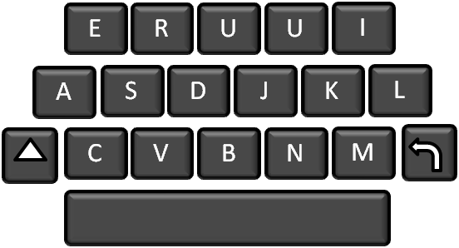
Should We Judge Others?
Mathias Tualima Tunai
Mother Teresa
Albert Einstein
Jesus
Judging a person does not define who they are. It defines who you are.
If you judge people, you have no time to love them.
Everybody is a genius. But if you judge a fish by its ability to climb a tree, it will live its whole life believing that it is stupid.
Judge not, that ye be not judged

Slide 37
Judgment
Sometimes people feel that it is wrong to judge others in any way.
As much as you can, judge people’s situations rather than judging the people themselves.
All your judgments must be guided by righteous standards
Judgment is an important use of your agency and requires great care, especially when you make judgments about other people..
While it is true that you should not condemn others or judge them unrighteously, you will need to make judgments of ideas, situations, and people throughout your life. . . ..
Remember that only God, who knows each individual’s heart, can make final judgments of individuals.
Whenever possible, refrain from making judgments until you have an adequate knowledge of the facts. Always be sensitive to the Holy Spirit, who can guide your decisions”
What types of judgments should we make?
Matthew 7:1 Revelation 20:12; 3 Nephi 27:14; D&C 137:9
(1)

Slide 38
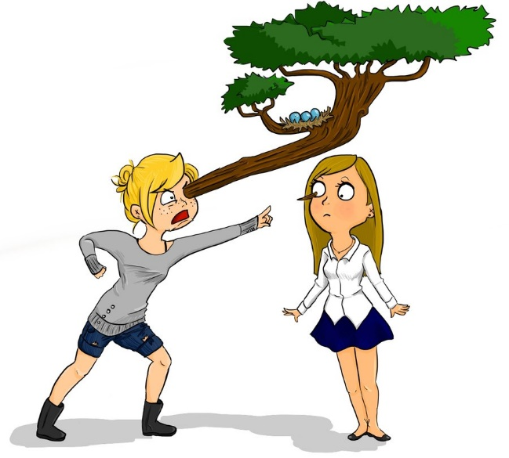
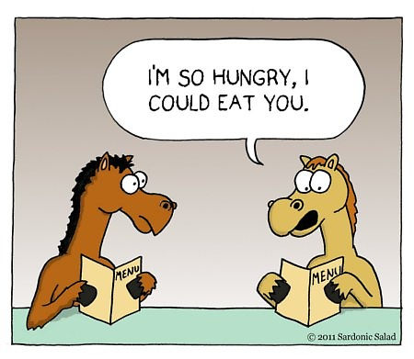
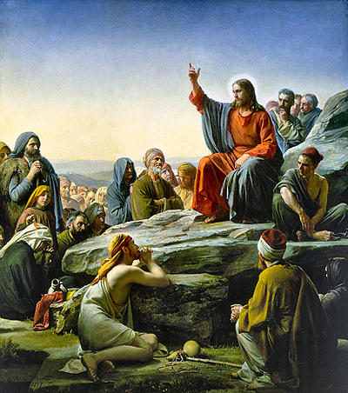
Should We Judge Others?
The Greek word mote = tiny speck, chip, or splinter.
The Greek word beam = a large wooden beam used in constructing houses.
Jimmi Babby
The Savior’s reference to the mote and beam is an example of hyperbole, a figure of speech that uses exaggeration to make a point.
The Savior’s teaching turns our focus from other people’s faults to our own.
Matthew 7:3; Matthew 5:29; 19:24 (figure of speech)

Slide 39
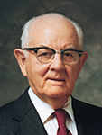
“This business of beams and motes seems to be closely related to our inability to see ourselves clearly. I’m not sure why we are able to diagnose and recommend remedies for other people’s ills so well, while we often have difficulty seeing our own.” (2)
"Our vision is completely obscured when we have no mirror to hold up to our own faults and look only for the foibles of others. When we follow the instructions of the Lord, we are kept so busy perfecting ourselves that we come to realize that the faults of others are small in comparison. We should establish the delightful habit, then, of minimizing the weaknesses of others and thus increase our own virtues. (3)
If we focus on removing our own sins and weaknesses, then we will be less likely to judge others unrighteously
Matthew 7:3; Matthew 5:29; 19:24 (figure of speech)

Slide 40
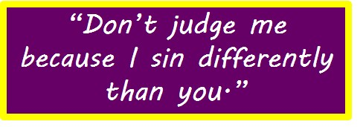
When it comes to hating, gossiping, ignoring, ridiculing, holding grudges, or wanting to cause harm, please apply the following:
STOP
IT!
“We simply have to stop judging others and replace judgmental thoughts and feelings with a heart full of love for God and His children. God is our Father.”
I recently saw [a bumper sticker]…attached to the back of a car whose driver appeared to be a little rough around the edges, but the words on the sticker taught an insightful lesson. It read:
Matthew 7:3-5

Slide 41
Judgment is an important use of our agency and requires great care, especially when we make judgments about other people.
All our judgments must be guided by righteous standards.
Only God, who knows each individual’s heart, can make final judgments of individuals.
Sometimes people feel that it is wrong to judge others in any way.
While it is true that we should not condemn others or judge them unrighteously, we will need to make judgments of ideas, situations, and people throughout our lives. …
… As much as we can, we should judge people’s situations rather than judging the people themselves.
Whenever possible, we should refrain from making judgments until we have an adequate knowledge of the facts.
And we should always be sensitive to the Holy Spirit, who can guide our decisions.
(14)

Slide 42
The Rest of
Matthew 7
Pearls before swine
Ask, Seek, and Knock
Go Ye into the World
The Strait Gate
False Prophets, A Warning
Being Saved
Upon the Rock or the Sand
Those in Authority

Slide 43
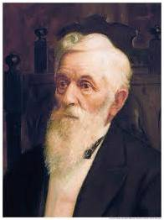
Pearls Before Swine
“…His pearls of wisdom, knowledge, and precious gifts.
The consequence is, we lose blessings instead of retaining them-a decrease of the Holy Spirit follows, instead of an increase, and our minds become darkened.”
(4)
“Negative criticism, or “unrighteous judgment,” as the Lord calls it, seems to come naturally to mortals. It can be a form of self-righteousness and also a way of excusing our own actions.
“Righteous judgment is made under the influence of the Spirit by those who are seeking to become worthy recipients of the Spirit. This type of judgment always builds rather than tears down.” (5)
Matthew 7:6

Slide 44
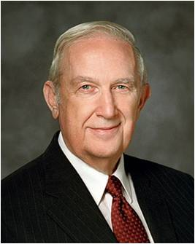
Ask, Seek, and Knock
“Our Father in Heaven has invited you to express your needs, hopes, and desires unto Him.
That should not be done in a spirit of negotiation, but rather as a willingness to obey His will no matter what direction that takes.
His invitation ‘Ask, and ye shall receive’ does not assure that you will get what you want. It does guarantee that, if worthy, you will get what you need, as judged by a Father that loves you perfectly, who wants your eternal happiness even more than do you.” (6)
?
Therefore, ask, and ye shall receive; knock, and it shall be opened unto you; for he that asketh, receiveth; and unto him that knocketh, it shall be opened.
Matthew 7:7; 3 Nephi 27:29

Slide 45
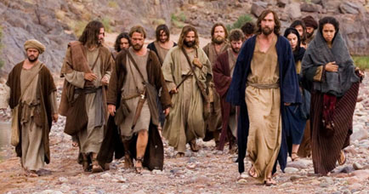
JST- Matthew 7:9-11
9 Go ye into the world, saying unto all, Repent, for the kingdom of heaven has come nigh unto you.
10 And the mysteries of the kingdom ye shall keep within yourselves; for it is not meet to give that which is holy unto the dogs; neither cast ye your pearls unto swine, lest they trample them under their feet.
11 For the world cannot receive that which ye, yourselves, are not able to bear; wherefore ye shall not give your pearls unto them, lest they turn again and rend you.
The Savior taught that just as a loving father would not give a stone or a snake when his son asks for bread or fish, Heavenly Father will not deny the gift of personal revelation to His children who ask for it.
The disciples were to teach repentance but keep the mysteries of the kingdom to themselves. In other words, they were not to discuss sacred subjects with people who were not ready to receive them.

Slide 46
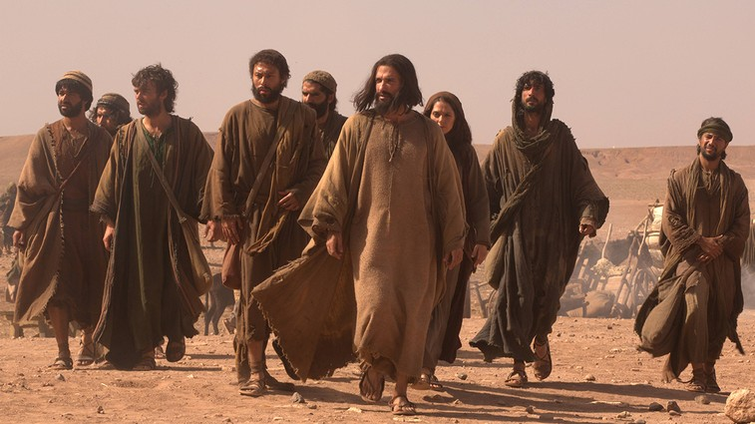
JST- Matthew 7:12
What were the disciples told to say to people who wanted to receive knowledge from God?
12 Say unto them, Ask of God; ask, and it shall be given you; seek, and ye shall find; knock, and it shall be opened unto you.
As we ask, seek, and knock in our search for truth, Heavenly Father will answer and bless us with personal revelation
A.Calvin

Slide 47
The Strait Gate
For strait is the gate, and narrow the way that leadeth unto the exaltation and continuation of the lives, and few there be that find it, because ye receive me not in the world neither do ye know me.
But if ye receive me in the world, then shall ye know me, and shall receive your exaltation; that where I am ye shall be also.
D&C 132:22-23
Few there be that find it.
Strait = used in reference to a situation characterized by a specified degree of trouble or difficulty--Definition
Strait = those who enter into it will find it restricted. It is narrow…they cannot take with them that which does not apply, or which does not belong to the kingdom of God.
All such things must be left behind when we enter into this narrow way which leads in to the presence of god, where we can receive life eternal..” (7)
Matthew 7:13

Slide 48
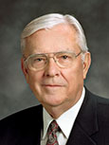
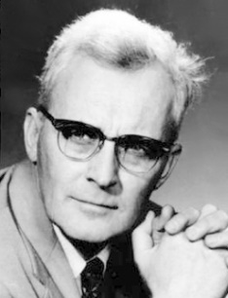
False Prophets
A warning
“both men and women, who are self-appointed declarers of the doctrines of the Church” as well as “those who speak and publish in opposition to God’s true prophets and who actively proselyte others with reckless disregard for the eternal well-being of those whom they seduce.” (8)
A False Prophet is:
Anyone who competes with God’s work.
Anyone who makes claims on the time and energies of men which rightly belong to God.
Anyone who puts the word of god in 2nd place to the theories of men.
Anyone who forces the teaching of true prophets to yield precedence to his own discourses.
Anyone who puts his own knowledge above or on a level with revelation from heaven. (9)
We can discern false prophets by their fruits
Matthew 7:15-20

Slide 49
A prophecy which goes unfulfilled is the fruit of a corrupt tree.
We can discern false prophets by their fruits
“…how often do we say to an investigator, "Don't judge the Church by the members---the Church is perfect, but its members are not"?
Certainly, the members of the Church are not perfect, but the fruits of their discipleship should stand as a witness to the goodness of their souls. If not, we are not living up to the standard which the Lord has established. (10)
Matthew 7:16-20

Slide 50
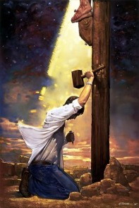
Not Everyone
Can we be saved by just going to church?
Can we be saved by believing in Jesus?
Is there more that we need to do in order to enter into the kingdom of God?
Many will preach that the phrase, "by grace ye are saved," means that the individual only has to believe in Christ to be saved.
“…merely acknowledging Jesus' lordship, merely saying the words or making the confession, while refusing to make Him our Lord by serving Him and conforming our behavior to His will-this will not get us into the kingdom.
The confession or the acknowledgment must be accompanied by doing the will of the Father in heaven and by not doing iniquity.“ (11)
“I never knew you” = “Ye never knew me” JST
Matthew 7:21-23

Slide 51
Upon the Rock or the Sand?
"Where could any of us locate a more suitable blueprint whereby he could wisely and properly build?
Such a house would meet the building code outlined in Matthew, even a house built 'upon a rock.'...a house capable of withstanding the rains of adversity, the floods of opposition, and the winds of doubt everywhere present in our challenging world...
Let the Lord be the General Contractor for the family-even the home-we build. Then each of us can be the subcontractors responsible for a vital segment of the whole project. All of us are thereby builders." (12)
Matthew 7:24-27

Slide 52
If we hear and act on the Lord’s teachings, then He will strengthen us to endure our trials.
If we hear the Lord’s teachings but do not follow them, then we will not have the support we need when trials come.

Slide 53
Those in Authority
"The Sermon on the Mount has stood through all the years since its delivery without another to be compared with it.
No mortal man has ever since preached a discourse of its kind. The spirit of the address is throughout that of sincerity and action, as opposed to empty profession and neglect...
Such doctrines as these astonished the people. For His distinctive teachings the Preacher had cited no authority but His own." (13)
Matthew 7:28-29

Slide 54
Sources:
True to the Faith: A Gospel Reference [2004], 90–91).
President Dieter F. Uchtdorf Lord, Is it I? Ensign or Liahona, Nov. 2014, 56).
President Spencer W. Kimball The Miracle of Forgiveness p. 269
President Lorenzo Snow (The Teachings of Lorenzo Snow, p. 73)
Arthur R. Bassett Floods, Winds, and the Gates of Hell June 1991 Ensign
Elder Richard G. Scott (“Trust in the Lord,” Ensign, Nov. 1995, 17).
Joseph Fielding Smith (Doctrines of Salvation, vol. 2. pp. 13-14 as taken from Latter-day Commentary on the Book of Mormon compiled by K. Douglas Bassett, p.31-2)
Elder M. Russell Ballard “Beware of False Prophets and False Teachers,” Ensign, Nov. 1999, 63.
Hugh Nibley The World and the Prophets, pp. 254-5
Elder John Wells (Conference Report, Apr. 1925, p. 88
Stephen E. Robinson Following Christ p. 77
President Thomas S. Monson (Live the Good Life, p. 124 as taken from The Mount and the Master, by Robert E. Wells, p. 211-12)
James E. Talmage (Jesus the Christ, 229-30)
Gospel Topics, “Judging Others,” topics.ChurchofJesusChrist.org
Presentation by ©http://fashionsbylynda.com/blog/

Slide 55
Matthew 7:15-20 False Prophets:
“When we think of false prophets and false teachers, we tend to think of those who espouse an obviously false doctrine or presume to have authority to teach the true gospel of Christ according to their own interpretation. We often assume that such individuals are associated with small radical groups on the fringes of society. However, I reiterate: there are false prophets and false teachers who have or at least claim to have membership in the Church. There are those who, without authority, claim Church endorsement to their products and practices. Beware of such. …
“… Beware of those who speak and publish in opposition to God’s true prophets and who actively proselyte others with reckless disregard for the eternal well-being of those whom they seduce” Elder M. Russell Ballard (“Beware of False Prophets and False Teachers,” Ensign, Nov. 1999, 62–63).
Matthew 7:24 Building a house upon the rock:
"Every person builds a house of faith. We do so knowingly or unknowingly. And every builder soon learns that a good building with bad foundations is worse than useless; it is dangerous. As one Christian writer has observed, 'If the stability of buildings depends largely on their foundations, so does the stability of human lives. The search for personal security is a primal instinct, but many fail to find it today. Old familiar landmarks [will be] obliterated. Moral absolutes which were once thought to be eternal are being abandoned' (Stott 22). Thus our house of faith can be no more secure than the foundation upon which it is built. Foolish men build upon the shifting sands of ethics and the marshlands of human philosophies and doctrines. The wise build upon the rock of revelation, heeding carefully the living oracles, lest they be 'brought under condemnation ... and stumble and fall when the storms descend, and the winds blow, and the rains descend, and beat upon their house' (D&C 90:5). All that we do as members of The Church of Jesus Christ of Latter-day Saints must be built upon a foundation of faith and testimony and conversion. When external supports fail us, then our hearts must be riveted upon the things of the Spirit, those internal realities which provide the meaning, the perspective, and the sustenance for all else that matters in life." (Robert L. Millet, Book of Mormon Symposium Series, Helaman 3 - 3 Nephi 8, edited by PR Cheesman, MS Nyman, and CD Tate, Jr., 1988, pp. 26-8)
Matthew 7:21 Conversion:
“The conversion [Jesus] required for those who would enter the kingdom of heaven (see Matt. 18:3) was far more than just being converted to testify to the truthfulness of the gospel. To testify is to know and to declare. The gospel challenges us to be ‘converted,’ which requires us to do and to become. If any of us relies solely upon our knowledge and testimony of the gospel, we are in the same position as the blessed but still unfinished Apostles whom Jesus challenged to be ‘converted’ [see Luke 22:32]” Elder Richard G. Scott (“The Challenge to Become,” Ensign, Nov. 2000, 33).
Matthew 7:21-23 For the lazy Latter-day saint, the passage could read, "Many will say to me in that day, Lord, Lord, are we not members of thy kingdom, and have we not sent our children to Church and paid some fast offerings?"
For the abusive husbands and fathers, "Lord, Lord, are we not holders of thy priesthood, and did we not hold responsible positions in thy kingdom, and attend church regularly."
For the prideful, "Lord, Lord, have I not done as well as the rest of my ward, and do not my worldly attainments demonstrate my ability, and my riches demonstrate thy good pleasure?"
For all these people, the answer may well be, 'I never knew you; depart from me, ye that work iniquity.' Alma asks, 'do ye imagine to yourselves that ye can lie unto the Lord in that day, and say-Lord, our works have been righteous works upon the face of the earth-and that he will save you?...Behold, my brethren, do ye suppose that such an one can have a place to sit down in the kingdom of God, with Abraham, with Isaac, and with Jacob, and also all the holy prophets, whose garments are cleansed and are spotless, pure and white? I say unto you, Nay' (Alma 5:17, 24-25). gospeldoctrine.com
Matthew 7:21-23
"None would want to hear the Lord speak such disappointing words. That is why we need to do everything in our power to be certain our spiritual bonfire of testimony is burning brightly enough to keep the wolves of darkness away. We can always use more dry kindling. As the Apostle Paul taught, each of us has 'come short of the glory of God.' (Romans 3:23.) None of us has progressed so far in this life that we do not need to continually fortify our testimonies." Joseph B. Wirthlin (Finding Peace in Our Lives, p. 126)

Slide 56
Matthew 7:1-2 Judging
“There are two kinds of judging: final judgments, which we are forbidden to make, and intermediate judgments, which we are directed to make, but upon righteous principles. …
… Let us consider some principles or ingredients that lead to a “righteous judgment.”
First, a righteous judgment must, by definition, be intermediate. It will refrain from declaring that a person has been assured of exaltation or from dismissing a person as being irrevocably bound for hellfire. …
Second, a righteous judgment will be guided by the Spirit of the Lord, not by anger, revenge, jealousy, or self-interest. …
Third, to be righteous, an intermediate judgment must be within our stewardship. We should not presume to exercise and act upon judgments that are outside our personal responsibilities. …
Fourth, we should, if possible, refrain from judging until we have adequate knowledge of the facts. …
A fifth principle of a righteous intermediate judgment is that whenever possible we will refrain from judging people and only judge situations.
“… Why did the Savior command that we not judge final judgments? I believe this commandment was given because we presume to make final judgments whenever we proclaim that any particular person is going to hell (or to heaven) for a particular act or as of a particular time. …
“We all make judgments in choosing our friends, in choosing how we will spend our time and our money, and, of course, in choosing an eternal companion. Some of these intermediate judgments are surely among those the Savior referenced when He taught that ‘the weightier matters of the law’ include judgment (Matt. 23:23). …
“In the intermediate judgments we must make, we should take care to judge righteously. We should seek the guidance of the Spirit in our decisions. We should limit our judgments to our own stewardships. Whenever possible we should refrain from judging people until we have an adequate knowledge of the facts. So far as possible, we should judge circumstances rather than people. In all our judgments we should apply righteous standards. And, in all of this we must remember the command to forgive” Elder Dallin H. Oaks (“‘Judge Not’ and Judging,” Ensign, Aug. 1999, 7, 9, 13).

