Slide 1
Matthew 14; Mark 6; John 5-6

Slide 2
Herod and John the Baptist

Slide 3
Herod Antipas
He was the son of Herod the Great and Malthace and half brother Philip I
He was “the tetrach” = (in the Roman Empire) the governor of Galilee and Perea, being named by Augustus to the throne upon the death of his father in 4 BC
Antipas (New Testament term) was called to build his capital in Tiberias, on the Sea of Galilee
He married the daughter of King Aretas IV of Nabatea, but divorced her to marry Herodias
He took as his wife, Herodias, the wife of his half brother Philip I
He was reluctant to behead John the Baptist but compelled by Herodias’ daughter, Salome
He had a role in the trial of Jesus, but released him back to Pilate
He lived in Jerusalem and was anxious to be regarded as an orthodox Jew. He began a persecution of the Church and put James, the brother of John to death, Peter escaping by a miracle (Acts 12:1–23)
He was eaten by worms (Acts 12:23)
His son, Agrippa Ⅱ, was allowed by the Emperor Claudius to succeed to only a small part of his father’s dominions. (Acts 25:13)
He was the last of the Herods.
(2)

Slide 4
Unlawful Marriage
Herod the Great
Doris (m. 42 BC)
Mariamne I
Mariamne II (m. 24 BC)
Malthace (m. 23 BC)
Cleopatra (m. 22 BC)
Antipater
Alexander
Herod Philip I
Archelaus
Phillip II
Aristobulus
Herod Antipas
Herodias
Their pretended marriage was both adulterous and incestuous under Jewish law. (1)
Herod claimed Herodias his wife even though she was still legally married to Philip I who was her first husband.

Slide 5
Herod and John the Baptist
Herod Antipas, who governed the regions of Galilee and Perea following the death of his father, Herod the Great.
Herod Antipas had divorced his wife and married Herodias, the wife of his brother Philip.
This act was a blatant violation of Jewish law, and John the Baptist had vocally condemned it.
John’s opposition to this marriage angered Herodias, so Herod imprisoned John to appease her.
Mark 6:17-29

Slide 6
Herodias’ Doing
Herodias quarreled that John be killed, but Herod feared John knowing he was a just man—a man of God
Why did Herod have John beheaded if he knew it was wrong and did not want to do it?
“for their sakes which sat with him,” =
Herod was concerned about the opinion of those who sat with him.
Seeking to please others instead of doing what we know is right can lead to wrong choices, sorrow, and regret
Mark 6:17-29

Slide 7
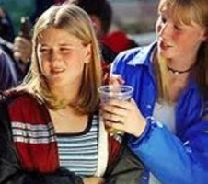
Joining Along With Others
Does giving in to pressures from other bring sorrow and regret?
Do you know someone who chose to do right instead of seeking to please others?
What can help us choose to do what we know is right instead of seeking to please others?

Slide 8
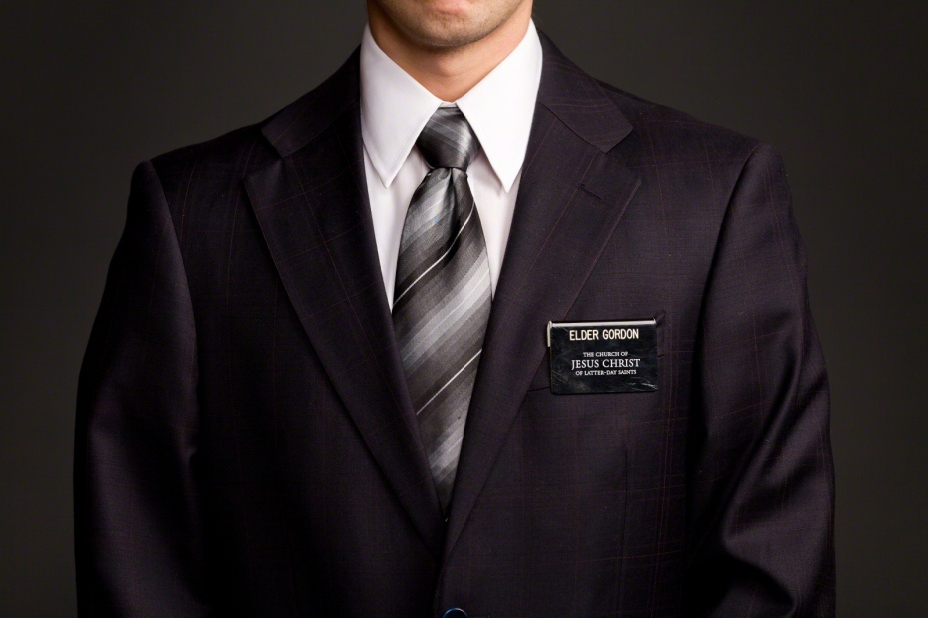
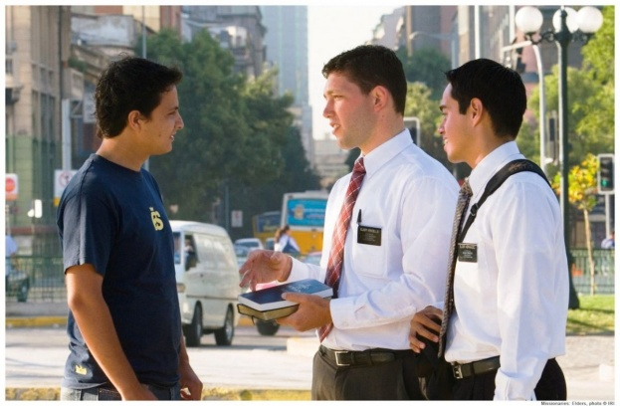
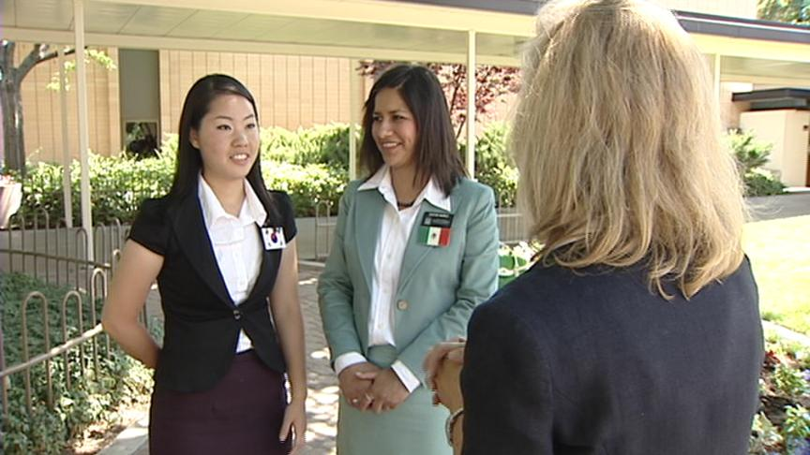
Feeling Inadequate
A newly called missionary is very nervous to depart on his or her mission. This person is not a good speaker and struggles in social settings.
Whether you come into the mission with many successes under your belt or few, if you are humble, teachable, and willing to keep trying and working, the Lord can work with you. But your missionary skills will only improve as you practice, ask questions, get help, and keep trying.
If you are convinced that people are just naturally good (or naturally bad) at missionary work, languages, testimony, or relationships, you’ll have a harder time. (11)
Mark 6:30-44

Slide 9
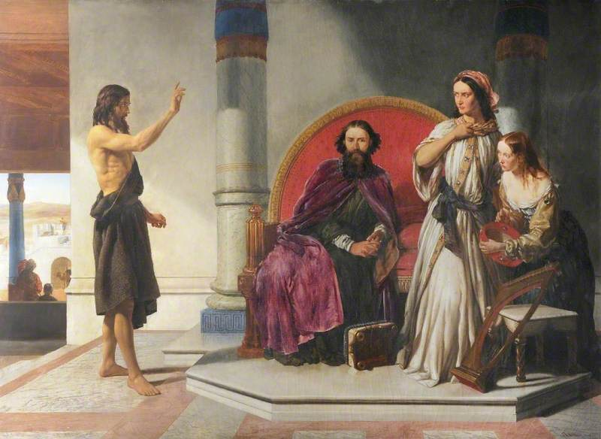
John Condemns Herod
Thou shalt not uncover the nakedness of thy brother’s wife: it is thy brother’s nakedness
Leviticus 18:16
For Herod himself had sent forth and laid hold upon John, and bound him in prison for Herodias’ sake, his brother Philip’s wife: for he had married her.
For John had said unto Herod, It is not lawful for thee to have thy brother’s wife.
Mark 6:17-18
John is sent to prison
Matthew 14:1-4

Slide 10
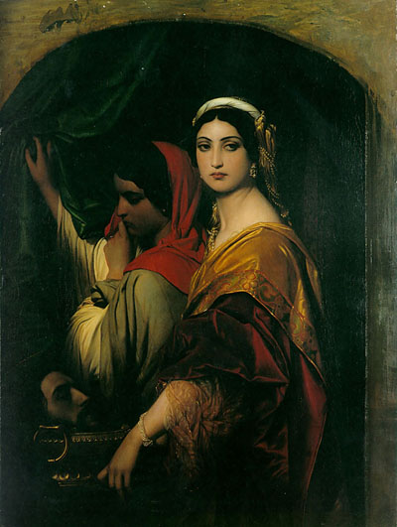
Herod’s Birthday
The king celebrated his birthday by a great feast…
Salome, daughter of Herodias and Philip I, came in and danced before the Herod’s company.
So enchanted were Herod and his guests that the king bade the damsel ask whatever she would, and he swore he would give it unto her, even though the gift were half of his kingdom.
Salome retired to consult her mother, Herodias, and returned with the demand:
“I will that thou give me by and by in a charger the head of John the Baptist.” Mark 6:23
And immediately the king sent an executioner, and commanded his head to be brought: and he went and beheaded him in the prison,
Mark 6:27
Matthew 14:6-11; Mark 6:21-28

Slide 11
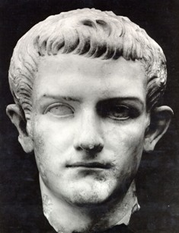
Sin Begets Sin
Often one evil act becomes father to another more wicked than the first.
Even though Herod feared and respected John as a just and holy man, yet, bound by the chains of his own adulterous and incestuous relationship with Herodias, he was unable to resist the pressure leading to the arrest, imprisonment, and murder of the Lord’s forerunner.
Even legal killings rank as murder. Though covered with the cloak of legality, they are morally and ethically indefensible; those who authorize them stand condemned before the eternal judgment bar.
Herod’s command to slay john classed the sin laden tyrant as a murderer.
(3)

Slide 12
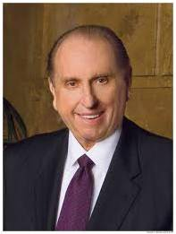
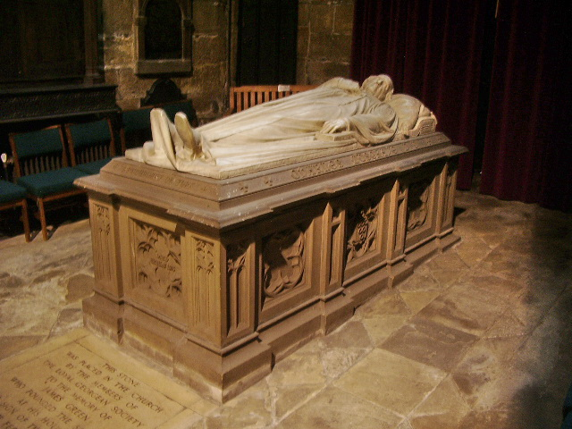
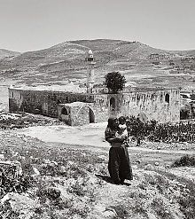
Disciples Take John’s Body
"The tomb in which his body was placed could not contain that body. Nor could the act of murder still that voice.
The current official place for the Catholic Church is the Shrine of Saint John the Baptiste (Nabi Yahya in Arabic) inside the Umayyad Mosque in Damascus;.
To the world we declare that at Harmony, Pennsylvania, on 15 May 1829, an angel, 'who announced himself as John, the same that is called John the Baptist in the New Testament' (D&C 13, section heading), came as a resurrected personage to Joseph Smith and Oliver Cowdery. . . .
The Aaronic Priesthood was restored to the earth.
"Thanks to that memorable event, I was given the privilege to bear the Aaronic Priesthood, as have millions of young men in these latter days.”
Nabi Yahya Mosque in Sebastia, near Nablus, West Bank, the traditional burial site
Matthew 14:12
(4)

Slide 13
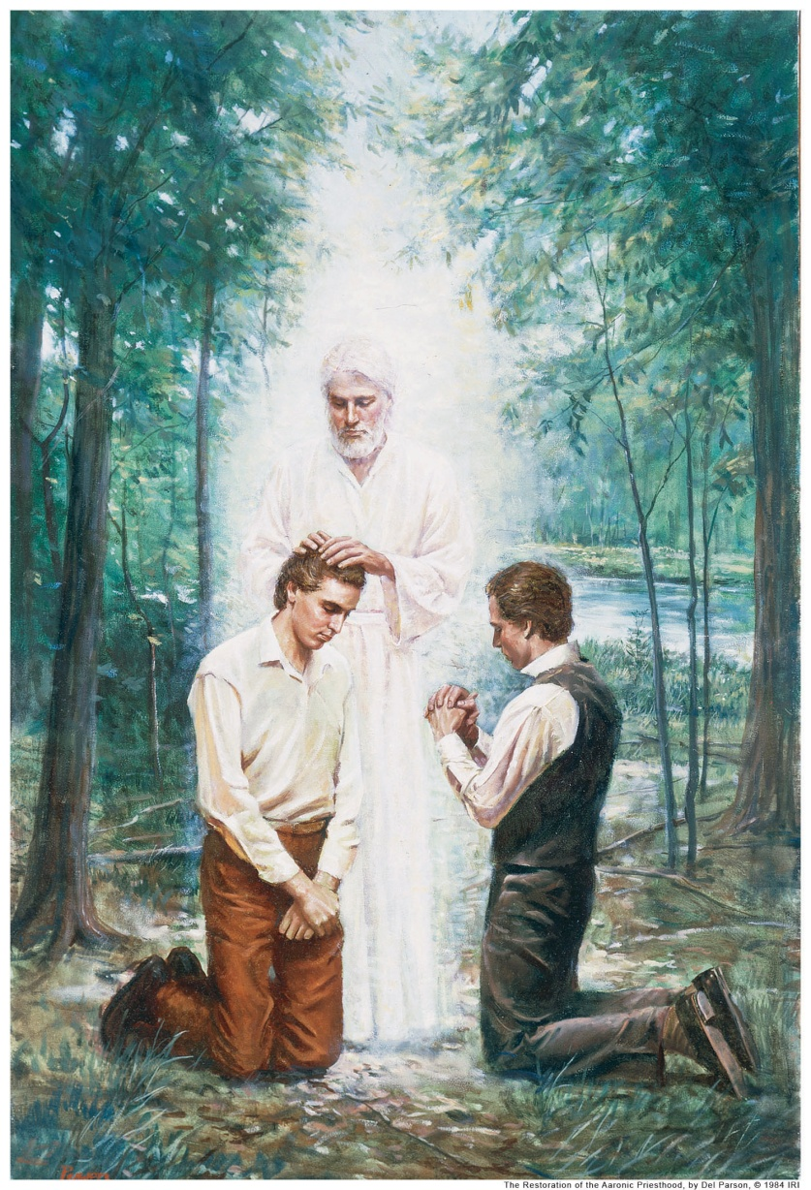
John’s Testimony
John wore the martyr’s crown and sealed his testimony with his own blood.
He was raised in glorious immortality, has ministered again among mortals, conferring that holy Levitical Order of which he held the keys in time’s meridian.
(3)

Slide 14
Feeding 5,000 and Walking on the Water
Matthew 14
Jesus answered them and said, Verily, verily, I say unto you, Ye seek me, not because ye saw the miracles, but because ye did eat of the loaves, and were filled.
John 6:26

Slide 15
Scenario 1
Your friend Roger was really close with his cousin who recently passed away unexpectedly.
Each time you have tried to visit, Roger has told you he wants to be left alone.
After you’ve made many attempts, he finally lets you in.
As he begins to open up, he says, “This has been really hard for me. How can I get through it?”

Slide 16
Scenario 2
Your friend Claire was just called to be the president of her Young Women class.
She is already very busy, and she feels that other young women in her class are more outgoing and could do a better job.
Claire shares her concerns with you and says, “I’m not sure I can do this.”

Slide 17
We can follow the example of Jesus Christ by showing compassion and serving others even while we are experiencing our own difficulties.

Slide 18
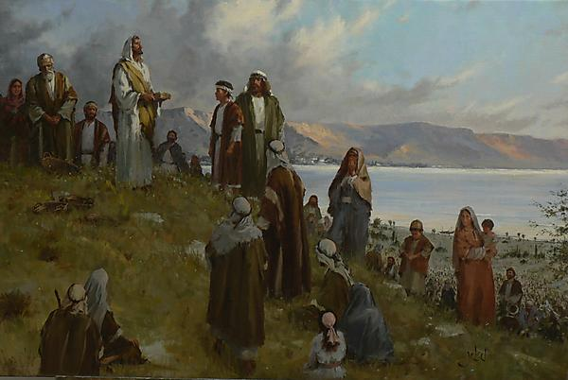
A Desert Place Apart
Upon hearing of John’s death, Jesus departed by ship to a desert place whereupon multitudes followed him.
A solitary place
“He brought reality to the word compassion. He showed us the way. He marked the path we should follow. Selfless service characterized His life. …
The Savior’s entire ministry exemplified love of neighbor.”
Matthew 14:14; Mark 6:30-34; Luke 9:10; John 6:1-3
(4)

Slide 19
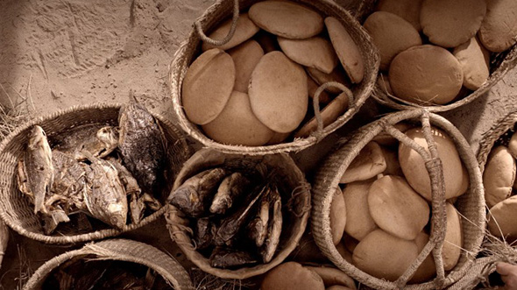
Feeding 5,000
What Happened First?
7
The Twelve Apostles returned from preaching the gospel and reported to Jesus what they had done and taught. Jesus and the Twelve Apostles boarded a ship to travel to a place where they could be alone and rest.
However, people from several nearby towns went to where Jesus would land and were awaiting Him when He arrived.
____ The Savior multiplied what the disciples brought, meeting and surpassing what was needed.
____ The disciples said they had five loaves and two fishes.
____ The disciples proposed sending the people away to buy food.
____ The Savior asked what the disciples could provide.
____ The Savior told the disciples to give the people food.
____ The multitude had nothing to eat.
____ The Savior asked the disciples to give Him what they had.
5
2
4
3
1
6
Mark 6:30-44

Slide 20
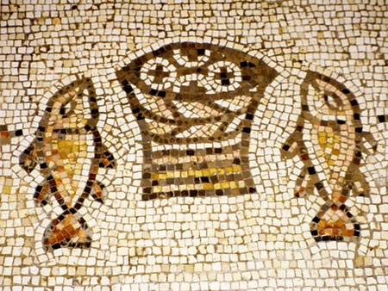
Give Ye Them To Eat
“five thousand men” meant five thousand males. (5)
Why did Jesus feed the 5,000?
They were hungry, fainting for want of temporal food, and there was none available for them. They had left their camps and villages to hear His word…temporal need.
A testimony and witness that He was the Son of God, the promised Messiah (John 6:14)
Jesus performed this miracle as a setting for one of his strongest and deepest recorded discourses—the Sermon on the bread of Life…so to provide temporal food to sustain mortal life, He provided the lesson that man must eat spiritually to gain eternal life. (3)
The mosaic is from the floor of a church built in the fifth century A.D. at the traditional site of the feeding of the five thousand.
Matthew 14:15-21; Mark 6:37; Luke 9:

Slide 21
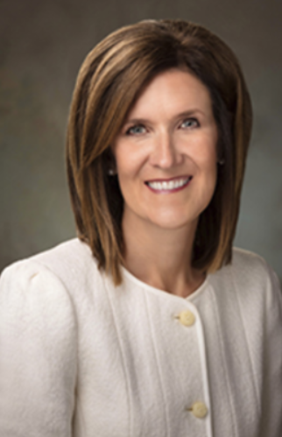
Give What You Have
Have you ever felt your talents and gifts were too small for the task ahead? …But you and I can give what we have to Christ, and He will multiply our efforts.
What you have to offer is more than enough—even with your human frailties and weaknesses—if you rely on the grace of God.
(10)

Slide 22
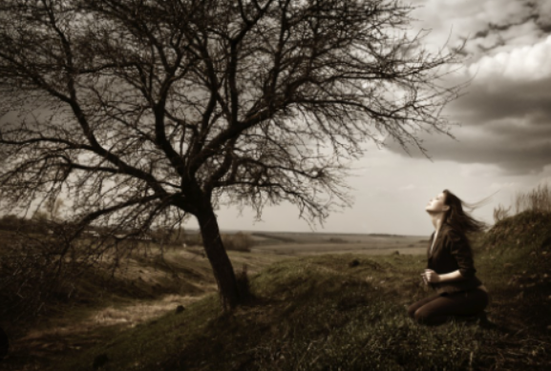
When we offer the Savior all that we have, He can multiply our efforts to accomplish His purposes.
Matthew 14:13-21

Slide 23
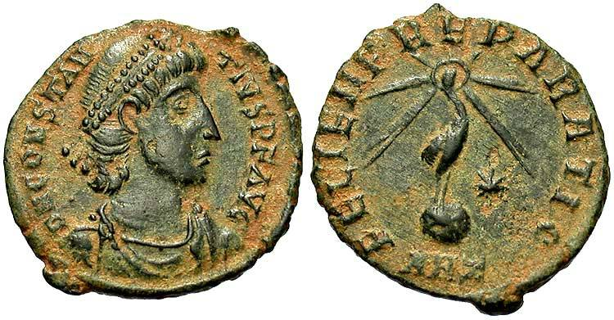
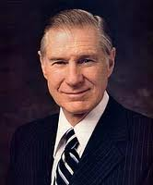
To Bless and Brake Bread
Shall we go and buy two hundred pennyworth of bread, and give them to eat? Mark 6:37
“two hundred pennyworth,” or two hundred denarii—roughly eight months’ wages for a common laborer.
“A major reason this church has grown from its humble beginnings to its current strength is the faithfulness and devotion of millions of humble and devoted people who have only five loaves and two small fishes to offer in the service of the Master.” (6)
Matthew 14:17; Mark 6:37; John 6:7

Slide 24
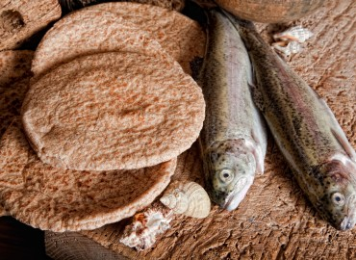
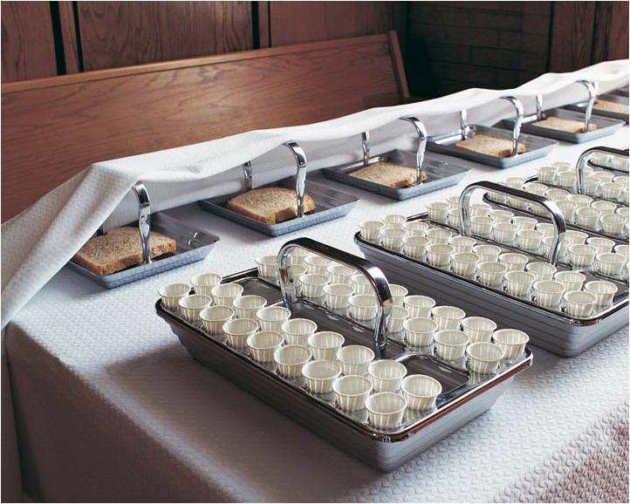
The Bread of Life
We eat food to stimulate our physical bodies. Without the partaking of food we would become weak and sickly, and fail physically. It is just as necessary, for our spiritual body, that we should partake of this sacrament and by it obtain spiritual food for our souls.
“We must come, however, to the sacrament table hungry. If we should repair to a banquet where the finest of earth’s providing may be had, without hunger, without appetite, the food would not be tempting, nor do us any good.
If we repair to the sacrament table, we must come hungering and thirsting for righteousness, for spiritual growth.” (7)
And they were filled
Matthew 14:20-21; John 6:22-58

Slide 25
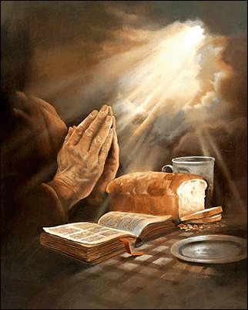
Jesus Christ is the Way:
He is the Bread and Water
Meat = food
The living manna sent from God
What did the Savior tell them they should be seeking?
Why did the people seek Him?
John 6:22-59

Slide 26
Manna was “bread from heaven” that God provided for the children of Israel as they wandered in the wilderness
John 6:31

Slide 27
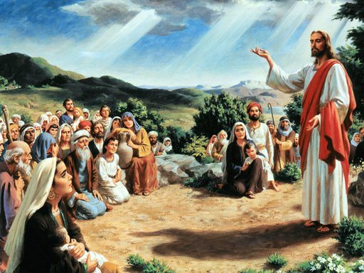
To the Jews in Capernaum
“…My father giveth you the true bread from heaven.”
John 6:32

Slide 28
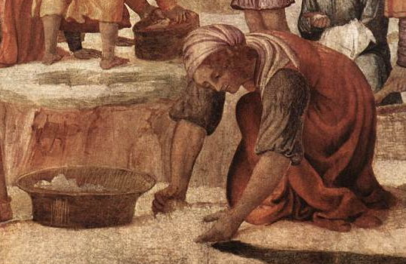
“For the bread of God is he which cometh down from heaven, and giveth life unto the world.”
John 6:33

Slide 29
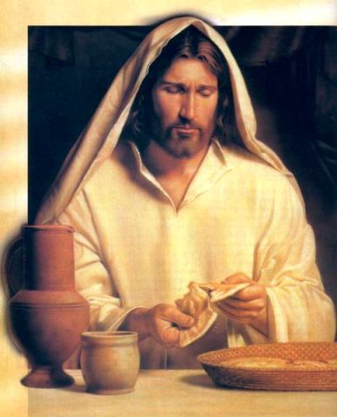
“..I am the bread of life; he that cometh to me shall never hunger; and he that believeth on me shall never thirst.”
John 6:35

Slide 30
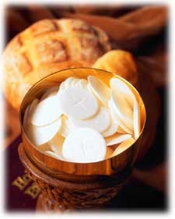
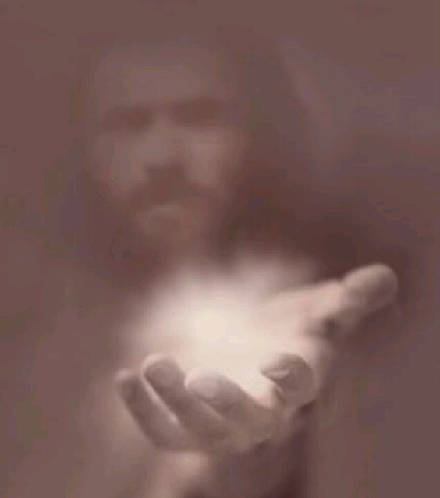
Jesus offers:
The Bread of Life…
either we eat and hunger no more, or we don’t and foolishly remain weak and hungry still
Unlike the bread that can satisfy us only for a short time, Jesus Christ offers us blessings that will last forever.
(13)

Slide 31
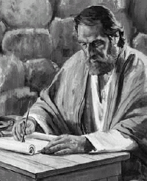
Paul says,
“They ‘did all eat the same spiritual meat; And did all drink the same spiritual drink; for they drank of that spiritual Rock that followed them: and that Rock was Christ.”
1 Corinthians 10:3-4

Slide 32
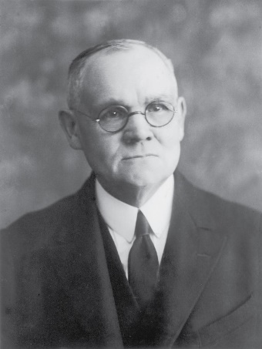
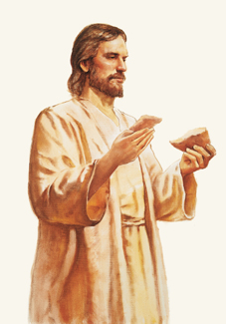
Eat of the Flesh and Drink of the Blood
“To eat the flesh and drink the blood of Christ was and is to believe in and accept Him as the literal Son of God and Savior of the world, and to obey His commandments. By these means only may the Spirit of God become an abiding part of man’s individual being, even as the substance of the food he eats is assimilated with the tissues of his body.
“… The figure used by Jesus—that of eating His flesh and drinking His blood as typical of unqualified and absolute acceptance of Himself as the Savior of men—is of superlative import; for thereby are affirmed the divinity of His Person, and the fact of His preexistent and eternal Godship.
The sacrament of the Lord’s supper, established by the Savior on the night of His betrayal, perpetuates the symbolism of eating His flesh and drinking His blood, by the partaking of bread and wine in remembrance of Him. Acceptance of Jesus as the Christ implies obedience to the laws and ordinances of His gospel.”
John 6:51-58
Del Parson
(1)

Slide 33
After the Miracle
Capernaum
Besaida
Gennesaret
"Only by persisting in His questioning did Jesus succeed in getting His disciples to remember that there were actually twelve baskets of 'leftovers' after the miracle of the loaves.
The Bread of Life always gives 'enough and to spare', but we're so forgetful." (12)
Tiberias
In the region of Gennesaret
"This region-a rich, fertile, and productive plain-extended southward along the western shore of the Sea of Galilee from Capernaum on the north to the region around Magdala and Tiberias.
Though having set out for Capernaum, apparently because of the storm, Jesus and the apostles landed somewhat south of that city. It was while traveling northward to Capernaum that the sick and diseased from the cities, villages, and whole region of Gennesaret were brought to him to be healed." (3)
Mark 6:30-44; Matthew 14:15-21; 16:9-10; D&C 104:17

Slide 34
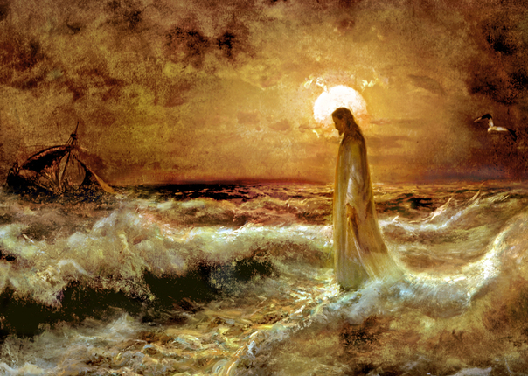
The Fourth Watch
The Romans divided the night hours into four watches, corresponding roughly to 6:00–9:00 p.m., 9:00 p.m.–midnight, midnight–3:00 a.m., and 3:00–6:00 a.m.
9
6
When the Savior came to the disciples in the fourth watch, they had been rowing all night against a contrary wind.
Matthew 14:22-25

Slide 35
The disciples had been on the ship roughly 9-12 hours
Who hath ascended up into heaven, or descended? who hath gathered the wind in his fists? who hath bound the waters in a garment? who hath established all the ends of the earth? what is his name, and what is his son’s name, if thou canst tell?
Proverbs 30:4
Thy way is in the sea, and thy path in the great waters, and thy footsteps are not known.
Psalms 77:19
Matthew 14:22-25

Slide 36
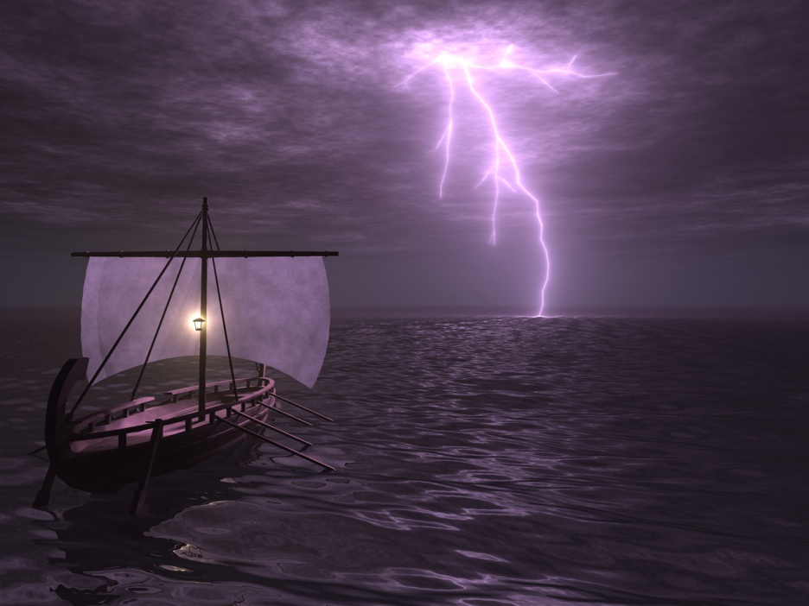
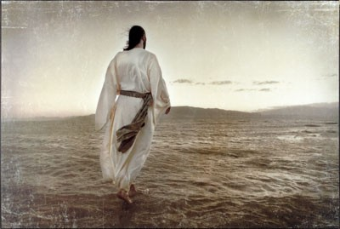
Coming To Our Aid
Could Jesus have spared the disciples from their struggles sooner?
What might have been the purpose of letting the disciples struggle for a time before they were delivered?
Even though God might not always spare us from struggles, He knows what we are experiencing and will, in His own time, come to our aid
Matthew 14:26; Mark 6:47-48

Slide 37
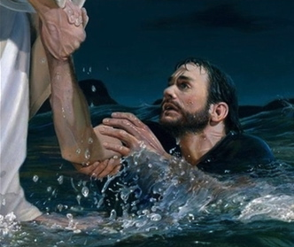
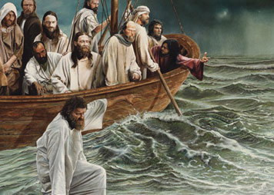
Peter’s Faith
"Peter's faith began to reach heights virtually without equal in the New Testament record. It so surged within him that upon the Lord's invitation, Peter once climbed down out of his fishing boat and 'walked on the water, to go to Jesus.’
That fact of faith has never been recorded of any other mortal man. If his faith faltered because of treacherous waves and adverse winds, 'perhaps we should take a few steps on [the] water' before ascending to the judgment seat.
Matthew 14:28-29

Slide 38
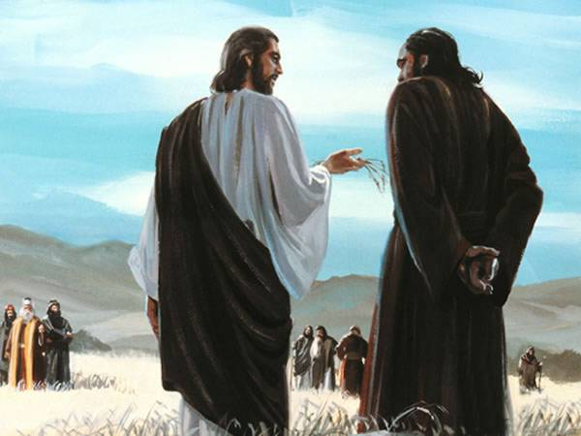
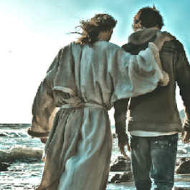
Power To Endure
…to whom shall we go? thou hast the words of eternal life.
And we believe and are sure that thou art that Christ, the Son of the living God.
"Peter's answer defines the real core of commitment.
When we know without a doubt that Jesus is the Christ, we will want to stay with Him. When we are surely converted, the power to endure is ours."
John 6:68-69
(14)

Slide 39
Fear
“This scriptural account reminds us that the first step in coming to Christ—or his coming to us—may fill us with something very much like sheer terror. It shouldn’t, but it sometimes does. One of the grand ironies of the gospel is that the very source of help and safety being offered us is the thing from which we may, in our mortal shortsightedness, flee.
For whatever the reason, I have seen investigators run from baptism,
I have seen elders run from a mission call,
I have seen sweethearts run from marriage, and I have seen young couples run from the fear of families and the future.
Too often too many of us run from the very things that will bless us and save us and soothe us. Too often we see gospel commitments and commandments as something to be feared and forsaken” (8)
Matthew 14:30

Slide 40
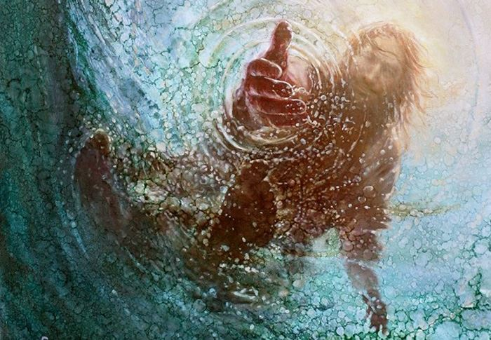
Lord Save Me
“Into every adult human life come experiences like unto the battling of the storm-tossed voyagers with contrary winds and threatening seas; oft times the night of struggle and danger is far advanced before succor appears; and then, too frequently the saving aid is mistaken for a greater terror.
[But,] as came unto [these disciples] in the midst of the turbulent waters, so comes to all who toil in faith, the voice of the Deliverer-'It is I; be not afraid' ' (1)
Matthew 14:28-29

Slide 41
How can focusing on your faith in Jesus Christ and His power and love for you during difficult situations help you?
What are some ways to focus on the Savior during challenges?
Sea of Galilee

Slide 42
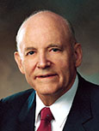
“It is my firm belief that if as individual people, as families, communities, and nations, we could, like Peter, fix our eyes on Jesus, we too might walk triumphantly over ‘the swelling waves of disbelief’ and remain ‘unterrified amid the rising winds of doubt.’
But if we turn away our eyes from him in whom we must believe, as it is so easy to do and the world is so much tempted to do, if we look to the power and fury of those terrible and destructive elements around us rather than to him who can help and save us, then we shall inevitably sink in a sea of conflict and sorrow and despair.”
(9)
Matthew 14:30-31

Slide 43
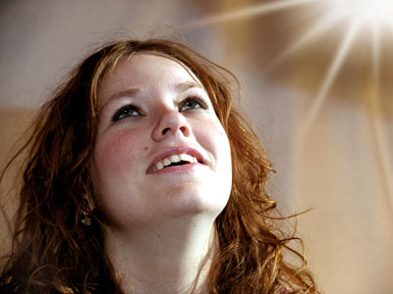
if we keep our eyes fixed on Jesus Christ and maintain our faith in Him, we will not be overcome by our fears and doubts
If we seek God’s help when our faith wanes, He can lift us from our fears and doubts
Matthew 14:30-31

Slide 44
Sources:
James E. Talmage Jesus the Christ p. 253, 337; Bread of Life: 342–43
Bible Dictionary and Wikipedia
Bruce R. McConkie Doctrinal New Testament Commentary p. 339, excerpts from 343-344; Bruce R. McConkie (Doctrinal New Testament Commentary, 3 vols. [Salt Lake City: Bookcraft, 1965-1973], 1: 350.)
Thomas S. Monson (LDS Church News, 1991, 01/19/91)
“The Way of the Master,” Ensign, May 1996, 51).
New Testament Institute Student Manual Chapter 12
President James E. Faust (“Five Loaves and Two Fishes,” Ensign, May 1994, 5–6).
Melvin J. Ballard … Crusader for Righteousness, pp. 132–33.)
Elder Jeffrey R. Holland (“Come unto Me” [Brigham Young University fireside, Mar. 2, 1997], 8; speeches.byu.edu
(See Richard Lloyd Anderson, "Simon Peter," Ensign, February 1975, pp. 47-49.)" (However Long and Hard the Road, 98.)
President Howard W. Hunter (“The Beacon in the Harbor of Peace,” Ensign, Nov. 1992, 19).)
Michelle D. Craig, “Divine Discontent,” Ensign or Liahona, Nov. 2018, 54)
The Hardest Part of Being a Missionary By Wendy Ulrich, PhD June 2016 New Era
Elder Neal A. Maxwell (That Ye May Believe, 199;9.
Elder Lawrence E. Corbridge Notes From: The Way October 2008 Gen. Conf.
Elder Russell M. Nelson (Perfection Pending, and Other Favorite Discourses [Salt Lake City: Deseret Book Co., 1998], 129.)
Presentation by ©http://fashionsbylynda.com/blog/

Slide 45
The Herodian family were Idumeans by birth but had become converts to the Jewish faith. Their object was to found, under the protection of Rome, a semi-independent kingdom. By his marriage with Mariamne, Herod the Great allied himself with the family of the Maccabees, who had been for several generations the leaders of the patriotic party among the Jews. Herod was a successful ruler and was on terms of friendship with Augustus, the Roman Emperor. In order to gain favor with his subjects, with whom he was most unpopular, he rebuilt the temple at an immense cost.
His reign was disgraced by many acts of cruelty. In a fit of jealousy he had his wife, whom he dearly loved, put to death; later on he had her two sons, Alexander and Aristobulus, also murdered. In the same year in which he gave the order for the massacre of the infants at Bethlehem, he had Antipater, another of his own sons, put to death. A few months later Herod himself died. His kingdom was then divided between three of his sons: Archelaus, who received Judea, Idumea, and Samaria; Antipas, who had Galilee and Perea; and Philip, who had the northeast districts of Palestine. Bible Dictionary
To Buy Bread: Matthew14:17
The coinage in use was that of Rome, and the penny, or denarius, was the chief Roman silver coin. It was worth about fifteen to seventeen of our cents. Two hundred pennyworth of bread would have cost approximately thirty-two dollars. (See Smith, A Dictionary of the Bible, rev. ed., s.v. “Penny, Pennyworth.”)
The Sacrament---Bread of Life John 6:22-58
-To eat the flesh and drink the blood of the Son of God is, first, to accept him in the most literal and full sense, with no reservation whatever, as the personal offspring in the flesh of the Eternal Father; and, secondly, it is to keep the commandments of the Son by accepting his gospel, joining his Church, and enduring in obedience and righteousness unto the end. Those who by this course eat his flesh and drink his blood shall have eternal life, meaning exaltation in the highest heaven of the celestial world. Speaking of ancient Israel, for instance, Paul says: They “did all eat the same spiritual meat; And did all drink the same spiritual drink: for they drank of that spiritual Rock that followed them: and that Rock was Christ.” (1 Cor. 10:3–4.) The Life and Teaching of Jesus and His Apostles Course manual Rel. 211-212 Chapter 12
Herod’s Birthday Matthew 14:6
"Such feasts as this were not complete without entertainment, without something to feed the lusts and arouse the passions of those now gorged with food and half drunken with wine. Dancers, especially dancing women, were in great demand. Taking into account the sensuous nature of the Herods, the mean and vulgar demeanor of the military men, the adultery-centered proclivities of the chief priests; having in mind the depraved and vulgar displays Herod would have seen at Caesar's banquets; knowing of the perversions and sexual excesses found in all Oriental courts, and the loose and low moral standard of all the Gentiles and many of the Jews; being aware of all this...we have no difficulty envisioning the type of banquet entertainment that was presented at these kingly feasts." elder Bruce R. McConkie (The Mortal Messiah: From Bethlehem to Calvary, 2: 333.)
The Fourth Watch Matthew 14:24
“I know that [the Lord’s] tender mercies and His miracles, large and small, are real. They come in His way and on His timetable. Sometimes it is not until we have reached our extremity. Jesus' disciples on the Sea of Galilee had to toil in rowing against a contrary wind all through the night before Jesus finally came to their aid. He did not come until the ‘fourth watch,’ meaning near dawn. Yet He did come. (See Mark 6:45–51.) My testimony is that miracles do come, though sometimes not until the fourth watch” Sister Susan W. Tanner (“My Soul Delighteth in the Things of the Lord,” Ensign or Liahona, May 2008, 83).
Herod Stunned Matthew 14:9
"Herod is stunned [at the request for John's head]; he is plunged into sudden grief; his fawning friends are appalled...Antipas...feared to lose face with his nobles should he break his intemperate oath.
"'If a single touch of manliness had been left in him he would have repudiated the request as one which did not fall either under the letter or spirit of his oath, since the life of one cannot be made the gift to another; or he would have boldly declared that if such was her choice, his oath was more honoured by being broken than by being kept. But a despicable pride and fear of man prevailed over his better impulses. More afraid of the criticisms of his guests than of the future torment of such conscience as was left him, he immediately sent an executioner to the prison, and so at the bidding of a dissolute coward, and to please the loathly fancies of a shameless girl, the axe fell, and the head of the noblest of the prophets was shorn away.' (Farrar)" Elder Bruce R. McConkie (The Mortal Messiah: From Bethlehem to Calvary, 2: 334-5.)
Fear VS Faith Matthew 14:28-31
"Perhaps it was Peter's failure to keep his eye fixed on Jesus? Like the not fully committed plowman? Instead of looking straight ahead at Jesus, Peter looked around, computed the odds, and was terrified. As any of us would be! How does one ignore wind-whipped whitecaps?...But if we are willing to proceed with our eye upon Jesus Christ instead of upon all that might go wrong, or upon the waves pounding and swirling about us, if we 'go to Jesus' directly, knowing that He can save us, we will not be forsaken either. Even if we seem to be sinking, we are still to reach out to Him...Oh, the fierce interplay of faith and circumstance!...James said it well, didn't he? If we doubt, we become like those very waves, tossed by the wind! (James 1:6.)" Neil A. Maxwell (We Talk of Christ, We Rejoice in Christ, 18.)

Slide 46
Event | Matthew | Mark | Luke | John
John the Baptist Imprisoned by Herod | 14:3-5 | 6:17-20 | 3:19,20
Apostles Are Sent on Missions | 10:1, 5-42 | 6:7-13 | 9:1-6
Herod Antipas Has John the Baptist Beheaded | 14:6-12 | 6:21-29
The Twelve Apostles Return and Depart—Jesus is to Rest | 14:13 | 6:30-33 | 9:10 | 6:1, 2
Jesus Feeds 5,000 | 14:14-21 | 6:34-44 | 9:11-17 | 6:3-14
Jesus Departs to the Mountain to Avoid Being Made King | 14:22, 23 | 6:45, 46 |  | 6:15
Jesus Walks on Water | 14:24-33 | 6:47-52 |  | 6:16-21
Jesus Heals People of Gennesaret | 14:34-36 | 6:53-56
Herod Wonders if Jesus is John the Baptist Raised from Dead | 14:1, 2 | 6:14-16 | 9:7-9
Source: Horizontal Harmony of the Four Gospels by Thomas M. Mumford

Slide 47
The Miracle of Feeding 5,000 Mark 6:30-40:
"In our time, we seem to have forgotten the miracle of the five loaves and the two fishes in favor of the miracles wrought by the mind and hand of men. I refer to the marvels of modern transportation and the increasing sophistication of all scientific knowledge, including the new electronic highway. We have forgotten that this amazing knowledge comes to mankind only as God chooses to reveal it, and it should be used for purposes nobler and wiser than mere entertainment....A miracle even greater than that of the loaves and the fishes was the vision of the Prophet Joseph Smith, who saw the Father and the Son in the Sacred Grove near Palmyra, New York. Subsequently the keys, the priesthood, and the saving ordinances were restored in their fulness, and Christ's church was reestablished in our time. Thus God has again 'fed' us and filled our 'baskets' to overflowing." President James E. Faust ("Five Loaves and Two Fishes," Ensign, May 1994, 4-5)
Jesus Walks on the Water Mark 6:45-56 and Matthew 14:27-31:
“In [the disciples’] moment of greatest extremity they looked and saw in the darkness an image in a fluttering robe, walking toward them on the ridges of the sea. They cried out in terror at the sight, thinking that it was a phantom that walked upon the waves. And through the storm and darkness to them—as so often to us, when, amid the darknesses of life, the ocean seems so great and our little boats so small—there came the ultimate and reassuring voice of peace with this simple declaration, ‘It is I; be not afraid.’ Peter exclaimed, ‘Lord, if it be thou, bid me come unto thee on the water.’ And Christ’s answer to him was the same as to all of us: ‘Come.’
“Peter sprang over the vessel’s side and into the troubled waves, and while his eyes were fixed upon the Lord, the wind might toss his hair and the spray might drench his robes, but all was well. Only when with wavering faith he removed his glance from the Master to look at the furious waves and the black gulf beneath him, only then did he begin to sink. Again, like most of us, he cried, ‘Lord, save me.’ Nor did Jesus fail him. He stretched out his hand and grasped the drowning disciple with the gentle rebuke, ‘O thou of little faith, wherefore didst thou doubt?’ … (Adapted from [Frederic W.] Farrar, The Life of Christ, pp. 310–13; see Matt. 14:22–33.)
“It is my firm belief that if as individual people, as families, communities, and nations, we could, like Peter, fix our eyes on Jesus, we too might walk triumphantly over ‘the swelling waves of disbelief’ and remain ‘unterrified amid the rising winds of doubt.’ But if we turn away our eyes from him in whom we must believe, as it is so easy to do and the world is so much tempted to do, if we look to the power and fury of those terrible and destructive elements around us rather than to him who can help and save us, then we shall inevitably sink in a sea of conflict and sorrow and despair.
“At such times when we feel the floods are threatening to drown us and the deep is going to swallow up the tossed vessel of our faith, I pray we may always hear amid the storm and the darkness that sweet utterance of the Savior of the world: ‘Be of good cheer; it is I; be not afraid.’ (Matt. 14:27.)” (“The Beacon in the Harbor of Peace,” Pres. Howard W. Hunter Ensign, Nov. 1992, 19).
Those Who Give All:
Many nameless people with gifts equal only to five loaves and two small fishes magnify their callings [in the Church] and serve without attention or recognition, feeding literally thousands. … These are the hundreds of thousands of leaders and teachers in all of the auxiliaries and priesthood quorums, the home teachers, the Relief Society visiting teachers. These are the many humble bishops in the Church, some without formal training, but greatly magnified, always learning, with a humble desire to serve the Lord and the people of their wards. …
“A major reason this church has grown from its humble beginnings to its current strength is the faithfulness and devotion of millions of humble and devoted people who have only five loaves and two small fishes to offer in the service of the Master.” President James E. Faust (“Five Loaves and Two Fishes”Ensign, May 1994, 5–6).

Slide 48
To Be Made Whole
John 5
Verily, verily, I say unto you, The Son can do nothing of himself, but what he seeth the Father do: for what things soever he doeth, these also doeth the Son likewise.
John 5:19
And hath given him authority to execute judgment also, because he is the Son of man. John 5:27

Slide 49
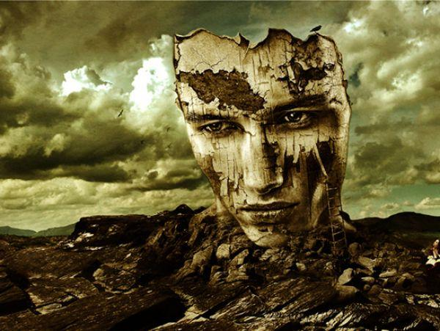
Have you ever broken something important or valuable.
As children of Heavenly Father we are important and have great worth.
Because of our choices or the challenges we face, at times we may feel broken or like we have little value.

Slide 50
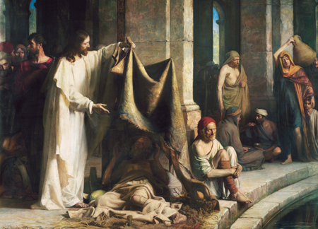
Feast
While in Jerusalem, Jesus went to a pool near the temple.
Carl H. Bloch
John 5:1

Slide 51
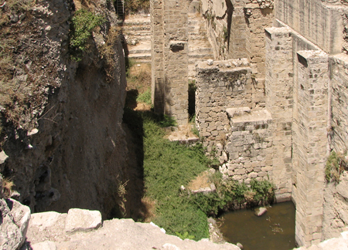
Bethesda
House of mercy, or House of grace
Archaeological excavations have identified the site for the pool of Bethesda as being just outside a north gate of the ancient temple precinct in Jerusalem, possibly a gate through which sacrificial sheep were led into the temple grounds.
Pool of Bethesda Today
(1)
John 5:1

Slide 52
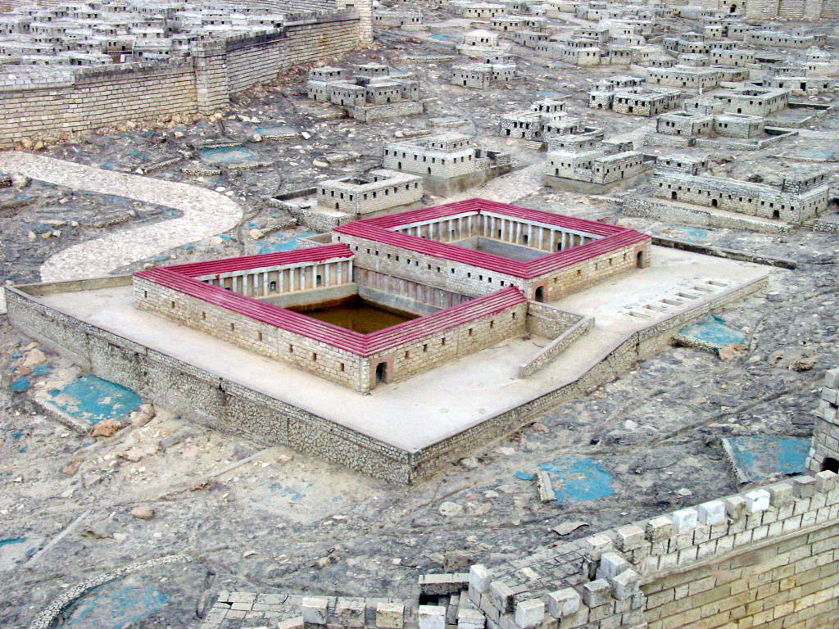
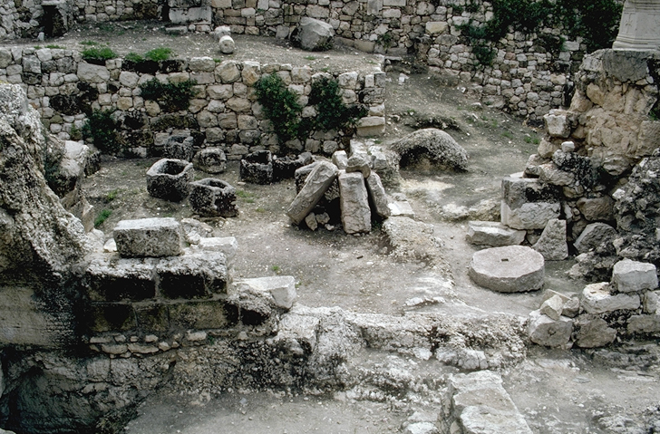
In Jerusalem by the sheep market is a pool
Impotent, blind, halt, and withered -- describe people who were sick, feeble, or disabled in some way…
John 5:2-3

Slide 53
Waiting to Be Healed
People of all kinds of inflictions gather at this pool…
…and wait for the moving water.
John 5:3

Slide 54
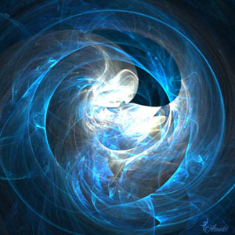
Tradition :The angels stirred the water, moving it, during a certain season, and those who able to wash in it were healed.
“No doubt the pool of Bethesda was a mineral spring whose waters had some curative virtue.
“Any notion that an angel came down and troubled the waters, so that the first person thereafter entering them would be healed, was pure superstition.
Healing miracles are not wrought in any such manner.” (2)
John 5:4

Slide 55
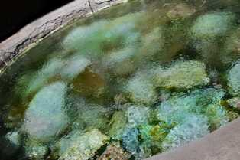
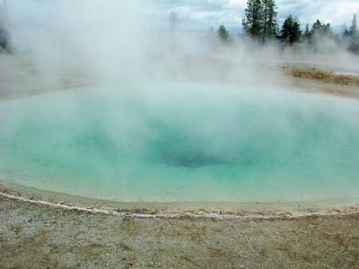
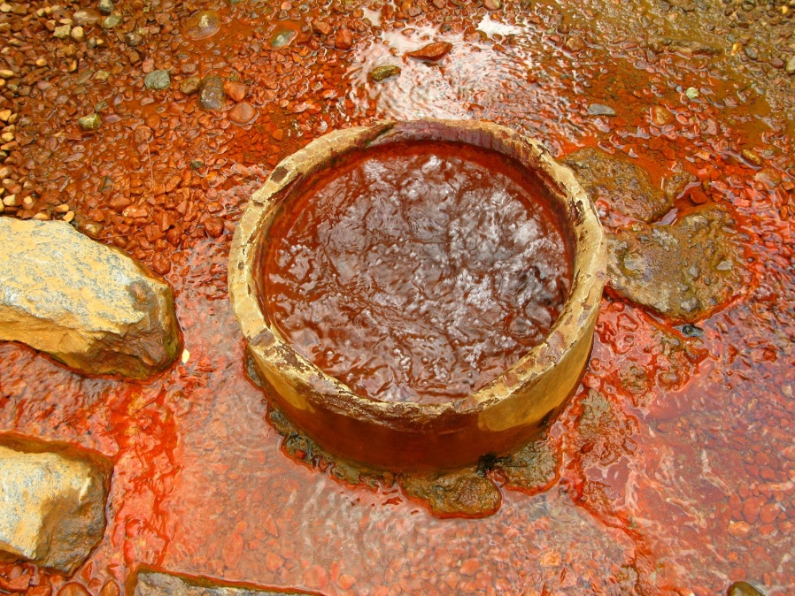
Mineral Spring
At intervals the spring rose with bubbling disturbance. Then receded to normal level

Slide 56
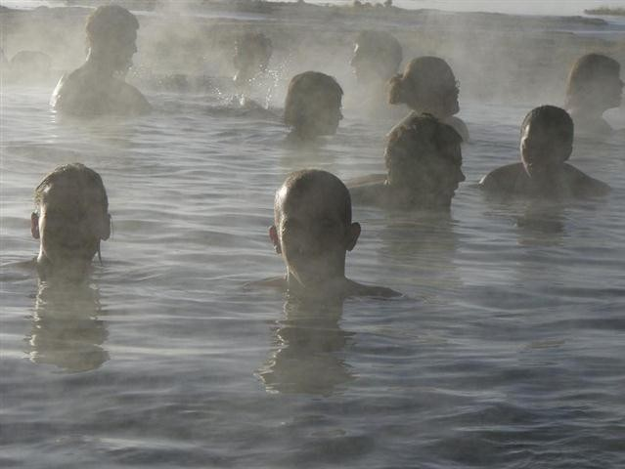
Some believed that the upwelling of the Bethesda waters was the result of supernatural agency and that if they stepped into the water during this time they would be healed.

Slide 57
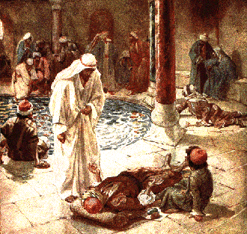
“And a certain man was there, which had an infirmity thirty and eight years.”
John 5:5

Slide 58
Others, less crippled, crowded him away, and according to legend only the first to enter the pool after the agitation of the water might expect to be healed.
John 5:5

Slide 59
When Jesus saw him and recognized that he would be fit for a blessing, He asked,
“Wilt thou be made whole?”
John 5:6

Slide 60
Troubled, the man said,
“Sir, I have no man, when the water is troubled, to put me into the pool…”
John 5:7

Slide 61
Through the power and mercy of Jesus Christ, we can be made whole
“Rise, take up thy bed, and walk”
John 5:8

Slide 62
“Just as the lame man at the Pool of Bethesda needed someone stronger than himself to be healed, so we are dependent on the miracles of Christ’s atonement if our souls are to be made whole from grief, sorrow, and sin. …
Through Christ, broken hearts are mended and peace replaces anxiety and sorrow.”
John 5:9
(3)

Slide 63
The man was made whole. And walked away
The Pharisees question him about breaking the Sabbath Law
John 5:9-13

Slide 64
Jesus finds him later in the temple. Perhaps the man went looking for the one who healed him.
“Behold, thou art made whole: sin no more…”
John 5:14

Slide 65
Jesus is willing to help those in need.
It is up to us whether we want to be made whole.

Slide 66
Healing on the Sabbath
When the Jewish leaders learned that the man had been healed by Jesus on the Sabbath, they persecuted and tried to kill the Savior.
The Jews persecuted the Savior not only because He healed a man on the Sabbath, but because He said that God was His Father. (1)
John 5:10-16

Slide 67
“‘Equal with God!’—awful blasphemy or awesome truth!—one or the other. There is no middle ground, no room for compromise; there are no principles to compose: either Jesus is divine or he is blaspheming!
“‘Equal with God!’—not, as yet, in the infinite and eternal sense, but in the sense of being one with him, of being his natural heir, destined to receive, inherit, and possess all that the Father hath.
“‘Equal with God!’—not that he was then reigning in glory and exaltation over all the works which their hands had made, but in the sense that he was God’s Son, upon whom the Father had placed his own name and to whom he had given glory and honor and power.”
John 5:10-16
(2)

Slide 68
Jesus Christ Our Final Judge
He stands as the head of The Church of Jesus Christ of Latter-day Saints.
“Knowing that Jesus Christ is the firstborn Son of God in the spirit and the Only Begotten Son in the flesh gives a far more noble and majestic view of him than if he were just a great teacher or philosopher. He is our Lord, the Redeemer of all mankind, our Mediator with the Father. Because of his love for us, he has atoned for the sins of the world and has provided a way for the faithful to return to our Heavenly Father’s presence.”
“He will come again in power and glory to dwell on the earth, and will stand as Judge of all mankind at the last day.”
John 5:22, 27, 30
fabichaco
(5)

Slide 69
Jesus’s Divinity
John 5:33-35
John the Baptist
“…and he bare witness unto the truth.”
John 5:37
The Scriptures
“… for in them ye think ye have eternal life: and they are they which testify of me.”
John 5:36
His Works
“…the same works that I do, bear witness of me, that the Father hath sent me.”
John 5:37
His Father
“…the Father himself, which hath sent me, hath borne witness of me.”
Andrea del Sarto
John 5:33-37
(5)
J.D.
Cima da Conegliano

Slide 70
Qualifying for Eternal Life
Many Jews in Jesus’s day believed that merely studying the scriptures would allow them to receive eternal life.
They failed to understand that the purpose of the scriptures was to point them to Jesus Christ.
He said, in essence, “You think you have eternal life, but search the scriptures, for they testify of me.”
PICK ME
PICK ME
Only by coming unto Jesus Christ can we receive eternal life
John 5:39-40
(5)

Slide 71
How To Achieve Eternal Life Through Scriptures
Once we understand why we need guidance and where we obtain it, we then ask, how can we achieve it?
Scriptural guidance helps you to recognize error and make the necessary correction.
Guidance can come when grappling with a serious challenge in life.
To feast means to savor. We savor the scriptures by studying them in a spirit of delightful discovery and faithful obedience.
You cultivate such revelatory experiences by living according to the light already given you and by searching the scriptures with pure motives.
We all need guidance through life. We obtain it best from the standard works and teachings of the prophets of God.
With diligent effort, we can achieve that guidance and thus qualify for all of the blessings that God has in store for His faithful children.
John 5:39-40
(6)

Slide 72
Sources:
New Testament Institute Student Manual Chapter 23
Elder Bruce R. McConkie (Doctrinal New Testament Commentary, 3 vols. [1965–73], 1:188). “Equal with God” (The Mortal Messiah: From Bethlehem to Calvary, 4 vols. [1979–81], 2:71).
Elder Merrill J. Bateman(“The Power to Heal from Within,” Ensign, May 1995, 13).
Elder Joseph B. Wirthlin Fruits of the Restored Gospel of Jesus Christ 1991 Oct. Gen. Conf.
Excerpts from: Elder Russell M. Nelson Living by Scriptural Guidance 2000 Oct. Gen Conf.
Presentation by ©http://fashionsbylynda.com/blog/

Slide 73
Event | Matthew | Mark | Luke | John
Jesus Attends a Feast at Jerusalem |  |  |  | 5:1
Jesus Heals a Man on the Sabbath |  |  |  | 5:2-16
Jesus to Do the Work of His Father |  |  |  | 5:17-47
Needing to Be Healed:
“Just as the lame man at the Pool of Bethesda needed someone stronger than himself to be healed (see John 5:1–9), so we are dependent on the miracles of Christ’s atonement if our souls are to be made whole from grief, sorrow, and sin. … Through Christ, broken hearts are mended and peace replaces anxiety and sorrow. … As Isaiah stated concerning the Savior: ‘Surely he hath borne our griefs, and carried our sorrows. … And with his stripes we are healed’ (Isa. 53:4–5).
“The Savior’s atonement in the garden and on the cross is intimate as well as infinite. Infinite in that it spans the eternities. Intimate in that the Savior felt each person’s pains, sufferings, and sicknesses. Consequently, he knows how to carry our sorrows and relieve our burdens that we might be healed from within, made whole persons, and receive everlasting joy in his kingdom. May our faith in the Father and the Son help each of us to become whole” Bishop Merrill J. Bateman (“The Power to Heal from Within,” Ensign, May 1995, 13–14).
So Focused on Moses John 5:46:
"It is ironic that many in Jesus' time refused to listen to Him because they were so fixed on Moses. To those who persecuted Him because He had healed an invalid on the Sabbath, he said: 'Had ye believed Moses, ye would have believed me: for he wrote of me. But if ye believe not his writings, how shall ye believe my words?' (John 5:46-47. See also Mormon 7:9.) Yet Jesus had personally called, instructed, and tutored Moses!
He told the Nephites, 'Behold, . . . the law is fulfilled that was given unto Moses. Behold, I am he that gave the law, and I am he who covenanted with my people Israel; therefore, the law in me is fulfilled, for I have come to fulfill the law; therefore it hath an end.' (3 Nephi 15:4-5.)" Elder Neal A. Maxwell (Meek and Lowly [Salt Lake City: Deseret Book Co., 1987], 77.)
Scripture Searching John 5:39-40:
“In the end, the central purpose of all scripture is to fill our souls with faith in God the Father and in His Son, Jesus Christ—faith that They exist; faith in the Father’s plan for our immortality and eternal life; faith in the Atonement and Resurrection of Jesus Christ, which animates this plan of happiness; faith to make the gospel of Jesus Christ our way of life; and faith to come to know ‘the only true God, and Jesus Christ, whom [He has] sent’ (John 17:3)” (“The Blessing of Scripture,” Ensign or Liahona, May 2010, 34).
Equal John 5:19:
To come to earth with such a responsibility, to stand in place of Elohim—speaking as He would speak, judging and serving, loving and warning, forbearing and forgiving as He would do—this is a duty of such staggering proportions that you and I cannot comprehend such a thing. But in the loyalty and determination that would be characteristic of a divine child, Jesus could comprehend it and He did it. Then, when the praise and honor began to come, He humbly directed all adulation to the Father [see John 5:19; 14:10]” Elder Jeffrey R. Holland (“The Grandeur of God,” Ensign or Liahona, Nov. 2003, 70–71).

Slide 74
Event | Matthew | Mark | Luke | John
The Twelve Apostles Return and Depart—Jesus is to Rest | 14:13 | 6:30-33 | 9:10 | 6:1, 2
Jesus Feeds 5,000 | 14:14-21 | 6:34-44 | 9:11-17 | 6:3-14
Jesus Departs to the Mountain to Avoid Being Made King | 14:22, 23 | 6:45, 46 |  | 6:15
Jesus Walks on Water | 14:24-33 | 6:47-52 |  | 6:16-21
Jesus is the Bread of Life |  |  |  | 6:22-59
Many Reject Jesus |  |  |  | 6:60-71
Similarities between Moses and the Savior: (I AM):
Perhaps one of the most striking similarities between the ministries of Moses and the Savior is the use of “I Am” statements. When Moses asked the Lord what to say when the children of Israel asked for His name, the Lord responded, “I AM THAT I AM” (Exodus 3:13–14).
“I Am”—one of the names by which the Savior is known in the Old Testament—is recorded repeatedly by John, and Moses was told to use this name so the Israelites would know that Jehovah had spoken. John recorded that the Savior declared, “I am the bread of life” (John 6:35, 48, 51; italics added). He made other similar “I am” statements during His ministry (see John 8:12; 10:9, 11;11:25; 14:6; 15:1). (1)
Bread:
As a common food staple in many cultures, bread serves as an ideal metaphor for the fundamental role the Savior and His teachings should have in our lives. As Jesus taught people about “the bread of life,” He drew upon the background of His listeners. He used their religious history as a teaching tool—the feeding of the five thousand and the Bread of Life discourse took place as the Jews were preparing for the Passover, during which the children of Israel ate unleavened bread in memory of their deliverance from Egypt and the manna that God had provided for them in the wilderness. He drew upon the people’s personal experience—many of those who listened to the Master on this occasion had also been among the five thousand who had eaten the bread He miraculously provided just the day before.
The Savior also drew upon his listeners’ geographical location—they were now hearing Him teach in Capernaum, a region that appears to have been associated with bread making; more remnants of grinding mills have been discovered at Capernaum than at any other place in Israel. When the crowd referred to the manna provided for Israel in the days of Moses, the Savior reminded them that the same God who had provided that “bread from heaven” now offered to them the “true bread from heaven” (John 6:32). Jesus had demonstrated that He could indeed provide for them temporally, but He was also “that bread of life” (John 6:48) who could give eternal life to those who would partake of the spiritual nourishment He now offered (see John 6:51).(1)
Tradition that the Messiah would come and feed: John 5:15:
“There was a tradition, taught by the Rabbis and firmly entrenched in the public mind, that when Messiah came, he would feed them with bread from heaven. … It had even become a fixed belief that the Messiah, when He came, would signalize His advent by a repetition of this stupendous miracle. ‘As the first Saviour—the deliverer from Egyptian bondage,’ said the Rabbis, ‘caused manna to fall for Israel from heaven, so the second Saviour—the Messiah—will also cause manna to descend for them once more’ [Cunningham Geikie, The Life and Words of Christ (1886), 516–17].
“Thus, when Jesus multiplied the five barley loaves and the two small fishes, it was as though the traditional sign had been given. The peak of his popular appeal had come. In their eyes he stood on the summit. He was the Messiah, they reasoned, and must reign as their king” (Mortal Messiah, 2:367–68).

