Slide 1
Matthew 15-17
Mark 7-9

Slide 2
Lesson For The Pharisees
Matthew 15
And said, Verily I say unto you, Except ye be converted, and become as little children, ye shall not enter into the kingdom of heaven.
Matthew 18:3

Slide 3
A young couple is preparing for marriage. They live in a place where it is widely accepted to participate in premarital sexual relations. Some people have told this couple that they are old-fashioned and odd because they are waiting to be married before engaging in sexual intimacy.
A young woman is encouraged by her friends to wear an inappropriate outfit to a school dance. The young woman knows that the outfit does not meet the Lord’s standards of modesty, even though it is generally accepted in her culture to wear outfits like it.
A young man belongs to a Latter-day Saint family that loves sporting events. When popular sporting events are shown on television, the family routinely sets aside family prayer, scripture study, family home evening, and Sunday Church meetings in order to watch the events.
Each scenario presents a conflict between obeying God’s commandments and acting according to traditions or customs.
What do these scenarios have in common?

Slide 4
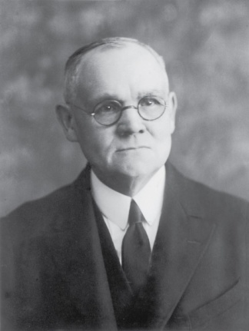
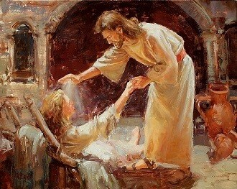
Previously…
Capernaum
Besaida
Jesus and his disciples reached the land of Gennesaret
Gennesaret
The word of the Lord’s presence there spread rapidly…the people flocked to Him, bringing their afflicted to receive of His beneficence by word or touch.
Tiberias
In the towns through which He walked, the sick were laid in the streets that the blessing of His passing might fall upon them; and many “besought him that they might touch if it were but the border of his garment; and as many as touched him were made whole.” (1)
Mark 6:56

Slide 5
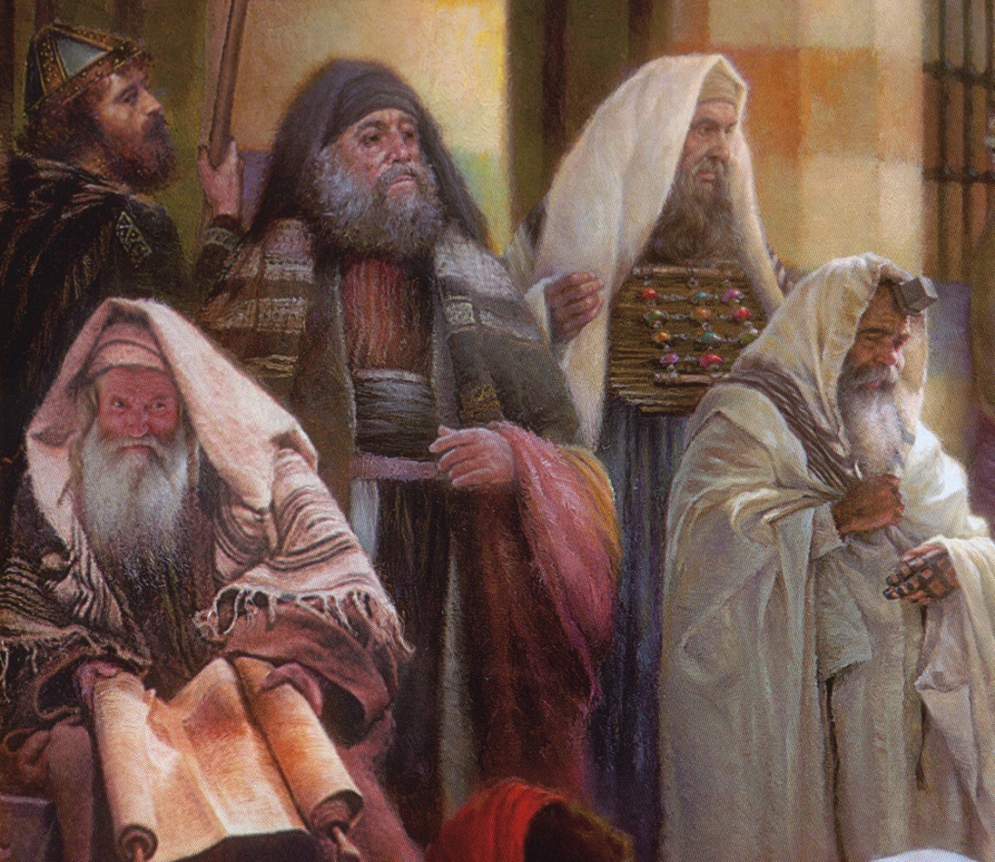
Tradition and Customs
The numerous washings required by Jewish custom in the time of Christ were admittedly incident to rabbinism and “the tradition of the elders” and not in compliance with the Mosaic law. (1)
Oral Law—sometimes called Traditions of the Fathers
The Pharisees clamed that Moses had received the law on Mount Sinai in two parts—one written and one oral. The written part made up the 5 books of Moses, which were accepted by all Jews…but according to the Pharisees another part of the law had also been given to Moses orally and had been handed down and preserved by the Pharisees and their predecessors. (2)
“Whenever written scripture failed to give clear instructions, the Pharisees appealed to the oral law….the Pharisees denied that God could ever change or add anything to the revelation given…(2)

Slide 6
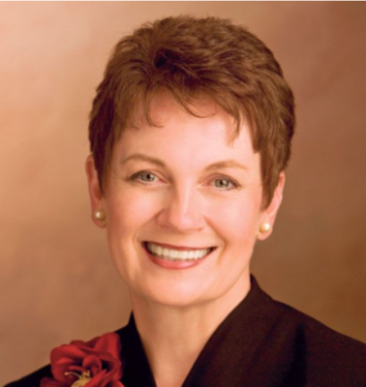
What kinds of traditions do we have?
Some of them may have come from our fathers, and now we are passing them along to our own children.
Are they what we want them to be?
Are they based on actions of righteousness and faith?
Are they mostly material in nature, or are they eternal?
Are we consciously creating righteous traditions, or is life just happening to us?
Are our traditions being created in response to the loud voices of the world, or are they influenced by the still, small voice of the Spirit?
Are the traditions that we are creating in our families going to make it easier for our children to follow the living prophets, or will they make it difficult for them?
(9)

Slide 7
What traditions are helping you become more like Heavenly Father and Jesus Christ and focus on what matters most?
What traditions may be taking you away from Jesus Christ and preventing you from accomplishing those things that matter most?
What steps might you need to take to remove these traditions from your life?
How can the Savior’s example help you recognize and focus on the traditions that matter most?

Slide 8
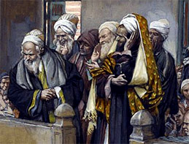
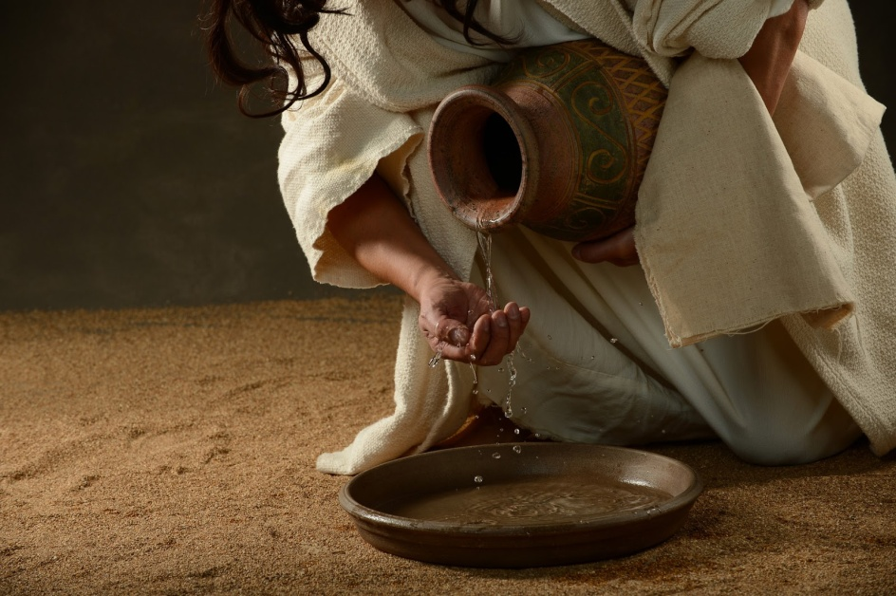
Failing to Wash
A ceremonial washing for the sake of ritual purity and does not refer to washing for sanitation.
The scribes and Pharisees try to discredit the disciples of Jesus by failing to wash before they ate.
Under the law of Moses, many aspects of daily life were divided into categories of “clean” and “unclean.” Uncleanness referred to being ceremonially or ritually unclean and did not mean that the person was either unsanitary or morally unclean, though ritually “unclean” persons were excluded from certain religious and social activities until they were purified. (3)
Matthew 15:1-2; Mark 7:1-3

Slide 9
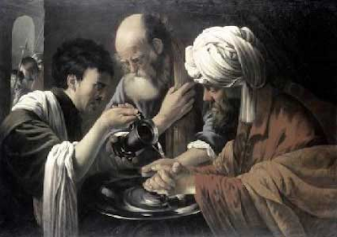
Inward Washing
Some seek only external washing, whereas they should be seeking internal renewal.
Mark lists inner evils:
Covetousness
Wickedness
Deceit
Lasciviousness
An evil eye
Pride
Foolishness
“The scriptures reveal that the Lord will save his greatest wrath and condemnation for those who outwardly appear religious but who are actually full of evil within.” (4)
Now I would that ye should remember that God has said that the inward vessel shall be cleansed first, and then shall the outer vessel be cleansed also.
Alma 60:23
“…as we cleanse the inner vessel, there will have to be changes made in our own personal lives, in our families, and in the Church. The proud do not change to improve, but defend their position by rationalizing. Repentance means change, and it takes a humble person to change.” (5)
Matthew 15:1-2; Mark 7

Slide 10
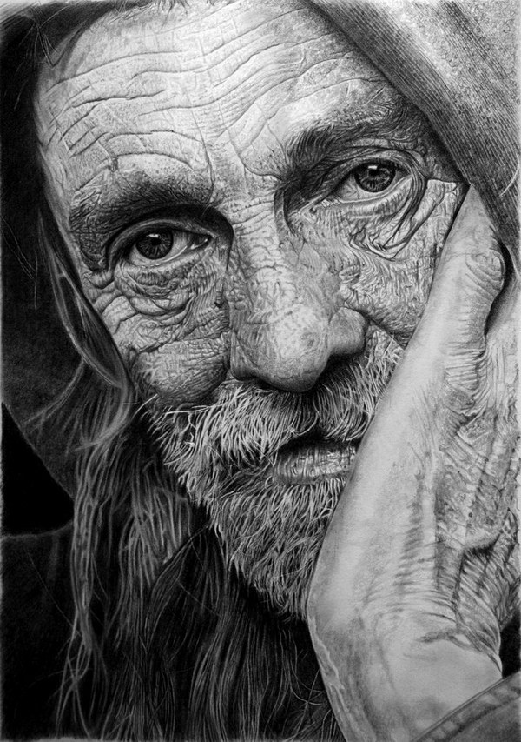
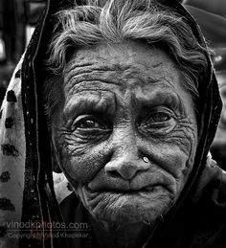
Honor Thy Father and Mother
Corban = that people “shall be free” of their obligation to take care of their aging parents by declaring that their money was reserved as a gift to God,…
However, Jesus taught that in doing so, they violated the commandment to honor one’s father and mother.
Matthew 15:5-6; Mark 7:10-12

Slide 11
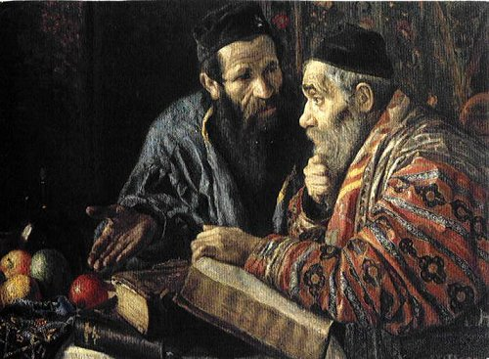
Traditions As An Excuse
Though they professed God with their mouths, their hearts were far from Him
“In contrast to the institutions of the world, which teach us to know something, the gospel of Jesus Christ challenges us to become something. …
“Jesus’ challenge shows that the conversion He required for those who would enter the kingdom of heaven was far more than just being converted to testify to the truthfulness of the gospel. …
“To testify is to know and to declare.
The gospel challenges us to be ‘converted,’ which requires us to do and to become.” (6)
If we desire to draw near to God, we must place His commandments above any traditions and customs we may have
Matthew 15:7-9; Mark 7:10-12

Slide 12
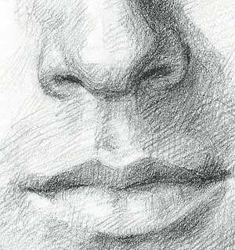
Defileth
His disciples not to concern themselves with the Pharisees, who were offended by His words
Stay out of the gutter in your conversation. Foul talk defiles the man who speaks it. (2)
"Church leaders have implored and pleaded with the Saints to use the right language.
President Spencer W. Kimball said, 'When we go to places of entertainment and mingle among people, we are shocked at the blasphemy that seems to be acceptable among them.
The commandment says, 'Thou shalt not take the name of the Lord thy God in vain.' (Exodus 20:7.)
Except in prayers and proper sermons, we must not use the name of the Lord. Blasphemy used to be a crime punishable by heavy fines. Profanity is the effort of a feeble brain to express itself forcibly.‘ (7)
Matthew 15:10-11

Slide 13
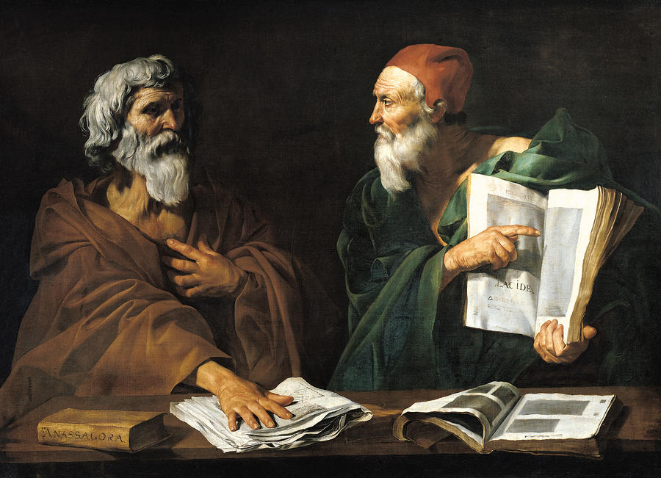
Every Plant
Do Not Buy Into Everything Someone Tells You!
"If you 'buy into' the philosophies of men, you may have your testimony repossessed. Your respect for moral law may go with it, and you will end up with nothing.” (8)
And everything that is in the world, whether it be ordained of men, by thrones, or principalities, or powers, or things of name, whatsoever they may be, that are not by me or by my word, saith the Lord, shall be thrown down, and shall not remain after men are dead, neither in nor after the resurrection, saith the Lord your God. D&C 132:13
Matthew 15:12-16

Slide 14
Laws of Man VS Laws of God
"The laws of man are never concerned about a person's desires or thoughts, in isolation. When the law inquires into a person's state of mind or intent, it only seeks to determine what consequence should be assigned to particular actions that person has taken.
"In contrast, the laws of God are concerned with spiritual things. Spiritual consequences are affected by actions, but they are also affected by desires or thoughts, independent of actions. Gospel consequences flow from the desires of our hearts...”
God judges us not only for our acts, but also for the desires of our hearts.
Matthew 15:17-20
(6)

Slide 15
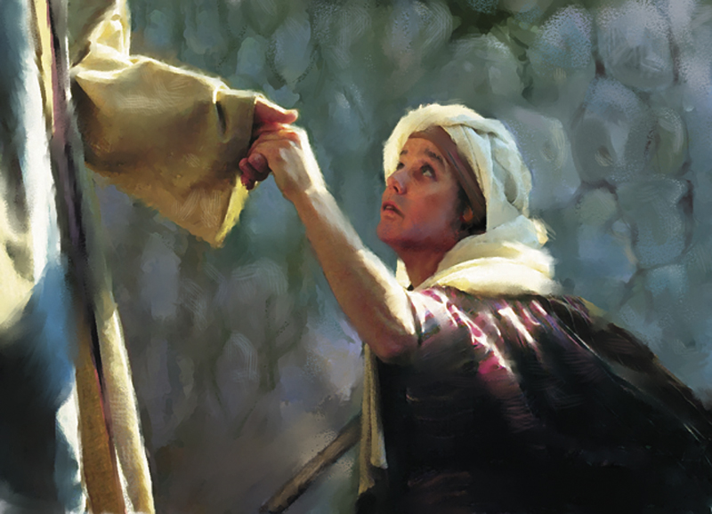
Woman of Canaan--Gentile
At a time when the gospel was being proclaimed to the Jews and not yet to the Gentiles.
O woman, great is thy faith: be it unto thee even as thou wilt. And her daughter was made whole from that very hour.
A Gentile woman recognized Jesus as the “Son of David,” the promised Messiah.
She did not take offense at Jesus’s words, but she humbly recognized that she was a beggar at Israel’s table.
The Greek word translated “dogs” referred to small dogs that could be household pets. Such pets would eat morsels of food given to them from the table or carelessly dropped.
Understanding the Savior’s distinction between Israel and Gentiles, the woman correctly pointed out that household pets were allowed to eat that which had been rejected.
Matthew 15:21-28
(3)

Slide 16
“When we have faith in the Lord Jesus Christ, we must have trust in him. We must trust him enough that we are content to accept his will, knowing that he knows what is best for us. …
“… Faith, no matter how strong it is, cannot produce a result contrary to the will of him whose power it is. … We cannot have true faith in the Lord without also having complete trust in the Lord’s will and in the Lord’s timing”
Matthew 15:27
(6)

Slide 17
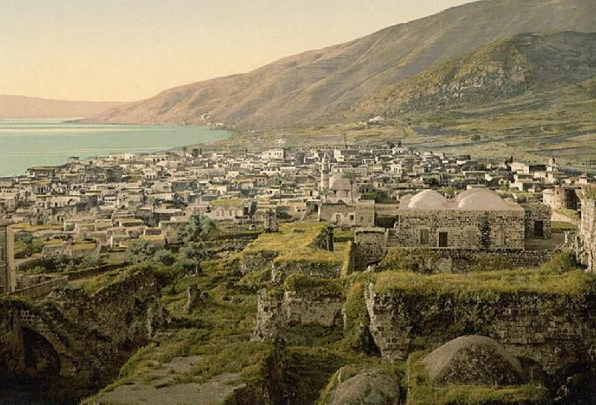
4,000 Fed
Jesus returned to Galilee. While He was there, over four thousand people gathered to Him, bringing with them people who were suffering from various physical ailments and disabilities.
The Savior healed them, and after the people spent three days with Him, He performed another miracle by feeding all of them with only seven loaves of bread and a few small fishes.
Matthew 15:29-39

Slide 18
Sources:
James E. Talmage Jesus the Christ p. 338, 340
Ed J. Pinegar, K. Douglas Bassett, Ted L. Earl Latter-day commentary on the New Testament p.192
New Testament Institute Student Manual Chapter 12
Larry Tippets Cleansing the Inner Vessel: The Process of Repentance Oct. Ensign 1992
President Ezra T. Benson Cleansing the Inner Vessel May 1986 Ensign
Elder Dallin H. Oaks (“The Challenge to Become,” Ensign, Nov. 2000, 32–33).
The Desires of Our Hearts," Ensign, June 1986, 64)
Faith in the Lord Jesus Christ,” Ensign, May 1994, 99, 100
7. Elder L. Tom Parry (Living with Enthusiasm, 116-17.)
Elder Boyd K. Packer Things of the Soul, 52
9 Cheryl C. Lant, “Righteous Traditions,” Ensign or Liahona, May 2008, 13)
Presentation by ©http://fashionsbylynda.com/blog/

Slide 19
Washing Traditions: Matthew 15:1-2
Under certain conditions, successive washings were prescribed, in connection with which we find mention of “first,” “second” and “other” waters, the “second water” being necessary to wash away the “first water,” which had become defiled by contact with the “common” hands; and so further with the later waters. Sometimes the hands had to be dipped or immersed; at other times they were to be cleansed by pouring, it being necessary that the water be allowed to run to the wrist or the elbow according to the degree of supposed defilement; then again, as the disciples of Rabbi Shammai held, only the finger tips, or the fingers up to the knuckles, needed to be wetted under particular circumstances. Rules for the cleansing of vessels and furniture were detailed and exacting; distinct methods applied respectively to vessels of clay, wood, and metal. Fear of unwittingly defiling the hands led to many extreme precautions. It being known that the Roll of the Law, the Roll of the Prophets, and other scriptures, when laid away were sometimes touched, scratched, or even gnawed by mice, there was issued a rabbinical decree, that the Holy Scriptures, or any part thereof comprising as many as eighty-five letters (the shortest section in the law having just that number), defiled the hands by mere contact. Thus the hands had to be ceremonially cleansed after touching a copy of the scriptures, or even a written passage there from. James E. Talmage Jesus The Christ p. 366
Hand Washing of Today: Jewish Law
Washing of hands when one wakes from his sleep (known in Yiddish as נעגל וואַסער, negel vasser), poured out from a vessel three times, intermittently, over each hand. This washing is said to remove an evil spirit from one's fingers.
Washing of hands before prayer.
Washing of hands when one touches his privy parts, or the sweat from his body (excluding his face), or when one crops his fingernails[
Washing of hands when one leaves the latrine, lavatory or bathhouse
Washing of hands when one leaves a cemetery
Washing of hands before breaking bread served in one's supper, and only bread made from one of the five chief grains (wheat, cultivated barley, spelt, wild barley,[and oats)
Washing of hands after eating a meal where the salt of Sodom was served at that table
Washing of hands (practised by the Cohanim, or priests, of some communities) prior to going up to bless the people, as prescribed in the Sacerdotal Blessing
Washing of hands when, prior to eating, one dips a morsel of food within a liquid (e.g. water, honey, oil, etc.) which then clings to that morsel, with the one exception of fruits, seeing that they do not require hand washing.
In two of these hand washings, water is poured out over one's hands with the aid of a vessel, viz., 1) whenever one wakes from his sleep, and 2) before eating bread. These hand washings are nearly always accompanied with a special blessing prior to concluding the actual act of washing (see infra).
Although the minimal quantity of water needed to fulfill one's religious duty is 1/4 of a log (a liquid measure of capacity equal to the bulk or volume of one and half medium-sized eggs), and must be sufficient to cover at least the middle joints of one's fingers, water poured out in excess of this amount is considered praiseworthy in Jewish law. The hand washing made when one leaves the lavatory or latrine, or when one touches his privy parts, or sweat, may be done simply with running tap water (faucet).
The most developed and, perhaps, important of these washings is the washing of hands before eating bread. Such washing of hands is called in Hebrew, netilat yadayim, meaning "the lifting up of the hands." It is looked upon with such rigidity, that those who willfully neglect its practice are said to make themselves liable to excommunication, and bring upon themselves a state of scarcity, and are quickly taken out of the world. Wikipedia
Inward Cleansing:
1. Sexual impurity, which he calls “the plaguing sin of this generation.” The Prophet Joseph Smith called it “the source of more temptation, buffetings, and more difficulties … than any other.” (Ensign, May 1986, p. 4; Journal of Discourses, 8:55.)
2. Neglect of the scriptures, especially the Book of Mormon. Such neglect has brought the Church “under condemnation” and has caused a “scourge and judgment to be poured out upon the children of Zion.” (See Ensign, May 1986, p. 5; D&C 84:57–58.)
3. Pride, or wanting to be successful at any price. President Benson characterizes it as “self-will as opposed to God’s will.” (Ensign, May 1986, p. 7.) (5)
Corban Matthew 15:5:
"The practice referred to as 'corban' is that a son, if he were of independent age, could pledge his property to God, and thus it would not be available to be used to support needy parents, although the son could continue to use it for himself as long as he lived. Such a vow (which was permitted by the religious leaders) became more binding than the command of God, and hence the law of God was made 'of none effect' by the tradition.
"Having thus shown the delegation that they themselves were guilty of gross negligence and corruption far greater than eating with unwashed hands, Jesus then proceeded to explain that defilement that comes from within the heart is worse than defilement from the soil on one's outer body." (Robert J. Matthews, Studies in Scripture, Vol. 5: The Gospels, ed. by Kent P. Jackson and Robert L. Millet, 299.)

Slide 20
Dogs Eat of the Crumbs Matthew 15:27
“The rabbis often spoke of the Gentiles as dogs, e.g. ‘He who eats with an idolater is like one who eats with a dog.’ … ‘The nations of the world are compared to dogs.’ ‘The holy convocation belongs to you, not to the dogs.’ Yet Jesus in adopting the contemptuous expression slightly softens it. He says not ‘dogs,’ but ‘little dogs,’ i.e. household, favorite, dogs; and the woman cleverly catches at the expression, arguing that if the Gentiles are household dogs, then it is only right that they should be fed with the crumbs that fall from their masters’ table.” Edersheim, referring to the original text, says: “The term means ‘little dogs,’ or ‘house dogs.’” (1) p. 340
“The gospel (with all its healing powers and graces) was to be offered to the Jews before it went to the Gentiles. Jesus’ mortal ministry was with Israel, not with other nations. His healing of this or any Gentile person came by special dispensation because of great faith. Previously he had commanded the apostles to go only to the lost sheep of the house of Israel and not to preach the message of salvation to the Gentiles. (Matt. 10:5–6.) Certainly the course he followed in this instance was instructive to his disciples, tested the faith of the Gentile woman, taught that persistence and importunity in prayer will bring reward, and showed that greater faith is sometimes found among heathens than in the chosen lineage of Israel” Elder Bruce R. McConkie (Doctrinal New Testament Commentary, 3 vols. [1965–73], 1:371).
Gentiles of Great Faith Matthew 15:21-28:
Though a Gentile, the woman had great faith, yet the disciples asked Jesus to send her away. Instead, Jesus ministered to her. When the time came for the disciples to carry the gospel to the Gentiles (see Matthew 28:19–20), they could expect to find many individuals who, like this woman, were ready to receive their message. (30
Feeding the 4,000 Matthew 15:29-39:
“‘[The Savior] took the seven loaves and the fishes, and gave thanks, and brake them, and gave to his disciples, and the disciples to the multitude.’
“Notice that the Savior gave thanks for what they had—and a miracle followed: ‘And they did all eat, and were filled: and they took up of the broken meat that was left seven baskets full’ [see Matthew 15:32–38; italics added; see also Mark 8:1–8]. …
“Regardless of our circumstances, each of us has much for which to be grateful if we will but pause and contemplate our blessings. … To live with gratitude ever in our hearts is to touch heaven” President Thomas S. Monson (“The Divine Gift of Gratitude,” Ensign or Liahona, Nov. 2010, 88, 90).
A philosopher is someone who practices philosophy, which involves rational inquiry into areas that are outside of either theological dogma or science. The term "philosopher" comes from the Ancient Greek φιλόσοφος (philosophos) meaning "lover of wisdom". Its origination has been ascribed to the Greek thinker Pythagoras. Wikipedia

Slide 21
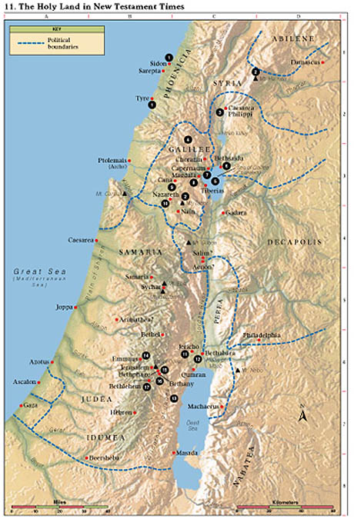
1. Tyre and Sidon Jesus compared Chorazin and Bethsaida to Tyre and Sidon (Matt. 11:20–22). He healed the daughter of a Gentile woman (Matt. 15:21–28).
2. Mount of Transfiguration Jesus was transfigured before Peter, James, and John, and they received the keys of the kingdom (Matt. 17:1–13). (Some believe the Mount of Transfiguration to be Mount Hermon; others believe it to be Mount Tabor.)
3. Caesarea Philippi Peter testified that Jesus is the Christ and was promised the keys of the kingdom (Matt. 16:13–20). Jesus foretold His own death and Resurrection (Matt. 16:21–28).
4. Region of Galilee Jesus spent most of His life and ministry in Galilee (Matt. 4:23–25). Here He gave the Sermon on the Mount (Matt. 5–7); healed a leper (Matt. 8:1–4); and chose, ordained, and sent forth the Twelve Apostles, of whom only Judas Iscariot was apparently not Galilean (Mark 3:13–19). In Galilee the risen Christ appeared to the Apostles (Matt. 28:16–20).
5. Sea of Galilee, later called Sea of Tiberias Jesus taught from Peter’s boat (Luke 5:1–3) and called Peter, Andrew, James, and John to be fishers of men (Matt. 4:18–22; Luke 5:1–11). He also stilled the tempest (Luke 8:22–25), taught parables from a boat (Matt. 13), walked on the sea (Matt. 14:22–32), and appeared to His disciples after His Resurrection (John 21).
6. Bethsaida Peter, Andrew, and Philip were born in Bethsaida (John 1:44). Jesus went away privately with the Apostles near Bethsaida. The multitudes followed Him, and He fed the 5,000 (Luke 9:10–17;John 6:1–14). Here Jesus healed a blind man (Mark 8:22–26).
7. Capernaum This was Peter’s home (Matt. 8:5, 14). In Capernaum, which Matthew called Jesus’ “own city,” Jesus healed a paralytic (Matt. 9:1–7; Mark 2:1–12), cured a centurion’s servant, healed the mother of Peter’s wife (Matt. 8:5–15), called Matthew to be one of His Apostles (Matt. 9:9), opened blind eyes, cast out a devil (Matt. 9:27–33), healed a man’s withered hand on the Sabbath (Matt. 12:9–13), gave the bread of life discourse (John 6:22–65), and agreed to pay taxes, telling Peter to get the money from a fish’s mouth (Matt. 17:24–27).
8. Magdala This was the home of Mary Magdalene (Mark 16:9). Jesus came here after feeding the 4,000 (Matt. 15:32–39), and the Pharisees and Sadducees requested that He show them a sign from heaven (Matt. 16:1–4).
9. Cana Jesus turned water into wine (John 2:1–11) and healed a nobleman’s son who was at Capernaum (John 4:46–54). Cana was also the home of Nathanael (John 21:2).
10. Nazareth The annunciations to Mary and Joseph took place in Nazareth (Matt. 1:18–25; Luke 1:26–38; 2:4–5). After returning from Egypt, Jesus spent His childhood and youth here (Matt. 2:19–23;Luke 2:51–52), announced that He was the Messiah, and was rejected by His own (Luke 4:14–32).
11. Jericho Jesus gave sight to a blind man (Luke 18:35–43). He also dined with Zacchaeus, “chief among the publicans” (Luke 19:1–10).
12. Bethabara John the Baptist testified that he was “the voice of one crying in the wilderness” (John 1:19–28). John baptized Jesus in the Jordan River and testified that Jesus is the Lamb of God (John 1:28–34).
13. Wilderness of Judea John the Baptist preached in this wilderness (Matt. 3:1–4), where Jesus fasted 40 days and was tempted (Matt. 4:1–11).
14. Emmaus The risen Christ walked on the road to Emmaus with two of His disciples (Luke 24:13–32).
15. Bethphage Two disciples brought Jesus a colt on which He began His triumphal entry into Jerusalem (Matt. 21:1–11).
16. Bethany This was the home of Mary, Martha, and Lazarus (John 11:1). Mary heard Jesus’ words, and Jesus spoke to Martha of choosing the “good part” (Luke 10:38–42); Jesus raised Lazarus from the dead (John 11:1–44); and Mary anointed Jesus’ feet (Matt. 26:6–13; John 12:1–8).
17. Bethlehem Jesus was born and was laid in a manger (Luke 2:1–7); angels heralded to the shepherds the birth of Jesus (Luke 2:8–20); wise men were directed by a star to Jesus (Matt. 2:1–12); and Herod slew the children (Matt. 2:16–18).

Slide 22
Event | Matthew | Mark | Luke | John
Conflict with Scribes and Pharisees over Cleanliness | 15:1-20 | 7:1-23
Jesus Heals a Gentile’s Daughter | 15:21-28 | 7:24-30
Jesus Returns to the Sea of Galilee and Heals Many | 15:29-31 | 7:31-37
Jesus Feeds 4,000 | 15:32-38 | 8:1-9
Jesus Goes to Magdala | 15:39 | 8:10
Source: Horizontal Harmony of the Four Gospels by Thomas M. Mumford

Slide 23
Receiving and Strengthening Our Testimony
Matthew 16
Surely the Lord God will do nothing, but he revealeth his secret unto his servants the prophets.
Amos 3:7
REVELATION

Slide 24
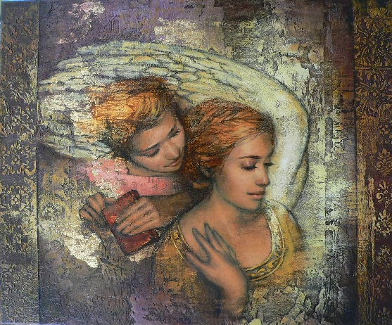
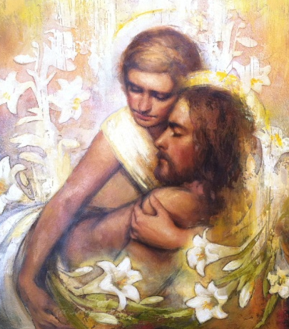
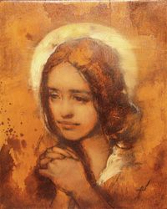
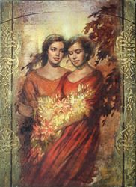
How would you like to receive a testimony of the gospel?
Through believing the words of a friend or family member
Through the appearance of an angel
Through witnessing a miracle
Through the Holy Ghost
Annie Henrie Artist

Slide 25
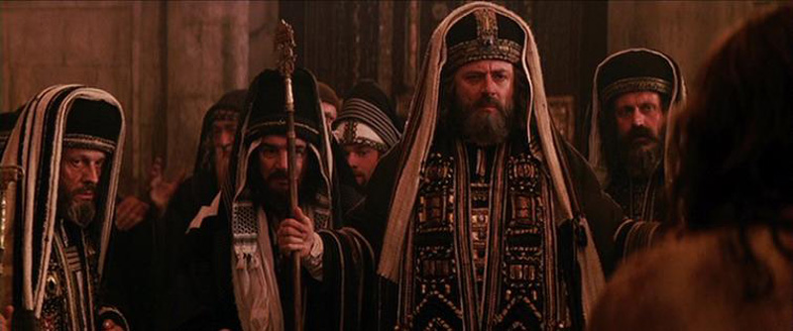
Show Me A Sign
The Savior rebuked the Pharisees and Sadducees for insisting that He show them a sign from heaven.
He declared that they were able to forecast the weather based on the appearance of an evening sky, yet they were unable to discern the “signs of the times”, by which the Savior meant the evidence that He was the promised Messiah.
…Why doth this generation seek after a sign? verily I say unto you, There shall no sign be given unto this generation.
Mark 8:12
Matthew 16:1-3

Slide 26
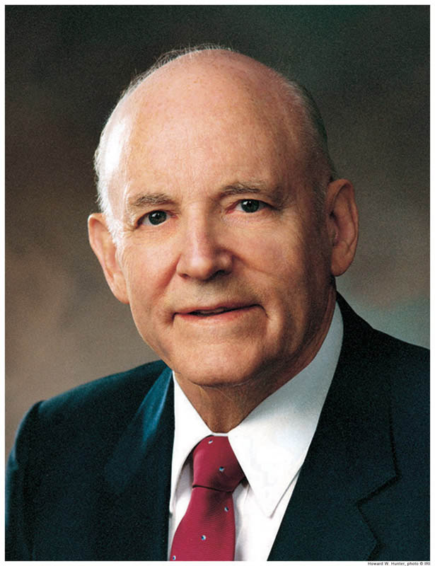
"Perhaps it was with them, as with many today, that truth is not recognized as truth unless it is accompanied by the sensational. What would have been accomplished had the Lord called down thunder and lightning, or plucked a star from the sky, or divided the water to satisfy the curiosity of men?
They would probably have said that it was the work of the devil, or that their eyes deceived them.
"Signs are evident to the faithful. Sick persons are healed; prayers are answered; changes are wrought in the lives of those who believe, accept, and live the commandments. We prove Christ by living the principles of his gospel.”
(1)

Slide 27
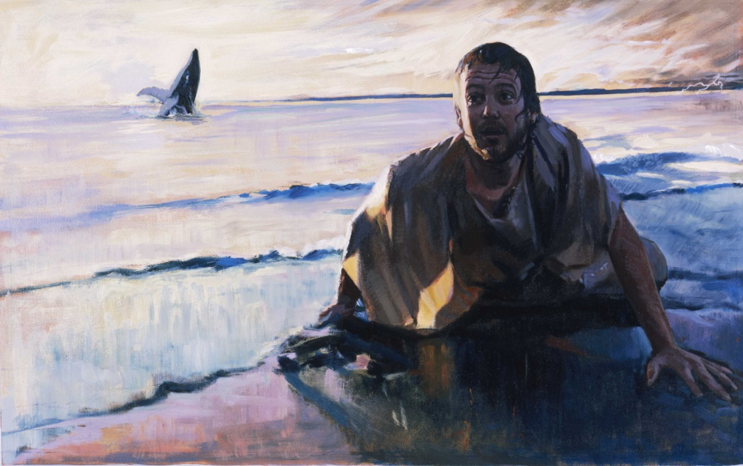
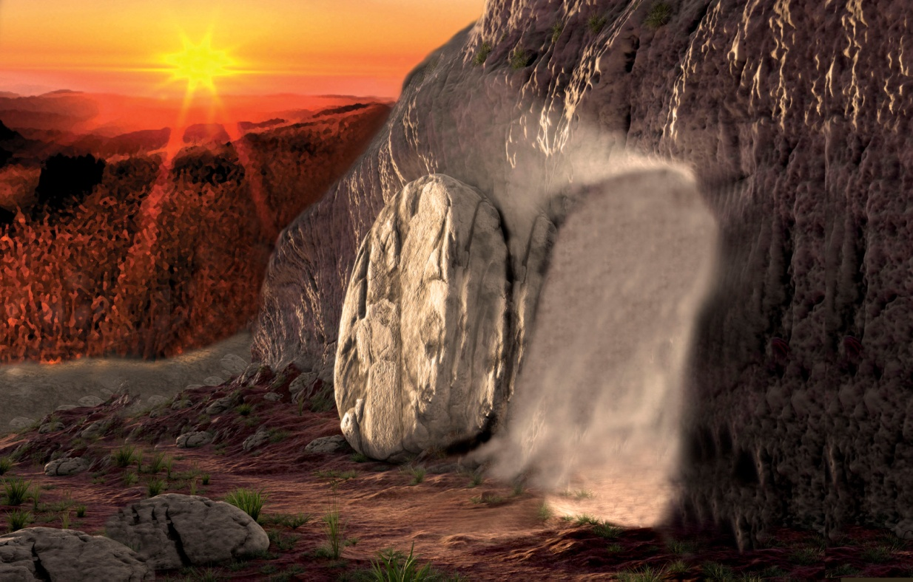
The Sign of Jonas
Jonah’s “burial” in and then coming forth from the belly of the fish after three days symbolized the death, burial, and Resurrection of Jesus Christ from the tomb on the third day.
We do not receive spiritual truth by seeking for signs
Matthew 16:4

Slide 28
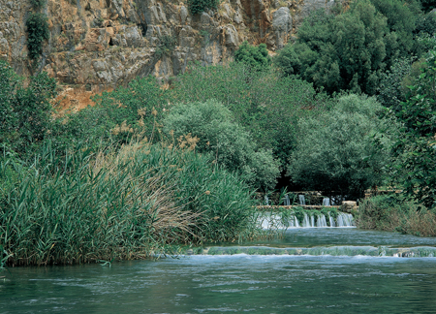
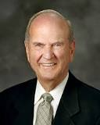
Caesarea Philippi
Caesarea Philippi is a region (“coasts” means region) composed of small towns.
It is located near the base of Mount Hermon, is one of the sources of the Jordan River, and is overlooked by the most prominent geological feature of the area—a huge rock formation at the base of Mount Hermon.
Could it be that the Savior brought His disciples to this spot to teach the lesson that this majestic mountain symbolized the rock of Christ from whom revelation would flow?—revelation to bring light and life to them, just as that flowing water of the River Jordan nourishes Israel” (2)
Headwaters of the Jordan River near Caesarea Philippi
Matthew 16:13-19; Mark 8:27

Slide 29
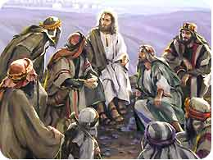
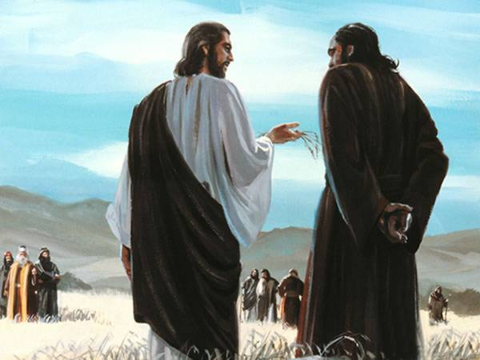
Whom Say Ye That I Am?
"Many profess to be Christians and yet do not believe that Jesus Christ is the literal Son of God, indeed, the eldest son of God the Father. Men are willing to follow some of his teachings but do not recognize the divine, eternal purpose and the significance of his life to all mankind.
'What think ye of Christ?' and 'Whom say ye that I am?'
These were questions asked by Jesus to make men think, so that he might teach them who he was, that they might use their own free agency, come to their own conclusions and commitments, follow him, and gain a testimony that he is the Son of God, our Redeemer.
Matthew 16:13-19

Slide 30
Doctrinal Mastery
He saith unto them, But whom say ye that I am?
And Simon Peter answered and said, Thou art the Christ, the Son of the living God.
And Jesus answered and said unto him, Blessed art thou, Simon Bar-jona: for flesh and blood hath not revealed it unto thee, but my Father which is in heaven.
And I say also unto thee, That thou art Peter, and upon this rock I will build my church; and the gates of hell shall not prevail against it.
And I will give unto thee the keys of the kingdom of heaven: and whatsoever thou shalt bind on earth shall be bound in heaven: and whatsoever thou shalt loose on earth shall be loosed in heaven.
Matthew 16:15-19

Slide 31
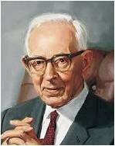
“The Spirit of God speaking to the spirit of man has power to impart truth with greater effect and understanding than the truth can be imparted by personal contact even with heavenly beings.
Through the Holy Ghost the truth is woven into the very fiber and sinews of the body so that it cannot be forgotten” (4)

Slide 32
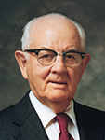
Individual Revelation
“We cannot depend on the testimonies of other people. We need to know for ourselves.
President Gordon B. Hinckley said, ‘Every Latter-day Saint has the responsibility to know for himself or herself with a certainty beyond doubt that Jesus is the resurrected, living Son of the living God’ (5)
Matthew 16:17-18

Slide 33
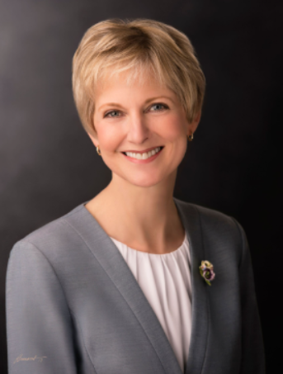
Testimony of Jesus Christ
Are our testimonies built on the bedrock foundation of Jesus Christ and His gospel?
When the storms of life press upon us, do we frantically look for a how-to book or an internet post for help?
Taking the time to build and strengthen our knowledge and testimony of Jesus Christ will yield rich dividends in times of trial and adversity.
Daily reading of scriptures and pondering the words of living prophets, engaging in meaningful personal prayer, mindfully partaking of the sacrament each week, giving service as the Savior would—each of these simple activities becomes a building block for a joyful life.
(12)

Slide 34
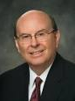
Being Valiant in Testimony
These are they who are not valiant in the testimony of Jesus; wherefore, they obtain not the crown over the kingdom of our God. D&C 79:76
An essential test between those who will inherit the blessings of the celestial kingdom and those in the lesser terrestrial kingdom.
To be valiant, we need to focus on the power of Jesus Christ and His atoning sacrifice to overcome death and, through our repentance, to cleanse us from sin, and we need to follow the doctrine of Christ.
We also need the light and knowledge of the Savior’s life and teachings to guide us on the covenant pathway, including the sacred ordinances of the temple.
We must be steadfast in Christ, feast upon His word, and endure to the end.
(13)

Slide 35
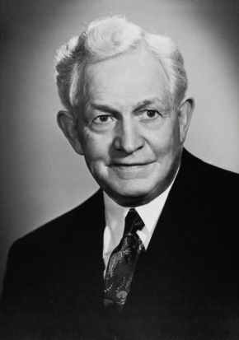
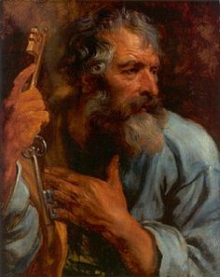
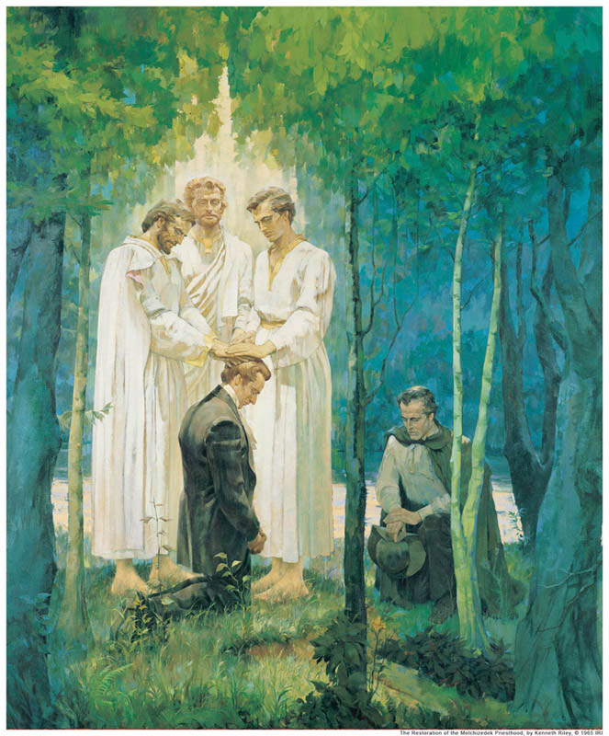
Upon This Rock
"By that He meant that as Simon's name 'Peter' means rock, so this testimony that comes by revelation shall be the rock upon which Christ's Church shall be built. Because when one receives such divine assurance in his soul that the gospel is true, no views of men, nor waves of temptation nor 'the power of hell' can deprive him of it. You remember when Jesus first met Simon, He said He should be called 'the Rock.’
Ever since then it would seem that Jesus has been waiting for the time when Peter's testimony would be like his character-expressive and firm. That time has come; and Peter is now prepared to receive a greater responsibility." (6)
The Greek word petros means an isolated small rock or stone. The Greek word petra can also mean “a stone,” but in addition it can refer to stony soil, bedrock, or a large mass of rock.
Matthew 16:18

Slide 36
“The Church of Jesus Christ of Latter-day Saints was founded upon direct revelation, as the true Church of God has ever been, according to the Scriptures .” (7)
Holy Bible
The
Book
of
Mormon
ANOTHER TESTAMENT
OF JESUS CHRIST
Jesus Christ’s Church is built upon revelation from God
REVELATION

Slide 37
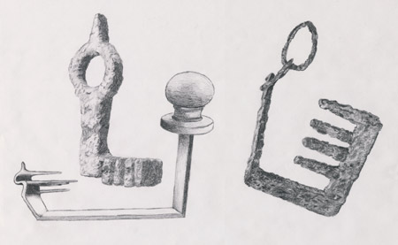
Ancient Keys
In the first century A.D., keys were typically made of iron and were bulkier, more expensive, and less common than modern house keys.
To hold the keys of a house was a position of great trust.
Thus, keys were a fitting symbol of special authority, responsibility, and purpose.
Ancient scriptures make repeated use of the symbol of keys, which represents the power to lock and unlock, open and shut, and permit or prevent entrance. (8)
Roman keys found in Israel
Matthew 16:19

Slide 38
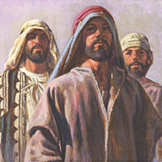
What Are the Keys of the Kingdom?
Peter, together with James and John, received the promised keys on the Mount of Transfiguration. Matthew 17:1-9
"These keys, as we are aware, are the right and power to preside over the kingdom which is the Church.
They enable the legal administrators who hold them to perform the ordinances of salvation so they will be binding on earth and sealed in heaven.
These sealing keys were, in fact, given to Peter, James, and John about a week later, when they climbed nearby Mount Hermon to meet with Moses and Elijah and to participate in the glory of the Transfiguration.
Later they were given to all of the Twelve, so that all had the power to bind and loose both on earth and in heaven. (Matt. 18:18.)" (9)
Matthew 16:19

Slide 39
Some Priesthood Key Holders
Stake and district presidents
Bishops and branch presidents
The President of the Church
Temple presidents
Mission presidents
(8)

Slide 40
Gospel Blessings That Require Priesthood Keys
Baptism
Confirmation and the bestowal of the gift of the Holy Ghost
Patriarchal blessings
Administration of the sacrament
Extending Church callings and assignments
Temple endowment
Temple Sealing
(8)

Slide 41
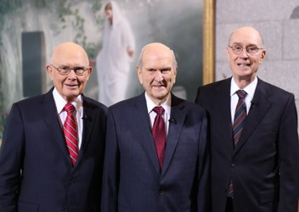
Peter and the Keys
Peter exercised these priesthood keys when he presided over the selection of a new Apostle (see Acts 1:15–26)
He oversaw the spreading of the gospel to Samaria (see Acts 8:14–25)
He received a revelation regarding Gentile converts (see Acts 10:9–48), and presided over the Jerusalem conference
The President of The Church of Jesus Christ of Latter-day Saints holds all the keys of the kingdom. The President and his counselors—the First Presidency—have the right to preside over the Church.
Unto whom I have given the keys of the kingdom, which belong always unto the Presidency of the High Priesthood: D&C 81:2
Matthew 16:19
(8)

Slide 42
“‘Priesthood keys are the authority God has given to priesthood [holders] to direct, control, and govern the use of His priesthood on earth’.
Every act or ordinance performed in the Church is done under the direct or indirect authorization of one holding the keys for that function” (10)
(8)

Slide 43
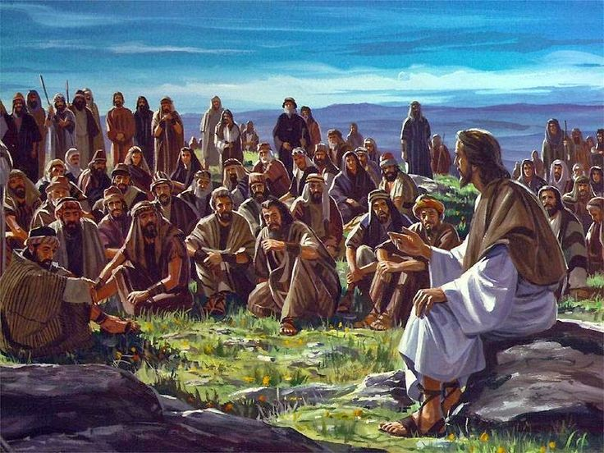
Tell No Man—Idea 1
Jesus Christ instructed His disciples and others not to speak about miracles He had done or about who He was.
The scriptures suggest several possible reasons why the Savior might have asked for secrecy or silence on certain occasions:
Mark relates that Jesus’s fame grew so great that it created difficulties. At times Jesus could not enter certain villages, people who wanted to see Him could not get through the crowds, and He and His disciples were so beset by throngs of people that they could not even find time or space to eat
Matthew 16:20; Mark 1:34, 44
(8)

Slide 44
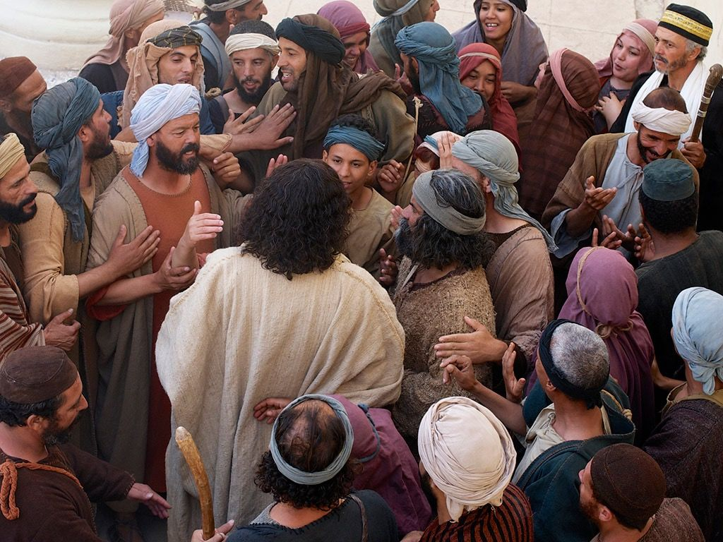
Tell No Man—Idea 2
The Savior may also have asked for silence in order to forestall the opposition that would lead to His Crucifixion—until the time was right.
The more people learned about Jesus, the more the chief priests increased their opposition to Him, for they did not want Him to undermine their place in society.
After Jesus entered Jerusalem in a way that clearly and publicly proclaimed Him as the Messiah, less than a week passed before He was arrested and put to death.
Matthew 16:20; Mark 9:30-31; John 7:1-10
(8)

Slide 45
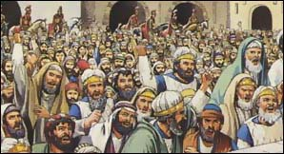
Tell No Man—Idea 3
Some of the Savior’s commandments for silence were directed at devils, who vocally acknowledged Jesus as the Son of God.
“Jesus “consistently refused to permit [devils] to bear record of his divinity.
Converting testimony comes from God, not from Lucifer. Had Jesus let unclean spirits go unrebuked, or had he acquiesced in their testimony of him (though in fact it was true), the Jews would have claimed greater justification for their false charge against him, ‘He hath a devil, and is mad; why hear ye him?’ (9)
Matthew 16:20; Mark 1:24, 34; 3:11-12; Acts 16:16-18; John 10:20
(8)

Slide 46
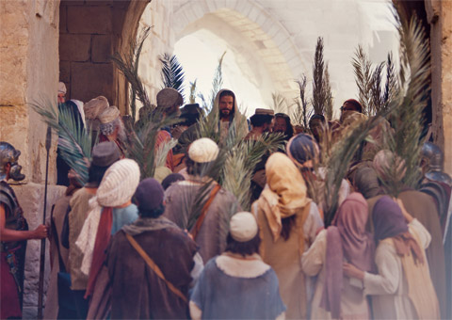
Tell No Man—Idea 4
The Savior knew that most Jews of His day were expecting the Messiah to put an end to Israel’s political enemies and reign as a Jewish king. It is clear that Jesus wanted to avoid presenting Himself as the Messiah of popular expectation. Therefore, one likely reason the Savior instructed His disciples not to tell people He was the Christ.
He was that He wanted to teach people a new understanding of what kind of salvation He had come to bring. He had come not to overthrow Rome but to conquer the eternal enemies of mankind—death, sin, and suffering.(9)
Matthew 16:20; Mark 8:29-30
(8)

Slide 47
Translated
Verily I say unto you, There be some standing here, which shall not taste of death, till they see the Son of man coming in his kingdom.
Christ did not say that one would not taste of death, but that some would not taste of death.
Was another disciple to be translated?
Tradition suggests that all the disciples, save Judas Iscariot and John, were killed as martyrs.
So why did Christ say that some would not taste of death?
Perhaps there were others who were also translated.
Matthew 16:28
(11)

Slide 48
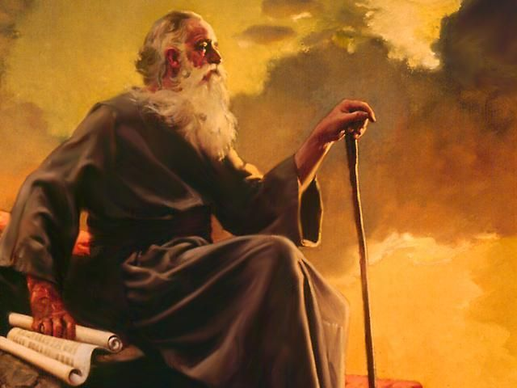
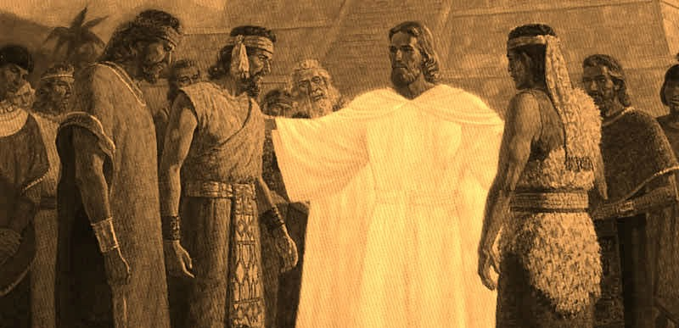
"...for special purposes a few persons who have lived in the Christian Era have been translated. Our Lord said on one occasion, 'There be some standing here, which shall not taste of death, till they see the Son of man coming in his kingdom.‘
The Lord may have had reference to these or other translated persons when he said in March, 1831, 'All are under sin, except those which I have reserved unto myself holy men that ye know not of.'
In any event John was translated.
And on the American continent, among the Nephites, three of the Twelve were also given power over death so that they could continue their ministry until the Second Coming.
"There are no other known instances of translation during the Christian Era, and unless there is some special reason which has not so far been revealed.
Matthew 16:28; John 21:20-23; Rev. 10; D. & C. 7; 77:14 3 Nephi 28; Isaiah 65:17-25
(9)

Slide 49
Perhaps others were translated, but perhaps John was the only one, and the scripture has another meaning. We are told that 'those that die in me shall not taste of death, for it shall be sweet unto them'.
Perhaps Christ's message had another layer of meaning-that although many of the apostles would die-and die as martyrs-they would not 'taste of death', for God's mercy would make even martyrdom 'sweet unto them.'
(8)

Slide 50
Sources:
Howard W. Hunter That We Might Have Joy, 24
Elder Russell M. Nelson (“Why This Holy Land?” Ensign, Dec. 1989, 15–16).
Robert D. Hales “What Think Ye of Christ?” “Whom Say Ye That I Am?” Ensign, May 1979, 77
Joseph Fielding Smith(Teachings of Presidents of the Church: Joseph Fielding Smith [2013], 183–84)
President Dieter F. Uchtdorf (‘Fear Not to Do Good,’ Ensign, May 1983, 80.
David O. McKay (Ancient Apostles, 48.)
Teachings: Joseph Smith, 195
New Testament Institute Student Manual Chapter 6
Elder Bruce R. McConkie The Millennial Messiah: The Second Coming of the Son of Man, 125; Elder Bruce R. McConkie (Doctrinal New Testament Commentary, 1:168; Mormon Doctrine, 806
Elder Dallin H. Oaks (“The Keys and Authority of the Priesthood,” Ensign or Liahona, May 2014, 49) Handbook 2: Administering the Church (2010), 2.1.1.
Gospeldoctrine.com
Jean B. Bingham, “That Your Joy Might Be Full,” Ensign or Liahona, Nov. 2017, 8
Quentin L. Cook, “Valiant in the Testimony of Jesus,” Ensign or Liahona, Nov. 2016, 43
Presentation by ©http://fashionsbylynda.com/blog/

Slide 51
Annie Henrie:
With a Bachelors of Fine Arts degree from the Illustration program at Brigham Young University, and has shown her work in galleries since the age of 16. Her work is now shown at Bronze Coast Gallery in Cannon Beach, Oregon, Deseret Bookstores throughout Utah, along with Authentique Gallery in St. George Utah.
Annie grew up in Bountiful, Utah, and is the daughter of Cary and Sauni Henrie. Her father, a professional illustrator and fine artist, has taught his daughter how to paint and draw since kindergarten. Annie remembers her first art lessons in church when her father would keep her busy by drawing little pictures for her to copy. Her parents have been a huge source of support and encouragement through her progression in art, and to this day are her favorite art critics. Annie gained much of her inspiration from studies abroad in England, Italy and traveling throughout Europe. Her religious art stems from the early Renaissance art she saw in Italy, combined with her experiences serving as a missionary for the Church of Jesus Christ of Latter-Day Saints in southern England. Annie currently lives in Salt Lake City, Utah.
Annie is grateful for her friends, family, teachers and Altus Fine Art for their enthusiasm and support in sharing her work, and is grateful to God for giving her the opportunity to create art.
Feel free to observe and comment on Annie’s art. For information regarding portrait commissions and gallery work, please refer to the Contact page of this site.
“These are a few images of what it looks like when I go to ‘work’. I love being an artist- it is forever challenging, rewarding, frustrating, and SO MUCH FUN.” – Annie Henrie
Peter the Rock Matthew 16:18-19
"Jesus said to him 'thou art Peter,' adding, 'and upon this rock I will build my church.' In the course of the general apostasy subsequent to the ancient apostolic ministry, the Bishop of Rome laid claim to supreme authority as the alleged lineal successor to Peter; and an erroneous doctrine gained currency to the effect that Peter was the 'rock' upon which the Church of Christ was founded. Detailed consideration of this inconsistent and infamous claim cannot be undertaken here; it is sufficient to say that a church founded or dependent upon Peter or any other man would be Peter's or the other man's church, and not the Church of Jesus Christ. (See The Great Apostasy, chap. 9; also 3 Ne. 27:1-8; also chapter 40 herein.)“ James E. Talmage (Jesus The Christ, 341)
Priesthood Keys Matthew 16:19
“The Priesthood in general is the authority given to man to act for God. Every man ordained to any degree of the Priesthood has this authority delegated to him. But it is necessary that every act performed under this authority shall be done at the proper time and place, in the proper way, and after the proper order. The power of directing these labors constitutes the keys of the Priesthood” (Teachings of Presidents of the Church: Joseph F. Smith [1998], 141).
Tell No Man Matthew 16:"Proclamation of Jesus as the Messiah, particularly if made by the apostles who were publicly known as His most intimate disciples and associates, or open assumption of the Messianic title by Himself, would have aggravated the hostility of the rulers, which had already become a grave interference if not an actual menace to the Savior's ministry; and seditious uprisings against the political government of Rome might easily have resulted. A yet deeper reason for the secrecy enjoined upon the Twelve appears in the fact that the Jewish nation was not prepared to accept their Lord; and to ignore Him through lack of certain knowledge involved a lesser degree of culpability than would have attached to an unpalliated rejection. The particular mission of the apostles at the time then future was to proclaim to all nations Jesus, the crucified and resurrected Christ." James E. Talmage (Jesus the Christ,337)
Sign Seeking: Matthew 16:1-3
The Lord has poured and is pouring out the signs of the times on every hand. He is showing forth the very things, promised of old, that are to herald the coming of the Son of Man. And the issue before all men is whether they are able to read the signs of the times or whether they will ignore the divine warnings and continue on their godless course to an assured destruction. The true saints have this promise: 'Unto you it shall be given to know the signs of the times, and the signs of the coming of the Son of Man.' (D&C 68:11.)" Elder Bruce R. McConkie(The Millennial Messiah: The Second Coming of the Son of Man, 400.)

Slide 52
Event | Matthew | Mark | Luke | John
Another Discourse on Signs | 16:1-4 | 8:11-13
Beware of the Leaven of the Pharisees | 16:5-12 | 8:14-21
Peter Testifies That Jesus is the Christ (The Rock) | 16:13-20 | 8:27-30 | 9:18-21
Jesus Foretells His Death and Resurrection | 16:21-28 | 8:31-9:1 | 9:22-27
Source: Horizontal Harmony of the Four Gospels by Thomas M. Mumford

Slide 53
Transfiguration
Matthew 17
As the dew of Hermon, and as the dew that descended upon the mountains of Zion: for there the Lord commanded the blessing, even life for evermore. Psalms 133:3

Slide 54
License To Drive
Arizona State
What does possessing a driver’s license authorize a person to do?
DRIVER LICENSE
ID: 061 225 456B
Yolonda Green
555 West 1st St
Sierra Vista, AZ 85650
DOB: 23-09-55
SEX: F EYES: BR HT:5.09
ISSUED: 06-10-2011 EXPIRES: 06-10-2031
CLASS C
Why is it important to have access to car keys in addition to having a driver’s license?
License To Preside
Just as those who hold driver’s licenses are authorized to drive, many men hold the authority of the priesthood.
But just as car keys enable a driver to operate only a particular vehicle, priesthood keys authorize an individual to operate or direct the work of God within a particular sphere.
The President of the Church holds and uses priesthood keys to preside over and direct all of the Lord’s work upon the earth.

Slide 55
Preparation
Matthew 16:19
The Lord promised to give Peter the keys of the kingdom, or the authority to direct God’s work on the earth.
At that time, Peter and each of the other Apostles had already been given priesthood authority, but they had not yet been given the keys of the kingdom.
Matthew 17:1-2

Slide 56
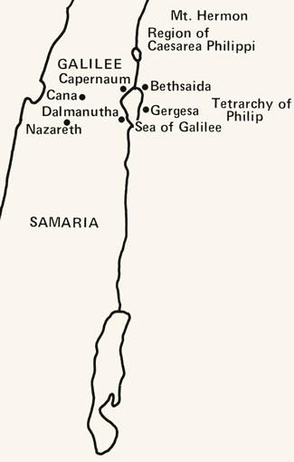
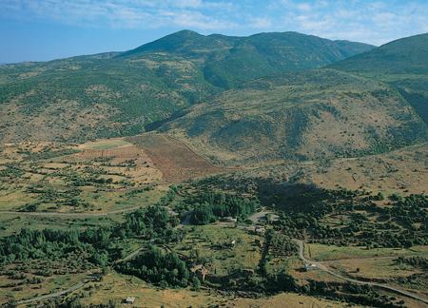
To A High Mountain
It is the highest point in Syria at 7,336 ft and the highest elevation in the Israeli-controlled territory.
Mount Hermon has seasonal winter and spring snow falls, which cover all three of its peaks for most of the year
Mount Hermon is also called the "snowy mountain," the "gray-haired mountain"
It is the highest permanently manned UN position in the world, known as "Hermon Hotel". (3)
Caesarea Philippi with Mount Hermon in the background. Mount Hermon is one of the plausible locations of the Transfiguration.

Slide 57
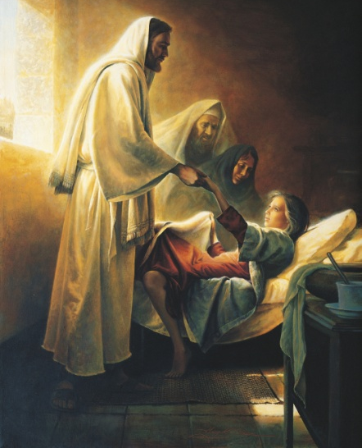
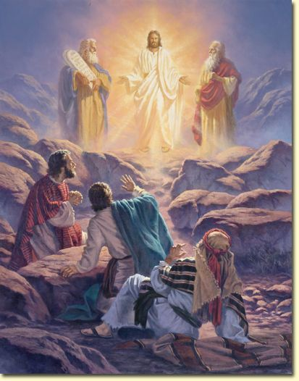
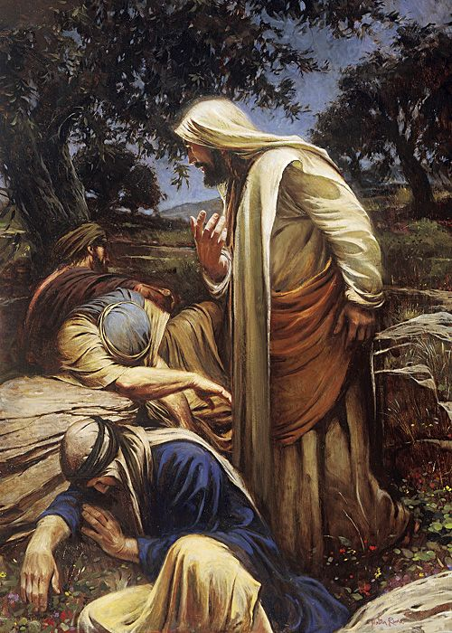
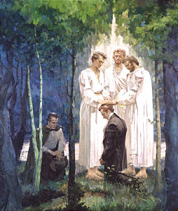
Peter, James, and John
They Alone
1. Were at the raising of Jairus’ daughter from the dead.
2. Beheld the glory and majesty of the transfigured Jesus.
3. Received from Him, and from Moses and Elijah the keys of the kingdom, being prohibited from so much as telling the others of the Twelve of these transcendent events until after our Lord’s resurrection.
4. Were taken to a spot in Gethsemane where they could behold his agony as he took upon himself the sins of the world.
5. The ones who came to Joseph Smith and Oliver Cowdery in this dispensation to confer priesthood and keys. (1)
Mark 5:22-24, 35-43; Mark 14:32-42; D&C 27:12-13; 128:20

Slide 58
Transfiguration
This occurred about a week after the promise made to Peter that he would receive the keys of the kingdom of heaven.
The Transfiguration occurred in about October, some six months before the death of Jesus.
The Savior, Moses, and Elias (Elijah) gave the promised keys of the priesthood to Peter, James, and John, which enabled these brethren to carry forth the work of the kingdom on the earth after the departure of Jesus. These keys were later given to all of the Twelve. (2)
“the condition of persons who are temporarily changed in appearance and nature—that is, lifted to a higher spiritual level—so that they can endure the presence and glory of heavenly beings” (4)
Matthew 17:1-9

Slide 59
Moses and Elias
“The Savior, Moses, and Elias [Elijah], gave the keys [of the priesthood] to Peter, James, and John, on the mount, when they were transfigured before him” (5)
Moses and Elijah appeared in the Kirtland Temple on April 3, 1836, to restore priesthood keys: Moses restored the keys of the gathering of Israel, and Elijah restored the keys associated with the sealing power.
These appearances in Kirtland provide a pattern for understanding what took place on the Mount of Transfiguration.
Matthew 17:3; D&C 110:11; D&C 110:13-16

Slide 60
Who Was Involved?
Matthew 17:5
Was transfigured on the mount
Appeared as a translated being on the mount and conferred the keys of the gathering of Israel on Peter, James, and John
God the Father
Spoke from the cloud, saying, “This is my beloved Son … ; hear ye him”
Appeared with God the Father in the Sacred Grove and in the Kirtland Temple
(JSH 1:17; D&C 110)
Matthew 17:2-8
keys of the sealing power
D&C 110:13-16
keys of the gathering of Israel
D&C 110:11
JSH 1:17
Spoke in the Sacred Grove, saying, “This is My Beloved Son. Hear Him!”
Were transfigured and received priesthood keys from angelic ministers
Matthew 17:1; 3-8
As angelic ministers, conferred the Melchizedek Priesthood and all its keys on Joseph Smith and Oliver Cowdery (JSH 1:72; D&C 27:12-13)
Appeared as a spirit on the mount (JST Mark 9:4)
(6)

Slide 61
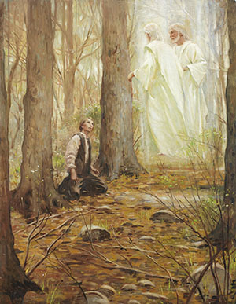
Priesthood is Restored in This Dispensation
A gospel dispensation is a period of time in which Heavenly Father dispenses priesthood authority, ordinances, and knowledge of His plan of salvation to people on the earth through His authorized servants.
John the Baptist restored the Aaronic Priesthood
In each dispensation, God confers priesthood keys upon His chosen servants so they can direct His work upon the earth
Peter, James, and John restore the Melchizedek Priesthood
Elijah restores sealing keys in the Kirtland Temple

Slide 62
Characteristics of Translated Beings
3 Nephi 28:7
3 Nephi 28:8, 39-40
3 Nephi 28:30
3 Nephi 28: 38
3 Nephi 28: 39
Translated beings “Never taste of death.”
At the Second Coming translated beings will be immediately changed to a resurrected condition.
They can appear and disappear like angels.
They suffer neither “pain nor sorrow’ except for the sins of the world.
Satan cannot tempt them.

Slide 63
Jesus
Melchizedek
Peter
James
John the Baptist
John
Aaronic
Peter, James, and John are ordained by the Savior
Mark 3:14
Matthew 16:19
Joseph Smith

Slide 64
Joseph Smith
May 1829
The Three Witnesses
14 Feb 1835
Heber C. Kimball
14 Feb 1835
Brigham Young
14 Feb 1835
Lorenzo Snow
12 Feb 1849
John Taylor
19 Dec 1838
Wilford Woodruff
26 Apr 1839
Joseph F. Smith
01 Jul 1866
George Q. Cannon
26 Aug 1860
An Apostolic Authority Diagram
George Albert Smith
08 Oct 1903
David O. McKay
09 Apr 1906
Joseph Fielding Smith
07 Apr 1910
Heber J. Grant
16 Oct 1882
Howard W. Hunter
15 Oct 1959
Gordon B. Hinckley
05 Oct 1961
Thomas S. Monson
10 Oct 1963
Heber C. Kimball and George Q. Cannon were not Presidents of the Church but the line of authority went through them
Harold B. Lee
10 Apr 1941
Spencer W. Kimball
07 Oct 1943
Ezra Taft Benson
07 Oct 1943

Slide 65
Faith as a Grain of Mustard Seed
A father brought his son to the Savior to be healed. After Jesus healed the child, He taught His disciples that some blessings can be obtained only by prayer and fasting. He also prophesied of His death and Resurrection.
Is it possible to move mountains?
“I have never witnessed the
removal of an actual mountain.
But because of faith, I have seen a mountain of doubt and despair removed and replaced with hope and optimism. Because of faith, I have personally witnessed a mountain of sin replaced with repentance and forgiveness. And because of faith, I have personally witnessed a mountain of pain replaced with peace, hope, and gratitude.” (7)
For the brother of Jared said unto the mountain Zerin, Remove—and it was removed. And if he had not had faith it would not have moved; wherefore thou workest after men have faith. Ether 12:30
Matthew 17:14-23

Slide 66
Tribute Money
Strangers = everyone in a kingdom who is not one of the king’s children.
The “strangers” must pay taxes, while the king’s children are exempt.
A Denarius from around the time of Jesus inscribed with the face of Caesar Tiberius.
The temple tax required of all Israelite males over the age of 20
This money was used to support the daily costs associated with the temple, such as the cost of incense, robes worn by the priests, and oil for the lamps. Jesus taught Peter that since the temple was His Father’s house .
Bartolomeo Manfredi, The Tribute Money, c. 1610-22
Jesus was exempt from the payment of this tax. However, aware that others would follow His example and not wanting to give any cause for offense, Jesus, with His divine foreknowledge, instructed Peter how to make provision for payment.
Matthew 17:24-26
(8)

Slide 67
Lest We Offend
If He had not paid the tax, some Jews might have looked unfavorably upon Him and His followers and become less receptive toward the gospel message
Matthew 17:27
(8)

Slide 68
Money From a Fish
“[The Savior] told His disciples to go and catch a fish and they would find the requisite coin in there. …
A Denarius from around the time of Jesus inscribed with the face of Caesar Tiberius.
They did and the coin was just the right denomination to pay the tribute. We can’t comprehend the staggering omniscience, but it is there and it operates to bless each of our lives.”
Matthew 17:27
(9)

Slide 69
Sources:
Video:
Where Are the Keys and Authority of the Priesthood?
Elder Bruce R. McConkie Doctrine of the New Testament Commentary 1:401:2
History of the Church 3:387
Wikipedia
Guide to Scriptures
Teachings of Presidents of the Church: Joseph Smith [2007], 105).
Chart adapted from D. Kelly Ogden and Andrew C. Skinner, Verse by Verse: The Four Gospels (2006), 343.
Elder Richard C. Edgley (“Faith—the Choice Is Yours,” Ensign or Liahona, Nov. 2010, 33).
New Testament Institute Student Manual Chapter 6
Elder Neal A. Maxwell (“We Can’t Comprehend the Capacity of God,” Church News, Feb. 22, 2003, 3).
Presentation by ©http://fashionsbylynda.com/blog/

Slide 70
Peter, James, and John
“Why always these three and not various ones or even all of the Twelve. The plain fact is that Peter, James, and John were the First Presidency of the Church in their day. … by latter-day revelation we know that they held and restored ‘the keys of the kingdom, which belong always unto the Presidency of the High Priesthood’ (D&C 81:2), or in other words, they were the First Presidency in their day. (McConkie, DNTC, 1:401–2.)
James E. Talmage Jesus the Christ on the place of Transfiguration p. 376
“The mountain on which the Transfiguration occurred is neither named nor otherwise indicated by the Gospel-writers in such a way as to admit of its positive identification. Mount Tabor, in Galilee, has long been held by tradition as the site, and in the sixth century three churches were erected on its plateau-like summit, possibly in commemoration of Peter’s desire to make three tabernacles or booths, one each for Jesus, Moses, and Elijah. Later a monastery was built there. Nevertheless, Mt. Tabor is now rejected by investigators, and Mt. Hermon is generally regarded as the place. Hermon stands near the northerly limits of Palestine, just beyond Cæsarea Philippi, where Jesus is known to have been a week before the Transfiguration. Mark (9:30) distinctly tells us that after His descent from the mount, Jesus and the apostles departed and went through Galilee. Weight of evidence is in favor of Hermon as the Mount of Transfiguration, though nothing that may be called decisive is known in the matter.”
Possible Places of Transfiguration: Mount Hermon: Traditional
Hebrew: Har Hermon
In the Book of Enoch, Mount Hermon is the place where the Watcher class of fallen angels descended to Earth.
The Book of Chronicles also mentions Mount Hermon as a place where Epher, Ishi, Eliel, Azriel, Jeremiah, Hodaviah and Jahdiel were the heads of their families.
Hermon was said to have become known as "the mountain of oath" by Charles Simon Clermont-Ganneau *New Testament Instituted Student Manual suggests this is a possible place of the transfiguration.
Or Mount Tabor: (575 metres or 1,886 feet high) is the traditional location. The earliest identification of the Mount of Transfiguration as Tabor is by Origen in the 3rd century. It is also mentioned by St. Cyril of Jerusalem and St. Jerome in the 4th century.The Church of the Transfiguration is located atop Mount Tabor. It is later mentioned in the 5th century Transitus Beatae Mariae Virginis.
Mount Tabor battle between Barak under the leadership of the Israelite judge Deborah, and the army of Jabin commanded by Sisera Wikipedia
On the Mount of Transfiguration:
Joseph Smith taught that on the mount of transfiguration, Peter, James, and John were also transfigured. They saw a vision of the earth as it will appear in its future glorified condition (D&C 63:20–21). They saw Moses and Elijah, two translated beings, and heard the voice of the Father. The Father said, “This is my beloved Son, in whom I am well pleased; hear ye him” (Matt. 17:5).
An Elias: Matthew 17:3 (Elijah, forerunner, Restorer, A man in Abraham’s dispensation, or Jesus Chirst Himself
In Matthew’s account of the Savior’s transfiguration, the name Elias is used to mean the prophet Elijah. The Guide to the Scriptures explains that the name or title Elias has several different meanings in the scriptures:
“Elijah: Elias is the New Testament (Greek) form of Elijah (Hebrew), as in Matt. 17:3–4, Luke 4:25–26, and James 5:17. In these instances, Elias was the ancient prophet Elijah whose ministry is recorded in 1 and 2 Kings.
“Forerunner: Elias is also a title for one who is a forerunner. For example, John the Baptist was an Elias because he was sent to prepare the way for Jesus (Matt. 17:12–13).
“Restorer: The title Elias has also been applied to others who had specific missions to fulfill, such as John the Revelator (D&C 77:14) and Gabriel (Luke 1:11–20; D&C 27:6–7; 110:12).
“A man in Abraham’s dispensation: A prophet called Esaias or Elias who apparently lived in the days of Abraham (D&C 84:11–13; 110:12)” (Guide to the Scriptures, “Elias”; scriptures.lds.org).
The title Elias can also be applied to Jesus Christ Himself (see Joseph Smith Translation, John 1:28 [in the Bible appendix]). New Testament Institute Student Manual
Mount Hermon
Mount Tabor

Slide 71
Event | Matthew | Mark | Luke | John
The Transfiguration | 17:1-13 | 9:2-13 | 9:28-36
Demonic Boy Healed | 17:14-21 | 9:14-29 | 9:37-43
Jesus Again Foretells His Death and Resurrection | 17:22, 23 | 9:30-32 | 9:43-45
Tribute Money | 17:24-27 | 9:33
Transfigured Beings in the Scripture—The Guide to the Scriptures
Event | Scripture
They saw the god of Israel | Exodus 24:9-11
The skin of his face shone while he talked with god | Exodus 34:29 Mark 9:2-3
Jesus’ face did shine | Matthew 17:2 Mark 9:2-3
Israel could not stedfastly behold the face of Moses for the glory | 2 Corinthians 3:7
Abinadi’s face shown with exceeding luster | Mosiah 13:5-9
They were encircled about as if by fire | Helaman 5:23, 36, 43-45 3 Nephi 17:24 3 Nephi 19:14
They were as white as the countenance of Jesus | 3 Nephi 19:25
It did seem unto them like a transfiguration | 3 Nephi 28:15
No man has seen God in the flesh, except quickened by the Spirit | D&C 67:10-12
By the power of the Spirit our eyes were opened | D&C 76:12
The glory of God was upon Moses | Moses 1:2
I beheld the heavens open, and I was clothed upon with glory | Moses 7:3-4
Source: Horizontal Harmony of the Four Gospels by Thomas M. Mumford
Working By Faith Matthew 17:20
"We ask, then, what are we to understand by a man's working by faith? We answer-we understand that when a man works by faith he works by mental exertion instead of physical force. It is by words, instead of exerting his physical powers, with which every being works when he works by faith." Joseph Smith Lectures on Faith 7:3

Slide 72
D&C 27:12
Jesus Christ
Peter, James, and John
|
|
Joseph Smith
(May 1829)
|
|
The Three Witnesses
(14 Feb 1835)
|
_____________________|______________________
| |
Heber C Kimball Brigham Young
(14 Feb 1835) (14 Feb 1835)
| |
______|______ _________________________________|________________
| | | | | |
Lorenzo Snow John Taylor Wilford Woodruff Joseph F Smith George Q Cannon
(12 Feb 1849) (19 Dec 1838) (26 Apr 1839) (01 Jul 1866) (26 Aug 1860)
| |
_________________________________________| |
| | | |
George Albert Smith David O McKay Joseph Fielding Smith Heber J Grant
(08 Oct 1903) (09 Apr 1906) (07 Apr 1910) (16 Oct 1882)
| | |
| Thomas S Monson |
| (10 Oct 1963) |
________________________________| ______________________________|____
| | | | |
Howard W Hunter Gordon B Hinckley Harold B Lee Spencer W Kimball Ezra Taft Benson
(15 Oct 1959) (05 Oct 1961) (10 Apr 1941) (07 Oct 1943) (07 Oct 1943)
http://www.ldsfacts.net/propht12.htm

Slide 73
Mount of Transfiguration Summary: Matthew 17:
“(1) Jesus singled out Peter, James, and John from the rest of the Twelve; took them upon an unnamed mountain; there he was transfigured before them, and they beheld his glory. … [Peter] said they ‘were eyewitnesses of his majesty.’ (2 Pet. 1:16.)
“(2) Peter, James, and John, were themselves ‘transfigured before him’ [Teachings of Presidents of the Church: Joseph Smith(2007), 105], … thus enabling them to entertain angels, see visions and comprehend the things of God. …
“(3) Moses and Elijah—two ancient prophets who were translated and taken to heaven without tasting death, so they could return with tangible bodies on this very occasion, an occasion preceding the day of resurrection—appeared on the mountain; and they and Jesus gave the keys of the kingdom to Peter, James, and John [see Teachings: Joseph Smith, 105].
“(4) John the Baptist, previously beheaded by Herod, apparently was also present. …
“(5) Peter, James, and John saw in vision the transfiguration of the earth, that is, they saw it renewed and returned to its paradisiacal state—an event that is to take place at the Second Coming when the millennial era is ushered in. [D&C 63:20–21.]
“(6) It appears that Peter, James, and John received their own endowments while on the mountain. [See Joseph Fielding Smith, Doctrines of Salvation, comp. Bruce R. McConkie, 3 vols. (1954–56), 2:165.] … It also appears that it was while on the mount that they received the more sure word of prophecy, it then being revealed to them that they were sealed up unto eternal life. (2 Pet. 1:16–19; D&C 131:5.)
“(7) Apparently Jesus himself was strengthened and encouraged by Moses and Elijah so as to be prepared for the infinite sufferings and agony ahead of him in connection with working out the infinite and eternal atonement. [See James E. Talmage, Jesus the Christ, 3rd ed. (1916), 373.] …
“(8) Certainly the three chosen apostles were taught in plainness ‘of his death, and also his resurrection’ [Joseph Smith Translation, Luke 9:31 (in Luke 9:31, footnote a)]. …
“(9) It should also have been apparent to them that the old dispensations of the past had faded away, that the law (of which Moses was the symbol) and the prophets (of whom Elijah was the typifying representative) were subject to Him whom they were now commanded to hear.
“(10) Apparently God the Father, overshadowed and hidden by a cloud, was present on the mountain” Elder Bruce R. McConkie (Doctrinal New Testament Commentary, 3 vols. [1965–73], 1:399–401).
Why John the Baptist was included in the Mount of Transfiguration: Mark 9:3 (Mark 9:4 footnote a):
Joseph Smith Translation, Mark 9:3 (in Mark 9:4, footnote a), indicates that John the Baptist, who had been martyred but not yet resurrected, also appeared on the Mount of Transfiguration. Elder Bruce R. McConkie of the Quorum of the Twelve Apostles suggested a reason why John the Baptist was present:
“It is not to be understood that John the Baptist was the Elias who appeared with Moses to confer keys and authority upon those who then held the Melchizedek Priesthood, which higher priesthood already embraced and included all of the authority and power John had held and exercised during his ministry. Rather, for some reason that remains unknown—because of the partial record of the proceedings—John played some other part in the glorious manifestations then vouchsafed to mortals. Perhaps he was there, as the last legal administrator under the Old Covenant, to symbolize that the law was fulfilled and all old things were done away, thus contrasting his position with that of Peter, James, and John who were then becoming the ‘first’ legal administrators of the New Kingdom” Bruce R. McConkie (Doctrinal New Testament Commentary, 3 vols. [1965–73], 1:404).

Slide 74
Opportunities to Serve
Mark 7-8
Including:
Unwashed Hands
Jesus Heals
Jesus Feeds 4,000

Slide 75
Unwashed Hands
Under the law of Moses, many aspects of daily life were divided into categories of “clean” and “unclean.” Uncleanness referred to being ceremonially or ritually unclean and did not mean that the person was either unsanitary or morally unclean, though ritually “unclean” persons were excluded from certain religious and social activities until they were purified.
The washing of hands = a ceremonial washing for the sake of ritual purity.
By New Testament times, Jewish concern for ritual purity had given rise to many traditions, including the ritual washings. These traditions in Jesus' day were oral (not written) and were passed down from rabbi to rabbi and to their followers or students. They later became incorporated in written form in the Talmud.
When the Pharisees found fault with the Savior’s disciples for not observing these traditional rituals, the Savior reproved the Pharisees for professing devotion to God while placing a higher priority on man-made traditions than on God’s commandments.
Mark 7:1-13
(1)

Slide 76
“I testify that you will remove barriers to happiness and find greater peace as you make your first allegiance your membership in the Church of Jesus Christ, and His teachings the foundation of your life.
Where family or national traditions or customs conflict with the teachings of God, set them aside.
Where traditions and customs are in harmony with His teachings, they should be cherished and followed to preserve your culture and heritage.
There is one heritage that you need never change. It is that heritage that comes from your being a daughter or son of Father in Heaven. For happiness, control your life by that heritage.”
Morgan Weistling
(3)

Slide 77
The Man in Decapolis
After the Savior left Tyre and Sidon, He traveled to the east side of the Sea of Galilee, to the region of Decapolis.
Sidon
Tyre
“The Lord is dealing with a believing soul who cannot hear his words or give fluent answer to them. And so what is more natural than to make use of common signs, known to and understood by the deaf and speech inhibited man, to indicate what the Master could and would do … ?” (2)
Region of Decapolis
Jerusalem
Despite the Savior’s warning to those He healed to not publish His miracles, people in the Decapolis region still heard about the wonderful things the Savior had done, and great multitudes gathered to Him
The Savior’s healing enabled this man to speak immediately and plainly.
Mark 7:31-37

Slide 78
How often do we have opportunities to help others in need?
How often do we act upon it?

Slide 79
“First Observe, Then Serve”
(4)
I have compassion on the multitude
Despite the Savior’s warning to those He healed to not publish His miracles, people in the Decapolis region still heard about the wonderful things the Savior had done, and great multitudes gathered to Him
Many people followed Jesus and for three days they were without food.
Mark 8:1-9

Slide 80
“How many times has your heart been touched as you have witnessed the need of another? How often have you intended to be the one to help? And yet how often has day-to-day living interfered and you’ve left it for others to help, feeling that ‘oh, surely someone will take care of that need.’
“We become so caught up in the busyness of our lives. Were we to step back, however, and take a good look at what we’re doing, we may find that we have immersed ourselves in the ‘thick of thin things.’ In other words, too often we spend most of our time taking care of the things which do not really matter much at all in the grand scheme of things, neglecting those more important causes.”
Mark 8
(5)

Slide 81
Gradual Healing
Jesus personally:
(1) led the blind man by the hand out of the town,
(2) applied his own saliva to the eyes of the sightless one,
(3) performed the ordinance of laying on of hands, and
(4) put his hands a second time upon the man’s eyes.
Walter Rane
“I see men as trees, walking” [verse 24] indicates that the blind man could see, but not clearly.)
Mark 8:22-26
(5)

Slide 82
“Certainly the manner in which this healing took place teaches that men should seek the Lord’s healing grace with all their strength and faith, though such is sufficient for a partial cure only.”
Following the receipt of this partial cure, “they may then gain the added assurance and faith to be made whole and well every whit.
Men also are often healed of their spiritual maladies by degrees, step by step as they get their lives in harmony with the plans and purposes of Deity.”
Mark 8:22-26
(5)

Slide 83
Our Gradual Healing
”It must be remembered that whether the Lord sees fit to heal instantaneously or gradually, whether it be through surgery and treatment or without it, the healing is still the Lord’s miracle.”
Mark 8:22-26
(6)

Slide 84
Peter’s Testimony
Jesus prophesied that the Son of Man would suffer and be killed.
Because of the popular Jewish expectations of a conquering Messiah, it was difficult for Peter, as well as for many Jews of that time, to understand and accept the idea of a Messiah who would suffer and die.
Mark 8:27-32

Slide 85
Sources:
New Testament Institute Student Manual Chapter 12, 13
Elder Bruce R. McConkie (Doctrinal New Testament Commentary, 3 vols. [1965–73], 1:373, 1:379–80).
Elder Richard G. Scott “Removing Barriers to Happiness,” Ensign, May 1998, 87
Linda K. Burton (“First Observe, Then Serve,” Ensign or Liahona, Nov. 2012, 78
President Thomas S. Monson “What Have I Done for Someone Today?” Ensign or Liahona, Nov. 2009, 85
President Spencer W. Kimball President Kimball Speaks Out on Administration to the Sick August 1982 Ensign
Presentation by ©http://fashionsbylynda.com/blog/

Slide 86
Event | Matthew | Mark | Luke | John
Conflict with Scribes and Pharisees over Cleanliness | 15:1-20 | 7:1-23
Jesus Heals a Gentile’s Daughter | 15:21-28 | 7:24-30
Jesus Returns to the Sea of Galilee and Heals Many | 15:29-31 | 7:31-37
Jesus Feeds 4,000 | 15:32-38 | 8:1-9
Jesus Goes to Magdala | 15:39 | 8:10
Another Discourse on Signs | 16:1-4 | 8:11-13
Conflict with Scribes and Pharisees over Cleanliness | 15:1-20 | 7:1-23
Jesus Heals a Gentile’s Daughter | 15:21-28 | 7:24-30
Jesus Returns to the Sea of Galilee and Heals Many | 15:29-31 | 7:31-37

Slide 87
Hypocrisy—tradition of Corban Mark 7:10-13
An example of this hypocrisy was the Pharisees’ observance of the tradition of “corban”. Corban meant “given to God.” A tradition of the elders held that if a man had money or other resources he intended to give to God or the temple, those resources could be declared “corban” and need not be used to care for his aging parents, even though God had commanded, “Honour thy father and thy mother” (Exodus 20:12). Placing man-made tradition above the word of God in ways like this showed that traditions had taken precedence over the word of God (see Mark 7:6, 13). New Testament Student Institute Manual Chapter 12
Feeding of the 4,000 Mark 7:31
According to Mark 7:31, the feeding of the four thousand occurred in the largely Gentile Decapolis region, which was on the southeastern shore of the Sea of Galilee. There had been people in this area who believed in Jesus Christ from at least the time of the healing of the man out of whom the Savior cast a legion of devils (see Mark 5:19–20; Matthew 4:25), and the number of believers had grown to a “very great” multitude (Mark 8:1).
“This miraculous feeding of the four thousand is not a mere duplication or repetition of the feeding of the five thousand which took place a short time before near Bethsaida. Then our Lord was mingling with his own kindred of Israel; now he is teaching other hosts who in substantial part, being inhabitants of Decapolis, are presumed to be Gentile. Then he was laying the foundation for his incomparable sermon on the Bread of Life; now he is prefiguring the future presentation of the living bread to the Gentile nations. And significantly, this mixed multitude from the east of the Jordan were more receptive, and took a more sane and sound view of the matchless miracle of feeding thousands by use of the creative powers resident in him, than did the members of the chosen seed” elder Bruce R. McConkie (Doctrinal New Testament Commentary, 3 vols. [1965–73], 1:375).
The Divine Gift of Gratitude:
“‘[The Savior] took the seven loaves and the fishes, andgave thanks, and brake them, and gave to his disciples, and the disciples to the multitude.’
“Notice that the Savior gave thanks for what they had—and a miracle followed: ‘And they did all eat, and were filled: and they took up of the broken meat that was left seven baskets full’ [see Matthew 15:32–38; italics added; see also Mark 8:1–8]. …
“Regardless of our circumstances, each of us has much for which to be grateful if we will but pause and contemplate our blessings. … To live with gratitude ever in our hearts is to touch heaven” President Thomas S. Monson (“The Divine Gift of Gratitude,” Ensign or Liahona, Nov. 2010, 88, 90).
Hypocrites:
“The teachings of Jesus also challenged the traditions of different groups. … ‘Hypocrites’ is what He called those whose adherence to their traditions kept them from keeping the commandments of God [see Mark 7:6;Matthew 15:7]. …
“The traditions or culture or way of life of a people inevitably include some practices that must be changed by those who wish to qualify for God’s choicest blessings.
“Chastity is an example. … Always the prophets of God have condemned whoredoms. Yet these eternal commands have frequently been ignored, opposed, or mocked by powerful traditions in many lands. … Sexual relations out of wedlock are tolerated or advocated by many. So is the rapidly expanding culture of pornography. All who have belonged to these cultures of sin must repent and change if they are to become the people of God, for He has warned that ‘no unclean thing can enter into his kingdom’ (3 Nephi 27:19). …
“Another example is honesty. Some cultures allow lying, stealing, and other dishonest practices. But dishonesty in any form—whether to appease, to save face, or to get gain—is in direct conflict with gospel commandments and culture. God is a God of truth, and God does not change. We are the ones who must change.” Elder Dallin H. Oaks (“Repentance and Change,” Ensign or Liahona, Nov. 2003, 38).
Healing Mark 7:31-37
“The Lord is dealing with a believing soul who cannot hear his words or give fluent answer to them. And so what is more natural than to make use of common signs, known to and understood by the deaf and speech inhibited man, to indicate what the Master could and would do in accordance with the law of faith?” Elder Bruce R. McConkie (Doctrinal New Testament Commentary, 1:373).

Slide 88
Why Did Jesus Instruct His Apostles Not to Tell People He Was the Messiah?
Mark 8:30:
1. Mark relates that Jesus’s fame grew so great that it created difficulties. At times Jesus could not enter certain villages, people who wanted to see Him could not get through the crowds, and He and His disciples were so beset by throngs of people that they could not even find time or space to eat (see Mark 1:45; 2:2;3:20). Instructing people not to tell others about His miracles may have been one way the Savior carefully managed such difficulties so as not to hinder His overall mission.
2. The Savior may also have asked for silence in order to forestall the opposition that would lead to His Crucifixion—until the time was right (see Mark 9:30–31; compare John 7:1–10 with Matthew 26:18). The more people learned about Jesus, the more the chief priests increased their opposition to Him, for they did not want Him to undermine their place in society. After Jesus entered Jerusalem in a way that clearly and publicly proclaimed Him as the Messiah, less than a week passed before He was arrested and put to death (see Mark 11:8–11; 14:1–2; 15:22–25;2 Nephi 10:5).
3. Some of the Savior’s commandments for silence were directed at devils, who vocally acknowledged Jesus as the Son of God (see Mark 1:24, 34; 3:11–12; compare Acts 16:16–18).
Elder Bruce R. McConkie taught that Jesus “consistently refused to permit [devils] to bear record of his divinity. Converting testimony comes from God, not from Lucifer. Had Jesus let unclean spirits go unrebuked, or had he acquiesced in their testimony of him (though in fact it was true), the Jews would have claimed greater justification for their false charge against him, ‘He hath a devil, and is mad; why hear ye him?’ (John 10:20)” (Doctrinal New Testament Commentary, 1:168).
4. The Savior knew that most Jews of His day were expecting the Messiah to put an end to Israel’s political enemies and reign as a Jewish king. It is clear that Jesus wanted to avoid presenting Himself as the Messiah of popular expectation. Therefore, one likely reason the Savior instructed His disciples not to tell people He was the Christ (see Matthew 16:20; Mark 8:29–30) was that He wanted to teach people a new understanding of what kind of salvation He had come to bring. He had come not to overthrow Rome but to conquer the eternal enemies of mankind—death, sin, and suffering.
New Testament Institute Student Manual Chapter 13

Slide 89
That I May Heal You
Mark 9:1-29
O all ye that are spared because ye were more righteous than they, will ye not now return unto me, and repent of your sins, and be converted, that I may heal you?
3 Nephi 9:13

Slide 90
Foretelling of the Savior’s Suffering, Death, and Resurrection
“He began to teach them, that the Son of man must suffer many things, … and be killed, and after three days rise again”
…that the Son of man must suffer many things, and be rejected of the elders, and of the chief priests, and scribes, and be killed, and after three days rise again.
For he taught his disciples, and said unto them, The Son of man is delivered into the hands of men, and they shall kill him; and after that he is killed, he shall rise the third day.
…Saying, Behold, we go up to Jerusalem; and the Son of man shall be delivered unto the chief priests, and unto the scribes; and they shall condemn him to death, and shall deliver him to the Gentiles:
And they shall mock him, and shall scourge him, and shall spit upon him, and shall kill him: and the third day he shall rise again.
Scott M. Snow
Mark 8:31: Mark 9:31: Mark 10:33-34

Slide 91
“Jesus knew who He was—the Son of God. He knew His purpose—to carry out the will of the Father through the Atonement.
His vision was eternal—‘to bring to pass the immortality and eternal life of man’
(2)

Slide 92
Elias—John the Baptist—One Who Prepares The Way
The Joseph Smith Translation indicates that John the Baptist also appeared on the Mount of Transfiguration
JST Mark 9:4
John’s appearance to Jesus, Peter, James, and John foreshadowed his role in the latter days when he would come to restore the Aaronic Priesthood.
Many things happened on the Mount of Transfiguration that are not recorded in our scriptures.
When the earth shall be transfigured, even according to the pattern which was shown unto mine apostles upon the mount; of which account the fulness ye have not yet received. D&C 63:21
During this heavenly event Moses and Elias also appeared, and the three Apostles heard the voice of the Father bearing witness that Jesus is his Beloved Son and the command that they were to hear and obey. (3)
Mark 9:1-13

Slide 93
“Help Thou Mine Unbelief”
The challenge of faith
“In moments of fear or doubt or troubling times, hold the ground you have already won, even if that ground is limited. In the growth we all have to experience in mortality, the spiritual equivalent of this boy’s affliction or this parent’s desperation is going to come to all of us.”
“…the father asserts his strength first and only then acknowledges his limitation. His initial declaration is affirmative and without hesitation: ‘Lord, I believe.’ I would say to all who wish for more faith, remember this man!
Walter Rane
“…hold fast to what you already know and stand strong until additional knowledge comes. …”
Mark 9:14-29

Slide 94
When problems come and questions arise, do not start your quest for faith by saying how much you do not have, leading as it were with your ‘unbelief.’ …
I am not asking you to pretend to faith you do not have.
I am asking you to be true to the faith you do have.
Sometimes we act as if an honest declaration of doubt is a higher manifestation of moral courage than is an honest declaration of faith.
It is not! So let us all remember the clear message of this scriptural account:
Be as candid about your questions as you need to be; life is full of them on one subject or another.
But if you and your family want to be healed, don’t let those questions stand in the way of faith working its miracle. …
Mark 9:14-29

Slide 95
Facing Challenges
What did the Savior do in response to the father’s pleas?
Mark 9:14-29

Slide 96
Why Couldn’t the Disciples Cast Out the Evil Spirit?
When the Savior cast a devil out of a deaf and dumb child, he used the occasion to teach His disciples about the power of fasting and prayer.
"How beautiful in the eyes of the Lord are the spiritually well, those who have been taken by the hand and lifted up and made spiritually whole. How beautiful in the eyes of the Lord are those who take the time to lift the needy hand. Peace of mind only comes to us when we are spiritually healed. True joy comes from within. Freedom from a troubled soul is a worthy goal of all.
"Frequently the Savior admonished the physically healed to boast not of their new strength, but rather to go their ways, walking in truth and using their new powers to lift others.
Evidence teaches us many were healed physically but remained undisciplined and spiritually ill. '... return unto me, and repent of your sins, and be converted, that I may heal you'
Mark 9:28-29
(5)

Slide 97
Fasting and Prayer
“This account [of Jesus casting out an evil spirit from a man’s son] teaches that prayer and fasting can give added strength to those giving and receiving priesthood blessings.
The account can also be applied to your personal efforts to live the gospel.
If you have a weakness or sin that you have struggled to overcome, you may need to fast and pray in order to receive the help or forgiveness you desire.
Like the demon that Christ cast out, your difficulty may be the kind that will go out only through prayer and fasting.”
Mark 9:29
(6)

Slide 98
“We observe that in the scriptures, fasting almost always is linked with prayer.
Without prayer, fasting is not complete fasting; it’s simply going hungry.
If we want our fasting to be more than just going without eating, we must lift our hearts, our minds, and our voices in communion with our Heavenly Father.
Fasting, coupled with mighty prayer, is powerful.”
Mark 9:29
(7)

Slide 99
Sources:
New Testament Institute Student Manual Chapter 13
Elder Robert D. Hales (“Behold, We Count Them Happy Which Endure,” Ensign, May 1998, 75).
Elder David B. Haight “The Keys of the Kingdom” Nov. 1982 Ensign
Elder Jeffrey R. Holland (“Lord, I Believe,” Ensign or Liahona, May 2013, 93–94).
Elder Marvin J. Ashton ("He Took Him by the Hand," Ensign, Jan. 1974, 102-104)
(True to the Faith: A Gospel Reference [2004], 67)
Elder Joseph B. Wirthlin (“The Law of the Fast,” Ensign, May 2001, 73).
Presentation by ©http://fashionsbylynda.com/blog/

Slide 100
Event | Matthew | Mark | Luke | John
The Transfiguration | 17:1-13 | 9:2-13 | 9:28-36
Demonic Boy Healed | 17:14-21 | 9:14-29 | 9:37-43
Jesus Again Foretells His Death and Resurrection | 17:22, 23 | 9:30-32 | 9:43-45
Tribute Money | 17:24-27 | 9:33
Discourse on Humility, Service, and Forgiveness | 18:1-35 | 9:33-50 | 9:46-50
The Transfiguration | 17:1-13 | 9:2-13 | 9:28-36
Demonic Boy Healed | 17:14-21 | 9:14-29 | 9:37-43
Jesus Again Foretells His Death and Resurrection | 17:22, 23 | 9:30-32 | 9:43-45
Tribute Money | 17:24-27 | 9:33
Discourse on Humility, Service, and Forgiveness | 18:1-35 | 9:33-50 | 9:46-50

Slide 101
Master, I have brought unto Thee my son Mark 9:17-18:
he son was possessed by an evil spirit, which caused speech loss, deafness and other maladies. Whenever the evil spirit seized hold of the son, the son would convulse, foam at the mouth, grind his teeth, and become rigid. Teacher Manual
Trusting In the Lord:
"Has someone convinced you that you are no good at music or mathematics, or that you'll always be overweight? Re-evaluate your attitudes. Each of us has great gifts, but many of us severely limit ourselves with negative attitudes about our potential.
"The Lord said, 'As [a man] thinketh in his heart, so is he.' (Prov. 23:7.) And again, 'If thou canst believe, all things are possible to him that believeth.' (Mark 9:23.) You cannot rise higher than your own beliefs and thoughts about yourself.
"Trust the Lord to help you unlock the door to the gifts you have just begun to recognize and use. There is literally genius locked inside each of us. Don't let anyone convince you otherwise!" Gene R. Cook ("Trust in the Lord," Ensign, Mar. 1986, 78-79)
Lord, I Believe Mark 9:17-22:
“With no other hope remaining, this father asserts what faith he has and pleads with the Savior of the world, ‘If thou canst do any thing, have compassion on us, and help us’ [Mark 9:22; italics added]. I can hardly read those words without weeping. The plural pronoun us is obviously used intentionally. This man is saying, in effect, ‘Our whole family is pleading. Our struggle never ceases. We are exhausted. Our son falls into the water. He falls into the fire. He is continually in danger, and we are continually afraid. We don’t know where else to turn. Can you help us? We will be grateful for anything—a partial blessing, a glimmer of hope, some small lifting of the burden carried by this boy’s mother every day of her life.’”
“When facing the challenge of faith, the father asserts his strength first and only then acknowledges his limitation. His initial declaration is affirmative and without hesitation: ‘Lord, I believe.’ I would say to all who wish for more faith, remember this man! In moments of fear or doubt or troubling times, hold the ground you have already won, even if that ground is limited. In the growth we all have to experience in mortality, the spiritual equivalent of this boy’s affliction or this parent’s desperation is going to come to all of us. When those moments come and issues surface, the resolution of which is not immediately forthcoming, hold fast to what you already know and stand strong until additional knowledge comes”. Elder Jeffrey R. Holland “Lord, I Believe,” Ensign or Liahona, May 2013, 93)
Having Enough Faith:
"We do not need to wait for perfect faith to have enough faith to begin building Christ-centered families. When the apostles could not cast an evil spirit out of a boy, the father carried him to Jesus, who gave him a piercing challenge: 'If thou canst believe, all things are possible.' The father, knowing the imperfect state of his faith but also his desire for more, cried out, weeping, 'Lord, I believe; help thou mine unbelief.' (Mark 9:23-24.) Jesus did not rebuke him or say, 'Come back when you have more faith.' He healed the child.
"The scriptures show us examples of families with whom Jesus interacted during his premortal and mortal ministries. They had hearts willing to receive him even if their circumstances were not ideal. They had faith and yearned for more. They sacrificed, served others, prayed, fasted, and pondered the promises of the prophets.
"What is our Heavenly Father's work and glory? It is 'to bring to pass [our] immortality and eternal life.' (Moses 1:39.) The work of salvation goes on despite imperfect circumstances and imperfect faith. 'I am come that they might have life,' the Savior explained, 'and that they might have it more abundantly.' (John 10:10.) His task was not only to give life to the dead, miraculous though that was, but to give increased life to those living with less than flourishing faith, less than vibrant hope, less than burning charity.
"He accepts our imperfections even as he challenges us to rise above them. He loves us even when we are not very lovable. He rewards even a struggling faith with miracles.“Chieko N. Okazaki (Aloha! [Salt Lake City: Deseret Book Co., 1995], 9-10.)
Healing Mark 7:31-37
“The Lord is dealing with a believing soul who cannot hear his words or give fluent answer to them. And so what is more natural than to make use of common signs, known to and understood by the deaf and speech inhibited man, to indicate what the Master could and would do in accordance with the law of faith?” Elder Bruce R. McConkie (Doctrinal New Testament Commentary, 1:373).

Slide 102
Separating From Unrighteous Influences
Mark 9:30-50
'When men are called unto mine everlasting gospel, and covenant with an everlasting covenant, they are accounted as the salt of the earth and the savor of men;
They are called to be the savor of men; therefore, if that salt of the earth lose its savor, behold, it is thenceforth good for nothing only to be cast out and trodden under the feet of men.‘ D&C 101:39-40

Slide 103
Lack of Understanding
The Apostles revealed a lack of understanding about leadership in the kingdom of God. In each instance, the Savior patiently taught them that their callings were not about receiving glory and honor, but about humbly serving others.
If any man desire to be first, the same shall be last of all, and servant of all.
Mark 9:33-39

Slide 104
Who is Greatest?
“It matters not where we serve in this great cause, but how we serve. We each make our own contribution, and that contribution adds up to the building of the cause.” (2)
Missionaries should be taught that it doesn't matter where they serve, but how. Position doesn't save anyone, but faithfulness does. Aspiring to positions of responsibility can destroy the spirit of the mission as well as the spirit of a missionary." (3)
Mark 9:34

Slide 105
Receive One
"Parents are to nourish, tend, and teach their children so they will grow to their full stature and potential.
True teachers and leaders see children as they may become.
"To see our children grow, succeed, and take their places in society and in the Lord's kingdom is an eternal reward worth any inconvenience or sacrifice.” (4)
Whosoever shall humble himself like one of these children, and receiveth me, ye shall receive in my name. (1)
“And whosoever shall receive me, receiveth not me only, but him that sent me, even the Father”
JST Mark 9:37

Slide 106
Casting Out Devils
“He that is not against us is on our part” (Mark 9:40)
“He that is not with me is against me” (Matthew 12:30)
The Pharisees said that the Savior cast out devils by the power of the devil.
The Savior declared that He cast out devils by the power of God and that the Pharisees could not take a neutral position concerning Him
The Apostles forbade this man from casting out devils because he was not a traveling companion of the Twelve Apostles.
However, the Savior told them not to forbid the man (indicating he was a righteous man who had authority) and taught that people who help His representatives will be rewarded.
Wherefore, all things which are good cometh of God;
Moroni 7:12
Mark 9:38-40

Slide 107
Milestone Around Neck
“Few crimes are as gross and wicked as that of teaching false doctrine and leading souls away from God and salvation. … If eternal joy is the reward given those who teach the truth and bring souls to salvation, shall not those who teach false doctrines and lead souls to damnation receive as their reward eternal remorse?
Read: D&C 18:10–16
“… It is better to die and be denied the blessings of continued mortal existence than to live and lead souls from the truth, thereby gaining eternal damnation for oneself.”
Mark 9:42
(6)

Slide 108
Hell—Valley of Hinnom
The word hell is a translation of the word gehenna, which is the Greek form of the Hebrew words ge hinnom, meaning “valley of Hinnom.”
In this deep valley on the south side of Jerusalem, “idolatrous Jews offered their children [as sacrifices] to [the pagan god] Moloch.
After King Josiah ended this practice, the valley was “used as a place for burning the refuse of the city (2 Kgs. 23:10) and in that way became symbolic of the place of torment.
Expressions about ‘hell-fire’ are probably due to the impression produced on men’s minds by the sight of this ceaseless burning and are figurative of the torment of those who willfully disobey God.”
Mark 9:43, 45, 47
(7)

Slide 109
Worms
The rebellious having a worm that “dieth not.”
Some types of worms gnaw through refuse.
Parasitic worms infest living bodies, causing various ailments and intense pain.
Thus, the worm that “dieth not” represents the memories and remorse of conscience of the rebellious that will continually gnaw at and torment them in the next life.
Mark 9:44,46

Slide 110
If Thy Hand Offend Thee, Cut It Off
“offend” comes from the Greek word skandalizō, meaning “to put a stumbling block or impediment in the way; to cause to sin.”
We must eliminate from our lives any association or influence, no matter how dear, that would keep us from entering the kingdom of God.
“Fortunately, the Savior Himself taught the meaning of cutting off our hand. It’s not about self-mutilation but rather about removing from our lives today those influences that keep us from preparing for tomorrow’s [times of adversity].
If I have friends who are bad influences for me, the advice is clear: ‘It is better for thee to enter into life without thy brother, than for thee and thy brother to be cast into hell’
It follows that such cutting off refers not only to friends but to every bad influence, such as inappropriate television shows, Internet sites, movies, literature, games, or music.
Engraving in our souls this principle will help us to
resist the temptation to yield to any bad influence.” (5)
Mark 9:42-48
(1)

Slide 111
It is better to separate ourselves from unrighteous influences than to end up being separated from God
Even though separating ourselves from influences that lead us to sin can sometimes be difficult, what can we gain through this sacrifice?
Mark 9:42-48
(1)

Slide 112
Salted With Fire
The Savior emphasized that followers of Jesus Christ must be willing to sacrifice unworthy aspects of their lives (represented by their hands, feet, or eyes) in order to enter the kingdom.
The Savior then spoke of the entire person as a sacrifice to God
James Tissot
I beseech you therefore, brethren, by the mercies of God, that ye present your bodies a living sacrifice, holy, acceptable unto God, which is your reasonable service. Romans 12:1
Sacrifices in ancient Israel were made with salt and with fire. Salt was an important symbol of the covenant between the Lord and Israel (see Leviticus 2:13),
and fire was often a symbol of spiritual preservation, purification, trials, and complete dedication to God.
Mark 9:49
(1)

Slide 113
“Every member of the Church shall be tested and tried in all things, to see whether he will abide in the covenant ‘even unto death.’”
Mark 9:49
(6)

Slide 114
Sources:
New Testament Institute Student Manual Chapter 13
President Gordon B. Hinckley "Our Testimony to the World," Ensign, May 1997, 84)
President Ezra Taft Benson (The Teachings of Ezra Taft Benson [Salt Lake City: Bookcraft, 1988], 202.)
Elder M. Russell Ballard Teach the Children, Ensign, May 1991, 78-79
Elder Walter F. González (“Today Is the Time,” Ensign or Liahona, Nov. 2007, 54–55)
Elder Bruce R. McConkie (Doctrinal New Testament Commentary, 1:421; 3 vols. 1:420).
Bible Dictionary “Hell”
Presentation by ©http://fashionsbylynda.com/blog/

Slide 115
Event | Matthew | Mark | Luke | John
The Transfiguration | 17:1-13 | 9:2-13 | 9:28-36
Demonic Boy Healed | 17:14-21 | 9:14-29 | 9:37-43
Jesus Again Foretells His Death and Resurrection | 17:22, 23 | 9:30-32 | 9:43-45
Tribute Money | 17:24-27 | 9:33
Discourse on Humility, Service, and Forgiveness | 18:1-35 | 9:33-50 | 9:46-50
The Transfiguration | 17:1-13 | 9:2-13 | 9:28-36
Demonic Boy Healed | 17:14-21 | 9:14-29 | 9:37-43
Jesus Again Foretells His Death and Resurrection | 17:22, 23 | 9:30-32 | 9:43-45
Tribute Money | 17:24-27 | 9:33
Discourse on Humility, Service, and Forgiveness | 18:1-35 | 9:33-50 | 9:46-50

Slide 116
Who is the Greatest Mark 9:34
“Position in the Church does not exalt anyone, but faithfulness does. On the other hand, aspiring to a visible position—striving to become a master rather than a servant—can destroy the spirit of the worker and the work.
“Occasionally confusion exists regarding servants and masters. The Bible reports that a group of men ‘had disputed among themselves, who should be the greatest’ among them. Jesus said, ‘If any man desire to be first, the same shall be last of all, and servant of all’’. Elder Russell M. Nelson (“Thou Shalt Have No Other Gods,” Ensign, May 1996, 15–16).
Separating Ourselves from sin Mark 9:43-48
“With whom will you choose to associate?
“You will mingle with many good people who also believe in God. Whether they be Jewish, Catholic, Protestant, or Muslim, believers know that there actually is absolute truth. …
“As you move along life’s journey, you will also become acquainted with people who do not believe in God. Many of them have not yet found divine truth and don’t know where to look for it. But you youth of the noble birthright are coming to their rescue. …
“As you mingle with nonbelievers, be aware that there may be a few who do not have your best interest at heart (see D&C 1:16;89:4). As soon as you discern that, flee from them quickly and permanently (see 1 Timothy 6:5–6, 11)” (“What Will You Choose?”Ensign, Jan. 2015, 33, or Liahona, Jan. 2015, 21).
He Followed Us Not Mark 9:38-40
John’s concern by explaining that the man “was not one of the inner circle of disciples who traveled, ate, slept, and communed continually with the Master. Luke has it: ‘He followeth not with us’ [Luke 9:49; italics added]; that is, he is not one of our traveling companions. But from our Lord’s reply it is evident that he was a member of the kingdom, a legal administrator who was acting in the authority of the priesthood and the power of faith. Either he was unknown to John who therefore erroneously supposed him to be without authority or else John falsely supposed that the power to cast out devils was limited to the Twelve and did not extend to all faithful priesthood holders. It is quite possible that the one casting out devils was a seventy. [see Luke 10:1, 17]
The Savior’s answer to John, recorded in Mark 9:40, reassured John and the Twelve that the man was a disciple with authority, though not an Apostle” Elder Bruce R. McConkie (Doctrinal New Testament Commentary, 1:417).
Elder Walter F. González
General Authority Seventy Elder Walter F. González was sustained a member of the First Quorum of the Seventy of The Church of Jesus Christ of Latter-day Saints on March 31, 2001. He had previously served in the Fourth Quorum of the Seventy, beginning in April 1997, and as an Area Authority in the South America North Area since August 15, 1995.
He is currently serving as president of the South America South Area. Elder González previously served in the Presidency of the Seventy with supervisory responsibility for the North America Southeast Area, as president of the South America West Area, president of the Brazil North Area, first counselor in the Brazil North Area Presidency, and first counselor in the South America North Area Presidency.
He earned a bachelor of general studies degree at Indiana University and a technician’s certificate in business administration at CEMLAD Institute. His professional career led him to be director of the Church Educational System for the South America North Area. Prior to taking that position, he was a CES employee in several South American countries.

