Slide 1
Matthew 9-10, Mark 5, Luke 9
Presentation by ©http://fashionsbylynda.com/blog/

Slide 2
Legion—Many Evil Spirits
A word that in New Testament times referred to a division of the Roman army usually composed of 3,000 to 6,000 soldiers.
“(1) Evil spirits, actual beings from Lucifer’s realm, gain literal entrance into mortal bodies;
“(5) The desire to gain bodies is so great among Lucifer’s minions as to cause them, not only to steal the mortal tabernacles of men, but to enter the bodies of animals;
“(2) They then have such power over those bodies as to control the physical acts performed … ;
“(6) The devils know their eventual destiny is to be cast out into an eternal hell from whence there is no return;
“(3) Persons possessed by evil spirits are subjected to the severest mental and physical sufferings and to the basest sort of degradation—all symbolical of the eternal torment to be imposed upon those who fall under Satan’s control in the world to come;
“(7) Rebellious and worldly people are not converted to the truth by observing miracles; and
“(8) Those cleansed from evil spirits can then be used on the Lord’s errand to testify of his grace and goodness so that receptive persons may be led to believe in him.”
“(4) Devils remember Jesus from pre-existence … ;
Mark 5:1-20
(3)

Slide 3
Power Over Satan
Jesus Christ has power over the devil.
Through the power of Jesus Christ we can overcome Satan’s influence in our life.
The devil does not care about our well-being but rather seeks to make us miserable and to destroy us.
The devil and the spirits who follow him have a knowledge of Jesus Christ’s divinity and power.
Mark 5:2-15

Slide 4
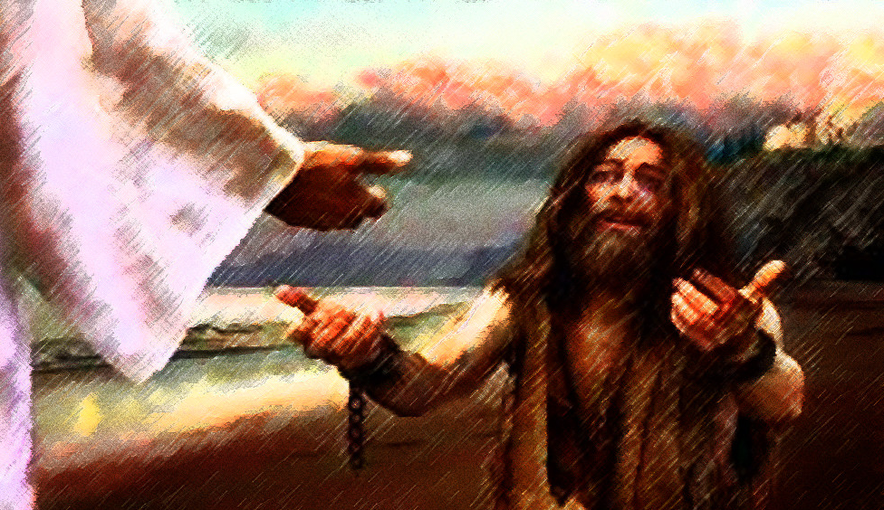
Tell Your Friends
Jesus healed a man full of “unclean,” or evil, spirits. After these unclean spirits had been cast out of the man, they entered a herd of swine, which then violently ran off a cliff into the sea. The man then sought to enter the ship where Jesus was.
The miracle occurred in the Gentile region of Decapolis, away from the influence of Jewish leaders. (1)
When we experience the Savior’s power in our lives, we can testify to others of His blessings and compassion

Slide 5
Stretching Exercises
What are the benefits of stretching?
When athletes stretch, they perform better and are less likely to suffer injury.
Stretching our minds and going beyond regular study habits increases learning.
Our spirituality increases as we exercise our faith in the Savior and draw on His power.

Slide 6
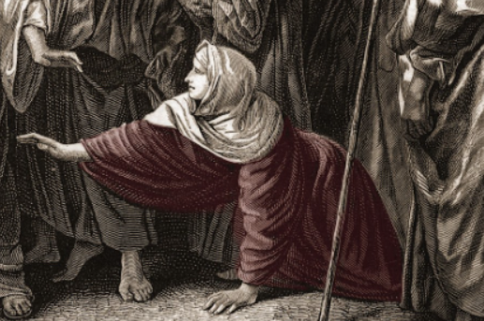
Issue of Blood
The scriptures do not define the nature of the woman’s “issue of blood”.
We know that it disrupted her life in multiple ways.
She “had spent all that she had” seeking a cure from physicians.
Under the law of Moses, someone with an issue of blood was considered ritually unclean.
SEE Leviticus 15:19-33
This likely meant that the woman was excluded from society in some ways during the 12 years of her ailment.
Mark 5:25-26; Luke 8:43-44

Slide 7
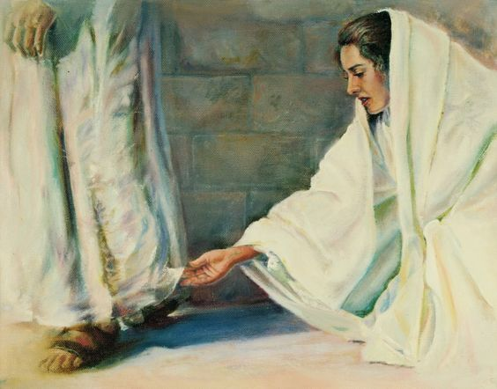
Only Believe
If I may touch but his clothes, I shall be whole.
Virtue=Power and strength
Daughter, thy faith hath made thee whole; go in peace, and be whole of thy plague.
Mark 5:-27-34

Slide 8
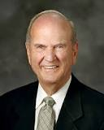
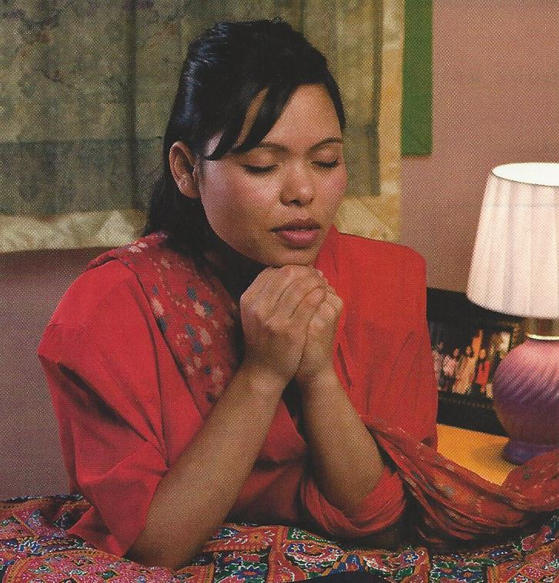
This faithful, focused woman needed to stretch as far as she could to access His power. Her physical stretching was symbolic of her spiritual stretching. …
When you reach up for the Lord’s power in your life with the same intensity that a drowning person has when grasping and gasping for air, power from Jesus Christ will be yours.
When the Savior knows you truly want to reach up to Him—when He can feel that the greatest desire of your heart is to draw His power into your life—you will be led by the Holy Ghost to know exactly what you should do
When you spiritually stretch beyond anything you have ever done before, then His power will flow into you.
(5)
Doctrine and Covenants 88:63

Slide 9
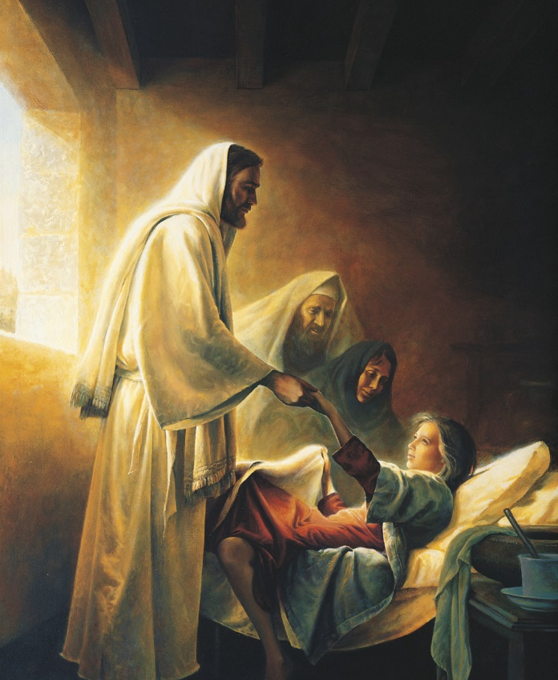
Only Believe
I pray thee, come and lay thy hands on her, that she may be healed; and she shall live.
And he took the damsel by the hand, and said unto her, Talitha cumi; which is, being interpreted, Damsel, I say unto thee, arise.
Mark 5:35-43

Slide 10
Sources:
New Testament Institute Student Manual Chapter 11 and 12
Picture of Sea of Galilee and Mt. Arbel
Elder Bruce R. McConkie (Doctrinal New Testament Commentary, 3 vols. [1965–73], 1:311).
Greg K. Olsen ‘Jairus Daughter’ artwork
Russell M. Nelson, “Drawing the Power of Jesus Christ into Our Lives,” Ensign or Liahona, May 2017, 41–42

Slide 11
Event | Matthew | Mark | Luke | John
Jesus Casts Legion of Devils into Swine | 8:28-34 | 5:1-20 | 8:26-39
Return to Capernaum | 9:1 | 5:21 | 8:40
Jairus Seeks Jesus to Heal His Dying Daughter | 9:18, 19 | 5:22-24 | 8:41, 42
Woman Touches Jesus and is Healed | 9:20-22 | 5:25-34 | 8:43-48
Jairus’ Daughter Raised from Death | 9:23-26 | 5:35-43 | 8:49-56
Faith: As you study Christ’s life and teachings in a myriad of ways, your faith in Him will increase. You will come to know that He loves you individually and understands you perfectly. …
No matter what we have suffered, He is the source of healing. Those who have experienced any manner of abuse, devastating loss, chronic illness or disabling affliction, untrue accusations, vicious persecution, or spiritual damage from sin or misunderstandings can all be made whole by the Redeemer of the world. However, He will not enter without invitation. We must come unto Him and allow Him to work His miracles.
(Jean B. Bingham, “That Your Joy Might Be Full,” Ensign or Liahona, Nov. 2017, 86)

Slide 12
Swine: Mark 5:1-5:
Though Mark and Luke identified the location of this miracle as Gadara and Matthew identified it as Gergesa, it is clear that the miracle took place on the eastern shore of the Sea of Galilee, which was inhabited by Gentiles. This explains the presence of swine herding in the area—Gentiles could eat pork, but Jews could not, for eating pork was forbidden by the law of Moses (see Leviticus 11:1–8). New Testament Institute Student Institute Manual Chapter 12
Jairus, Chief Ruler: Mark 5:23:
In Jesus’s day, synagogues were presided over by a council of elders under the direction of a chief ruler, such as Jairus. Though he was held in high esteem by the Jews, Jairus showed great reverence to the Savior. The laying on of hands is the same ordinance of healing used today in The Church of Jesus Christ of Latter-day Saints., such as Jairus. (1)
Bringing Back From the Dead
“Nowhere else in the scriptures does this man [Jairus] or his name appear except on this occasion, yet his memory lives in history because of a brief contact with Jesus. Many, many lives have become memorable that otherwise would have been lost in obscurity had it not been for the touch of the Master’s hand that made a significant change of thought and action and a new and better life. …
“… The tremor we hear in Jairus’s voice as he speaks of ‘My little daughter’ stirs our souls with sympathy as we think of this man of high position in the synagogue on his knees before the Savior.
“Then comes a great acknowledgement of faith: ‘I pray thee, come and lay thy hands on her, that she may be healed; and she shall live’ [Mark 5:23]. These are not only the words of faith of a father torn with grief but are also a reminder to us that whatever Jesus lays his hands upon lives. If Jesus lays his hands upon a marriage, it lives. If he is allowed to lay his hands on the family, it lives. …
“… When they got to the home of the ruler of the synagogue, Jesus took the little girl by the hand and raised her from the dead. In like manner, he will lift and raise every man to a new and better life who will permit the Savior to take him by the hand” President Howard W. Hunter (“Reading the Scriptures,” Ensign, Nov. 1979, 65).
Talitha and Cumi: Mark 5:41
Aramaic was the language commonly spoken by the Jewish people in the first century A.D., and it is the language the Savior spoke. Mark recorded the actual Aramaic words the Savior spoke to the young girl (see Mark 5:41). Talitha is an Aramaic word meaning “young girl” or “damsel” (and may have been a nickname applied to a young girl in a moment of tenderness), while cumi is an Aramaic word of command meaning to “stand” or “arise.” After the Savior’s words, the young girl immediately arose.(1)
Matthew 14:36: “The hem of his garment” refers to “an important part of an Israelite’s dress.” The hem was “a tassel at each ‘wing’ or corner of the tallith or mantle ( Matt. 14:36)” (Bible Dictionary, “ Hem of garment ”). The tassels were bound by blue thread, symbolizing heaven (see Numbers 15:38–40). The tassel that hung over the shoulder at the back was the one that the woman touched. Her act of reaching up to touch the tassel represents a reach for the Savior’s heavenly power. The prophet Malachi prophesied that the Savior would “arise with healing in his wings” ( Malachi 4:2).
Among the Crowd a Woman Mark 5:25-34
Outwardly, there was little to distinguish her from any other person in the crowd. No one tried to stop her from moving toward Jesus. Certainly, the Apostles neither noticed her nor made any attempt to stop her. But there was something that set her apart from all others in the crowd that day. Though buried among the thronging mass, she resolutely and quietly pressed forward with a single purpose in mind: to come to the Savior, having faith that He had the power to heal her, that He cared about her and would respond to her need. In this one thing she set herself apart from the crowd. The crowd came to see, but the woman came to be healed. …
“… All of us are among the crowds of this world. Almost all of us are like the woman who, despite the crowd, comes to the Savior. We all have faith that just a touch will bring healing to our aching souls and relief to our innermost needs.
“… In all of life’s circumstances let us quietly and resolutely press forward to the Savior, having faith that He cares about us and has the power to heal and save us” Elder Dennis B. Neuenschwander (“One among the Crowd,” Ensign or Liahona, May 2008, 101–3).

Slide 13
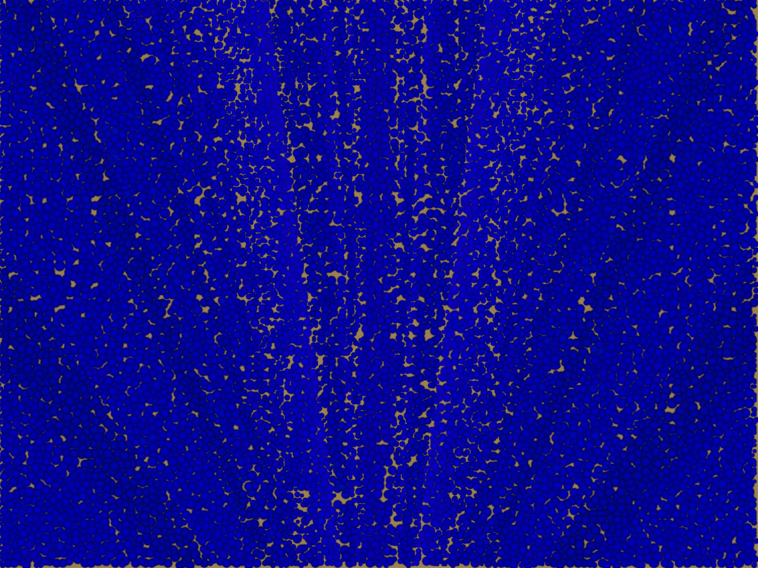
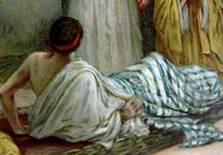
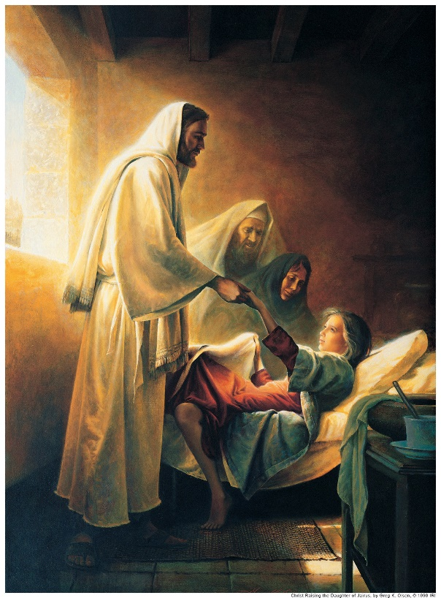
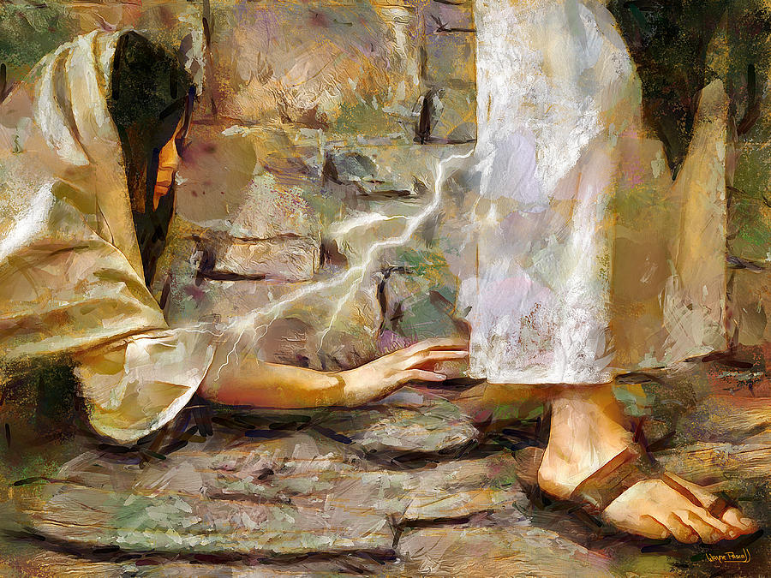
The Miracles
Matthew 9:1-8
Matthew 9:20-22
Matthew 9:18-19, 23-26
Wayne Pascall

Slide 14
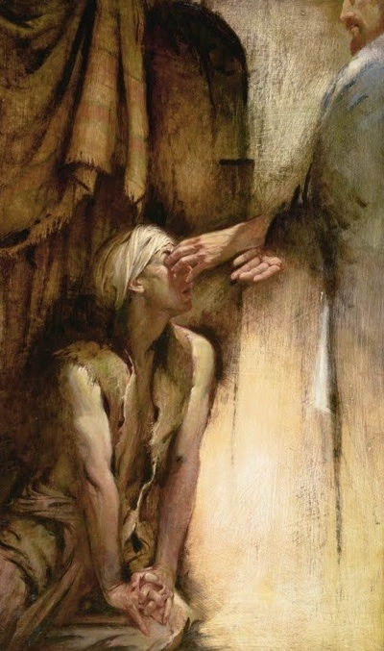
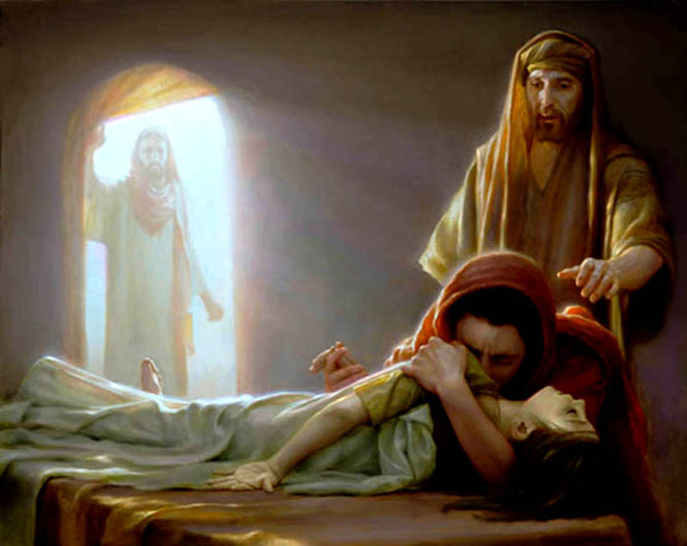
More Miracles
Matthew 9:27-31
Matthew 9:32-33
Matthew 9:23-26

Slide 15
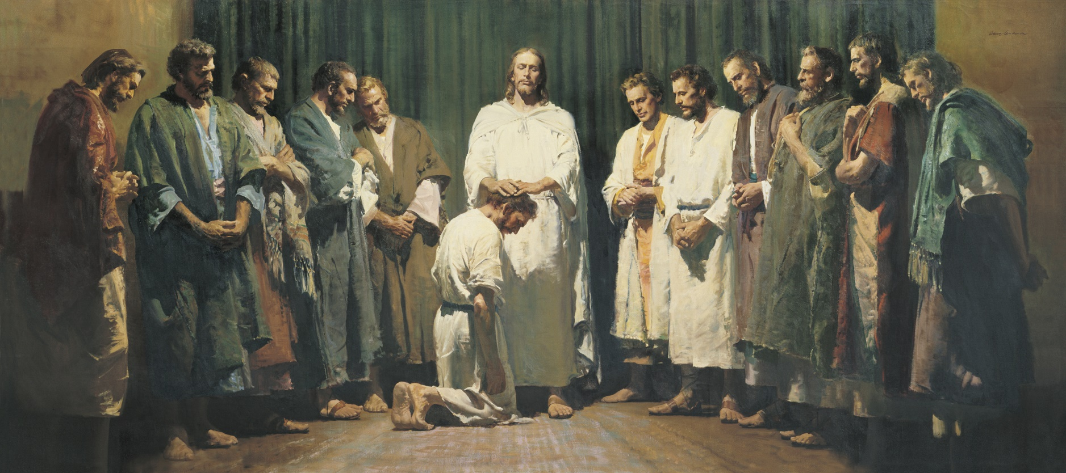
Jesus Calls the Apostles
And confers His authority upon them
The word apostle comes from a Greek word that means “one sent forth.”
At first the Apostles were sent only among the house of Israel. Later, the resurrected Savior commanded that the gospel also be preached among the Gentiles, or those who are not of the house of Israel.
Matthew 10:1-4

Slide 16
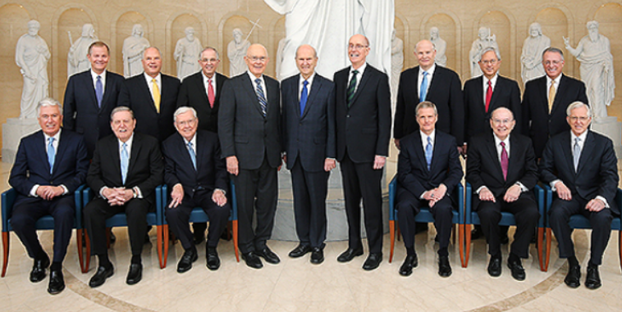
Apostle-One Sent Forth
Do you sustain the members of the First Presidency and the Quorum of the Twelve Apostles as prophets, seers, and revelators?

Slide 17
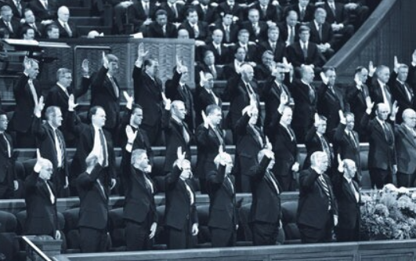
Sustaining
We often think of sustaining Church leaders as the physical act of raising our hand.
But sustaining is more than just giving an outward sign.
Sustaining includes supporting, encouraging, trusting, and following those we sustain because we believe they are called of God.

Slide 18
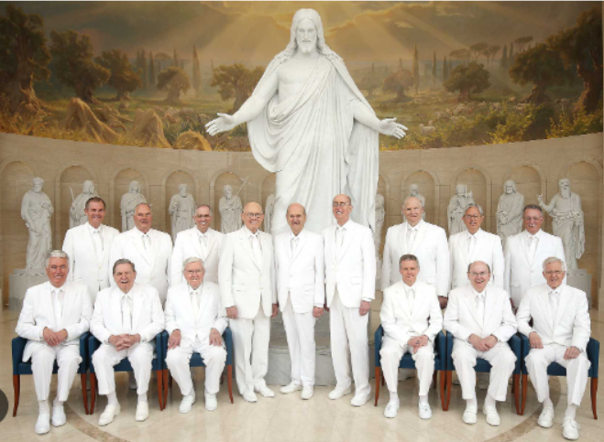
Witnesses
The Lord calls Apostles to be special witnesses of the name of Christ in all the world and do His works.
D&C 107:23

Slide 19
How are you and your family doing at receiving and following the counsel of the Savior’s modern Apostles?
In what ways have you drawn closer to Jesus Christ because of the counsel and teachings of the Savior’s Apostles?
How might having a specific plan to better know and follow the Savior’s Apostles bless you?
Were your questions about the Savior’s Apostles answered today? What did you learn? What questions do you still have, and how might you find answers to them?
Thinking of your family, friends, and others you interact with or could influence, who might benefit by learning about and discussing your experiences today? How might you share this with them?

Slide 20
Go Forth and Preach
The first, Simon, who is called Peter, and Andrew his brother; James the son of Zebedee, and John his brother;
Philip, and Bartholomew; Thomas, and Matthew the publican; James the son of Alphæus, and Lebbæus, whose surname was Thaddæus;
Simon the Canaanite, and Judas Iscariot, who also betrayed him.
And Judas the brother of James Luke 6:16
Matthew 10:2-4; Luke 6:16

Slide 21
The Kingdom of Heaven is at Hand
Heal the sick, raise the dead, and cast out
devils
Work for your meals
and clothes
Go to the lost sheep of Israel (the Jews)
Lodge with those who are worthy (trust)
Don’t take money,
nor script
And Bless them…
Matthew 10:6-13

Slide 22
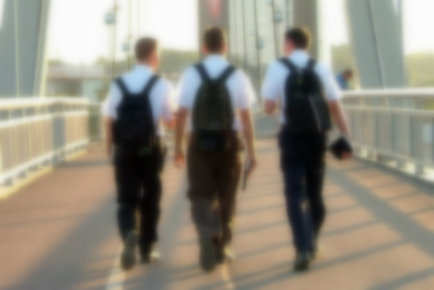
Shake off the Dust
"If the people refused to hear their message, the apostles were to leave that home or city and shake off the dust of their feet. This dusting of feet would be 'against them as a testimony.' (D&C 24:15.)
The servants of the Lord would have power 'to seal both on earth and in heaven, the unbelieving and rebellious; yea, verily to seal them up unto the day when the wrath of God shall be poured out upon the wicked without measure.' (D&C 1:8-9.)
They would know 'that in the day of judgment [they] shall be judges of that house, and condemn them.' (D&C 75:21}.
'It is as though those who reject the message are not worthy to receive even the dust that cleaves to an apostolic sandal.'" (1)
Matthew 10:14

Slide 23
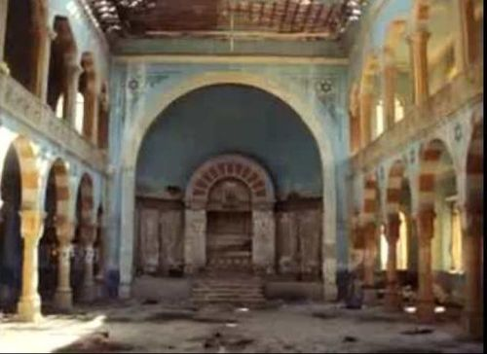
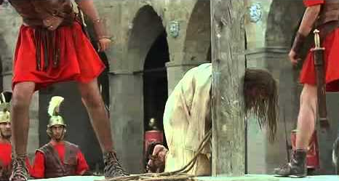
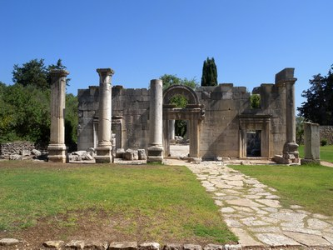
Synagogue of Satan
"In process of time the synagogues became houses of hate and persecution rather than houses of learning and true worship.
…In those sacred spots where sermons had attested to the saving power of the Promised Messiah, cries of anguish would now be heard from the lips of true believers as the scourgers' lash cut their flesh. …
…By rejecting Jesus and opposing the truth, the congregation of Israel became the congregation of unbelief, of hatred, of evil, of Lucifer. They became, as the scripture recites, 'the synagogue of Satan.' (Rev. 2:9)" (1)
Matthew 10:17-23

Slide 24
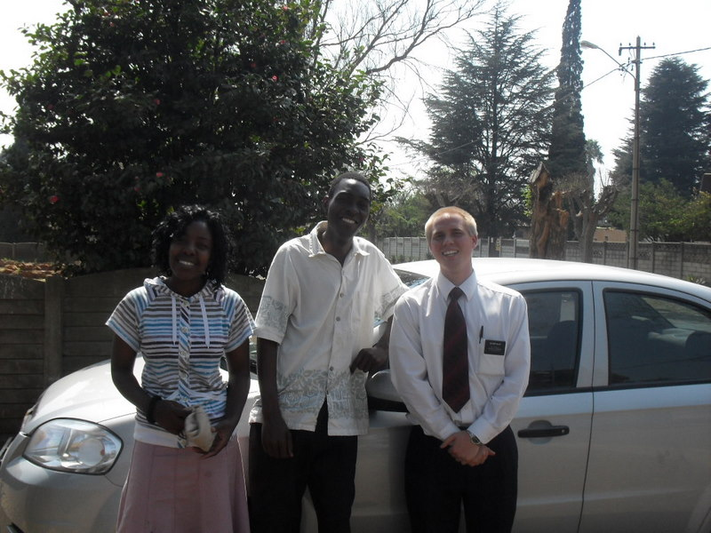
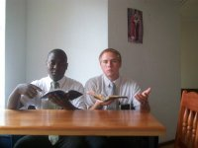
When we are in the service of the Lord, He will inspire us with what to say when needed
Matthew 10:19-20

Slide 25
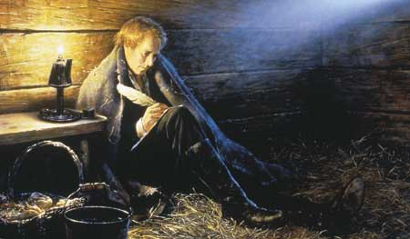
Fear Not
"I do not regard my own life. I am ready to be offered a sacrifice for this people; for what can our enemies do?
Only kill the body, and their power is then at an end.
Stand firm, my friends; never flinch.
Do not seek to save your lives, for he that is afraid to die for the truth, will lose eternal life." (2)
Some of the prophets and other church members were tortured and hung on the cross because of their beliefs.
Matthew 10:28

Slide 26
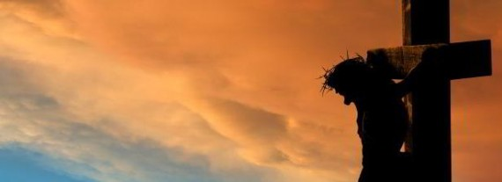
The Cross
One of the initial steps in becoming a disciple is to put away the natural man.
¶ Then said Jesus unto his disciples, If any man will come after me, let him deny himself, and take up his cross, and follow me. Matthew 16:24
We learn that to take up one's individual cross by putting off the natural man is a necessary prerequisite to true discipleship.
Then later, we will be worthy to bear the cross of Christ-which is to suffer the shame of the world
…they who have endured the crosses of the world, and despised the shame of it, they shall inherit the kingdom of God,
2 Nephi 9:18
Matthew 10:38

Slide 27
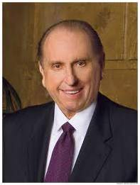
Lose and Find
To be willing to give of ourselves each day to serve Him and the people around us
He that findeth his life shall lose it: and he that losethhis life for my sake shall find it.
“I believe the Savior is telling us that unless we lose ourselves in service to others, there is little purpose to our own lives. Those who live only for themselves eventually shrivel up and figuratively lose their lives, while those who lose themselves in service to others grow and flourish—and in effect save their lives.” (3)
Matthew 10:39

Slide 28
Sources:
Elder Bruce R. McConkie (The Mortal Messiah: From Bethlehem to Calvary, 1: 199
Joseph Smith (History of The Church of Jesus Christ of Latter-day Saints, 6: 503.)
Elder Thomas S. Monson (May 11, 1965, BYU Speeches of the Year, 1965, p. 9.)
What Have I Done for Someone Today? Ensign or Liahona, Nov. 2009, 85).

Slide 29
Matthew 9:23-26 Jesus Heals the maid
"Oriental customs of public mourning and display at the time of death prevailed among the Jews of Jesus' day. Noise, tumult, weeping, screeching, screaming, flute playing, and the use of hired mourners-all were part of the orthodox mourning rituals." (Doctrinal New Testament Commentary, 1: 316.) Bruce R. McConkie
By this statement, Christ did not mean that the girl had not yet died, but that her condition was only temporary-like sleep. The statement seemed ridiculous and brought scorn, but it was intended as a foreshadowing of the miracle He intended to perform.
"That same power has been restored in this generation. It came through the laying on of hands by Peter, James, and John, who received it from the Lord himself. It was bestowed upon Joseph Smith, the prophet of this dispensation. Its presence is among us. Those who are acquainted with the history of the Church are familiar with the account related by Wilford Woodruff concerning the events of July 22, 1839. Nauvoo at that time was an unhealthy and swampy place. There was much sickness. Joseph was among those who were afflicted. But being filled with the Spirit, he rose from his bed and went out among the sick, healing them and raising them. He then crossed the river to the settlement in Montrose, Iowa.
I now refer to the account of Elder Woodruff:
'The first house he visited was that occupied by Elder Brigham Young, the president of the quorum of the twelve, who lay sick. Joseph healed him, then he arose and accompanied the Prophet on his visit to others who were in the same condition. They visited Elder W. Woodruff, also Elders Orson Pratt and John Taylor, all of whom were living in Montrose. They also accompanied him. The next place they visited was the home of Elijah Fordham, who was supposed to be about breathing his last. When the company entered the room the Prophet of God walked up to the dying man, and took hold of his right hand and spoke to him; but Brother Fordham was unable to speak, his eyes were set in his head like glass, and he seemed entirely unconscious of all around him. Joseph held his hand and looked into his eyes in silence for a length of time. A change in the countenance of Brother Fordham was soon perceptible to all present. His sight returned, and upon Joseph asking him if he knew him, he, in a low whisper, answered, 'Yes.' Joseph asked him if he had faith to be healed. He answered, 'I fear it is too late; if you had come sooner I think I would have been healed.' The Prophet said, 'Do you believe in Jesus Christ?' He answered in a feeble voice, 'I do.' Joseph then stood erect, still holding his hand in silence several moments; then he spoke in a very loud voice, saying: 'Brother Fordham, I command you in the name of Jesus Christ to arise from this bed and be made whole.' His voice was like the voice of God, and not of man. It seemed as though the house shook to its very foundations. Brother Fordham arose from his bed and was immediately made whole. His feet were bound in poultices, which he kicked off, then putting on his clothes, he ate a bowl of bread and milk, and followed the Prophet into the street. (As quoted in Joseph Fielding Smith, Essentials in Church History, rev. ed. [Salt Lake City: Deseret Book, 1979], pp. 223-24.)'" (Gordon B. Hinckley, Faith: The Essence of True Religion [Salt Lake City: Deseret Book Co., 1989], 31.)(As quoted in Joseph Fielding Smith, Essentials in Church History, rev. ed. [Salt Lake City: Deseret Book, 1979], pp. 223-24.)'" (Gordon B. Hinckley, Faith: The Essence of True Religion [Salt Lake City: Deseret Book Co., 1989], 31.)
Matthew 9:32-33 Jesus Heals the Dumb
Jesus healed many from physical diseases, but He did not withhold healing from those who sought to be “made whole” from other ailments. Matthew writes that He healed every sickness and every disease among the people (see Matthew 4:23 9:35 Great multitudes followed Him, and He “healed them all” Matthew 12:15 Surely these healings included those whose sicknesses were emotional, mental, or spiritual. He healed them all. Dallin H. Oaks 2006 Oct. Gen. Conf.
Matthew 10:14 Shake off the dust
"The elders were to seek out from among the people the honest in heart and leave their warning testimony with all others, thus they would become clean from their blood. The cleansing of their feet, either by washing or wiping off the dust, would be recorded in heaven as a testimony against the wicked. This act, however, was not to be performed in the presence of the offenders, 'lest thou provoke them, but in secret, and wash thy feet, as a testimony against them in the day of judgment.'" Joseph Fielding Smith (Doctrine and Covenants Encyclopedia, 514.)
Matthew 10:16 Wise As A Serpent
"The Lord foresaw the evils of our day and the designs of cunning and deceiving men who operate under the influence of Satan and his satanic hosts. Satan's power to deceive and to lead astray the children of men is unquestioned...We, the people of the Lord, cannot afford to be lulled into peaceful security and complacency. The dangers of our day are real and knocking constantly and unrelentingly at our doors. How ably will we meet the challenge of these evil influences and designs of wicked men? The test of true Church membership is here. Can we stand firm and true to the principles, ideals and standards of the gospel, or will we be so naive and unsuspecting as to fall into the traps of evil so cunningly planned and promoted by designing and conspiring men? Those of a religious nature are so often classified naive and innocently unsuspecting. The Savior knowing of this attribute counseled his disciples, 'Behold, I send you forth as sheep in the midst of wolves: be ye therefore wise as serpents and harmless as doves.' And he added: '. . . beware of men...' (Matt. 10:16-17.)
"Possessing, as we do, the endowment of the Holy Ghost, if worthy, we are entitled to the gift of discernment to guide and help us avoid the pitfalls of scheming and designing men to trap and ensnare us into the meshes of worldly lusts, influences, and pleasures.“ Elder Delbert L. Stapley (Conference Report, October 1961,

Slide 30
Save, Not Destroy
Luke 8-9
For the Son of man is not come to destroy men’s lives, but to save them.
Luke 9:56
SAVE

Slide 31
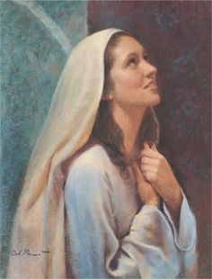
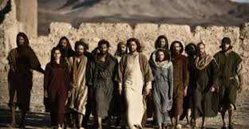
The Women Who Traveled With Jesus
During the Savior’s ministry in Galilee, teaching in “every city and village” of the region His Apostles traveled with Him, as did many women, some of whom had been healed of various maladies.
Others could have been wives of the Apostles. Some women followed Jesus to the time of His death and beyond Using the means they had, these women were supporting Jesus and His leaders.
Mary Magdalene, the woman to whom the resurrected Savior first appeared was one of the women who accompanied Jesus. Luke recorded that the Savior had cast seven devils out of her (see Luke 8:2).
Mary Magdalene should not be confused with the sinful woman mentioned in Luke 7:36–50 or with Mary of Bethany (see Luke 10:38–42; John 11:1).
Mary Magdalene held an honored place in the kingdom.
Luke 8:1-3; Luke 23:27; 24:10; John 20:11–18
(1)

Slide 32
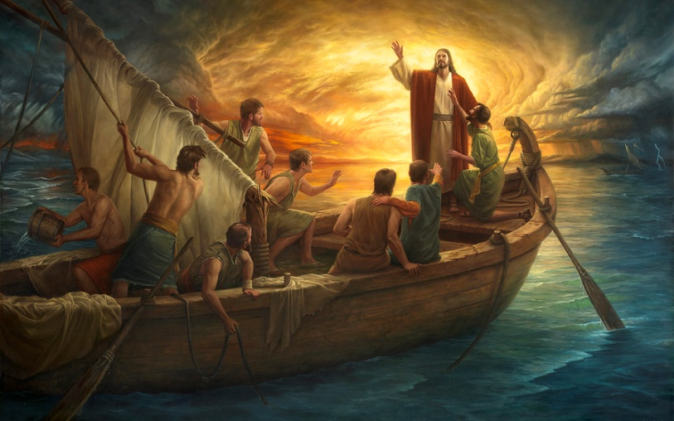
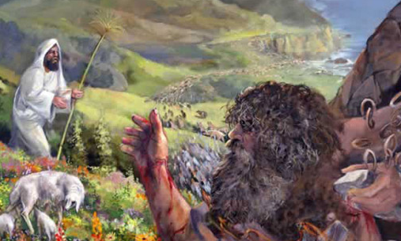
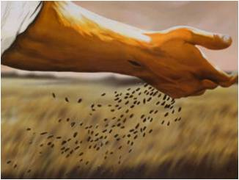
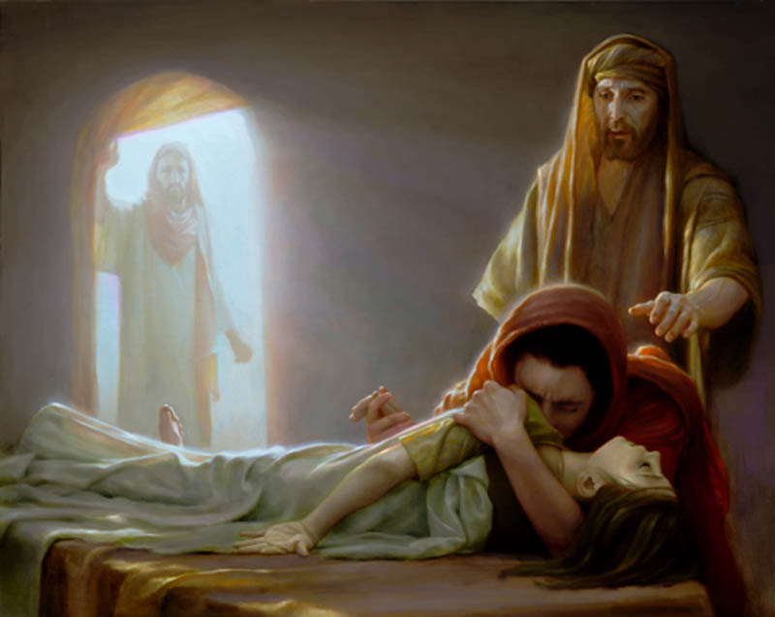
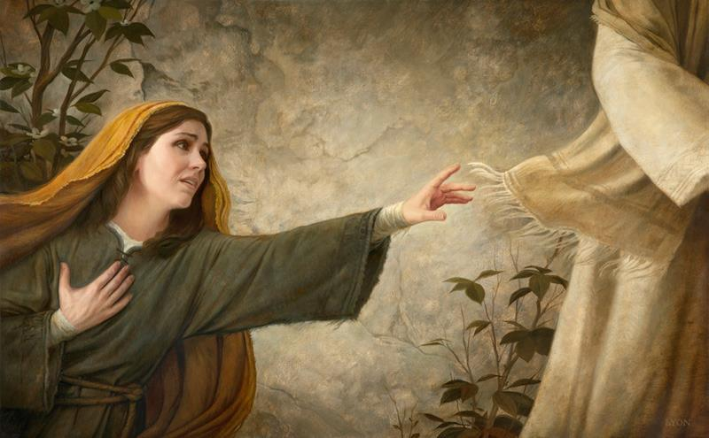
Luke’s Added Insight…
Christ gave the parable of the sower.
Matthew 13:4-8
Howard Lyon
The Savior cast out a legion of devils.
Mark 5:1-20
Jesus Christ calmed a storm.
Mark 4:35-41
The Savior healed a woman with an issue of blood.
Mark 5:25-34
Jesus Christ raised Jairus’s daughter from the dead.
Mark 5:22–24, 35–42
Howard Lyon
Luke 8

Slide 33
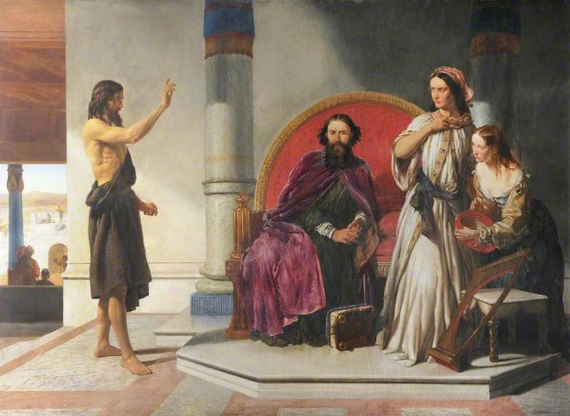
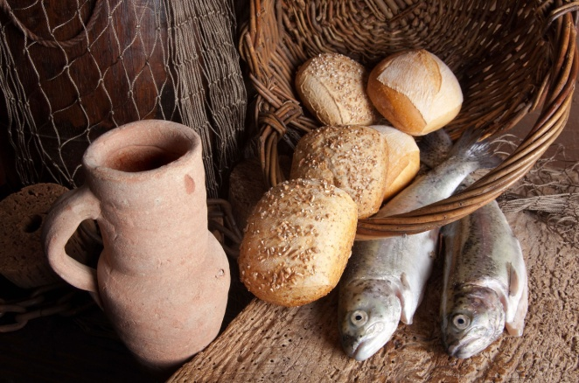
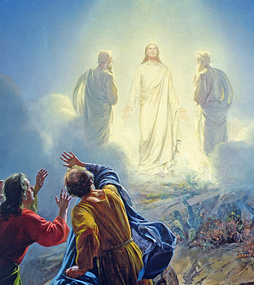
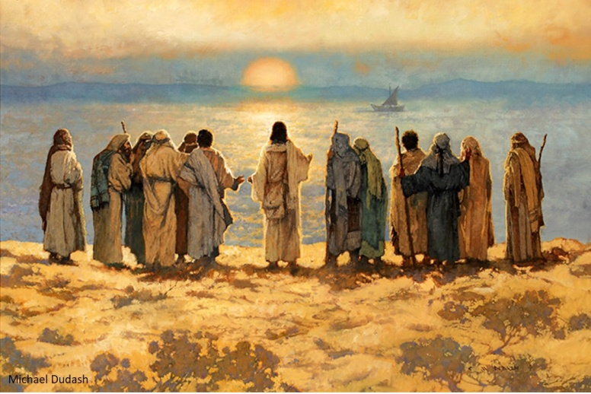
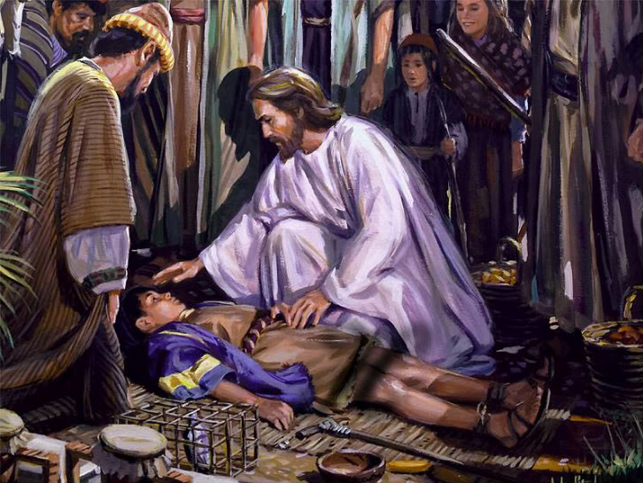
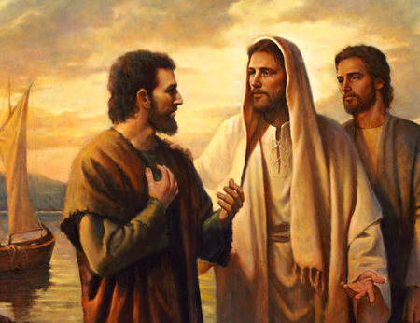
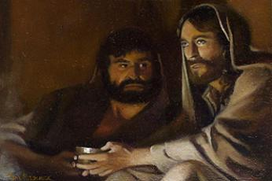
The Savior sent the Twelve out to preach and heal.
Matthew 10:1-5
Christ fed the five thousand.
Mark 6:32-44
Herod had John the Baptist killed and desired to see Jesus.
Mark 6:14-29
Carl Bloch
The Transfiguration took place.
Matthew 17:1-13
A man’s son, who was possessed by an unclean spirit, was healed.
Mark 9:17-29
Peter testified that Jesus is the Christ.
Mark 8:27-32
The disciples asked which should be greatest among them.
Mark 9:33–37; 10:35–45
Luke 9:1-48

Slide 34
Becoming a Disciple of Jesus
Throughout His ministry, Jesus Christ invited people to follow Him and become His disciples
A disciple is someone who has been baptized, follows Jesus Christ, and strives to live according to His teachings.
Luke 9:24-26

Slide 35
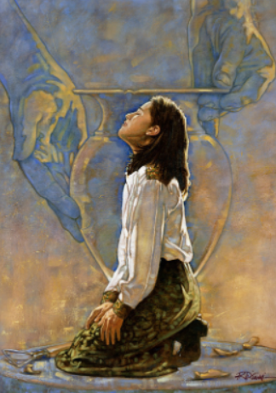
Take Up Your Cross
The physical cross Jesus Christ carried and suffered upon in order to fulfill His Father’s will.
Although we are not asked to carry a physical cross like the Lord did, we are asked to follow Him by fulfilling Heavenly Father’s will for us even when it is difficult.
Luke 9:23
Ron DiCianni

Slide 36
Lose Your Life To Save It
Those who live only for themselves eventually shr`ivel up and figuratively lose their lives…
…while those who lose themselves in service to others grow and flourish—and in effect save their lives.
(7)
Luke 9:24

Slide 37
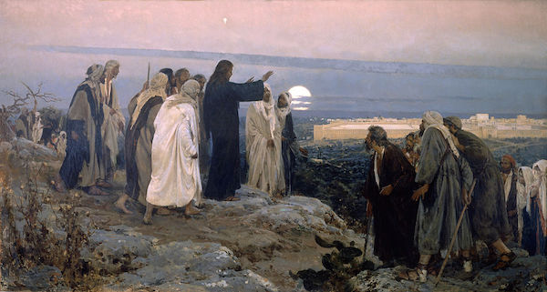
“be received up”
The Savior’s approaching Ascension into heaven
After Jesus completed His mission in Galilee and knew that it was time for Him to travel toward Jerusalem, He sent messengers to prepare a place for Him in a Samaritan village.
But because the Samaritans hated the Jews, the villagers would not let the Savior stay in their village.
In these circumstances, Jesus demonstrated patience and forbearance and admonished
His disciples to do the same.
He taught them that they
were not acting under the
influence of God’s Spirit.
Galilee
Jerusalem
Luke 9:51-56

Slide 38
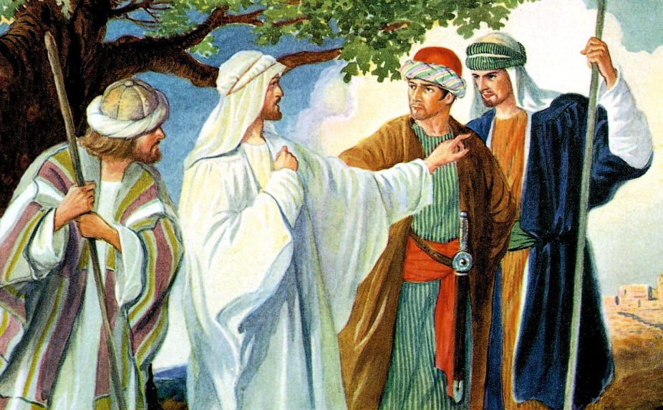
Exercising Forbearance
How did James and John react to the Samaritans’ inhospitality toward and rejection of the Savior?
“There is so great a need for civility and mutual respect among those of differing beliefs and philosophies.
We must not be partisans of any doctrine of ethnic superiority. We live in a world of diversity.
We can and must be respectful toward those with whose teachings we may not agree.
We must be willing to defend the rights of others who may become the victims of bigotry.” (2)
…he that hath the spirit of contention is not of me, but is of the devil, who is the father of contention, and he stirreth up the hearts of men to contend with anger, one with another.
Behold, this is not my doctrine, to stir up the hearts of men with anger, one against another; but this is my doctrine, that such things should be done away. 3 Nephi 11:29-30
Luke 9:54-56

Slide 39
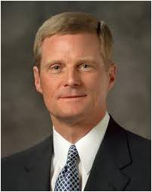
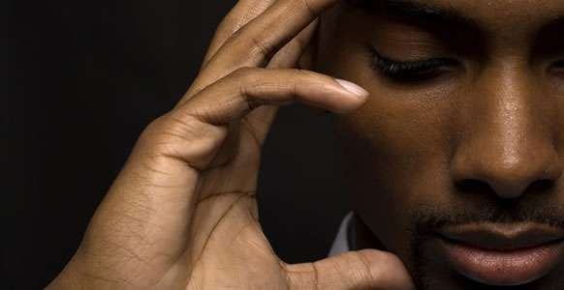
“To believe that someone or something can make us feel offended, angry, hurt, or bitter diminishes our moral agency and transforms us into objects to be acted upon.
As agents, however, you and I have the power to act and to choose how we will respond to an offensive or hurtful situation. …
“The Savior is the greatest example of how we should respond to potentially offensive events or situations.” (5)
Luke 9:54-56

Slide 40
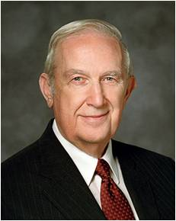
However…
You should not allow any type of abuse to continue against you.
If you are a victim of abuse, you should immediately seek help from parents, priesthood leaders, and other authorities as appropriate.
“As a victim, do not waste effort in revenge or retribution against your aggressor. Focus on your responsibility to do what is in your power to correct.
Leave the handling of the offender to civil and Church authorities.” (3)
Luke 9:54-56

Slide 41
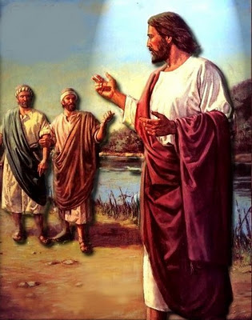
Following Jesus Christ
When a “certain man” said that he would follow the Savior wherever He went, the Savior answered that “the Son of man hath not where to lay his head”, indicating that He had no home of His own.
His mission was void of comforts and ease, implying that such may also be the case for those who follow Him.
"In other words, Jesus wanted it to be understood that nothing was to stand in the way of preaching the kingdom of God, not even the care of one's dead or the saying of farewell.” (4)
Luke 9:57-62

Slide 42
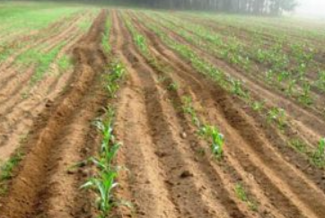
To dig a straight furrow [or trench], the plowman needs to keep his eyes on a fixed point ahead of him.
That keeps him on a true course. If, however, he happens to look back to see where he has been, his chances of straying are increased.
The results are crooked and irregular furrows. … If our energies are focused not behind us but ahead of us—on eternal life and the joy of salvation—we assuredly will obtain it.
Luke 9:62
8)

Slide 43
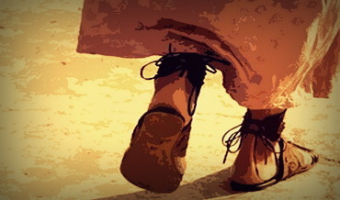
“Those who have entered the waters of baptism and received the gift of the Holy Ghost have set their feet on the path of discipleship and are charged to follow steadily and faithfully in the footsteps of our Savior.”
Luke 9:62
(6)

Slide 44
Seek the Guidance of the Holy Ghost
Now, behold, this is the spirit of revelation;
…and which shall dwell in your heart.
By the Holy Ghost, which shall come upon you …
Yes, behold I will tell you in your mind and in your heart,
D&C 8:2-3

Slide 45
Sources:
New Testament Institute Student Manual Chapter 16 and 17
President Gordon B. Hinckley (“This Is the Work of the Master,” Ensign, May 1995, 71).
Elder Richard G. Scott Healing the Tragic Scars of Abuse may 1992 Ensign
Elder LeGrand Richards (A Marvelous Work and a Wonder, 247.)
David A. Bednar (“And Nothing Shall Offend Them,” Ensign or Liahona, Nov. 2006, 90).
President Dieter F. Uchtdorf (“Saints for All Seasons,” Ensign or Liahona, Sept. 2013, 5).
Thomas S. Monson, “What Have I Done for Someone Today?” Ensign or Liahona, Nov. 2009, 85
Howard W. Hunter, “Am I a ‘Living’ Member?” Ensign, May 1987, 17
Presentation by ©http://fashionsbylynda.com/blog/

Slide 46
Parable of the Sower
(planting the seed)
Lehi’s Dream
(reactions to the tree of life)
Some seeds fell by the way side
(Luke 8-5) (Matthew 13:4,19)
Some went directly to the great and spacious building
(1 Nephi 8:31:32)
Some seeds grew, then withered in the sun
(Matthew 13:5-6, 20-21)
Some partook of the fruit, then fell away
(1Nephi 8:25)
Some grew among thorns and choked
(Luke 8:7) (Matthew 13:7, 22)
Some started on the path, then wandered off
(1 Nephi 8:23)
Some grew in good soil and brought forth fruit
(Luke 8:8) (Matthew 13:8, 23)
Some partook of the fruit and stayed by the tree
(1 Nephi 8:30)

Slide 47
Event | Matthew | Mark | Luke | John
Preaching in Galilee with the Twelve |  |  | 8:1-3
Jesus’ Mother and Brother Seek Him | 12:46-50 | 3:31-35 | 8:19-21
Parable of the Sower, or Different Kinds of Soil | 13:1-23 | 4:1-25 | 8:4-18
Jesus Calms the Storm at the Sea | 8:18, 23-27 | 4:35-41 | 8:22-25
Jesus Casts Legion of Devils into Swine | 8:28-34 | 5:1-20 | 8:26-39
Return to Capernaum | 9:1 | 5:21 | 8:40
Jairus Seeks Jesus to Heal His Dying Daughter | 9:18, 19 | 5:22-24 | 8:41, 42
Woman Touches Jesus and is Healed | 9:20-22 | 5:25-34 | 8:43-48
Jairus’ Daughter Raised from Death | 9:23-26 | 5:35-43 | 8:49-56
Apostles Are Sent on Missions | 10:1, 5-42 | 6:7-13 | 9:1-6
The Twelve Apostles Return and Depart—Jesus is to Rest | 14:13 | 6:30-33 | 9:10 | 6:1, 2
Jesus Feeds 5,000 | 14:14-21 | 6:34-44 | 9:11-17 | 6:3-14

Slide 48
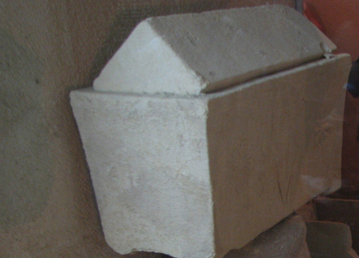
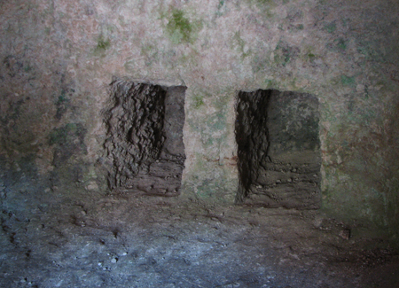
Support of the Women Luke 8:1-3:
“It must be comforting to you beloved sisters of his Church to remember that this same Jesus, our Savior through the Atonement, demonstrated his love and concern for the women of his time. He enjoyed the company of women and had close friends among them. … Is there any reason to think that he cares any less about women today? …
“As our Lord and Savior needed the women of his time for a comforting hand, a listening ear, a believing heart, a kind look, an encouraging word, loyalty—even in his hour of humiliation, agony, and death—so we, his servants all across the Church, need you, the women of the Church, to stand with us and for us in stemming the tide of evil that threatens to engulf us. Together we must stand faithful and firm in the faith against superior numbers of other-minded people. It seems to me that there is a great need to rally the women of the Church to stand with and for the Brethren in stemming the tide of evil that surrounds us and in moving forward the work of our Savior” President Howard W. Hunter (“To the Women of the Church,” Ensign, Nov. 1992, 95–96).
Let the Dead Bury Their Dead Luke 9:59-60
Respect for parents was very important in Jewish culture and included the responsibility to provide a proper burial for them when they died. After preparing a body for burial and placing it in a tomb, family members typically returned a year later to place the bones in a stone box called an ossuary, which remained in the tomb as a secondary burial. If the disciple was speaking of his father’s secondary burial, the Savior’s response would seem to communicate that now was the time for the man to serve a mission (see Luke 9:59–60). The man could be at peace about letting his deceased father remain in the tomb with other dead members of the family. It is also possible that the Savior’s response could be understood, “Let the [spiritually] dead bury their [physically] dead.”
In either case, the Savior’s words do not mean it is wrong to mourn the loss of a loved one or give proper respect at a funeral. Rather, these words emphasize devotion to the Lord as a disciple’s highest priority. (1)
Luke 9:23Take up Your Cross
We learn through the scriptures that those who wish to take their cross upon themselves love Jesus Christ in such a way that they deny themselves of all ungodliness and of every worldly lust and keep His commandments.
Our determination to cast off all that is contrary to God’s will and to sacrifice all we are asked to give and to strive to follow His teachings will help us to endure in the path of Jesus Christ’s gospel—even in the face of tribulation, the weakness of our souls, or the social pressure and worldly philosophies that oppose His teachings.
(Ulisses Soares, “Take Up Our Cross,” Ensign or Liahona, Nov. 2019, 113–14)
An ossuary—a stone box in which bones of the deceased are respectfully placed. Below: A niche that has been chiseled out of a stone tomb, where an ossuary is placed for permanent burial.
Looking Back Luke 9:62:
“To dig a straight furrow, the plowman needs to keep his eyes on a fixed point ahead of him. That keeps him on a true course. If, however, he happens to look back to see where he has been, his chances of straying are increased. The results are crooked and irregular furrows. We invite those of you who are new members to fix your attention on your new goal and never look back on your earlier problems or transgressions except as a reminder of your growth and your worth and your blessings from God. If our energies are focused not behind us but ahead of us—on eternal life and the joy of salvation—we assuredly will obtain it.” President Howard W. Hunter (“Am I a ‘Living’ Member?” Ensign, May 1987, 17).

Slide 49
Artist Howard Lyon:
Howard Lyon was born and raised in Mesa, Arizona. He is the youngest of five children. Howard had very supportive parents who, even when he was very young, made sure he had the materials and education to hone his talents. While attending high school, Howard met his wife, Shari Lunt. After they graduated, Howard served a mission and then they married and went to BYU and started their family. He began his career studying illustration at Brigham Young University working with artists such as Robert Barrett, Don Seegmiller, James Christensen, and Greg Olsen. Over the past twenty years he has worked in the video game industry as an art director, concept artist, and freelance illustrator. For much of his career he has painted dragons and trolls or scenes from science fiction. His work can be found in products from Dungeons and Dragons books, World of Warcraft cards, Magic: the Gathering and Star Wars. He has studied art in Italy, France, and most recently at the Grand Central Academy in New York. He has recently combined these experiences to switch gears and expand his subject matter to create inspirational pieces in the style of some of his favorite old masters: William Bouguereau, Lawrence Alma-Tadema, and John William Waterhouse.

