Slide 1
Matthew 8; Mark 2-4; Luke 7

Slide 2
The Miraculous Power of Jesus Christ
Matthew 8, Luke 7:11-17
Looking unto Jesus the author and finisher of our faith; who for the joy that was set before him endured the cross, despising the shame, and is set down at the right hand of the throne of God.
Hebrews 12:2

Slide 3
Sidon and Tyre
Sidon = an ancient Phoenician port city.
Tyre and Sidon were a powerful city-state and first manufactured the purple dye…synonymous with royalty.
It was a Phoenician city port and later absorbed by Rome.
Both Sidon and Tyre are mentioned 12 times in the New Testament and is where Jesus and Paul, the Apostle visited.
Tyre = meaning ‘rock’
In myth, Tyre is known as the birthplace of Europa (who gave Europe its name).
The main trade was on an island about ½ mile from the mainland.
The old city, known as Ushu, was founded in 2750 BC.
The Tyrians were known as workers in dye from the shells of the Murex shellfish. This purple dye was highly valued and held royal connotations in the ancient world.
(1)

Slide 4
Chorazin
Chorazin = an ancient village in northern Galilee, two and a half miles from Capernaum on a hill above the northern shore of the Sea of Galilee.
Chorazin, along with Bethsaida and Capernaum, was named in the gospels of Matthew and Luke as "cities" (more likely just villages) in which Jesus performed "mighty works".
However, because these towns rejected his work ("they had not changed their ways"), they were subsequently cursed.
The Babylonian Talmud (Menahot, 85a) mentions that Chorazin was a town known for its grain.
Chorazin is mentioned 2 times in the New Testament
(2)

Slide 5
Gadara
Gadara/Geresa was called in the New Testament “the country of the Gadarenes.”
Gadara was a city of Decapolis, southeast of the Sea of Galilee, on the main road to Damascus.
The people were partly Greek and partly Syrian.
The district is mentioned in connection with the healing of a man with an unclean spirit; but the Gospels and the Greek manuscripts do not agree as to its name.
Compare the above passages with Matt. 8:28. The miracle was probably worked near Gergesa.
Gergesa
(4)

Slide 6
Bethsaida
Bethsaida is known as ‘House of fish, or house of fishers’. Probably there are two places of this name mentioned in the New Testament.
The older city was on the northeast end of the Sea of Galilee, near Capernaum, and was the home of Peter, Andrew, and Philip.
Et-Tel, the mound identified as ancient Bethsaida, is located on a basaltic spur north of the Sea of Galilee, near the inflow of the Jordan River into the Sea of Galilee.
The name Bethsaida means "house of the hunt" in Hebrew.
Bethsaida is, as Mark 8:22-23 described, a town where Jesus met a blind man seeking healing.
Bethsaida is mentioned 7 times in the New Testament.
(2,3,4)

Slide 7
Capernaum
Capernaum is known as the Village of Nahum.
It is a town on the northern end of the Sea of Galilee, probably on the site now known as Tell-Hûm.
At the time of our Lord the district was one of the most prosperous and crowded in all Palestine. Here the Lord lived after the beginning of His ministry, so that Capernaum is called “his own city”.
It was the home of Peter and Andrew and of Matthew . Many of our Lord’s miracles were worked here (In the synagogue at Capernaum was spoken the wonderful discourse found in John 6:59.
Later the Lord upbraided the people of the place for their rejection of Him.
Capernaum is mentioned 16 times in the New Testament.
(4)

Slide 8
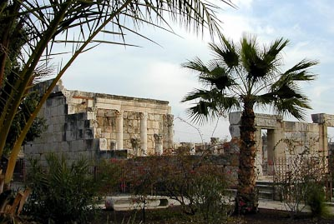
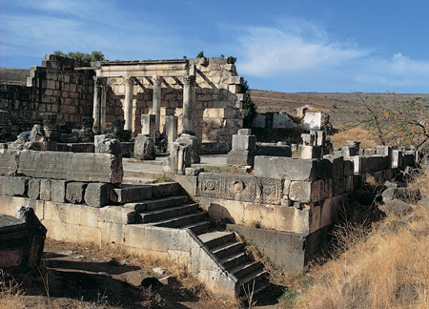
The Savior’s “Own City”
Matthew 9:1
It was a prosperous town, located on the famous Roman road, the Via Maris (the Way of the Sea), which linked ancient Egypt with Syria and Mesopotamia.
It was the home of Peter, the chief Apostle, and his brother Andrew, another of the Twelve Apostles.
Jesus delivered a powerful discourse at the synagogue located in Capernaum.
More recorded miracles occurred at Capernaum than at any other site. (5)
John 6:24-65—Ruins of Capernaum

Slide 9
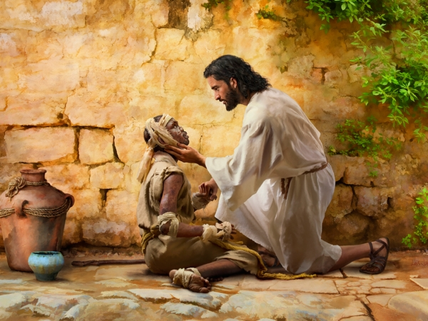
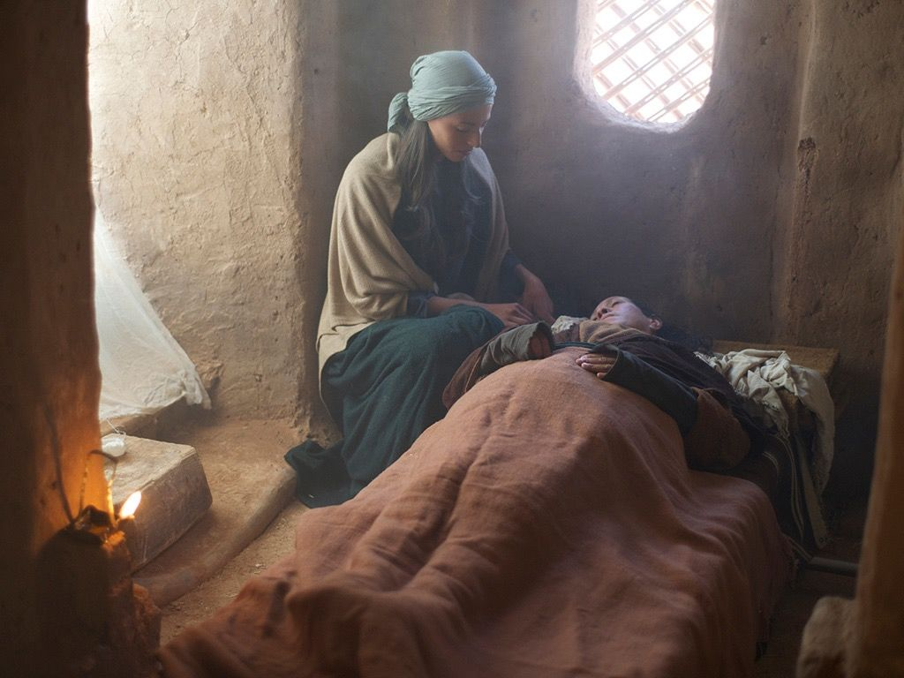
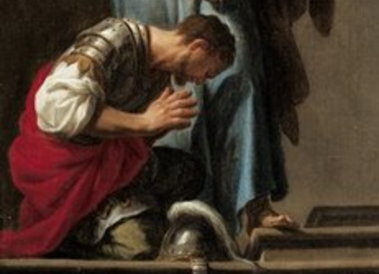
The Miracles
Matthew 8:1-4
Matthew 8:14-15
Matthew 8:5-13
A miracle is “an extraordinary event caused by the power of God. … Faith is necessary in order for miracles to be manifested”

Slide 10
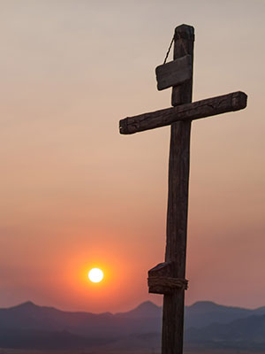
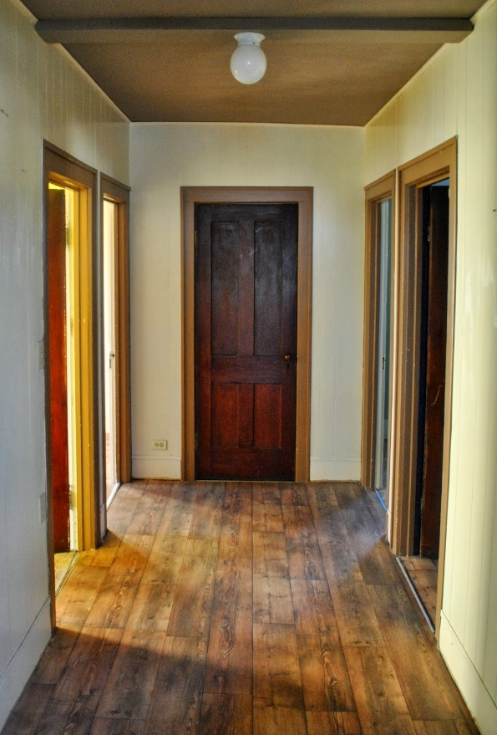
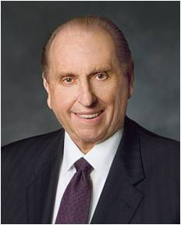
Foxes and Birds
"There is no lonelier picture in history than of the Savior upon the cross, alone, the Redeemer of mankind, the Savior of the world, bringing to pass the atonement, the Son of God suffering for the sins of mankind." (6)
"Seek the help of the Lord...Remember, we do not run alone in this great race of life-we can have the help of the Lord.
However, before we can take Jesus as our companion, before we can follow Him as our guide, we must find Him. You ask, 'How can we find
Jesus?' I would like to suggest that, first of
all, we need to make room for Him.” (7)
Matthew 8:20

Slide 11
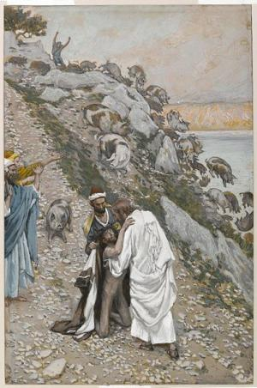
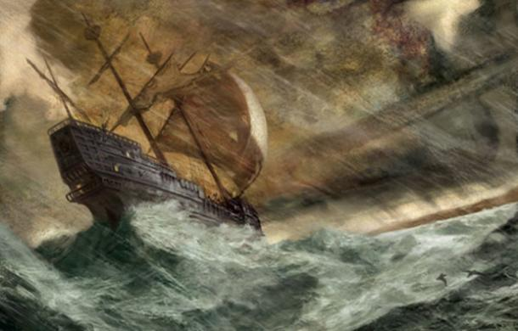
The Miracles
Matthew 8:28-32
Matthew 8:23-27

Slide 12
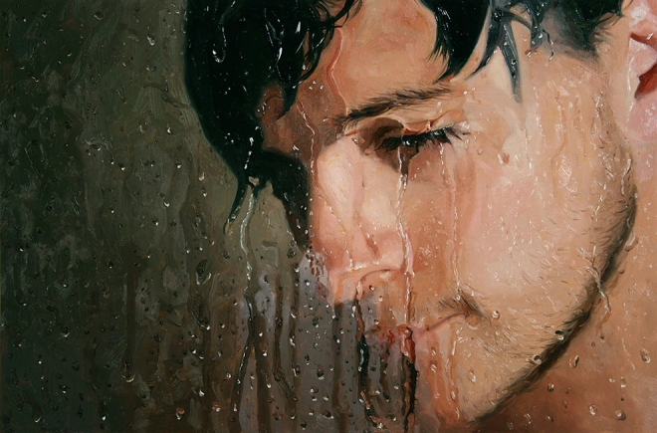
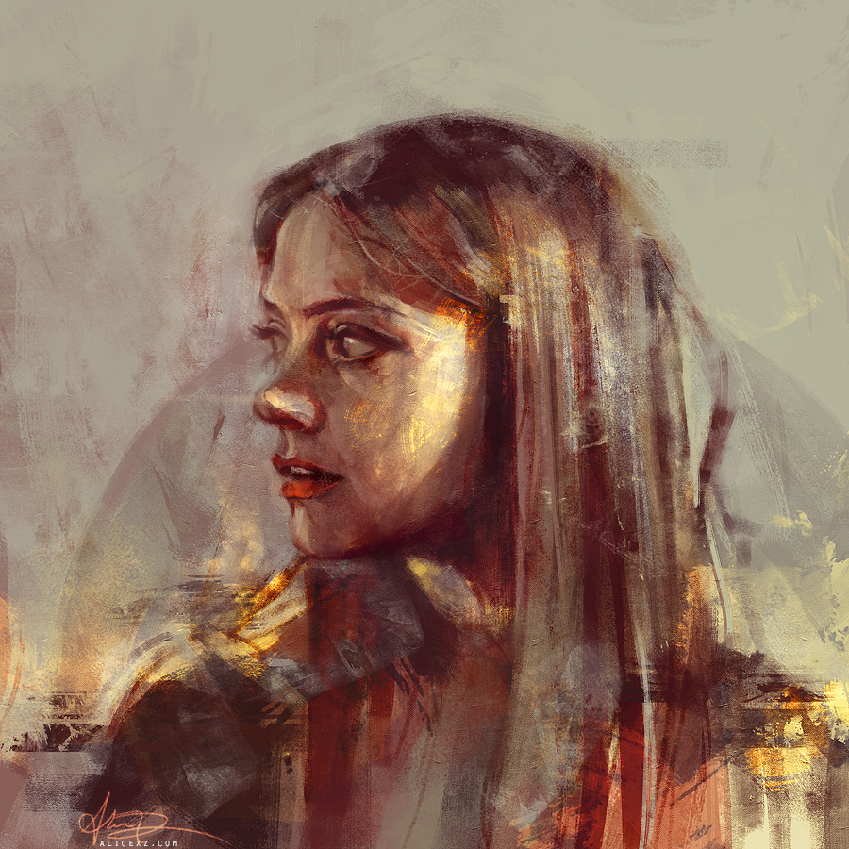
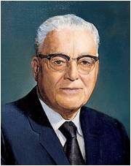
"The greatest miracles I see today are not necessarily the healing of sick bodies, but the greatest miracles I see are the healing of sick souls, those who are sick in soul and spirit and are downhearted and distraught, on the verge of nervous breakdowns.
We are reaching out to all such, because they are precious in the sight of the Lord, and we want no one to feel that they are forgotten.“ (8)

Slide 13
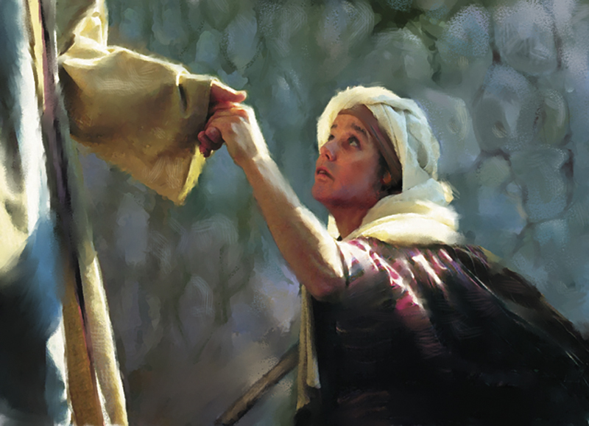
Miracles
An important part of Jesus’ earthly ministry
He used miracles to show compassion, to teach, to inspire, to motivate, and to testify that he was the true Messiah.
After his death and resurrection, his disciples continued to perform miracles and to testify that he was the Messiah, the Son of God who had come in power and authority.

Slide 14
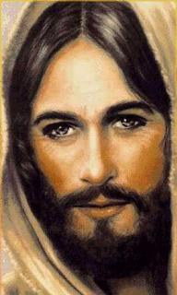
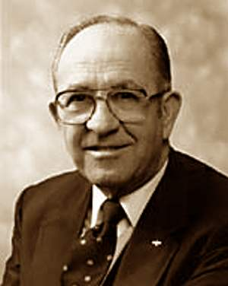
The Gospel Writers
Used Jesus’ miracles to testify that He had power over all enemies
“The healing of the leper, the centurion's servant, and Peter's mother-in-law testified that his power extends to persons of all nations, both Jew and Gentile.
The calming of the sea extended his power to include power over nature and the elements. Casting out the unclean spirits testified of his power over devils and all evil...
“For individuals in all generations, accounts of the miracles reveal the power of Jesus over all enemies and testify that he was the Son of God and that he had sufficient power to perform the Atonement and bring immortality and the possibility of eternal life to all men.“ (9)

Slide 15
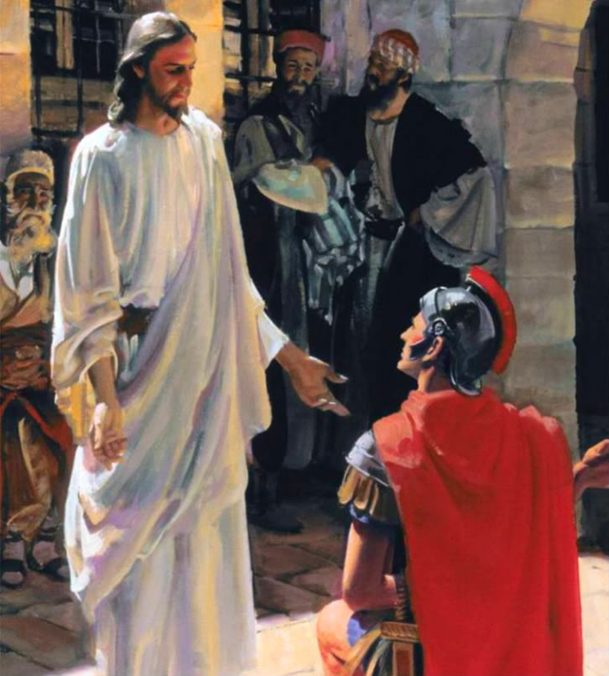
The Compassion of Jesus Christ
Jesus heals the centurion’s servant
A centurion was a Roman army officer in command of a company of 50 to 100 men.
Jews generally disliked centurions because they represented the Romans’ political and military power over the Jews and their land. (1)
Luke 7:1-10

Slide 16
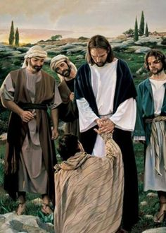
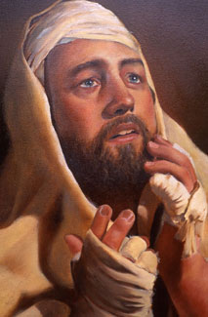
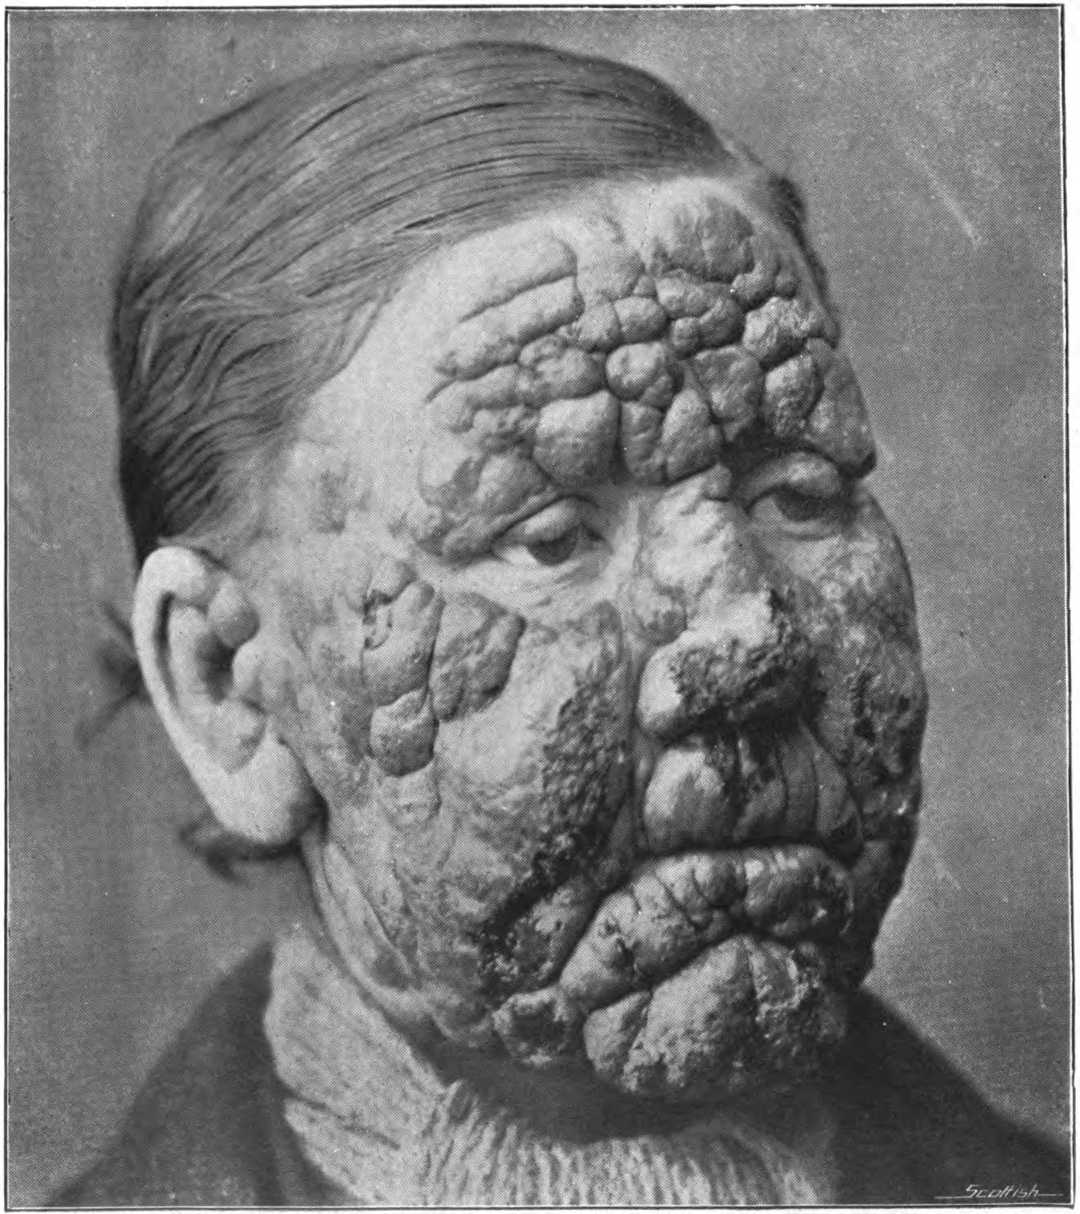
Healing a Leper
Leprosy is a chronic disease that attacks skin, nerves, eyes, bones, and limbs. Left untreated, it leads to a painful death. In ancient times, it was believed that anyone who came in contact with lepers would contract the disease.
Beseeching = begging
It is remarkable that Jesus touched this leper while healing him. (1)
After healing the man, the Savior commanded him to obey the Mosaic commandment that healed lepers present themselves to a priest, offer sacrifice, and undergo a purification ritual.
He also told him to tell no one, but word spread anyway and Jesus had to leave the city.
People still came to Him in the desert.
To protect a community’s health and well-being, lepers were forced to live outside the town. The law required them to call out “Unclean!” to warn anyone approaching them
Kyle Vincent
Mark 1:40-42; Leviticus 13:44–46
(3)

Slide 17
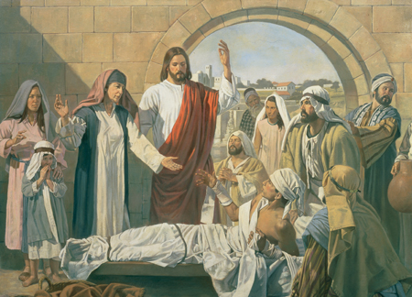
Widow of Nain
Jesus Christ Restored to Life the Son of a Widow of Nain
A bier is a coffin or the stand on which a coffin is placed.)
The young man was “the only son of his mother, and she was a widow”.
The loss of her only son meant that the widow was left without means of temporal support.
Robert T. Barrett
Luke 7:11-18

Slide 18
“Few accounts of the Master’s ministry touch me more than His example of compassion shown to the grieving widow at Nain. …
“What power, what tenderness, what compassion did our Master thus demonstrate! We, too, can bless if we will but follow His noble example. Opportunities are everywhere.
Needed are eyes to see the pitiable plight and ears to hear the silent pleadings of a broken heart.
Yes, and a soul filled with compassion, that we might communicate not only eye to eye or voice to ear but, in the majestic style of the Savior, even heart to heart.”
Luke 7:11-18
(10)

Slide 19
Many miracles happen every day in the work of our Church and in the lives of our members.
Many of you have witnessed miracles, perhaps more than you realize.
(11)

Slide 20
What are some miracles the Savior has performed as part of the Restoration and through the work of His Church?
What miracles have you or your loved ones seen in your lives?
What do these personal miracles reveal about Heavenly Father and Jesus Christ?

Slide 21
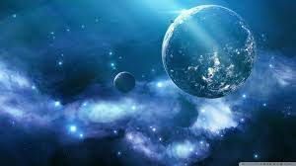
Miracles
The Savior’s miracles reveal the Savior’s great compassion and teach eternal truths about the plan of salvation.
Miracles were “an important element in the work of Jesus Christ, being not only divine acts, but forming also a part of the divine teaching. …
They were intended to be a proof to the Jews that Jesus was the Christ
Each miracle points to something larger than the event itself, and to look for specific truths about God and His work that the miracle affirms.
Mark 5
(5)

Slide 22
Sources:
Joshua J. Mark Ancient History Encyclopedia
Wikipedia
Jewish Virtual Library
Bible Dictionary
New Testament Student Manual Institute Chapter 4
Teachings of Gordon B. Hinckley, 304
President Harold B. Lee (Ensign, July 1973, p. 123.)
Rex C. Reeve, Jr., Studies in Scripture, Vol. 5: The Gospels, ed by Kent P. Jackson and Robert L. Millet, 226.)
President Thomas S. Monson (“Meeting Life’s Challenges,” Ensign, Nov. 1993, 71).
Dallin H. Oaks, “Miracles,” Ensign, June 2001, 6
Presentation by ©http://fashionsbylynda.com/blog/

Slide 23
Ruins of a Capernaum synagogue dating to the fourth or fifth century A.D. Beneath the remains of the white limestone synagogue, the black basalt foundation of an earlier synagogue can be seen. It has been dated to the first century A.D. and is likely the synagogue built by the centurion, as described in Luke 7:5. In this synagogue, the Savior taught (see Mark 1:21; John 6:59), cast evil spirits out of a man (see Mark 1:21–26), and healed a man with a withered hand (see Mark 2:1; 3:1–5).
NT Student Institute Manual Chapter 4
Event | Matthew | Mark | Luke | John
Jesus Heals Peter’s Mother-in-Law and Others | 8:14-17 | 1:29-34 | 4:38-41
Jesus Cleanses a Leper | 8:2-4 | 1:40-45 | 5:12-16
Jesus Heals a Man with Palsy | 9:2-8 | 2:1-12 | 5:17-26
Matthew Follows Jesus | 9:9 | 2:13-14 | 5:27, 28
Jesus Came to Call Sinners to Repentance | 9:10-13 | 2:15-17 | 5:29-32
Jesus is the New law | 9:14-17 | 2:18-22 | 5:33-39
Call and Ordination of the Twelve Apostles | 10:2-4 | 3:13-19 | 6:12-16
Jesus Goes to Capernaum and Heals Centurion’s Servant | 8:1, 5-13 |  | 7:1-10
Jesus Calms the Storm at the Sea | 8:18, 23-27 | 4:35-41 | 8:22-25
Jesus Casts Legion of Devils into Swine | 8:28-34 | 5:1-20 | 8:26-39
Return to Capernaum | 9:1 | 5:21 | 8:40
Jairus Seeks Jesus to Heal His Dying Daughter | 9:18, 19 | 5:22-24 | 8:41, 42
Woman Touches Jesus and is Healed | 9:20-22 | 5:25-34 | 8:43-48
Jairus’ Daughter Raised from Death | 9:23-26 | 5:35-43 | 8:49-56
Two Blind Men are Healed | 9:27-31
Casting Devil Out of Dumb Man | 9:32-34
Miracles of Jesus:
"The miracles performed by Jesus were an important part of his earthly ministry. He used miracles to show compassion, to teach, to inspire, to motivate, and to testify that he was the true Messiah. After his death and resurrection, his disciples continued to perform miracles and to testify that he was the Messiah, the Son of God who had come in power and authority.
The Gospel writers used his miracles to testify that he had power over all enemies. The healing of the leper, the centurion's servant, and Peter's mother-in-law testified that his power extends to persons of all nations, both Jew and Gentile. The calming of the sea extended his power to include power over nature and the elements. Casting out the unclean spirits testified of his power over devils and all evil... For individuals in all generations, accounts of the miracles reveal the power of Jesus over all enemies and testify that he was the Son of God and that he had sufficient power to perform the Atonement and bring immortality and the possibility of eternal life to all men." (Rex C. Reeve, Jr., Studies in Scripture, Vol. 5: The Gospels, ed by Kent P. Jackson and Robert L. Millet, 226.)
Source: Horizontal Harmony of the Four Gospels by Thomas M. Mumford

Slide 24
Matthew 8:1-4 Healing a Leper:
A terrible form of skin disease spoken of in the Bible. Many notables were at some time afflicted with it, including Moses (Ex. 4:6–7), his sister Miriam (Num. 12:10), Naaman (2 Kgs. 5), and King Uzziah (2 Chr. 26:19–21).
In these cases leprosy was given as a sign, a warning, or a punishment. There were apparently several types of leprosy, and the word is used in the Bible to designate other sicknesses or diseases. For example, clothing and walls were said to be leprous when they had patches of mildew or some fungous growth, as in Lev. 13:47–59; 14:33–37. Instances of Jesus curing leprosy are recorded in Matt. 8:2–4; Mark 1:40–45; Luke 5:12–15; 17:11–15. Bible Dictionary
No Jew would dare approach a leper, let alone touch him. Yet, there was One whose perfect love knew no fear-the Holy One could not be contaminated by decaying flesh, and this leper was privileged to feel the touch of the Master's hand. Sister Chieko Okazaki said, "...he 'put forth his hand, and touched him.' Then he said, 'I will; be thou clean' (Matt. 8:1Matt. 8:2Matt. 8:3Matt. 8:1-3). I can't help thinking that the sheer physical fact of a loving touch was as healing to this person, whom no one had willingly touched for years, as the words of compassion and the act of healing must have been." (Disciples, 121 - 122.) gospeldoctrine.com
Tell No Man:
"My thoughts turned backward in time-back to the Holy Land; back to Him who on that special mountain taught His disciples the true spirit of giving when He counseled, 'Take heed that ye do not your alms before men, to be seen of them. . . . When thou doest alms, let not thy left hand know what thy right hand doeth.' (Matthew 6:1, 3.)
"Then, as though to indelibly impress on their souls the practical application of this sacred truth, He came down from the mountain with a great multitude following Him. 'And, behold, there came a leper and worshipped him, saying, Lord, if thou wilt, thou canst make me clean. And Jesus put forth his hand, and touched him, saying, I will; be thou clean. And immediately his leprosy was cleansed. And Jesus saith unto him, See thou tell no man.' (Matthew 8:2-4.)
"The word anonymous had a precious meaning then. It still has." President Thomas S. Monson (Live the Good Life, 28.)
Shew Thyself to a Priest:
In the rare circumstance that leprosy should go into remission, there was provision in the Law of Moses for the individual to be cleansed ceremonially and return to a normal life. The process involved an 8-day cleansing in which the individual offered two birds, the blood of one was taken and sprinkled on the leper. All body hair had to be shaved, the body and clothes cleaned. A week later, the individual could return to the priest. The priest would then offer a sin offering of two lambs or, if poor, one lamb and two birds. Once the atoning blood and ceremonial oil were anointed, the individual was clean (Lev 14). The cleansing process involved water, oil (symbolic of the Spirit) and blood, 'For by the water ye keep the commandment; by the Spirit ye are justified, and by the blood ye are sanctified' (Moses 6:60).
Matthew 8:5-13 Healing a Centurion’s Servant:
A centurion was an officer in the Roman army in command of a company of 50 to 100 men. The Jews generally viewed centurions with contempt, for they symbolized the Roman political and military authority. However, Luke highlighted several admirable qualities of this particular centurion. He was altruistic, centering his request on the needs of his servant, “who was dear unto him” (Luke 7:2). The centurion’s goodness was affirmed by elders of the Jews. He demonstrated genuine humility, deeming himself unworthy to visit Jesus in person or to have Jesus enter his house (see Luke 7:6–7). Another reason the centurion may not have sought a personal visit with Jesus is that observant Jews were forbidden to have close contact with Gentiles, such as eating with them or entering their homes.
The centurion, however, did not allow his feelings of unworthiness to prevent him from seeking the Savior’s help. He exercised tremendous faith in Jesus Christ, believing His word alone was sufficient to heal the servant. The centurion acknowledged Jesus’s divine authority and by using the word also likened it unto the military authority with which he was familiar (see Luke 7:8). The Savior’s response that He had “not found so great faith, no, not in Israel” (Luke 7:9) corresponds with His messianic declaration that He was anointed to bless all who would accept Him (see Luke 4:16–30) and supports Luke’s theme regarding the Lord’s concern for Gentiles.
Matthew 8:14-17 Healing of Peter’s Mother-in-law:
Elder Bruce R. McConkie (1915–85) of the Quorum of the Twelve Apostles used the account of Peter’s mother-in-law being healed by the Savior to teach that “Jesus’ specially selected disciples were married men with wives and children and families of their own, as his specially called servants should be in all ages” Elder Bruce R. McConkie (The Mortal Messiah: From Bethlehem to Calvary, 4 vols. [1979–81], 2:37).

Slide 25
What is the ultimate miracle?
President Dallin H. Oaks of the First Presidency taught:
Some miracles affect many people. The ultimate such miracle is the Atonement of Jesus Christ—His triumph over physical and spiritual death for all mankind. No miracle is more far-reaching or more magnificent.
(Dallin H. Oaks, “Miracles,” Ensign, June 2001, 9)
Do dramatic miracles like those recorded in the scriptures still happen today?
One example of a remarkable modern-day miracle was shared by President Gordon B. Hinckley (1910–2008):
I was asked if I would visit a woman in the hospital whose doctors had told her she was going blind and would lose her sight within a week. She asked if we would administer to her and we did so, and she states that she was miraculously healed. … I said to her, “I didn’t save your sight. Of course, the Lord saved your sight. Thank Him and be grateful to Him.”
(Teachings of Gordon B. Hinckley [1997], 343)
Why don’t people receive every miracle they seek with faith in Jesus Christ?
President Dallin H. Oaks of the First Presidency said:
Miracles are not available for the asking. … The will of the Lord is always paramount. The priesthood of the Lord cannot be used to work a miracle contrary to the will of the Lord. We must also remember that even when a miracle is to occur, it will not occur on our desired schedule. The revelations teach that miraculous experiences occur “in his own time, and in his own way” ( D&C 88:68).
(Dallin H. Oaks, “Miracles,” Ensign, June 2001, 9)
Why would the devils in the account in Mark 5:11–13 desire to enter swine?
The Prophet Joseph Smith (1805–44) explained:
We came to this earth that we might have a body and present it pure before God in the celestial kingdom. The great principle of happiness consists in having a body. The devil has no body, and herein is his punishment. He is pleased when he can obtain the tabernacle of man, and when cast out by the Savior he asked to go into the herd of swine, showing that he would prefer a swine’s body to having none. All beings who have bodies have power over those who have not.
(Teachings of Presidents of the Church: Joseph Smith [2007], 211)
Will more miracles occur before the Savior returns?
President Russell M. Nelson testified:
Our Savior and Redeemer, Jesus Christ, will perform some of His mightiest works between now and when He comes again. We will see miraculous indications that God the Father and His Son, Jesus Christ, preside over this Church in majesty and glory.
(Russell M. Nelson, “Revelation for the Church, Revelation for Our Lives,” Ensign or Liahona, May 2018, 96)

Slide 26
Jesus Heals Man With Palsy
Mark 2:1-12

Slide 27
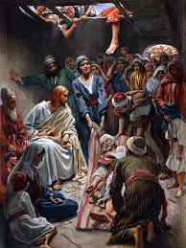
Palsy
In the village of Capernaum in Galilee, there was a man “sick of the palsy” which means he was paralyzed.
Four other men carried this man to the house where Jesus was.
When they found that the house was so crowded that they could not enter it, they disassembled part of the roof of the house and lowered the paralytic man into the Savior’s presence.
Mark 2:1-4

Slide 28
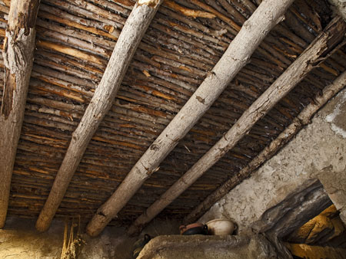
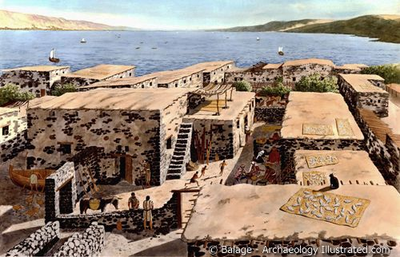
Houses in Capernaum
First-century houses in Capernaum were constructed of stone walls that were topped by a flat roof made from wooden beams, thatch, and packed earth. (1)
Underside of the roof of a reconstructed ancient house in Israel by James Jeffrey
It would not have been difficult to raise the ceiling by the courtyard stairs and to remove a part to allow the bed to be brought down to where Jesus stood. (2)
Mark 2:1-4

Slide 29
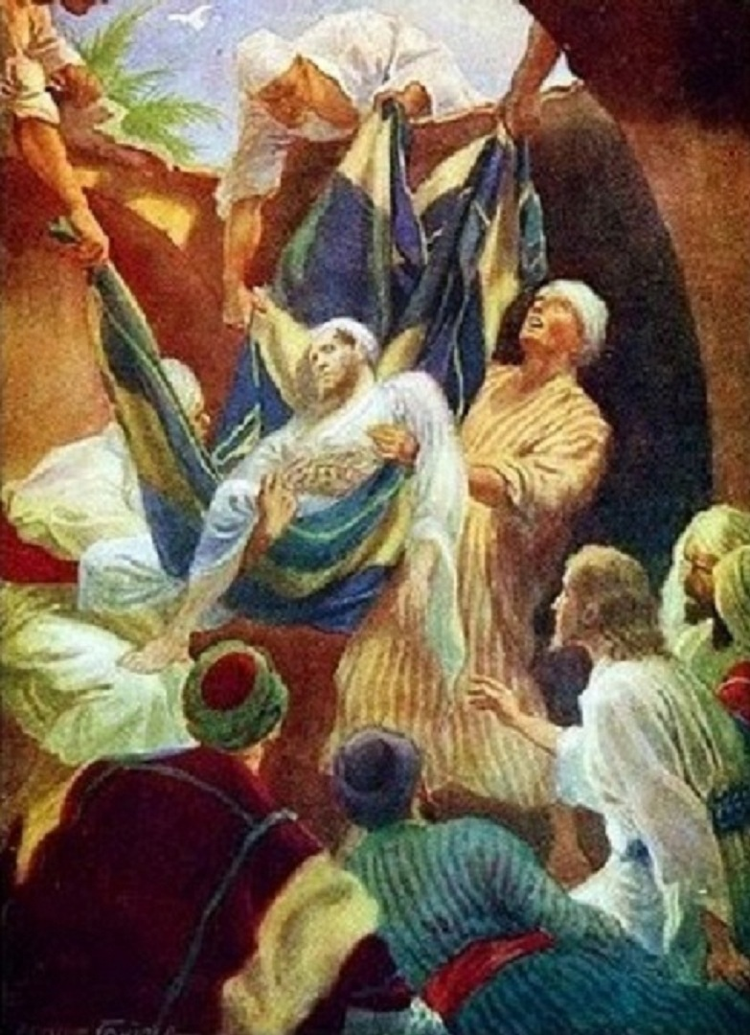
Jesus Saw Their Faith
Faith is the power to see things which are unseen
This was the combined faith of all five, as demonstrated by their unusual persistence and united effort in striving to reach the Savior. (1)
Jesus Christ has the power to heal us spiritually and physically
Mark 2:5

Slide 30
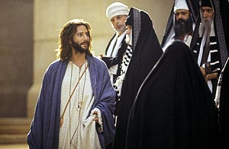
Opposing and Plotting
The Savior healed and forgave the man with palsy, called Matthew to the ministry, ate with sinners, and healed a man with a withered hand on the Sabbath.
The scribes and Pharisees opposed each event, increasing their opposition from skeptical thoughts to plotting to destroy Jesus. (1)
They were angered by His claim to grant forgiveness for sins.
Mark 2:6-7

Slide 31
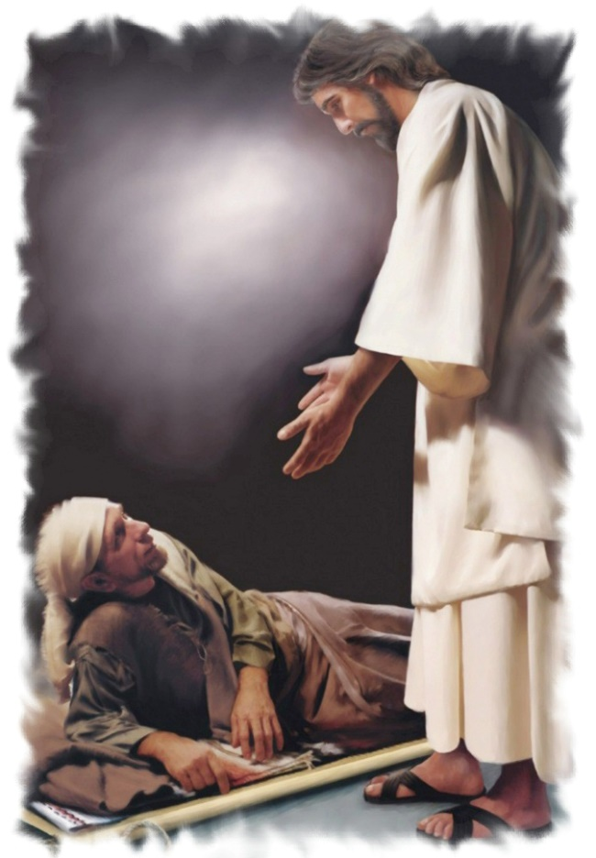
“Take Thy Bed”
"Jesus could have told the palsied man that his sins were forgiven, and no observer would have been able to prove or disprove whether it actually was so.
But when he commanded a sick man to rise and walk, the validity of his power was immediately able to be tested.
Hence in a hostile situation it is easier to say that sins are forgiven. But so that those present would know that he had power to do both, Jesus used the healing of the body as evidence of his power to forgive sins." (3)
And immediately he arose, took up the bed, and went forth before them all; insomuch that they were all amazed, and many glorified God, saying, We never saw the power of God after this manner” JST Mark 2:9
Mark 2:9-12

Slide 32
Sometimes spiritual illness comes as a result of sin or emotional wounds. …
Even the deepest spiritual wounds—yes, even those that may appear to be incurable—can be healed.
My dear friends, the healing power of Jesus Christ is not absent in our day.
The Savior’s healing touch can transform lives in our day just as it did in His. If we will but have faith, He can take our hands, fill our souls with heavenly light and healing, and speak to us the blessed words, “Rise, take up thy bed, and walk”
(11)
John 5:8

Slide 33
Are there any spiritual wounds in your life that need to be healed?
How can you seek the healing power of Jesus Christ?
Do you know someone else who needs the healing power of Jesus Christ?
What could you do to help them access it?

Slide 34
The Rest of Mark 2-3
The Tax Collector
Publicans
Jesus’ Power to Heal
Fasting
New Verses Old
The Sabbath
Good Verses Evil
Herodians
Those Who Followed Jesus
Teaching from the Ship
Sending Forth to Preach
A Strong Man’s House

Slide 35
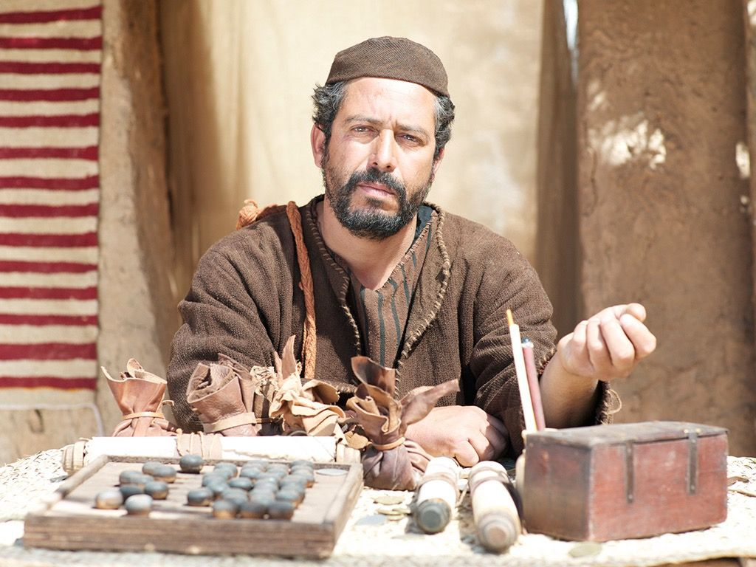
The Tax Collector
"Publicans are tax collectors; they represent Rome and are a symbol of the tyranny and oppression of the Gentile yoke. Partiality, avarice, greed, exacting more than is lawful, and petty oppression are deemed, in the public mind, to be a way of life with them. 'The rabbis ranked them as cutthroats and robbers, as social outcasts, as religiously half-excommunicated.'
It is assumed their wealth comes from rapine and their business is the business of extortioners.
"It is to this class of people that Matthew belongs. Manifestly the claims made against them are exaggerated and do not apply to all individual tax collectors."
Mark 2:13-32
(4)

Slide 36
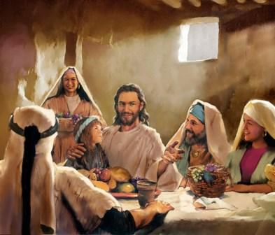
Eating and Drinking with Publicans
In the ancient Near East, sharing a meal with others meant much more than simply eating and drinking together. It was a sign of fellowship; it indicated that a bond of friendship and peace existed or was at least being offered.
The Savior often used the occasion of sharing a meal to extend the invitation to repent and obtain forgiveness.
On a number of these occasions, pious Jews criticized Jesus for dining in fellowship with people they regarded as sinners.
Mark 2:15-17
(1)

Slide 37
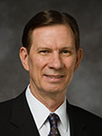
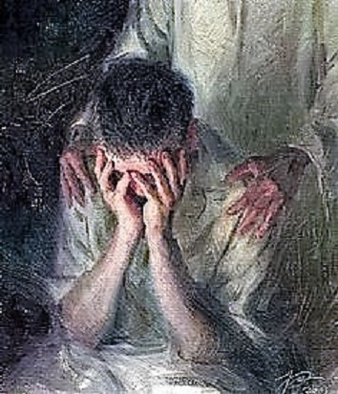
The Physician
The Savior reaffirmed His power to heal both spiritually and physically.
The Lord loves us and wants us to understand His willingness to forgive. …
“… All of us, including those struggling to overcome addictive behaviors such as substance abuse or pornography and those close to them, can know that the Lord will recognize our righteous efforts and will lovingly forgive when repentance is complete” (5)
The Pharisees and the Scribes did not come to Him to be healed
Mark 2:17

Slide 38
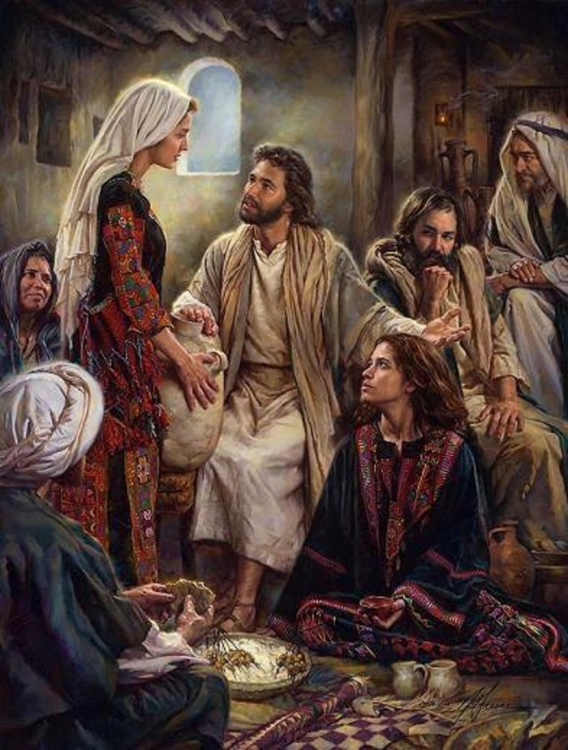
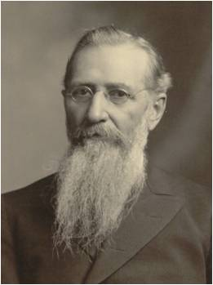
Fasting In the Presence of God?
“As Long as They Have the Bridegroom With Them, They Cannot Fast
Christ's answer teaches us something fundamental about fasting. He indicates that since his disciples were in the presence of God already, they did not need to fast. Fasting, then, is intended to bring us closer to God. The disciples had already come as close as you can get, walking and talking with Jesus Christ.
"As fasting should always be accompanied by prayer, this law would bring the people nearer to God, and divert their minds once a month at least, from the mad rush of worldly affairs and cause them to be brought into immediate contact with practical, pure, and undefiled religion - to visit the fatherless and the widow, and keep themselves unspotted from the sins of the world." (6)
Mark 2:18-20

Slide 39
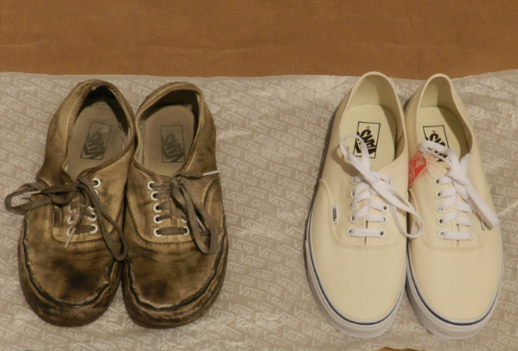
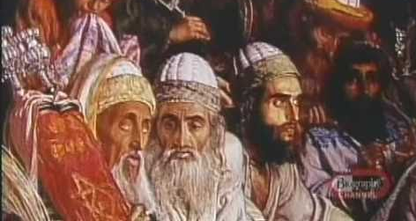
New VS Old
'Then said the Pharisees unto him, Why will ye not receive us with our baptism, seeing we keep the whole law?
But Jesus said unto them, Ye keep not the law, If ye had kept the law, ye would have received me, for I am he who gave the law.
I receive not you with your baptism, because it profiteth you nothing.
For when that which is new is come, the old is ready to be put away.' (JST Matt 9:18-21)
The baptism of the Pharisees and their hypocritical application of the law were not to be mixed with the teachings of the Lawgiver and his baptism by fire. (7)
See JST Matthew 9:18
Mark 2:21-22

Slide 40
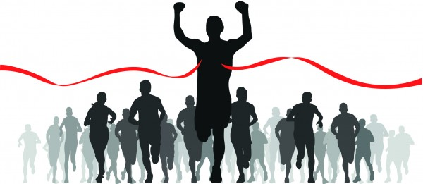
The Sabbath
How do you know whether an activity is appropriate to do on the Sabbath?
Mark 2:23

Slide 41
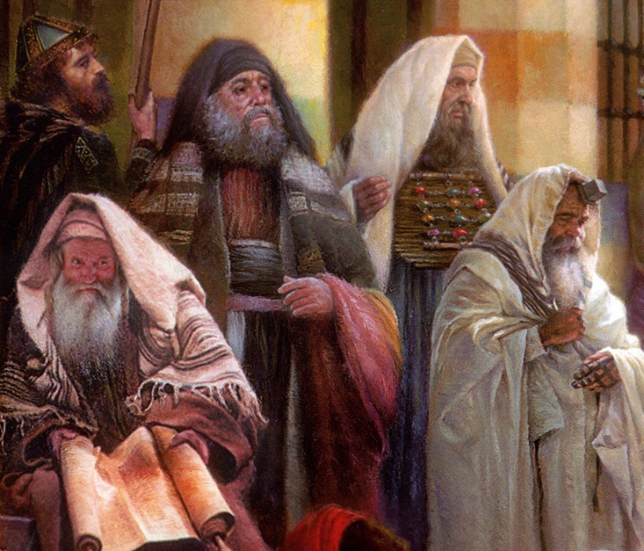
The Sabbath
Many of the objections Jewish leaders brought against the Savior during His mortal ministry concerned what activities were appropriate on the Sabbath day.
In ancient Israel the Sabbath was regarded as something that set Israel apart from all other people.
Other cultures had holy sites, sacrificial laws, and various religious customs, but only Israel had the Sabbath
To safeguard their holy day, Jewish rabbis developed many rules about what activities were or were not permissible on the Sabbath.
Such traditions of the “oral law” were intended to prevent violations of the written law.
By New Testament times, these traditions of forbidding certain activities on the Sabbath day had become points of contention among many Jews.
Mark 2:23
(1)

Slide 42
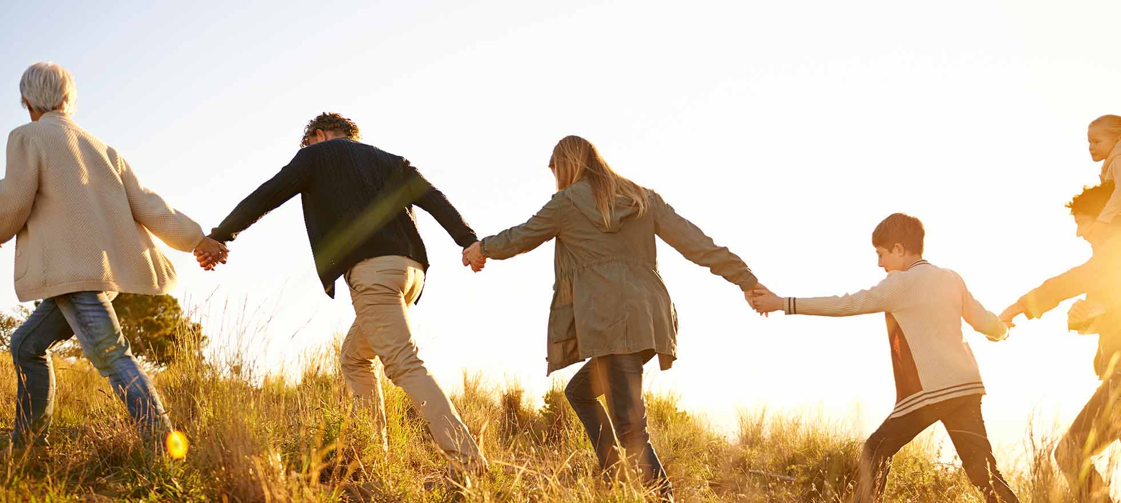
The Sabbath Was Made For Man
“Wherefore the Sabbath was given unto man for a day of rest; and also that man should glorify God, and not that man should not eat; for the Son of man made the Sabbath day, therefore the Son of man is Lord also of the Sabbath”
JST Mark 2:26-27
Mark 2:27-28
(1)

Slide 43
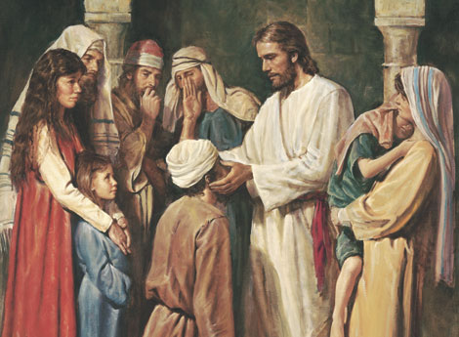
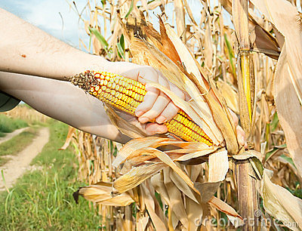
Good Vs Evil
“Is it lawful to do good on the sabbath days, or to do evil? to save life, or to kill?”
What did the Pharisees believe was unlawful for the Savior and His disciples to do on the Sabbath?
Jewish teachers added their own rules and interpretations, called the oral law or tradition, to the law of Moses.
These added rules were intended to prevent violation of God’s law, but they also prevented some people from understanding the true purpose of certain commandments, including the command to keep the Sabbath day holy.
Mark 3:1-6

Slide 44
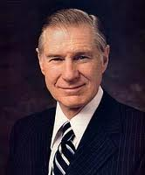
“Where is the line as to what is acceptable and unacceptable on the Sabbath? Within the guidelines, each of us must answer this question for ourselves.
While these guidelines are contained in the scriptures and in the words of the modern prophets, they must also be written in our hearts and governed by our conscience. …
It is quite unlikely that there will be any serious violation of Sabbath worship if we come humbly before the Lord and offer him all our heart, our soul, and our mind.
“What is worthy or unworthy on the Sabbath day will have to be judged by each of us by trying to be honest with the Lord. On the Sabbath day we should do what we have to do and what we ought to do in an attitude of worshipfulness and then limit our other activities.”
Mark 3:2-6
(8)

Slide 45
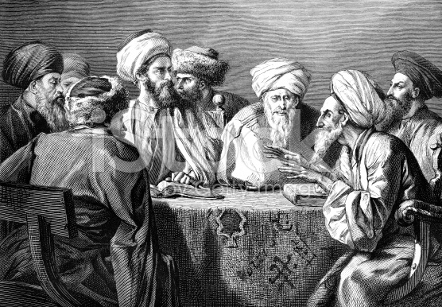
Herodians
The Herodians were a political group with religious objectives. They supported the Herodian family and its leadership—in particular Herod Antipas during Jesus’s ministry.
They appear to have been in league with the Pharisees in opposing the Savior and attempting to entrap Him. To what extent they were influenced by the Pharisees is not known.
Mark 3:6; Matthew 22:15-16

Slide 46
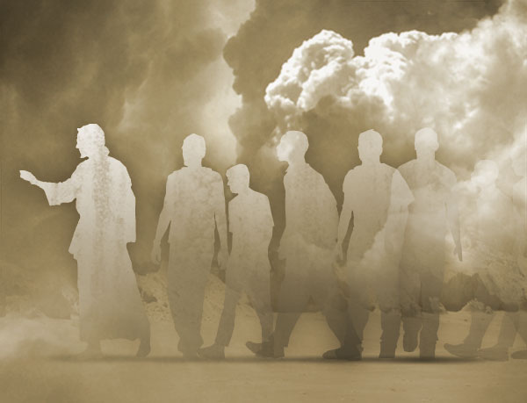
Those Who Followed Jesus
People came from all around Galilee to see Jesus. Some even came from Idumea, a region south of Judea, which was almost 120 miles from Galilee.
They came when they heard of what great things he did.
They didn't come because of the great things he said or because of the great principles he taught, but because he could work mighty miracles.
Least of all, did they come because of who he was. Yet, the marvelous miracles,… were not as important as the timeless doctrines or the significance of who he was-the Great God of Israel, the long-awaited Messiah. (7)
What Would Make You Follow Jesus?
Mark 3:7-8

Slide 47
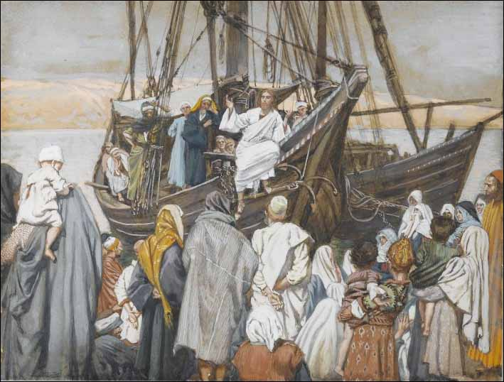
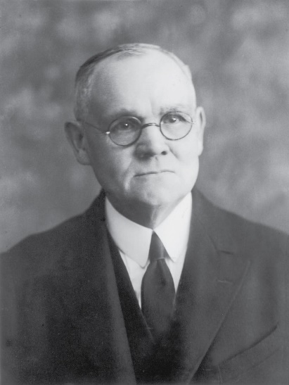
Teaching From a Ship
"One effect of the people's eagerness, which led them to press and crowd around Him, was to render difficult if not impossible at times the effective delivery of any discourse. His usual place for open-air teaching while He tarried in the vicinity of the sea, or lake, of Galilee was the shore; and thither flocked the crowds to hear Him.
James J. Tissot
At His request the disciples had provided a 'small ship,' which was kept in readiness on the beach; and it was usual with Him to sit in the boat a short distance off shore, and preach to the people, as He had done when in the earlier days He called the chosen fishermen to leave their nets and follow Him.“ (9)
Mark 3:9

Slide 48
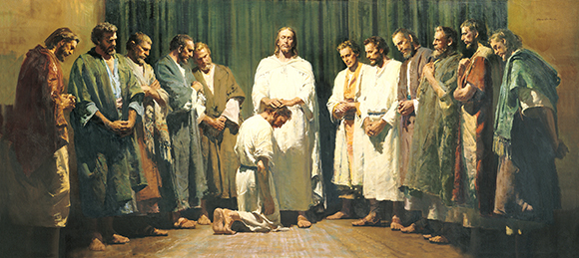
Sending Forth to Preach
And he ordained twelve, that they should be with him, and that he might send them forth to preach,
They had been given power to heal the sick and cast out devils
Mark 3:14-15

Slide 49
A Strong Man’s House
A Strong Man = Satan
Spoil his goods = cast out his servants
First bind a strong man = power and control over Satan
Spoil his house = The Savior had power to enter Satan's dominion and cast out his servants-not because he was a devil but because He was a God. (7)
DELETE
Mark 3:27

Slide 50
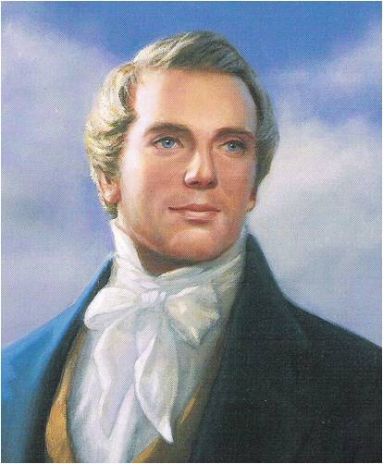
All sin, and all blasphemies, and every transgression, except one, that man can be guilty of, may be forgiven; and there is a salvation for all men, either in this world or the world to come, who have not committed the unpardonable sin, there being a provision either in this world or the world of spirits.
Hence God hath made a provision that every spirit in the eternal world can be ferreted out and saved (at least in the telestial kingdom) unless he has committed that unpardonable sin which cannot be remitted to him either in this world or the world of spirits.
God has wrought out a salvation for all men, unless they have committed a certain sin; and every man who has a friend in the eternal world can save him, unless he has committed the unpardonable sin. And so you can see how far you can be a savior."
READ
DC 76:31-39
Mark 3:28
(10)

Slide 51
Sources:
New Testament Institute Student Manual Chapter 11; New Testament Student Manual [Church Educational System manual, 2014], 153).
Wikipedia
Robert J. Matthews, Behold the Messiah [Salt Lake City: Bookcraft, 1994], 137.
Elder Bruce R. McConkie New Testament Commentary 1:181.
The Mortal Messiah: From Bethlehem to Calvary, 4 vols. [Salt Lake City: Deseret Book Co., 1979-1981], 2: 56
Elder Craig A. Cardon (“The Savior Wants to Forgive,” Ensign or Liahona, May 2013, 16).
Joseph F. Smith (Gospel Doctrine, 5th ed., pp. 237-238.)
Gospeldoctrine.com
President James E. Faust (“The Lord’s Day,” Ensign, Nov. 1991, 35).
James E. Talmage (Jesus the Christ, [Salt Lake City: Deseret Book Co., 1983], 262.)
(Teachings of the Prophet Joseph Smith, selected and arranged by Joseph Fielding Smith [Salt Lake City: Deseret Book Co., 1976], 356-357.)
Dieter F. Uchtdorf, “Bearers of Heavenly Light,” Ensign or Liahona, Nov. 2017, 78

Slide 52
Event | Matthew | Mark | Luke | John
Jesus Heals a Man with Palsy | 9:2-8 | 2:1-12 | 5:17-26
Matthew Follows Jesus | 9:9 | 2:13-14 | 5:27, 28
Jesus Came to Call Sinners to Repentance | 9:10-13 | 2:15-17 | 5:29-32
Jesus is the New law | 9:14-17 | 2:18-22 | 5:33-39
Jesus is Lord of the Sabbath | 12:1-8 | 2:23-28 | 6:1-5
Jesus Heals Man With Withered Hand on the Sabbath | 12:9-14 | 3:1-6 | 6:6-11
Multitudes Throng Jesus | 12:15-21 | 3:7-12
Call and Ordination of the Twelve Apostles | 10:2-4 | 3:13-19 | 6:12-16
Jesus Accused of Working with Beelzebub | 12:22-30 | 3:19-27
No Forgiveness for Blasphemy Against Holy Ghost | 12:31-37 | 3:28-20
Jesus’ Mother and Brother Seek Him | 12:46-50 | 3:31-35 | 8:19-21
Jesus’ Followers: Mark 3:7-8:
"The multitudes flocked to him in Palestine, not for the spiritual truths he proclaimed, nor to follow the pattern of life he declared and led. They cared little for either of these. They came to him because he healed their sick, made whole their crippled, cast out from them their evil spirits." J. Reuben Clark (Behold the Lamb of God [Salt Lake City: Deseret Book Co., 1991], 299.)

Slide 53
Capernaum: was a fishing village established during the time of the Hasmoneans, located on the northern shore of the Sea of Galilee. It had a population of about 1,500. Archaeological excavations have revealed two ancient synagogues built one over the other. A house turned into a church by the Byzantines is said to be the home of Saint Peter. The village was inhabited continuously from the 2nd century BCE to the 11th century CE, when it was abandoned sometime before the Crusader conquest.
Kfar Nahum, the original name of the small town, means "Nahum's village" in Hebrew, but apparently there is no connection with the prophet named Nahum.
The town is cited in all four gospels (where it was reported to have been near the hometown of the apostles Simon Peter, Andrew, James, and John, as well as the tax collector Matthew.
Given the coarse construction of the walls, there was no second story to a typical home, and the roof would have been constructed of light wooden beams and thatch mixed with mud. This, along with the discovery of the stairs to the roof, recalls the biblical story of the Healing of the Paralytic: "And when they could not come nigh unto him for the press, they uncovered the roof where he was: and when they had broken it up, let down the bed wherein the sick of the palsy lay." (Mark 2:4) With the type of construction seen in Capernaum, it would not have been difficult to raise the ceiling by the courtyard stairs and to remove a part to allow the bed to be brought down to where Jesus stood.
Wikipedia
Tax Collector Mark 2:14:
A tax collector or a taxman is a person who collects unpaid taxes from other people or corporations. Tax collectors are often portrayed in fiction as being evil, and in the modern world share a similar stereotype to that of lawyers.
Tax collectors, also known as publicans, are mentioned many times in the Bible (mainly in the New Testament). They were reviled by the Jews of Jesus' day because of their perceived greed and collaboration with the Roman occupiers. Tax collectors amassed personal wealth by demanding tax payments in excess of what Rome levied and keeping the difference. They worked for tax farmers. In the Gospel of Luke, Jesus sympathizes with the tax collector Zacchaeus, causing outrage from the crowds that Jesus would rather be the guest of a sinner than of a more respectable or "righteous" person. Saint Matthew in the New Testament was a tax collector. Wikipedia
The Sabbath Mark 2:26-27
“The Mosaic injunctions of Sabbath day observance contained many detailed do’s and don’ts. This may have been necessary to teach obedience to those who had been in captivity and had long been denied individual freedom of choice. Thereafter, these Mosaic instructions were carried to many unwarranted extremes which the Savior condemned. In that day the technicalities of Sabbath day observance outweighed the ‘weightier matters of the law’ (Matt. 23:23) such as faith, charity, and the gifts of the Spirit.
“In our time God has recognized our intelligence by not requiring endless restrictions. Perhaps this was done with a hope that we would catch more of the spirit of Sabbath worship rather than the letter thereof. In our day, however, this pendulum of Sabbath day desecration has swung very far indeed. We stand in jeopardy of losing great blessings promised. After all, it is a test by which the Lord seeks to ‘prove you in all things’ (D&C 98:14) to see if your devotion is complete.
“Where is the line as to what is acceptable and unacceptable on the Sabbath? Within the guidelines, each of us must answer this question for ourselves. While these guidelines are contained in the scriptures and in the words of the modern prophets, they must also be written in our hearts and governed by our conscience. … It is quite unlikely that there will be any serious violation of Sabbath worship if we come humbly before the Lord and offer him all our heart, our soul, and our mind. (See Matt. 22:37)
“What is worthy or unworthy on the Sabbath day will have to be judged by each of us by trying to be honest with the Lord. On the Sabbath day we should do what we have to do and what we ought to do in an attitude of worshipfulness and then limit our other activities. I wish to testify unequivocally concerning the blessings of Sabbath day worship” President James E. Faust (“The Lord’s Day,” Ensign, Nov. 1991, 35).
Who Can Forgive Others: Mark 2:7
“This event in the life of our Lord was visible and irrefutable proof that he was the Messiah; and it was so recognized by those among whom he ministered. He had borne frequent verbal testimony that God was his Father and had supported that personal witness with an unparalleled ministry of preaching and healing. Now it was his purpose to announce that he had done what no one but God could do and to prove that he had done it by a further manifestation of his Father’s power.
“Both Jesus and the ‘doctors of the law’ who were then present knew that none but God can forgive sins. Accordingly, as a pointed and dramatic witness that the power of God was resident in him, Jesus took (perhaps sought) this appropriate occasion to forgive sins. Being then called in question by the scripturalists who knew (and that rightly) that the false assumption of the power to forgive sins was blasphemy, Jesus did what no imposter could have done—he proved his divine power by healing the forgiven man. To his query, ‘Does it require more power to forgive sins than to make the sick rise up and walk?’ there could be only one answer! They are as one; he that can do the one, can do the other” Elder Bruce R. McConkie (Doctrinal New Testament Commentary, 3 vols. [1965–73], 1:177–78).

Slide 54
The 12 Apostles Are Ordained
Simon | Given a special name by Jesus: Cephas (Syriac) or Petros (Greek) which means "stone or rock." He is Andrew's brother.
James | James is the Greek form of the Hebrew Jacob. The Hebrew James means "supplanter." He is John's brother.
John | The name means "Jehovah's Gift," from the Hebrew Johanan. He is James' brother.
Andrew | The name means "manly." He is Simon Peter's brother.
Philip | The name comes from the Greek and means "lover of horses."
Bartholomew (Nathanael) | The name means "gift of God," and is from the Hebrew.
Thomas | He is also called Didymus, from the Greek, meaning "twin." See John 11:16; 20:24.
Matthew | He was also called Levi, a Hebrew word meaning "gift of Jehovah." Also called the Publican. He is James the Less' brother.
James | Called "the less" to distinguish him from James, son of Zebedee. He is Matthew's brother.
Thaddeus (Judas, not Iscariot) | Thaddeus is the Hebrew root for "heart." He is also called Lebbaeus which is Arabic for "root."
Simon | Called "the Canaanite" (Matthew 10:4) and "the Zealot" (Lu. 6:15). The Hebrew word for zealots wasKananim. This would explain the title "Canaanite."
Judas | Called Iscariot, probably because he was from the village of Kerioth (Joshua 15:24).
Adapted from Institute Manual, The Life and Teachings of Jesus & his Apostles, 2nd ed., p. 55

Slide 55
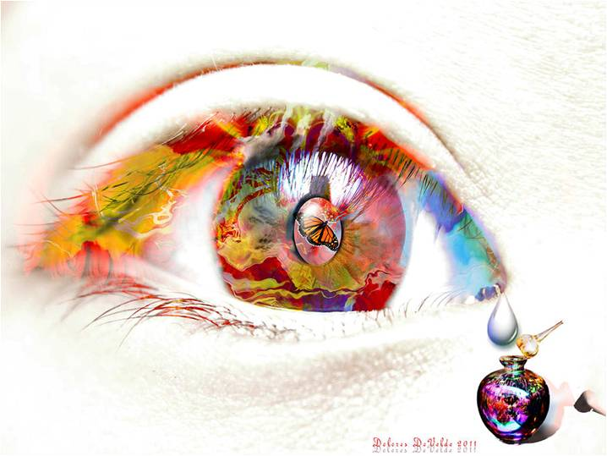
“…Go in Peace.”
“…And never, until I did cry out unto the Lord Jesus Christ for mercy, did I receive a remission of my sins. But behold, I did cry unto him and I did find peace to my soul.”
Alma 38:8
Luke 7:36-50

Slide 56
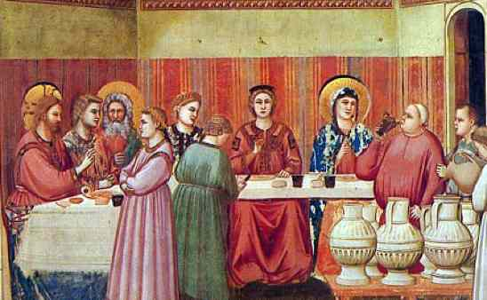
Jesus is invited to Simon the Pharisees’ house to eat
Luke 7:36

Slide 57
As a distinguished guest the host would be:
Received with a welcome “kiss”
Provided water for washing dusty feet
Provided with oil for anointing the hair of the head and the beard
All of these courteous attentions were omitted by Simon
(3)

Slide 58
Because of the layout of the homes, it was common for people who were not invited to walk in during the supper.

Slide 59
The custom was to lay on their side to eat

Slide 60
A woman, who was a sinner, knew Jesus was at Simon’s
Luke 7:37

Slide 61
She brought an alabaster box of Ointment
Luke 7:37

Slide 62
She stood at his feet and began to wash them
Luke 7:38
With her tears…
Luke 7:38

Slide 63
Her tears were collected and save….
They were tears of repentance

Slide 64
Tears in the
Old Testament
“Thou tellest my wanderings: put thou my tears into a bottle; are they not in thy book?”
Psalms 56:8
King David during a time of distress…

Slide 65
Tear Bottles in the East were made of skin…but any bottles were used to collect tears
“ lachrymatory"

Slide 66
These “lachrymatory” bottles have been found in ancient tombs but the bottles only have dust in them.

Slide 67
“Tears were collected as a custom during times of calamity and sorrow, and preserved in small bottles.”

Slide 68
The Romans had a custom, that in a time of mourning, such as a funeral, a friend went to one in sorrow, and wiped away the tears from the eyes with a piece of cloth, and squeezed the tears into a small bottle of glass or earth made and preserved, as a memorial of friendship and sorrow.

Slide 69
Sometimes women were even paid to cry into these vessels, as they walked along the mourning procession.
Those crying the loudest and producing the most tears received the most compensation, or so the legend goes.

Slide 70
Tear bottles reappeared during the Victorian period of the 19th century, when those mourning the loss of loved ones would collect their tears in bottles with special stoppers that allowed the tears to evaporate. When the tears had evaporated, the mourning period would end.

Slide 71
In some American Civil war stories were said to have cried into tear bottles and saved them until their husbands returned from battle. Their collected tears would show the men how much they were adored and missed.

Slide 72
“There is a sacredness in tears. They are not a mark of weakness, but of power.
They speak more eloquently than ten thousand tongues.
They are the messengers of overwhelming grief, of deep contrition and of unspeakable love." - WASHINGTON IRVING

Slide 73
“…did wipe them with the hairs of her head, and kissed his feet, and anointed them with the ointment.”
Luke 7:38

Slide 74
Simon questions Jesus’ letting “a sinner” touch him and Jesus replies with the parable of the two debtors.
Luke 7:39-43

Slide 75
This woman had done what Simon should have done…
Luke 7:44-46

Slide 76
Jesus forgave her sins
Luke 7:48
Go in Peace
Luke 7:50

Slide 77
The woman is not offering her love hoping to receive forgiveness. Rather, she has already received forgiveness.

Slide 78
“It happened when she believed and was baptized in his name; it happened when she repented with full purpose of heart…
She was now free from the from the crushing burden of her many offenses; who now walked into newness of life because of him whose feet she now kissed.”
(2)

Slide 79
You keep track of all my sorrows.
You have collected all my tears in your bottle.
You have recorded each one in your book.

Slide 80
“…And never, until I did cry out unto the Lord Jesus Christ for mercy, did I receive a remission of my sins. But behold, I did cry unto him and I did find peace to my soul.” Alma 38:8

Slide 81
Sources:
New Testament Student Manual [Church Educational System manual, 2014], 153).
Elder Bruce R. McConkie The Mortal Messiah pp. 200-201
James E. Talmage Jesus the Christ p. 261

Slide 82
Event | Matthew | Mark | Luke | John
Jesus Goes to Capernaum and Heals Centurion’s Servant | 8:1, 5-13 |  | 7:1-10
Jesus Raises a Widow’s Son from the Dead |  |  | 7:11-17
John the Baptist Sends Messenger to Jesus | 11:2-6 |  | 7:18-23
Jesus Testifies of John’s Greatness | 11:7-19 |  | 7:24-35
Woman Anoints Jesus’ Feet with Oil |  |  | 7:36-50
Ruins of Capernaum Synagogue dating to the fourth or fifth century A.D. Beneath the remains of the white limestone synagogue, the black basalt foundation of an earlier synagogue can be seen. It has been dated to the first century A.D. and is likely the synagogue built by the centurion.
In this synagogue, the Savior taught (see Mark 1:21; John 6:59), cast evil spirits out of a man (see Mark 1:21–26), and healed a man with a withered hand (see Mark 2:1; 3:1–5). New Testament Institute Student Manual Chapter 16

Slide 83
Peace Be Still
Mark 4

Slide 84
Parable of the Sower
God must be the primary force behind our harvest
This parable of the seed growing by itself, found only in the Gospel of Mark, teaches about the partnership between God and man. The man plants seeds in an environment where growth can occur, but then he must wait for that growth to happen
As time passes, the earth that God created gradually brings “forth fruit of herself”
Only God can make things grow. This principle applies to spiritual growth in individuals and to the growth of the Church throughout the world. (1)
I have planted, Apollos watered; but God gave the increase.
So then neither is he that planteth any thing, neither he that watereth; but God that giveth the increase.
1 Corinthians 3:6-7
Mark 4:26-29

Slide 85
The Sea of Galilee is 700 feet below sea level and is surrounded on three sides by mountains. At times, cool, dry winds rush down the mountains and collide with warm, moist air over the Sea of Galilee, creating sudden, intense storms—sometimes in a matter of minutes—with large waves on this relatively small body of water.

Slide 86
Why Are Challenges Like A Storm?
Physical
Spiritual
Mental
Social

Slide 87
In times of peril He is aroused by the pleas of His servants
He delivers those who have faith in His name
He rebukes the winds and the waters
Faithful passengers never drown
Christ sails His own ship
He may seem to be asleep , but He is there.
“Peace
Be Still”
He speaks peace to troubled souls
Mark 4:35-41

Slide 88
Why Are Ye So Fearful?
As we seek the Savior’s help during the storms of life, He can bring us peace and calm.
Mark 4:40

Slide 89
There is a mortal tendency, even a temptation, when we find ourselves in the middle of trials, troubles, or afflictions to cry out, “Master, carest thou not that I perish? Save me.” …
I can imagine that Jesus’s disciples in the storm-tossed boat were, of necessity, busy watching the waves crash onto their deck and bailing out the water. I can picture them handling the sails and trying to maintain some semblance of control over their little craft. Their focus was on surviving the moment, and their plea for help was urgently sincere.
Many of us are no different in our day. … In times of turmoil our faith can feel stretched to the limits of our endurance and understanding. Waves of fear can distract us, causing us to forget God’s goodness, thus leaving our perspective short-sighted and out of focus. Yet it is in these rough stretches of our journey that our faith can be not only tried but fortified.
(Lisa L. Harkness, “Peace, Be Still,” Ensign or Liahona, Nov. 2020, 81)

Slide 90
Parable of the Sower Mark 4:26-29: Compare Matthew 13:1-23
“An important lesson of this parable is for those of us who are teachers, whether in the home or Church classroom, or who are involved in missionary work. The germination and full flowering of living gospel seeds in the hearts and minds of those we teach depend on factors over which we may have little control. The choice of whether a person will ponder and accept the truths of the gospel belongs, as a matter of personal agency, with those we teach. If a person’s testimony is to grow until it bears mature fruit, or conversion, God must be the primary force behind our harvest. Under the influence of the Holy Spirit, we may participate in the education of those who are growing and becoming fruitful. We, as authorized sowers, need to understand and trust that the restored gospel of Jesus Christ is a living seed and that if we will teach it, the grace of God will attend those we teach, as they grow to spiritual maturity and bring forth good works. Our joy will then be full in the day of the harvest.” Elder Wilfredo R. López (“The Parable of the Seed Growing Secretly,” Ensign, Feb. 2003, 58).
Storms in our lives Mark 4:35-41:
“All of us have seen some sudden storms in our lives. A few of them, though temporary like these on the Sea of Galilee, can be violent and frightening and potentially destructive. As individuals, as families, as communities, as nations, even as a church, we have had sudden squalls arise which have made us ask one way or another, ‘Master, carest thou not that we perish?’ And one way or another we always hear in the stillness after the storm, ‘Why are ye so fearful? how is it that ye have no faith?’
“None of us would like to think we have no faith, but I suppose the Lord’s gentle rebuke here is largely deserved. This great Jehovah, in whom we say we trust and whose name we have taken upon us, is he who said, ‘Let there be a firmament in the midst of the waters, and let it divide the waters from the waters.’ (Gen. 1:6.) And he is also the one who said, ‘Let the waters under the heaven be gathered together unto one place, and let the dry land appear.’ (Gen. 1:9.) Furthermore, it was he who parted the Red Sea, allowing the Israelites to pass through on dry ground. (See Ex. 14:21–22.) Certainly it should be no surprise that he could command a few elements acting up on the Sea of Galilee. And our faith should remind us that he can calm the troubled waters of our lives. …
“But Jesus was not spared grief and pain and anguish and buffeting. … His ship was tossed most of his life, and, at least to mortal eyes, it crashed fatally on the rocky coast of Calvary. We are asked not to look on life with mortal eyes; with spiritual vision we know something quite different was happening upon the cross.
“Peace was on the lips and in the heart of the Savior no matter how fiercely the tempest was raging. May it so be with us—in our own hearts, in our own homes, in our nations of the world, and even in the buffetings faced from time to time by the Church. We should not expect to get through life individually or collectively without some opposition.” President Howard W. Hunter (“Master, the Tempest Is Raging,” Ensign, Nov. 1984, 33, 35).
Sources for Mark 4:
New Testament Institute Manual
Lisa L. Harkness, “Peace, Be Still,” Ensign or Liahona, Nov. 2020, 81

