Slide 1
John 7-10

Slide 2
Divinity of Christ
John 7
Feast of the Tabernacles

Slide 3
The Law
Three times a year all the males of the covenant people were to appear before the Lord in the place that he should choose:
The Feast of Unleavened Bread—Passover
The Feast of Harvest--The Feast of Weeks or Pentecost
The Feast of Ingathering--The Feast of Tabernacles
(Ex 23:14-17; Deut. 16:16)
(1)

Slide 4
John 7-8 takes place in the autumn of the third year of the Lord’s ministry.
In New Testament times, the Feast of Tabernacles was considered “the greatest and most joyful” of the feasts.
Celebrated in the modern months of September and October.
The ceremonial 7 day feast was of thanksgiving and praise, followed by a holy convocation on the 8th day.
(1,2)

Slide 5
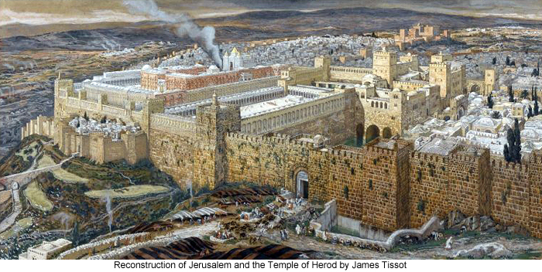
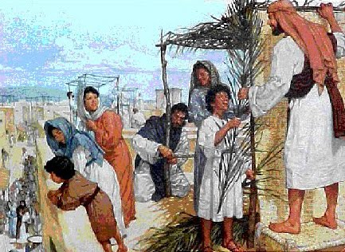
Jesus was planning to attend the Feast of the Tabernacles in Jerusalem.
James Tissot
John 7:2

Slide 6
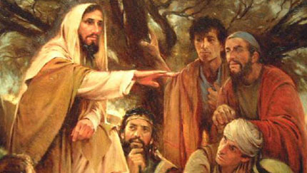
Some of His brethren (kinsmen) felt the feast would be a good opportunity for Jesus to make a public declaration of His divine mission.
John 7:4

Slide 7
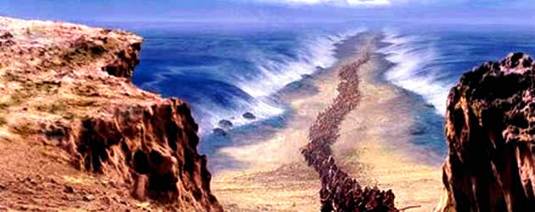
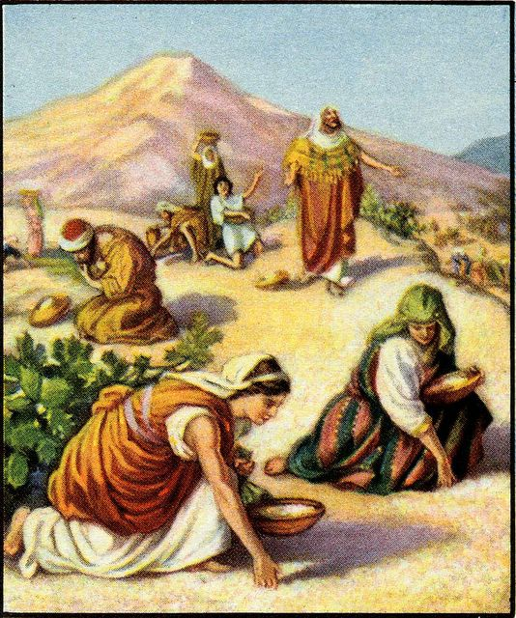
What was the Feast of Tabernacles about?
A remembrance of Exodus out of Egypt,
and the time spent in the wilderness.
And the “gathering-in” of all the fruits of the year.
Lev. 23:43; Ex. 23:16

Slide 8
During the feast they live in tents
Building small booths…walls of plaited branches and thatched roofs made from all earth materials.
“sekhakh”
Leviticus 23:42
(2)

Slide 9
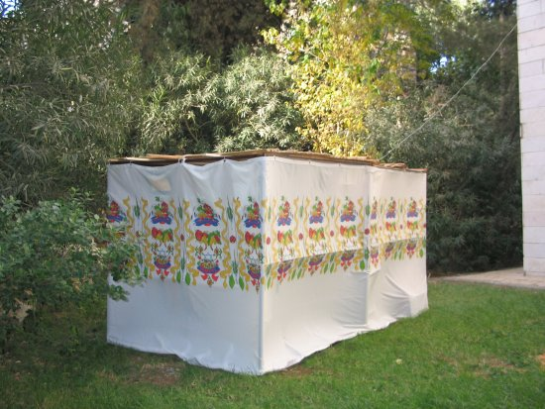
“lulaw”
made of the branches of palm trees, myrtles and willows tied together with a golden thread.
Modern day
“sekhakh”
Or
“Sukkot”
During the celebration in the Temple these lulaw would be waved at certain times during the service.
(2)

Slide 10
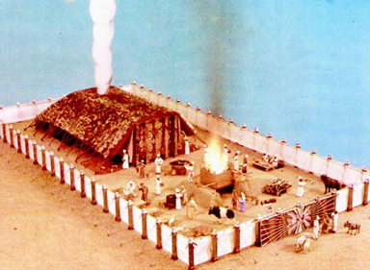
During the 40 years in the wilderness they built a Tabernacle… and worshipped there

Slide 11
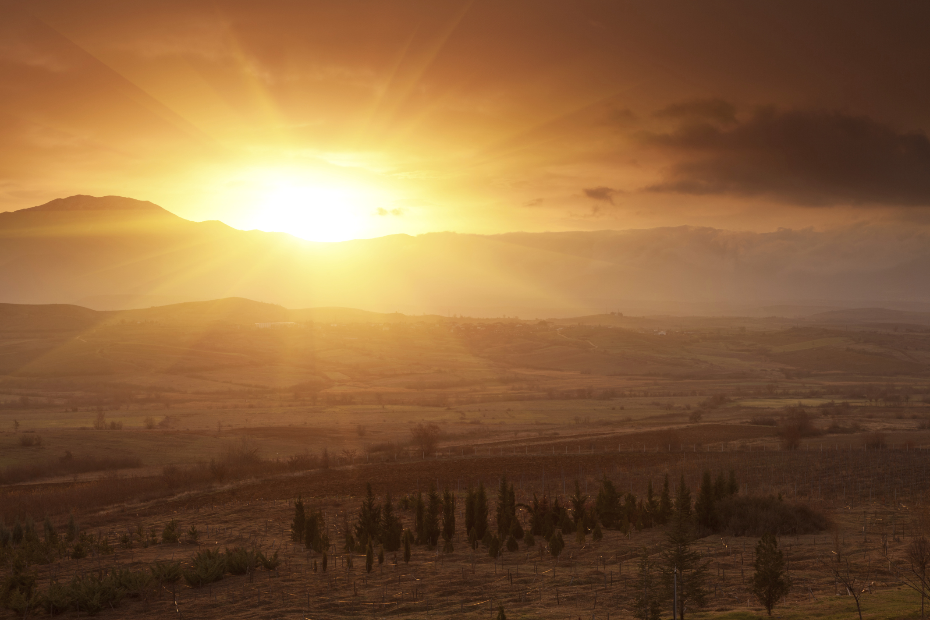
Zechariah in prophetic imagery represents the nations as coming up to Jerusalem to keep the Feast of Tabernacles and described the curse that should fall on those who did not come.
Zechariah 14:16-19
No rain and plagues

Slide 12
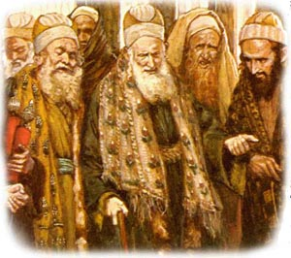
Jewish leaders, not the Jewish public in general.
Jesus had been staying in the Galilee area, where he had experienced great popularity, and avoiding the regions surrounding Jerusalem because they were heavily influenced by Jewish leaders who sought to kill Him.
Galilee
Jerusalem
John 7:1

Slide 13
Did Jesus Have Brothers and Sisters?
Matthew 12:46
While he yet talked to the people, behold, his mother and his brethren stood without, desiring to speak with him.
Is not this the carpenter’s son? is not his mother called Mary? and his brethren, James, and Joses, and Simon, and Judas?
Matthew 13:55
After this he went down to Capernaum, he, and his mother, and his brethren, and his disciples: and they continued there not many days.
John 2:12
These all continued with one accord in prayer and supplication, with the women, and Mary the mother of Jesus, and with his brethren.
Acts 1:14
1 Corinthians 9:5
Have we not power to lead about a sister, a wife, as well as other apostles, and as the brethren of the Lord, and Cephas?

Slide 14
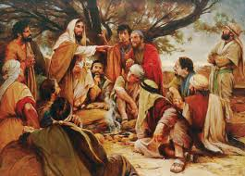
“My time is not yet come”
Jesus rejected the suggestion and delayed His departure for a few days, but he told the brethren to go.
Jesus’s half-brothers urged Him to go to Jerusalem to the Feast of Tabernacles. Jesus told them no, but He later went to the feast secretly and began to teach in the temple
John 7:1-4
(1)

Slide 15
“A testimony of the divinity of Christ and of the saving power of his gospel is not bestowed automatically because of family relationship.
“… Though they were reared in the same household and came under the benign influence of Joseph and Mary, though they were aware of the teachings, ministry, and miracles of Jesus himself, yet these his close relatives had not so far accepted him as the Messiah.
However, all of them, apparently, were converted later.”
John 7:5; Acts 1:14
(3)

Slide 16
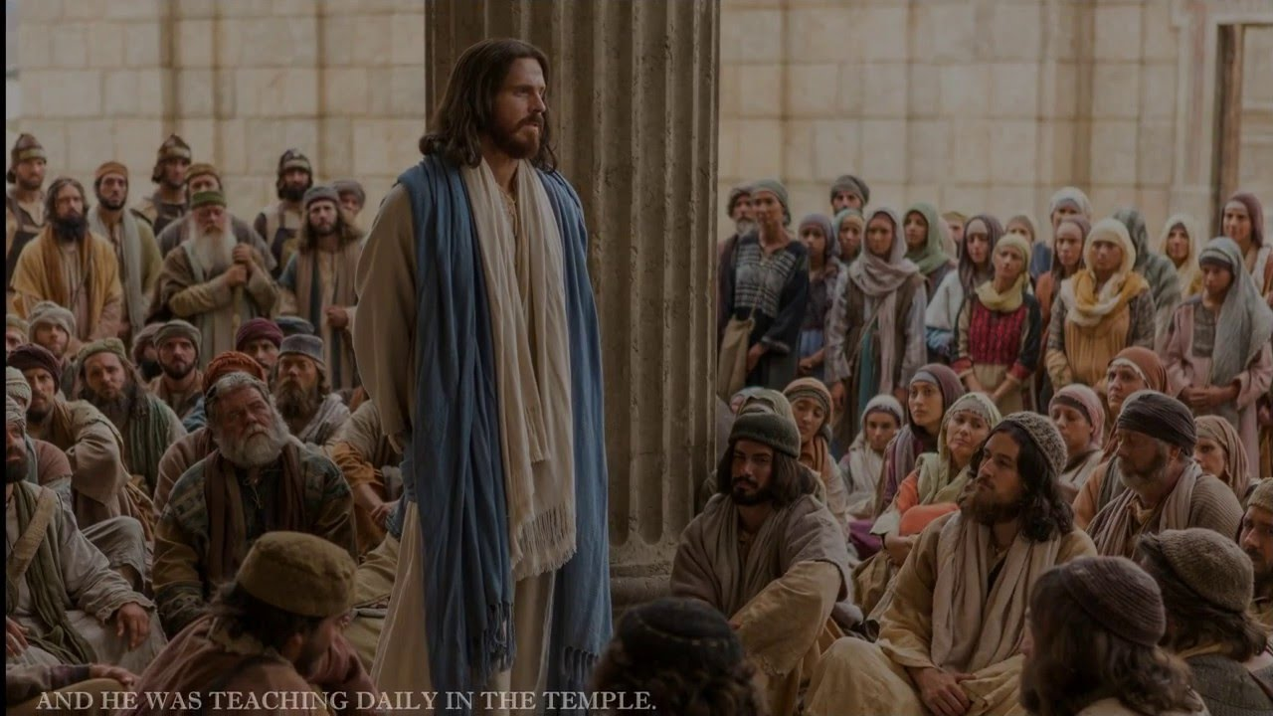
Teaching at the Temple
During the 3rd or 4th day Jesus went to Jerusalem
He honors His Teacher, His Eternal Father and not Himself
He tells them that they do not keep the Law of Moses
He asks why they want
to kill him when he has
done some marvelous
works among them
He asks them to not
be judgmental
John 7:16, 19, 21, 24

Slide 17
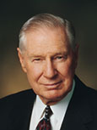
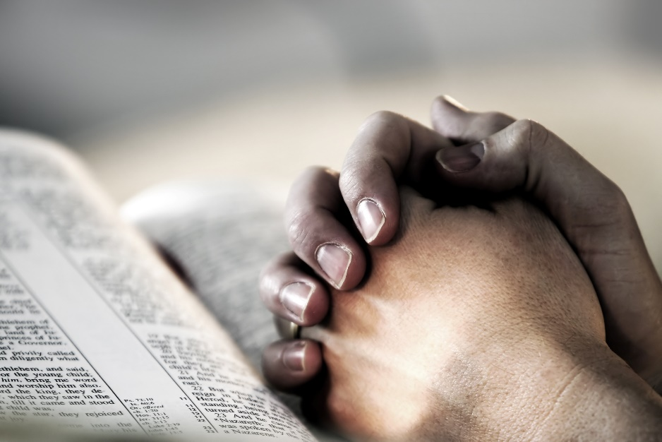
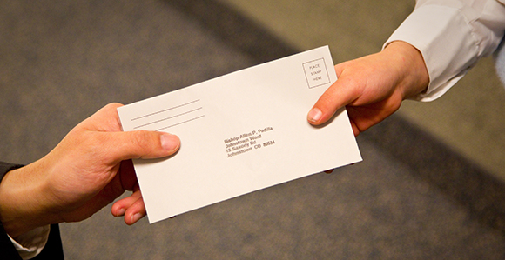
“We acquire a testimony of the principles of the gospel by obediently trying to live them. …
A testimony of the efficacy of prayer comes through humble and sincere prayer.
A testimony of tithing comes by paying tithing.”
(4)

Slide 18
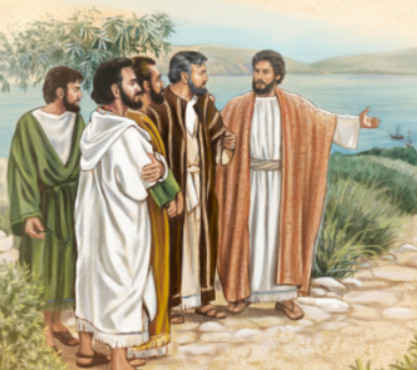
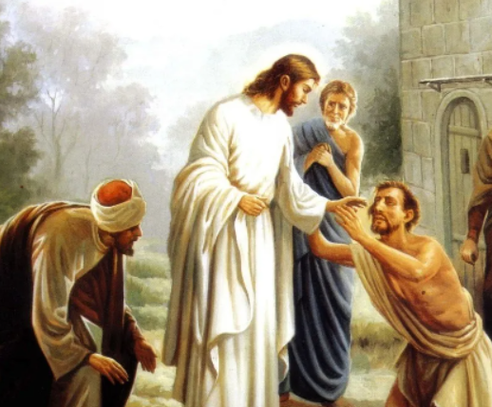
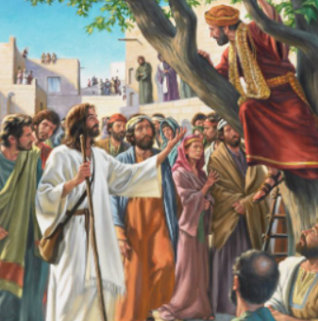
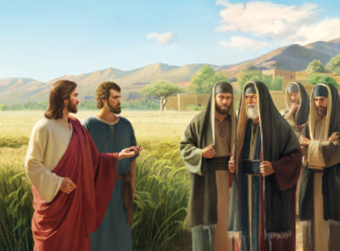
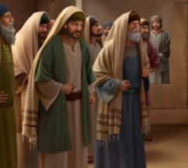
What was it about Jesus that stood out to the officers who were asked to arrest Him?
How did the Pharisees describe anyone who believed in Jesus?
What different ideas did people have about who Jesus was?
Why did some people believe in Jesus?
Why did people discuss where Jesus was from?
John 7:12, 40–41
John 7:31
John 7:41–42, 52
John 7:45–46
John 7:47

Slide 19
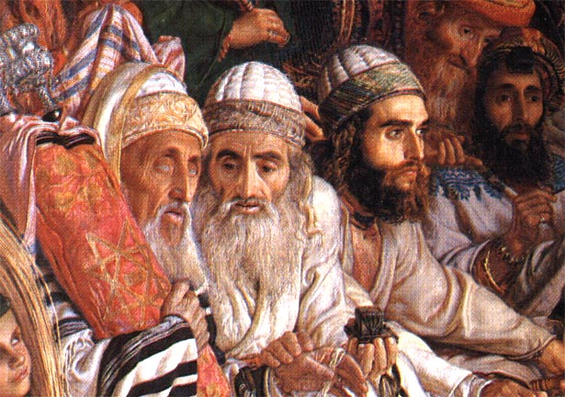
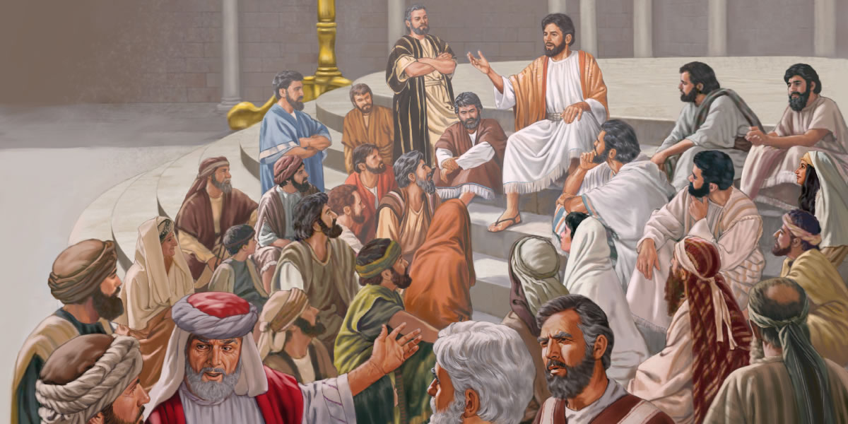
Unbelief
Many Jews refused to listen to Jesus because they believed He was not obeying the Mosaic law, which over the centuries had become corrupted.
They were angry with Him because He had healed a man on the Sabbath day, which was not allowed by the Mosaic law of that time.
At times, we may need to abandon certain traditions in order to keep the laws of God.
“Judge not according to your traditions, but judge righteous judgment”
Some people heard the Savior’s teachings and believed that He was the Messiah.
The Pharisees, knowing that Jesus was helping the Jews to see the truth, sent officers to arrest Him.
Jesus told them that soon they would seek Him but not find Him, for “where I am, thither ye cannot come”
John 7:21-23; 30-34
(1)

Slide 20
Doctrinal Mastery
John 7:17
If any man will do his will, he shall know of the doctrine, whether it be of God, or whether I speak of myself.

Slide 21
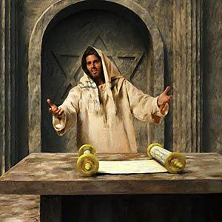
“Then cried Jesus in the temple as he taught, saying, Ye both know me, and ye know whence I am: and I am not come of myself, but He that sent me is true, who ye know not.”
John 7:28

Slide 22
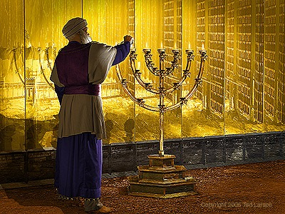
Illumination
On the temple mount, four large golden candelabras (also called menorahs or candlesticks) illuminated the temple grounds during dances and other festivities held late into the night and early morning.
The golden candelabras, which were 50 cubits tall (approximately 73 feet or 22.25 meters), not only provided light for the celebrations, but they symbolized that Israel was to be a light to those who walked in darkness.
The most renowned and anticipated ceremony of the feast was the daily procession, during which an appointed priest drew water from the pool of Siloam with a golden pitcher and poured the water into the silver basin at the base of the temple altar, along with the morning wine offering.
John 7:21-23; 30-34
(1)

Slide 23
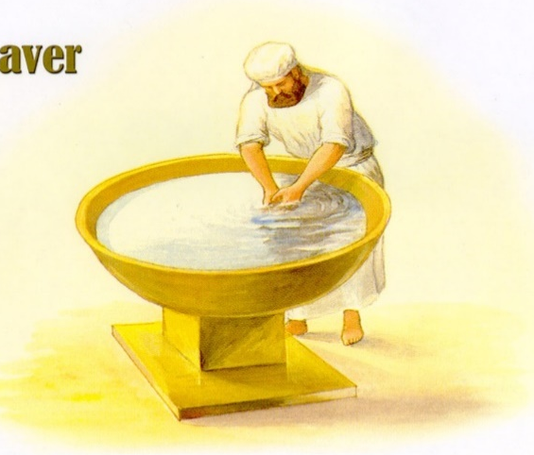
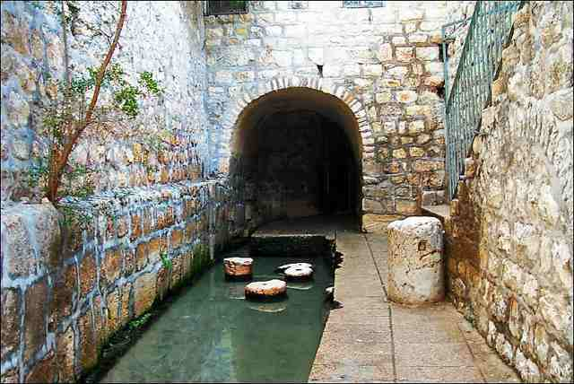
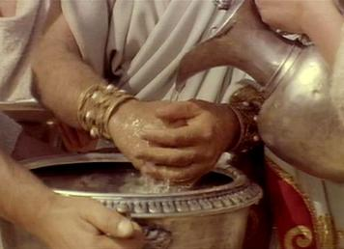
Water and Light
Water and light were used as important symbols during the Feast of Tabernacles, and the Savior used these symbols to call the people to believe in Him as the Messiah.
But this spake he of the Spirit, which they that believe on him should receive: for the Holy Ghost was not yet given; because that Jesus was not yet glorified.
During each of the eight days of the Feast of Tabernacles an appointed priest drew water from the pool of Siloam with a golden pitcher and poured the water into the silver basin at the base of the temple altar.
On the last day of the Feast of Tabernacles, when the priest had done so, Jesus stood and offered an invitation to the people.
John 7:37-39
(1,3)

Slide 24
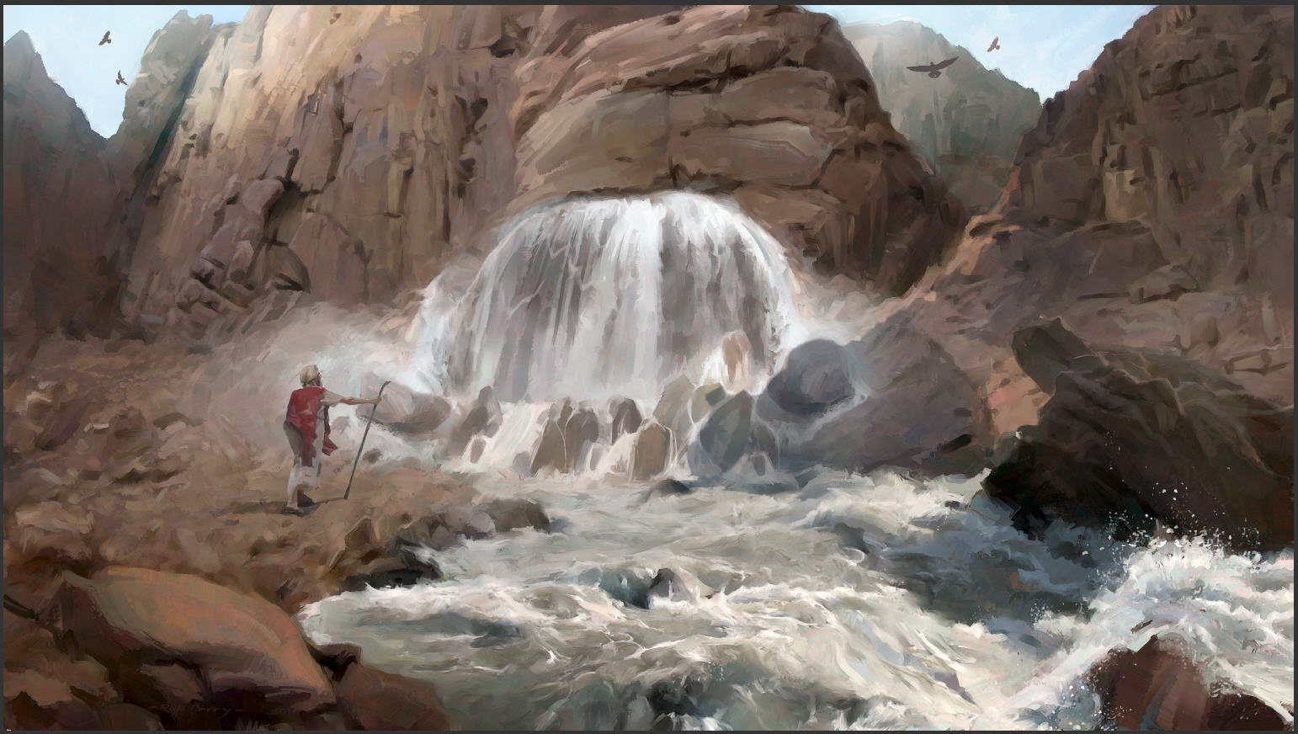
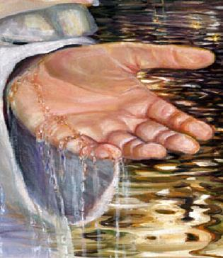
The Living Water = The Holy Ghost
The Savior’s imagery of ‘living water’ drew upon a long Israelite tradition that water represented important spiritual truths.
In the arid climate of the ancient Near East, access to water was crucial for survival, and the scarcity of water made it both a valuable resource and a powerful symbol.
The Lord saved Israel in Horeb when Moses miraculously brought forth water out of a rock
The Old Testament prophets Isaiah, Jeremiah, and Ezekiel used water as a symbol of the Lord’s Spirit, provident care, and healing power.
Exodus 17; Numbers 20; Isaiah 41:17–18; 58:11; Jeremiah 2:13; Ezekiel 47:1–12
(1)

Slide 25
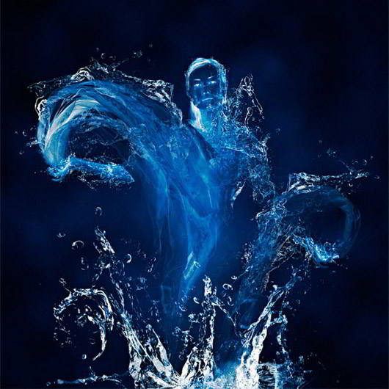
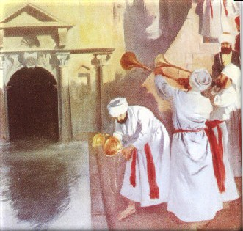
Within the Believer
The Savior taught that when someone believes in Him, “out of his belly shall flow rivers of living water.”
This phrase suggests that the “living water” will be within the believer.
It will not be poured out by a priest on the altar as was done at the Feast of Tabernacles; it will arise and flow miraculously from within the believer.
The Savior’s promise that those who believed in Him would at some future time have “living water” within them reflected the fact that “the Holy Ghost was not yet given”
John 7:38-39
(1)

Slide 26
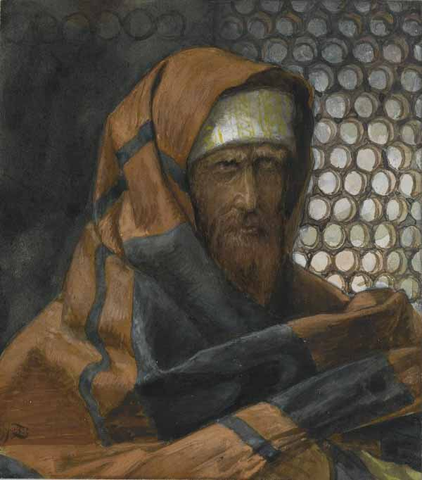
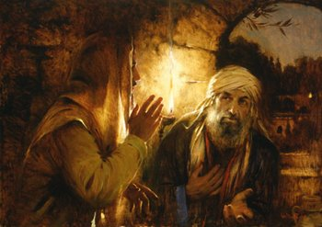
Nicodemus Defends The Savior
The chief priests and Pharisees again desired to have Jesus arrested.
Nicodemus, the Pharisee who had come to the Savior by night, came to the Savior’s defense and reminded his fellow Pharisees and the chief priests that their own law would not allow an individual to be condemned until he was given a chance to be heard.
James Tissot
John 7:50-53; John 3:1-2
(1)

Slide 27
Sources:
New Testament Institute Student Manual Chapter 23
Bible Dictionary
Elder Bruce R. McConkie (Doctrinal New Testament Commentary, 3 vols. [1965–73], 1:437).
President James E. Faust (“Lord, I Believe; Help Thou Mine Unbelief,” Ensign or Liahona, Nov. 2003, 22).
Presentation by ©http://fashionsbylynda.com/blog/

Slide 28
Event | Matthew | Mark | Luke | John
Jews Seek to Kill Jesus |  |  |  | 7:1
Jesus is Urged to Attend the Feast of the Tabernacles |  |  |  | 7:2-9
Jesus Goes to the Feast in Secret |  |  | 9:51-56 | 7:10
Crowds at Feast Discussing Jesus |  |  |  | 7:11-13
Jesus Teaches at the Temple |  |  |  | 7:14-36
Crowds Debate Jesus |  |  |  | 7:37-53
The Brethren of Christ: John 7:4
“Frequent special reference is made to the sons of Joseph and Mary as the ‘brethren’ of Jesus, though in fact they were his half-brothers. (Matt. 12:46; 13:55; John 2:12; Acts 1:14; 1 Cor. 95.) Though they were reared in the same household and came under the benign influence of Joseph and Mary, though they were aware of the teachings, ministry, and miracles of Jesus himself, yet these his close relatives had not so far accepted him as the Messiah. However, all of them, apparently, were converted later (Acts 1:14); one of them, identified by Paul as ‘James the Lord’s brother’ (Gal. 1:19), was to minister in the holy apostleship; and yet another, Judas, who calls himself, ‘Jude, the … brother of James’ (Jude 1), wrote the epistle of Jude” Bruce R. McConkie (Doctrinal New Testament Commentary, 3 vols. [1965–73], 1:437).
Brethren Doubts John 7:4:
"Even a quick reading of the Gospels and Acts shows that the New Testament writers did not intend to give a comprehensive picture of the personal life or family of Jesus...Still, one naturally wonders about Jesus' family, who they were and what they did.
"We do know that Jesus had four brothers and more than one sister. The people of Nazareth objected to the divine calling of Jesus on the grounds that he was someone who had grown up in their midst. 'Is not this the carpenter's son?' they asked in astonishment. 'Is not his mother called Mary? and his brethren, James, and Joses, and Simon, and Judas? And his sisters, are they not all with us?' (Matt. 13:55-56.)...John relates an interesting event concerning the brethren of Jesus telling us that they did not fully accept him as the Messiah while he was laboring among them: 'Now the Jews' feast of tabernacles was at hand. His brethren therefore said unto him [their brother, Jesus], Depart hence, and go into Judaea, that thy disciples also may see the works that thou doest. For there is no man that doeth any thing in secret, and he himself seeketh to be known openly. If thou do these things, shew thyself to the world. For neither did his brethren believe in him.' (John 7:2-5.)
"The brothers knew something of Jesus' work and miracles and of his following, but they were doubtful themselves, or at least wished him to be more open about his mission. They did not believe in him, which may refer to the claims he made about being the Messiah and the Son of God. In fact, when the people of Nazareth rejected the Savior, he exclaimed, 'A prophet is not without honour, but in his own country, and among his own kin, and in his own house.' (Mark 6:4.) But evidently the brothers were converted shortly thereafter, for Luke records that immediately after Christ's ascension into heaven, the church met in 'prayer and supplication, with the women, and Mary the mother of Jesus, and with his brethren.' (Acts 1:14.) Also, Paul includes James in his list of those who had seen the resurrected Lord. (See 1 Cor. 15:7.)" Gerald N. Lund (Jesus Christ, Key to the Plan of Salvation [Salt Lake City: Deseret Book Co., 1991], 47.)
Half-brothers:
Though early on, these half-brothers of the Lord didn't believe, later on some of them would become great leaders in the Church. In particular, James was an apostle who took an important role in the leadership of the early Church. He may have replaced James, the brother of John, after his martyrdom (Acts 12:1-2). James conducted a meeting in which the policy of the Church regarding the law of Moses was determined (Acts 15). He was later known as the Bishop of Jerusalem and has been referred to as "James the Just." Judas, or Jude, was another brother of the Lord. He was probably the author of the book of Jude (See Bible Dictionary).

Slide 29
If Any Man Will Do His Will John 7:17:
“Sometimes we try to do it backward. For example, we may take this approach: I will be happy to live the law of tithing, but first I need to know that it’s true. Maybe we even pray to gain a testimony of the law of tithing and hope the Lord will bless us with that testimony before we have ever filled out a tithing slip. It just doesn’t work that way. The Lord expects us to exercise faith. We have to consistently pay a full and honest tithe in order to gain a testimony of tithing. This same pattern applies to all the principles of the gospel, whether it is the law of chastity, the principle of modesty, the Word of Wisdom, or the law of the fast” Sister Bonnie L. Oscarson (“Be Ye Converted,” Ensign or Liahona, Nov. 2013, 77).
Shall Christ Come out of Galilee? John 7:41:
Christ had just taught the people that they should 'judge righteous judgment' (v. 24). Yet, their personal prejudice and self-righteousness are evident in the way they condescendingly speak of Galileans. They were judging according to their traditions (see JST Jn. 7:24), not according to righteousness. The Master would not correct them by declaring his rightful birth in Bethlehem because 'He that speaketh of himself seeketh his own glory' (v. 18). Gospeldoctrine.com
"Jerusalem was the place where the sects (Pharisees and Sadducees) flourished, with few of their followers dwelling outside its vicinity. The masses that made up the towns and villages of the land were known as the Am ha Aretz or the 'people of the land.' Uninstructed in the detail of the traditions, they were looked upon as ignorant, common, country folk. The people of the region of Galilee and the countryside of Judea fell short in the eyes of the sects in fulfilling the requirements of the law of God. The scriptural record demonstrates the skeptical view held of the country folk by the religionists, 'Can there any good thing come out of Nazareth? ...' (John 1:46.) 'Art thou also of Galilee? Search, and look: for out of Galilee ariseth no prophet.' (John 7:52.) Yet it was from among the people of the land that Jesus called those who were to be apostles." (Edward J. Brandt, "Everyday Life in Palestine," Ensign, Sept. 1974, 22)
The Living Water John 7:39:
“The Savior’s promise that those who believed in Him would at some future time have ‘living water’ within them reflected the fact that ‘the Holy Ghost was not yet given’ (John 7:39). ‘For some reason not fully explained in the scriptures, the Holy Ghost did not operate in the fulness among the Jews during the years of Jesus’ mortal sojourn (John 7:39; 16:7). Statements to the effect that the Holy Ghost did not come until after Jesus was resurrected must of necessity refer to that particular dispensation only, for it is abundantly clear that the Holy Ghost was operative in earlier dispensations. Furthermore, it has reference only to the gift of the Holy Ghost not being present, since the power of the Holy Ghost was operative during the ministries of John the Baptist and Jesus; otherwise no one would have received a testimony of the truths that these men taught (Matt. 16:16–17; see also 1 Cor. 12:3)’ (Bible Dictionary, ‘Holy Ghost’)” (New Testament Student Manual [Church Educational System manual, 2014], 224).
Nicodemus John: 7:51-52:
"Nicodemus also eventually overcame his trepidation and his fear of not appearing to be respectable. He defended the Savior before the chief priests and Pharisees, saying: 'Doth our law judge any man, before it hear him, and know what he doeth?' This was a very daring course of action on the part of Nicodemus, for it caused his colleagues to ask, 'Art thou also of Galilee?' (John 7:51-52.) The courage of Nicodemus in the face of opposition was confirmed at the crucifixion site when he 'brought a mixture of myrrh and aloes' to assist in the preparation of the crucified body of Jesus (John 19:39)." Spencer J. Condie (Your Agency, Handle with Care [Salt Lake City: Bookcraft, 1996], 47.)
The Gift of the Holy Ghost: John 7:39
“For some reason not fully explained in the scriptures, the Holy Ghost did not operate in the fulness among the Jews during the years of Jesus’ mortal sojourn (John 7:39; 16:7). Statements to the effect that the Holy Ghost did not come until after Jesus was resurrected must of necessity refer to that particular dispensation only, for it is abundantly clear that the Holy Ghost was operative in earlier dispensations. Furthermore, it has reference only to the gift of the Holy Ghost not being present, since the power of the Holy Ghost was operative during the ministries of John the Baptist and Jesus; otherwise no one would have received a testimony of the truths that these men taught (Matt. 16:16–17; see also 1 Cor. 12:3)” (Bible Dictionary, “Holy Ghost”).

Slide 30
Ten Commandments | Actions of the Jews
1. Thou shalt have no other gods before me | The Jews placed their tradition before God, and rejected the Holy One of Israel
2. No graven image | Though they made no graven images, they were guilty of a more heinous form of idolatry.
3. Do not take the name of the Lord thy God in vain | They did worse than take the name of the Lord in vain-they took the life of the Lord Jesus in vain
4. Remember the Sabbath day | They had lost the Spirit of the Sabbath by distorting Sabbath worship into a profuse list of restrictive rules
5. Honor thy Father and thy Mother | They would release themselves from this duty by the law of corban (Matthew 14:4-6)
6. Thou shalt not kill | They would plot and consent to the murder of Christ
7. Thou shalt not commit adultery | They were a wicked and adulterous generation (Matthew 16:1-4)
8. Thou shalt not steal | They would devour widow's houses (Matthew 23:14) and were full of extortion and excess (Matthew 23:25)
9. Thou shalt not bear false witness | Many would bare false witness against Christ (Mark 14:56, see also John. 8:55)
10. Thou shalt not covet | They coveted Christ's knowledge, authority, and popularity (Mark 15:10)
John 7:19
None of you keepeth the law?

Slide 31
Excerpts from "Our Relationship with the Lord"
by Bruce R. McConkie
We worship the Father and him only and no one else.
We do not worship the Son, and we do not worship the Holy Ghost. I know perfectly well what the scriptures say about worshipping Christ and Jehovah, but they are speaking in an entirely different sense—the sense of standing in awe and being reverentially grateful to him who has redeemed us. Worship in the true and saving sense is reserved for God the first, the Creator.
Our relationship with the Father is supreme, paramount, and preeminent over all others. He is the God we worship. It is his gospel that saves and exalts. He ordained and established the plan of salvation. He is the one who was once as we are now. The life he lives is eternal life, and if we are to gain this greatest of all the gifts of God, it will be because we become like him.
Our relationship with the Father is one of parent and child. He is the one who gave us our agency. It was his plan that provided for a fall and an atonement. And it is to him that we must be reconciled if we are to gain salvation. He is the one to whom we have direct access by prayer, and if there were some need—which there is not!—to single out one member of the Godhead for a special relationship, the Father, not the Son, would be the one to choose.
Our relationship with the Son is one of brother or sister in the premortal life and one of being led to the Father by him while in this mortal sphere. He is the Lord Jehovah who championed our cause before the foundations of the earth were laid. He is the God of Israel, the promised Messiah, and the Redeemer of the world.
By faith we are adopted into his family and become his children. We take upon ourselves his name, keep his commandments, and rejoice in the cleansing power of his blood. Salvation comes by him. From Creation’s dawn, as long as eternity endures, there neither has been nor will be another act of such transcendent power and import as his atoning sacrifice.
We do not have a fraction of the power we need to properly praise his holy name and ascribe unto him the honor and power and might and glory and dominion that is his. He is our Lord, our God, and our King. There are yet others who have an excessive zeal which causes them to go beyond the mark. Their desire for excellence is inordinate. In an effort to be truer than true they devote themselves to gaining a special, personal relationship with Christ that is both improper and perilous.
I say perilous because this course, particularly in the lives of some who are spiritually immature, is a gospel hobby which creates an unwholesome holier-than-thou attitude. In other instances it leads to despondency because the seeker after perfection knows he is not living the way he supposes he should.
Another peril is that those so involved often begin to pray directly to Christ because of some special friendship they feel has been developed.
It is true that there may, with propriety, be a special relationship with a wife, with children, with friends, with teachers, with the beasts of the field and the fowls of the sky and the lilies of the valley. But the very moment anyone singles out one member of the Godhead as the almost sole recipient of his devotion, to the exclusion of the others, that is the moment when spiritual instability begins to replace sense and reason. It is a fine and sacred line, but clearly there is a difference between a personal and intimate relationship with the Lord, which is improper, and one of worshipful adoration, which yet maintains the required reserve between us and him who has bought us with his blood.
Brigham Young University on 2 March 1982.

Slide 32
He That is Without Sin
John 8:1-30
Acknowledging our own imperfections can help us avoid condemning others.

Slide 33
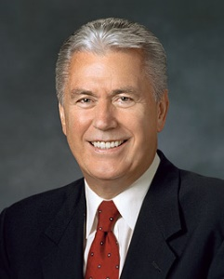
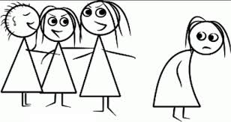
Who Are We To Judge?
What should we do in situations when we are with others whose appearance or behavior is not in harmony with the Lord’s standards?
How do we treat those whose behavior and appearance is not in harmony with the Lord’s standard?
When it comes to hating, gossiping, ignoring, ridiculing, holding grudges, or wanting to cause harm, please apply the following:
Stop it!
We simply have to stop judging others and replace judgmental thoughts and feelings with a heart full of love for God and His children.
“Don’t judge me because I sin differently than you.”
(2)

Slide 34
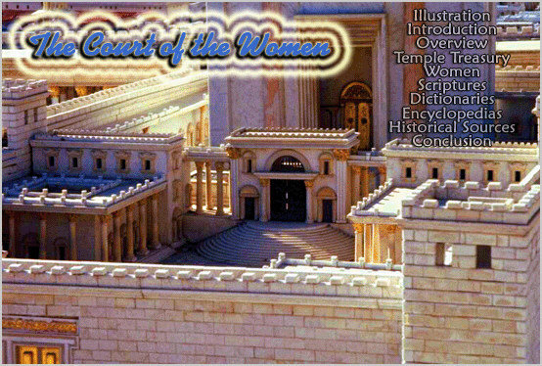
Early in the morning Jesus went to the temple
The usual public place to teach was in the Women’s Court

Slide 35
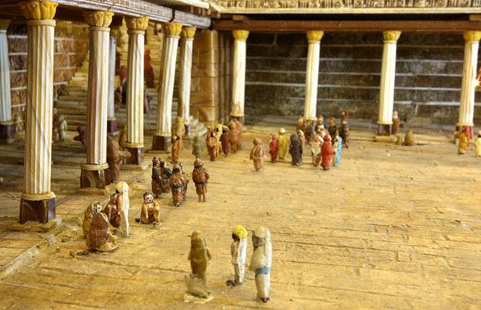
Gentile’s Court
Large and paved with stones of a variety of colors
Anyone can enter this court such as cattle dealers and money changers.

Slide 36
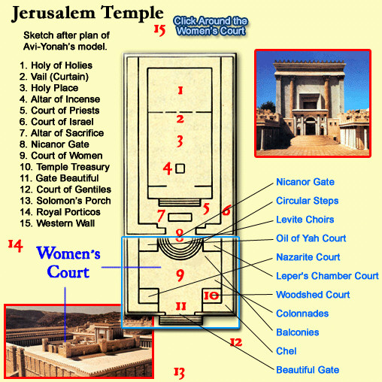
Herod’s Temple

Slide 37
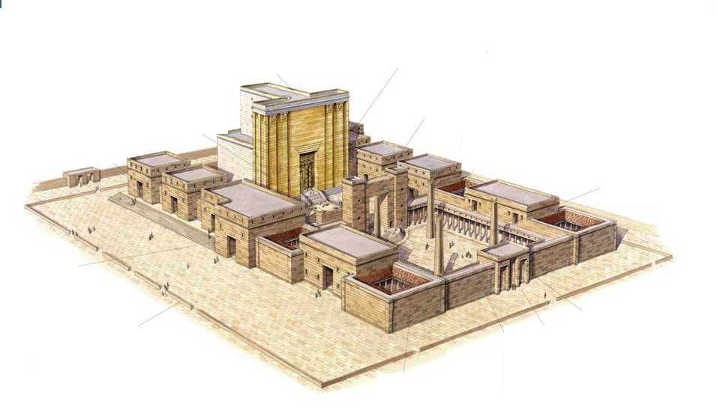
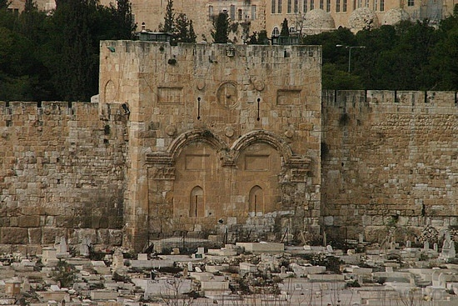
Gentile Court
Also called:
Outer Courts,
Lower Courts,
The Rabbi’s sometimes called it “The Mountain of the Lord’s House”
Outer court
Gate Beautiful
Acts 3:2, 10
Gate Beautiful sometimes called Gate Susan, for the sculpture relief of the City of Susa.
During morning and evening sacrifices this gate entrance was the place of public worship

Slide 38
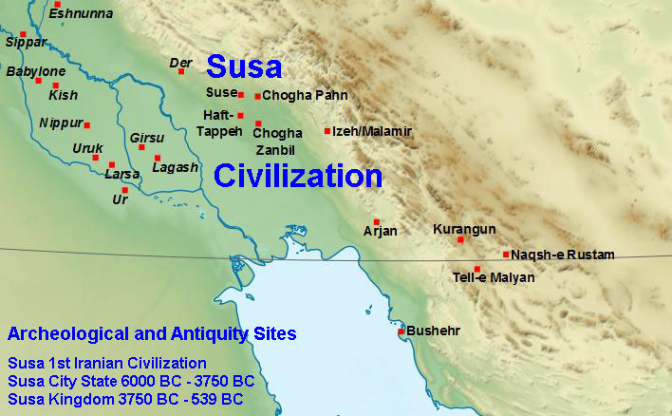
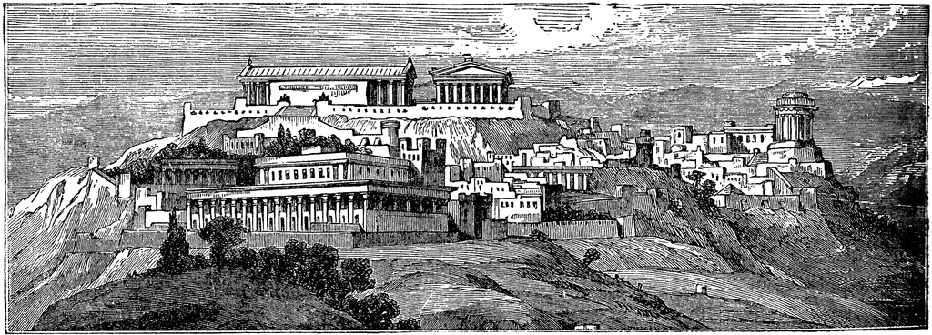
The scene of the Biblical book of Esther is laid in Susa, where king Ahasverus (Xerxes) resides.
Archaeologists have been able to identify several ruins with buildings mentioned by the author of Esther although the plot of the story is known to be fictional.
Ancient City of Susa

Slide 39
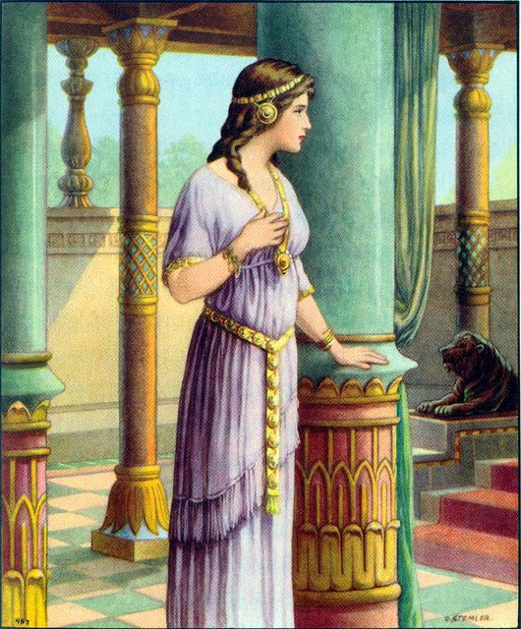
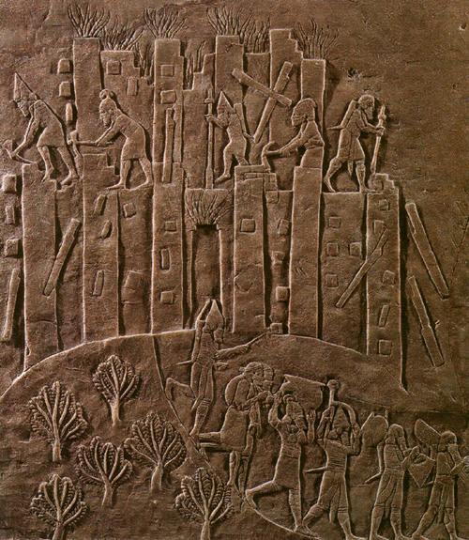
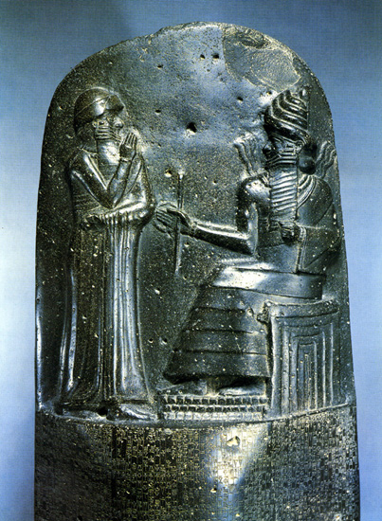
Esther
Sculpture reliefs from the City of Susa

Slide 40
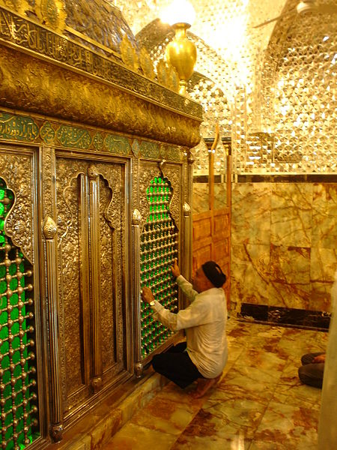
The city is also the reputed location of the tomb of the Prophet Daniel

Slide 41
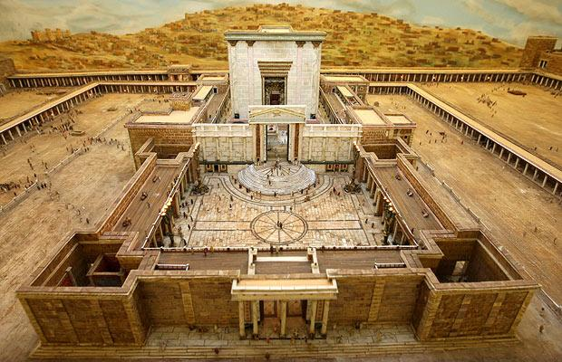
Through the gate is the court of women

Slide 42
Not just women were allowed in these courts, it is called this because women could not go any further into the temple.

Slide 43
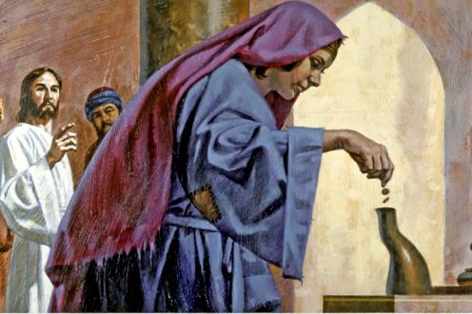
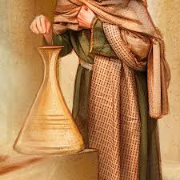
In front of the columns were eleven treasure chests for collecting money. Also two chests at the gate for collecting a half-shekel tax

Slide 44
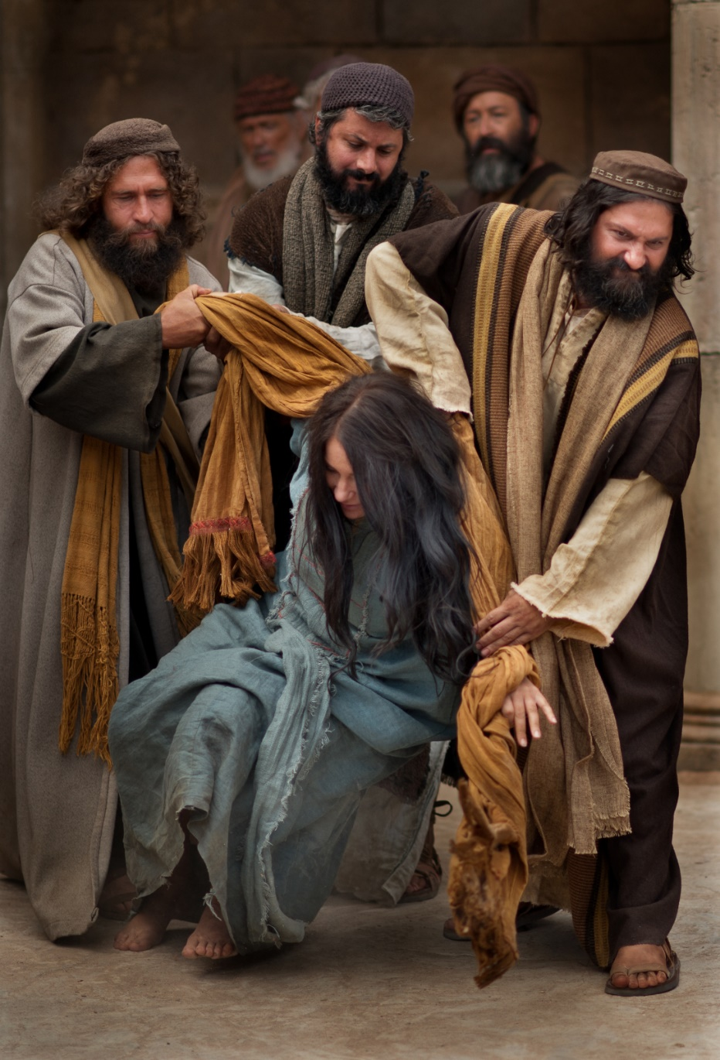
Taken in Adultery
Law of Moses: Stoning
Why did they not bring the man involved?
Where was her accuser?
And the man that committeth adultery with another man’s wife, even he that committeth adultery with his neighbour’s wife, the adulterer and the adulteress shall surely be put to death.
Leviticus 20:10

Slide 45
Scribes and Pharisees Tempt Jesus
Breaking the Roman law
Disrespect for the Law of Moses
While the law of Moses was death by stoning as a penalty for adultery, the extreme punishment had lapsed long before the time of Christ

Slide 46
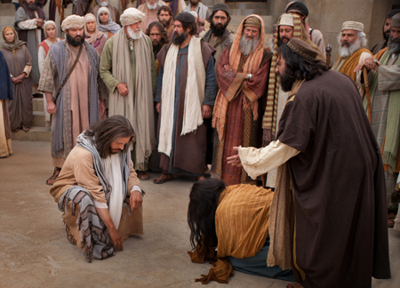
(1) If he agreed with Moses that she should be stoned, he would both
(a) arouse the ire of the people generally by seeming to advocate the reinstitution of a penalty which did not have popular support, and
(b) run counter to the prevailing civil law by prescribing what Rome [prohibited].
“In bringing this adulteress to Jesus, the scribes and Pharisees were laying this trap for the Master:
(2) If he disagreed with Moses and advocated anything less than death by stoning, he would be accused of perverting the law, and of advocating disrespect of and departure from the hallowed practices of the past.”
(3)

Slide 47
The letter of the law would have killed that woman then and there. But the Spirit of God, in the person of his Son, the living oracle, opened her way unto life.
It is the living oracles that lead the people of God. In them there is life; but in the letter of the law there is death.
The early commandments of God to his Church and the manner in which we were led at that time will not fit our case in all respects now. We must have teachings and revelations adapted to our present circumstances and condition."
(4)

Slide 48
He Heard Them Not
Jesus stoops down, and writes on the ground
Jesus comes to her level;
Her level of suffering
John 8:6

Slide 49
Jesus knows the hearts of every person
He wrote on the ground, writing so beautifully, enabling to relieve the stresses of the world; a small glimpse of how the Atonement works
"We do not know what Jesus wrote, but we know that he regarded many of the Pharisees as adulterers themselves. When he said that any in that crowd who was 'without sin' could cast a stone, he didn't mean just any sin, he meant anyone there who was not as guilty of adultery as she was." (5)

Slide 50
Christ was able to communicate specifically to her, his sister, a daughter of Heavenly Father.

Slide 51
He Rebukes the Accusers
James Tissot
“He that is without sin among you, let him first cast a stone at her”
Luke 8:7

Slide 52
Jesus stooped down again and wrote on the ground
The Accusers leave one by one
Yongsung Kim
Luke 8:8-9

Slide 53
“…go, and sin no more.”
Luke:8:11
An invitation that is both a promise and a blessing.
Go and have a life that is closer to Him.
The Savior shows us mercy by giving us opportunities to repent

Slide 54
“His command to her was, ‘Go, and sin no more.’ He was directing the sinful woman to go her way, abandon her evil life, commit no more sin, transform her life.
He was saying, Go, woman, and start your repentance; and he was indicating to her the beginning step—to abandon her transgressions.”
(6)

Slide 55
Go Forth and Change
“Another way to say “go, and sin no more” could be “go forth and change.”
The Savior was inviting her to repent: to change her behavior, her associations, the way she felt about herself, her heart.”
“Because of Christ, our decision to “go forth and change” can also allow us to “go forth and heal,” for He is the source of healing all that is broken in our lives.” (12)
John 8:11

Slide 56
“…believe that ye must repent of your sins and forsake them, and humble yourselves before God; and ask in sincerity of heart that he would forgive you; and now, if you believe all these things see that ye do them.”
(8)

Slide 57
“And the woman glorified God from that hour, and believed on his name”
John 8:11
…for I, the Lord, forgive sins, and am merciful unto those who confess their sins with humble hearts…”
D&C 61:2

Slide 58
The Light of the World
“I am the light of the world: he that followeth me shall not walk in darkness, but shall have the light of life.”
The great lamps set up in the court as a feature of the joyful celebration just ended gave point to our Lord’s avowal of Himself as the Light of the World. It was another proclamation of His divinity as God and the Son of God.
Luke 8:12-
(1)

Slide 59
“Jesus Christ is the light of the world because he is the source of the light which ‘proceedeth forth from the presence of God to fill the immensity of space’ (D&C 88:12). …
“Jesus Christ is also the light of the world because his example and his teachings illuminate the path we should walk to return to the presence of our Father in Heaven. …
“Jesus Christ is also the light of the world because his power persuades us to do good.”
Yongsung Kim
Luke 8:12
(9)

Slide 60
Light and Salvation
If we follow the Savior, we will avoid spiritual darkness and be filled with His light
And he said, It is a light thing that thou shouldest be my servant to raise up the tribes of Jacob, and to restore the preserved of Israel: I will also give thee for a light to the Gentiles, that thou mayest be my salvation unto the end of the earth.
Isaiah 49:6
Arise, shine; for thy light is come, and the glory of the Lord is risen upon thee.
Isaiah 60:1

Slide 61
Testimony of Two Men
At the mouth of two witnesses, or three witnesses, shall he that is worthy of death be put to death; but at the mouth of one witness he shall not be put to death.
Deuteronomy 17:6
The Pharisees said that the law of Moses required the testimony of at least two men to establish truth.
I am one that bear witness of myself, and the Father that sent me beareth witness of me.
The Father and the Son are two separate beings.
John 8:17

Slide 62
“In all that Jesus came to say and do, including and especially in His atoning suffering and sacrifice, He was showing us who and what God our Eternal Father is like, how completely devoted He is to His children in every age and nation. In word and in deed Jesus was trying to reveal and make personal to us the true nature of His Father, our Father in Heaven. …
“So feeding the hungry, healing the sick, rebuking hypocrisy, pleading for faith—this was Christ showing us the way of the Father, He who is ‘merciful and gracious, slow to anger, long-suffering and full of goodness.’
In His life and especially in His death, Christ was declaring, ‘This is God’s compassion I am showing you, as well as that of my own.’” (11)
John 8:19

Slide 63
In a world of accusations and unfriendliness, it is easy to gather and cast stones. But before we do so, let us remember the words of the One who is our Master and model: “He that is without sin among you, let him first cast a stone”. (2)
Let us be kind.
Let us forgive.
Let us talk peacefully with each other.
Let the love of God fill our hearts.
“Let us do good unto all men”
John 8:7 Galatians 6:10

Slide 64
Coming Up Next…
The truths that can free us from our sins, guilt, false concepts, erroneous understanding, and unproductive habits and behavior are to be had only through the Holy Spirit. (10)
T
R
U
T
H
"The central core of the Father's plan of salvation is that to obtain these truths and the peace, happiness, security, and freedom these truths bring to their righteous adherents, we must draw upon a source of knowledge that lies above and beyond the reach of ordinary learning processes.
"The road to this sure knowledge is a sincere and honest desire to obtain truth from God, seeking such truth through sustained prayer, through devoted study of God's scriptures, and through righteous, charitable behavior in our daily lives.“
Luke 8:30-32
(10)

Slide 65
Sources:
New Testament Institute Student Manual Chapter 24
President Dieter F. Uchtdorf The Merciful Obtain Mercy 2012 April. Gen. Conf.
Elder Bruce R. McConkie Doctrinal New Testament Commentary, 3 vols. [1965–73], 1:450–51, (Truth) 456-57
Elder Orson Hyde (Journal of Discourses, 26 vols. [London: Latter-day Saints' Book Depot, 1854-1886], 7: 151.)
(Robert J. Matthews, Behold the Messiah [Salt Lake City: Bookcraft, 1994], 197.)
President Spencer W. Kimball (The Miracle of Forgiveness [1969], 165).
Elder James E. Talmage Jesus the Christ p. 406
Elder Russell M. Nelson Thanks Be to God April 2012 Gen. Conf.
Elder Dallin H. Oaks (“The Light and Life of the World,” Ensign, Nov. 1987, 63–64).
Marion G. Romney ("Receiving and Applying Spiritual Truth," Ensign, Feb. 1984, 4)
Elder Jeffrey R. Holland (“The Grandeur of God,” Ensign or Liahona, Nov. 2003, 70, 72).
Amy A. Wright General Conference April 2022 Sunday Morning Session
Presentation by ©http://fashionsbylynda.com/blog/

Slide 66
The Self Test
“Do you harbor a grudge against someone else?
“Do you gossip, even when what you say may be true?
“Do you exclude, push away, or punish others because of something they have done?
“Do you secretly envy another?
“Do you wish to cause harm to someone?
“If you answered yes to any of these questions, you may want to apply the two-word sermon from earlier: stop it!
“In a world of accusations and unfriendliness, it is easy to gather and cast stones. But before we do so, let us remember the words of the One who is our Master and model: ‘He that is without sin among you, let him first cast a stone.’
“Brothers and sisters, let us put down our stones.”
President Dieter F. Uchtdorf (“The Merciful Obtain Mercy,”
Ensign or Liahona, May 2012, 76).

Slide 67
Event | Matthew | Mark | Luke | John
Woman Taken in Adultery (Casting the 1st Stone) |  |  |  | 8:1-11
Jesus Testifies of Himself |  |  |  | 8:12-30
Adultery, the Law of Moses: John 8:5:
It wasn't Moses who had commanded the stoning of adulterers; it was Jehovah. The words, 'the adulterer and the adulteress shall surely be put to death' (Lev. 20:10), came from Jesus when he communed with Moses and gave him the law (3 Ne. 15:5). Ironically, Christ is tempted to conform to the very law he gave to a previous generation. gospeldoctrine.com
At one time, when Israel was ruled by a righteous judge, i.e. Moses, when the Lord was trying to teach the people the difference between the holy and unholy (Lev. 10:10), and when deviance from the law could not be tolerated, Jehovah commanded that adulterers be put to death.
In the meridian of time, when Israel was ruled by wicked men, when the tempters motivation was not holiness but wickedness, when Christ's mission was a mission of mercy and not judgment (Jn. 3:17), the Lord's answer condemned the scribes and Pharisees, not the woman. And he did so without nullifying the law he had previously given. Christ knew that the woman's accusers were guilty of the very same crime (see Matt 12:38-39), they just hadn't been caught 'in the very act' (v. 4).
"Jesus, who knows the hearts of every person, knows the hearts of those Pharisees...When they continue to press him for an opinion, he says: 'He that is without sin among you, let him first cast a stone at her' (John 8:7), and he writes again on the ground. The Pharisees, each convicted by his own conscience, leave one by one.
(Robert J. Matthews, Behold the Messiah [Salt Lake City: Bookcraft, 1994], 197.)
The Lord Gives Us Time to Repent John 8:15:
Elder Oaks further explained that Jesus did not condone the woman’s sin, but He was allowing her time to repent and acknowledging that her final judgment would come later: “The Lord obviously did not justify the woman’s sin. He simply told her that He did not condemn her—that is, He would not pass final judgment on her at that time. This interpretation is confirmed by what He then said to the Pharisees: ‘Ye judge after the flesh; I judge no man’ (John 8:15). The woman taken in adultery was granted time to repent, time that would have been denied by those who wanted to stone her” (“‘Judge Not’ and Judging,” Ensign, Aug. 1999, 8).
Yongsung Kim is a Korean painter working in oil on canvas and with computer.
Adultery:
Surely, the Savior did not condone adultery. But He also did not condemn the woman. He encouraged her to reform her life. She was motivated to change because of His compassion and mercy. The Joseph Smith Translation of the Bible attests to her resultant discipleship: “And the woman glorified God from that hour, and believed on his name” [Joseph Smith Translation, John 8:11 (in John 8:11, footnote c)].
(Dale G. Renlund, “Our Good Shepherd,” Ensign or Liahona, May 2017, 30)
While we are grateful for second chances following mistakes, or failures of the mind, we stand all amazed at the Savior’s grace in giving us second chances in overcoming sin, or failures of the heart.
No one is more on our side than the Savior. … To become like Him will require countless second chances in our day-to-day struggles with the natural man, such as controlling appetites, learning patience and forgiveness, overcoming slothfulness, and avoiding sins of omission, just to name a few. …
I am eternally grateful for the loving-kindness, patience, and long-suffering of Heavenly Parents and the Savior, who allow us countless second chances on our journey back to Their presence.
(Lynn G. Robbins, “Until Seventy Times Seven,” Ensign or Liahona, May 2018, 22–23)

Slide 68
The Light John 8:12
"The light of life is divine light that permeates and radiates in the human soul and brings out the godlike qualities and attributes of godliness. The light of life is the gospel of Jesus Christ, the gospel of love. The light of life has within it the glorious promises from God of eternal life in his heavenly kingdom. The light of life will bring divine truth and happiness and peace into a troubled heart. The light of life brings divine light into the problems and troubles of this life and helps to turn life's problems into steppingstones to eternal progression and to developing a godlike character.
"Jesus also said: '... light is come into the world, and men loved darkness rather than light, because their deeds were evil. For every one that doeth evil hateth the light, neither cometh to the light, lest his deeds should be reproved. But he that doeth truth cometh to the light, that his deeds may be made manifest, that they are wrought in God.' (John 3:19-21.)
"To know God, you must walk in the light of life. To know God as a living child of God, we should know our relationship to him, our divine potential, and we should know that in knowing God there is great responsibility to respect and love and follow his counsel and his doctrines and his commandments and to grow as a child to become more godlike." Bernard P. Brockbank ("Knowing God," Ensign, July 1972, 122)
Freedom:
"Freedom is based on truth, and no man is completely free as long as any part of his belief is based on error, for the chains of error bind his mind. This is why it is so important for us to learn all the truth we can from all the sources we can. We need particularly to search the scriptures, for in them are the words which, if accepted and lived, will lead us to eternal life.“ N. Eldon Tanner ("Ye Shall Know the Truth,“ Ensign, May 1978, 14)
Some Can Not Come John 8:22-24
While the Savior invites all to come unto Him and eventually be where He is, some will decline the invitation and “die in [their] sins” (John 8:21, 24)—meaning they will not repent and be made clean through the Atonement. The Savior’s statement “Whither I go, ye cannot come” (John 8:22) applies to those who understand the invitation and the opportunity to accept the Savior but decline. (1)
Challenging the Lord John 8:18
The Pharisees challenged His testimony, declaring it of no worth because He bore record of Himself. Jesus admitted that He testified of Himself, but affirmed nevertheless that what He said was true, for He knew whereof He spoke, whence He came and whither He would go, while they spoke in ignorance. They thought, talked, and judged after the ways of men and the frailties of the flesh; He was not sitting in judgment, but should He choose to judge, then His judgment would be just, for He was guided by the Father who sent Him. Their law required the testimony of two witnesses for the legal determination of any question of fact; and Jesus cited Himself and His Father as witnesses in support of His affirmation. His opponents then asked with contemptuous or sarcastic intent, “Where is thy Father?” The reply was in lofty tone: “Ye neither know me, nor my Father: if ye had known me, ye should have known my Father also.” Enraged at their own discomfiture, the Pharisees would have seized Him, but found themselves impotent. “No man laid hands on him; for his hour was not yet come.” James E. Talmage Jesus the Christ

Slide 69
F
R
E
D
O
M
E
F
R
S
O
M
I
N
Jesus said unto them, Verily, verily, I say unto you, Before Abraham was, I am.
John 8:58
John 8:31-59
Hagar
Sarah
Abraham
Keturah
Ishmael
Rebekah
Isaac
Midian
Ishmaelites
Jacob
Midianites
Israelites

Slide 70
Freedom From Sin
Continue in Truth
Become Christ’s Disciples
Know the Truth
Freedom
T
R
T
U
H
Truth
If we continue in Jesus Christ’s word, then we will be His disciples and know the truth, which will make us free
John 8:31-32

Slide 71
The Truth Shall Make You Free
Free from power of false doctrine
Free from the bondage of appetite and lust
Free from the shackles of sin
Free from every evil and corrupt influence
Free from every restraining and curtailing power
Free to go on to the unlimited freedom enjoyed it its fulness only by exalted beings
John 8:30-32
(3)

Slide 72
G
S
A Servant of
D
O
N
I
The Greek verb translated as “committeth” implies continuing in sin rather than a single occurrence of sin.
Addiction
Enslavement
Experiment
Habit
Dependence
“Agency, or the power to choose, was ours as spirit children of our Creator before the world was.
It is a gift from God, nearly as precious as life itself.
“Often, however, agency is misunderstood. While we are free to choose, once we have made those choices, we are tied to the consequences of those choices.”
Enslaving shackles of habit are too small to be sensed until they are too strong to be broken. …
John 8:34
(2)

Slide 73
“Yielding to [Satan’s] temptations leads to a narrower and narrower range of choices until none remains and to addictions that leave us powerless to resist. …
“… Does anyone doubt that, as a consequence of possessing all light and truth, God possesses ultimate freedom to be and to do?
“Likewise, as our understanding of gospel doctrine and principles grows, our agency expands.
First, we have more choices and can achieve more and receive greater blessings because we have more laws that we can obey.
… Second, with added understanding we can make more intelligent choices because we see more clearly not only the alternatives but also their potential outcomes.”
John 8:34
(4)

Slide 74
Entitlement
The Jews mistakenly believed that simply being descendants of Abraham and heirs to the Abrahamic covenant entitled them to spiritual freedom.
The book of Genesis records some of Abraham’s works that stand in contrast to the behavior of the Jewish leaders.
Abraham converted others to the gospel.
He avoided strife.
He was obedient to God.
He welcomed heavenly messengers.
He exercised tremendous faith.
"Judaism held that the posterity of Abraham had an assured place in the kingdom of the expected
Messiah, and that no
proselyte from among the
Gentiles could possibly
attain the rank and
distinction of which the 'children' were sure." (3)
Ron DiCianni
John 8:37; Abraham---Genesis 12:1-9; 13:7-9; 15:1-6; 18:1-8; 22:1-19
(1)

Slide 75
Deeds of Their Fathers
Jesus was clearly implying that the Jews were serving someone other than God.
In apparent retaliation, bristling at the suggestion that they were “sons” or followers of the devil, the Jewish leaders said, “We be not born of fornication”, which was an insult about what was thought to be Jesus’s illegitimate birth because Mary and Joseph were not legally married at the time of Mary’s conception.
This insult helps us understand the kind of treatment Jesus may have endured throughout His life. In many ways, He knew what it was like to have people revile Him, persecute Him, and say all manner of evil against Him falsely.
John 8:41
(1)

Slide 76
Receiving God’s Word
“He that is of God receiveth God’s words; ye therefore receive them not, because ye are not of God”
John 8:47
The response of the Jewish leaders was to call Jesus a Samaritan—the lowest of all people and not of Jewish descent—and state that He was possessed of a devil.
These leaders had hardened their hearts, refusing to believe that Jesus was the Son of God—even though their father Abraham, all other ancient prophets, and their scriptures taught clearly of Him.
John 8:42-52
(1)

Slide 77
I Am
Jesus said unto them, Verily, verily, I say unto you, Before Abraham was, I am.
The term identifies Jehovah, the God of Abraham, Isaac, and Jacob; …
Jehovah is derived from the Hebrew word hayah, which means ‘to be’ or ‘to exist.’ A form of the word hayah in the Hebrew text of the Old Testament was translated as I AM
And God said unto Moses, I AM THAT I AM: and he said, Thus shalt thou say unto the children of Israel, I AM hath sent me unto you.
Exodus 3:14
Jehovah had thus revealed to Moses this very name that He had meekly and modestly chosen for His own premortal identification: ‘I AM’” (2)
Yongsung Kim
John 8:58
(1)

Slide 78
Sources:
New Testament Institute Student Manual Chapter 24
Elder Russell M. Nelson (“Addiction or Freedom,” Ensign, Nov. 1988, 6–7). I AM--(“Jesus the Christ: Our Master and More,” Ensign, Apr. 2000, 6–7).
Elder James E. Talmage (Jesus the Christ, 115)
4. Elder D. Todd Christofferson (“Moral Agency,” Ensign, June 2009, 49, 50–51).
Presentation by ©http://fashionsbylynda.com/blog/

Slide 79
Event | Matthew | Mark | Luke | John
The Truth Shall Make You Free |  |  |  | 8:30-32
Who is Abraham’s Seed? |  |  |  | 8:31-59
True Freedom John 8:30-32:
“Obedience leads to true freedom. The more we obey revealed truth, the more we become liberated. …
“Freedom and liberty are precious gifts that come to us when we are obedient to the laws of God and the whisperings of the Spirit. … Obedience to [principles of revealed truth] makes us truly free to reach the potential and the glory which our Heavenly Father has in store for us.” President James E. Faust (“Obedience: The Path to Freedom,” Ensign, May 1999, 45, 47).
Abraham is Our Father John 8:39:
"...according to the common notion of the time, the vials of wrath were to be poured out only on the Gentiles, while they, as Abraham's children, were sure of escape-in the words of the Talmud, that 'the night' (Isa. 21:12) was 'only to the nations of the world, but the morning to Israel'? (Jer. Taan. 64a).
"For, no principle was more fully established in the popular conviction, than that all Israel had part in the world to come (Sanh. 10.1), and this, specifically, because of their connection with Abraham...'The merits of the Fathers,' is one of the commonest phrases in the mouth of the Rabbis. Abraham was represented as sitting at the gate of Gehenna (hell), to deliver any Israelite who otherwise might have been consigned to its terrors. In fact, by their descent from Abraham, all the children of Israel were nobles, infinitely higher than any proselytes. 'What,' exclaims the Talmud, 'shall the born Israelite stand upon the earth, and the proselyte be in heaven?' (Jer. Chag. 76a)." (Edersheim, The Life and Times of Jesus the Messiah, p. 187-88)
Addition or Freedom John 8:31-32:
From an initial experiment thought to be trivial, a vicious cycle may follow. From trial comes a habit. From habit comes dependence. From dependence comes addiction. Its grasp is so gradual. Enslaving shackles of habit are too small to be sensed until they are too strong to be broken. …
“Agency, or the power to choose, was ours as spirit children of our Creator before the world was. (See Alma 13:3; Moses 4:4.) It is a gift from God, nearly as precious as life itself.
“Often, however, agency is misunderstood. While we are free to choose, once we have made those choices, we are tied to the consequences of those choices” Elder Russell M. Nelson (“Addiction or Freedom,” Ensign, Nov. 1988, 6–7).
Bible Dictionary: Abraham, Covenant of:
“Abraham first received the gospel by baptism (which is the covenant of salvation). Then he had conferred upon him the higher priesthood, and he entered into celestial marriage (which is the covenant of exaltation), gaining assurance thereby that he would have eternal increase. Finally he received a promise that all of these blessings would be offered to all of his mortal posterity (D&C 132:29–50; Abr. 2:6–11). … Abraham’s posterity would receive certain lands as an eternal inheritance (Gen. 17;22:15–18; Gal. 3; Abr. 2).
These promises taken together are called the Abrahamic covenant. …
“The portions of the covenant that pertain to personal salvation and eternal increase are renewed with each individual who receives the ordinance of celestial marriage (see D&C 132:29–33). Those of non-Israelite lineage, commonly known as gentiles, are adopted into the house of Israel, and become heirs of the covenant and the seed of Abraham, through the ordinances of the gospel (Gal. 3:26–29).
“Being an heir to the Abrahamic covenant does not make one a ‘chosen person’ per se but does signify that such are chosen to responsibly carry the gospel to all the peoples of the earth. Abraham’s seed have carried out the missionary activity in all the nations since Abraham’s day. (Matt. 3:9; Abr. 2:9–11)”
Boosting of Heritage John 8:39:
When the Jewish leaders boasted that they were Abraham’s seed, implying they held special privileges in the sight of God, the Savior reproved them for failing to do the works of their highly esteemed ancestral father. They were not acting like the covenant children of Abraham; rather, they were trying to kill the God of Abraham, who was standing before them and telling them the truth. (1)

Slide 80
“I AM” Statements
REFERENCE IN JOHN | “I AM” STATEMENT | FULFILLMENT
6:35, 48, 51 | “I am the bread of life.” | Jesus Christ gave Himself for us in the Atonement. He feeds us spiritually.
8:12; 9:5 | “I am the light of the world.” | Jesus Christ is the source of all truth. If we follow His words and example, we will not stumble or walk in spiritual darkness.
8:58 | “Before Abraham was, I am.” | Jesus Christ is Jehovah of the Old Testament.
10:7, 9 | “I am the door of the sheep.” | Jesus Christ protects us like a shepherd at the door of a sheep enclosure. No one can enter His kingdom except through Him.
10:11, 14 | “I am the good shepherd.” | Jesus Christ leads us. He gave His life for us. He knows each of us individually.
10:36 | “I am the Son of God.” | Jesus Christ is the Firstborn of the Father’s spirit children (see D&C 93:21) and His Only Begotten in the flesh (see John 1:14).
11:25 | “I am the resurrection, and the life.” | Through the Atonement of Jesus Christ we can overcome physical and spiritual death. Jesus Christ gave us the gift of resurrection.
14:6 | “I am the way, the truth, and the life.” | Jesus Christ is the only way to the Father, and He is the source of all truth. Because of His Atonement, we will all be resurrected and through our faithfulness may inherit eternal life.
15:1, 5 | “I am the true vine.” | We depend on Jesus Christ for life. Only by abiding by His teachings will we be able to bear the fruit of righteousness.
New Testament Seminary Teacher Manual

Slide 81
Spiritual Blindness VS
Physical Blindness
John 9
And in that day shall the deaf hear the words of the book, and the eyes of the blind shall see out of obscurity, and out of darkness. Isaiah 29:18

Slide 82
Isaiah’s Prophecy
Then the eyes of the blind shall be opened, and the ears of the deaf shall be unstopped.
Isaiah 35:5
I the Lord have called thee in righteousness, and will hold thine hand, and will keep thee, and give thee for a covenant of the people, for a light of the Gentiles;
To open the blind eyes, to bring out the prisoners from the prison, and them that sit in darkness out of the prison house.
Isaiah 42:6-7
And in that day shall the deaf hear the words of the book, and the eyes of the blind shall see out of obscurity, and out of darkness. Isaiah 29:18

Slide 83
Who Did Sin?
“Master, who did sin, this man, or his parents, that he was born blind?”
The disciples observed:
that suffering was the result of iniquity and
that there was a premortal existence of some kind.
“Neither hath this man sinned, nor his parents: but that the works of God should be made manifest in him”
This question teaches that a person suffering from a mortal adversity, such as a disability, is not necessarily guilty of sin. (1)
John 9:2-3

Slide 84
“We are sent here to be tested.
There must be opposition in all things. We are meant to learn and grow through that opposition, through meeting our challenges, and through teaching others to do the same. …
The Lord will not only consecrate our afflictions for our gain, but He will use them to bless the lives of countless others.
“Jesus taught this lesson when He and His disciples met a man who was born blind.
“If we see life through the lens of spirituality, we can see many examples of the works of God being furthered through the adversities of His children. …
“When we understand this principle, that God offers us opportunities for blessings and blesses us through our own adversities and the adversities of others, we can understand why He has commanded us again and again to ‘thank the Lord thy God in all things’ (D&C 59:7)”
John 9:2-3
(2)

Slide 85
“It is natural for parents with handicapped children to ask themselves, ‘What did we do wrong?’
The idea that all suffering is somehow the direct result of sin has been taught since ancient times.
It is false doctrine.
That notion was even accepted by some of the early disciples until the Lord corrected them.
“There is little room for feelings of guilt in connection with handicaps. Some handicaps may result from carelessness or abuse, and some through addiction of parents. But most of them do not.
Afflictions come to the innocent”
(3)

Slide 86
How can our testimonies of Jesus Christ be strengthened as we withstand opposition or trials of faith?
What do we learn about the attributes of Jesus Christ from His interactions with the man born blind?
How did the Savior help the blind man’s testimony grow?
How does He help us strengthen our testimonies?
How can what you learned about the Savior in this account help you in facing opposition now or in the future?

Slide 87
Being Cast Out
“Synagogues served as the religious and social center for many Jewish communities. Synagogues offered access to spiritual instruction and worship, as well as educational and social opportunities. Because the synagogue was so integral to Jewish society, to be cast out of the synagogue … meant more than being excommunicated and losing fellowship with the religious community. It meant banishment from cultural and social affairs as well. This threat was apparently severe enough to keep the parents of the man born blind from getting too involved in the investigation of this miracle” (10)

Slide 88
Pool of Siloam
When the Savior saw the man who had been blind from birth, He anointed the man’s eyes with clay and told him to wash in the pool of Siloam.
Yongsung Kim
He is instantly healed.
John 9:5-7

Slide 89
Spittle
"Strange-we provide pure, sterile tissue for spittle and forbid expectorating even on sidewalks.
"We bathe with soap, scrub with disinfectants, and scald dishes, pots, and pans with boiling water to kill the germs from the filth of clay.
"We use for culinary purposes and especially in hospitals and sickrooms only water purified by chemical processes.
"But here the Master disregarded all our rules of sanitation and prescribed spittle, germ-ridden clay, and impure water...
The miracle was conceived in the womb of faith and born and matured in the act of obedience.
"Had the command involved oil instead of spittle, herbs instead of clay, and waters of a pure bubbling spring instead of filthy Siloam, the result would have been the same. But some would have said that oil and herbs and pure water had healed the eyes, but even the untrained must know that these could not cure one.
The unparalleled miracle was positively the result of faith obedience.
"Though there is no compulsion, the spiritual laws of today must also be obeyed if blessings are to be realized.“
John 9:5-7
(5)

Slide 90
“A Man Called Jesus”
With commitment and resolve, the man believed and accepted Jesus as “the Son of God”
“Conversion is a process that seldom occurs in an instant suddenly. Gospel grace dawns gradually upon most believers.” (4)
John 9:11, 35-38

Slide 91
“Put Out of the Synagogues”
“Synagogues served as the religious and social center for many Jewish communities.
Synagogues offered access to spiritual instruction and worship, as well as educational and social opportunities.
Because the synagogue was so integral to Jewish society, to be cast out of the synagogue … meant more than being excommunicated and losing fellowship with the religious community.
This meant banishment from cultural and social affairs as well. This threat was apparently severe enough to keep the parents of the man born blind from getting too involved in the investigation of [their son’s healing]”
John 9:22, 34-35
(1)

Slide 92
OR
Is it more important to be spiritually clean?
Is it more important to be physically clean?
John 9:35-38

Slide 93
Evil
Thoughts
Speaking the Lord’s name in vain
Unrighteous
Actions
False
accusations
“I implore you to think clean thoughts. Every action is preceded by a thought. If we want to control our action, we must control our thinking.” (7)
What kinds of things make people spiritually unclean?
Gossiping
Vulgarity
King Solomon states twice:
“A lying tongue and a false witness that speaketh lies” are an abomination unto Him
(Proverbs 6:16-19)
Lying

Slide 94
“The brain won’t vomit back filth.
Once recorded, it will always remain subject to recall, flashing its perverted images across your mind and drawing you away from the wholesome things in life”
(2)

Slide 95
Unhealthy
Foods
“The body has defenses to rid itself of unwholesome food.” (2)
However…
“Drugs impair our ability to think, to reason, and to make prudent and wise choices.”
(8)
What kinds of things make people physically unclean?
Harmful drugs

Slide 96
Exercise Faith
“I solemnly testify that Jesus Christ guides this, His church. He knows and loves you personally. As you walk in faithful obedience, He will bless you, inspire you, and lead you to greater knowledge and capacity. “
(9)
What kinds of things make people spiritually clean?
Obedience

Slide 97
“Sight For the Spiritual”
“Now sight had been given twice—once to remedy a congenital defect and once to behold the King of Kings before He would ascend to His eternal throne. Jesus had quickened both temporal and spiritual vision.” (6)
How might the man’s healing from physical blindness represent his healing from spiritual blindness?
Why do you think exercising faith is necessary in order to see and understand spiritual truth more clearly?
As we exercise faith in Jesus Christ, our spiritual vision and understanding become clearer
John 9:36-38

Slide 98
“Blind Also”
After the Savior healed the man born blind, some Pharisees asked Jesus whether they were “blind also.” In reply, the Savior used a metaphor, teaching that individuals who were “blind”—those who did not know who He was—“should have no sin”.
On the other hand, individuals who could “see”—those who had received enough witnesses concerning the Savior and His divine mission that they should have known who He was—would be accountable for their actions.
The Pharisees were among those who could “see,” and thus their “sin remaineth.” Spiritually speaking, they chose to be blind because they refused to recognize Jesus as the Son of God, despite the many witnesses they had received.
John 9:39-41
(1)

Slide 99
“Choosing to Be Blind”
The Pharisees were among those who could ‘see,’ and thus their ‘sin remaineth.’ Spiritually speaking, they chose to be blind because they refused to recognize Jesus as the Son of God, despite the many witnesses they had received”
Do You Choose To Be Blind Also?
John 9:39-41
(1)

Slide 100
Sources:
New Testament Institute Student Manual Chapter 24
Elder Dallin H. Oaks (“Give Thanks in All Things,” Ensign or Liahona,May 2003, 97–98). Things They’re Saying New Era Feb. 1974
Elder Boyd K. Packer (“The Moving of the Water,” Ensign, May 1991, 7–8).
Elder Bruce R. McConkie The Mortal Messiah: From Bethlehem to Calvary, 4 vols. [1979–81], 2:188).
President Spencer W. Kimball (Conference Report, October 1954, Afternoon Meeting 55.)
President Howard W. Hunter (“The God That Doest Wonders,” Ensign, May 1989, 16–17).
Quote from: President David O. McKay President Thomas S. Monson That We May Touch Heaven Nov. 1990 Gen. Conf.
President Thomas S. Monson Peace Be Still 2002 Oct. Gen. Conf.
Elder Richard G. Scott (“Acquiring Spiritual Knowledge,” Ensign, Nov. 1993, 88).
New Testament Student Manual [2014], 230)
Good Reading:
Elder Lynn G. Robbins The Eyes of the Blind Shall See Ensign June 2016
Presentation by ©http://fashionsbylynda.com/blog/

Slide 101
Event | Matthew | Mark | Luke | John
Jesus Heals a Man Born Blind |  |  |  | 9:1-41
Pre-existence John 9:2:
"Apparently the Jews had some understanding of the doctrine of pre-existence. Among their righteous forbears it had been taught plainly as a basic gospel truth. (Moses 3:4-9; 4:1-4; 6:51; Abraham 3:22-28.) Such scriptures as were then available to them however, contained only passing allusions to it. (Num. 16:22; Isa. 14:12-20; Jer. 1:5.) But it was a doctrine implicit in the whole plan of salvation... Jesus' disciples-probably as a direct result of his teachings-knew and believed that men were the spirit children of God in pre-existence and that in such prior estate they were subject to law and endowed with agency. Otherwise they never would have asked nor would there have been any sense or reason to a question which is predicated upon the assumption that men can sin before they are born into mortality." Elder Bruce R. McConkie (Doctrinal New Testament Commentary, 3 vols. [Salt Lake City: Bookcraft, 1965-1973], 1: 480.)
Healing by the Power of the Priesthood John 9:6-7:
Priesthood administrations are always performed by the laying on of hands. The Savior, however, frequently performed many miracles using other means. While the pattern has been taught by the Brethren and established for our generation, Christ's manner of healings teach us that it is the faith that heals not the oil nor the ordinance. Elder Bruce R. McConkie noted, "Healing miracles are performed by the power of faith and in the authority of the priesthood. By doing these physical acts, however, the Master's apparent purpose was to strengthen the faith of the blind or deaf person, persons who were denied the ability to gain increased assurance and resultant faith by seeing his countenance or hearing his words." (Doctrinal Commentary on the New Testament 1:320.)
In the case of the blind man, he has never seen nor heard Jesus before. How could he have had any faith in Jesus? Remarkably, the Savior didn't ask whether he believed or not. He just responded with a kind word and a healing touch-bolstering the man's faith in the goodness of Jesus. This blind man knew that no man born blind from birth had ever been healed (v. 32), but he did not quarrel with Christ's instructions. His response was remarkably obedient. Gospeldoctrine.com
Having a handicapped Child John 9:1-3:
“It is natural for parents with handicapped children to ask themselves, ‘What did we do wrong?’ The idea thatall suffering is somehow the direct result of sin has been taught since ancient times. It is false doctrine. That notion was even accepted by some of the early disciples until the Lord corrected them.
“‘As Jesus passed by, he saw a man which was blind from his birth.
“‘And his disciples asked him, saying, Master, who did sin, this man, or his parents, that he was born blind?
“‘Jesus answered, Neither hath this man sinned, nor his parents: but that the works of God should be made manifest in him.’ (John 9:1–3.)
“There is little room for feelings of guilt in connection with handicaps. Some handicaps may result from carelessness or abuse, and some through addiction of parents. But most of them do not. Afflictions come to the innocent” Elder Boyd K. Packer (“The Moving of the Water,” Ensign, May 1991, 7–8).
Pool of Siloam:
The water from the Gihon Springs and Hezekiah’s Tunnel that came through the Pool of Siloam. It continues to flow today. It was discovered when a New City Sewer System was being built. From here it flows out and across the street into a drain. Soil still cover the unexcited part of the pool.

Slide 102
David took the city by telling his army that the only way to enter the fortified city was through the water shaft the Jebusites had cut.
The Jebusites had made an underground passage way for the public to descend in. This public tunnel led to a shaft that served as a well to lower buckets in to draw water up from the Gihon Springs.
1 Chronicles 11:6 says that Joab led David's men into the Gihon Springs, shimmied up the shaft to reach the underground public tunnel. From there they stormed the city.
Hezekiah's Tunnel (the blue stream running underground) was a tunnel chipped out by Hezekiah's men around the year 701 BC. Large groups of Israelites had fled the northern kingdom because of the Assyrians. They moved to Jerusalem. The tunnel was cut by Hezekiah to provide water to these people on the other side of the ridge of the city and to ensure the city had water when the Assyrians invaded Judah and Jerusalem.
"It was Hezekiah who blocked the upper outlet of the Gihon spring and channeled the water down to the west side of the City of David."
Second Chronicles 32:2-4 says that Hezekiah had blocked off the Gihon's springs flow to pools and streams outside the city so that when the Assyrians came they would not find any water around the outside of the city. This water was then diverted into Hezekiah's tunnel that ran under the city into the new pool called the Pool of Siloam. The Bible reads: "When Hezekiah saw that Sennacherib had come and that he intended to make war on Jerusalem, he consulted with his officials and military staff about blocking off the water from the springs outside the city, and they helped him. A large force of men assembled, and they blocked all the springs and the stream that flowed through the land.
'Why should the kings of Assyria come and find plenty of water?' they asked."
"The tunneling was completed. . . While the hewers wielded the ax, each man toward his fellow. . . there was heard a man's voice calling to his fellow. . . the hewers hacked each toward the other, ax against ax, and the water flowed from the spring to the pool, a distance of 1,200 cubits.“
Galyn is the water at the end of Hezekiah's tunnel. This channel of water was formerly thought to be the Pool of Siloam.
In 2004 large stone steps further down the water flow were found. By 2005 the new site for the original Pool of Siloam had clearly been discovered
http://www.generationword.com/Israel/jerusalem_sites/hezekiah_tunnel.html

Slide 103
Set of 6—see instructions in Teachers Manual

Slide 104
Look at the plus sign (+) with their right eye and to slowly move the paper toward their face. At some point, the dark circle on the right should disappear from their peripheral vision. (You may want to explain that the point at which the dot disappears is referred to as a blind spot.)
As students adjust the distance of the paper from their eye, the dot will reappear. Invite them to ponder the following question: If the dot on the diagram represents the Savior, what adjustments could you make in your life so that you can see the Savior more clearly?

Slide 105
Jesus is the Good Shepherd
John 10
Behold, I say unto you, that the good shepherd doth call you; yea, and in his own name he doth call you, which is the name of Christ; and if ye will not hearken unto the voice of the good shepherd, to the name by which ye are called, behold, ye are not the sheep of the good shepherd.
Alma 5:38

Slide 106
Knowing My Sheep
A shepherd in the Middle East was once asked how well he knew his sheep. He responded,
“If you were to put a cloth over my eyes, and bring me any sheep and only let me put my hands on its face, I could tell in a moment if it was mine or not.”
(2)

Slide 107
Shepherds
Shepherds led their flocks to food, water, and shelter during the day.
At night, several shepherds gathered their individual flocks into a common sheepfold.
A sheepfold is a cave or enclosure surrounded by rock walls that have sharp thorns placed along the top to prevent wild animals from entering.
John 10:2-5
(2)

Slide 108
Our Shepherd
He enters by the door
He calls us by name
He leads His sheep
John 10:2-5
Yongsung Kim

Slide 109
I Am The Door
Shepherds in Israel stood at the entrance of a sheepfold and inspected each sheep as it entered, treating injuries as needed.
After the sheep were gathered in the enclosure for the night, the shepherd would lie down to sleep in the entrance, barring the way so predators or thieves could not hurt the sheep.
“I am the door,” makes clear that He was willing to “lay down [His] life for the sheep”, and that He ultimately will decide who will enter the kingdom of heaven.
John 10:7, 15
(2)

Slide 110
“He waits for you ‘with open arms.’ That imagery is too powerful to brush aside. …
It is imagery that should work itself into the very center core of one’s mind—a rendezvous impending, a moment in time and space, the likes of which there is no other.
And that rendezvous is a reality. I certify that to you.
He does wait for us with open arms, because his love of us is perfect.”
John 10:7, 15
(4)

Slide 111
Strangers In A Sheepfold
“At night shepherds would bring their sheep to a corral called a sheepfold. High walls surrounded the sheepfold, and thorns were placed on top of these walls to prevent wild animals and thieves from climbing over.
“Sometimes, however, a wild animal driven by hunger would leap over the walls into the midst of the sheep, frightening them.
Such a situation separated the true shepherd—one who loved his sheep—from the hireling—one who worked only for pay and duty.”
John 10:6
(3)

Slide 112
A True Shepherd
“The true shepherd was willing to give his life for the sheep. He would go in amongst the sheep and fight for their welfare. The hireling, on the other hand, valued his own personal safety above the sheep and would usually flee from the danger.
“Jesus used this common illustration of his day to declare that He was the Good Shepherd, the True Shepherd.
Because of His love for His brothers and sisters, He would willingly and voluntarily lay down His life for them.”
John 10:14, 17-18
(3)

Slide 113
Who Are These Other Sheep?
When the resurrected Jesus Christ ministered to the Nephites, He told them that they were the ones He had spoken of when He said,
“Other sheep I have which are not of this fold; them also I must bring, and they shall hear my voice; and there shall be one fold, and one shepherd”
3 Nephi 15:21–24
“The Savior told His followers in the Americas that he was going ‘to show [Himself]’ to these ‘lost tribes of Israel, for they are not lost unto the Father, for he knoweth whither he hath taken them.’” (3 Nephi 17:4).
Simon Dewey
And verily, verily, I say unto you that I have other sheep, which are not of this land, neither of the land of Jerusalem, neither in any parts of that land round about whither I have been to minister. 3 Nephi 16:1
John 10:16
(5)

Slide 114
As the literal Son of God, Jesus Christ had power to lay down His life and take it up again
Why did the Savior have both the ability to die and the ability to rise again after dying?
From His mother, Mary, a mortal woman, Jesus inherited mortality, including the capacity to die. From Elohim, His Father, He inherited immortality, the power to live forever.
Thus, He had inherited the abilities to die and to rise again, which were necessary for Jesus to be able to perform the Atonement.
John 10:17-18
(5)

Slide 115
Feast of Dedication
The Feast of Dedication is also known as Hanukkah or the Festival of Lights.
Hanukkah = “dedication” in Hebrew
This commemoration celebrates the rededication of the Jerusalem temple and its new altar in about 165 BC Syrian warriors led by Antiochus Epiphanes had desecrated the temple in 168 B.C. and tried to wipe out the Jewish religion.
But freedom fighters led by a family of priests—Judah Maccabee being the most famous—repulsed the Syrians in a war of liberation for the Jewish people.
John 10:22-23
(1)

Slide 116
Burning for 8 Days
A story in the Talmud recounts that the Maccabees found only a small amount of oil when they captured the temple and witnessed the oil miraculously burn for eight days.
Hanukkah
Based on this account, the Feast of Dedication lasts eight days beginning on the 25th of the month of Kislev, which roughly corresponds to the beginning of the month of December.
John 10:22-23
(1)

Slide 117
The Voice of the Shepherd
“How are we to know the voice of the Good Shepherd from the voice of a stranger?”
“When an individual, filled with the Spirit of God, declares the truth of heaven, the sheep hear that, the Spirit of the Lord pierces their inmost souls and sinks deep into their hearts; by the testimony of the Holy Ghost light springs up within them, and they see and understand for themselves.”
And ye are called to bring to pass the gathering of mine elect; for mine elect hear my voice and harden not the irhearts; D&C 29:7
John 10:25
(6)

Slide 118
The Voice:
My sheep hear my voice
John 10:25
(6)

Slide 119
“The Lord loves all of His children. He desires that all have the fulness of His truth and the abundance of His blessings.
He knows when they are ready, and He wants us to hear and heed His directions on sharing His gospel.
When we do so, those who are prepared will respond to the message of Him who said, ‘My sheep hear my voice … and they follow me.’”
John 10:27
(5)

Slide 120
Eternal Safety
We have eternal safety in the sheepfold of the Savior, who promised that no man can “pluck” His sheep out of His hand and that “no man is able to pluck them out of my Father’s hand”
Neither shall Satan have power to pluck them out of his hand, for they are the elect of God. Christ's mission of salvation includes giving eternal life to all those elect souls foreordained to this glory.
Of these, Jesus would lose none, 'but the son of perdition; that the scripture might be fulfilled' It is truly amazing that the Savior can save all these souls without violating their agency.
He encourages them, he admonishes them, he leads them, and they follow him-not by coercion-but because they know his voice.
John 10:27-28; John 17:22; John 6:37-39
(8)

Slide 121
I and My Father Are One
Singleness of purpose and shared love
“Jesus and his Father are … one in knowledge, in truth, in wisdom, in understanding, and in purpose; just as the Lord Jesus himself admonished his disciples to be one with him, and to be in him, that he might be in them.
“It is in this sense that I understand this language, and not as it is construed by some people, that Christ and his Father are one person.
I declare to you that they are not one person, but that they are two persons, two bodies, separate and apart, and as distinct as are any father and son.”
John 10:30, 37-38
(7)

Slide 122
“Let it be observed that in the above conversation when Jesus was accused of making himself God, he did not deny the charge; but on the contrary, called their attention to the fact that God in the law he had given to Israel had said to some of them—‘ye are Gods.’
And further, Jesus argued, if those unto whom the word of God came were called Gods in the Jewish law, and the scripture wherein the fact was declared could not be broken, that is, the truth denied or gainsaid [declared untrue or invalid]—why should the Jews complain when he, too, that is Christ, who had been especially sanctified by God the Father, called himself the Son of God?”
(11)
John 10:30

Slide 123
"'I and my Father are one,' says Jesus; what, one body? No, it never entered the Savior's mind that such a rendering of this saying would ever enter into the minds of persons holding the least claim to good sense. They are no more one person than I and one of my sons are one person. If my son receives my teaching, will walk in the path I mark out for him to walk in, if his faith is the same as mine, his purpose is the same, and he does the work of his father as Jesus did the work of his Father, then is my son one with me in the Scriptural sense." (6)
"There is a principle connected with this that I think is very important to us as a people and as a Church on the earth. With all the divisions, and all the discontent, and the quarrelings and opposition among the powers on earth, or that have been revealed from heaven, I have never heard that it has ever been revealed to the children of men that there was any division between God the Father, God the Son, and God the Holy Ghost.
They are one. They always have been one. They always will be one, from eternity unto eternity.“ (9)
John 10:30, 37-38

Slide 124
“We believe these three divine persons constituting a single Godhead are united in purpose, in manner, in testimony, in mission. We believe Them to be filled with the same godly sense of mercy and love, justice and grace, patience, forgiveness, and redemption.
I think it is accurate to say we believe They are one in every significant and eternal aspect imaginable except believing Them to be three persons combined in one substance, a Trinitarian notion never set forth in the scriptures because it is not true.”
John 10:30; Articles of Faith 1:1
(10)

Slide 125
What do you need the Savior’s help or guidance with?
Which of the blessings that the Savior offers His sheep do you desire?
Why would you want to increase your ability to hear the voice of the Good Shepherd?

Slide 126
Our Father knows that when we are surrounded by uncertainty and fear, what will help us the very most is to hear His Son.
Because when we seek to hear—truly hear—His Son, we will be guided to know what to do in any circumstance.
… In [these] two words—“Hear Him”—God gives us the pattern for success, happiness, and joy in this life. We are to hear the words of the Lord, hearken to them, and heed what He has told us!
As we seek to be disciples of Jesus Christ, our efforts to hear Him need to be ever more intentional. It takes conscious and consistent effort to fill our daily lives with His words, His teachings, His truths.
(12)

Slide 127
Sources:
New Testament Institute Student Manual Chapter 24
(G. M. Mackie, Bible Manners and Customs [n.d.], 35).
President Ezra Taft Benson (“A Call to the Priesthood: ‘Feed My Sheep,’” Ensign, May 1983, 43).
Elder Neal A. Maxwell (“But a Few Days” [address to CES religious educators, Sept. 10, 1982], 7; si.lds.org).
Elder Dallin H. Oaks (“All Men Everywhere,” Ensign or Liahona, May 2006, 79–80). And (“Sharing the Gospel,” Ensign, Nov. 2001, 9).
President Brigham Young (Teachings of Presidents of the Church: Brigham Young [1997], 319). And (Journal of Discourses, 10: 192.)
President Joseph F. Smith Teachings of Presidents of the Church: Joseph F. Smith [1998], 357.
Gospeldoctrine.com
Wilford Woodruff The Discourses of Wilford Woodruff, edited by G. Homer Durham [Salt Lake City: Bookcraft, 1969], 136.
Elder Jeffrey R. Holland (“The Only True God and Jesus Christ Whom He Hath Sent,” Ensign or Liahona, Nov. 2007, 40).
Elder B. H. Roberts (New Witnesses for God, 3 vols. [1909–11], 1:465–66).
12. Russell M. Nelson, “Hear Him,” Ensign or Liahona, May 2020, 89
Presentation by ©http://fashionsbylynda.com/blog/

Slide 128
Event | Matthew | Mark | Luke | John
Jesus is the Good Shepherd |  |  |  | 10:1-21
Jesus at the Feast of Dedication in Jerusalem |  |  |  | 10:22-39
Jesus Escapes from the Jews by going across the Jordan |  |  |  | 10:39-42
Sheepfold John 10:1-5:
Most sheep folds were constructed of low stone walls, unroofed (although sheepcotes were sometimes sheds with roofs), and quite often circular. The shepherd could lay across the threshold or entrance of the holding pen and that way anything (or anyone) coming or going would literally have to pass by him. It was quite a security system. The shepherd was that gate and, one might also say, the gatekeeper (see verse 3).
The gatekeeper opens the sheepfold for the shepherd. In much the same way, the Holy Spirit opens the Church (the sheep and sheepfold) for the shepherd (The Word) to lead and protect. The sheep obey the shepherd who has conditioned them to know his voice. They know when that voice speaks there is safety for it is the shepherd’s leading that takes them to graze on verdant slopes and rest by running waters which are always fresh and clean rather than stagnant puddles and ponds. The shepherd values his sheep, so much in fact that he names them and calls them by their names much like we name our pets. But for shepherds in Biblical times – and most likely even today in herds not run by agribusiness – sheep are not just pets, and yet are more than just livestock. The sheep provided wool, leather, meat, and a sacrificial victim for important feasts and rites. Shepherds invested time and effort in caring for the sheep because they were a major component of their lives. They took care of the sheep because they needed the sheep; to fail to take care of them would be to abandon them. Scripture uses the imagery of sheep and shepherd to describe the relationship between Israel and Jehovah. Sheep are the most-mentioned animals in the Bible – at least 200 times – and the shepherds are often mentioned with them.
We also tend to think of sheep being driven, like other domesticated herd animals. But sheep are better led than driven. The shepherd is at the head of his flock. He goes where they are going and gets there before them. If they are going to the sheepfold, he enters first. If they are leaving, he exits first. If they are going to pastures for grazing, he finds those pastures. The sheep follow only the shepherd; they run from strangers; they panic when attacked by carnivores like wolves or lions. They form a sort of attachment to the shepherd – something like we do with our pets – and they are contented to remain in that relationship. Moon beam network blog http://www.aloha-friday.org/archives/5974
Sheep Folds on foothills of Moel Hebog in Snowdonia, photographed by Charles Hawes
Holy Land sheepfold
Borie ancient dry stone sheepfold, Provence France

Slide 129
Other Sheep Not of This Fold John 10:16:
“The Bible contains no related passage affording explanation. Commentators treat this verse as an isolated and unconnected utterance, and content themselves with the suggestion that the ‘other sheep’ may be the Gentile nations who are to be brought into the Jewish fold under the one Shepherd. The Jews who heard the Lord speak so understood Him”
James E. Talmage (The Vitality of Mormonism [1919], 151).
"I had the privilege of talking to a group of ministers just a few years ago by assignment from President McKay, and I quoted some of these scriptures. I asked them if they knew why the verses were in the Bible and if they knew of any Church in the world that did know why they were in the Bible, and the next record that I quoted was the one where Jesus said:
'And other sheep I have, which are not of this fold: them also I must bring, and they shall hear my voice; and there shall be one fold, and one shepherd.' (John 10:16.)
"I asked those men if they knew anything about those other sheep or the fulfillment of the promise of the Lord that he would visit them, and they would hear his voice, and there should be one fold and one shepherd. None of them could tell, and so I just turned to the Book of Mormon and showed them that when Jesus, following his crucifixion and resurrection and ascension, visited his people here in the land of America, he told them they were the other sheep of whom he spoke to his disciples in Jerusalem, and he said that never at any time did the Lord command him that he should tell his disciples in Jerusalem who the other sheep were; only that he had other sheep that were not of that fold, and them should he visit. He told them they were the other sheep. No one can answer intelligently that statement in John 10:16 without the knowledge that the Book of Mormon has brought to us."
Legrand Richards (Conference Report, April 1963, Afternoon Meeting 117 - 118.)
Dedication is the act of consecrating an altar, temple, church, or other sacred building. It also refers to the inscription of books or other artifacts when these are specifically addressed or presented to a particular person. This practice, which once was used to gain the patronage and support of the person so addressed, is now only a mark of affection or regard. In law, the word is used of the setting apart by a private owner of a road to public use.
The Feast of Dedication, today Hanukkah, once also called "Feast of the Maccabees," was a Jewish festival observed for eight days from the 25th of Kislev (usually in December, but occasionally late November, due to the lunisolar calendar). It was instituted in the year 165 B.C. by Judas Maccabeus, his brothers, and the elders of the congregation of Israel in commemoration of the reconsecration of the Jewish Temple in Jerusalem, and especially of the altar of burnt offerings, after they had been desecrated during the persecution under Antiochus Epiphanes (168 BC). The significant happenings of the festival were the illumination of houses and synagogues, a custom probably taken over from the Feast of Tabernacles, and the recitation of Psalm 30:1-12. J. Wellhausen suggests that the feast was originally connected with the winter solstice, and only afterwards with the events narrated in Maccabees.
The Feast of Dedication is also mentioned in John 10:22 where it mentions Jesus being at the Jerusalem Temple during "the Feast of Dedication" and further notes "and it was winter." The Greek term used in John is "the renewals" (Greek ta engkainia τὰ ἐγκαίνια). Josephus refers to the festival in Greek simply as "lights.“
Wikipedia
Follow Me John 10:27:
“If we will live worthy, then the Lord will guide us—by a personal appearance, or by His actual voice, or by His voice coming into our mind, or by impressions upon our heart and our soul. And oh, how grateful we ought to be if the Lord sends us a dream in which are revealed to us the beauties of the eternity or a warning and direction for our special comfort. Yes, if we so live, the Lord will guide us for our salvation and for our benefit” President Harold B. Lee (Teachings of Presidents of the Church: Harold B. Lee [2000], 51–52).
“How do we follow the Savior? By exercising faith. By believing in Him. By believing in our Heavenly Father. By believing that God speaks to man on earth today.
“We follow the Savior by repenting of our sins—by experiencing sorrow because of them and forsaking them.
“We follow the Savior by entering the waters of baptism and receiving a remission of our sins, by receiving the gift of the Holy Ghost and allowing that influence to inspire, instruct, guide, and comfort us.
“How do we follow the Savior? By obeying Him. He and our Heavenly Father have given us commandments—not to punish or torment us, but to help us come to a fulness of joy, both in this life and for the eternities to come, worlds without end” elder Joseph B. Wirthlin (“Follow Me,” Ensign, May 2002, 16–17).

Slide 130
A Shepherd--Symbolically, a person who cares for the Lord’s children.
John 10:11 | I am the good shepherd: the good shepherd giveth his life for the sheep.
Ezekiel 34:23 | And I will set up one shepherd over them, and he shall feed them, even my servant David; he shall feed them, and he shall be their shepherd.
Alma 5:38 | Behold, I say unto you, that the good shepherd doth call you; yea, and in his own name he doth call you, which is the name of Christ; and if ye will not hearken unto the voice of the good shepherd, to the name by which ye are called, behold, ye are not the sheep of the good shepherd.
Psalm 23:1 | The Lord is my shepherd; I shall not want.
Isaiah 40:11 | He shall feed his flock like a shepherd: he shall gather the lambs with his arm, and carry them in his bosom, and shall gently lead those that are with young.
Hebrews 13:20 | Now the God of peace, that brought again from the dead our Lord Jesus, that great shepherd of the sheep, through the blood of the everlasting covenant,
Jeremiah 31:10 | Hear the word of the Lord, O ye nations, and declare it in the isles afar off, and say, He that scattered Israel will gather him, and keep him, as a shepherd doth his flock
1 Nephi 22:25 | And he gathereth his children from the four quarters of the earth; and he numbereth his sheep, and they know him; and there shall be one fold and one shepherd; and he shall feed his sheep, and in him they shall find pasture.
Alma 5:60 | And now I say unto you that the good shepherd doth call after you; and if you will hearken unto his voice he will bring you into his fold, and ye are his sheep; and he commandeth you that ye suffer no ravenous wolf to enter among you, that ye may not be destroyed.
Jesus Christ is the Good Shepherd.
Symbolically, his followers are like sheep whom Jesus watches over
Bible Dictionary and Guide to criptures

