Slide 1

Matthew 18; Luke 10

Slide 2
Become As Little Children
Matthew 18
For the natural man is an enemy to God, and has been from the fall of Adam, and will be, forever and ever, unless he yields to the enticings of the Holy Spirit, and putteth off the natural man and becometh a saint through the atonement of Christ the Lord, and becometh as a child, submissive, meek, humble, patient, full of love, willing to submit to all things which the Lord seeth fit to inflict upon him, even as a child doth submit to his father.
Mosiah 3:19

Slide 3
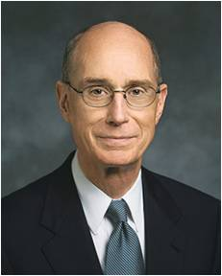
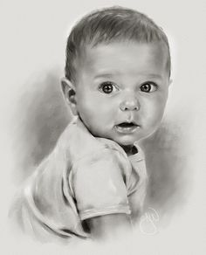
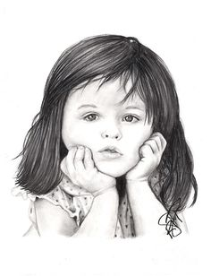
Become Like Little Children
Jesus Christ emphasized that greatness in the kingdom of heaven is achieved by being converted and humbling oneself as a little child. (1)
“To be like a child is not to be childish. It is to be like the Savior, who prayed to His Father for strength to be able to do His will and then did it. Our natures must be changed to become as a child” (2)

Slide 4
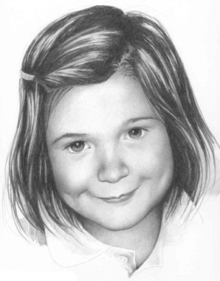
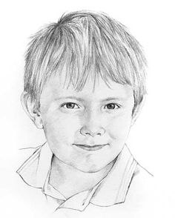
What are the characteristics of the little children?
Matthew 18:1-4
Margaret Scanlan
Betty Warren

Slide 5
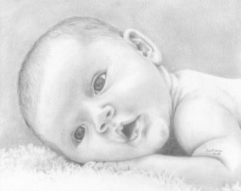
Trait
Innocence
Children are born innocent and free from sin

Slide 6
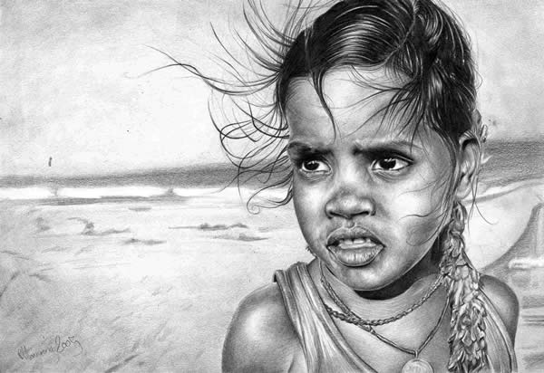
Trait
Humility
Children are not proud or arrogant

Slide 7
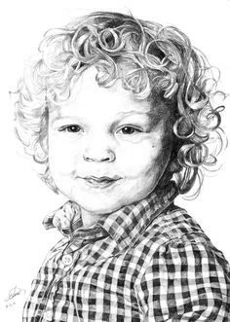

Trait
Teachable
Anna Gilhespy
Children do not have to see to believe
Irina Krivoruchko

Slide 8
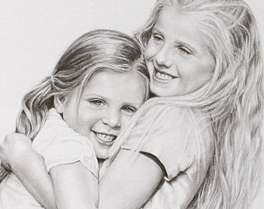
Trait
Love and forgiveness
Children forget anger and are soon friends again

Slide 9
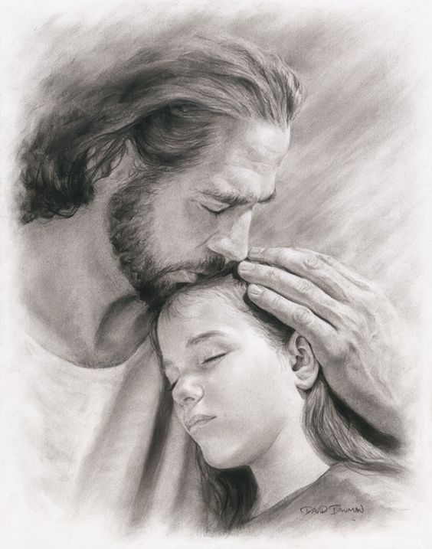
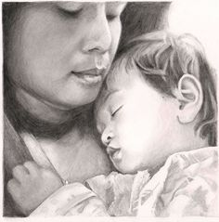
Trait
Dependence on parents
Children trust their parents and their Heavenly Father

Slide 10
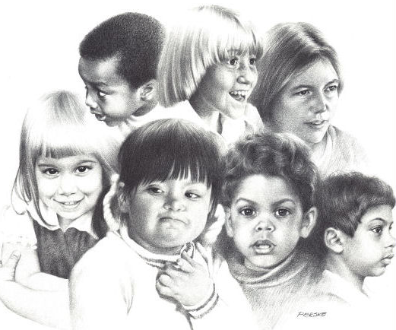
Trait
Lack of prejudice
Children more easily accept differences such as race and physical disabilities

Slide 11
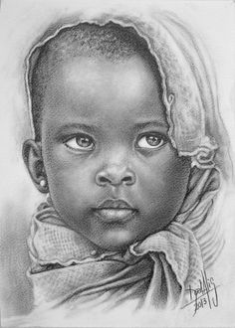
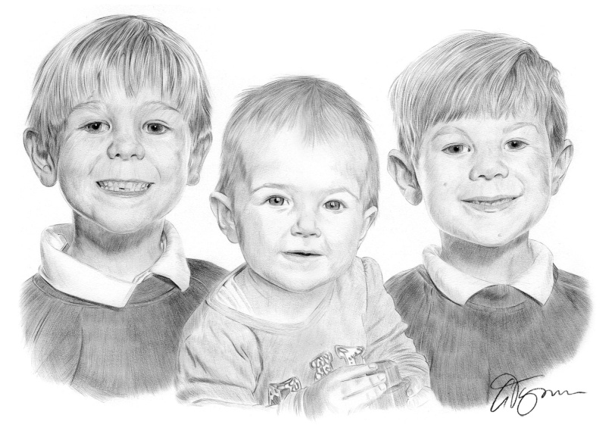
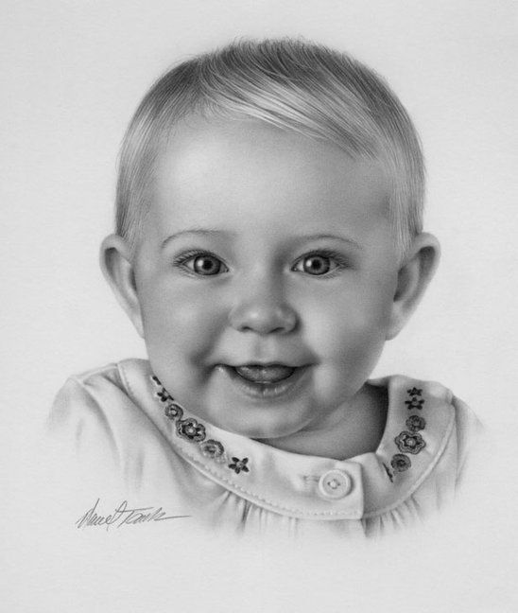
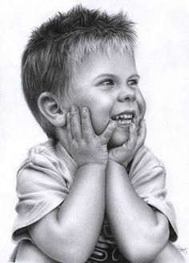
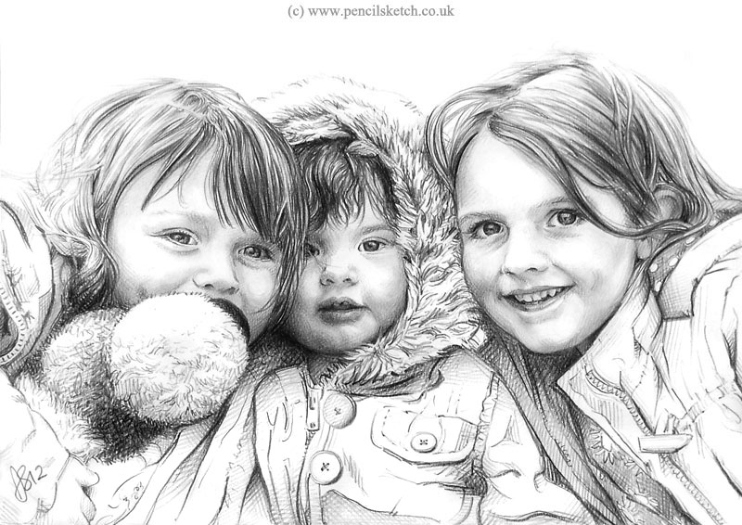
Gary Tymon
Darrel Tank
“How serious is it or harm the children of our Father in Heaven?”
Matthew 18:6

Slide 12
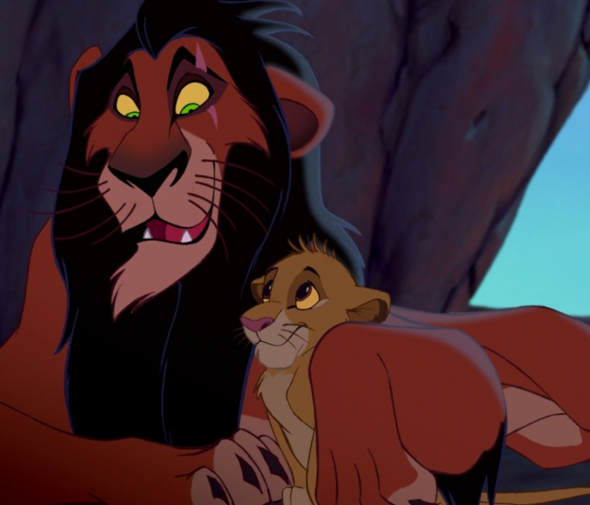

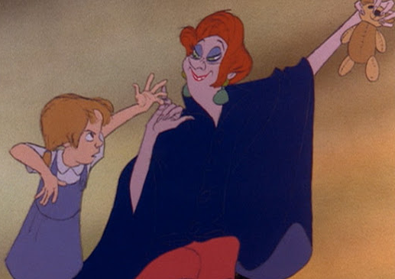
Offences
Which one of these would be the hardest to forgive?
Being betrayed by a friend
Having something stolen
Being lied to

Slide 13
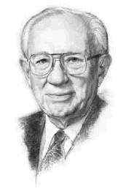
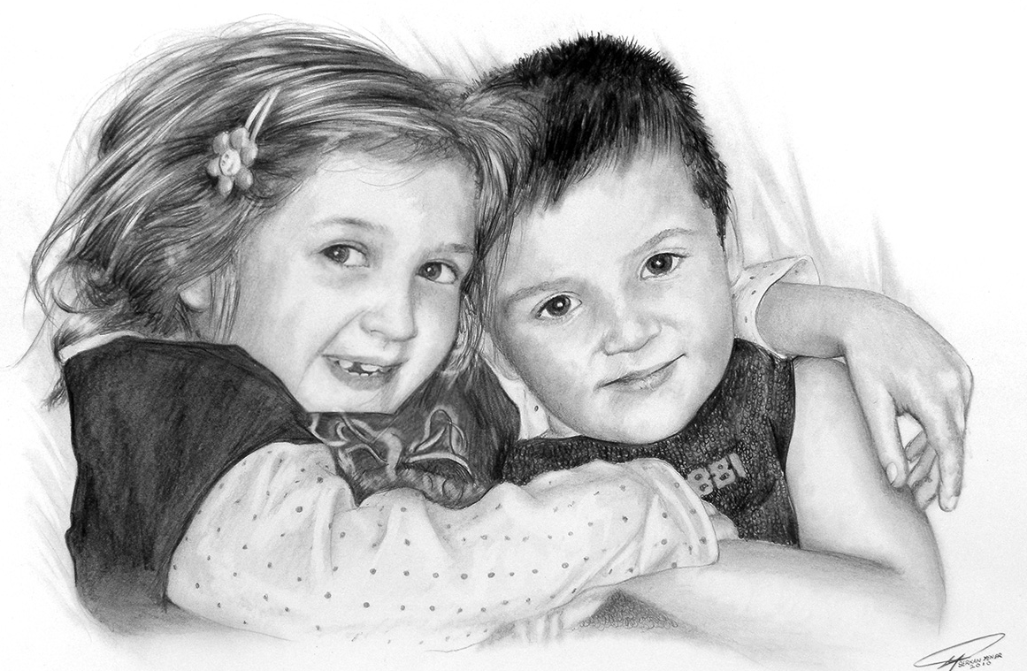
Who Shall Offend Them
"My plea-and I wish I were more eloquent in voicing it-is a plea to save the children. Too many of them walk with pain and fear, in loneliness and despair.
Children need sunlight. They need happiness. They need love and nurture. They need kindness and refreshment and affection.
Every home, regardless of the cost of the house, can provide an environment of love which will be an environment of salvation." (3)
Serkan Yener
Matthew 18:6-7

Slide 14

True or False
Them and They=Jesus and Heavenly Father
F
____It is frustrating to Them to forgive sinners, but They will do so if we sincerely repent.
____They would prefer that we repent so They can forgive us, but They are happy with whatever we choose.
____ They feel great joy in forgiving sinners who repent.
F
T
Matthew 18:11

Slide 15
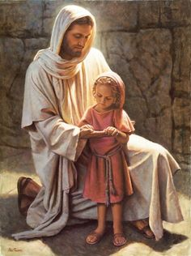
Love and Concern for All
For the Son of man is come to save that which was lost, and to call sinners to repentance; but these little ones have no need of repentance, and I will save them. (JST)
Matthew 18:11
Del Parson

Slide 16
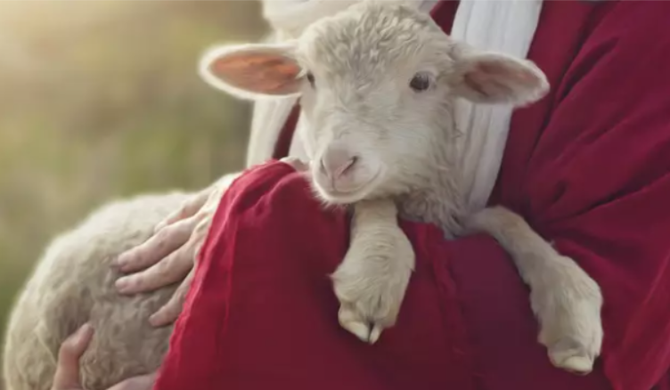
Those Who Are Spiritually Lost
Over the centuries, this parable [of the lost sheep] has traditionally been interpreted as a call to action for us to bring back the lost sheep and to reach out to those who are lost. While this is certainly appropriate and good, I wonder if there is more to it.
It matters not how you became lost—whether because of your own poor choices or because of circumstances beyond your control. …
Is it possible that Jesus’s purpose, first and foremost, was to teach about the work of the Good Shepherd?
Is it possible that He was testifying of God’s love for His wayward children? …
Because He loves you, He will find you. He will place you upon His shoulders, rejoicing. And when He brings you home,
He will say to one and all, “Rejoice with me; for I have found my sheep which was lost”
Matthew 18:11-14; Luke 15:6

Slide 17
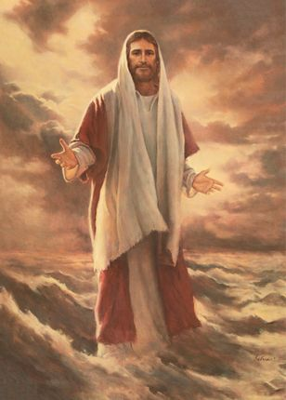

Those Who Have Gone Astray
All We Like Sheep= All of Us
The lost sheep that needs to be rescued by the Good Shepherd represents every one of us.
Matthew 18:11-14; Isaiah 53:6

Slide 18
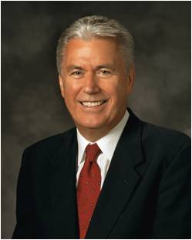

We Can Fail and Fall
We have all seen a toddler learn to walk. He takes a small step and totters. He falls. Do we scold such an attempt? Of course not. What father would punish a toddler for stumbling? We encourage, we applaud, and we praise because with every small step, the child is becoming more like his parents.
Now, brethren, compared to the perfection of God, we mortals are scarcely more than awkward, faltering toddlers. But our loving Heavenly Father wants us to become more like Him, and, dear brethren, that should be our eternal goal too. God understands that we get there not in an instant but by taking one step at a time. (9)
Matthew 18:11-14

Slide 19

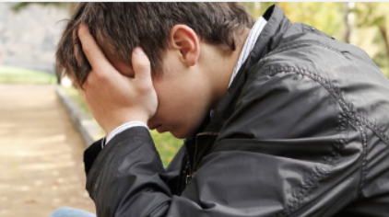
We Can Fail and Fall
I do not believe in a God who would set up rules and commandments only to wait for us to fail so He could punish us.
I believe in a Heavenly Father who is loving and caring and who rejoices in our every effort to stand tall and walk toward Him.
Even when we stumble, He urges us not to be discouraged—never to give up or flee our allotted field of service—but to take courage, find our faith, and keep trying.
(9)
Matthew 18:11-14

Slide 20
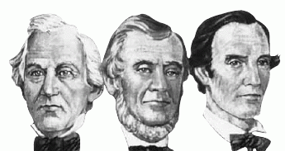
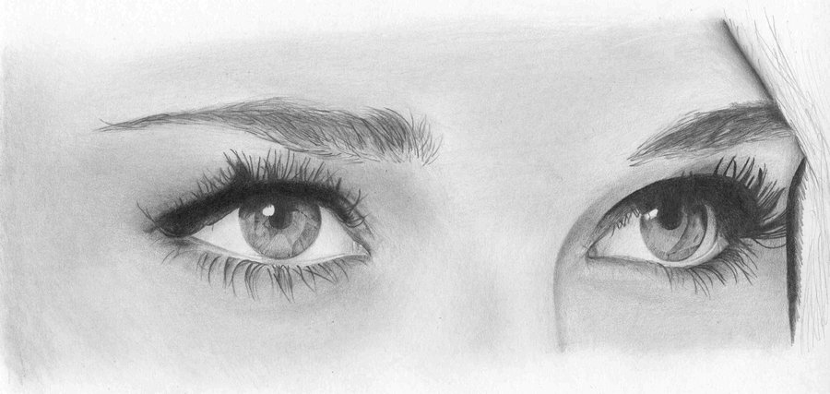
Law of Witness
The foundation of this law, which required that two or three witnesses establish or decide certain matters.
One witness shall not rise up against a man for any iniquity, or for any sin, in any sin that he sinneth: at the mouth of two witnesses, or at the mouth of three witnesses, shall the matter be established.
Deuteronomy 19:15
Matthew 18:16-20

Slide 21

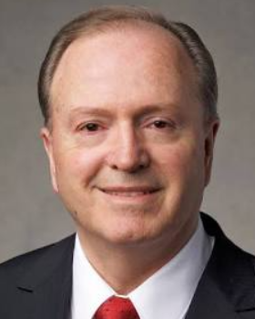
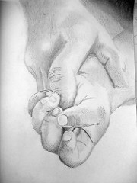
Law of Forgiveness
70 X 7 = Putting no limit on how many times we need to forgive
The Savior essentially told Peter to not even count—to not establish limits on forgiveness. …
Obviously, the Savior was not establishing an upper limit of 490. That would be analogous to saying that partaking of the sacrament has a limit of 490, and then on the 491st time, a heavenly auditor intercedes and says, “I’m so sorry, but your repentance card just expired—from this point forward, you’re on your own.”
The Lord used the math of seventy times seven as a metaphor of His infinite Atonement, His boundless love, and His limitless grace. “Yea, and as often as my people repent will I forgive them their trespasses against me” (4)
But if he trespass against thee the fourth time thou shalt not forgive him, but shalt bring these testimonies before the Lord; and they shall not be blotted out until he repent and reward thee four-fold in all things wherewith he has trespassed against thee.
D&C 98:44
Matthew 18:21-23 D&C 98:23-48; Mosiah 26:30

Slide 22
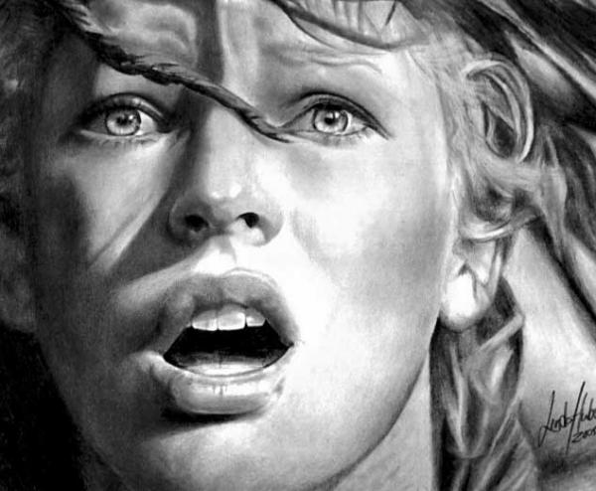
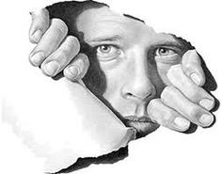
Forgiving With All Our Hearts
“A common error is the idea that the offender must apologize and humble himself to the dust before forgiveness is required. Certainly, the one who does the injury should totally make his adjustment, but as for the offended one, he must forgive the offender regardless of the attitude of the other. Sometimes men get satisfactions from seeing the other party on his knees and grovelling in the dust, but that is not the gospel way.” (6)
Linda Huber
“For if ye forgive men their trespasses, your heavenly Father will also forgive you:
“But if ye forgive not men their trespasses, neither will your Father forgive your trespasses.” (Matt. 6:14–15.)
Henry Ward Beecher expressed the thought this way: “I can forgive but I cannot forget is another way of saying I cannot forgive.”
Antonio Canova
Matthew 18:21-23

Slide 23
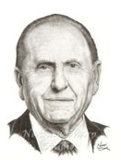
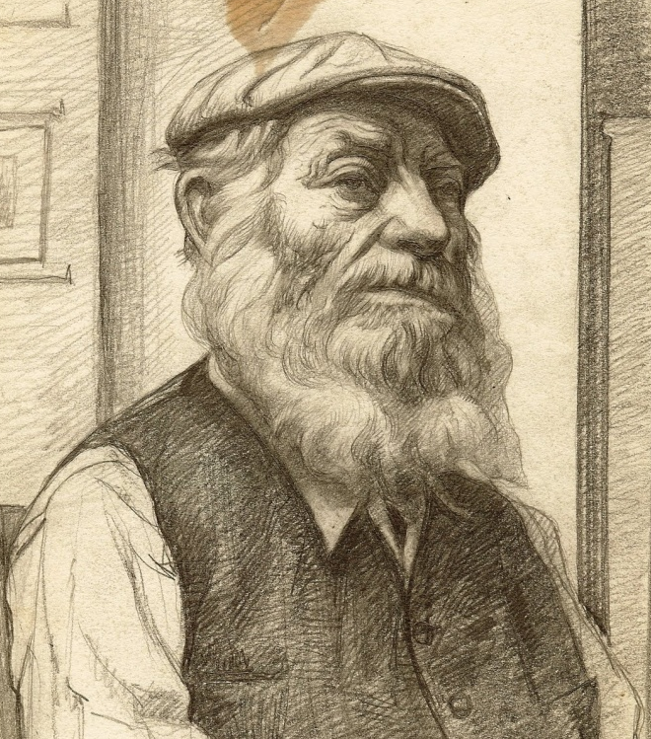
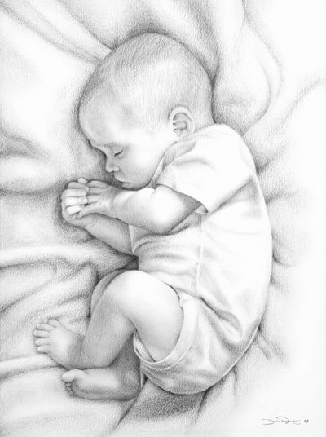
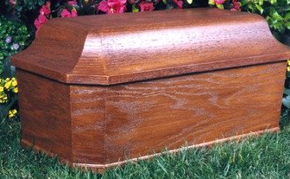
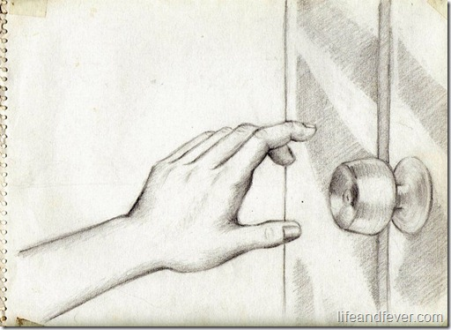
The Cabinet Maker
“[The] father was a cabinetmaker and fashioned a beautiful casket for the body of his precious child. The day of the funeral was gloomy, thus reflecting the sadness they felt in their loss. As the family walked to the chapel, with Father carrying the tiny casket, a small number of friends had gathered. However, the chapel door was locked. The busy bishop had forgotten the funeral. Attempts to reach him were futile. Not knowing what to do, the father placed the casket under his arm and, with his family beside him, carried it home, walking in a drenching rain” (6)
Would it be difficult to forgive the bishop?

Slide 24
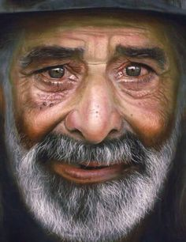
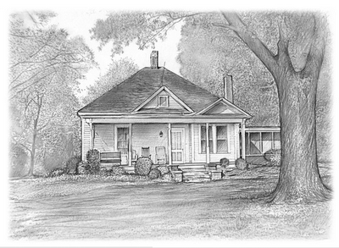
The Cabinet Maker—Cont.
“If the family were of a lesser character, they could have blamed the bishop and harbored ill feelings. When the bishop discovered the tragedy, he visited the family and apologized. With the hurt still evident in his expression, but with tears in his eyes, the father accepted the apology, and the two embraced in a spirit of understanding” (6)

Slide 25
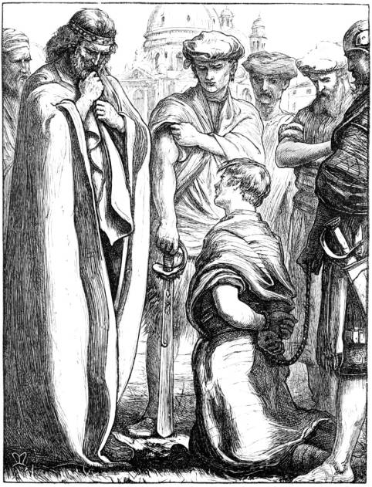

The Unmerciful Servant
King and Servant
In Jesus’s day “10,000 talents equaled 100,000,000 denarii [Roman currency]. One denarius was a typical day’s wage for a common laborer.”
King = Heavenly Father
Servant = Us
Fellowservant = Those who have offended us.
Servant and his fellowservant
100 pence was about 4 months worth of work
It would take 300,000 years to earn 10,000 talents assuming he worked 300 days a year
The Servant was to go into service and his family to pay the debt
The servant cast his fellowservant into prison until the dept was paid
The king was merciful and forgave his debts.
“One day, all of us will be called to account for our lives. Withholding forgiveness from others who have wronged us will prevent us from receiving the forgiveness we desperately need.” (7)
Matthew 18:23-27

Slide 26
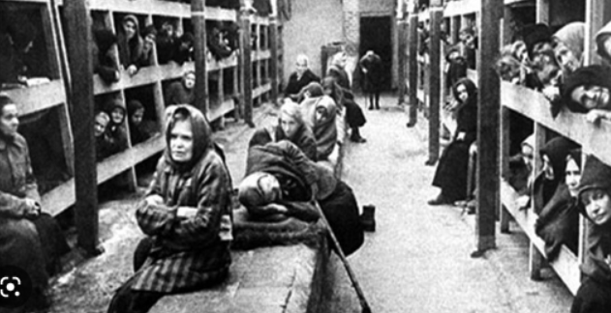
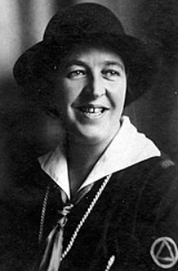
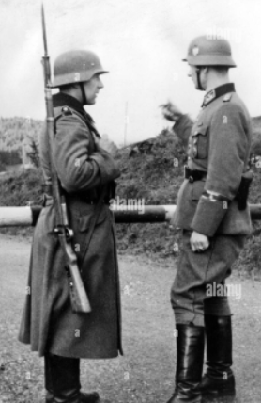
Will You Forgive Me?
During World War II, a woman named Corrie ten Boom suffered for months in a Nazi concentration camp in Ravensbrück, Germany. Her sister Betsie died there. Following the war, Corrie spoke to a group of people about the forgiveness of God.
A man approached her. She recognized him as one of the cruelest guards in the camp. “You mentioned Ravensbrück in your talk,” he said. “I was a guard there. … But since that time, … I have become a Christian.” He explained that he had sought God’s forgiveness for the cruel things he had done. He extended his hand and asked, “Will you forgive me?”
(10)
Matthew 18:21-23

Slide 27
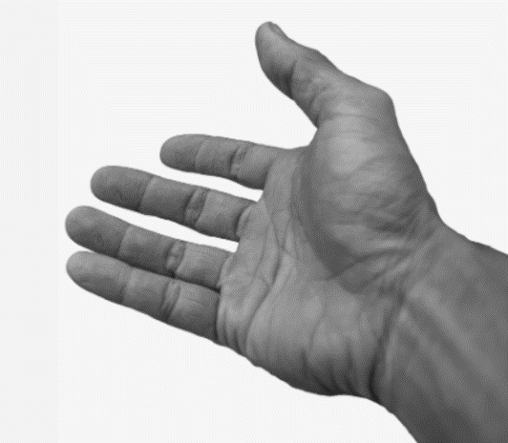
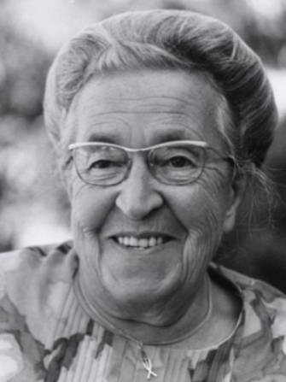
“It could not have been many seconds that he stood there—hand held out—but to me it seemed hours as I wrestled with the most difficult thing I had ever had to do.
“… The message that God forgives has a … condition: that we forgive those who have injured us. …
“… ‘Help me!’ I prayed silently. ‘I can lift my hand. I can do that much. You supply the feeling.’
“… Woodenly, mechanically, I thrust my hand into the one stretched out to me. As I did, an incredible thing took place. The current started in my shoulder, raced down my arm, sprang into our joined hands. And then this healing warmth seemed to flood my whole being, bringing tears to my eyes.
“‘I forgive you, brother!’ I cried. ‘With all my heart.’
“For a long moment we grasped each other’s hands, the former guard and the former prisoner. I had never known God’s love so intensely, as I did then”
(10)

Slide 28
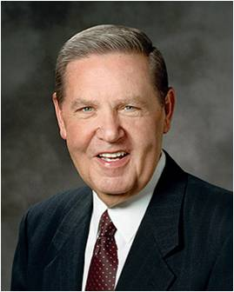
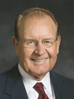
Feeling Pain
Does feeling pain for what was done to me mean I have not yet forgiven someone?
It is, however, important for some of you living in real anguish to note what [Jesus Christ] did not say. He did not say, “You are not allowed to feel true pain or real sorrow from the shattering experiences you have had at the hand of another.”
(11)
I would like to make it clear that forgiveness of sins should not be confused with tolerating evil. … Although we must forgive a neighbor who injures us, we should still work constructively to prevent that injury from being repeated.
(12)

Slide 29
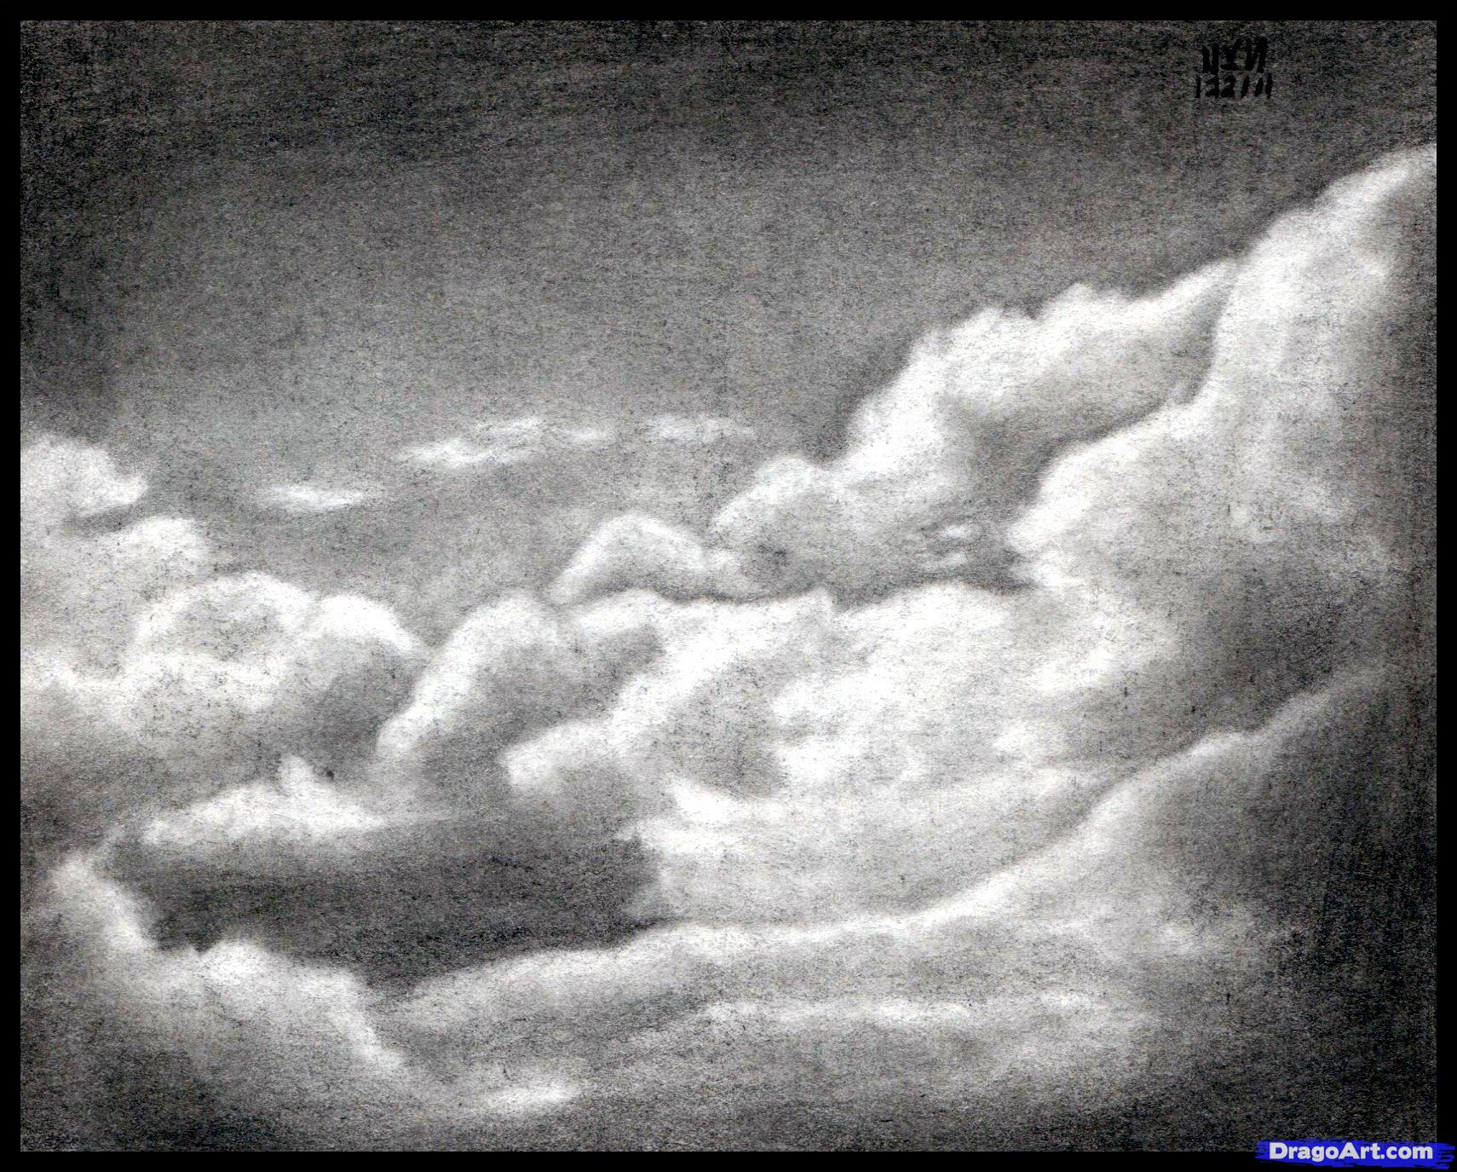
“Remember, heaven is filled with those who have this in common: They are forgiven. And they forgive”
(8)

Slide 30
Sources:
New Testament Institute Student Manual Chapter 6
President Henry B. Eyring (“As a Child,” Ensign or Liahona, May 2006, 15).
Gordon B. Hinckley (Ensign, November 1994, 54)
Lynn G. Robbins, “Until Seventy Times Seven,” Ensign or Liahona, May 2018, 23 President Spencer W. Kimball Chapter 9: Forgiving Others with All Our Hearts
President Thomas S. Monson “Hidden Wedges,” Ensign, May 2002, 19
John Bytheway Of Pig, Pearls, and Prodigals p. 53-55
President Dieter F. Uchtdorf(“The Merciful Obtain Mercy,” Ensign or Liahona, May 2012, 77).
Dieter F. Uchtdorf, “He Will Place You on His Shoulders and Carry You Home,” Ensign or Liahona, May 2016, 102; (Dieter F. Uchtdorf, “Four Titles,” Ensign or Liahona, May 2013, 58
[Corrie ten Boom, Tramp for the Lord (1974), 56]. Keith B. McMullin, “Our Path of Duty,” Ensign or Liahona, May 2010, 13
Jeffrey R. Holland, “The Ministry of Reconciliation,” Ensign or Liahona, Nov. 2018, 79
David E. Sorensen, “Forgiveness Will Change Bitterness to Love,” Ensign or Liahona, May 2003, 12
Presentation by ©http://fashionsbylynda.com/blog/

Slide 31
Little Children Matthew 18:6
"The innocence with which children come into the world is one of the awesome responsibilities of all who, in any way, influence their lives. And to see such unstained innocence neglected or abused, or exposed to evil or unwholesome influence, or warped by bad example, or by false teaching-or by failure to teach-is a sobering concern.
"There are many who have responsibility for teaching children: parents, teachers, friends, anyone who in any way enters their lives, including the makers and promoters of products, of policies; creators of entertainment, and the whole community, publicly and privately. And children in their innocence have a right to be protected from exploitation and from evil influence." Richard l. Evans (Conference Report, April 1969, Afternoon Meeting 73-74.)
Forgiveness Matthew 18:16-17
Rabbinism called upon the offender to initiate a course of reconciliation with his brother and specified that forgiveness should not be extended more than three times to any offender. His soul as yet not afire with the Holy Spirit, Peter asked a question that, as he must have then supposed, assumed a far more liberal rule than that imposed by the Rabbis. ‘Lord, how oft shall my brother sin against me, and I forgive him? till seven times?’ Jesus answered: ‘I say not unto thee, Until seven times: but, Until seventy times seven,’ meaning there is no limit to the number of times men should forgive their brethren” Elder Bruce r. McConkie (The Mortal Messiah: From Bethlehem to Calvary, 4 vols. [1979–81], 3:91).
Innocent Children Matthew 18:11 Infant Baptism
"The question of the innocence of children was also a matter that arose in discussions between the Christians and the Jews in the meridian of time. Paul emphasized that the law of circumcision and 'the tradition [should] be done away, which saith that little children are unholy; for it was had among the Jews' (D&C 74:6). Joseph Smith's translation of the Bible is a witness that Jesus had taught concerning the innocent status of children. 'Take heed that ye despise not one of these little ones,' the Master said, 'for I say unto you, That in heaven their angels [spirits] do always behold the face of my Father which is in heaven. For the Son of man is come to save that which was lost and to call sinners to repentance; but these little ones have no need of repentance, and I will save them' (JST Matthew 18:10-11; italics added; compare JST Matt. 19:13)."
"During the period of the Great Apostasy (after the first century of the Christian era) the doctrine of infant baptism again reared its ugly head.
Elder James E. Talmage has written, 'There is no authentic record of infant baptism having been practiced during the first two centuries after Christ, and the custom probably did not become general before the fifth century; from the time last named until the Reformation, however, it was accepted by the dominant church organization.' Elsewhere Elder Talmage observed: 'Not only was the form of the baptismal rite radically changed [during the time of the Apostasy], but the application of the ordinance was perverted. The practice of administering baptism to infants was recognized as orthodox in the third century and was doubtless of earlier origin. In a prolonged disputation as to whether it was safe to postpone the baptism of infants until the eighth day after birth-in deference to the Jewish custom of performing circumcision on that day-it was generally decided that such delay would be dangerous, as jeopardizing the future well-being of the child should it die before attaining the age of eight days, and that baptism ought to be administered as soon after birth as possible.'"(Robert L. Millet, The Power of the Word: Saving Doctrines from the Book of Mormon, 252.)
Forgiveness Matthew 18:16-17
A variation of this theme is being taught here by the Savior. If you have tried to privately resolve a conflict and have been rejected, the case should be brought before witnesses and then the elders of the Church for resolution (see DC 42:88-89). This gives the individual three chances to reconcile differences. If the person is unrepentant, the Lord does not expect us to forgive him-he may be considered as a 'heathen man and a publican.' While not meant to detract from the importance of forgiveness, this doctrine is reassuring to those who have been repeatedly violated. The Lord does not expect us to be forever trampled upon. His saints are not to be the doormats of the world. The Lord taught us that we should turn the other cheek (Matt 5:39), but he didn't give us 490 cheeks to turn.
Gospeldoctrine.com
“We need to recognize and acknowledge angry feelings. It will take humility to do this, but if we will get on our knees and ask Heavenly Father for a feeling of forgiveness, He will help us. The Lord requires us ‘to forgive all men’ [D&C 64:10] for our own good because ‘hatred retards spiritual growth’ [Orson F. Whitney, Gospel Themes(1914), 144]. Only as we rid ourselves of hatred and bitterness can the Lord put comfort into our hearts. …
“… When tragedy strikes, we should not respond by seeking personal revenge but rather let justice take its course and then let go. It is not easy to let go and empty our hearts of festering resentment. The Savior has offered to all of us a precious peace through His Atonement, but this can come only as we are willing to cast out negative feelings of anger, spite, or revenge. For all of us who forgive ‘those who trespass against us’ [Joseph Smith Translation, Matthew 6:13], even those who have committed serious crimes, the Atonement brings a measure of peace and comfort” (James E. Faust, “The Healing Power of Forgiveness,” Ensign or Liahona, May 2007, 69).

Slide 32

Parable of the Good Samaritan
Luke 10:1-37
Thou shalt love the Lord thy God with all thy heart, and with all thy soul, and with all thy strength, and with all thy mind; and thy neighbour as thyself. Luke 10:27

Slide 33


Do you ever feel like you have too much responsibility?
Holy Bible
The
Book
of
Mormon
Doctrine
And
Covenants
ANOTHER TESTAMENT
OF JESUS CHRIST

Slide 34
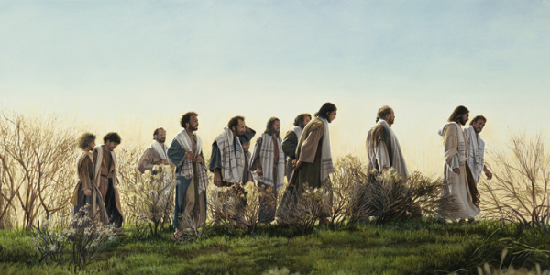
Appointing the Seventy
An office in the Melchizedek Priesthood
Luke is the only Gospel writer to record that Jesus Christ called the Seventy, in addition to the Twelve Apostles, to preach the gospel and prepare the way for Him.
The Savior’s calling of the Seventy and instructions to them were similar to the instructions He gave to His Twelve Apostles.
See Matthew 10
Luke 10:1-16
(1)

Slide 35
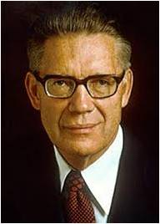

Modern Day Seventy
Because modern Apostles cannot go everywhere they are needed, they assign members of the Seventy to minister in their stead.
“Each of the Seventy has had conferred upon him the apostolic authority. … The Seventy go where the Twelve, limited by their number, cannot. Seventies are scattered across the world, as they were in the early days of the Church.”
The Seventy today are called to be “traveling ministers”, while deacons and teachers and elders are appointed to be “standing ministers unto the church.”
Luke 10:1-16; D&C 107:97; D&C 84;111; D&C 124:137
(1,2)

Slide 36


The Need For Laborers
“I repeat what prophets have long taught—that every worthy, able young man should prepare to serve a mission. Missionary service is a priesthood duty—an obligation the Lord expects of us who have been given so very much. Young men, I admonish you to prepare for service as a missionary. …
“A word to you young sisters: while you do not have the same priesthood responsibility as do the young men to serve as full-time missionaries, you also make a valuable contribution as missionaries, and we welcome your service.”
(3)

Slide 37

Worldwide Statistics
As of 2021
Missionaries | 54,539
Missions | 411
Mission Training Centers | 10
Seminary Students Enrolled | Over 400,000
Just think: if all the Senior Seminary Students enrolled in last year, graduating class of 2021 went on missions in the next year or two, what would be the result?
(4)

Slide 38

Who is My Neighbor?
To obtain eternal life we must love God and love our neighbor as ourselves
The Parable of the
Good Samaritan Luke 10:30-37

Slide 39


Went down…
One early Christian writer saw in this phrase the descent of Adam from the garden into this world – from immortality to mortality.
The story implies that the man went down intentionally, knowing the risks that would be involved in the journey. No one forced him to go down to Jericho.
He apparently felt that the journey was worth the well-known risks of such travel.
(5)

Slide 40

Jesus depicts the person as going down from Jerusalem.
Because of the sanctity of the holy temple-city, early Christians readily saw in this element the idea that a person had come down from the presence of God.
Bourges
(5)

Slide 41

To Jericho…
Jericho was identified with this world
Jericho is the lowest city on earth
(825 feet below sea level)
(5)

Slide 42


Fell…
It is easy to see here an allusion to the fallen mortal state and to the plight of individual sinfulness:
  “Yea, all are fallen and are lost.” Alma 34:9
The parable of the Woman Taken in Adultery by James C. Christensen
(5)

Slide 43


Among thieves…
The early Christian writers variously saw the thieves or robbers as the devil and his satanic forces, evil spirits, or false teachers.
These thieves were not casual operators.
The traveler was assailed by a band of pernicious highwaymen in a scheming, organized society that acted with deliberate and concerted intent.
Who are the thieves of Today?
(5)

Slide 44

This scene from the Bourges window shows the traveler falling among robbers and appears in the context of scenes depicting the creation and fall of Adam.
(5)

Slide 45

Which stripped him of his raiment…
The attackers apparently wanted the traveler’s clothing, for no mention is made of any wealth or commodities he might be carrying.
For some reason, the robbers seem interested in his garment, something brought down from the holy place and something they envy and want to take away.
What are some of the things people might want to take away from you?
(5)

Slide 46

And wounded him…
This term was seen as a similitude of the pains of life, travails of the soul, and afflictions due to diverse sins and vices. Indeed, the enemies of the soul leave wounds.
Transgression has real effects.
(5)

Slide 47

Half dead…
The robbers departed, leaving the person precisely “half dead.” We may see in this detail an allusion to the first and second deaths.
The person had fallen, had become subject to sin, and had suffered the first death, becoming mortal.
But the second death, the permanent separation from God, could still be averted.

Slide 48

Luke 10:31-32
“And by chance there came down a certain priest (representing the law of Moses) that way: and when he saw him, he passed by on the other side.”
“And likewise a Levite” -representing the Old Testament prophets, whose word the Lord came to fulfill
The Levite came close to helping – perhaps he wanted to help, but he lacked the power to save the dying person.

Slide 49

This scene in the window at Bourges with the priest and Levite is surrounded by images of Moses.
Notice the golden calf in the lower right scene.

Slide 50

Luke 10:33-34
“But a certain Samaritan, as he journeyed, came where he was: and when he saw him, he had compassion on him, and went to him, and bound up his wounds, pouring in oil and wine…”
What do these key words symbolize?

Slide 51

Bound his wounds…
Do the bandages represent love, faith and hope, “ligatures of salvation which cannot be undone?”
Does Christ bind us up with his teachings?
Do we understand that we are bound to the Lord through covenants?

Slide 52


Oil…
An olive oil lotion is very soothing.
One early author, Chrysostom, saw this as a “holy anointing” – which may refer to several priesthood ordinances, the healing of the sick, the gift of the Holy Ghost (often symbolized by olive oil), or the anointing of a king or queen.

Slide 53

Wine…
In addition to rendering physical help, a truly good Samaritan administers the saving principles and ordinances of the gospel as well.
The wine may sting at first, but its effects soon bring healing peace.
The Repentance process is very difficult at first, but you can be forgiven and spiritually healed.
(5)

Slide 54

Set him on his own beast
Christ, fulfilling prophecy, bears our infirmities. The Samaritan’s beast was thought to symbolize Christ’s body.
Being placed on his beast is to believe that God became flesh, bore our sins, and suffered for us.
(5)

Slide 55



And brought him to an inn…
For the early Christians this element readily symbolized the Church. An “inn” was a “public house open to all.”
A public shelter is comparable to the Church of Christ in several ways.
A wayside inn is not the heavenly destination but a necessary aid in helping travelers reach their eternal home.
(5,6)

Slide 56

Early commentators believed the Samaritan stayed with the traveler through the night in the inn
(5)

Slide 57

Luke 10:35
“And on the morrow when he departed, he took out two pence, and gave them to the host, and said unto him, Take care of him; and whatsoever thou spendest more, when I come again, I will repay thee.”
On the morrow – Early commentators saw here the idea that Jesus would rise on Resurrection morning. Christ ministered in person to His disciples for a short time. After His Ascension, He left the traveler to be cared for by the Church.
(5)

Slide 58

Two Pence could symbolize…
The father and the Son
Old and New Testament
Two priesthoods
Two witnesses to the truth
The two denarii represented two days’ wages. These coins could well represent making adequate provision for the needs of the person.
The temple tax for each male was two denarii (half a shekel).
(5)

Slide 59

On our dusty roads to Jericho, we are beset upon, wounded, and left in pain.
Though we should help each other, too often we pass to the other side of the road, for whatever reason.
However, with compassion, the Good Samaritan stops and binds our wounds with wine and oil. Symbols of the sacrament and other ordinances, the wine and oil point us to the spiritual healing in Jesus Christ.
The Good Samaritan puts us on His own donkey or, in some stained-glass accounts, carries us on His shoulders. He brings us to the inn, which can represent His Church. At the Inn, the Good Samaritan says, “Take care of him; … when I come again, I will repay thee”.
The Good Samaritan, a symbol of our Savior, promises to return, this time in majesty and glory.
(7)
Luke 10:35

Slide 60

Jesus Christ is our most exemplary neighbor!
How can we be like Him?
Who is our neighbor?
Simon Dewey
(5)

Slide 61


Opportunities to serve others in meaningful ways, as we have covenanted to do, rarely come at convenient times. But there is no spiritual power in living by convenience. The power comes as we keep our covenants.
(7)
Never let a problem to be solved become more important than a person to be loved.
(8)

Slide 62

Jesus Christ our Savior will rescue us, each one of us, in sin, transgression, sickness, loneliness, all that and more
Go, and do thou likewise
wraithdt
(6)

Slide 63
Sources:
New Testament Institute Student Manual Chapter 17
Elder Bruce R. McConkie Fledgling Finches and Family Life [Brigham Young University devotional, Aug. 18, 2009], 4;speeches.byu.edu).
President Thomas S. Monson (“As We Meet Together Again,” Ensign or Liahona, Nov. 2010, 5–6).
Mormon news room facts and statistics
Various slides by Becky Davies and Lesley Meacham of Poway Institute in California
Various slides by Author of Website
Gerrit W. Gong, “Room in the Inn,” Liahona, May 2021, 24–25
M. Russell Ballard, “Like a Flame Unquenchable,” Ensign, May 1999, 86
Thomas S. Monson, “Finding Joy in the Journey,” Ensign or Liahona, Nov. 2008, 86
Presentation by ©http://fashionsbylynda.com/blog/

Slide 64
Event | Matthew | Mark | Luke | John
Parable of the Good Samaritan |  |  | 10:25-37
Jesus Visit Mary and Martha |  |  | 10:38-42
Return of the Seventy | 11:25-27 |  | 10:17-24
Seventies Luke 10:1-2:
This same office exists in the restored Church today. (If possible, show the pages titled “General Authorities and General Officers of The Church of Jesus Christ of Latter-day Saints” in the most recent conference issue of the Ensign or Liahona.) There are now multiple quorums of the Seventy, though only members of the first two quorums are called as General Authorities. Each quorum may have up to 70 members. Their work to preach the gospel and help administer the Church is directed by the Quorum of the Twelve Apostles and the Presidency of the Seventy. Guide to the scriptures
Jews and Samaritans:
There was considerable antipathy between the Jews and the Samaritans at the time of Christ. Under normal circumstances, these two groups avoided association with each other. It would still be a good, instructive parable if the man who fell among thieves had been rescued by a brother Jew.
His deliberate use of Jews and Samaritans clearly teaches that we are all neighbors and that we should love, esteem, respect, and serve one another despite our deepest differences﻿—including religious, political, and cultural differences.
(M. Russell Ballard, “Doctrine of Inclusion,” Ensign or Liahona, Nov. 2001, 36)
The Harvest is Great Luke 10:2:
I repeat what prophets have long taught—that every worthy, able young man should prepare to serve a mission. Missionary service is a priesthood duty—an obligation the Lord expects of us who have been given so very much. Young men, I admonish you to prepare for service as a missionary. …
“A word to you young sisters: while you do not have the same priesthood responsibility as do the young men to serve as full-time missionaries, you also make a valuable contribution as missionaries, and we welcome your service” President Thomas S. Monson (“As We Meet Together Again,” Ensign or Liahona, Nov. 2010, 5–6).
Go, and do thou likewise Luke 10:37:
“Each of us, in the journey through mortality, will travel his own Jericho Road. What will be your experience? What will be mine? Will I fail to notice him who has fallen among thieves and requires my help? Will you? Will I be one who sees the injured and hears his plea, yet crosses to the other side? Will you? Or will I be one who sees, who hears, who pauses, and who helps? Will you?
“Jesus provided our watchword: ‘Go, and do thou likewise.’ When we obey that declaration, there opens to our view a vista of joy seldom equaled and never surpassed. …
“… When we walk in the steps of that good Samaritan, we walk the pathway that leads to perfection” President Thomas S. Monson (“Your Jericho Road,” Ensign, Feb. 1989, 2, 4).

Slide 65



Slide 66

Elements from this window in Sens are organized by the themes they represent. The parable of the good Samaritan uses the three central panes of the windows, while themes from the plan of salvation, including the Fall of Adam and Eve and the Crucifixion of the Savior surround the parable to complete the window.
Ensign, The Good Samaritan Forgotten Symbols, by John W. Welch, 47

Slide 67

Fell among the thieves
Here the themes of the parable of the Good Samaritan are digitally isolated on the right.
Ensign, The Good Samaritan Forgotten Symbols, 47
Priest and Levite pass by
Taken to the inn

Slide 68

Window at Sens Cathedral
Luke 10:35

Slide 69
Parable | Symbolically | Me
Certain Man | All mankind | Me
Jerusalem (2700 ft above sea level) “Went down” to Jericho (80 ft below sea level) | Left the premortal existence From the presence of God To the world | Spiritual death
Fell among thieves | A fallen state to Satan (false teachings) | The world and its ways
Stripped of raiment | The experiences of mortality | Sin (Human)---natural man
Wounded | Subject to first death 2nd death-a permanent separation from God | Sin and Vices
Levite Priest—left him | Those with partial authority can’t save. | Priesthood

Slide 70
Parable | Symbolically | Me
Half Dead | Christ was half divine half mortal which is the symbolism of a Samaritan | Only Jesus can save
Samaritan | Jesus—purposely look for people—pure love of Christ | Service and Charity towards one another.
Had Compassion on Him | Christ is compassionate Greek word: Charis---means Grace. Pure love of Christ | The action we take towards one another.
Bind Wounds | Jesus Helps those in need. Binds him with covenants | Knowing when to ask for help. Putting a band-aid on symbolically
Pours oil | The healing of the Holy Ghost with Peace and Knowledge | Olive oil used in anointing, with worthiness
Pours wine | The Atonement, representing His Blood | It may sting at first but then it heals

Slide 71
Parable | Symbolically | Me
Set on Beast | Donkey is the symbol of “Peace” When one road in on a donkey it was in Peace, when one rode in on a horse it meant “War” | What animal do we ride in on?
Took him to the Inn | Church, where he will be taken care of. Leaving him there in Good hands | Spiritually weak we go to church and take the sacrament. Souls who are wafting to be repaired. A place to get healed. Physically weak we go to the Hospital.
The Innkeeper | Agents of Christ, one to help bring back into the fold. Church leaders. | Prophets, bishops, Priesthood holders, teachers, etc.
On the morrow. Paid what he owed | Born again. Covering all the cost, a reward , an eternal round | Repentance and the Atonement He will rescue us in our sins
When I come again | The Second Coming | Christ will come again to live on the earth. The Millennium
Repay | Christ covers all costs through the Atonement and rewards well | Repentance will bring you back to the arms of Heavenly Father, for Christ has paid that through the Atonement. All may receive forgiveness.

Slide 72
Luke 10:38-42

Slide 73

A Home of Friendship
After teaching the parable of the good Samaritan in Jericho, the Savior traveled to Bethany and visited the home of a woman named Martha.
Hospitality was very important in Jewish society, and a woman’s honor and reputation depended partly on how well she fulfilled cultural expectations regarding the role of hostess. (1)
Jericho
Jerusalem
Bethany
Luke 10:38

Slide 74

Cumbered—Being Burdened
Martha was trying to do what would normally have been expected of her as the hostess. She was focused on temporal concerns such as preparing and serving the meal.
Because of the social customs, Martha’s complaint that her sister, Mary, had left her to serve alone would have been seen as justified by many people of the time. (1)
Walter Rane
Luke 10:38-42

Slide 75


“Mary Hath Chosen The Good Part”
One of the things the Savior’s response clarified is that there are higher priorities than social customs, even if they are good customs. (1)
“Just because something is good is not a sufficient reason for doing it. The number of good things we can do far exceeds the time available to accomplish them. Some things are better than good, and these are the things that should command priority attention in our lives...
It was praiseworthy for Martha to be ‘careful and troubled about many things’, but learning the gospel from the Master Teacher was more ‘needful.’” (2)
Luke 10:38-42

Slide 76




“Consider how we use our time in the choices we make in viewing television, playing video games, surfing the Internet, or reading books or magazines. Of course it is good to view wholesome entertainment or to obtain interesting information.
But not everything of that sort is worth the portion of our life we give to obtain it. Some things are better, and others are best. …
“Some uses of individual and family time are better, and others are best.
We have to forego some good things in order to choose others that are better or best because they develop faith in the Lord Jesus Christ and strengthen our families” (2)
If we choose to devote ourselves to spiritual matters over temporal concerns, then we will receive lasting blessings
Luke 10:38-42

Slide 77
Sources:
New Testament Institute Student Manual Chapter 17
Elder Dallin H. Oaks (“Good, Better, Best,” Ensign or Liahona, Nov. 2007, 104–5, 107).
Bible Dictionary
4. J. Jeremias, the Prayers of Jesus, London 1967 P 98
Presentation by ©http://fashionsbylynda.com/blog/

Slide 78
Martha’s Faith Luke 10:39-42:
“Many Sunday lessons have been taught using this story which have cast Martha in a lesser position in terms of her faith. Yet there is another story of this great woman, Martha, which gives us a deeper view of her understanding and testimony. It happened when the Savior arrived to raise her brother, Lazarus, from the dead. On this occasion it was Martha whom we find going to Jesus ‘as soon as she heard’ He was coming.”
The Savior shared with Martha the “great doctrine of the resurrection” and asked her if she believed in Him.
“She responded with her powerful testimony: ‘Yea, Lord: I believe that thou art the Christ, the Son of God, which should come into the world’ [see John 11:20–27]. …
“Many a sister has often heard the first story and wondered if she were a Mary or a Martha, yet the truth lies in knowing the whole person and in using good judgment. By knowing more about Martha, we find she was actually a person of deep spiritual character who had a bold and daring testimony of the Savior’s mission and His divine power over life. A misjudgment of Martha may have caused us not to know the true nature of this wonderful woman.” Elder Gregory A. Schwitzer (“Developing Good Judgment and Not Judging Others,” Ensign or Liahona, May 2010, 103–4).
Keeping Focused:
Are there so many fascinating, exciting things to do or so many challenges pressing down upon you that it is hard to keep focused on that which is essential? When things of the world crowd in, all too often the wrong things take highest priority. Then it is easy to forget the fundamental purpose of life. Satan has a powerful tool to use against good people. It is distraction. He would have good people fill life with “good things” so there is no room for the essential ones. Have you unconsciously been caught in that trap?
(Richard G. Scott, “First Things First,” Ensign, May 2001, 7)
Martha’s Request:
Within Martha’s request for assistance was an unspoken but clear judgment: “I am right; she is wrong.”
Do we judge one another? Do we criticize each other for individual choices, thinking we know better, when in fact we rarely understand another’s unique circumstance or individual inspiration? … Such judgments … rob us of the good part, that pure love of Christ.
We also lose sight of that good part when we compare ourselves to others. Her hair is cuter, my legs are fatter, her children are more talented, or her garden’s more productive—sisters, you know the drill. We just can’t do that. We cannot allow ourselves to feel inadequate by focusing on who we aren’t instead of on who we are!
(Bonnie D. Parkin, “Choosing Charity: That Good Part,” Ensign or Liahona, Nov. 2003, 105)
Serving:
Just because something is good is not a sufficient reason for doing it. The number of good things we can do far exceeds the time available to accomplish them. Some things are better than good, and these are the things that should command priority attention in our lives.
(Dallin H. Oaks, “Good, Better, Best,” Ensign or Liahona, Nov. 2007, 104)
Adversary:
The adversary will try to persuade you that spiritual nourishment isn’t necessary or, more cunningly, that it can wait. He is the master of distraction and author of procrastination. He will bring things to your attention that seem urgent but in reality aren’t that important. He would have you become so “troubled about many things” that you neglect the “one thing [that] is needful” [ Luke 10:41–42 ].
(Steven W. Owen, “Be Faithful, Not Faithless,” Ensign or Liahona, Nov. 2019, 13)

