Slide 1
Joseph Smith—Matthew 1; Matthew 25; Mark 12–13; Luke 21

Slide 2
Revealing the Second Coming
Joseph Smith—Matthew
Matthew 24
Including:
Prophecy of the Destruction of Jerusalem and the temple
“For behold, and lo, vengeance cometh speedily upon the ungodly as the whirlwind; and who shall escape it?
“Nevertheless, Zion shall escape if she observe to do all things whatsoever I have commanded her.”
Doctrine and Covenants 97: 22, 25

Slide 3
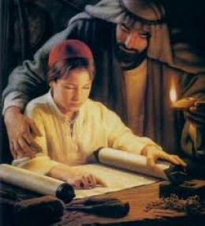
Jewish Customs
A father was clearly responsible for his children’s education. In addition to teaching his trade to his sons, a father would be highly concerned with their moral and religious education, since a father’s duty was to teach his children the commandments.
For he established a testimony in Jacob, and appointed a law in Israel, which he commanded our fathers, that they should make them known to their children: Psalms 78:5
A father was also required by law to teach his children the meaning and purpose behind the great feasts and the customs associated with them.
And thou shalt shew thy son in that day, saying, This is done because of that which the Lord did unto me when I came forth out of Egypt. Exodus 13:8
(1)

Slide 4
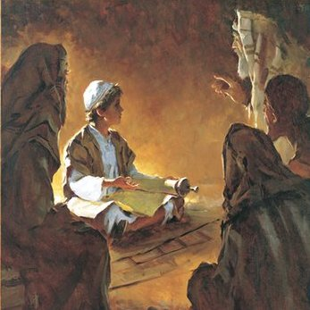
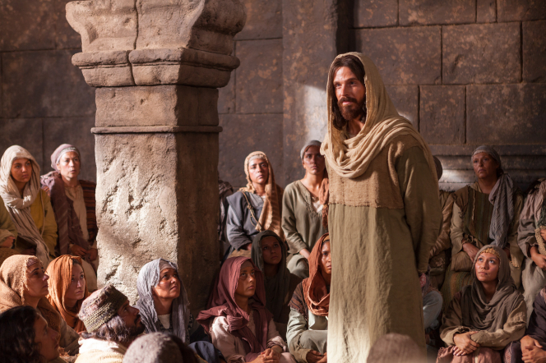
Jesus’ Education and Training
Simon ben-Shetach, the brother of Queen Alexandra (who reigned over Judea from 76 to 67 B.C.), enacted that “children shall attend the elementary school.”(2)
There is some uncertainty that this was universally observed, but this enactment indicates the value that the Jewish people at the time of Christ placed on education. It is likely that many young boys did in fact enjoy some formal education.
We do not know whether Jesus received any formal education, particularly in light of JST Matthew 3:24–26 [JST, Matt. 3:24–26], in which we learn that Jesus “spake not as other men, neither could he be taught; for he needed not that any man should teach him.”
The central site of formal education at the time of Christ was the synagogue, which served as a place of both worship and study.
This use of the synagogue contrasts with that of the temple, which served as a place of ritual performance and worship but not of formal study.
(1)

Slide 5
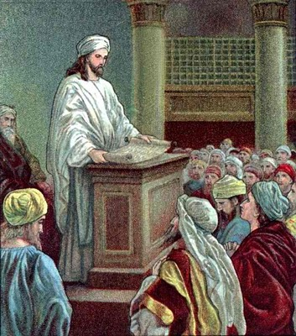
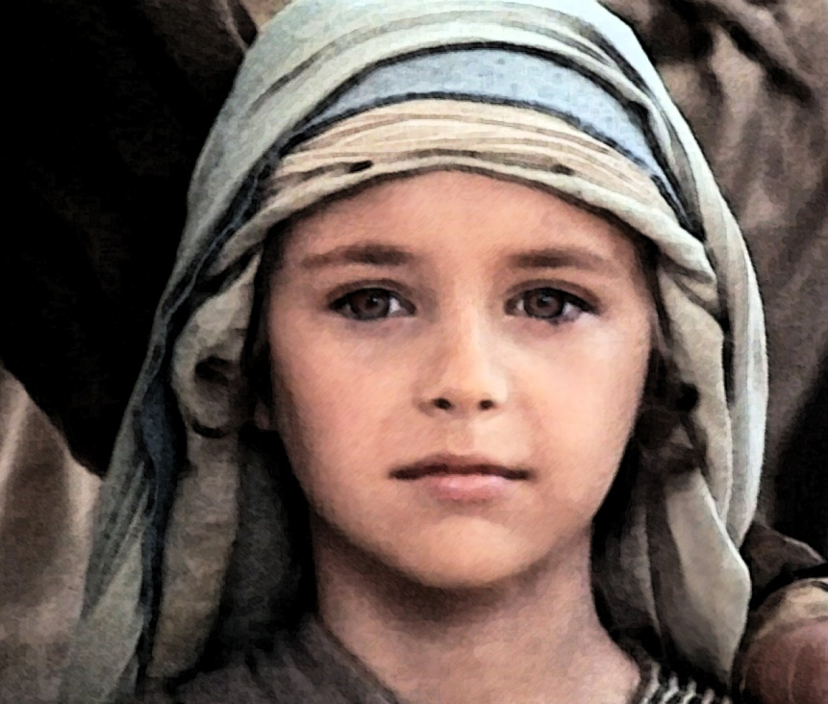
Knowledge of the Law
The exact knowledge of the law and the ability to interpret the scriptures was the goal of education among the Jews.
Though we may not know the details of how Jesus was educated, we do know that he fulfilled the goal of Jewish education better than any other person who ever lived.
(1)

Slide 6
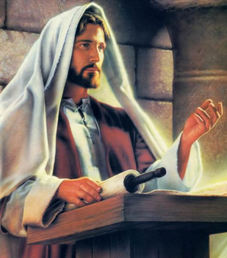
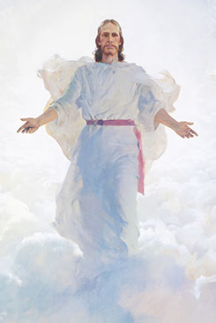
Joseph Smith Translation
Joseph Smith—Matthew is the Joseph Smith Translation of Matthew 23:39 and Matthew 24-25. Found in the Pearl of Great Price
As Jesus Christ taught at the temple in Jerusalem, His disciples understood that He would return to the earth.
Jesus then left the temple, and His disciples came to Him, wanting to know more about when the temple would be destroyed.

Slide 7
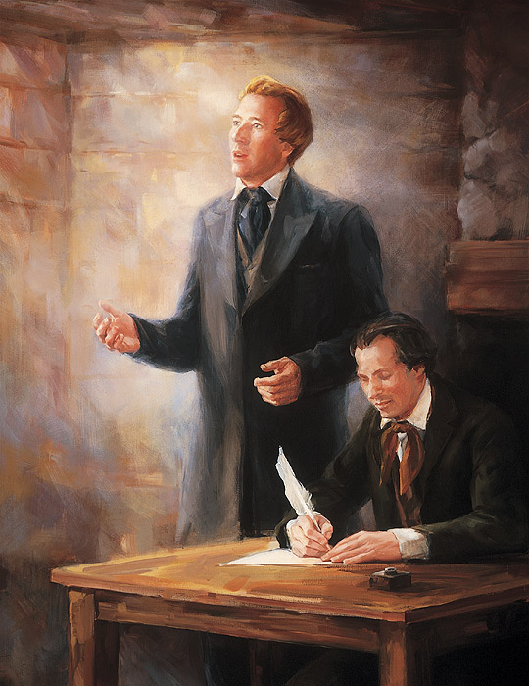
Changes to Matthew 24
The Prophet Joseph Smith made more changes to Matthew 24 than to any other chapter in the New Testament. Matthew 24 in the King James Version contains 1,050 words, while Joseph Smith—Matthew contains some 1,500.
And now, behold, I say unto you, it shall not be given unto you to know any further concerning this chapter, until the New Testament be translated, and in it all these things shall be made known;
Wherefore I give unto you that ye may now translate it, that ye may be prepared for the things to come.
For verily I say unto you, that great things await you;
D&C 45:60-62
A date written on one of the manuscripts of the New Testament translation indicates that on 26 September 1831 the transcription and refinement of Matthew continued, starting with Matthew 26:1
(9)

Slide 8
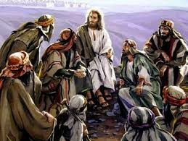
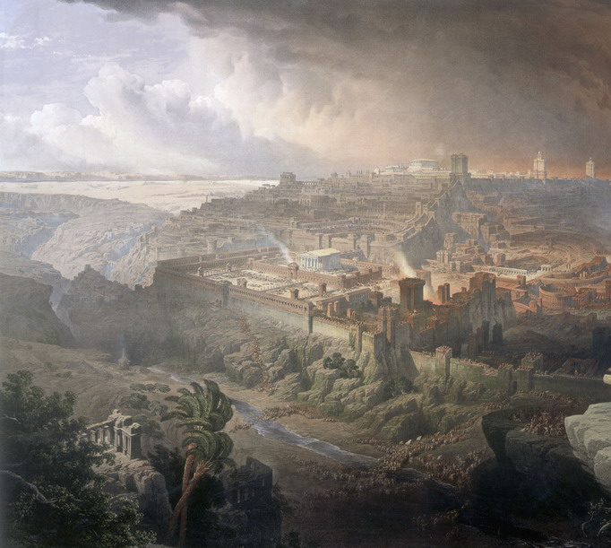
Olivet Discourse
Delivered to his disciples on Mount of Olives. so named because the Savior delivered it on the Mount of Olives.
After spending much of the final week of His mortal ministry teaching at the temple, Jesus looked back on the temple and its surrounding structures and prophesied:
“I say unto you, There shall not be left here one stone upon another, that shall not be thrown down”
And Jesus said unto them: See ye not all these things, and do ye not understand them? Verily I say unto you, there shall not be left here, upon this temple, one stone upon another that shall not be thrown down. JST—Matthew 1:3
Matthew 24:2
(3)

Slide 9
A Private Discussion
Matthew 24:3– Joseph Smith—Matthew 1:4
Peter, James, John, and Andrew later approached Jesus privately with two questions:
(1) “When shall these things be?”—referring to the destruction of the temple; and
(2) “What shall be the sign of thy coming, and of the end of the world?”

Slide 10
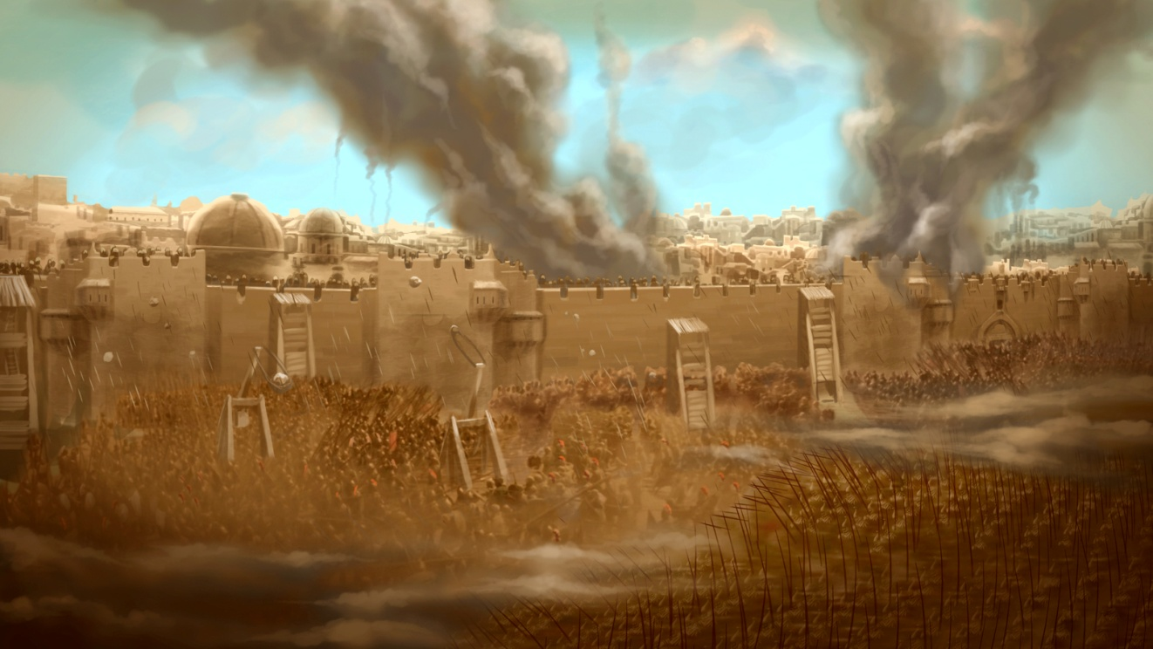
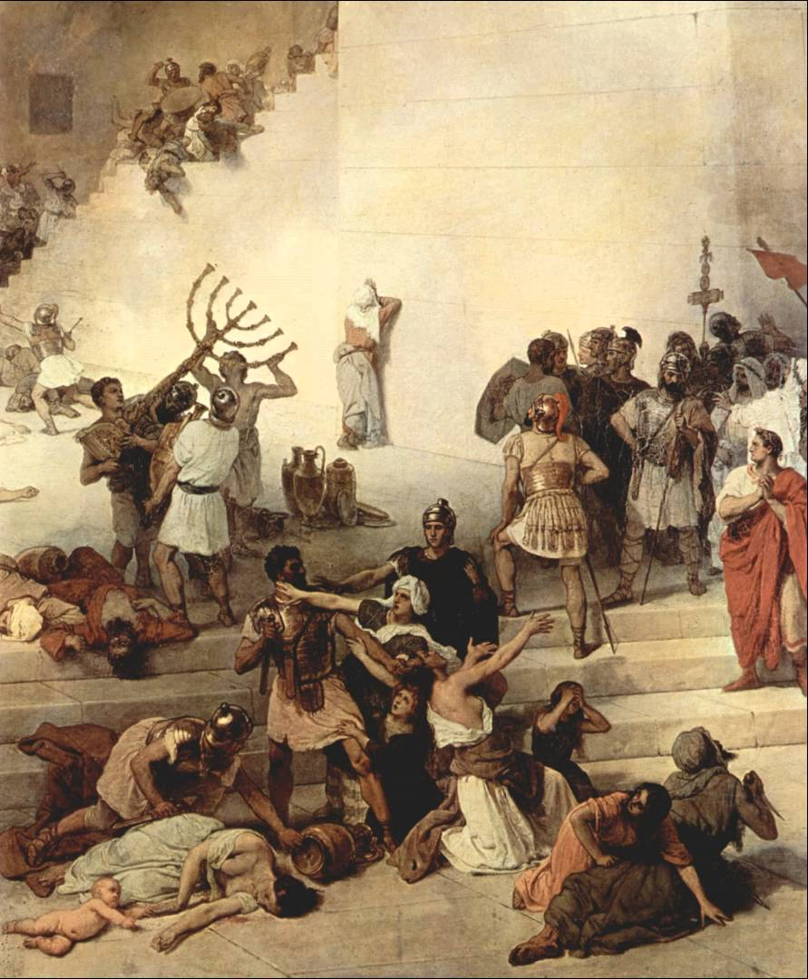
Temple in Jerusalem Will Be Destroyed
Matthew 24:1-3 – Joseph Smith—Matthew 1:2-4
The Savior prophesied that the temple in Jerusalem would be destroyed, a prophecy that was fulfilled about 40 years later when the Jews were fighting for freedom from their Roman rulers.
In A.D. 70, after months of intense fighting between the Roman army and Jewish rebels, the rebels took refuge within the walls of Jerusalem, and the Romans laid siege to the city.
The famine and hunger that followed were so severe that some resorted to cannibalism. Any Jew caught trying to escape was crucified in front of the walls of the city for all inside to see.
(3)

Slide 11
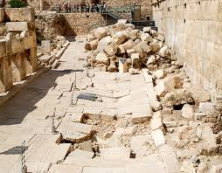
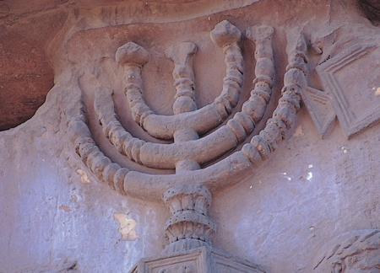
In The End – 70 AD
Matthew 24:1-3– Joseph Smith—Matthew 1:2-4
The magnificent temple was destroyed and has not been rebuilt since.
Josephus estimated that 1,100,000 Jews perished in the conflict.
The arch depicts Roman soldiers carrying objects from the temple of Jerusalem.
The Arch of Titus was built in A.D. 81 to commemorate the destruction of Jerusalem and the temple by the Roman general Titus and his armies.
As prophesied by Jesus Christ, not one stone of the temple was left standing on another (see Matthew 24:2).
(3)

Slide 12
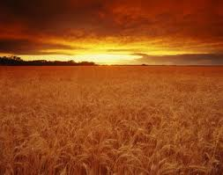
The End of the World
Matthew 24:4 --Joseph Smith—Matthew 1:3
According to [the Savior’s] language, the end of the world is the destruction of the wicked; the harvest and the end of the world have an allusion directly to the human family in the last days, instead of the earth, as many have imagined
Thus, the end of the world is not the end of the earth but the end of wickedness.
Read Matthew 13:36-43
(3)

Slide 13
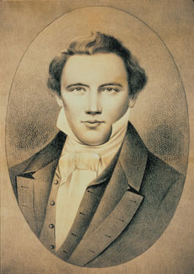
Take Heed That No Man Deceive You
Matthew 24:4-5, 11, 24 JST—Matthew 1:5-6, 9, 22
The Savior taught that false Christs and false prophets would arise and would “deceive many … if possible, “the very elect, who are the elect according to the covenant.” (4)
The term elect refers to “those who love God with all their hearts and live lives that are pleasing to Him” (5)
Steadfast suggests being immovable, solid, unshakable, and undefeatable
(3)

Slide 14
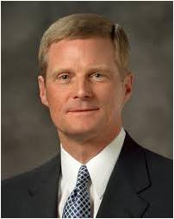
“A person who is steadfast and immovable is solid, firm, resolute, firmly secured, and incapable of being diverted from a primary purpose or mission. …
“A building or structure that is stable and immovable must be built upon a strong foundation. If you and I desire to become steadfast and immovable disciples of the Master, we must build appropriately and effectively upon Him as our foundation. …
“As we become more spiritually mature and increasingly steadfast and immovable, we focus upon and strive to understand the fundamental and foundational doctrines of the restored gospel of Jesus Christ.
Disciples who are steadfast and immovable do not become fanatics or extremists, are not overzealous, and are not preoccupied with misguided gospel hobbies.”
(6)

Slide 15
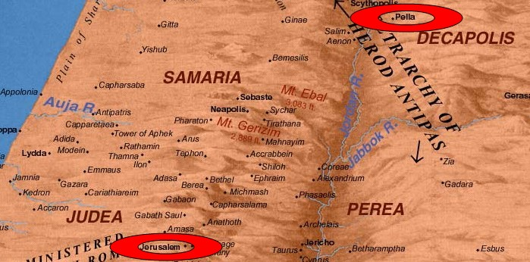
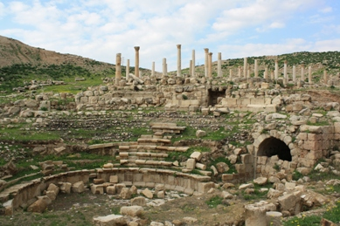
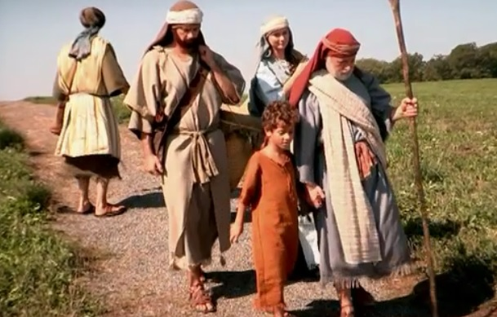
Pella
However, those who heeded Jesus’ warning safely escaped to Pella, a town about 50 miles northeast of Jerusalem.
Not mentioned in the New Testament, Pella was a gentile settlement to which Christians of Jerusalem fled at the beginning of the Jewish rebellion against Rome in A.D. 66.
Jesus prophesied that though the Jews would suffer great trials, they would be preserved because of God’s covenant with them. JST—Matthew 1:19-20
(2)

Slide 16
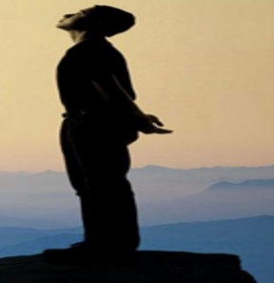
Stand In the Holy Place
Matthew 24:15--Joseph Smith—Matthew 1:12
“…the counsel that the saints should then ‘stand in the holy place’ meant that they should assemble together where they could receive prophetic guidance that would preserve them from the desolations of the day.” (7)
“…holy places consist of our temples, our chapels, our homes, and stakes of Zion, which are, as the Lord declares, ‘for a defense, and for a refuge from the storm, and from wrath when it shall be poured out without mixture upon the whole earth’.” (8)
And that the gathering together upon the land of Zion, and upon her stakes, may be for a defense, and for a refuge from the storm, and from wrath when it shall be poured out without mixture upon the whole earth. D&C 115:6

Slide 17
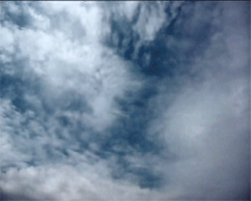
The Second Coming
Joseph Smith—Matthew 1:21-24
How will the Savior appear at His Second Coming?
Before the Second Coming of Jesus Christ, the Lord’s elect will be gathered and the gospel will be preached in all the world
How can knowing this help the elect avoid being deceived?
What difficulties will people face before the Second Coming?
(2)

Slide 18
Signs of the Second Coming

Slide 19
JS- M 1:22
False Christs and prophets will do miracles to deceive the elects.
JS-M1:23, 28
There will be wars and rumors of wars.

Slide 20
JS-M 1:26
Christ will come as the sun in the east. All the earth will know He has come.
JS-M 1:27
The righteous will be gathered.

Slide 21
JS-M 1:29
There will be wars, famines, pestilences, and earthquakes
Food
JS-M 1:30
Wickedness and hatred will abound

Slide 22
JS-M 1:31
The gospel will be preached in all the world, and then the wicked will be destroyed
The Book of Mormon
JS-M 1:32
The “abomination of desolation” will be fulfilled a second time

Slide 23
JS-M 1:33
The sun and moon will not shine, and the stars will fall.
JS-M 1:34-35
All the prophecies will be fulfilled
Luke 21:25-26

Slide 24
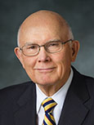
Only Heavenly Father knows when the Savior’s Second Coming will occur
If we watch for the signs and obey the Lord’s commandments, then we will be prepared for the Savior’s Second Coming
“What if the day of His coming were tomorrow? If we knew that we would meet the Lord tomorrow—through our premature death or through His unexpected coming—what would we do today?
What confessions would we make?
What practices would we discontinue?
What accounts would we settle?
What forgivenesses would we extend?
What testimonies would we bear?
“If we would do those things then, why not now
?
(10)

Slide 25
Overcoming Fears
Sin and the cares of this life can distract us from being ready for the Savior’s return.
In the last days, many people will feel overcome with fear.
As we diligently watch for the signs of the Savior’s Second Coming, pray, and strive to be worthy, we can be ready for the Lord’s return.
Luke 21:25–26, 34-36

Slide 26
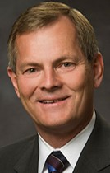
Falsehoods and Deceptions
Satan is seeking ways to deceive the world
Satan disguises the destructive consequences of illicit drugs or drinking and instead suggests that it will bring pleasure.
Satan immerses us in the various negative elements that can exist in social media, including debilitating comparisons and idealized reality.
Satan camouflages other dark, harmful content found online, such as pornography, blatant attacks on others through cyberbullying, and sowing misinformation to cause doubt and fear in our hearts and minds. (11)

Slide 27
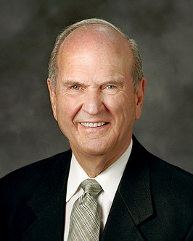
Of course, our ultimate security comes as we yoke ourselves to Heavenly Father and Jesus Christ! Life without God is a life filled with fear. Life with God is a life filled with peace.
(12)

Slide 28
Sources:
1. Stephen and Shirley Smith Ricks Jewish Religious Education in the Meridian of Time 1987 Oct. Ensign
2. William Barclay, Educational Ideals in the Ancient World (Grand Rapids, Michigan: Baker Book House, 1980), pp. 32–33.
3. New Testament Institute Student Manual Chapter 8
Joseph Smith (Teachings of Presidents of the Church: Joseph Smith [2007], 300).
Bible Dictionary
Elder David A. Bednar (“Steadfast and Immovable, Always Abounding in Good Works,” New Era, Jan. 2008, 2, 4–5).
President Thomas S. Monson (The Mortal Messiah: From Bethlehem to Calvary, 4 vols. [1979–81], 3:430).
President Ezra Taft Benson (The Teachings of Ezra Taft Benson [1988], 106).
Pearl of Great Price Student Manual
Elder Dallin H. Oaks (“Preparation for the Second Coming,” Ensign or Liahona, May 2004, 9).
Gary E. Stevenson, “Deceive Me Not,” Ensign or Liahona, Nov. 2019, 95
Russell M. Nelson, “Embrace the Future with Faith,” Ensign or Liahona, Nov. 2020, 75
I know there are a lot of quotes, but this is too good of a chapter to skip anything
Presentation by ©http://fashionsbylynda.com/blog/

Slide 29
Event | Matthew | Mark | Luke | John
Signs of the Destruction of the Temple and of Jesus’ Second Coming | 24:1-31 | 13:1-27 | 21:5-28
Parable of the Fig Tree | 24:32-36 | 13:28-32 | 21:29-33
Second Coming Likened to the Days of Noah | 24:37-42 | 13:33 | 21:34-36
Parable of a man Taking a Far Journey |  | 13:34-37
Son of Man to Come as a Thief in the Night | 24:43, 44
The Faithful and Evil Servants | 24:45-51
What Each Jewish Boy was expected to know:
1. The Shema. (Deut. 6:4–9; Deut. 11:13–21; Num. 15:37–41.) Shema,which means hear, is the name for the three passages of scripture. It derived from the first word of Deuteronomy 6:4 [Deut. 6:4]: “Hear, O Israel: The Lord our God is one Lord.” This verse is the foundation of the Jewish creed and the sentence with which every morning service in the synagogue still begins. In addition, every devout Jew must recite it every morning and evening. Jesus himself named verses 4 and 5 as the foremost of all the commandments. (See Mark 12:29)
2. The Hallel. (Ps. 113–18.) Hallel, which means “Praise [God]!” is the series of psalms of praise that were recited at all new moons and festivals and that also had an important place in the Passover ritual. The hymn that Jesus and the Apostles sang at the Last Supper may have been one or more of these psalms. (See Matt. 26:30.)
Many concepts and phrases from Psalm 118 are woven throughout the Lord’s teachings. (See, for example, Ps. 118:17 and John 11:26; Ps. 118:22–23and Mark 12:10–11; Ps. 118:26 and Matt. 23:39.)
3. The story of the Creation and the Fall. (Gen. 1–5.)
4. The basic elements of the Levitical Law. (Lev. 1–8.) These chapters concentrate on the purpose, performance, and types of offerings and sacrifice. As the foundation of the law, they are part of what the Lord referred to when he declared: “Think not that I am come to destroy the law, or the prophets: I am not come to destroy, but to fulfill.” (Matt. 5:17.)
(1)
Other Instructional Subjects:
Besides teaching young boys the four basic passages of scripture, teachers would have included some instruction in reading the Hebrew of the Old Testament, since the men of the congregation were expected to read sections of the Hebrew scriptures in the course of synagogue service. In accordance with this custom, Jesus read several verses of scripture to the congregation, after which he commented on them. (See Luke 4:16–29.) (1)
The language:
Throughout the Gospels, Jesus demonstrates a mastery of Hebrew and Aramaic. He may also have known Greek, though the scriptures are unclear on this point. (See John 12:20–23.) The study of Greek was not an important component in the education of Jewish boys, but since so many of the sizable non-Jewish minority in Palestine spoke only Greek, many Jews, for business or communication, learned at least some Greek on their own. (1)

Slide 30
Simeon ben Shetach, or Shimon ben, was a Pharisee scholar and Nasi of the Sanhedrin during the reigns of Alexander Jannæus (c. 103-76 BCE)
During the reign of Alexander the Sanhedrin consisted almost entirely of Sadducees; nevertheless he succeeded in ousting the Sadducean members and in replacing them with Pharisees.[
Together with his colleague, Judah ben Tabbai, Simeon began to supersede the Sadducean teachings and to re-establish the authority of the Pharisaic interpretation of the Torah. He is therefore called "the restorer of the Law," who "has given back to the crown of learning its former brightness".
Up to Simeon's time there were no schools in Judea, and the instruction of children was, according to Biblical precepts, left to their fathers. Simeon ordered that yeshivot be established in the larger cities in which the young might receive instruction in the Holy Scriptures as well as in the traditional knowledge of the Law. Wikipedia
Pella:
The people of the Church in Jerusalem were commanded by an oracle given by revelation before the war to those in the city who were worthy of it to depart and dwell in one of the cities of Perea which they called Pella. To it those who believed on Christ traveled from Jerusalem, so that when holy men had altogether deserted the royal capital of the Jews and the whole land of Judaea…"
— Eusebius, Church History 3, 5, 3
This heresy of the Nazoraeans exists in Beroea in the neighbourhood of Coele Syria and the Decapolis in the region of Pella and in Basanitis in the so-called Kokaba (Chochabe in Hebrew). From there it took its beginning after the exodus from Jerusalem when all the disciples went to live in Pella because Christ had told them to leave Jerusalem and to go away since it would undergo a siege. Because of this advice they lived in Perea after having moved to that place, as I said."
— Epiphanius, Panarion 29,7,7-8
For after all those who believed in Christ had generally come to live in Perea, in a city called Pella of the Decapolis of which it is written in the Gospel that it is situated in the neighbourhood of the region of Batanaea and Basanitis, Ebion's preaching originated here after they had moved to this place and had lived there."
— Epiphanius, Panarion 30, 2, 7
So Aquila, while he was in Jerusalem, also saw the disciples of the disciples of the apostles flourishing in the faith and working great signs, healings, and other miracles. For they were such as had come back from the city of Pella to Jerusalem and were living there and teaching. For when the city was about to be taken and destroyed by the Romans, it was revealed in advance to all the disciples by an angel of God that they should remove from the city, as it was going to be completely destroyed. They sojourned as emigrants in Pella, the city above mentioned in Transjordania. And this city is said to be of the Decapolis."
— Epiphanius, On Weights and Measures 15
Destruction of Jerusalem:
“While the temple blazed, the victors plundered everything that fell in their way and slaughtered wholesale all who were caught. No pity was shown for age, no reverence for rank; children and greybeards, laity and priests, alike were massacred; every class was pursued and encompassed in the grasp of war. … There were the war-cries of the Roman legions sweeping onward in mass, the howls of the rebels encircled by fire and sword, the rush of the people who, cut off from above, fled panic-stricken only to fall into the arms of the foe. … You would indeed have thought that the temple-hill was boiling over from its base, being everywhere one mass of flame, but yet that the stream of blood was more copious than the flames and the slain more numerous than the slayers”
In the end, the magnificent temple was destroyed and has not been rebuilt since. Josephus estimated that 1,100,000 Jews perished in the conflict. (Josephus, The Jewish War, trans. H. St. J. Thackeray, Loeb Classical Library [Cambridge: Harvard University Press, 1928], 257).
Abomination of Desolation Joseph Smith—Matthew 1:12–20, 31–32; Matthew 24:15–22.
“Daniel spoke prophetically of a day when there would be ‘the abomination that maketh desolate’ (Dan. 11:31;12:11), and the phrase was recoined in New Testament times to say ‘the abomination of desolation, spoken of by Daniel the prophet’ (Matt. 24:15).
“Conditions of desolation, born of abomination and wickedness, were to occur twice in fulfillment of Daniel’s words. The first was to be when the Roman legions under Titus, in A.D. 70, laid siege to Jerusalem (Matt. 24:15; JS—M 1:12).
“Speaking of the last days, of the days following the Restoration of the gospel and its declaration ‘for a witness unto all nations,’ our Lord said: ‘And again shall the abomination of desolation, spoken of by Daniel the prophet, be fulfilled’ (JS—M 1:31–32). That is, Jerusalem again will be under siege. “In a general sense, abomination of desolation also describes the latter-day judgments to be poured out upon the wicked wherever they may be. And so that the honest in heart may escape these things, the Lord sends His servants forth to raise the warning voice, to declare the glad tidings of the Restoration, lest ‘desolation and utter abolishment’ come upon them [D&C 84:114]” (Bible Dictionary, “Abomination of desolation”). Bible Dictionary

Slide 31
Deceiving the Elect: M Russell Ballard Story
“One of my fine missionaries who served with me when I was the mission president in Toronto [Canada] came to see me some years later. I asked him, ‘Elder, how can I help you?’
“‘President,’ he said, ‘I think I’m losing my testimony.’
“I couldn’t believe it. I asked him how that could be possible.
“‘For the first time I have read some anti-Mormon literature,’ he said. ‘I have some questions, and nobody will answer them for me. I am confused, and I think I am losing my testimony’”
“I asked him what his questions were, and he told me. They were the standard anti-Church issues, but I wanted a little time to gather materials so I could provide meaningful answers. So we set up an appointment 10 days later, at which time I told him I would answer every one of his questions. As he started to leave, I stopped him.
“‘Elder, you’ve asked me several questions here today,’ I said. ‘Now I have one for you.’
“‘Yes, President?’
“‘How long has it been since you read from the Book of Mormon?’ I asked.
“His eyes dropped. He looked at the floor for a while. Then he looked at me. ‘It’s been a long time, President,’ he confessed.
“‘All right,’ I said. ‘You have given me my assignment. It’s only fair that I give you yours. I want you to promise me that you will read in the Book of Mormon for at least one hour every day between now and our next appointment.’ He agreed that he would do that.
“Ten days later he returned to my office, and I was ready. I pulled out my papers to start answering his questions, but he stopped me.
“‘President,’ he said, ‘that isn’t going to be necessary.’ Then he explained: ‘I know that the Book of Mormon is true. I know Joseph Smith is a prophet of God.’
“‘Well, that’s great,’ I said. ‘But you’re going to get answers to your questions anyway. I worked a long time on this, so you just sit there and listen.’
“And so I answered all his questions and then asked, ‘Elder, what have you learned from this?’
“And he said, ‘Give the Lord equal time’”
Elder M. Russell Ballard “When Shall These Things Be?” Ensign, Dec. 1996, 60).
Being Deceived: Matthew 24:22
“We can accept nothing as authoritative but that which comes directly through the appointed channel, the constituted organizations of the priesthood, which is the channel that God has appointed through which to make known his mind and will to the world.
“… And the moment that individuals look to any other source, that moment they throw themselves open to the seductive influences of Satan, and render themselves liable to become servants of the devil; they lose sight of the true order through which the blessings of the Priesthood are to be enjoyed; they step outside of the pale of the kingdom of God, and are on dangerous ground. Whenever you see a man rise up claiming to have received direct revelation from the Lord to the Church, independent of the order and channel of the priesthood, you may set him down as an imposter” Joseph F. Smith (Gospel Doctrine, 5th ed. [1939], 42).
Carcass and Eagles: JS—Matthew 1:28/ Matthew 24:28
“In the parable, as here given, the carcass is the body of the Church to which the eagles, who are Israel, shall fly to find nourishment” Elder Bruce R. McConkie (Doctrinal New Testament Commentary, 3 vols. [1965–73], 1:648).
Gathering Together:
“With the creation of stakes and the construction of temples in most nations with sizeable populations of the faithful, the current commandment is not to gather to one place but to gather in stakes in our own homelands. There the faithful can enjoy the full blessings of eternity in a house of the Lord. There, in their own homelands, they can obey the Lord’s command to enlarge the borders of His people and strengthen her stakes (see D&C 101:21;133:9, 14). In this way, the stakes of Zion are ‘for a defense, and for a refuge from the storm, and from wrath when it shall be poured out without mixture upon the whole earth’ (D&C 115:6)” Elder Dallin H. Oaks (“Preparation for the Second Coming,” Ensign or Liahona, May 2004, 8).
Wars and Rumors of Wars: JS—Matthew 1:29/ Matthew 24:7
“We believe that these severe, natural calamities are visited upon men by the Lord for the good of his children, to quicken their devotion to others, and to bring out their better natures, that they may love and serve him. We believe, further, that they are the heralds and tokens of his final judgment, and the schoolmasters to teach the people to prepare themselves by righteous living for the coming of the Savior to reign upon the earth” President Joseph F. Smith (Teachings of Presidents of the Church: Joseph F. Smith [1998], 393).
As Samuel the Lamanite told the people of his day, these events are foretold “that ye might know of the signs of his coming, to the intent that ye might believe on his name” (Helaman 14:12).
Waxed Cold JS—Matthew 1:30:
“I saw men hunting the lives of their own sons, and brother murdering brother, women killing their own daughters, and daughters seeking the lives of their mothers. I saw armies arrayed against armies. I saw blood, desolation, fires. The Son of Man has said that the mother shall be against the daughter, and the daughter against the mother. These things are at our doors. They will follow the Saints of God from city to city. Satan will rage, and the spirit of the devil is now enraged” Joseph Smith (History of the Church, 3:391).

Slide 32
How Did Joseph Smith—Matthew Become a Part of the Pearl of Great Price?
The first edition of the Pearl of Great Price was printed in Liverpool, England, in July 1851. It was compiled as a pamphlet for use in the British Mission by Elder Franklin D. Richards, a member of the Quorum of the Twelve Apostles and president of the mission. In the preface to the pamphlet, Elder Richards explained that nearly all of its contents (which included Joseph Smith—Matthew) had appeared earlier in various Church publications in the United States, but with limited circulation. It is presumed that Elder Richards had access to these publications; however, he did not identify any of his source documents. (9)
The Second Coming, No Certain Time:
“The time for the Second Coming of Christ is as fixed and certain as was the hour of his birth. It will not vary as much as a single second from the divine decree. He will come at the appointed time. The Millennium will not be ushered in prematurely because men turn to righteousness, nor will it be delayed because iniquity abounds. …
“… [Jesus Christ] knows the set time and so does his Father” Elder Bruce R. McConkie (The Millennial Messiah, 26–27).
Jesus Christ Prophesied about the Destruction of Jerusalem
Joseph Smith—Matthew 1:1. “I Am He”
Jesus said, “I am he of whom it is written by the prophets” (see also JST, Matthew 4:18). With those words, He proclaimed to His disciples that He was the Messiah, the Anointed One, of whom all the prophets had prophesied (see Helaman 8:16–23). Their prophecies concerning the Messiah foretold not only His suffering for the sins of the world, but also His glorious Second Coming at the end of the world.
A Thief in the Night Matthew 24:42-44
“Those who treasure up his word will not be deceived as to the time of that glorious day, nor as to the events to precede and to attend it. (Jos. Smith 1:37.) The righteous will be able to read the signs of the times. To those in darkness he will come suddenly, unexpectedly, ‘as a thief in the night,’ but to ‘the children of light’ who ‘are not of the night, nor of darkness,’ as Paul expressed it, that day will not overtake them ‘as a thief.’ They will recognize the signs as certainly as a woman in travail foreknows the approximate time of her child’s birth. (1 Thess. 5:1–6)” Elder Bruce R. McConkie (Mormon Doctrine, 688).
The End of the World JS—Matthew 1:4
‘The end of the world is the end of unrighteousness or of worldliness as we know it, and this will be brought about by “the destruction of the wicked.” When our world ends and the millennial era begins, there will be a new heaven and a new earth. (Isa. 65:17–25; D&C 101:23–24.) Lust, carnality, and sensuousness of every sort will cease, for it will be the end of the world.’ (Mormon Doctrine, pp. 767–768.)” (Doctrinal New Testament Commentary, 1:640).v
The End of Earth JS—Matthew 1:55
“When the Savior has completed the work, when the faithful Saints have preached the Gospel to the last of the spirits who have lived here and who are designed to come to this earth; when the thousand years of rest shall come and thousands and thousands of Temples shall be built, and the servants and handmaids of the Lord shall have entered therein and officiated for themselves, and for their dead friends back to the days of Adam; when the last of the spirits in prison who will receive the Gospel has received it; when the Savior comes and receives his ready bride, and all who can be are saved in the various kingdoms of God—celestial, terrestrial and telestial, according to their several capacities and opportunities; when sin and iniquity are driven from the earth, and the spirits that now float in this atmosphere are driven into the place prepared for them; and when the earth is sanctified from the effects of the fall, and baptized, cleansed, and purified by fire, and returns to its paradisiacal state, and has become like a sea of glass, a urim and thummim; when all this is done, and the Savior has presented the earth to his Father, and it is placed in the cluster of the celestial kingdoms, and the Son and all his faithful brethren and sisters have received the welcome plaudit—‘Enter ye into the joy of your Lord,’ and the Savior is crowned, then and not till then, will the Saints receive their everlasting inheritances” President Brigham Young (in Journal of Discourses,17:117).
One Taken, One Left JS—Matthew 1:44-45
“The servants of God are angels in one sense, sent forth to gather the house of Israel from the four corners of the earth; and the Elders of this Church in their labors have fulfilled, partly, the sayings of the Savior, when they have found two working in the field, one has received the Gospel and been gathered, and the other left; two working in a mill, one has been taken and the other left; two lying in a bed, the one has been taken and the other left. But no doubt these sayings will have their final and complete fulfilment about the time of the second coming of the Savior” Heber C. Kimball (in Journal of Discourses, 10:103).
No Man Knoweth JS—Matthew 1:40
“Jesus Christ never did reveal to any man the precise time that He would come. Go and read the Scriptures, and you cannot find anything that specifies the exact hour He would come; and all that say so are false teachers” (Teachings of the Prophet Joseph Smith,341; see also D&C 49:7).

Slide 33
Joseph Smith—Matthew 1 Comparison to Matthew 24
Joseph Smith Translation | Event | Matthew 24 | Other Scriptures
JS--Matthew 1:1 | I AM HE—Jesus proclaimed He was the Messiah Holy angels will appear with Jesus at the Second Coming | Matthew 24:31 | JS—Matthew 4:18 Helaman 8:16-23
JS—Matthew 1:2-3 | Destruction of the Temple | Matthew 24:2 | Mark 13:1-2; Luke 21:5-6
JS—Matthew 1:4-5 | Olivet…2 events | Matthew 24:3 | 2 Samuel 15:30
JS—Matthew 1:6, 9 | False Prophets | Matthew 24:5,11, 24 | Acts 8:9, 13, 18–24
JS—Matthew 1:7 | Disciples afflicted and killed | Matthew 24:9, 22 | Acts 4:1–3, 17–18, 29; 5:17–19, 40; 7:54–60; 8:1–3; 11:19; 12:1–5; 13:50; 14:1–7, 19–20; 16:19–24;17:1–9; 21–26; 2 Corinthians 11:23–29.
JS—Matthew 1:8 | Many saints will fall away | Matthew 24:10, 12 | 2 Cor. 11:13, 2 Tim. 2:17-18
JS—Matthew 1:10 | People will cease to love and care (wax cold) | Matthew 24:7, 10, 12 | Moses 7:33
JS—Matthew 1:12 JS—Matthew 1:32 | Abomination of Desolation 2nd Occurrence= Latter day destruction | Matthew 24:15 | Daniel 11:31; 12:11
JS—Matthew 1:13-17 | Saints are told to flee for safety | Matthew 24:16-20 | 1 Nephi 19:14, 2 Nephi 6:9-11
JS—Matthew 1:18 | Tribulation of the Jews | Matthew 24:9, 21, 51
JS—Matthew 1:19 | The beginning of great sorrows following the death of Jesus | Matthew 24:8
JS—Matthew 1:4, 21 | Prophecy about the end of the world—the end of sin | Matthew 24:6-28
JS—Matthew 1:22 | False Christs, False Prophets, Great Signs and Wonders, Deceiving the Elect | Matthew 24:24, Matthew 24:27, 30 Matthew 24:22, 31 | 2 Nephi 26:29 D&C 29:7-9
JS—Matthew 1:23 | Be not troubled | Matthew 24:6
JS—Matthew 1:25 | He is in the desert—He has withdrawn from the world | Matthew 24:26

Slide 34
Joseph Smith—Matthew 1 Comparison to Matthew 24 (continued)
Joseph Smith Translation | Event | Matthew 24 | Other Scriptures
JS—Matthew 1:26 | Light in the morning | Matthew 24:27 | Zechariah 14:5-9
JS—Matthew 1:27 | Gathering Parable | Matthew 24: 28, 32-35 | Luke 17:37
JS—Matthew 1:28-29 | Wars and Famine | Matthew 24:6-7 | D&C 45:26, 63, D&C 63:33-34
JS—Matthew 1:30 | Waxed Cold (see vision of Joseph Smith) | Matthew 24:12
JS—Matthew 1:31 | Gospel Preached to all the world | Matthew 24:14
JS—Matthew 1:33 | No sun, moon, and the stars will fall | Matthew 24:28
JS—Matthew 1:36 | The Tribes of the Earth will morn and also see the Son of Man coming | Matthew 24:27, 30 | D&C 101:23; Article of Faith 1:10; D&C 133:44, 49, Acts 1:11
JS—Matthew 1:37 | Treasure up His word. | Matthew 24:34 | 1 Thess. 5:1-6
JS—Matthew 1:38 | Parable of the Fig Tree | Luke 13:6-9
JS—Matthew 1:40 | No one knows when He will come | Matthew 24:36, 42 | D&C 49:7
JS—Matthew 1:41-43 | Days of Noah—Noe | Matthew 24:37-39 | Genesis 6:11
JS—Matthew 1:44-45 | One taken, One left | Matthew 24:40-41
JS—Matthew 1:46-47 | Those in the dark, Come as a thief in the night verses those who are prepared | Matthew 24:42-43 Matthew 24:44 | 2 Nephi 22:17-19
JS—Matthew 1:49-50 | Parable of the Lord and His servants | Matthew 24:45-51 | Malachi 3:2
JS—Matthew 1:55 | The End of the Earth and it’s wickedness | Matthew 24:3 | Isaiah 65:17-25, D&C 101:23-24
Excerpts from Pearl of Great Price Student Manual

