Slide 1
Lesson 73
For the Strength of Joshua
Joshua 1-2
Every place that the sole of your foot shall tread upon, that have I given unto you...
Joshua 1:2

Slide 2
Joshua
2 Chronicles
Judges
1 Chronicles
Joshua
Ruth
1 Kings
2 Kings
2 Samuel
1 Samuel
Nehemiah
Ezra
Esther
Joshua is the first of 12 historical books.
It is a link between the Pentateuch and the remainder of Israel’s history
Through 3 military campaigns involving more than 33 enemy armies, the people of Israel learn a crucial lesson under Joshua’s leadership.
We do not know for certain who wrote the book of Joshua. The book is named for Joshua—its principal figure and Moses’s successor as the Lord’s prophet to Israel—most likely written in Canaan (2)
Victory comes through faith in God and obedience to His word

Slide 3
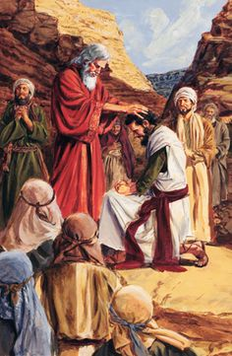
Joshua’s Names
Meaning—God is Help
Hoshea (Deut. 32:44)
Oshea, of the tribe of Ephraim (Numbers 13:8)
Moses changes his name to Jehoshua in (Numbers 13:16)
Jeshua (Ezra 2:2)
He is also called Yeshua...see notes*
Joshua, the son of Nun (Numbers 27:18)
Jesus, (Iesous) (from the Greek) is equivalent to the Hebrew name Joshua (Acts 7:45, and Hebrews 4:8)
His name is symbolic of the fact that although he is the leader of the Israelite nation during the conquest, the Lord is the Conqueror.

Slide 4
Joshua
He was the son of Nun and born in Egypt, and from the Tribe of Ephraim (Joseph)
He was a leader in the battle with Amalek
He was one of the 12 spies Moses sent to the land of Canaan
He was the successor of Moses in leading the Israelites
His first commandment was to have the people cross the Jordan River and the Levites carry the ark of the covenant
He was instructed to conquer Jericho by marching around the city for 6 days, then on the 7th day the warriors circled around 7 times… the walls of Jericho fell and they captured the city
He was commanded to battle in the land of Ali
He was 110 when he died and was buried in his own city, Timnath-Serah.
(1, 2, 3)

Slide 5
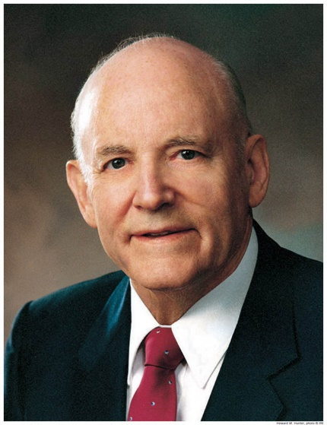
Task of Leadership
“Joshua is remembered as the one who, on the death of Moses, took command and completed the task of giving leadership to the tribes of Israel.
Perhaps to comfort Joshua, who now had the responsibility for the children of Israel, who didn’t yet have a homeland, and perhaps to comfort that large body of people who had just lost their leader of more than forty years, the Lord spoke to Joshua and said:
As I was with Moses, so I will be with thee: I will not fail thee, nor forsake thee.
Be strong and of a good courage: for unto this people shalt thou divide for an inheritance the land, which I sware unto their fathers to give them. (Josh. 1:5–8)
“Joshua would need courage for what he had to do. He would need the Lord’s help at every step. Here is a commitment of the Lord to provide that help.
With faith in the Lord, Joshua could now go forward, knowing that the Lord would direct him in the way he should go. Joshua knew that his obedience would bring success, and although he did not know exactly how he would succeed, he now had confidence in the result.”
Joshua 1-9
(4)

Slide 6
Strong and Courageous
How many times is the word Strong and Courageous (Courage) mentioned in Chapter 1?
When the Lord is with us, we can be strong and of a good courage
Joshua 1-19

Slide 7
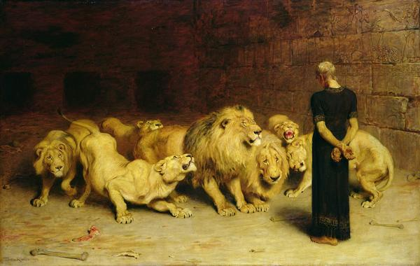
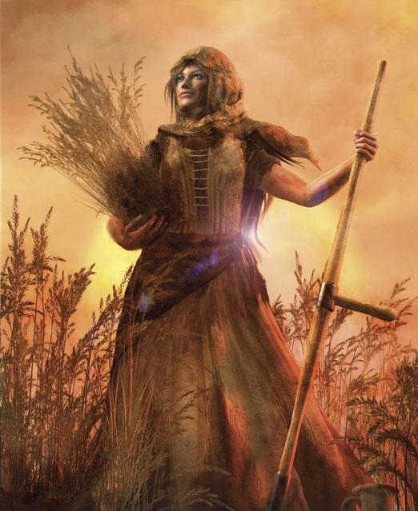
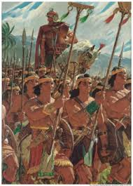
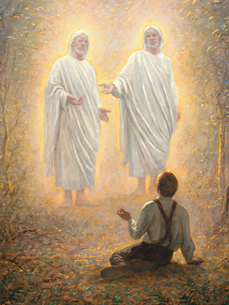
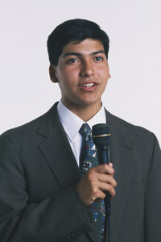
Times of Courage

Slide 8
Book of Law
Genesis
Exodus
Leviticus
Deuteronomy
Numbers
Meditate on the scriptures
contemplate, ponder, reflect, consider, think, and study
If we meditate on the scriptures daily and live according to the teachings therein, then we will prosper and have success
Joshua 1:8

Slide 9
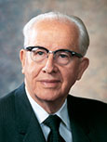
“The Lord was not promising Joshua material wealth and fame, but that his life would prosper in righteousness and that he would have success in that which matters most in life, namely the quest to find true joy. (5)

Slide 10
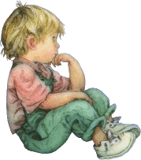
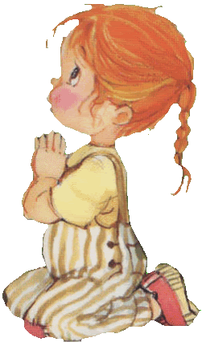
Times of Today
Today we are encouraged to:
Study, Ponder, and Pray
Read
then
Act

Slide 11
Preparation
Victuals—food and provisions
Prepare you victuals; for within three days ye shall pass over this Jordan, to go in to possess the land, which the Lord your God giveth you to possess it.
Reminder:
The tribes of Reuben and Gad and half the tribe of Manasseh were granted their land inheritances on the east of the Jordan River on the condition that the men would assist the remaining tribes of Israel in fighting for and obtaining their land inheritances on the west side of the river
Joshua 1:10-18

Slide 12
Spies to Jericho
Joshua sent two spies across the Jordan River to the city of Jericho. Jericho was the first city on the west side of the Jordan River that the Israelites were commanded to conquer.
Joshua 2:1-8

Slide 13
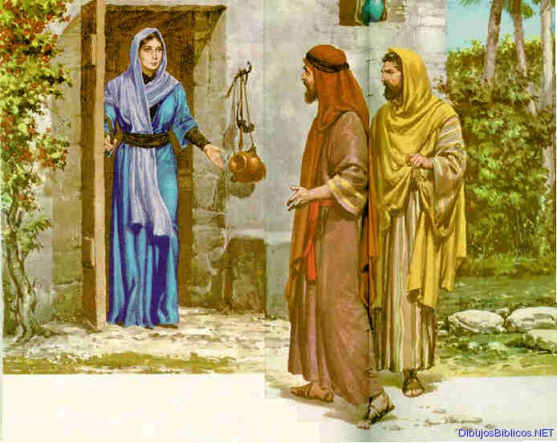
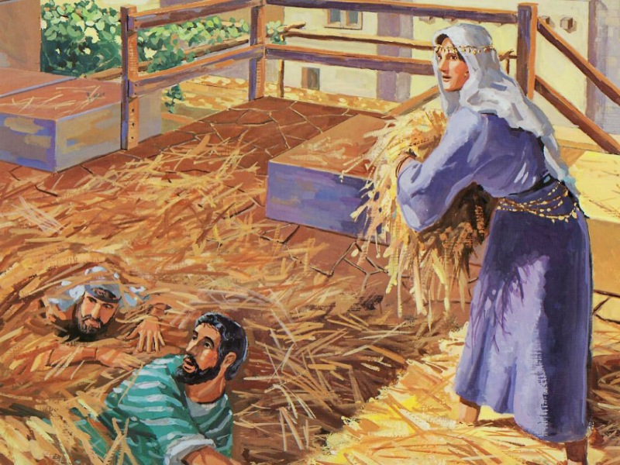
Story of Rahab
The two spies entered into city and made contact with an innkeeper named Rahab
They made their lodgings there.
The spies were followed by a man, and he sent word to the King of Jericho who quickly sent messengers to the inn.
She hid them on the roof of the inn under drying flax.
She told the messengers of the king that the Hebrews were making their way back to the river.
Rahab and her family were saved from death by Joshua and given “certain lands immediately and had her in great esteem ever afterwards.” (6)
Joshua 2:1-8

Slide 14
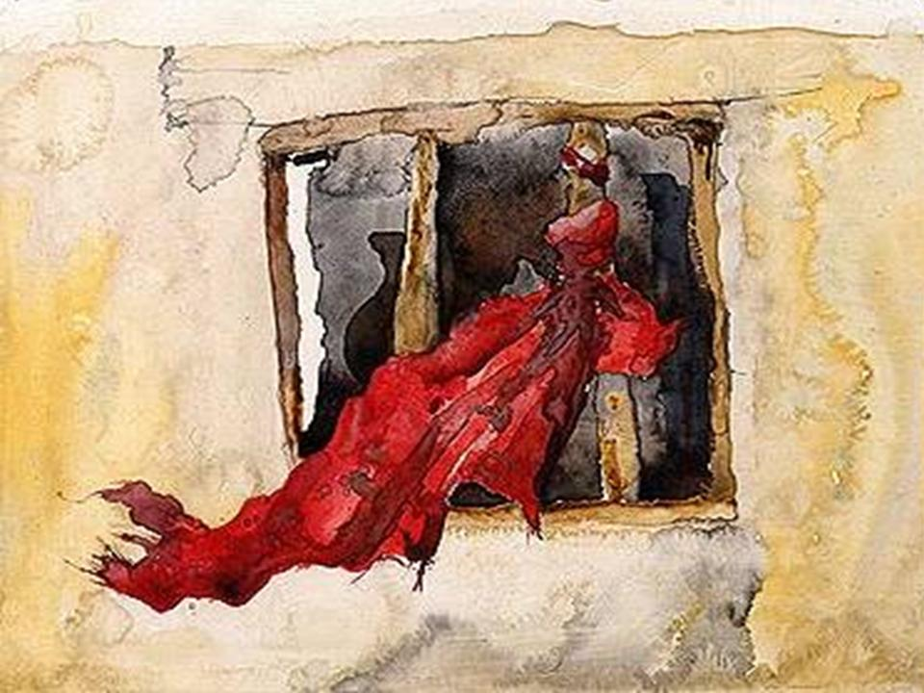
Our Live For Yours
As Rahab offered to shelter the spies and aid them in their escape, she told them she knew of their journeys and their promised to inherit the land of Canaan.
She let down a scarlet rope so the spies could escape
and she received from them the promise that when they returned to her country, along with Joshua and his army, that she and her family would be spared alive.
She awaited her own deliverance. That red token at the window was likewise a signal to the outside world that Rahab believed in the ultimate triumph of Jehovah.
Joshua 2:9-14

Slide 15
Jesus—Lineage
Abraham
Isaac
Jacob
Likewise also was not Rahab the harlot justified by works, when she had received the messengers, and had sent them out another way?
James 2:25
See * Rahab in notes
Judas
Zara
Phares
Esrom
Aram
Aminadab
Naasson
And Salmon begat Booz of Rachab; and Booz begat Obed of Ruth; and Obed begat Jesse;
Matthew 1:5
Salmon
Rachab
Booz
Obed
Ruth
Jesse
King David
Matthew 1:1-16

Slide 16
Sources:
Suggested Hymn: #114 Come Unto Him
Bible Dictionary
Sherrie Johnson Joshua: Spiritual Giant Friend January 1987
Ed J. Pinegar and Richard J. Allen Who’s Who in the Old Testament p. 109-110
Howard W. Hunter “Commitment to God,” Ensign, Nov. 1982, 57
President Ezra Taft Benson (See 2 Nephi 2:25.)” (“The Power of the Word,” Ensign, May 1986, 81).
Josephus “The Antiquities of the Jews” page 152 (5.1.7)
Presentation by ©http://fashionsbylynda.com/blog/

Slide 17
*For if Jesus had given them rest, then would he not afterward have spoken of another day. Hebrews 4:8
Jesus is the Greek form of the Hebrew name Yeshua and is transferred into the English as Joshua. Paul has reference here to the man Joshua of the Old Testament rather than to Jesus Christ. His point is that the Israelites did not find their “rest” under Moses nor Joshua, under whose direction they found and entered the promised land, or even under David, their greatest king.
Chapter 46: “Let Us Go on unto Perfection”
The Life and Teachings of Jesus and His Apostles, (1979), 380–87
Rahab:
While Rahab’s parents, brothers and sisters were alive at the time of her association with the spies Joshua sent out, we are not given any of their names (Joshua 2:13). Some of the ancient Jewish fathers who held her in high reputation reckoned that she was the wife of Joshua himself, but in the royal genealogy of Jesus, Rahab is referred to as being the wife of Salmon, one of the two spies she sheltered. In turn, she became the mother of Boaz, who married Ruth from whose son, Obed, Jesse the father of David came, through whose line Jesus was born (Matthew 1:5, where the asv reads, “Salmon begat Boaz of Rahab”—not Rachab).
Salmon was a prince of the house of Judah, and thus, Rahab, the one time heathen harlot, married into one of the leading families of Israel and became an ancestress of our Lord, the other foreign ancestresses being Tamar, Ruth and Bathsheba. The gratitude Salmon felt for Rahab ripened into love, and when grace erased her former life of shame he made her his wife. Jerome’s comment of the inclusion of the four foreign women in Matthew’s genealogy is suggestive—
It has been suggested that the word “harlot” can be translated “innkeeper,” thus making Rahab the landlady of a wayside tavern. Guesses have been made that she had been a concubine, such as Hagar and Zilpah had been, but that in Jericho she was a reputable woman identified with a respectable business. The Bible, however, makes no attempt to smooth over the unpleasant fact that Rahab had been a harlot. Endeavoring to understand her character, we have—
Rahab became an ancestress in the royal line from which Jesus came as the Saviour of lost souls.
Paul highly commends Rahab for her energetic faith and gives her a place on the illustrious roll of the Old Testament of those who triumphed by faith. “By faith the harlot Rahab perished not with them that believed not, when she received the spies with peace” (Hebrews 11:31)
The Apostle James adds to Paul’s record about Rahab being justified by faith by saying that she was likewise justified by works (James 2:25)
Excerpt from Biblegateway
*Dr. Adam Clarke counts the modern Bible translator’s error, “I am fully satisfied that the term zonah in the test, which we translate harlot, should be rendered tavern or inn-keeper or hostess” Dr. Clarke feels there was no excuse for the translators to presume as much just simply because she kept a public house of lodging. Clake’s Bible Commentary Vol. 2 p. 11
Being Strong and Having Courage:
The Young Men general presidency in 2010 taught how the Lord’s promises to Joshua apply to youth:
“In the space of four verses in the first chapter of Joshua, the Lord commands Joshua to be strong and courageous—three times! (see verses 6–9). Then the Lord promises Joshua that he will succeed in bringing the Israelites to their land of inheritance, that strength and courage will come to him because of his obedience to all the law, and—most significantly—that the Lord will be with him wherever he goes. …
“That same call to courage is yours. And the same promises are yours as well. With the Savior’s help, you too will succeed in your callings and in your life. You will have strength to withstand any temptation as you obey the commandments and keep the standards found in For the Strength of Youth” (“Facing Challenges with Courage,” New Era, Jan. 2010, 7).
Meditation: Elder Richard G. Scott of the Quorum of the Twelve Apostles taught how pondering on the scriptures blesses us:
“As you ponder—not just read but ponder and meditate—on scriptural passages, the power of the Holy Ghost will distill truths in your mind and heart as a secure foundation in this uncertain time in which we live” (“He Lives! All Glory to His Name!” Ensign or Liahona, May 2010, 78).
President Thomas S. Monson explained the benefits of daily scripture study:
“I would encourage all of us to continue to read and study the scriptures, that we might understand them and apply in our lives the lessons we find there. …
“Spending time each day in scripture study will, without doubt, strengthen our foundations of faith and our testimonies of truth” (“How Firm a Foundation,” Ensign or Liahona, Nov. 2006, 68).

Slide 18
Joshua 1-6 | Joshua 7-12 | Joshua 13-21 | Joshua 22-24
The children of Israel miraculously cross the Jordan River and enter the promised land. They begin their conquest of the land by destroying the city of Jericho. | Israel loses a battle against the people of Ai because of disobedience. After repenting of their disobedience, the Israelites prosper in battle as the Lord fights for them. They gain control of the promised land. | The promised land is divided among the tribes of Israel. However, not all of the wicked inhabitants are driven out of the land. The Israelites set up the tabernacle in a place called Shiloh. Certain cities are designated as cities of refuge. | Prior to his death, Joshua exhorts the people to have courage, keep the Lord’s commandments, and love the Lord. He and the people covenant to choose the Lord and serve only Him. Joshua and Eleazar, the third son of Aaron, die.
One Month (March-April) 1405 B.C. | 7 years (April) 1405-1398 B.C. | 8 years 1398/7-1390 B.C. | Joshua dies at 110 1390 B.C.
Approximate Dates taken from Talk thru the Bible by Bruce Wilkinson and Kenneth Boa

