Slide 1
Luke 15-17; John 11

Slide 2
On a scale of 1 to 10, with 1 being low and 10 being high, how much would you want the following?
Your favorite dessert ______
Your favorite dessert if it fell on the floor ______
Your favorite dessert if someone stepped on it ______
A $20 bill ______
A $20 bill if it fell on the floor ______
A $20 bill if someone stepped on it ______
How might this analogy compare with how accurately we view our own value?

Slide 3
Lost
Luke 15
Including:
Parable of the Lost Sheep
Parable of the Lost Coin
Parable of the Prodigal Son

Slide 4
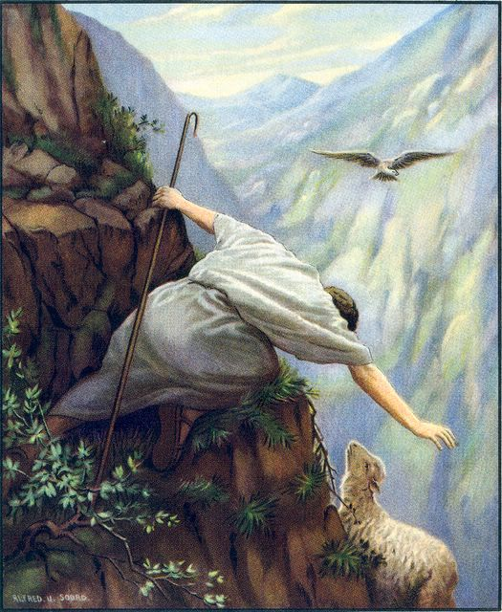
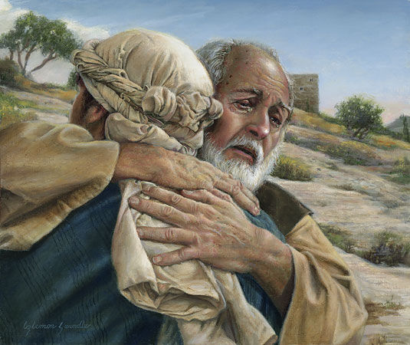
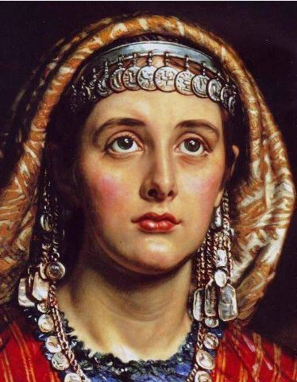
Luke 15 is a message within the message, and the gospel within the gospel.
The message is: “God loves his children, all of them, and he will do everything in his power to save them.”
Three Parables in One
Only found in Luke
All inter-related

Slide 5
“…for I have found my sheep which was lost.”
Luke 15:3-7

Slide 6
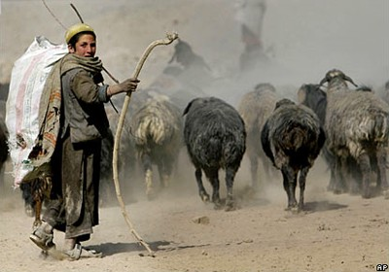
Parable of The
Lost Sheep
Luke 15:3-7

Slide 7
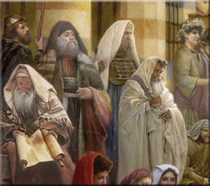
“Then drew near unto him all the publicans and sinners for to hear him.”
Jesus sits with them and teaches
Luke 15:1

Slide 8
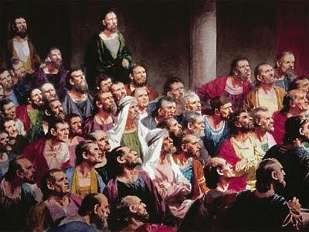
“And the Pharisees and scribes murmured, saying, This man receiveth sinners, and eateth with them”
They viewed sinners as unclean and any person touching a sinner was unclean themselves.
Luke 15:2

Slide 9
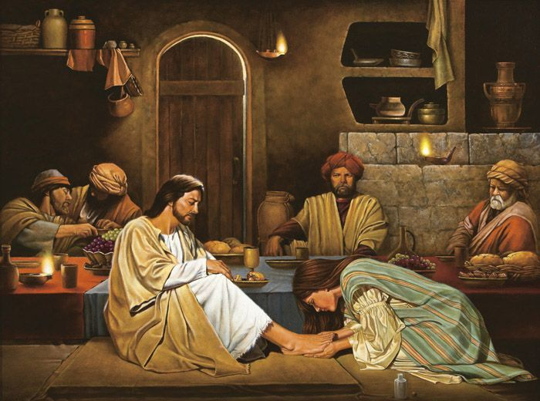
Jesus ate with sinners, he didn’t sin with them
His fellowship invites discipleship

Slide 10
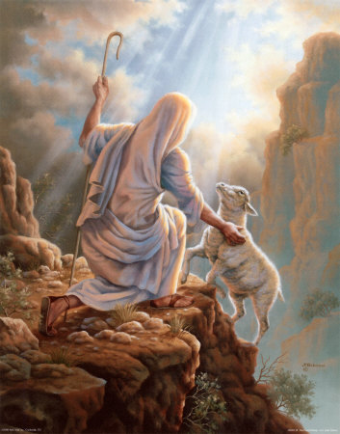
“What man of you, having an hundred sheep, if he lose one of them, doth not leave the ninety and nine in the wilderness, and go after that which is lost, until he find it?”
Luke 15:4

Slide 11
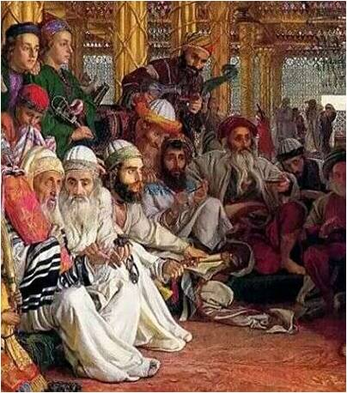
“What man of you,…”
Jesus was implicating the Pharisees and scribes.
He compare them to shepherds.
Luke 15:4

Slide 12
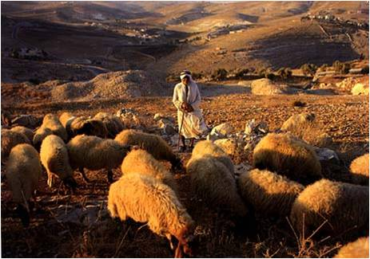
Shepherding was a job beneath the dignity and status of his audience and to compare them to shepherds was an insult.

Slide 13
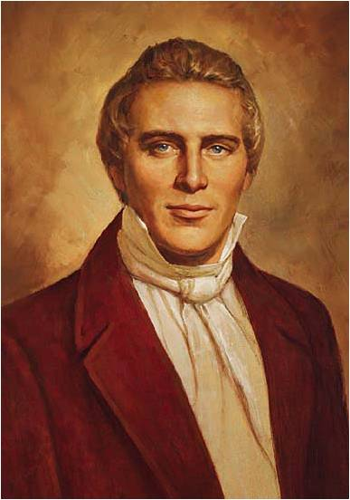
Joseph Smith explained:
“The hundred sheep represent one hundred Sadducees and Pharisees, as though Jesus had said, ‘If you Sadducees and Pharisees are in the sheepfold, I have no mission for you; I am sent to look up sheep that are lost and when I have found them, I will back them up and make joy in heaven’. This represents hunting after a few individuals or one poor publican, which the Pharisees and Sadducees despised.”

Slide 14
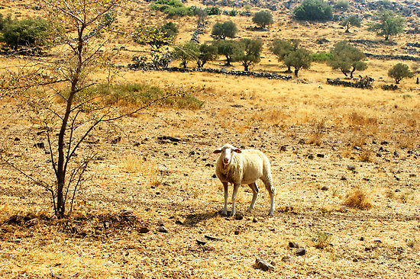
“…if he lose one of them, …”
Middle Eastern culture one would usually not take the blame for losing something. He would say, “One of my sheep is lost” but he would not say, “I lost one of my sheep”.
Luke 15:4

Slide 15
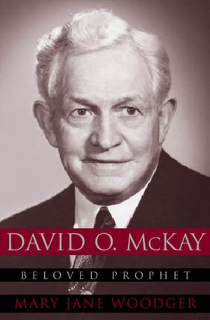
President McKay asked:
“How did that sheep get lost? He was not rebellious. If you follow the comparison, the lamb was seeking its livelihood in a perfectly legitimate manner, but either stupidly, perhaps unconsciously; it followed the enticement of the fields, the prospect of better grass until it got out beyond the fold and was lost.”

Slide 16
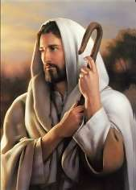
A good shepherd is one with his sheep.
A good shepherd would seek after any lost sheep.
A shepherd is held responsible for the loss of his sheep. He would be shamed and his honor and reputation would be questioned.

Slide 17
President McKay’s application?
“So we have those in the Church, young men and young women, who wander away from the fold in perfectly legitimate ways. They are seeking success, success in business, success in their professions, and before long they become disinterested in Church and finally disconnected from the fold; they have lost track of what true success is, perhaps stupidly, perhaps unconsciously, in some cases, perhaps willingly. They are blind to what constitutes true success.”

Slide 18
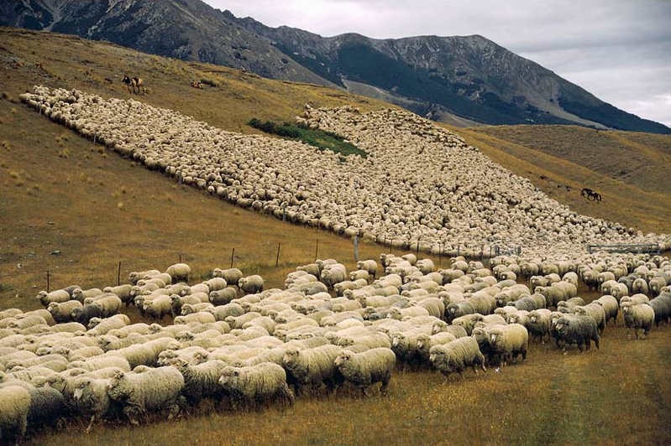
“…doth not leave the ninety and nine in the wilderness,…”
JST change: It is important to note that the King James Version says all one hundred sheep are out in the wilderness. But the JST says "....if he loseth one of them, doth not leave the ninety and nine and go into the wilderness..."
Luke 15:4

Slide 19
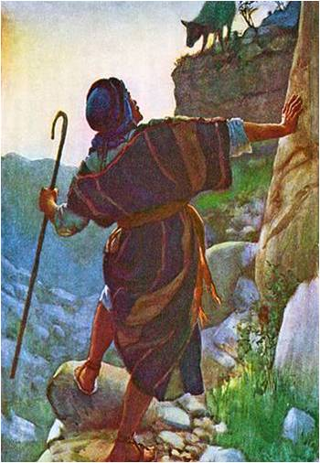
The shepherd leaves the sheep safely in the fold and he goes out into the wilderness to look for the lost sheep.
Luke 15:4

Slide 20
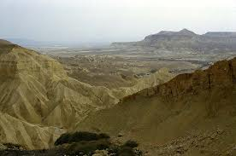
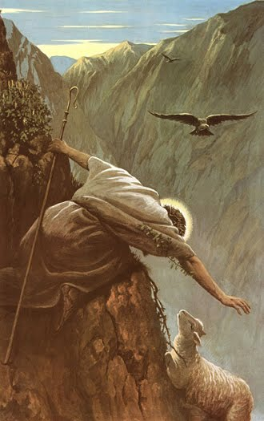
The wilderness is a dangerous place both for the shepherd and his sheep.
Many times the sheep has fallen down a crevice or has been attacked by a wild animal.

Slide 21
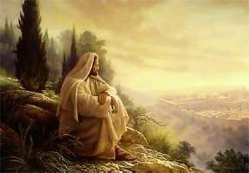
“…and go after that which is lost…”
Jesus shows compassion on His lost children.
Luke 15:4

Slide 22
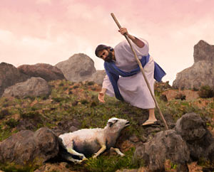
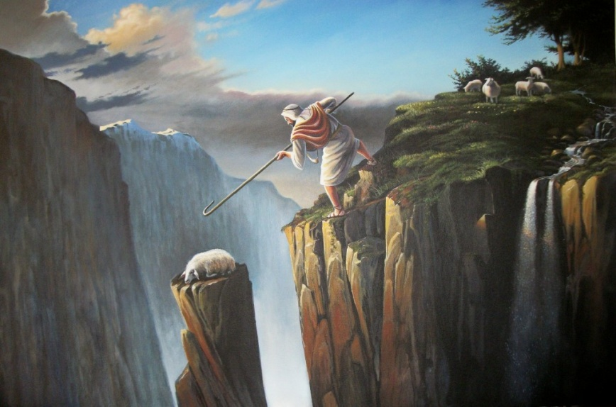
The shepherd takes his rod to fight off predators
The rod = The Word of God that leads to the Tree of Life = Atonement
The shepherd takes his staff to use as a tool for rescuing.
The staff = Mercy = only through the grace of God are we saved

Slide 23
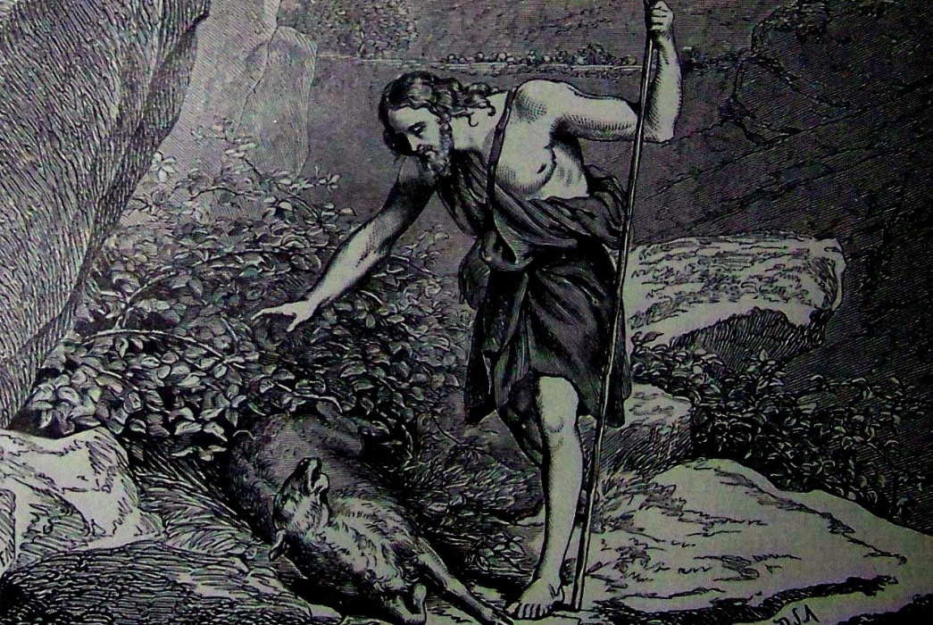
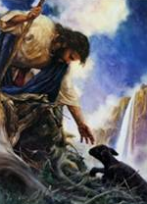
When sheep get lost they become terrified. They often collapse in a thicket and begin bleating.
When found they are too terrified to even rise to their feet. They cannot be herded or led on a rope. They must be carried.

Slide 24
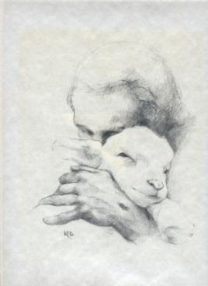
“…until he find it.”
The sheep offers no service to the shepherd and in no way earns or deserves his rescue.
Luke 15:4

Slide 25
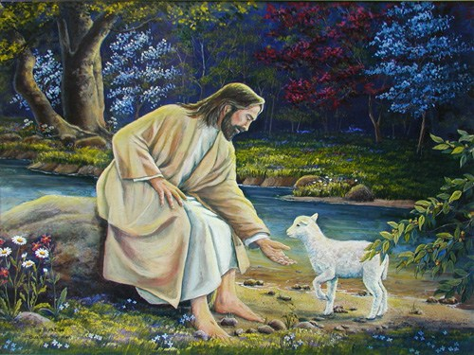
“And when he hath found it…”
It comes as a gift. Just as we who are undeserving, are rescued by Christ through His Grace
Luke 15:5

Slide 26
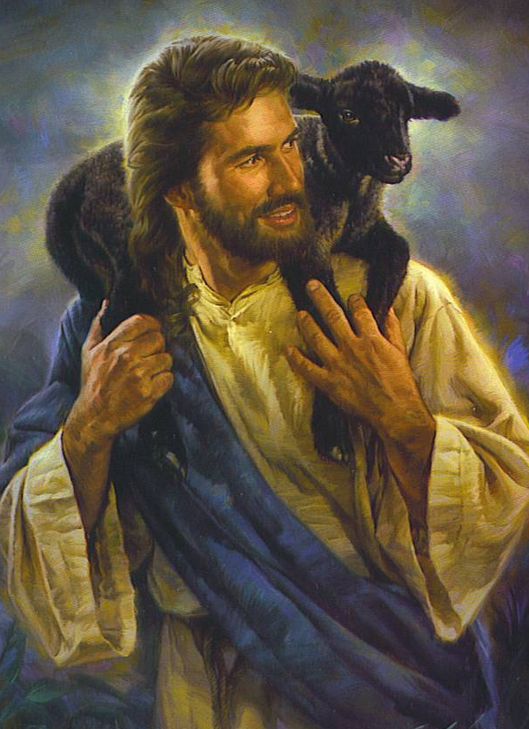
“…he layeth it on his shoulders, rejoicing”
An average sheep weighs up to 70 pounds.
Luke 15:5

Slide 27
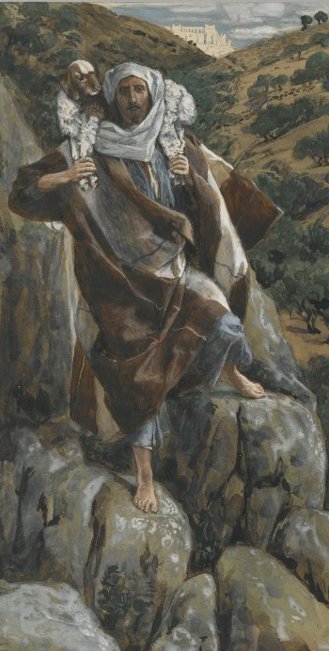
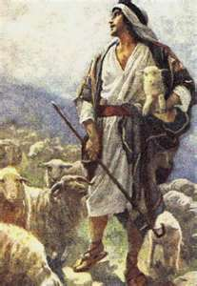
The terrain was rugged. The shepherd would place the sheep around his shoulders and grab his legs in front.
This was hard work. The Western images have Jesus carrying a little lamb under his arm…

Slide 28
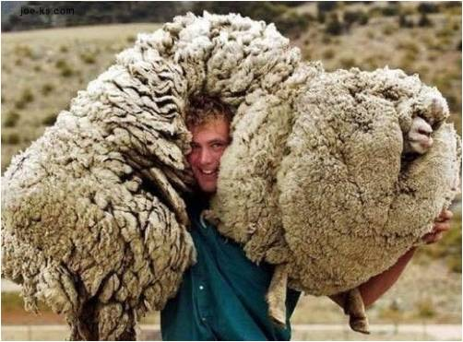
…Most Eastern images have sheep that are as big as the shepherd indicating a heavy load that is carried.

Slide 29
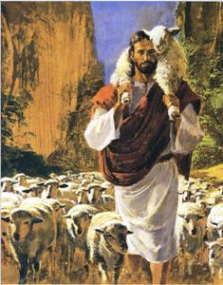
“And when he cometh home...”
The act of the shepherd in carrying the sheep back to his home in the village and the sheep’s acceptance of that act are symbolic of our acceptance of Christ’s atonement…
Luke 15:6

Slide 30
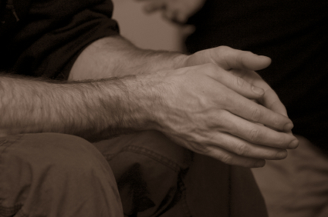
…We can believe that He can and will cleanse us.

Slide 31
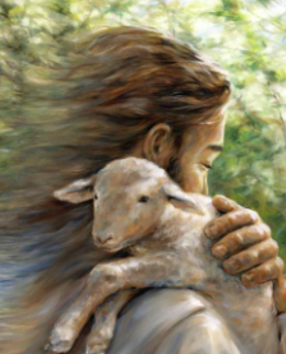
“…he calleth together his friends and neighbours, saying unto them, Rejoice with me;...”
The shepherd returns home with his lost sheep and calls for a celebration.
Why?
Melani Pyke
Luke 15:6

Slide 32
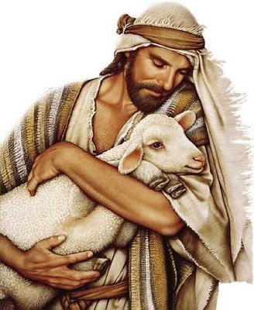
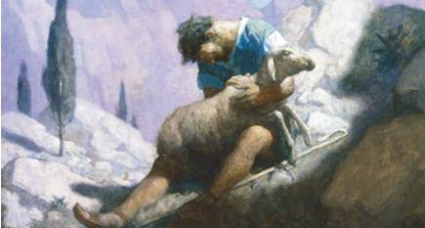
The Western tradition is that He loves the sheep and is relieved to find it.
The Eastern tradition, if the shepherd loses the sheep, he loses his character and reputation.

Slide 33
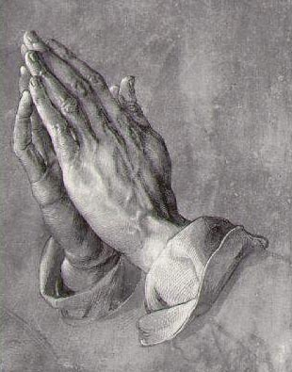
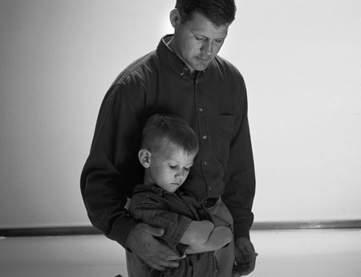
“I say unto you, that likewise joy shall be in heaven over one sinner that repenteth,…”
Through the Atonement we can be forgiven, and Heavenly Father will rejoice at our return.
Luke 15:7

Slide 34
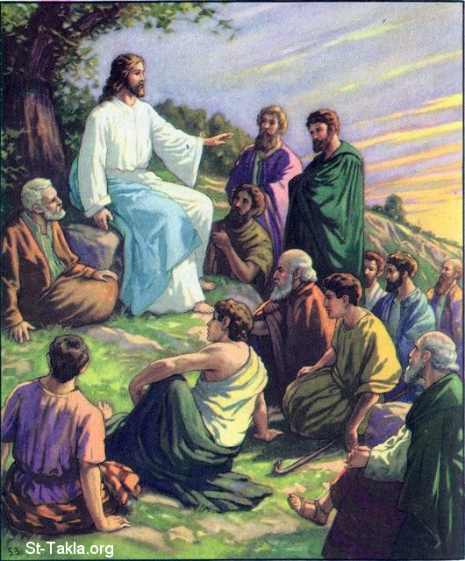
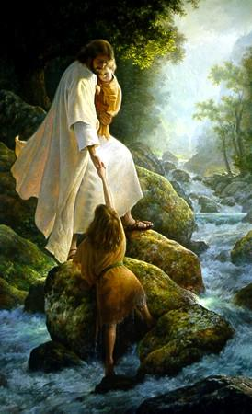
“…more than over ninety and nine just persons, which need no repentance.”
What about the ninety-nine?
They are already safe in the fold.
Luke 15:7

Slide 35
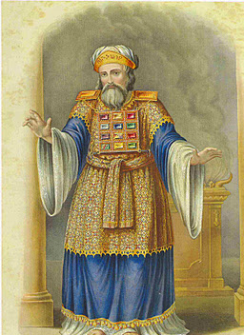
Who would those people be?
Who exactly needs no repentance?
This jab was directed to the Pharisees and Scribes who were striving to live the Law perfectly so that they would be “justified” for heaven and would need no Savior.

Slide 36
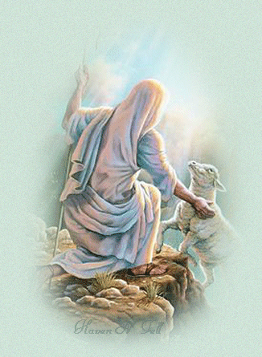
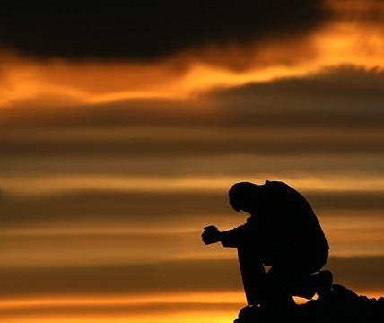
What does the lost sheep do to save himself?
Do you need a Savior?
At most, he bleats so he may be found.
Salvation comes only from the Shepherd.

Slide 37
Psalms 14:3
“There is none that doeth good, no not one.”
Romans 3:23
“All have sinned, and come short of the glory of God”

Slide 38
Chiasmus
The Lost Sheep
1. YOU 4 "Which one of you, having a hundred sheep
2. ONE and losing one of them,
3. NINETY-NINE does not leave the ninety-nine in the wilderness
A. LOST and go after the one
B. FIND that is lost until he finds it? 5 When he has found it,
C. REJOICE he places it on his shoulders, rejoicing.
D. RESTORE 6 And when he comes home, he calls together his friends and neighbors,
C. REJOICE saying to them, 'Rejoice with me,
B. FIND for I have found my sheep
A. LOST that was lost.'
4. YOU 7 Just so, I tell you, there will be more joy in heaven
5. ONE over one sinner who repents
6. NINETY-NINE than over ninety-nine righteous persons who need no repentance.

Slide 39
Joseph Smith stated:
“There is joy in the presence of the angels of God over one sinner that repenteth, more than over ninety-and-nine just person that are so righteous; they (the prideful ones) will be damned anyhow; you cannot save them.”

Slide 40
“Rejoice With Me”
The Parable of the Lost Coin
Luke 15:8-10

Slide 41
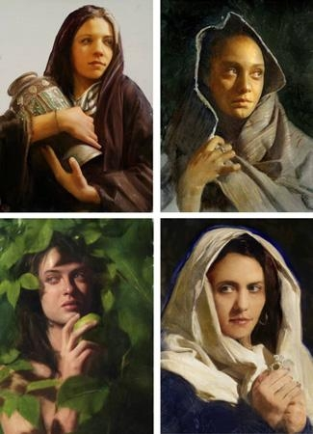
Jesus speaks of a woman in this parable.
A speaker in Middle Eastern culture cannot compare a male audience to a woman without giving offense. Jesus does it anyway with the intent of elevating the status of all women.

Slide 42
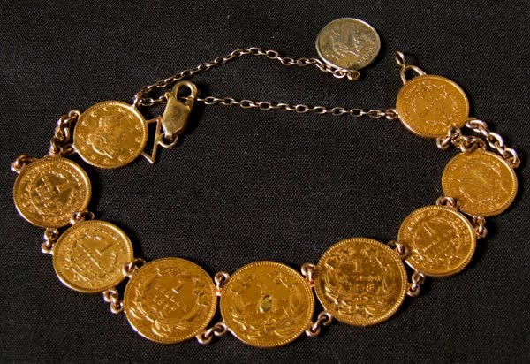
“Either what woman having ten pieces of silver,…”
Drachmas
Luke 15:8

Slide 43
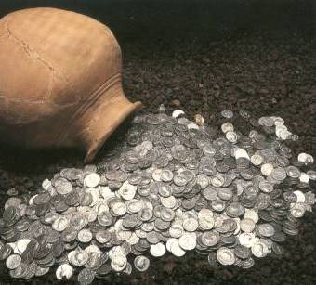
The coins were her insurance that if she ever lost her husband she would have the coins to support her

Slide 44
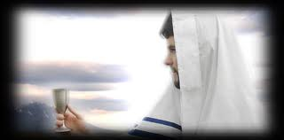
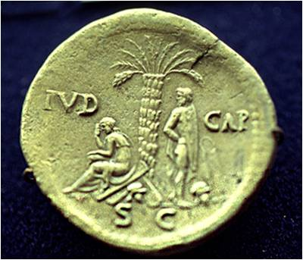
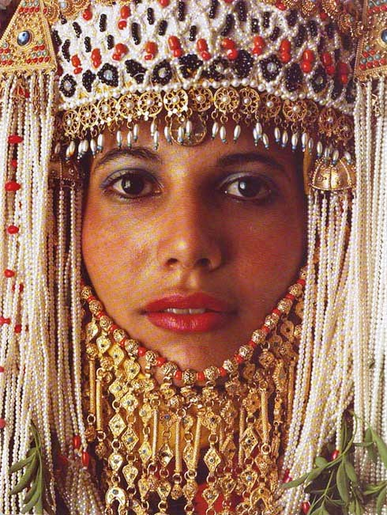
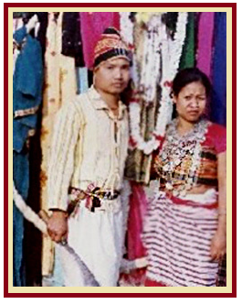
Bride Price
A drachma is about one day’s wages.
Paid by husband at the betrothal.

Slide 45
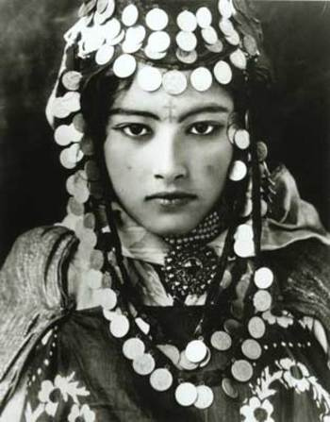
If the woman is found unfaithful her husband might take the coins away to her disgrace
If the husband discovers a coin missing he might get the wrong idea

Slide 46
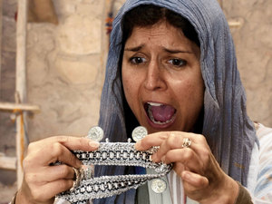
A complete set of coins represented a faithful wife.
“…if she lose one piece,…”
Luke 15:8

Slide 47
Middle Easterners do not take direct blame for such an act. They might say, “The coin is lost” but would not say “I lost the coin.”
Jesus emphasizes that this woman has indeed lost the coin and she take responsibility for having done so
Luke 15:8

Slide 48
“…doth not light a candle…”
Luke 15:8

Slide 49
The homes were made with basalt (black volcanic rock) floors. The rooms were about 7 feet high with six inch slits near the top for the only windows. The floors were stones pieced together, with numerous cracks where the stones met.
The woman must light a lamp in the dark room and painstakingly search for the coin.

Slide 50
“…and sweep the house, and seek diligently till she find it?”
Luke 15:8

Slide 51
Transgression or neglect, that which is lost, perhaps virtue or chastity, needs to be found

Slide 52
In order to get back what is lost, we need to repent by searching and praying for forgiveness.
How do you know when you have been forgiven?

Slide 53
Joy in Finding
Knowing that you had done everything possible to find that which was lost

Slide 54
“And when she hath found it, she calleth her friends and her neighbours together, saying, Rejoice with me; for I have found the piece which I had lost.”
The woman finds the coin and invites the neighbors to a celebration.
Luke 15:9

Slide 55
Having found the coin she has proven her faithfulness and it is her success that she wants to celebrate.
So it is with us, when we fully repent we rejoice to be able to return to the Savior

Slide 56
“Just so, I say unto you, there is joy in the presence of the angels of God over one sinner that repenteth.”
Luke 15:10

Slide 57
Chiasmus
INTRODUCTION "Or what woman having ten silver coins”
1. LOST if she loses one of them,
2. FOUND does not light a lamp, sweep the house, and search carefully until she finds it?
3. REJOICE When she has found it, she calls together her friends and neighbors, saying, 'Rejoice with me,
4. FOUND for I have found the coin
5. LOST that I had lost.
CONCLUSION “Just so, I tell you, there is joy in the presence of the angels of God over one sinner who repents."

Slide 58
“…he was lost, and is found”
Parable of the Prodigal Son
Luke 15:11-32

Slide 59
“And a certain man had two sons…”
Luke 15:11

Slide 60
“ And the younger of them said to his father, Father, give me the portion of that falleth to me…”
The Younger Son Requests his Inheritance
Cultural:
Betrayal
of Family and Community Values
Akin to wishing the Father was dead
He would have
been shunned
by the community
Luke 15:12

Slide 61
The prodigal asked not only for his inheritance, but the right to dispose of it as he pleased.
According to tradition, a father had claim on all his property and the income from it until his death.

Slide 62
Why did the Father give this inheritance to his son?
Land was given to each tribe of Israel as an eternal inheritance.
By complying, the father wrecked the family generational estate.
Then it was divided within each tribe into family inheritances that were passed generation to generation intact.
The father would have had to liquidate the son's portion, keep the property and give the son the money.

Slide 63
Deuteronomy 21:18-21
The Law of Moses
A Rebellious Son could be stoned to death

Slide 64
“…And he divided unto him his living.”
The father had to sell 1/3 of the family’s generational estate and convert it to cash.
Luke 15:11

Slide 65
The Father allowed his son to experience the consequences.
Tough Love
He wanted his son to learn through life’s trials.

Slide 66
“And not many days after the younger son gathered all together, …”
Luke 15:13

Slide 67
“…and took his journey into a far country…”
Gentile country—Babylon.
Luke 15:13

Slide 68
As long as you had money in Babylon you were treated well
If a Jewish boy spent his inheritance among the Gentiles, his home community would perform a “Kutzash”

Slide 69
Like the prodigal son, we too can go to “a far country” is not measured by miles but by how far our hearts and minds are from Jesus!
Fidelity, not geography, really determines the distance.
Neal A. Maxwell Conference October 2000

Slide 70
“…and there wasted his substance with riotous living…”
Luke 15:13

Slide 71
What did he want?
The 4 P’s
Popularity
Power
Possession
Passions
Luke 15:13

Slide 72
“…And when he had spent all,…”
The King James Version is incorrect in their translation of “riotous living.” We assume this speaks of his dissipated, immoral life. The Greek word, “asotozs” means “a glutton.” There is no hint of immorality from the language. He is simply living an expensive, carefree life as a spendthrift.
Luke 15:14

Slide 73
“…there arose a mighty famine in that land,…”
Luke 15:14

Slide 74
“…and he began to be in want.”
The natural thing to do would be to return home, but in the Middle East, cultural life is governed by honor and shame.
Luke 15:14

Slide 75
He loses everything…if he was with family they would of helped, but he has departed from them…he is an alien in a Gentile country and had no family to return to.

Slide 76
“…And he went and joined himself to a citizen of that country; and he sent him into his fields to feed swine.”
He goes to work for the lowest job and the lowest pay
Luke 15:15

Slide 77
“And he would fain have filled his belly with the husks that the swine did eat: and no man gave unto him.”
According to Jewish law, this makes him ritually unclean. He has sunk to the lowest a Jewish boy could get. He also was not allowed to eat the pig’s food.

Slide 78
The Son left home seeking his freedom.
Where is his freedom now?

Slide 79
“And when he came to himself, he said. How many hired servants of my father’s have bread enough and to spare, and I perish with hunger!”
During the famine the swine would have been worth more than the Prodigal who was no more than a slave.
Luke 15:17

Slide 80
“Came to Himself”
The repentance process begins when he starts being honest with himself over his situation. He is now “compelled” to be humble which prepares him to even think of submitting to a higher power.
The spirit can begin his work within the son.

Slide 81
"The returning prodigals are never numerous enough, but regularly some come back from “a far country”. Of course, it is better if we are humbled “because of the word” rather than being compelled by circumstances, yet the latter may do!
Famine can induce spiritual hunger."
(1)

Slide 82
“I will arise and go to my father, and will say unto him, Father, I have sinned against heaven and before thee,…”
Realizing he needs his father’s help and he makes his plan to return to his father.
Luke 15:18

Slide 83
“And am no more worthy to be called they son…”
He has broken the law of Moses, sinned against his father by humiliating him publicly and bringing dishonor to his family name.
Luke 15:19

Slide 84
“If you have repented form serous transgression and mistakenly believe that you will always be a second-class citizen in the kingdom of God, learn that is not true…find encouragement in the lives of Alma the Younger and the sons of Mosiah. They were tragically wicked. Yet their full repentance and service qualified them to be considered as a noble as righteous Captain Moroni.”
Luke 15:19
(2)

Slide 85
“And am no more worthy to be called they son: make me as one of the hired servants.”
He is now hoping his father will take him back as a servant
3 types of servants:
Bondsmen—a native Israelite sold for a debt or crime—freed on the 7th year.
Lower-class slaves—purchased slaves from heathen tribes.
Hired hands—day laborers—outsiders who had no job security and lived in destitution.
Luke 15:19

Slide 86
“And he arose, and came to his father…”
Joe Cavazos
Luke 15:20

Slide 87
“…But when he was yet a great way off, his father saw him,…
The Prodigal’s father has been watching and waiting for his son. The father knows the son and that he had failed in the world. He also knows his son is proud and will not come back until he falls to his lowest point.
Luke 15:20

Slide 88
When his father sees him, he knows he needs to greet him before the son gets to the village and is seen by the community and openly shamed.
The Village would expect the father to yell and berate the son when he see him.

Slide 89
Protecting the boy the father runs to greet him before he gets to the village
In the near east, for an elderly gentleman to run was disgraceful. He often has long flowing robes, and running would require him to roll up his robes, allowing people to see his legs, this would be humiliating.
‘gird up his loins’
Gird(up) your loins-- to prepare yourself mentally to do something difficult Usage notes:
This phrase comes from the Bible, where girding up your loins meant to tie up long, loose clothes so that they were more practical when you were working or travelling.
Both sides are presently girding their loins for the legal battles that lie ahead.

Slide 90
“Kutzasah”
Or
“Kezazah”
Once a vessel became ritually unclean, it had to be taken out of use. An impure pottery vessel, for example, had to be broken.
The community would throw down an earthen pot, breaking it.
It signifies that the Jewish boy is dead to them unless he brings his inheritance back.

Slide 91
“…and had compassion, and ran, and fell on his neck, and kissed him.”
The father’s kiss was a sign of reconciliation and forgiveness.
Luke 15:20

Slide 92
When a serious quarrel has taken place in the village and reconciliation is achieved, a part of the ceremony enacted as a sacrament of reconciliation is a public kiss by the leading men involved.

Slide 93
In the Law of Moses the Scribes and Pharisees would have required a ritual cleansing of the son before they would even have touched him.

Slide 94
“…And the son said unto him, Father, I have sinned against heaven, and in they sight, and am no more worthy to be called they son.”
Luke 15:21

Slide 95
“But the father said to his servants, Bring forth the best robe, and put it on him; and put a ring on his had, and shoes on his feet:”
Clothing his son is symbolic:
It is a public statement of his unconditional acceptance.
Luke 15:22

Slide 96
Best Robe….Putting on the spirit or Righteousness
Ring….access to the estates most important documents and possession authority as part of the family
Freedom…no slave would wear shoes…only freemen. Shoes were worn by the master, not the guest, who removed them when they entered the house.

Slide 97
The servants are asked to place the shoes on the son, thus suggesting his reinstatement as a member of the family.

Slide 98
“And bring hither the fatted calf, and kill it; and let us eat, and be merry:”
The father modeled for the townspeople how they should accept his son.
A fatted calf was kept only for sacred festivals…it would have fed over 100 people. This would have been no small gathering to celebrate.
Luke 15:23

Slide 99
The Fatted calf = Sacrifice of an animal Christ’s atonement

Slide 100
“For this my son was dead, and is alive again; he was lost , and is found, and they began to be merry…”
Ary Scheffer
Luke 15:24

Slide 101
“Now his elder son was in the field: and as he came and drew night to the house, he heard music and dancing.”
The devoted son hears music and dancing and asks a servant about it.
Luke 15:25

Slide 102
“And he called one of the servants, and asked what these things meant.
And he said unto him Thy brother is come; and thy father hath killed the fatted calf, because he hath received him safe and sound.”
Luke 15:25

Slide 103
“And he was angry, and would not go in: therefore came his father out, and intreated him.”
The devoted son feels betrayed, because he has served and worked while his brother had gone and squandered his inheritance
Luke 15:28

Slide 104
“And he answering said to his father, Lo these many years do I serve thee, neither transgressed I at any time thy commandment; and yet thou never gavest me a kid, that I might make merry with my friends:”
You are always with me
Luke 15:29

Slide 105
“But as soon as this thy son was come, which hath devoured thy living with harlots, thou hast killed for him the fatted calf.”
Almost as if he were saying, “I am slaving for you, and he has done nothing, and yet you have treated him with more favor than me.”
Luke 15:30

Slide 106
“The older son forgets for a moment that he has never had known filth or despair, fear or self-loathing. He forgets for a moment that every calf on the ranch is already his and so are all the robes in the closet and every ring in the drawer. He forget for a moment that his faithfulness has been and always will be rewarded.”
Luke 15:29
(3)

Slide 107
“And he said unto him Son, thou art ever with me, and all that I have is thine.”
Keep in mind the older son is the “birthright” son which means his inheritance is a “double portion”.
Luke 15:31

Slide 108
“It was meet that we should make merry, and be glad; for this thy brother was dead, and is alive again; and was lost, and is found.”
His father reminds him that this is his brother. That he was faithful all along and that he has not lost anything. This is what Christ would do, forgive his brothers.
Luke 15:32

Slide 109
There is no limit to the number of lost souls who can be welcomed back.
We can tell how close we are to Heavenly Father
by checking how we
feel about people
who are in sin.

Slide 110
"Nothing is so much calculated to lead people to forsake sin as to take them by the hand, and watch over them with tenderness.....
….The nearer we get to our Heavenly Father, the more we are disposed to look with compassion on perishing souls; we feel that we want to take them upon our shoulders, and cast their sins behind our backs.
Joseph Smith TPJS 240-241

Slide 111
Message of Hope
“The Other Prodigal” Elder Jeffrey R Holland May 2002 Ensign
Lessons learned from the Prodigal Son

Slide 112
Lessons learned from the Prodigal Son
Coming to Christ is true freedom from bondage
It’s never over ‘til it’s over. Do we really know the final outcome in the lives of our spiritual sibling? It’s in God’s hands. Joseph Smith said, “A soul is never too old to repent.” TPJS p 191
Be careful not to condemn. Remorse is not repentance but it is a good beginning.
The lowest point (rock bottom) is someone’s life can be a switch point for turning back to God. There also is “Foxhole” religion” Repentance borne of desperation is not always lasting. Time will tell for the younger son.

Slide 113
Repentance is not a work we perform on our own. We must allow God to “find” us. The lost sheep and coin didn’t regent---they were found.
There are limits to the mercy of God. We don’t sin so that mercy can abound. We could lose something we can never reclaim.
It is always better to “prepare and prevent” than to “repair and repent.” You ALWAYS lose something during a period of rebellion.
Ask yourself: Would I have attended the banquet of the returning prodigal? Would I feel I am condoning the actions of the guilty: Remember: All of us fall short of perfection. God cheers on every runner, calling out that the race is against sin, not against each other.
In order to have faith in Jesus Christ and God the Father, we must understand their character and attributes. This parable should be “the parable of the Loving Father’ The Father of the prodigal sons is our father. He is the “hero”.

Slide 114
“When we are lost, we can ‘come to ourselves’ but we may not always be able to ‘find ourselves,’ and, worlds without end, we cannot ‘save ourselves.’ Only the Father and His only Begotten Son can do that. Salvation is in Them only.
So we pray that They will help us, that They will ‘come out’ to meet and embrace us and bring us into the feast They have prepared.”
(3)

Slide 115
Sources:
Neal A. Maxwell, CR October 2000
Elder Richard G. Scott Conference Oct. 2000
Elder Jeffrey R. Holland The Other Prodigal May Ensign 2002
Inspired by Poway Institute:
By Becky Davies and Lesley Meacham
Amazing Grace
https://www.youtube.com/watch?v=X6Mtpk4jeVA
https://www.youtube.com/watch?v=GYMLMj-SibU
Presentation by ©http://fashionsbylynda.com/blog/

Slide 116
Event | Matthew | Mark | Luke | John
Parable of the Lost Sheep |  |  | 15:1-7
Parable of the Lost Coin |  |  | 15:8-10
Parable of the Prodigal Son |  |  | 15:11-37
“The three parables … are as one in portraying the joy that abounds in heaven over the recovery of a soul once numbered among the lost, whether that soul be best symbolized by a sheep that had wandered afar, a coin that had dropped out of sight through the custodian’s neglect, or a son who would deliberately sever himself from home and heaven. There is no justification for the inference that a repentant sinner is to be given precedence over a righteous soul who had resisted sin. … Unqualifiedly offensive as is sin, the sinner is yet precious in the Father’s eyes, because of the possibility of his repentance and return to righteousness. The loss of a soul is a very real and a very great loss to God. He is pained and grieved thereby, for it is His will that not one should perish” James E. Talmage (Jesus the Christ, 3rd ed. [1916], 461
Searching for the Lost:
“Some of our own … cry out in pain and suffering and loneliness and fear. Ours is a great and solemn duty to reach out and help them, to lift them, to feed them if they are hungry, to nurture their spirits if they thirst for truth and righteousness. …
I would hope, I would pray that each of us … would resolve to seek those who need help, who are in desperate and difficult circumstances, and lift them in the spirit of love into the embrace of the Church, where strong hands and loving hearts will warm them, comfort them, sustain them, and put them on the way of happy and productive lives” President Gordon B. Hinckley (“Reach with a Rescuing Hand,” Ensign, Nov. 1996, 86).
The Prodigal Son:
“The tender image of this boy’s anxious, faithful father running to meet him and showering him with kisses is one of the most moving and compassionate scenes in all of holy writ. It tells every child of God, wayward or otherwise, how much God wants us back in the protection of His arms”
The Other Son:
“This son is not so much angry that the other has come home as he is angry that his parents are so happy about it. Feeling unappreciated and perhaps more than a little self-pity, this dutiful son—and he is wonderfully dutiful—forgets for a moment that he has never had to know filth or despair, fear or self-loathing. He forgets for a moment that every calf on the ranch is already his and so are all the robes in the closet and every ring in the drawer. He forgets for a moment that his faithfulness has been and always will be rewarded. …
“… He has yet to come to the compassion and mercy, the charitable breadth of vision to see thatthis is not a rival returning. It is his brother. …
“Certainly this younger brother had been a prisoner—a prisoner of sin, stupidity, and a pigsty. But the older brother lives in some confinement, too. He has, as yet, been unable to break out of the prison of himself. He is haunted by the green-eyed monster of jealousy”
Elder Jeffrey R. Holland (“The Other Prodigal,” Ensign, May 2002, 62).

Slide 117
Chiasmus
The Lost Sheep
YOU 4 "Which one of you, having a hundred sheep
2. ONE and losing one of them,
3. NINETY-NINE does not leave the ninety-nine in the wilderness
A. LOST and go after the one
B. FIND that is lost until he finds it? 5 When he has found it,
C. REJOICE he places it on his shoulders, rejoicing.
D. RESTORE 6 And when he comes home, he calls together his friends and neighbors,
C. REJOICE saying to them, 'Rejoice with me,
B. FIND for I have found my sheep
A. LOST that was lost.'
4. YOU 7 Just so, I tell you, there will be more joy in heaven
5. ONE over one sinner who repents
6. NINETY-NINE than over ninety-nine righteous persons who need no repentance.

Slide 118
Chiasmus
The Lost Coin
INTRODUCTION "Or what woman having ten silver coins,
1. LOST if she loses one of them,
2. FOUND does not light a lamp, sweep the house, and search carefully until she finds it?
3. REJOICE When she has found it, she calls together her friends and neighbors, saying, 'Rejoice with me,
4. FOUND for I have found the coin
5. LOST that I had lost.
CONCLUSION Just so, I tell you, there is joy in the presence of the angels of God over one sinner who repents."

Slide 119
Eternal Riches
Luke 16
Including:
Parable of the Unjust Steward
Parable of the Rich Man and Lazarus
But lay up for yourselves treasures in heaven, where neither moth nor rust doth corrupt, and where thieves do not break through nor steal.
For where your treasure is, there will your heart be also.
3 Nephi 13:20-21

Slide 120
What are some items that people often set their hearts on and try to obtain?

Slide 121
What are some riches that Heavenly Father wants us to seek?

Slide 122
Parable of the Unjust Steward
Steward = someone who is given authority to oversee or to manage his master’s property.
What had the steward be doing with the rich man’s goods?
Was the steward about to lose his job because of his wastefulness?
The steward worried about what he would do when he lost his job because he did not feel he could do manual labor and was too ashamed to beg.
Luke 16:1-4

Slide 123
The Plan
The steward devised a plan that he thought might lead to job opportunities in other households.
He visited two of the rich man’s debtors and significantly discounted their debts, which he hoped would earn their favor.
Luke 16:3-7

Slide 124
Preparation for Temporal Future
This parable does not encourage us to be dishonest or to cheat others in any way; rather, it encourages us to prepare for our eternal future with the same energy and effort as this steward prepared for his temporal future.
If we wisely prepare for our eternal future and righteously use earthly riches, we can be blessed with eternal riches.
Luke 16:3-7
(1)

Slide 125
“Our Lord’s purpose was to show the contrast between the care, thoughtfulness, and devotion of men engaged in the money-making affairs of earth, and the half hearted ways of many who are professedly striving after spiritual riches. …
“… Take a lesson from even the dishonest and the evil; if they are so prudent as to provide for the only future they think of, how much more should you, who believe in an eternal future, provide therefor! …
Emulate the unjust steward and the lovers of mammon, not in their dishonesty, cupidity [selfish greed], and miserly hoarding of the wealth that is at best but transitory [temporary], but in their zeal, forethought, and provision for the future.”
Luke 16:8
(4)

Slide 126
We Cannot Serve God and Mammon
No servant can serve two masters: for either he will hate the one, and love the other; or else he will hold to the one, and despise the other. Ye cannot serve God and mammon.
Servir a Dois Senhore
"We know that 'a double minded man is unstable in all his ways' (James 1:8) and that we cannot 'serve two masters.'
President Marion G. Romney wisely observed that there are too many of us 'who try to serve the Lord without offending the devil.'"
Luke 16:13-14
(2)

Slide 127
Parable of the Rich Man and Lazarus
Luke 16:13-31

Slide 128
Folktale brought out by Jesus to teach a lesson

Slide 129
Before Jesus there was an Egyptian folktale circulating depicting a rich man dressed in fine linen and a poor man on a straw mat, whose roles were reversed after death…

Slide 130
Brought to Israel by Alexandrian Jews, the folktale was altered to a rich tax collector
by the name of
Bar Ma’jan and a poor teacher of the law…
Tax collector

Slide 131
…after death, the teacher of the law strolled along the broad streams of Paradise while the tax collector standing next to the water was unable to reach it to quench his thirst

Slide 132
A Certain rich man, clothed in purple and fine linen, did very well for himself
Luke 16:19

Slide 133
A poor man, Lazarus, begs for crumbs from the table
Luke 16:21

Slide 134
They both die and Lazarus was taken by angels into Abraham’s bosom, and the rich man was buried
R.I.P.
Lazarus

Slide 135
“Abraham’s Bosom”
This is the only phrase used in the entire Bible. It meant Paradise to the rabbis
To sit on someone’s right side during dinner was to recline in their “bosom”, which is also a position of close friendship.
Lazarus was now at Abraham’s bosom, a place where every Jew wanted to be.

Slide 136
“Paradise, the temporary abode of righteous Abraham as he awaited the day of his resurrection.”
(2)

Slide 137
The tables had been turned. Lazarus was with Abraham in Paradise and the rich man in torment
Luke 16:22-23

Slide 138
Lazarus had received evil things in life, while the rich man had received good things.
Now Lazarus is comforted, while the man is tormented
“And beside all this, between us and you there is a great gulf fixed…”
Luke 16:25-26

Slide 139
Lazarus could not bring the man water because of the “great gulf” between them
One can not move from one kingdom to another until after the resurrection.

Slide 140
I desire these things be known to my 5 brothers.
They have the prophets to hear the Word of God.
But if they see me, they will believe. (A sign)
If they haven’t already listened to the Word of God, they will not now.
Luke 16:27-31

Slide 141
Jesus gave the beggar a name, Lazarus, he may have used this name because of his good friend Lazarus (Mary and Martha’s brother) Lazarus’ name means “Helped of God”
This parable came just before the raising of Lazarus from the dead
(3)

Slide 142
Perhaps this parable condemns those who seek for a sign but also reminds the Pharisees to take care of the poor.
Food

Slide 143
“”Therefore, if any man shall take of the abundance which I have made, and impart not his portion, according to the law of my gospel, unto the poor and the needy, he shall, with the wicked, lift up his eyes in hell, being in torment”
D&C 104:18

Slide 144
Conversion comes through believing and heeding the words of prophets, not by witnessing miracles or seeing angels

Slide 145
Sources:
New Testament Institute Teacher Manual Chapter 18 and Student Manual
Elder Bruce R. McConkie New Testament Commentary 1:521
Bible Dictionary
James E. Talmage (Jesus the Christ, 3rd ed. [1916], 463, 464).
Joseph B. Wirthlin ("True to the Truth," Ensign, May 1997, 16)
Presentation by ©http://fashionsbylynda.com/blog/

Slide 146
Event | Matthew | Mark | Luke | John
Parable of the Unjust Steward |  |  | 16:1-13
Hypocrisy of the Pharisees |  |  | 16:14-18
Parable of the Rich man and Lazarus |  |  | 16:19-31
Serving God or Mammon Luke 16:13-14:
“The scriptures say to have thoughts of God always within our hearts. Many people now fill their hearts with thoughts of riches, power, and fame. They worship their possessions, loving things without life.”
• “We serve ourselves much too often when we should be serving the Lord. We must not worship our time—a graven image that takes the place of God in many cases. God asks us to sacrifice our time, making sure that he, not our own selfish interests, is first in our lives.”
• “The graven images I see people worshiping are clothing, cars, homes, hobbies, and recreation. The fact that I spend more time deciding what to wear each morning than I do in prayer is very telling.”
“Alma 1:32 says, ‘Those who did not belong to their church did indulge themselves in sorceries, and in idolatry or idleness.’ This is something that I had never contemplated before: idleness as a form of idolatry.”
• “Money is one of the most common images that people bow down to today. They bow down by giving up their integrity and honesty in dealing with others in order to obtain it. They bend their principles as they are bowing down.”
• “Too often people make man their graven image. Because we are afraid of others’ opinions, we won’t serve others or be kind to those society looks down on. We worship others’ praise and honor; we desire above all else the prestige others can give us. We want the right titles and awards. We want to wear the right clothing. We want to be popular.” By Dennis Largey Refusing to Worship Today’s Graven Images march 1998 Ensign
Exchanged Between Jesus and the Pharisees Luke 16:16-23:
The Pharisees claimed that the law of Moses and other prophetic scripture (the Old Testament) served as their law, and they therefore rejected Jesus as their judge. Jesus explained that the law of Moses and the prophets had testified of Him. He questioned the Pharisees for denying what had been written and rebuked them for “pervert[ing] the right way” (Joseph Smith Translation, Luke 16:21). To help the Pharisees, whose hearts were set on worldly riches and power, to understand their behavior and the consequences of it, the Savior likened them to the rich man in the parable recorded in Luke 16:19–31.
The parable of the rich man and Lazarus teaches us about the principle of divine justice. In the parable, the rich man found that after his death, he would have to suffer for a time because of the decisions he had made as a mortal. Lazarus found that after his death, he was blessed and comforted. This teaches us that all the inequities of this life will be made up to the righteous in the next life. Justice is the friend of those who rely on the Atonement of Jesus Christ. As Abraham said to the rich man in the parable, in the next life the injustices of mortality are made right: “Remember that thou in thy lifetime receivedst thy good things, and likewise Lazarus evil things: but now he is comforted, and thou are tormented” (1)
Lazarus:
A short time after the parable was given, the Savior’s close friend Lazarus died and the Savior restored him to life (see John 11). In literal fulfillment of Jesus’s prophecy that someone who had risen from the dead would not persuade the wicked to repent, Jewish leaders responded to the raising of Lazarus from the dead by seeking to have him killed (see John 12:10–11). Not too many months later, Jesus Himself would be slain and would rise from the dead, and the Jewish leaders would continue to refuse to be persuaded.

Slide 147
“Thy Faith Hath Made Thee Whole”
Luke 17
Including:
Forgiveness
Parable of the Unprofitable Servant
The 10 Lepers Are Cleansed

Slide 148
Leading Others Astray
The Savior warned that those who lead others astray or persuade them to sin will be held accountable.
The Savior’s disciples must watch themselves so they do not cause others to stumble
Luke 17:1-2

Slide 149
Forgive—7 Times a Day
Jesus also taught us to forgive others, even if they trespass “seven times in a day” and then repent each time.
Forgiveness is required of everyone
Wherefore, I say unto you, that ye ought to forgive one another; for he that forgiveth not his brother his trespasses standeth condemned before the Lord; for there remaineth in him the greater sin.
D&C 64:9
Luke 17:3-5
(1)

Slide 150
Parable of the Unprofitable Servant
A master provided all the necessities of life to his servant as the servant faithfully fulfilled his expected duties.
Because of this, there was no need for the master to give special thanks to his servant or to feel indebted to him for performing his duties…
The servant should not expect any special reward or adopt a sense of entitlement simply because he had done his duty.
No matter how well a servant performed his duties, he was still in his master’s debt for all that he had.
Luke 17:5-10
(1)

Slide 151
Indebted
We are eternally indebted to our Heavenly Father and can never fully pay Him back or place Him in our debt.
Thus, in answer to the Apostles’ request to strengthen their faith, the Savior taught that faith in God involves recognizing our indebtedness to Him and dependence on Him.
"You will not be surprised that the Lord responded by speaking of a seed. The first thing to know about how faith in him increases is to think of its growth like that of a tree. You remember how Alma used that illustration. The seed is the word of God. It must be planted in the heart of the person you serve and whose faith you want to see increase.”
Luke 17:5-10
(2)

Slide 152
“…thy faith hath made thee whole.”
Cleansing the 10 Lepers

Slide 153
“And it came to pass, as he went to Jerusalem, that he passed through the midst of Samaria and Galilee.”
Luke 17:11

Slide 154
“And as he entered into a certain village…
“…there met him ten men that were lepers, which stood afar off:”
Luke 17:12

Slide 155
Leprosy
The term “leprosy” (including leper, lepers, leprosy, leprous) occurs:
68 times in the Bible—
55 times in the Old Testament (Hebrew = tsara’ath) and
13 times in the New Testament (Greek = lepros, lepra).
(3)

Slide 156
Leviticus 13
Laws of Leprosy: Those who have the appearance of a skin disorder
Brought to a Priest (Aaron)
Pronounce unclean
White, not deep…shut up for 7 days
If not cleared up then shut up for 7 more days

Slide 157
If plague does not spread, the priest pronounces clean
If plague is spread Priest
pronounces unclean.
His clothes shall be burned,
He head shall be bare
He puts a covering upon his upper lip, and cry, “unclean, unclean.”
He shall dwell alone; without the camp.

Slide 158
In the Old Testament, the instances of leprosy most likely meant a variety of infectious skin diseases, and even mold and mildew on clothing and walls.

Slide 159
Aaron pleads for Miriam:
Numbers 12:10-12
“…and behold, Miriam became leprous, white as snow; and Aaron looked upon Miriam, and behold, she was leprous.
“Let her (Miriam) not be as one dead, of whom the flesh is half consumed…”

Slide 160
Leviticus 14:2-57 "This shall be the law of the leper.“
God's law for lepers: Get two birds. Kill one. Dip the live bird in the blood of the dead one.
Sprinkle the blood on the leper seven times, and then let the blood-soaked bird fly away.
Next find a lamb and kill it. Wipe some of its blood on the patient's right ear, thumb, and big toe.
Sprinkle seven times with oil and wipe some of the oil on his right ear, thumb and big toe. Repeat.
Finally find another pair of birds. Kill one and dip the live bird in the dead bird's blood.
Wipe some blood on the patient's right ear, thumb, and big toe. Sprinkle the house with blood 7 times.
That's all there is to it.
(3)

Slide 161
The precise meaning of the leprosy in both the Old and New Testaments is still in dispute, but it probably includes the modern Hansen’s disease (especially in the New Testament) and infectious skin diseases.
Mycobacterium leprae, the infectious bacterial agent of leprosy.
(3)

Slide 162
Leprosy is reported as early as 600 BC in India, China, and Egypt.
Leprosy was considered a curse of God, often associated with sin.
(3)

Slide 163
Leprosy did not kill, but neither did it seem to end.
Leprosy lingered for years, causing the tissues to degenerate and deform the body.
(3)

Slide 164
Many thought leprosy to be a disease of the skin…
It is better classified as a disease of the nervous system, because the bacterium attacks the nerves.
(3)

Slide 165
Patients with leprosy experience disfigurement of the skin and bones, twisting of the limbs, and curling of the fingers to form the characteristic claw hand. Facial changes include thickening of the outer ear and collapsing of the nose.
(3)

Slide 166
“Leprosy was nothing short of a living death, …a poisoning of the very springs of life; a dissolution, little by little, of the whole body, so that one limb after another actually decayed and fell away.
The disease was incurable
by the art and skill of
man…”
(3)

Slide 167
…The leper, thus fearfully bearing about the body the outward and visible token of sin in the soul, was treated throughout as a sinner.”
Considered unclean, they were shut out from society.
(3)

Slide 168
11 Chamber of Leper (Metzorah) This chamber served as a gathering place for people with a Biblical skin disease caused by speaking slander. It was only diagnosed by a qualified Priest (Kohain).
(3)

Slide 169
Leprosy is related to the tuberculosis bacterium…Leprosy is spread by multiple skin contacts, as well as secretions transmitted from person to person
To touch a person with Leprosy you were considered unclean.
(3)

Slide 170
Jesus freely touched people with leprosy. While people with leprosy traditionally suffered banishment from family and neighbors…
…Jesus broke from the tradition. He treated lepers with compassion, touching and healing them.
(3)

Slide 171
Like leprosy, sin starts out small but can then spread, leading to other sins and causing great damage to our relationship with God and others.

Slide 172
Inner Leprosy
Although we can’t know all the reasons that God allows disease into our lives, biblical leprosy is a powerful symbol reminding us of sin’s spread and its horrible consequences.

Slide 173
“And they lifted up their voices, and said…
“Jesus, Master, have mercy on us.”
Luke 17:13

Slide 174
“And when he saw them, he said unto them…
…Go shew yourselves unto the priests…
Luke 17:14

Slide 175
Obedience would be their test of faith
No one who had been leprous could be lawfully restored to the community until pronounced clean by a priest
(3)

Slide 176
“…as they went, they were cleansed.”
We receive the Lord’s blessings as we do what He has instructed us to do
In hast they went in obedience of the Lord.
Luke 17:14

Slide 177
“…And one of them, when he saw that he was healed…
…turned back, and with a loud voice glorified God.”
Luke 17:15

Slide 178
“And fell down on his face at his feet, giving him thanks…
It is important to express gratitude for the blessings we receive
…and he was a Samaritan.”
Luke 17:16

Slide 179
“…Were there not ten cleansed?…
Luke 17:17

Slide 180
Doubtless the nine who did not come back were obedient to the strict letter of the Lord’s command…
James Christensen
…but their lack of gratitude and their failure to acknowledge the power of God was in contrast to the one filled with the spirit.
(3)

Slide 181
“Gratitude is deeper than thanks. Thankfulness is the beginning of gratitude. Gratitude is the completion of thankfulness. Thankfulness may consist merely of words. Gratitude is shown in acts.”
(4)

Slide 182
“There are not found that returned to give glory to God…
…save this stranger.”
Luke 17:18

Slide 183
Through faith and obedience and repentance we can be made clean
(3)

Slide 184
“…Arise, go thy way…
Liz lemon Swindle
…thy faith hath made thee whole.”
Luke 17:19

Slide 185
“Thou shalt thank the Lord thy God in all things.”
D&C 59:7
“My brothers and sisters, do we remember to give thanks for the blessings we receive? Sincerely giving thanks not only helps us recognize our blessings, but it also unlocks the doors of heaven and helps us feel God’s love”

Slide 186
The Habit of Saying Thankyou
“The habit of saying thank you is the mark of an educated man or woman. …
“… Let a spirit of thanksgiving guide and bless your days and nights. Work at it. You will find it will yield wonderful results.”
(6)

Slide 187
Sources:
New Testament Institute Student Manual Chapter 18
President Henry B. Eyring ("To Touch a Life with Faith,“ Ensign, Nov. 1995, 38)
Leprosy notes from: Dr. Alan Gillen, a biology professor at Liberty University and James E. Talmage “Jesus the Christ” pg. 201,470-471 and Bible Dictionary
David O. McKay (Improvement Era, Nov. 1964)
President Thomas S. Monson “The Divine Gift of Gratitude,” Ensign or Liahona, Nov. 2010, 87).
President Gordon B. Hinckley (“A Prophet’s Counsel and Prayer for Youth,” Ensign, Jan. 2001, 4, orL iahona, Apr. 2001, 32).
Presentation by ©http://fashionsbylynda.com/blog/

Slide 188
Event | Matthew | Mark | Luke | John
Sin, forgiveness, Faith, and Duty |  |  | 17:1-4
Parable of Unprofitable Servant (Faith as a Mustard Seed) | 17:20 |  | 17:5-10
Jesus Goes North into Samaria and Galilee |  |  | 17:11
Jesus Cleanses Ten lepers |  |  | 17:12-19
Signs and Times of the Kingdom of God |  |  | 17:20-37
Mustard Seed Luke 17:5-10:
Elder John K. Carmack taught: “No matter how difficult and impossible the circumstances we face, we must retain the attitude that we are still in the Lord’s debt. Just keeping the commandments, while laudable, may be enough to maintain our faith but not enough to increase it. We must continue sacrificing and serving with no thought of reward. We do it out of love and gratitude for the Lord, to whom we owe everything” (“Lord, Increase Our Faith,” Ensign, Mar. 2002, 56).
Dr. Alan Gillen, a biology professor at Liberty University, is the author of Body by Design and The Genesis of Germs. He has also written more than 30 papers on topics in microbiology, zoology, and anatomy. Dr. Gillen is a regular contributor to various creation-based magazines, journals, and books.
Healing Inside Luke 17:11-19
“In becoming a whole person, the grateful leper was healed inside as well as on the outside. That day nine lepers were healed skin deep, but only one had the faith to be made whole” Bishop Merrill J. Bateman, (“The Power to Heal from Within,” Ensign, May 1995, 14).
Kingdom of God Luke 17:21:
The Prophet Joseph Smith taught the following about the “kingdom of God”:
“Some say the kingdom of God was not set up on the earth until the day of Pentecost, and that John [the Baptist] did not preach the baptism of repentance for the remission of sins; but I say, in the name of the Lord, that the kingdom of God was set up on the earth from the days of Adam to the present time. Whenever there has been a righteous man on earth unto whom God revealed His word and gave power and authority to administer in His name, … there is the kingdom of God” (Teachings of Presidents of the Church: Joseph Smith [2007], 82).

Slide 189
“…Thy Brother Shall Live.”
A Power Over Death
John 11
Yea, and are willing to mourn with those that mourn; yea, and comfort those that stand in need of comfort, and to stand as witnesses of God at all times and in all things, and in all places that ye may be in, even until death, that ye may be redeemed of God, and be numbered with those of the first resurrection, that ye may have eternal life. Mosiah 18:9
Presentation by ©http://fashionsbylynda.com/blog/

Slide 190
What are some ways people’s faith in Jesus Christ may be affected as they experience trials?

Slide 191
7 Miracles in John
Turning water to wine
(John 2:1–11)
Healing a nobleman’s son (John 4:46–54)
Healing of an invalid at the pool of Bethesda
(John 5:1–15)
Feeding the five thousand
(John 6:1–14)
Walter Rane
Power to create or to change something from one condition to another
Power to restore us to health
Brian Jekel
Nathan Greene
Power to create in order to satisfy physical hunger
Power to heal us both physically and spiritually

Slide 192
7 Miracles in John
Healing a man born blind
(John 9:1–7)
Raising Lazarus from the dead
(John 11:1–45)
Walking on water
(John 6:16–21)
JOHANN VON KLEVER
Power over nature
James R C Martin
Walter Rane
Power over physical death
Power over physical sight

Slide 193
Previously…
The Savior had brought two individuals back to life:
The daughter of Jairus
And the son of the widow of Nain.
Luke 8:41–42, 49–56; Luke 7:11-17

Slide 194
Lazarus, brother of Mary and Martha
John 11:1

Slide 195
“…behold, he whom thou lovest is sick.”
A message was sent by Mary and Martha to Jesus
Bethabara
Bethany
Jesus was in Bethabara of Perea, which was approximately a day’s journey from Bethany.
It would have taken at least one day for a person to bring this message to Jesus and another day for Jesus to travel to Bethany.
John 11:3; John 1:28; 10:40

Slide 196
An Expectation?
Was Jesus willing to immediately travel to Bethany and heal Lazarus;
or perhaps speak and heal him from a distance, as Jesus had done for a nobleman’s son
“…this sickness is not unto death, but for the glory of God, that the Son of God might be glorified thereby.”
The Savior decided to stay where He was for two days before departing to visit the ailing Lazarus.
John 11:4

Slide 197
This statement Jesus said was probably the word sent back to the sisters.

Slide 198
“Now Jesus loved Martha, and her sister, and Lazarus.”
John 11:5

Slide 199
“When he had heard therefore that he was sick, he abode two days still in the same place where he was.”
Jesus with full knowledge of Lazarus' sickness, did nothing to prevent his death; [and] allowed his body to be prepared for burial; (2)
Was this a test of faith for Mary and Martha?
John 11:6

Slide 200
“…let us go to Judaea”
"The custom among the Jews was to bury their deceased on the same day of death; they held a superstition that the spirit lingered around the body for three days and then departed on the fourth day.
Jesus was very familiar with their beliefs, and He therefore delayed His arrival in Bethany until Lazarus had been in the grave for four days.
In that way there would be no question about the miracle He was to perform." (3)
John 11:7

Slide 201
“…the Jews of late sought to stone thee…”
“Certainly Jesus would go to Judea in spite of the threats of death that faced him there.
‘Though it be the eleventh hour of my life, yet there are twelve hours in the day, and during that designated period, I shall do the work appointed me without stumbling or faltering.” (2)
John 11:8

Slide 202
“…If any man walk in the day, he stumbleth not, because he seeth the light of this world.”
"Jesus made clear to them that He was not to be deterred from duty in the time thereof, nor should others be; for as He illustrated, the working day is twelve hours long; and during that period a man may walk without stumbling, for he walks in the light, but if he let the hours pass and then try to walk or work in darkness, he stumbles.
It was then His day to work, and He was making no mistake in returning to Judea." (4)
John 11:9

Slide 203
“But if a man walk in the night, he stumbleth, because there is no light in him.”
“This is the time given me to do my work. I cannot wait for the night when perchance the opposition will die down.
He that shirks his responsibilities and puts off his labors until the night shall stumble in the darkness and fail in his work.’” (2)
John 11:10

Slide 204
The Lord’s Time Table
“The first principle of the gospel is faith in the Lord Jesus Christ. Faith means trust—trust in God’s will, trust in His way of doing things, and trust in His timetable. We should not try to impose our timetable on His. ”
“‘The issue for us is trusting God enough to trust also His timing. If we can truly believe He has our welfare at heart, may we not let His plans unfold as He thinks best? …’ “Indeed, we cannot have true faith in the Lord without also having complete trust in the Lord’s will and in the Lord’s timing.”
John 11:10
(5)

Slide 205
“Our friend Lazarus sleepeth; but I go, that I may awake him out of sleep.”
It was very common among the Jews to express death by sleep…falling asleep—sleeping with their fathers…
The Hebrews probably used this form of speech to signify their belief in the immortality of the soul, and the resurrection of the body.
It is certain that our Lord received no intimation of Lazarus's death from any person, and that he knew it through that power by which he knows all things.
Then they also which are fallen asleep in Christ are perished. 1 Corinthians 15:18
(6)
John 11:11

Slide 206
“Lazarus is dead”
4 days
“Decomposition was well under way; death had long since been established as an absolute certainty. …
To the Jews the term of four days had special significance; it was the popular belief among them that by the fourth day the spirit had finally and irrevocably departed from the vicinity of the corpse.” (2)
John 11:12-15

Slide 207
In ancient times depicted in the bible, people buried their dead in various ways.
Sometimes bodies were buried in the dirt, but most often, bodies were buried in caves that were naturally occurring or chiseled out of rock.
The way people sealed the tomb depended on the type of tomb, and also upon who they buried inside.

Slide 208
A burial took place, if possible, on the same day. The body was laid without coffin on a bier, and carried out beyond the town walls to the place of burial.
The tomb was visited by family and friends for at least the first three days.
Tombs were carefully marked and generally kept whitewashed in order that people might not be defiled by walking over them unawares.
Matt. 23:27; Luke 11:44
(7)

Slide 209
“…Thy Brother Shall Rise”
John 11:24

Slide 210
“…I am the resurrection, and the life; he that believeth in me, though here dead, yet shall he live…”
John 11:25

Slide 211
“Frequently death comes as an intruder. It is an enemy that suddenly appears in the midst of life’s feast, putting out its lights and gaiety. Death lays its heavy hand upon those dear to us and at times leaves us baffled and wondering.
In certain situations, as in great suffering and illness, death comes as an angel of mercy. But for the most part, we think of it as the enemy of human happiness.
“The darkness of death can ever be dispelled by the light of revealed truth.”
“This reassurance—yes, even holy confirmation—of life beyond the grave could well provide the peace promised by the Savior when He assured His disciples: ‘Peace I leave with you, my peace I give unto you: not as the world giveth, give I unto you. Let not your heart be troubled, neither let it be afraid.’” (John 14:27)
John 11:25-27
(8)

Slide 212
“And whosoever liveth and believeth in me shall never die. Believest thou this?
"This raising of Lazarus from the dead is thus a witness, for all the world and through all the eternities, that the Man who did it is the resurrection and the life; that immortality and eternal life come by him; that he is the Son of the Living God." (2)
John 11:26

Slide 213
Faith of the Sisters
“…Yea, Lord; I believe that thou art the Christ, the Son of God, which should come into the world.”
“…Lord, if thou hadst been here, my brother had not died.”
Martha testified that she knew her brother, Lazarus, would rise again in the Resurrection.
Her knowledge was expressed in her testimony to the Savior on this occasion.
Mary also knew that if He would have been there her brother would have been saved.
John11:27, 32

Slide 214
“…Jesus was not yet come into town…”
As the Jewish burying places were without their cities and villages, it appears that the place where our Savior was, when Martha met him, was not far from the place where Lazarus was buried. (6)
John 11:30

Slide 215
“…When Jesus saw her weeping, and the Jews also weeping which came with her, he groaned in the spirit, and was troubled.”
Jesus shows himself to be truly man; and a man, too, who, notwithstanding his amazing dignity and excellence, did not feel it beneath him to sympathize with the distressed, and weep with those who wept. (6)
Read Mosiah 18:9
John 11:33

Slide 216
“Jesus wept.”
The Jews presumed that Jesus wept because he was sad that Lazarus was dead. Such was not the case, for he knew that Lazarus would be raised from the dead in only five minutes.
Others have presumed that Christ wept because of his love and tender feelings for Mary and Martha. Certainly, he "mourned with those that mourned, and comforted those that stood in need of comfort," (Mosiah 18:9) but Christ knew that this mourning would shortly be turned into joy.
Although Jesus Christ knew that He would raise Lazarus from death, His tears on this occasion show His compassion for all those who suffer and mourn.
John 11:36
(9)

Slide 217
Those Who Still Don’t Believe
The greatest tragedy of the story of Lazarus is that some of the Jews who would witness this miracle would still not believe. Jesus knows that the leaders of the Jews will hate him even more for performing this miracle.
Jesus wept at the wickedness of those who could witness the raising of Lazarus and yet would not repent. He wept over the wickedness of Jerusalem (Lu. 19:41)
and lamented that they would not be gathered together, 'even as a hen gathereth her chickens under he wings'
O Jerusalem, Jerusalem, thou that killest the prophets, and stonest them which are sent unto thee, how oftenwould I have gathered thy children together, even as a hen gathereth her chickens under her wings, and ye would not! Matthew 23:27
John 11:36-37
(9)

Slide 218
“…Take ye away the stone…”
Why didn’t Jesus remove the stone, why didn’t he unwrap the corpse?
In raising Lazarus from the dead after four days, Jesus showed that He has power over death in a way that Jews could not deny or misinterpret.
John 11:38-39

Slide 219
A man must do all he can and when he has reached his limits, when he has asserted all his mental, moral, and spiritual energies, then will the powers of heaven intervene.
Man could remove the stone and unwrap the body, so he must do it; but only the power of God could call the dead to life.”
John 11:38-39
(10)

Slide 220
“…said I not unto thee, that, if thou wouldest believe, thou shouldest see the glory of God?”
John 11:40

Slide 221
“…they took away the stone from the place where the dead was laid. And Jesus lifted up his eyes, and said, Father, I thank thee that thou hast heard me.”
John 11:41-42

Slide 222
“…Lazarus, come forth.”
"The passage of time has not altered the capacity of the Redeemer to change men's lives. As He said to the dead Lazarus, so He says to you and me:
'Come forth.‘…
A Message to Us:
…Come forth from the despair of doubt. Come forth from the sorrow of sin. Come forth from the death of disbelief. Come forth to a newness of life. Come forth."
John 11:43
(8)

Slide 223
“And he that was dead came forth, bound hand and foot with graveclothes…”
John 11:44

Slide 224
Graveclothes
Jewish Custom
After death the body was washed, covered with spices, and wound round and round with long cloths of linen or other material.
(7)

Slide 225
“…Loose him, and let him go.”
John 11:44

Slide 226
“…many of the Jews which came to Mary, and had seen the things which Jesus did, believed on him.”
“But some of them went their ways to the Pharisees, and told them what things Jesus had done.”
John 11:45-46

Slide 227
Caiaphas, the high priest, advocated that Jesus should be killed to prevent their nation’s destruction by the Romans.
He also unwittingly prophesied of the effects the death of Jesus would have on God’s children.
The Jewish leaders determined to put Jesus to death and commanded that those knowing of His whereabouts should notify them so He could be taken.
James Tissot
But because of priestcrafts and iniquities, they at Jerusalem will stiffen their necks against him, that he be crucified. 2 Nephi 10:5
John 11:49-57

Slide 228
Sources:
New Testament Institute Student Manual Chapter 25 and 1999 Teacher Resource Manual (New Testament)
Bruce R. McConkie (Doctrinal New Testament Commentary, 3 vols. [Salt Lake City: Bookcraft, 1965-1973], 1: 530-533.) and ("Drink from the Fountain," Ensign, Apr. 1975, 71)
Ezra Taft Benson (Come unto Christ [Salt Lake City: Deseret Book Co., 1983], 5.)
James E. Talmage (Jesus the Christ, 491)
Elder Dallin H. Oaks and Neal A. Maxwell (“Timing” [Brigham Young University devotional, Jan. 29, 2002], 2; speeches.byu.edu).
Adam Clarke New Testament Commentary
Bible Dictionary
President Thomas S. Monson (“Now Is the Time,” Ensign, Nov. 2001, 59). And ("The Paths Jesus Walked," Ensign, Sept. 1992, 6)
Gospeldoctrine.com
Tad R. Callister page 188 “Inevitable Apostasy”
Presentation by ©http://fashionsbylynda.com/blog/

Slide 229
Event | Matthew | Mark | Luke | John
Jesus Raises Lazarus from the Dead |  |  |  | 11:1-46
Chief Priest and Pharisees Counsel to Kill Jesus |  |  |  | 11:47-53
Jesus Seeks Refuge in Ephraim |  |  |  | 11:54
7 Miracles in the Gospel of John
MIRACLE | POWER DEMONSTRATED | ASSOCIATED TEACHINGS
Turning water to wine (John 2:1–11) | Power to create or to change something from one condition to another | This “beginning of miracles” may be considered an introduction to the Savior’s teachings to Nicodemus and to the woman at the well in Samaria (see John 3–4). Both individuals experienced a change in their spiritual condition.
Healing a nobleman’s son (John 4:46–54) | Power to restore us to health | This “second miracle”—restoring the nobleman’s son from sickness to health—may be considered a conclusion to the Savior’s teachings recorded in John 3–4, which resulted in both Nicodemus and the Samaritan woman being spiritually healed.
Healing of an invalid at the pool of Bethesda (John 5:1–15) | Power to heal us both physically and spiritually | Jesus Christ will bring to pass the Resurrection of all mankind—the time when all physical problems will be healed—and be the Final Judge of all (see John 5:21–29).
Feeding the five thousand (John 6:1–14) | Power to create in order to satisfy physical hunger | In the Bread of Life discourse, Jesus Christ taught that He is divine and we must believe in Him to have everlasting life (see John 6:25–59). Just as Jesus satisfied physical hunger, He can satisfy spiritual hunger as well.
Walking on water (John 6:16–21) | Power over nature | The Savior can overcome natural elements, and we can have faith that He will help us overcome the natural man; we can walk with Him even when His sayings are hard (see John 6:60–69).
Healing a man born blind (John 9:1–7) | Power over physical sight | Just as the Savior can restore physical sight, He can give spiritual sight to those who believe in Him (see John 9:8–41).
Raising Lazarus from the dead (John 11:1–45) | Power over physical death | Jesus Christ is “the resurrection, and the life” (see John 11:20–32). Through Him, all mankind will live again and can receive eternal life.
New Testament Institute Manual Chapter 25

Slide 230
Difference Between Raising Daughter of Jairus and Son of Widow:
“With ‘our friend Lazarus’ it was different. … Two reasons in particular stand out.
(1) As our Lord neared the climax of his mortal ministry, he was again bearing testimony, in a way that could not be refuted, of his Messiahship, of his divine Sonship, of the fact that he was in very deed the literal Son of God; and
(2) He was setting the stage, so as to dramatize for all time, one of his greatest teachings: That he was the resurrection and the life, that immortality and eternal life came by him, and that those who believed and obeyed his words should never die spiritually.”
Bruce R. McConkie (Doctrinal New Testament Commentary, 3 vols. [1965–73], 1:531).
“I Am the Resurrection” John 11:25-26:
"The whole purpose of the plan of salvation is to provide immortality for all men and to make eternal life available for those who overcome the world and qualify for such a high exaltation. 'For behold, this is my work and my glory,' saith God, 'to bring to pass the immortality and eternal life of man.' (Moses 1:39.) This is accomplished through the redemption of Christ, by virtue of which all men are 'raised in immortality,' thus being redeemed from the temporal fall, and by virtue of which the saints are 'raised [also] unto eternal life,' thus being 'redeemed from their spiritual fall.' (D&C 29:43-44.)
"Immortality/Salvation is in Christ. Immortality comes through him; his resurrection brings to pass the resurrection of all men. Eternal life is his gift to those whose sins he has borne. 'I am the resurrection, and the life,' he said. 'Both immortality and eternal life come because of my atoning sacrifice.' 'He that believeth in me, though he were dead, yet shall he live.' Temporal death and spiritual death are both swallowed up in Christ. 'And whosoever liveth and believeth in me shall never die.' (John 11:25-26.)" Elder Bruce R. McConkie (A New Witness for the Articles of Faith [Salt Lake City: Deseret Book Co., 1985], 153.)
The Light: John 11:9:
Life is the time to fulfill the will of God, and to prepare for glory. Jesus is the light of the world; he that walks in his Spirit, and by his direction, cannot stumble - cannot fall into sin, nor be surprised by an unexpected death. But he who walks in the night, in the darkness of his own heart, and according to the maxims of this dark world, he stumbles - falls into sin, and at last falls into hell. Reader! do not dream of walking to heaven in the night of thy death. God has given thee the warning: receive it, and begin to live to him, and for eternity.) (6)
Graveclothes: John 11:44
These were long slips of linen a few inches in breadth, with which the body and limbs of the dead were swathed, and especially those who were embalmed, that the aromatics might be kept in contact with the flesh. But as it is evident that Lazarus had not been embalmed, it is probable that his limbs were not swathed together, as is the constant case with those who are embalmed, but separately, so that he could come out of the tomb at the command of Christ, though he could not walk freely till the rollers were taken away. But some will have it that he was swathed exactly like a mummy, and that his coming out in that state was another miracle. But there is no need of multiplying miracles in this case: there was one wrought which was a most sovereign proof of the unlimited power and goodness of God. Several of the primitive fathers have adduced this resurrection of Lazarus as the model, type, proof, and pledge of the general resurrection of the dead.
Mourning John 11:19
Mourning, among the Jews, lasted about thirty days: the three first days were termed days of weeping: then followed seven of lamentation. During the three days, the mourner did no servile work; and, if any one saluted him, he did not return the salutation. During the seven days, he did no servile work, except in private - lay with his bed on the floor - did not put on his sandals - did not wash nor anoint himself - had his head covered - and neither read in the law, the Mishnah, nor the Talmud. All the thirty days he continued unshaven, wore no white or new clothes, and did not sew up the rents which he had made in his garments. (6)
Weeping at the Grave John 11:31:
It appears that it was the custom for the nearest relatives of the deceased to go at times, during the three days of weeping, accompanied by their friends and neighbors, to mourn near the graves of the deceased. They supposed that the spirit hovered about the place where the body was laid for three days, to see whether it might be again permitted to enter, but, when it saw the face change, it knew that all hope was now past. It was on this ground that the seven days of lamentation succeeded the three days of weeping, because all hope was now taken away. They had traditions that, in the course of three days, persons who had died were raised again to life. See Lightfoot. (6)

Slide 231
The Messiahship of Jesus John 11:47:
“[The miracle of raising Lazarus] was such irrefutable proof of the Messiahship of Jesus that the Sanhedrin determined Jesus must die because, they said, He ‘doeth many miracles’ which will cause the people to believe (see John 11:47). Sadly, however, John also recorded, ‘But though he had done so many miracles before them, yet [the people] believed not on him’
“Today there are unbelievers among us who would spread seeds of heresy that Jesus could not cast out evil spirits, did not walk on the water or heal the sick or miraculously feed 5,000 or calm storms or raise the dead. They would have you believe that such claims are fantastic or that there is a natural explanation for each alleged miracle. Some have gone so far as to publish psychological explanations for His reported miracles. … But I say, Jesus’ entire ministry was a mark of His divinity. He spoke as God, He acted as God, and performed works which only God Himself can do. His works bear testimony of His divinity” President Ezra Taft Benson(“Five Marks of the Divinity of Jesus Christ,” Ensign, Dec. 2001, 11).
Caiaphas’ Prophecy:
The great miracle of restoring Lazarus to life caused many Jews who witnessed it to believe in Jesus Christ. When word of this reached the Pharisees, they met in council to deal with the threat to their power and influence with the people. Rather than exercising righteous leadership, they employed priestcraft, fulfilling the prophecy of Jacob uttered centuries earlier: “Because of priestcrafts and iniquities, they at Jerusalem will stiffen their necks against him [Jesus Christ], that he be crucified”

