Slide 1
Matthew 21-23; Mark 11; Luke 19-20; John 12

Slide 2
Jesus’ Last Week
Matthew 21-22:1-14
Including:
The Triumphal Entry
Cleansing the Temple
Cursing a Fig Tree
Parable of Two Sons
Parable of Wicked Husbandman
Parable of King’s Wedding

Slide 3
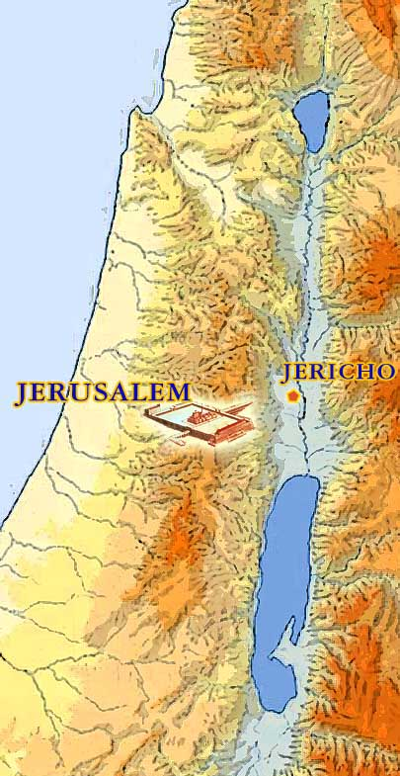
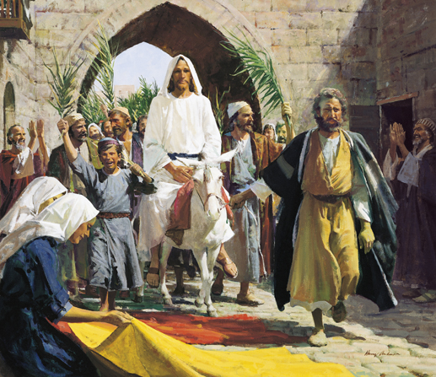
The Triumphal Entry
5 days before the Savior’s Crucifixion—During the Observance of Passover
A multitude of people followed Jesus and His Apostles as they traveled to Jerusalem from Jericho
Prophecy Fulfilled:
Rejoice greatly, O daughter of Zion; shout, O daughter of Jerusalem: behold, thy King cometh unto thee: he is just, and having salvation; lowly, and riding upon an ass, and upon a colt the foal of an ass. Zechariah 9:9
…and his dominion shall be from sea even to sea, and from the river even to the ends of the earth.
Zechariah 9:10
Matthew 21:1-11; Luke 19:30-35

Slide 4
“A colt tied, whereon yet never man sat”
Horse is a symbol of war
Donkey = Peace
The owners of the colt readily permitted the two brethren to take him, and it is assumed they also were disciples (1)
Zechariah 9:9; Matthew 21:2-7; Mark 11:2-7; John 12:14-15

Slide 5
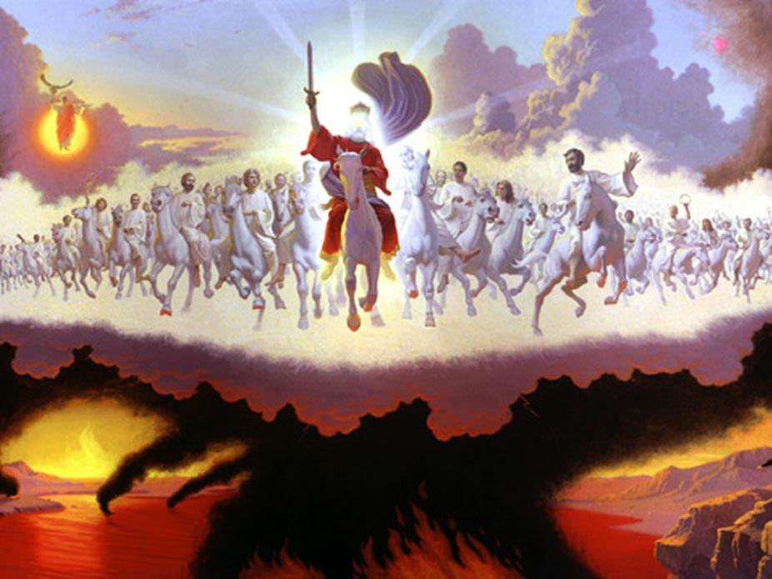
At Jesus' Second Coming
And I saw heaven opened, and behold a white horse; and he that sat upon him was called Faithful and True, and in righteousness he doth judge and make war. Revelation 19:11
Jesus will return to earth in great power and glory. As a symbol of His glory, the book of Revelation describes Him coming to earth on a “white horse,” rather than on the ass that He rode into Jerusalem. (2)
Matthew 21:1-11

Slide 6
“They spread their clothes in the way”
Only kings and conquerors received such an extraordinary token of respect.
Then they hasted, and took every man his garment, and put it under him on the top of the stairs, and blew with trumpets, saying, Jehu is king.
2 Kings 9:13
Matthew 21:8 ; Luke 19:36; Mark 1:8

Slide 7
“Took branches of palm trees, and went forth to meet him”
Token of Victory and Triumph
Matthew 21:8; Mark 11:8; John 12:13

Slide 8
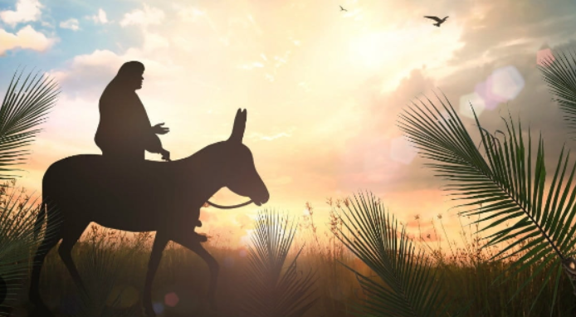
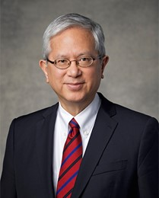
Traditionally, palms are a sacred symbol to express joy in our Lord, as in Christ’s Triumphal Entry into Jerusalem, where “much people … took branches of palm trees, and went forth to meet him”
… In the book of Revelation, those who praise God and the Lamb do so “clothed with white robes, and palms in their hands”.
Along with “robes of righteousness” and “crowns of glory,” palms are included in the Kirtland Temple dedicatory prayer …
(9)
John 12:12–13; Matthew 21:8–9 ; Mark 11:8–10; Revelation 7:9; D&C 109:76

Slide 9
Hosanna
Hosanna to the Son of David: Blessed is he that cometh in the name of the Lord”
All the city was moved:
These people recognized Christ as the long-awaited Messiah
Hosanna = Save Now
Save now, I beseech thee, O Lord: O Lord, I beseech thee, send now prosperity. Psalms 118:25
Matthew 21:9-10

Slide 10
“If these should hold their peace, the stones, would immediately cry out”
Luke 19:40
John 12:19

Slide 11
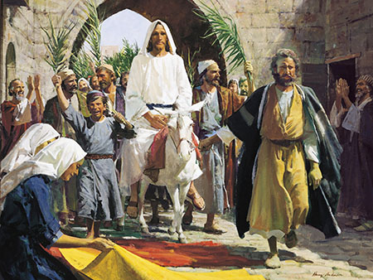
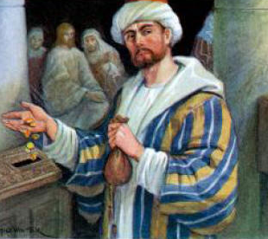
The Temple Treasury
As the Savior neared the end of His mortal ministry, He rode triumphantly into Jerusalem, cleansed the temple, and taught the people there.
While Jesus was at the temple, He witnessed individuals bringing money to the temple treasury as an offering to God.
Mark 11:1-11

Slide 12
Cleansing the Temple
How were some people treating God’s house?
The visitors who came to Jerusalem to celebrate the Passover needed to purchase animals to offer as sacrifices in the temple as part of their worship.
Even though this business was necessary and served a good purpose, handling it where and how the merchants did was disrespectful and irreverent.
Moneychangers exchanged Roman and other currencies for temple currency so the animals could be purchased, and other merchants sold the animals.
Moneychangers and merchants were more interested in making a financial profit than in worshipping God and helping others to do so.
Matthew 21:12-16

Slide 13
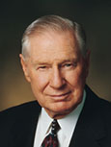
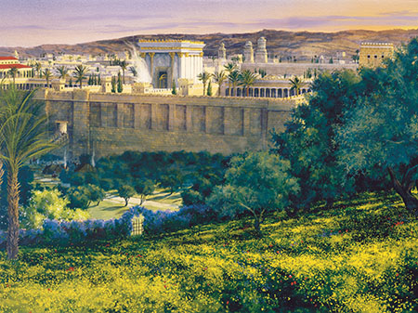
“The Lord has provided many avenues by which we may receive [His] healing influence.
I am grateful that the Lord has restored temple work to the earth.
It is an important part of the work of salvation for both the living and the dead. Our temples provide a sanctuary where we may go to lay aside many of the anxieties of the world.
Our temples are places of peace and tranquility. In these hallowed sanctuaries God ‘healeth the broken in heart, and bindeth up their wounds.’

Slide 14
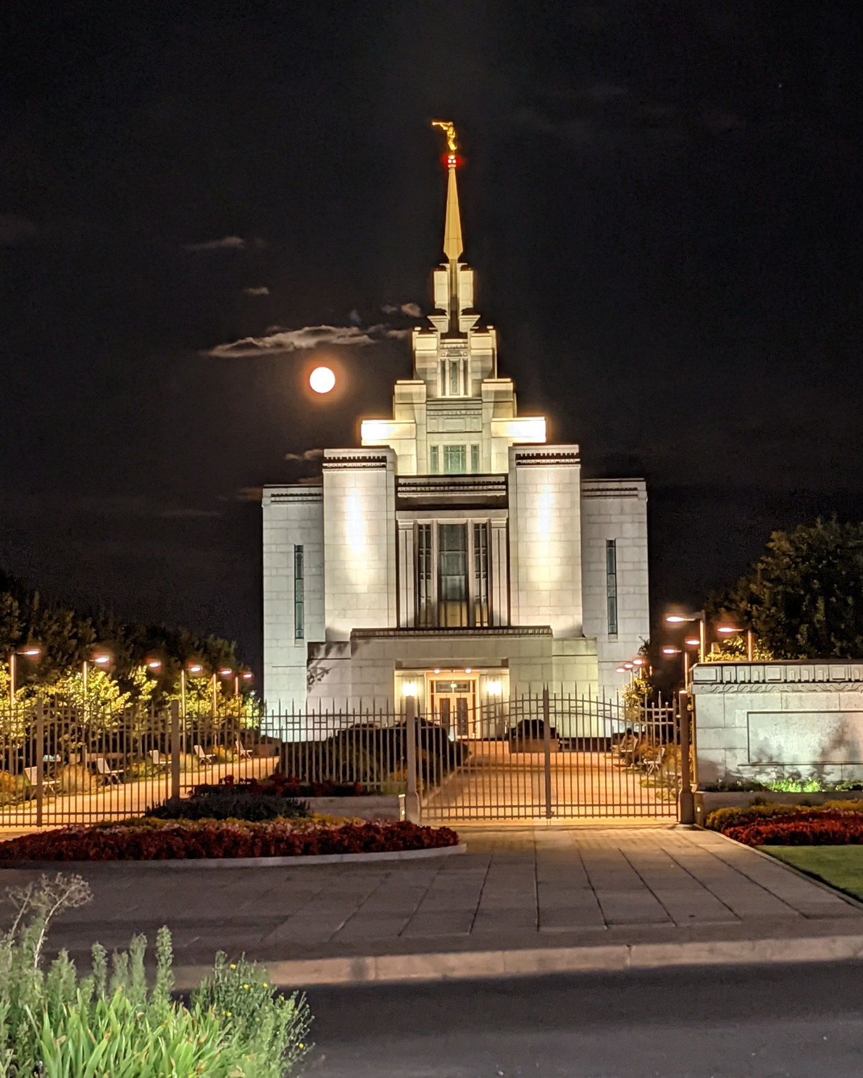
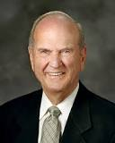
The temple is the house of the Lord. The basis for every temple ordinance and covenant—the heart of the plan of salvation—is the Atonement of Jesus Christ.
Every activity, every lesson, all we do in the Church, point to the Lord and His holy house. …
… Our Redeemer requires that His temples be protected from desecration.
No unclean thing may enter His hallowed house. Yet anyone is welcome who prepares well.
(10)
Kiev Temple, Ukraine (October 2021)

Slide 15
Matthew 21:18-19 and Mark 21:11-12
“The leaves are commencing to show on the fig tree”
President Spencer W. Kimball
Signs and wonders shall take place in the last days.
There shall arise false Christs, and false Prophets and they shall deceive the very elect.
The Lord said: “Peace shall be taken from the earth, and the devil shall have power over his own dominion.” D&C 1:35
For in those days shall be affliction, such as was not from the beginning of the creation which God created unto this time, neither shall be. Mark 13:19
All things shall be in commotion…men’s hearts shall fail them;…fear shall come upon all people.
D&C 88:91
The saints also shall hardly escape; nevertheless, I, the Lord, am with them.
D&C 63:34
And the Lord shall have power over his saints, and shall reign in their midst, and shall come down in judgment upon the world. D&C 1:37
Unto you it shall be given to know the signs of the times and the signs of the coming of the Son of Man
D&C 68:11
(4)

Slide 16
What is to Happen When Christ Comes Again?
The Church of Jesus Christ is never again to be taken from the earth.
The Holy Ghost and the priesthood of God will continue to be on the earth.
There shall be in the last days living prophets and living apostles chosen and called by Jesus Christ.
The Lord promised, “My disciples shall stand in holy places, and shall not be moved” D&C 45:32
This gospel of the kingdom shall be preached in all the world for a witness unto all nations; and then shall the end come. Matt. 24:14
“ Of Judah and Jerusalem in the last days the Lord promised, “Then will the Father gather them together again, and five unto them Jerusalem for the land of their inheritance…And it shall come to pass that the time cometh, when the fulness of my gospel shall be preached unto them; and they shall believe in me, that I am Jesus Christ the Son of God.”
3 Nephi 20:30-31
“And they shall learn the parable of the fig tree, for even now already summer is nigh.” D&C 35:15-16
(4)

Slide 17
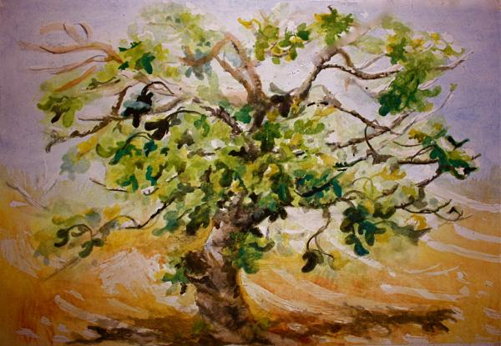
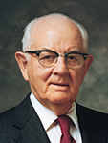
Deceived By Appearance--Hypocrisy
The leaves on the fig tree indicated that it should have had fruit, but it did not. With its misleading appearance, the tree symbolized hypocrisy.
One reason the Savior may have cursed the fig tree was to teach His disciples about the corrupt religious leaders of the Jews.
“…the unproductive tree was cursed for its barrenness. What a loss to the individual and to humanity if the vine does not grow, the tree does not bear fruit, the soul does not expand through service! One must live, not merely exist; he must do, not merely be; he must grow, not just stagnate. We must use our talents in behalf of our fellowmen, rather than burying them in the tomb of a self-centered life.” (6)
Matthew 21:18-19

Slide 18
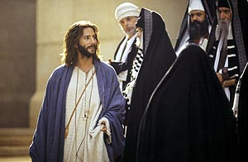
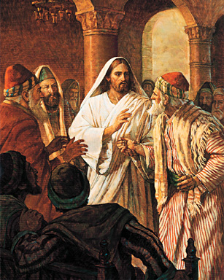
Approaching The Savior
Jewish leaders approached the Savior in the temple and questioned the authority by which He had made His triumphal entry into Jerusalem and cleansed the temple.
The Savior responded by asking them whether the baptism (or ministry) of John the Baptist had been commissioned by God or by man.
These leaders would not answer the Savior’s question for fear of condemning themselves or offending people who accepted John as a prophet.
The Savior said He would not answer their questions either and then related three parables that illustrate the actions of the corrupt Jewish leaders.
Matthew 21:18-19

Slide 19
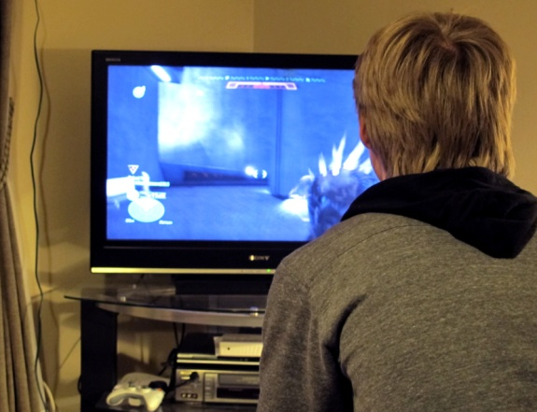
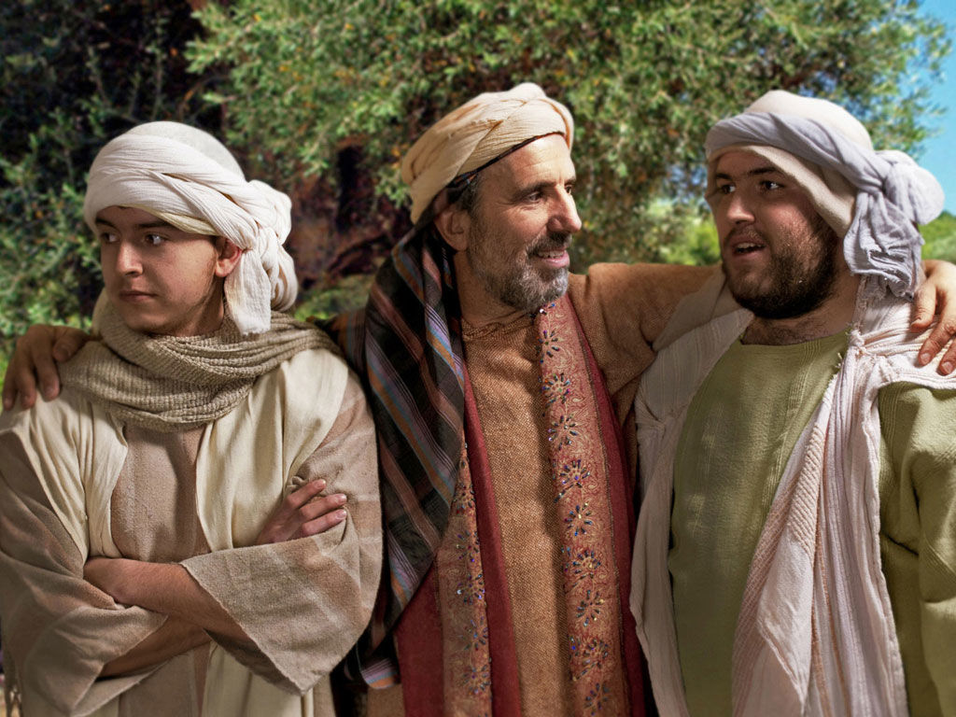
Parable of the Two Sons
“A Father approaches his boys and asks, “Son, will you mow the lawn?” “No, Dad.”
“How about you, son?” “Yeah, I’ll do it.”
Two hours later, the son who said no changed his mind and mowed the lawn, and the son who said yes didn’t budge. Sound familiar? (8)
“The Father of the sons is God himself who offers employment in his earthly vineyard to all his children. The first son, who initially refused to labor in his Father’s vineyard but later repented and served him, is symbolical of the publicans and harlots who repented of their early sins and became faithful servants in their Father’s cause. …
“The second son, who willingly accepted an assignment in the vineyard but then failed to render the appointed labors, is symbolical of the Jewish leaders who professed to be about their Father’s business but were in fact letting the vineyard degenerate. … (1)
Matthew 21:28-31

Slide 20
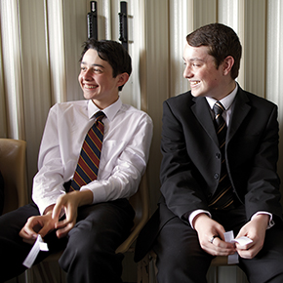
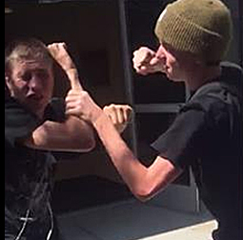
Pretending
To enter the kingdom of God, we must obey our Heavenly Father and repent of our sins rather than only saying or pretending that we obey Him
A young man often tells his parents that he is attending Church activities when he actually goes to a friend’s house instead. When he is around Church leaders and instructors, he talks and acts as though he keeps Heavenly Father’s commandments, but outside of those settings he knowingly breaks many of the commandments.

Slide 21
Pretending
To enter the kingdom of God, we must obey our Heavenly Father and repent of our sins rather than only saying or pretending that we obey Him
A young woman gossips with her friends about several girls in her school but pretends to be friendly to these girls when they are around. She regularly attends church and partakes of the sacrament, but during the meetings she often sends her friends text messages containing criticisms of those around her.

Slide 22
The Parable of the Wicked Husbandmen
Matthew 21:33-46
Luke 20:9-18
Mark 12:1-12

Slide 23
Far country = Heaven
Husbandmen = people of the world
Vineyard = the world
Matthew 21:33
A Certain Man = Heavenly Father

Slide 24
Servants = prophets, Apostles, those who preach the gospel of Jesus Christ
Matthew 21:34-35

Slide 25
Matthew 21:36

Slide 26
His Son = Jesus Christ
Matthew 21:37

Slide 27
Matthew 21:38

Slide 28
Cast and killed = rejected Jesus Christ, crucified Him, and rejected the gospel
Matthew 21:39

Slide 29
Taken and given to other nations = Destroy vineyard and give to others
Matthew 21:40-43

Slide 30
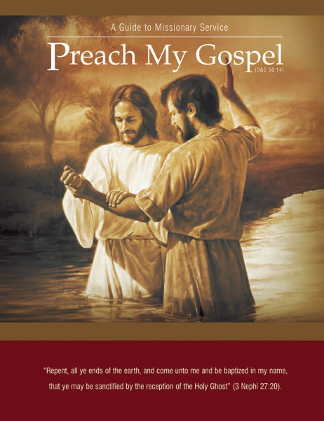
Message from Preach My Gospel
People have repeatedly chosen to reject the Gospel of Jesus Christ.
Messages that have been reveled to His servants such as Adam, Noah, Abraham, and Moses have also been rejected.
If we continue to reject His gospel the Lord will withdraw His kingdom and establish His Gospel to those who will listen.

Slide 31
A Certain Man
Vineyard
Far country
Husbandmen (farmers)
Servants
Beloved Son
Cast and killed
Destroy vineyard and give to others
Our Father in Heaven
The world
Heaven
People of the world
Prophets, Apostles, those who preach the gospel of Jesus Christ
Jesus Christ
Rejected Jesus and crucified him. Rejecting the Gospel
Heavenly Father will withdraw His spirit from those who reject the gospel and give it to those who will embrace it.
Symbolism

Slide 32
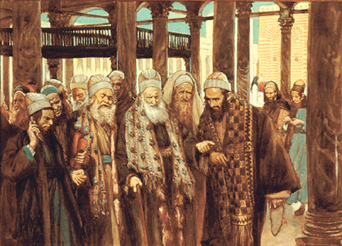
Fear of the People’s Reaction
The chief priests and Pharisees became angry when they realized that the wicked husbandmen in the parable represented them.
However, they refrained from laying hands on the Savior because they feared the people’s reaction if they did so.
Matthew 21:45-46

Slide 33
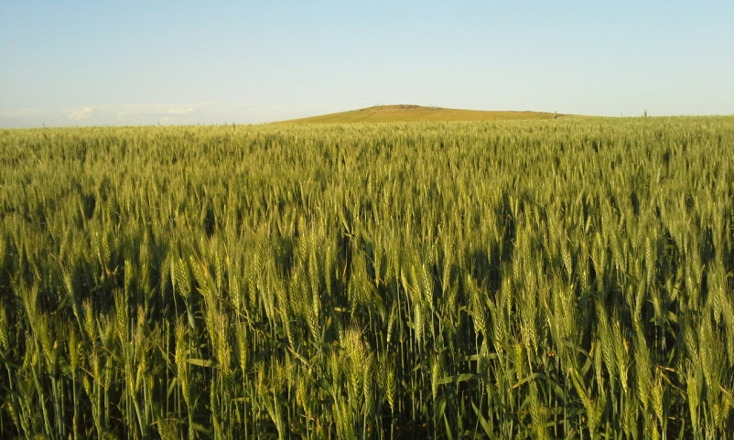
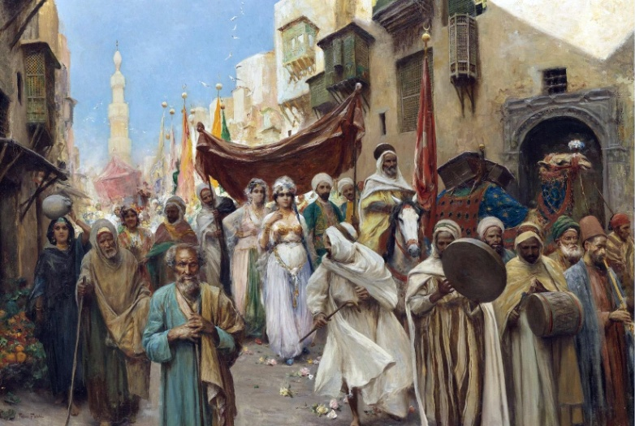
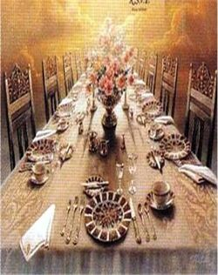
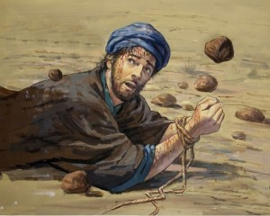
Parable of the Marriage of the King’s Son
Bridegroom = Savior
Kingdom of God = Bride
Those invited = the covenant people of the Lord
But they refused to come = their own choice not to participate
When the second bidding came, some “made light” of the invitation = “made light of the servants who brought the invitations” and left to go to their farms and merchandise
Those who remained were more cruel and acted with violence by slaying the servants.
The king responded by destroying the murderers and burning their city.
Matthew 22:2-14
(8)

Slide 34
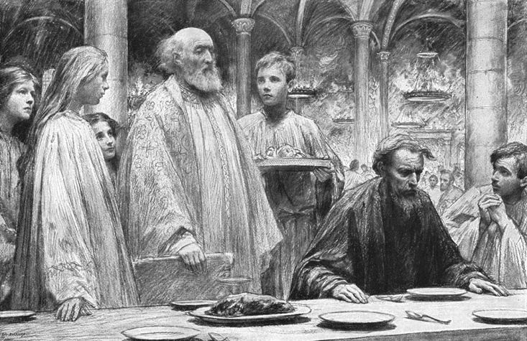
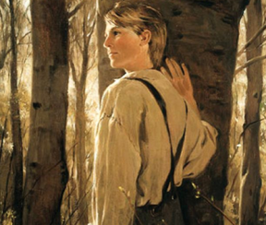
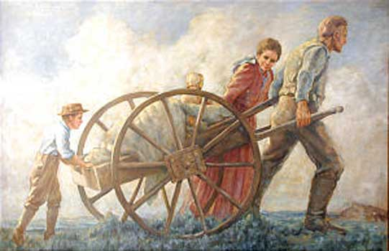
Those Who Accepted The Invitation
New invitations were extended to those in the highways = Gentiles (To all the world)
The Kingdom was take from the Jews and given to others
For all those who desire to feast
Those who are not wearing the “wedding garment”
The man had not put on the garment that was offered to him = willfully refused– wanted to be a part of kingdom but refused to comply with the standards
Cast out = outer darkness
Matthew 22:2-14; Mark 16:15
(8)

Slide 35
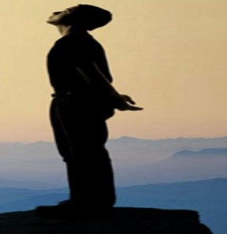
Warning To Those Who Are “Undressed”
Hold thy peace at the presence of the Lord God: for the day of the Lord is at hand: for the Lord hath prepared a sacrifice, he hath bid his guests.
8 And it shall come to pass in the day of the Lord’s sacrifice, that I will punish the princes, and the king’s children, and all such as are clothed with strange apparel. Zephaniah 1:7-8
I will greatly rejoice in the Lord, my soul shall be joyful in my God; for he hath clothed me with the garments of salvation, he hath covered me with the robe of righteousness, as a bridegroom decketh himself with ornaments, and as a bride adorneth herself with her jewels. Isaiah 61:10
Not everyone who acknowledges the Savior, is called, and accepts the invitation to be part of the kingdom will be prepared and worthy to dwell eternally with Him and Heavenly Father.
The wedding garment we should be seeking is righteousness, which we cannot obtain without Christ and obedience to his gospel. (8)
Matthew 22:11-12

Slide 36
"And so it is, as the millennial day approaches, that the servants of the Lord go forth, inviting all men, Jew and Gentile alike, to come to 'the supper of the Lamb,' to 'make ready for the Bridegroom,' to come to 'a feast of fat things,' and 'of wine on the lees well refined,' to come to 'a supper of the house of the Lord, well prepared, unto which all nations shall be invited.'
And it shall yet come to pass that those who accept the invitation and come to the feast, but who do not wear the approved wedding garments and are not clothed in the robes of righteousness, shall be cast into outer darkness. In that day only the pure and the clean shall feast at the eternal table." (1)

Slide 37
Summary of Jesus’ Teachings Mathew 21-22:1-14
Matthew 21:18-22
Matthew 21:23-27
Matthew 21:28-32
Matthew 21:22-46
Matthew 22:1-14
All things are possible to those who ask God with faith.
Jesus and John the Baptist acted with God’s authority.
Through repentance we can serve our Heavenly Father.
Those who reject the prophets and Jesus Christ will be destroyed.
The Lord will accept those who follow Him willingly and correctly.

Slide 38
Sources:
Elder Bruce R. McConkie Doctrinal New Testament Commentary p. 1:578-579, 589-590 and The Millennial Messiah: The Second Coming of the Son of Man, 354
New Testament Student Institute Manual Chapter 7
Hugh B. Brown (The Eternal Quest [Salt Lake City: Bookcraft, 1956], 392.)
“The Leaves Are Commencing to Show on the Fig Tree” Bernard P. Brockbank April 1976 Gen. Conf.
” Elder James E. Talmage (Jesus the Christ, 3d ed. [1916], 526).
Spencer W. Kimball President Kimball Speaks Out, 44.)
President James E. Faust (Ps. 147:3.)” (“Spiritual Healing,” Ensign, May 1992, 7).
John Bytheway of Pigs, Pearls, and Prodigals p. 67
Gerrit W. Gong, “Hosanna and Hallelujah—The Living Jesus Christ: The Heart of Restoration and Easter,” Ensign or Liahona, May 2020, 53
Russell M. Nelson, “Personal Preparation for Temple Blessings,” Ensign, May 2001, 32–33
Presentation by ©http://fashionsbylynda.com/blog/

Slide 39
Ritual During King Saul’s Time: Mattew 21:2-7
During the time of the monarchy in ancient Israel, following the enthronement of King Saul, the Jews held annual reenthronement rituals that featured a king riding into Jerusalem upon a donkey. The rider approached Jerusalem from east of the city, through the Mount of Olives and the Kidron Valley, and then came to the temple.
These rituals looked forward to the time when the Messiah would come to His people in this same way. Thus, at a time when Jerusalem was flooded with Jews, Jesus entered Jerusalem in a manner that demonstrated He was the Messiah, the King of Israel. Riding on a donkey also showed that Jesus came as a peaceful and “lowly” Savior, not as a conqueror upon a warhorse. New Testament Institute Student Manual Chapter 7
Reaction to cleansing the temple Matthew 21:15
"The chief priests were the guardians of the temple and, in fact, guardians (as they supposed) of the whole structure of Jewish religion. They glutted themselves on the profits from temple business, and so the temple was not just the source of their favored social position (which they coveted so jealously) but also the source of their incomes-more, their fortunes. . . .
The anger of the chief priests and scribes was raging against Him; but it was impotent. They had decreed His death, and had made repeated efforts to take him, and there he sat within the very area over which they claimed supreme jurisdiction, and they were afraid to touch Him because of the common people, whom they professed to despise yet heartily feared-'for all the people were very attentive to hear him.' (JTC, pp. 528-29.)" (Daniel H. Ludlow, A Companion to Your Study of the Doctrine and Covenants, 2: 147 - 148.)
Hosanna Matthew 21:9
Save now. The word is taken from Ps. 118:25, one of the Psalms of the Hallel. The chanting of this psalm was connected at the Feast of Tabernacles with the waving of palm branches; hence the use of the word by the multitudes at our Lord’s triumphal entry into Jerusalem (Matt. 21:9, 15; Mark 11:9–10; John 12:13). Bible Dictionary
Hosanna is a Hebrew word that “means ‘please save us’ and is used in praise and supplication. … At the Lord’s triumphal entry into Jerusalem, the multitudes cried ‘Hosanna’ and spread palm branches for Jesus to ride upon, thus demonstrating their understanding that Jesus was the same Lord who had delivered Israel anciently
Barren Fig Tree Matthew 21:18-19
"Why did Jesus curse the fruitless fig tree? Unique among our Lord's miracles, this manifestation of divine power teaches a number of great truths:
"(1) By exercising his power over nature, Jesus was testifying in language written in the earth itself that he was Lord of all. As the Lord Jehovah he had in times past created all things in heaven and on earth; now, though tabernacled in mortal clay, he possessed the same eternal powers over life, death, and the forces of nature. By using these powers-as he had before done in calming the tempest, multiplying loaves and fishes, walking on the water, healing multitudes, and raising the dead-he was leaving a visible and tangible witness of his own divine Sonship.
"(2) Though Jesus had come to bless and save, yet he had the power to smite, destroy, and curse. 'It must needs be, that there is an opposition in all things' ("#2 ne. 2:112 Ne. 2:11); if blessings are born of righteousness, their opposite, curses, must come from wickedness. True gospel ministers seek always to bless, yet curses attend rejection of their message. 'Whomsoever you bless I will bless, and whomsoever you curse I will curse, saith the Lord.' ("D&C 132:47D. & C. 132:47.) It is fitting that Jesus should leave a manifestation of his power to curse, and the fact that he chose, not a person, but a tree, is an evident act of mercy.
"(3) Withering and dying at Jesus' command, the fruitless fig tree stands as a type and a shadow of what shall befall hypocrites..." Bruce R. McConkie (Doctrinal New Testament Commentary, 1: 582.)
Lurking Pharisees: Luke 19:40
"Agents of the scribes and Pharisees who were lurking in the crowd were disturbed and scandalized as the jubilant multitude shouted in harmony: 'Blessed be the King that cometh in the name of the Lord,. . .glory in the highest.' (Luke 19:38.) To their learned ears and suspicious hearts such words of adulation to an impostor were bordering on blasphemy, and they admonished Jesus to rebuke his disciples, but instead he justified their enthusiasm by saying: 'I tell you that, if these should hold their peace, the stones would immediately cry out.' (Luke 19:40.) This was an assertion of his right to be called the Christ. All who read the story must be moved by the matchless, majestic courage of the man. He could have turned back to the home of Lazarus and Mary and Martha, his usual abiding place in Bethany. But he voluntarily chose to do his Father's will to bring to pass the immortality and eternal life of man...And so began the most eventful week in history.“ Hugh B. Brown (The Eternal Quest [Salt Lake City: Bookcraft, 1956], 392.)

Slide 40
Matthew 21:7-11 Social Media
The following instruction can help students further understand the truth that as we publicly acknowledge and speak about Jesus Christ, we can help others develop a desire to know more about Him.
“Social media channels are global tools that can personally and positively impact large numbers of individuals and families. And I believe the time has come for us as disciples of Christ to use these inspired tools appropriately and more effectively to testify of God the Eternal Father, His plan of happiness for His children, and His Son, Jesus Christ, as the Savior of the world; to proclaim the reality of the Restoration of the gospel in the latter days; and to accomplish the Lord’s work” Elder David A. Bednar (“To Sweep the Earth as with a Flood” [address given at BYU Campus Education Week, Aug. 19, 2014], LDS.org).
Providing a Garment Matthew 22:11-12
Weren’t the wedding guests pulled in from off the streets? The custom for a wealthy host was to provide the appropriate wedding garments for his guests. The man who ‘had not on a wedding garment” did not lack for one but willfully refused to put it on.” Jay A. and Donald W. Parry (Understanding the Parables) 228-229
Temple Clothing—Clothing of Covenants:
Today, the clothing worn in the temple symbolizes clothing ourselves in covenants, righteousness, and purity in preparation for entering into God’s presence. We cannot participate in the great “marriage supper” of the Son of God unless we have accepted and put on the protective clothing of His Atonement (see Revelation 19:8–9)
Parable of the King’s Sons Wedding or Royal Wedding Feast Matthew 22:1-14
Joseph Smith: …we find the kingdom of heaven likened unto a king who made a marriage for his son. That this son was the Messiah will not be disputed, since it was the kingdom of heaven that was represented…and that the Saints, or those who are found faithful to the Lord, are the individuals who will be found worthy to inherit a seat at the marriage supper, is evident from the sayings of John in the Revelation where he represents the sound which he heard in heaven to be like a great multitude, or like the voice of mighty thunderings, saying, the Lord God Omnipotent reigneth. …for the marriage of the Lamb is come, and His wife hath made herself ready. And to her was granted that she should be arrayed in fine line, clean and white: For the fine linen is the righteousness of Saints (Rev. 9:7-9) Teachings, 63
Parable of the Marriage of the King’s Son: Matthew 22:1-14
"In this Parable of the Marriage of the King's Son, sometimes called the Parable of the Royal Marriage Feast, Jesus teaches these truths: (1) His own divine Sonship; (2) the impending destruction of Jerusalem; (3) the rejection of the Jewish remnant of the covenant race; (4) the gospel call to the Gentiles; and (5) that those who answer the gospel call will not be chosen for salvation unless they put on (the robes of righteousness.) Compare Luke 14:16-24.
"Deity himself is the king in the parable; Jesus, his offspring and heir, is the king's son; and those first invited to 'the marriage of the Lamb' (D. & C. 58:11) are the chosen and favored hosts of Israel to whom the gospel had been offered in ages past. 'The remnant' who rejected the later invitation with violence and murder were Jewish descendants of ancient Israel; and it was their city, Jerusalem, which was violently destroyed." Elder Bruce R. McConkie (Doctrinal New Testament Commentary, 1: 597.)
Rejecting the Gospel Matthew 22:5
“All who reject the gospel are not damned to the same degree. Those who simply turn to their farms and merchandise, thereby putting temporal things ahead of spiritual, are denied the filling satisfaction of the feast, while those who persecute and murder the King’s servants are by him condemned to an awful destruction.” Bruce R. McConkie Doctrinal New Testament Commentary 1:598
Temples are the most holy of all places of worship. A temple literally is the house of the Lord, a sacred space specifically set apart for worshipping God and for receiving and remembering His great and precious promises.
… The principal focus of temple worship is participating in ordinances and learning about, receiving, and remembering covenants. We think, act, and dress differently in the temple than in other spaces that we may frequent.
A principal purpose of the temple is to elevate our vision from the things of the world to the blessings of eternity.
(David A. Bednar, “Exceeding Great and Precious Promises,” Ensign or Liahona, Nov. 2017, 92)
Outer Darkness Matthew 22: 1-14
“Ancient banquets were usually held at night in rooms which were brilliantly lighted, and anyone who was excluded from the feast was said to be cast out of the lighted room into “the outer darkness” of the night. …This expression “outer darkness” takes on new meaning, when it is realized what a dread the Oriental has for the darkness of the night. In the East, a lamp is usually kept burning all night. To sleep in the dark as the Westerner usually does, would be a terrible experience to the Oriental. Because of this fear of darkness, the Savior could have chosen no more appropriate words than “outer darkness” to represent the future punishment of the unrighteous.” Fred H. Wight Manners and Customs, 62-63

Slide 41
Last Week of Jesus’ Life
Event | Matthew | Mark | Luke | John
Triumphal Entry into Jerusalem and Return to Bethany | 21:1-11 | 11:1-11 | 19:29-44 | 12:12-19
Jesus Curses a Fig Tree | 21:18, 19 | 11:12-14
Second Cleansing of the Temple | 21:12-16 | 11:15-18 | 19:45-48
Return to Bethany | 21:17 | 11:19 | 21:37
Seeing Withered Fig Tree, Faith, Prayer and Forgiveness | 21:20-22 | 11:20-26
By What Authority? | 21:23-27 | 11:27-33 | 21:38, 20:1-8
Parable of the Two Sons | 21:28-32
Parable of the Wicked Husbandmen | 21:33-46 | 12:1-12 | 20:9-19
Parable of the marriage of the King’s Son | 22:1-14
Question about Paying Tribute to Caesar | 22:15-22 | 12:13-17 | 20:20-26
Marriage and Resurrection | 22:23-33 | 12:18-27 | 20:27-39
“Which is the Great Commandment in the Law?” | 22:41-46 | 12:35-37 | 20:41-44
“What Think Ye of Christ/ Whose Son is He?” | 22:41-46 | 12:35-37 | 20:41-44

Slide 43
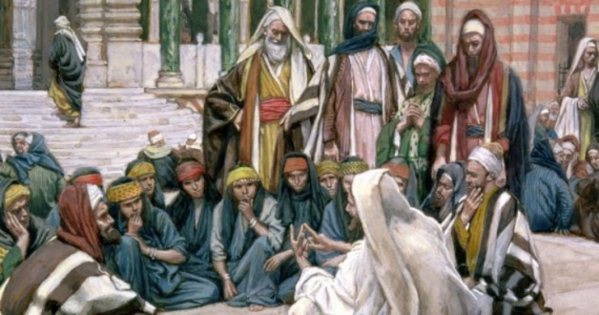

Slide 44
Jesus Taught At the Temple
Matthew 22:15-46
Let no man break the laws of the land, for he that keepeth the laws of God hath no need to break the laws of the land.
D&C 58:21

Slide 45
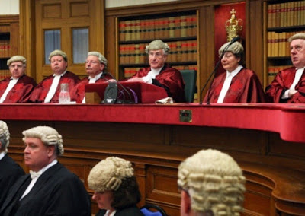
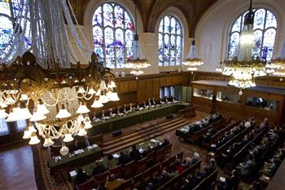
Laws of the Land
What are some important laws the government has established in our society?
Why are they are important?
A poll tax, a tax instituted in A.D. 6 = A poll tax, also known as a head tax or capitation, is a tax of a uniform, fixed amount applied to an individual in accordance with the census (as opposed to a percentage of income, or any proxy for ability-to-pay).
Head taxes were important sources of revenue for many governments from ancient times until the 19th century.
(2)
Matthew 22:17

Slide 46
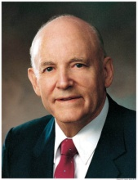
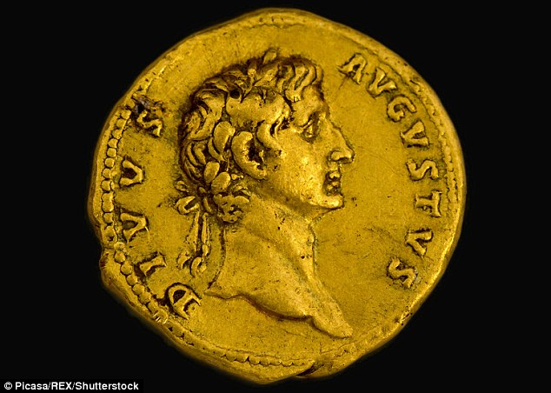
Why Tempt Ye Me?
Is it lawful to give tribute unto Cæsar, or not?
“If he had said, ‘Yes, pay the tax,’ he would have been called a traitor. It would have driven a wedge between him and his followers and created rebellion. If his answer had been, ‘No, it is not lawful to pay the tax,’ they would have delivered him into the hands of Rome on the charge of treason.”
“The wisdom of [the Savior’s] answer defines the limitations of dual sovereigns and defines the jurisdiction of the two empires of heaven and earth.
The image of monarchs stamped on coins denotes that temporal things belong to the temporal sovereign.
The image of God stamped on the heart and soul of a man denotes that all its facilities and powers belong to God and should be employed in his service.”
(1)
Matthew 22:17

Slide 47
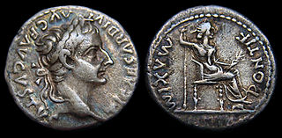
Tribute Penny
It is usually thought that the coin was a Roman denarius with the head of Tiberius.
Caesar = a title
The inscription reads “Ti[berivs] Caesar Divi Avg[vsti] F[ilivs] Avgvstvs” (“Caesar Augustus Tiberius, son of the Divine Augustus”), claiming that Augustus was a god.
The reverse shows a seated female, usually identified as Livia depicted as Pax (Roman goddess of peace)
Matthew 22:17-21
(2)

Slide 48
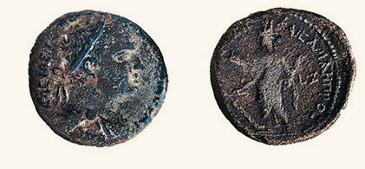
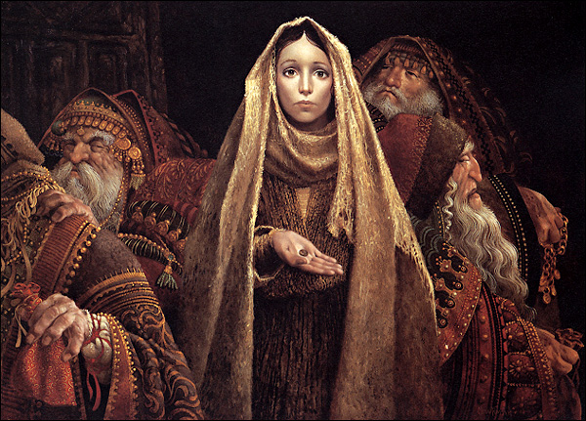
Widow’s Mite
ב
ד
w
O
B
V
ל
x
V
ר
w
.
Y
ג
The “mites” the widow donated to the temple treasury were small Jewish coins called lepta (Greek for small). They weighed about 1/2 gram (less than 1/50 of an ounce) and were worth less than a “farthing” or quadran, which was the Roman coin of lowest value at the time.
M
א
E
w
I
E
U
z
z
E
Bronze lepton--Minted before Christ’s time
The fact that the widow gave “all that she had” exemplified her sincere devotion to God, in contrast to the pretense of the scribes.
Mark 12:41-44

Slide 49
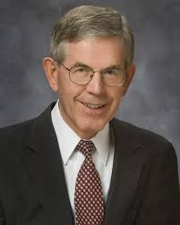
Giving All We Have
That this poor widow hath cast more in, than all they which have cast into the treasury:
If we are willing to give all that we have to the Lord, He will accept our offering even if it appears small in comparison to that of others
If we must give all that we have, then our giving only almost everything is not enough.
If we almost keep the commandments, we almost receive the blessings. (11)

Slide 50
Is There A Difference?
1. A woman gave her bishop a very large sum of money as a fast offering.
Another woman who lives in the same ward gave a very small amount to her bishop as a fast offering.
2. A man serves as a stake president.
Another man in the same stake serves as a primary teacher.
How might a person feel if his or her offering to the Lord appears small when compared to the offerings of others?

Slide 51
Obligations To Laws
Render therefore unto Cæsar the things which are Cæsar’s; and unto God the things that are God’s.
Render = an obligation to obey civil laws, such as the law to pay taxes.
The Lord expects us to be good citizens and obey the laws of the land
We believe in being subject to kings, presidents, rulers, and magistrates, in obeying, honoring, and sustaining the law.
Article of Faith 12
Matthew 22:21

Slide 52
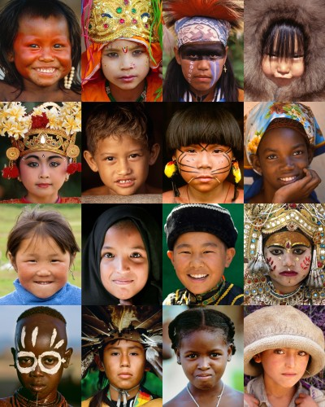
“Some Latter-day Saints are confused over the content, purposes, and procedures of the two kinds of laws that apply to them, the laws of God and the laws of man.
"The divinely directed pattern in this dispensation is clear. It is one of dual jurisdiction.
The children of God in every nation are subject to one authority that establishes and administers the laws of God and to another group of authorities who establish and administer the laws of man.”
(3)
Matthew 22:21

Slide 53
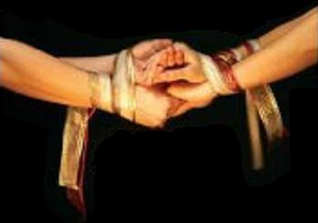
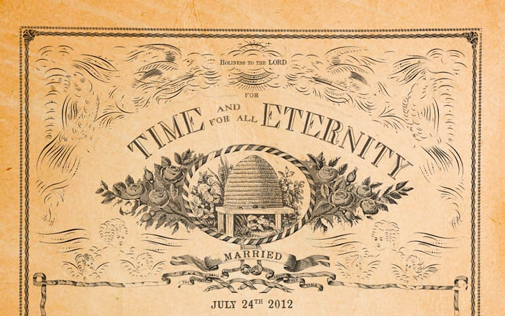
A Question of Marriage
Sadducees = did not believe in resurrection
“The Savior’s words do not state that marriages will not exist after the Resurrection, but that marriages will not be performed after the Resurrection: “In the resurrection there will be no marrying nor giving in marriage; for all questions of marital status must be settled before that time.”
Read D&C 137:15-17
The Lord revealed that marriage can be eternal only if it is entered into according to His law, performed by one who has authority, and sealed by the Holy Spirit of Promise.
D&C 137:19
Matthew 22:23-31
(4)

Slide 54
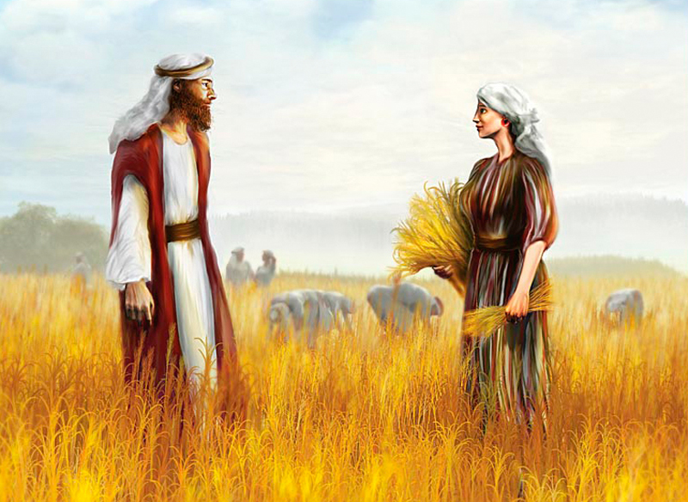
Levirate Marriage
Sadducees intentionally misapplied an Old Testament custom that was designed to provide for widows
If brethren dwell together, and one of them die, and have no child, the wife of the dead shall not marry without unto a stranger: her husband’s brother shall go in unto her, and take her to him to wife, and perform the duty of an husband’s brother unto her.
And it shall be, that the firstborn which she beareth shall succeed in the name of his brother which is dead, that his name be not put out of Israel.
Deuteronomy 25:5-6
Boaz and Ruth
The custom of a widow marrying her deceased husband’s brother or sometimes a near heir. The word has nothing to do with the name Levi or the biblical Levites but is so called because of the Latin levir, meaning “husband’s brother,” connected with the English suffix -ate, thus constituting levirate.
Matthew 22:23-28
(5)

Slide 55
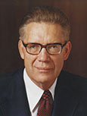
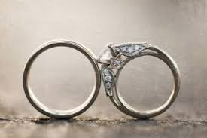
“ Jesus Christ] is not denying but limiting the prevailing concept that there will be marrying and giving in marriage in heaven.
He is saying that as far as ‘they’ (the Sadducees) are concerned, that as far as ‘they’ (‘the children of this world’) are concerned, the family unit does not and will not continue in the resurrection. …
“‘Therefore, when they [those who will not, do not, or cannot live the law of eternal marriage] are out of the world they neither marry nor are given in marriage’
“That is, there is neither marrying nor giving in marriage in heaven for those to whom Jesus was speaking; for those who do not even believe in a resurrection, let alone all the other saving truths.”
For in the resurrection they neither marry, nor are given in marriage, but are as the angels of God in heaven.
Matthew 22:23-30
(6)

Slide 56
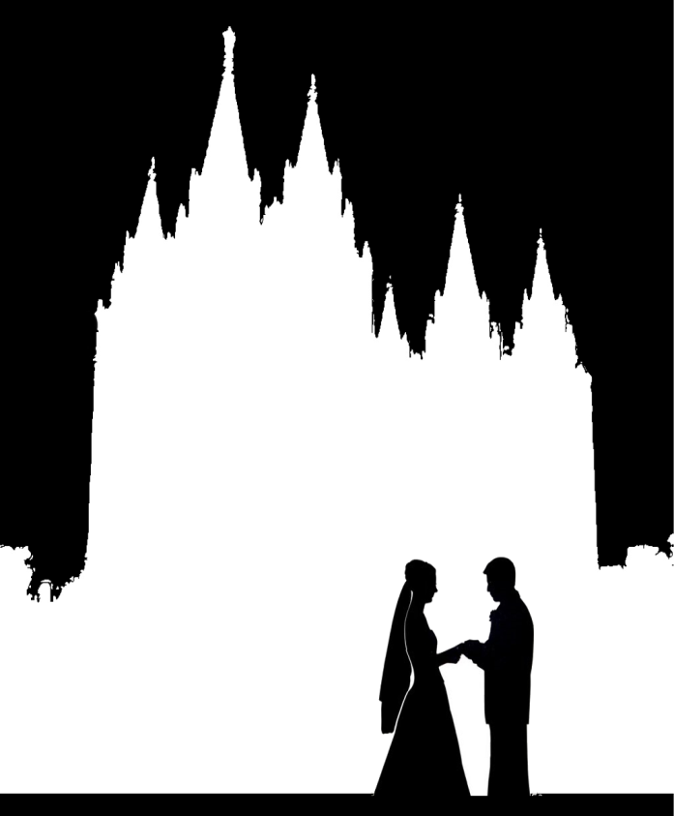
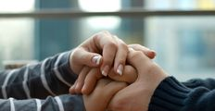
Those who are not sealed by priesthood authority to their spouses in mortality or through proxy ordinances in temples will not be married in the world to come
Matthew 22:29-30

Slide 57
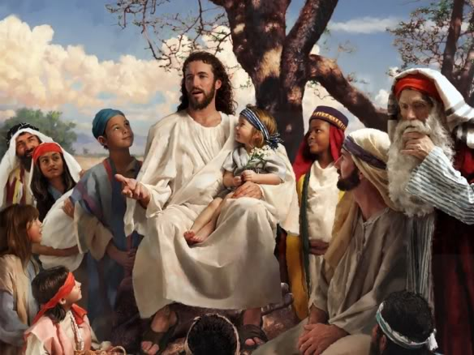
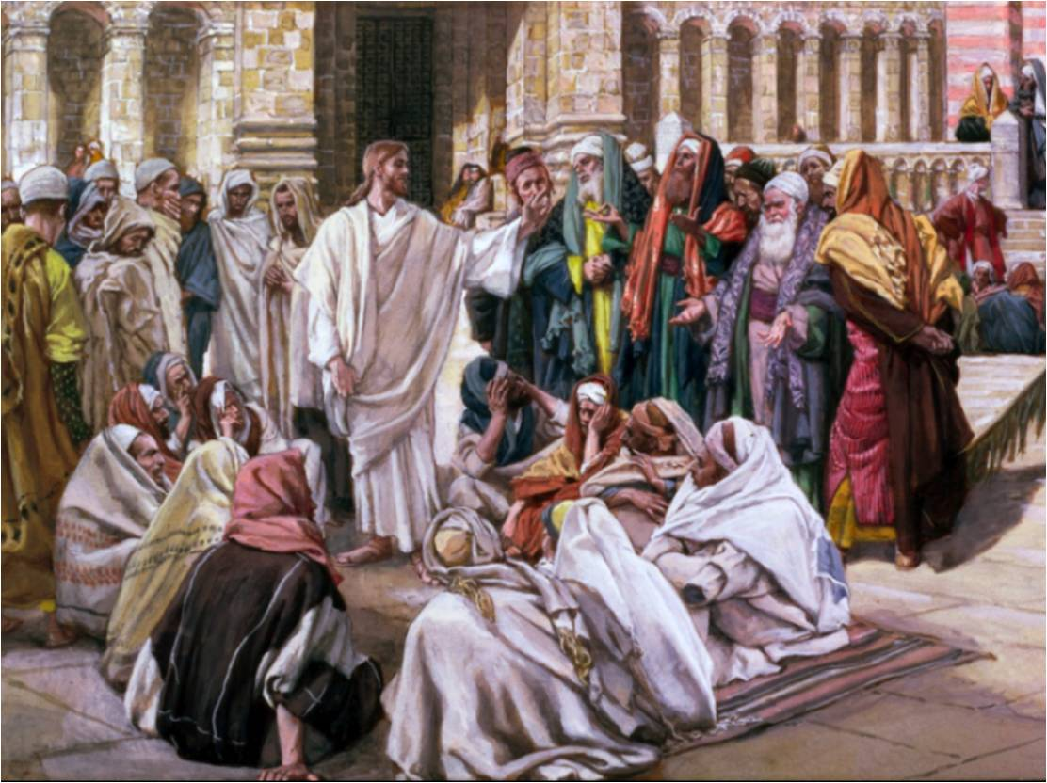
Two Great Commandments
And thou shalt love the Lord thy God with all thine heart, and with all thy soul, and with all thy might.
Deuteronomy 6:5
Thou shalt not avenge, nor bear any grudge against the children of thy people, but thou shalt love thy neighbour as thyself: I am the Lord.
Leviticus 19:18
Mark 11:12-34; Deuteronomy 6:5 and Leviticus 19:18

Slide 58
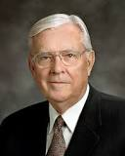
When we love God with all our hearts, He turns our hearts to the well-being of others in a beautiful, virtuous cycle.
Obedience to those two commandments provides a way to experience more peace and joy. When we love and serve the Lord and love and serve our neighbors, we will naturally feel more happiness that comes to us in no better way.
(9, 10)

Slide 59
Law of Moses
Judaism teaches that the law of Moses contains 613 commandments.
“To love God with all your heart, soul, mind, and strength is all-consuming and all-encompassing. It is no lukewarm endeavor. It is total commitment of our very being—physically, mentally, emotionally, and spiritually—to a love of the Lord.
Leviticus 19:18
Thou shalt not avenge, nor bear any grudge against the children of thy people, but thou shalt love thy neighbour as thyself:
Deuteronomy 6:5
And thou shalt love the Lord thy God with all thine heart, and with all thy soul, and with all thy might.
If we truly love God and love our neighbor as ourselves, we will strive to keep all of God’s commandments
Matthew 22:41-46
(7)

Slide 60
Doctrinal Mastery
Matthew 22: 36-39
Master, which is the great commandment in the law?
Jesus said unto him, Thou shalt love the Lord thy God with all thy heart, and with all thy soul, and with all thy mind.
This is the first and great commandment.
And the second is like unto it, Thou shalt love thy neighbour as thyself.

Slide 61
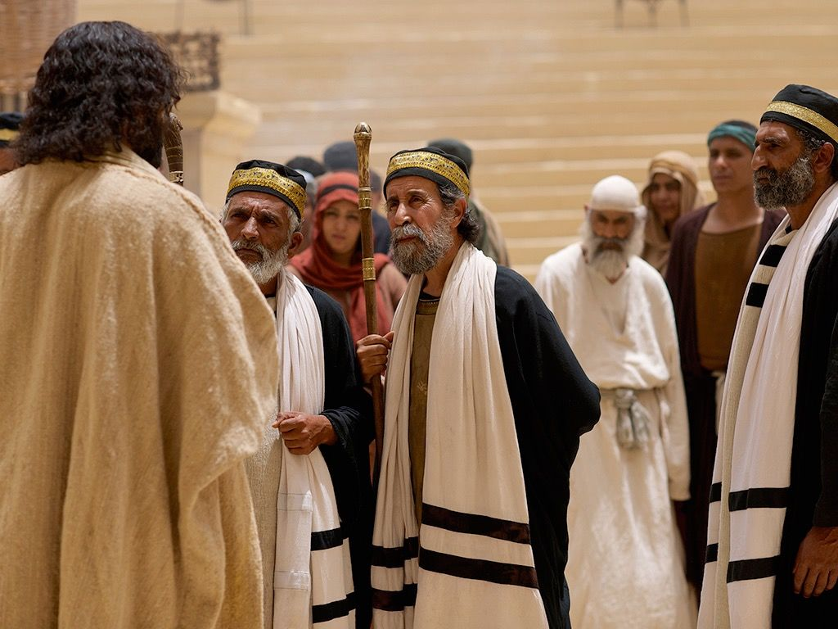
What Think Ye?
Most Jews knew that Christ, or the Messiah, would be a descendant of King David.
The Pharisees believed the Messiah would be crowned king of Israel and help them defeat foreign enemies (such as Rome) and receive their freedom, as King David had done previously.
Jesus taught the Pharisees that according to their own scriptures, Christ was more than just the son of David—He was also the Son of God. Or, as later revealed to John the Beloved, Christ is both “the root and the offspring of David”
He is both David’s Lord and his descendant.
I Jesus have sent mine angel to testify unto you these things in the churches. I am the root and the offspring of David, and the bright and morning star.
Revelation 22:16
Matthew 22:42-46

Slide 62
“What you sincerely in your heart think of Christ will determine what you are, will largely determine what your acts will be. No person can study this divine personality, can accept his teachings without becoming conscious of an uplifting and refining influence within himself.”
(8)

Slide 63
Matthew 22:15-22
Matthew 22 23-33
Matthew 22:34-40
Matthew 22:41-46
We should serve God and obey the Law of the land.
The Resurrection is real. Those who aren’t sealed won’t be married in the Resurrection.
The great commandment is to love God, The second great commandment is to love others.
Jesus Christ is the Son of God.

Slide 64
Sources:
Howard W. Hunter Conference Report, Apr. 1968, 64–65).
Wikipedia
Elder Dallin H. Oaks (The Lord's Way, 210.)
James E. Talmage Jesus the Christ p. 548
Bible Dictionary
Elder Bruce R. McConkie Doctrinal New Testament Commentary, 3 vols. [1965–73], 1:606
Ezra Taft Benson (“The Great Commandment—Love the Lord” Ensign, May 1988
President David O. McKay (in Conference Report, Apr. 1951, 93).
Russell M. Nelson, “The Second Great Commandment,” Ensign or Liahona, Nov. 2019, 97
M. Russell Ballard, “The True, Pure, and Simple Gospel of Jesus Christ,” Ensign or Liahona, May 2019, 29
Elder Bruce C. Hafen The Atonement: All for All April Gen. Conf. 2004
Presentation by ©http://fashionsbylynda.com/blog/

Slide 65
Tribute Coin Matthew 22:17
However, it has been suggested that denarii were not in common circulation in Judaea during Jesus' lifetime and that the coin may have instead been an Antiochan tetradrachm bearing the head of Tiberius, with Augustus on the reverse. Another suggestion often made is the denarius of Augustus with Caius and Lucius on the reverse, while coins of Julius Caesar, Mark Antony and Germanicusare all considered possibilities.
A similar episode occurs in the Gospel of Thomas(verse 100), but there the coin in question is gold.
Tiberius a Roman Emperor from 14 AD to 37 AD. Born Tiberius Claudius Nero, a Claudian, Tiberius was the son of Tiberius Claudius Nero and Livia Drusilla. His mother divorced Nero and married Octavian later known as Augustus, in 39 BC, making him a step-son of Octavian.
Livia Drusilla (Classical Latin: LIVIA•DRVSILLA, LIVIA•AVGVSTA) (30 January 58 BC – 28 September 29 AD), also known as Julia Augusta after her formal adoption into the Julian family in AD 14, was the wife of the Roman emperor Augustus throughout his reign, as well as his adviser. She was the mother of the emperor Tiberius, paternal grandmother of the emperor Claudius, paternal great-grandmother of the emperor Caligula, and maternal great-great-grandmother of the emperor Nero. She was deified by Claudius who acknowledged her title of Augusta. Wikipedia
Sadducees (Jewish Religious Sects)
The Sadducees were an aristocratic, priestly class of Jews and influential in the temple and the Sanhedrin.
Their name derived from the high priest Zadok, since the sons of Zadok were the most worthy to minister to the Lord in the temple.
They originated when the wealthier elements of the population united during the Hellenistic (Greek culture around 200 B.C.) period.
They held to older doctrines and always opposed the Pharisees, both politically and religiously.
Although both groups believed in the Pentateuch (Torah), the Pharisees accepted the oral law while the Sadducees refused to accept anything not written in the Torah.
Strict Sadducees questioned the existence of the spirit and the concept of punishments and rewards in a life after death, and denying the doctrine of the physical resurrection
They represented the worldly minded aristocrats, and interested in maintaining their own privileged position.
Both John the Baptist and Jesus strongly denounced the Sadducees, who were also unpopular with the common people.
Their strength was in their control of the temple, and when it was destroyed in 70 A.D. they ceased to exist as a viable political or religious force among the Jews.
Victor L. Ludlow January 1975 Ensign and Bible dictionary
Image of Caesar Matthew 22:21
"One may draw a lesson if he will, from the association of our Lord's words with the occurrence of Caesar's image on the coin. It was that effigy with its accompanying superscription that gave special point to His memorable instruction, 'Render therefore unto Caesar the things which are Caesar's.' This was followed by the further injunction: 'and unto God the things that are God's.' Every human soul is stamped with the image and superscription of God, however blurred and indistinct the line may have become through the corrosion or attrition of sin; and as unto Caesar should be rendered the coins upon which his effigy appeared, so unto God should be given the souls that bear His image. Render unto the world the stamped pieces that are made legally current by the insignia of worldly powers, and give unto God and His service, yourselves-the divine mintage of His eternal realm." James E. Talmage (Jesus the Christ, 506)

Slide 66
Levirate Marriage Matthew 22:23-28
A widow with no surviving children faced problems – no support/ no way to carry on the line of the husband and important for a link to property.
The Book of Ruth shows this principle of levirate marriage in action. Ruth could have married a relative closer than Boaz, but he declined—the son of Ruth and Boas is Obed, grandfather of King David.
The Best Measuring Stick Matthew 22:41-46
"If you or I were there, we might then have asked, 'Master, how might we best show our love?' Perhaps we would have heard the words, 'He that hath my commandments, and keepeth them, he it is that loveth me.' (John 14:21.) Or, 'If ye love me, keep my commandments.' (John 14:15.)
"Another question: 'How might I best show my love for my fellowmen?' And the words of King Benjamin could well apply: 'When ye are in the service of your fellow beings ye are only in the service of your God.' (Mosiah 2:17.) Service is the best measuring stick of love." President Thomas S. Monson (Be Your Best Self, 193-194.)
The Great Commandment Matthew 22:35-40
“The breadth, depth, and height of this love of God extend into every facet of one’s life. Our desires, be they spiritual or temporal, should be rooted in a love of the Lord. Our thoughts and affections should be centered on the Lord. …
“Why did God put the first commandment first? Because He knew that if we truly loved Him we would want to keep all of His other commandments. …
“We should put God ahead of everyone else in our lives.
“When Joseph was in Egypt, what came first in his life—God, his job, or Potiphar’s wife? When she tried to seduce him, he responded by saying, ‘How then can I do this great wickedness, and sin against God?’ (Genesis 39:9). … When Joseph was forced to choose, he was more anxious to please God than to please his employer’s wife. When we are required to choose, are we more anxious to please God than our boss, our teacher, our neighbor, or our date? …
“If someone wants to marry you outside the temple, whom will you strive to please—God or a mortal? … You should qualify for the temple. Then you will know that there is no one good enough for you to marry outside the temple. If such individuals are that good, they will get themselves in a condition so that they too can be married in the temple.
“We bless our fellowmen the most when we put the first commandment first” (7)
What think Ye? Matthew 22:41-46
“Jesus the Christ is the Son of David in the physical way of lineage. … But while Jesus was born in the flesh as late in the centuries as the ‘meridian of time’ He was Jehovah, Lord and God, before David, Abraham, or Adam was known on earth” James E. Talmage (Jesus the Christ, 3rd ed. [1916], 552).

Slide 67
Hypocrites
Matthew 23
But they refused to hearken, and pulled away the shoulder, and stopped their ears, that they should not hear.
Therefore it is come to pass, that as he cried, and they would not hear; so they cried, and I would not hear, saith the Lord of hosts:
Zechariah 7:11, 13

Slide 68
Are those with the largest scriptures the most righteous?
Can we determine others’ righteousness by their outward appearance?
Hypocrisy
The word generally denotes one who pretends to be religious when he is not”.
It could also refer to someone who pretends not to be religious when he or she really is.

Slide 69
Moses Seat
This stone seat was found in the excavation of a synagogue at Chorazin, and similar stone seats have been discovered in other ancient synagogues. They may have been used by scribes and other teachers of the law of Moses.
To sit in someone’s seat meant to succeed that person, to serve in his place. As teachers of the law, the scribes were the successors of Moses. (1)
"[The traditions of the Pharisees] provided for every possible and impossible case [scenario], entered into every detail of private, family, and public life; and with iron logic, unbending rigour, and most minute analysis pursued and dominated man, turn whither he might, laying on him a yoke which was truly unbearable." (2)
Matthew 23:2-3

Slide 70
Phylacteries--also called tefillin
It was customary for the Jews to wear phylacteries, which were small leather boxes strapped onto the forehead and arm. Inside the phylacteries were small rolls of parchment that contained excerpts from the Hebrew scriptures. The Jews wore phylacteries to help them remember to follow God’s commandments.
Modern phylacteries around forearm and forehead by James Jeffrey
The Lord did not condemn those who wore phylacteries, but He did condemn those who used them hypocritically or enlarged them to cause others to notice them or to appear more important.
Deuteronomy 6:4–9; 11:13–21; Exodus 13:5–10, 14–16)

Slide 71
Pretending To Be Righteous
Zechariah 7 records that the Lord condemned the people of Jerusalem in Zechariah’s day for pretending to be righteous by fasting and doing other outward ordinances without being kind, fair, or charitable to others.
The Savior also warned His disciples not to follow the example of the scribes, who wore “long robes” to draw attention to themselves.
Most Jews wore phylacteries only at prayer time, but the Pharisees sometimes displayed them throughout the day. The Pharisees also made “broad their phylacteries,” or wore enlarged boxes, thus drawing attention to their supposed piety. (1)
Matthew 23:1-7

Slide 72
Equal in His Sight
The Savior taught the people not to consider themselves better than others, because they were all God’s children, equal in His sight.
“It is important to be appreciated.
But our focus should be on righteousness, not recognition; on service, not status.
The faithful visiting teacher, who quietly goes about her work month after month, is just as important to the work of the Lord as those who occupy what some see as more prominent positions in the Church.
Visibility does not equate to value.” (3)
Matthew 23:5-6, 11-12

Slide 73
Woe, Woe, Woe
Matthew 23:13
Matthew 23:16-22
Matthew 23:14
Matthew 23:15
Through their oaths, they gave more reverence to the gold and furnishings of the temple than to the Lord, whom the temple honors.
They not only rejected Christ, His Church, and His offer of salvation, but they also sought to prevent others from accepting Christ and salvation.
They were greedy and materialistic, and they preyed upon the misfortunes of others.
They were recruiting souls to false beliefs.
Matthew 23:25-28
Matthew 23:23
Matthew 23:29-30
They hid internal greed and self-indulgence beneath an exterior show of righteousness. They looked clean and good on the outside, but on the inside they were full of corruption and spiritual decay.
They obeyed rules but ignored the more important doctrines and principles the rules were based on.
They rejected living prophets while claiming allegiance to dead prophets.

Slide 74
Weightier Matters of the Law
Judgment, mercy, and faith
“The Ten Commandments are still a vital thread in the fabric of the gospel of Christ, but with His coming came new light and life which brings a fuller measure of joy and happiness.
Jesus introduced a higher and more difficult standard of human conduct.
It is simpler as well as more difficult because it focuses on internal rather than external requirements:
Do unto others as you would have them do unto you. Love your neighbor as yourself. When smitten, turn the other cheek. When asked for a coat, give your cloak also. Forgive, not just once but seventy times seven.
This was the essence of the new gospel. There was more emphasis on do than do not. More moral agency was given to each of us.” (4)
Matthew 23:23-24

Slide 75
Zacharias Son of Barachias
Father of John the Baptist
“When Herod’s edict went forth to destroy the young children, John was about six months older than Jesus, and came under this hellish edict, and Zacharias caused his mother to take him into the mountains, where he was raised on locusts and wild honey.
When his father refused to disclose his hiding place, and being the officiating high priest at the Temple that year, [he] was slain by Herod’s order, between the porch and the altar, as Jesus said” (6)
Matthew 23:35

Slide 76
Gathered By The Savior
Why do hens gather their chicks under their wings?
“More than once [the Savior] has said that He would gather us to Him as a hen would gather her chickens under her wings. He says that we must choose to come to Him. …
“One way to do that is to gather with the Saints in His Church. Go to your meetings, even when it seems hard. If you are determined, He will help you find the strength to do it.” (7)
To protect them from danger. Point out that a hen would sacrifice her life to protect her chicks.
Matthew 23:37-39

Slide 77
Oh, Jerusalem-- The Holy City
“Jerusalem—city of depravity, ‘which spiritually is called Sodom and Egypt’! (Rev. 11:8.)
“Jerusalem—doomed spiritually and soon to be desolated temporally. (Luke 19:41–44.)
“Jerusalem—site of the temple; home of the prophets; city of our Lord’s ministry.
“Jerusalem—city where the Son of God was crucified, crucified by ‘the more wicked part of the world,’ for ‘there is none other nation on earth that would crucify their God.’ (2 Ne. 10:3.)
“Jerusalem—future world capital and center from which ‘the word of the Lord’ shall go unto all people. (Isa. 2:3.)
Greg K. Olsen
“Truly Jerusalem’s history is like that of no other place; and truly Jesus with cause, wept because of the rebellion of her children”
Matthew 23:37-39
(5)

Slide 78
Sources:
New Testament Institute Student Manual Chapter 7
Edersheim, Jesus the Messiah, p. 69
President Howard W. Hunter (“To the Women of the Church,” Ensign, Nov. 1992, 96–97).
James E. Faust (“The Weightier Matters of the Law: Judgment, Mercy, and Faith,” Ensign, Nov. 1997, 53).
Elder Bruce R. McConkie (Doctrinal New Testament Commentary, 1:626).
Joseph Smith (“Persecution of the Prophets,” Times and Seasons, Sept. 1, 1842, 902).
President Henry B. Eyring (“In the Strength of the Lord,” Ensign or Liahona, May 2004, 18).
Presentation by ©http://fashionsbylynda.com/blog/

Slide 79
Event | Matthew | Mark | Luke | John
Jesus’ Warning; Against Scribes and Pharisees | 23:1-39 | 12:38-40 | 20:45-47
Phylacteries Matthew 23:1-7
"Through a traditional interpretation of Ex. 13:9 and Deut. 6:8, the Hebrews adopted the custom of wearing phylacteries, which consisted essentially of strips of parchment on which were inscribed in whole or in part the following texts: Ex. 13:2-10 and 11-17; Deut. 6:4-9, and 11:13-21. Phylacteries were worn on the head and arm. The parchment strips for the head were four, on each of which one of the texts cited above was written. These were placed in a cubical box of leather measuring from 1/2 inch to 1 1/2 inches along the edge; the box was divided into four compartments and one of the little parchment rolls was placed in each. Thongs held the box in place on the forehead between the eyes of the wearer. The arm phylactery comprised but a single roll of parchment on which the four prescribed texts were written; this was placed in a little box which was bound by thongs to the inside of the left arm so as to be brought close to the heart when the hands were placed together in the attitude of devotion. The Pharisees wore the arm phylactery above the elbow, while their rivals, the Sadducees, fastened it to the palm of the hand (see Ex. 13:9). The common people wore phylacteries only at prayer time; but the Pharisees were said to display them throughout the day. Our Lord's reference to the Pharisees' custom of making broad their phylacteries had reference to the enlarging of the containing box, particularly the frontlet. The size of the parchment strips was fixed by rigid rule.
"The Lord had required of Israel through Moses (Num. 15:38) that the people attach to the border of their garment a fringe with a ribbon of blue. In ostentatious display of assumed piety, the scribes and Pharisees delighted to wear enlarged borders to attract public attention. It was another manifestation of hypocritical sanctimoniousness." James E. Talmage (Jesus the Christ, 526.)
Weightier Matters Matthew 23:23-24
“weightier matters of the law,” he told them they were “blind guides, which strain at a gnat, and swallow a camel”.
This was a reference to the practice of some Jewish leaders who carefully strained their drinking water to avoid mistakenly swallowing the smallest of unclean animals. Yet they would symbolically swallow a camel—the largest of unclean animals Leviticus 11:4 (1)
The Pharisaic Jews who prided themselves in their knowledge of law and tradition were fervent in their rejection of Jesus.
What did he mean, they wondered, when he said he had tried to gather the children of Israel in the past? They didn’t understand that the God at Sinai, the Holy One of Israel, was Jesus Christ, that observance of the law of Moses was to prepare them and point them to Christ. (See Matt. 5:17–18; John 5:46–47.) They were expecting a mighty king-Messiah to come and release them from political bondage under the Romans; not understanding the freedom the Lord offered, they rejected him as the true Messiah.
Judah through the Centuries
By Ann N. Madsen and Barnard N. Madsen January 1982 Ensign
Two Kinds of Hypocrisy: Matthew 23:1-7
“Harry Emerson Fosdick observed that there are two kinds of hypocrisy: when we try to appear better than we are, and when we let ourselves appear worse than we are. We have been speaking of the kind of hypocrisy where people pretend to be more or better than they are. Too often, however, we see members of the Church who in their hearts know and believe, but through fear of public opinion fail to stand up and be counted. This kind of hypocrisy is as serious as the other” President N. Eldon Tanner (“Woe unto You … Hypocrites,” Improvement Era, Dec. 1970, 33).

Slide 80
Several similarities still exist between the modern families of Judah and Joseph:
1. Conversion: A new convert is adopted into the house of Israel by immersion and receives a new name after conversion. Jews receive a Hebrew name; Latter-day Saints take upon themselves the name of Jesus Christ.
2. Covenant people: We claim to be a renewal of the covenant made with Abraham—the “new and everlasting covenant.”
3. Heritage of persecution: We have both been mobbed, hated, and persecuted.
4. Family worship: Sabbath services held Friday evenings in Jewish families for two thousand years can be seen as similar to the LDS family home evening.
5. Dietary laws: Kosher, Word of Wisdom.
6. Emphasis on doing: Observant Jew, active Latter-day Saint.
7. First-last, last-first: “Wherefore they both shall be established in one; for there is one God and one Shepherd over all the earth.
Judah through the Centuries
By Ann N. Madsen and Barnard N. Madsen January 1982 Ensign

Slide 81
Come Unto Christ Liberty
Depths of Humility
Seek help from God
Blessings
Prosperity
Humility Cycle
Misery/Endless Wo
We come to ourselves
Selfishness
Self-Indulgence
Pride Cycle
Become “Lifted Up”
Inequality
Class divisions
Hatred
War
Persecution of Others
Seek Control over others
Use others
Insensitivity
Past Feeling
Personal Apostasy
Sin and Bondage

Slide 82
Come Unto Christ Liberty
Depths of Humility
Seek help from God
Blessings
Prosperity
Humility Cycle
Misery/Endless Wo
We come to ourselves
Selfishness
Self-Indulgence
Become “Lifted Up”
Inequality
Class divisions
Hatred
War
Pride Cycle
Persecution of Others
Seek Control over others
Use others
Insensitivity
Past Feeling
Personal Apostasy
Sin and Bondage

Slide 83
Perean Ministry
Event | Matthew | Mark | Luke | John
Jesus Blesses the Little Children | 19:13-15 | 10:13-16 | 18:15-17
Jesus Teaches a Rich Young Ruler | 19:16-26 | 10:17-27 | 18:18-27
Results of Following Jesus | 19:27-30 | 10:28-31 | 18:28-30
Jesus Foretells his Death and Resurrection in Jerusalem | 20:17-19 | 10:32-34 | 18:31-34
Blind Bartimaeus and Another Healed Near Jericho | 20:29-34 | 10:46-52 | 18:35-43
Zacchaeus the Sinner is Saved |  |  | 19:1-10
Parable Showing the Kingdom of God Not to appear Immediately |  |  | 19:11-27
Jesus Approaches Jerusalem for the Passover |  |  | 19:28
Triumphal Entry into Jerusalem and Return to Bethany | 21:1-11 | 11:1-11 | 19:29-44 | 12:12-19
Second Cleansing of the Temple | 21:12-16 | 11:15-18 | 19:45-48

Slide 84
Widows Luke 18:1-8
“Widows were a traditionally vulnerable group in Palestinian society. Girls were regularly married at the age of thirteen or fourteen, and so a widow could be quite young, with no grown-up children to care for her. For such a wife to lose her husband was to lose her position and status in society, and also her natural male protector. Whether your or old, widows were often easy game for the ruthless exploiter, and Jesus speaks in mark 12:40 of teachers of the law who should have been the first to car for the weak “devouring widows’ houses” –presumably a reference to economic exploitation of some kind. David Wenham Parables of Jesus , p. 185-86
Pharisees and Publicans Luke 18:9—14
Luke stated that the Savior addressed the parable of the Pharisee and the publican to people who “trusted in themselves that they were righteous, and despised others” (Luke 18:9). The parable probably surprised those who heard it, for Pharisees were generally admired and regarded as very obedient to the law, though Jesus had rebuked them for hypocrisy. Publicans, however, were tax collectors and were hated, shunned, and seen as corrupt. Though they were :often grouped with harlots and sinners, many were receptive to Jesus’s teaching
The four Gospels record no instance of Jesus being critical of those who were willing to listen, to be taught, and to change their lives for good. To the self-righteous, proud, or hypocritical, however, He was often fearless and unyielding in His denunciation of their behavior, as He was in this parable. The Savior stated the moral of the parable in terms of pride and humility: “For every one that exalteth himself shall be abased; and he that humbleth himself shall be exalted”
(1)
Keep Knocking Luke 18:1-8
“When lonely, cold, hard times come, we have to endure, we have to continue, we have to persist. That was the Savior’s message in the parable of the importuning widow. … Keep knocking on that door. Keep pleading. In the meantime, know that God hears your cries and knows your distress. He is your Father, and you are His child” Elder Jeffrey R. Holland (“Lessons from Liberty Jail,” Ensign, Sept. 2009, 30).
Perseverance is rooted in the foundational gospel principles of faith and hope. Perseverance reflects our faith that our actions will bring the Lord’s blessings into our lives.(1)
Bruce R. McConkie: “If an evil magistrate, caring nothing for a poor widow, will finally adjudge her case, how much more shall the Judge of all the earth, who loves his saints, finally, in the day of vengeance at his coming, avenge his elect upon all their enemies” (The Mortal Messiah: From Bethlehem to Calvary, 4 vols. [1979–81], 3:289).
Parable of the Pounds Luke 19:11-27:
To correct the false concept that ‘the kingdom of God’—meaning the political kingdom, the kingdom which should rule all nations with King Messiah at its head, the millennial kingdom—‘should immediately appear,’ Jesus gave the Parable of the Pounds. …
“Christ is the nobleman; the far off country is heaven; the kingdom there to be given him is ‘all power … in heaven and in earth’ (Matt. 28:18); and his promised return is the glorious Second Coming, when the literal and visible kingdom shall be set up on earth. … The servants are commanded to labor in the vineyard on their Lord’s errand until he returns” Elder Bruce R. McConkie (Doctrinal New Testament Commentary [1965–73], 1:571–72).
Faith of the Widow Luke 8:1-8:
“True faith is focused in and on the Lord Jesus Christ and always leads to righteous action” (“Ask in Faith,” Ensign or Liahona, May 2008, 95).
Mercy of the Lord:
“The Lord’s tender mercies are the very personal and individualized blessings, strength, protection, assurances, guidance, loving-kindnesses, consolation, support, and spiritual gifts which we receive from and because of and through the Lord Jesus Christ” Elder David A. Bednar (“The Tender Mercies of the Lord,” Ensign or Liahona, May 2005, 99).

Slide 85
A Certain Man
Vineyard
Far country
Husbandmen (farmers)
Servants
Beloved Son
Cast and killed
Destroy vineyard and give to others
Our Father in Heaven
The world
Heaven
People of the world
Prophets, Apostles, those who preach the gospel of Jesus Christ
Jesus Christ
Rejected Jesus and crucified him. Rejecting the Gospel
Heavenly Father will withdraw His spirit from those who reject the gospel and give it to those who will embrace it.
Symbolism
Symbolism
The Parable of the Wicked Husbandmen

Slide 86
Miracles – Believe It Or Not
John 12
Not Believe
Believe
For this people’s heart is waxed gross, and their ears are dull of hearing, and their eyes they have closed; lest at any time they should see with their eyes, and hear with their ears, and should understand with their heart, and should be converted, and I should heal them.
Matthew 13:15

Slide 87
Mary, Martha, and Lazarus
Six days before the Passover, Jesus ate supper with some friends in Bethany.
Mary, the sister of Martha and Lazarus, anointed Jesus’s feet with expensive ointment.
Many people heard that Jesus was in Bethany and came to see Him and Lazarus, whom Jesus had previously raised from the dead.
Robert T. Barrett

Slide 88
"To anoint the head of a guest with ordinary oil was to do him honor; to anoint his feet also was to show unusual and signal regard; but the anointing of head and feet with spikenard, and in such abundance, was an act of reverential homage rarely rendered even to kings.
Mary's act was an expression of adoration; it was the fragrant outwelling of a heart overflowing with worship and affection."
Daniel F. Gerhartz
(4)

Slide 89
“Here sat the Lord of Heaven, in the house of his friends, as the hour of his greatest trials approached, with those who loved him knowing he was soon to face betrayal and crucifixion.
What act of love, of devotion, of adoration, of worship, could a mere mortal perform for him who is eternal?
Could a loved one do more than David had said the Good Shepherd himself would do in conferring honor and blessing upon another, that is: ‘Thou anointest my head with oil’?
(Psalm 23:5.)”
John 12:3
(3)

Slide 90
Spikenard
The oil was known in ancient times and was part of the Ayurvedic herbal tradition of India.
It was obtained as a luxury in ancient Egypt, the Near East.
In Rome, it was the main ingredient of the perfume, which was part of the Ketoret used when referring to the consecrated incense described in the Hebrew Bible and Talmud.
It was offered on the specialized incense altar in the time when the Tabernacle was located in the First and Second Jerusalem Temples.
Spikenard, also called nard, nardin, and muskroot, is a class of aromatic amber-colored essential oil derived from Nardostachys jatamansi, a flowering plant of the Valerian family which grows in the Himalayas of Nepal, China, and India. The oil has, since ancient times, been used as a perfume, as a medicine and in religious contexts, across a wide territory from India to Europe.
Pope Francis has included the spikenard in his coat of arms.
(2)

Slide 91
“Let Her Alone”
Mary anointed the feet of Jesus with costly ointment (300 pence was most of an average year’s wages) and then wiped His feet with her hair, underscoring the gratitude she felt for Him.
Judas Iscariot, who would soon sell his soul to Lucifer, protested but only to try to cover up his own thievery.
…for she hath preserved this ointment until now, that she might anoint me in token of my burial”
John 12:7 JST

Slide 92
“There Will Be Poor Always”
Take Care of the Poor
We must have the facilities to do so…It is part of the Lord’s plan
Can we say:
“Oh, the Church will take care of that”….
For ye have the poor with you always, and whensoever ye will ye may do them good: but me ye have not always.
Mark 14:7
We need to think as individual, reach down and extend a helping hand without notice, without thanks, without expectation of anything in return, to give of that which the Lord has so generously blessed us.
Diego Rivera
John 12:8
Julia Collard
(5)
Alexandre Antigna

Slide 93
Will We See Jesus?
"Sooner or later, every person who has ever lived on earth will be given a knowledge about the divinity of Jesus Christ...
But knowledge about him is not enough. The knowledge that saves comes from our personal efforts to develop a close companionship with the Lord through prayer and meditation. (6)
The little children have another way of expressing the same wish. Most often they say: 'Tell me the stories of Jesus I love to hear; things I would ask him to tell me if he were here.' (7)
"They seek after Jesus, and so it has ever been. No search is so universal. No undertaking so richly rewarding. No effort so ennobling. No purpose so divine." (8)
John 12:20-21

Slide 94
“Corn is the Seed”
Christ died a physical death in order to bring life to all the world
Symbolically, Christ is the seed of the harvest.
He is likened unto a grain of wheat which must die in order to produce its fruit.
Just as a seed is of no value unless it is planted, so Christ's earthly mission would have been almost meaningless without his death and atoning sacrifice.
Anyone who would “lose” his life by serving and following Him would receive eternal life from the Father.
The blessings of the gospel are for all men…the message of salvation would eventually be taken to all the nations of the earth (1)
John 12:24-25
(9)

Slide 95
Troubled Soul
And he taketh with him Peter and James and John, and began to be sore amazed, and to be very heavy;
And saith unto them,
My soul is exceeding sorrowful unto death: tarry ye here, and watch.
Mark 14:33-34
Walter Rane
"Imagine, Jehovah, the Creator of this and other worlds, 'astonished'! Jesus knew cognitively what He must do, but not experientially. He had never personally known the exquisite and exacting process of an atonement before. Thus, when the agony came in its fulness, it was so much, much worse than even He with his unique intellect had ever imagined!"
“I … will glorify it again” =
Heavenly Father’s full confidence in His Son that He will complete the Atonement.
John 12:27-28
(10)

Slide 96
Children of Light
Darkness is absent of Light
We become spiritually begotten of Jesus Christ through accepting the gospel, and in this sense we become his children, or 'children of light.'
Walk while ye have the light
Believe in the light
Daniel Gerhartz
'The coming of the Lord draweth nigh, and it overtaketh the world as a thief in the night-therefore, gird up your loins, that you may be the children of light, and that day shall not overtake you as a thief.' (D&C 106:4-5.)"
John 12:35-36
(11)

Slide 97
“We are engaged in a battle between the forces of light and darkness.
If it were not for the Light of Jesus Christ and His gospel, we would be doomed to the destruction of darkness.
But the Savior said, ‘I am come a light into the world’. ‘He that followeth me shall not walk in darkness, but shall have the light of life’.
“The Lord is our light and, literally, our salvation. Like the sacred fire that encircled the children in 3 Nephi His light will form a protective shield between you and the darkness of the adversary as you live worthy of it.
You need that light. We need that light”
John 12:46; Psalm 27:1; John 8:12; 3 Nephi 17:24
(13)

Slide 98
Believe Or Not
And he said, Go, and tell this people, Hear ye indeed, but understand not; and see ye indeed, but perceive not.
Make the heart of this people fat, and make their ears heavy, and shut their eyes; lest they see with their eyes, and hear with their ears, and understand with their heart, and convert, and be healed. Isaiah 6:9-10
Miracles alone do not cause us to believe in Jesus Christ
John 12:38-41

Slide 99
"Today some unbelievers among us spread seeds of heresy, claiming that Jesus could not cast out evil spirits and did not walk on water nor heal the sick nor miraculously feed five thousand nor calm storms nor raise the dead.
These would have us believe that such claims are fantastic and that there is a natural explanation for each alleged miracle.
Some have gone so far as to publish psychological explanations for His reported miracles. But Jesus' entire ministry was a mark of His divinity.
He spoke as God, He acted as God, and He performed works that only God Himself can do. His works bear testimony to His divinity.“
(12)
John 12:38-41

Slide 100
Can You Not Believe?
Why did some chief rulers not openly acknowledge their belief in Jesus?
“The fear of man bringeth a snare: but whoso putteth his trust in the Lord shall be safe” Proverbs 29:25
John 12:42-43
Paul Mann
(11)

Slide 101
Danger
There is danger in making decisions based on what others think about us
“Every time we make choices in our lives, we should weigh the ultimate effect our decisions will have on our goal of attaining eternal life. …
“We make poor and irrational decisions if we are motivated by fear: fear of man, fear of not being popular, fear of failure, fear of public opinion.”
Caring more about pleasing others than pleasing God can prevent us from openly acknowledging our belief in Jesus Christ and His gospel.
John 12:42-43
(13)

Slide 102
Spiritual Light
Spiritual Darkness
What dangers can come from living in spiritual darkness?
The Lord is my light and my salvation; whom shall I fear? the Lord is the strength of my life; of whom shall I be afraid?
Psalm 27:1
Satan is most anxious to capture our hearts and place us in bondage to him to draw us into spiritual darkness. (14)
He . . . is the author of all sin. And behold, he doth carry on his works of darkness . . . from generation to generation according as he can get hold upon the hearts of the children of men. [Helaman 6:30]
If ye will turn to the Lord with full purpose of heart, and put your trust in him, and serve him with all diligence of mind, if ye do this, he will, according to his own will and pleasure, deliver you out of bondage. [Mosiah 7:33]
John 12:44-46
(13)

Slide 103
The Word of God
For I have not spoken of myself; but the Father which sent me, he gave me a commandment, what I should say, and what I should speak.
"Jesus Himself, though He was sent by His Father, and came forth from God, did not presume to teach of Himself, or perform anything pertaining to the work of the ministry, without first obtaining a revelation from the Father to direct Him.”
John 12:47-50
(14)

Slide 104
Sources:
New Testament Institute Student Manual Chapter 25
Wikipedia
Elder Bruce R. McConkie (Doctrinal New Testament Commentary, 1:700).
James E. Talmage (Jesus the Christ, p. 512.)
President Gordon B. Hinckley (General Authority Training Meeting, April 2, 1996.)" (Teachings of Gordon B. Hinckley [Salt Lake City: Deseret Book Co., 1997], 459.)
David A. Whetten, "Sir, We Would See Jesus,"Ensign, Oct. 1978, 5-7)
(W. H. Parker, The Children Sing, No. 65.)
Elder Thomas S. Monson (Conference Report, October 1965, Afternoon Meeting 141.)
Gosepldoctrine.com
Elder Neal A. Maxwell ("Willing to Submit,“ Ensign, May 1985, 72-73)
Excerpts from Jo Ann H. Seely, Studies in Scripture, Vol. 6: Acts to Revelation, ed. by Jackson and Millet, 163.
President Ezra Taft Benson (Come unto Christ[Salt Lake City: Deseret Book Co., 1983], 6.)
Elder Robert D. Hales (“Out of Darkness into His Marvelous Light,” Ensign, May 2002, 70). And(“Making Righteous Choices at the Crossroads of Life,” Ensign, Nov. 1988, 10–11).
J. Thomas Fyans BYU Speeches Cycle of Life April 10, 1988
(Orson Pratt's Works [Salt Lake City: Deseret News Press, 1945], 145 - 146.)

Slide 105
Event | Matthew | Mark | Luke | John
Mary Anoints Jesus at the Home of Simon the Leper | 26:6-13 | 14:3-9 |  | 12:1-8
Many See Lazarus at Bethany and Believe |  |  |  | 12:9-11
Triumphal Entry into Jerusalem and Return to Bethany | 21:1-11 | 11:1-11 | 19:29-44 | 12:12-19
Jesus Testifies of His Death |  |  |  | 12:20-36
Jesus Relationship to His Father |  |  |  | 12:44-50
Jesus Departs from Crowds at the Temple |  |  |  | 12:36
Reaction of People to Jesus’ Teachings |  |  |  | 12:37-43
Robert T. Barrett

Slide 106
Spikenard: John 12:3
Your plants are an orchard of pomegranates With pleasant fruits, Fragrant henna with spikenard, spikenard and saffron, calamus and cinnamon, with every kind of incense tree, with myrrh and aloes, and all the finest spices.
Song of Solomon 4:13-14
Full Article of Pres. Gordon B. Hinckley’s Statement:
"We must take care of the poor. Said the Lord, 'The poor ye have with you always.' (Mark 14:7;John 12:8.) There have always been poor and I guess there always will be poor until the Millennium. We must take care of them and we must have the facilities to do so. But we must be very careful not to over institutionalize that care. We must not shift the burden that we ought to carry in our own hearts of spreading kindness and love and help to others, to the institution, which at best, is impersonal.
"I do not want you to get any idea that I am saying we should not have the welfare program. We must have it. It is a part of the Lord's plan and the good it does is vast and incalculable. But I think there is a tendency among us to say, 'Oh, the Church will take care of that. I pay my fast offering. Let the Church take care of that.' We need as individuals, I think, to reach down and extend a helping hand without notice, without thanks, without expectation of anything in return, to give of that with which the Lord has so generously blessed us. (General Authority Training Meeting, April 2, 1996.)" (Teachings of Gordon B. Hinckley [Salt Lake City: Deseret Book Co., 1997], 459.)
Judas, the Hypocrite: John 12:6
"The dishonest man brings only misery into the world. Look what Judas brought upon himself by not being true! He associated with his Lord and heard the divine truths from his Master's lips. It may be that once he felt in his heart the truth, but he let outside influences come upon him. He let his appetite for greed lead him into dishonesty.
"Following that prompting, he opposed the work of the Master, found fault with conditions around him. Six days before the Passover, Mary, out of the great love in her heart, anointed Jesus with costly oils. Who was it that found fault? Not the honest man in whose heart was the truth; but Judas. And even in his faultfinding, you detect the lie: 'Why was not this ointment sold for three hundred pence, and given to the poor?' (John 12:5.)
"What a dissembler! What a hypocrite! He did not want the money for the poor, 'but,' says one of his companions, 'because he was a thief, and had the bag. . . .' (John 12:6.) He sat at meat with his Lord, near his Master's side, there in the presence of the Divine Man, pretending to be one with him-not only in friendship, but in discipleship; not only that, but a disciple in whom had been placed trust. There at the table eating bread by the side of the Master, he was still untrue and had already bargained to betray his Lord into the hands of his enemies.“ President David O. McKay (Man May Know for Himself: Teachings of President David O. McKay, compiled by Clare Middlemiss [Salt Lake City: Deseret Book Co., 1967], 272.)
Corn as Seed John 12:24:
The Law also required the firstfruits of the field. We might wonder how the firstfruits of the field are symbolic of Christ's life and mission. This passage from John helps to understand the meaning. The Lord tells us that he is likened unto a grain of wheat which must die in order to produce its fruit. Just as a seed is of no value unless it is planted, so Christ's earthly mission would have been almost meaningless without his death and atoning sacrifice. The Law states, 'ye shall bring a sheaf of the firstfuits of your harvest unto the priest: And he shall wave the sheaf before the Lord, to be accepted for you' (Lev. 23:10-11). Symbolically, Christ is the seed of the harvest. Before Elohim is waved the sheaf of Jesus' sacrifice, which will be accepted for us, lest we be punished for our many sins (see DC 19:5-20; 45:3-5).
The latter-day application is that we must follow the Lord's example. Just as Christ died a physical death in order to bring life to all the world, so we must die as to the carnal things of the world so that we can bring forth spiritual fruit
Submitting ourselves John 12:25:
"The submission of one's will is placing on God's altar the only uniquely personal thing one has to place there. The many other things we 'give' are actually the things He has already given or loaned to us. However, when we finally submit ourselves by letting our individual wills be swallowed up in God's will, we will really be giving something to Him! It is the only possession which is truly ours to give. Consecration thus constitutes the only unconditional surrender which is also a total victory." Elder Neal A. Maxwell (If Thou Endure It Well [Salt Lake City: Bookcraft, 1996], 54.)
Mary probably understood that Jesus would be sacrificed. It is doubtful that she understood that exactly one week from her anointing, Jesus body would be taken from the cross and anointed again. Mary anointed Jesus' living head and feet with ointment one Friday evening, and Nicodemus anointed Jesus' dead body with myrrh and aloes the next (Jn. 19:38-39). Mary's privilege was greater, for she anointed the living Christ. She had earned the privilege with faith and devotion which had stood the test of time. Tragically, Nicodemus, one who had feared being put out of the synagogue, was only able to declare his allegiance when the Master was already gone. Gospeldoctrine.com
Glorify John 12:29:
"There has always been to me a great lesson in that incident. We do not always understand the Savior. We do not always understand the messages from heaven. We are not in tune. When the Savior was introduced upon this continent, the Father spoke from heaven. The people heard the noise but did not understand. He spoke again, but they did not understand. Finally, the third time they heard and knew what he said: 'Behold my Beloved Son.' (3 Ne. 11:3-7)." Rueben J. Clark (Conference Report, October 1950, Afternoon Meeting 101 - 102.)

Slide 107
Satan is the Prince of the World John 12:31:
The 'prince of this world' is Satan (see Jn. 14:30; 16:11; DC 127:11). Jesus says 'now' he will be cast out in the sense that Christ's atonement will deny the prince of all his power over death. In another sense, the prince of this world will be literally cast from the earth at the beginning of the Millenium (Rev. 20:1-3). (9)
Corn as Seed John 12:24:
The Law also required the firstfruits of the field. We might wonder how the firstfruits of the field are symbolic of Christ's life and mission. This passage from John helps to understand the meaning. The Lord tells us that he is likened unto a grain of wheat which must die in order to produce its fruit. Just as a seed is of no value unless it is planted, so Christ's earthly mission would have been almost meaningless without his death and atoning sacrifice. The Law states, 'ye shall bring a sheaf of the firstfuits of your harvest unto the priest: And he shall wave the sheaf before the Lord, to be accepted for you' (Lev. 23:10-11). Symbolically, Christ is the seed of the harvest. Before Elohim is waved the sheaf of Jesus' sacrifice, which will be accepted for us, lest we be punished for our many sins (see DC 19:5-20; 45:3-5).
The latter-day application is that we must follow the Lord's example. Just as Christ died a physical death in order to bring life to all the world, so we must die as to the carnal things of the world so that we can bring forth spiritual fruit. (9)
Did Jesus Have to Die? John 12:34:
"Most of Jesus' contemporaries...did not expect that the Messiah would suffer and die. When Jesus taught the crowds in Jerusalem about his impending crucifixion, 'the people answered him, We have heard out of the law that [Messiah] abideth for ever: and how sayest thou, The Son of man must be lifted up?' (John 12:34.)
"Even the Apostles were confused about the sacrificial role of the Messiah. After Peter declared that Jesus was the Messiah, the Son of the living God, Peter presumed to rebuke the Lord for saying that the Messiah 'must go unto Jerusalem, and suffer many things of the elders and chief priests and scribes, and be killed, and be raised again the third day.' (Matt. 16:16, 21-22.)" (Keith Meservy, "This Day Is This Scripture Fulfilled," Ensign, Apr. 1987, 7)
Fears John 12:43-44:
“To not take counsel from our fears simply means that we do not permit fear and uncertainty to determine our course in life. … To not take counsel from our fears means that faith in the Lord Jesus Christ overrules our fears and that we press forward with a steadfastness in Him” Elder David A. Bednar (“Fear Not, I Am with Thee,” BYU–Hawaii commencement address, Dec. 15, 2012; byuh.edu).
Believe Not the Miracles? John 37:
"The viewing of signs or miracles is not a secure foundation for conversion. Scriptural history attests that people converted by signs and wonders soon forget them and again become susceptible to the lies and distortions of Satan and his servants. (Hel. 16:23; 3 Ne. 1:22,12:1) 'How long will this people provoke me?' the Lord said to Moses, 'and how long will it be ere they believe me, for all the signs that I have shewed among them?' (Num. 14:11.)
"Jesus made a triumphal entry into Jerusalem, but John records in sadness, 'Though he had done so many miracles before them, yet they believed not on him.' (John 12:37.)
"In contrast to the witness of the Spirit, which can be renewed from time to time as needed by a worthy recipient, the viewing of a sign or the experiencing of a miracle is a one-time event that will fade in the memory of its witness and can dim in its impact upon him or her. For example, as President Kimball observed, 'Oliver Cowdery saw many signs. He handled the sacred plates; saw John the Baptist; received the higher priesthood from Peter, James, and John, and was the recipient of many great miracles, and yet they could not hold him to the faith.‘ Elder Dallin H. Oaks The Lord's Way [Salt Lake City: Deseret Book Co., 1991], 87.)
To Save the World John 12:47:
"The time of Christ and the apostles was not to be the time of judgment, but of testing; without the opportunity of freely accepting or rejecting, there could be no judgment: 'If I had not done among them the works which none other man did, they had not had sin: but now they have both seen and hated both me and my Father' (John 15:24; italics added). That was the purpose of his preaching to them-to give them the chance, not to convert them no matter what-'That the saying of Esaias the prophet might be fulfilled, which he spake, Lord, who hath believed our report? . . .
"'Therefore they could not believe' (John 12:38-41); 'their ears are dull of hearing, and their eyes they have closed; lest at any time they should see with their eyes, and hear with their ears, and should understand with their heart, and should be converted' (Matthew 13:15).
The world is not going to be converted, but it is going to be judged. The first act of the drama is all a preparation, not for the second act, but for the last one-the second coming and the judgment; on that time and event all the apostles fix their gaze as the reward and vindication of all they are doing. In between lies the dark and dismal interlude of the second act about which the Lord and the apostles have a great deal to say." Hugh Nibley (Mormonism and Early Christianity, 270.)

Slide 108
Something of Interest Aromatherapy:
It is believed that ancient Egyptians were the first in the world to invent extraction of flower essences, and they are credited as some of the first perfumers in history. Egyptians were the first civilization to incorporate perfume into their culture.
The roots of aromatherapy lie in ancient civilizations, particularly that of Egypt. The goal of aromatherapy is to provide holistic therapy in such a manner that the body cannot be separated from the mind, soul, or spirit.
Ancient Egyptians were masters of the holistic and believed that beauty, magic, and medicine were inseparable. They recognized body care and beauty to start with cleanliness. Unpleasant smells were associated with impurity, and good smells indicated the presence of the sacred.
In no other country or culture was the concern with body care and beautification so extensive, and it even transcended economic status. Body care was a prerequisite for all Egyptians. It was a common practice for both, men and women, of all classes, to oil their bodies daily as a form of moisturization and protection from the hot arid conditions. Records show that body oil for daily use was one of the basic supplies issued in the form of wages even to the lowest class of workers. Body care and cosmetics were a common daily concern cutting all societal divisions, just as they are today.
Egypt is recognized as the origin for significant development in aromatherapy, and the first distillation of essential oils (dating back to 3500 B.C.) was done in Egypt.
During the 3rd Dynasty (2650-2575 BC) in Egypt, the process of embalming and mummification was developed by the Egyptians in their search for immortality. Frankincense, myrrh, galbanum, cinnamon, cedarwood, juniper berry and spikenard are all known to have been used at some stage to preserve the bodies of their royalty in preparation of the afterlife. Extensive knowledge of Egyptian beauty regime can be credited to the burial customs and arid climate which preserves artifacts well.
One of the first extractions was done with the lotus flower. The lotus flower was growing everywhere along the River Nile and became the symbol of Upper Egypt. Many aromatic substances were necessary for the afterlife, and in ancient Egyptian mythology, the lotus flower essence was believed to help in the resurrection.
During the period between the 18th and the 25th Dynasty (1539-657 BC), the Egyptians continued to refine their use of aromatics in incense, medicine, cosmetics, and finally perfumes. Until just a few hundred years before the birth of Christ, the Egyptian perfumery industry was celebrated as the finest in the whole of the Middle East and beyond.
Evidence of this has been found in the tomb of King Tutankhamon, where the funeral furniture displays the pharaoh’s wife wrapping his body with the lotus oil. It is believed that jars in the tomb contained lotus flower essence (the tomb was robbed during the Late period).
Early graves contained cosmetic implements and later tombs contained sealed, airtight jars. The perfume industry of ancient Egypt was justifiably famous, as the aromas of these jars lingered even after being opened thousands of years later. Many of these jars were made from alabaster, which was known as the finest material for storing scent.
Ancient cosmetic papyrus is filled with mentions of myrrh, marjoram, olibanum, jasmine, rose, cardamom, cinnamon, lemongrass, almond, and other botanical oils. In addition, it is documented that Egyptians had access and used 21 different types of vegetable oils for cosmetic purposes—many of which are still used today in natural products.
There is a great deal of historical evidence that ancient Egyptians used essential oils for medicinal, spiritual, and cosmetic applications to establish the foundation of what we know, today, as modern aromatherapy.
http://areejaromatherapy.com/aromatherapy-in-egypt/

