Slide 1
Matthew 26; Mark 14; John 13
Presentation by ©http://fashionsbylynda.com/blog/

Slide 2
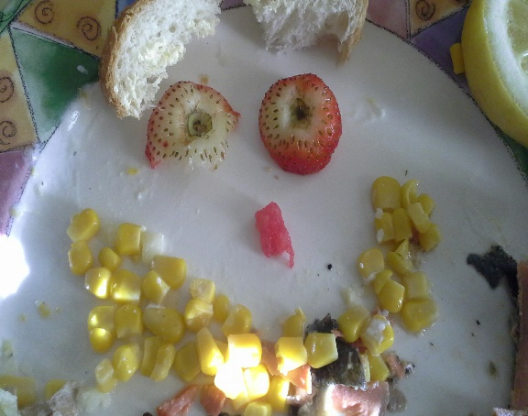
How Happy Are You?
Unhappy
Truly Happy
Where would you place yourself on this continuum?
Would you like to be happier than you currently are?
Can you think of someone whom you would like to help become happier?

Slide 3
The Last Supper
Jesus celebrated the Passover feast with His Apostles.
John 13:1-3

Slide 4
Traditional Locations in Jerusalem
The Savior suffered in Gethsemane
Jesus Christ ate the Last Supper with His disciples
Jesus Christ instituted the sacrament
Jesus Christ was betrayed, arrested, and tried before Caiaphas

Slide 5
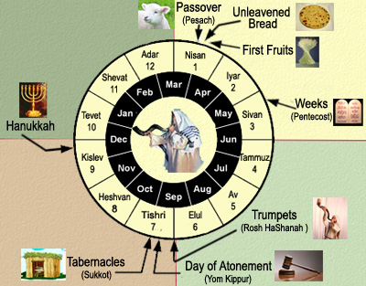
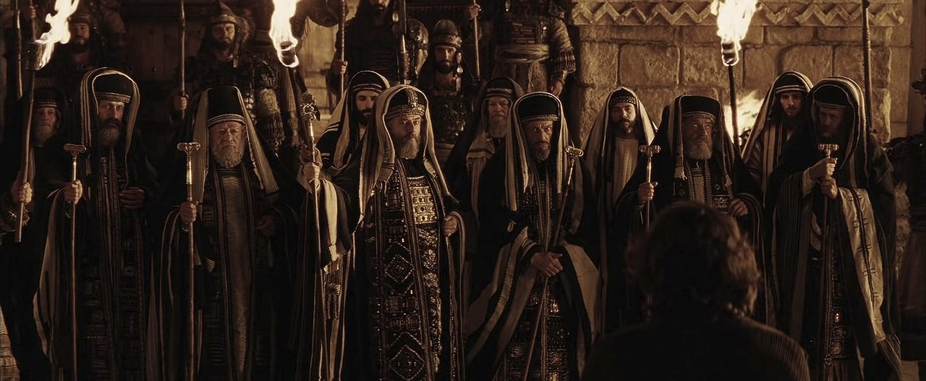
After 2 Days Is the Feast
As the Feast of the Passover approached, the Savior knew that His betrayal and Crucifixion were near, and He prophesied to His disciples that these things would occur during the feast time.
The chief priests and scribes gathered together at the palace of Caiaphas, the high priest, to consult about how they could take Jesus and kill Him without creating an uproar among the people.
The chief priests and elders represented the religious and lay leadership of the great Jerusalem Sanhedrin. They knew that many people admired Jesus Christ, and they were concerned that if they tried to take Jesus when there were so many pilgrims in Jerusalem for the holidays, there would be riots.
Matthew 26:1-5
(1)

Slide 6
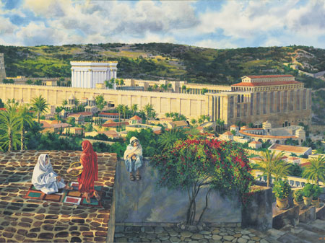
Large Upper Room
In cities of ancient Israel, upper rooms of houses were the choicest rooms because they were above the crowds of the city streets and provided privacy—an appropriate setting for the sacred events of the Last Supper.
Al Rounds
The Last Supper and the symbolism associated with the emblems of the sacrament.
Mark 14:15, 17-25
(1)

Slide 7
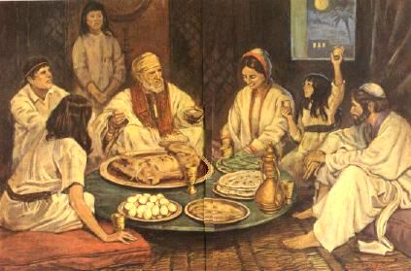
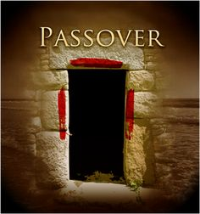
Passover
The Passover was instituted in Moses’ time to remind the children of Israel that the destroying angel passed over their houses and slew the firstborn children in Egypt.
As part of the Passover, the Israelites sacrificed a lamb and sprinkled its blood over their doorposts. This lamb symbolized the coming Messiah, whose atoning sacrifice would save mankind from death and sin.
Exodus 12:21–28; 13:14–15

Slide 8
Anointing With Spikenard
John identified the woman who anointed Jesus as Mary, the sister of Martha and Lazarus.
The “alabaster box” was a jar containing “ointment of spikenard,” an aromatic ointment used as perfume and to anoint the dead.
By anointing Jesus while He was still alive, the woman acknowledged His impending death and burial.
“She is come aforehand to anoint my body to the burying,”
The ointment was very expensive, worth more than 300 denarii, or about a year’s wages for a common laborer.
Mark 14:3-9
(1)

Slide 9
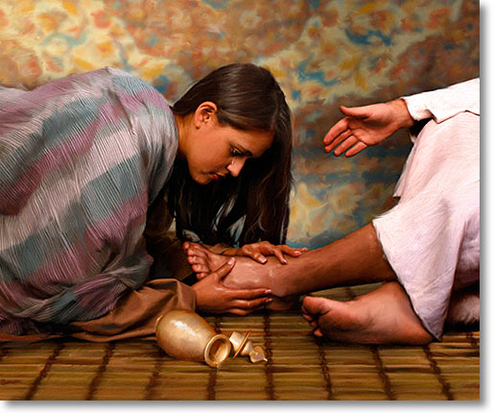
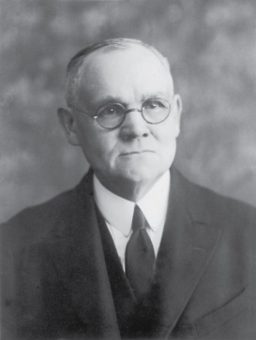
“To anoint the head of a guest with ordinary oil was to do him honor; to anoint his feet also was to show unusual and signal regard; but the anointing of head and feet with spikenard, and in such abundance, was an act of reverential homage rarely rendered even to kings.
Mary’s act was an expression of adoration; it was the fragrant outwelling of a heart overflowing with worship and affection.”
The woman of Bethany stands out as the first disciple in the Gospel of Mark to understand and openly accept the Savior’s teaching that He must suffer and die. (10)
Mark 14:3-9
(4)

Slide 10
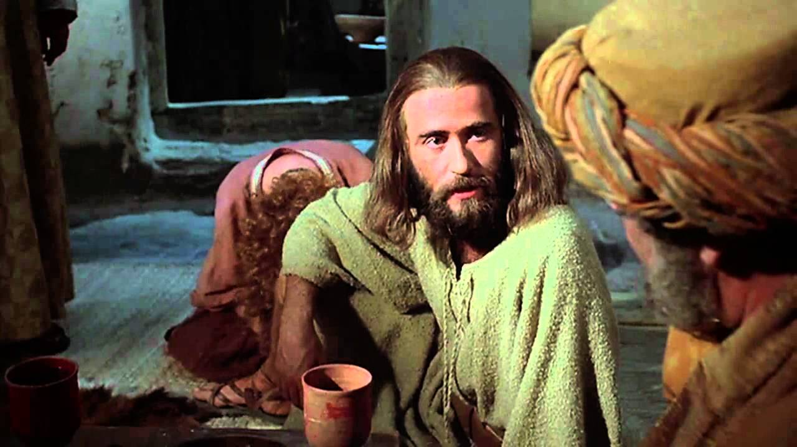
Judas’ Reaction VS Jesus’ Reaction
Judas Iscariot was the one who complained about Mary’s act.
Some of His disciples, including Judas, one of the Twelve Apostles and the group’s treasurer, complained that the ointment should have been sold to help the poor.
“she hath wrought a good work on me” = The Savior was pleased with what Mary had done.
“she hath done what she could” = Mary had given her best to the Lord.
However, Judas was not truly concerned for the poor but was a thief who wanted the money for himself.
Matthew 26:6-13; Mark 11-13; John12:4-6
(4)

Slide 11
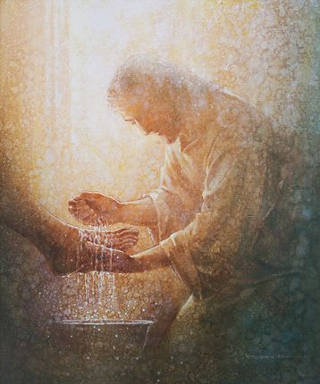
Washing Feet of Apostles
“laid aside his garments” = Jesus took off an outer garment, similar to someone removing a jacket in our day.
“In New Testament times, people wore open sandals, walked on mostly dirt roads that accumulated the filth of beasts, and had only irregular access to bathing water. Their feet became very dirty, and washing another person’s feet could have been a distasteful task. …
This custom of hospitality was usually performed by the lowest level of servants.
“Christ quietly arose, girded himself as a slave or servant would, and knelt to wash the Apostles’ feet” (2)
John 13:4-5

Slide 12
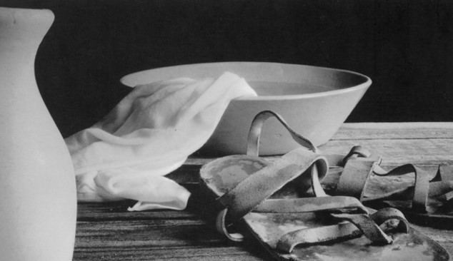
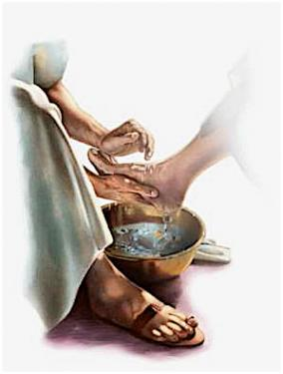
“Washing of feet is a gospel ordinance; it is a holy and sacred rite, one performed by the saints in the seclusion of their temple sanctuaries.
It is not done before the world or for worldly people. For his day and dispensation Jesus instituted it in the upper room at the time of the Last Supper.
“Our Lord did two things in the performance of this ordinance:
1. He fulfilled the old law given to Moses; and
2. He instituted a sacred ordinance which should be performed by legal administrators among his true disciples from that day forward.
“As part of the restoration of all things, the ordinance of washing of feet has been restored in the dispensation of the fulness of times.”
John 13:4-5
(3)

Slide 13
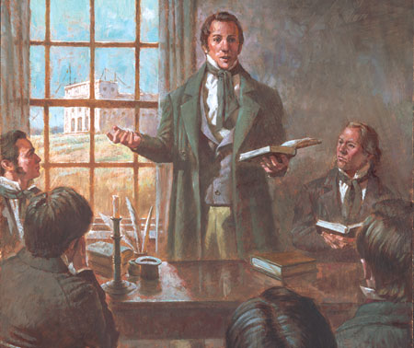
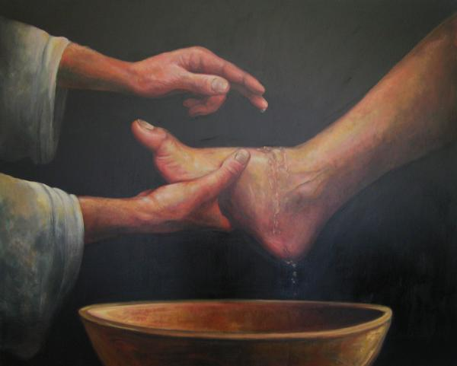
On December 27, 1832, the Prophet Joseph Smith received a revelation that declared:
“Sanctify yourselves; yea, purify your hearts, and cleanse your hands and your feet before me, that I may make you clean” (D&C 88:74).
In that same revelation the Lord commanded the Prophet to organize the School of the Prophets, saying that those who were part of the school.
“And he shall be received by the ordinance of the washing of feet” (D&C 88:139)
“In the case of [the School of the Prophets] the ordinance [of washing of feet] is to be performed by the President of the Church.
In compliance with this revelation the Prophet on January 23, 1833, washed the feet of the members of the school of the prophets.”
John 13:4-5
(4)

Slide 14
“On March 29 and 30, 1836, [in the newly dedicated Kirtland Temple] the leading brethren, including the First Presidency, Council of the Twelve, bishoprics, and presidents of quorums, participated in the ordinance of washing of feet.”
“Thus the knowledge relative to the washing of feet has been revealed step by step in this day until a full knowledge is now incorporated in the revealed ordinances of the Lord’s house.”
John 13:4-5
(3,4)

Slide 15
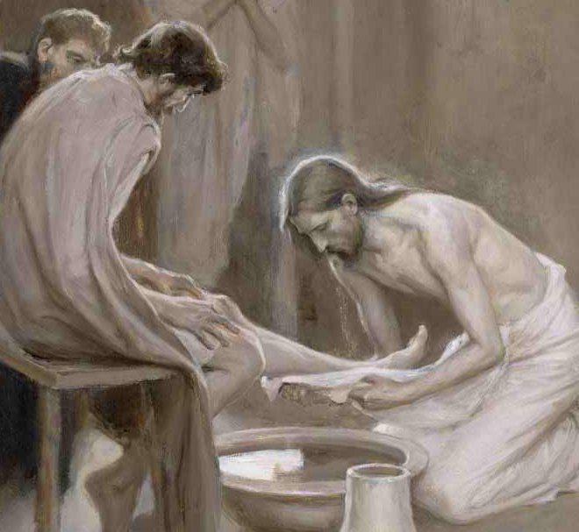
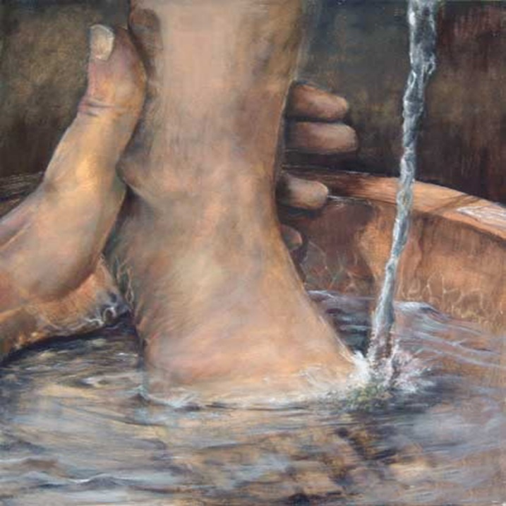
Peter Objects
Lord, dost thou wash my feet?
Peter’s initial rejection of the Master’s offer to wash his feet can be understood in light of the fact that this custom of hospitality was usually performed by the lowest level of servants.
However, when the Savior explained to Peter that having his feet washed was essential to fellowship with Him, Peter then asked for a more complete washing, which the Savior explained was not necessary. Peter’s request illustrates the respect he had for the Lord and his earnest desire to follow Him completely.
John 13:6-10
(4)

Slide 16
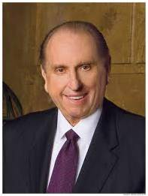
Happy Are Ye If Ye Do Them
Happiness was contingent upon their service to others.
Unhappy
“To find real happiness, we must seek for it in a focus outside ourselves. No one has learned the meaning of living until he has surrendered his ego to the service of his fellow man. Service to others is akin to duty—the fulfillment of which brings true joy.”
Truly Happy
(5)

Slide 17
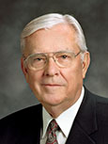
“In your morning prayer each new day, ask Heavenly Father to guide you to recognize an opportunity to serve one of His precious children.
Then go throughout the day with your heart full of faith and love, looking for someone to help.
If you do this, your spiritual sensitivities will be enlarged and you will discover opportunities to serve that you never before realized were possible.”
(6)

Slide 18
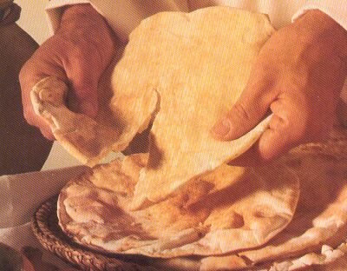
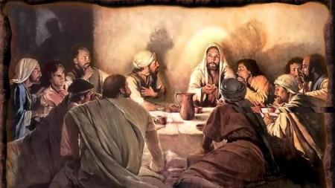
The Sacrament—Our Passover
“Do we see [the sacrament] as our Passover, remembrance of our safety and deliverance and redemption?” (2)
At the Last Supper, the Savior instituted the sacrament, a new symbolic “meal” of commemoration. Just as partaking of the emblems of the Passover pointed to the future sacrifice of Jesus Christ and helped ancient Israel remember their release from Egyptian bondage, partaking of the sacrament helps us remember Jesus Christ’s atoning sacrifice, which can release us from the bondage of sin. (1)
Matthew 26:17-25; Mark 14:12–25; Luke 22:7–30; John 13:1–2

Slide 19
Doctrinal Mastery
Luke:22:19-20
And he took bread, and gave thanks, and brake it, and gave unto them, saying, This is my body which is given for you: this do in remembrance of me.
Likewise also the cup after supper, saying, This cup is the new testament in my blood, which is shed for you.

Slide 20
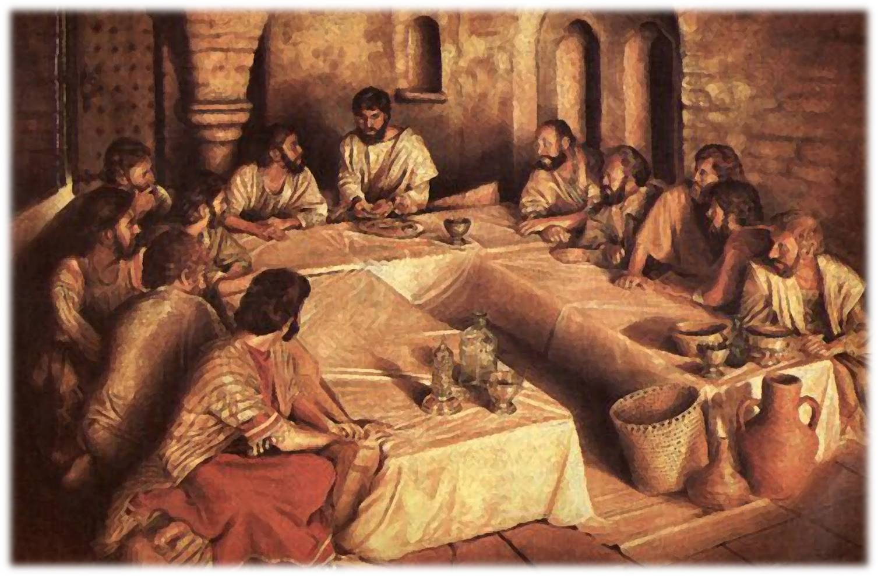
The Emblems of the Sacrament
When Jesus instituted the sacrament during the Last Supper, He taught His Apostles that the emblems of the sacrament represented His body and His blood. (1)
With a crust of bread, always broken, blessed, and offered first, we remember his bruised body and broken heart, his physical suffering on the cross where he cried, ‘I thirst,’ and finally, ‘My God, my God, why hast thou forsaken me?’
“The Savior’s physical suffering guarantees that through his mercy and grace (see 2 Ne. 2:8) every member of the human family shall be freed from the bonds of death and be resurrected triumphantly from the grave. …
“With a small cup of water we remember the shedding of Christ’s blood and the depth of his spiritual suffering, anguish which began in the Garden of Gethsemane…(2)
Matthew 26:26-28, 38; John 19:28; Luke 22:44

Slide 21
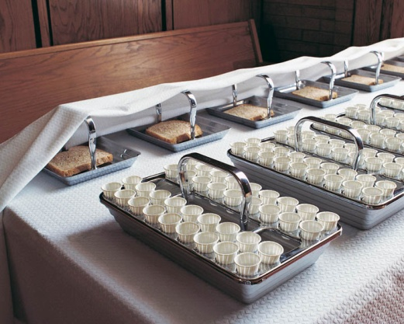
Instituting the Sacrament
Merely eating the bread and drinking the water during the sacrament does not automatically qualify us to receive a remission, or forgiveness, of our sins.
We must exercise faith in Jesus Christ, repent, and partake of the sacrament with real intent by always remembering Him and striving to keep His commandments.
By worthily partaking of the sacrament, we renew our baptismal covenants
Matthew 26:26-28

Slide 22
What was one result of the Fall of Adam?
Moses 5:4
Moroni 10:30, 32
What is the mission of the Church?
What is the scriptural term for this condition?
Understanding the
Atonement
Alma 42:9
1 John 1:8
How many of us are unclean?
In what spiritual condition must we be to dwell with God?
“The sacrament not only symbolizes the Savior’s Atonement but also looks forward in anticipation to the time when He will return to the earth in glory.
Moses 6:57
Matthew 26:26-29

Slide 23
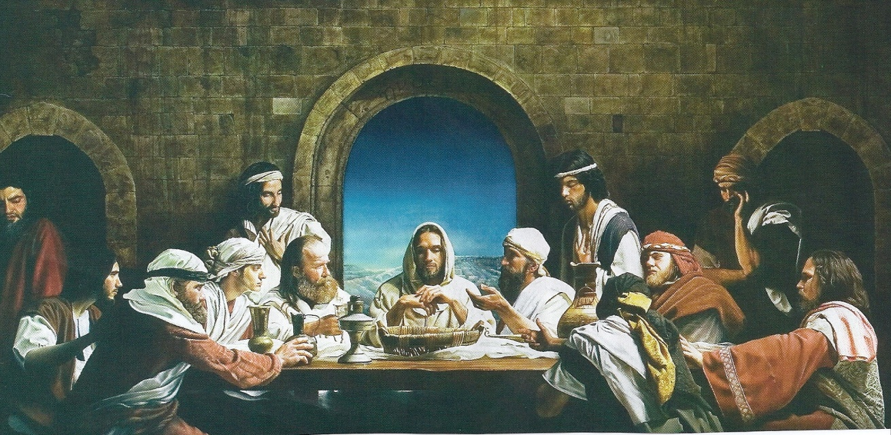
Lord, Is It I?
The Apostles had traveled with the Savior throughout Galilee and Judea. In the course of their travels and interactions with Him, they had become His trusted friends. Surely they were shocked by His announcement during the Passover meal, “One of you shall betray me.”
“I remind you that these men were apostles. They were of apostolic stature. …
It reflects something of their stature. Rather it is recorded that:
“‘They were exceeding sorrowful, and began every one of them to say unto him, Lord, is it I?’
“Would you, I plead, overrule the tendency to disregard counsel and assume for just a moment something apostolic in attitude at least and ask yourself these questions: Do I need to improve myself? Should I take this counsel to heart and act upon it? If there is one weak or failing, unwilling to follow the Brethren, Lord, is it I?” (12)
Matthew 26:22

Slide 24
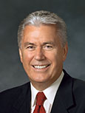
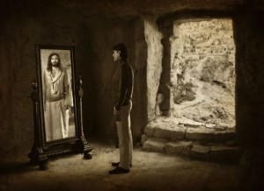
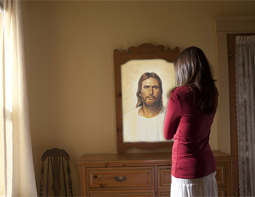
“In these simple words, ‘Lord, is it I?’ lies the beginning of wisdom and the pathway to personal conversion and lasting change. …
“We must put aside our pride, see beyond our vanity, and in humility ask, ‘Lord, is it I?’
“And if the Lord’s answer happens to be ‘Yes, my son [or daughter], there are things you must improve, things I can help you to overcome,’ I pray that we will accept this answer, humbly acknowledge our sins and shortcomings, and then change our ways by becoming better.” (11)
Matthew 26:22

Slide 25
When disciples of Jesus Christ hear the word of the Lord, they examine their own lives to see how it applies to them.
“The disciples didn’t question the truth of what [Jesus] said. Nor did they look around, point to someone else, and ask, ‘Is it him?’
“Instead, ‘they were exceeding sorrowful, and began every one of them to say unto him, Lord, is it I?’
“I wonder what each of us would do. … Would we look at those around us and say in our hearts, ‘He’s probably talking about Brother Johnson. I’ve always wondered about him,’ or ‘I’m glad Brother Brown is here. He really needs to hear this message’? Or would we, like those disciples of old, look inward and ask that penetrating question: “Lord is it I?” (11)
Matthew 26:22

Slide 26
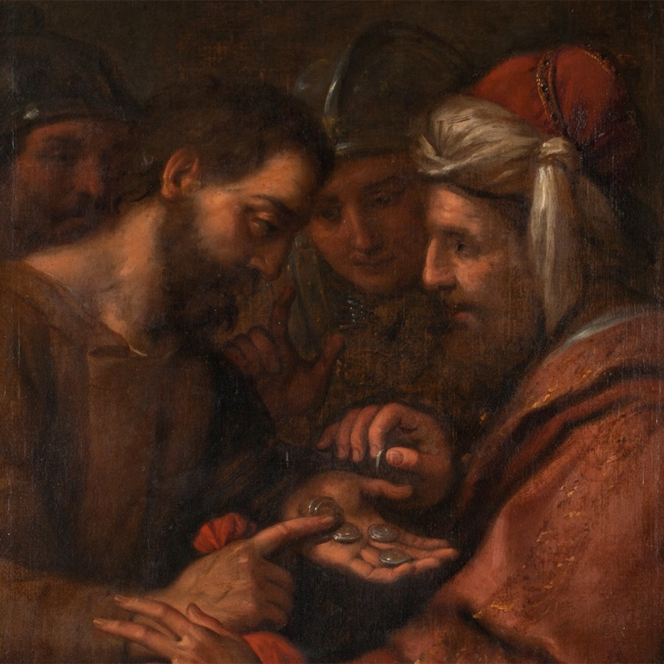
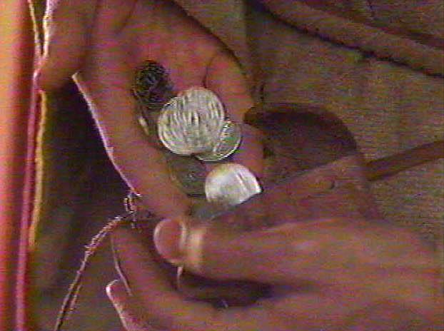
Conspiring/Low Regard
Judas conspired with the chief priests to help them locate and arrest Jesus.
How much money did the chief priests give Judas?
And I said unto them, If ye think good, give me my price; and if not, forbear. So they weighed for my price thirty pieces of silver.
And the Lord said unto me, Cast it unto the potter: a goodly price that I was prised at of them. And I took the thirty pieces of silver, and cast them to the potter in the house of the Lord. Zechariah 11:12-13
30 pieces (shekels) of silver = about $17.00
This was a fixed price for the death of a slave, also a forseen sum of the blood-money to be paid for the Lord’s betrayal. (10)
Matthew 26:14-16; Exodus 21:32

Slide 27
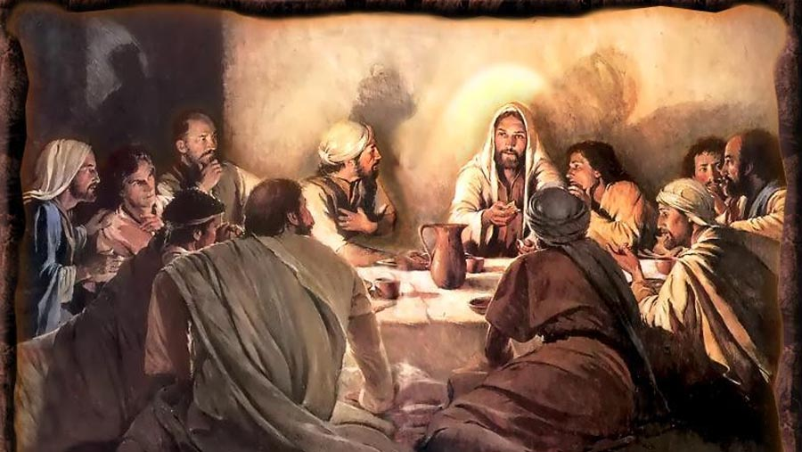
The Betrayer Amongst Them
When Jesus had thus said, he was troubled in spirit, and testified, and said, Verily, verily, I say unto you, that one of you shall betray me.
Leaning on the bosom =
In New Testament times, those dining at formal meals often reclined on low couches placed around tables, leaning on their left arms with their heads toward the table and their feet pointed away from the table.
Therefore, the guest seated to the right of the host would have leaned toward the host. This appears to have been where the Apostle John sat, “leaning on Jesus’ bosom,” or reclining toward Jesus, during the meal.
This position would have allowed John, the disciple “whom Jesus loved,” to have private conversations with the Savior that would not have been heard by everyone at the meal, such as the one concerning Judas’s betrayal.
Walter Rane
John 13:18-30; Luke 16:22
(1)

Slide 28
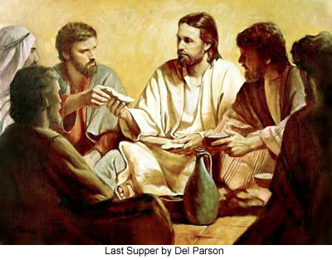
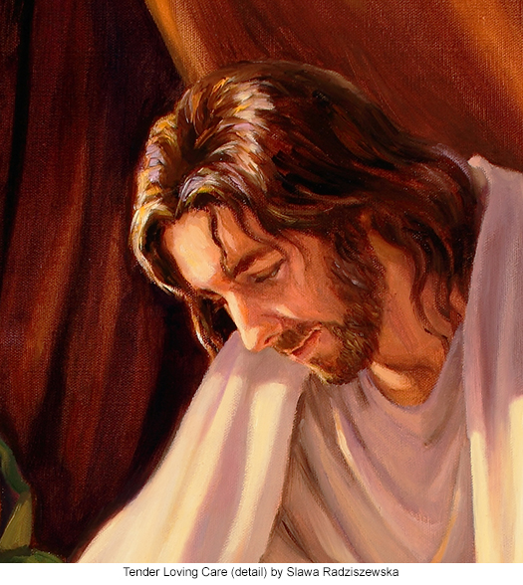
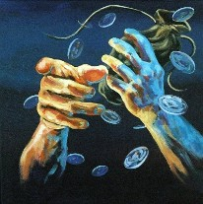
Sop
A small piece of bread that those dining would use to scoop broth and meat from a bowl.
Since it was a gesture of kindness and respect for a host to dip a sop and give it to a dinner guest, the Savior by this act presented Judas with an offer of friendship, perhaps one final opportunity for him to abandon his planned betrayal.
Del Parson
“That thou doest, do quickly”
The Savior gave a sop to Judas, after which “Satan entered into him”
He already knew what Judas had determined to do and that the time had come for him to act upon his final decision.
Slawa Radziszewska
(1)
John 13:26-27

Slide 29
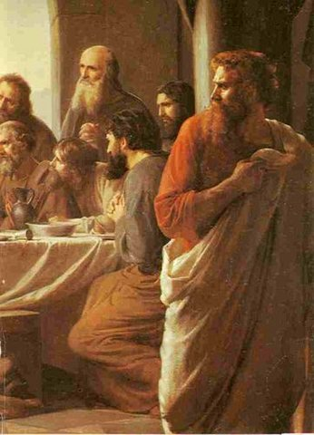
Judas is Identified
Immediately after Jesus identified Judas as the one who would betray Him, Judas left
He then having received the sop went immediately out: and it was night. John 13:30
Matthew 26:23-25

Slide 30
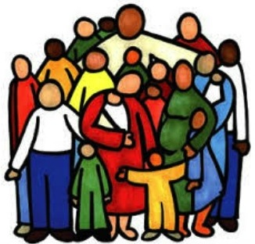
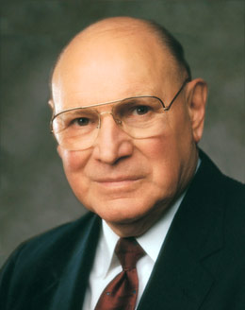
Love One Another
Thou shalt not avenge, nor bear any grudge against the children of thy people, but thou shalt love thy neighbour as thyself: I am the Lord.
Leviticus 19:18
After the Savior dismissed Judas, the setting was prepared for the Savior to give important teachings to the rest of the Apostles.
The Savior commands us to love one another as He loves us
“Love is the beginning, the middle, and the end of the pathway of discipleship. It comforts, counsels, cures, and consoles. It leads us through valleys of darkness and through the veil of death. In the end love leads us to the glory and grandeur of eternal life. …
(1)
John 13:34-35

Slide 31
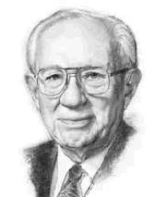
"Love is the only force that can erase the differences between people, that can bridge chasms of bitterness…
"If the world is to be improved, the process of love must make a change in the hearts of mankind. It can do so when we look beyond self to give our love to God and others, and do so with all our heart, with all our soul, and with all our mind.
Hate drew a circle that shut me out- Heretic, rebel, a thing to flout.
But Love and I had the wit to win:
We drew a circle that took him in.
“Love is the defining characteristic of a disciple of Christ” (9)
Edwin Markham
(7)

Slide 32
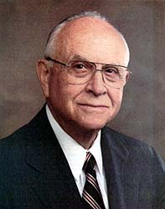
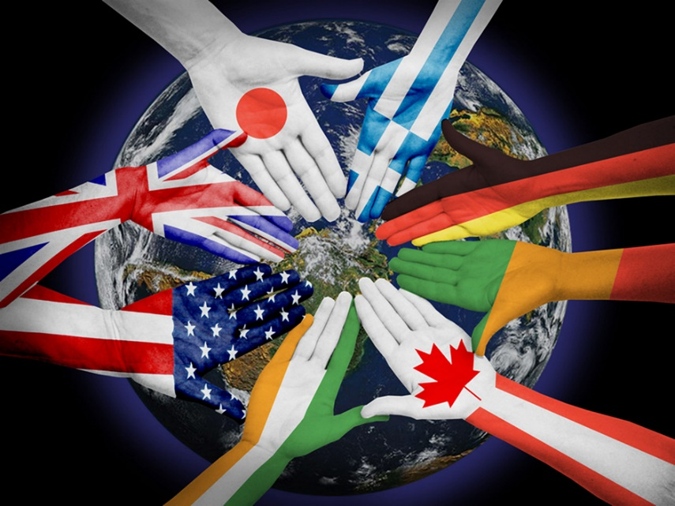
By This Shall Men Know
"Besides loving God, we are commanded to follow what to many is a more difficult commandment: to love all, even enemies, and to go beyond the barriers of race or class or family relationships.
It is easy, of course, to be kind to those who are kind to us-the usual standard of friendly reciprocity. But we are commanded to cultivate genuine fellowship and even a kinship with every human being on earth.
Whom should we bar from our circle?
We might deny ourselves a nearness to our Savior because of our prejudices of neighborhood or possession or race-attitudes that Christ would surely condemn. Love has no boundary, no limitation of good will."
(8)
John 13:34-35

Slide 33
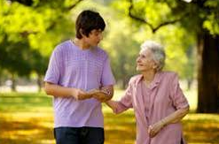
Love and Serve Others
Do something to show love and kindness to someone who is different from you or even someone you have struggled to get along with in the past.
Do something today for a family member, friend, or someone in the community.
efforts.
Identify someone you feel impressed to show greater love or respect toward..
Consider how you could invite the Savior’s love into your efforts.

Slide 34
Sources:
New Testament Institute Student Manual Chapter 25
Jeffrey R. Holland, “He Loved Them unto the End,” Ensign, Nov. 1989, 25; Elder Jeffrey R. Holland “This Do in Remembrance of Me,” Ensign, Nov. 1995, 68).
Elder Bruce R. McConkie (Doctrinal New Testament Commentary, 1:708-710).
History of the Church, 1:323; 2:430–31]
President Thomas S. Monson (“Guideposts for Life’s Journey” [Brigham Young University devotional, Nov. 13, 2007], 4;speeches.byu.edu).
Elder M. Russell Ballard (“Be Anxiously Engaged,” Ensign or Liahona, Nov. 2012, 31).
Gordon B. Hinckley (Faith: The Essence of True Religion [Salt Lake City: Deseret Book Co., 1989], 48-49.)
Elder David B. Haight (A Light unto the World [Salt Lake City: Deseret Book Co., 1997], 124.)
President Dieter F. Uchtdorf “The Love of God,” Ensign or Liahona, Nov. 2009, 22).
James E. Talmage Jesus the Christ p. 592
President Dieter F. Uchtdorf (“Lord, Is It I?” Ensign or Liahona, Nov. 2014, 58).
President Boyd K. Packer (“That All May Be Edified” [1982], 237).
Presentation by ©http://fashionsbylynda.com/blog/

Slide 35
Event | Matthew | Mark | Luke | John
Jesus Washes Apostles Feet |  |  |  | 13:1-17, 20
Jesus Announces His Betrayal | 26:21-25 | 14:18-21 | 22:21-23 | 13:18-22
Judas, Alone, Leaves the Upper Room |  |  |  | 13:23-30
Commandment to Love One Another |  |  |  | 13:31-35
Peter’s Denial Prophesied and Profess Loyalty | 26:34, 35 | 14:30, 31 | 22:33-38 | 13:36-38
Loving His Disciples to the End John 13:1:
This small circle of believers in this scarcely founded kingdom were about to pass through their severest trial, so he would set aside his own increasing anguish in order that he might yet once more serve and strengthen them. It does not matter that no one washed his feet. In transcendent humility he would continue to teach and to cleanse them. He would to the final hour—and beyond—be their sustaining servant. As John wrote, who was there and watched the wonder of it all, ‘Having loved his own which were in the world, he loved them unto the end.’ (John 13:1.)
“So it had been, and so it was to be—through the night, and through the pain, and forever. He would always be their strength, and no anguish in his own soul would ever keep him from that sustaining role” Elder Jeffrey R. Holland (“He Loved Them unto the End,” Ensign, Nov. 1989, 25).
Love is the Great Commandment John 34-35:
“Love is the beginning, the middle, and the end of the pathway of discipleship. It comforts, counsels, cures, and consoles. It leads us through valleys of darkness and through the veil of death. In the end love leads us to the glory and grandeur of eternal life. …
Continued
“Brethren and sisters, as you prayerfully consider what you can do to increase harmony, spirituality, and build up the kingdom of God, consider your sacred duty to teach others to love the Lord and their fellowman. This is the central object of our existence. Without charity—or the pure love of Christ—whatever else we accomplish matters little. With it, all else becomes vibrant and alive.
“When we inspire and teach others to fill their hearts with love, obedience flows from the inside out in voluntary acts of self-sacrifice and service. …
“When Jesus gave His disciples a new commandment to ‘love one another; as I have loved you’ [John 13:34], He gave to them the grand key to happiness in this life and glory in the next.
“Love is the greatest of all the commandments—all others hang upon it. It is our focus as followers of the living Christ” Elder Joseph B. Wirthlin (“The Great Commandment,” Ensign orLiahona, Nov. 2007, 28–31).
The Great Example John 13:13-15:
“When the Savior was about to leave his Apostles, he gave them a great example of service. You remember he girded himself with a towel and washed his disciples’ feet [see John 13:3–17]. …
“What an example of service to those great servants, followers of the Christ! He that is greatest among you, let him be least. So we sense the obligation to be of greater service to the membership of the Church, to devote our lives to the advancement of the kingdom of God on earth” President David O. McKay (in Conference Report, Apr. 1951, 158–59).

Slide 36
Love One Another John 34-35:
"How often have we read the words 'a new commandment I give unto you'? The Ten Commandments had sounded down through the millennia since Moses' time, and now an additional commandment came from the Master: 'That ye love one another; as I have loved you, that ye also love one another.' (John 13:34.)
"Only those who are true possessors of charity can measure up to the full stature of this new commandment. This is the commandment that lifts us to the more noble and virtuous life. We cannot nor ever will love one another as He has loved us until we exercise in our own lives the full dimensions of charity. Those who practice charity may not always receive the promised benefits and ultimate successes. Ours is a different time schedule, but by and by we will all learn and know that 'charity never faileth.' (Corinthians 13:8.) The pure love of Christ will eventually triumph over all the evils, including power, pride, boasting, worldly acclaim, cruelty, wars, perversion, sadness, and heartache. The Lord through His servants has promised that charity will never fail. One day charity, the pure love of Christ, will triumph over all the world. Those who are possessors of charity will triumph over all evil and will dwell with the author of this 'new commandment' forever and forever.“Vaughn J. Featherstone (The Incomparable Christ: Our Master and Model [Salt Lake City: Deseret Book Co., 1995], 78-79.)
By This Shall Men Know John 13:34-35:
"In building the kingdom of God, every positive act, every friendly greeting, every warm smile, every thoughtful, kind note contributes to the strength of the whole. It is my prayer that we may be open and outgoing, friendly, and helpful to all who come among us. But let us give special care and concern for the new converts to the Church. When we detect a halting step or a stumble as they begin their journey on the gospel path, let us be there to lift and support with words of kindness and concern; let us be available to give gentle, loving counsel that will strengthen and sustain. Let us conscientiously look for occasions to show that love which the Savior admonished us to have when He said, 'A new commandment I give unto you, That ye love one another' (John 13:34)." Elder Carl B. Pratt ("Care for New Converts," Ensign, Nov. 1997, 12)
The Love of the Savior “The love the Savior described is an active love. It is not manifested through large and heroic deeds but rather through simple acts of kindness and service” Elder M. Russell Ballard (“Finding Joy through Loving Service,” Ensign or Liahona, May 2011, 47).

Slide 37
Event | Matthew | Mark | Luke | John
Jesus Foretells His Betrayal and Crucifixion | 26:1, 2 | 14:1 | 22:1
Rulers consult How They Can Kill Jesus | 26:3-5 | 14:1, 2 | 22:2
Judas Iscariot promises to Betray Jesus | 26:14-16 | 14:10, 11 | 22:3-6
Preparation for the Passover | 26:17-19 | 14:12-16 | 22:7-13
Jesus and the Apostles Begin Last Supper | 26:20 | 14:17 | 22:14-18
Jesus Announces His Betrayal | 26:21-25 | 14:18-21 | 22:21-23 | 13:18-22
The Sacrament | 26:26-29 | 14:22-25 | 22:19-20
Departing to Mount of Olives | 26:30 | 14:26 | 22:39
Betrayal:
No one is foreordained to do evil—Judas chose to betray the Savior. The Joseph Smith Translation explains that one reason for Judas’s betrayal was the doctrine the Savior taught: “Nevertheless, Judas Iscariot, even one of the twelve, went unto the chief priests to betray Jesus unto them; for he turned away from him, and was offended because of his words” (Joseph Smith Translation, Mark 14:31; compare Mark 14:10, footnote a). (1)
Sacrament Emblems Matthew 26:26-28
… There he said, ‘My soul is exceeding sorrowful, even unto death’. He was in agony and ‘prayed more earnestly: and his sweat was as it were great drops of blood falling down to the ground’.
“The Savior’s spiritual suffering and the shedding of his innocent blood, so lovingly and freely given, paid the debt for what the scriptures call the ‘original guilt’ of Adam’s transgression (Moses 6:54). Furthermore, Christ suffered for the sins and sorrows and pains of all the rest of the human family, providing remission for all of our sins as well, upon conditions of obedience to the principles and ordinances of the gospel he taught (see 2 Ne. 9:21–23). As the Apostle Paul wrote, we were ‘bought with a price’ (1 Cor. 6:20). What an expensive price and what a merciful purchase!
“That is why every ordinance of the gospel focuses in one way or another on the atonement of the Lord Jesus Christ, and surely that is why this particular ordinance with all its symbolism and imagery comes to us more readily and more repeatedly than any other in our life” Elder Jeffrey R. Holland (“This Do in Remembrance of Me,” 67).
Dipped His Hand With Me: Matthew 26:23
The “sop” described in John 13:26 was a small piece of bread that those dining would use to scoop broth and meat from a bowl. Since it was a gesture of kindness and respect for a host to dip a sop and give it to a dinner guest, the Savior by this act presented Judas with an offer of friendship, perhaps one final opportunity for him to abandon his planned betrayal. The Savior gave a sop to Judas, after which “Satan entered into him” (John 13:27). By saying to Judas, “That thou doest, do quickly” (John 13:27), the Lord showed that He already knew what Judas had determined to do and that the time had come for him to act upon his final decision. (1)

