Slide 1

John 14-17

Slide 2


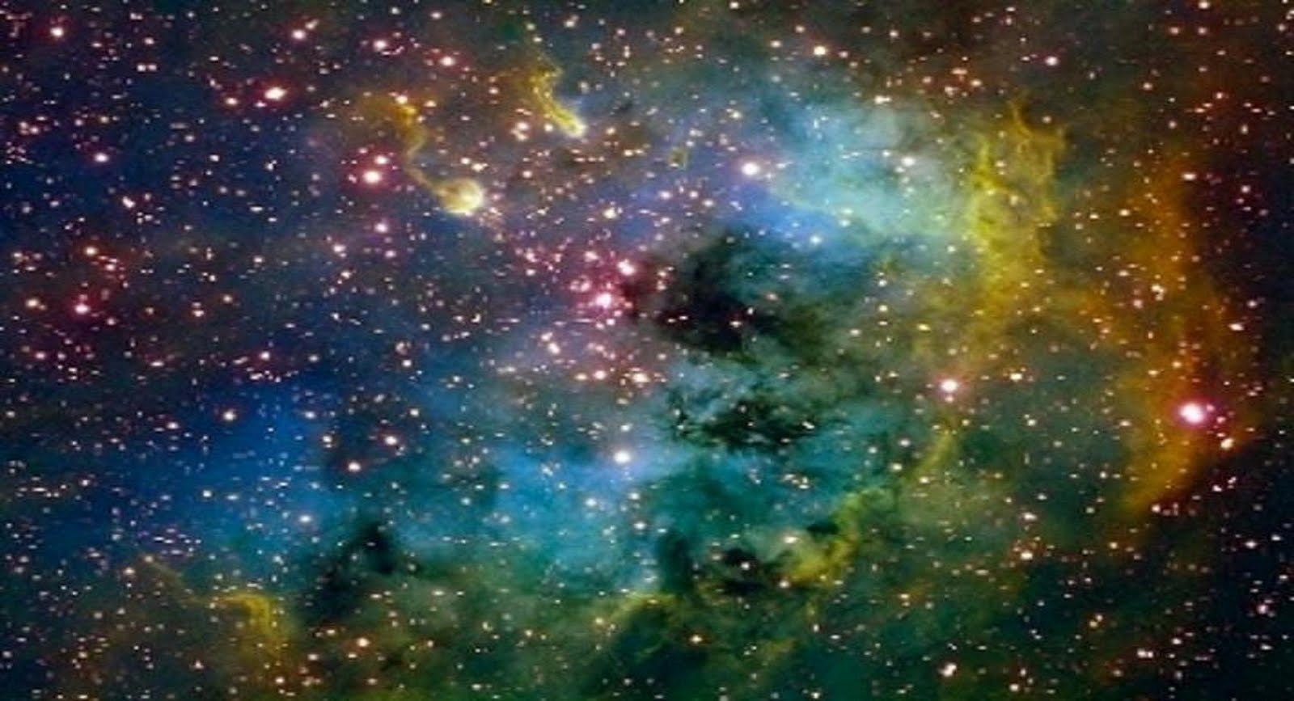
Many Kingdoms
John 14
Wherefore, as it is written, they are gods, even the sons of God—
Wherefore, all things are theirs, whether life or death, or things present, or things to come, all are theirs and they are Christ’s, and Christ is God’s.
These shall dwell in the presence of God and his Christ forever and ever.
D&C 76:58-59, 62

Slide 3
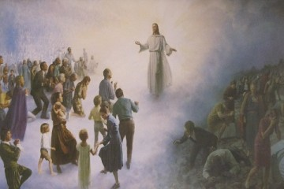
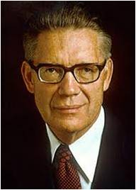
Celestial Kingdom
Through the Atonement of Jesus Christ, all people will be resurrected.
After we are resurrected, we will stand before the Lord to be judged according to our desires and actions.
Each of us will accordingly receive an eternal dwelling place in a specific kingdom of glory.
“Some of the mysteries of his kingdom, some of the deep and hidden doctrines, some things that can be understood only by the power of the Spirit” (2)
John 14:2
(3)

Slide 4

Kingdoms of Glory
The celestial kingdom is the highest of the three kingdoms of glory.
Those in this kingdom will dwell forever in the presence of God the Father and His Son Jesus Christ.
To inherit celestial glory and to help others receive that great blessing as well. Such a goal is not achieved in one attempt; it is the result of a lifetime of righteousness and constancy of purpose.
The celestial kingdom is the place prepared for those who have “received the testimony of Jesus” and been “made perfect through Jesus the mediator of the new covenant, who wrought out this perfect atonement through the shedding of his own blood.”
To inherit this gift, we must receive the ordinances of salvation, keep the commandments, and repent of our sins.
John 14:2
(3)

Slide 5

“Some of the mysteries of his kingdom, some of the deep and hidden doctrines, some things that can be understood only by the power of the Spirit”
The Savior’s teachings about what the Holy Ghost can do for us are among the clearest instructions on the Holy Ghost in all scripture.
(1,2)

Slide 6
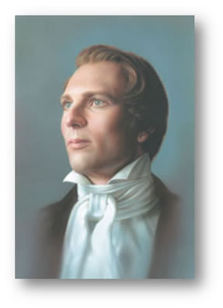
“[The statement] ‘In my Father’s house are many mansions’ … should be—‘In my Father’s kingdom are many kingdoms,’ in order that ye may be heirs of God and joint-heirs with me. …
There are mansions for those who obey a celestial law, and there are other mansions for those who come short of the law, every man in his own order.”
John 14:2
(4)

Slide 7
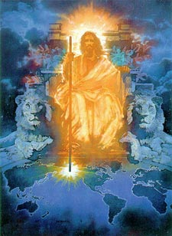
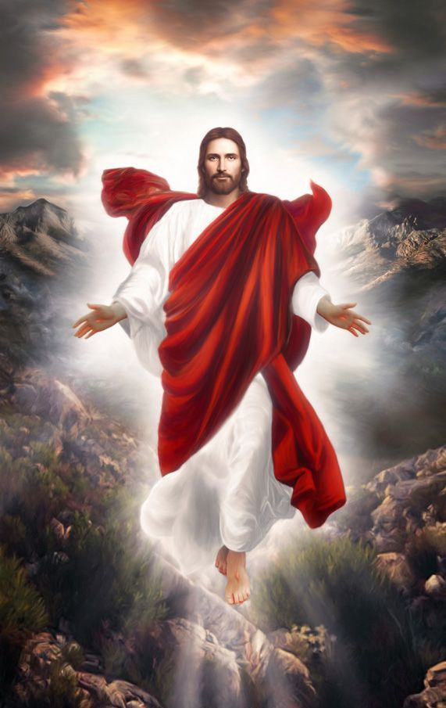
Jesus Will Return Again
And if I go and prepare a place for you, I will come again, and receive you unto myself; that where I am, there ye may be also.
John 14:3
“And when I go, I will prepare a place for you, and come again, and receive you unto myself; that where I am, ye may be also”
Joseph Smith Translation, John 14:3
(4)

Slide 8


I Am the Way
A “way” (Greek hodos) was a road or highway for traveling from one place to another…
…it could also refer to one’s course of behavior or “way of life.”
He did not say that He knew the way, but that He was the way, the truth, and the life.
Coming to the Father means we must do more than learn about Jesus Christ—we must follow Him and try to be like Him
No other way, no other road, no other system, no other name will bring salvation. (5)
John 14:6
(1)

Slide 9
Doctrinal Mastery
John 14:6
Jesus saith unto him, I am the way, the truth, and the life: no man cometh unto the Father, but by me.
(4)

Slide 10
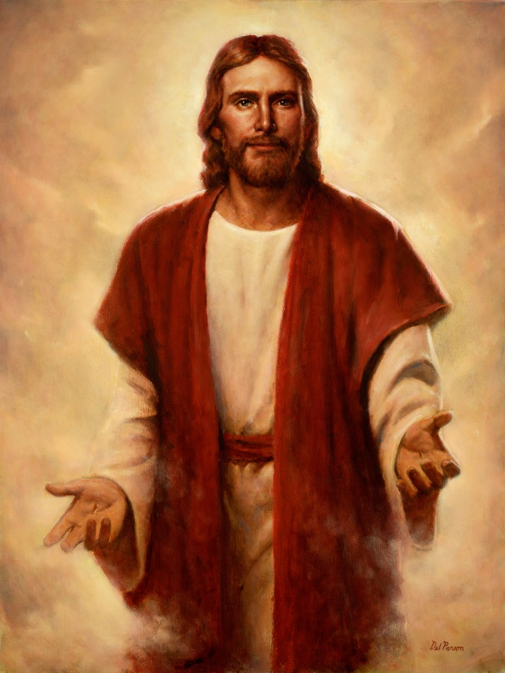
In that it is in and through Him that salvation comes; ‘no man cometh unto the Father, but by me,’ He said.
He is the Way
He is the embodiment and personification of that holy attribute. (Alma 5:48.)
He is the Truth
Del Parson
In Him the light of life centers; except for Him and His power there would be no existence; should He withdraw the light of life, death would gain an immediate victory; and without Him there would be neither immortal life, nor eternal life, which is life in unending glory.”
He is the Life
(2)

Slide 11
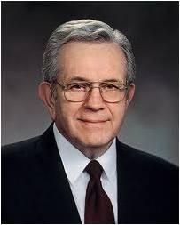
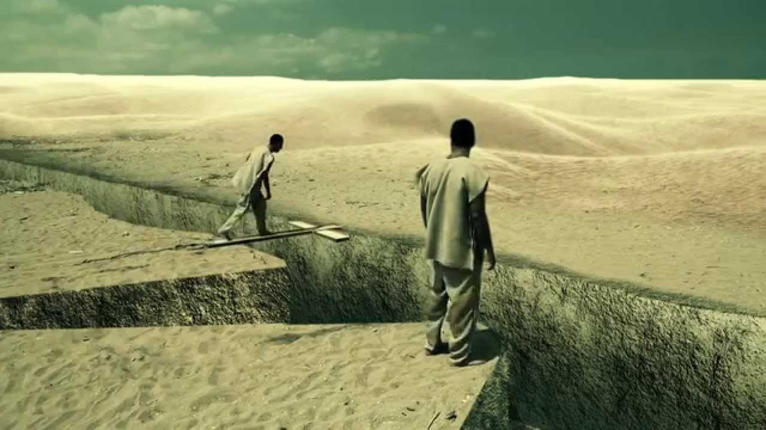
"When the Lord was upon the earth He made it very clear that there was one way, and one way only, by which man may be saved.
[The idea] was clear in the minds of His Apostles also, and their preaching provided for one way, and one way only, for people to be saved.“
(6)

Slide 12
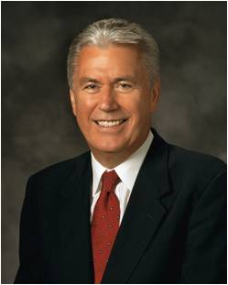

God wants you to find your way back to Him, and the Savior is the way.
God wants you to learn of His Son, Jesus Christ, and experience the profound peace and joy that come from following the path of divine discipleship.
John 14:6
(12)

Slide 13
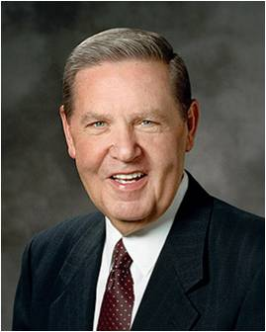
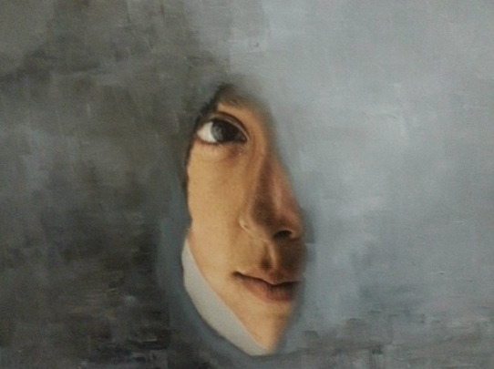
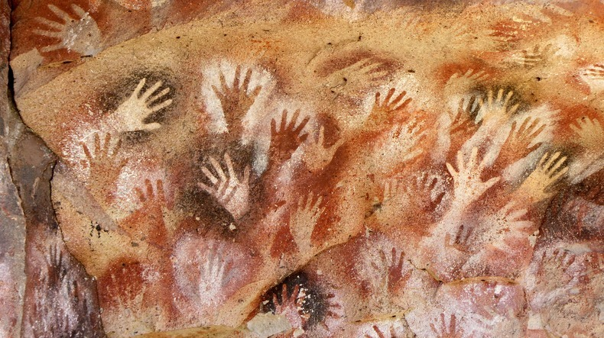
“Shew Us the Father”
“In all that Jesus came to say and do, including and especially in His atoning suffering and sacrifice, He was showing us who and what God our Eternal Father is like, how completely devoted He is to His children in every age and nation. …
Donya Hafezi Haghani,
“…God in His ultimate effort to have us know Him, sent to earth His Only Begotten and perfect Son, created in His very likeness and image, to live and serve among mortals in the everyday rigors of life. …
John 14:8-11
(7)

Slide 14
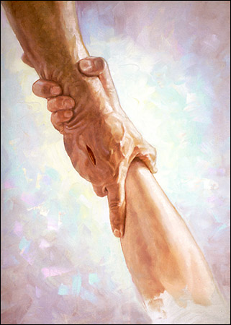
How Can We Show Love To Him?
“…So feeding the hungry, healing the sick, rebuking hypocrisy, pleading for faith—this was Christ showing us the way of the Father, He who is ‘merciful and gracious, slow to anger, long-suffering and full of goodness’.
In His life and especially in His death, Christ was declaring, ‘This is God’s compassion I am showing you, as well as that of my own.’”
Chris Hopkins
John 14:8-11; Lectures on Faith. P. 42 (1985)
(7)

Slide 15
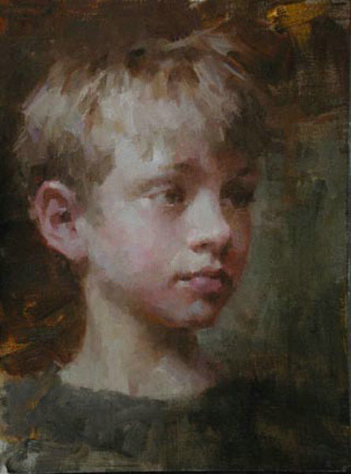
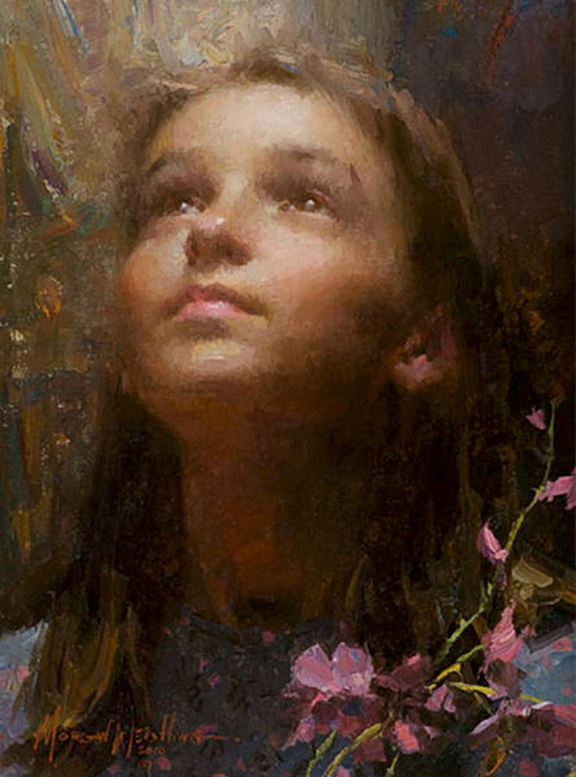
If Ye Love Me
Keep the Commandments
“When we love the Lord, obedience ceases to be a burden. Obedience becomes a delight.”
Morgan Weistling
Morgan Weistling
John 14:15
(8)

Slide 16
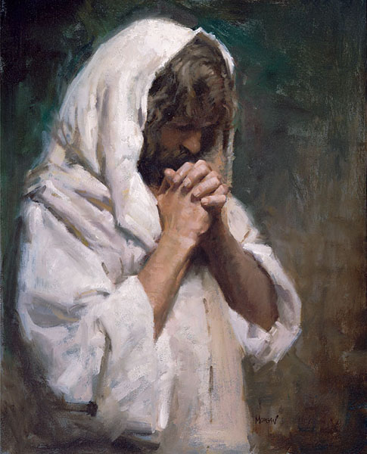
The Comforter
“Comforter” in the King James Version, appears only in the writings of John.
One who is summoned
Because the Savior had been a comforter to His Apostles during His mortal ministry, He called the Holy Ghost another Comforter.
Morgan Weistling
John 14:16-17
(1)

Slide 17
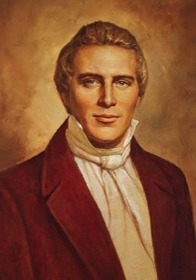
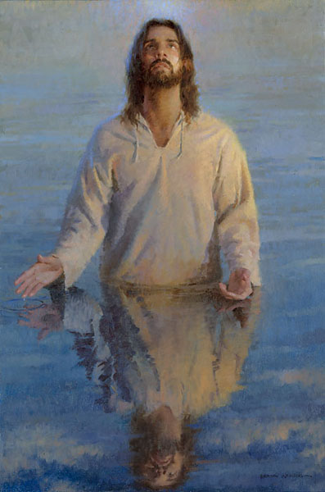
“There are two Comforters spoken of.
One is the Holy Ghost, the same as given on the day of Pentecost, and that all Saints receive after faith, repentance, and baptism. This first Comforter [is the] Holy Ghost. …
Morgan Weistling
“The other Comforter spoken of is a subject of great interest, and perhaps understood by few of this generation.
After a person has faith in Christ, repents of his sins, and is baptized for the remission of his sins and receives the Holy Ghost, (by the laying on of hands), which is the first Comforter, then let him continue to humble himself before God, hungering and thirsting after righteousness, and living by every word of God...
John 14:16-17
(4)

Slide 18
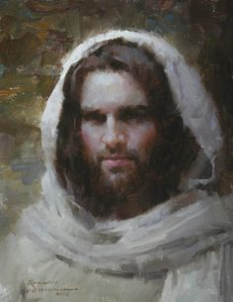
“When the Lord has thoroughly proved him, and finds that the man is determined to serve Him at all hazards, then the man will find his calling and his election made sure, then it will be his privilege to receive the other Comforter, which the Lord hath promised the Saints.”
“What is this other Comforter?
It is no more nor less than the Lord Jesus Christ Himself; and this is the sum and substance of the whole matter; that when any man obtains this last Comforter, he will have the personage of Jesus Christ to attend him, or appear unto him from time to time, and even He will manifest the Father unto him, and they will take up their abode with him, and the visions of the heavens will be opened unto him, and the Lord will teach him face to face, and he may have a perfect knowledge of the mysteries of the Kingdom of God.”
Morgan Weistling
John 14:16-17
(4)

Slide 19
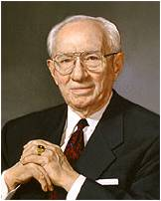
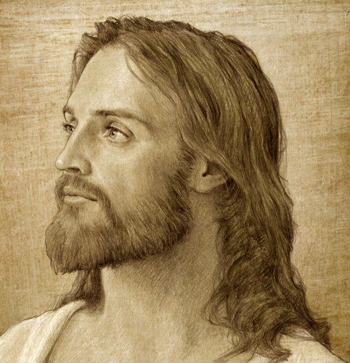
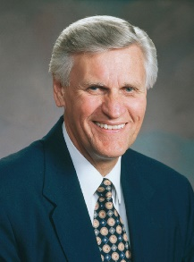
Testify of Truth
“The Holy Ghost is the Testifier of Truth, who can teach men things they cannot teach one another. ..”
And when ye shall receive these things, I would exhort you that ye would ask God, the Eternal Father, in the name of Christ, if these things are not true; and if ye shall ask with a sincere heart, with real intent, having faith in Christ, he will manifest the truth of it unto you, by the power of the Holy Ghost.
And by the power of the Holy Ghost ye may know the truth of all things.
“Sometimes the feeling [of a spiritual witness] is like a memory. We first learned the gospel in our heavenly home. We have come to this earth with a veil of forgetfulness. And yet lingering in each of our spirits are those dormant memories. The Holy Ghost can part the veil and bring those things out of their dormancy.”
John 14:26
(9, 10)

Slide 20
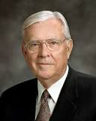

The Promise of Peace
“Was He promising His beloved associates the kind of peace the world recognizes—safety, security, with the absence of contention or tribulation?
Those original Apostles knew much of trial and persecution throughout the remainder of their lives:
‘Not as the world giveth, give I unto you. Let not your heart be troubled, neither let it be afraid’.
“‘These things I have spoken unto you, that in me ye might have peace,’
‘In the world ye shall have tribulation: but be of good cheer; I have overcome the world’ .
“Peace—real peace, whole-souled to the very core of your being—comes only in and through faith in the Lord Jesus Christ.”
John 14:27
(11)

Slide 21
Sources:
New Testament Institute Student Manual Chapter 26
Elder Bruce R. McConkie (The Mortal Messiah: From Bethlehem to Calvary, 4 vols. [1979–81], 4:73). Mormon Doctrine, 2nd ed. [1966], 832).
LDS Topics
Prophet Joseph Smith (Teachings of Presidents of the Church: Joseph Smith[2007], 219). History of the Church, 3:380–81
Robert E. Wells (The Mount and the Master [Salt Lake City: Deseret Book Co., 1991], 189)
President Boyd K. Packer (Let Not Your Heart Be Troubled [Salt Lake City: Bookcraft, 1991], 44.)
Excerpts from Elder Jeffrey R. Holland (“The Grandeur of God,” Ensign or Liahona, Nov. 2003, 70–72).
Elder Joseph B. Wirthlin(“The Great Commandment,” Ensign or Liahona, Nov. 2007, 30).
President Gordon B. Hinckley (“The Father, Son, and Holy Ghost,” Ensign, Mar. 1998, 7).
Elder Glenn L. Pace (“Do You Know?” Ensign or Liahona, May 2007, 79).
Elder M. Russell Ballard (“The Peaceable Things of the Kingdom,” Ensign, May 2002, 88).
Dieter F. Uchtdorf, “Receiving a Testimony of Light and Truth,” Ensign or Liahona, Nov. 2014, 21
Presentation by ©http://fashionsbylynda.com/blog/

Slide 22
Event | Matthew | Mark | Luke | John
Discourse on Peace Through Knowing God |  |  |  | 14:1-31
Many Mansions John 14:2:
“At the time Joseph Smith received revelations and organized the Church, the vast majority of [Christian] churches taught that the Savior’s Atonement would notbring about the salvation of most of mankind. The common precept was that a few would be saved and the overwhelming majority would be doomed to endless tortures of the most awful and unspeakable intensity. The marvelous doctrine revealed to the Prophet Joseph unveiled to us a plan of salvation that is applicable to all mankind, including those who do not hear of Christ in this life, children who die before the age of accountability, and those who have no understanding.
“… Because of the Atonement of Jesus Christ, all spirits blessed by birth will ultimately be resurrected, spirit and body reunited, and inherit kingdoms of glory that are superior to our existence here on earth [see D&C 76:89]. The exceptions are confined to those who, like Satan and his angels, willfully rebel against God [see Isaiah 14:12–15; Luke 10:18; Revelation 12:7–9; D&C 76:32–37]” Elder Quentin L. Cook (“Our Father’s Plan—Big Enough for All His Children,” Ensign or Liahona, May 2009, 36–37).
“He that hath seen me hath seen the Father” John 14:9:
: “Jesus Christ, the Son of God, is ‘the express image’ of His Father’s person (Hebrews 1:3). He walked the earth as a human being, as a perfect man, and said, in answer to a question put to Him: ‘He that hath seen me hath seen the Father’ (John 14:9). This alone ought to solve the problem to the satisfaction of every thoughtful, reverent mind. The conclusion is irresistible, that if the Son of God be the express image (that is, likeness) of His Father’s person, then His Father is in the form of man; for that was the form of the Son of God, not only during His mortal life, but before His mortal birth, and after His resurrection. It was in this form that the Father and the Son, as two personages, appeared to Joseph Smith, when, as a boy of fourteen years, he received his first vision” (Teachings of Presidents of the Church: Joseph F. Smith [1998], 334).
The Comforter John 14:16-17:
In the New Testament, the Greek word paraklētos,translated “Comforter” in the King James Version, appears only in the writings of John. The word is composed of para, meaning “beside,” and klētos,meaning “one who is summoned.” A paraklētos is one who is summoned to another’s side as a helper, intercessor, or advocate. In John’s writings, the titleparaklētos is applied to two individuals: the Holy Ghost and Jesus Christ. The Savior promised His disciples that after He departed, they would not be left alone but would have the companionship of the Holy Ghost to help them (see John 14:16, 26; 15:26; 16:7). The Savior’s promise that He would give His disciples the Holy Ghost as “another Comforter” (John 14:16; italics added) meant that He Himself was also a Comforter. Elder Jeffrey R. Holland
He is the Way John 4:6:
“There is only one way to happiness and fulfillment. He is the Way. Every other way, any other way, whatever other way, is foolishness. …
“… We can either follow the Lord and be endowed with His power and have peace, light, strength, knowledge, confidence, love, and joy, or we can go some other way, any other way, whatever other way, and go it alone—without His support, without His power, without guidance, in darkness, turmoil, doubt, grief, and despair. And I ask, which way is easier? …
“There is only one way to happiness and fulfillment. Jesus Christ is the Way.” Elder Lawrence E. Corbridge (“The Way,” Ensign or Liahona,Nov. 2008, 34, 36).

Slide 23
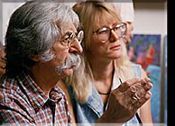
Morgan Weistling Artist:
Morgan studied art at an early age with his father, a former art student. His parents both met at art school. His father, Howard, a POW in Germany, entertained his fellow American prisoners in Stalag 1 with a daily comic strip that he created and drew to keep morale up. Drawn on scraps of paper found on the prison grounds, he crafted a humorous world of characters that managed to bring a smile to imprisoned soldiers. In the last days of the war and feeling the Russians would be coming, his talents with painting saved his life. Using some paints supplied by the Geneva Convention, he painted a American Flag on the shoulder of his prisoner uniform so that the Russians invading Germany would identify him and not shoot him. It worked.
Weistling's father came back from the war with dreams of being an artist. With the G.I. Bill, he took classes at Woodbury Art College in Los Angeles where he met Morgan's mom. After marrying and starting a family, Morgan's father had to abandon his artistic dreams and support his new family by becoming a gardener. But, he saved all his art books.....
Morgan, much younger than his brother and sister, began his artistic training as early as 19 months old. His father would sit with him on his lap at night and teach him how to draw and use his imagination. " My dad and I bonded together with drawing and spoke to each other with pictures". Weistling's father had a real talent for telling a story in comic strip form and so it began in Morgan, a natural sense of the narrative."It was here that art became a language for me".
That led to his studying the art books his father had acquired years earlier. Authors such as Andrew Loomis, Vanderpole, and Bridgeman. The most important books, though, were the volume set from the Famous Artist School.
At the age of 12, Weistling was determined to go through the entire course on his own since the school was no longer in existence. By the age of 15, his study of anatomy, drawing, and painting needed a mentor's direction.
That direction came through a retired illustrator named Fred Fixler. Fred's school, then called the Brandes Art Institute, was dedicated to one thing: learning how to draw from life. "The minute I saw his life drawings I knew this was the guy to study with, there was no doubt," says Morgan. Working part-time as a janitor for the school to pay his tuition, Weistling studied there for 3 years.
While still a student and working at an art store, one day a prominent illustrator came in for supplies. Weistling showed him his student work. The next day he found himself employed at one of the top movie poster agencies in Hollywood. "At that time, all I wanted to be was an illustrator," Weistling says, "but that was amazingly fast." For the next 14 years he illustrated for every movie studio in Hollywood as well as many other fields of illustration.
After being art-directed for years, Morgan needed to paint something for himself. He took time out to produce a painting of two children and brought it to Scottsdale Arizona on the advice of long time friend, Julio Pro .
The first gallery he walked into signed him on the spot, Trailside Galleries. Co-owner Maryvonne Leshe was quick to spot new talent. She was soon proven right. "He would send his paintings to us un-framed and before we could get them hung, they would be sold," quips Maryvonne. Soon a "draw" system for Weistling's paintings became necessary. His first one-man show had 26 paintings and all were sold opening night. Since then, Morgan has had five more one-man shows and they sold -out opening night as well.
Also interested in depicting his Christian faith, Morgan has portrayed the life of Christ in many of his paintings. Those images can be found in the best selling book, The Image of Christ, with paintings and text by Morgan.
Morgan and his wife, JoAnn, have been married since 1990 and also met in art school. JoAnn is represented by Trailside Galleries and paints under the name "J. Peralta" in honor of her grandmother. She also exhibits in the Master's show at the Autry Museum. They have two daughters, Brittany and Sienna. Both girls model for paintings frequently. Brittany's work can seen on the main page of this site.

Slide 24
Those Who Will Live in the Celestial Kingdom
And again we bear record—for we saw and heard, and this is the testimony of the gospel of Christ concerning them who shall come forth in the resurrection of the just— D&C 76:50
D&C 76:51 | Those who received a testimony of Jesus | D&C 76:58 | They are Gods, even the Sons of Gods
D&C 76:51 | Those who are baptized by water in His name | D&C 76:59-60 | All things are theirs in life and death and overcome all things
D&C 76:52 | Those who keep the commandments | D&C 76:62 | They will dwell in the presence of God and His Son forever
D&C 76:52 | Those who are washed clean through repentance | D&C 76:63 | They will come with Jesus Christ when He will reign upon the earth
D&C 76:52 | Those who receive the Holy Ghost by proper authority--ordained | D&C 76:64-65 | They will have a part in the first resurrection and of the just
D&C 76:53 | Those who are just and true | D&C 76:66-67 | They will come to Mount Zion and be accompanied by angels
D&C 76:54 | They are they who are the church of the Firstborn. | D&C 76:68 | There names will be written in Heaven
D&C 76:55 | Those who have been given all things by Heavenly Father | D&C 76:69 | They are just men who are made perfect through Jesus Christ, the mediator
D&C 76:56 | Those who are priests and kings who have received His fullness and glory | D&C 76:70 | Their bodies are celestial, the highest of all, whose glory is the sun
D&C 76:57 | Those who are priests after the order of Melchizedek, Enoch, and the Son of God

Slide 25


There is a law, irrevocably decreed in heaven before the foundations of this world, upon which all blessings are predicated—
And when we obtain any blessing from God, it is by obedience to that law upon which it is predicated.
D&C 130:20-21

Slide 26

productive
dead
unsuccessful
fruitful
abundant
unproductive
Which of these words would you like to describe your life?
unhappy
worthwhile

Slide 27
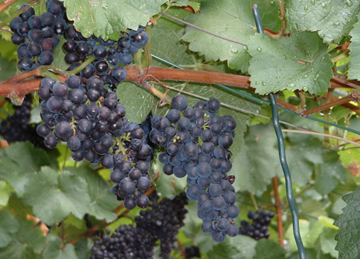
Metaphors
Israel’s prophets commonly used grapevines and vineyards as metaphors
Yet I had planted thee a noble vine, wholly a right seed: how then art thou turned into the degenerate plant of a strange vine unto me?
Jeremiah 2:21
For the vineyard of the Lord of hosts is the house of Israel, and the men of Judah his pleasant plant: and he looked for judgment, but behold oppression; for righteousness, but behold a cry.
Isaiah 5:1
And it came to pass that the master of the vineyard went forth, and he saw that his olive tree began to decay; and he said: I will prune it, and dig about it, and nourish it, that perhaps it may shoot forth young and tender branches, and it perish not.
Jacob 5:4
Israel is an empty vine, he bringeth forth fruit unto himself: according to the multitude of his fruit he hath increased the altars; according to the goodness of his land they have made goodly images.
Hosea 10:1
John 15:4

Slide 28
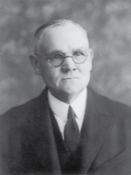
“Those ordained servants of the Lord were as helpless and useless without Him as is a bough severed from the tree.
As the branch is made fruitful only by virtue of the nourishing sap it receives from the rooted trunk, and if cut away or broken off withers, dries, and becomes utterly worthless except as fuel for the burning, so those men, though ordained to the Holy Apostleship, would find themselves strong and fruitful in good works, only as they remained in steadfast communion with the Lord.
Without Christ what were they, but unschooled Galileans, some of them fishermen, one a publican, the rest of undistinguished attainments, and all of them weak mortals?”
(2)

Slide 29


Vines, Branches, and Fruit
What does the vine represent?
What do the branches represent?
If Jesus Christ is the vine and we are the branches, what does the fruit represent?
Jesus Christ
Disciples of Jesus Christ
Righteous Works
John 15:4
(2)

Slide 30

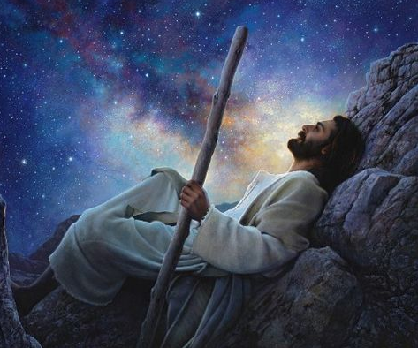
Husbandman
I am the true vine, and my Father is the husbandman.
Someone who cares for a vineyard.
God the Father planted the true vine [Jesus Christ] from which all others would take nourishment.
Greg Olsen
John 15:1

Slide 31
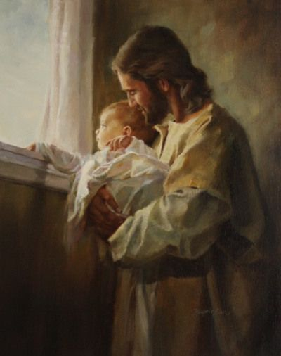
Abide In Me
“The branch cannot bear fruit of itself, except it abide in the vine; no more can ye, except ye abide in me”
“In Spanish that familiar phrase is rendered ‘permaneced en mi.’ Like the English verb ‘abide,’ permanecer means ‘to remain, to stay,’ but even [English speakers] like me can hear the root cognate there of ‘permanence.’
The sense of this then is ‘stay—but stay forever.’
That is the call of the gospel message to [everyone] in the world. Come, but come to remain.
Come with conviction and endurance. Come permanently, for your sake and the sake of all the generations who must follow you. …”
Harry Anderson
John 15:5
(3)

Slide 32
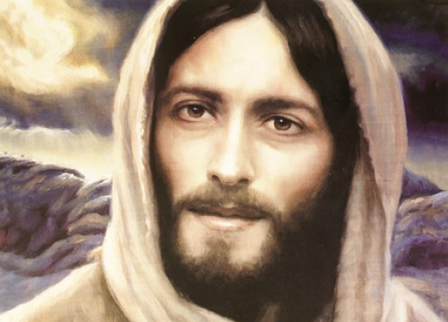
If Ye Love Me…
Keep My Commandments
“It is … through the grace of the Lord that individuals, through faith in the Atonement of Jesus Christ and repentance of their sins, receive strength and assistance to do good works that they otherwise would not be able to maintain if left to their own means.
This grace is an enabling power that allows men and women to lay hold on eternal life and exaltation after they have expended their own best efforts.”
Keeping Their commandments allows us to receive a fulness of the blessings They lovingly desire to give us
John 15:9-11
(3)

Slide 33
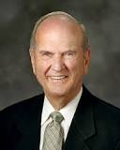
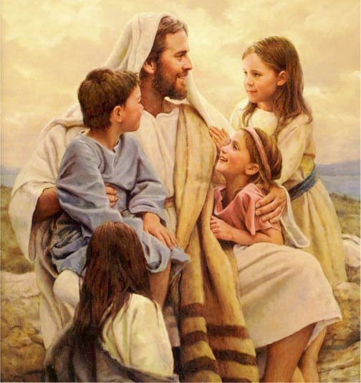
Love One Another
“Surely the best evidence of our adoration of Jesus is our emulation of Him”
Adoration =
great love and respect
Emulation =
to imitate or copy.
This is my commandment, That ye love one another, as I have loved you.
John 15:12
(5)

Slide 34
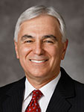
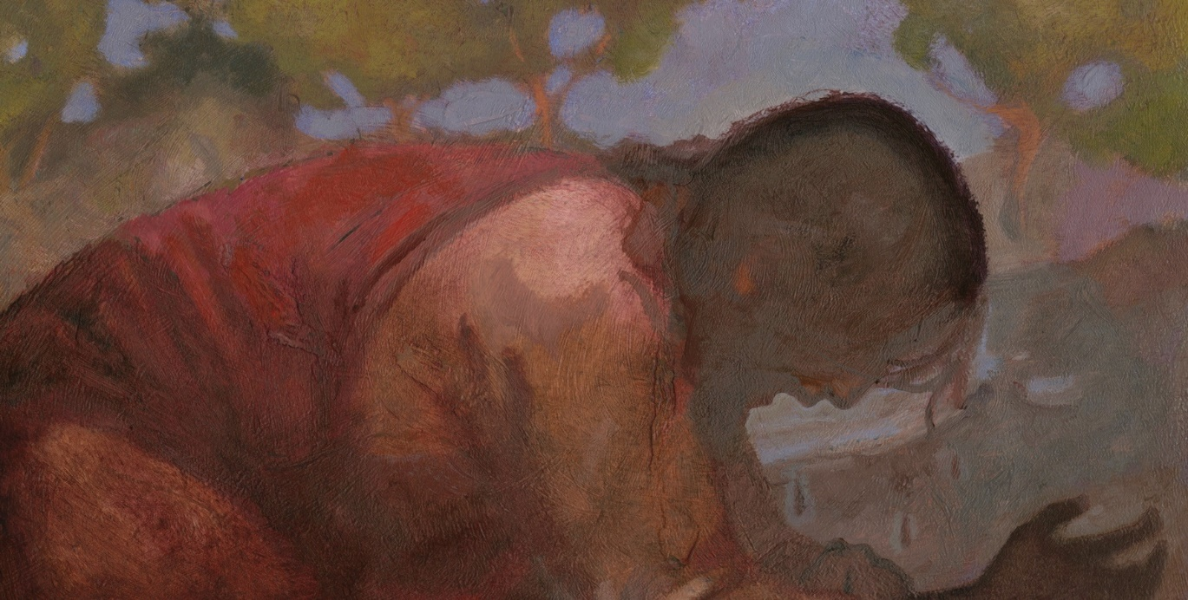
“[Jesus Christ] gave us the supreme example of love when He declared, ‘Greater love hath no man than this, that a man lay down his life for his friends’.
He later atoned for all our sins and finally gave His life for all of us.
“We can lay down our lives for those we love not by physically dying for them but rather by living for them—giving of our time; always being present in their lives; serving them; being courteous, affectionate, and showing true love for those of our family and to all men—as the Savior taught”
J. Kirk Richards
(6)
John 15:13

Slide 35

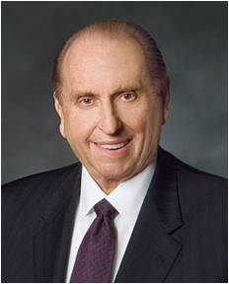
Do We Have to Die to Defend Our Faith?
For I am not ashamed of the gospel of Christ: for it is the power of God unto salvation to every one that believeth; to the Jew first, and also to the Greek.
Romans 1:16
One of the things we agree to do as part of the baptismal covenant is “to stand as witnesses of God at all times and in all things, and in all places that [we] may be in” (Mosiah 18:9).
In the April 2014 general conference, several speakers reminded us that there will be times when standing as a witness of God will mean having to face opposition, criticism, and ridicule.
So what should you do when you’re required to take the uncomfortable, uncool, or unpopular step of defending your beliefs?
“We will all face fear, experience ridicule, and meet opposition.
Let us—all of us—have the courage to defy the consensus, the courage to stand for principle. Courage, not compromise, brings the smile of God’s approval.” (8)
John 15:13
(7)

Slide 36
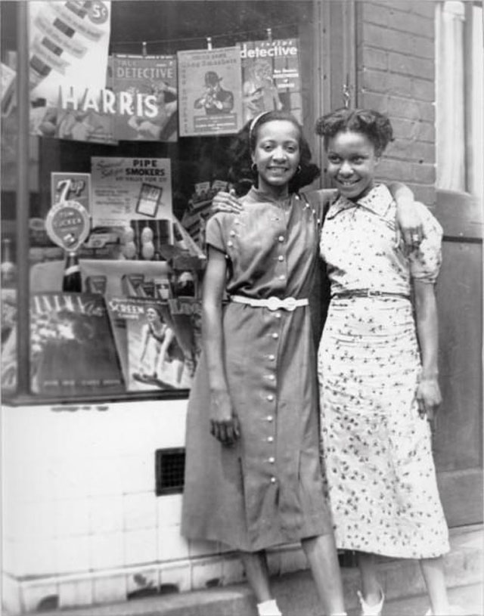
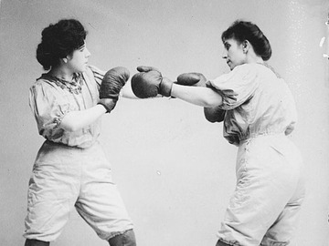
Our Beliefs Are Tested
The World = those who oppose the message of Jesus Christ
“One of mortality’s great tests comes when our beliefs are questioned or criticized. In such moments, we may want to respond aggressively—to ‘put up our dukes.’
But these are important opportunities to step back, pray, and follow the Savior’s example.
Remember that Jesus Himself was despised and rejected by the world. …
When we respond to our accusers as the Savior did, we not only become more Christlike, we invite others to feel His love and follow Him as well.
John 15:15-18
(5)

Slide 37

Opposition
When the winds of adversity come, remember one thing ---
Kites fly the very highest against the wind.
Kites don’t fly in spite of Opposition, kites fly high because of opposition. In fact, they couldn't fly without opposition.
John Bytheway
John 15:15-18
(5)

Slide 38
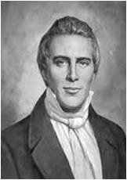
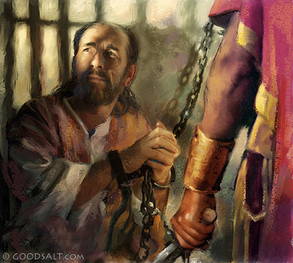
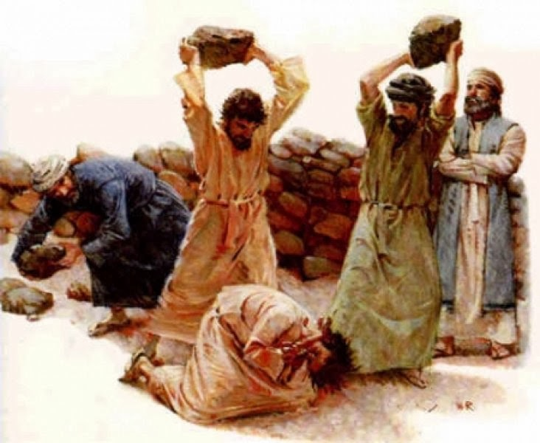
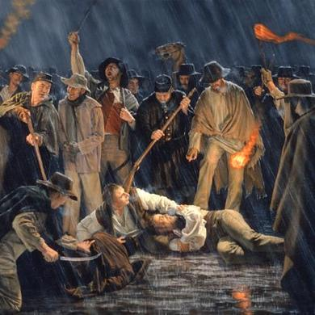
The Disciples Will Testify of Him
"The trials [the Saints] have had to pass through shall work together for their good and prepare them for the society of those who have come up out of great tribulation, washed their robes, and made them white in the blood of the Lamb.
Marvel not then if you are persecuted, but remember the words of the Savior, 'The servant is not above his Lord; if they have persecuted me, they will persecute you also,' and that all the afflictions through which the Saints have to pass are in fulfillment of the words of the prophets which have spoken since the world began. . . .
Afflictions, persecutions, imprisonments, and deaths we must expect according to the scriptures.”
John 15:21-25
(9)

Slide 39
Sources:
New Testament Institute Student Manual Chapter 26
Elder James E. Talmage (Jesus the Christ, 3rd ed. [1916], 604–5).
Elder Jeffrey R. Holland “Abide in Me,” Ensign or Liahona, May 2004, 32
Bible Dictionary, “Grace”.
President Russell M. Nelson “The Mission and Ministry of Jesus Christ,” Ensign, Apr. 2013, 38.)
Elder Claudio R. M. Costa(“Don’t Leave for Tomorrow What You Can Do Today,” Ensign or Liahona, Nov. 2007, 74).
Faith Youth Article Magazine The Do’s and Don’ts of Defending Your Faith by David A. Edwards
President Thomas S. Monson “Be Strong and of a Good Courage,” Ensign or Liahona, May 2014, 69).
(Kent P. Jackson, comp. and ed., Joseph Smith's Commentary on the Bible [Salt Lake City: Deseret Book Co., 1994], 139.)
Presentation by ©http://fashionsbylynda.com/blog/

Slide 40
Event | Matthew | Mark | Luke | John
Jesus is the True Vine |  |  |  | 15:1-11
Love One Another |  |  |  | 15:12-17
The World Will Hate the Apostle |  |  |  | 15:18; 16:3
Branches and Vines John 15:2
"How many of us belong to that branch which beareth good fruit? How many of us are in danger of being cut off because of our inactivity, because of our failure to take advantage of every opportunity that comes to us for service in this great work?
"May we be numbered among the branches that bear fruit; may God purge us that we may bring forth more fruit; may we always abide in him and may his words abide in us, that we may eventually be glorified with that glory which he has promised to those who are faithful in all things. May God help us to see the way; may we be guided by his Spirit that we may go forward and accomplish that which is required of us, doing it in faith and humility." Elder David A. Smith (Conference Report, April 1926, Third Day-Morning Session 130.)
Keep Commandments, Abide in His love John 15:10
“God’s love is so perfect that He lovingly requires us to obey His commandments because He knows that only through obedience to His laws can we become perfect, as He is. …
“God’s choicest blessings are clearly contingent upon obedience to God’s laws and commandments. The key teaching is from modern revelation:
“‘There is a law, irrevocably decreed in heaven before the foundations of this world, upon which all blessings are predicated—
“‘And when we obtain any blessing from God, it is by obedience to that law upon which it is predicated’ (D&C 130:20–21). …
“If a person understands the teachings of Jesus, he or she cannot reasonably conclude that our loving Heavenly Father or His divine Son believes that Their love supersedes Their commandments” Elder Dallin H. Oaks (“Love and Law,” Ensign or Liahona, Nov. 2009, 27–28).
Abide in Him John 15:5
To abide in Christ is to trust in him, rely on him, be patient with him and his plan for us, yield ourselves to his mercies, surrender to him, and thereby draw upon his life and his strength.
"Though the vine and the branch are related, they are not the same. The uniting factor is the sap that flows through the branches. That is like the Holy Spirit in our lives: we appropriate Christ's strength through the power of the Holy Ghost. When that Spirit dwells in us, we begin to bear the 'fruit of the Spirit.' Paul contrasts the 'works of the flesh'-such things as adultery, fornication, idolatry, witchcraft, hatred, strife, and so forth, which are behaviors and attitudes characterizing the natural man-with the fruit of the Spirit, the works and dispositions that characterize the man or woman who has been born again. 'But the fruit of the Spirit is love, joy, peace, longsuffering, gentleness, goodness, faith, meekness, temperance. . . . And they that are Christ's have crucified the flesh with the affections and lusts.' Paul then offers this wonderful plea to the household of faith: 'If we live in the Spirit, let us also walk in the Spirit' (Galatians 5:19-25).
"In other words, if we claim membership in the Church of Jesus Christ, let us act like it. If we profess discipleship, people ought to be able to see that discipleship without difficulty. The fruit of the Spirit is the characteristics and attributes that flow from a changed heart-the ways that truly Christlike people feel and act." (Robert L. Millet, Alive in Christ: The Miracle of Spiritual Rebirth [Salt Lake City: Deseret Book Co., 1997], 59)
Love One Another John 15:12
"How critical it is that all who serve together in God's kingdom do so from a foundation of love: love for the Lord, love for the work, and love for each other. No matter how intense our effort or how carefully we follow the handbooks and guidelines, if we don't truly love each other we can't possibly hope to convey the full power of the gospel of love. And I can't help but believe that members are more likely to seek counsel from leaders from whom they feel sincere love emanating. Miracles seem to follow after Church leaders who are motivated by a keen feeling of loving devotion to those over whom they preside." M. Russell Ballard (Counseling with Our Councils: Learning to Minister Together in the Church and in the Family [Salt Lake City: Deseret Book Co., 1997], 35.)

Slide 41
Die for your faith John 15:13:
"Some men are willing to die for their faith but will not fully live for it. Christ both lived and died for us. . . .
"That man is greatest and most blessed and joyful whose life most closely fits the pattern of the Christ. This has nothing to do with earthly wealth, power, or prestige. The only true test of greatness, blessedness, joyfulness is how close a life can come to being like the Master, Jesus Christ." Ezra Taft Benson (I Know That My Redeemer Lives: Latter-day Prophets Testify of the Savior [Salt Lake City: Deseret Book Co., 1990], 216.)
The Price of Discipleship John 15:18-21:
“One of mortality’s great tests comes when our beliefs are questioned or criticized. In such moments, we may want to respond aggressively—to ‘put up our dukes.’ But these are important opportunities to step back, pray, and follow the Savior’s example. Remember that Jesus Himself was despised and rejected by the world. … When we respond to our accusers as the Savior did, we not only become more Christlike, we invite others to feel His love and follow Him as well.
“To respond in a Christlike way cannot be scripted or based on a formula. The Savior responded differently in every situation. When He was confronted by wicked King Herod, He remained silent. When He stood before Pilate, He bore a simple and powerful testimony of His divinity and purpose. Facing the moneychangers who were defiling the temple, He exercised His divine responsibility to preserve and protect that which was sacred. Lifted up upon a cross, He uttered the incomparable Christian response: ‘Father, forgive them; for they know not what they do’ (Luke 23:34). …
“The Prophet Joseph Smith demonstrated [Christian] courage throughout his life. … He did not retaliate or give in to hatred. Like all true disciples of Christ, he stood with the Savior by loving others in a tolerant and compassionate way. That is Christian courage.
“When we do not retaliate—when we turn the other cheek and resist feelings of anger—we too stand with the Savior. We show forth His love, which is the only power that can subdue the adversary and answer our accusers without accusing them in return. That is not weakness. That is Christian courage” Elder Robert D. Hales (“Christian Courage: The Price of Discipleship,” Ensign or Liahona, Nov. 2008, 72).

Slide 42

Joy VS Sorrow
John 16
"For the faithful, there is short-term tribulation but long-term joy."
–Neal A. Maxwell

Slide 43

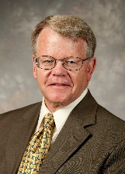
One By One
"One by one the Apostles chosen by Christ were killed, as he had predicted.
James, the brother of John, was the first member of the Quorum of the Twelve that we know of to be executed, sometime around A.D. 44.
Others followed. James the Just, the brother of the Lord, may have been martyred in A.D. 62.
And then during the Neronian persecutions of Christianity in Rome (A.D. 64-67), 'the Church suffered the greatest loss it had yet sustained in the death of the apostles Peter and Paul.'
Thus, as scholars point out, no tradition about the early Church is more firmly held than that 'all the Apostles except John were martyrs.' The Apostolic Age came to an end, and the keys of the kingdom were gone."
John 16:1-4: Acts 12:1-2
(2)

Slide 44

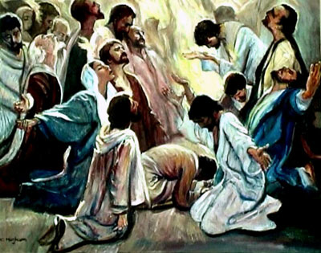
The Gift of the Holy Ghost
During Christ's ministry the gift of the Holy Ghost was not given to the disciples.
The influence of the Holy Ghost was operative during his ministry but there was no need for the disciples to have two members of the Godhead testifying to them at the same time.
There was no need for this sort of divine redundancy.
Therefore, in order for them to benefit from the constant companionship of the Holy Ghost, they had to first lose the privilege of the constant companionship of Jesus. The Holy Ghost was poured out upon them, as promised, on the day of Pentecost.
John 16:7; Acts 2
(3)

Slide 45

To Be Alone
“The Holy Ghost did not operate in the fulness among the Jews during the years of Jesus’ mortal sojourn.” (4)
Whom did Jesus promise would come after He departed?
Jesus would send the Comforter, or the Holy Ghost
John 16:7
John 16:7; Acts 2
(3)

Slide 46
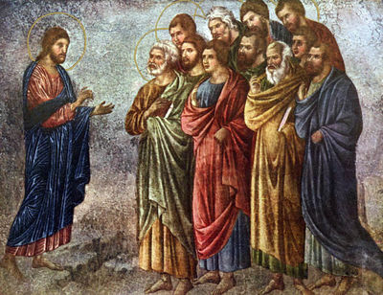
“As long as Jesus was with the disciples in person, there was not the full need for them to have the constant companionship of the Spirit that there would be after Jesus left.”
John 16:7
(5)

Slide 47


The Role of the Holy Ghost
To reprove the world of sin = often kindly intent to correct a fault
“’And he shall remind the world of sin, and of righteousness, and of judgment.‘
This comforter reminds of these things through the servants of the Lord.”
The Holy Ghost will guide you in Spirit to know the truth
John 16:8-11
John 16:7; Acts 2
(6)

Slide 48

Mission of the Holy Ghost
The mission, then, of the Holy Ghost is to remind the world of sin-one of the greatest of which is unbelief in Jesus Christ.
The Holy Ghost is to remind the world of the righteousness of Jesus Christ who was indeed the Son of God as evidenced by his return to his Father.
And the Holy Ghost is to remind the world of a final judgment, 'to teach them of a judgment which is to come' (DC 84:87) upon the prince of this world (Satan) and all of his followers. (3)
The Holy Ghost guides the Savior’s true Church in every dispensation and also guides individuals in their efforts to find truth and live their lives in accordance with God’s will.
Behold, I send you out to reprove the world of all their unrighteous deeds, and to teach them of a judgment which is to come. D&C 84:87
John 16:8-11
John 16:7; Acts 2
(1)

Slide 49
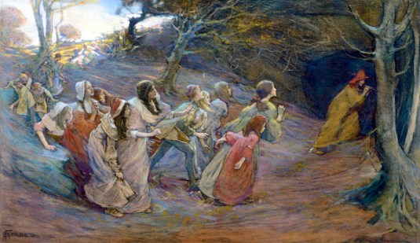
The Pied Piper VS The Holy Ghost
“We are surrounded—even at times bombarded—by the messages of the adversary. … Lucifer, that clever pied piper, plays his lilting melody and attracts the unsuspecting away from the safety of their chosen pathway … .
He seeks not just the so-called refuse of humanity; he seeks all of us, including the very elect of God. … Lucifer’s methods are cunning; his victims, numerous. …
I plead with you to make a determination right here, right now, not to deviate from the path which will lead to our goal: eternal life with our Father in Heaven. …
No temptation, no pressure, no enticing can overcome us unless we allow such.”
John 16:8-11
John 16:7; Acts 2
(7)

Slide 50
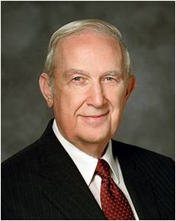
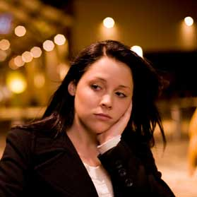

To Bear Witness
The Holy Ghost, whose role is to bear witness of the Father and the Son, will
“not speak of himself; but whatsoever he shall hear, that shall he speak.”
“Father in Heaven knew that you would face challenges and be required to make some decisions that would be beyond your own ability to decide correctly.
In His plan of happiness, He included a provision for you to receive help with such challenges and decisions during your mortal life.
That assistance will come to you through the Holy Ghost as spiritual guidance.”
The Holy Ghost reveals truths and instruction that come from Heavenly Father and Jesus Christ
John 16:13
John 16:7; Acts 2
(8)

Slide 51
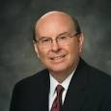
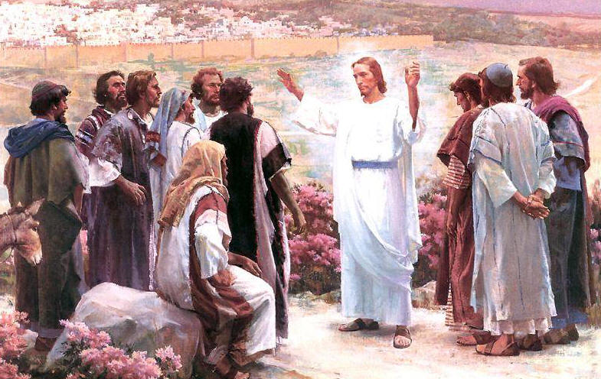
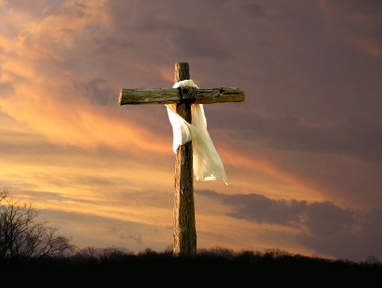
The Source of Joy
“The source of the kind of joy which causes us to rejoice is an understanding of the plan of salvation.
The Savior in the Gospel of John was approaching the closing hours of His mortal life when He would take upon Himself the sins of the world.
As He prepared His disciples for what He knew was to come, He told them, ‘A little while, and ye shall not see me: and again, a little while, and ye shall see me’.
“They were not yet ready to comprehend the Resurrection.
Instead the Savior explained in gentle terms that He would leave and return and told them what they would feel: sorrow at His leaving, ‘but I will see you again, and your heart shall rejoice, and your joy no man taketh from you’”.
John 16:16, 22
(9)

Slide 52


“Just as the Savior’s death brought sorrow, the vicissitudes of life, like death, disease, poverty, and injury, can and often will bring unhappiness.
Separation from those we love invariably brings sorrow and mourning. Life is not easy, and it would be improper to diminish in any way the trials and tribulations that most experience.
“That having been said, the Resurrection and Atonement wrought by the Savior and the promise of eternal life with our loved ones are of such overwhelming significance that to not rejoice would demonstrate a lack of understanding of the Savior’s gift.”
“Joy comes when we have the Spirit in our lives”
John 16:16, 22
(9)

Slide 53


Be of Good Cheer
Jesus taught His disciples to pray directly to Heavenly Father in His (Christ’s) name and assured them of the Father’s love for them and Him.
Can we have happiness amidst sorrow?
“As part of our mortal probation, we pass through affliction, pain, and disappointment. Only in Jesus Christ can we find peace. He can help us to be of good cheer and to overcome all the challenges of this life.
It means having hope, not getting discouraged, not losing faith, and living life joyfully. ‘Men are, that they might have joy’ [2 Nephi 2:25]. It means facing life with confidence.
“The gospel of Jesus Christ gives us the strength and the eternal perspective to face what is coming with good cheer.”
John 16:33
(10)

Slide 54





"Peace can come to an individual only by an unconditional surrender to him who is the Prince of peace and who has the power to confer peace.
"One may live in beautiful and peaceful surroundings, yet, because of inner dissension and discord, be in a state of constant turmoil.
On the other hand, one may be in the midst of utter destruction and the bloodshed of war, yet have the serenity of unspeakable peace.
If we look to the ways of the world, we will find turmoil and confusion.
If we will but turn to God, we will find peace for the restless soul.
'Peace I leave with you, my peace I give unto you: not as the world giveth.' (John 14:27.)
John 16:33
(11)

Slide 55


Finding Peace
"We can find such peace in a world of conflict if we will but accept his great gift and his further invitation:
'Come unto me, all ye that labour and are heavy laden, and I will give you rest. Take my yoke upon you, and learn of me; for I am meek and lowly in heart: and ye shall find rest unto your souls.' (Matt. 11:28-29.)
"This peace shelters us from the worldly turmoil. The knowledge that God lives, that we are his children, and that he loves us soothes the troubled heart. The answer to the quest lies in faith in God and in his Son, Jesus Christ. This will bring peace to us now and in the eternity to follow."
John 16:33
(10)

Slide 56
Sources:
New Testament Institute Student Manual Chapter 26
Andrew C. Skinner, "Apostasy, Restoration, and Lessons in Faith," Ensign, Dec. 1995, 29
Gospeldoctrine.com
Bible Dictionary
Elder Bruce R. McConkie (Doctrinal New Testament Commentary, 3 vols. [1965–73], 753).
Kent P. Jackson, Joseph Smith's Commentary on the Bible, p. 139, italics added
President Thomas S. Monson, “The Three Rs of Choice,” Ensign, Nov. 2010, 67–69.
Elder Richard G. Scott (“To Acquire Spiritual Guidance,” Ensign or Liahona, Nov. 2009, 6).
Elder Quentin L. Cook (“Rejoice!” Ensign, Nov. 1996, 28).
Elder Adhemar Damiani (“Be of Good Cheer and Faithful in Adversity,” Ensign or Liahona, May 2005, 94).
President Howard W. Hunter (That We Might Have Joy [Salt Lake City: Deseret Book Co., 1994], 30.)
Picture of Jesus in frame 13 by Jared Barnes
Neal A. Maxwell quote (Frame 1): (Even As I Am [Salt Lake City: Deseret Book Co., 1982], 91.)

Slide 57
Event | Matthew | Mark | Luke | John
Jesus Further Explains His Death |  |  |  | 16:4-33
Receiving the Gift of the Holy Ghost John 16:7:
"...in the New Testament, the full powers and gifts of the Holy Ghost were not given in the Old World meridian Church until the day of Pentecost...While the Bridegroom was present with his disciples in the flesh, he was their Comforter, their Revelator, their Testator. He was their Life and Light, their source of power and might. 'Hence, as long as Jesus was with the disciples in person, there was not the full need for them to have the constant companionship of the Spirit that there would be after Jesus left.' But because of the vital role that Spirit would play thereafter in the growth, development, and expansion of the early Christian Church, Jesus said: 'It is expedient for you that I go away: for if I go not away, the Comforter will not come unto you; but if I depart, I will send him unto you' (John 16:7)." (Selected Writings of Robert L. Millet: Gospel Scholars Series [Salt Lake City: Deseret Book Co., 2000], 194.)
Peace Comes by Obedience John 16:33:
"Peace does not come to the transgressor of law, Peace comes by obedience to law, and it is that message which Jesus would have us establish among men-peace to the individual that he may be at peace with his God; perfect harmony existing between his Creator and himself, perfect harmony existing between himself and law, the righteous laws to which he is subject and from which he never can escape peace in the home, families living at peace with each other and with their neighbors." (Conference Report, October 1965, First Day-Morning Meeting 10.)
The Future is Bright: John 16:33:
“I testify to you that our promised blessings are beyond measure. Though the storm clouds may gather, though the rains may pour down upon us, our knowledge of the gospel and our love of our Heavenly Father and of our Savior will comfort and sustain us and bring joy to our hearts as we walk uprightly and keep the commandments. There will be nothing in this world that can defeat us.
“My beloved brothers and sisters, fear not. Be of good cheer. The future is as bright as your faith” President Thomas S. Monson (“Be of Good Cheer,” Ensign or Liahona, May 2009, 91–92).
The Holy Ghost As Our Guide John 16:12-13:
“How do we take the Holy Spirit for our guide? We must repent of our sins each week and renew our covenants by partaking of the sacrament with clean hands and a pure heart, as we are commanded to do (see D&C 59:8–9, 12). Only in this way can we have the divine promise that we will ‘always have his Spirit to be with [us]’ (D&C 20:77). That Spirit is the Holy Ghost, whose mission is to teach us, to lead us to truth, and to testify of the Father and the Son (see John 14:26; John 15:26; John 16:13; 3 Nephi 11:32, 36)” Elder Dallin H. Oaks (“Be Not Deceived,” Ensign or Liahona, Nov. 2004, 46).
Be of Good Cheer John 16:33:
“Your level of spirituality is also directly related to how well you fill the Lord’s commandments to ‘Be of good cheer’ and ‘Lift up your heart and rejoice’ (D&C 31:3). How many times in the scriptures did the Lord command us to be of good cheer? He didn’t say, ‘Be of good cheer if everything is going well, if you have enough money to pay all your bills, if [you are feeling well],’ or whatever. No. For us to be of good cheer is a commandment and not merely a suggestion” Elder Joe J. Christensen (“Ten Ideas to Increase Your Spirituality,” Ensign, Mar. 1999, 59).

Slide 58
The Pied Piper:
The town of Hamlyn was once full of rats. They ate all the food, troubled sleeping babies, and made a lot of noise. The people had grown tired of the rats but were unable to do anything. Even the cats were not able to kill the rats.
One day, a queer fellow with piercing eyes, came to town. He was called the Pied Piper. He went to the Mayor and asked him, “What will you pay me if I free your town of every single rat?” The mayor offered fifty pounds to the Pied Piper.
Happy with the offer, the Pied Piper started playing his pipe. Hearing the shrill, keen note, every rat came out from its hole and started following him. The Pied Piper kept on playing his pipe and the rats followed hirn. The piper walked up to the harbour with millions of rats behind him and led them into the water and waited till every rat had drowned.
Now the town was free of the little devils and the people were very happy.
After all the rats were dead, the Pied Piper returned and asked the Mayor for his money. The Mayor said that he could only give him twenty pounds for such an easy job. Now that the rats were dead, the Mayor thought that there was nothing to worry about. But the Pied Piper wanted to teach him a lesson. This time he played a different tune. Hearing his music, the children came out of their houses. They started following the piper, dancing and shouting. The elders watched in disbelief as the Pied Piper led the children far, far away. The Mayor sent his men to look for the piper and bring the children back but none could find the lost children.
http://shortstoriesshort.com/story/the-pied-piper/

Slide 59

The Intercessory Prayer
John 17
This is eternal lives—to know the only wise and true God, and Jesus Christ, whom he hath sent. I am he. Receive ye, therefore, my law.
D&C 132:24

Slide 60





What is the difference between knowing about someone and actually knowing that person?
What does it take to really know someone?
Who are some individuals whom you feel would be important for you to get to know better?

Slide 61


Intercede
“[The Intercessory Prayer is] so named because the Lord prayerfully interceded with His Father for the benefit of His disciples.
Jesus Christ spoke to Heavenly Father in behalf of His disciples, pleading that they might receive eternal life.
To speak to someone in behalf of another person.
‘These words spake Jesus, and lifted up his eyes to heaven, and said, Father, … glorify thy Son, that thy Son also may glorify thee. …
“‘I have finished the work which thou gavest me to do. …
“From this prayer of the Lord we learn how keenly He feels His responsibility as our Mediator and Advocate with the Father.”
John 17:1-3
(2)

Slide 62





Receiving Eternal Life
“It is one thing to know about God and another to know him. We know about him when we learn that he is a personal being in whose image man is created; when we learn that the Son is in the express image of his Father’s person; when we learn that both the Father and the Son possess certain specified attributes and powers…
…To know God is to think what he thinks, to feel what he feels, to have the power he possesses, to comprehend the truths he understands, and to do what he does.
Those who know God become like him, and have his kind of life, which is eternal life.”
John 17:1-3
(3)

Slide 63


Receiving Eternal Life
No Christ, No Peace
Know Christ,
Know Peace
Hubble Picture-Pillars of Creation
“We are created as much from the dust of eternity as we are from the dust of the earth.
To believe in God is to know that all the rules will be fair and that there will be wonderful surprises.
You have the Savior of the world on your side if you seek his help and follow his direction.”
John 17:1-3

Slide 64
Doctrinal Mastery
John 17:3
And this is life eternal, that they might know thee the only true God, and Jesus Christ, whom thou hast sent.

Slide 65

The Completion of His Mission
“Jesus ‘was like unto God’ before the world was; he had glory and dominion then; and he then became, under the direction of the Father, the Creator of this earth and of worlds without number.
And there stood one among them that was like unto God, and he said unto those who were with him: We will go down, for there is space there, and we will take of these materials, and we will make an earth whereon these may dwell; Abraham 3:24
“Jesus is certifying to the Father that the Son has done the appointed work, and asks that as a consequence he be given again the state of dignity and honor he once held.”
John 17:4-8
(3)

Slide 66

Purify
Father, I thank thee that thou hast purified those whom I have chosen, because of their faith, and I pray for them, and also for them who shall believe on their words, that they may be purified in me, through faith on their words, even as they are purified in me.
3 Nephi 29:28
Father, behold the sufferings and death of him who did no sin, in whom thou wast well pleased; behold the blood of thy Son which was shed, the blood of him whom thou gavest that thyself might be glorified;
Wherefore, Father, spare these my brethren that believe on my name, that they may come unto me and have everlasting life.
D&C 45:4-5
If we remain faithful, there will come a day when we will hear him intercede on our behalf as well. The Mediator and Advocate with the Father will plead our cause…
When we hear these words said on our behalf we will feel as the apostles did and will be filled with joy indescribable.
John 17:9-10
(4)

Slide 67


Who is a Son of Perdition?
The Greek word from which “perdition” is translated (apōleia) = a condition of being lost or destroyed.
Elsewhere in the New Testament, apōleia is translated as “destruction” (1)
Sons of perdition are those who receive “no forgiveness in this world nor in the world to come—having denied the Holy Spirit after having received it, and having denied the Only Begotten Son of the Father, having crucified him unto themselves and put him to an open shame.” (10)
“We know the divine plan required Jesus to be crucified, but it is wrenching to think that one of His special witnesses who sat at His feet, heard Him pray, watched Him heal, and felt His touch could betray Him and all that He was for 30 pieces of silver.
We are not the ones to judge Judas’s fate, but Jesus said of His betrayer, ‘Good [were it] for that man if he had not been born.”
*See Commentary by Joseph F. Smith
John 17:12
(6)

Slide 68


In the World—Not Of the World
First, ‘Be in the world.’ Be involved; be informed. Try to be understanding and tolerant and to appreciate diversity. Make meaningful contributions to society through service and involvement.
Second, ‘Be not of the world.’ Do not follow wrong paths or bend to accommodate or accept what is not right. …
“Members of the Church need to influence more than we are influenced. We should work to stem the tide of sin and evil instead of passively being swept along by it. We each need to help solve the problem rather than avoid or ignore it.”
John 17:14-16
(5)

Slide 69


Being One—In Purpose
“The literal meaning of the English word Atonement is self-evident: at-one-ment, the bringing together of things that have been separated or estranged.” (6)
As we come unto Jesus Christ and receive the blessings of His Atonement, we can become one with the Father and the Son
“We should earnestly seek not just to know about the Master, but to strive, as He invited, to be one with Him …
“… The days ahead will be filled with affliction and difficulty. But with the assuring comfort of a personal relationship with God, we will be given a
calming courage.” (7)
John 17:20-23

Slide 70


Behold, this I have given unto you … I say unto you, be one; and if ye are not one ye are not mine.
D&C 38:27
If we are not united, we are not His. Here unity is the test of divine ownership as thus expressed.
If we would be united in love and fellowship and harmony, this church would convert the world, who would see in us the shining example of these qualities which evidence that divine ownership."
John 17:20-23
(8)

Slide 71
The Father and The Son
“They are distinct beings, but they are one in purpose and effort. They are united as one in bringing to pass the grand, divine plan for the salvation and exaltation of the children of God. …
“It is that perfect unity between the Father, the Son, and the Holy Ghost that binds these three into the oneness of the divine Godhead.”
John 17:20-23
(9)

Slide 72



The Love of God
“When filled with God’s love, we can do and see and understand things that we could not otherwise do or see or understand. Filled with His love, we can endure pain, quell fear, forgive freely, avoid contention, renew strength, and bless and help others in ways surprising even to us.
“Jesus Christ was filled with unfathomable love as He endured incomprehensible pain, cruelty, and injustice for us.
Through His love for us, He rose above otherwise insurmountable barriers. His love knows no barriers. He invites us to follow Him and partake of His unlimited love so we too may rise above the pain and cruelty and injustice of this world and help and forgive and bless.”
Chad Winks
John 17:26
(11)

Slide 73
Sources:
New Testament Institute Student Manual Chapter 27
Elder Russell M. Nelson (“Lessons from the Lord’s Prayers,” Ensign or Liahona, May 2009, 47).
Elder Bruce R. McConkie (Doctrinal New Testament Commentary, 3 vols. [1965–73], 1:762). (Doctrinal New Testament Commentary, 1:762).
Gospeldoctrine.com
Elder M. Russell Ballard “The Effects of Television,” Ensign, May 1989, 80.
Elder Jeffrey R. Holland (“The Atonement of Jesus Christ,” Ensign, Mar. 2008, 34–35). (“None Were with Him,” Ensign or Liahona, May 2009, 86).
President James E. Faust (“That We Might Know Thee,” Ensign, Jan. 1999, 2, 5).
President Harold B. Lee (The Teachings of Harold B. Lee, edited by Clyde J. Williams [Salt Lake City: Bookcraft, 1996], 388.)
President Gordon B. Hinckley (“The Father, Son, and Holy Ghost,” Ensign, Nov. 1986, 51).
Gospel Topics: Sons of Perdition
Elder John H. Groberg (“The Power of God’s Love,” Ensign or Liahona, Nov. 2004, 11).
Presentation by ©http://fashionsbylynda.com/blog/

Slide 74

Event | Matthew | Mark | Luke | John
Jesus Prays For His Disciples |  |  |  | 17:1-26
Knowing God John 17:1-3:
Knowing God means more than believing that He exists or having an intellectual understanding about Him; it means becoming acquainted with Him through personal experience and living His teachings. (1)
One in Purpose John 17:20-23:
How glorious it is to contemplate that we have been invited into that perfect unity that exists with the Father and the Son. How can this happen? …
“Jesus achieved perfect unity with the Father by submitting Himself, both flesh and spirit, to the will of the Father. … Referring to His Father, Jesus said, ‘I do always those things that please him’ (John 8:29). …
“Surely we will not be one with God and Christ until we make Their will and interest our greatest desire. Such submissiveness is not reached in a day, but through the Holy Spirit, the Lord will tutor us if we are willing until, in process of time, it may accurately be said that He is in us as the Father is in Him. At times I tremble to consider what may be required, but I know that it is only in this perfect union that a fulness of joy can be found. I am grateful beyond expression that I am invited to be one with those holy beings I revere and worship as my Heavenly Father and Redeemer.” Elder D. Todd Christofferson (“That They May Be One in Us,” Ensign, Nov. 2002, 71–73).
The Creator:
Christ is the Creator and Redeemer of worlds so numerous that they cannot be numbered by man. As to his infinite and eternal creative and redemptive enterprises the divine word attests: “And worlds without number have I created,” saith the Father, “and I also created them for mine own purpose; and by the Son I created them, which is mine Only Begotten. … But only an account of this earth, and the inhabitants thereof, give I unto you.” As to all of the other worlds of the Lord’s creating we know only that it is his work and his glory “to bring to pass”—through the Redeemer—“the immortality and eternal life” of all their inhabitants. (Moses 1:33, 35, 39.) Christ and the Creation June 1982 Ensign By Elder Bruce R. McConkie
At One John 17:11
"The Saviour sought continually to impress upon the minds of his disciples that a perfect oneness reigned among all celestial beings-that the Father and the Son and their minister, the Holy Ghost, were one in their administration in heaven and among the people pertaining to this earth. Between them and all the heavenly hosts there can be no disunion, no discord, no wavering on a suggestion, on a thought or reflection, on a feeling or manifestation; for such a principle would differ widely from the character of Him who dictates them, who makes his throne the habitation of justice, mercy, equity, and truth. If the heavenly hosts were not one, they would be entirely unfit to dwell in eternal burnings with the Father and Ruler of the universe.
"A perfect oneness will save a people, because intelligent beings cannot become perfectly one only by acting upon principles that pertain to eternal life. Wicked men may be partially united in evil; but, in the very nature of things, such a union is of short duration. The very principle upon which they are partially united will itself breed contention and disunion to destroy the temporary compact. Only the line of truth and righteousness can secure to any kingdom or people, either of earthly or heavenly existence, an eternal continuation of perfect union; for only truth and those who are sanctified by it can dwell in celestial glory." President Brigham Young (Journal of Discourses,7: 277-8.)
*Was Judas a Son of Perdition? John 17:12
President Joseph F. Smith (1838–1918) wrote about whether or not Judas is a son of perdition, after first referring to Doctrine and Covenants 76:31–37, 43, which describes the knowledge that must be understood and then rejected by those who become sons of perdition: “That Judas did partake of all this knowledge—that these great truths had been revealed to him—that he had received the Holy Spirit by the gift of God, and was therefore qualified to commit the unpardonable sin, is not at all clear to me. To my mind it strongly appears that not one of the disciples possessed sufficient light, knowledge nor wisdom, at the time of the crucifixion, for either exaltation or condemnation; for it was afterward that their minds were opened to understand the scriptures, and that they were endowed with power from on high; without which they were only children in knowledge, in comparison to what they afterwards became under the influence of the Spirit.” (Gospel Doctrine, 5th ed. [1939], 433).

Slide 75
HOW THE FATHER AND THE SON ARE ONE
_____ 1. John 17:1, 5, 22 _____ 2. John 17:2 _____ 3. John 17:6–8, 17 _____ 4.John 17:3, 18 _____ 5. John 17:24–26 | a. One in purpose b. One in word and truth c. One in love d. One in power e. One in glory
HOW THE FATHER AND THE SON ARE ONE
_____ 1. John 17:1, 5, 22 _____ 2. John 17:2 _____ 3. John 17:6–8, 17 _____ 4.John 17:3, 18 _____ 5. John 17:24–26 | a. One in purpose b. One in word and truth c. One in love d. One in power e. One in glory
HOW THE FATHER AND THE SON ARE ONE
_____ 1. John 17:1, 5, 22 _____ 2. John 17:2 _____ 3. John 17:6–8, 17 _____ 4.John 17:3, 18 _____ 5. John 17:24–26 | a. One in purpose b. One in word and truth c. One in love d. One in power e. One in glory
HOW THE FATHER AND THE SON ARE ONE
_____ 1. John 17:1, 5, 22 _____ 2. John 17:2 _____ 3. John 17:6–8, 17 _____ 4.John 17:3, 18 _____ 5. John 17:24–26 | a. One in purpose b. One in word and truth c. One in love d. One in power e. One in glory
HOW THE FATHER AND THE SON ARE ONE
_____ 1. John 17:1, 5, 22 _____ 2. John 17:2 _____ 3. John 17:6–8, 17 _____ 4.John 17:3, 18 _____ 5. John 17:24–26 | a. One in purpose b. One in word and truth c. One in love d. One in power e. One in glory
HOW THE FATHER AND THE SON ARE ONE
_____ 1. John 17:1, 5, 22 _____ 2. John 17:2 _____ 3. John 17:6–8, 17 _____ 4.John 17:3, 18 _____ 5. John 17:24–26 | a. One in purpose b. One in word and truth c. One in love d. One in power e. One in glory

