Slide 1
Luke 22; John 18
Including Matthew 26:36-46

Slide 2
The Week of Atonement
Luke 22

Slide 3
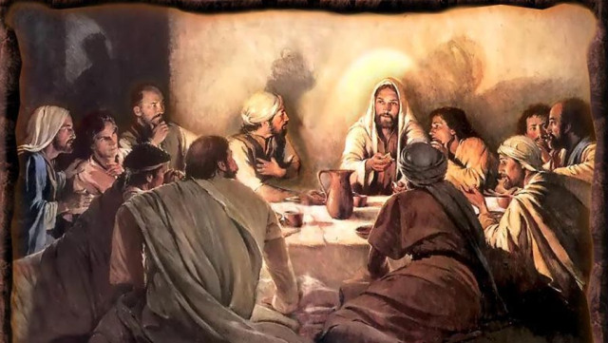
“Master, is it I?”
During the Passover and “the last supper” Jesus announced that someone would betray Him.
Judas Iscariot, who had already covenanted to sell his Master for money asked, “Master, is it I?”
Walter Rane
Matthew 26:25

Slide 4
Betrayal
Luke 22:2-6

Slide 5
Luke 22:21
One will betray me
Betrayal

Slide 6
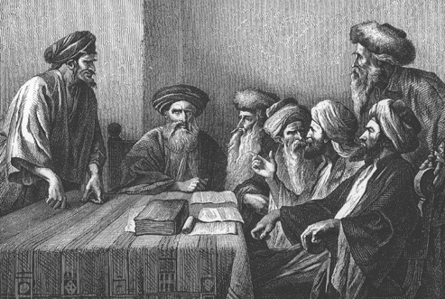
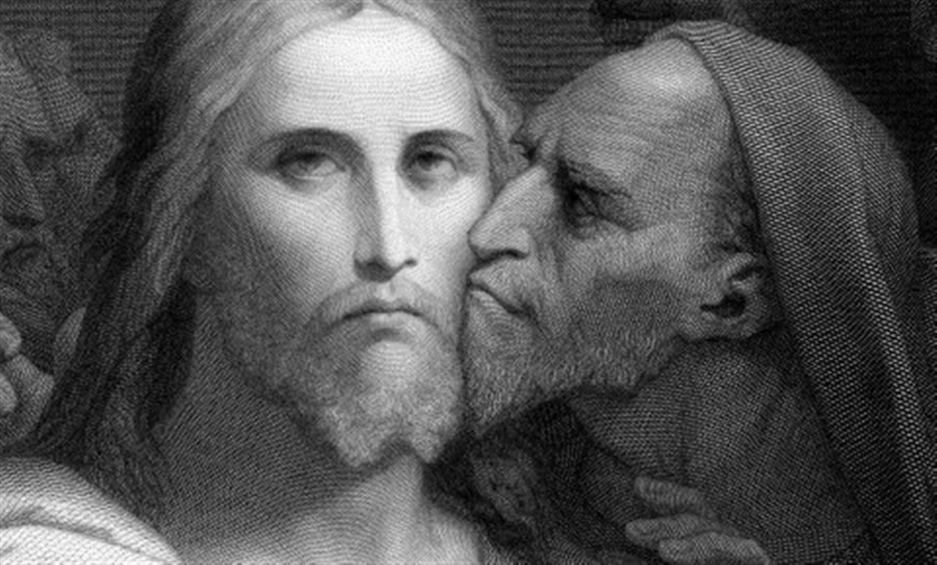
And he went his way, and communed with the chief priests and captains, how he might betray him unto them
To betray means
to deceive, beguile, ensnare, trap, sell out, desert, to be a traitor
Luke 22:4

Slide 7
Luke 22:21
One will betray me
A willful, deliberate, premeditated act
Betrayal

Slide 8
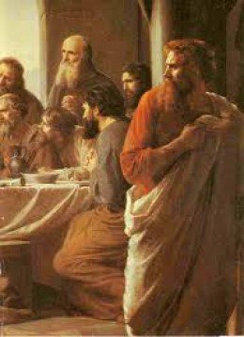
And they were glad, and covenanted to give him money.
“Judas took the initiative.
He sought out the chief priest; he chose to betray the Lord:
he asked for money.”
Luke 22:5
(2)

Slide 9
Luke 22:21
One will betray me
A wilful, deliberate, premeditated act
Betrayal
Prophecy
of
Zechariah
And I said unto them, If ye think good, give me my price; and if not, forbear. So they weighed for my price thirty pieces of silver. Zechariah 11:12

Slide 10
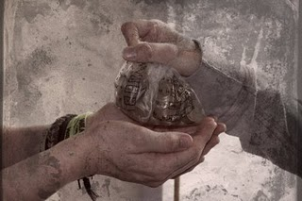
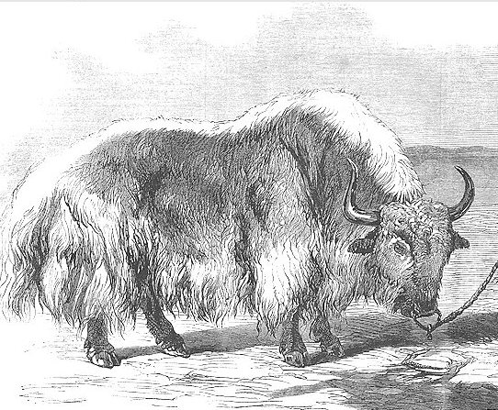
And said unto them, What will ye give me, and I will deliver him unto you? And they covenanted with him for thirty pieces of silver.
30 pieces of silver was the amount recognized as the price of a slave in the law of Moses.
It also shows a low regard that Judas and the chief priests had for Jesus.
If the ox shall push a manservant or a maidservant; he shall give unto their master thirty shekels of silver, and the ox shall be stoned.
Matthew 26:15; Exodus 21:32

Slide 11
Luke 22:21
One will betray me
A willful, deliberate, premeditated act
Betrayal
Then entered Satan into Judas
Prophecy of Zechariah
Zechariah 11:12

Slide 12
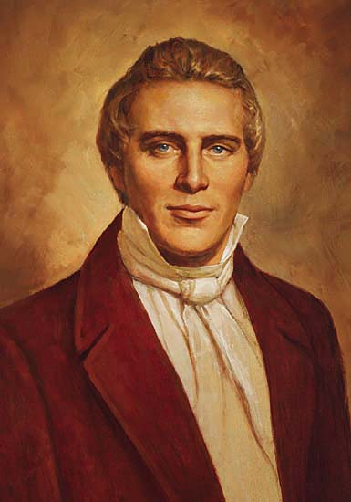
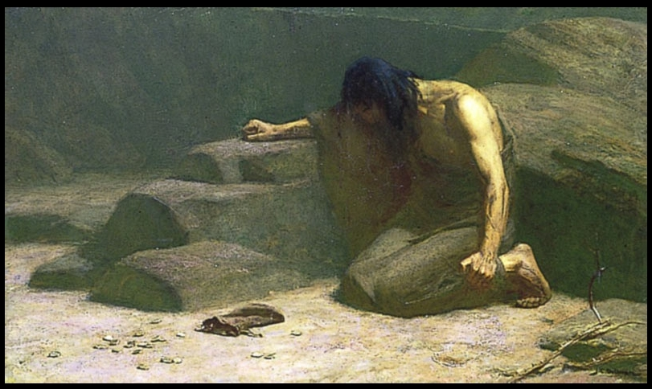
No one is foreordained to do evil—Judas chose to betray the Savior.
The Joseph Smith Translation explains that one reason for Judas’s betrayal was the doctrine the Savior taught:
“Nevertheless, Judas Iscariot, even one of the twelve, went unto the chief priests to betray Jesus unto them; for he turned away from him, and was offended because of his words”
(3)

Slide 13
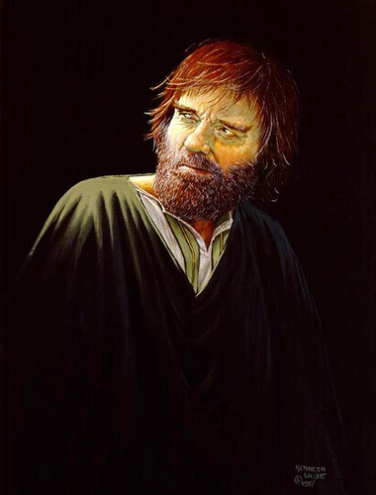
“Satan can have no power over human souls unless it is given to him by them.
People are subject to him only when they hearken to his enticements. In other words, Judas was an evil traitor because of personal wickedness, because he preferred to live after the manner of the world, because he ‘loved Satan more than God.’
He truly had become ‘carnal, sensual, and devilish’ by choice.”
(Read Moses 5:12-13)
(2)

Slide 14
The Upper Room
Who is this man? His name is never mentioned.
The disciples partook of his food and in his own house, yet he did not share the Passover with them.
How did he know to prepare a place for the Master and his disciples?
The Lord has a way of preparing special servants for special tasks
This man becomes a metaphor for all those saints who are asked of the Lord to perform a specific duty. They are obedient and humble servants. We never know their names. We never hear of them again.
They just do what they're supposed to do and fade away.
Sometimes they may not even be invited to the big feast that their own hands prepared, but they don't care. They know their job and do it well. Their compensation is not of this world but it is undoubtedly great, for they will one day feast with him at the Great Supper of the Lamb.
William Hole
Luke 22:7-13
(1)

Slide 15
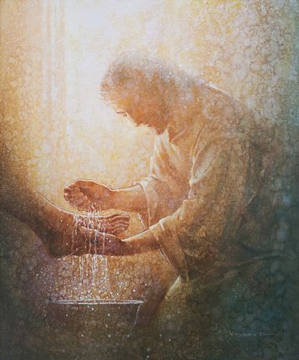
Recap-Washing the Feet
The proceeding was something more than mere service for personal comfort, and more than an object lesson of humility.
”The ordinance of the washing of feet was reestablished through revelation December 27, 1832. It was made a feature of admission to the school of the prophets, and detailed instructions relating to its administration were given
Further direction as to the ordinance involving washing were reveled January 19, 1841”
John 13:1-30; D&C 88:140.141 ; D&C 124:37-39
(4)

Slide 16
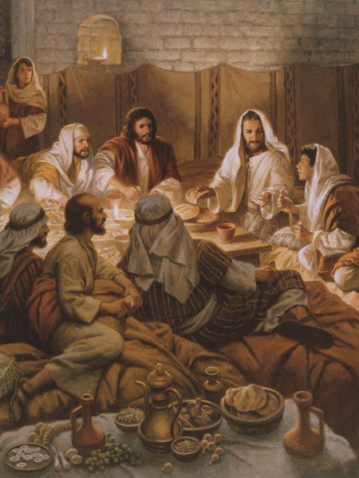
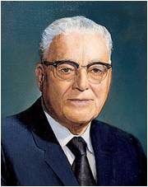
Recap-The Sacrament
This Do in Remembrance of Me
"With a crust of bread, always broken, blessed, and offered first, we remember his bruised body and broken heart, his physical suffering on the cross…”
"The Savior's physical suffering guarantees that through his mercy and grace every member of the human family shall be freed from the bonds of death and be resurrected triumphantly from the grave…
…based upon our faithfulness.”
"With a small cup of water we remember the shedding of Christ's blood and the depth of his spiritual suffering, anguish which began in the Garden of Gethsemane.
He was in agony and 'prayed more earnestly: and his sweat was as it were great drops of blood falling down to the ground.”
"The partaking of the sacrament is a renewal, a refreshing of our recollection of what it meant to be baptized as a member of the Church. We had the law of sacrifice before the coming of the Savior, and we have the sacrament administered since the Savior's death, repeatedly refreshing our minds of
the covenant of the gospel of Jesus Christ
which all of us have entered into.” (6)
Luke 22:7-13, 19-20, 44; 2 Nephi 2:8
(5)

Slide 17
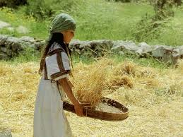
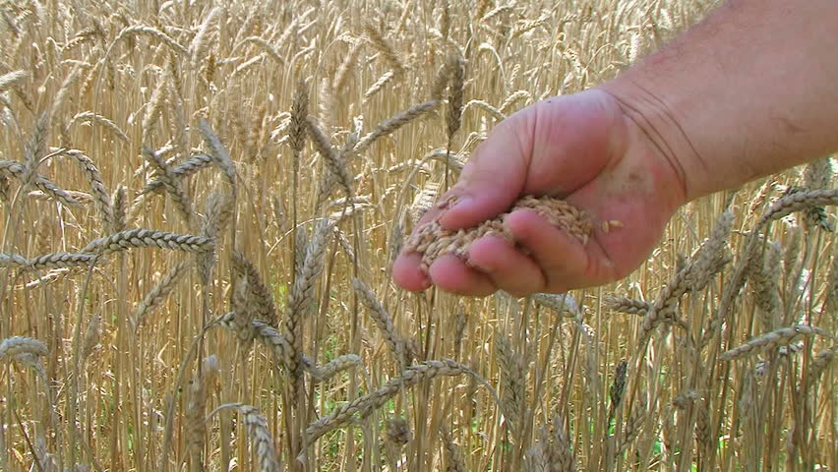
Peter
And the Lord said, Simon, Simon, behold, Satan hath desired to have you, that he may sift you as wheat:
The Greek pronoun translated as “you” is plural, indicating that the Savior gave this warning to all His disciples.
Wheat is sifted by separating kernels of grain from chaff. The valuable grain is kept, while the common chaff is discarded.
If Saints yield to temptation and partake of the sins of the world, they lose their distinctiveness and become like chaff.
Luke 22:31-33
(1)

Slide 18
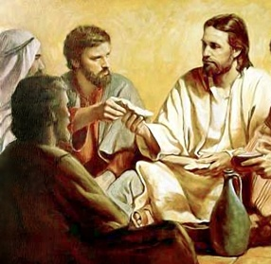
“When Thou Art Converted”
What is the difference between having a testimony of the gospel and being converted to the gospel?
Having a testimony of the gospel means we have received a spiritual witness of the truth through the Holy Ghost.
Being converted to the gospel means “changing [our] beliefs, heart, and life to accept and conform to the will of God.
Del Parson
Repent ye therefore, and be converted, that your sins may be blotted out, when the times of refreshing shall come from the presence of the Lord; Acts 3:19
Luke 22:32
(1)

Slide 19
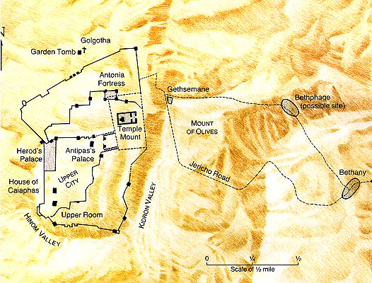
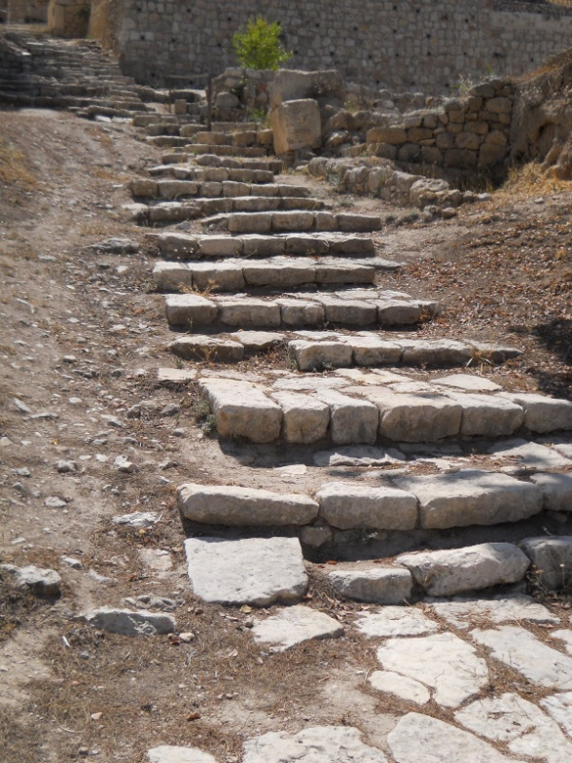
On the Way to Gethsemane
Jesus and the eleven apostles went forth from the house, passed through the city gate, crossed the ravine of the Cedron (Kidron) brook, and entered an olive orchard known as Gethsemane on the slope of Mount Olivet.
Luke 22:32
(1)

Slide 20
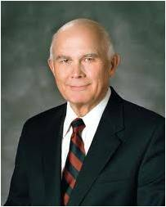
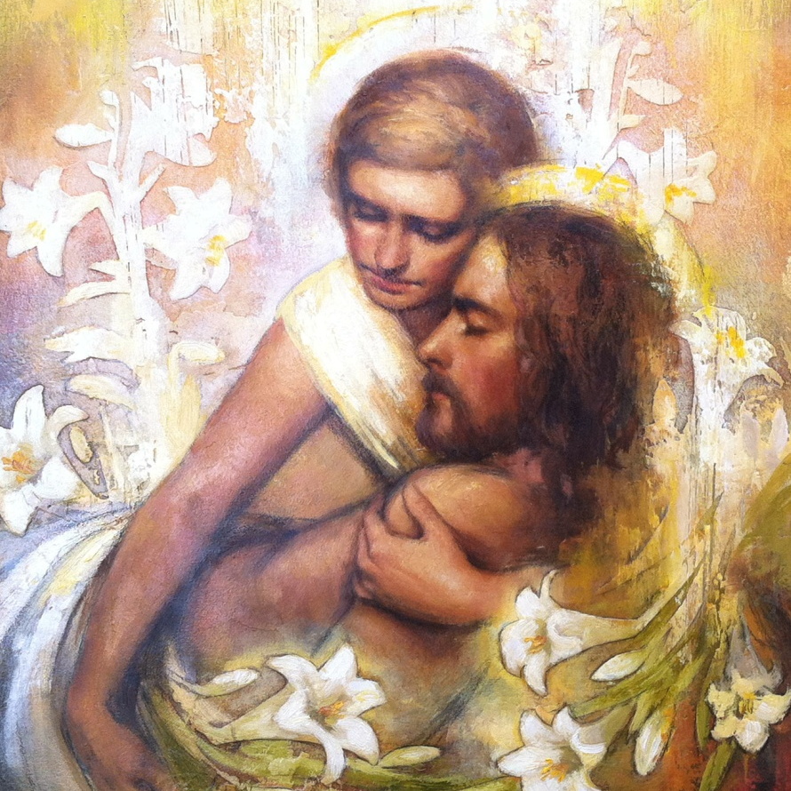
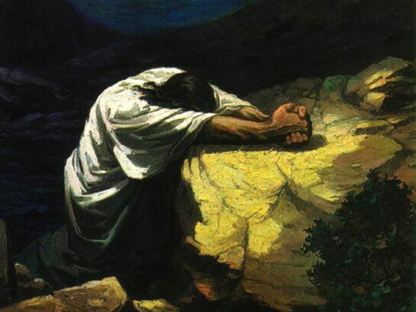
An Angel
“The gospel of Luke … describes how he knelt down and prayed: ‘Father, if thou be willing, remove this cup from me; nevertheless, not my will, but thine be done’
Annie Henri
“… The Father’s answer was to deny the plea of his Only Begotten Son. The Atonement had to be worked out by that lamb without blemish. But though the Son’s request was denied, his prayer was answered. The scripture records: ‘And there appeared an angel unto him from heaven, strengthening him’ …
Luke 22:42-43 (JST)
(7)

Slide 21
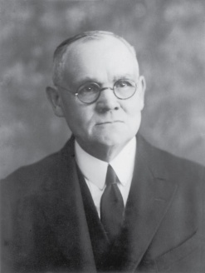
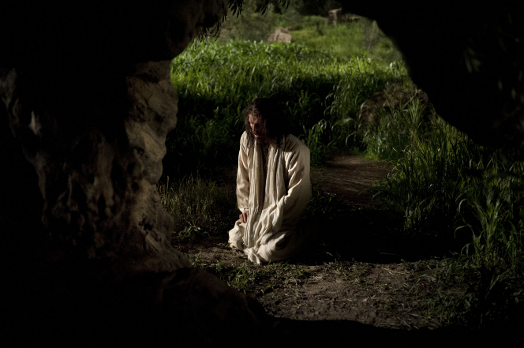
Suffering in Gethsemane
“It was not physical pain, nor mental anguish alone, that caused Him to suffer such torture as to produce an extrusion of blood from every pore; but a spiritual agony of soul such as only God was capable of experiencing.
No other man, however great his powers of physical or mental endurance, could have suffered so; for his human organism would have succumbed, [producing] unconsciousness and welcome oblivion.
In that hour of anguish Christ met and overcame all the horrors that Satan, ‘the prince of this world’ could inflict”
Jesus submitted His will in all things
Luke 22:44
(4)

Slide 22
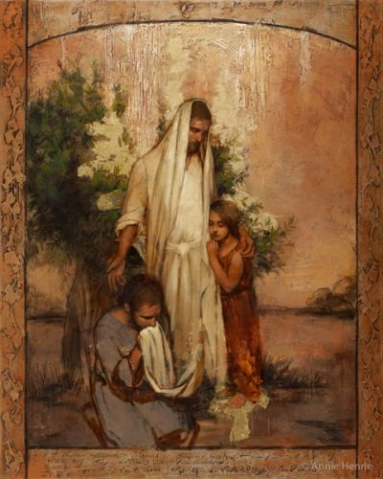
Triumph Over Sin and Death is Complete
But eventually even the angel left the Savior, for He was required to complete the great atoning sacrifice by Himself.
In these latter days, the Savior has declared that when He comes to earth in glory, His voice will be heard saying, “I have trodden the wine-press alone, and have brought judgment upon all people; and none were with me”.
Annie Henri
Luke 22:44
(7)

Slide 23
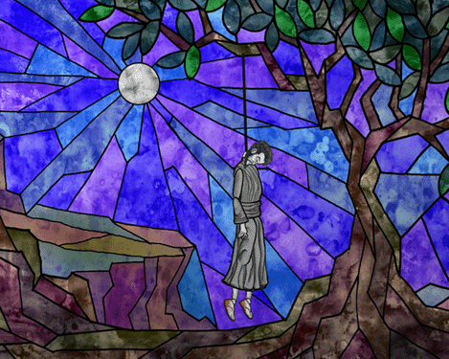
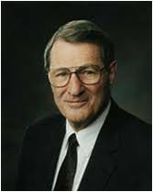
Betrayal In the Garden
"Up one mountain came Judas 'with a great multitude' to kiss and to betray the Master. One wonders what the walk down the mountain that night was like for Judas and which was more searing-his lips on Jesus' face or Jesus' words in his ears, 'Betrayest thou the Son of man with a kiss.
Few scenes of pathos rank with that of a guilty Judas trying to give back the 30 pieces of silver and seeing how those who had used him so fiendishly were devoid of mercy and empathy for him.
Judas' soul-slide was not a sudden thing, and his subsequent suicide ranks as perhaps the most self-contemptuous in history.”
Luke 22:48
(8)

Slide 24
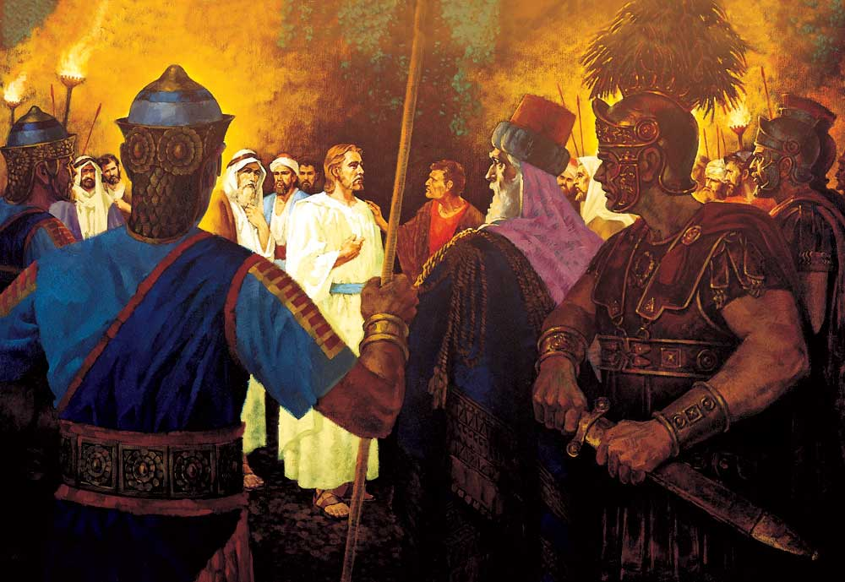
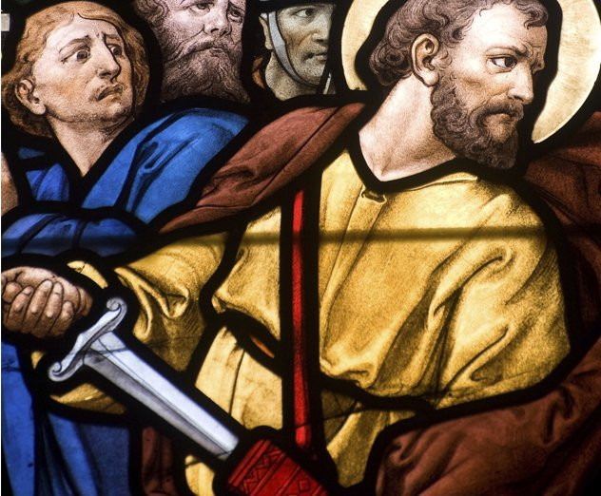
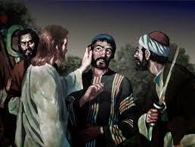
The Ambush
And one of them smote the servant of the high priest, and cut off his right ear.
And Jesus answered and said, Suffer ye thus far. And he touched his ear, and healed him.
“…Jesus carefully restored the severed ear of a hostile guard.
Christ's way was not the way of the sword Even in the deepest duress, He did not hesitate or equivocate." (7)
Luke 22:50-51; Matthew 26:52

Slide 25
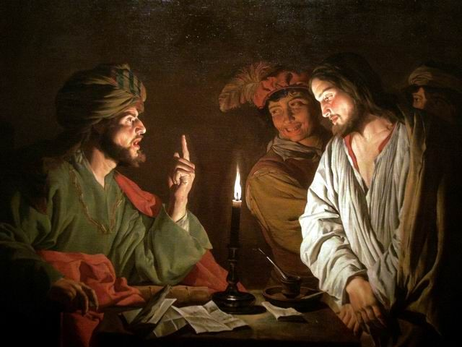
Taken to the High Priests House
Be ye come out, as against a thief, with swords and staves?
When I was daily with you in the temple, ye stretched forth no hands against me: but this is your hour, and the power of darkness.
When the Savior was taken to the high priest’s house to be tried, Peter followed.
Luke 22:53-54

Slide 26
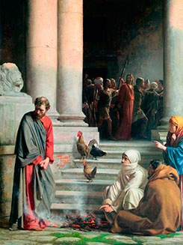
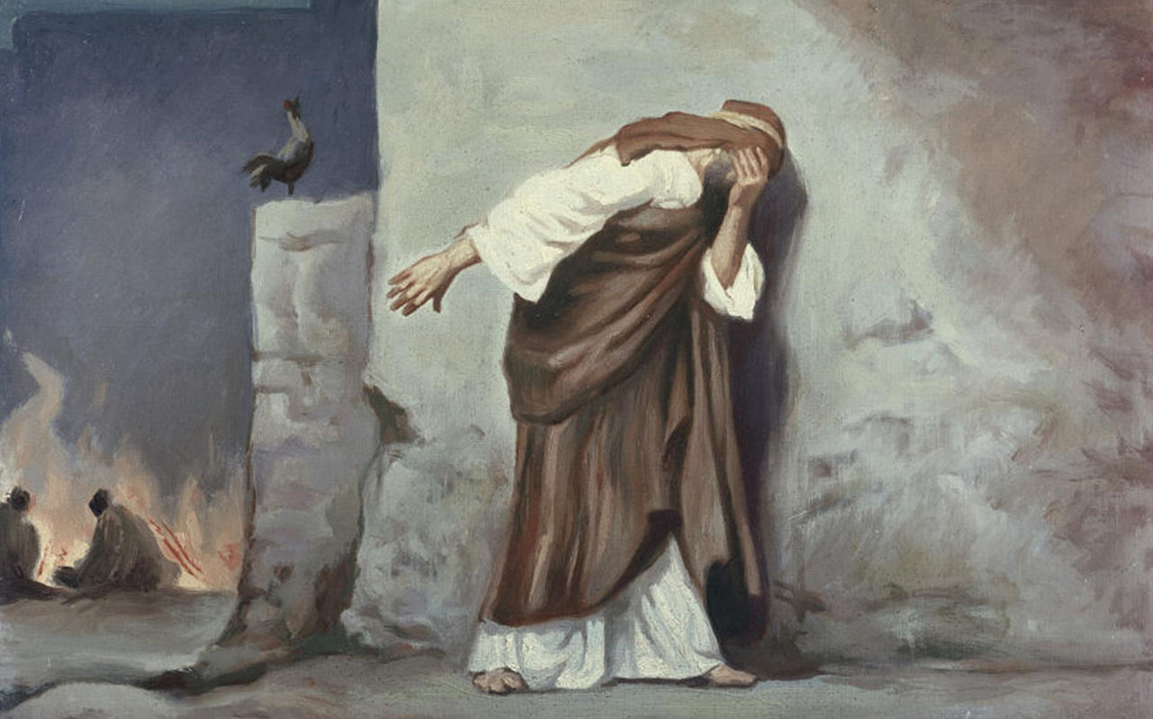
Peter’s Denial
Although Peter had a testimony of the gospel, he was not yet completely converted.
However, he recognized his weakness, became wholly converted, and devoted his life to serving God and sharing the gospel.
Carl Heinrich Bloch
Luke 22:53-62

Slide 27
Sources:
New Testament Institute Student Manual Chapter 19
Elder Bruce R. McConkie (Doctrinal New Testament Commentary, 1:702) and (Mortal Messiah, 4:15)
Joseph Smith Translation, Mark 14:31; compare Mark 14:10, footnote a
Elder James E. Talmage Jesus the Christ p. 613, 619
Elder Jeffrey R. Holland ("This Do in Remembrance of Me," Ensign, Nov. 1995, 67)
President Harold B. Lee(The Teachings of Harold B. Lee, edited by Clyde J. Williams [Salt Lake City: Bookcraft, 1996], 208.)
Elder Dallin H. Oaks (“Faith in the Lord Jesus Christ,” Ensign, May 1994, 99–100).
Elder Neal A. Maxwell (Deposition of a Disciple [Salt Lake City: Deseret Book Co., 1976], 75 - 76.) and (Lord, Increase Our Faith [Salt Lake City: Bookcraft, 1994], 25.)
Presentation by ©http://fashionsbylynda.com/blog/

Slide 28
The Week of Atonement
Event | Matthew | Mark | Luke | John
Jesus Foretells His Betrayal and Crucifixion | 26:1, 2 | 14:1 | 22:1
Rulers consult How They Can Kill Jesus | 26:3-5 | 14:1, 2 | 22:2
Judas Iscariot promises to Betray Jesus | 26:14-16 | 14:10, 11 | 22:3-6
Preparation for the Passover | 26:17-19 | 14:12-16 | 22:7-13
Jesus and the Apostles Begin Last Supper | 26:20 | 14:17 | 22:14-18
Strife Among the Apostles over Greatness |  |  | 22:24-30
Jesus Announces His Betrayal | 26:21-25 | 14:18-21 | 22:21-23 | 13:18-22
The Sacrament | 26:26-29 | 14:22-25 | 22:19-20
Jesus Prophesies the Apostles’ Reaction to His Arrest | 26:31-33 | 14:27-29 | 22:31,32
Peter’s Denial Prophesied and Profess Loyalty | 26:34, 35 | 14:30, 31 | 22:33-38 | 13:36-38
Departing to Mount of Olives | 26:30 | 14:26 | 22:39
Prayer and Agony of Gethsemane | 26:36-46 | 14:32-42 | 22:40-46 | 18:1
The Betrayal by Judas | 26:47, 50 | 14:43-45 | 22:47, 48 | 18:2-9
Peter Rebuked for Trying to Stop the Arrest | 26:51-55 | 14:47-49 | 22:49-53 | 18:10, 11
Taken to the Palace of Annas and Caiaphas Followed by Peter and John | 26:57, 58 | 14:53, 54 | 22:54, 55 | 18:13-16, 18
Mocking of Jesus | 26:67, 68 | 14:65 | 22:63-65
Peter Denies Knowing Jesus | 26:69-75 | 14:66-72 | 22:56-62 | 18:17, 25-27
Formal Trial and Condemnation | 27:1 | 15:1 | 22:66-71

Slide 29
The Sacrament Luke 22:7-13
"That is the real purpose of the sacrament, to keep us from forgetting, to help us to remember. I suppose there would never be an apostate, there would never be a crime, if people remembered, really remembered, the things they had covenanted at the water's edge or at the sacrament table and in the temple. I suppose that is the reason the Lord asked Adam to offer sacrifices, for no other reason than that he and his posterity would remember-remember the basic things that they had been taught. I guess we as humans are prone to forget. It is easy to forget. Our sorrows, our joys, our concerns, our great problems seem to wane to some extent as time goes on, and there are many lessons that we learn which have a tendency to slip from us. The Nephites forgot. They forgot the days when they felt good.
"I remember a young Navaho boy returning from his mission who was supported largely by a seventies quorum in the Bonneville Stake. I happened to be present the day he made his report and as tears rolled down his face, he said, 'Oh, if I could only remember always just how I feel now.'" (The Teachings of Spencer W. Kimball, edited by Edward L. Kimball [Salt Lake City: Bookcraft, 1982], 113.)
Excluding Luke: 22:43-44:
Some modern Bibles do not include verses 43–44 of Luke 22 because they do not appear in all ancient Greek manuscripts of Luke. Historical evidence suggests that some scribes in the centuries following the Apostles’ deaths may have removed these verses. The scribes felt embarrassed at the description of Christ’s agony, which contradicted popular Hellenistic ideals of emotionless suffering. Such tampering with the biblical text verifies the testimony of the Book of Mormon prophet Nephi: “They have taken away from the gospel of the Lamb many parts which are plain and most precious” (1 Nephi 13:26). Latter-day scriptures and prophets affirm the authenticity of what is recorded in Luke 22:43–44 (see Mosiah 3:7; D&C 19:18). (1)
Earnest Prayer Luke 22:44:
President James E. Faust (1920–2007) of the First Presidency explained that all our prayers should be sincere, drawing “from the earnest feelings of our hearts.” But, of necessity, some prayers are more intense than others, as was the Savior’s prayer at the time of His agony in Gethsemane: “Jeremiah counsels us to pray with all our heart and soul [see Jeremiah 29:13]. Enos recounted how his soul had hungered and that he had prayed all the day long [see Enos 1:4]. Prayers vary in their intensity. Even the Savior ‘prayed more earnestly’ in His hour of agony [see Luke 22:44]. Some are simple expressions of appreciation and requests for a continuation of blessings on our loved ones and us. However, in times of great personal hurt or need, more may be required than mere asking. … Blessings sought through prayer sometimes require work, effort, and diligence on our part” (“The Lifeline of Prayer,” Ensign, May 2002, 60).
Remember Me Luke 22:19-20:
Remembering was a primary purpose of many Jewish practices, such as the Passover meal. At Passover, as the people of Israel commemorated the Lord’s deliverance of their ancestors from bondage, the symbolic meal and its accompanying story of deliverance connected the past to the present. Observing Passover made a statement about how one would live and about one’s loyalty to the Lord and His people. Similarly, the sacrament, which the Savior instituted at Passover, is a symbolic “meal” of remembrance that replaced the Passover meal. By partaking of the sacrament, followers of Jesus Christ may experience anew the blessings of His Atonement, reaffirm their loyalty to Him and His Church, and recommit their lives to following Him. (1)
From Every pore Luke 22:44:
Luke was the only Gospel writer to record the important detail that the Savior’s suffering included “great drops of blood” (Luke 22:44). The Savior’s unparalleled suffering—the extreme pressure caused by taking upon Himself the infinite sin, sorrow, and guilt of all mankind—caused a physical condition in his body known as hematidrosis. This condition leads to the rupture of capillaries just under the surface of the skin, causing the skin to exude a bloody sweat. Any other person would have died before this condition reached the point of bleeding from every pore, but the Savior was the Son of God and so was able to endure this great agony for us.
Other scriptures give further insight into the reality and cause of the Savior’s bleeding from the pores of His skin. In the Book of Mormon, King Benjamin testified that Christ would “suffer temptations, and pain of body, hunger, thirst, and fatigue, even more than man can suffer, except it be unto death; for behold, blood cometh from every pore, so great shall be his anguish for the wickedness and the abominations of his people” (Mosiah 3:7; italics added). In his Epistle to the Hebrews, Paul encouraged early Christians to remain faithful by remembering that Christ had “resisted unto blood, striving against sin” (Hebrews 12:4). The Lord Himself spoke of bleeding from every pore (see Doctrine and Covenants 19:16–19). (1)
Chaff Luke 22:31:
"Satan wanted to harvest the earth, to sift the saints as wheat, so that both wheat and tares would be garnered into his bin. This he would find easier to do were Peter not there to guide them. Hence, Jesus' special prayer that Peter's faith fail not; and hence the continuing prayers of the saints, always and ever, for the apostles and prophets who guide the Church." Bruce R. McConkie (Doctrinal New Testament Commentary, 3 vols. [Salt Lake City: Bookcraft, 1965-1973], 1: 770.)

Slide 30
Peter’s Denial Luke 22:61:
With one look-one 'glance of the piercing eye of the Almighty God' (Jacob 2:10)-the Master communicated the sermon of a lifetime. He who had declared, 'I am ready to go with thee, both to prison, and to death,' (v. 33) at once realized what he had done.
Peter was not insulated, as we are, by the veil. His failure was immediately rebuked by one divine glance. And what if Jesus were to look on us in our moments of failure? He has declared, 'I the Lord cannot look upon sin with the least degree of allowance' (DC 1:31). If the veil were drawn in our greatest moments of weakness, would we feel any different than Peter? Would we be able to look him in the eye? Wouldn't we go out as well, and weep bitterly? Alma described the feeling as follows, 'the very thought of coming into the presence of my God did rack my soul with inexpressible horror' (Alma 36:14). We would do well to remember the gall of bitterness and 'inexpressible horror' which awaits those who don't repent, for at the last day, 'they shall quake, tremble, and shrink beneath the glance of his all-searching eye' (Mosiah 27:31) (gospeldoctrine.com)
Peter the Convert:
“Peter is the classic example of how the power of conversion works on receptive souls. During our Lord’s mortal ministry, Peter had a testimony, born of the Spirit, of the divinity of Christ and of the great plan of salvation which was in Christ. ‘Thou art the Christ, the Son of the living God,’ he said, as the Holy Ghost gave him utterance. (Matt. 16:13–19.) When others fell away, Peter stood forth with the apostolic assurance, ‘We believe and are sure that thou art that Christ, the Son of the living God.’ (John 6:69.) Peter knew, and his knowledge came by revelation.
“But Peter was not converted, because he had not become a new creature of the Holy Ghost. Rather, long after Peter had gained a testimony, and on the very night Jesus was arrested, he said to Peter: ‘When thou art converted, strengthen thy brethren.’(Luke 22:32.) Immediately thereafter, and regardless of his testimony, Peter denied that he knew Christ. (Luke 22:54–62.) After the crucifixion, Peter went fishing, only to be called back to the ministry by the risen Lord. (John 21:1–17.) Finally on the day of Pentecost the promised spiritual endowment was received; Peter and all the faithful disciples became new creatures of the Holy Ghost; they were truly converted; and their subsequent achievements manifest the fixity of their conversions. (Acts 3; 4.)” Elder Bruce R. McConkie (Mormon Doctrine, 2nd ed. [1966], 162–63).
Peter Wept Bitterly Luke 22:62:
"I personally believe this was the beginning of the conversion of Peter. Up to this time Peter had never questioned his own ability to cleave to truth. He was an honest man by nature and felt the strength that honesty gives a man. Perhaps, as so many of us, he lacked humility. As a result of this experience, however, he learned humility. There is no question of his remorse, for he wept bitterly at his own weakness. I feel, however, that a great change began to work in Peter, beginning with this knowledge of his own weakness." Theodore M. Burton (October 6, 1964, BYU Speeches of the Year, 1964, p. 4)
"I believe this incident strengthened Peter's commitment. He was never to be weak again. The resolve borne of that disappointment in his own temporary weakness tempered his metal into the hardest steel. He proved his devotion every day of his life thereafter, and in his death. So it can be with all of us. When we have been less than we ought to be and have fallen below our own standards, we can have newfound resolve and strength by forsaking our weakness.“ Pres. James E. Faust (Reach Up for the Light [Salt Lake City: Deseret Book Co., 1990], 62.)

Slide 31
“I Am He”
John 18-19
Including:
Jesus is Arrested and Tried
The Crucifixion
Jesus is Buried

Slide 32
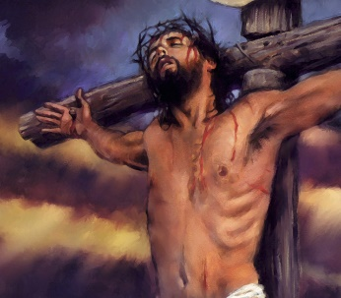
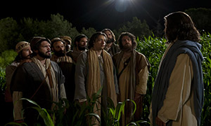
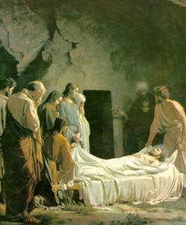
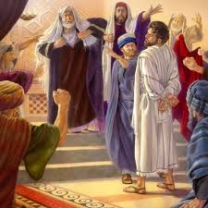
The Savior was crucified at Golgotha
Jesus Christ offered the great Intercessory Prayer
The body of Jesus Christ was placed in a tomb by Joseph of Arimathea and Nicodemus
He was betrayed, arrested, and tried before Annas, Caiaphas, and Pilate

Slide 33
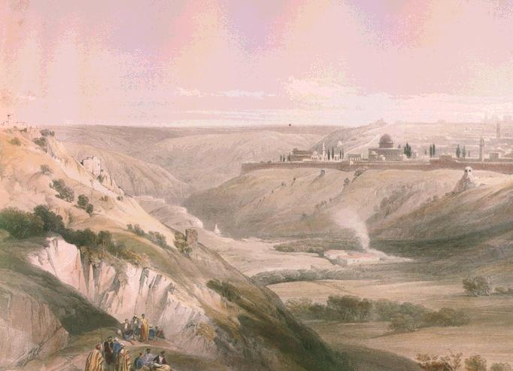
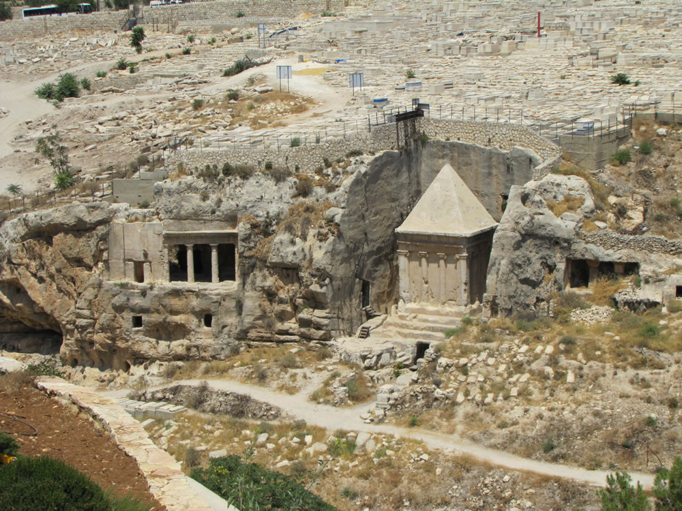
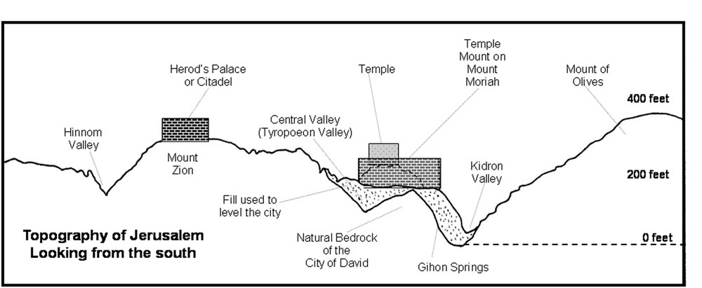
The Cedron Valley
Yea, though I walk through the valley of the shadow of death,...Psalm 23:4
The Kidron Valley contained tombs in Jesus' time, as it does today. The walk Jesus and His disciples would have taken through this area the night before He died. (1)
Looking down into the Kidron Valley from the base of the southeast corner of the Temple Mount at 2000 year old tombs cut into the west side of the Mount of Olives. (4)
John 18:1

Slide 34
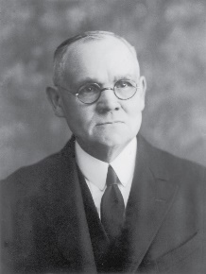
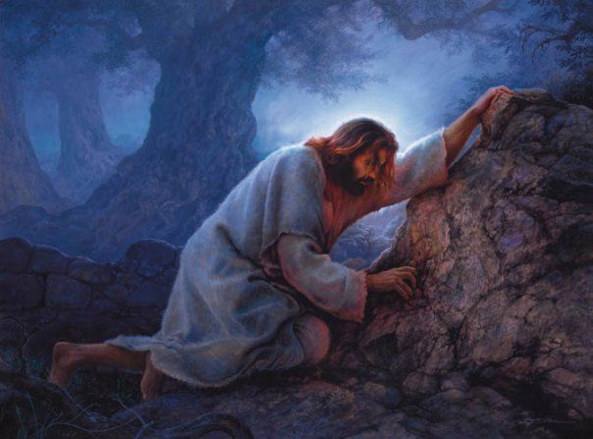
The Suffering
“Christ’s agony in the garden is unfathomable to the finite mind, both as to intensity and cause. The thought that He suffered through fear of death is untenable.
Death to Him was preliminary to resurrection and triumphal return to the Father from whom He had come, and to a state of glory even beyond what He had before possessed; and, moreover, it was within His power to lay down His life voluntarily.”
In some manner, actual and terribly real, though to man incomprehensible, the Savior took upon Himself the burden of the sins of mankind from Adam to the end of the world.”
Greg Olsen
John 18:1; Matthew 26:36-46; Mark 14:32-42; Luke 22:40-46
(2)

Slide 35
“The Savior’s physical suffering guarantees that through his mercy and grace every member of the human family shall be freed from the bonds of death and be resurrected triumphantly from the grave. Of course the time of that resurrection and the degree of exaltation it leads to are based upon our faithfulness.”
Wherefore, how great the importance to make these things known unto the inhabitants of the earth, that they may know that there is no flesh that can dwell in the presence of God, save it be through the merits, and mercy, and grace of the Holy Messiah, who layeth down his life according to the flesh, and taketh it again by the power of the Spirit, that he may bring to pass the resurrection of the dead, being the first that should rise. 2 Nephi 2:8
The Savior’s spiritual suffering and the shedding of his innocent blood, so lovingly and freely given, paid the debt for what the scriptures call the “original guilt” of Adam’s transgression. Furthermore, Christ suffered for the sins and sorrows and pains of all the rest of the human family, providing remission for all of our sins as well, upon conditions of obedience to the principles and ordinances of the gospel he taught
(3)

Slide 36
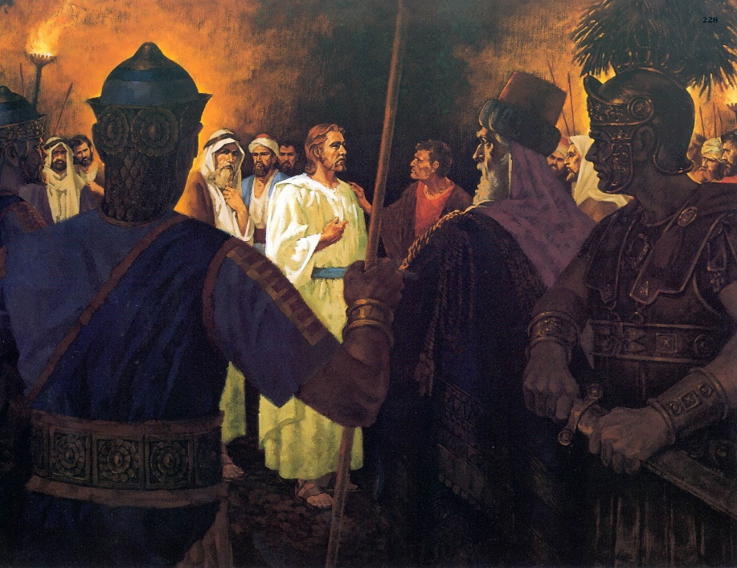
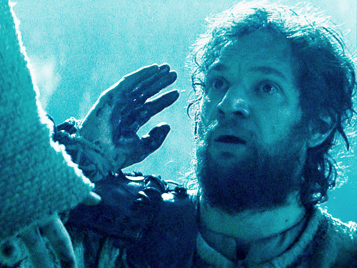
Jesus’ Concerns
Protecting His Apostles; healing the servant’s (Malchus) ear and doing Heavenly Father’s will
Jesus Christ offered Himself to His enemies if they would let His disciples go free.
This ensured the immediate physical safety of the Apostles, who would become the leaders of the Church following Jesus' death.
This small detail is a reflection of the larger event that was then taking place, a mirror of the Atonement of Christ. The Savior gave Himself so all of us could be set free from the eternal enemies of sin and death. (1)
John 18:8-9

Slide 37
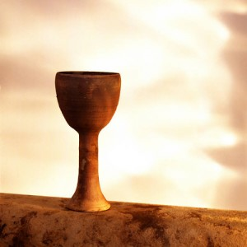
The Cup
“drink of the cup” was “a metaphorical expression meaning,
‘To do the things which my lot in life requires of me.’”
He explained that the phrase “be baptized with the baptism that I am baptized with” means “to follow my course, suffer persecution, be rejected of men, and finally be slain for the truth’s sake” (5)
The Savior refocused the attention of James and John on carrying out the Father’s will, rather than on receiving glory and honor. (1)
John 18:11; Mark 10:38

Slide 38
Jesus Allowed the Officers to Arrest Him
After Caiaphas questioned Jesus, the Jewish leaders took Jesus to Pilate, the Roman provincial governor of Judea, to be tried and sentenced.
They took Him to Annas, one of the Jewish leaders
And then to Caiaphas, the high priest who sought to condemn Jesus to death
The trial may have taken place at Antonia Fortress near the temple.
Peter and another disciple followed Jesus. When three different people asked Peter whether he was one of Jesus' disciples, Peter denied knowing Him each time.
Only the Romans had the authority to carry out a death sentence in Jerusalem.
John 18:12-32

Slide 39
Did Peter know who he was?
I am not one of the man’s disciples
I am not one of the disciples
I was not in the garden with him
John 18:17, 25-27

Slide 40
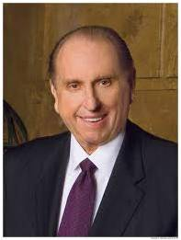
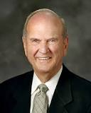
Who Am I?
“We must remember who we are and what God expects us to become.” (6)
“As you continue to face many challenging choices in life, remember, there is great protection when you know who you are, why you are here, and where you are going.” (7)

Slide 41
Sources:
New Testament Institute Student Manual Chapter 27
Elder James E. Talmage (Jesus the Christ, p. 613, 648-649; 661.)
Elder Jeffrey R. Holland This Do In Remembrance of Me Oct. 1995 Gen. Conf. And ("None Were with Him" Ensign, May 2009, 86)
Generationword.com Jerusalem 101 (Kidron Valley)
Elder Bruce R. McConkie (Doctrinal New Testament Commentary, 1:566; 1:817).
Presentation by ©http://fashionsbylynda.com/blog/

Slide 42
Event | Matthew | Mark | Luke | John
Prayer and Agony of Gethsemane | 26:36-46 | 14:32-42 | 22:40-46 | 18:1
The Betrayal by Judas | 26:47, 50 | 14:43-45 | 22:47, 48 | 18:2-9
Peter Rebuked for Trying to Stop the Arrest | 26:51-55 | 14:47-49 | 22:49-53 | 18:10, 11
The Arrest and the Apostles Flee | 26:50, 56 | 14:46, 50-52 |  | 18:12
Taken to the Palace of Annas and Caiaphas Followed by Peter and John | 26:57, 58 | 14:53, 54 | 22:54, 55 | 18:13-16, 18
Questioned by Annas |  |  |  | 18:19-24
Peter Denies Knowing Jesus | 26:69-75 | 14:66-72 | 22:56-62 | 18:17, 25-27
First Appearance Before Pilate | 27:2, 11-14 | 15:1-5 | 23:1-7 | 18:28-38

Slide 43
“I AM” Statements
REFERENCE IN JOHN | “I AM” STATEMENT | FULFILLMENT
6:35, 48, 51 | “I am the bread of life.” | Jesus Christ gave Himself for us in the Atonement. He feeds us spiritually.
8:12; 9:5 | “I am the light of the world.” | Jesus Christ is the source of all truth. If we follow His words and example, we will not stumble or walk in spiritual darkness.
8:58 | “Before Abraham was, I am.” | Jesus Christ is Jehovah of the Old Testament.
10:7, 9 | “I am the door of the sheep.” | Jesus Christ protects us like a shepherd at the door of a sheep enclosure. No one can enter His kingdom except through Him.
10:11, 14 | “I am the good shepherd.” | Jesus Christ leads us. He gave His life for us. He knows each of us individually.
10:36 | “I am the Son of God.” | Jesus Christ is the Firstborn of the Father’s spirit children (see D&C 93:21) and His Only Begotten in the flesh (see John 1:14).
11:25 | “I am the resurrection, and the life.” | Through the Atonement of Jesus Christ we can overcome physical and spiritual death. Jesus Christ gave us the gift of resurrection.
14:6 | “I am the way, the truth, and the life.” | Jesus Christ is the only way to the Father, and He is the source of all truth. Because of His Atonement, we will all be resurrected and through our faithfulness may inherit eternal life.
15:1, 5 | “I am the true vine.” | We depend on Jesus Christ for life. Only by abiding by His teachings will we be able to bear the fruit of righteousness.
New Testament Seminary Teacher Manual

Slide 44
Jesus Christ made seven statements from the cross that are recorded in the Gospels
SCRIPTURE REFERENCE | Statements
Luke 23:34 | “Father, forgive them; for they know not what they do.”
Luke 23:43 | “To day shalt thou be with me in paradise.”
John 19:26–27 | “Woman, behold thy son! … Behold thy mother!”
Matthew 27:46; Mark 15:34 | “My God, my God, why hast thou forsaken me?”
John 19:28 | “I thirst.”
John 19:30 | “It is finished.”
Luke 23:46 | “Father, into thy hands I commend my spirit.”

Slide 45
John Does not write about the suffering of Christ John 18:1
Ironically, John was the only of the Gospel writers who was closer than a stone's throw of Christ's suffering in Gethsemane, yet his record lacks any mention of the event. We cannot suppose from this notable absence that John thought it unimportant. Rather, as other evidence indicates, John seems to be writing his gospel with a full knowledge of what is contained in the other testimonies. His record seems to be designed specifically to fill in the gaps. With regard to the events in the Garden, we may assume that the synoptic authors were comprehensive. Matthew, Mark, and Luke all spoke of the great sacrifice in Gethsemane while John seems to have had nothing more to add.
As we know, John had slept through portions of that monumental moment. Possibly, the narrative silence represents his grief about his own weak and slumbering flesh which could not remain awake despite the Master's specific request (Matt. 26:38-43). Meanwhile, the Master was suffering 'according to the flesh' even 'the pains of every living creature, both men, women, and children, who belong to the family of Adam' (Matt. 26:41, Alma 7:13, 2 Ne. 9:21). Certainly, the heaviness of John's eyelids can hardly be compared to the heaviness of Christ's burden on that fateful night. Such is the contrast between even great men and the Master!
Gospeldoctrine.com
John 18:12-13:
"John alone informs us that the Lord was taken first to Annas, who sent Him, still bound to Caiaphas, the high priest; the synoptists record the arraignment before Caiaphas only. No details of the interview with Annas are of record; and the bringing of Jesus before him at all was as truly irregular and illegal, according to Hebrew law, as were all the subsequent proceedings of that night. Annas, who was father-in-law to Caiaphas, had been deposed from the high-priestly office over twenty years before; but throughout this period he had exerted a potent influence in all the affairs of the hierarchy." Elder James E. Talmage (Jesus the Christ, 576)
Who was the Other Disciple? John 18:16
How John, the son of Zebedee and a Galilean fisherman, knew the high priest is entirely unclear. Not only did he know the high priest, but he knew his servant Malchus by name (v. 10). He may even have known the woman that kept the door. The whole incident proves that even in Jesus time, it's not what you know but who you know. Instructively, we learn that the disciple had no qualms about using his "in" with the high priest so he could witness the unfolding drama. Sometimes it is appropriate to play the games of the world when performing the Lord's work. John seemed to understand the Lord's meaning when he said, 'I send you forth as sheep in the midst of wolves: be ye therefore wise as serpents, and harmless as doves' (Matt 10:16).
Gospeldoctrine.com
The Arrest John 18:3-8:
"One cannot help but be struck with the tremendous difference between Christ's behavior during those terrible hours and the actions of those around him. Throughout, it becomes clear that Jesus was the only one who was not thrown off balance by the passions of that night and the following day. Judas betrayed him, then committed suicide, apparently in a great overflowing feeling of guilty remorse. The armed party sent out to arrest him fell back in fright when he told them he was Jesus. Peter vowed perfect support and then failed miserably as fear washed out his determination. The high priest was thrown into a rage by the calm demeanor of the accused. Pilate, symbol and wielder of Roman might, became a frightened vacillating man when faced with the King of the Jews. Even the hardened Roman soldier was awed by Christ's manner of dying. Throughout, it becomes clear that Jesus was not the victim but the Master.“ Elder Gerald Lund (Selected Writings of Gerald N. Lund: Gospel Scholars Series [Salt Lake City: Deseret Book Co., 1999], 308.)
Peter Denies Jesus John 18:15-18, 25-27:
“My heart goes out to Peter. So many of us are so much like him. We pledge our loyalty; we affirm our determination to be of good courage; we declare, sometimes even publicly, that come what may we will do the right thing, that we will stand for the right cause, that we will be true to ourselves and to others.
“Then the pressures begin to build. Sometimes these are social pressures. Sometimes they are personal appetites. Sometimes they are false ambitions. There is a weakening of the will. There is a softening of discipline. There is capitulation. And then there is remorse, followed by self-accusation and bitter tears of regret. …
“Now, if there be those throughout the Church who by word or act have denied the faith, I pray that you may draw comfort and resolution from the example of Peter, who, though he had walked daily with Jesus, in an hour of extremity momentarily denied the Lord and also the testimony which he carried in his own heart. But he rose above this and became a mighty defender and a powerful advocate. So, too, there is a way for any person to turn about and add his or her strength and faith to the strength and faith of others in building the kingdom of God.” President Gordon B. Hinckley (“And Peter Went Out and Wept Bitterly,” Ensign, Mar. 1995, 2, 4, 6). For more insight on Peter’s denials, see the commentary for Matthew 26:69–75.
In the Bible, Malchus is the servant of the Jewish High Priest Caiaphas who participated in the arrest of Jesus. According to the Bible, one of the disciples, Simon Peter, being armed with a sword, cut off the servant's ear in an attempt to prevent the arrest of Jesus.
Simon cutting off Malchus' ear is related in all four canonical gospels, in Matthew 26:51, Mark 14:47, Luke 22:50-51, and John 18:10–11, but Simon and Malchus are named only in the Gospel of John. Also, Luke is the only gospel that says Jesus healed the servant's ear. This was Jesus' last recorded miracle prior to His resurrection. Wikipedia

Slide 46
The Arrest John 18:3-8:
"One cannot help but be struck with the tremendous difference between Christ's behavior during those terrible hours and the actions of those around him. Throughout, it becomes clear that Jesus was the only one who was not thrown off balance by the passions of that night and the following day. Judas betrayed him, then committed suicide, apparently in a great overflowing feeling of guilty remorse. The armed party sent out to arrest him fell back in fright when he told them he was Jesus. Peter vowed perfect support and then failed miserably as fear washed out his determination. The high priest was thrown into a rage by the calm demeanor of the accused. Pilate, symbol and wielder of Roman might, became a frightened vacillating man when faced with the King of the Jews. Even the hardened Roman soldier was awed by Christ's manner of dying. Throughout, it becomes clear that Jesus was not the victim but the Master.“ Elder Gerald Lund (Selected Writings of Gerald N. Lund: Gospel Scholars Series [Salt Lake City: Deseret Book Co., 1999], 308.)
John 18:12-13:
"John alone informs us that the Lord was taken first to Annas, who sent Him, still bound to Caiaphas, the high priest; the synoptists record the arraignment before Caiaphas only. No details of the interview with Annas are of record; and the bringing of Jesus before him at all was as truly irregular and illegal, according to Hebrew law, as were all the subsequent proceedings of that night. Annas, who was father-in-law to Caiaphas, had been deposed from the high-priestly office over twenty years before; but throughout this period he had exerted a potent influence in all the affairs of the hierarchy." Elder James E. Talmage (Jesus the Christ, 576)
Who was the Other Disciple? John 18:16
How John, the son of Zebedee and a Galilean fisherman, knew the high priest is entirely unclear. Not only did he know the high priest, but he knew his servant Malchus by name (v. 10). He may even have known the woman that kept the door. The whole incident proves that even in Jesus time, it's not what you know but who you know. Instructively, we learn that the disciple had no qualms about using his "in" with the high priest so he could witness the unfolding drama. Sometimes it is appropriate to play the games of the world when performing the Lord's work. John seemed to understand the Lord's meaning when he said, 'I send you forth as sheep in the midst of wolves: be ye therefore wise as serpents, and harmless as doves' (Matt 10:16).
Gospeldoctrine.com
In the Bible, Malchus is the servant of the Jewish High Priest Caiaphas who participated in the arrest of Jesus. According to the Bible, one of the disciples, Simon Peter, being armed with a sword, cut off the servant's ear in an attempt to prevent the arrest of Jesus.
Simon cutting off Malchus' ear is related in all four canonical gospels, in Matthew 26:51, Mark 14:47, Luke 22:50-51, and John 18:10–11, but Simon and Malchus are named only in the Gospel of John. Also, Luke is the only gospel that says Jesus healed the servant's ear. This was Jesus' last recorded miracle prior to His resurrection. Wikipedia

