Slide 1
Matthew 28; Luke 24; Mark 16; John 20-21

Slide 2
Resurrection and Ascension of Jesus Christ
Luke 24
“Believe in the Son of God, that he will come to redeem his people, and that he shall suffer and die to atone for their sins; and that he shall rise again from the dead, which shall bring to pass the resurrection, that all men shall stand before him, to be judged at the last and judgment day”
(Alma 33:22).

Slide 3
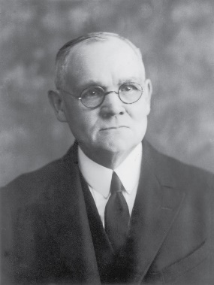
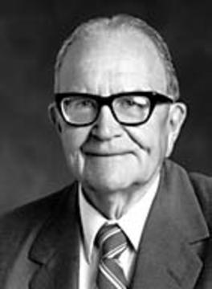
Between Death and Resurrection
Behold, it has been made known unto me, by an angel, that the spirits of all men, as soon as they are departed from this mortal body; yea, the spirits of all men, whether they be good or evil, are taken home to that God who gave them life. And then shall it come to pass that the spirits of those who are righteous, are received into a state of happiness, which is called paradise; a state of rest; a state of peace, where they shall rest from all their troubles and from all care, and sorrow.
Alma 40:11-12
While divested of His body Christ ministered among the departed, both in paradise and in the prison realm where dwelt in a state of durance the spirits of the disobedient. (17)
Tissot
Tissot
"During that period between death and resurrection, Jesus went into the spirit world, as he had promised the thieves on the cross. There he organized the preaching of the gospel to the spirits in prison.“ (21)
Mark 16:1-2

Slide 4
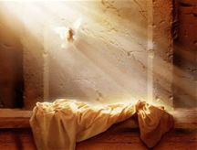
Resurrection of Many
And came out of the graves after his resurrection, and went into the holy city, and appeared unto many.
And there were gathered together in one place an innumerable company of the spirits of the just, who had been faithful in the testimony of Jesus while they lived in mortality;
They were assembled awaiting the advent of the Son of God into the spirit world, to declare their redemption from the bands of death.
While this vast multitude waited and conversed, rejoicing in the hour of their deliverance from the chains of death, the Son of God appeared, declaring liberty to the captives who had been faithful;
D&C 138:12,16,18
Many righteous people who had died were also resurrected and appeared to many people in Jerusalem.
Read D&C 138:12-18
Matthew 27:52-53

Slide 5
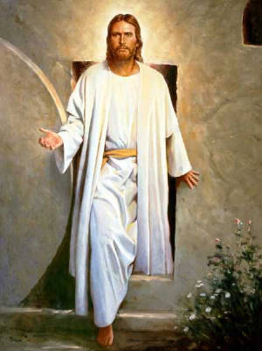
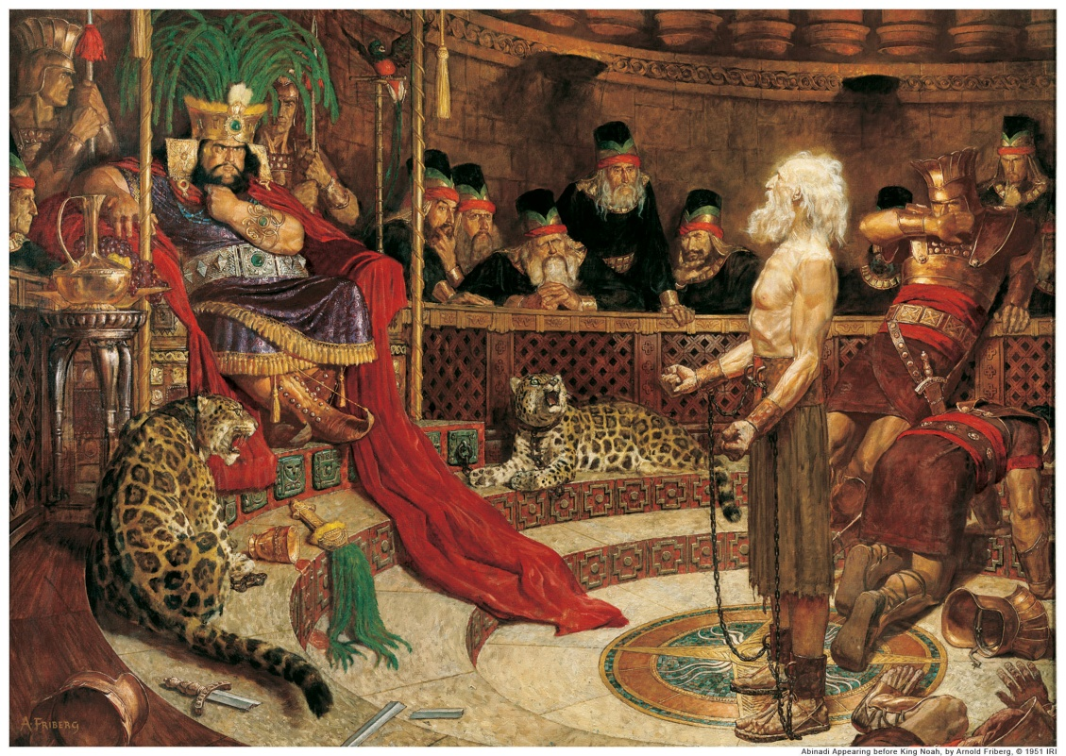
Jesus’ Resurrection
That Christ should suffer, and that he should be the first that should rise from the dead, and should shew light unto the people, and to the Gentiles. Acts 26:23
Jesus Christ was the first person resurrected
The Book of Mormon prophet Abinadi taught that those who were resurrected at the time of the Savior’s Resurrection were all the prophets and those who had kept God’s commandments
And there cometh a resurrection, even a first resurrection; yea, even a resurrection of those that have been, and who are, and who shall be, even until the resurrection of Christ—for so shall he be called.
And now, the resurrection of all the prophets, and all those that have believed in their words, or all those that have kept the commandments of God, shall come forth in the first resurrection; therefore, they are the first resurrection.
Mosiah 15:21-22
Matthew 27:52-53

Slide 6
Everyone Will Be Resurrected
Marvel not at this: for the hour is coming, in the which all that are in the graves shall hear his voice,
And shall come forth; they that have done good, unto the resurrection of life; and they that have done evil, unto the resurrection of damnation.
John 5:28-29
The spirit and the body shall be reunited again in its perfect form; both limb and joint shall be restored to its proper frame, even as we now are at this time; and we shall be brought to stand before God, knowing even as we know now, and have a bright recollection of all our guilt.
Now, this restoration shall come to all, both old and young, both bond and free, both male and female, both the wicked and the righteous; and even there shall not so much as a hair of their heads be lost; but every thing shall be restored to its perfect frame, as it is now, or in the body, and shall be brought and be arraigned before the bar of Christ the Son, and God the Father, and the Holy Spirit, which is one Eternal God, to be judged according to their works, whether they be good or whether they be evil.
Alma 11:43-44
For as in Adam all die, even so in Christ shall all be made alive.
1 Corinthians 15:22

Slide 7
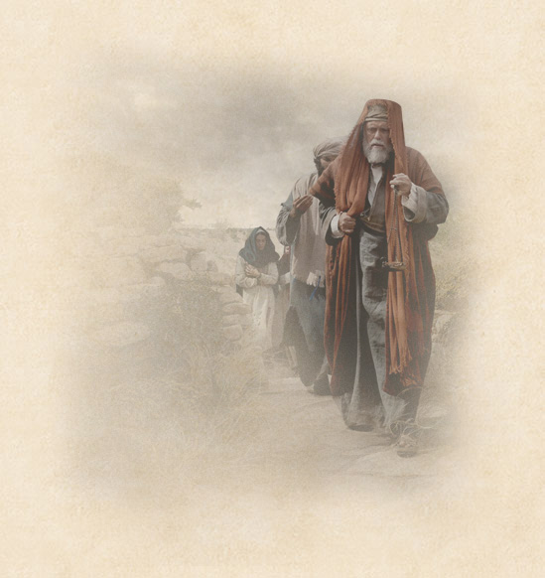
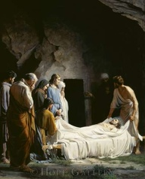
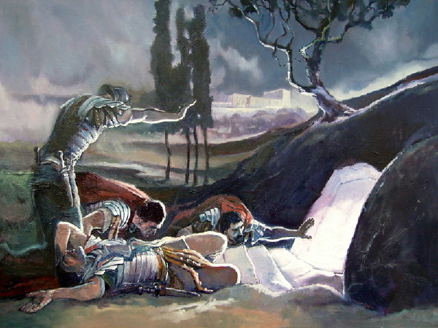
Witnesses of Empty Tomb
A rich disciple named Joseph of Arimathea “begged for the body of Jesus.”
The body of Jesus was prepared by Joseph of Arimathea, Nicodemus, another member of the Sanhedrin, who brought a costly “mixture of myrrh and aloes, about an hundred pound weight” to anoint the body. Mary Magdalene, and the other Mary sat by the sepulchre.
John 19:39
Soldiers were sent by Pilate to seal the tomb.
Those who witnessed Jesus' death were a Roman centurion and many women.
Matthew 27:54-61

Slide 8
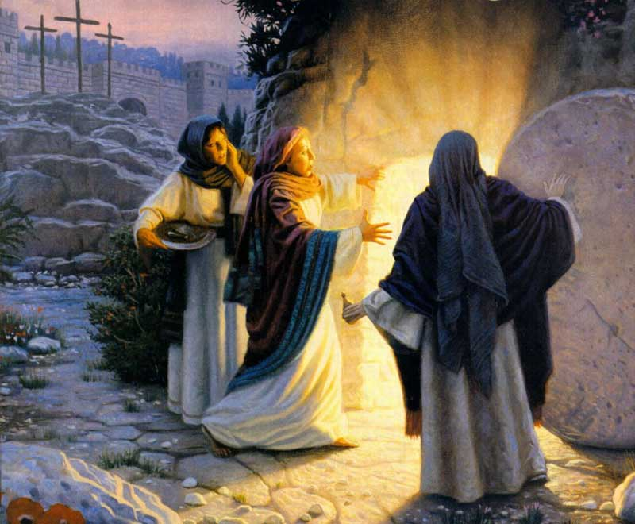
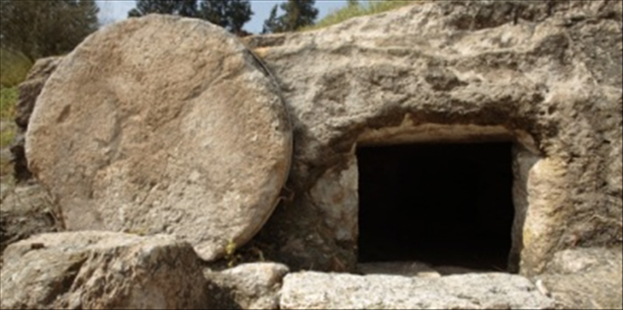
He Is Not Here
Mary Magdalene and another woman named Mary came to the tomb to anoint Jesus' body as an expression of their love and adoration.
Among which was Mary Magdalene, and Mary the mother of James and Joses, and the mother of Zebedee’s children.
Matthew 27:54-56

Slide 9
Resurrection VS Brought Back From the Dead
What is the difference between being brought back from the dead and being resurrected?
What will happen to all humankind as a result of the Resurrection of Jesus Christ?
How can understanding the doctrine of the Resurrection provide comfort for those who have lost loved ones?
Matthew 28:6

Slide 10
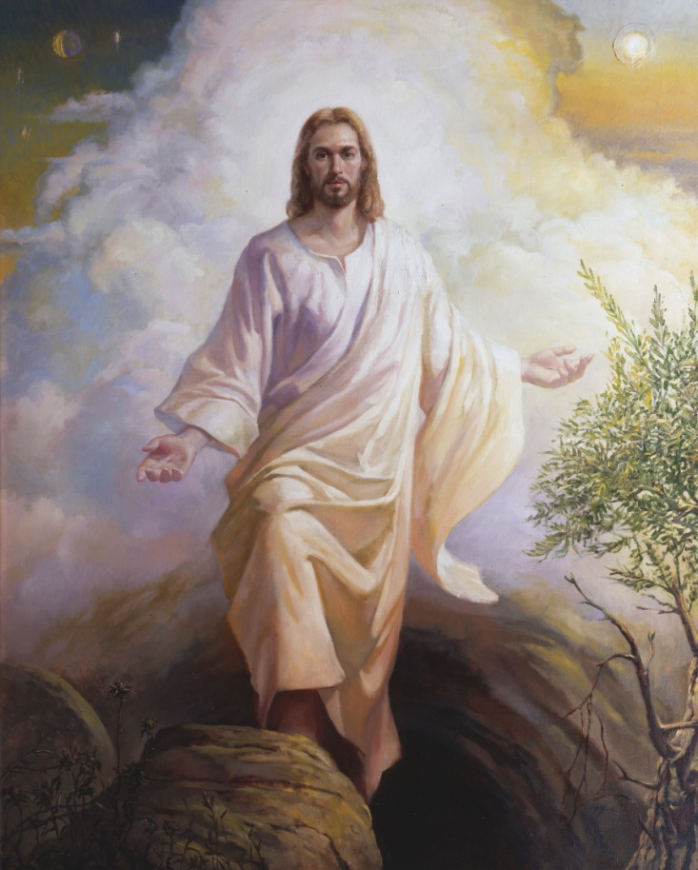
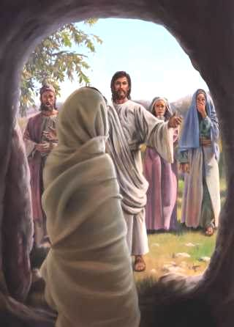
The Resurrection consists in the uniting of a spirit body with a body of flesh and bones, never again to be divided. The Resurrection shall come to all, because of Christ’s victory over death. Jesus Christ was the first to be resurrected on this earth.
Others had been brought back from death but were restored to mortality whereas a resurrection means to become immortal, with a body of flesh and bone.
All will not be raised to the same glory in the Resurrection nor will all come forth at the same time. Christ was first; the righteous have precedence over the wicked and come forth in the First Resurrection, whereas the unrepentant sinners come forth in the last resurrection.
Matthew 28:6
(3)

Slide 11
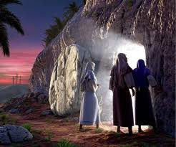
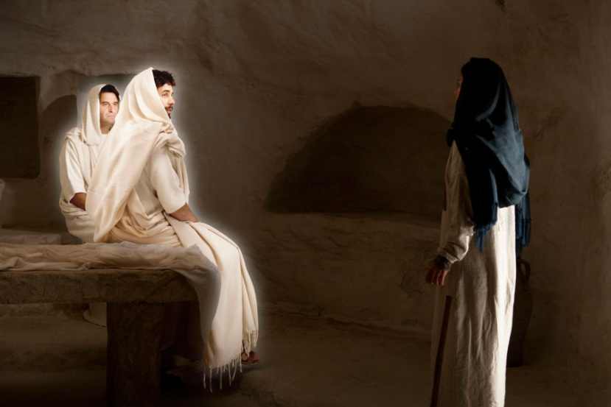
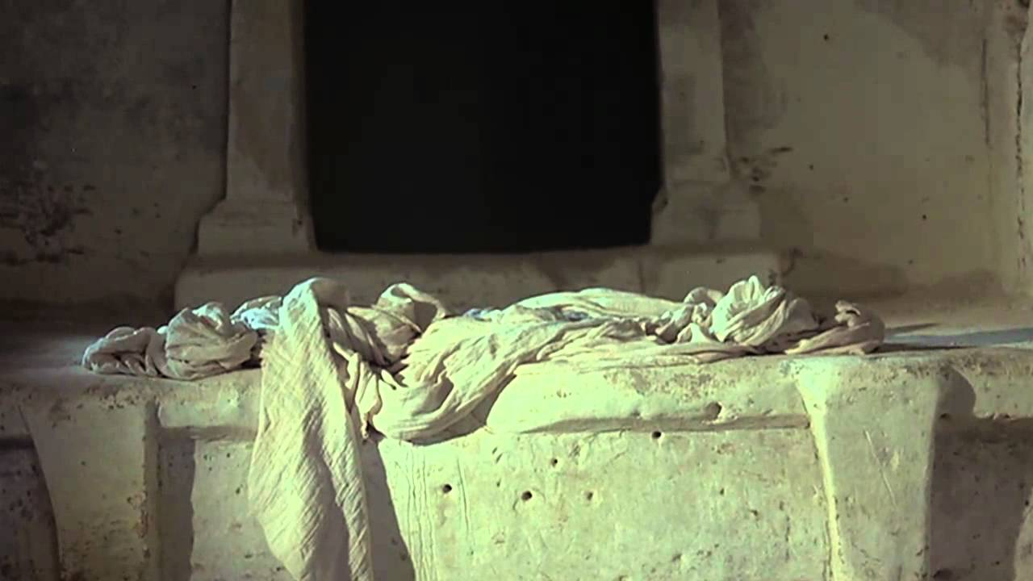
“He is Risen”
The New Testament gives ample evidence that Jesus rose with His physical body: He ate fish and honey
He said He had flesh and bones the people touched Him. the tomb was empty and the angels said He had risen.
One of the most fundamental doctrines taught by the Twelve was that Jesus was risen from the tomb, with His glorified, resurrected body, as in. To obtain a resurrection with a celestial, exalted body is the center point of hope in the gospel of Jesus Christ. The Resurrection of Jesus is the most glorious of all messages to mankind.
Matthew 28:6
(3)

Slide 12
What day of the week was it? (Matthew 28:1)

Slide 13
Who went to the sepulcher?
(Matthew 28:1)

Slide 14
Who appeared?
(Matthew 28:2)

Slide 15
How was the stone rolled away from the sepulcher?
(Matthew 28:2)

Slide 16
What happened to the soldiers?
(Matthew 28:4)

Slide 17
What did the angel say?
(Matthew 28:5-7)
He is not here: for he is risen, as he said. Come, see the place where the Lord lay.

Slide 18
Where did the women go?
(Matthew 28:8)

Slide 19
What happened to them on the way?
(Matthew 28:9-10)
Be not afraid: go tell my brethren that they go into Galilee, and there shall they see me.

Slide 20
What happened to some of the dead in Jerusalem after Christ was resurrected?
(Matthew 28:52-53)

Slide 21
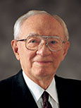
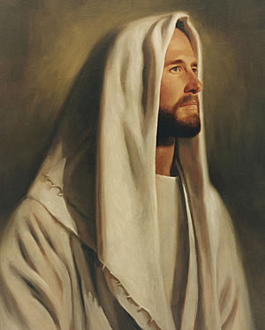
“The miracle of that resurrection morning, that first Easter Sunday, is a miracle for all mankind. It is the miracle of the power of God, whose Beloved Son gave His life to atone for the sins of all, a sacrifice of love for every son and daughter of God. In so doing He broke the seals of death. …
“And just as He took up His body and came forth from the tomb, even so shall all of us enjoy a reunion of body and spirit to become living souls in the day of our own resurrection.
“We rejoice, therefore, as do many, and as should all mankind, when we remember the most glorious, the most comforting, the most reassuring of all events of human history—the victory over death.” (13)
(4)

Slide 22
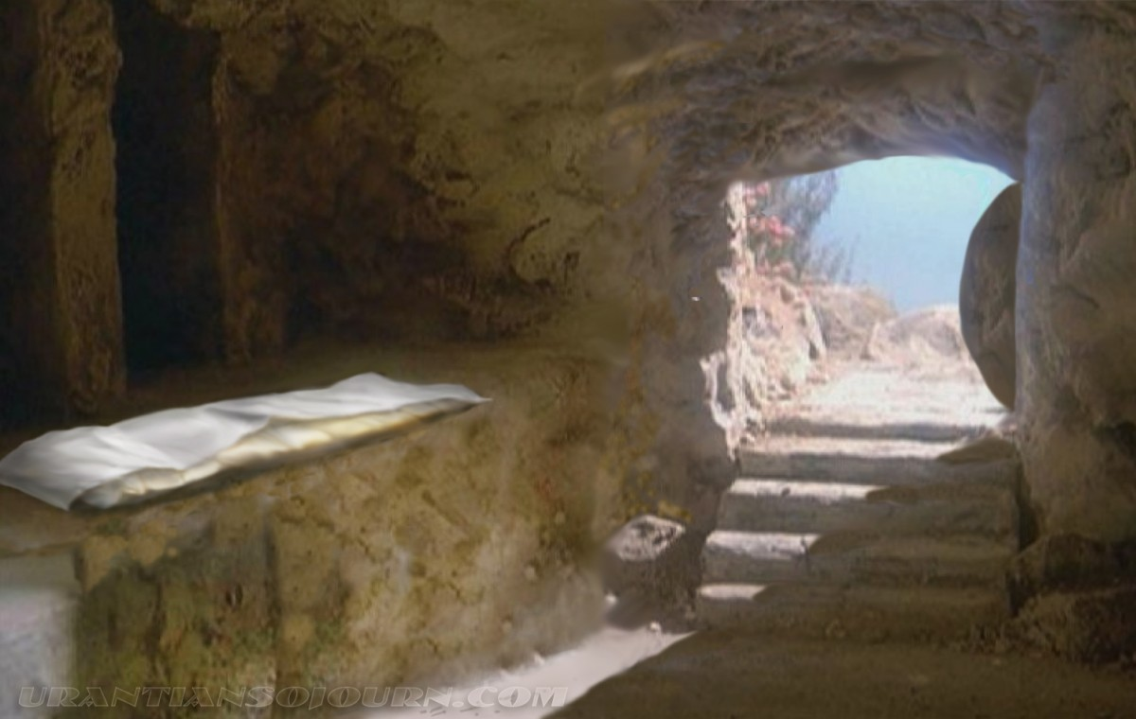
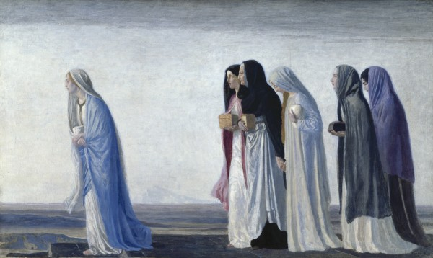
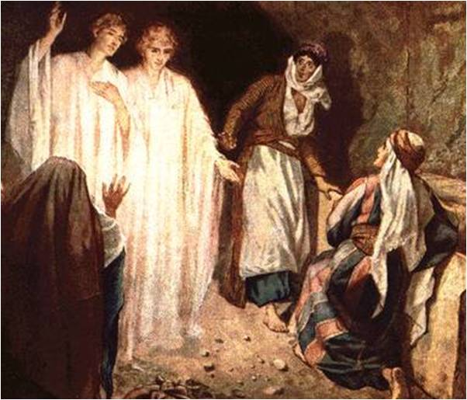
Day After Sabbath
After the day of the Sabbath when Mary Magdalene and other women came to the Savior’s tomb on Sunday morning, they found the body of Jesus gone.
Two heavenly messengers reminded them that Jesus had spoken to them about his death and Resurrection while they were in Galilee. At that time He had testified,
“The Son of man must be delivered into the hands of sinful men, and be crucified, and the third day rise again”
Luke 24:1-7; Matthew 17:22-23
(1)

Slide 23
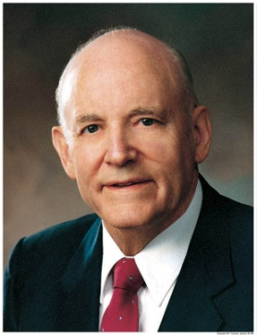
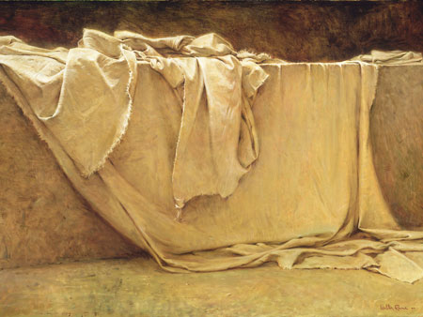
“He is Risen; He is Not Here”
He was the Son of God, the Son of our immortal Father in Heaven, and his triumph over physical and spiritual death is the good news every Christian tongue should speak. …
“Without the Resurrection, the gospel of Jesus Christ becomes a litany of wise sayings and seemingly unexplainable miracles—but sayings and miracles with no ultimate triumph. No, the ultimate triumph is in the ultimate miracle: for the first time in the history of mankind, one who was dead raised himself into living immortality.
Walter Rane
“On the third day, he did arise to live again—the Savior of all mankind and the firstfruits of the Resurrection. Through this atoning sacrifice, all men shall be saved from the grave and shall live again.”
Mark 16
(14)

Slide 24
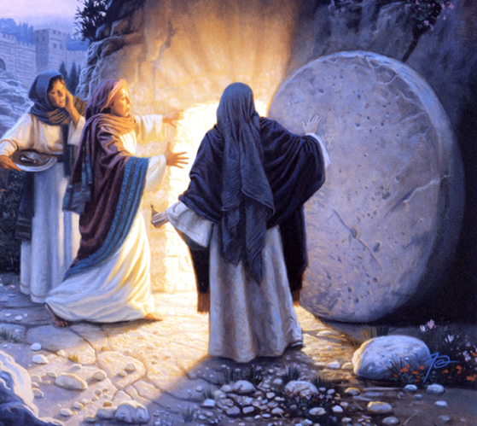
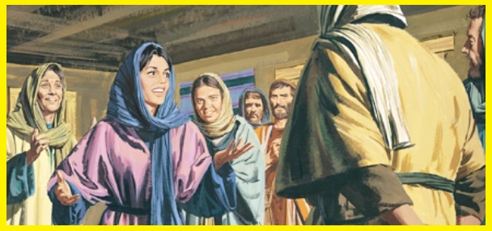
“Go Quickly”
“…tell his disciples that he is risen from the dead; and, behold, he goeth before you into Galilee; there shall ye see him; lo, I have told you.
Matthew 28:7
Mary Magdalene, and Joanna, and Mary the mother of James, and other women that were with them, and told the things to the disciples.
Luke 24:9-10
(1)

Slide 25
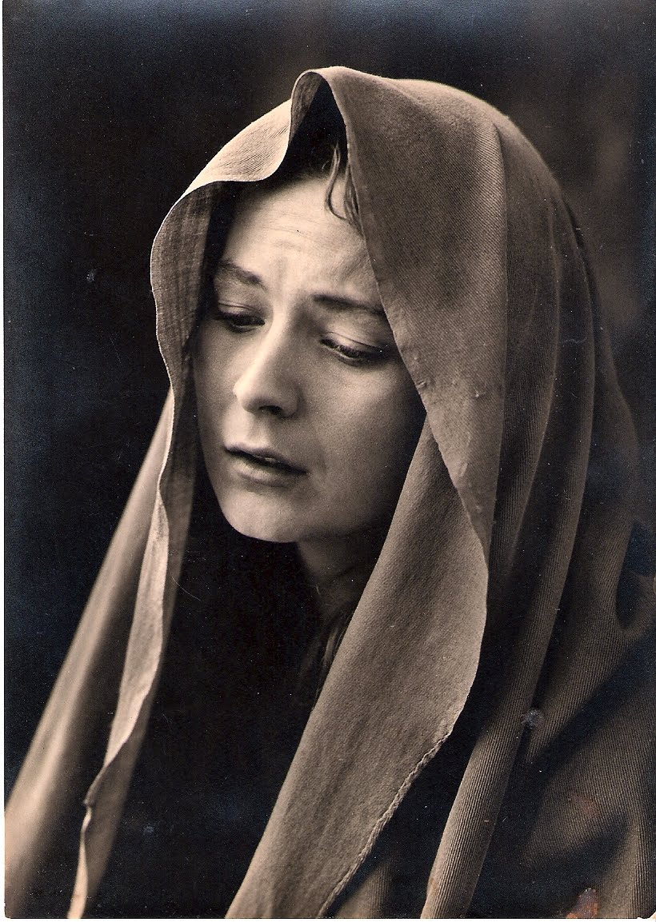
Mary Magdalene
Mary Magdalene seems to have served in a leadership capacity and had a prominent role in serving the Savior and a close association with Him.
She is mentioned first in several listings of female followers.
She was near the cross when Jesus died.
She was the first to speak and see the resurrected Lord.
Luke 24:9-10; Matthew 27:56; John 20:1-18
(1)

Slide 26
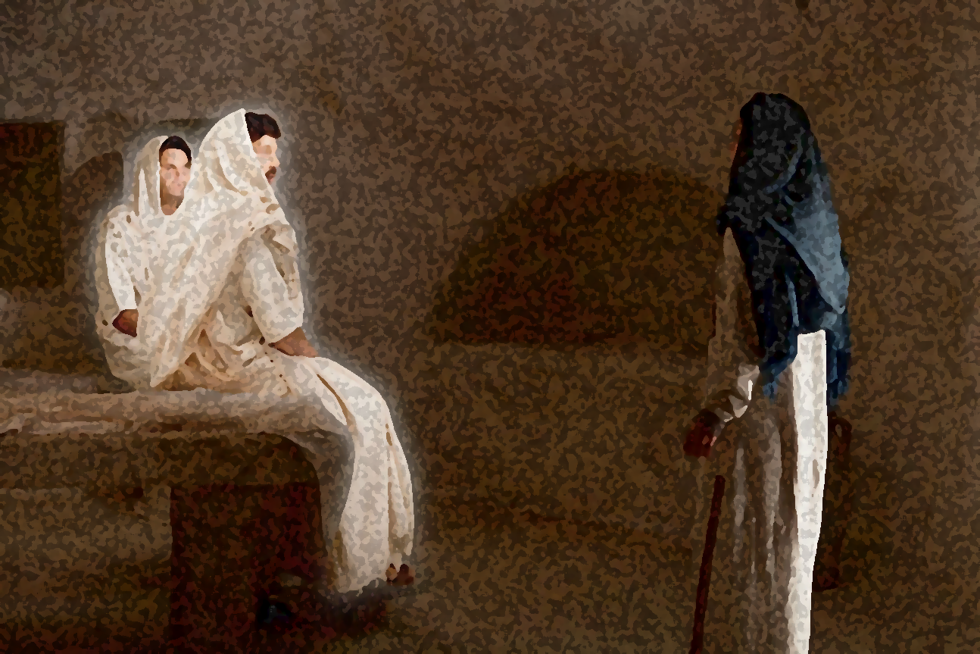
“Why Seek Ye Among the Living?”
And shall deliver him to the Gentiles to mock, and to scourge, and to crucify him: and the third day he shall rise again.
Matthew 20:19
And they shall scourge him, and put him to death: and the third day he shall rise again.
Luke 18:33
And they shall mock him, and shall scourge him, and shall spit upon him, and shall kill him: and the third day he shall rise again.
Mark 10:34
Remember What He Has Taught?
The Son of man must be delivered into the hands of sinful men, and be crucified, and the third day rise again.
Luke 24:5-8; John 20:12

Slide 27
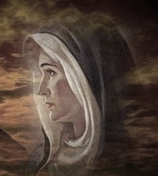
“Why Weepest Thou?”
…Because they have taken away my Lord, and I know not where they have laid him.”
John 20:13
John 20:13

Slide 28
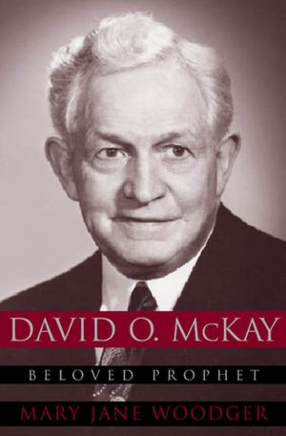
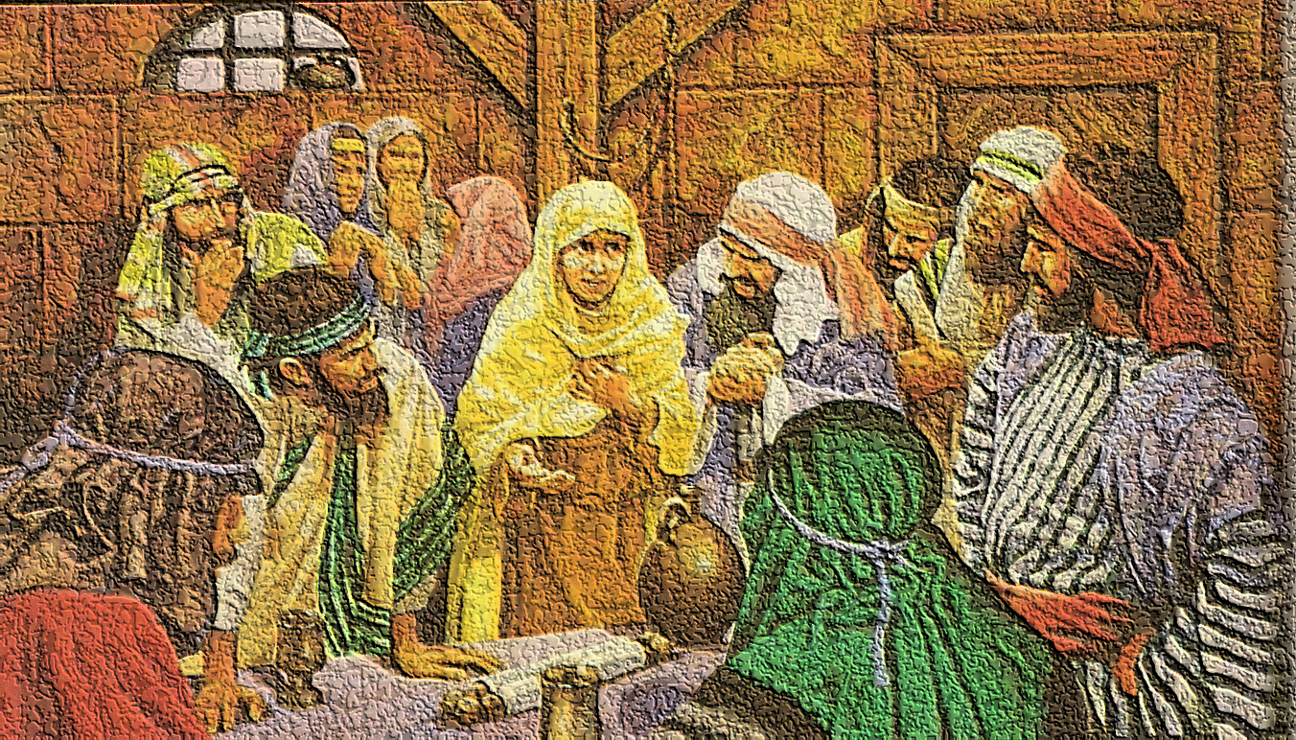
Idle Tales
…they have taken away the Lord out of the sepulchre, and we know not where they have laid him.”
"Like the apostles of old, this knowledge and belief should transform all of us to be confident, settled, unafraid, and at peace in our lives as followers of the divine Christ.
It should help us carry all burdens, bear any sorrows, and fully savor all joys and happiness that can be found in this life.“ (16)
“And their words seemed to them as idle tales, and they believed them not.”
John 20:2; Luke 24:11

Slide 29
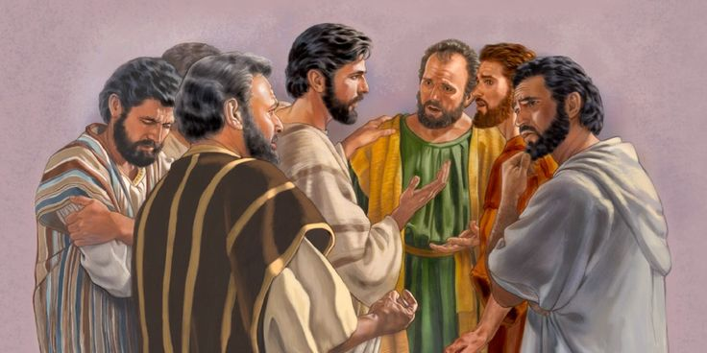
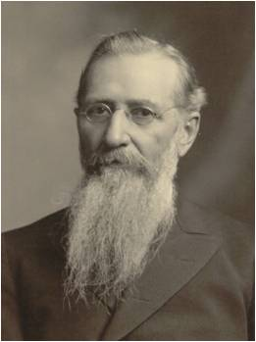
Forgetful
Even though Jesus had foretold His death and Resurrection on several occasions the Apostles found it difficult to believe the news of the Lord’s Resurrection when they heard it.
“Why were they thus forgetful and seemingly ignorant of all they had been taught by the Savior respecting the objects of his mission to the earth?
Because they lacked one important qualification, they had not yet been ‘endowed with power from on high.’
They had not yet obtained the gift of the Holy Ghost.”(2)
Luke 24:11, 49
(1)

Slide 30
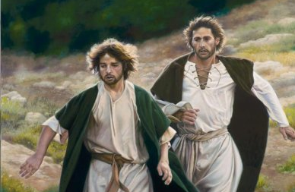
Peter and That Other Disciple
It was probably John the Beloved that ran with Peter to the sepulchre.
“Peter, and “that other disciple” who, doubtless, was John, set forth in haste, running together toward the sepulchre. John outran his companion, and on reaching the tomb stooped to look in, and so caught a glimpse of the linen cerements lying on the floor; [but it was Peter who entered first].” (17)
John 20:3

Slide 31
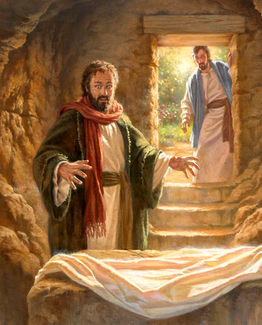
“And he (John) stooping down, and looking in, saw the linen clothes lying; yet went he not in.”
“Then cometh Simon Peter following him, and went into the sepulchre, and seeth the linen clothes lie.”
John 20:5-6; Luke 24:12

Slide 32
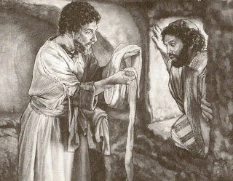
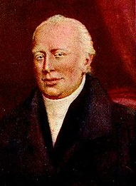
“Then went in also that other disciple, which came first to the sepulchre and he saw, and believed.”
Peter seeth the linen clothes lie, and the napkin that was about his head not lying with the linen clothes, but wrapped together in a place by itself. All these circumstances prove that the thing was done leisurely; order and regularity being observed through the whole. Hurry and confusion necessarily mark every act of robbery. (18)
“And the napkin, that was about his head, not lying with the linen clothes, but wrapped together in a place by itself.”
It must have been John, the Beloved as “that other disciple”.
The other authors do not mention the napkin.
John had an eye for detail.
“Then the disciples went away again unto their own home.”
John 20:7-8, 10

Slide 33
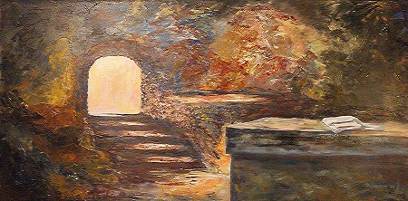
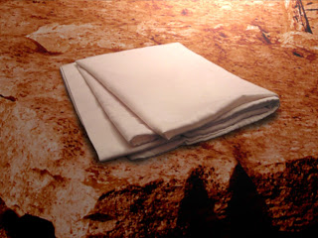
Neatly Folded Napkin
The head covering over the body of Jesus Christ in the grave was a neatly “folded napkin.”
It goes on to say that among Jews of the time a master would let his servants know whether he was finished eating or coming back to the table by the way he left his napkin.
If he tossed it aside, he was finished.
If he folded it, he was not finished and would return.
The hidden message in the story is that by laying his “napkin” aside and neatly folded Jesus was saying he was coming back.
See notes*
John 20:7

Slide 34
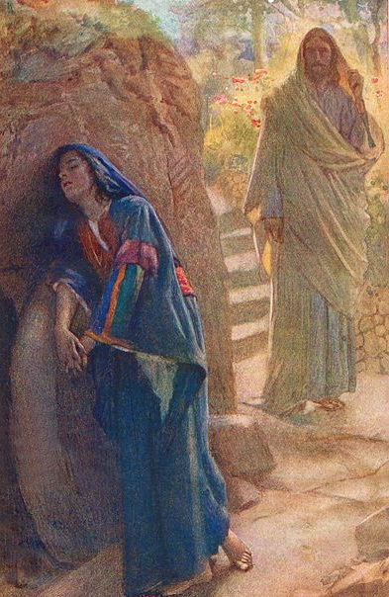
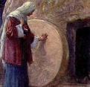
Jesus Appears to Mary
Mary followed Peter and John to the tomb, stayed and wept.
She is the only person mentioned in each of the four Gospels as a witness to the Crucifixion, burial, and empty tomb.(1)
Mary Magdalene, or Mary of Magdala, likely came from a town called Magdala on the western shore of the Sea of Galilee.
According to Mark 16:9 and Luke 8:2, the Savior previously cleansed her of “seven devils.”
She was a disciple of Jesus Christ and “became one of the closest friends Christ had among women.” (17)
John 20:10-11
Harold Copping

Slide 35
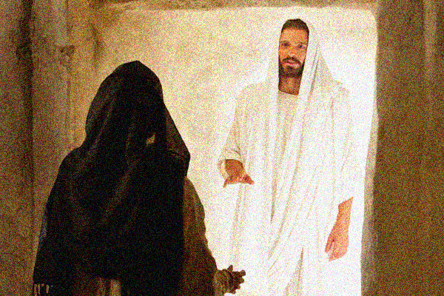
Turn Around
“And when she had thus said, she turned herself back, and saw Jesus standing, and knew not that it was Jesus.”
“Now when Jesus was risen early the first day of the week, he appeared first to Mary Magdalene…”
John 20:14; Mark 16:9

Slide 36
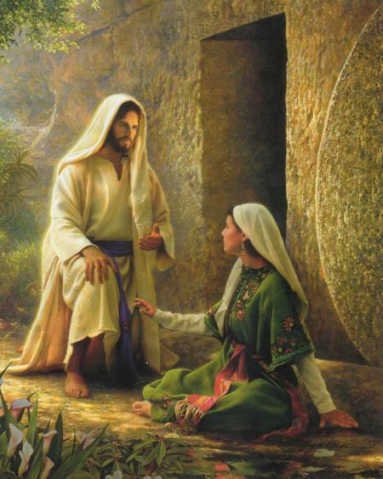
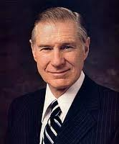
The Gardener
“Jesus saith unto her, Woman, why weepest thou?...
…Sir, if thou have borne him hence, tell me where thou hast laid him, and I will take him away.”
"The Savior was speaking not just to the sorrowing Mary. He was also speaking to us-men, women, and children and all of mankind ever born or yet to be born, for the tears of sorrow, pain, or remorse are the common lot of mankind.
Some have so much, while others struggle with so very little...Jesus said, 'Be not faithless, but believing' .
Through faith and righteousness all of the inequities, injuries, and pains of this life can be fully compensated for and made right. Blessings denied in this life will be fully recompensed in the eternities.“ (19)
Greg Olsen
John 20:15

Slide 37
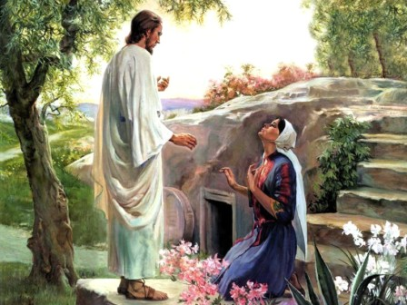
Rabboni
“Jesus saith unto her, Mary…
The Aramaic word Rabboni, used by Mary to address the resurrected Savior, is used only twice in the New Testament.
The King James translators retained the Aramaic word and John’s translation for his readers, which is “Master.”
In Mark 10:51, the word is translated as “Lord.”
The title Rabbi was used for respected teachers among first-century Jews.
Rabboni, a more lofty form of the title Rabbi, was a title that was rarely used and was usually reserved for highly esteemed teachers who had both divine knowledge and authority to teach others.
John 20:16
(1)

Slide 38
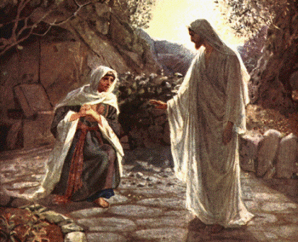
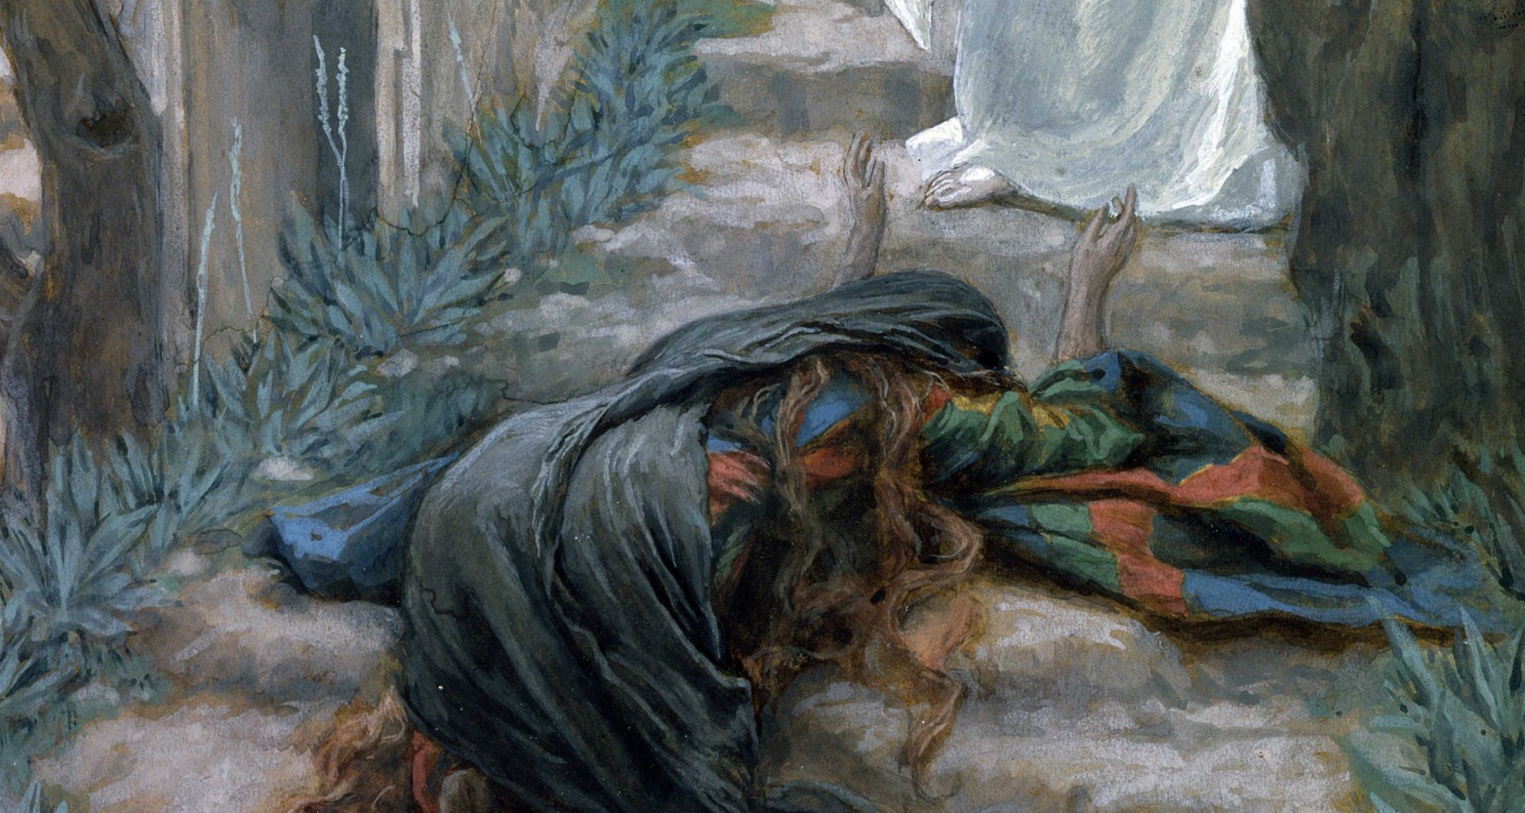
“Touch Me Not”
“…touch me not; for I am not yet ascended to my Father…
Some give the meaning as ‘Do not cling to me any longer,’ or ‘Do not hold me any longer.’
Some speak of ceasing to hold him or cling to him, leaving the inference that Mary was already holding him.
There is valid reason for supposing that the thought conveyed to Mary by the Risen Lord was to this effect: ‘You cannot hold me here, for I am going to ascend to my Father.’”
Tissot
The King James Version = ‘Touch me not.’
The Joseph Smith Translation = ‘Hold me not.’
Greek Variations = ‘Do not cling to me’ or ‘Do not hold me.’
John 20:17
(12)

Slide 39
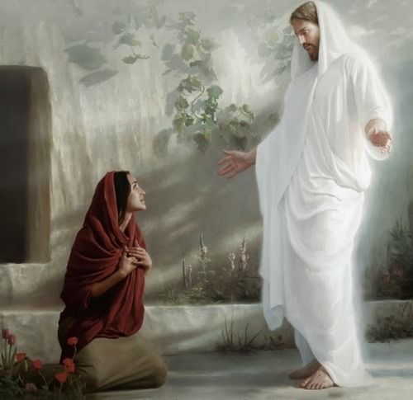
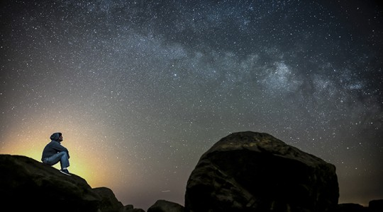
After Resurrection
Jesus Christ’s appearance to Mary Magdalene makes clear that after His Resurrection, there would be a respectful separation between the mortal disciples and the immortal Christ.
Joseph Brickey
Jesus' appearance also clarifies that He did not go directly into the presence of God the Father after His death.
In the same way, after we die, our spirits will go to the world of spirits and await the time when they will be reunited with our physical bodies.
John 20:17
(1)

Slide 40
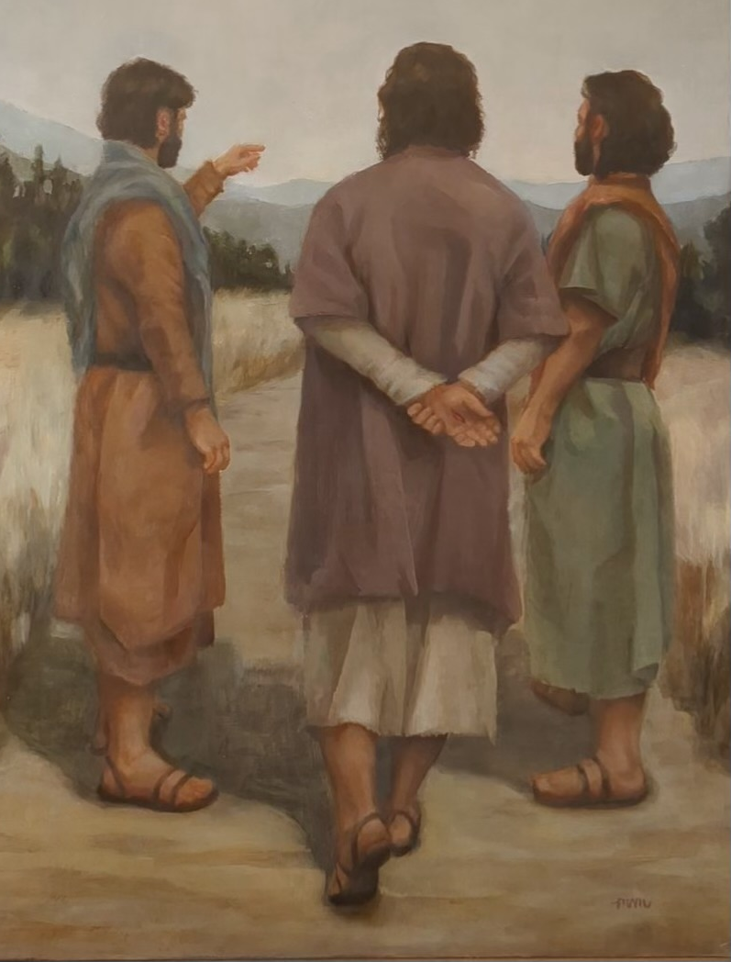
Road to Emmaus
Two of His disciples, one of whom was Cleopas, were walking toward Emmaus, a distance of “threescore furlongs” from Jerusalem (about seven miles or eleven kilometers)
Like Peter, these disciples had hoped that Jesus would be the political and military leader desired by the Jews. Thus, after the Savior began walking with them without them knowing His identity, they sadly spoke of the Savior’s death and said,
“We trusted that it had been he which should have redeemed Israel”
Will we recognize Christ when He returns?
Have we been taught that He will return?
Maureen Goates Merrell
Luke 24:13-35
(1)

Slide 41
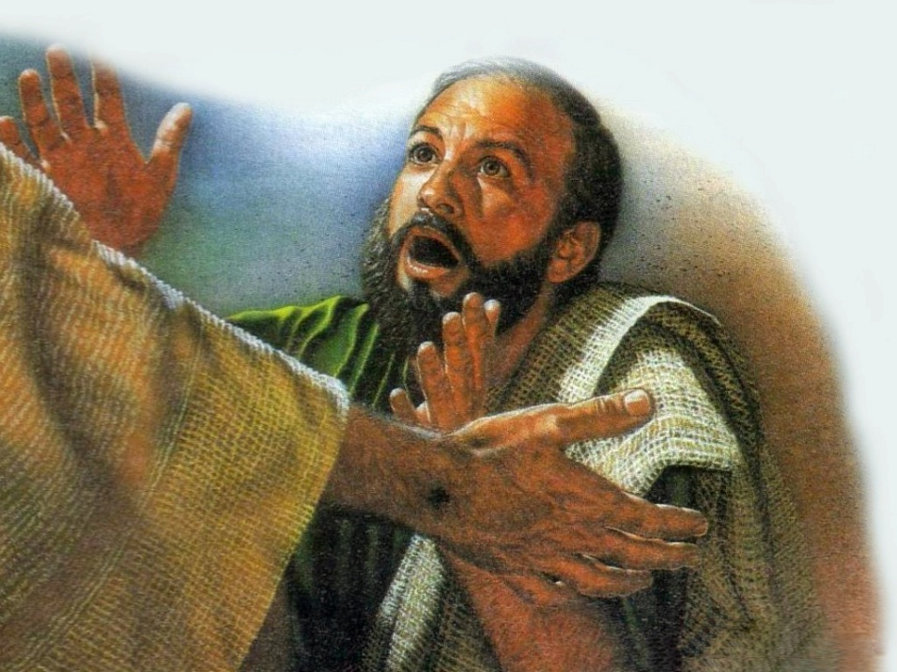
Jesus Meets With Simon Peter
And they rose up the same hour, and returned to Jerusalem, and found the eleven gathered together, and them that were with them,
Saying, The Lord is risen indeed, and hath appeared to Simon.
On the day of the Savior’s Resurrection, a sacred meeting occurred between the Lord and Peter, His chief Apostle. This meeting is mentioned only in Luke 24:34 and in 1 Corinthians 15:5, but these references give no details about what took place.
Luke 24:33-53
(1)

Slide 42
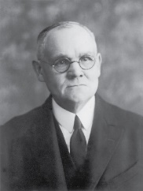
Peter Sees the Lord
"This is the sole mention made by the Gospel-writers of Christ's personal appearance to Simon Peter on that day.
The interview between the Lord and His once recreant but now repentant apostle must have been affecting in the extreme.
Peter's remorseful penitence over his denial of Christ in the palace of the high priest was deep and pitiful; he may have doubted that ever again would the Master call him His servant; but hope must have been engendered through the message from the tomb brought by the women...
To the repentant Peter came the Lord, doubtless with forgiveness and loving assurance."
Luke 24:34; 1 Corinthians 15:5
(17)

Slide 43
"...while he was teaching them they had no realization, of the greatness of the experience that was theirs.
It was only at their journey's end, when they sat to eat and Christ broke bread and blessed it, that their 'eyes were opened, and they knew him.' Only then did the one turn to the other and say, 'Did not our heart burn within us, while he talked with us by the way, and while he opened to us the scriptures?’
"As is so often the case, the spiritual hindsight of these two disciples was appreciably better than their immediate spiritual insight.“
Luke 24:31-32
(4)

Slide 44
Other Women Witnesses The Savior
“… Jesus chose to appear to and be handled by a group of other women-all before he came even to Peter and the rest of the Twelve... We know that women in general are more spiritual than men, and certainly their instincts and desires to render compassionate service exceed those of their male counterparts.”(12) See Notes*
Tissot
It appears reasonable and probable that between Mary's impulsive attempt to touch the Lord, and the action of the other women who held Him by the feet as they bowed in worshipful reverence, Christ did ascend to the Father, and that later He returned to earth to continue His ministry in the resurrected state." (17)
Matthew 26:9-10

Slide 45
The 10 Apostles See the Lord
“In an instant the eyes that had been filled with ever-flowing tears dried. The lips that had whispered prayers of distress and grief now filled the air with wondrous praise, for Jesus the Christ, the Son of the living God, stood before them as the firstfruits of the Resurrection, the proof that death is merely the beginning of a new and wondrous existence.” (3)
Which Apostle was not present when the other disciples saw the resurrected Lord?
John 20:19-20
(20)

Slide 46
Doctrinal Mastery
And as they thus spake, Jesus himself stood in the midst of them, and saith unto them, Peace be unto you.
But they were terrified and affrighted, and supposed that they had seen a spirit.
And he said unto them, Why are ye troubled? and why do thoughts arise in your hearts?
Behold my hands and my feet, that it is I myself: handle me, and see; for a spirit hath not flesh and bones, as ye see me have.
Luke 24:36-39

Slide 47
The 11 Apostles See the Lord
“We think of Thomas as one who had traveled and talked with the Master, and who had been chosen by him. Inwardly we wish that Thomas could have turned toward the future with confidence in the things which were not then visible, instead of saying in effect, ‘To see is to believe.’ …
“A week later, the disciples were again together in the same house in Jerusalem. This time Thomas was with them. The door was closed, but Jesus came and stood in the midst of them and said, ‘… Peace be unto you.
“‘Then saith he to Thomas, Reach hither thy finger, and behold my hands; and reach hither thy hand, and thrust it into my side: and be not faithless, but believing.’”
Jeff Ward
Thomas Was Devoted to Jesus:
Then said Thomas, which is called Didymus, unto his fellow disciples, Let us also go, that we may die with him.
John 11:16
John 20:26-27
(14)

Slide 48
The Holy Spirit
Apostles must receive the Gift of the Holy Ghost prior to preaching the gospel
"He would not suffer them to commence this mission until the promise of the Father-the Holy Ghost-was given to them. They already had power to work mighty miracles, but had not the power to build up the kingdom of God.
This power they were to tarry for in Jerusalem, and when they should receive it, they were then to commence the duties of their mission, first, in the city of Jerusalem, and afterwards extend their labors to all nations.
The power to work miracles is entirely a different thing from the power to build up the kingdom of God: the latter power, however, always includes the former, but the former power does not always include the latter." (10)
Luke 24:47-49

Slide 49
Given the Authority to Remit Sins
The “keys of the kingdom of heaven” that the Savior had earlier bestowed on the Apostles gave them the power to bind or loose on earth and in heaven.
The Savior used similar language as He instructed the Apostles about their authority to remit or retain sins.
This same apostolic power is always found in the true Church.
The Lord said to Joseph Smith: “I have conferred upon you the keys and power of the priesthood … ; and whosesoever sins you remit on earth shall be remitted eternally in the heavens; and whosesoever sins you retain on earth shall be retained in heaven”
Joseph Brickey
John 20:23; Matthew 16:19; Matthew 18:18; D&C 132:45-46
(1)

Slide 50
Retaining His Wounds
Several possible reasons why Jesus Christ has retained the wounds of the Crucifixion in His hands, feet, and side:
To substantiate His literal, physical Resurrection
To testify that He is the Messiah of whom the prophets wrote
To identify Himself as the Messiah to the Jews in the last days and to assure the faithful of His power to save and bless
John 20:27; 3 Nephi 11:11-17; Zechariah 12:9-10; D&C 45:51-52; D&C 6:34-37
(1)

Slide 51
“Even though the power of the Resurrection could have—and undoubtedly one day will have—completely restored and made new the wounds from the crucifixion, nevertheless Christ chose to retain those wounds for a purpose, including for his appearance in the last days when he will show those marks and reveal that he was wounded ‘in the house of [his] friends’.
“The wounds in his hands, feet, and side are signs that in mortality painful things happen even to the pure and the perfect, signs that tribulation is not evidence that God does not love us. It is a significant and hopeful fact that it is the wounded Christ who comes to our rescue. He who bears the scars of sacrifice, the lesions of love, the emblems of humility and forgiveness is the Captain of our Soul.
That evidence of pain in mortality is undoubtedly intended to give courage to others who are also hurt and wounded by life, perhaps even in the house of their friends.”
(12)

Slide 52
Resurrection
"We...believe in the literal resurrection of the body, reunited with the spirit, becoming the spiritual body or the soul as defined by scripture. If we should eliminate from our religious beliefs the doctrine of the atonement and resurrection of Jesus Christ and the resurrection of mankind, there would be nothing left but a code of ethics.” (5)
"Jesus did not lose his body after his resurrection. In some mysterious way it did not evaporate, neither did it expand to fill the immensity of space. Jesus had his body as he ascended to his Father from the Mount of Olives, and the record is perfectly clear that he will still have that same body when he comes in glory to judge the world." (6)
Luke 24:38-39

Slide 53
Proofs—Hearing, Seeing, Touched, Breathed Upon, and Witnessing
"That Jesus literally rose from the grave in the most real physical sense, with the same body of flesh and bones he had on earth, is demonstrated in many ways.
The Angels said He had risen.
The Apostles felt his resurrected body with their own hands and saw the nail holes and the hole from the spear.
After he shewed them his hands and feet, he breathed on them.
(John 20:20,22)
The women and then the brethren noted that the body was no longer in the tomb.
The women held Jesus by the feet
(Matthew 28:9)
Jesus ate real food.
(Luke 24:42)
Such evidences attest not only to Jesus' having a body but also that it was the same body he possessed at death-the body which was nailed to the cross. The evidence that he was resurrected and alive must of necessity be as clear and definite as the evidence that he had died." (7)
Luke 24:36-40

Slide 54
All Things Must Be Fulfilled
“…Christ's reference to the canon of scripture in the meridian of time... Jesus here made reference to the threefold division of the Hebrew Bible-the Law, the Prophets, and the Writings (although he called the Writings 'the psalms' here, probably because the book of Psalms is the first and longest book in the third section)." (8)
"The fact that the Lord himself reads to men out of the ancient books, 'for . . . they are they which testify of me', even though he is personally present among them as the risen Savior addressing them with his own lips, gives awesome testimony to the authority of the written word.” (9)
Luke 24:44; John 5:39

Slide 55
Carried Up Into Heaven
“Christ’s Ascension is literal in the fullest and most complete sense of the word. He was a resurrected man, a personage of tabernacle who, though immortal, walked and talked and ate with his earthly friends. …
The resurrected Lord ascended from the earth and went to the place where his Father is. As our latter-day revelation expresses it:
Wherefore, the Almighty God gave his Only Begotten Son, as it is written in those scriptures which have been given of him.
He suffered temptations but gave no heed unto them.
He was crucified, died, and rose again the third day;
And ascended into heaven, to sit down on the right hand of the Father, to reign with almighty power according to the will of the Father;
D&C 20:21-24
Luke 24:47-49

Slide 56
Ascension Into Heaven
First account in the New Testament
It records the fulfillment of the Savior’s earlier declarations that He would sit at the right hand of God in heaven.
“We believe that the greatest story ever told in all the annals of history, is the story of the atonement of Christ. The record of his resurrection and ascension, without which the atonement would not have been complete, is the climax to that story, and now, two thousand years after the event, it is still central and pivotal in all true Christian thought.”
Mark 16:19
(15)

Slide 57
“Through the Atonement of Jesus Christ, all people will be resurrected—saved from physical death. Resurrection is the reuniting of the spirit with the body in a perfect, immortal state, no longer subject to disease or death. …
“An understanding and testimony of the resurrection can give you hope and perspective as you experience the challenges, trials, and triumphs of life.
You can find comfort in the assurance that the Savior lives and that through His Atonement, ‘he breaketh the bands of death, that the grave shall have no victory, and that the sting of death should be swallowed up in the hopes of glory.’ ”
1 Corinthians 15:22; Alma 11:42:45; Alma 22:14
(11)

Slide 58
“Believe in the Son of God, that he will come to redeem his people, and that he shall suffer and die to atone for their sins; and that he shall rise again from the dead, which shall bring to pass the resurrection, that all men shall stand before him, to be judged at the last and judgment day”
(Alma 33:22).
“The central purpose of all scripture is to fill our souls with faith in God the Father and in His Son, Jesus Christ. …
“… Faith comes by the witness of the Holy Spirit to our souls, Spirit to spirit, as we hear or read the word of God.
And faith matures as we continue to feast upon the word. …
“… Study the scriptures carefully, deliberately. Ponder and pray over them.
Scriptures are revelation, and they will bring added revelation.”
(3)

Slide 59
Sources:
New Testament Institute Student Manual Chapter 20
Joseph F. Smith (Gospel Doctrine, 5th ed. [1939], 20).
D. Todd Christofferson,“ The Blessing of Scripture,” Ensign or Liahona, May 2010, 34, 35
Joseph Fielding McConkie, Seeking the Spirit [Salt Lake City: Deseret Book Co., 1978], 7.
President Howard W. Hunter (Conference Report, April 1969, Afternoon Session 138.)
Sterling W. Sill (Conference Report, April 1963, Second Day-Morning Meeting 42 - 43.)
Excerpts from (Robert J. Matthews, Behold the Messiah [Salt Lake City: Bookcraft, 1994], 278.)
Robert L. Millet, Selected Writings of Robert L. Millet: Gospel Scholars Series [Salt Lake City: Deseret Book Co., 2000], 7.)
Hugh Nibley (Enoch the Prophet, 133 - 134.)
Orson Pratt's Works [Salt Lake City: Deseret News Press, 1945], 41 - 42
True to the Faith: A Gospel Reference[2004], 139, 140).
Elder Bruce R. McConkie (Doctrinal New Testament Commentary,1:872). Bruce R. McConkie (The Mortal Messiah, 4 vols. [1979–81], 4:264) and (The Mortal Messiah: From Bethlehem to Calvary, 4 vols. [Salt Lake City: Deseret Book Co., 1979-1981], 4: 265
President Gordon B. Hinckley (“The Victory over Death,” Ensign, Apr. 1997, 4).
President Howard W. Hunter (“An Apostle’s Witness of the Resurrection,” Ensign, May 1986, 16–17); Pres. Howard W. Hunter (in Conference Report, Oct. 1962, 22–23).
Hugh B. Brown (Continuing the Quest [1961], 74).
President David O. McKay (Reach Up for the Light [Salt Lake City: Deseret Book Co., 1990], 136.)
Elder James E. Talmage Jesus the Christ p. 264, 638, 672, 682.
Adam Clarke Commentary
President James E. Faust ("Woman, Why Weepest Thou?" Ensign, Nov. 1996, 52)
Elder Joseph B. Wirthlin (“Sunday Will Come,” Ensign or Liahona, Nov. 2006, 29–30).
Elder Theodore M. Burton ("Neither Cryptic Nor Hidden," Ensign, May 1977, 28)
Presentation by ©http://fashionsbylynda.com/blog/

Slide 60
Order of Appearances of the Resurrected Savior | Scripture
To Mary Magdalene, near the sepulchre | Mark 16:9, 10 John 20:14
To other women, somewhere between the sepulchre and Jerusalem | Matthew 28:9
To two disciples on the road to Emmaus | Mark 16:12 Luke 24:13
To Peter, in or near Jerusalem | Luke 24:34 1 Corinthians 15:5
To ten of the apostles and others at Jerusalem | Luke 24:36 John 20:19
To the eleven apostles at Jerusalem --Thomas | Mark 16:14 John 20:26
To the apostles at the Sea of Tiberias, Galilee | John 21
To the eleven apostles on a mountain in Galilee | Matthew 28:16
To five hundred brethren at once | 1 Corinthians 15:6
To James (note: no record of this manifestation is made by the Gospel-writers) | 1 Corinthians 15:7
To the eleven apostles at the time of the ascension, Mount of Olives, near Bethany | Mark 16:19 Luke 24:50-51
To the Nephites in the Americas | 3 Nephi 10-28

Slide 61
Event | Matthew | Mark | Luke | John
Veil of the Temple Torn from Top to Bottom | 27:51 | 15:38 | 23:45
Testimony of Witnesses | 27:54-56 | 15:39-41 | 23:47-49
The Burial of Jesus | 27:57-61 | 15:42-47 | 23:50-56 | 19:38-42
Guards Placed at the Tomb | 27:62-66
Angel Rolls Back the Stone | 28:2-4
Women Find the Tomb Opened | 28:1 | 16:2-4 | 24:1, 2 | 20:1
Women Enter Tomb and See Angels Who Proclaim, “He is Not Here; for He is Risen” | 28:5-7 | 16:5-7 | 24:3-8
Women Hurry to Tell the Apostles | 28:8 | 16:8 | 24:9-11
Jesus Appears to Other Women | 28:9-10
Others Resurrected After Jesus | 27:52, 53
Guards Are Bribed by Chief Priests | 28:11-15
Jesus Appears to Other Women | 28:9-10
Others Resurrected After Jesus | 27:52, 53
Guards Are Bribed by Chief Priests | 28:11-15
Jesus Appears to the 11 in Galilee | 28:16-20 | 16:15-18

Slide 62
Event | Matthew | Mark | Luke | John
Women Find the Tomb Opened | 28:1 | 16:2-4 | 24:1, 2 | 20:1
Mary Magdalene Runs Immediately to Tell the Apostles |  |  |  | 20:2
Peter and John Witness the Empty tomb |  |  | 24:12 | 20:3-10
Jesus Appears to Mary Magdalene |  | 16:9-11 |  | 20:11-18
Jesus Appears to 10 Apostles and Those with Them |  | 16:14 | 24:36-48 | 20:19-23
Jesus Again Appears to Apostles including Thomas |  |  |  | 20:24-29
The Size of the Stone John 20:1:
The entrance of a Jewish tomb was quite small, so the stone needed to cover the opening would only be 4-6’ in diameter, and approximately 1’ thick. How much would such a stone weigh? Depending on the type of stone used, it could weigh between 1-2 tons (2000-4000 pounds). This is quite heavy, but two men could move it into place (Mt 27:60; John 19:38-42). The more difficult task was removing the stone.
Generally speaking, the rolling stone was set inside a groove in front of the entrance, and secured from falling over by a stone wall that stood in front of tomb opening (the rolling stone was sandwiched between the tomb entrance and stone wall as the pictures below illustrate). Often, the groove was not level, but slightly sloped. To close the tomb, the stone would be rolled down the groove at a decline and come to rest in front of the entrance. To open the tomb, the stone would have to be rolled up the groove at an incline.
Given the structure of such tombs, it would not have been possible for Jesus to simply push the stone over from the inside of the tomb. He would have to roll the 2000+ pound stone back up the groove without having anything to grip. Such a feat would not be possible for one healthy man, yet alone a man who had just been beaten (and hung on a cross) by the Romans.
The Size of the Stone Covering Jesus’ Tomb
Posted by Theosophical Ruminator
The Herodian family tomb west of the Old City provides an idea of what Joseph of Arimathea's tomb would have looked like

Slide 63
The Resurrected Matthew 27:53
How grateful are we to Matthew for including this important detail? Mark makes no mention of the resurrection of the saints. Luke says nothing. John is silent. Nephi is chastised for forgetting to record it (see 3 Ne. 23:7-13). Matthew's careful attention to detail underscores the importance of the resurrection, not just of the Master, but of all the saints. But who were these saints?
While Christ's earthly disciples mourned his crucifixion, his heavenly disciples anxiously awaited his visit to Spirit Paradise. On the cross, Christ was enclosed by 'the assembly of the wicked' (Ps. 22:16). Meanwhile, another great gathering commenced. It included Adam, Eve, with many of her faithful daughters, Abel, Seth, Noah, Shem, Abraham, Isaac, Jacob, Moses, Isaiah, Ezekiel, Daniel, Elias, Malachi, Elijah, the Nephite prophets-'All these and many more' (DC 138:38-49). What was the cause of such an important conference? They were all awaiting their glorious resurrection. gospeldoctrine.com
Myrrh and Aloes:
The amount of myrrh and aloes purchased by Nicodemus was similar to that used in royal burials, indicating that the Savior’s followers acknowledged His status as a king. (1)
Christ Resurrected on a Sunday:
As a result of Jesus Christ resurrecting early in the morning of Sunday, the observance of the Sabbath was changed from Saturday to Sunday:
“In Old Testament times, God’s covenant people observed the Sabbath on the seventh day of the week because God rested on the seventh day when He had created the earth. …
“After the Resurrection of Jesus Christ, which occurred on the first day of the week, the Lord’s disciples began observing the Sabbath on the first day of the week, Sunday (see Acts 20:7)” (True to the Faith: A Gospel Reference [2004], 145–46). See also the commentary for John 20:1–10.
Rewards of Resurrection
"What is the reward and status of those who were with Christ in his resurrection? 'They are raised to dwell with God who has redeemed them; thus they have eternal life through Christ, who has broken the bands of death.' (Mosiah 15:20-23.) Theirs is a state of glory and exaltation. Three of them-Abraham, Isaac, and Jacob-are singled out by name and made patterns for all the rest. Of these three the Lord says: 'They have entered into their exaltation, according to the promises, and sit upon thrones, and are not angels but are gods.' (D&C 132:29, 37.) These are they who were with Christ in his resurrection, who, as Matthew says, 'came out of the graves after his resurrection, and went into the holy city, and appeared unto many.' (Matt. 27:53.) These are they whom the Lord Jesus will bring with him in the clouds of glory when he comes to rule and reign among men for a thousand years." Elder Bruce R. McConkie (The Millennial Messiah: The Second Coming of the Son of Man, 632.)
He is Not Here (Special Witnesses of Christ’s Resurrection Matthew 28:6
“‘He is not here: for he is risen, as he said. Come, see the place where the Lord lay’
“These are the most reassuring words in all of human history. Death—universal and final—had now been conquered. …
“Never had this occurred before. There had been only death without hope. Now there was life eternal. Only a God could have done this. The Resurrection of Jesus Christ was the great crowning event of His life and mission. It was the capstone of the Atonement. The sacrifice of His life for all mankind was not complete without His coming forth from the grave, with the certainty of the Resurrection for all who have walked the earth.
“Of all the victories in the chronicles of humanity, none is so great, none so universal in its effects, none so everlasting in its consequences as the victory of the crucified Lord, who came forth from the tomb that first Easter morning.
“Those who were witnesses of that event, all who saw and heard and spoke with the Risen Lord, testified of the reality of this greatest of all miracles. His followers through the centuries lived and died in proclamation of the truth of this supernal act.
“To all of these we add our testimony that He who died on Calvary’s cross arose again in wondrous splendor as the Son of God, the Master of life and death” Pres. Gordon B. Hinckley (“Special Witnesses of Christ,” Ensign, Apr. 2001, 15).
.
The Empty Tomb Matthew 27:52-53:
“The empty tomb that first Easter morning brought comforting assurance, an affirmative answer to Job’s question, ‘If a man die, shall he live again?’ [Job 14:14].
“To all who have lost loved ones, we would turn Job’s question to an answer: If a man die, he shall live again. …
“Through tears and trials, through fears and sorrows, through the heartache and loneliness of losing loved ones, there is assurance that life is everlasting. Our Lord and Savior is the living witness that such is so.
“With all my heart and the fervency of my soul, I lift up my voice in testimony as a special witness and declare that God does live. Jesus is His Son, the Only Begotten of the Father in the flesh. … He became the firstfruits of the Resurrection. Because He died, all shall live again.” President Thomas S. Monson (“I Know That My Redeemer Lives!” Ensign or Liahona, May 2007, 25).

Slide 64
Did Not Believe Luke 24:11:
"Perhaps the apostles should not be unduly criticized for not believing that Jesus, having been crucified and buried in a tomb, had come back to earth as a glorified being. In all human experience, this had never happened before. This was completely unprecedented. This was a different experience from the raising of Jairus's daughter (Mark 5:22-24, 35-43), the young man of Nain (Luke 7:11-15), or Lazarus (John 11:1-44). They all died again. Jesus, however, became a resurrected being. He would never die again. So it was that to the apostles the story of Mary Magdalene and the other women who witnessed the resurrection 'seemed to them as idle tales, and they believed them not.' ("Luke 24:11.)
"Like the apostles of old, this knowledge and belief should transform all of us to be confident, settled, unafraid, and at peace in our lives as followers of the divine Christ. It should help us carry all burdens, bear any sorrows, and fully savor all joys and happiness that can be found in this life." James E. Faust Reach Up for the Light [Salt Lake City: Deseret Book Co., 1990], 136
Flesh and Bones Luke 24:39:
"Although a resurrected body has 'flesh and bones,' it does not have 'blood.' Joseph Smith taught that resurrected beings have 'spirit in their bodies, and not blood.' President John Taylor also taught this principle: 'When the resurrection . . . of man shall be consummated, . . . he [will] still be in the same image, . . . without variation or change in any of his parts or faculties, except the substitution of spirit for blood.'" (Daniel H. Ludlow, Selected Writings of Daniel H. Ludlow: Gospel Scholars Series [Salt Lake City: Deseret Book Co., 2000], 87.)
"Paul...says 'Flesh and blood cannot inherit the kingdom of God.' (1 Cor. 15:50) Blood is corruptible; the blood-quickened body is subject to the law of death. But Christ's body when it was raised from the dead was 'quickened by the spirit.' There was a great deal of difference, not only in this respect but in others. When the disciples were shut up in that room Christ was able to enter it without opening the door, which could not be done by mortals. He had power to manifest himself to his disciples, and he had power to cover himself from their gaze. He had power to overcome the laws of gravity, and on a certain occasion, after he had visited his disciples, had appeared to 500 brethren at once, had given instructions to his apostles to build up his church, as he spoke to them 'a cloud received him out of their sight.' He was able to lift himself up from the earth and depart from this sphere to another; his body was no longer a mortal body, no longer governed by the same laws as those by which we are governed." Charles W. Penrose (Journal of Discourses, 26 vols. [London: Latter-day Saints' Book Depot, 1854-1886], 21: 229.)
Teaching By the Scriptures Luke 24:27,32:
The Gospels record that initially the followers of Jesus did not fully recognize how Old Testament prophecies were fulfilled in the life of Jesus Christ. This lack of understanding contrasts with their later vivid understanding of His saving mission and the ways it fulfilled prophecy. For example, in Peter’s first public teaching after the Resurrection, he quoted Psalm 16:8–11 and Psalm 110:1 and explained how these prophecies were fulfilled by Jesus (see Acts 2:22–36). In Peter’s next recorded public teaching, he explained how the prophecies in Deuteronomy 18:15 and Genesis 22:18 were fulfilled by Jesus, and he taught that “all the prophets” had “foretold of these days” (see Acts 3:22–26). Later, Peter, Paul, and other disciples consistently referred to ways the scriptures of the Old Testament testified of Jesus and His work. (1)
Teaching from the Scriptures:
“If the Savior were among us in the flesh today, He would teach us from the scriptures as He taught when He walked upon the earth. In the synagogue at Nazareth, ‘there was delivered unto him the book of the prophet Esaias. … And he began to say unto them, This day is this scripture fulfilled in your ears’ [Luke 4:17, 21]. Later when the Sadducees and Pharisees posed a difficult question, ‘Jesus answered and said unto them, Ye do err, not knowing the scriptures, nor the power of God’ [Matthew 22:29]. And after His Resurrection, on the road to Emmaus, His disciples ‘said one to another, Did not our heart burn within us, while he talked with us by the way, and while he opened to us the scriptures?’ [Luke 24:32]. To His disciples then and now, His words ring out: ‘Search the scriptures; for … they are they which testify of me’ [John 5:39]—a testimony borne by the Holy Ghost, for ‘by the power of the Holy Ghost ye may know the truth of all things’ [Moroni 10:5]” Elder Robert D. Hales “Holy Scriptures: The Power of God unto Our Salvation,” Ensign or Liahona, Nov. 2006, 26).
Witness of Jesus Christ Through the Holy Ghost Luke 24:47-49:
"'Ye shall be witnesses unto me both in Jerusalem, and in all Judaea, and in Samaria, and unto the uttermost part of the earth.' (Acts 1:8; see also Acts 10:42-43.) However, he cautioned them that their witnessing would be after they had received the Holy Ghost. (See Acts 1:8; see also Luke 24:49.)
"An eyewitness was not enough. Even the witness and testimony of the original Apostles had to be rooted in the testimony of the Holy Ghost. A prophet has told us that the witness of the Holy Ghost makes an impression on our soul that is more significant than 'a visitation of an angel.' (Joseph Fielding Smith, Doctrines of Salvation, 1:44.) And the Bible shows that when we testify on the basis of this witness, the Holy Ghost testifies to those who hear our words. (See Acts 2; Acts 10:44-47.)" Dallin H. Oaks ("Witnesses of Christ,“ Ensign, Nov. 1990, 30)

Slide 65
Idle Tales Luke 24:11:
"Perhaps the apostles should not be unduly criticized for not believing that Jesus, having been crucified and buried in a tomb, had come back to earth as a glorified being. In all human experience, this had never happened before. This was completely unprecedented. This was a different experience from the raising of Jairus's daughter (Mark 5:22-24, 35-43), the young man of Nain (Luke 7:11-15), or Lazarus (John 11:1-44). They all died again. Jesus, however, became a resurrected being. He would never die again. So it was that to the apostles the story of Mary Magdalene and the other women who witnessed the resurrection 'seemed to them as idle tales, and they believed them not.' ("Luke 24:11Luke 24:11.)
Mary: John 20:11:
“No woman should question how the Savior values womanhood. The grieving Mary Magdalene was the first to visit the sepulchre after the Crucifixion, and when she saw that the stone had been rolled away and that the tomb was empty, she ran to tell Peter and John. The two Apostles came to see and then went away sorrowing. But Mary stayed. She had stood near the cross [see Matthew 27:56; Mark 15:40; John 19:25]. She had been at the burial [see Matthew 27:61; Mark 15:47]. And now she stood weeping by the empty sepulchre [see John 20:11]. There she was honored to be the first mortal to see the risen Lord.” President James E. Faust (“Woman, Why Weepest Thou?” Ensign, Nov. 1996, 54).
Jesus Spoke to Mary Calling Her by Her Name John 20:16:
"Jesus then spoke to her but one word-and the tenderness with which the word was uttered revealed to her his identity...But only one word was spoken to the woman and she no longer supposed him to be the gardener. 'Jesus saith unto her, Mary.'
"The burden of a saddened heart was lifted when she heard her name thus spoken. Many times before she had thus been addressed by her Lord, but never before had her name been spoken by immortal lips. It was a woman's name, not the name of a disciple, that the resurrected Son of God first uttered. To him Mary was the most favored of names. It was not only the name of the first woman to whom Christ spoke as the risen Lord. It was the name of the sainted mother who had given him birth; it was the name of the sister of Lazarus who had seen him restore life to her brother; it was the name of the mother of James and John; and many others whom he loved no doubt bore the name which he had spoken to the woman in the garden near the place of his burial." Matthew Cowley (Matthew Cowley Speaks [Salt Lake City: Deseret Book Co., 1954], 323.)
*Neatly Folded Napkin John 20:7
The head covering over the body of Jesus Christ in the grave was a neatly “folded napkin.” It goes on to say that among Jews of the time a master would let his servants know whether he was finished eating or coming back to the table by the way he left his napkin. If he tossed it aside, he was finished. If he folded it, he was not finished and would return. The hidden message in the story is that by laying his “napkin” aside and neatly folded Jesus was saying he was coming back.
https://www.truthorfiction.com/folded-napkin/
The folded napkin had to do with the Master and Servant, and every Jewish boy knew this tradition.
When the servant set the dinner table for the master, he made sure that it was exactly the way the master wanted it. The table was furnished perfectly, and then the servant would wait, just out of sight, until the master had finished eating, and the servant would not dare touch that table, until the master was finished. Now if the master was done eating, he would rise from the table, wipe his fingers, his mouth, and clean his beard, and would wad up that napkin and toss it onto the table. The servant would then know to clear the table. For in those days, the wadded napkin meant, 'I'm done'. But if the master got up from the table, and folded his napkin, and laid it beside his plate, the servant would not dare touch the table, because..........
The folded napkin meant, 'I'm coming back!‘
http://www.propheticrevelation.net/misc/the_folded_napkin.htm
Touch Me Not John 20:17:
"One may wonder why Jesus had forbidden Mary Magdalene to touch Him, and then, so soon after, had permitted other women to hold Him by the feet as they bowed in reverence. We may assume that Mary's emotional approach had been prompted more by a feeling of personal yet holy affection than by an impulse of devotional worship such as the other women evinced. Though the resurrected Christ manifested the same friendly and intimate regard as He had shown in the mortal state toward those with whom He had been closely associated, He was no longer one of them in the literal sense. There was about Him a divine dignity that forbade close personal familiarity. To Mary Magdalene Christ had said: 'Touch me not; for I am not yet ascended to my Father.' If the second clause was spoken in explanation of the first, we have to infer that no human hand was to be permitted to touch the Lord's resurrected and immortalized body until after He had presented Himself to the Father. It appears reasonable and probable that between Mary's impulsive attempt to touch the Lord, and the action of the other women who held Him by the feet as they bowed in worshipful reverence, Christ did ascend to the Father, and that later He returned to earth to continue His ministry in the resurrected state.” Elder James E. Talmage (Jesus the Christ, p. 682.)

Slide 66
I Am Not Yet Ascended to My Father John 20:17:
"...we as members of the Church also stand in jeopardy if we do not do our temple work. Much of our time is taken up with the mundane details of everyday living, which must be done, of course; but those who are members of His kingdom at this critical time should endeavor to give much time and effort to this important work.
"These things of eternity pertaining to the spirit world and the hereafter were on the mind of the Savior when he was crucified. This is reflected in his statement to the repentant thief, which has puzzled many people: '...To day shalt thou be with me in paradise.'
"You will remember also that when the woman came to the tomb of the buried Savior, the Savior was not in his tomb. When he met her in the garden, he said, 'Touch me not; for I am not yet ascended to my Father [in heaven]: but ... I ascend unto my Father, and your Father; and to my God, and your God.' (John 20:17.) He had still not been to see his Heavenly Father, so he hadn't gone directly to the heaven we think of. He had gone some other place." ("The Things of Eternity-Stand We in Jeopardy?" President Spencer W. Kimball Ensign, Jan. 1977, 5)
Thomas John 20:28-29:
“The record does not indicate that Thomas accepted this invitation—this loving rebuke by the Lord. Thomas could see the print of the nails and the wound of the spear. He only answered: ‘… My Lord and my God’ [John 20:28]. Now he believed, but Thomas had missed the highest form of faith.
“‘Jesus saith unto him, Thomas, because thou hast seen me, thou hast believed: blessed are they that have not seen, and yet have believed’ [John 20:29].
“This occurrence stands as one of the great lessons of all times. Thomas had said, ‘To see is to believe,’ but Christ answered: ‘To believe is to see’” Pres. Howard W. Hunter (in Conference Report, Oct. 1962, 22–23).
“Have you not heard others speak as Thomas spoke? ‘Give us,’ they say, ‘the empirical evidence. Prove before our very eyes, and our ears, and our hands, else we will not believe.’ This is the language of the time in which we live. Thomas the Doubter has become the example of men in all ages who refuse to accept other than that which they can physically prove and explain—as if they could prove love, or faith, or even such physical phenomena as electricity.”
President Hinckley then quoted John 20:26–29 and continued: “To all within the sound of my voice who may have doubts, I repeat the words given Thomas as he felt the wounded hands of the Lord: ‘Be not faithless, but believing.’ Believe in Jesus Christ, the Son of God, the greatest figure of time and eternity” President Spencer W. Kimball (“Be Not Faithless,” Ensign, May 1978, 59).
Jesus Appears to Other Women Matthew 28:9-10:
"Does the Lord respect women? Do women matter to the Lord? The answer is yes-a resounding yes!...Of this you may be certain: The Lord especially loves righteous women-women who are not only faithful but filled with faith, women who are optimistic and cheerful because they know who they are and where they are going, women who are striving to live and serve as women of God." Elder M. Russell Ballard ("Women of Righteousness", Ensign, Apr. 2002, 66)
No Doubt John 20:29-31:
“Can anyone doubt the veracity of that account? No event of history has been more certainly confirmed. There is the testimony of all who saw and felt and spoke with the risen Lord. He appeared on two continents in two hemispheres and taught the people before His final ascension. Two sacred volumes, two testaments speak of this most glorious of all events in all of human history. But these are only accounts, the faithless critic says. To which we reply that beyond these is the witness and the testimony, borne by the power of the Holy Ghost, of the truth and validity of this most remarkable event. Through the centuries untold numbers have paid with the sacrifice of their comforts, their fortunes, their very lives for the convictions they carried in their hearts of the reality of the risen, living Lord.
“And then comes the ringing testimony of the Prophet of this dispensation that in a wondrous theophany he saw and was spoken to by the Almighty Father and the Risen Son. That vision, glorious beyond description, became the wellspring of this The Church of Jesus Christ of Latter-day Saints” President Gordon B. Hinckley (“This Glorious Easter Morn,” Ensign, May 1996, 67).
Receiving the Holy Ghost John 20:22:
“They thus received, but did not at that moment actually enjoy, the gift of the Holy Ghost. … The gift of the Holy Ghost is the right, based on faithfulness, to receive the constant companionship of this member of the Godhead; and this gift is conferred by the laying on of hands following baptism. This gift offers certain blessings provided there is full compliance with the law involved; everyone upon whom the gift is bestowed does not in fact enjoy or possess the offered gift. In the case of the apostles the actual enjoyment of the gift was delayed until the day of Pentecost. (Acts 2.)” Elder Bruce R. McConkie (Doctrinal New Testament Commentary, 1:857).

Slide 67
*Something of Interest
Women VS Men: Women are more soulful than men. While men may excel in physical prowess, women are far ahead when it comes to spiritual strength. Women are more sensitive to matters of the soul, more receptive to ideas of faith, more drawn to the divine than men. The feminine soul has an openness to the abstract and a grasp of the intangible that a male soul can only yearn for. This is why G‑d told Abraham, the first Jewish man, "Whatever Sarah your wife tells you, listen to her voice." She was the greater prophet, her soul more intuitive than his.
The Torah gives men more physical mitzvahs to tame the body and give the soul extra power. Women don't need this help, because although men can jump higher in the air, women can reach higher into the heavens.
http://www.chabad.org/library/article_cdo/aid/2576222/jewish/The-Gender-Gap.htm
"A mountain of Gallup survey data attests to the idea that women are more religious than men, hold their beliefs more firmly, practice their faith more consistently, and work more vigorously for the congregation," Gallup wrote.
Among the reasons women tend to be more religious, he says:
Mothers have tended to spend more time raising children, which often means overseeing their involvement in church activities.
Though two-income households are more common today, in the past women often had more flexible daily schedules, permitting more church involvement during the week.
Women tend to be more open about sharing personal problems and are more relational than men. Other Gallup research shows a higher proportion of women than men say they have a "best friend" in their congregation, he wrote.
Lastly, Gallup argued, "More so than men, women lean toward an empirical [depending on experience or observation] rather than a rational basis for faith.“
http://www.livescience.com/7689-women-religious-men.html
…countless studies have shown that women are more likely to be religious than men. Now, that doesn’t mean that every study shows such a difference, or that the difference is always significant. Nor does it mean that the difference is discernable on every measure of religiosity/secularity -- for example, orthodox Jewish men are more likely to regularly attend synagogue than orthodox Jewish women.
Consider, for example, that according to the American Religious Identification Survey, men currently make up 58% of Americans who claim “no religion,” 70% of Americans who self-identify as atheist, and 75% of those who self identify as agnostic. Or consider the Pew Forum’s Religious Landscape national survey, which found that 86% of American women claim to be religious affiliated, but only 79% of American men claim as much; 77% of women believe in God with absolute certainly, but only 65% of men do; 66% of women pray daily, but only 49% of men do; 63% of women say that religion is very important in their lives, but only 49% of men say as much; 44% of women attend religious services on a weekly basis, but only 34% of men do. The differences may or may not be significant – social science gets fuzzy here -- but they are consistent.
In short, on just about whatever measures one uses to assess religiosity – frequency of prayer, belief in God, church attendance, or self-identification – women are more likely than men in the United States to be religious.
…are these averages and percentages universal? Do we find similar differences in other countries around the world?
Yes.
To see the article further: https://www.psychologytoday.com/blog/the-secular-life/201409/why-are-women-more-religious-men
BYU Religious Study Center Gender and Religious Devotion
The Religiosity of Mormon Men and Women through the Life Cycle
Small Excerpt:
Mormon men and women are quite different in the way they evaluate their own religious devotion. In the United States and many other societies, women are typically more religious than men. A recent Gallup poll (1993, pp. 43, 55) found that 46 percent of American women attended religious services weekly, while only 39 percent of men did so. In addition, 66 percent of women and only 48 percent of men said that religion was very important in their lives.
Are LDS people different? Religious devotion among LDS people generally followed the same pattern of other Americans, with some interesting variations, as the data in table 10.1 demonstrate. Mormon women were typically slightly more religious than Mormon men.
For Further Information:
https://rsc.byu.edu/archived/latter-day-saint-social-life-social-research-lds-church-and-its-members/10-religiosity

Slide 68
Monsieur James Tissot
5 October 1836 – 8 August 1902
A French painter
Monsieur James Tissot is now a man of sixty-two, yet his vigor of mind and body is remarkable. One might al­most speak of his vigor of soul, for the spiritual quality in this distinguished artist is one of his most striking characteristics. Not only is he deeply religious in his daily life, but he is something beyond that: he is a mystic and seer of visions.
But the Tissot of today, the man of soli­tude and meditation, the reverent worshiper, the almost ecstatic believer in divine mys­teries, is a very different Tissot from the one who left Paris twelve years ago to undertake a great work in Palestine. Up to that time Tissot had been known as an artist of unusual power and versatility, but an artist who was also much of a worldling. He was a traveler and a cosmopolitan; he was at home in many cities. Ten years of his life were spent in London, where he earned some millions of francs from his paintings and where his house was famous among grand establishments for the beautiful things within and without it. This was the house that later passed into the hands of Tissot's friend Alma-Tadema.
The cause of this sudden change in a man of mature years was sought for eagerly by Tissot's friends. There was much gossip about him in Paris and London. It was rumored that he had entered a monastery. There was no doubt that he went to prayer frequently, that he shunned the busy and frivolous paths once trodden by him with pleasure. People who had known him well saw little of him now. But why this change had come on, or just what it meant, remained in the realm of conjecture. It is sufficient for us to know that the death of a very dear friend about this time had much to do with turning M. Tissot's thoughts in a new direction. He saw life more sadly and more seriously. He felt himself alone in the world, for he had never married, and with ebbing fires of the body, the soul fires began to burn more brightly. The worship of God was no longer a subject of speculation, but a real thing that had come into his heart. And now in the East a star of guidance shone out clear, a sign in the heavens beckoning this man, calling him to Jerusalem, and he heard the call and answered it. Tissot the artist became Tissot the pilgrim.
Ten years to do 500 paintings: so stands the record. And although these paintings, measured by inches, are not so very large, yet they present such variety of scene and incident, such knowledge of antiquity, such faithfulness in smallest details, such understanding of Oriental character, such convincingness in the setting forth of Christ's 'life, and withal such power of the imagina­tion and spiritual insight, that one would think twenty years all too short for the task. What other artist ever painted one picture a week with merit in it and kept up that aver­age for 500 weeks? Nor does this take ac­count of hundreds of sketches done in prep­aration, nor of hundreds of initial letters and chapter endings and delicate bits of page decoration (two or three hours for each), done by this indefatigable man for the great French edition of his work just pub­lished. There was needed strength of soul as well as ar­tistic power for this business!
“To do my work best I must be able to think and feel quite alone, I must have solitude. So, for weeks at a time, I would withdraw from Paris to a wonderful lonely valley, shaped like a vast amphitheater, where the wind blows always and a little river runs. This is one of nature’s worship spots, where reverence is in the air. Hun­dreds of years ago godly men chose this place for a monastery, and on the ruins of their building I have made my home for con­templation. Ah, the days that I have spent there listening to the wind sigh and watching the river flow!“
Originally published in McClure’s Magazine in March of 1899.
For further read: http://www.digitalhistoryproject.com/2012/05/artist-james-j-tissot-his-paintings-of.html
Jacques Tissot was born in the port town of Nantes, France and spent his early childhood there. His father, Marcel Théodore Tissot, was a successful drapery merchant. His mother, Marie Durand, assisted her husband in the family business and designed hats. A devout Catholic, Tissot's mother instilled pious devotion in the future artist from a very young age. Tissot's youth spent in Nantes likely contributed to his frequent depiction of shipping vessels and boats in his later works. The involvement of his parents in the fashion industry is believed to have been an influence on his painting style, as he depicted women's clothing in fine detail. By the time Tissot was 17, he knew he wanted to pursue painting as a career. His father opposed this, preferring his son to follow a business profession, but the young Tissot gained his mother's support for his chosen vocation. Around this time, he began using the given name of James. By 1854 he was commonly known as James Tissot; he may have adopted it because of his increasing interest in everything English. Wikipedia

Slide 69
Fishers of Men
John 21

Slide 70
On the Sea of Galilee
North shore of the Sea of Galilee near Capernaum. John referred to the Sea of Galilee as “the sea of Tiberias”
A stranger calls out then enters a boat

Slide 71
“And Simon answering said unto him, Master, we have toiled all the night, and have taken nothing…
“…nevertheless at thy word I will let down the net.”
Luke 5:5

Slide 72
“And when they had this done, they inclosed a great multitude of fishes: and their net brake.”
Luke 5:6

Slide 73
Matthew 4:19
“…Follow me and I will make you fishers of men.”
Mark 1:17
“…Come ye after me, and I will make you to become fishers of men.
Luke 5:7
“…Fear not; from henceforth thou shalt catch men.”

Slide 74
“And when they had brought their ships to land, they forsook all, and followed him.”
Luke 5:11

Slide 75
“Three years later their Lord and Master, their counselor and King, was crucified. His mortal ministry was over.”
(2)

Slide 76
Peter wonders:
“…But that is over. He has finished His work, and He has risen from the tomb. He has worked out His salvation and ours. So you ask, ‘What do we do now?’”
Kamille Corry
(2)

Slide 77
“Simon Peter saith unto them, I go a fishing. They say unto him, We also go with thee.”
At least six of the ten other remaining Apostles went with Peter. But caught nothing.
John 21:3

Slide 78
“But when the morning was now come, Jesus stood on the shore:
Greg Olsen
“…but the disciples knew not that it was Jesus.”
John 21:4

Slide 79
“…Children, have ye any meat?”
Children…
“Although the Apostles had been with the Savior for several years, the Savior’s use of this word may have indicated that His disciples still needed to grow and develop in their faith.
In a similar way, in 1832 the Lord told the Prophet Joseph Smith and other early members of the restored Church…
“Ye are little children, and ye have not as yet understood how great blessings the Father hath in his own hands and prepared for you; and ye cannot bear all things now; nevertheless, be of good cheer, for I will lead you along” (D&C 78:17–18).
“…They answered him, No.”
John 21; John 4:49; John 16:215

Slide 80
“Cast the net on the right side of the ship, and ye shall find,”
“…They cast therefore, and now they were not able to draw it for the multitude of fishes.
John 21:7

Slide 81
“…It is the Lord…”
When Simon Peter heard this he ‘cast himself into the sea’
John 21:7

Slide 82
"When they came to shore they found a fire of coals with fish broiling and a supply of bread...Jesus then gave them bread and fish to eat, and although the account does not so state, he himself must also have eaten, for, as in the upper room, such would have been one of the main purposes of providing the food." (3)
… it was the Master who prepared His disciples to be fed more than fish and bread. He let them eat first. And then He taught them of spiritual feeding. And He gave a commandment to them which still stands for each of us." (4)
John 21:9-13

Slide 83
“…so when they had dined, Jesus saith to Simon Peter…
…Simon, son of Jonas, lovest thou me more than these?”
John 21:15

Slide 84
Feed my lambs
“The word feed comes from the Greek term bosko, which means ‘to nourish or to pasture.’ The word lamb comes from the diminutive term arnion, meaning ‘little lamb.’”
Jay Bryant Ward
“Anyone serving in any capacity in the Church in which he is responsible for the spiritual or temporal well-being of any of the Lord's children is a shepherd to those sheep.”
Little lambs need to be nourished in order to grow
John 21:15
(5,7)

Slide 85
Feed my sheep
“The word feed comes from a different term, poimaino, which means ‘to shepherd, to tend, or to care.’ The word sheep comes from the term probaton, meaning ‘mature sheep.’
Sheep need to be tended
“The Lord holds his shepherds accountable for the safety [meaning the salvation] of his sheep.”
(5,7)
John 21:16

Slide 86
Feed my sheep
“The word feed again comes from the Greek bosko, referring to nourishment. The word sheep was again translated from the Greek term probaton, referring to adult sheep.”
Sheep need to be nourished
"Today our prophet is calling for enthusiastic and dynamic love for our Heavenly Father's children. He asks us to see the spiritual hunger around us and to respond by willingly sharing our abundance. No power on earth can accomplish as much as one righteous man or woman or boy or girl."
(6,7)
John 21:17

Slide 87
“Jesus responded…
‘Then Peter, why are you here? Why are we back on this same shore, by these same nets, having this same conversation? Wasn’t it obvious then and isn’t it obvious now that if I want fish, I can get fish? What I need, Peter, are disciples—and I need them forever.
I need someone to feed my sheep
and save my lambs. I need
someone to preach my gospel
and defend my faith….”
(2)

Slide 88
“…for the second and presumably the last time, I am asking you to leave all this and to go teach and testify, labor and serve loyally until the day in which they will do to you exactly what they did to me.”
Harold Copping
(2)

Slide 89
“This spake he, signifying by what death he should glorify God…
…And when he had spoken this, he saith unto him, Follow me.”
John 21:15-19

Slide 90
If we love the Savior and Heavenly Father more than anything else, we will feed Their sheep
Meagan Rieker

Slide 91
“The Crucifixion, Atonement, and Resurrection of Jesus Christ mark the beginning of a Christian life, not the end of it. It was this truth, this reality, that allowed a handful of Galilean fishermen-turned-again-Apostles without “a single synagogue or sword” to leave those nets a second time and go on to shape the history of the world in which we now live.”
Howard Lyon
(2)

Slide 92
“Your Father in Heaven expects your loyalty and your love at every stage of your life.”
(2)

Slide 93
Leave those nets and follow Him
(2)

Slide 94
Sources:
New Testament Institute Student Manual Chapter 28
Jeffrey R. Holland Oct. 2012 General Conference Report The First Great Commandment
Elder Bruce R. McConkie (The Mortal Messiah: From Bethlehem to Calvary, 4 vols. [Salt Lake City: Deseret Book Co., 1979-1981], 4: 289.)
President Henry B. Eyring ("Feed My Lambs," Ensign, Nov. 1997, 82)
President David O. McKay (Improvement Era, 1949, Vol. Lii. December, 1949. No. 12)
Elder M. Russell Ballard ("Feasting at the Lord's Table," Ensign, May 1996, 81)
Elder Russell M. Nelson (“Shepherds, Lambs, and Home Teachers,” Ensign, Aug. 1994, 16).
Presentation by ©http://fashionsbylynda.com/blog/

Slide 95
Event | Matthew | Mark | Luke | John
Jesus Visits and Eats with 7 Disciples at the Sea of Tiberias |  |  |  | 21:1-14
Peter’s Love for Jesus to Be manifest by Service |  |  |  | 21:15-17
Peter’s Death Foretold |  |  |  | 21:18, 19
Peter’s Questions Jesus About John’s Future |  |  |  | 21:20-23
John’s Concluding Testimony |  |  |  | 20:30, 31 21:24, 25
Naked: John 21:7:
The Greek term translated as “naked” in the King James Version does not always mean “nude” but can mean “lightly clad” or “without an outer garment.” When Peter recognized the Lord, he quickly put on his outer cloak and “cast himself into the sea”. This detail reveals how eager Peter was to be with the Savior. (1)
Feed My Sheep John 21:15-17:
“This is the call of Christ to every Christian today: ‘Feed my lambs. … Feed my sheep’—share my gospel with young and old, lifting, blessing, comforting, encouraging, and building them, especially those who think and believe differently than we do.” Elder Robert D. Hales (“Being a More Christian Christian,” Ensign or Liahona, Nov. 2012, 91).

Slide 96
“ …And we know that his testimony is true.”
John 20:30-31
Matthew 28:16-20
Mark 16:15-20
Luke 24:49-53
John 21:20-31

Slide 97
The Master’s First Message
“Then the eleven disciples went away into Galilee…
The Masters' first message to the brethren was not about a brief meeting in Jerusalem but something more important which would take place in Galilee.
A careful reading indicates that this Galilean meeting was truly something special.
It took place on a 'mountain where Jesus had appointed them'. The group was large for this is thought to be the occasion when over 500 of the brethren saw him at one time. (1)
After that, he was seen of above five hundred brethren at once; of whom the greater part remain unto this present, but some are fallen asleep. 1 Corinthians 15:6
Matthew 28:10-18

Slide 98
Mountain = Temple
“And Jesus came and spake unto them, saying,
All power is given unto me in heaven and in earth.
Matthew 28:18

Slide 99
“Go ye therefore, and teach all nations, baptizing them in the name of the Father, and of the Son, and of the Holy Ghost:”
Matthew 28:18

Slide 100
Go ye therefore, and teach all nations, baptizing them in the name of the Father, and of the Son, and of the Holy Ghost:
“And he said unto them, Go ye into all the world and preach the gospel to every creature.”
Matthew 28:19; Mark 16:15

Slide 101
“Teaching them to observe all things whatsoever I have commanded you…
Matthew records the word of the Lord at this important meeting. Yet, he records only three verses. Did the Lord gather all these people together just to give them three verses?
Certainly, the location on a mountain and the scarcity of the record implies that this was a temple experience. (2)
…and, lo, I am with you alway, even unto the end of the world. Amen.
Matthew 28:20

Slide 102
Saved VS Damned
“He that believeth and is baptized shall be saved;
“…but he that believeth not shall be damned.”
Mark 16:16

Slide 103
“And these signs shall follow them that believe;…
…In my name shall they cast out devils; they shall speak with new tongues:”
Such miracles have always been a witness of His church on the earth, and they are known among us-I could even say they are common among us-but they are not often talked about. We regard them with humility and with unmeasured reverence. (3)
Mark 16:17

Slide 104
“They shall take up serpents…
…and if they drink any deadly thing, it shall not hurt them…
Mark 16:18

Slide 105
The Promise of Our Great Redeemer
“This promise of our Great Redeemer was also made to every creature in all the world who should believe the gospel.
The use of this miraculous gift was to preserve life, in case any believer should accidentally be bitten by a poisonous serpent as Paul was.
or should unintentionally swallow a deadly poison, as the sons of the prophets did…
And when Paul had gathered a bundle of sticks, and laid them on the fire, there came a viper out of the heat, and fastened on his hand. Acts 28:3
Set on the great pot, and seethe pottage for the sons of the prophets.
So they poured out for the men to eat. And it came to pass, as they were eating of the pottage, that they cried out, and said, O thou man of God, there is death in the pot. And they could not eat thereof. 2 Kings 40:38-40
Mark 16:18
(4)

Slide 106
…and when the Israelites were bitten by poisonous serpents, they were healed by simply looking at a brazen serpent which the Lord commanded Moses to raise up in the wilderness; …
And the Lord said unto Moses, Make thee a fiery serpent, and set it upon a pole: and it shall come to pass, that every one that is bitten, when he looketh upon it, shall live.
And Moses made a serpent of brass, and put it upon a pole, and it came to pass, that if a serpent had bitten any man, when he beheld the serpent of brass, he lived. Number 21:8-9
…so the believers in Christ can prevail against deadly poisons by simply looking to Him in faith; for Jesus cannot fail to fulfill His promise to the believer.”
Mark 16:18
(4)

Slide 107
“…they shall lay hands on the sick…
…and they shall recover.”
“Miracles happen when the authority of the priesthood is used to bless the sick.
There are five parts to the use of priesthood authority to bless the sick:
the anointing,
(2) the sealing of the anointing,
(3) faith,
(4) the words of the blessing, and
(5) the will of the Lord.”
“We must always remember that faith and the healing power of the priesthood cannot produce a result contrary to the will of Him whose priesthood it is.” (5)
Mark 16:18

Slide 108
Their Eyes Were Open
"...while he was teaching them they had no realization, of the greatness of the experience that was theirs. It was only at their journey's end, when they sat to eat and Christ broke bread and blessed it, that their 'eyes were opened, and they knew him.' Only then did the one turn to the other and say, 'Did not our heart burn within us, while he talked with us by the way, and while he opened to us the scriptures?'
"As is so often the case, the spiritual hindsight of these two disciples was appreciably better than their immediate spiritual insight." (6)
Luke 24:31-32

Slide 109
The Ascension
“And, behold, I send the promise of my Father upon you…
…but tarry ye in the city of Jerusalem, until ye be endued with power from on high.”
Luke 24:49

Slide 110
“And he led them out as far as to Bethany…
…and he lifted up his hands, and blessed them.”
Luke 24:50

Slide 111
“So then after the Lord had spoken unto them, he was received up into heaven, and sat on the right hand of God.”
“And it came to pass, while he blessed them, he was parted from them, and carried up into heaven.”
Luke 24:51; Mark 16:19

Slide 112
“And they worshipped him, and returned to Jerusalem with great joy:”
Luke 24:52

Slide 113
“And were continually in the temple, praising and blessing God. Amen.”
Luke 24:53

Slide 114
“And they went forth, and preached every where…
“…the Lord working with them, and confirming the word with signs following. Amen”
Mark 16:20

Slide 115
John’s Testimony
“And many other signs…
“…which are not written in this book.”
John 20:30

Slide 116
“But these are written that ye might believe that Jesus is the Christ, the Son of God…
…and that believing ye might have life through his name.”
John 20:31

Slide 117
Special witnesses of Jesus--2019

Slide 118
Joseph Smith
“And now, after the many testimonies which have been given of him, this is the testimony, last of all, which we give of him: That he lives!”
D&C 76:22
Read further D&C 76:22-24

Slide 119
Brigham Young
“…I know that I exist and have a being, and I testify that there is a God, and that Jesus Christ lives, and that he is the Savior of the world. “
Discourses of Brigham Young 1951 ed., p. 433

Slide 120
David O. McKay
“I know that his Father, our Creator, lives…I know because I have heard his voice, and I have received his guidance in matters pertaining to his kingdom here on earth.”
D&C 76:22
Read further D&C 76:22-24

Slide 121
President Thomas S. Monson
“I leave with you my testimony that this work in which we are engaged is true. The Lord is at the helm. That we may ever follow Him is my sincere prayer, and I ask it in the name of Jesus Christ, amen.

Slide 122
Peter’s Marytrdom
Jesus prophesied that when Peter became old he would “stretch forth [his] hands” and be carried where he did not want to go. It is traditionally believed that Peter died by crucifixion.
However, it is said (tradition) that Peter requested to be crucified upside down because he considered himself unworthy to die in the same manner as the Savior (7)
The charcoal inscription reads: "Shimon Bar Yonah" which means "Simon [Peter] son of Jonah".
Found in Jerusalem
John 21:18-25
The tomb of St. Peter in the Basilica of St. Peter in Rome

Slide 123
“This is the disciple which testifieth of these things, and wrote these things:
…and we know that his testimony is true.”
John 21:24

Slide 124
John’s Future
Tarry = to remain alive on the earth.
Thus, John would remain on the earth as a translated being until Jesus Christ’s Second Coming.
Translated beings are “persons who are changed so that they do not experience pain or death until their resurrection to immortality” (8)
Place where John wrote
The Book of Revelation
John 21:24

Slide 125
“And there are also many other things which Jesus did…
…if they should be written every one, I suppose that even the world itself could not contain the books that should be written. Amen.”
John 21:25

Slide 126
Sources:
Elder James E. Talmage Jesus the Christ p. 694
Gospeldoctrine.com
Elder Boyd K. Packer (Things of the Soul [Salt Lake City: Bookcraft, 1996], 18.)
(Orson Pratt's Works [Salt Lake City: Deseret News Press, 1945], 85.)
Elder Dallin H. Oaks Healing the Sick 2010 April Gen. Conf.
Joseph Fielding McConkie, Seeking the Spirit [Salt Lake City: Deseret Book Co., 1978], 7.
Joseph Fielding Smith, Doctrines of Salvation, comp. Bruce R. McConkie, 3 vols. [1954–56], 3:151–52).
(Guide to the Scriptures, “Translated Beings,” scriptures.lds.org).
Presentation by ©http://fashionsbylynda.com/blog/

Slide 127
Event | Matthew | Mark | Luke | John
Jesus Visits and Eats with 7 Disciples at the Sea of Tiberias |  |  |  | 21:1-14
Peter’s Love for Jesus to Be manifest by Service |  |  |  | 21:15-17
Peter’s Death Foretold |  |  |  | 21:18, 19
Peter’s Questions Jesus About John’s Future |  |  |  | 21:20-23
John’s Concluding Testimony |  |  |  | 20:30, 31 21:24, 25
Meeting on the Mountain Matthew 28:16-18:
"Of all the recorded appearances of the risen Christ to his disciples in Palestine, this one is paramount; and yet of it the present Bible preserves only a most fragmentary account. This was an appearance by appointment, by pre-arrangement, to which probably a great multitude of disciples was invited. It is likely the occasion of which, as Paul wrote later, 'he was seen of above five hundred brethren at once.' (1 Cor. 15:6.) If so, the seventies and leading brethren of the Church would have been present, as also perhaps the faithful women who are inheritors of like rewards with obedient priesthood holders.
"We may suppose that great preparation preceded this meeting; that it dealt with many things, perhaps being similar to his resurrected ministry to multitudes of Nephites; and that from it, by the months of many witnesses, the sure testimony of his divine Sonship went forth to the world.“ Elder Bruce R. McConkie (Doctrinal New Testament Commentary, 3 vols. [Salt Lake City: Bookcraft, 1965-1973], 1: 866.)
Meeting on the Mountain Matthew 28:16-18:
"Of all the recorded appearances of the risen Christ to his disciples in Palestine, this one is paramount; and yet of it the present Bible preserves only a most fragmentary account. This was an appearance by appointment, by pre-arrangement, to which probably a great multitude of disciples was invited. It is likely the occasion of which, as Paul wrote later, 'he was seen of above five hundred brethren at once.' (1 Cor. 15:6.) If so, the seventies and leading brethren of the Church would have been present, as also perhaps the faithful women who are inheritors of like rewards with obedient priesthood holders.
"We may suppose that great preparation preceded this meeting; that it dealt with many things, perhaps being similar to his resurrected ministry to multitudes of Nephites; and that from it, by the months of many witnesses, the sure testimony of his divine Sonship went forth to the world.“ Elder Bruce R. McConkie (Doctrinal New Testament Commentary, 3 vols. [Salt Lake City: Bookcraft, 1965-1973], 1: 866.)
All Power Matthew 28:18:
The time is very near when he will come to the earth again with great power and glory, accompanied by his mighty angels in flaming fire. Jesus has power over life and death and every detail of our existence. He is the light of the sun and the power by which it was made. One of the primary purposes of his life is to give us power. And more than almost any other thing, that is what we are in greatest need of both here and hereafter. We have the power of repentance, the power of excellence, the power to be like God. Emerson said, 'Do the thing and you shall have the power.' That is, we learn to do by doing. Certainly our age of power is no place for incompetents, cowards, and weaklings. But the apostle John gives us a profitable direction for attaining power when he says of us and of Christ: 'But as many as received him, to them gave he power to become the sons of God....' (John 1:12.) We need the power to build character, the power to overcome temptation, the power to destroy the weaknesses and sins in ourselves." Sterling W. Sill (Principles, Promises, and Powers [Salt Lake City: Deseret Book Co., 1973], 26.)
See Also:
Special Witnesses of Christ
April 2001 Ensign

Slide 128
They will be healed Mark 16:18:
Latter-day Saints believe in applying the best available scientific knowledge and techniques. We use nutrition, exercise, and other practices to preserve health, and we enlist the help of healing practitioners, such as physicians and surgeons, to restore health.
The use of medical science is not at odds with our prayers of faith and our reliance on priesthood blessings. When a person requested a priesthood blessing, Brigham Young would ask, “Have you used any remedies?” To those who said no because “we wish the Elders to lay hands upon us, and we have faith that we shall be healed,”
President Young replied: “That is very inconsistent according to my faith. If we are sick, and ask the Lord to heal us, and to do all for us that is necessary to be done, according to my understanding of the Gospel of salvation, I might as well ask the Lord to cause my wheat and corn to grow, without my plowing the ground and casting in the seed. It appears consistent to me to apply every remedy that comes within the range of my knowledge, and [then] to ask my Father in Heaven … to sanctify that application to the healing of my body.”¹
Of course we don’t wait until all other methods are exhausted before we pray in faith or give priesthood blessings for healing. In emergencies, prayers and blessings come first. Most often we pursue all efforts simultaneously. This follows the scriptural teachings that we should “pray always” (D&C 90:24) and that all things should be done in wisdom and order. Elder Dallin H Oaks Healing the Sick April 2010 Gen. Conf.
After the Ascension:
See Also:
The Brothers of Jesus: Loving the Unbelieving Relative
By Carlfred B. Broderick
Ensign March 1987
After the Ascension:
Following the Savior’s death, the Apostles spread the gospel, and the Church grew quickly throughout the Roman Empire. But almost immediately after the Ascension of the Savior, the Apostles began to be persecuted. James, the brother of John and one of the original Twelve Apostles, was killed by Herod (see Acts 12:1–2). Peter and Paul were also killed during New Testament times.
We don’t have records of the deaths of all the Apostles, but we do know that all but John the Beloved died and, after a time, ceased to be replaced. The keys and authority of the holy priesthood were lost with the deaths of the Church leaders. Without this authority, no new revelation, doctrine, or scripture could come.
The Apostles were killed during a time when the entire Church was being persecuted. Nero, a Roman emperor, was the first to make laws to exterminate Christians, in about A.D. 65. Under his reign, thousands were cruelly killed. A second round of persecutions began in about A.D. 93 under Emperor Domitian. Succeeding emperors continued torturing and killing Christians. As a result of these persecutions, thousands of Christians were martyred. Many others apostatized.
In about A.D. 324 Constantine became the emperor of the Roman Empire. He made Christianity a legal religion, stopping centuries of persecution. His actions linked the church to the government, and corrupt church leaders began seeking power and the honors of the world.
Teachers within the church began to adopt false religious concepts from Greek philosophy and pagan religions. False ordinances and ceremonies were also introduced. Even though the church still taught some truth, the true Church of Christ and the priesthood were no longer on the earth. And as Christianity spread to various parts of the world—including to Africa, Asia, Europe, and the Americas—new churches were formed and grew. None of these churches, however, was the true Church, since the Lord had already taken priesthood authority and priesthood keys from the earth.
What Happened to Christ’s Church?
By Shanna Butler Liahona Feb. 2005

