Slide 1
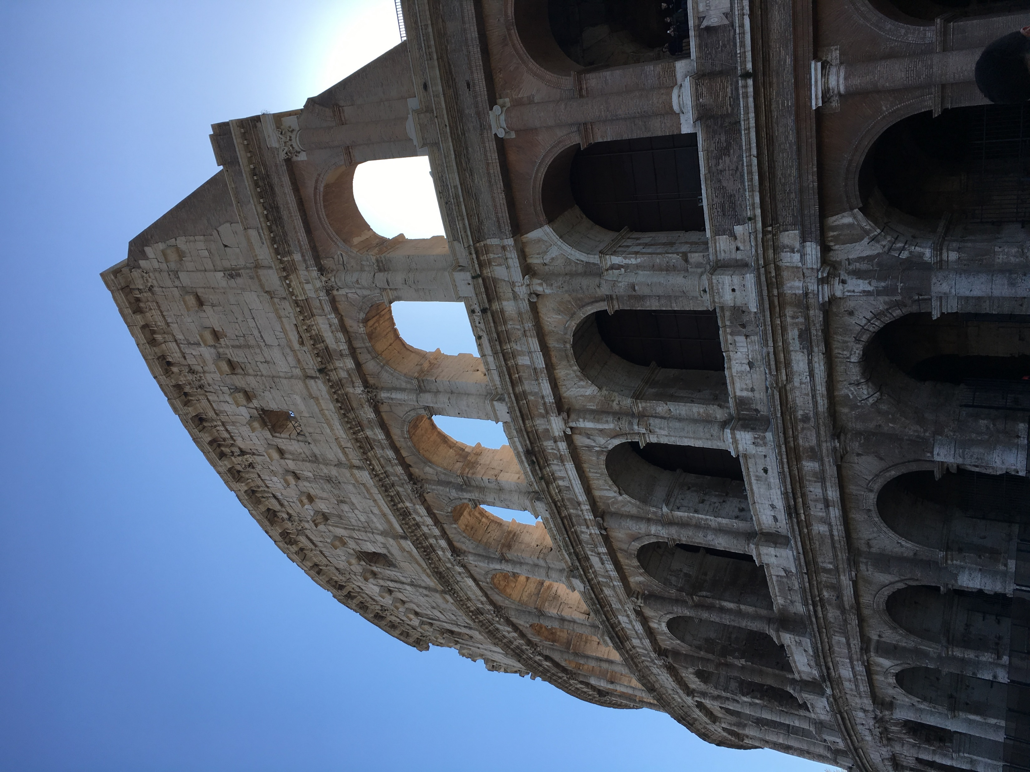
1-2 Peter

Slide 2
Faithfully Endure
1 Peter 1-2
Behold, I am the law, and the light. Look unto me, and endure to the end, and ye shall live; for unto him that endureth to the end will I give eternal life.
3 Nephi 15:9

Slide 3
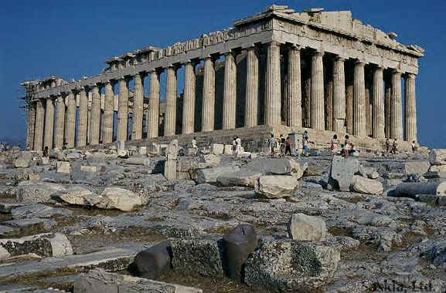
Roman Government
The Roman Government displayed a general tolerance for all religions, including Christianity.
The Church was under a divine commission to preach the gospel unto “all the world” and began circulating in the Roman Empire.
The messages was not a favorite message to the Roman monarchs.

Slide 4
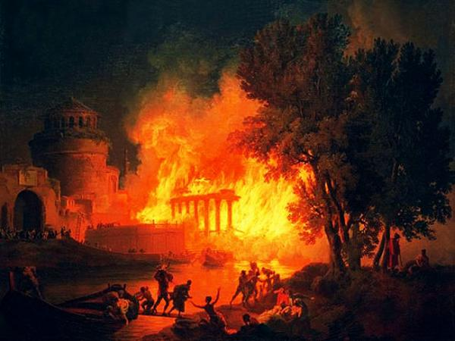
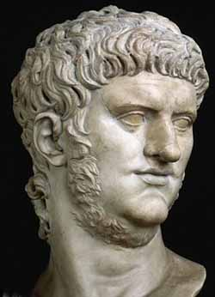
Fire in Rome
In A.D 64 a fire destroyed much of Rome.
An accusing (Nero) finger was pointed at the Christians and the Saints were persecuted.
Peter wrote from “Babylon” which probably means Rome.

Slide 5
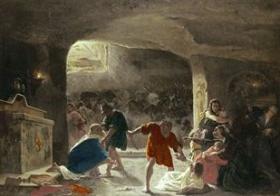
Heightened Persecution
It was rumored that Emperor Nero himself ordered the fire to be started in order to put the blame on the Christians living in Rome.
Intense persecution began to take place in the Provinces of Rome.
Peter exhorted the Saints to turn to one another in love and tenderness and that the Church leaders needed to strengthen their congregations.

Slide 6
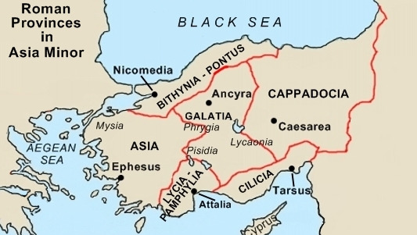
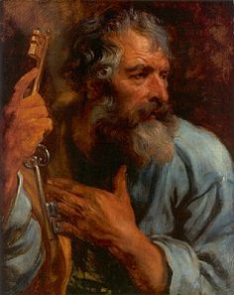
1 Peter
Peter writes this epistle to the Church members living in the 5 roman provinces of Asia Minor located in modern-day Turkey.
Peter considers his readers to be the “Elect” of God.
1 Peter 1:1-2

Slide 7
Peter
He was the brother of Andrew and son of Jonah. He is also known as Simon or Simeon.
He was the chief apostle of the Church.
He held the priesthood keys of the kingdom on the earth.
He held a position similar to that of the President of The Church of Jesus Christ of Latter-day Saints in our day.
Peter mentioned that Silvanus had served as a scribe.
Silvanus, also known as Silas, had previously served as both a scribe and a mission companion to Paul.
Peter addressed this epistle to Church members “scattered throughout Pontus, Galatia, Cappadocia, Asia, and Bithynia”—the five Roman provinces in Asia Minor.
In the latter days Peter, with James and John, came from heaven and literally conferred the Melchizedek Priesthood and the keys thereof upon Joseph Smith and Oliver Cowdery. This took place in May or June 1829, near Harmony, Pennsylvania.

Slide 8
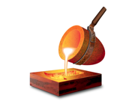
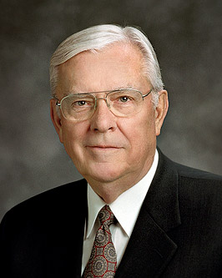
Crucible
A crucible is a container in which metals or other substances are refined, which means they are heated and melted in order to remove impurities and strengthen the final product.
As we faithfully endure trials, our faith in Jesus Christ is refined and strengthened
“As I travel throughout the Church, I see members being tried in the crucible of affliction.” (2)
What does he mean?
The challenging trials or adversities of life.

Slide 9
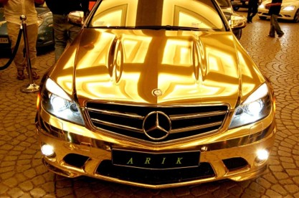
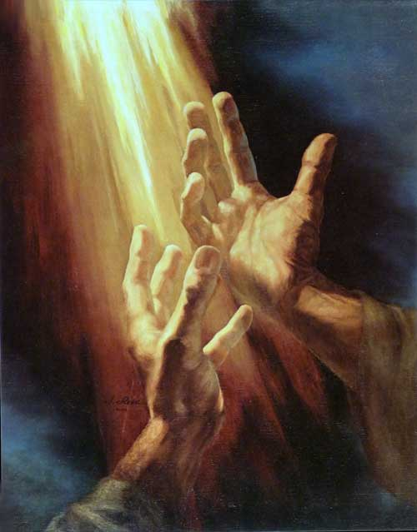
More Precious Than Gold
“That the trial of your faith, being much more precious than gold that perisheth, though it be tried with fire, might be found unto praise and honour and glory at the appearing of Jesus Christ”
“Yet if any man suffer as a Christian, let him not be ashamed; but let him glorify God on this behalf.”
1 Peter 1:7 1 Peter 4:16
1 Peter 1:7

Slide 10
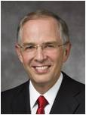
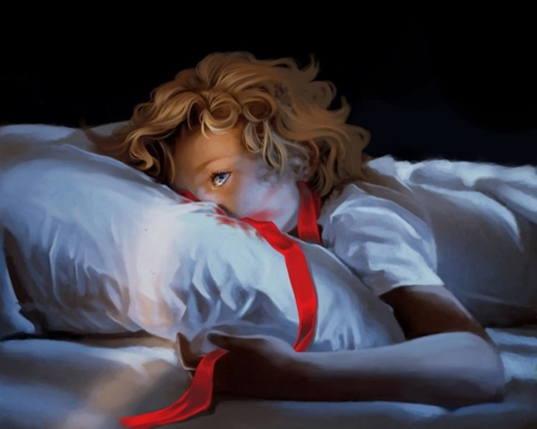
“These fiery trials are designed to make you stronger, but they have the potential to diminish or even destroy your trust in the Son of God and to weaken your resolve to keep your promises to Him.
“How do you remain ‘steadfast and immovable’ during a trial of faith? You immerse yourself in the very things that helped build your core of faith: you exercise faith in Christ, you pray, you ponder the scriptures, you repent, you keep the commandments, and you serve others.
1 Peter 1:7 1 Peter 4:16
1 Peter 1:7

Slide 11
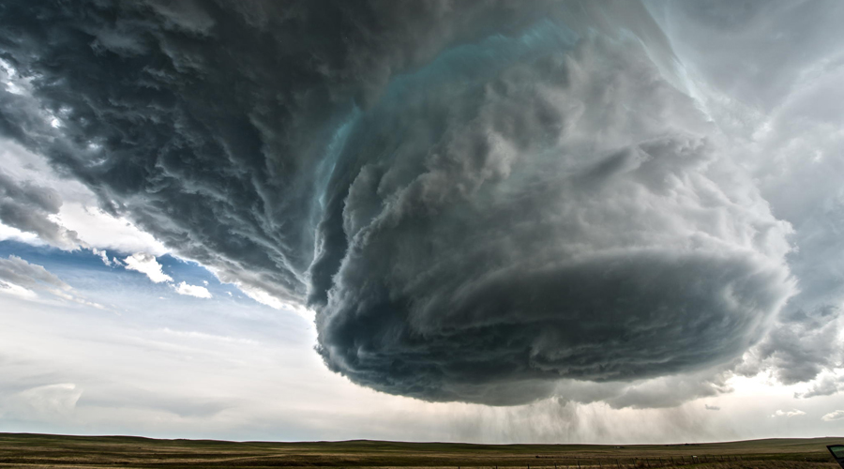
“When faced with a trial of faith—whatever you do, you don’t step away from the Church!
Distancing yourself from the kingdom of God during a trial of faith is like leaving the safety of a secure storm cellar just as the tornado comes into view.”
1 Peter 1:7 1 Peter 4:16
1 Peter 1:7

Slide 12
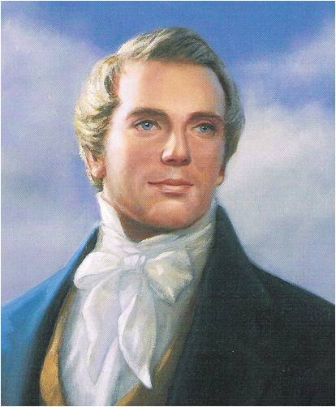
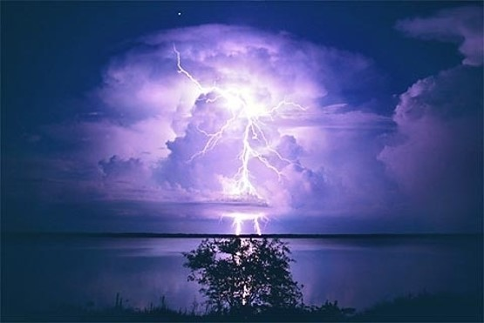
Support
“Though the thunders might roll and lightnings flash, and earthquakes bellow, and war gather thick around, yet this hope and knowledge would support the soul in every hour of trial, trouble and tribulation.”
(4)

Slide 13
Vulnerable
These trials can take root in our weaknesses, our vulnerabilities, our sensitivities, or in those things that matter most to us.
In the crucible of earthly trials, patiently move forward, and the Savior’s healing power will bring you light, understanding, peace, and hope. Pray with all your heart. Strengthen your faith in Jesus Christ, in His reality, in His grace. … Look forward. Your troubles and sorrows are very real, but they will not last forever. Your dark night will pass, because the Son … [did rise] with healing in his wings.
(3)

Slide 14
Enduring to the End—The Goal
…Hope having seen not…
…yet believing.
Receiving the end of your faith…
…salvation
Ether 12:4
1 Peter 1:8-9

Slide 15
Above all, taking the shield of faith, wherewith ye shall be able to quench all the fiery darts of the wicked.
Ephesians 6:16
Failing a test
Chastity issues
Someone tells false lies about you
Unexpected death of a loved one
Problems at home
Testing Our Faith
v
v

Slide 16
Increasing our faith will provide us with a hope that anchors us to God as we endure the trials of Life.
Except and deal with it
Go through steps to fix it
Talk to a person
Understanding the eternal Plan of Salvation
Prayer and follow counsel of the Prophets
Enduring
Enduring With Faith

Slide 17
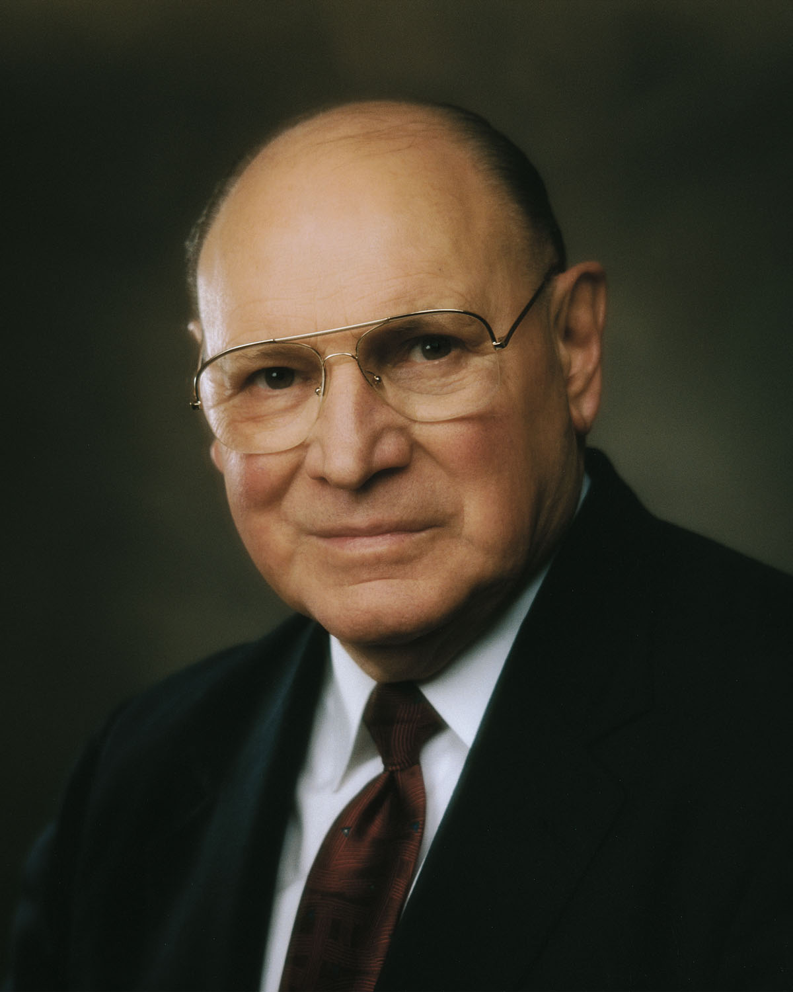
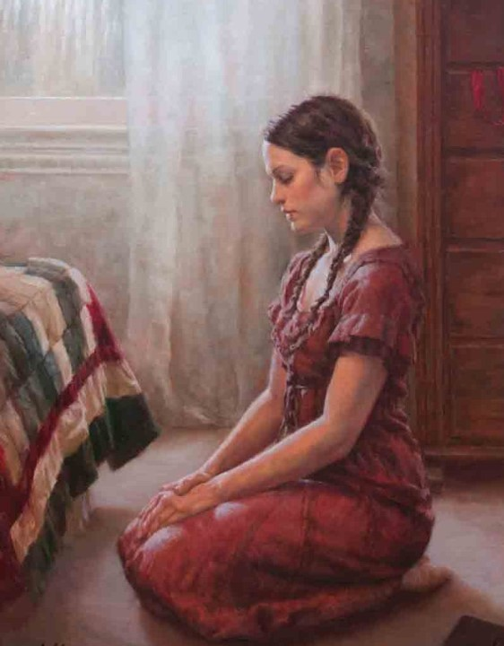
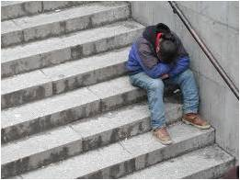
Finding Happiness During Adversity
How can we love days that are filled with sorrow? We can’t—at least not in the moment.
I don’t think my mother was suggesting that we suppress discouragement or deny the reality of pain. I don’t think she was suggesting that we smother unpleasant truths beneath a cloak of pretended happiness.
But I do believe that the way we react to adversity can be a major factor in how happy and successful we can be in life. If we approach adversities wisely, our hardest times can be times of greatest growth, which in turn can lead toward times of greatest happiness. …
As we look for humor, seek for the eternal perspective, understand the principle of compensation, and draw near to our Heavenly Father, we can endure hardship and trial. We can say, as did my mother, “Come what may, and love it.”
(6)
Justin Burton Kunz

Slide 18
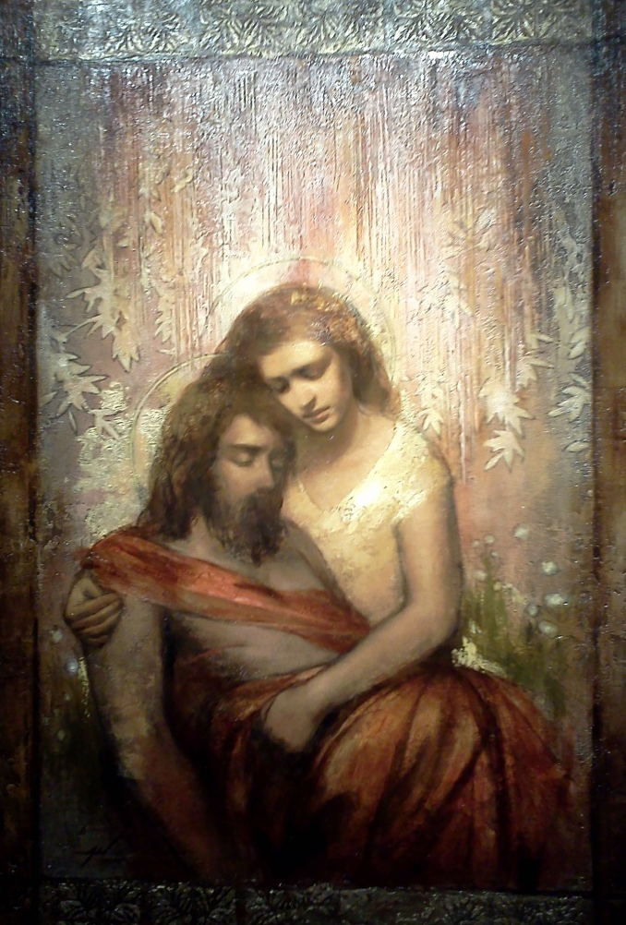
Redeemed Through Jesus Christ
“For it is better, if the will of God be so, that ye suffer for well doing, than for evil doing.”
1 Peter 3:17
We are redeemed through the precious blood of Jesus Christ. Because Jesus Christ lived a sinless life, He could offer Himself as a perfect sacrifice for us.
Jesus Christ was foreordained to be our Redeemer.
Annie Henrie Nadar
1 Peter 13-14

Slide 19
Love One Another
Peter encouraged the Saints to love one another and to remember that they had been born again by embracing the word of God, which endures forever.
1 Peter 1:22-25

Slide 20
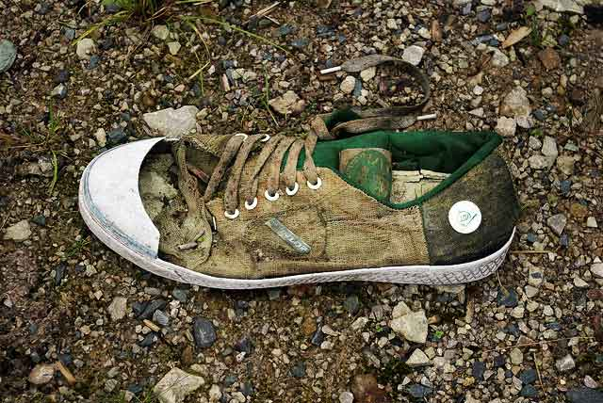
All Flesh is as Grass
The voice said, Cry. And he said, What shall I cry? All flesh is grass, and all the goodliness thereof is as the flower of the field:
The grass withereth, the flower fadeth: because the spirit of the Lord bloweth upon it: surely the people is grass.
The grass withereth, the flower fadeth: but the word of our God shall stand for ever.
Isaiah 40:6-8
A man’s frailties to the withering of vegetation in the hot desert wind.
Unlike the withering grass, the word of the Lord “abideth for ever”; it gives life and strength to all who embrace it and are born again.
1 Peter 1:23-25

Slide 21
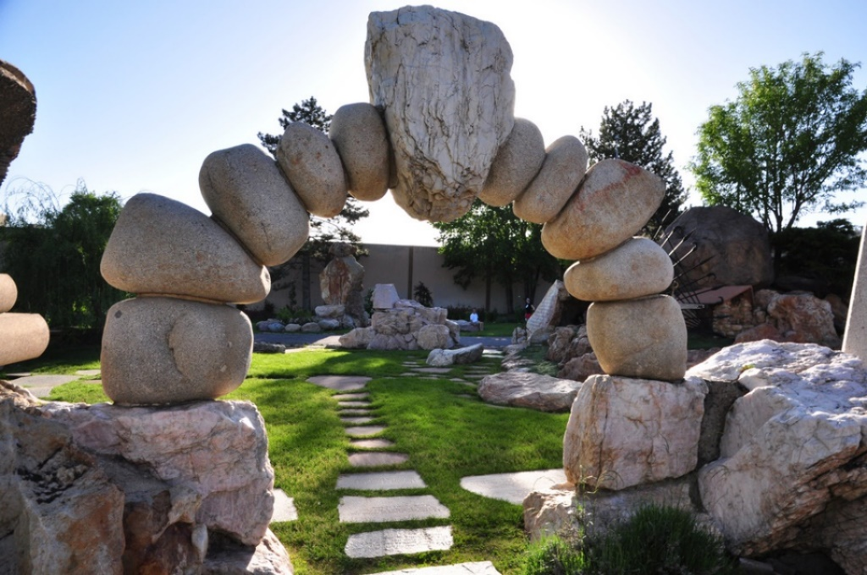
Living Stones
Lay Aside Past Sins
Peter taught that when the Saints come unto Jesus Christ, who is the “living stone,” they become a “lively stone” that is added to the building of God’s spiritual house.
Peter also called Christ the “chief corner stone,” emphasizing that the house is built upon the resurrected Jesus Christ.
Gilgal Sculpture Garden in Salt Lake City, Utah
1 Peter 2:1-5

Slide 22
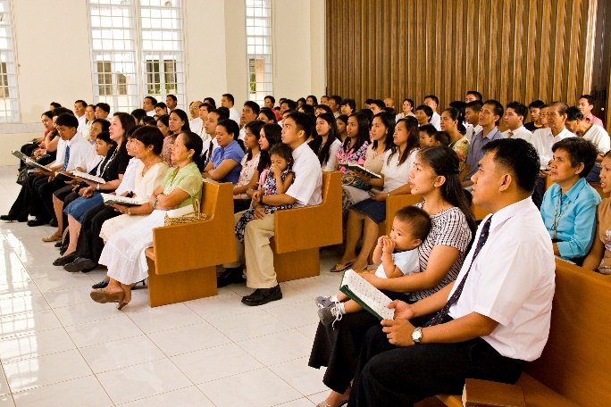
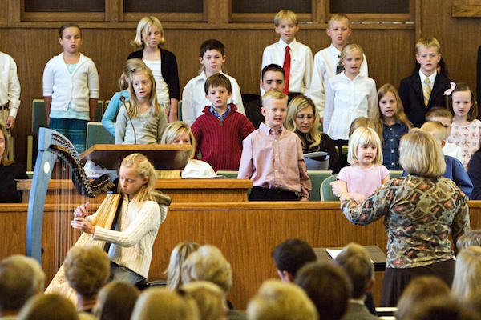
A Peculiar People
A Chosen Generation
A Royal Priesthood
A Holy Nation
Peter’s message was that by embracing the gospel, gentile converts had become part of God’s chosen people, the new Israel.
1 Peter 2:9-10

Slide 23
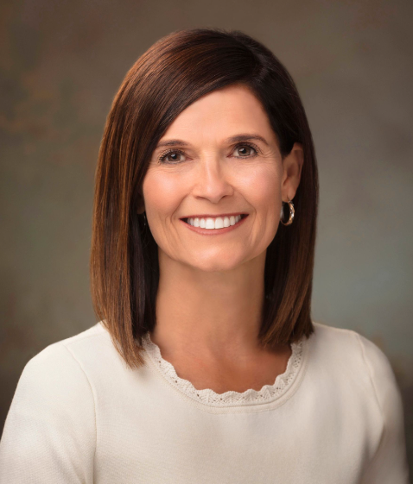
Influences of the World
We do not lower our standards to fit in or to make someone else feel comfortable. We are disciples of Jesus Christ, and as such we are about elevating others, lifting them to a higher, holier place where they too can reap greater blessings. …
Can others easily see His image in our countenance and know who we represent by the way we carefully conduct our lives?
As a covenant people, we are not meant to blend in with the rest of the world.
We have been called “a peculiar people—what a compliment!
As the influences of the world increasingly embrace the evil, we must strive with all diligence to stay firmly on the path that leads us safely to our Savior, widening the distance between our covenant living and worldly influences.
(7)
1 Peter 2:9

Slide 24
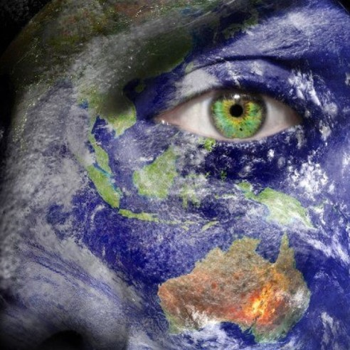
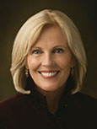
God calls His Saints to be separate and distinct from the world so that others can see their example and glorify Him
“If you desire to make a difference in the world, you must be different from the world.”
1 Peter 2:11-12
(5)

Slide 25
Why is it sometimes difficult to be different from those around you?
What are some things we can do to help us feel more comfortable being peculiar and distinct from the world?
What are some examples from your life or the scriptures that show how being different from the world helped others come closer to God?

Slide 26
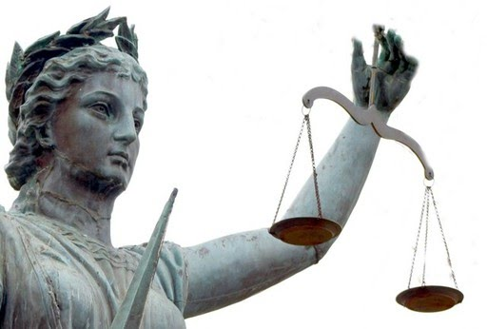
Submit to Civil Laws
Peter taught the Saints to submit themselves to the laws and civil authorities that governed them (including the Roman emperor who promoted persecution against them.)
Let no man break the laws of the land, for he that keepeth the laws of God hath no need to break the laws of the land.
Wherefore, be subject to the powers that be, until he reigns whose right it is to reign, and subdues all enemies under his feet. D&C 58:21-22
He encouraged those who suffered hardship as servants to bear their suffering with patience and to remember that God was aware of them.
1 Peter 2:13-25

Slide 27
Sources:
Videos:
The Refiner's Fire (5:02)
New Testament Institute Student Manual Chapter 51
Elder M. Russell Ballard (“Hyrum Smith: ‘Firm As the Pillars of Heaven,’” Ensign, Nov. 1995, 9).
Elder Neil L. Anderson (“Trial of Your Faith,” Ensign or Liahona, Nov. 2012, 39–40). Neil L. Andersen, “Wounded,” Ensign or Liahona, Nov. 2018, 85
Joseph Smith “Teachings of the Prophet Joseph Smith Pg. 298
Sister Elaine S. Dalton,(“Now Is the Time to Arise and Shine!” Ensign or Liahona, May 2012, 124).
Joseph B. Wirthlin, “Come What May, and Love It,” Ensign or Liahona, Nov. 2008, 26–28
Becky Craven, “Careful versus Casual,” Ensign or Liahona, May 2019, 10
Presentation by ©http://fashionsbylynda.com/blog/

Slide 28
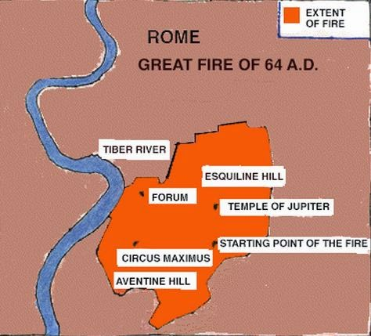
THE FIRST LETTER OF PETER TO SAINTS IN FIVE PROVINCES APPARENTLY WRITTEN FROM ROME, CA. A.D. 62–64 (1 PETER)
Salvation Comes by Faith in Christ | 1:1–16
Christ Was Foreordained to Be the Redeemer | 1:17–21
Converts Experience a New Birth in Christ | 1:22–25; 2:1–3
Christ, the Cornerstone for a Holy Nation | 2:4–10
The Obligation of Christians Towards Gentiles | 2:11, 12
Saints to Accept Civil Authority | 2:13–25
Husbands and Wives Should Honor Each Other | 3:1–7
“Be Followers of That Which Is Good” | 3:8–17
Christ Preached the Gospel to Spirits in Prison | 3:18–22; 4:1–6
“Speak as an Oracle of God” | 4:7–11
Saints to Be Tried in All Things | 4:12–19
Elders to Feed the Flock of God | 5:1–4
God Refuses the Proud and Favors the Humble | 5:5–14
Roman Fire:
During the night of July 18, 64 AD, fire broke out in the merchant area of the city of Rome. Fanned by summer winds, the flames quickly spread through the dry, wooden structures of the Imperial City. Soon the fire took on a life of its own consuming all in its path for six days and seven nights. When the conflagration finally ran its course it left seventy percent of the city in smoldering ruins. From the ashes of the fire rose a more spectacular Rome. A city made of marble and stone with wide streets, pedestrian arcades and ample supplies of water to quell any future blaze. The debris from the fire was used to fill the malaria-ridden marshes that had plagued the city for generations.
J.P. Ronan
Trial of Your Faith 1 Peter 1:7:
"Imagine yourself as a living house. God comes in to rebuild that house. At first, perhaps, you can understand what He is doing. He is getting the drains right and stopping the leaks in the roof and so on: you knew that those jobs needed doing and so you are not surprised. But presently he starts knocking the house about in a way that hurts abominably and does not seem to make sense. What on earth is He up to? The explanation is that He is building quite a different house from the one you thought of-throwing out a new wing here, putting on an extra floor there, running up towers, making courtyards. You thought you were going to be made into a decent little cottage: but He is building a palace. ..." (C. S. Lewis, New York: The Macmillan Company, 1952, p. 160.)
Life and Teachings of Jesus and His Apostles Chapter
Gird Up Your Loins of Your Mind 1 Peter 1:13:
Think clean thoughts. Those who think clean thoughts do not do filthy deeds. You are responsible before God not only for your acts but also for controlling your thoughts. So live that you would not blush with shame if your thoughts and acts should be flashed on a screen in your chapel. The old adage is still true that you sow thoughts and you reap acts, you sow acts and you reap habits, you sow habits and you reap a character, and your character determines your eternal destiny. "As [a man] thinketh in his heart, so is he" (Proverbs 23:7). (The Teachings of Ezra Taft Benson [Salt Lake City: Bookcraft, 1988], 445 - 446.)

Slide 29
A Peculiar People 1 Peter 2:9-10:
“In the Old Testament, the Hebrew term from which peculiar was translated is segullah, which means ‘valued property,’ or ‘treasure.’ In the New Testament, the Greek term from which peculiar was translated is peripoiesis, which means ‘possession,’ or ‘an obtaining.’
“Thus, we see that the scriptural term peculiar signifies ‘valued treasure,’ ‘made’ or ‘selected by God.’ For us to be identified by servants of the Lord as his peculiar people is a compliment of the highest order.” Elder Russell M. Nelson (“Children of the Covenant,” Ensign, May 1995, 34).
Submit to Civil Law 1 Peter 2: 20-23:
Peter specifically addressed household servants, who in the Roman Empire were almost always slaves and were often mistreated by their masters. He taught about the difference between suffering for one’s faults and enduring undeserved punishment (see 1 Peter 2:20). Peter encouraged servants to learn from the example of Jesus Christ, who was falsely accused before Jewish and Roman leaders and yet did not retaliate (see 1 Peter 2:23). The Greek word Peter used that was translated as buffeted (1 Peter 2:20) literally means “to be struck with fists” and is the term used by both Matthew and Mark to describe the treatment of the Master.
Peter hinted at the contemptuous scorn of the Jewish leaders and Christ’s silent acceptance of it (see 1 Peter 2:23). Peter mentioned the stripes the Lord received, using the word which means “bruise” or the “bloody welt which results from lashing with a whip,” which is exactly the result of a Roman scourging (see Isaiah 53:5–12). (1)
Elder Alexander B. Morrison taught: “Peter, the great apostle, who himself suffered a martyr’s death (see John 21:18–19), recognized that divine merit is associated with patient suffering for Christ’s sake but that little glory accrues to us if we suffer for our own sins. [1 Peter 2:19–20.] As we endure undeserved suffering, we develop Christlike attributes that perfect our souls and bring us closer to Him” (Feed My Sheep: Leadership Ideas for Latter-day Shepherds [1992], 166).
A Royal Priesthood 1 Peter 2:9:
"As bearers of the priesthood, we have been placed on earth in troubled times. We live in a complex world with currents of conflict everywhere to be found. Political machinations ruin the stability of nations, despots grasp for power, and segments of society seem forever downtrodden, deprived of opportunity and left with a feeling of failure.
"We who have been ordained to the priesthood of God can make a difference. When we qualify for the help of the Lord, we can build boys, we can mend men, we can accomplish miracles in His holy service. Our opportunities are without limit.
"Though the task looms large, we are strengthened by the truth: 'The greatest force in this world today is the power of God as it works through man.' If we are on the Lord's errand, we are entitled to the Lord's help. That divine help, however, is predicated upon our worthiness. To sail safely the seas of mortality, to perform a human rescue mission, we need the guidance of that eternal mariner-even the great Jehovah. We reach out, we reach up, to obtain heavenly help." President Thomas S. Monson ("You Make a Difference," Ensign, May 1988, 41)

Slide 30
1 Peter and Isaiah
1 Peter 2:21-26 | Isaiah 53
v. 21 'Christ also suffered for us' | v. 4 'Surely he hath borne our griefs, and carried our sorrows'
v. 22 'Who did no sin, neither was guile found in his mouth' | v. 9 'he had done no violence, neither was any deceit in his mouth'
v. 23 'Who, when he was reviled, reviled not again' | v. 7 'He was oppressed, and he was afflicted, yet he opened not his mouth'
v. 24 'who his own self bare our sins' | v. 12 'and he bare the sin of many'
v. 24 'by whose stripes ye were healed' | v. 5 'and with his stripes we are healed'
v. 25 'For ye were as sheep going astray' | v. 6 'All we like sheep have gone astray'

Slide 31
Be Ready To Testify
1 Peter 3-5
Our father Lehi was driven out of Jerusalem because he testified of these things. Nephi also testified of these things, and also almost all of our fathers, even down to this time; yea, they have testified of the coming of Christ, and have looked forward, and have rejoiced in his day which is to come.
Helaman 8:22

Slide 32
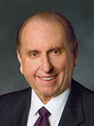
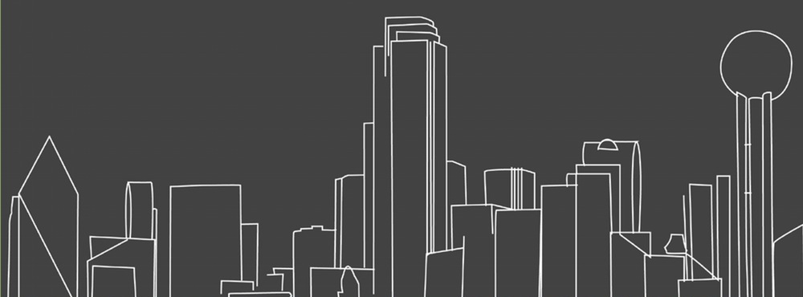
An Opportunity
“We will have opportunities throughout our lives to share our beliefs, although we don’t always know when we will be called upon to do so.
“Such an opportunity came to me in 1957, when I worked in the publishing business and was asked to go to Dallas, Texas, [USA,] sometimes called ‘the city of churches,’ to address a business convention.”
(2)

Slide 33
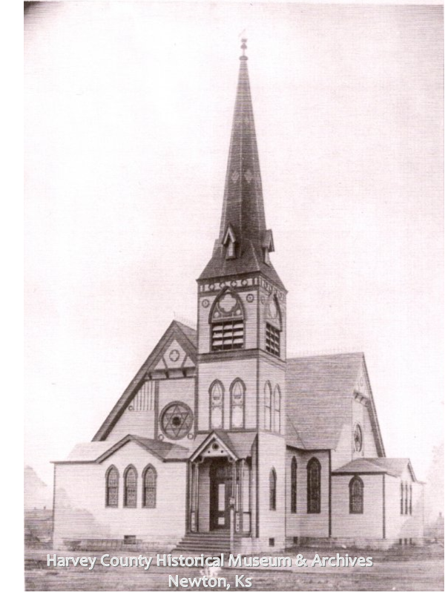
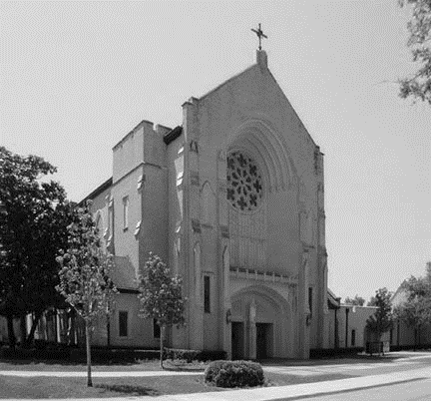
“Following the conclusion of the convention, I took a sightseeing bus ride through the city’s suburbs.
As we passed the various churches, our driver would comment, ‘On the left you see the Methodist church’ or ‘There on the right is the Catholic cathedral.’
(2)

Slide 34
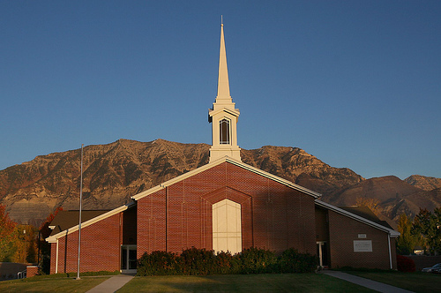
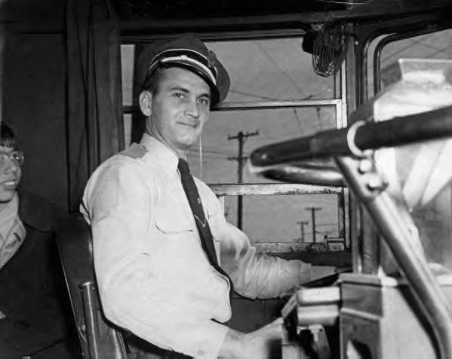
“As we passed a beautiful red brick building situated upon a hill, the driver exclaimed, ‘That building is where the Mormons meet.’ A lady in the rear of the bus called out, ‘Driver, can you tell us something more about the Mormons?’
“The driver pulled the bus over to the side of the road, turned around in his seat, and replied, ‘Lady, all I know about the Mormons is that they meet in that red brick building. Is there anyone on this bus who knows anything more about the Mormons?’”
(2)

Slide 35
Household Codes
He counseled husbands to honor their wives.
He also counseled members to live according to gospel standards.
Wives are to help bring unbelieving husbands to Christ through their righteous conduct.
1 Peter 3:1-11

Slide 36
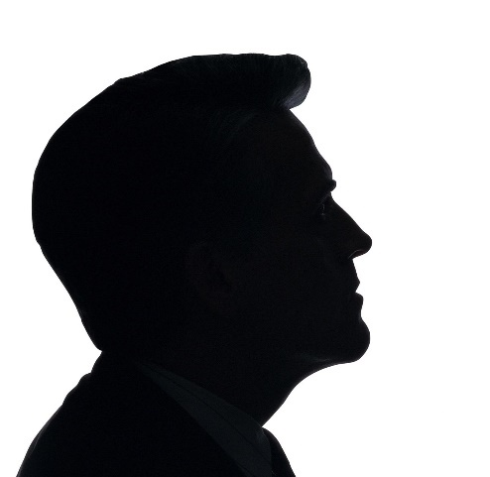
Heirs Together
In the true Patriarchal Order man holds the priesthood and is the head of the household of faith, but he cannot attain a fulness of joy here or of eternal reward hereafter alone. Woman stands at his side a joint-inheritor with him in the fulness of all things.
Exaltation and eternal increase is her lot as well as his.
Godhood is not for men only; it is for men and women together.
1 Peter 3:7; D&C 131:1-4; 132:19-20
(3)

Slide 37
Be Ready To Give An Answer
The Savior taught us to love all as our brothers and sisters, and we honor that teaching by sharing the witness and message of the restored gospel “among all nations, kindreds, tongues, and people.”
As followers of Jesus Christ, we should strive to always be ready to share and defend our beliefs with meekness and reverence
1 Peter 3:15; D&C 112:1
(3)

Slide 38
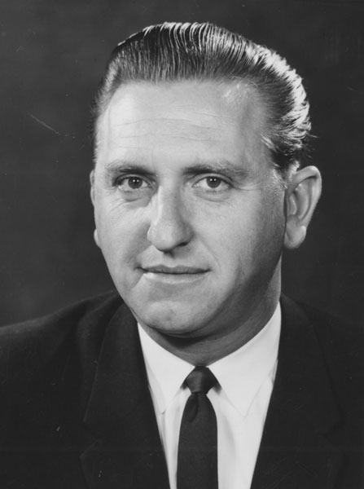
An Opportunity (Continues)
“I waited for someone to respond. I gazed at the expression on each person’s face for some sign of recognition, some desire to comment. Nothing. I realized it was up to me to do as the Apostle Peter suggested, to ‘be ready always to give an answer to every man that asketh you a reason of the hope that is in you.’ I also realized the truth of the adage ‘When the time for decision arrives, the time for preparation is past.’
“For the next 15 or so minutes, I had the privilege of sharing with those on the bus my testimony concerning the Church and our beliefs. I was grateful for my testimony and grateful that I was prepared to share it”
(2)

Slide 39
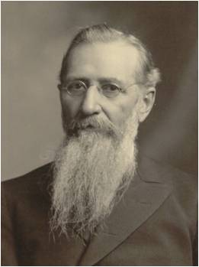
The Spirit World
Jesus went to preach in the Spirit World between his death and Resurrection
President Joseph F. Smith was wondering how the Savior could perform such a work in such a short time.
The answer was that the Lord didn't go in person to preach to all those spirits but "organized his forces and appointed messengers".
The spirits in prison were not worthy of a direct visitation of the Lord.
The resurrected Lord never appeared to the wicked.
He only appeared to the righteous Jewish saints as a resurrected being. Similarly, the wicked Nephites were destroyed before he could openly minister on that continent.
Read D&C 138:28-30
1 Peter 3:18-20; 4:6

Slide 40
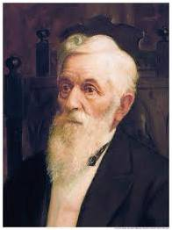
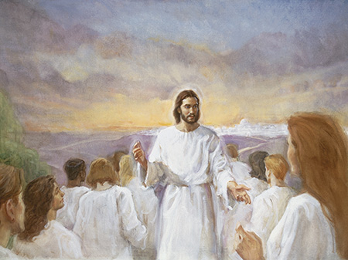
Teaching in Spirit Prison
Those in the spirit world who did not accept the gospel or have the opportunity to hear it while in mortality.
“When the Gospel is preached to the spirits in prison, the success attending that preaching will be far greater than that attending the preaching of our Elders in this life.
I believe there will be very few indeed of those spirits who will not gladly receive the Gospel when it is carried to them.
The circumstances there will be a thousand times more favorable.”
D. Keith Larson
1 Peter 3:19
(5)

Slide 41
Doctrinal Mastery
1 Peter 4:6
For for this cause was the gospel preached also to them that are dead, that they might be judged according to men in the flesh, but live according to God in the spirit.
(5)

Slide 42
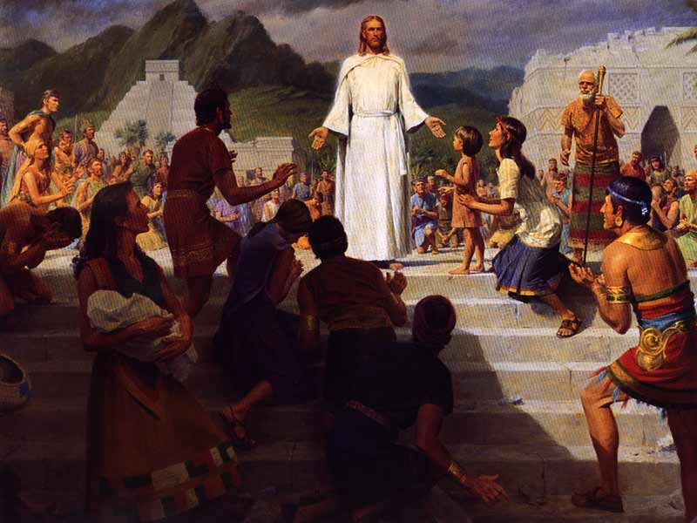
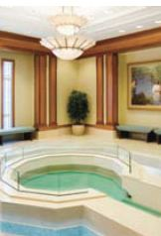
Doctrine of Salvation
The Savior’s preaching to the spirits in prison is an example of God’s fairness and justice. This doctrine of salvation for the dead makes it possible for all mankind to accept the gospel even though they may never have heard it in mortality. The doctrine of salvation for the dead is unique to Latter-day Saints. (1)
The gospel is preached to the dead so that they can have the same opportunities as those who hear the gospel in mortality.
“Not only did Jesus Christ organize his Church and choose missionaries to teach the gospel on earth, but he also spent three days in the spirit world, where the spirits of those who have died await the resurrection. There he organized his work so that all the dead will be able to hear the gospel fully." (6)
1 Peter 4:6
Papeete Tahiti Temple: baptismal font

Slide 43
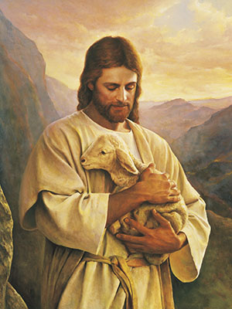
Watching Over God’s Flocks
“feed the flock of God” = to take care of and watch over the members of the Church.
Church leaders were to serve willingly and with love rather than grudgingly or out of a desire for reward.
They were to be examples to the members instead of “lords” over them.
Church leaders have the responsibility to care for and watch over God’s flock in love and by example
1 Peter 5:1-3

Slide 44
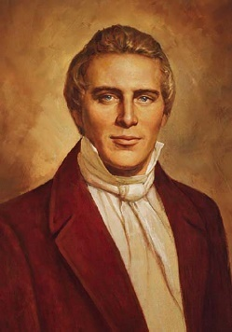
Casting Your Care Upon Him
Our only confidence can be in God; our only wisdom obtained from Him: and He alone must be our protector and safeguard, spiritually and temporally, or we fall. (7)
“We depend upon God; and in all our works and labors, and in all the success that attends us in our labors, we feel that it has been God who has wrought it.” (5)
1 Peter 5:5-19

Slide 45
Sources:
New Testament Institute Student Manual Chapter 51
President Thomas S. Monson (“Dare to Stand Alone,” Ensign or Liahona, Nov. 2011, 67).
Elder Bruce R. McConkie (Mormon Doctrine, 2d ed. [Salt Lake City: Bookcraft, 1966], 844.)
Elder Dallin H. Oaks Sharing the Restored Gospel Oct. 2016 Gen. Conf.
Lorenzo Snow(“Discourse by President Lorenzo Snow,” Millennial Star, Jan. 22, 1894, 50). (The Teachings of Lorenzo Snow, edited by Clyde J. Williams [Salt Lake City: Bookcraft, 1984], 14.)
George Lyman, "I Have a Question," Ensign, June 1988, 58)
President Joseph Smith (History of The Church of Jesus Christ of Latter-day Saints, 7 vols. 5:65)
Presentation by ©http://fashionsbylynda.com/blog/

Slide 46
THE FIRST LETTER OF PETER TO SAINTS IN FIVE PROVINCES APPARENTLY WRITTEN FROM ROME, CA. A.D. 62–64 (1 PETER))
Salvation Comes by Faith in Christ | 1:1–16
Christ Was Foreordained to Be the Redeemer | 1:17–21
Converts Experience a New Birth in Christ | 1:22–25; 2:1–3
Christ, the Cornerstone for a Holy Nation | 2:4–10
The Obligation of Christians Towards Gentiles | 2:11, 12
Saints to Accept Civil Authority | 2:13–25
Husbands and Wives Should Honor Each Other | 3:1–7
“Be Followers of That Which Is Good” | 3:8–17
Christ Preached the Gospel to Spirits in Prison | 3:18–22; 4:1–6
“Speak as an Oracle of God” | 4:7–11
Saints to Be Tried in All Things | 4:12–19
Elders to Feed the Flock of God | 5:1–4
God Refuses the Proud and Favors the Humble | 5:5–14
Household codes 1 Peter 1-11:
"The wife is to obey her husband in righteousness, which I believe includes her righteousness, for she is not to be his judge. If she attempts to be his judge and to obey whatever suits her fancy, withdrawing her support or obedience when she disagrees, or if she competes with him for leadership and direction, the patriarchal concept will be distorted. If she 'punishes him' in one way or another when he's 'off base' in her eyes, her husband could likely feel that he has atoned and no longer has to change or repent. The wife is called to love and to sustain the husband, and I believe nothing will do more to encourage and chasten him in his own stewardship than consistent acceptance, unconditional love, and steadfast sustaining. If he is absolutely unworthy, or consistently makes unrighteous demands, then she might counsel with the steward over him, the bishop, but she is not to be his judge and punisher. (quotes Ephesians 5:22-24 and 1 Peter 3:1-6)
"Children are to obey and honor their parents. Children first need examples or models to follow. They need understanding and respect; they need clear limits, well-established rules, and consistently applied discipline. They need explicit teaching and testifying; they need order, system, and regularity; they need work and responsibility and opportunities to give an accounting; they need time for fun, free expression, and good humor.
"I have come to believe from my own experience, as well as my observations of others, that children tend not to obey their parents when the father does not in truth or in deed obey the Lord, or when the wife does not in truth or in deed obey her husband, or when the parents do not have this vision of the patriarchal family concept and at least a deep commitment to their parenthood responsibility." (Stephen R. Covey, Spiritual Roots of Human Relations [Salt Lake City: Deseret Book Co., 1970], 189.)
Equal Valued Roles For Husbands and Wives 1 Peter 3: 1-11:
“In our Heavenly Father’s great priesthood-endowed plan, men have the unique responsibility to administer the priesthood, but they are not the priesthood. Men and women have different but equally valued roles. Just as a woman cannot conceive a child without a man, so a man cannot fully exercise the power of the priesthood to establish an eternal family without a woman. In other words, in the eternal perspective, both the procreative power and the priesthood power are shared by husband and wife” Elder M. Russell Ballard (“This Is My Work and Glory,” Ensign or Liahona, May 2013, 19).
Life and Teachings of Jesus and His Apostles Chapter 51

Slide 47
Preparing to teach to the wicked 1 Peter 3:18-20
“In the justice of the Father, he is going to give to every man the privilege of hearing the gospel. Not one soul shall be overlooked or forgotten. This being true, what about the countless thousands who have died and never heard of Christ, never had an opportunity of repentance and remission of their sins, never met an elder of the Church holding the authority? …
“The Lord has so arranged his plan of redemption that all who have died without this opportunity shall be given it in the spirit world. … All those who did not have an opportunity here to receive it, who there repent and receive the gospel, shall be heirs of the celestial kingdom of God. The Savior inaugurated this great work when he went and preached to the spirits held in prison, that they might be judged according to men in the flesh (or in other words, according to the principles of the gospel) and then live according to God in the spirit, through their repentance and acceptance of the mission of Jesus Christ who died for them” (Doctrines of Salvation, comp. Bruce R. McConkie, 3 vols. [1954–56], 2:132–33).
Doctrine of Salvation 1 Peter 4:6:
[The Savior] provided the opportunity whereby they might repent of their sins, change their attitudes and their lives, and live according to God in the spirit. We do not know how many millions of spirits are involved. We know that many have passed away in wars, pestilence, and in various accidents. We know that the spirit world is filled with the spirits of men who are waiting for you and me to get busy-waiting as the signers of the Declaration of Independence waited. "Why," they asked President Wilford Woodruff, "why do you keep us waiting?" That question continues to be asked of us also, by our own people.
We wonder about our progenitors-grandparents, great-grandparents, great-great-grandparents, etc. What do they think of you and me? We are their offspring. We have the responsibility to do their temple work, and the beautiful temples of the Lord stand day after day, yet we do not fill them always. We have a grave responsibility that we cannot avoid, and may stand in jeopardy if we fail to do this important work.
I hope our Saints will understand the glorious reality of it all: that as the work in our temples is done in this world, it helps to prepare us for another and better world. President Spencer W. Kimball ("The Things of Eternity-Stand We in Jeopardy?" Ensign, Jan. 1977, 5)

Slide 48
Calling Election Made Sure
2 Peter 1
(May 17th, 1843.) The more sure word of prophecy means a man’s knowing that he is sealed up unto eternal life, by revelation and the spirit of prophecy, through the power of the Holy Priesthood.
D&C 131:5

Slide 49
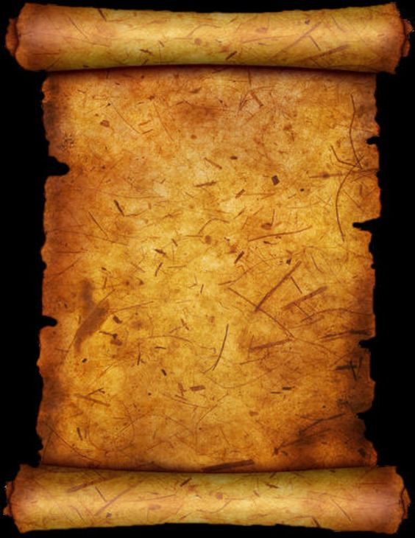
Who Wrote 2 Peter?
Church members and leaders have traditionally accepted Peter as the author.
Some modern scholars, however, have questioned whether the epistle was truly written by Peter because the style and language differ from 1 Peter, which was written with the scribal aid of Silvanus (Silas).
It may be that 2 Peter was written with the help of a different scribe, or that the epistle was put into its current form by others but contains authentic material from Peter himself.
The Second Epistle of Peter states that it was written by “Simon Peter, a servant and an apostle of Jesus Christ
Peter may have written his second epistle shortly before his death in Rome; if so, this Second Epistle of Peter is one of his last testimonies.

Slide 50
The Will Within
Our Best Selves
Obtain Faith in Jesus Christ
Stay True to Your
Testimony
2 Peter 1:1-4

Slide 51
"Those members of the Church who devote themselves wholly to righteousness, living by every word that proceedeth forth from the mouth of God, make their calling and election sure.
That is, they receive the more sure word of prophecy, which means that the Lord seals their exaltation upon them while they are yet in this life.
Peter summarized the course of righteousness which the saints must pursue to make their calling and election sure and then (referring to his experience on the Mount of Transfiguration with James and John) said that those three had received this more sure word of prophecy.”
(2)

Slide 52
Attributes
To
Develop
charity
kindness
As we develop divine attributes within ourselves, we can come to know Jesus Christ
godliness
patience
temperance
knowledge
virtue
diligence
faith
2 Peter 1:5-7

Slide 53
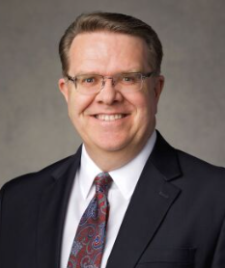
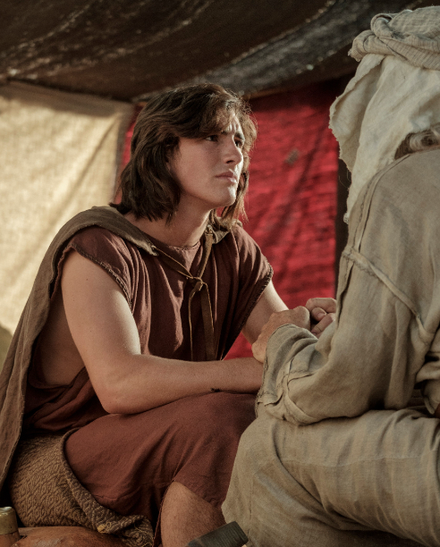
In order to see real progress, you will need to put in sustained effort.
Much like climbing a mountain requires preparation before and endurance and perseverance during ascent, so too will this journey require real effort and sacrifice.
True Christianity, in which we strive to become like our Master, has always required our best efforts. …
I know that becoming like Him through His divine help and strength is achievable step by step. If not so, He would not have given us this commandment.
(7)
Read: 1 Nephi 3:7
2 Peter 1:5-7; 1 Nephi 3:7

Slide 54
“The principle of knowledge is the principle of salvation.
This principle can be comprehended by the faithful and diligent; and every one that does not obtain knowledge sufficient to be saved will be condemned.
The principle of salvation is given us through the knowledge of Jesus Christ.”
(3)

Slide 55
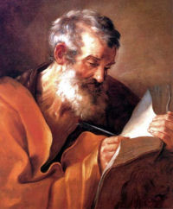
Assurance
“to make your calling and election sure” = to receive in this life God’s assurance that you will obtain eternal life.
Peter also referred to this as “a more sure word of prophecy.”
If we are diligent in developing our divine potential while in this life, we can receive God’s assurance of eternal life.
2 Peter 1:10-11

Slide 56
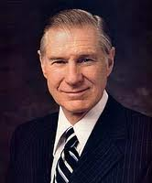
Witnesses of Jesus Christ
"Those of us who hold the holy apostleship always wish to fulfill our responsibility by testifying of the divinity of the Savior. I feel compelled to do so. I have had a testimony all of my life.
Recently, however, there has come into my soul an overpowering witness of the divinity of this holy work.
This sure witness is more certain than ever before in my life." (1997)
2 Peter 1:12-21
(3)

Slide 57
A Sure Witness
A sure witness is the Second Comforter.
Two Comforters are spoken of. The first is the Holy Ghost.
The Second Comforter is the Lord Jesus Christ Himself. “When any man obtains this last Comforter, he will have the personage of Jesus Christ to attend him, or appear unto him from time to time, and even He will manifest the Father unto him”
“I am a witness of the Resurrection of the Lord as surely as if I had been there in the evening with the two disciples in the house on Emmaus road. I know that He lives as surely as did Joseph Smith when he saw the Father and the Son in the light of a brilliant morning in a grove of trees in Palmyra.” (6)
2 Peter 1:12-21; John 14:16-27; Moroni 8:26; D&C 21:9; 42;:17; 90:11
(5)

Slide 58
Scriptures
Holy Bible
And whatsoever they shall speak when moved upon by the Holy Ghost shall be scripture, shall be the will of the Lord, shall be the mind of the Lord, shall be the word of the Lord, shall be the voice of the Lord, and the power of God unto salvation.
D&C 68:4
The
Book
of
Mormon
Doctrine
And
Covenants
ANOTHER TESTAMENT
OF JESUS CHRIST
“[Scriptures are] words, both written and spoken, by holy men of God when moved upon by the Holy Ghost.”
Some scripture has been canonized. A canon is “a recognized, authoritative collection of sacred books.
In The Church of Jesus Christ of Latter-day Saints, the canonical books are called the standard works and include the Old and New Testaments, the Book of Mormon, the Doctrine and Covenants, and the Pearl of Great Price.”
Prophets receive scripture through the Holy Ghost
(7)
2 Peter 1:20

Slide 59
Sources:
New Testament Institute Student Manual Chapter 51
Elder Bruce R. McConkie (Teachings, pp. 149-151.)" (Mormon Doctrine, 2d ed. [Salt Lake City: Bookcraft, 1966], 109.)
Prophet Joseph Smith (Teachings of Presidents of the Church: Joseph Smith [2007], 212).
President James E. Faust ("The Weightier Matters of the Law: Judgment, Mercy, and Faith," Ensign, Nov. 1997)
Bible Dictionary (Comforter)
President Henry B. Eyring Come Unto Me April 2013 Gen. Conf.
Guide to the Scriptures (Scriptures; Canon)
Scott D. Whiting, “Becoming like Him,” Ensign or Liahona, Nov. 2020, 14
Presentation by ©http://fashionsbylynda.com/blog/

Slide 60
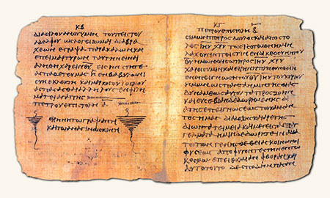
WRITTEN FROM ROME PRIOR TO A.D. 68 (2 PETER)
“Make Your Calling and Election Sure” | 1:1–19
Prophecy Comes by the Holy Ghost | 1:20, 21
False Teachers Are Damned | 2:1–9
The Fallen State of Lustful Saints | 2:10–22
Latter-day Scoffers Shall Deny the Second Coming | 3:1–10
Holy and Saintly Lives Are Prepared for the Lord | 3:11–18
To Know God 2 Peter 1:1-3:
“It is one thing to know about God and another to know him. We know about him when we learn that he is a personal being in whose image man is created; when we learn that the Son is in the express image of his Father’s person; when we learn that both the Father and the Son possess certain specified attributes and powers. But we know them, in the sense of gaining eternal life, when we enjoy and experience the same things they do. To know God is to think what he thinks, to feel what he feels, to have the power he possesses, to comprehend the truths he understands, and to do what he does. Those who know God become like him, and have his kind of life, which is eternal life” Elder Bruce R. McConkie (Doctrinal New Testament Commentary, 3 vols. [1965–73], 1:762).
What is a Sure Witness? Interview with Elder Richard G. Scott
“There are 15 men on earth who hold all of the keys of the kingdom,” Elder Richard G. Scott of the Quorum of the Twelve Apostles said in an interview recently. “And [that apostolic calling] is a constant, 24-hour-a-day … burden and privilege … each of us feels. For me, the best way [to fulfill my calling] is to bear testimony of truth, to express gratitude for that sacred privilege and honor, and to respond to what is in section 46 of the Doctrine and Covenants, where it says: ‘To some it is given by the Holy Ghost to know that Jesus Christ is the Son of God, and that he was crucified for the sins of the world.
“‘To others it is given to believe on their words, that they also might have eternal life if they continue faithful’ [verses 13–14].
“That word know is a very important word for those 15 men who are Apostles. [It expresses] the sacred experiences and the confirmation that there is a certainty that our Father in Heaven lives and that His Son, Jesus Christ, is our Savior—not a hope, not a belief, not a wish, but an absolute, confirmed certainty. . . . Our Father in Heaven is real. His Son, Jesus Christ, is real. I know that personally and bear certain witness because I know the Savior.”
A Sure Witness of Jesus Christ: Elder Richard G. Scott
Prophets and Apostles LDS.org
Life and Teachings of Jesus and His Apostles Chapter 51
Text written on papyrus. The oldest known source of Peter’s Second Epistle
Scripture Today 2 Peter 1:20:
“[Prophets are] the channel by which God has spoken to His children through the scriptures in times past. And it is this line through which He currently speaks through the teachings and counsel of living prophets and apostles and other inspired leaders” (“Two Lines of Communication,” Elder Dallin H. Oaks Ensign or Liahona, Nov. 2010, 84).

Slide 61
Who are some who have had their calling and election made sure?
Abraham D&C132:29
Moroni Ether12:37
Peter 2 Peter 1:1-19
Zion’s camp D&C 105:35-36
John Rev. 1:6
Alma Mosiah 26:20
Hyrum Smith D&C 124:124
Bro. of Jared Ether 3:19-30
Joseph Smith D&C 132:49
William Clayton HC, Vol 5, 391
“They Knew the Prophet” by Hyrum Andrus Page 23-24

Slide 62
Deceivers
2 Peter 2-3
With him is strength and wisdom: the deceived and the deceiver are his.
Job 12:16

Slide 63
False Prophets Plague Ancient Israel
Heresies = any belief or theory that is strongly at variance with established beliefs or customs.
A heretic is a proponent of such claims or beliefs.
Distinct from both apostasy, which is the explicit renunciation of one's religion, principles or cause,[and blasphemy, which is an impious utterance or action concerning God or sacred things.
Burchard Precht
(2)

Slide 64
“False prophets and false teachers are those who declare that the Prophet Joseph Smith was a duplicitous deceiver; they challenge the First Vision as an authentic experience.
They declare that the Book of Mormon and other canonical works are not ancient records of scripture.
They also attempt to redefine the nature of the Godhead, and they deny that God has given and continues to give revelation today to His ordained and sustained prophets. …
2 Peter 2:1-7
(3)

Slide 65
“False prophets and false teachers are also those who attempt to change the God-given and scripturally based doctrines that protect the sanctity of marriage, the divine nature of the family, and the essential doctrine of personal morality.
They advocate a redefinition of morality to justify fornication, adultery, and homosexual relationships.”
2 Peter 2:1-7
(3)

Slide 66
Consequences of False Preaching
The Past
The Flood
Baalam
All but 8 are destroyed
Sodom and Gomorrah
Paul Gustave
People are destroyed spiritually
Everyone left in the cities are destroyed by fire
2 Peter 2:5-6, 15
(2)

Slide 67
Description of Deceivers
Wells Without Water
Clouds that are carried with a tempest
False teachers would meet the same destruction that came upon the wicked in ancient times.
Why might people choose to sin even when they know that what they are doing is wrong
2 Peter 2:17
(2)

Slide 68
Lures and Bates
How do false teachers entice and deceive Church members?
Examples of Today’s Lures and Bates
False teachers seek to deceive us into believing that sin leads to greater liberty
Inappropriate internet use and texting
2 Peter 2:18-19

Slide 69
Better To Have Never Known
"...when a person once enlightened by the Spirit so that he receives knowledge that Jesus Christ is the Only Begotten Son of God in the flesh, then turns away and fights the Lord and his work, he does so against the light and testimony he has received by the power of God.
Therefore, he has resigned himself to evil knowingly. Therefore, Jesus said there is no forgiveness for such a person.
"The testimony of the Holy Ghost is the strongest testimony that a man can receive.“
For of him unto whom much is given much is required; and he who sins against the greater light shall receive the greater condemnation.
D&C 81:3
2 Peter 2:20-22
(4)

Slide 70
The Promise of His Coming
“one day is with the Lord as a thousand years, and a thousand years as one day”
“God lives in an eternal now where the past, present, and future are constantly before Him.
His divine determinations are guaranteed, since whatever He takes in His heart to do, He will surely do it.
He knows the end from the beginning!”
Ron DiCianni
2 Peter 3:1-8; D&C 130:7; Abraham 3:17
(5)

Slide 71
To Prepare For the Second Coming
Looking forward to a new heaven and earth
The earth is to be purified and become the abode of the righteous.
The new heaven and new earth will be the same heaven and the same earth on which we now sojourn, for this earth is to receive the resurrection after this day of mortality and be the abode of the righteous in eternity.
Without the revelations of the Lord given to men, this truth would not be made known. Neither would we have knowledge of the final glory to which this earth will be assigned."
2 Peter 3:10-14
(4)

Slide 72
Sources:
New Testament Institute Student Manual Chapter 51
Wikipedia
Elder M. Russell Ballard (“Beware of False Prophets and False Teachers,” Ensign, Nov. 1999, 63, 64).
Joseph Fielding Smith (Answers to Gospel Questions, 5 vols. [Salt Lake City: Deseret Book Co., 1957-1966], 4: 92.); Conference Report, October 1964, First Day-Morning Meeting 7.
Elder Neal A. Maxwell (“Care for the Life of the Soul,” Ensign or Liahona, May 2003, 70).
Presentation by ©http://fashionsbylynda.com/blog/

Slide 73
WRITTEN FROM ROME PRIOR TO A.D. 68 (2 PETER)
“Make Your Calling and Election Sure” | 1:1–19
Prophecy Comes by the Holy Ghost | 1:20, 21
False Teachers Are Damned | 2:1–9
The Fallen State of Lustful Saints | 2:10–22
Latter-day Scoffers Shall Deny the Second Coming | 3:1–10
Holy and Saintly Lives Are Prepared for the Lord | 3:11–18
Baalam 2 Peter 2:15:
Balaam was an Old Testament prophet, whose actions are recorded in Numbers 22–24; 31:16. He appeared at first to be true to the Lord and His people, repeatedly refusing Balak’s request to curse Israel. Nevertheless, Balaam eventually succumbed to Balak’s offer of riches and taught Balak how to cause the army of Israel to weaken themselves through sexual sin and idolatry (see Numbers 25:1–5; 31:13–16). The plan included having Moabite women seduce the men of Israel and persuade them to offer sacrifices to heathen gods, thus destroying them spiritually. (1)
“[At the Second Coming] 2 Peter 3:12:
a seemingly impossible experience [will occur]: ‘All flesh,’ the Lord says, ‘shall see me together’ [D&C 101:23]. How will it happen? We do not know. But I testify it will happen—exactly as prophesied. We will kneel in reverence, ‘and the Lord shall utter his voice, and all the ends of the earth shall hear it’ [D&C 45:49]. ‘It shall be … as the voice of many waters, and as the voice of a great thunder’ [D&C 133:22]. ‘[Then] the Lord, … the Savior, shall stand in the midst of his people’ [D&C 133:25]. …
“In that day the skeptics will be silent, ‘for every ear shall hear … , and every knee shall bow, and every tongue shall confess’ [D&C 88:104] that Jesus is the Christ, the Son of God, the Savior and Redeemer of the world.” Elder Neal A. Maxwell (“Thy Kingdom Come,” Ensign or Liahona, May 2015, 122).
Life and Teachings of Jesus and His Apostles Chapter 51
Crucifixion of St. Peter, by Caravaggio. When writing his Second Epistle, Peter knew that he would soon be put to death. This painting depicts the manner in which Peter is traditionally believed to have been killed—by being crucified upside down (see 2 Peter 1:14–15; see also John 21:18–19). (1)
Those who are not afraid to speak evil of dignities 2 Peter 2:10-12
“They ‘speak evil of dignities’ and ‘of the things that they understand not,’ says Peter. (2 Pet. 2:10, 1.) They complain of the programs, belittle the constituted authorities, and generally set themselves up as judges. After a while they absent themselves from Church meetings for imagined offenses and fail to pay their tithes and meet their other Church obligations. In a word, they have the spirit of apostasy, which is almost always the harvest of the seeds of criticism. … As Peter puts it, they ‘perish in their own corruption’ [2 Peter 2:12]” President Spencer W. Kimball (The Miracle of Forgiveness [1969], 42–43).

