Slide 1
1-3 John; Jude

Slide 2
God is Love
1 John
But ye will teach them to walk in the ways of truth and soberness; ye will teach them to love one another, and to serve one another.
Mosiah 4:15

Slide 3
Traditionally John is identified as the author of 1, 2, and 3 John.
Clues point to him as the author although his name is never mentioned.
John was one of the original 12 Apostles.
The contents of this letter suggests that he wrote to believers, and were addressed to several locations.
John resided in Ephesus for a long period of time.
The First Epistle General of John
The author of the Epistles of John was an eyewitness of the resurrected Savior, which was certainly true of John the Apostle

Slide 4
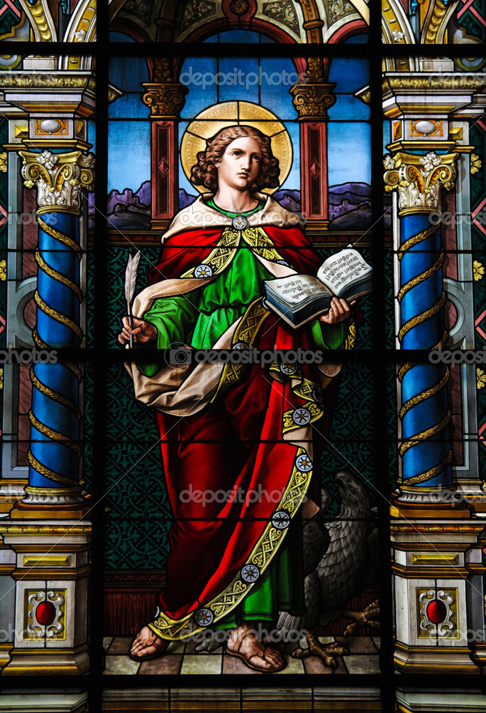
History
At this time, false teachers had created a schism, or division, among the Saints in the region, and apostasy was spreading in the Church.
A particular philosophy that was gaining popularity was Docetism.
Docetism was part of a larger movement known as Gnosticism.
A core teaching in many forms of Gnosticism was that the spirit was wholly good and that matter, including the physical body, was wholly evil.
1 John 2:18-19; 22; 26; 4:1

Slide 5
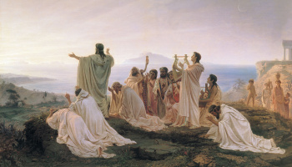
Followers of Gnosticism
Followers of Gnosticism believed that salvation was not achieved by being freed from sin but rather by freeing the spirit from matter, meaning the physical body.
They also believed that salvation was achieved through special knowledge (gnosis) rather than through faith in Jesus Christ.
1 John 2:18-19; 22; 26; 4:1

Slide 6
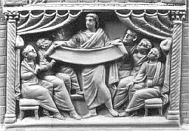
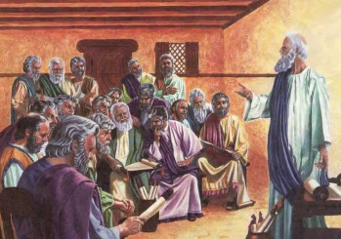
Followers of Docetism
Docetism comes from the Greek word dokeō, meaning “to seem” or “to appear.”
Followers of Docetism overemphasized Jesus’s spiritual nature to the point that they rejected the idea that He came to earth in actual bodily form.
They believed that God was invisible, immortal, all-knowing, and immaterial, and they considered the physical world and the physical body to be base and evil.
Therefore, they believed that since Jesus was the divine Son of God, He could not have experienced the limitations of being human.
In their view, Jesus Christ was not literally born in the flesh, and He did not inhabit a tangible body, bleed, suffer, die, or rise with a physical resurrected body—He only seemed to do these things.
1 John 2:18-19; 22; 26; 4:1

Slide 7
Apostasy
Turning away from the truth
Antichrist
Anyone or anything that counterfeits the true gospel plan of salvation and that openly or secretly opposes Christ” and the authority and teachings of His chosen servants
Some antichrists in John’s day were teaching that Jesus Christ did not have a physical body while on earth but only appeared to be a physical being.
(2)

Slide 8
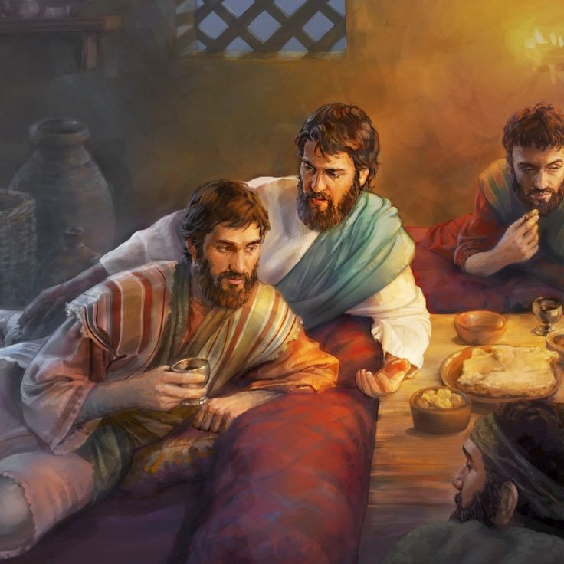
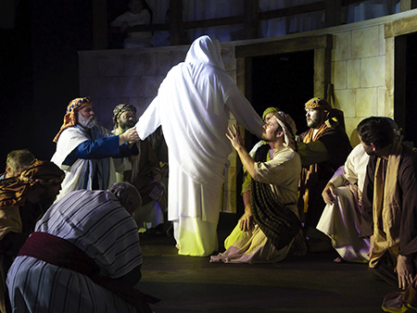
The Word of Life
Christ
John and the Apostles had personally seen, been with, and heard Jesus Christ as a teacher, leader, and the Son of God.
They were witnesses of miracles and healings, and of His resurrection.
1 John:1-4
(2)

Slide 9
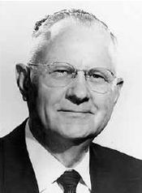
Light From God
Light leads to salvation; it edifies and uplifts.
“The gospel of Christ is a lamp in our hands to guide us in righteous paths. Light can always dissipate darkness, but darkness can never replace light.
It is only when the light of the Spirit within us is dimmed or goes out that the darkness of temptation and sin enters in, and Satan takes over.”
1 John:5-7
(3)

Slide 10
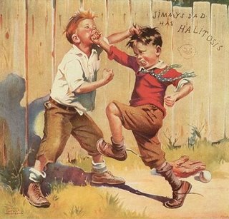
Struggling to Obey
A young man reads the scriptures each day and faithfully performs many of his priesthood duties,
but he is often unkind to his younger brother.
A young woman regularly attends her Church meetings and has earned her Young Womanhood Recognition. However, she often posts rude comments about some of her classmates and teachers on social media.
1 John:2:4
(3)

Slide 11
God is Love
He that loveth his brother abideth in the light, and there is none occasion of stumbling in him.
“Our feelings toward one another must be those of brotherly love. Religion should cement and strengthen and never weaken this feeling. It is most important that we respect and honor the religious beliefs and feelings of our neighbors.”
1 John 2:10-21
(4)

Slide 12
Love Not the World
“Since you don't let people come in and walk around in your house with muddy feet, do not let them walk through your minds with muddy feet...
Because our behavioral standards are different... we must come to despise the shame of the world.
We must not hold the people of the world in contempt; we must love them. But we must come to have contempt for the shame of the world, because it matters so little in the end...
“Remember, those who are in error must not call the cadence for your life, for those who boast of their sexual conquests are only boasting of that which has conquered them-in the same way that people who make nervous jokes about drunkenness are only mocking that which has come to mock them. We may pity behavioral clones, but we do not envy them.
1 John:2:10-21
(5)

Slide 13
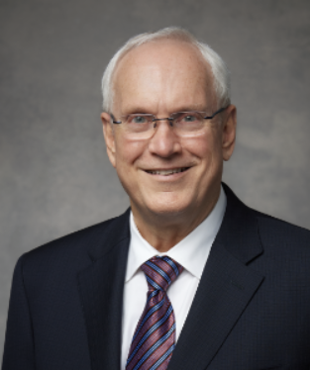
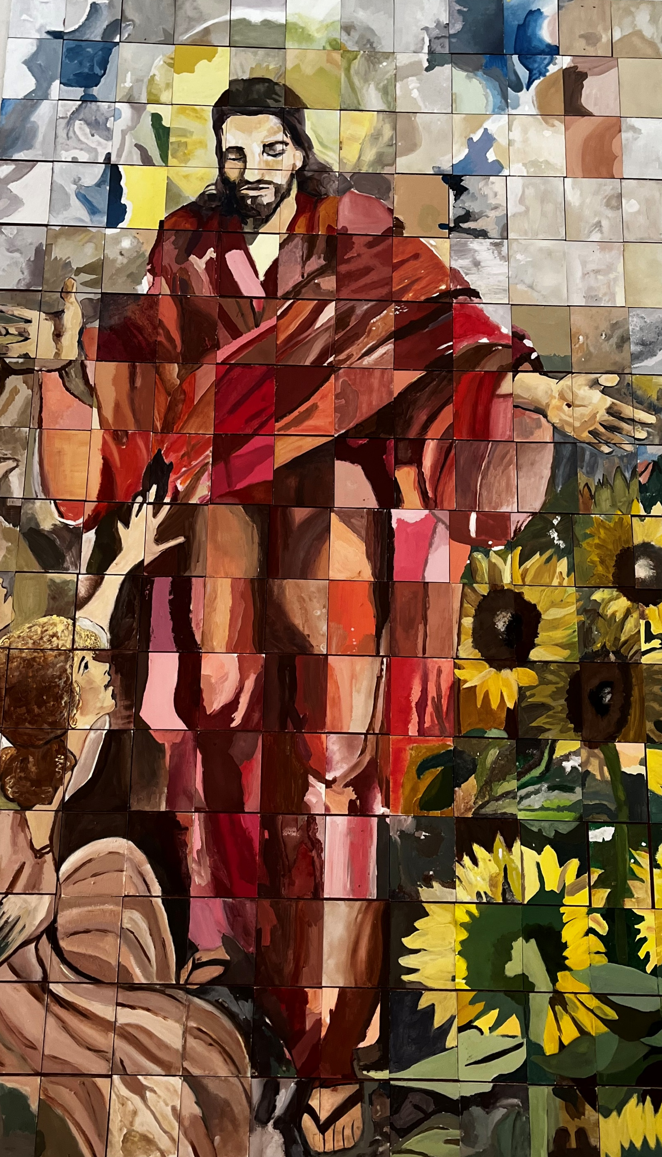
God’s Love For Us
His love is greater than our fears, our wounds, our addictions, our doubts, our temptations, our sins, our broken families, our depression and anxieties, our chronic illness, our poverty, our abuse, our despair, and our loneliness.
He wants all to know there is nothing and no one He is unable to heal and deliver to enduring joy.
(8)
1 John 2:4-8

Slide 14
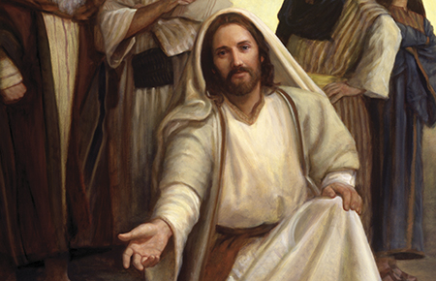
Love Through Our Actions
Why do you think it is important that we demonstrate our love through our actions and not through our words alone?
My little children, let us not love in word, neither in tongue; but in deed and in truth.
1 John 3:17-18

Slide 15
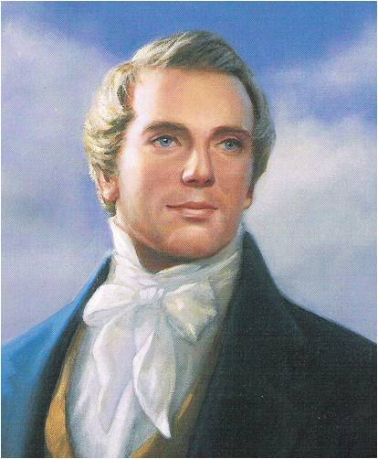
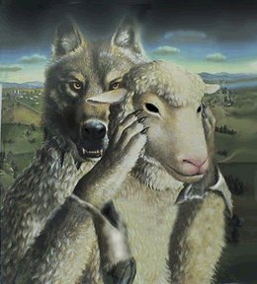
The False Spirit
“[The] power of discernment is essential if we are to distinguish between genuine spiritual gifts and the counterfeits Satan seeks to use to deceive men and women and thwart the work of God.” (6)
"Nothing is a greater injury to the children of men than to be under the influence of a false spirit when they think they have the spirit of God."
“No man nor sect of men without the regular constituted authorities, the Priesthood and discerning of spirits, can tell true from false spirits." (7)
1 John 4:1

Slide 16
34 Love Words in 1 John 4:7-5:5

Slide 17
1 John 4:7
1, 2, 3, 4
Beloved, let us love one another: for love is of God; and every one that loveth is born of God, and knoweth God
1 John 4: 8
5, 6
He that loveth not knoweth not God; for God is love.
1 John 4:9
7
In this was manifested the love of God toward us, because that God sent his only begotten Son into the world, that we might live through him.
1 John 4:10
8, 9, 10
Herein is love, not that we loved God, but that he loved us, and sent his Son to be the propitiation for our sins.
1 John 4:11
11, 12, 13
Beloved, if God so loved us, we ought also to love one another.
1 John 4:12
14, 15
No man hath seen God at any time. If we love one another, God dwelleth in us, and his love is perfected in us.
1 John 4:16
16, 17, 18
And we have known and believed the love that God hath to us. God is love; and he that dwelleth in love dwelleth in God, and God in him.
1 John 4:17
19
Herein is our love made perfect, that we may have boldness in the day of judgment: because as he is, so are we in this world.

Slide 18
1 John 4:18
20, 21, 22
There is no fear in love; but perfect love casteth out fear: because fear hath torment. He that feareth is not made perfect in love.
1 John 4:19
23, 24
We love him, because he first loved us.
1 John 4:20
25, 26, 27
If a man say, I love God, and hateth his brother, he is a liar: for he that loveth not his brother whom he hath seen, how can he love God whom he hath not seen?
1 John 4:21
28, 29
And this commandment have we from him, That he who loveth God love his brother also.
1 John 5:1
30, 31
Whosoever believeth that Jesus is the Christ is born of God: and every one that loveth him that begat loveth him also that is begotten of him.
1 John 5:2
32, 33
By this we know that we love the children of God, when we love God, and keep his commandments.
1 John 5:3
34
For this is the love of God, that we keep his commandments: and his commandments are not grievous.

Slide 19
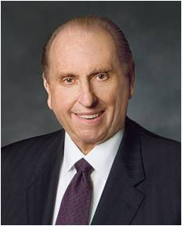
God’s commandments are not given to frustrate us or to become obstacles to our happiness.
Just the opposite is true. He who created us and who loves us perfectly knows just how we need to live our lives in order to obtain the greatest happiness possible.
He has provided us with guidelines which, if we follow them, will see us safely through this often treacherous mortal journey. …
… He understands that when we keep the commandments, our lives will be happier, more fulfilling, and less complicated. Our challenges and problems will be easier to bear, and we will receive His promised blessings.
(9)

Slide 20
Who Are Our “Brothers”?
Our highest priorities in life are to love God and to love our neighbors. That broadly includes neighbors in our own family, our community, our nation, and our world.
(10)

Slide 21
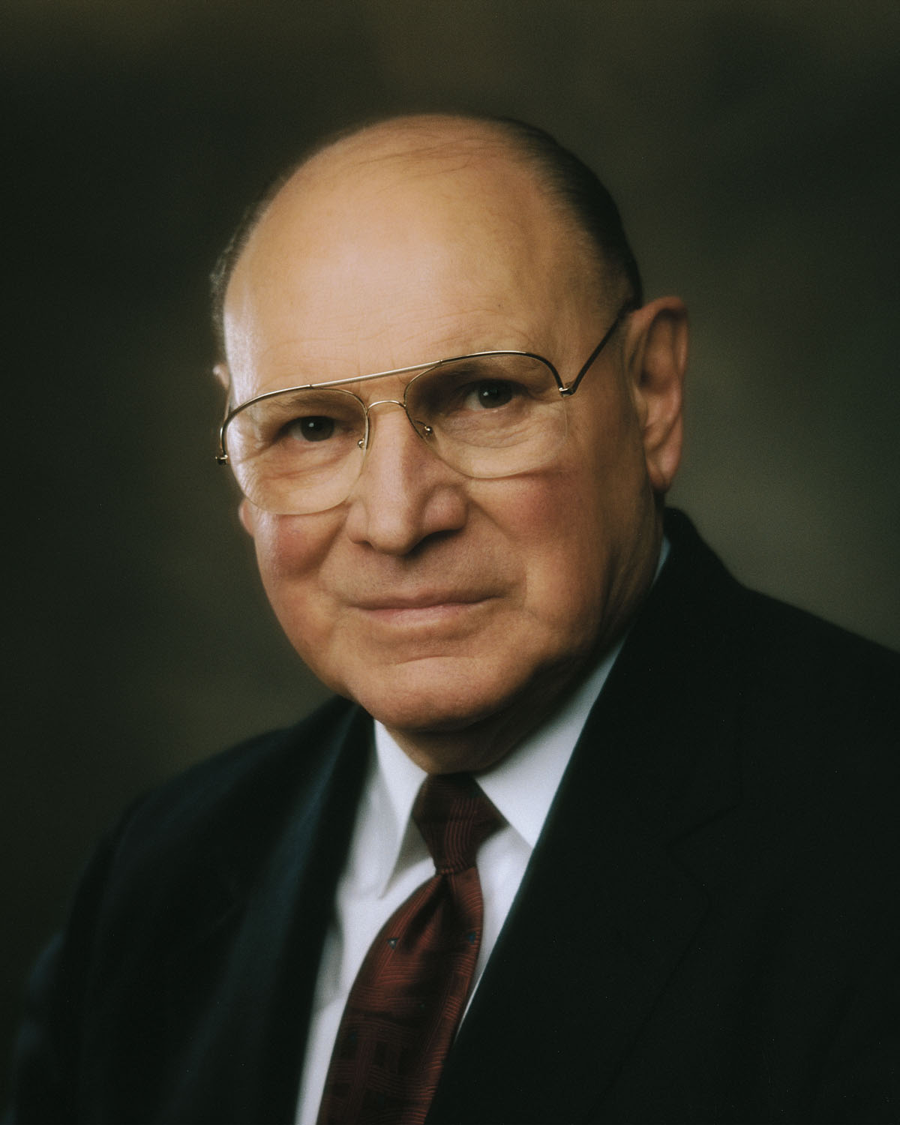
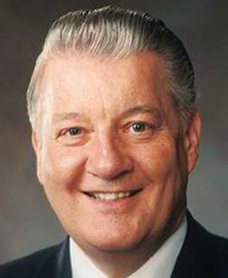
Love Quotes
Often, the greatest manifestations of love are the simple acts of kindness and caring we extend to those we meet along the path of life.
When filled with God’s love, we can do and see and understand things that we could not otherwise do or see or understand.
Love is the healing balm that repairs rifts in personal and family relationships. It is the bond that unites families, communities, and nations.

Slide 22
Sources:
New Testament Institute Student Manual Chapter 52
Guide to the Scriptures
Elder Delbert L. Stapely (Conference Report, April 1968, Afternoon Meeting 28.)
N. Eldon Tanner ("The Great Commandments," Ensign, July 1980, 3-4)
Elder Neal A. Maxwell ("The Stern but Sweet Seventh Commandment," New Era, June 1979, 41-42)
Elder Dallin H. Oaks "Spiritual Gifts," Ensign, Sept. 1986, 71-72)
Prophet Joseph Smith (Teachings, p. 213.)
Robert C. Gay, “Taking upon Ourselves the Name of Jesus Christ,” Ensign or Liahona, Nov. 2018, 99
Thomas S. Monson, “Keep the Commandments,” Ensign or Liahona, Nov. 2015, 83
Russell M. Nelson, “Teach Us Tolerance and Love,” Ensign or Liahona, May 1994, 69
Presentation by ©http://fashionsbylynda.com/blog/

Slide 23
A LETTER TO THE CHRISTIAN COMMUNITIES, CA. A.D. 96 John
Walk in the Light of Christ | 1:1–7
We Must Break from Our Sins | 1:8–10; 2:1, 2
The Saints May Know God and Christ | 2:3–6
Abide in the Light Through the Law of Love | 2:7–14
“Love Not the World” | 2:15–17
Anti-Christs to Come in Latter Days | 2:18–26
The Holy Ghost Leads Saints to Truth | 2:27–29
The Sons of God Shall Be Like Christ | 3:1–3
Saints Must Not Continue in Sin | 3:4–9
Love the Brethren and Gain Eternal Life | 3:10–18
Gaining Answers to Prayers | 3:19–24
“Try the Spirits” | 4:1–6
“God Is Love” | 4:7–21
“Who Is Born of God?” | 5:1–4
Many Witnesses Testify of Eternal Life in Christ | 5:5–21
The Theme of 1 John:
“Written by the Disciple whom Jesus loved, and who in turn had such great love for his Lord and his fellowmen that he gained permission to remain on earth and seek to save souls until the Second Coming—this Epistle has as its essential Theme:
“That God is love;
“That love is the foundation upon which all personal righteousness rests;
“That all the purposes and plans of Deity are based on his infinite and eternal love; and
“That if men will personify that love in their lives, they will become like the Lord himself and have eternal life with him.
“The doctrines expounded include how to gain fellowship with God; how to know God and Christ; how to become the sons of God; how to abide in the light and love the brethren; how to dwell in God and have him dwell in us; how to be born again and gain eternal life.” Elder Bruce R. McConkie, DNTC, 3:371.)
The Light of Christ 1 john 1:7:
Where the true gospel of Christ is, there is light; and where that gospel is not found, darkness reigns. "The whole world lieth in sin, and groaneth under darkness and under the bondage of sin, . . . because they come not unto me," the Lord said. (D. & C. 84:49-54.) "Darkness covereth the earth, and gross darkness the minds of the people," (D. & C. 112:23.) The kingdom of the devil is "full of darkness," (Rev. 16: 10.) And men "love darkness rather than light, because their deeds are evil." (D. & C. 10:21; John 3:19.) But when men repent and heed the call of Christ, they thereby come "out of darkness into his marvelous light." (1 Pet. 2:9; 1 Thess. 5:4; 1 John 2:9.) Elder Bruce R. McConkie (Mormon Doctrine, 2d ed. [Salt Lake City: Bookcraft, 1966], 179.)
Spirit of antichrist 1 John 4:3
Today there are many men who proclaim the doctrine that man has the power in himself to rise through his native intelligence, and if there is any salvation to be obtained such a man will receive it irrespective of any act or virtue coming from Jesus Christ. This is the spirit of anti-Christ which the Lord said would be in the world. Joseph Fielding Smith (Church History and Modern Revelation, 4 vols. [Salt Lake City: The Church of Jesus Christ of Latter-day Saints, 1946-1949], 1: 88, footnote 6)
Life and Teachings of Jesus and His Apostles Chapter 52
“…Only the pure love of Christ will see us through. It is Christ’s love which suffereth long, and is kind. It is Christ’s love which is not puffed up nor easily provoked. Only his pure love enables him- and us- to bear all things, believe all things, hope all things, and endure all things.” Elder Jeffrey R. Holland

Slide 24
Do You Really Know Him? 1 John 2:4-5:
"The scriptures make crystal clear that proper behavior (works) must be part of our life in Christ. The Savior himself taught, 'Not every one that saith unto me, Lord, Lord, shall enter into the kingdom of heaven; but he that doeth the will of my Father which is in heaven. . . . Depart from me, ye that work iniquity' (Matthew 7:21, 23; emphasis added). In other words, merely acknowledging Jesus' lordship, merely saying the words or making the confession, while refusing to make him our lord by serving him and conforming our behavior to his will-this will not get us into the kingdom. The confession or the acknowledgment must be accompanied by doing the will of the Father in heaven and by not doing iniquity. Jesus explicitly established the undeniable link between salvation and good works: 'If thou wilt enter into life, keep the commandments' (Matthew 19:17). In John's Gospel (3:20-21) he is quoted as saying: 'Every one that doeth evil hateth the light, neither cometh to the light, lest his deeds should be reproved. But he that doeth truth cometh to the light, that his deeds may be made manifest, that they are wrought in God' (emphasis added). You can't do evil and be in the light-our deeds and our spiritual condition and destiny are interconnected. Moreover, Jesus also makes keeping his commandments-that is, behavior-a part of abiding in his love: 'If ye keep my commandments, ye shall abide in my love; even as I have kept my Father's commandments, and abide in his love' (John 15:10; see also 14:15, 21). The necessary link between proper behavior and being 'in Christ' is further taught by John: 'He that saith, I know him, and keepeth not his commandments, is a liar, and the truth is not in him. But whoso keepeth his word, in him verily is the love of God perfected: hereby know we that we are in him' (1 John 2:4). Who is truly 'in Christ'? Those who keep the commandments! There are those who profess him but will not work for him, those who claim to be sons and daughters but refuse to do their chores. But these, according to the scripture, are 'liars.'" (Stephen E. Robinson, Following Christ: The Parable of the Divers and More Good News [Salt Lake City: Deseret Book Co., 1995], 77.)
God’s Love:
When filled with God’s love, we can do and see and understand things that we could not otherwise do or see or understand. Filled with His love, we can endure pain, quell fear, forgive freely, avoid contention, renew strength, and bless and help others in ways surprising even to us.
Jesus Christ was filled with unfathomable love as He endured incomprehensible pain, cruelty, and injustice for us. Through His love for us, He rose above otherwise insurmountable barriers. His love knows no barriers. He invites us to follow Him and partake of His unlimited love so we too may rise above the pain and cruelty and injustice of this world and help and forgive and bless.
(John H. Groberg, “The Power of God’s Love,” Ensign or Liahona, Nov. 2004, 11)
"God is love (1 John 4:7-5:5)... The word love is used thirty-four times in these twenty verses, which highlight at least five characteristics of love: God, through his Son, is the source of love (1 John 4:7-12); love is a gift of faith received through the Spirit (1 John 4:13-16); love brings confidence and dispels fear (1 John 4:17-18); love of God is manifest in our love for others (1 John 4:19-21); and the ultimate reward of keeping God's commandment to love is to share in his Son's victory (1 John 5:1-5). For John, these are the cardinal principles of Christian discipleship." (Victor L. Ludlow, "John: The Once and Future Witness," Ensign, Dec. 1991, 54)

Slide 25
Wood Block painting was created by the Olympus stake Young Women at Girls’ Camp 2019. Each girl individual painted one block, combining the blocks to make this mural.
Their statement:
“It is our testimony that each of us is vital in the gospel plan, and although our life circumstances may not always make sense, the Lord knows the bigger picture and will care for us.

Slide 26
Receiving the Lord’s Servants
2 John and 3 John
And the arm of the Lord shall be revealed; and the day cometh that they who will not hear the voice of the Lord, neither the voice of his servants, neither give heed to the words of the prophets and apostles, shall be cut off from among the people;
D&C 1:14

Slide 27
John 2 --History
Early Saints often housed and supported
traveling Church leaders and teachers.
False teachings travelers took advantage of the hospitality of the Saints, John tells his readers to use discernment and avoid supporting these people
The 2 letters were written about A.D. 85-95 somewhere in the Roman Empire.

Slide 28
The Elect Lady and Her Children
May have been either a direct address to a female Church member and her children or symbolic language to describe a Church congregation.
In D&C 25:3 Emma Smith, wife of the Prophet Joseph Smith, was called “an elect lady”
2 John 1-4
(2)

Slide 29
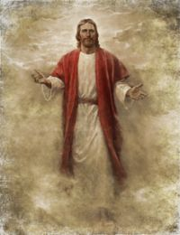
Walk After His Commandments
We must put God in the forefront of everything else in our lives. He must come first, just as He declares in the first of His Ten Commandments: "Thou shalt have no other gods before me" (Exodus 20:3).
When we put God first, all other things fall into their proper place or drop out of our lives. Our love of the Lord will govern the claims of our affection, the demands on our time, the interests we pursue, and the order of our priorities.
2 John 1:6
(3)

Slide 30
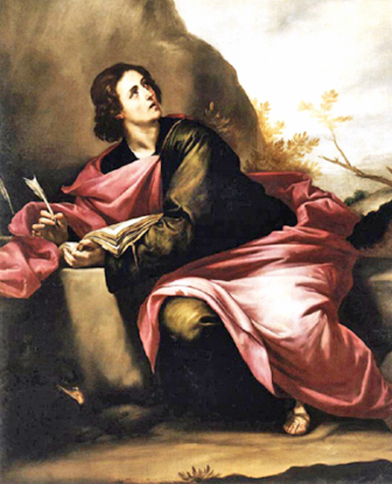
Deceivers of the World
John advised the Saints that if they encountered a false teacher, they should “receive him not into your house, neither bid him God speed”
John was not suggesting that the Saints should fail to extend common courtesy to those who taught contrary doctrines.
However, since early Christian congregations gathered to worship in the homes of Church members, traditional customs of hospitality could inadvertently enable heretical teachers to infiltrate congregations.
2 John 1:7-10
(1)

Slide 31
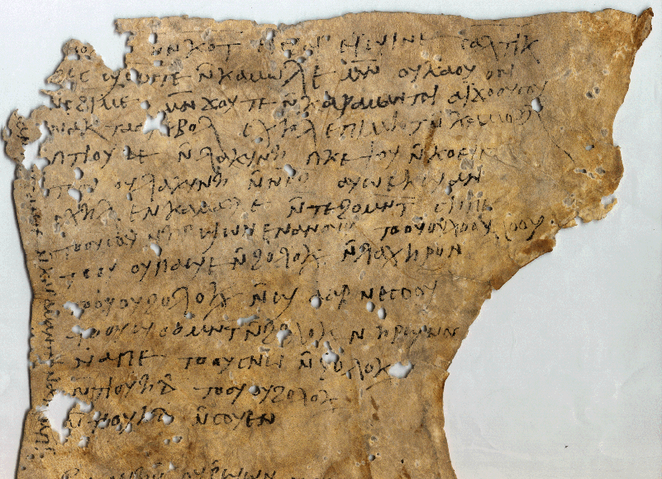
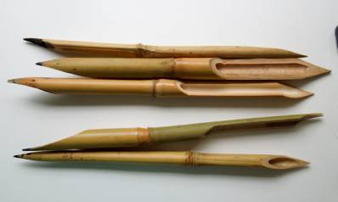
Paper and Ink
"How were the sacred words recorded? It appears that anciently two main substances were used in writing. Papyrus was made from the inner bark of a reed plant that grew beside rivers and marshes...
The second material on which writing was done was parchment. Parchment was formed through shaving and scraping clean the skins of sheep, goats, antelope, and other animals in order to produce a material for writing which was more durable than papyrus...
Cyperus Papyrus
... Pen and ink were used to write on papyrus or parchment. The pen was a reed 'fashioned from rushes about 6-16 in. long, the end being cut to a flat chisel-shape to enable thick and thin strokes to be made with
the broad or narrow sides.
' The ink was made of charcoal,
gum, and water.
2 John 1:12
(1)

Slide 32
Gaius—the Name Only
1. A Christian Gaius is mentioned in Macedonia as a traveling companion of Paul, along with Aristarchus (Acts 19:29).
One chapter later, a Gaius from Derbe is named as one of Paul's seven traveling companions who waited for him at Troas(Acts 20:4).
2. A Gaius is mentioned residing in Corinth as being one of only a few people there (the others being Crispus and the household of Stephanas) who were baptized by Paul, who founded the Church in that city (1 Corinthians 1:14).
3. A Gaius is referred to in a final greeting portion of the Epistle to the Romans (Romans 16:23) as Paul's "host" and also host of the whole church, in whatever city Paul is writing from at the time. In all likelihood, this was Corinth.
Lastly, Gaius of Ephesus to whom the third Epistle of John is addressed (3 John 1). He may be one of the men mentioned in any of the other contexts. (2)
(2)

Slide 33
Diotrephes
"John's third letter is a letter of apostasy.
In it he made reference to one Diotrephes, a local church leader who had refused to receive John.
Diotrephes, according to John, 'loveth to have the preeminence' among the saints.
John - the presiding authority of the church - had written to him; but Diotrephes would not receive John. Neither would he receive 'the brethren,' and he would not let his congregation do so either. In fact, he excommunicated those who would.
3 John 1:9-10
(5)

Slide 34
Gaius—A Faithful Member
John praised Gaius for his willingness to receive traveling Church leaders or missionaries.
3 John 1:5-14
(2)

Slide 35
Sources:
Suggested Hymn: #21 Come Listen to a Prophet’s Vioce
New Testament Institute Student Manual Chapter 51
Wikipedia
President Ezra Taft Benson CR April 1988, Ensign 18 [May 1988]: 4.) (The Teachings of Ezra Taft Benson [Salt Lake City: Bookcraft, 1988], 349 - 350.)
Robert Millet (Selected Writings of Robert L. Millet: Gospel Scholars Series [Salt Lake City: Deseret Book Co., 2000], 4 - 5.)
(John M. Lundquist and Stephen D. Ricks, eds., By Study and Also by Faith: Essays in Honor of Hugh W. Nibley on the Occasion of His Eightieth Birthday, 27 March 1990, 2 vols. [Salt Lake City and Provo: Deseret Book Co., Foundation for Ancient Research and Mormon Studies, 1990], 1: 111 - 112.)
Presentation by ©http://fashionsbylynda.com/blog/

Slide 36
2 JOHN: TO A BRANCH OF THE CHURCH
3 JOHN: TO GAIUS, A CHRISTIAN CONVERT
Written between 70 – 100 AD
False Prophets and teachers 2 John 1:7-10:
“Let us beware of false prophets and false teachers, both men and women, who are self-appointed declarers of the doctrines of the Church and who seek to spread their false gospel and attract followers by sponsoring symposia, books, and journals whose contents challenge fundamental doctrines of the Church. Beware of those who speak and publish in opposition to God’s true prophets and who actively proselyte others with reckless disregard for the eternal well-being of those whom they seduce. …
“Perhaps most damningly, they deny Christ’s Resurrection and Atonement, arguing that no God can save us. They reject the need for a Savior. In short, these detractors attempt to reinterpret the doctrines of the Church to fit their own preconceived views, and in the process deny Christ and His messianic role” Elder M. Russell Ballard (“Beware of False Prophets and False Teachers,” Ensign, Nov. 1999, 63).
John 2
Saints Are Commanded to Teach the Law of Love | 1:1–6
Do Not Aid the Enemies of Christ | 1:6
3 John
Gaius Praised for His Labors | 1:1–8
Beware of the Example of Diotrephes | 1:9–11
Demetrius Commended | 1:12–14
Diotrephes 3 John 1:9-10:
“Here is Diotrephes, a local church officer of prominence and influence: (1) Who refuses to permit the doctrine and instructions of a member of the First Presidency of the Church to be read in his congregation; (2) Who preaches against the apostolic heads of the Church; (3) Who refuses to receive the church representatives sent to him; (4) Who refuses to let others in the congregation care for or give heed to the church authorities; and (5) Who casts out (apparently excommunicates) worthy members of the Church” Elder Bruce R. McConkie (Doctrinal New Testament Commentary, 3 vols. [1965–73], 3:413–14).
Life and Teachings of Jesus and His Apostles Chapter 53

Slide 37
Earnestly Contend For The Gospel
Jude
They stand fast for ever and ever, and are done in truth and uprightness.
Psalms 111:8

Slide 38
Jude
He was one of the brethren of the Lord and probable author of the epistle of Jude
Although the question of authorship has been much debated, no solid evidence has been produced to show that anyone other than Jude, brother of Jesus and James, wrote the letter
We have no indication that Jude held any office of importance in the early church, but the epistle seems to suggest that he eventually attained to a position wherein a letter from him would carry some weight
Jude was evidently a Church member of high esteem in Jerusalem, and he may have traveled as a missionary
Jude is the shortest letter in the New Testament. Like the other general epistles, little is known concerning the group or groups to which the epistle was directed. Jude merely addresses his writing “to them that are sanctified by God the Father, and preserved in Jesus Christ, and called.” (Jude 1:1)
The Epistle of Jude contains information that is not found anywhere else in the Bible
(2,3)

Slide 39
Pre-existence
“In the whole Bible, it is Jude only who preserves for us the concept that pre-existence was our first estate and that certain angels failed to pass its tests.
“It is to him that we turn for our meager knowledge of the disputation between Michael and Lucifer about the body of Moses.
“He alone records Enoch’s glorious prophecy about the Second Coming of the Son of Man.
“And he is the only inspired writer to express the counsel that the saints should hate even the garments spotted with the flesh.”
The General Epistle
Of
Jude
(2,3)

Slide 40
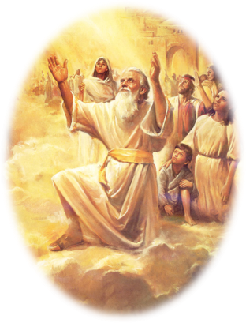
“And Enoch also, the seventh from Adam, prophesied of these, saying, Behold, the Lord cometh with ten thousands of his saints,”
Jude 1:14

Slide 41
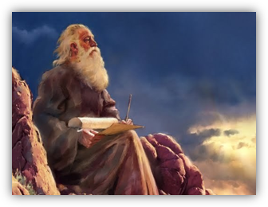
“To execute judgment upon all, and to convince all that are ungodly among them of all their ungodly deeds which they have ungodly committed, and of all their hard speeches which ungodly sinners have spoken against him.”
Jude 1:15

Slide 42
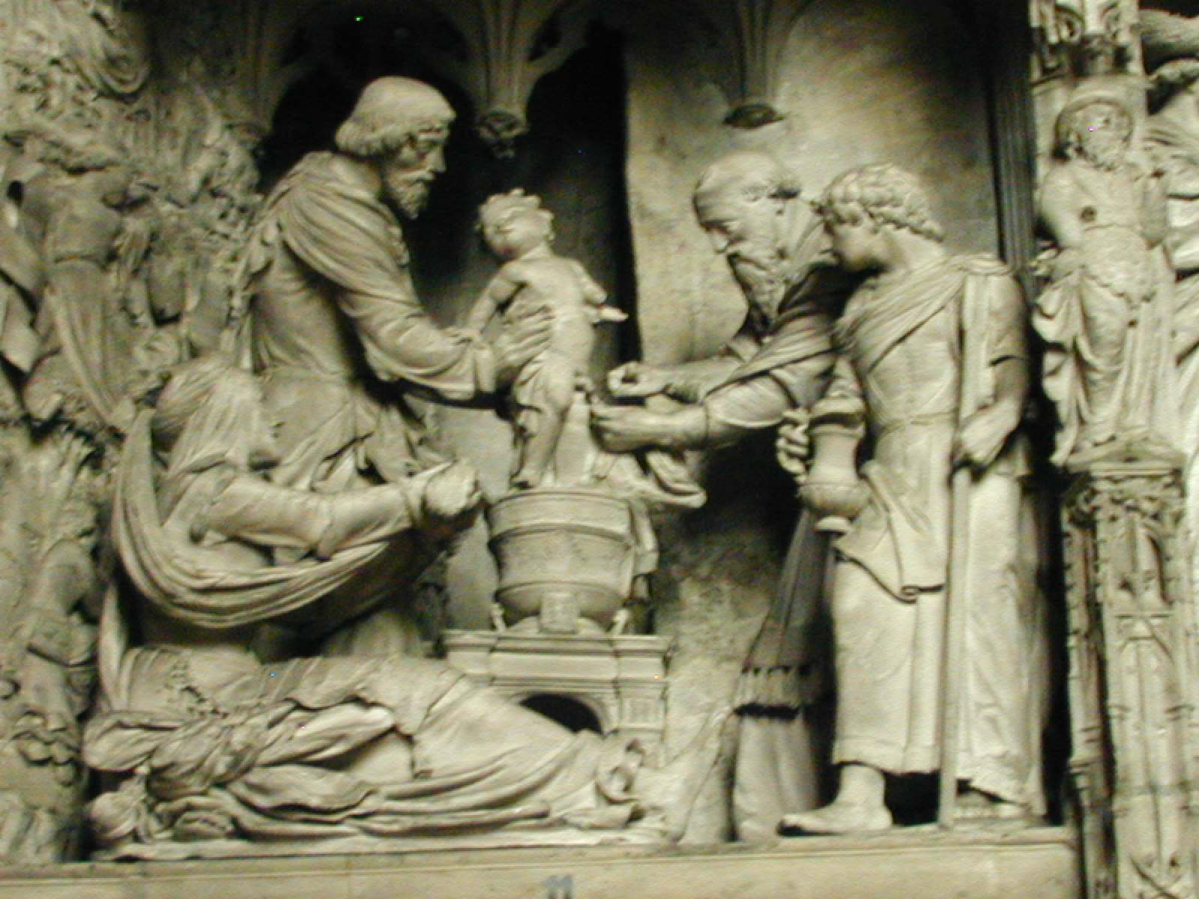
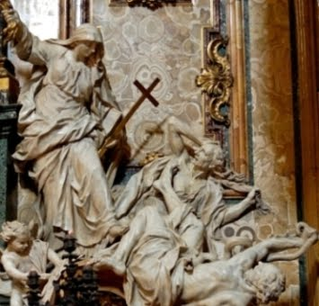
Ungodly Men With False Teachings
These Church members promoted corrupt, immoral practices by teaching that the doctrine of grace allowed for a complete license to sin because God would mercifully forgive.
They also rejected certain truths about Heavenly Father and Jesus Christ.
The phrase “who were before of old ordained to this condemnation” = the condemnation of such people had been written about long ago.
Jude 1:4

Slide 43
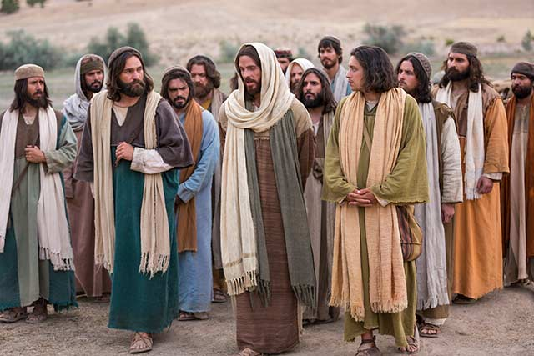
Earnestly Contend For Their Faith
Jude was referring to the faith that was taught originally by Christ Himself and then by His Apostles.
The same faith that we read about in the New Testament has been restored in our day and is found in The Church of Jesus Christ of Latter-day Saints.
Disciples of Jesus Christ should earnestly contend for the gospel of Jesus Christ against false teachings and corrupt practices
Jude 1:3
(1)

Slide 44
Characteristics of False Teachers
Defile their bodies with immorality
Despise authority and speak evil of dignities
Speak evil of things they do not understand
Corrupt themselves by living by the carnal knowledge they possess
Act in ungodly ways
Speak harsh words against God
Murmur and complain
Follow and act upon their lusts
Boast
Express admiration for others for the sake of personal advantage
Mock the Lord’s Church and its standards
Separate themselves from the believers
Think and act in sensual ways
Do not have the Spirit
Jude 1:8-19
(1)

Slide 45
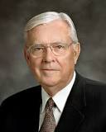
Apostles and prophets warn us of and help us recognize those who seek to weaken our faith and obedience
“Today we warn you that there are false prophets and false teachers arising; and if we are not careful, even those who are among the faithful members of The Church of Jesus Christ of Latter-day Saints will fall victim to their deception.”
(6)

Slide 46
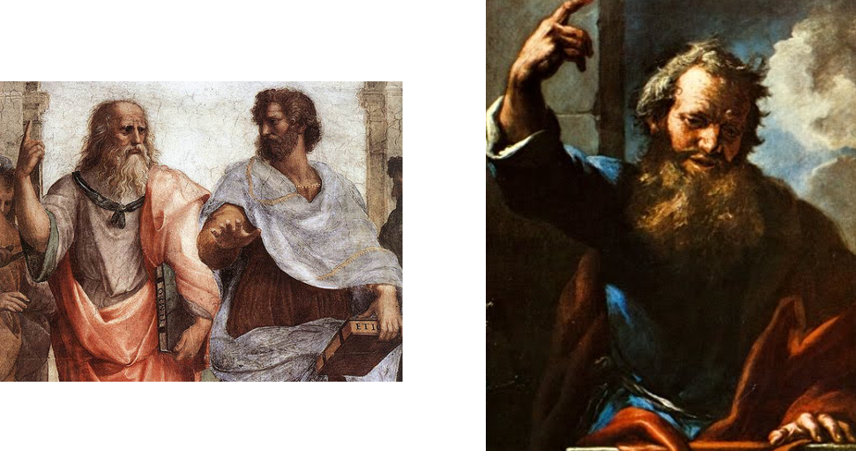
“These are murmurers, complainers, walking after their own lusts; and their mouth speaketh great swelling words, having men’s persons in admiration because of advantage.”
Jude 1:15

Slide 47
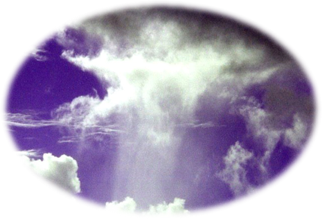
“But ye, beloved, building up yourselves on your most holy faith, praying in the Holy Ghost,”
Jude 1:20

Slide 48
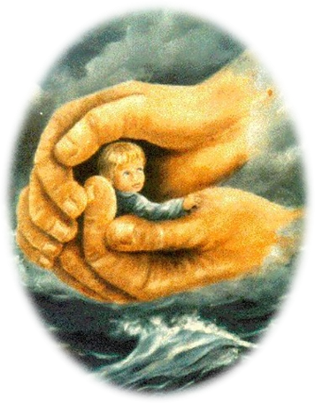
“Keep yourselves in the love of God, looking for the mercy of our Lord Jesus Christ unto eternal life.”
Jude 1:21

Slide 49
“The example of our living will carry a greater influence than will all the preaching in which we might indulge. We cannot expect to lift others unless we stand on higher ground ourselves.”
Jude 1:20-21
(5)

Slide 50
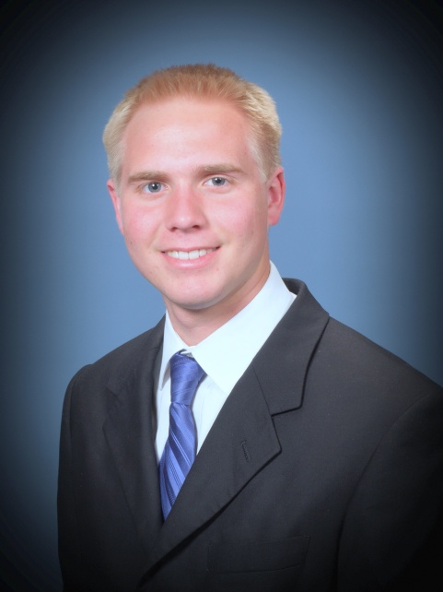
“It is your friendliness, your concern for others, and the good examples of your lives that result in the opinions held by others concerning the Latter-day Saints.”
Jude 1:20-21
(5)

Slide 51
Sources:
New Testament Institute Student Manual Chapter 51
Bible Dictionary
Life and Teachings of Jesus and His Apostles Chapter 53
Elder Bruce R. McConkie (McConkie, DNTC, 3:415.)
President Gordon B. Hinckley Oct. 1975 Conference Report
Elder M. Russell Ballard (“Beware of False Prophets and False Teachers,” Ensign, Nov. 1999, 62).
Presentation by ©http://fashionsbylynda.com/blog/

Slide 52
THE LETTER OF JUDE, A BROTHER OF THE LORD, TO JEWISH CHRISTIANS FROM JERUSALEM, CA. A.D. 70–90 (JUDE)
Jude’s words are sharp and incisive against the particular form of apostasy with which he was concerned. In graphic style, he cites three scriptural precedents to show how God has dealt in times past with disbelievers: the destruction of those who came out of Egypt and were not permitted to enter the Promised Land, the angels “who kept not their first estate,” and the inhabitants of Sodom and Gomorrah. These Jude likens to apostates of his own day, and he predicts that the same fateful calamity which befell those in other eras will come to modern apostates as well. They err, he contends, in the same way that Cain, Balaam, and Korah of old erred—they trust in themselves rather than God. The only solution for those who would avoid such calamities is to call to mind the source of their blessings and to continue in prayer and good works. (See vss. 20, 21.) Having preserved themselves from apostasy, faithful members should be active in helping to avoid a similar fate (vss. 22, 23).
Jude
“Contend for the Faith” | 1:1–5
Certain Angels Kept Not their First Estate | 1:7–13
The Disputation of Michael the Archangel | 1:7–13
Enoch Prophesied of Christ’s Second Coming | 1:14–16
Earnestly Contend for the Gospel Jude 1:6:
“When evil wants to strike out and disrupt the essence of God’s work, it attacks the family. It does so by attempting to disregard the law of chastity, to confuse gender, to desensitize violence, to make crude and blasphemous language the norm, and to make immoral and deviant behavior seem like the rule rather than the exception.
“We need to remember Edmund Burke’s statement: ‘The only thing necessary for the triumph of evil is for good men to do nothing’ [attributed in John Bartlett, comp., Familiar Quotations,15th ed. (1980), ix]. We need to raise our voices with other concerned citizens throughout the world in opposition to current trends” Elder M. Russel Ballard (“Let Our Voice Be Heard” Ensign or Liahona,Nov. 2003, 18).
Modern Apostles have instructed Church members on how to contend for the gospel without being contentious. For example, see Elder Robert D. Hales, “Christian Courage: The Price of Discipleship,” Ensign or Liahona, Nov. 2008, 72–75; Elder Jeffrey R. Holland, “The Cost—and Blessings—of Discipleship,” Ensign or Liahona, May 2014, 6–9; and Elder Dallin H. Oaks, “Loving Others and Living with Differences,” Ensign or Liahona, Nov. 2014, 25–28.
Life and Teachings of Jesus and His Apostles Chapter 53
The Angels Who Did Not Keep Their First Estate Jude 1:6:
Both Abraham and Jude speak of the premortal world as our “first estate” (Abraham 3:26). Those spirits who were faithful in that initial stage of eternal progression qualified for the privilege of coming into mortality, our second estate, while those who rebelled against God and followed Lucifer are they of whom Jude speaks, “angels which kept not their first estate.’’ The Prophet Joseph Smith explains their condition:
“The spirits in the eternal world are like the spirits in this world. When those have come into this world and received tabernacles, then died and again have risen and received glorified bodies, they will have an ascendancy over the spirits who have received no bodies, or kept not their first estate, like the devil. The punishment of the devil was that he should not have a habitation like men.” (Smith, Teachings, pp. 305–6.)

