Slide 1
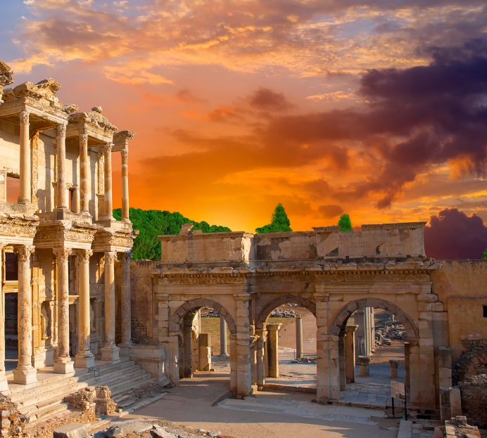
1 Corinthians 1-7

Slide 2
That There Be No Division
1 Corinthians 1-2
Behold, how good and how pleasant it is for brethren to dwell together in unity!
Psalm 133:1
Presentation by ©http://fashionsbylynda.com/blog/

Slide 3
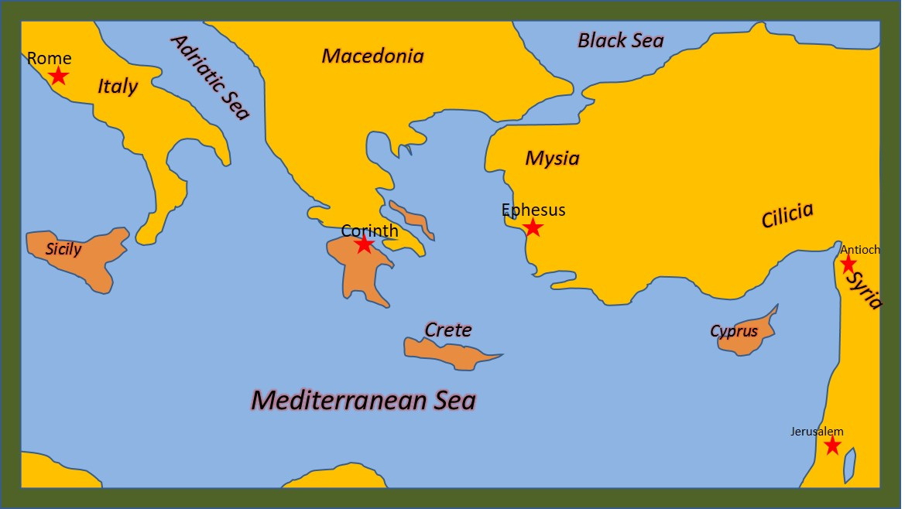
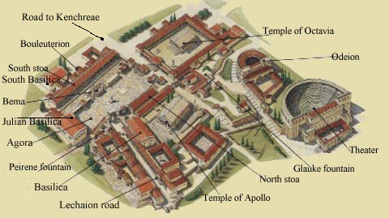
Corinth
Corinth is on an isthmus connecting mainland Greece with the Peloponnesian peninsula.
Corinth was the capital of the Roman province Achaia, which covered most of ancient Greece south of Macedonia.
Corinth was the most important city in Greece during Paul’s day.
It was the hub for commerce, philosophy, and religion from the East and the West.
Religious culture included idol worship. People worshiped in 12 temples throughout the city. They also engaged in immoral behavior.
Corinth was destroyed by Romans in 146 BC and rebuilt by Julius Caesar as a Roman colony in 46 BC.
The official language was Latin, but a common language remained Greek
(2,3)

Slide 4
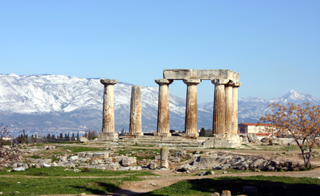
Church Established
For a year and a half Paul established the Church in Corinth during his second missionary journey around A.D. 50
Acts 18:1-17.
Persecution drove Paul to Athens.
The Corinthian Saints became divided and combined pagan beliefs and rituals with some of the true gospel principles and ordinances Paul had taught them.
Paul wrote these letters near the conclusion of his three-year visit in Ephesus (during his third mission), which likely ended sometime between A.D. 55 and 56
Earlier during his mission he received communication from Church members in Corinth. He wrote a response to the branch (1 Corinthians 5:9), but unfortunately this epistle was lost and is therefore not found in our scriptures.
(2,3)

Slide 5
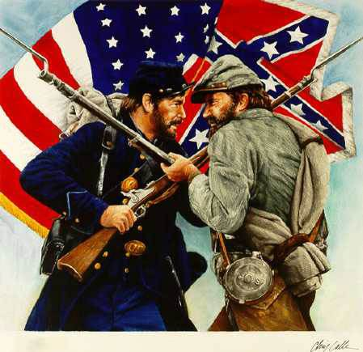
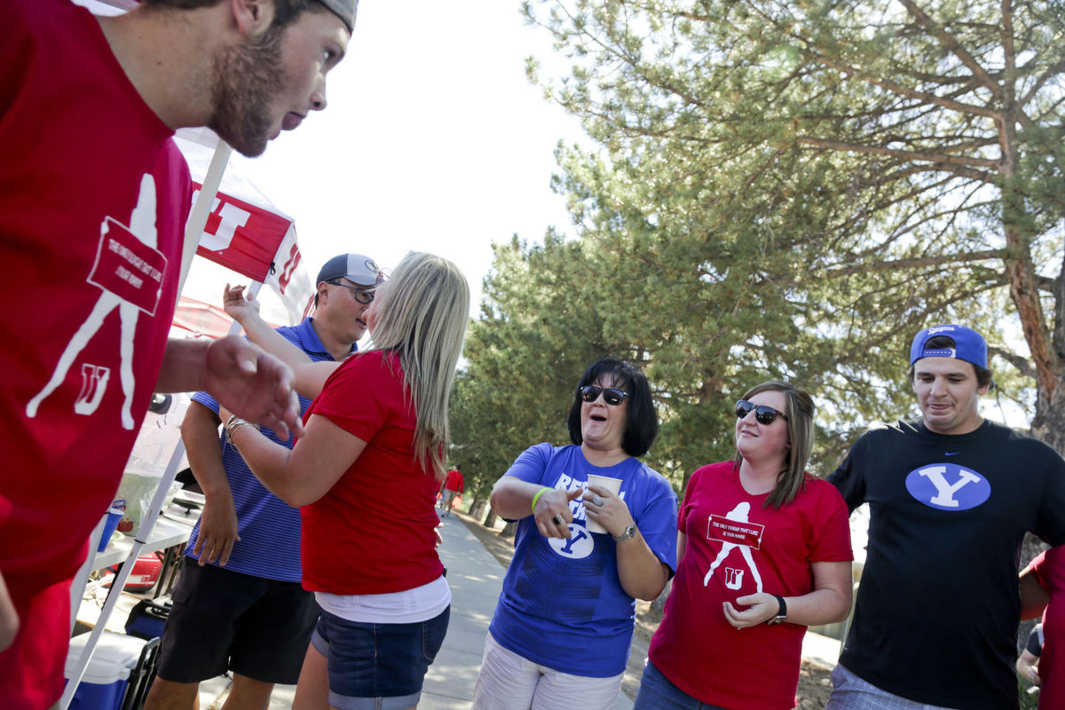
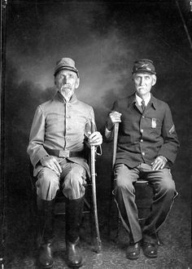
“That there be no division among you”
What might cause divisions and contention in each of these groups?
How can such divisions and contention affect a family, team, or group of friends?
How can such divisions and contention among Church members affect the Church?
1 Corinthians 1:10-11
“Brother vs. Brother”

Slide 6
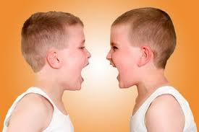
A Voice of Warning
Divisions and petty bickering
“…and that there be no divisions among you: but that ye be perfectly joined together in the same mind and in the same judgment.”
1 Corinthians 1:10

Slide 7
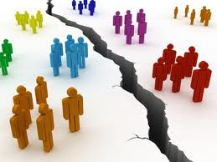
How To Treat One Another
That ye all speak the same thing
That there be no division among you
That ye be perfectly joined together in the same mind and in the same judgment
1 Corinthians 1:10

Slide 8
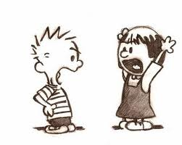
Division of Unity
Jealousy, leads to contention
Some are divided in doctrine and principles
“…he that hath the spirit of Contention is not of me, but is of the devil…
…who is the father of contention, and he stirreth up the hearts of men to contend with anger, one with another.”
3 Nephi 11:29

Slide 9
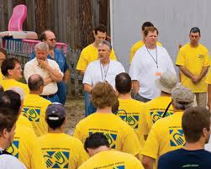
To Be Called A Saint
“…chastened for all your sins, that you might be one…” (D&C 61:8)
“…the Lord called his people Zion, because they were of one heart and one mind.” (Moses 7:18)
“That they all may be one; as thou, Father, art in me, and I in thee, that they also may be one in us…” (John 17:21)

Slide 10
One Purpose of Mind
This is not to say that we should be merged into one physical mass; Being controlled like robots.
But it is to say that we must be of one purpose and of one mind.

Slide 11
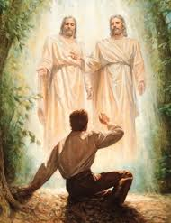
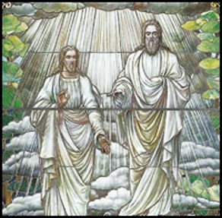
Just As Jesus and Heavenly Father Are One
“Understand that Jesus did not say “I and the Father am one, but are one.”
The word “are” refers to two persons
“I and my Father are one. (John 10:30)

Slide 12
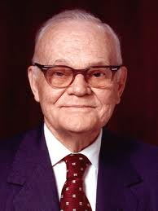
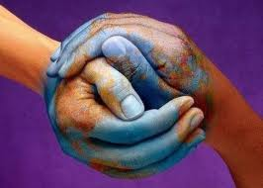
Unified and Bound Together In Our Beliefs
“The way to unity is for us to learn the will of the Lord and then to do it…
“The power of the Church for good in the world depends upon the extent to which we, the members thereof, observe this principle.”
(5)

Slide 13
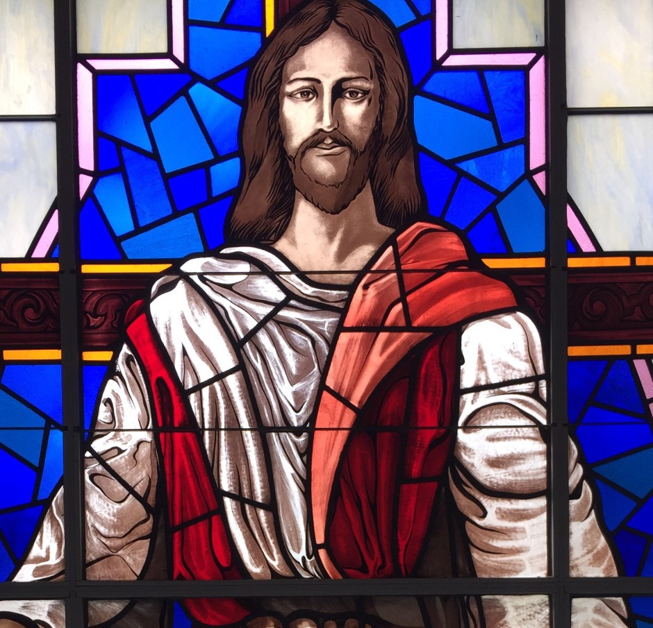
Who Baptized You?
The Saints in Corinth were dividing into groups based on who baptized them.
Contention developed because they believed their status in the Church was determined by the importance of the person who baptized them.
Church at Grace Park, White House, TN
Paul taught that there was no status gained by receiving baptism from a specific individual. Members were to be “perfectly joined together in the same mind and in the same judgment,” with Christ at their head.
1 Corinthians 1:12-16
(4)

Slide 14
Crispus
Where the size of a congregation permitted, the Jewish synagogue was presided over by a college of elders, who in turn were under control of one who was “the chief of the synagogue”
Crispus was in charge of the synagogue in Corinth at the time that Paul ministered the gospel in that city.
He was converted by Paul’s words and shortly thereafter baptized, with his household, by the great apostle to the gentiles.
Paul mentions him specifically as being one of the few he baptized in Corinth along with Gaius and the household of Stephans.
1 Corinthians 1:14, 16
(4)

Slide 15
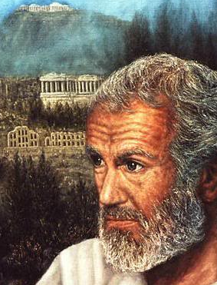
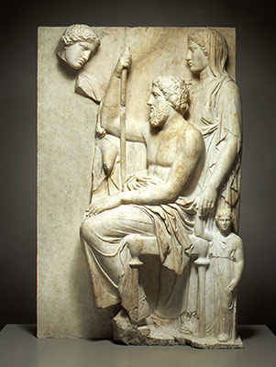
The Greeks
During the time of Paul, many Greeks lived in Corinth. These Greeks placed a high value on philosophical ideas and worldly wisdom.
Why might someone who values worldly philosophies find it difficult to accept the gospel?
O that cunning plan of the evil one! O the vainness, and the frailties, and the foolishness of men! When they are learned they think they are wise, and they hearken not unto the counsel of God, for they set it aside, supposing they know of themselves, wherefore, their wisdom is foolishness and it profiteth them not. And they shall perish.
2 Nephi 9:28
1 Corinthians 1:17
(4)

Slide 16
World’s Wisdom VS God’s Wisdom
1 Corinthians 1:17-18
1 Corinthians 1:19-20
1 Corinthians 1:21-22
1 Corinthians 1:23-24
Paul referred to the flawed philosophical traditions of his day and not to the worthwhile pursuit of learning and education that the Lord encourages.
"Those who rely exclusively on study and reason reject or remain doubtful of all absolutes that cannot be established through the five senses, including good and evil and the existence and omniscience of God. They also reject all other methods of acquiring knowledge, including revelation. They tend to be self-sufficient, self-important, and enamored of their own opinions. Reason is their god and intellectualism is their creed. They dwell in that 'large and spacious building' seen in a prophet's vision of the 'wisdom' and 'pride of the world.‘” (6)
Paul was not sent to build a reputation of baptisms based on numbers
"A major stumbling block of the Jews in Jesus' day,… was their expectation about what the Messiah would do when He came, such as emancipating them politically. But Jesus of Nazareth was not such an emancipator; thus to the Jews His death was a confirming stumbling block!
The Greeks, on the other hand, regarded the whole idea of a crucified Messiah as foolishness. (6)
He was there to preach the word of God, by the saving grace of the atonement
Philosophical ideas were regularly the subject of public debates. Paul contrasted limited human wisdom with the powerful message of God’s crucified Son. (1)
Preaching from the cross =
A shortened word for atonement. (4)

Slide 17
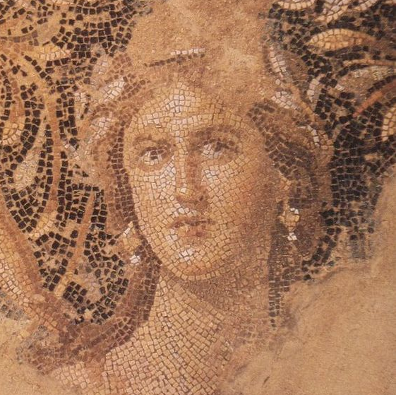
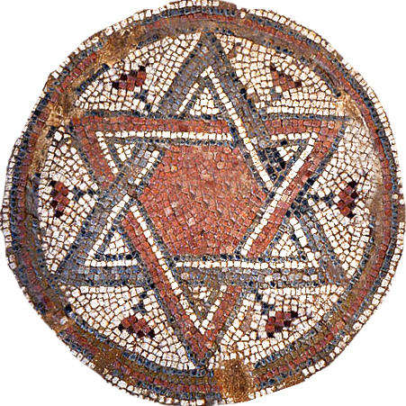
The Message of the Crucifixion
In the Roman world, crucifixion was a punishment reserved for criminals or slaves and symbolized shame and defeat.
The idea of someone vicariously suffering and dying for others, then subsequently coming back to life, was “foolishness” to the philosophically minded Greeks
For the Jews, whose concept of the Messiah brought the expectation of royalty, power, and victory, the message that the Messiah had died on a cross was a “stumbling block” and an unacceptable idea.
1 Corinthians 1:23
(1)

Slide 18
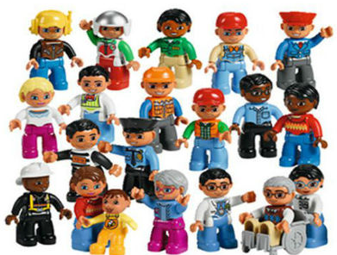
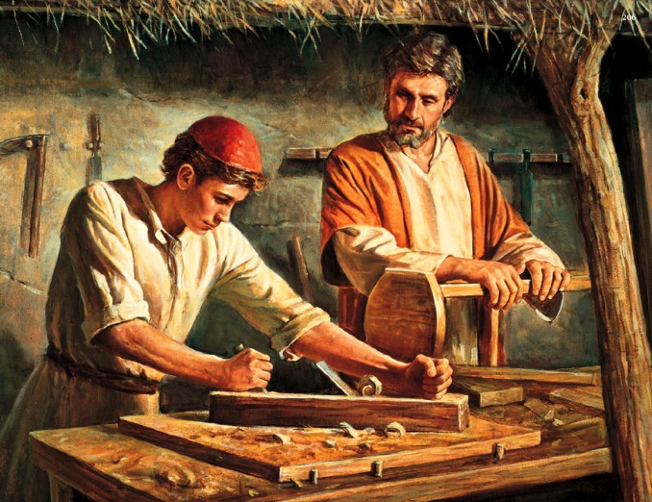
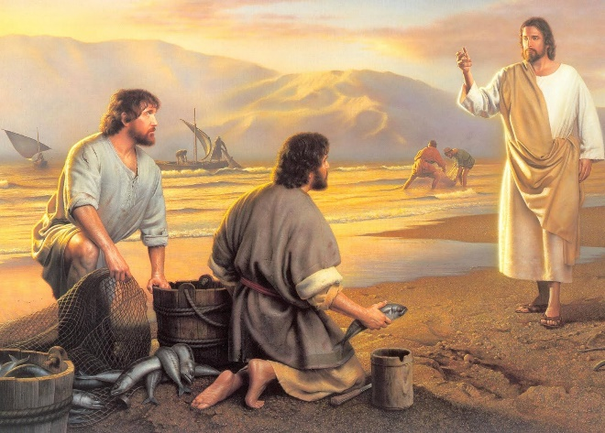
"Unlike some other religions, the gospel of Jesus Christ does not grant special status to theologians, philosophers, or other academics. All are welcome to enjoy the bounteous blessings of the gospel, regardless of educational background or social status.
Those called by the Savior to serve in His kingdom represent this broad cross-section of humanity.
Jesus Christ, raised by Mary and by Joseph the carpenter, first called as His disciples' fishermen and others engaged in common professions. (8)
1 Corinthians 1:26-27

Slide 19
“I sat on a plane next to a professed atheist who pressed his disbelief in God so urgently that I bore my testimony to him. ‘You are wrong,’ I said, ‘there is a God. I know He lives!’
“When I used the words Spirit and witness, the atheist responded,
‘You don’t know. Nobody knows that! You can’t know it!’
‘I don’t know what you are talking about.’
When I would not yield, the atheist, who was an attorney, asked perhaps the ultimate question on the subject of testimony. In a sneering condescending way he said…
The words prayer, discernment, and faith, were equally meaningless to him.
‘you don’t really know. If you did, you would be able to tell me how you know.’
‘All right…you say you know. Tell me how you know.’
“When I attempted to answer, even though I held advanced academic degrees, I was helpless to communicate. …
“I … was at a loss as to what to do”
What would you have said to the atheist?
(9)

Slide 20
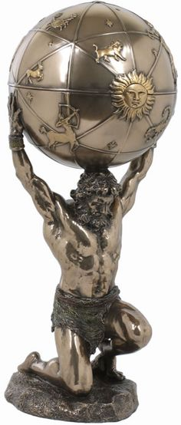
Teaching by the Spirit
Paul did not use the world’s wisdom to convince them of the gospel. He taught them by the Spirit so they would have faith in God.
But to be learned is good if they hearken unto the counsels of God. 2 Nephi 9:29
Paul told them that unbelievers cannot understand the mysteries of God.
Regardless of those who scoffed at the gospel, the Saints’ faith should not depend on “the wisdom of men, but … the power of God” (1)
1 Corinthians 2:1-8

Slide 21
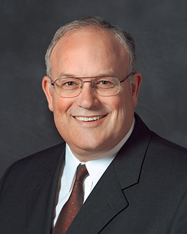
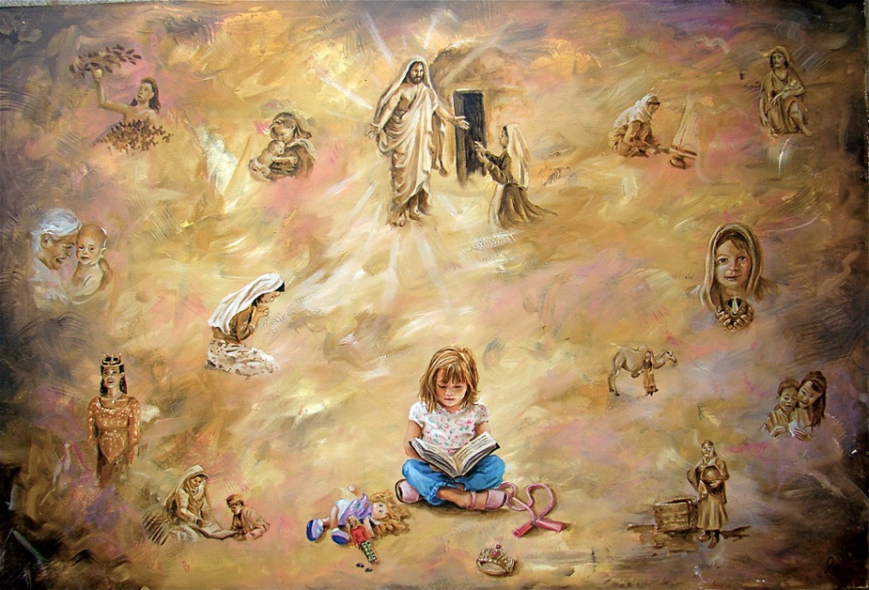
“In the scientific world the scientific method is used to learn truth and advance knowledge.
It has been extremely helpful over the years and has yielded tremendous amounts of scientific knowledge and continues to push back the curtain of ignorance about our physical world.
Learning spiritual things, however, requires a different approach than learning scientific things.
The scientific method and intellect are very helpful, but they alone will never bring spiritual knowledge.
(10)

Slide 22
“Learning spiritual things involves the intellect, but that is not enough. We only learn spiritual things by the Spirit. …
“… Answers to spiritual questions are given to individuals who don’t harden their hearts; who ask in faith, believing they will receive; and who diligently keep the commandments.
Even when we follow this pattern, we don’t control the timing of getting answers.
?
Sometimes our answers come quickly, and sometimes we must place questions on the shelf for a time and rely on our faith that has developed from the answers we do know.”
(10)

Slide 23
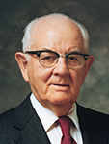
"We must remember that neither God nor his gospel can be found and understood through research alone. … (11)
We can only know and understand the things of God through His Spirit
"There are 'hidden treasures' of knowledge-truths beyond the reach of reason alone. Paul recognized this basic truth when writing to the Corinthians.
He said: 'For what man knoweth the things of man, save the spirit of man which is in him? even so the things of God knoweth no man, but the Spirit of God.' (1 Cor. 2:11.) (12)

Slide 24
The Mind of Christ
"The Apostle Paul said that persons who have been converted 'have the mind of Christ'
I understand this to mean that those who have been converted begin to see things as our Savior sees them and to hear and follow His voice instead of the voice of the world.
Persons with 'the mind of Christ' will do things in His way instead of by the ways of the world." (13)
1 Corinthians 2:16

Slide 25
“What do you think salt tastes like?”
“After several attempts, of course, he could not do it. He could not convey, in words alone, so ordinary an experience as tasting salt.
‘I know there is a God. You ridiculed that testimony and said that if I did know, I would be able to tell you exactly how I know.
My friend, spiritually speaking, I have tasted salt. I am no more able to convey to you in words how this knowledge has come than you are to tell me what salt tastes like. But I say to you again, there is a God! He does live!
And just because you don’t know, don’t try to tell me that I don’t know, for I do!’
“As we parted, I heard him mutter,
‘I don’t need your religion for a crutch! I don’t need it.’
“From that experience forward, I have never been embarrassed or ashamed that I could not explain in words alone everything I know spiritually”
(9)

Slide 26
Learning by the Spirit
Why is the Holy Ghost a better source of knowledge than the wisdom and reasoning of the world?
What can you do to seek knowledge from Heavenly Father?
Heavenly Father is real and loves me, Jesus Christ is my Savior, and Joseph Smith was a prophet of God.
Knowing by the Spirit

Slide 27
Sources:
New Testament Institute Student Manual Chapter 38
Bible Dictionary
“Talk Thru The Bible” by Bruce Wilkinson and Kenneth Boa p. 382
The Life and Teachings of Jesus Christ and His Apostles Chapter 34
Pres. Marion G. Romney – Conference Report April 1983 or Ensign May 1983
Elder Dallin H. Oaks The Lord's Way [Salt Lake City: Deseret Book Co., 1991], 53.
Elder Neal A. Maxwell (If Thou Endure It Well [Salt Lake City: Bookcraft, 1996], 32.)
Paul Alan Cox, On Becoming a Disciple Scholar, ed. by Henry B. Eyring, [Salt Lake City: Bookcraft, 1995], 25
President Boyd K. Packer (“The Candle of the Lord,” Ensign, Jan. 1983, 51).
Elder Paul V. Johnson (“A Pattern for Learning Spiritual Things”[Seminaries and Institutes of Religion satellite broadcast, Aug. 7, 2012]; si.lds.org).
President Spencer W. Kimball ("Seek Learning Even by Study and Also by Faith," Ensign, Sept. 1983, 6)
President Ezra Taft Benson (So Shall Ye Reap, compiled by Reed A. Benson [Salt Lake City: Deseret Book Co., 1960], 153 - 154.)
(Henry B. Eyring, ed., On Becoming a Disciple Scholar [Salt Lake City: Bookcraft, 1995], 94.)
Presentation by ©http://fashionsbylynda.com/blog/

Slide 28
First Letter of Paul to the Saints at Corinth— Written from Ephesus, ca. Spring, A.D. 57
Dissensions Among the Saints | 1:1–16
True and False Wisdom | 1:17–31
Christ is Known by the Spirit | 2:1–16
"Academic credentials are not requisite for service in the Lord's kingdom. Indeed there are explicit warnings within the scriptures to both the rich and the learned to avoid pride. Yet we can see within such scriptures an intriguing pattern: the warnings to the learned are often given by prophets and Apostles who have themselves sought learning. Paul, for example, was a student of Gamaliel and an associate of the Sanhedrin. He gained fluency in several languages, and, as demonstrated by his masterful address on Mars Hill, was conversant with Greek philosophy." (Paul Alan Cox, On Becoming a Disciple Scholar, ed. by Henry B. Eyring, [Salt Lake City: Bookcraft, 1995], 25.)
Life and Teachings of Jesus and His Apostles Chapter 34
Worldly Wisdom 1 Corinthians 2:1-8:
“If all the talent, tact, wisdom, and refinement of the world had been combined in one individual, and that person had been sent to me with the Book of Mormon, and had declared in the most exalted of earthly eloquence, the truth of it, undertaking to prove it by his learning and worldly wisdom, it would have been to me like the smoke which arises only to vanish. But when I saw a man without eloquence, or talents for public speaking, who could only just say, ‘I know by the power of the Holy Ghost that the Book of Mormon is true, that Joseph Smith is a Prophet of the Lord,’ the Holy Ghost proceeding from that individual illuminates my understanding, and light, glory, and immortality is before me; I am encircled by it, filled with it, and know for myself that the testimony of the man is true” President Brigham Young (Deseret News Weekly, Feb. 9, 1854, 24).
First Corinthians reveals the problems, pressures, and struggles of a church called out of a pagan society.
The oldest recorded title of this epistle is Pros Korinthious A, in effect, the “First to the Corinthians.” The A was no doubt a later addition to distinguish this book from Second Corinthians.
In Paul’s day the population of Corinth was approximately 700,000, about 2/3 of whom were slaves.
Greek philosophy influenced any speculative thought that was there. “Talk Thru the Bible” by Bruce Wilkinson and Kenneth Boa pp. 382-383
“Brother vs. Brother, Richwood, West Virginia, 1910s” by Finley Taylor Early Appalachian Photographer “America has no north, no south, no east, no west. The sun rises over the hills and sets over the mountains, the compass just points up and down, and we can laugh now at the absurd notion of there being a north and a south. We are one and undivided.” ~Pvt. Sam Watkins, 1st Tennessee, Co. H. “Brother Against Brother” is a slogan used in histories of the American Civil War describing the predicament faced in families (primarily, but not exclusively, residents of border states) in which loyalties and military service were divided between the Union and the Confederacy. There are a number of stories of brothers fighting in the same battles on opposite sides, or even of brothers killing brothers over the issues.
Learning Through the Sprit:
The Lord’s prescribed methods of acquiring sacred knowledge are very different from the methods used by those who acquire learning exclusively by study. For example, a frequent technique of scholarship is debate or adversarial discussion, a method with which I have had considerable personal experience. But the Lord has instructed us in ancient and modern scriptures that we should not contend over the points of his doctrine. (See 3 Ne. 11:28–30; D&C 10:63.) … Gospel truths and testimony are received from the Holy Ghost through reverent personal study and quiet contemplation” Elder Dallin H. Oaks (“Alternate Voices,” Ensign ,May 1989, 29).
Contention: 1 Corinthians:
Many years ago I read the following Associated Press dispatch which appeared in the newspaper: An elderly man disclosed at the funeral of his brother, with whom he had shared, from early manhood, a small, one-room cabin near Canisteo, New York, that following a quarrel, they had divided the room in half with a chalk line, and neither had crossed the line or spoken a word to the other since that day—62 years before. Just think of the consequence of that anger. What a tragedy!
May we make a conscious decision, each time such a decision must be made, to refrain from anger and to leave unsaid the harsh and hurtful things we may be tempted to say.
President Thomas S. Monson School Thy Feelings, Oh My Brother Oct. 2009 Gen. Conf.
"The gospel requires us to yield our minds as well as bend our knees. Minds are often more arthritic than knees. No wonder we are to seek to obtain the 'mind of Christ' (1 Corinthians 2:16). Yielding intellectually, but only partially, is often the problem. There is the intellectual equivalent of Ananias and Sapphira's holding back a portion of their money (see Acts 5:1-11). Such holding back may be motivated by a mistaken notion that by so doing a person somehow preserves his individuality or demonstrates his God-given agency." Elder Neal A. Maxwell (That Ye May Believe [Salt Lake City: Bookcraft, 1992], 101.)

Slide 29
Line Upon Line
1 Corinthians 3-4
For precept must be upon precept, precept upon precept; line upon line, line upon line; here a little, and there a little
Isaiah 28:10:
Presentation by ©http://fashionsbylynda.com/blog/

Slide 30
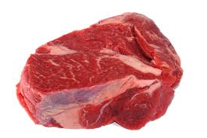
Milk and Meat
Line Upon Line
Milk comes before the meat
Those who do not understand the full principles
Those who are ready and worthy to receive the sacred things of the Lord
1 Corinthians 3:1-3

Slide 31
"Undernourished children must be carefully fed; so it is with the spiritually underfed. Some are so weakened by mischief and sin that to begin with they reject the rich food we offer. They must be fed carefully and gently.
"Some are so near spiritual death that they must be spoon fed on the broth of fellowship, or nourished carefully on activities and programs.
But we must take care lest the only nourishment they receive thereafter is that broth."
(2)

Slide 32
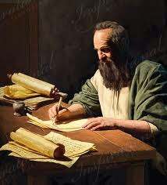
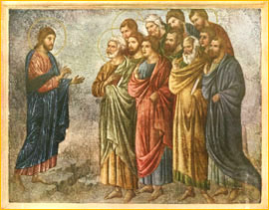
Those in Corinth
… were not yet ready to receive greater truths, they were not unified and that some of them included pagan (ungodly) beliefs and practices in their observance of the gospel.
Paul used several metaphors to teach these Saints the importance of being unified, to correct false beliefs and practices, and to strengthen their faith in the gospel of Jesus Christ.
1 Corinthians 3:4-7

Slide 33
Paul Planted-Apollos Watered
Apollos (Greek: Ἀπολλώς) was a 1st century Alexandrian Jewish Christian mentioned several times in the New Testament.
A contemporary of Paul the Apostle, he played an important role in the early development of the churches of Ephesus and Corinth.
And a certain Jew named Apollos, born at Alexandria, an eloquent man, and mighty in the scriptures, came to Ephesus.
This man was instructed in the way of the Lord; and being fervent in the spirit, he spake and taught diligently the things of the Lord, knowing only the baptism of John. Acts 18:24-25
1 Corinthians 3:5
(1)

Slide 34
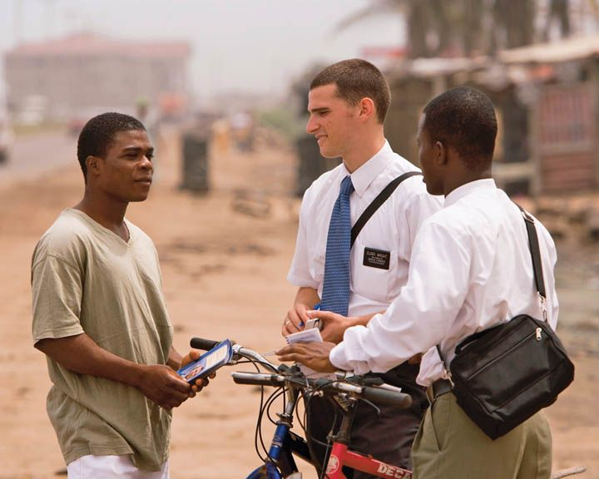
The Harvest
Those who plant and water
Missionaries are instruments in the hands of God, but it is “God that giveth the increase,” meaning that God causes the changes in people’s hearts and souls that lead to conversion.
In the Book of Mormon, Ammon expressed similar sentiments…
Read Alma 27:11-14
1 Corinthians 3:4-7
(1)

Slide 35
"...in the conversion process some missionaries will plant, some will water, and some will baptize.
You are not concerned with who gets the credit for the baptisms because 'God [gives] the increase‘.
1 Corinthians 3:6
(3)

Slide 36
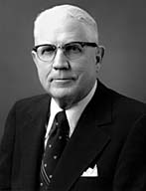
Legend of Stone Cutters
"No man can be engaged in a more godly business than that of building the character, excellence, and righteousness that will go with him throughout eternity.”
'I am cutting stones. I work four hours in the morning and four hours in the afternoon. I am a stone cutter.'
What are you doing?
1st man
1 Corinthians 3:9-10
(4)

Slide 37
2nd man
'I am cutting stones. I make four dollars in the morning and four dollars in the afternoon. I am a stone cutter.'
What are you doing?
1 Corinthians 3:9-10
(4)

Slide 38
"'. . . ye are God's building .... [therefore] let every man take heed how he buildeth....'
What are you doing?
'I am building a cathedral.'
3rd man
"Each of us is also building a cathedral, one that is far more important than a mere physical structure."
1 Corinthians 3:9-10
(4)

Slide 39
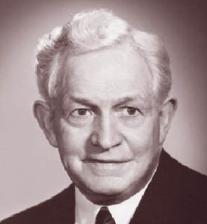
…the purpose of the gospel is to make men better.
The primary objective in the mission of Jesus was to provide the world with better men and women. God himself has said…
It is God's work to build character, ability, and Godliness into the lives of his children.
Any influence that works against that purpose is evil, and whenever we build evil into our lives, we are tending toward failure."
…this is my work and my glory-to bring to pass the immortality and eternal life of man.' (Moses 1:39.)
1 Corinthians 3:9-10
(5)

Slide 40
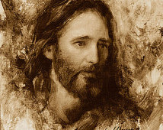
The Foundation
Who needs to be the foundation of our lives?
Other foundation can no man lay than that is laid, which is Jesus Christ
And also: Ye 'are built upon the foundation of the apostles and prophets, Jesus Christ himself being the chief corner stone' (Eph. 2:20).
As we build the foundation of our lives on Jesus Christ, we can overcome Satan’s influence and worldly challenges.
1 Corinthians 3:11

Slide 41
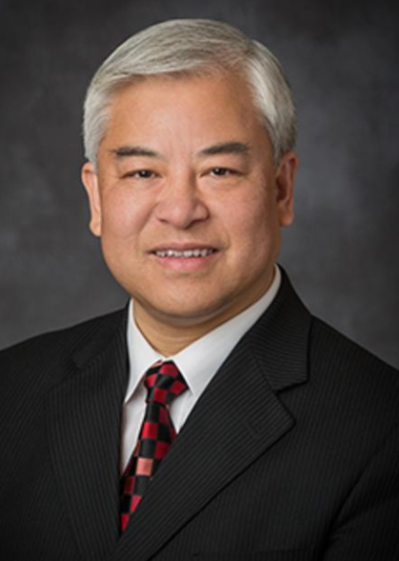
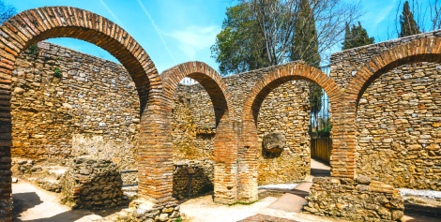
If we build our foundation on Jesus Christ, we cannot fall!
As we endure faithfully to the end, God will help us establish our lives upon His rock, “and the gates of hell shall not prevail against [us).
We may not be able to change all of what is coming, but we can choose how we prepare for what is coming.
(10)
Ronda, Spain
(Doctrine and Covenants 10:69)

Slide 42
Temples—Our Bodies
Paul used ye, a plural pronoun, to refer to the Corinthian Saints collectively as God’s temple. Paul’s point was that the congregations of the Church functioned as temples where the Spirit of God could dwell.
In whom all the building fitly framed together groweth unto an holy temple in the Lord:
Ephesians 2:21
"If we truly want to be as living temples of our God, we would do well to remember, in our thoughts and words and actions, the dedication that is inscribed on each of the sacred buildings we call temples: 'Holiness to the Lord.'“ (6)
(1)
1 Corinthians 3:16-17

Slide 43
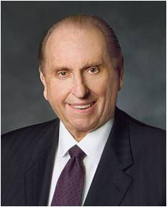
"In our own personal temple building, as in the building of this holy house, the words of John Ruskin typify my personal feelings:
'When we build let us think that we build forever. Let it not be for present delight, nor for present use alone; let it be such work as our descendants will thank us for, and let us think as we lay stone on stone that a time is to come when those stones will be held sacred, because our hands have touched them; and men will say, as they look upon the labour and wrought substances of them: See, this our fathers did for us.'"
(7)
1 Corinthians 3:16-17

Slide 44
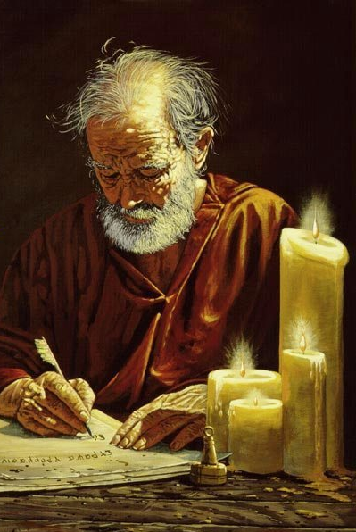
Judgment
It appears that some members of the Church in Corinth had judged Paul’s performance as a missionary and Church leader.
They may have questioned his judgment or thought someone else might have done a better job.
…that ye might learn in us not to think of men above that which is written, that no one of you be puffed up for one against another.
1 Corinthians 4:1-6

Slide 45
Apostles Were Called To ‘Suffer’
Paul told the Saints in Corinth that the Apostles of Jesus Christ are called to suffer because of the wickedness of the world.
The world judges the Apostles and other Church leaders to be “fools” for seeking to follow Christ.
James, brother of the Lord
A.D. 62
James, brother of John,
A.D. 44
Peter
A.D. 67
Paul
A.D. 67
John outlived the rest but was not seen after the 'times of Trajan' (A.D. 98 to 117).“ (8)
1 Corinthians 4:9-10

Slide 46
The Kingdom of God
God is not in word, but in power
“... men do not gain the kingdom...until they possess the power. The gospel is the power of God unto salvation.
There must be priesthood...or there is no kingdom of God, no Church of Jesus Christ, no saving gospel.
Where God's power is manifest, there is the Church and kingdom of God on earth, and where his power is not found, there the Church and kingdom is not."
1 Corinthians 4:20
(9)

Slide 47
Sources:
New Testament Institute Student Manual Chapter 38
President Boyd K. Packer (Let Not Your Heart Be Troubled [Salt Lake City: Bookcraft, 1991], 34.)
President Ezra Taft Benson Mission Presidents Seminar, Provo, Utah, 25 June 1986.)" (The Teachings of Ezra Taft Benson [Salt Lake City: Bookcraft, 1988], 201.)
Sterling W. Sill (Thy Kingdom Come [Salt Lake City: Deseret Book Co., 1975], 150.)
President David O. McKay (Conference Report, April 1962, First Day-Morning Meeting 13.)
(Selected Writings of Robert L. Millet: Gospel Scholars Series [Salt Lake City: Deseret Book Co., 2000], 450.)
Thomas S. Monson ("News of the Church," Ensign, July 1992, 77)
(Richard Lloyd Anderson, "Clement, Ignatius, and Polycarp: Three Bishops between the Apostles and Apostasy," Ensign, Aug. 1976, 51)
Elder Bruce R. McConkie (Doctrinal New Testament Commentary, 3 vols. [Salt Lake City: Bookcraft, 1965-1973], 2:333.)
Chi Hong [Sam] Wong, “They Cannot Prevail; We Cannot Fall,” Liahona, May 2021, 98
Presentation by ©http://fashionsbylynda.com/blog/

Slide 48
First Letter of Paul to the Saints at Corinth— Written from Ephesus, ca. Spring, A.D. 57
Milk Comes Before Meat | 3:1–7
Fire Shall Test All Work | 3:8–15
“Ye Are the Temple of God” | 3:16, 17
Saints Shall Inherit All Things | 3:18–23
Apostles Suffer, Minister, Keep the Faith | 4:1–21
The Harvest 1 Corinthians 3:6:
"One of Satan's techniques for thwarting the work of the Lord is to convince members and missionaries alike that certain individuals who decline invitations to attend church or to hear the gospel discussions 'have had their chance.' The number of converts to the Church who have 'gone through' several sets of missionaries emphasizes the fact that none of us can judge when another person has had an adequate opportunity to hear and accept the gospel.
"The apostle Paul observed: 'I have planted, Apollos watered; but God gave the increase.' (1 Cor. 3:6.) What if Apollos had failed to make efforts with those who were not converted with Paul's initial contact? Some of us become discouraged when our gospel green thumbs don't seem to bear fruit. Often some soul-searching will reveal that our approach has been ill timed or hastily planned, or perhaps that we were anxious to accept the credit for a future conversion, even though God gives the increase.“ Elder Spencer J. Condie ("Bring Them to Church," Ensign, Oct. 1977, 36)
Life and Teachings of Jesus Christ and His Apostles Chapter 34-35
Building upon a Foundation 1 Corinthians 3:11:
"...If we build our house of salvation on the rock of personal revelation; if we build it on the revealed reality that Jesus is the Lord; if we build it on him who is the eternal rock-it will stand forever. If we are guided by the spirit of inspiration while here in mortality, we will be able to withstand all the floods and storms that beat upon us. If we are founded upon a rock, we worship the Father in the name of the Son by the power of the Holy Ghost." (Sermons and Writings of Bruce R. McConkie [Salt Lake City: Bookcraft, 1998], 116.)
Milk and Honey 1 Corinthians 3:1-7:
"One essential element in [God's] plan is the principle of 'line upon line, precept upon precept.' Not only does he leave to us the initiative to believe, he also imparts to his hearers only what they are ready to hear. Milk comes before meat. 'I have yet many things to say unto you, but ye cannot bear them now.' (John 16:12.)...Hugh Nibley has described this guiding principle as the 'policy of reticence,' which the Lord has always followed 'to protect sacred things from common misunderstandings and to protect the unworthy from damaging themselves with them.'" Elder Bruce C. Hafen (The Believing Heart, 2nd ed. [Salt Lake City: Deseret Book Co., 1990], 6.)
"The scriptures teach emphatically that we must give milk before meat. The Lord made it very clear that some things are to be given only to those who are worthy.
"It matters very much not only what we are told but when we are told it. Be careful that you build faith rather than destroy it.“ President Boyd K. Packer (Let Not Your Heart Be Troubled [Salt Lake City: Bookcraft, 1991], 108.)
The Body is Your Temple 1 Corinthians 3:16-17:
"Your physical body is a magnificent creation of God. It is his temple as well as yours, and it must be treated with reverence." Elder Russell M. Nelson (The Power within Us [Salt Lake City: Deseret Book Co., 1988], 60.)
"'Ye must give thanks unto God,' said the Lord, 'for whatsoever blessing ye are blessed with.' (DC 46:32) And we can practice virtue and holiness before Him continually.
"We will regard our body as a temple of our very own. We will not let it be desecrated or defaced in any way. We will control our diet and exercise for physical fitness." Elder Russell M. Nelson ("We Are Children of God," Ensign, Nov. 1998, 87)
Giving credit to God 1 Corinthians 3:7
Men and women who even momentarily take their eyes off of God's glory and seek to exalt themselves, or who become entangled in the vain things of this world, will find that the kingdom quickly moves on without them. Unfortunately, none of us is immune from this all-too-human tendency.“ Marlin K. Jensen ("An Eye Single to the Glory of God," Ensign, Nov. 1989, 28)

Slide 49
One Bad Apple
1 Corinthians 5-6
Because thou hast spoiled many nations, all the remnant of the people shall spoil thee
Habakkuk 2:8

Slide 50
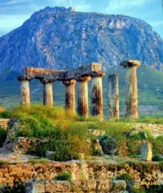
Corinth in a state of wickedness
“It is reported commonly that there is fornication among you, and such fornication as is not so much as named among the Gentiles, that one should have his father’s wife.”
The spoilage in rotten fruit will spread to good fruit.
Corinth had a worldwide reputation in the ancient world for its immorality. It was located very close to two major ports and subject to many of the evils which accompany centers of commerce and trade.
1 Corinthians 5:1-13

Slide 51
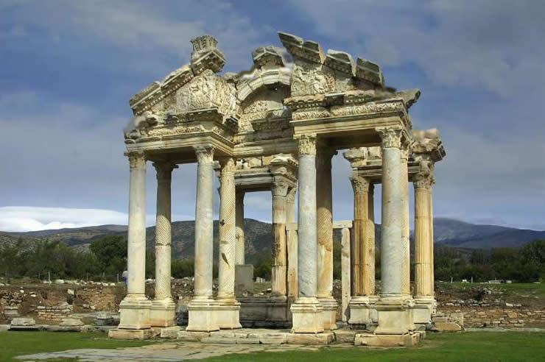
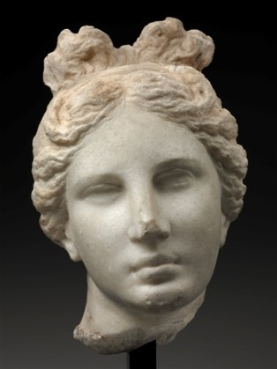
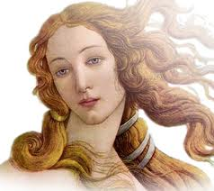
Corinth
Corinth was the site of the famous temple of Aphrodite (Venus), the goddess of love, where there were a thousand “priestesses.”
Priestesses---prostitutes glorified by the cloak of religious worship

Slide 52
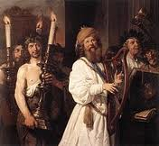
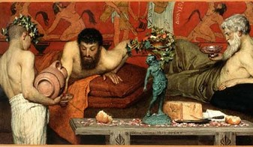
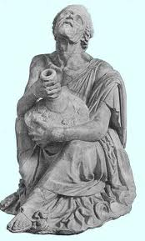
“Corinthianize” – meant to engage in reckless debauchery
Usually portrayed on the stage as drunkards.
Sometimes when one is called a “Corinthian” means he is given totally over to licentious desires.

Slide 53
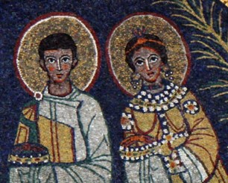
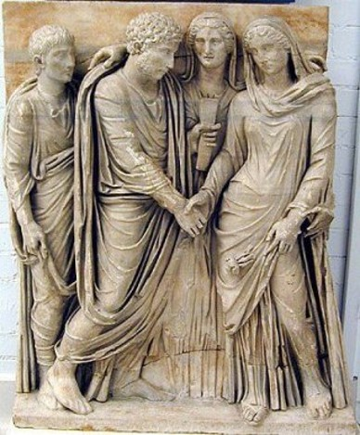
Paul’s stepmother had married a member of the Church in Corinth
She may have been a widow or had been separated from her prior husband.
Such Marriages were forbidden by the Mosaic code under penalty of excommunication (Lev. 18:6-8, 29)
Paul describes the intimacies resulting from such unions as fornication and condemns his Corinthian brethren.

Slide 54
Paul felt that if Church members who sin were left in Church, the sin would spread throughout the church.
“The Church must, therefore, purge out this old leaven of wickedness and replace it with a new influence or leaven of righteousness.”
One bad apple spoils the barrel
1 Corinthians 5:7
(2)

Slide 55
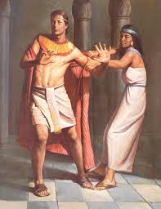
“ …do not company with fornicators—not because you are too good for them, but as C. S. Lewis wrote, because you are not good enough.
Remember that bad situations can wear down even good people. Joseph had both good sense and good legs in fleeing from Potiphar’s wife.”
(3)

Slide 56
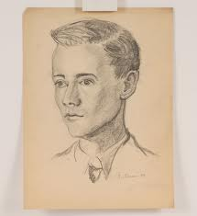
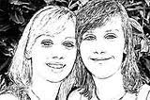
“Everyone needs good friends and true friends. They will be a great strength and blessing to you. They will influence how you think and act, and even help determine the person you will become. They will help you be a better person and will make it easier for you to live the gospel of Jesus Christ…
…Choose friends who share your values so you can strengthen and encourage each other in living high standards.”
(6)

Slide 57
This does not mean we should avoid those who are not members of the Church.
We have a duty to help others through our examples and through proclaiming the gospel.

Slide 58
Disciplinary Measures
As in Paul’s day, Church members today are sometimes excommunicated for sinful behavior. Formal Church councils carry out disciplinary actions, always with the goal of helping and saving the sinner by assisting him or her in the repentance process. (1)
1 Corinthians 5

Slide 59
Disciplinary Measures
(See D&C 102)
“In the scriptures, the Lord has given direction concerning Church disciplinary councils. The word council brings to mind a helpful proceeding—one of love and concern, with the salvation and blessing of the transgressor being the foremost consideration.
“Members sometimes ask why Church disciplinary councils are held. The purpose is threefold: to save the soul of the transgressor, to protect the innocent, and to safeguard the Church’s purity, integrity, and good name. …
“… The miracle of the gospel is that we all can repent. Church government calls for Church disciplinary councils. But the Lord’s system also calls for restoration following repentance. Disfellowshipment or excommunication is not the end of the story, unless the member so chooses.”
1 Corinthians 5
(5)

Slide 60
“But them that are without God judgeth. Therefore put away from among yourselves that wicked person.”
“For what have I to do to judge them also that are without? Do not ye judge them that are within?”
"Paul observed that he was not in the business of judging the actions of those 'without,' meaning those outside the Church, but that saints were obliged to evaluate adherence to gospel standards of those 'within,' meaning those inside the Church."
1 Corinthians 5:12-13
(4)

Slide 61
Sinful Behaviors:
Fornicators
Idolaters
Covetous
Extortioners
Railer
Drunkard
Fornication typically refers to consensual sexual in nature between two people not married to each other
Idolatry not only refers to false pagan worship. Man commits idolatry whenever he honors and reveres a creature in place of God, whether this be gods, or demons (for example satanism), power, pleasure race, ancestors, the state, money etc.
to covet; to desire; to want
Extortion (also called blackmail*, shakedown, outwresting, and exaction) is a criminal offence of unlawfully obtaining money, property, or services from a person, entity, or institution, through coercion.
Railer: anyone is to use insolent or reproachful language toward one.
A person who is habitually drunk
(7)
1 Corinthians 6:9-11

Slide 62
Avoid Legal Disputes With Fellow Saints
Paul counseled the Corinthian Saints to righteously resolve disputes among themselves rather than immediately resorting to civil courts.
One of the causes for division among Church members in Corinth was that Christians were bringing fellow Church members before civil magistrates over trivial civil disputes. Paul counseled Church members to seek to resolve their differences among themselves rather than entering a lawsuit against a fellow member.
Modern-day scripture acknowledges that there are times when it may be appropriate for Church members to pursue solutions to legal problems through the law of the land. (1)
See D&C 42:78–89
1 Corinthians 6:1-8

Slide 63
Immorality
“All these things are not lawful unto me, and all these things are not expedient. All things are not lawful for me, therefore I will not be brought under the power of any” JST 1 Corinthians 6:12
While many of the Corinthians apparently believed that the body was made simply for physical pleasures, Paul corrected that view by teaching that our bodies were created to accomplish the Lord’s purposes.
Paul refuted the notion that “all things were lawful” and that sexual immorality is incompatible with a spiritual relationship with Jesus Christ.
1 Corinthians 6:12-13

Slide 64
Flee Fornication
Sinful behavior, particularly the act of being “joined to an harlot,” was incompatible with a spiritual relationship or oneness with Jesus Christ.
Church leaders today continue to emphasize the importance of reserving sexual intimacy for marriage:
“Before marriage, do not participate in passionate kissing, lie on top of another person, or touch the private, sacred parts of another person’s body, with or without clothing.
Do not do anything else that arouses sexual feelings.
Do not arouse those emotions in your own body” (8)

Slide 65
1
2
3
4
5
Strongly Disagree
Disagree
Neutral
Agree
Strongly Agree
We live in a world where people have varying ideas of what sexual attitudes and actions are acceptable.
I understand the Lord’s standard of sexual purity (also known as the law of chastity).
I have a desire to live the Lord’s standard of sexual purity.
I recognize how the Lord’s standard of sexual purity blesses my life.
I have questions about the Lord’s standard of sexual purity.

Slide 66
Doctrinal Mastery
1 Corinthians 6:19-20
What? know ye not that your body is the temple of the Holy Ghost which is in you, which ye have of God, and ye are not your own?
For ye are bought with a price: therefore glorify God in your body, and in your spirit, which are God’s.

Slide 67
“Those who believe that our bodies are nothing more than the result of evolutionary chance will feel no accountability to God or anyone else for what they do with or to their body.
We who have a witness of the broader reality of premortal, mortal, and postmortal eternity, however, must acknowledge that we have a duty to God with respect to this crowning achievement of His physical creation.
Our bodies are temples of God in which the Spirit can dwell.
(9)

Slide 68
“Acknowledging these truths … , we would certainly not deface our body, as with tattoos; or debilitate it, as with drugs; or defile it, as with fornication, adultery, or immodesty.
… As our body is the instrument of our spirit, it is vital that we care for it as best we can.
We should consecrate its powers to serve and further the work of Christ.”
(9)

Slide 69
“Please, never say: ‘Who does it hurt? Why not a little freedom? I can transgress now and repent later.’ Please don’t be so foolish and so cruel. You cannot with impunity ‘crucify Christ afresh’
‘Flee fornication’ … Why?
Well, for one reason because of the incalculable suffering in both body and spirit endured by the Savior of the world so that we could flee.
We owe Him something for that. Indeed, we owe Him everything for that.”
(10)

Slide 70
Sources:
New Testament Institute Student Manual Chapter 38
Bruce R. McConkie (The Mortal Messiah: From Bethlehem to Calvary, 4 vols. [Salt Lake City: Deseret Book Co., 1979-1981], 1: 164.)
Elder Neal A. Maxwell Reasons to Stay Pure March 2003 New Era
(Eldin Ricks, "A Short Glossary of Obsolete Words in the King James New Testament," New Era, Apr. 1977, 11)
Elder M. Russell Ballard (“A Chance to Start Over: Church Disciplinary Councils and the Restoration of Blessings,” Ensign, Sept. 1990, 15, 18).
For the Strength of Youth Pamphlet page 16
Bible Dictionary
(For the Strength of Youth [booklet, 2011], 36).
Elder D. Todd Christofferson (“Reflections on a Consecrated Life,” Ensign or Liahona ,Nov. 2010, 17).
Elder Jeffrey R. Holland (“Personal Purity,” Ensign, Nov. 1998, 76).
Presentation by ©http://fashionsbylynda.com/blog/

Slide 71
Church Disciple: 1 Corinthians 5:13
Church leaders carefully consider many factors before excommunication, or any other form of Church discipline takes place. In addition to considering how serious the transgression is, Church leaders consider the various purposes for Church discipline: to help a person repent, to protect those who would be negatively affected by a person’s actions or the spreading of that person’s beliefs, and to protect the integrity of the Church’s teachings (see “Church Discipline” mormonnewsroom.org/articles/church-discipline).
When the Church formally puts away a person who is embracing serious sin, it is called Church discipline. The following entry from True to the Faith: A Gospel Reference explains the process of Church discipline:
“Bishops and branch presidents and stake, mission, and district presidents have a responsibility to help members overcome transgression through repentance. The most serious transgressions, such as serious violations of civil law, spouse abuse, child abuse, adultery, fornication, rape, and incest, often require formal Church discipline. Formal Church discipline may include restriction of Church membership privileges or loss of Church membership.
“The process of formal discipline begins when a presiding priesthood leader calls for a disciplinary council. The purposes of disciplinary councils are to save the souls of transgressors, protect the innocent, and safeguard the purity, integrity, and good name of the Church.
“Church discipline is an inspired process that takes place over a period of time. Through this process and through the Atonement of Jesus Christ, a member can receive forgiveness of sins, regain peace of mind, and gain strength to avoid transgression in the future. Church disciplinary action is not intended to be the end of the process. It is designed to help Heavenly Father’s children continue in their efforts to return to full fellowship and the full blessings of the Church. The desired result is that the person make whatever changes are necessary to repent completely” (“Church Disciplinary Councils,” True to the Faith [2004], 37–38).
Church Disciple:
Church leaders carefully consider many factors before excommunication, or any other form of Church discipline takes place. In addition to considering how serious the transgression is, Church leaders consider the various purposes for Church discipline: to help a person repent, to protect those who would be negatively affected by a person’s actions or the spreading of that person’s beliefs, and to protect the integrity of the Church’s teachings (see “Church Discipline” mormonnewsroom.org/articles/church-discipline).
Our Bodies Are Gifts from God: 1 Corinthians 6:20
"'We have been taught . . . to look upon these bodies of ours as gifts from God. We Latter-day Saints do not regard the body as something to be condemned, something to be abhorred. . . . We regard [the body] as a sign of our royal birthright. . . . We recognize the fact that those who kept not their first estate . . . were denied that inestimable blessing.. . . We believe that these bodies . . . may be made, in very truth, the temple of the Holy Ghost. . . .
"'It is peculiar to the theology of the Latter-day Saints that we regard the body as an essential part of the soul. Read your dictionaries, the lexicons, and encyclopedias, and you will find that nowhere, outside of the Church of Jesus Christ, is the solemn and eternal truth taught that the soul of man is the body and the spirit combined.' Elder James E. Talmage (Conference Report, October 1913, p. 117.)
"When we use our eyes to improve our minds and to edify our spirits, we do, indeed glorify God with our body. And when we listen to sublime music and to the spoken word of the Lord's servants, we pay Him honor. When we use our voices to share the gospel, to proclaim the truth, and to comfort and cheer others, we show our gratitude for the price by which our sins were bought. When we adorn our bodies with modest clothing, and when our behavior is also modest, we demonstrate that we are the Lord's children.
"Whenever we eat a well-balanced diet (including brussel sprouts and broccoli because we know they'll be good for us) and when we follow a program of physical exercise we are, in essence, paying tribute to our Father who created us all. When we take care of our eyes and ears and skin and cardiovascular and muscular-skeletal systems, we not only enjoy better health and vigor of mind and body now, but we are also better prepared to 'waste and wear out our lives' in building the Kingdom of God. May each of us take good care of the Lord's property-our bodies-the temples of our spirits." (In Perfect Balance [Spencer J. Condie Salt Lake City: Bookcraft, 1993], 240.)

Slide 72
First Letter of Paul to the Saints at Corinth— Written from Ephesus, ca. Spring, A.D. 57
Why the Church Cannot Fellowship Sinners | 5:1–13
Take Civil Cases to Church Courts | 6:1–11
The Body is Not for Immorality | 6:12–20
1 Corinthians 6:2,3:
“The man who passes through this probation, and is faithful, being redeemed from sin by the blood of Christ, through the ordinances of the gospel, and attains to exaltation in the kingdom of God, is not less but greater than the angels, and if you doubt it, read your Bible, for there it is written that the Saints shall ‘judge angels,’ and also they shall ‘judge the world.’ And why? Because the resurrected, righteous man has progressed beyond the pre-existent or disembodied spirits, and has risen above them, having both spirit and body as Christ has, having gained the victory over death and the grave, and having power over sin and Satan; in fact, having passed from the condition of the angels to that of a God. He possesses keys of power, dominion and glory that the angel does not possess—and cannot possess without gaining them in the same way that he gained them, which will be by passing through the same ordeals and proving equally faithful.” (Smith, Gospel Doctrine, pp. 18–19.)
Life and Teachings of Jesus and His Apostles Chapter 35
In today’s modern world, and in the Church as well, fornication has taken on a more technical meaning than it had during the time of the King James translation. Today it is defined as sexual intercourse between unmarried people. But the word which Paul used is porneia (the root word for our pornography) and meant any extramarital intercourse. Perhaps it might be well to point out here that Corinth had a worldwide reputation in the ancient world for its immorality. It was located very close to two major ports and therefore subject to many of the vices and evils which accompany centers of commerce and trade. In addition, Corinth was the site of the famous temple of Aphrodite (Venus), the goddess of love, where there were a thousand “priestesses.” They were actually nothing more than prostitutes glorified by the cloak of religious worship. Anciently, Corinth’s reputation was such that to “Corinthianize” meant to engage in reckless debauchery, and Corinthians were usually portrayed on the stage as drunkards. Even in modern English a person is sometimes called a Corinthian, meaning that he is given totally over to licentious desires. It is not surprising, then, that in this and the following chapter, Paul sharply condemns immorality and the lusts of the flesh.
“Apparently a member of the Church in Corinth had married his stepmother, either because she was a widow or had been separated from her prior husband. Such marriages were forbidden by the Mosaic code under penalty of excommunication. (Lev. 18:6–8, 29.) Paul endorses the Mosaic prohibition, describes the intimacies resulting from such unions as fornication, condemns his Corinthian brethren for winking at the offense, and directs the excommunication of the offender. If the sinner were left in the Church, Paul reasons, his influence, as leaven, would spread throughout the whole Church. The Church must, therefore, purge out this old leaven of wickedness and replace it with a new influence or leaven of righteousness.” (McConkie, DNTC, 2:335.) Life and Teachings of Jesus and His Apostles Chapter 35
Disputes:
"A 1919 article by Elder James E. Talmage explains the Church's continuing counsel that disputes among members should first be settled by brotherly mediation. If that failed, members disputing one another should go to the bishop's court, then to the high council, and only then to the Council of the Twelve Apostles. The article continues with what now seems to be the Church's last statement of counsel that members should not take their disputes to the civil courts. 'The courts of the Church in no sense assume to oppose or supersede the secular law,' the article states. However, it continues, 'We hold that in matters of difference between brethren, in which no specific infraction of the secular law is involved, and in offenses called `civil` as distinguished from `criminal,` it is as truly unworthy of members of the Church today as it was in Paul's time that `brother goeth to law with brother`; and that it stands to our shame if righteous judgment cannot be rendered among ourselves. (1 Cor. 6:5-7.)'" Elder Dallin H. Oaks (The Lord's Way [Salt Lake City: Deseret Book Co., 1991], 167.)
Fornicators:
"Alternatives to the legal and loving marriage between a man and a woman are helping to unravel the fabric of human society. That fabric, of course, is the family. These so-called alternative lifestyles cannot be accepted as right because they frustrate God's commandment for a life-giving union of male and female within a legal marriage (see Gen. 1:28). If practiced by all adults, these lifestyles would mean the end of family." (James E. Faust and James P. Bell, In the Strength of the Lord: The Life and Teachings of James E. Faust [Salt Lake City: Deseret Book Co., 1999], 264 - 265.)

Slide 73
10 Warnings—How to Stay Pure
6. Where mistakes have been made, remember we have the glorious gospel of repentance. The miracle of forgiveness awaits all who are seriously sorry and who will follow the necessary steps. Bear in mind, however, these are situations in which the soul must first be scalded by shame, for only with real cleansing can real healing occur. But the road of repentance is really there.
1. Resist the rhetoric of the world, and you will find that, if you stand fast, so will others—some surprisingly. As Paul said, “Where the Spirit of the Lord is, there is liberty” (2 Cor. 3:17). Neither women nor men can be truly free if they behave so as to lose the Spirit.
7. Where the impulse to do wrong appears, act against that impulse while the impulse is still weak and while the will is still strong. Dalliance merely means that the will weakens and the impulse grows stronger. There is a Parkinson’s law of temptation: Temptation expands so as to fill the time and space available to it. Keep “anxiously engaged” (D&C 58:27) in doing good things.
2. Since you don’t let people come in and walk around in your house with muddy feet, do not let them walk through your minds with muddy feet.
3. Build your strong personal link in a chain of chastity and family fidelity, so it can proceed forth from grandparents to parents to children and then on to their posterity. To be so welded together is, of course, to be drawn together in the strongest kind of bond and is to affirm, by your actions, that you believe in the commandments in spite of what is going on in the world around you..
8. Because our Church’s behavioral standards are different, connect that fact with what several prophets have told us about how we must come to despise the shame of the world. We must not hold the people of the world in contempt; we must love them. But we must come to have contempt for the shame of the world, because it matters so little in the end.
4. Do not company with fornicators—not because you are too good for them but because you are not good enough. Remember that bad situations can wear down even good people. Joseph had both good sense and good legs in fleeing from Potiphar’s wife.
9. Remember, those who are in error must not call the cadence for your life, for those who boast of their sexual conquests are only boasting of that which has conquered them. We may pity behavioral clones, but we do not envy them.
5. Along with the traditional, predatory, selfish male there is now the predatory, selfish female. Both, driven by appetite, have a false sense of being free—but it is, alas, the same sort of empty freedom Cain possessed (after he had broken a commandment by slaying Abel) when, ironically, he said, “I am free” (Moses 5:33).
10. … in your concern for justice, deal justly with yourselves! There is a very telling verse in the Book of Mormon that describes an ancient political leader with these words: “And he did do justice unto the people, but not unto himself because of his many whoredoms” (Ether 10:11 ).
Elder Neal A. Maxwell Reasons to Stay Pure March 2003 New Era Also found in (“The Stern but Sweet Seventh Commandment,” in Morality [1992], 29).

Slide 74
Christ our Passover is sacrificed for us
1 Corinthians 5:7
Symbolic Elements of the Passover
The paschal lamb was without blemish | Ex. 12:5,21
The lamb was not to have any bone broken | Ex. 12:46, Jn. 19:31-36
The lamb was slaughtered in the evening, the same time as the death of Christ | Ex. 12:6
The lamb was to be eaten. The sacrament represents the same concept | Ex. 12:8; Jn. 6:53-54
Neither the paschal feast nor the sacrament is appropriate for the "stranger" | Ex 12:43; 1 Cor. 11:29
The lamb's blood symbolized the token of the covenant | Ex. 12:13
The ordinance was given for a perpetual memorial | Ex. 13:9; Luke 22:19
The Egyptian firstborn die for sin; God's Firstborn dies for sin | Ex:12:29-30
The blood of the lamb spares Israel for the destroying angel; the blood of the Lamb saves us from sin and death | Ex. 12:13; DC 19:16-19
Great plagues and signs were shown in Egypt before the Passover; great miracles and signs were shown before Christ's crucifixion | Ex. 7-12
The many signs of God's power are rejected among the Egyptians and among the Jews | Ex. 7:4; Matt 11:20-21
There were three days of darkness in Egypt; there were three days of darkness in the Americas and three hours of darkness in Jerusalem after the Crucifixion | Ex. 10:22; 3 Ne. 8:20-23; Luke 23:44
Moses would deliver the house of Israel from physical bondage; Christ would hereby deliver the house of Israel from spiritual bondage.

Slide 75
Marriage-Ordained of God
1 Corinthians 7

Slide 76
False Beliefs
OR
It is acceptable to participate in physical intimacy with anyone.
It is never acceptable to participate in physical intimacy, not even in marriage.
The Corinthian Saints had questions about when and if physical intimacy was appropriate.
These are extreme views that vary from God’s standard for physical intimacy.
1 Corinthians 7:1-3

Slide 77
Avoid Fornication
Fornication = sexual relations outside of marriage
In the world today, Satan has led many people to believe that sexual intimacy outside of marriage is acceptable. But in God's sight, it is a serious sin.
It is an abuse of the power He has given us to create life.
1 Corinthians 7:2
(4)

Slide 78
“One who uses the God-given body of another without divine sanction abuses the very soul of that individual, abuses the central purpose and processes of life.”
(5)

Slide 79
Due Benevolence
The love and intimacy expressed between husband and wife
“Physical intimacy between husband and wife is beautiful and sacred. It is ordained of God for the creation of children and for the expression of love between husband and wife. God has commanded that sexual intimacy be reserved for marriage.”
1 Corinthians 7:3
(2)

Slide 80
“The power of procreation is not an incidental part of the plan; it is the plan of happiness; it is the key to happiness.
“The desire to mate in humankind is constant and very strong.
Our happiness in mortal life, our joy and exaltation are dependent upon how we respond to these persistent, compelling physical desires.”
(3)

Slide 81
Being Married
What are the purposes of physical intimacy between husband and wife?
Why is procreation—the ability to create mortal life—so important in Heavenly Father’s plan?
CHITRAMSUDHEER
1 Corinthians 7:3

Slide 82
Paul Taught:
Spouses should not generally withhold marital affection from each other.
Widowed and divorced members of the Church were permitted to remarry if they chose.
Church members should “abide with God” whatever their circumstances.
David Malan
Harold Erving Pratt
Paul also discouraged divorce.
1 Corinthians 7:4-24

Slide 83
“Keep yourselves above any domineering or unworthy behavior in the tender, intimate relationship between husband and wife.
Because marriage is ordained of God, the intimate relationship between husbands and wives is good and honorable in the eyes of God….
“Tenderness and respect—never selfishness—must be the guiding principles in the intimate relationship between husband and wife.
Each partner must be considerate and sensitive to the other’s needs and desires”
(6)
1 Corinthians 7:5

Slide 84
Better to Marry and Burn
The meaning of Paul’s counsel is not entirely clear. The Greek word which the King James translators have rendered burn is a passive infinitive used to convey the idea of being inflamed with passion, lust, or anger.
The Prophet Joseph Smith’s inspired account is even more explicit than the King James: “But if they cannot abide, let them marry; for it is better to marry than that any should commit sin.”
(1)
1 Corinthians 7:9

Slide 85
Unbelieving Spouses
Paul counseled members who were married to unbelievers not to divorce their spouses on the grounds of their unbelief, but to remain married and live as faithful followers of Christ.
In doing so, a marriage partner can become the means of sanctifying the unbelieving spouse.
Read D&C 74
(1)
1 Corinthians 7:12-19

Slide 86
Children Are Holy
The Jews had a tradition that little children were unholy, but the Lord declared, “Little children are holy, being sanctified through the atonement of Jesus Christ,” and He taught that male children need not be circumcised as required by the law of Moses.
But little children are holy, being sanctified through the atonement of Jesus Christ; and this is what the scriptures mean. D&C 74:7
(1)
1 Corinthians 7:12-19

Slide 87
Called to the Ministry
Paul explained that their circumstances allowed them to serve the Lord “without distraction”, or without temporal concerns related to providing for a family.
However, he did not forbid them to marry.
Annie Henrie
1 Corinthians 7:35

Slide 88
Sources:
New Testament Institute Student Manual Chapter 38
For the Strength of Youth, 35
President Boyd K. Packer (“The Plan of Happiness,” Ensign or Liahona, May 2015, 26)
Chastity lds.topics.
Elder Jeffrey R. Holland Personal Purity Jan. 1999 Liahona
President Howard W. Hunter (“Being a Righteous Husband and Father,” Ensign, Nov. 1994, 51)
Presentation by ©http://fashionsbylynda.com/blog/

Slide 89
First Letter of Paul to the Saints at Corinth— Written from Ephesus, ca. Spring, A.D. 57
Marriage Is Ordained of God | 7:1–24
Missionaries—Married or Single? | 7:25–40
Life and Teachings of Jesus and His Apostles Chapter 35
Married Couples 1 Corinthian 7:1-3:
Human intimacy is reserved for a married couple because it is the ultimate symbol of total union, a totality and a union ordained and defined by God. From the Garden of Eden onward, marriage was intended to mean the complete merger of a man and a woman—their hearts, hopes, lives, love, family, future, everything. Adam said of Eve that she was bone of his bones and flesh of his flesh, and that they were to be “one flesh” in their life together.¹³ This is a union of such completeness that we use the word seal to convey its eternal promise. The Prophet Joseph Smith once said we perhaps could render such a sacred bond as being “welded”¹ one to another.
(5)
Stumbling Block 1 Corinthians 8:9:
"Another important aspect to providing a nurturing environment for new members is to give them a sense of safety, love, and acceptance when they come to church. In particular, we must take care to avoid offending others even if this causes us discomfort. Jesus taught that it would be better to perish than to offend one of the 'little ones,' a caution that can also apply to new converts (see Matt. 18:14; Mark 9:42; Luke 17:2). The Apostle Paul indicates that new converts, who generally lack in gospel knowledge, can be offended by the otherwise harmless actions of those with greater knowledge, leading weaker new members to fall away. He taught that we should avoid such words and actions, even if our information is correct (see 1 Cor. 8:8-13). For example, it might be correct to point out that a new convert has made a mistake, but to do so publicly or in a way that causes unnecessary pain may harm a fragile, young soul. The way a new member prays or dresses or speaks may be different from our traditions or teachings, but correcting such differences should be undertaken only by a loving leader if done at all and only with the benefit and needs of the new member utmost in mind." David E. Sorenson ("Why Baptism Is Not Enough," Ensign, Apr. 1999, 20)

Slide 90
Helpful Information about Corinthians 7
First Corinthians 7 has been the source of more confusion regarding the doctrine of marriage than any other chapter in the Bible. Hereby, celibacy has been touted as a state of higher spiritual attainment than marriage, and sexual relations-even between a man and wife-have been considered sinful. Neither conclusion is true, nor can either conclusion be fairly drawn if one understands the context of Paul's comments.
By way of explanation, let's first take note that Joseph Smith made more corrections to this chapter than to any other chapter written by Paul save one (Romans 7). Second, Paul specifically addresses questions put to him by the Corinthian saints in a previous letter (v. 1); so some of his advice is specific to them and cannot be universally applied to all saints of all times. Third, Paul expressly states that his advice is his own opinion and not the word of the Lord (v. 25). Paul is only speaking the word of the Lord in the following seven verses: 1-5, 10, and 11 (see v. 6, 12, and 25); the rest is given as advice from 'one that hath obtained mercy of the Lord' (v. 25).
The point is not to discount what Paul has said but to place it in its appropriate historical context. At the time, Paul was writing as a single apostle and missionary of the Lord. In effect, he is married to his work and his children are his converts (1 Tim. 1:2; 2 Tim. 1:2). Therefore, when he says 'I would that all men were even as I' (meaning unmarried), he says that in the context of performing missionary work with its rigors of travel and perpetual persecution. Hence, no latter-day saint should place more emphasis on these comments by Paul than on Joseph Smith's heavenly teachings on the new and everlasting covenant of marriage or the First Presidency's proclamation on the family (1995).
"The Joseph Smith Translation makes many clarifications and corrections to the records about Paul, but two of the most useful deal with Paul's teachings about marriage (1 Cor. 7) and about how the gospel of Jesus Christ changed his life (Rom. 7:14-25). The popular myth that Paul was opposed to marriage is corrected by the Joseph Smith Translation so that his dictum that there is an advantage to remaining unmarried is limited to those on temporary mission assignments. This practice was advocated by Paul for efficiency in the temporary ministry, and is similar to the practice of The Church of Jesus Christ of Latter-day Saints today in calling young men and women, unmarried, to serve missions, and refrain from marriage while in the mission field. Paul's teachings against marriage were not for all Church members, any more than the policy for young missionaries to remain unmarried today is a permanent rejection of marriage. The Joseph Smith Translation restores the proper context." (Robert J. Matthews, Behold the Messiah [Salt Lake City: Bookcraft, 1994], 341.)

Slide 91
Was Paul Married? The Life and Teachings of Jesus and His Apostles Chapter 35
It is possible that Paul, who had once been married, was a widower at the time of his writing of First Corinthians. His heart was thoroughly set on missionary work, and thus he might have chosen not to remarry. Hence his counsel to those in similar circumstances was “I would that all men were even as I myself.”
Aside from the fact that marriage is an eternal command of God, which Paul, an apostle of Jesus Christ, would know as well as anyone, there are some other compelling reasons why the answer to the question Was Paul married? should be yes.
In the first place, Paul’s writings indicate a positive attitude toward marriage. Some of the finest counsel given in scripture on the subject comes to us from Paul (Ephesians 5:21–6:4; Colossians 3:8–21). It would be presumptive indeed for Paul to give such counsel if he had not obeyed the law of God himself.
In 1 Corinthians 9:5 Paul argues that apostles have as much right to marry as anyone else, “Have we not power to lead about a sister, a wife, as well as other apostles, and as the brethren of the Lord, and Cephas?” But marriage is more than a right; it is a solemn duty. Hence Paul writes in 1 Corinthians 11:11: “Nevertheless neither is the man without the woman, neither the woman without the man, in the Lord.” The need for all to marry if they would find approval “in the Lord” is thus undisputed.
Faithful Jews regarded marriage as a religious obligation and a condition of extraordinary importance. It was the custom for Jewish men and women to marry at an early age, generally between sixteen and eighteen but sometimes as early as fourteen. Paul, a strict Pharisee (Acts 26:5) was “taught according to the perfect manner of the law of the fathers, and was zealous toward God” (Acts 22:3), as faithful Jews were enjoined to be. Thus “there would seem to be no good reason … why Paul, a trained and ardent Pharisee, should fail to honor an obligation esteemed so sacred in the eyes of his people.” (Sperry, Paul’s Life and Letters, p. 9.) When a list of 613 precepts contained in the law of Moses was first drawn up, marriage was listed as number one. If Paul “lived unmarried as a Jerusalem Pharisee, his case was entirely exceptional.” (Farrar, The Life and Work of St. Paul, p. 46.)
Most scholars acknowledge that Paul was either a member of the Jewish ruling body, the Sanhedrin, or a close associate thereof (Acts 8:3; 9:1, 2; 22:5; 26:10). If he were indeed a member of the Sanhedrin, Paul would have been expected to be in compliance with the special requirements for membership in the body, one of which was marriage. If he were not a member, Paul would still, as an official representative of the ruling group, be expected to be in harmony with all accepted Jewish customs. Only such a condition would prevent his being charged with advocating obedience to laws with which he himself was not in strict compliance.
“For I would that all men were even as I myself. … I say therefore to the unmarried and widows, It is good for them if they abide even as I.” Elder Spencer W. Kimball has commented on this passage as follows: “Taking such statements in conjunction with others [Paul] made it is clear that he is not talking about celibacy, but is urging the normal and controlled sex living in marriage and total continence outside marriage. (There is no real evidence that Paul was never married, as some students claim, and there are in fact indications to the contrary.)” (Miracle of Forgiveness, p. 64.)

