Slide 1
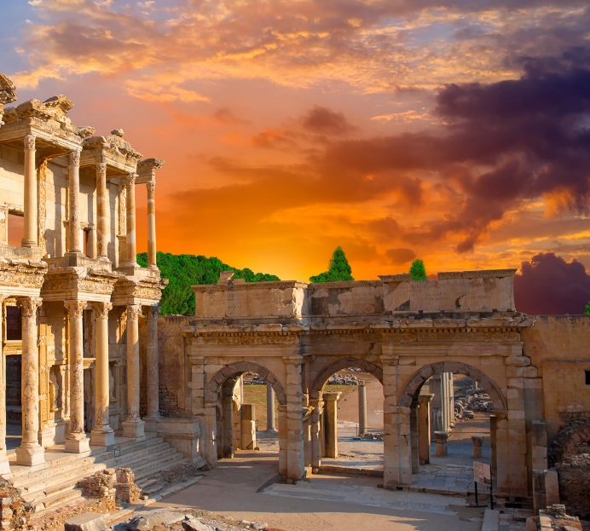
1 Corinthians 14-16

Slide 2
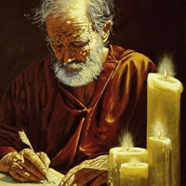
The Gift of Prophecy
A prophecy consists of divinely inspired words or writings, which a person receives through revelation from the Holy Ghost. The testimony of Jesus is the spirit of prophecy.
And I fell at his feet to worship him. And he said unto me, See thou do it not: I am thy fellow servant, and of thy brethren that have the testimony of Jesus: worship God: for the testimony of Jesus is the spirit of prophecy. Revelation 19:10
When a person prophesies, he speaks or writes that which God wants him to know, for his own good or the good of others” (12)
1 Corinthians 14:1-3

Slide 3
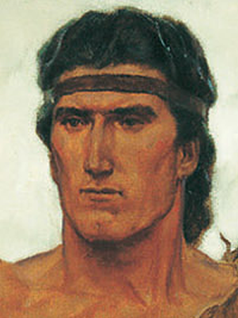
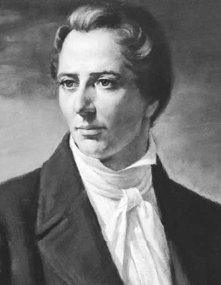
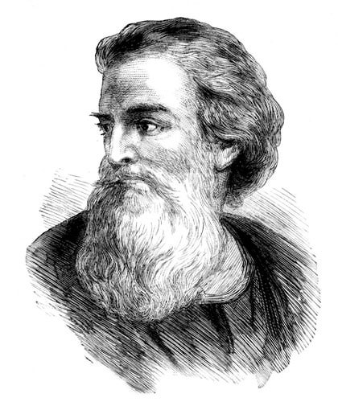
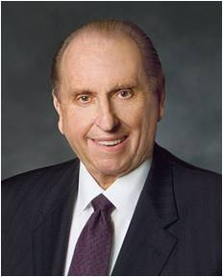
A True Prophet
"A true prophet is one who has the testimony of Jesus; one who knows by personal revelation that Jesus Christ is the Son of the living God, and that he was to be-or has been-crucified for the sins of the world; one to whom God speaks and who recognizes the still small voice of the Spirit.
“A true prophet is one who holds the holy priesthood; who is a legal administrator; who has power and authority from God to represent him on earth.
“A true prophet is a witness, a living witness, one who knows, and one who testifies. Such a one, if need be, foretells the future and reveals to men what the Lord reveals to him." (8)
“A true prophet is a teacher of righteousness to whom the truths of the gospel have been revealed and who presents them to his fellowmen so they can become heirs of salvation in the highest heaven.
1 Corinthians 14:3

Slide 4
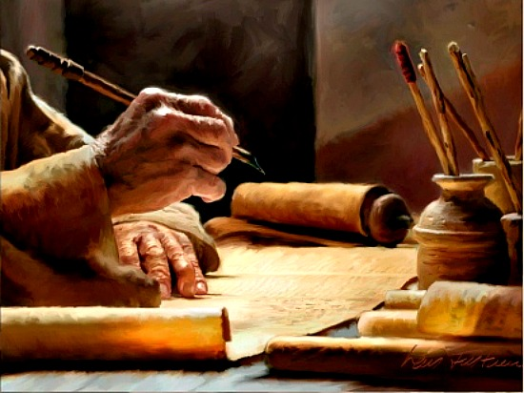
Improper Use of Gift of Tongues
Paul warned that if used improperly, the gift of tongues would fail to edify the Church and would distract members from seeking more useful spiritual gifts.
Acts 2:4-8 The Day of Pentecost:
The gift of tongues was manifest through God’s servants teaching the gospel in languages that were known to their listeners but unknown to the speakers.
Another manifestation of the gift of tongues occurs when a person is moved by the Spirit to speak in a language that is unknown to either the speaker or the hearers (8).
The second manifestation of the gift of tongues seems to have been highly sought after by some members of the Church in Corinth as supposed evidence of a person’s spirituality. Paul corrected this misunderstanding as he explained that this form of the gift of tongues provided unbelievers with evidence of God’s power but did not teach or edify the Saints.
1 Corinthians 14:5-7, 19, 22, 26

Slide 5
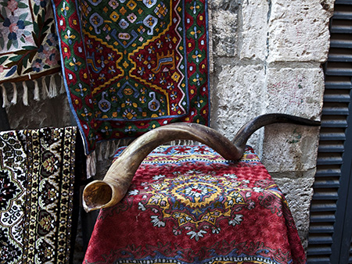
The Trumpet Gives An Uncertain Sound
If you are unfamiliar with the gift of the Holy Ghost…how will you know what is right?
A shofar, or ram’s horn trumpet.
The loud, clear signal of such trumpets was used in ancient Israel to call people to gather for battle or for important religious occasions. Paul drew upon this image as he counseled the Corinthian Saints about the ineffectiveness of speaking in unknown tongues and the importance of clear teaching in the Church. (1)
1 Corinthians 14:8-9

Slide 6
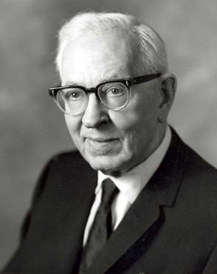
Edify—Build Upon
One reason we should seek for spiritual gifts is to build up or strengthen the Church of God.
For all have not every gift given unto them; for there are many gifts, and to every man is given a gift by the Spirit of God.
To some is given one, and to some is given another, that all may be profited thereby. D&C 46:11-12
"All members of the Church should seek for the gift of prophecy, for their own guidance, which is the spirit by which the word of the Lord is understood and his purposes made known." (14)
1 Corinthians 14:12

Slide 7
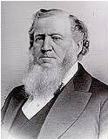
One By One
All, both male and female, may prophesy, or teach and testify. This should be done in order, one person at a time.
In the Church of Jesus Christ, all things are to be done in order
"Without revelation direct from heaven, it is impossible for any person to understand fully the plan of salvation. We often hear it said that the living oracles must be in the Church, in order that the Kingdom of God may be established and prosper on the earth. I will give another version of this sentiment. I say that the living oracles of God, or the Spirit of revelation must be in each and every individual, to know the plan of salvation and keep in the path that leads them to the presence of God." (13)
"Revelations are given for a two-fold purpose: to furnish guidance for the Church, and to give comfort to the individual.” (15)
1 Corinthians 14:31, 33. 40

Slide 8
Women Speaking In Church
It is difficult to understand the intent of Paul’s counsel since he clearly did not forbid women from praying or speaking in Church meetings
Let your women keep silence in the churches: for it is not permitted unto them to speak;
The Joseph Smith Translation:
(to rule)
This word change suggests the possibility that Paul was trying to correct a situation in which some Corinthian women were either being disorderly during worship services or were improperly seeking to take responsibility to lead rather than sustaining and following priesthood leaders. (16)
1 Corinthians 14:34-35

Slide 9
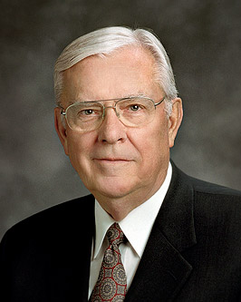
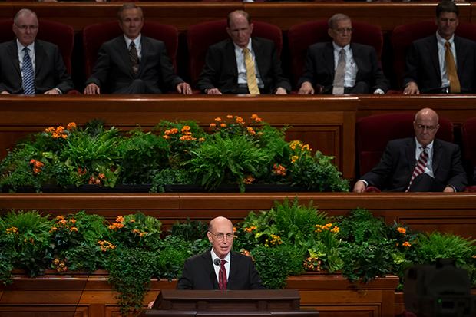
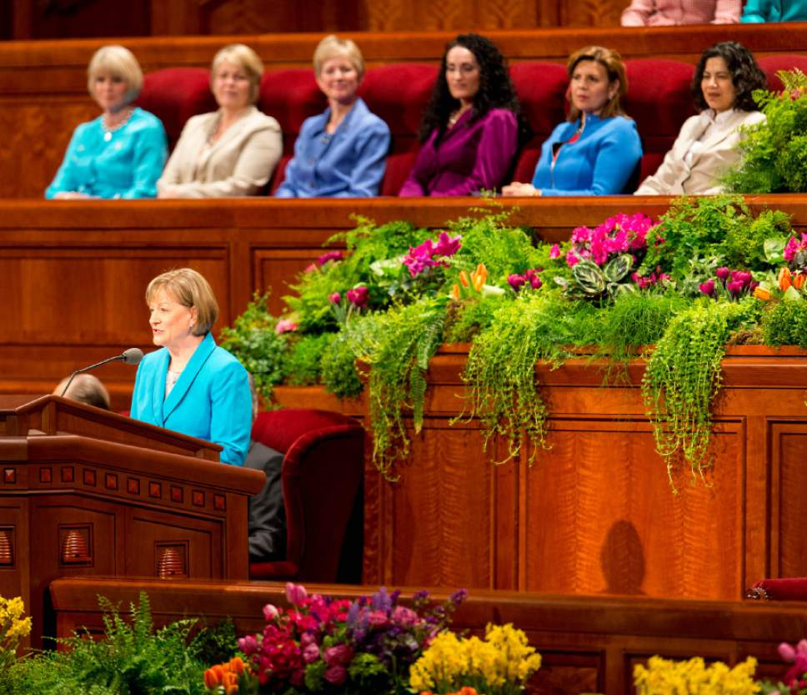
“‘In our Heavenly Father’s great priesthood-endowed plan, men have the unique responsibility to administer the priesthood, but they are not the priesthood.
Men and women have different but equally valued roles. Just as a woman cannot conceive a child without a man, so a man cannot fully exercise the power of the priesthood to establish an eternal family without a woman. …
… In the eternal perspective, both the procreative power and the priesthood power are shared by husband and wife.’ (17)
1 Corinthians 14:31, 33. 40

Slide 10
Sources:
New Testament Institute Student Manual Chapter 39
James E. Faust (Articles of Faith [Salt Lake City: Deseret Book Co., 1981], 389.)
Elder Reed Smoot (Conference Report, October 1931, Third Day-Morning Meeting 113.)
Harold Burke Peterson ("Our Responsibility to Care for Our Own," Ensign, May 1981, 81)
Elder Dallin H. Oaks (Pure in Heart [Salt Lake City: Bookcraft, 1988], 47.)
President Henry B. Eyring (“That We May Be One,” Ensign, May 1998, 68).
Elder Jeffrey R. Holland (Christ and the New Covenant [1997], 337).
Elder Bruce R. McConkie (Doctrinal New Testament Commentary, 2:380 and 383). The Mortal Messiah: From Bethlehem to Calvary, 4 vols. [Salt Lake City: Deseret Book Co., 1979-1981], 2: 169.)
President Howard W. Hunter (“A More Excellent Way,” Ensign, May 1992, 61).
Joseph Smith (History of The Church, 6: 50.)
Gospeldoctrine.com
Guide to the Scriptures, “Prophecy, Prophesy, scriptures.lds.org.
Brigham Young…John A. Widtsoe, comp., Discourses of Brigham Young, Salt Lake City: Deseret Book Co., 1954, p. 38.)
President Joseph Fielding Smith (Church History and Modern Revelation, 1:184.)
John A. Widtsoe, Evidences and Reconciliations, Salt Lake City: Bookcraft, 1960, pp. 98-99, 101; italics added.)" (Dean Sorensen, "I Have a Question," Ensign, Apr. 1990, 54
New Testament Student Manual [Church Educational System manual, 2014], 380).
Elder M. Russell Ballard (“This Is My Work and Glory,” Ensign or Liahona, May 2013, 19.)
Presentation by ©http://fashionsbylynda.com/blog/

Slide 11
The Gift of Prophecy 1 Corinthians 14:1-3:
“The nouns prophecy and prophet and their variations, such as the adjective prophetic and the verb prophesy, are used in several different senses.
“When we hear the word prophet in our day, we are accustomed to thinking of the prophet. These words signify him who holds the prophetic office and is sustained as the prophet, seer, and revelator. The priesthood offices and powers exercised by the President of the Church are unique. …
“The spiritual gift of prophecy is quite different. As we read in the Book of Revelation, ‘The testimony of Jesus is the spirit of prophecy.’ (Rev. 19:10.) The Prophet Joseph Smith relied on this scripture in teaching that ‘every other man who has the testimony of Jesus’ is a prophet [in History of the Church, 3:28]. Similarly, the Apostle Paul states that ‘he that prophesieth speaketh unto men to edification, and exhortation, and comfort.’ (1 Cor. 14:3.) Thus, in the sense used in speaking of spiritual gifts, a prophet is one who testifies of Jesus Christ, teaches God’s word, and exhorts God’s people. In its scriptural sense, to prophesy means much more than to predict the future.
“… In our day, Elder Joseph Fielding Smith declared that ‘all members of the Church should seek for the gift of prophecy, for their own guidance, which is the spirit by which the word of the Lord is understood and his purpose made known.’ (Church History and Modern Revelation, 3 vols., Salt Lake City, Deseret Book Co., 1953, 1:201.)
“It is important for us to understand the distinction between a prophet, who has the spiritual gift of prophecy, and the prophet, who has the prophetic office” Elder Dallin H. Oaks (“Spiritual Gifts,” Ensign, Sept. 1986, 71).
The Gift of Tongues 1 Corinthians 14:5-7, 19, 22, 26:
“We are told by prophets in this dispensation that revelation for the direction of the Church will not be given through the gift of tongues. The reason for this is that it is very easy for Lucifer to falsely duplicate the gift of tongues and confuse the members of the Church.
“Satan has the power to trick us as it pertains to some of the gifts of the Spirit. One in which he is the most deceptive is the gift of tongues. Joseph Smith and Brigham Young (1801–77) explained the need to be cautious when considering the gift of tongues.
“‘You may speak in tongues for your own comfort, but I lay this down for a rule, that if anything is taught by the gift of tongues, it is not to be received for doctrine’ (Teachings: Joseph Smith, 384).
“‘Speak not in the gift of tongues without understanding it, or without interpretation. The devil can speak in tongues’ (Teachings: Joseph Smith, 384).
“‘The gift of tongues is not … empowered to dictate … the Church. All gifts and endowments given of the Lord to members of his Church are not given to control the Church; but they are under the control and guidance of the Priesthood, and are judged of by it’ (Discourses of Brigham Young, comp. John A. Widtsoe [1941], 343)
“The gift of tongues is used by missionaries to teach the gospel to the nations of the world” Elder Robert D. Hales (“Gifts of the Spirit,” Ensign, Feb. 2002, 14–15)..
The Gift of Tongues and the Gift of Prophecy:
"There are only two gifts that could be made visible-the gift of tongues and the gift of prophecy. These are things that are the most talked about, and yet if a person spoke in an unknown tongue, according to Paul's testimony, he would be a 'barbarian' to those present. They would say that it was gibberish. And if he prophesied, they would call it nonsense. The gift of tongues is the smallest gift perhaps of the whole, and yet it is one that is the most sought after. . . . Be not so curious about tongues. Do not speak in tongues except there be an interpreter present. The ultimate design of tongues is to speak to foreigners, and if persons are very anxious to display their intelligence, let them speak to such in their own tongues." (Kent P. Jackson, comp. and ed., Joseph Smith's Commentary on the Bible [Salt Lake City: Deseret Book Co., 1994], 167.)

Slide 12
Men’s and Women’s Roles in the Church 1 Corinthians 14:34-35
“Why are men ordained to priesthood offices and not women? President Gordon B. Hinckley explained that it was the Lord, not man, ‘who designated that men in His Church should hold the priesthood’ and that it was also the Lord who endowed women with ‘capabilities to round out this great and marvelous organization, which is the Church and kingdom of God’ (“Women of the Church,” Ensign, November 1996, 70). When all is said and done, the Lord has not revealed why He has organized His Church as He has.
“When thinking about those things we do not fully understand, I am reminded of these words by my deceased friend and Apostle, Elder Neal A. Maxwell, who said, ‘What we already know about God teaches us to trust him for what we do not know fully’ (Deposition of a Disciple [Salt Lake City: Deseret Book, 1976], 56).
“And Elder Jeffrey R. Holland stated in this last April general conference, ‘In this Church, what we know will always trump what we do not know’ (“Lord, I Believe,” Ensign, May 2013, 94).
“Brothers and sisters, this matter, like many others, comes down to our faith. Do we believe that this is the Lord’s Church? Do we believe that He has organized it according to His purposes and wisdom? Do we believe that His wisdom far exceeds ours? Do we believe that He has organized His Church in a manner that would be the greatest possible blessing to all of His children, both His sons and His daughters?
“… Women are integral to the governance and work of the Church through service as leaders in Relief Society, Young Women, and Primary; through their service as teachers, full-time missionaries, and temple ordinance workers; and in the home, where the most important teaching in the Church occurs” Elder M. Russell Ballard (“Let Us Think Straight” [Brigham Young University campus education week devotional, Aug. 20, 2013], 4–5; speeches.byu.edu).

Slide 13
Death and Resurrection
1 Corinthians 15-16
And it shall be said in that day, Lo, this is our God; we have waited for him, and he will save us: this is the Lord; we have waited for him, we will be glad and rejoice in his salvation.
Isaiah 25:9

Slide 14
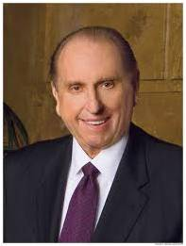
My Redeemer Lives
“With all my heart and the fervency of my soul, I lift up my voice in testimony as a special witness and declare that God does live.
Jesus is His Son, the Only Begotten of the Father in the flesh.
He is our Redeemer; He is our Mediator with the Father.
He it was who died on the cross to atone for our sins.
He became the firstfruits of the Resurrection. Because He died, all shall live again. ‘Oh, sweet the joy this sentence gives: “I know that my Redeemer lives!”’ May the whole world know it and live by that knowledge.” (2)
President Hinckley wrote the words to “My Redeemer Lives” (hymn 135) while Elder G. Homer Durham composed the music.

Slide 15
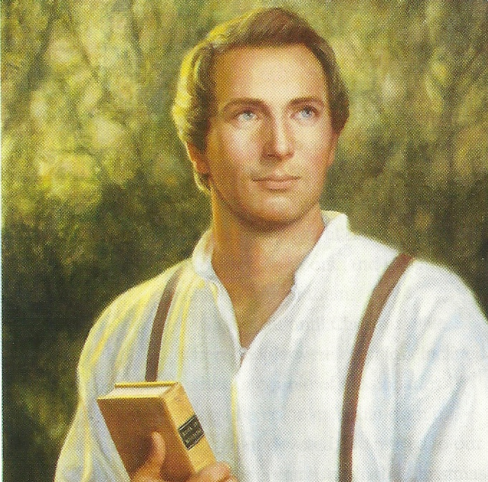
The Core Of Our Religion
“The fundamental principles of our religion are the testimony of the Apostles and Prophets, concerning Jesus Christ, that He died, was buried, and rose again the third day, and ascended into heaven; and all other things which pertain to our religion are only appendages to it” (3)

Slide 16
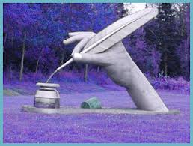
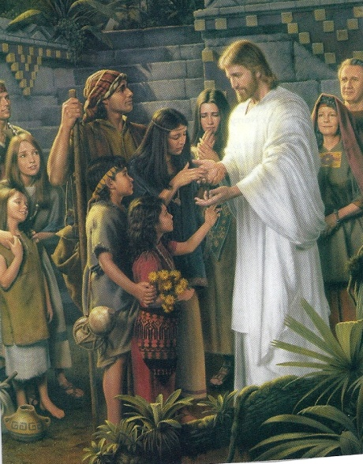
Message of Hope After Death
Those who received the gospel and will believe, will be saved.
Christ died for our sins according to the scriptures, he was buried, and rose again the third day and was seen by others.
1 Corinthians 15:1-4

Slide 17
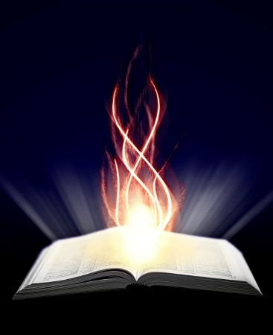
Cephas = Peter
"How can Paul, or Peter, or anyone prove that Christ rose from the dead?
The fact of resurrection is a spiritual reality, one wholly outside the realm of scientific investigation or proof; it cannot be established by research, or reason, or laboratory experiment.
Spiritual truths can be known only by revelation; they are always revealed to the world by witnesses-prophets and righteous men who have seen within the veil, who have heard the voices of beings from another sphere, and who can therefore testify of the things of God.
Peter and the others felt the nail marks in the hands of the Risen Lord, thrust their hands into the spear wound in his side, and ate and drank with him after he rose from the dead…”(4)
1 Corinthians 15:5

Slide 18
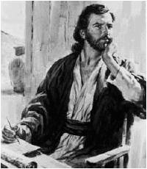
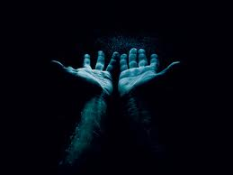
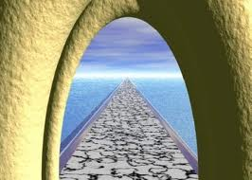
Is There No Resurrection?
Then Christ is not risen
Is (Paul’s and apostles) preaching in vain?
“If the dead rise not, then is not Christ raised:”
Then after death we would perish with nothing else of our existence?
1 Corinthians 15:12-26

Slide 19
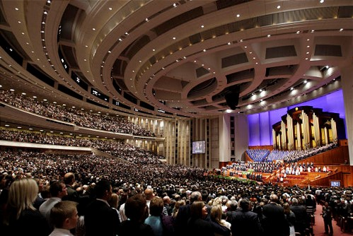
What Is This Life All About?
If there is no resurrection, then Christ could not have existed, and all this time we have listened and gone to church would have been a waste of time…so what is this life all about?
Are we here on earth just for the fun of it? A fluke of nature?
Are all these men who get up and talk, and all the people who attend Conferences, and all the people who join the church and worship Jesus, is this a farce?
1 Corinthians 15:13-19
(2)

Slide 20
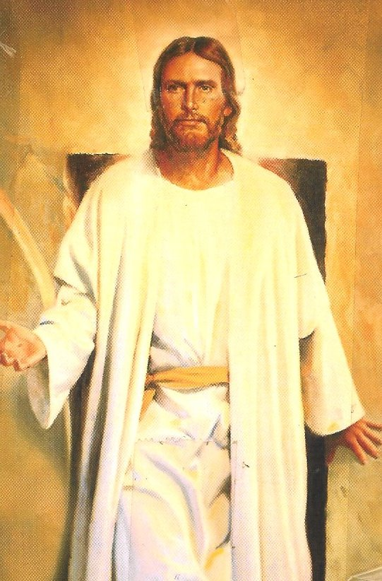
Death and Resurrection
“if in this life only we have hope in Christ, we are of all men most miserable.”
But now is Christ risen from the dead and become the firstfruits of them that slept.
(Jesus Christ was the first person to be resurrected)
1 Corinthians 15:19-20

Slide 21
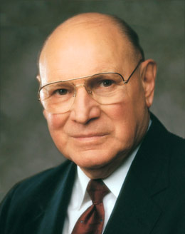
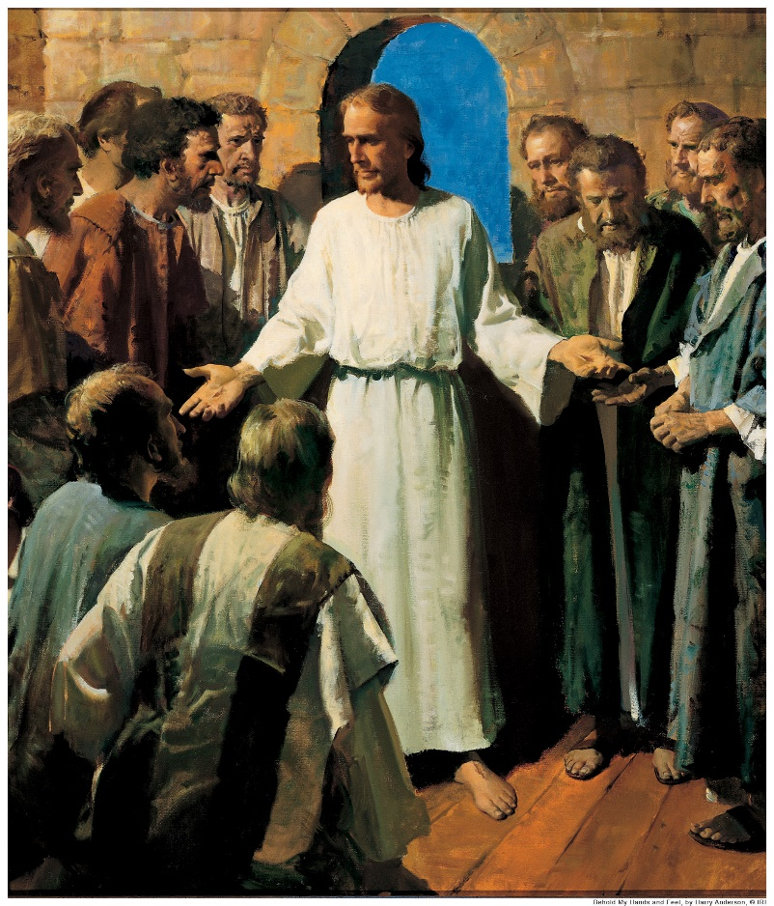
“When the Savior rose from the tomb, He did something no one had ever done. He did something no one else could do. He broke the bonds of death, not only for Himself but for all who have ever lived—the just and the unjust.
“When Christ rose from the grave, becoming the firstfruits of the Resurrection, He made that gift available to all. And with that sublime act, He softened the devastating, consuming sorrow that gnaws at the souls of those who have lost precious loved ones.” (5)
1 Corinthians 15:19-20

Slide 22
Doctrinal Mastery
1 Corinthians 15:20-22
But now is Christ risen from the dead, and become the firstfruits of them that slept.
For since by man came death, by man came also the resurrection of the dead.
For as in Adam all die, even so in Christ shall all be made alive.

Slide 23
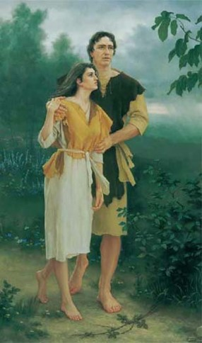
Adam—Death, Christ—Life
“For since by man came death, by man came also the resurrection of the dead.”
Because of the Resurrection of Jesus Christ, everyone will be resurrected
“For in Adam all die, even so in Christ shall all be made alive”
1 Corinthians 15:21-23

Slide 24
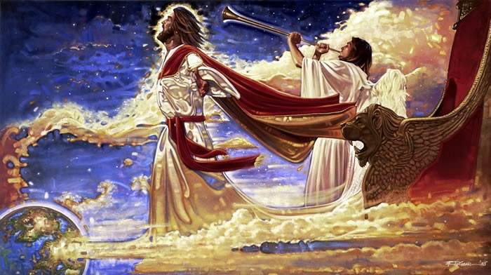
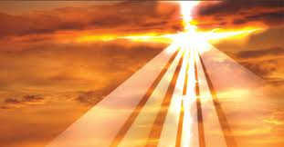
Put Down All Rule, Authority, and Power
Enemies = sin, corruption, wicked and adversary
“Then cometh the end, when he shall have delivered up the kingdom to God…
“For he must reign, till he hath put all enemies under his feet.”
“The last enemy that shall be destroyed is death.”
Paul taught that there will be an order to the Resurrection and that Jesus Christ will “[deliver] up the kingdom” to Heavenly Father after ending all forms of earthly (or worldly) “authority and power.”
1 Corinthians 15:24-26

Slide 25
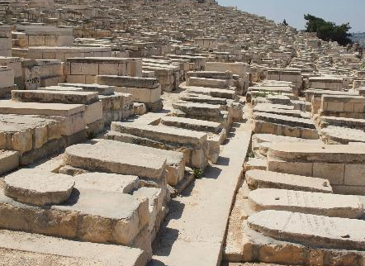
Order of the Resurrection
Some Church members in Corinth believed the dead would not be resurrected, but Paul pointed out that the Saints had been doing something that indicated their belief in the Resurrection of the dead.
"Order in the resurrection is determined by obedience to gospel law. The most righteous man was first, and most wicked shall be the last; Christ was first, the sons of perdition shall be last." (4)
Jesus Christ was the first to be resurrected. Immediately following His Resurrection, there were righteous Saints who rose from the grave.
At the Second Coming, the Resurrection will continue with the coming forth of other righteous Saints, who “are Christ’s at his coming.” (1)
1 Corinthians 15:23-26; Matthew 27:52-53

Slide 26
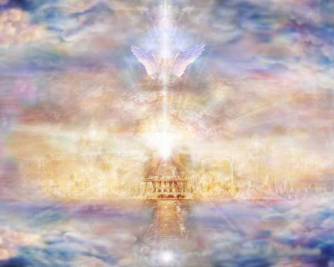
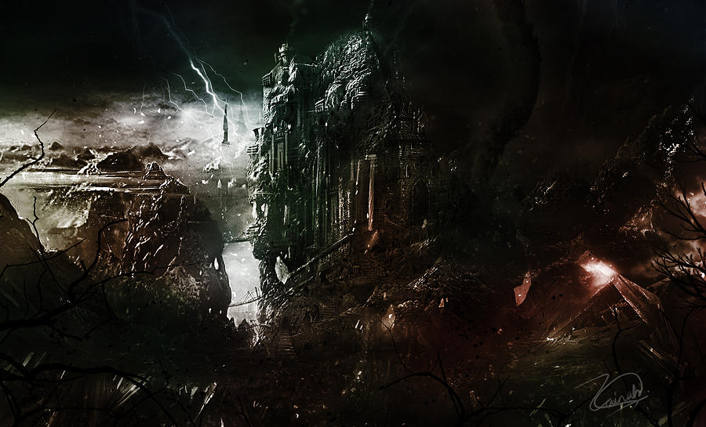
Through Latter-day Revelation We Learn…
…that these people will inherit the celestial kingdom.
Then will come the resurrection of those who will receive terrestrial glory .
They will be followed at the end of the Millennium by those who will inherit telestial glory.
Finally, the Resurrection will be concluded with the raising of those who are “filthy still”—the “sons of perdition” who will receive no degree of glory but will “return again to their own place, to enjoy that which they are willing to receive, because they were not willing to enjoy that which they might have received.”
Zainah Ayoob
D&C 76:50-79; 88:97-102;
(1)

Slide 27
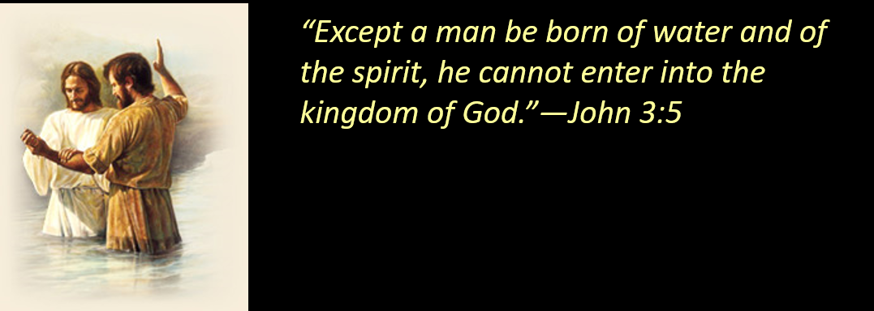
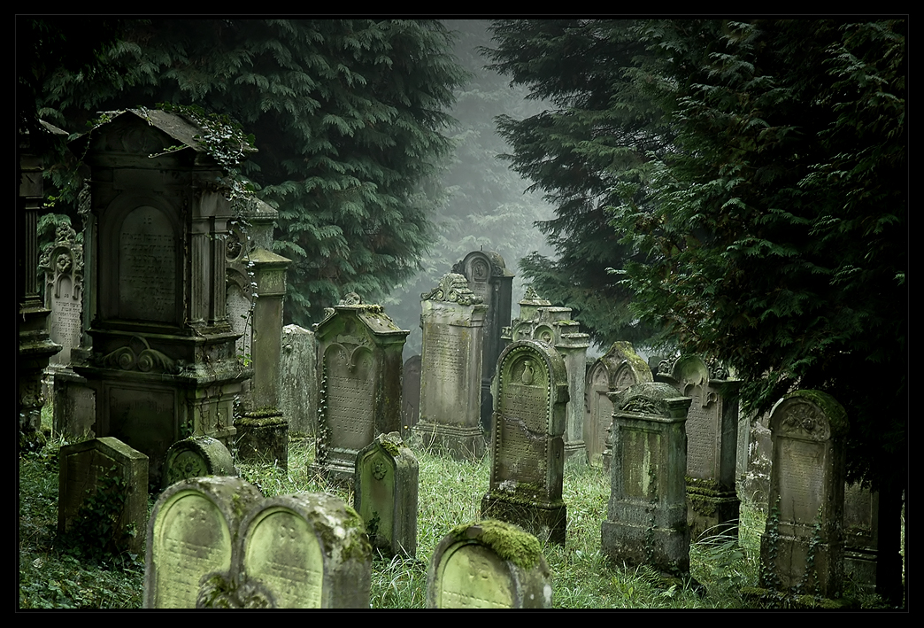
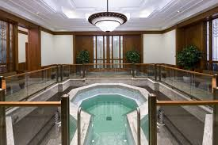
Those Who Have Died Without the Hearing the Gospel
“Else what shall they do which are baptized for the dead, if the dead rise not at all? Why are they then baptized for the dead?”
“for a baptismal font there is not upon the earth, that they, my saints, may be baptized for those who are dead”– Read D&C 28-31
Baptismal font in the Kyiv Temple, Ukraine
1 Corinthians 15:29

Slide 28
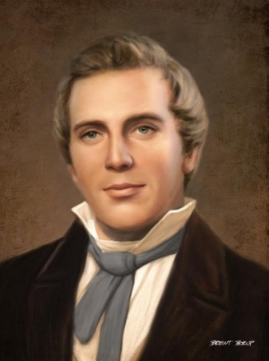
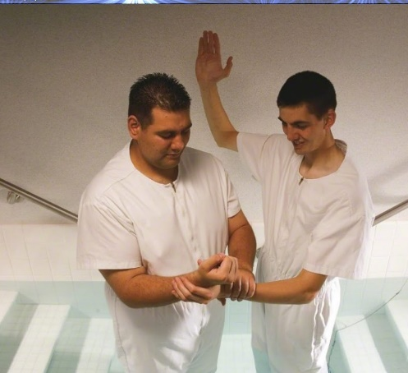
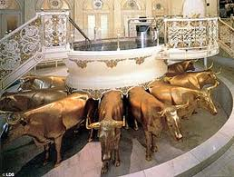
Belonging to the Kingdom Through Baptism
“Every man that has been baptized and belongs to the kingdom has a right to be baptized for those who have gone before; and as soon as the law of the Gospel is obeyed here by their friends who act as proxy for them, the Lord has administrators there to set them free:” (3)
Brent Borup
Those who have died without baptism may receive this essential ordinance

Slide 29
Biblical Evidence of Baptisms For the Dead
Millions of Heavenly Father’s children have died without gaining a knowledge of Jesus Christ or receiving the essential ordinance of baptism. Paul’s reference to baptism for the dead suggests that early Church members knew of God’s plan to redeem the dead.
Verily, verily, I say unto you, The hour is coming, and now is, when the dead shall hear the voice of the Son of God: and they that hear shall live.
John 5:25
For Christ also hath once suffered for sins, the just for the unjust, that he might bring us to God, being put to death in the flesh, but quickened by the Spirit:
By which also he went and preached unto the spirits in prison; 1 Peter 3:18-19
Marvel not at this: for the hour is coming, in the which all that are in the graves shall hear his voice, John 5:28
For for this cause was the gospel preached also to them that are dead, that they might be judged according to men in the flesh, but live according to God in the spirit.
1 Peter 4:6
Therefore we are buried with him by baptism into death: that like as Christ was raised up from the dead by the glory of the Father, even so we also should walk in newness of life. Romans 6:4
1 Corinthians 15:29

Slide 30
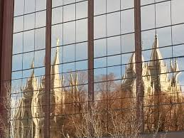
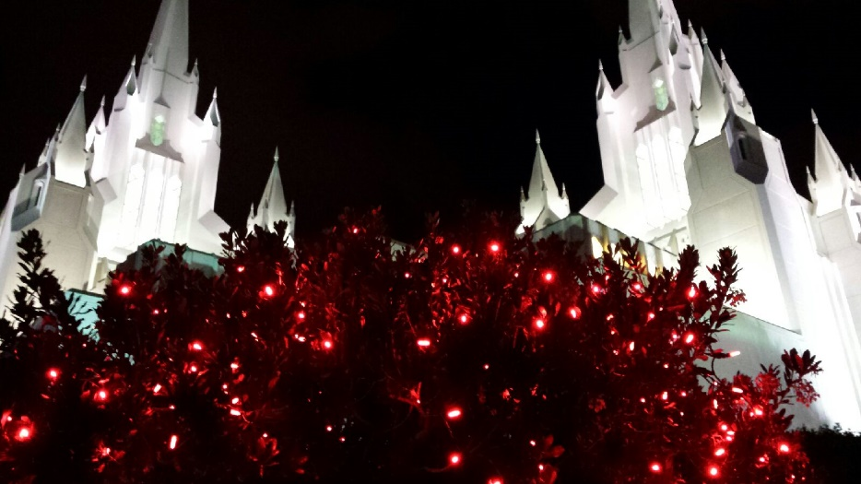
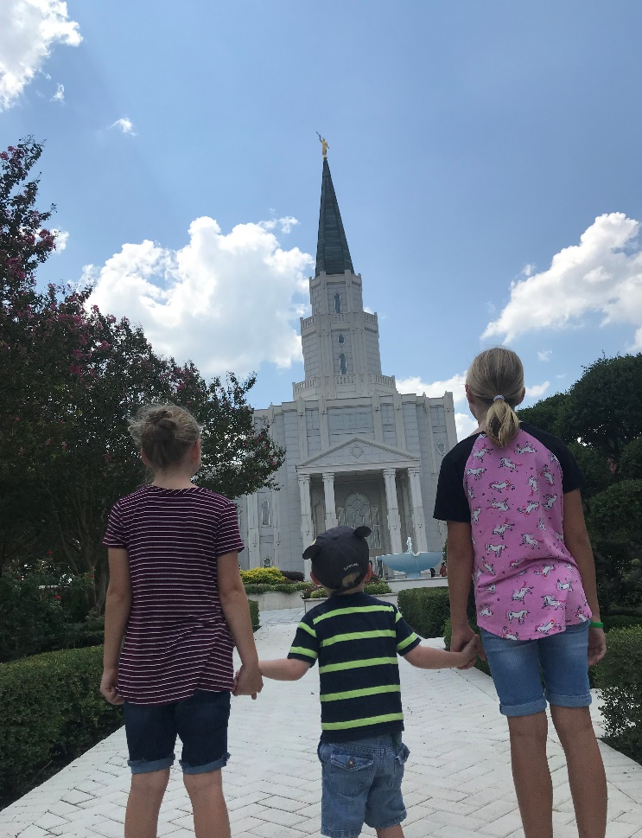
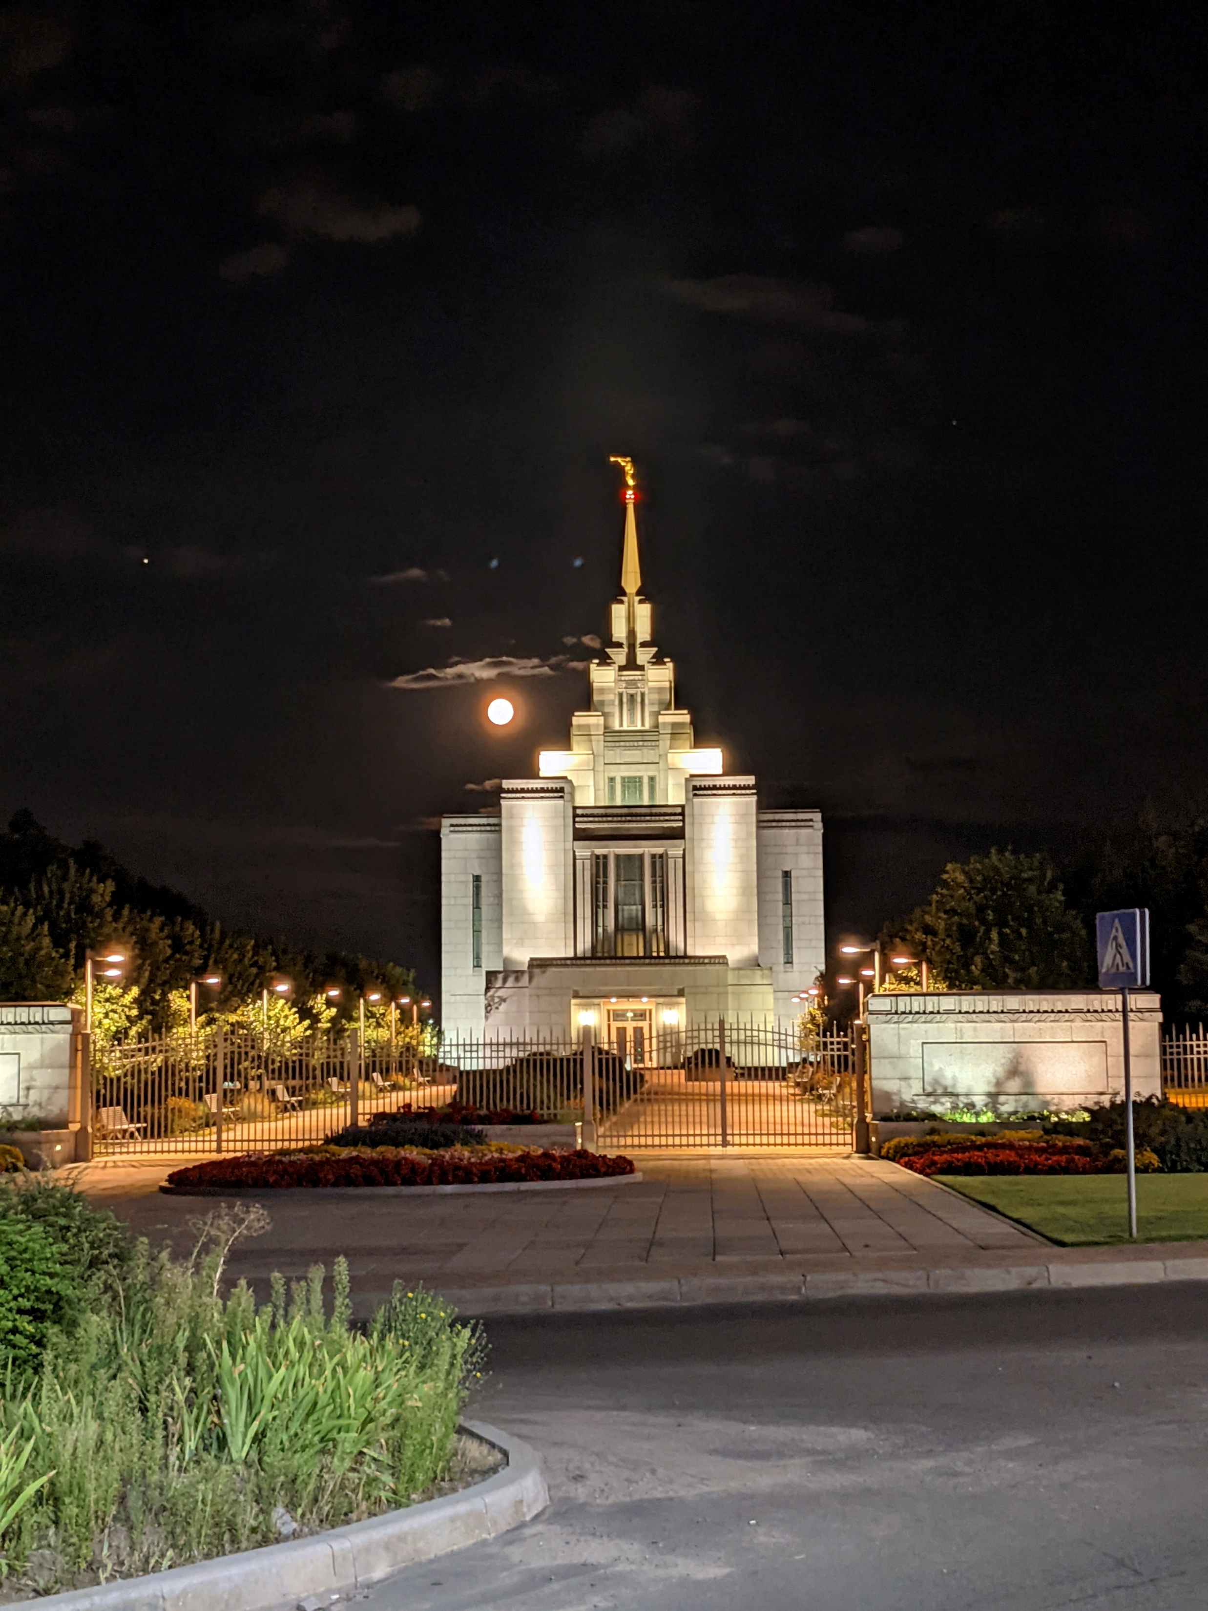
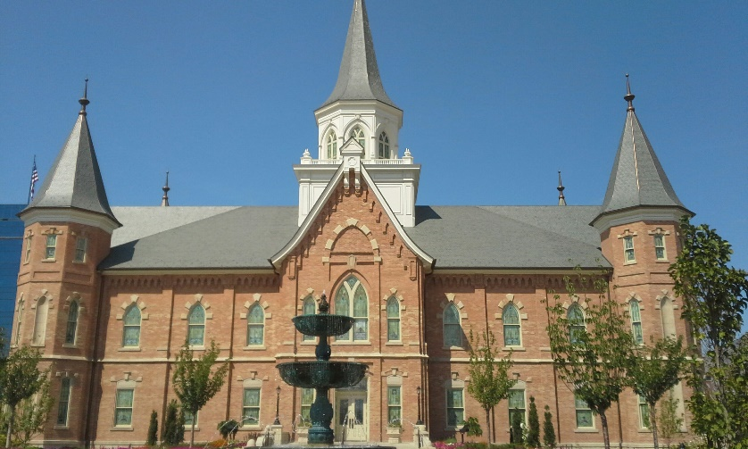
“Every temple, be it large or small, old or new, is an expression of our testimony that life beyond the grave is as real and certain as is mortality.” (6)
Salt Lake City Temple Reflection
San Diego Temple
Houston, Texas
Provo Temple
Kyiv Temple, Ukraine

Slide 31
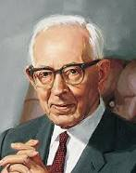
“No person who has lived and died on this earth will be denied the resurrection. Reason teaches this, and it is a simple matter of justice.
Adam alone was responsible for death, and therefore the Lord does not lay this to the charge of any other person.
Justice demands that no person who was not responsible for death shall be held responsible for it, and therefore, as Paul declared, ‘As in Adam all die, even so in Christ shall all be made alive’”.
(7)

Slide 32
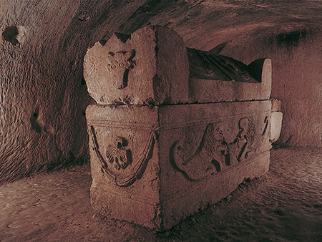
The Resurrected Body
In the ancient Greco-Roman world, families frequently visited the graves of their deceased relatives, including on the anniversaries of their loved ones’ deaths.
With such frequent reminders of human mortality, the Saints in Corinth may have understandably wondered how the deceased could be restored to life and what resurrected bodies would be like.
Sarcophagi (stone coffins) like this one from Beth She’arim, Israel, were common in the ancient Greco-Roman world.
1 Corinthians 15:35-38

Slide 33
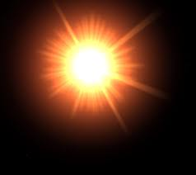
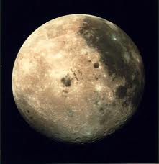
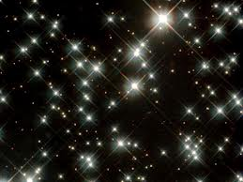
All flesh is not the same flesh--Glory
Paul taught that the resurrected body differs in glory and quality from the mortal body.
Celestial Bodies--Sun
To help remember the order:
Sea tur tle
Terrestrial Bodies--moon
Telestial Bodies--stars
1 Corinthians 15:39-42

Slide 34
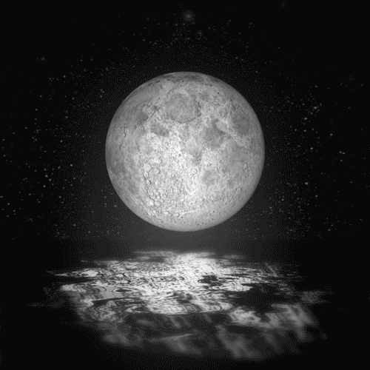
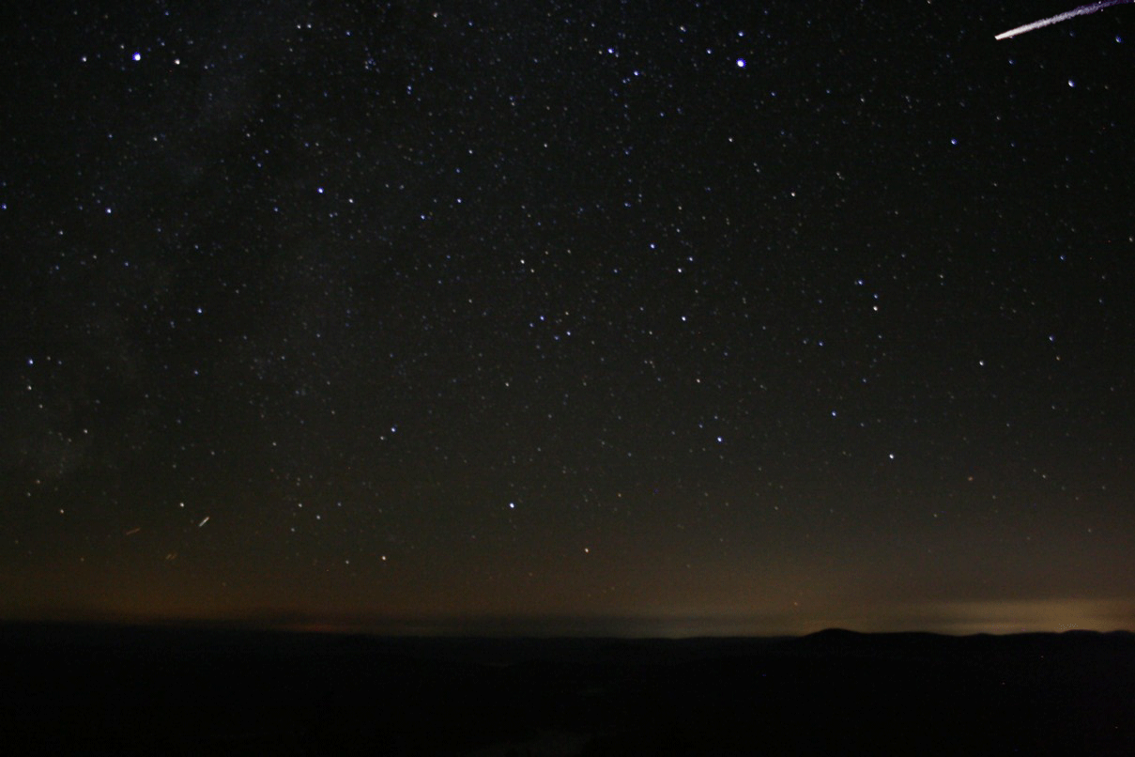
In February 1832 the Prophet Joseph Smith and Sidney Rigdon received a vision in which they saw those who receive each of the three degrees of glory, beginning with those who receive a celestial reward:
“And again, we saw the terrestrial world, and behold and lo, these are they who are of the terrestrial, whose glory differs from that of the church of the Firstborn who have received the fulness of the Father, even as that of the moon differs from the sun. …
“And again, we saw the glory of the telestial, which glory is that of the lesser, even as the glory of the stars differs from that of the glory of the moon.”
“These are they whose bodies are celestial, whose glory is that of the sun, even the glory of God, the highest of all. …
“Also celestial bodies, and bodies terrestrial, and bodies telestial; but the glory of the celestial, one; and the terrestrial, another; and the telestial, another” (JST)
D&C 76:50, 70–71, 81; 1 Corinthians 15:40

Slide 35
“In the resurrection there will be different kinds of bodies; they will not all be alike.
The body a man receives will determine his place hereafter. There will be celestial bodies, terrestrial bodies, and telestial bodies, and these bodies will differ as distinctly as do bodies here…(7)

Slide 36
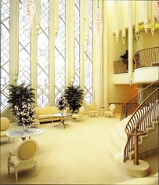
…Some will gain celestial bodies with all the powers of exaltation and eternal increase. These bodies will shine like the sun as our Savior’s does;
Those who enter the terrestrial kingdom will have terrestrial bodies, and they will not shine like the sun, but they will be more glorious than the bodies of those who receive the telestrial glory.”
San Diego Temple
(7)

Slide 37
Resurrection At Different Times
Resurrection will be concluded with the raising of the ‘sons of perdition’. Those will not receive a degree of glory but will ‘return again to their own place’ to enjoy that which they are willing to receive, because they were not willing to enjoy that which they might have received
Jesus Christ was the first to be resurrected.
The Second Coming, the resurrection will continue with the coming forth of other righteous Saints…These people will inherit the celestial kingdom
The resurrection of those who will receive terrestrial glory
Righteous Saints rose from grave immediately following His Resurrection.
At the end of the Millennium the resurrection of those who will inherit telestial glory
Those spirits who rebelled in premortality and did not receive a mortal body will not be among those who will be resurrected.
(1)
2. Matthew 27:52-53; 3. 1 Corinthians 15:23; D&C 76:50-70; 88:97-98; 4. D&C 76:71-79; 88:99; 5. D&C 76:81-86; 88:100-101 6. D&C 76:31-39, 43-44; 88;28-32,35,101-2; 7. D&C 76:32-39

Slide 38
First Man on Earth
Adam—earthly
“It is sown a natural body; it is raised a spiritual body…”
“…the first man Adam was made living soul; the last Adam was made a quickening spirit.”
Paul contrasted the “natural body” that is buried at death and the “spiritual body” that is raised up in the Resurrection.
corruption, dishonor, and weakness = “natural” or mortal bodies
1 Corinthians 15:44-45

Slide 39
Second Man—The Last Adam
The Lord from Heaven--heavenly
Jesus opens the door to celestial glory for those who are worthy.
incorruption, glory, and power =
“spiritual” or resurrected bodies.
The actions of Adam (with the Fall) and Jesus Christ (with the Atonement and Resurrection) were both necessary for our salvation.
1 Corinthians 15:47

Slide 40
A mystery—twinkling of an eye
"Flesh and blood cannot go there; but flesh and bones, quickened by the Spirit of God, can." (3)
We are born in an earthly state, but we shall bear the image of a heavenly state.
“We shall not all sleep, but we shall all be changed”
1 Corinthians 15:49-52

Slide 41
All Men Resurrected
“…at the last trump: for the trumpet shall sound, and the dead shall be raised incorruptible, and we shall be changed.”
Physical death has no victory over us, because of the Resurrection of Jesus Christ
“for this corruptible must put on incorruption, and this mortal must put on immortality.”
1 Corinthians 15:52-53

Slide 42
Each of us has physical, mental, and emotional limitations and weaknesses.
These challenges … will eventually be resolved.
None of these problems will plague us after we are resurrected. …
… We know that [Christ] can make us whole no matter what is broken in us.
We know that He “shall wipe away all tears from [our] eyes; and there shall be no more death, neither sorrow, nor crying, neither shall there be any more pain”.
(8)
1 Corinthians 15:51-58; Revelation 21:4

Slide 43
“The Sting of Death”
“the sting of death is sin; and the strength of sin is the law.”
“…meaning that if men die in their sins, they will suffer the prescribed penalty and gain a lesser glory in the realms ahead.”
—Spencer W. Kimball
1 Corinthians 15:55-56

Slide 44
Receiving a Blessing Before Death
“…if they die they shall die unto me, and if they live they shall live unto me.”
“Thou shalt live together in love, insomuch that thou shalt weep for the loss of them that die, and more especially for those that have not hope of a glorious resurrection.”
D&C 42:44-45

Slide 45
Sweet or Bitter Death
“…those that die in me shall not taste of death, for it shall be sweet unto them;”
“And they that die not in me, wo unto them, for their death is bitter.
D&C 42:46-47

Slide 46
“The pain of death is swallowed up in the peace of eternal life.
…Whenever the cold hand of death strikes, there shines through the gloom and the darkness of that hour the triumphant figure of the Lord Jesus Christ, He, the Son of God, who by His matchless and eternal power overcame death.
…He is our comfort, our only true comfort, when the dark shroud of earthly night closes about us as the spirit departs the human form.” (6)

Slide 47
Collections for the Poor
Paul instructed the Saints in Corinth that when they met each Sunday, they should collect donations to be sent to the Church in Jerusalem.
We learn from Romans 15:25–28 that the Saints in Achaia—a region that included Corinth—gladly made donations out of gratitude for the spiritual strength they received from the Church in Jerusalem.
By asking for their donations, Paul encouraged the Gentile Saints to assist and identify with their fellow Jewish Saints.
This is another example of Paul’s continuing efforts to build unity between the Jewish and Gentile members of the Church.
1 Corinthians 16:1-3
(1)

Slide 48
Anthema Maran-atha
Paul’s Warning
“Anathema is a Greek word meaning accursed. Hence, a person or thing cursed by God or his authority, as for instance one who has been excommunicated, is anathema.
‘Wo unto them who are cut off from my church, for the same are overcome of the world.’ (D. & C. 50:8)
Maranatha, an Aramaic word meaning, O our Lord, come, appears to have been used by the primitive saints as a watchword or salutation by which they reminded each other of the promised Second Coming” (4)
‘… let him be accursed until the Lord comes.’
1 Corinthians 16:21-24; Romans 9:3
(1)

Slide 49
Sources:
New Testament Institute Student Manual Chapter 40
President Thomas S. Monson (“I Know That My Redeemer Lives!” 25).
Joseph Smith (Teachings of Presidents of the Church: Joseph Smith [2007], 49). Teachings of the Prophet p. 367
(History of the Church, 6:52.)
Elder Bruce R. McConkie (Doctrinal New Testament Commentary, 3 vols. [Salt Lake City: Bookcraft, 1965-1973], 2: 389; 3:394.) (Mormon Doctrine, 2nd ed. [1966], 33–34).
Elder Joseph B. Wirthlin (“Sunday Will Come,” Ensign or Liahona, Nov. 2006, 29).
President Gordon B. Hinckley (“This Peaceful House of God,” Ensign, May 1993, 74). April 1996 Conf. Report
Joseph Fielding Smith (Doctrines of Salvation, comp. Bruce R. McConkie, 3 vols. [1954–56], 2:274, 286-87).
Paul V. Johnson, “And There Shall Be No More Death,” Ensign or Liahona, May 2016, 122–23
Presentation by ©http://fashionsbylynda.com/blog/

Slide 50
First Letter of Paul to the Saints at Corinth— Written from Ephesus, ca. Spring, A.D. 57
The Reality of the Resurrection | 15:1–22
The Order of Resurrection | 15:23–28
Baptism in Behalf of the Dead | 15:29
A Better Resurrection | 15:30–34
Resurrection into Kingdoms of Glory | 15:35–53
Christ Triumphed over Death | 15:54–58
“Stand Fast in the Faith” | 16:1–24
Testimony of an Apostle 1 Corinthians 15
“With all my heart and the fervency of my soul, I lift up my voice in testimony as a special witness and declare that God does live. Jesus is His Son, the Only Begotten of the Father in the flesh. He is our Redeemer; He is our Mediator with the Father. He it was who died on the cross to atone for our sins. He became the firstfruits of the Resurrection. Because He died, all shall live again. ‘Oh, sweet the joy this sentence gives: “I know that my Redeemer lives!”’ May the whole world know it and live by that knowledge.” President Thomas S. Monson (“I Know That My Redeemer Lives!” 25).
Universal Resurrection 1 Corinthians 15:21-22:
“The Atonement was accomplished, bringing a universal resurrection to billions and billions, lifting all from the grave—regardless of how and when we got there! Therefore, on a clear night, though we see stars of incomprehensible longevity, they are not immortal. But, thankfully, we are!” Elder Neal A. Maxwell (“Encircled in the Arms of His Love,” Ensign, Nov. 2002, 16).
“No person who has lived and died on this earth will be denied the resurrection. Reason teaches this, and it is a simple matter of justice. Adam alone was responsible for death, and therefore the Lord does not lay this to the charge of any other person. Justice demands that no person who was not responsible for death shall be held responsible for it, and therefore, as Paul declared, ‘As in Adam all die, even so in Christ shall all be made alive’” President Joseph Fielding Smith (Doctrines of Salvation, comp. Bruce R. McConkie, 3 vols. [1954–56], 2:274).
Life and Teachings of Jesus and His Apostles Chapter 36
Gospel 1 Corinthians 1-4:
"Gospel means 'good news' or 'glad tidings.' The bad news is that because of the fall of our first parents we are subject to the effects and pull of sin and death. The bad news is that because of the fall men and women experience spiritual death-separation and alienation from the presence and influence of God and of things of righteousness. The bad news is that every man, woman, and child will one day face the grim reaper, the universal horror we know as physical death. The good news is that there is help, relief, extrication from the pain and penalty of our sins. The good news is that there is reconciliation with God the Father through the mediation of his Son, Jesus Christ. The good news is that there is an atonement, literally an at-one-ment with the Father. The good news is that the victory of the grave and the sting of death are swallowed up in the power of One greater than death. (1 Cor. 15:54-55; see also Isa. 25:8.) The good news is the promise of eventual life after death through the resurrection. In short, the gospel is the good news that Christ came to earth, lived and taught and suffered and died and rose again, all to the end that those who believe and obey might be delivered from death and sin unto eternal life." (The Mormon Faith: Understanding Restored Christianity [Salt Lake City: Deseret Book Co., 1998], 48 - 49.)
Baptisms For the Dead 1 Corinthians 15:29:
“This is a challenging question. Why are you performing vicarious baptisms for those who are dead if there is no resurrection? History bears out the facts of the practice of baptizing for those who had died without the benefit of this ordinance. It would seem certain, from the question that was asked by Paul, that this vicarious practice was followed in the branch of the church in Corinth. His query is well taken. There would be no sense in such ordinances except there be a resurrection. Nothing matters if there is not a resurrection; everything would end in the darkness of death.” Howard W. Hunter (in Conference Report, Apr. 1969, 137).

Slide 51
Gathering and Correlating Genealogies for One Purpose:
"People not fully acquainted with this concept cannot understand the concern of The Church of Jesus Christ of Latter-day Saints with genealogy. Our expenditure of time, money, and effort in gathering and organizing the names and vital statistics of our ancestors is done to identify them properly. We only gather and correlate these genealogies for one purpose, so that we can do the necessary ordinance work for our kindred dead in the temples of God erected for that purpose. If our ancestors and kinfolk have the desire to accept the gospel of Jesus Christ even beyond the grave, they are free to accept these redeeming ordinances made in their behalf. There is neither force nor compulsion in the gospel of Jesus Christ, only love, mercy, and opportunity." Elder M. Theodore Burton (Conference Report, April 1964, Second Day-Morning Meeting 73.)
"Will translated beings ever die? Remember John's enigmatic words relative to his own translation: 'Then went this saying abroad among the brethren, that that disciple should not die: yet Jesus said not unto him, He shall not die; but, If I will that he tarry till I come, what is that to thee?' (John 21:23.) Note the distinction between avoiding death as such and living till the Lord comes. Then note that Jesus promises the Three Nephites, not that they shall not die, but that they 'shall never taste of death' and shall not 'endure the pains of death.' Again it is an enigmatic declaration with a hidden meaning. There is a distinction between death as we know it and tasting of death or enduring the pains of death. As a matter of doctrine, death is universal; every mortal thing, whether plant or animal or man, shall surely die. Jacob said: 'Death hath passed upon all men, to fulfil the merciful plan of the great Creator.' (2 Ne. 9:6.) There are no exceptions, not even among translated beings. Paul said: 'As in Adam all die, even so in Christ shall all be made alive.' (1 Cor. 15:22.) Again the dominion of death over all is acclaimed. But the Lord says of all his saints, not that they will not die, but that 'those that die in me shall not taste of death, for it shall be sweet unto them; And they that die not in me, wo unto them, for their death is bitter.' (D&C 42:46-47.) The distinction is between dying as such and tasting of death itself. Again the Lord says: 'He that liveth when the Lord shall come, and hath kept the faith, blessed is he; nevertheless, it is appointed to him to die at the age of man. Wherefore, children shall grow up until they become old; old men shall die; but they shall not sleep in the dust, but they shall be changed in the twinkling of an eye.' (D&C 63:50-51.) Thus, this change from mortality to immortality, though almost instantaneous, is both a death and a resurrection. Thus, translated beings do not suffer death as we normally define it, meaning the separation of body and spirit; nor do they receive a resurrection as we ordinarily describe it, meaning that the body rises from the dust and the spirit enters again into its fleshly home. But they do pass through death and are changed from mortality to immortality, in the eternal sense, and they thus both die and are resurrected in the eternal sense. This, we might add, is why Paul wrote: 'Behold, I shew you a mystery; We shall not all sleep, but we shall all be changed, In a moment, in the twinkling of an eye, at the last trump: for the trumpet shall sound, and the dead shall be raised incorruptible, and we shall be changed.' (1 Cor. 15:51-52.)" Bruce R. McConkie (The Mortal Messiah: From Bethlehem to Calvary, 4 vols. [Salt Lake City: Deseret Book Co., 1979-1981], 4: 389.)
Searching Out Your Ancestors:
“I encourage you to study, to search out your ancestors, and to prepare yourselves to perform proxy baptisms in the house of the Lord for your kindred dead (see D&C 124:28–36). And I urge you to help other people identify their family histories.
“As you respond in faith to this invitation, your hearts shall turn to the fathers. The promises made to Abraham, Isaac, and Jacob will be implanted in your hearts. Your patriarchal blessing, with its declaration of lineage, will link you to these fathers and be more meaningful to you. Your love and gratitude for your ancestors will increase. Your testimony of and conversion to the Savior will become deep and abiding. And I promise you will be protected against the intensifying influence of the adversary. As you participate in and love this holy work, you will be safeguarded in your youth and throughout your lives.” Elder David A. Bednar (“The Hearts of the Children Shall Turn,” Ensign or Liahona, Nov. 2011, 26–27).
Glorified Physical Bodies 1 Corinthians 15:50-52:
All men will be resurrected with glorified physical bodies, which are incorruptible (not subject to pain, disease, or death.
Corruptible (our present physical body) must put on incorruptible (a glorified physical body)
…after resurrection…and this mortal body must put on immortality. Tad R. McCalister “Infinite Atonement”
“There is a separation of the spirit and the body at the time of death. The resurrection will again unite the spirit with the body, and the body becomes a spiritual body, one of flesh and bones but quickened by the spirit instead of blood. Thus, our bodies after the resurrection, quickened by the spirit, shall become immortal and never die. This is the meaning of the statements of Paul that ‘there is a natural body, and there is a spiritual body’ and ‘that flesh and blood cannot inherit the kingdom of God.’ The natural body is flesh and blood, but quickened by the spirit instead of blood, it can and will enter the kingdom” President Howard W. Hunter (in Conference Report, Apr. 1969, 137–38).

