Slide 1
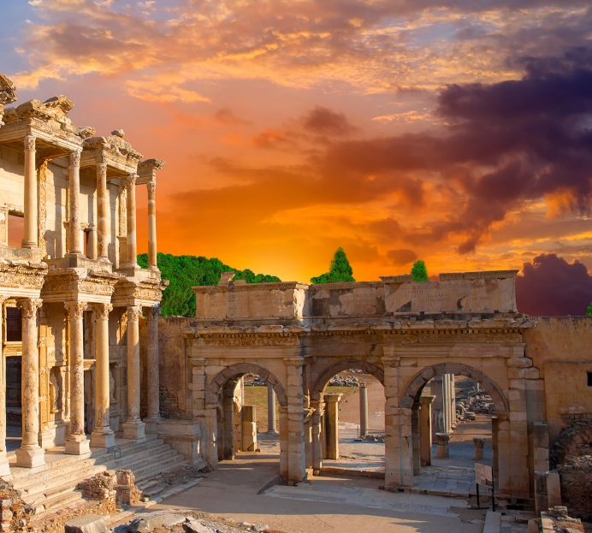
1 Corinthians 8-13
Presentation by ©http://fashionsbylynda.com/blog/

Slide 2
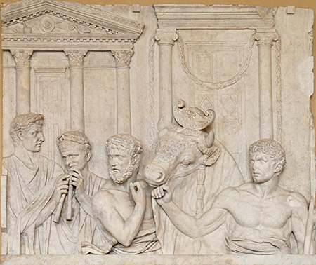
Acceptable Food to Eat
Church members in Corinth wondered if it was acceptable for them to eat food that had been offered to idols, or pagan gods.
A Roman marble relief depicting the preparation of an animal sacrifice; early second century
1 Corinthians 8:1-6

Slide 3
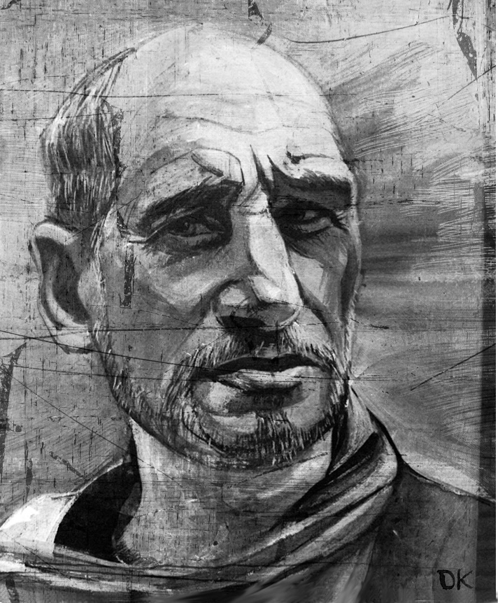
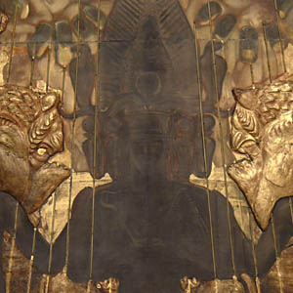
“He [Paul] replies that in theory it is completely immaterial whether the saints eat such meat or not, because idols are not true gods, and there is actually no religious significance to the pseudo-sacrifices one way or the other.
But, he reasons, in practice it may be wise not to eat this meat, since such a course might cause those who are weak in the faith to assume there was virtue and benefit in the sacrifices themselves and therefore to be led astray” (7)
The greater concern was to avoid doing anything that might weaken the faith of others, unintentionally leading them into sin.
1 Corinthians 8:1-6

Slide 4
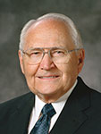
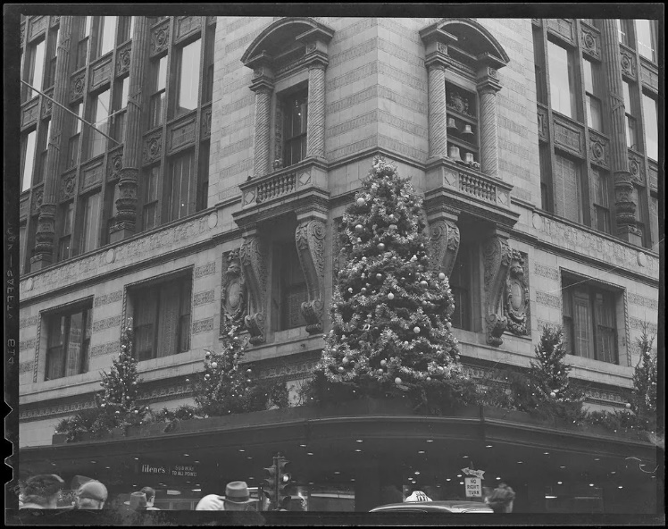
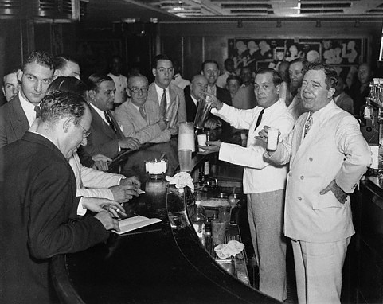
“I spent my career in the department store business. Because I was part of a management team, it was important for me to interact socially with local business organizations.
The meetings with most of these organizations always started with a cocktail hour [during which alcoholic drinks are traditionally served]. It was a time to mix and get acquainted with the men who belonged to the organization. I have always felt uncomfortable in these social hours.
At first I started asking for a lemon-lime soda. I soon discovered that lemon-lime soda looks like many of the other drinks. I could not build the impression I was a nondrinker with a clear soda in my hands”
(8)

Slide 5
“I decided I had to have a drink that would clearly mark me as a nondrinker.
The bartender had never had such a request. He went into the kitchen and found a glass of milk for me.
Now I had a drink that looked very different from the alcoholic beverages the others were drinking. …
“Milk became my drink of choice at the cocktail hours. It soon became common knowledge I was a Mormon. The respect I received really surprised me, as did an interesting event that started to occur. Others soon joined me in a pure milk cocktail!”
(8)

Slide 6
Rather Than offend
To stumble spiritually or lose faith
“Wherefore, if meat make my brother to offend, I will eat no flesh while the world standeth, lest I make my brother to offend.”
What should we do to be better examples to our friends, member or non-member?
1 Corinthians 8:7-13

Slide 7
Weak-weakness in understanding
Paul counseled:
If a Church member who was weaker in faith saw another member eat at a dining hall connected to a local pagan temple, the member of weaker faith may also believe that nothing was wrong with idol worship.
How do the nonmembers relate to the unrighteous actions of members of the church?
How might it appear for a member of the church to see another member eating or drinking something that is breaking the commandments?
What things might a member do that would weaken a nonmember from learning the gospel?

Slide 8
What can we do as members to be good examples?
In our Homes?
In the church?
Among our friends?
In our place of work?
With our technology connections?

Slide 9
Sources:
New Testament Institute Student Manual Chapter 38
For the Strength of Youth, 35
President Boyd K. Packer (“The Plan of Happiness,” Ensign or Liahona, May 2015, 26)
Chastity lds.topics.
Elder Jeffrey R. Holland Personal Purity Jan. 1999 Liahona
President Howard W. Hunter (“Being a Righteous Husband and Father,” Ensign, Nov. 1994, 51)
Elder Bruce R. McConkie (Doctrinal New Testament Commentary, 3 vols. [1966–73], 2:348).
Elder L. Tom Perry (“The Tradition of a Balanced, Righteous Life,” Ensign, Aug. 2011, 48–49).
Presentation by ©http://fashionsbylynda.com/blog/

Slide 10
Temporal Needs
1 Corinthians 9-10

Slide 11
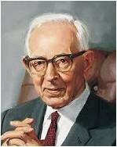
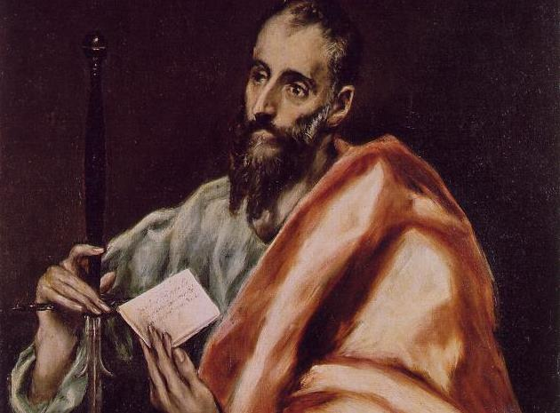
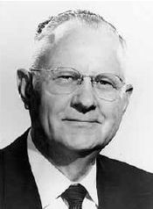
Paul Was Ordained
“We are extremely lacking in information in relation to many important details that failed to seep through the ages to our day, and we are left in darkness to know when and where Paul was ordained. …
“When he was ordained, Saul became a great defender of the faith, a dynamic teacher of righteousness, and a fearless preacher to the world.” (3)
“… The fact may be correctly surmised that Paul did find time to mingle with his brethren [of the Twelve] and that through the divine inspiration the apostleship was conferred on him by their action. …
We have no reason to believe that Paul received his ordination independent of the action of the other apostles.” (2)
1 Corinthians 9:1

Slide 12
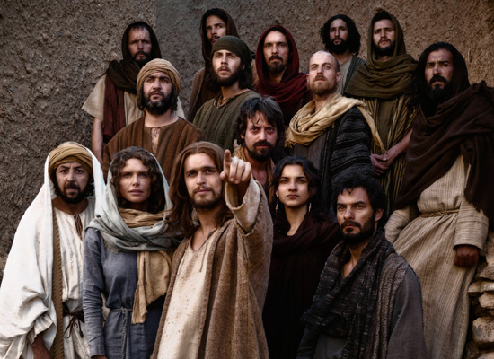
Paul Is Criticized
Women Traveling with the Apostles
Paul may be responding to criticisms that he had traveled at times with a sister missionary in his group. In his response, we learn that the other apostles, including the Lord's half-brothers and Peter, often performed missionary labors in company with their wives or other sister missionaries.
Paul saw nothing wrong with this and used it as his defense in this particular case. (4)
1 Corinthians 9:3-5

Slide 13
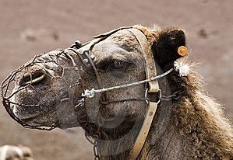
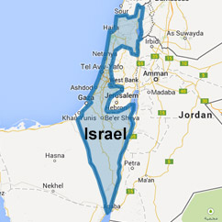
Muzzle
A muzzle was a device to keep an animal from eating or biting
"Paul was frequently criticized by his enemies, who accused him of living on the liberality of the Saints, taking food and money of them for his own advantage.
It was probably these accusations that caused him to emphasize so many times that he labored with his hands for his support." (5)
Paul's reasoning in referring to this passage from Deut. 25:4 is as follows:
If the Lord was concerned enough to command the House of Israel not to place unnecessary restrictions upon their beasts of burden, then the Corinthians should not place an unnecessary burden, or muzzle, on Paul.
1 Corinthians 9:9-11

Slide 14
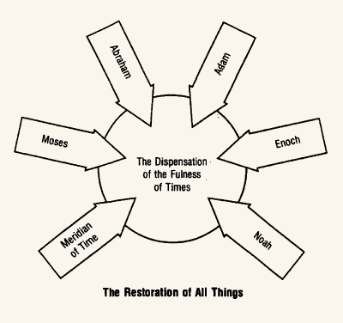
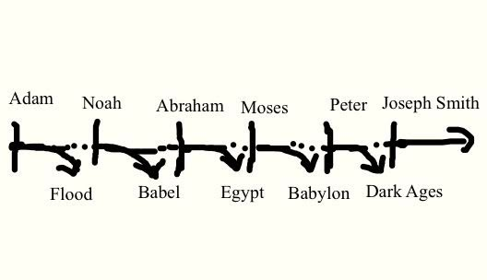
Gospel Dispensations
"Gospel dispensations are those periods of time during which the Lord reveals or dispenses the doctrines of the gospel to men so that reliance need not be placed on past ages for this saving knowledge.
If the priesthood and keys have not come down by proper descent from a previous dispensation, these also must necessarily be conferred upon men again by the opening of the heavens.
1 Corinthians 9:17
(6)

Slide 15
All Things to All Men
Paul was committed to sharing the gospel of Jesus Christ with all people, regardless of whether they were Jews or Gentiles, and he willingly adapted his behavior in order to minister more effectively to people from various cultural backgrounds. (1)
”Paul adapted himself to the conditions and circumstances of all classes of people, as a means of getting them to pay attention to his teachings and testimony.” (6)
1 Corinthians 9::20-23

Slide 16
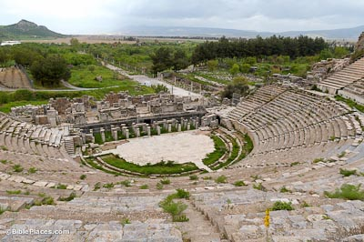
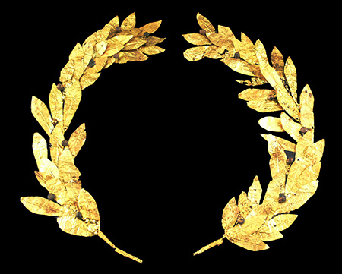
Athletic Contest
Greeks and Romans placed great importance on athletic contests. The ancient Olympic games were highly anticipated every four years throughout the Mediterranean area.
In Corinth, the Isthmian games were held every two years. Athletes competed for honor and for the winner’s crown made of natural olive, laurel, or pine branches.
Paul was probably alluding to the strict diets and training regimens that athletes adopted as they trained for competition.
1 Corinthians 9::24
(1)

Slide 17
Incorruptible Crown
Eternal Life
To obtain eternal life, we must learn to exercise self-mastery in all things
Paul suggested that followers of Jesus Christ should strive for victory in a similar manner, working to overcome temptation and achieve spiritual self-mastery.
Saints run a race not against others, but against sin and the challenges of mortal life.
And the reward is not a “corruptible” or perishable crown, but a crown of eternal life that lasts forever
1 Corinthians 9::24-25
(1)

Slide 18
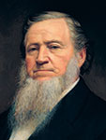
“You cannot inherit eternal life, unless your appetites are brought in subjection to the spirit that lives within you, that spirit which our Father in Heaven gave.
I mean the Father of your spirits, of those spirits which he has put into these tabernacles.
The tabernacles must be brought in subjection to the spirit perfectly, or your bodies cannot be raised to inherit eternal life. … Seek diligently, until you bring all into subjection to the law of Christ. …
“… If the spirit yields to the body, [the spirit] becomes corrupt; but if the body yields to the spirit [the body] becomes pure and holy”
(7)

Slide 19
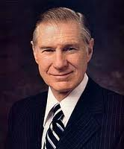
Invincible
“One of the great myths in life is when [individuals] think they are invincible. Too many think that they are [made] of steel, strong enough to withstand any temptation. They delude themselves into thinking, ‘It cannot happen to me.”
1 Corinthians 10:1-5
(8)

Slide 20
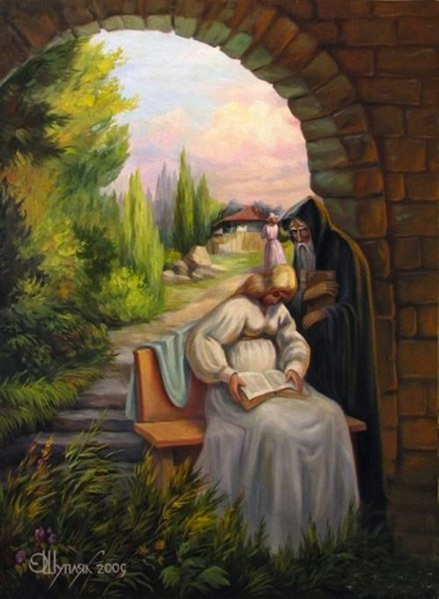
History of the Israelites
Paul referred to examples from Israelite history to warn the Corinthian Saints about temptation and sin.
Oleg Shuplyak
1 Corinthians 10:1-5
(8)

Slide 21
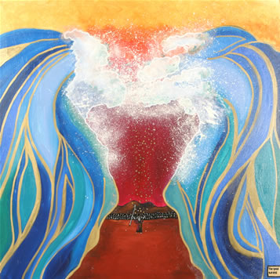
The ‘Spiritual Rock’
“[Paul] is saying that even as Israel, when they passed through the Red Sea, fled from the worldliness of Egypt, so their Christian descendants, through baptism, are to forsake the lusts of the flesh and live godly lives.”
1 Corinthians 10:1-5
(6)

Slide 22
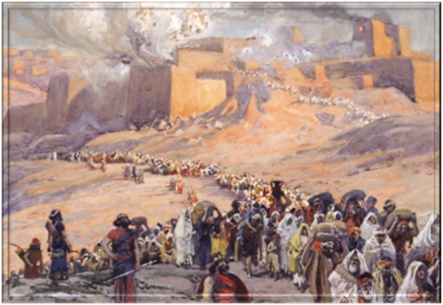
Ensamples
Paul wanted to warn the Corinthians Saints so they would avoid repeating the sins of the ancient Israelites
Paul also reassured his readers that if they would rely on the Lord, they would not be tempted beyond their strength to endure
1 Corinthians 10:5-11
(1)

Slide 23
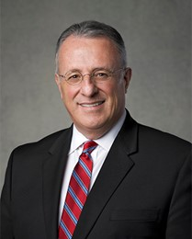
Metaphorically speaking, yielding to temptation is like approaching a magnet with a metal object.
The magnet’s invisible force attracts the metal object and holds it tightly.
The magnet loses its power over it only when the metal object is placed far from it.
Therefore, just as the magnet is unable to exercise power over a faraway metal object, as we resist temptation, it fades away and loses its power over our mind and heart and, consequently, over our actions.
(11)

Slide 24
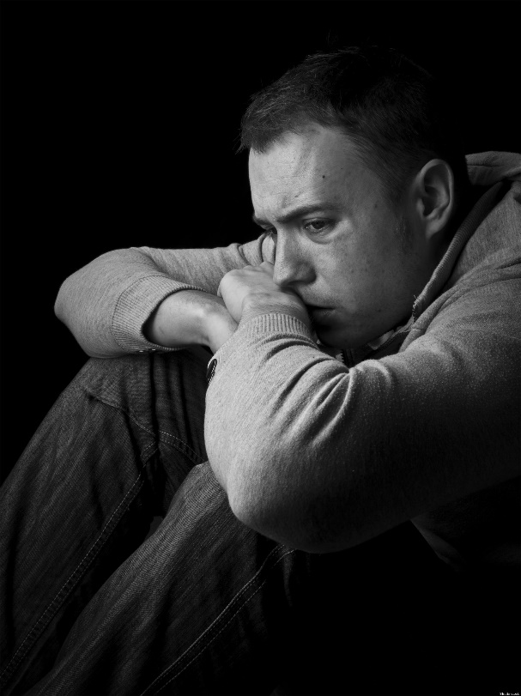
"...it is not uncommon for individuals to feel that the temptations and the trials they face are simply too much for them to manage.
Happily, we can feel overwhelmed and yet not be overwhelmed, but self-pity adds to our vulnerability. Paul gave us, therefore, a much-needed promise when he wrote this to the saints at Corinth:
"Certain temptations are common to those who come to this earth. It is our task to deal with these common temptations in an uncommon manner. The Lord has promised to succor us in our temptations, reminding us that He 'knoweth the weakness of man and how to succor them who are tempted’.
He truly knows our infirmities firsthand because He has actually borne them. “
1 Corinthians 10:5-11
(9)

Slide 25
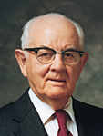
“Right decisions are easiest to make when we make them well in advance, having ultimate objectives in mind; this saves a lot of anguish [during moments of decision], when we’re tired and sorely tempted. …
“Develop discipline of self so that, more and more, you do not have to decide and redecide what you will do when you are confronted with the same temptation time and time again. You only need to decide some things once! …
“The time to quit evil ways is before they start. The secret of the good life is in protection and prevention. Those who yield to evil are usually those who have placed themselves in a vulnerable position.”
(10)

Slide 26
Able To Withstand
There hath no temptation taken you but such as is common to man: but God is faithful, who will not suffer you to be tempted above that ye are able; but will with the temptation also make a way to escape, that ye may be able to bear it.
God will provide a way for us to escape temptation, but we must choose to separate ourselves from the temptation
1 Corinthians 10:13

Slide 27
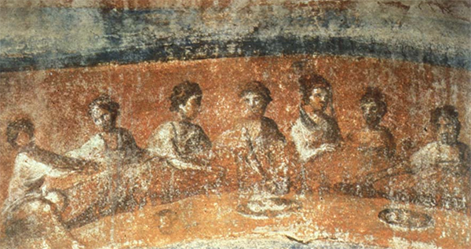
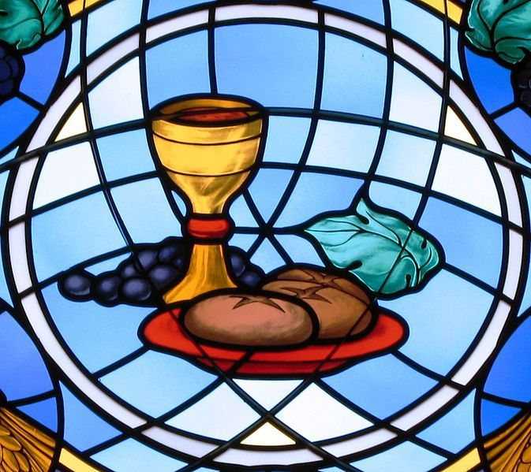
Cup and Bread of Communion
“partakers of that one bread”
In the culture of the ancient Near East, dining together at the same table was an expression of unity, peace, and friendship.
If there had been problems or disagreements among individuals before they sat down to eat, these were resolved, and all parties were reconciled.
Communion = fellowship, partnership, sharing
Sacrament symbol = a partnership with the Savior, Jesus Christ
1 Corinthians 10:16-21
(1)

Slide 28
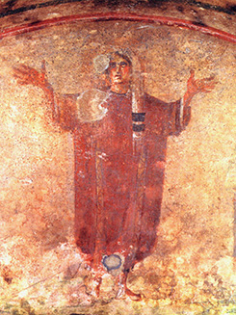
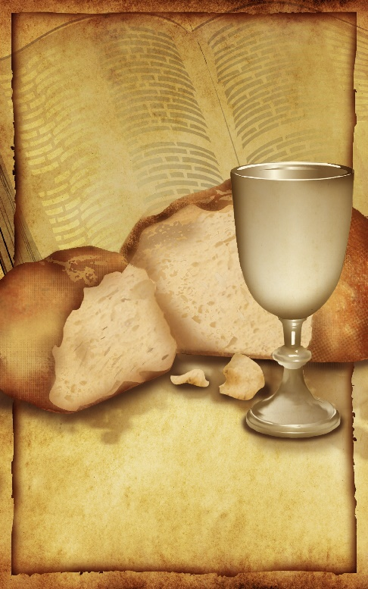
To Reconcile With Him
Partakers of the Lord’s Table
When members partake of “one bread” (loaf) during the ordinance of the sacrament, they affirm oneness or unity not only with Christ but also with one another.
They are “partakers of the Lord’s table” and have the opportunity to be reconciled with Christ and enjoy greater communion with Him.
Third century A.D. painting from the Priscilla Catacomb in Rome depicts a Christian woman praying according to custom—with her head covered with her arms lifted up
1 Corinthians 10:16-21
(1)

Slide 29
Sources:
New Testament Institute Student Manual Chapter 38
President Joseph Fielding Smith, Answers to Gospel Questions, 4:99–100. Gospel Doctrine, p. 272.)
Delbert L. Stapley Teachings of the Apostle Paul October 1976 Gen Conf.
Gospeldoctrine.com
Robert J. Matthews, Behold the Messiah [Salt Lake City: Bookcraft, 1994], 336
Bruce R. McConkie (Mormon Doctrine, 2d ed. [Salt Lake City: Bookcraft, 1966], 201.)
Doctrinal New Testament Commentary, 2:353, 2:355)).
President Brigham Young (Teachings of Presidents of the Church: Brigham Young [1997], 204–5).
Pres. James E. Faust (“It Can’t Happen to Me,” Ensign, May 2002, 46).
Elder Neal A. Maxwell (We Will Prove Them Herewith [Salt Lake City: Deseret Book Co., 1982], 41.)
Teachings of Presidents of the Church: Spencer W. Kimball [2006], 108–9
Ulisses Soares, “Seek Christ in Every Thought,” Ensign or Liahona, Nov. 2020, 83
Presentation by ©http://fashionsbylynda.com/blog/

Slide 30
First Letter of Paul to the Saints at Corinth— Written from Ephesus, ca. Spring, A.D. 57
Paul Rejoices in Christian Freedom | 9:1–12
Gospel Preached Without Cost | 9:13–18
Paul: All Things to All Men | 9:19–27
Christ Is the God of Israel | 10:1–4
Ancient Israel Rebelled Against Christ | 10:5–15
The Sacrament vs. Idolatry | 10:16–33
Paul Ordained 1 Corinthians 9:1:
Many have not understood that Saul joined the Church in addition to gaining a testimony of Christ, and was consequently obedient to church authorities as well as to the Savior; many mistakenly assume that the two allegiances can conflict. These people think that Saul was independent from the church and had sufficient authority from his vision to perform his new duties.
Instead, we see that after being healed, Saul submitted to baptism (see Acts 9:18), later went to Tarsus as commanded by “the brethren” (see Acts 9:30), went to Antioch under the direction of Barnabas (see Acts 11:26), and went on his missionary journey after being set apart and commissioned by the church authorities.
Although Saul represented the gentile churches as their leader in the Jerusalem Council.
The New Testament gives no record of Paul’s ordination, yet there are strong indications that he received his office at the end of his second journey. Although Barnabas and Paul are called apostles in Acts 14:4 and Acts 14:14 the term there likely refers to a missionary calling, since they were set apart by men who were not members of the Twelve. In his two letters to the Thessalonian saints, written from Corinth during the second journey, Paul does not refer to himself as an apostle in the introduction. Beginning with the correspondence of the third journey, however, Paul begins his epistles with “Paul, an Apostle of Jesus Christ” or some similarly worded phrase. (The exceptions are Philippians and Philemon, written from Rome during Paul’s imprisonment.) Further evidence may be seen in the Corinthian letters, written during the third journey, in which Paul defends his apostolic calling to a church that may still remember him as not being an apostle during his 18-month Stay in the second journey. Paul: The Long Road from Damascus
By C. Wilfred Griggs Sept. 1975 Ensign
Life and Teachings of Jesus and His Apostles Chapter 35
Contention: 1 Corinthians:
Many years ago I read the following Associated Press dispatch which appeared in the newspaper: An elderly man disclosed at the funeral of his brother, with whom he had shared, from early manhood, a small, one-room cabin near Canisteo, New York, that following a quarrel, they had divided the room in half with a chalk line, and neither had crossed the line or spoken a word to the other since that day—62 years before. Just think of the consequence of that anger. What a tragedy!
May we make a conscious decision, each time such a decision must be made, to refrain from anger and to leave unsaid the harsh and hurtful things we may be tempted to say.
President Thomas S. Monson School Thy Feelings, Oh My Brother Oct. 2009 Gen. Conf.
“Gospel Dispensation 1 Corinthians 9:17:
Since the gospel, 'the power of God unto salvation' (Rom. 1:16), was first revealed to Adam, we speak of the Adamic dispensation as the first from the standpoint of time. (Moses 5:57-59.) Thereafter, the saving knowledge and powers of the gospel, as Paul expressed it, were 'revealed from faith to faith' (Rom. 1:17), that is from era of faith to era of faith or from dispensation to dispensation...
"When we speak of the great gospel dispensations, we generally have in mind those given to Adam, Enoch (Moses 6; 7), Noah (Moses 8), Abraham (Abra. 2:6-11; Gal. 3:6-8, 18) Moses (D. & C. 84:17-28); the apostles in the meridian of time (Matt. 16:18-19; 18:18; D. & C. 27:12-13; 128:20), and to Joseph Smith and his associates, (D. & C. 112:14-32.) The keys and powers exercised by the Lord's prophets in each of these ancient dispensations have been conferred upon men in this final dispensation, for in 'the fulness of times,' the Lord says, 'I will gather together in one all things, both which are in heaven, and which are on earth.' (D. & C. 27:13; Eph. 1:10.)" Bruce R. McConkie (Mormon Doctrine, 2d ed. [Salt Lake City: Bookcraft, 1966], 201.)

Slide 31
Athletic Contests 1 Corinthians 9:24-27:
"Among the Greeks the rage for theatrical exhibitions was such that every city of any size possessed its theatre and stadium. At Ephesus an annual contest was held in honor of Diana. It is probable that St. Paul was present when these games were proceeding. A direct reference to the exhibitions that took place on such occasions is made in 1 Cor. 15:32; St. Paul's epistles abound with allusions to the Greek contests, borrowed probably from the Isthmian games, at which he may well have been present during his first visit to Corinth...The contests took place in the presence of a vast multitude of spectators, Hebrews 12:1; the competitors being the spectacle. 1 Cor. 4:9; Hebrews 10:33; The games were opened by the proclamation of a herald, 1 Cor. 9:27; whose office it was to give out the name and country of each candidate, and especially to announce the name of the victor before the assembled multitude. The judge was selected for his spotless integrity; 2 Timothy 4:8; his office was to decide any disputes, Colossians 3:15; and to give the prize, 1 Cor. 9:24; Philip. 3:14; consisting of a crown, 2 Timothy 2:6; 2 Timothy 4:8; of leaves of wild olive at the Olympic games, and of pine, or at one period ivy, at the Isthmian games. St. Paul alludes to two only out of the five contests, boxing and running, more frequently to the latter." (William Smith, Dictionary of the Bible, "Games")
Those Who May Be Tempted 1 Corinthians 10:13:
“With the help of the Holy Ghost, we can watch over ourselves. We can pray to recognize and reject the first thoughts of sin. … And we can, when we must, pray for the humility and the faith to repent.
“There will surely be some who hear my voice who will have this thought come into their minds: ‘But the temptations are too great for me. I have resisted as long as I can. For me, the commandments are too hard. The standard is too high.’
“That is not so. The Savior is our Advocate with the Father. He knows our weaknesses. He knows how to succor those who are tempted” Pres. Herny B. Eyring (“As a Child,” Ensign or Liahona, May 2006, 17).
Test of Mortal Life 1 Corinthians 9:27:
“In the premortal world before we left the presence of Heavenly Father, He warned and cautioned us about new experiences we would have in mortality. We knew that we would have a physical body of flesh and bone. Never having been mortal before, we had no experience dealing with the temptations of mortality. But Heavenly Father knew and understood. He charged us to control our mortal bodies and to make them subject to our spirits. Our spirits would have to master the physical temptations that our bodies would encounter in a temporal world. Spiritual power over the influence of Satan comes to us by keeping the commandments of our Lord, Jesus Christ” Elder M. Russell Ballard (“Keeping Covenants,” Ensign, May 1993, 6).
Temptation 1 Corinthians 10:5-11: Fighting against temptation takes a lifetime of diligence and faithfulness. But please know that the Lord is ready to assist us in our personal efforts and promises remarkable blessings if we endure to the end. …
My beloved brothers and sisters, I testify that as we rely upon the rock of salvation, the Savior of our souls, … our ability to control our thoughts will increase significantly. I can assure you that our spiritual maturity will grow at an increasing pace, changing our heart, making us more like Jesus Christ. Additionally, the influence of the Holy Ghost will be more intense and continuous in our life. Then the enemy’s temptations, little by little, will lose their power over us, resulting in a happier and more pure and consecrated life.
For those who, for whatever reason, fall into temptation and are dwelling upon unrighteous actions, I assure you that there is a way back, that there is hope in Christ.
(Ulisses Soares, “Seek Christ in Every Thought,” Ensign or Liahona, Nov. 2020, 83–84)
A Spiritual Rock 1 Corinthians 10:1-5:
"In the wilderness of Zin, the Israelites ran out of water to drink and once again began to murmur to Moses. By command of the Lord, Moses and Aaron gathered the people before a rock, Moses smote it, water came forth, and Israel lived (see Exod. 17:1-7). At the well in Samaria, Jesus told the woman of the 'living water' he could give, which, if partaken of, would become 'a well of water springing up into everlasting life' (John 4:14). In the closing parable of the Sermon on the Mount, Jesus likened his teachings to a rock. Moses and other Old Testament prophets called Jehovah the Rock of salvation (see, for example, Deut. 32:4, Deut. 32:15, Deut. 32:18; Sam. 22:32, Sam. 22:47; Ps. 18:2, Ps. 18:31, Ps. 18:46). Thus we see that when Israel hungered they were fed the bread that came down from heaven and when they thirsted they received the waters of life from the Rock." Gerald N. Lund (Neal A. Lambert, ed., Literature of Belief: Sacred Scripture and Religious Experience [Provo: BYU Religious Studies Center, 1981], 56.)
Temptation 1 Corinthians 10:5-11: A principle of eternal progression is that exercising self-control and living righteously strengthen our ability to resist temptation. This is true both in the spiritual realm and in temporal matters. …
As part of God’s divine plan, we are blessed with the gift of the Holy Ghost. … He also is a voice of warning against evil and a voice of protection against danger. As we navigate the seas of life, following the impressions of the Holy Ghost is essential. The Spirit will help us avoid temptations and dangers, and comfort and lead us through challenges.
(Quentin L. Cook, “Shipshape and Bristol Fashion: Be Temple Worthy—in Good Times and Bad Times,” Ensign or Liahona, Nov. 2015, 41–42)

Slide 32
Equal in God’s Eye
1 Corinthians 11

Slide 33
Common Feelings About Marriage
“I don’t want to commit to a long-term relationship. I worry about making a decision that I will later regret.”
“Being successful in my career is everything to me.
I don’t want to divide my attention between my career goals and my marriage.”
“Marriage would tie me down. I wouldn’t be able to do whatever I wanted.”
“I know that marriage is the most important decision I will ever make, and I look forward to it.”
How Do You Feel About Marriage?

Slide 34
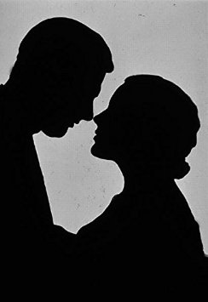
The Institution of Marriage
“The house of the Lord is a house of order and not a house of confusion; and that means that the man is not without the woman in the Lord, neither is the woman without the man in the Lord; and that no man can be saved and exalted in the kingdom of God without the woman, and no woman can reach the perfection and exaltation in the kingdom of God alone.
God instituted marriage in the beginning.
He made man in his own image and likeness, male and female, and in their creation it was designed that they should be united together in sacred bonds of marriage, and one is not perfect without the other.
Furthermore, it means that there is no union for time and eternity that can be perfected outside of the law of God, and the order of his house.
Men may desire it, they may go through the form of it, in this life, but it will be of no effect except it be done and sanctioned by divine authority, in the name of the Father and of the Son and of the Holy Ghost.”
1 Corinthians 11:11
(2)

Slide 35
Doctrinal Mastery
1 Corinthians 11:11
Nevertheless neither is the man without the woman, neither the woman without the man, in the Lord.

Slide 36
The Roles
“the head of the woman is the man” = the husband has the sacred responsibility of presiding in the home.
To preside means to righteously lead and guide others in spiritual and temporal matters.
Who is to preside over and guide the husband as he presides in his family?
Some readers of the New Testament misunderstand Paul’s teachings to mean that the man’s role is more important than the woman’s role or that the man is superior to or of more worth than the woman
1 Corinthians 11:11

Slide 37
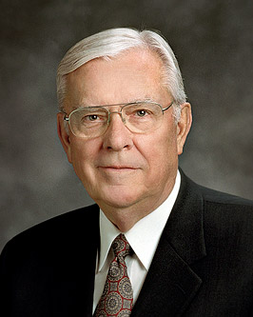
“Men and women are equal in God’s eyes and in the eyes of the Church, but equal does not mean they are the same.
The responsibilities and divine gifts of men and women differ in their nature but not in their importance or influence.
Our Church doctrine places women equal to and yet different from men. God does not regard either gender as better or more important than the other.”
1 Corinthians 11:11
(2)

Slide 38
The Lord’s Plan
Nevertheless neither is the man without the woman, neither the woman without the man, in the Lord.
In the Lord’s plan, men and women cannot obtain eternal life without each other.
1 Corinthians 11:11

Slide 39
Happiness in family life is most likely to be achieved when founded upon the teachings of the Lord Jesus Christ.
Successful marriages and families are established and maintained on principles of faith, prayer, repentance, forgiveness, respect, love, compassion, work, and wholesome recreational activities.
By divine design, fathers are to preside over their families in love and righteousness and are responsible to provide the necessities of life and protection for their families.
Mothers are primarily responsible for the nurture of their children.
In these sacred responsibilities, fathers and mothers are obligated to help one another as equal partners.
(9)

Slide 40
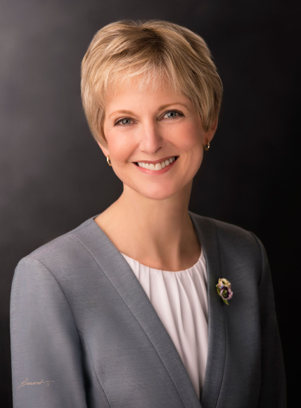
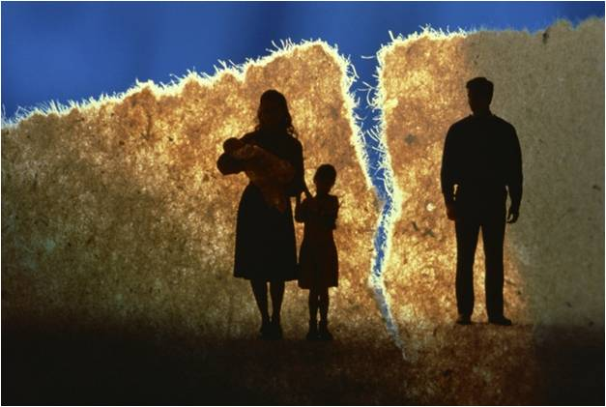
Dividing Husbands and Wives
The adversary has been quite successful in his goal to divide men and women in his attempts to conquer our souls.
Lucifer knows that if he can damage the unity men and women feel, if he can confuse us about our divine worth and covenant responsibilities, he will succeed in destroying families, which are the essential units of eternity.
Satan incites comparison as a tool to create feelings of being superior or inferior, hiding the eternal truth that men’s and women’s innate differences are God given and equally valued.
He has attempted to demean women’s contributions both to the family and in civil society, thereby decreasing their uplifting influence for good.
His goal has been to foster a power struggle rather than a celebration of the unique contributions of men and women that complement one another and contribute to unity.
(10)

Slide 41
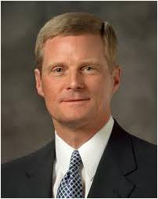
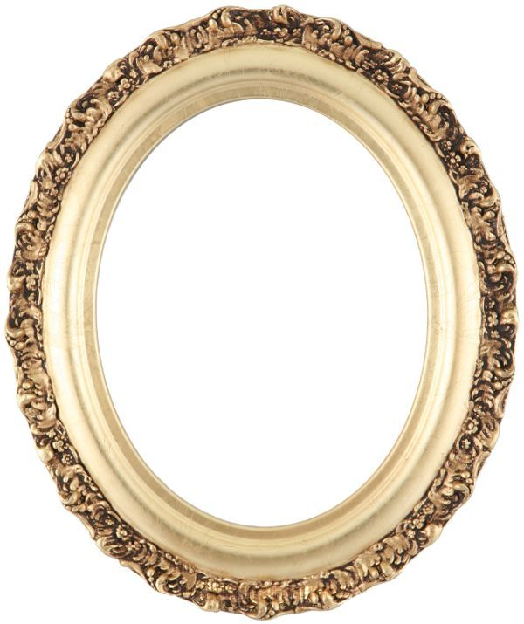
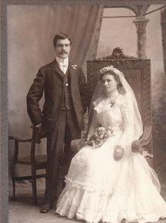
“By divine design, men and women are intended to progress together toward perfection and a fulness of glory. Because of their distinctive temperaments and capacities, males and females each bring to a marriage relationship unique perspectives and experiences.
The man and the woman contribute differently but equally to a oneness and a unity that can be achieved in no other way.
The man completes and perfects the woman and the woman completes and perfects the man as they learn from and mutually strengthen and bless each other.”
1 Corinthians 11:11
(3)

Slide 42
Power of the Sacrament
1 Corinthians 11: 23-31

Slide 43
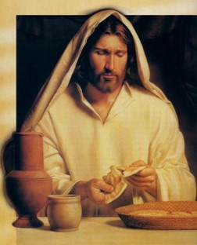
Remembrance—the body
“For I have received of the Lord that which also I delivered unto you, that the Lord Jesus the same night in which he was betrayed took bread:
…and when he had given thanks, he brake it, and said, Take, eat: this is my body, which is broken for you: this do in remembrance of me.”
1 Corinthians 11:23-24

Slide 44
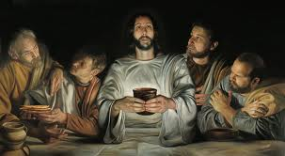
Remembrance—the blood
“After the same manner also he took the cup, when he had supped, saying, This cup is the new testament in my blood: this do ye, as oft as ye drink it in remembrance of me.
“For as often as ye eat this bread, and drink this cup, ye do shew the Lord’s death till he come.”
1 Corinthians 11:25-26

Slide 45
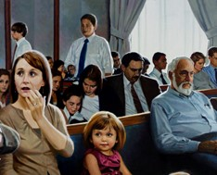
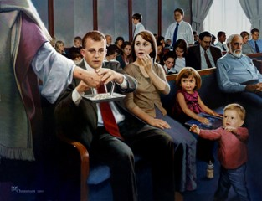
Which is more important?
What we take for the sacrament…
…or how prepared we are to partake of the sacrament?

Slide 46
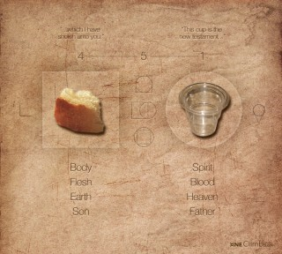
Importance of Sacrament
“For behold, I say unto you, that it mattereth not what ye shall eat or what ye shall drink when ye partake of the sacrament…
…if it so be that ye do it with an eye single to my glory---remembering…
D&C 27:2

Slide 47
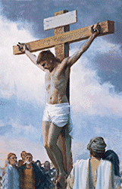
…unto the Father my body which was laid down for you…
…and my blood which was shed for the remission of your sins.”
D&C 27:2

Slide 48
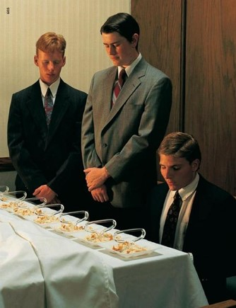
Sacramental Covenants
Eat and Do in Remembrance:
Witness unto thee
Willing to take upon them the name of thy Son
Always remember him and keep his commandments
Always have his Spirit to be with them
D&C 20:77-78

Slide 49
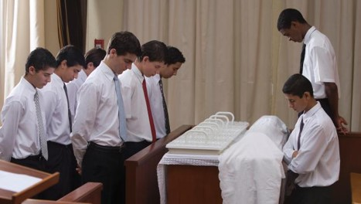
Sacramental Ordinance
The sacrament is the only ordinance we experience for ourselves more than once.

Slide 50
“The partaking of these emblems constitutes one of the most holy and sacred odinances in the Church”
(4)

Slide 51
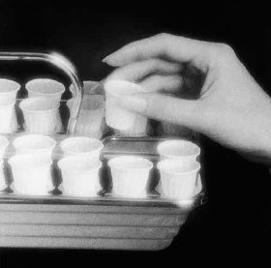
Warnings from Paul
“Wherefore, whosoever shall eat this bread, and drink this cup of the Lord, unworthily, shall be guilty of the body and blood of the Lord.”
1 Corinthians 11:27-31

Slide 52
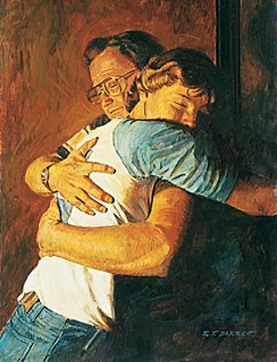
Warnings to Nephites
“For whoso eateth and drinketh my flesh and blood unworthily eateth and drinketh damnation to his soul…”
Nevertheless…
…ye shall not cast him our from among you, but ye shall minister unto him and shall pray for him.”
3 Nephi 18: 29-32

Slide 53
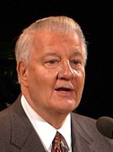
“If we desire to improve (which is to repent) and are not under priesthood restriction, then, in my opinion, we are worthy….
If, however, we refuse to repent and improve, if we do not remember him and keep his commandments, then we have stopped our growth…
The sacrament is an intensely personal experience, and we are the ones who knowingly are worthy or otherwise.”
(6)

Slide 54
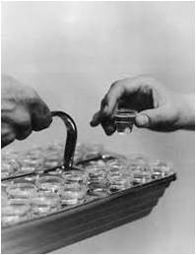
How Do You Know If You Are Worthy?
If we partake of the sacrament while living in serious sin or with an unrepentant heart, having no desire to remember and follow the Savior, we are partaking of the sacrament unworthily.
We “do not need to be perfect in order to partake of the sacrament, but [we] should have a spirit of humility and repentance in [our] heart.”
(7)

Slide 55
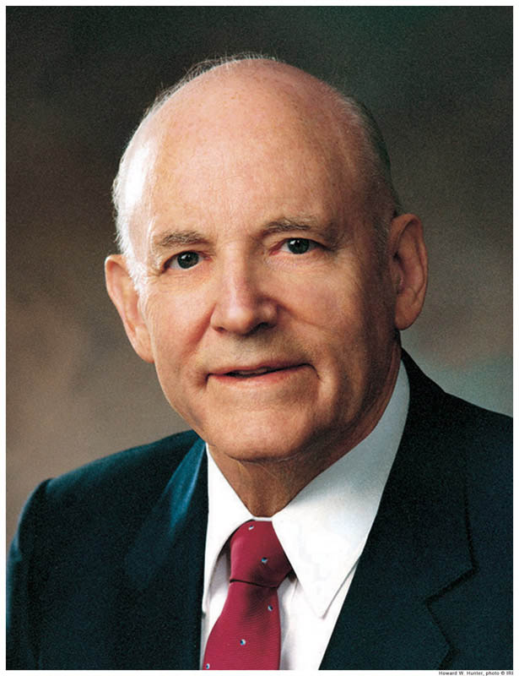
I asked myself this question: ‘Do I place God above all other things and keep all of His commandments?’ Then came reflection and resolution.
To make a covenant with the Lord to always keep His commandments is a serious obligation, and to renew that covenant by partaking of the sacrament is equally serious.
The solemn moments of thought while the sacrament is being served have great significance. They are moments of self-examination, introspection, self-discernment—a time to reflect and to resolve.”
(8)

Slide 56
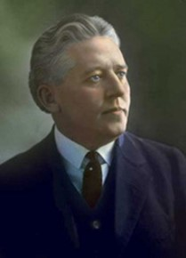
“If we have sincerely repented and put ourselves in proper condition, we shall be forgiven, and spiritual healing will come to our souls.”
(5)

Slide 57
The Sacred Nature and Power of the Sacrament in our lives is determined by your worthiness to partake…renew covenants with the Lord…and receive all the blessings the Lord has to offer.

Slide 58
Sources:
New Testament Institute Student Manual Chapter 38
Elder M. Russell Ballard “Men and Women in the Work of the Lord,” New Era, Apr. 2014, 4).
Elder David A. Bednar “Marriage Is Essential to His Eternal Plan,” Ensign, June 2006, 83–84).
Joseph Fielding Smith—”Doctrines of Salvation, 2:339
Elder Melvin J. Ballard “The Sacramental Covenant” New Era, Jan. 1976, 8
Elder John H. Groberg “The Beauty and the Importance of the Sacrament” Conference Report Apr. 1989, 49-50; or Ensign, May 1989
(True to the Faith: A Gospel Reference [2004], 148).
President Howard W. Hunter (“Thoughts on the Sacrament,” Ensign, May 1977, 25).er and follow the Savior, we are partaking of the sacrament unworthily.
“The Family: A Proclamation to the World,” ChurchofJesusChrist.org
Jean B. Bingham, “United in Accomplishing God’s Work,” Ensign or Liahona, May 2020, 60–61
Presentation by ©http://fashionsbylynda.com/blog/

Slide 59
First Letter of Paul to the Saints at Corinth— Written from Ephesus, ca. Spring, A.D. 57
The Status of Man and Woman | 11:1–16
Why We Partake of the Sacrament | 11:17–34
1 Corinthians 11: “A man who holds the priesthood accepts his wife as a partner in the leadership of the home and family with full knowledge of and full participation in all decisions relating thereto. Of necessity there must be in the Church and in the home a presiding officer (see D&C 107:21). By divine appointment, the responsibility to preside in the home rests upon the priesthood holder (see Moses 4:22). The Lord intended that the wife be a helpmeet for man (meet means equal)—that is, a companion equal and necessary in full partnership. Presiding in righteousness necessitates a shared responsibility between husband and wife; together you act with knowledge and participation in all family matters. For a man to operate independent of or without regard to the feelings and counsel of his wife in governing the family is to exercise unrighteous dominion” President Howard W. Hunter (“Being a Righteous Husband and Father,” Ensign ,Nov. 1994, 50–51.)
Life and Teachings of Jesus and His Apostles Chapter 35
Woman and Man 1 Corinthians 11:11:
“The house of the Lord is a house of order and not a house of confusion; and that means that the man is not without the woman in the Lord, neither is the woman without the man in the Lord; and that no man can be saved and exalted in the kingdom of God without the woman, and no woman can reach the perfection and exaltation in the kingdom of God alone. That is what it means. God instituted marriage in the beginning. He made man in his own image and likeness, male and female, and in their creation it was designed that they should be united together in sacred bonds of marriage, and one is not perfect without the other. Furthermore, it means that there is no union for time and eternity that can be perfected outside of the law of God, and the order of his house. Men may desire it, they may go through the form of it, in this life, but it will be of no effect except it be done and sanctioned by divine authority, in the name of the Father and of the Son and of the Holy Ghost.” (Joseph Fielding Smith, Gospel Doctrine, p. 272.)
1 Corinthians 11:11: In our Heavenly Father’s great priesthood-endowed plan, men have the unique responsibility to administer the priesthood, but they are not the priesthood. Men and women have different but equally valued roles. Just as a woman cannot conceive a child without a man, so a man cannot fully exercise the power of the priesthood to establish an eternal family without a woman. … In the eternal perspective, both the procreative power and the priesthood power are shared by husband and wife.
(M. Russell Ballard, “This Is My Work and Glory,” Ensign or Liahona, May 2013, 19)
1 Corinthians 11:11 males and females: The unique combination of spiritual, physical, mental, and emotional capacities of both males and females was needed to enact the plan of happiness. “Neither is the man without the woman, neither the woman without the man, in the Lord” ( 1 Corinthians 11:11). The man and the woman are intended to learn from, strengthen, bless, and complete each other.
(David A. Bednar, “We Believe in Being Chaste,” Ensign or Liahona, May 2013, 41–42)
Roles of Men and Women:
“In our Heavenly Father’s great priesthood-endowed plan, men have the unique responsibility to administer the priesthood, but they are not the priesthood. Men and women have different but equally valued roles. Just as a woman cannot conceive a child without a man, so a man cannot fully exercise the power of the priesthood to establish an eternal family without a woman. … In the eternal perspective, both the procreative power and the priesthood power are shared by husband and wife” Elder M. Russell Ballard “This Is My Work and Glory,” Ensign or Liahona, May 2013, 19).
The Sacrament: 1 Corinthians 11:23
“We want every Latter-day Saint to come to the sacrament table because it is the place for self-investigation, for self-introspection, where we may learn to rectify our course and make right our own lives, bringing ourselves into harmony with the teachings of the Church and with our brethren and sisters. It is the place where we become our own judges. …
“… The one thing that would make for the safety of every man and woman would be to appear at the sacrament table every Sabbath day. We would not get very far away in one week—not so far away that, by the process of self-investigation, we could not rectify the wrongs we may have done. … The road to the sacrament table is the path of safety for Latter-day Saints” (Bryant S. Hinckley, Sermons and Missionary Services of Melvin Joseph Ballard [1949], 150–51).

Slide 60
Gifts of the Spirit
But the manifestation of the Spirit is given to every man to profit withal.
1 Corinthians 12:7
1 Corinthians 12
1 Corinthians 12

Slide 61
President David O. McKay was serving a mission in Scotland, he saw this stone above the door of a building near Stirling Castle and was inspired by its message.
If any of these shapes were rearranged or if their values changed, the rows and columns on the stone would no longer add up to 18 in every direction.
Each symbol in the nine squares of this stone represents a numerical value.
From left to right, the symbols represent 5, 10, and 3 in the top row; 4, 6, and 8 in the middle row; and 9, 2, and 7 in the bottom row.
What is the sum of the three numbers represented in the top row? the middle row? the bottom row?
Consider:
we as members of the Church are like the shapes on the stone.
18
(2)

Slide 62
Gifts of the Spirit
Wherefore I give you to understand, that no man speaking by the Spirit of God calleth Jesus accursed: and that no man can say that Jesus is the Lord, but by the Holy Ghost.
“Say” Should Be “Know”
(3)
How can we obtain a personal testimony of Jesus Christ?
1 Corinthians 12
Only through the Holy Ghost can we obtain a personal testimony that Jesus Christ is our Savior
1 Corinthians 12:3

Slide 63
“A testimony is a most precious possession because it is not acquired by logic or reason alone, it cannot be purchased with earthly possessions, and it cannot be given as a present or inherited from our ancestors.
We cannot depend on the testimonies of other people.
We need to know for ourselves.
President Gordon B. Hinckley said, ‘Every Latter-day Saint has the responsibility to know for himself or herself with a certainty beyond doubt that Jesus is the resurrected, living Son of the living God’
Greg Olsen
“We receive this testimony when the Holy Spirit speaks to the spirit within us. We will receive a calm and unwavering certainty that will be the source of our testimony and conviction.”
Elspeth C. Young
(4)

Slide 64
“Every good gift and every perfect gift is from above, and cometh down from the Father of lights…”
—James 1:17
1 Corinthians 12
The Lord gives each member of His Church at least one spiritual gift to bless others with.
1 Corinthians 12
1 Corinthians 12:4-6

Slide 65
Spiritual Gifts
“For all have not every gift given unto them; for there are many gifts, and to every man is given a gift by the Spirit of God.”
D&C 46:11
1 Corinthians 12
“Now there are diversities of gifts, but the same Spirit.”
1 Corinthians 12:4

Slide 66
Manifestations of the Spirit-Paul
1 Corinthians 12
The word of wisdom
Knowledge
Faith—healing, working miracles and prophecy
Discerning of tongues
Good judgment and the appropriate application of knowledge
A knowledge of God and his laws;
Recognizing truth and untruth and perceiving the good and evil in others;
The ability to speak in foreign or unknown languages.
1 Corinthians 12:4-11

Slide 67
Manifestation of the Spirit—Marvin J. Ashton
Less conspicuous gifts
The gift of asking
The gift of listening
1 Corinthians 12
?
1 Corinthians 12
I hear what you are saying
The gift of hearing—a still, small voice
1 Corinthians 12
1 Corinthians 12
I hear you
The gift of being able to weep
I’m sorry
(5)

Slide 68
1 Corinthians 12
I agree
The gift of avoiding contention
1 Corinthians 12
That could work
The gift of being agreeable
The gift of avoiding vain repetition
The gift of seeking that which is righteous
1 Corinthians 12
1 Corinthians 12
Bla Bla
Bla Bla
Bla
CTR
(5)

Slide 69
1 Corinthians 12
Can you help me?
The gift of not passing judgment
1 Corinthians 12
He is such a nice person
The gift of looking to God for guidance
The gift of being a disciple
The gift of caring for others
1 Corinthians 12
1 Corinthians 12
I am trying to be like Jesus
Do you need any help?
(5)

Slide 70
1 Corinthians 12
The gift of being able to ponder
I’d be glad to say the prayer
1 Corinthians 12
The gift of offering prayer
The gift of bearing a mighty testimony
1 Corinthians 12
I feel what I am doing is right
1 Corinthians 12
I know
The gift of receiving the Holy Ghost
(5)

Slide 71
“Neglect not the gift that is in thee, which was given thee by prophecy, with the laying on of the hands of the presbytery {priesthood}.” 1 Timothy 4:14
See: “Songs Sung and Unsung” (11)
1 Corinthians 12
“Every Good Gift and every perfect gift is from above…”

Slide 72
“But covet earnestly the best gifts: and yet shew I unto you a more excellent way.”
1 Corinthians 12:31

Slide 73
1 Corinthians 12
As we use our unique spiritual gifts to serve others, we can strengthen the Church.
“We are all in this great endeavor together.
We are here to assist our Father in His work and His glory, ‘to bring to pass the immortality and eternal life of man’ (Moses 1:39).
Your obligation is as serious in your sphere of responsibility as is my obligation in my sphere. No calling in this church is small or of little consequence.
All of us in the pursuit of our duty touch the lives of others.”
(6)

Slide 74
1 Corinthians 12
Faith
Hope & Charity
Paul taught that of the spiritual gifts of faith, hope, and charity, the greatest is charity.

Slide 75
“And though I have the gift of prophecy, and understand all mysteries, and all knowledge; and though I have all faith, so that I could remove mountains, and have not charity, I am nothing.”
—1 Corinthians 13:2

Slide 76
How do you feel about Heavenly Father and Jesus Christ, knowing that They have blessed you with a spiritual gift?
How can knowing you have been given a spiritual gift influence how you view your divine identity?
Why do you think God gives spiritual gifts to every Church member and not to just a few members?
What is a spiritual gift you desire? What can you do to seek that gift?
What are some ways you can use your spiritual gifts to bless others?

Slide 77
When I think of the Savior, I often picture Him with hands outstretched, reaching out to comfort, heal, bless, and love. And He always talked with, never down to, people.
He loved the humble and the meek and walked among them, ministering to them and offering hope and salvation.
That is what He did during His mortal life; it is what He would be doing if He were living among us today; and it is what we should be doing as His disciples and members of The Church of Jesus Christ of Latter-day Saints. …
As we emulate His perfect example, our hands can become His hands; our eyes, His eyes; our heart, His heart.
(4)

Slide 78
Sources:
New Testament Institute Student Manual Chapter 39
David O. McKay (see Francis M. Gibbons, David O. McKay: Apostle to the World, Prophet of God [1986], 45).
Joseph Smith History of the Church, 4:602–3
President Dieter F. Uchtdorf (‘Fear Not to Do Good,’ Ensign, May 1983, 80). (“The Power of a Personal Testimony,” Ensign or Liahona, Nov. 2006, 38; “You Are My Hands,” Ensign or Liahona, May 2010, 68
Marvin J. Ashton Conference Report, Oct. 1987, or Ensign, Nov. 1987
President Gordon B. Hinckley (“This Is the Work of the Master,” Ensign, May 1995, 71).
https://www.youtube.com/watch?v=VlB0WoF18V0 Songs Unsung Video
Presentation by ©http://fashionsbylynda.com/blog/

Slide 79
First Letter of Paul to the Saints at Corinth— Written from Ephesus, ca. Spring, A.D. 57
The Holy Ghost Bears Witness of Christ | 12:1–3
Spiritual Gifts of the Church | 12:4–11
The Importance of Each Member | 12:12–31
To Find Spiritual Gifts 1 Corinthians 12:7:
“To find the gifts we have been given, we must pray and fast. Often patriarchal blessings tell us the gifts we have received and declare the promise of gifts we can receive if we seek after them. I urge you each to discover your gifts and to seek after those that will bring direction to your life’s work and that will further the work of heaven.” Elder Robert D. Hales (“Gifts of the Spirit,” Ensign, Feb. 2002, 16).
Feeling Inadequate? 1 Corinthians 12:22:
“You may feel that there are others who are more capable or more experienced who could fulfill your callings and assignments better than you can, but the Lord gave you your responsibilities for a reason. There may be people and hearts only you can reach and touch. Perhaps no one else could do it in quite the same way.” President Dieter F. Uchtdorf (“Lift Where You Stand,” Ensign or Liahona, Nov. 2008, 56).
Life and Teachings of Jesus and His Apostles Chapter 36
Something of Interest
David O. McKay: In 1897 a young David O. McKay stood at a door with a religious tract in his hand. As a missionary in Stirling, Scotland, he had done this many times before. But on that day a very haggard woman opened the door and stood before him. She was poorly dressed and had sunken cheeks and unkempt hair.
She took the tract Elder McKay offered to her and spoke six words that he subsequently would never forget: “Will this buy me any bread?”
This encounter left a lasting impression on the young missionary. He later wrote: “From that moment I had a deeper realization that the Church of Christ should be and is interested in the temporal salvation of man. I walked away from the door feeling that that [woman], with … bitterness in [her heart] toward man and God, [was] in no position to receive the message of the gospel. [She was] in need of temporal help, and there was no organization, so far as I could learn, in Stirling that could give it to [her].”...
A few decades later the world groaned under the burden of the Great Depression. It was during that time, on April 6, 1936, that President Heber J. Grant and his counselors, J. Reuben Clark and David O. McKay, announced what would later become known as the welfare program of the Church of Jesus Christ of Latter-Day Saints.
Posted by: http://riseaboveyourlimits.blogspot.com/2011/11/have-or-have-not.html
Unity 1 Corinthians 12:25:
"Within this Church there is a constant need for unity, for if we are not one, we are not his. (See D&C 38:27.) We are truly dependent on each other, 'and the eye cannot say unto the hand, I have no need of thee: nor again the head to the feet, I have no need of you.' (1 Cor. 12:21.) Nor can the North Americans say to the Asians, nor the Europeans to the islanders of the sea, 'I have no need of thee.' No, in this church we have need of every member, and we pray, as did Paul when he wrote to the church in Corinth, 'that there should be no schism in the body; but that the members should have the same care one for another.
"It is unity and oneness that has thus far enabled us to bear our testimony around the globe, bringing forward tens of thousands of missionaries to do their part. More must be done. It is unity that has thus far enabled the Church, its wards and stakes, branches and districts, and members, to construct temples and chapels, undertake welfare projects, seek after the dead, watch over the Church, and build faith. More must be done. These great purposes of the Lord could not have been achieved with dissension or jealousy or selfishness. Our ideas may not always be quite like those who preside in authority over us, but this is the Lord's church and he will bless each of us as we cast off pride, pray for strength, and contribute to the good of the whole.“ President Howard W. Hunter ("That We May Be One," Ensign, May 1976, 106)
Testimony 1 Corinthians 12:3:
“Real testimony of … precious truths comes as a witness by the Holy Ghost after sincere and dedicated effort, including teaching in the home, prayer, scripture study, service to others, and diligent obedience to Heavenly Father’s commandments. To gain and forever hold on to a testimony of gospel truths is worth whatever price in spiritual preparation we may be required to pay.” Elder M. Russell Ballard (“Pure Testimony,” Ensign or Liahona, Nov. 2004, 40).
Charity 1 Corinthians 13:2:
Paul emphasized the gift of charity, which he characterized as being pure, unselfish love and concern for the well-being of others. He taught that charity should govern the exercise of all other spiritual gifts in the Church. He cautioned that the gift of speaking in tongues, if used improperly, will fail to edify the Church and will distract members from seeking superior spiritual gifts. (1)

Slide 80
Comparison of Gifts Scriptures
Paul 1 Corinthians 12:8-11 Given By the Spirit | Joseph Smith D&C 46:11-26 Some is given one, and to some is given another | Moroni 10:8-19 Different Ways, but Same God who worketh in all:
The Word of Wisdom | To know that Jesus Christ is the Son of God | Teach the Word of Wisdom
Knowledge | Eternal life through faithfulness | Teach the work of knowledge
Faith | To know the differences of administration | Faith—exceedingly great
Healing | To know diversities of operation | Healing
Working miracles | Word of Wisdom | Working mighty miracles
Prophecy | Knowledge – to be wise | Prophecy
Discerning of spirits | Faith to be healed | Beholding of angels and ministering spirits
Diverse kinds of tongues | Faith to heal | All kinds of tongues
Interpretation of tongues | Working of miracles | Interpretation of tongues
 | Prophesy
 | Discerning of spirits
 | Speak with tongues
 | Interpretation of tongues

Slide 81
The Gifts
"No matter who believeth, these signs, such as healing the sick, casting out devils, etc., should follow all that believe, whether male or female" (Teachings of the Prophet Joseph Smith, 224)
"Paul enumerates many gifts of the Spirit. The greatest gift, however, is not the performing of miracles or talking in tongues, or prophesying, etc.; but the inception of an individual testimony is the greatest of all gifts of the Spirit. And that is a gift which comes from God through the Holy Ghost and can be received by any man, woman, or child in the world who desires to know the truth." Henry D. Moyle (Conference Report, April 1957, Afternoon Meeting 32.)
The Gift of Healing:
The gift of healing can be one of the most dramatic examples of a spiritual manifestation. However, the gift can apply to spiritual as well as physical blessings. The gift of healing can be applied to any ailment, whether physical spiritual, or emotional. Unlike many other gifts, the application of this gift depends upon the faith of the administrator and the recipient (see DC 46:19).
"He said the reason of these remarks being made was, that some little foolish things were circulating in the society, against some sisters not doing right in laying hands on the sick. Said that if the people had common sympathies, they would rejoice that the sick could be healed...No matter who believeth, these signs, such as healing the sick, casting out devils, etc., should follow all that believe, whether male or female. He asked the Society if they could not see by this sweeping promise, that wherein they are ordained, if it is the privilege of those set apart to administer in that authority, which is conferred on them; and if the sisters should have faith to heal the sick, let all hold their tongues, and let everything roll on.
"...Respecting females administering for the healing of the sick he further remarked, there could be no evil in it, if God gave His sanction by healing; that there could be no more sin in any female laying hands on and praying for the sick, than in wetting the face with water; it is no sin for anybody to administer that has faith, or if the sick have faith to be healed by their administration." (Teachings of the Prophet Joseph Smith, 223-224)
The Gift of Wisdom:
"The fundamental knowledge which the Church brings to you will bring you understanding. Your testimony, your spirit, and your service will direct the application of your knowledge; that is wisdom. Every man needs it a hundred times a day. Every woman needs it. Every youth needs it. The foolish and the wise are the antipodes of mankind as are the two poles of the earth. The foolish build on the sand; the wise on the rock. The one perishes; the other endures. Thank God for the gift of wisdom." Elder Stephen L. Richards (Where Is Wisdom? [Salt Lake City: Deseret Book Co., 1955], 201.)
The Gift of Knowledge:
"The greatest knowledge is that which opens the way to exaltation. As with wisdom, there are varying degrees of knowledge, temporal and spiritual, greater and smaller. The ultimate and sublime purpose of knowledge is 'for the salvation of our souls.' (Jacob 4:13.)
"Firsthand knowledge comes with the aid of the Spirit. To read the scriptures gives one knowledge of what others have said. That is secondhand knowledge. When the Spirit bears witness to the truth of what the prophets have written, it becomes the personal and firsthand knowledge of the reader. The knowledge thus obtained is a gift of God." (S. Brent Farley, Studies in Scripture, Vol. 8: Alma 30 to Moroni, ed. by Kent P. Jackson, [Salt Lake City: Deseret Book Co., 1988], 307.)
The Gift of Working Miracles:
"I bear my witness to you that if a record had been made of all those who have been afflicted, those who have been given up to die, and who have been healed by the power of God since the establishment of the Church of Christ in our day, it would make a book much larger than the New Testament. More miracles have been performed in the Church of Jesus Christ of Latter-day Saints than we have any account of in the days of the Savior and His Apostles. Today, sickness is cured by spiritual power ... The dead have been raised. My own brother was announced to be dead, but by the prayer of faith he lives and presides over one of the stakes of Zion. I know, as I know I live, that the healing power of Almighty God ... is in the Church of Christ of which you and I are members." (Conference Reports, October 6, 1910, p. 119)
The Gift of Faith:
"Faith is a gift, of course, and reason, by itself, cannot lead man out of the apparent maze. Man does not understand the mind of God and his timetable; nor do we have his perspective. The gift of faith, then, often gives form to what has been called 'tacit knowledge,' that form of knowledge that lies just below the level of the individual's powers of articulation, which whispers things to him that are true but which are difficult to share and can seldom be put in persuasive form for the ears of others. Nevertheless, without the gift of faith or the perspective-giving insights of the gospel, man's reason will sweep him into sadness and cynicism." (For the Power is in Them..., 18)

Slide 82
The Gift of Prophecy:
"We believe that we have a right to revelations, visions, and dreams from God, our Heavenly Father, and light and intelligence through the gift of the Holy Ghost, in the name of Jesus Christ, on all subjects pertaining to our spiritual welfare, if it so be that we keep his commandments so as to render ourselves worthy in his sight." Joseph Smith (Kent P. Jackson, comp. and ed., Joseph Smith's Commentary on the Bible [Salt Lake City: Deseret Book Co., 1994], 160.)
The Gift of Tongues:
"The gift of tongues is the smallest gift perhaps of the whole, and yet it is one that is the most sought after." (History of the Church, 5:28-30.)
"Be not so curious about tongues, do not speak in tongues except there be an interpreter present; the ultimate design of tongues is to speak to foreigners, and if persons are very anxious to display their intelligence, let them speak to such in their own tongues. The gifts of God are all useful in their place, but when they are applied to that which God does not intend, they prove an injury, a snare and a curse instead of a blessing." (History of the Church 5:31-32)
The Gift of Discerning Spirits:
"This power of discernment is essential if we are to distinguish between genuine spiritual gifts and the counterfeits Satan seeks to use to deceive men and women and thwart the work of God. The Prophet Joseph Smith said, 'Nothing is a greater injury to the children of men than to be under the influence of a false spirit when they think they have the spirit of God.' (Teachings, p. 205.) He also taught that 'no man nor sect of men without the regular constituted authorities, the Priesthood and discerning of spirits, can tell true from false spirits.' (Teachings, p. 213.)
"Satan-inspired and man-made counterfeits of spiritual gifts have been present throughout our religious history. This is evident from the enchantments wrought by Pharoah's sorcerers and magicians (see Ex. 7:11, 22; Ex. 8:7), and from Isaiah's warnings against 'wizards that peep, and that mutter' and 'them that have familiar spirits' (Isa. 8:19). The Savior warned against false Christs and false prophets who 'shall show great signs and wonders, insomuch, that, if possible, they shall deceive the very elect ... according to the covenant.' (JS-H 1:22.) The Apostle John said, 'Try the spirits whether they are of God: because many false prophets are gone out into the world.' (1 Jn. 4:1.)
"Just a few months after the Church was organized, Hiram Page, one of the earliest members, was receiving revelations through a seer stone. The Lord told the Prophet Joseph Smith to tell Hiram Page privately that 'those things which he has written from that stone are not of me and that Satan deceiveth him.' (D&C 28:11.) The receipt of revelation had not been 'appointed unto' Hiram Page, the Lord explained, 'neither shall anything by appointed unto any of this church contrary to the church covenants. For all things must be done in order, and by common consent in the church, by the prayer of faith.' (D&C 28:12-13.)
"Here we learn that Satan gives revelations to deceive the children of men and that our protection is in following the order of the Church on who should receive revelation for what subject. In this, both men and women have equal responsibility to follow the duly ordained leaders of the church who have the obligation to lead and, on occasion, to correct." Elder Dallin H. Oaks ("Spiritual Gifts," Ensign, Sept. 1986, 72)
The Gift of Interpretation of Tongues:
"The Gift of Interpretation-The occasion was a conference held at Huntly, New Zealand, a thousand people assembled. Before that time I had spoken through interpreters in China, Hawaii, Holland, and other places, but I felt impressed on that occasion to speak in the English language. In substance I said, 'I have never been much of an advocate of the necessity of tongues in our Church, but today I wish I had that gift. But I haven't. However, I am going to speak to you, my brothers and sisters, in my native tongue and pray that you may have the gift of interpretation of tongues. We will ask Brother Stuart Meha who is going to interpret for me, to make notes, and if necessary he may give us a summary of my talk afterwards.'
"Well, the outpouring of the gift of tongues on that occasion was most remarkable. Following the end of my sermon Brother Sid Christy, who was a student of Brigham Young University, a Maori, who had returned to New Zealand, rushed up and said, 'Brother McKay, they got your message!'
"Well, I knew they had by the attention and the nodding of their heads during the talk. I said, 'I think they have but for the benefit of those who may not have understood or had that gift, we shall have the sermon interpreted.'
"While Brother Meha was interpreting that or giving a summary of it in the Maori language some of the natives, who had understood it, but who did not understand English, arose and corrected him in his interpretations. Gospel Ideals: Selections from the Discourses of David O. McKay [Salt Lake City: Improvement Era, 1953], 552.)

Slide 83
Charity
1 Corinthians 13-14
But charity is the pure love of Christ, and it endureth forever; and whoso is found possessed of it at the last day, it shall be well with him.
Moroni 7:47

Slide 84
Charity
Moroni 7:45
“ And charity suffereth long, and is kind, and enveith not, and is not puffed up, seeketh not her own, is not easily provoked, thinketh no evil, and rejoiceth not in iniquity but rejoiceth in the truth, beareth all things, believeth all thing, hopeth all thing, endureth all things.”

Slide 85
Harmful effects resulting from having certain attitudes and behaviors
Classmates are rude to you, so you feel justified in being rude in response.
You frequently get annoyed and upset by the behavior of a sibling.
You feel envious of a friend’s talents and accomplishments.
Sometimes you find it easy to gossip and speak badly about others.

Slide 86
A Sounding Brass and Tinkling Cymbal
"Religion without morality, professions of godliness without charity, church-membership without adequate responsibility as to individual conduct in daily life, are but as sounding brass and tinkling cymbals-noise without music, the words without the spirit of prayer.“ (2)
"Wherever I go, outside of the families of the Church and the conferences that I attend in different places in which the Church gathers, there are few places where prayer is offered. And sometimes when I hear prayer in other places it is like a tinkling cymbal and sounding brass. It goes in one ear and out of the other. No power whatever is back of it. It is mere words and nothing else." (3)
1 Corinthians 13:1

Slide 87
Prophecy, Mysteries, Knowledge and Faith
"We have been taught in other scripture that no matter how great and significant our mortal accomplishments, no matter how much was accomplished under our hand-as a bishop, a clerk, a president, a teacher, or a parent-unless we learn to exhibit charity, we are nothing.
All our good deeds will not weigh in our favor if charity is lacking.“ (4)
Even the most extreme acts of service fall short of the ultimate 'profit' unless they are motivated by the pure love of Christ. If our service is to be most efficacious, it must be unconcerned with self and heedless of personal advantage. It must be accomplished for the love of God and the love of his children." (5)
1 Corinthians 13:2-3

Slide 88
Charity Suffereth Long
Forgives, forgets, tries again: does not judge or hold grudges; is kind, thoughtful, and concerned for others; is patient, even under adversity
“We do not know the hearts of those who offend us. Nor do we know all the sources of our own anger and hurt.
The Apostle Paul was telling us how to love in a world of imperfect people, including ourselves.”
Forget
Forgive
Be Patient
Try Again
“…And then he gave solemn warning against reacting to the fault of others and forgetting our own.” (6)
1 Corinthians 13:4-5

Slide 89
Rejoice in the Truth
“True charity … is shown perfectly and purely in Christ’s unfailing, ultimate, and atoning love for us. … It is that charity—his pure love for us—without which we would be nothing, hopeless, of all men and women most miserable. …
“Life has its share of fears and failures. Sometimes things fall short. Sometimes people fail us, or economies or businesses or governments fail us. But one thing in time or eternity does not fail us—the pure love of Christ.” (7)
1 Corinthians 13:6-8

Slide 90
Bareth All Things—Admonition of Paul
And charity suffereth long, and is kind, and envieth not, and is not puffed up, seeketh not her own, is not easily provoked, thinketh no evil, and rejoiceth not in iniquity but rejoiceth in the truth, beareth all things, believeth all things, hopeth all things, endureth all things.
Moroni 7:45
"Our trials need not overcome us. In fact, they can teach us humility, faith, courage, and compassion, and can ultimately help us develop charity, the pure love of Christ, which 'beareth all things, believeth all things, hopeth all things, [and] endureth all things.‘ (7)
1 Corinthians 13:8

Slide 91
Charity Never Faileth
“Shall the gifts of the Spirit cease? Is there to be a day when the saints shall no longer possess the gifts of prophecy and tongues? Or the gift of knowledge?
Yes, in the sense that these shall be swallowed up in something greater and shall no longer be needed in the perfect day.
When the saints know all tongues, none will be able to speak in an unknown tongue.
When the saints become as God and know all things—past, present, and future—there will be no need or occasion to prophesy of the future.” (8)
“Charity encompasses all other godly virtues. It distinguishes both the beginning and the end of the plan of salvation. When all else fails, charity—Christ’s love—will not fail. It is the greatest of all divine attributes.” (9)
1 Corinthians 13:8

Slide 92
Perfect Eternal Knowledge
Paul observed that the knowledge available in this life is incomplete as compared with the perfect knowledge we will enjoy in eternity.
Paul compared our current, imperfect knowledge to viewing a person’s image in the imperfect reflection of a metal mirror.
He then compared perfect eternal knowledge to the clarity of seeing that same person “face to face.” (1)
1 Corinthians 13:9-12

Slide 93
Through a Glass Darkly
A latter-day analogy might be that the Lord has sent each of us into mortality wearing a pair of sunglasses.
He gives them to us for our own protection. We may not take them off.
Still, we have the option of dwelling in light or darkness.
If we choose darkness, we are bound to stumble, living life with skinned knees and stubbed toes.
If we choose light, we will navigate the obstacle course of life successfully, without suffering the harmful effects of too much sunlight.
Indeed, it takes a long time of living in the light before our eyes can fully accommodate. (11)
1 Corinthians 13:9-12

Slide 94
Those Who Reject the Darkness
Those who have totally rejected the darkness-though they may not remove their sunglasses by themselves-may find that the Lord will briefly remove their sunglasses for them.
Such an illuminating experience can only happen to those who have developed far beyond the near-sightedness and darkness of mortality. (11)
Horace Spatula
"Could you gaze into heaven five minutes, you would know more than you would by reading all that ever was written on the subject." (10)
Apparently, Paul had gazed into heaven for at least five minutes, so he knew that his mortal eyes saw only 'through a glass, darkly.'
Read: 2 Cor. 12:1-4
1 Corinthians 13:9-12

Slide 95
Sources:
New Testament Institute Student Manual Chapter 39
James E. Faust (Articles of Faith [Salt Lake City: Deseret Book Co., 1981], 389.)
Elder Reed Smoot (Conference Report, October 1931, Third Day-Morning Meeting 113.)
Harold Burke Peterson ("Our Responsibility to Care for Our Own," Ensign, May 1981, 81)
Elder Dallin H. Oaks (Pure in Heart [Salt Lake City: Bookcraft, 1988], 47.)
President Henry B. Eyring (“That We May Be One,” Ensign, May 1998, 68).
Elder Jeffrey R. Holland (Christ and the New Covenant [1997], 337).
Elder Bruce R. McConkie (Doctrinal New Testament Commentary, 2:380 and 383). The Mortal Messiah: From Bethlehem to Calvary, 4 vols. [Salt Lake City: Deseret Book Co., 1979-1981], 2: 169.)
President Howard W. Hunter (“A More Excellent Way,” Ensign, May 1992, 61).
Joseph Smith (History of The Church, 6: 50.)
Gospeldoctrine.com
Presentation by ©http://fashionsbylynda.com/blog/

Slide 96
First Letter of Paul to the Saints at Corinth— Written from Ephesus, ca. Spring, A.D. 57
Charity: The Pure Love of Christ | 13:1–13
Tongues and Prophecy Compared | 14:1–28
Pure Love of Christ 1 Corinthians 13:8:
"The pure love of Christ will eventually triumph over all the evils, including power, pride, boasting, worldly acclaim, cruelty, wars, perversion, sadness, and heartache. The Lord through His servants has promised that charity will never fail. One day charity, the pure love of Christ, will triumph over all the world. Those who are possessors of charity will triumph over all evil and will dwell with the author of this 'new commandment' forever and forever." Vaughn J. Featherstone (The Incomparable Christ: Our Master and Model [Salt Lake City: Deseret Book Co., 1995], 78 - 79.)
Life and Teachings of Jesus and His Apostles Chapter 36
Developing True Charity:
"We don't develop character by chance. Good character is the result of continual effort in righteous thinking and the righteous acts that such thinking brings about.
"The scriptures tell us, 'As he thinketh in his heart, so is he' (Prov. 23:7), and 'Let virtue garnish thy thoughts unceasingly; then shall thy confidence wax strong in the presence of God' (D&C 121:45). Both the Apostle Paul and the prophet Mormon taught that charity, the pure love of Christ, 'thinketh no evil.' (See 1 Cor. 13:4-5; Moro. 7:45.) Clearly, we are what we think. And if we think righteous thoughts, we will very likely live righteously...
"We are the masters of our thoughts. Just as we would tend, prune, and cultivate a garden, so should we tend and cultivate our minds, pruning and weeding impure, negative, or sinful thoughts while cultivating righteous ones...
"To develop purity of mind, we need to do more than dismiss or avoid evil, negative, or impure thoughts. We also need to learn to think virtuous thoughts. Just as it takes effort to discover material treasures of the earth, it takes effort to develop good thoughts. The scriptures guide us in choosing what to think about:
"'Whatsoever things are true, whatsoever things are honest, whatsoever things are just, whatsoever things are pure, whatsoever things are lovely, whatsoever things are of good report ... think on these things.' (Philip. 4:8.)
"We can learn to 'think on' such things by seeking good surroundings, reading the scriptures and other good books, praying, singing hymns, fasting, observing the Sabbath, selecting uplifting entertainment, wearing modest clothing, developing talents, participating in church and community service, and striving to keep the commandments.
"As we learn to think virtuous thoughts, our lives become more virtuous. We will want to live righteously, in thought and in deed. We will be more Christlike." ("Charity Thinketh No Evil," Ensign, Aug. 1988, 61) Visiting Teaching Message
Fail, Cease, and Vanish Away 1 Corinthians 13:8:
"That is perfectly natural; for when that which is perfect is come, we shall see as we are seen, and know as we are known. There will be no need for men to prophesy what shall take place, for we shall all see and understand it. In that day it will not be necessary for one to say to another, Know ye the Lord; for all shall know Him. Perfect knowledge will be enjoyed by all. We shall see eye to eye, and be of one heart and mind in the kingdom of God. It will not be necessary for any to speak in an unknown tongue; for the original Adamic language will be restored, and all shall speak in the one tongue. Hence how consistent it is to say, 'When that which is perfect is come, then that which is in part shall be done away.' These gifts are now given to us as a lamp to lighten our pathway, to encourage us when our spirits are drooping, to heal our bodies when we are afflicted, and to give us knowledge of things to come, that we may be buoyed up and go on to perfection.“ Elder John W. Taylor (Conference Report, October 1903, Overflow Meeting 97.)
"Thus it will be seen that the gifts were not to cease until 'that which is perfect is come'-until we see the Lord face to face-until we know as we are known. Then tongues will cease, and the heavenly glorified throng will all speak the same language. Then prophesying in part will be done away; for the knowledge of the future will be fully understood. Then knowledge in part shall vanish away and the Saints will know in full. Then the day of perfection will come, and all the Saints shall enjoy the fullness of Christ, and see Him no longer through a glass darkly, but face to face. Until that day of glory and perfection shall arrive, all the spiritual gifts will be indispensably necessary, without which the Saints can never attain to that great salvation promised." (Orson Pratt's Works [Salt Lake City: Deseret News Press, 1945], 100.)

Slide 97
Faith Hope And Charity 1 Corinthians 13:13:
“The Apostle Paul taught that three divine principles form a foundation upon which we can build the structure of our lives. They are faith, hope, and charity. (See 1 Cor. 13:13.) Together they give us a base of support like the legs of a three-legged stool. Each principle is significant within itself, but each also plays an important supporting role. Each is incomplete without the others. Hope helps faith develop. Likewise, true faith gives birth to hope. When we begin to lose hope, we are faltering also in our measure of faith. The principles of faith and hope working together must be accompanied by charity, which is the greatest of all. According to Mormon, ‘charity is the pure love of Christ, and it endureth forever.’ (Moro. 7:47.) It is the perfect manifestation of our faith and hope.
“Working together, these three eternal principles will help give us the broad eternal perspective we need to face life’s toughest challenges, including the prophesied ordeals of the last days. Real faith fosters hope for the future; it allows us to look beyond ourselves and our present cares. Fortified by hope, we are moved to demonstrate the pure love of Christ through daily acts of obedience and Christian service.” Elder M. Russell Ballard (“The Joy of Hope Fulfilled,” Ensign, Nov. 1992, 33).

Slide 98
Charity
Quality Example
Suffereth long and is kind Forgives, forgets, tries again; does not judge or hold grudges; is kind, thoughtful, and concerned for others; is patient, even under adversity
Envieth not Is not jealous, discontented, or envious. Can appreciate others’ gifts, abilities and material blessings
Is not puffed up Is not self-righteous, conceited or proud. Is humble, and can correction and learn from it
Seeketh not her own Is not self-centered and selfish, is thoughtful of the feelings, desires and needs of others. Expresses appreciation easily and often.
Not easily provoked Does not lose temper; is not overly sensitive. Is patient even in irritation circumstances. Tolerant, thoughtful and returns good for evil. Absorbs the poison given out by some and does not let it pass to others
Thinketh no evil Is clean in thought and action; always looks for good in others; is not suspicious or hateful; is forgiving, does not hold grudges.
Rejoiceth not in iniquity Does not enjoy thinking, speaking or doing evil; seeks only uplifting entertainment. Does not (even secretly) rejoice over others’ trials or wrong-doing does not gossip, criticize, slander, or backbite.
Rejoiceth in the truth Studies and lives the gospel. Speaks the truth and searches for the truth. Improves talents, disposition, and relationships with others.
Beareth all things Bears injustice with dignity; endures sickness of self or family members with fortitude; accepts misfortune with patience.
Believeth all things Is trusting and believing, exhibits confidence in others.
Hopeth all things Sets high goals and has faith in the ability to reach them. Develops faith in the Lord, in self, and in others. Is optimistic
and develops and attitude of happiness.
Endureth all things Reacts to disappointments, sorrows, and trials with dignity. Keeps the channel of communication open with Heavenly Father for strength. Continues and functions and serves in time of adversity and trial. Sets the celestial kingdom as a goal.

