Slide 1

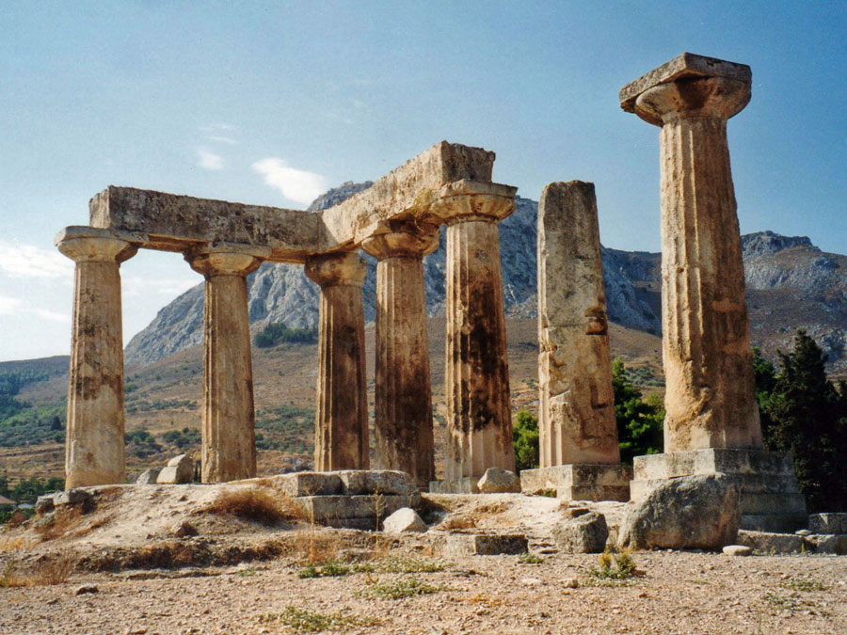
1 and 2nd Thessalonians

Slide 2

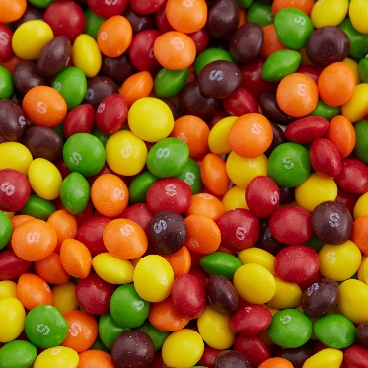
The Joy of Sharing
1 Thessalonians 1-2

Slide 3
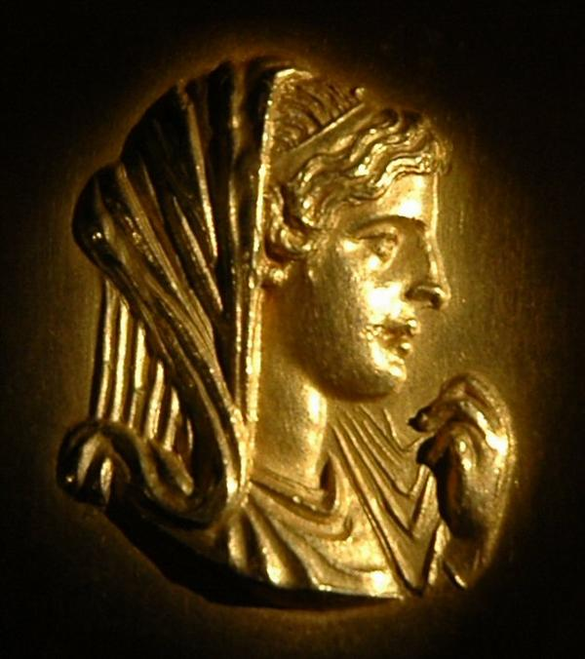
Thessalonica
Many believe it to be his earliest Epistle and the oldest book in the New Testament around A.D. 52-53.
Thessalonica was a major port city and trade center on the Aegean Sea.
Macedonia
Black Sea
Rome
Italy
Adriatic Sea
Thessalonica
Mysia
Thessaloniki:
The city was named in honor of Thessalonica, sister of Alexander the Great and wife of the Greek military leader Cassander.
Sicily
Crete
Mediterranean Sea

Slide 4
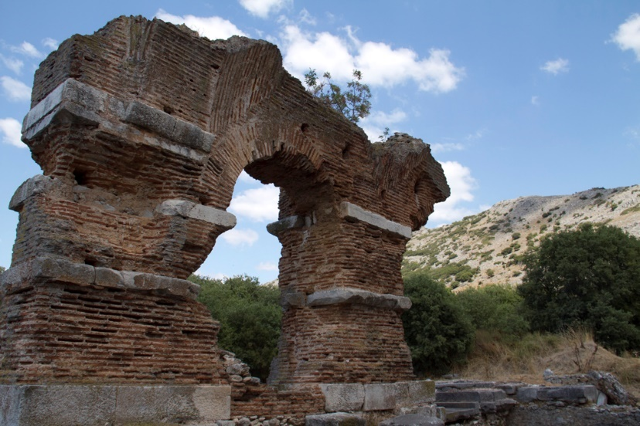
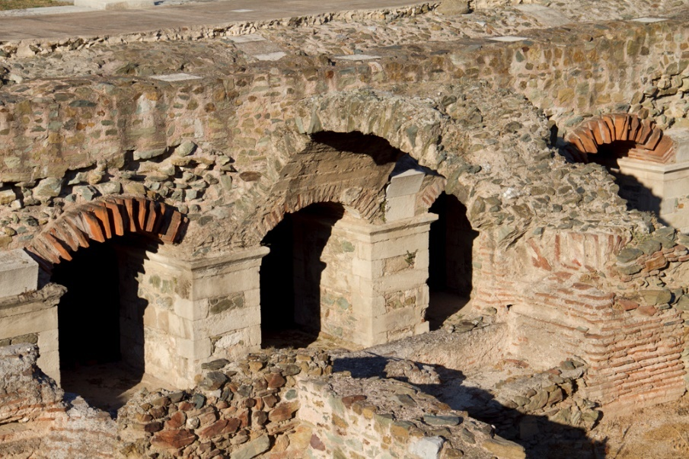
Paul’s Epistles
The church had its beginnings during Paul’s second missionary journey soon after leaving Philippi.
He had 3 successful Sabbath Days preaching the gospel of Jesus Christ in the Jewish synagogues. However, some unbelievers gathered a hostile crowd.
Concerned for the Saints safety Paul and other companions left. Later he sent Timothy back to strengthen the young church.
Paul wrote the letter from Corinth.
Philipi
Thessalonica
Corinth
Bible Dictionary

Slide 5
The Saints in Thessalonica
The Saints in Thessalonica were some of the earliest European converts to the Church.
Paul, Silas, and Timothy had first preached there during Paul’s second missionary journey but were driven out of the city by some of the Jewish leaders.
The Thessalonian Saints continued to be persecuted even after Paul and his companions left.
Paul later wrote his epistle to the Saints to encourage them as they faced persecution.
Silvanus = Silas
Timotheus= Timothy
Thessalonians 1:1; Acts 17:5-15

Slide 6

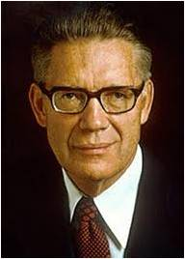
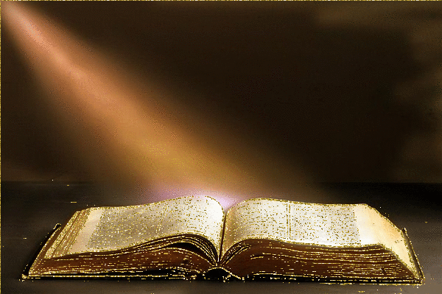
Preaching With Power
“The true gospel consists of two things:
The Word, and The Power.
Anyone can have the word; the books in which it is written are universally available.
But the power must come from God; it is and must be dispensed according to his mind and his will to those who abide the law entitling them to receive it.
“The word of the gospel is the spoken or written account of what men must do to be saved. …
“But actual salvation comes only when the power of God is received and used; and this power is the power of the priesthood and the power of the Holy Ghost.” (2)
Thessalonians 1:5-6

Slide 7
Following and Sharing
As we teach the gospel of Jesus Christ by the word and power of God, we can help others become followers of the Lord and His servants.
“And ye became followers of us, and of the Lord, having received the word in much affliction, with joy of the Holy Ghost:”—
1 Thessalonians 1:6
We can share the gospel through our example
Thessalonians 1:5-9

Slide 8

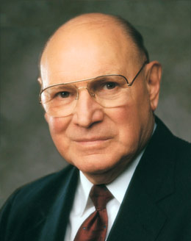
g
…[Paul] noted what must have been their crowning achievement—that they were inspiring examples to all their neighbors and that from them the word of the Lord had extended to others everywhere, far beyond their boundaries.
Paul paid tribute to them when he told them that wherever he traveled, he found people telling him about their remarkable good works and faith in God.” (3)
“Behold, I sent you out to testify and warn the people, and it becometh every man who hath been warned to warn his neighbor.”—
D&C 88:81
Thessalonians 1:5-6

Slide 9
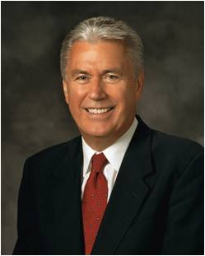
Others need to see you being an example, a representative of The Church of Jesus Christ of Latter-day Saints.
“The most effective way to preach the gospel is through example.
If we live according to our beliefs, people will notice.
If the countenance of Jesus Christ shines in our lives.
If we are joyful and at peace with the world, people will want to know why. (4)

Slide 10

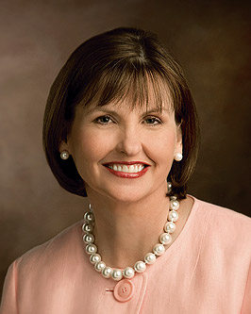
“The blessings you receive because of your goodness affect not only your lives but also… lives of countless others in profound but often unknown ways.”
As we minister to others in love, we can help them become better followers of Jesus Christ
(5)

Slide 11
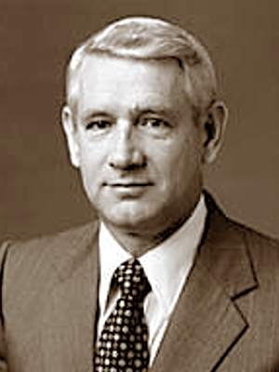

Mormon Example:
In dress---modestly
In manner—politeness, courteous
In character—honesty, trustworthy
In convictions—honoring priesthood,
obeying the Sabbath,
living the covenants, and
being not ashamed
to be a member of
the LDS Church.
“Those who receive the gospel are expected to manifest its fruits in their lives, not only for their own benefit and blessing, but for the purpose of drawing others to the truth. …
“… In significant ways their lives will manifest the fruits of the gospel and set them apart as a beacon to all who are seeking for light and truth” (6)
Thessalonians 2:1-13

Slide 12
“For I am not ashamed of the gospel of Christ: for it is the power of God unto salvation to every one that believeth.”
Romans 1:16

Slide 13
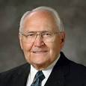
“Ye are witnesses, and God also…”
As of 2009:
The Church has over 50,000 full-time missionaries serving around the world.
Unfortunately most of our full-time missionaries spend more of their time trying to find people rather than teaching them.
I view our full-time missionaries as an underutilized teaching resource.
If you and I did more of the finding for the full-time missionaries and freed them up to spend more time teaching the people we find, great things would begin to happen.
We’re missing a golden opportunity to grow the Church when we wait for our full-time missionaries to warn our neighbors instead of doing it ourselves. (7)
True ministers live and teach the gospel in righteousness
1 Thessalonians 2:1-10

Slide 14
“Remember the worth of souls is great in the sight of God;”
--D&C 18-10

Slide 15
“…and bring, save it be one soul unto me, how great shall be your joy with him in the kingdom of my Father.”
--D&C 18:16

Slide 16
Missionaries will continue to do the best they can, but wouldn’t it be better if you and I stepped up to do a job that is rightfully ours? (7)
Every Member a Missionary
The Church of Jesus Christ of Latter-Day Saints
Brother ________________
The Church of Jesus Christ of Latter-Day Saints
Sister ________________

Slide 17
“…Go ye into the all the world, and preach the gospel to every creature.”
--Mark 16:15

Slide 18
Chewy Gum
Besides Missionaries who receive glory and have joy in those they teach and convert, so can we as neighbors (friends) have joy in sharing the Gospel of Christ.
1 Thessalonians 2:11-20

Slide 19
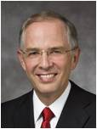
Ministering
A person with a good heart can help someone fix a tire, take a roommate to the doctor, have lunch with someone who is sad, or smile and say hello to brighten a day.
But a follower of the first commandment [who loves God with all his heart] will naturally add to these important acts of service, [by] encouraging the person who is doing well in keeping the commandments and sharing wise counsel to strengthen the faith of someone who is slipping or who needs help in moving back onto the path he once traveled.
(8)

Slide 20
Sources:
New Testament Institute Student Manual Chapter 45
Elder Bruce R. McConkie (Doctrinal New Testament Commentary, 3 vols. [1965–73], 3:42–43).
Elder Joseph B. Wirthlin (“There Am I in the Midst of Them,” Ensign, May 1976, 56–57).
President Dieter F. Uchtdorf (“Waiting on the Road to Damascus,” Ensign or Liahona, May 2011, 77).
Ann M. Dibb “I know it. I live it. I Love it” 2010 October General Conference
Elder Dean L. Larsen (in Conference Report, Oct. 1985, 85; or Ensign, Nov. 1985, 68).
Elder L. Tom Perry “Bring Souls unto Me” April 2009 Gen. Conf.
Neil L. Andersen, “A Holier Approach to Ministering” [Brigham Young University devotional, Apr. 10, 2018], 3, speeches.byu.edu

Slide 21

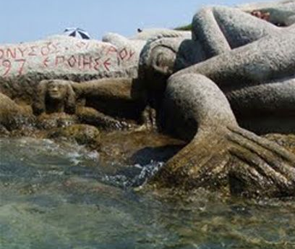
THE FIRST AND SECOND LETTERS OF PAUL TO THE SAINTS AT THESSALONICA, CA. A.D. 52–53 WRITTEN FROM CORINTH DURING PAUL’S SECOND MISSIONARY JOURNEY (1 AND 2 THESSALONIANS)
Gospel Comes in Word and Power | 1:1–10
Paul’s Example in Thessalonica | 2:1–12
Faith and Patience of the Converts | 2:13–20
About the Red Background for the slides January 23, 2017:
Thanks to a snafu during wet conditions, Skittles slid off a delivery truck and spilled all over the highway, where the Dodge County Sheriff’s Office came upon them and understandably felt perplexed. (Partly because all of them were the red color and had started to “disintegrate in the rain.”) The office later learned they were “intended to be feed for cattle,” confusing even more people. Now candy giant Mars says that it’s “investigating” why, exactly.
A representative for Mars tells the AP this situation — cows being fed candy — actually happens a lot. Producers will buy unused candies, then “incorporate” them with other materials to make feed. The mystery is why this giant box, since the Skittles in question weren’t authorized for that purpose. “We don’t know how it ended up as it did,” the representative says, “and we are investigating.” She adds these candies in particular were defective and should’ve been destroyed, but the only thing “defective” about them was improper branding. “There’s no little ‘S’ on them,” as the local sheriff, Dale Schmidt, explained to WISN. He says the “distinct Skittles smell” was a dead giveaway, though. He’s also using this time in the limelight to crack bad jokes: He wrote on Facebook that since only the red were involved, it was “difficult to ‘Taste the Rainbow’ in its entirety,” and that in the end, “these Skittles are actually for the Birds” (ba-dum chssh!). By Clint Rainey
Life and Teachings of Jesus and His Apostles Chapter 33
Just for Fun:
Something of Interest
Theslonike; Thessaloniki:
An interesting Greek legend is the story of Alexander the Great’s younger sister, Thesslonike. When Alexander came home from one of his conquests, he brought water from the Fountain of Immortality which he used to wash his sister’s hair. When Alexander died, Thesslonike was so filled with grief that she attempted to end her life by jumping off of a cliff into the ocean. Instead of drowning, she was transformed into a mermaid.
According to the legend, sailors in the Aegean Sea were approached by Thesslonike who asked “Is Alexander was still alive?” If they said “yes,” all was well and they could sail on. If they answered “no,” she transformed into a sea monster, killed the sailors, and sank the ship.
Skittles

Slide 22

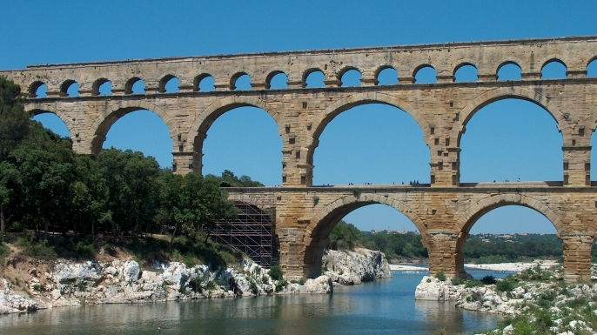
A Thief in the Night
1 Thessalonians 3-5
“And again, verily I say unto you, the coming of the Lord draweth nigh, and it overtaketh the world as a thief in the night—therefore, gird up your loins, that you may be the children of light, and that day shall not overtake you as a thief.”
D&C 106:4–5

Slide 23

True or False
1. The faithful Saints who die before the Second Coming will not be resurrected until the end of the Millennium.
Don’t Answer Yet!
2. The faithful Saints who are alive at the Second Coming will be caught up to meet Christ when He comes.
3. The Second Coming will surprise everyone as a thief in the night.

Slide 24
Forced to Leave
While preaching the gospel for a short time in Thessalonica, Paul, Silas, and Timothy were forced out of the city by Jewish leaders.
Acts 17:5-15
Timothy reported to Paul that the Saints had remained faithful despite experiencing persecution.
Timothy also likely reported that the Saints had many questions about the Second Coming of Jesus Christ.
Paul wrote his epistle to the Thessalonian Saints to answer their questions.
1 Thessalonians 3:1-7

Slide 25

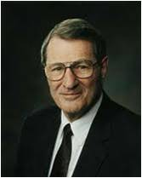
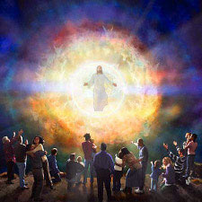
To Strengthen the Saints
“perfect that which is lacking in your faith”
Paul reminded them that discipleship required consistent growth and improvement. He encouraged them to “increase and abound in love one toward another,” to “abound more and more” in their efforts to please God, and to “increase more and more” in love. (1)
“discipleship is to be lived in crescendo”(2)
In order for them to grow and increase they needed to better understand how to prepare for the Second Coming of Christ.
1 Thessalonians 3:9-10; 12; 4:1, 10

Slide 26
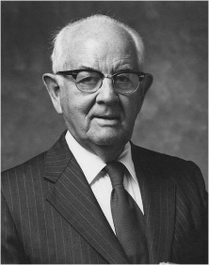
To Prepare
1 Thessalonians 4:2-5
Abstain from Fornication
"The world may countenance premarital sex experiences, but the Lord and his church condemn in no uncertain terms any and every sex relationship outside of marriage.
"Wholesome family life with children was set up as the perfect way, thousands of years ago. If all the world should devise some other sort of relationship, it would be wrong even if the voting were 3 1/2 billion to one." (3)

Slide 27

To Prepare
1 Thessalonians 4:6-8
God hath not called us unto uncleanness, but unto holiness
"In our journey toward eternal life, purity must be our constant aim. To walk and talk with God, to serve with God, to follow his example and become as a god, we must attain perfection.
In his presence there can be no guile, no wickedness, no transgression. In numerous scriptures he has made it clear that all worldliness, evil and weakness must be dropped before we can ascend unto 'the hill of the Lord.'
The Psalmist asked: 'Who shall ascend into the hill of the Lord? or who shall stand in his holy place?'
(3)
He that hath clean hands, and a pure heart; who hath not lifted up his soul unto vanity, nor sworn deceitfully.
Psalms 24:4

Slide 28
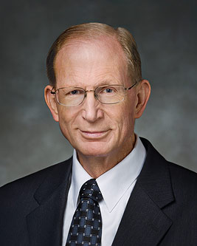
To Prepare
1 Thessalonians 4:9-12
Increase In Love for One Another and Study to be Quiet
“Personal prayer, study, and pondering are vital to the building up of the kingdom within our own souls.
It is in quiet moments of contemplation and communion with the Almighty that we come to know and love Him as our Father” (4)

Slide 29
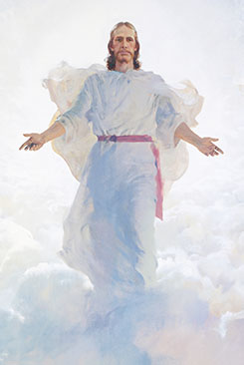
Resurrection
The Thessalonian Saints misunderstood certain aspects of the Second Coming. They worried that Church members in Thessalonica who had died would not be able to experience the blessings of the Second Coming.
Faithful Saints who die before the Second Coming will be resurrected when Christ comes again
1. The faithful Saints who die before the Second Coming will not be resurrected until the end of the Millennium.
False
1 Thessalonians 4:13-18

Slide 30
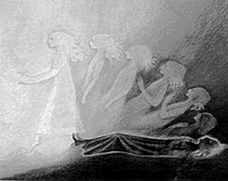
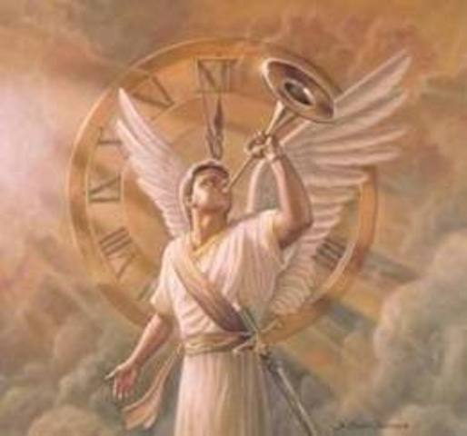
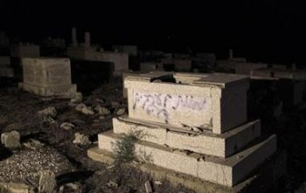
Asleep
The faithful Saints who are resurrected at the Second Coming will be caught up to meet Jesus Christ and will descend with Him in glory.
And they who have slept in their graves shall come forth, for their graves shall be opened; and they also shall be caught up to meet him in the midst of the pillar of heaven—
They are Christ’s, the first fruits, they who shall descend with him first, and they who are on the earth and in their graves, who are first caught up to meet him; and all this by the voice of the sounding of the trump of the angel of God.
D&C 88:97-98
1 Thessalonians 4:13-14, 16

Slide 31
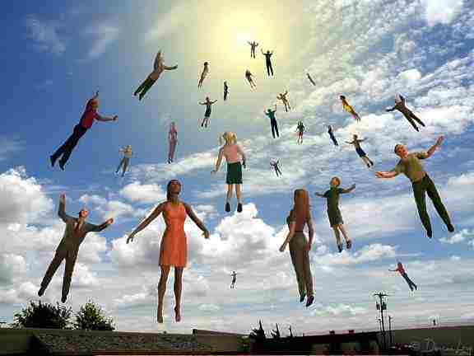
Caught Up
The Joseph Smith Translation replaces we in these verses with they, reflecting that the Second Coming would not occur in Paul’s day.
Faithful Saints who are alive at the Second Coming will be caught up to meet Jesus Christ when He comes
“Then they who are alive, shall be caught up together into the clouds with them who remain, to meet the Lord in the air; and so shall we be ever with the Lord” JST 1 Thessalonians 4:17 footnote a
Many Christians use the word rapture (from a Latin term meaning “caught up”) when referring to the time when the righteous will be caught up to meet the Savior at His coming. (1)
2. The faithful Saints who are alive at the Second Coming will be caught up to meet Christ when He comes.
True
rapture
1 Thessalonians 4:15-17

Slide 32
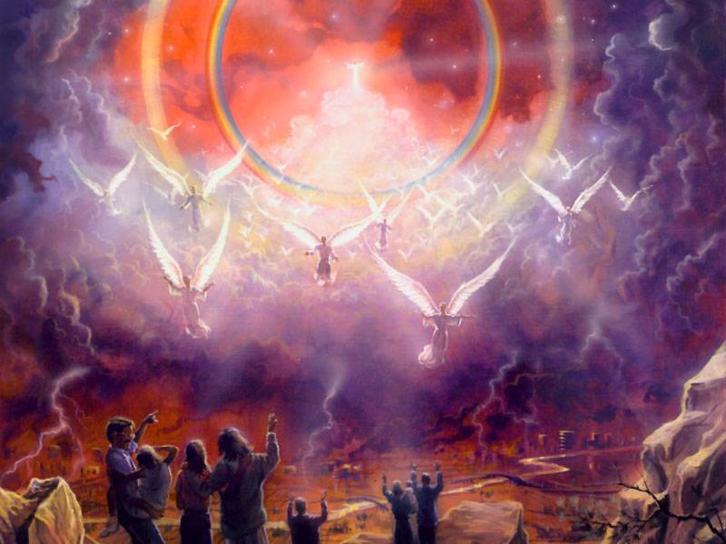
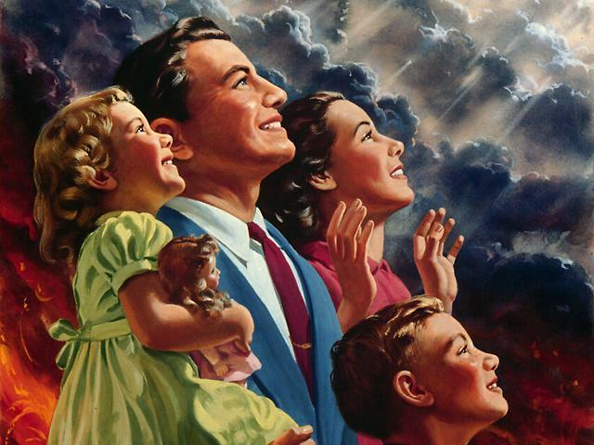
Doctrine and Covenants
And then they shall look for me, and, behold, I will come; and they shall see me in the clouds of heaven, clothed with power and great glory; with all the holy angels; and he that watches not for me shall be cut off. D&C 45:44
And the saints that are upon the earth, who are alive, shall be quickened and be caught up to meet him. D&C 88:96
And take the helmet of salvation, and the sword of my Spirit, which I will pour out upon you, and my word which I reveal unto you, and be agreed as touching all things whatsoever ye ask of me, and be faithful until I come, and ye shall be caught up, that where I am ye shall be also. Amen.
D&C 27:18
Last of all, these all are they who will not be gathered with the saints, to be caught up unto the church of the Firstborn, and received into the cloud. D&C 76:104

Slide 33
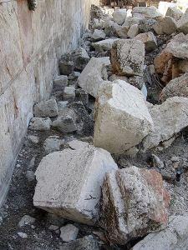
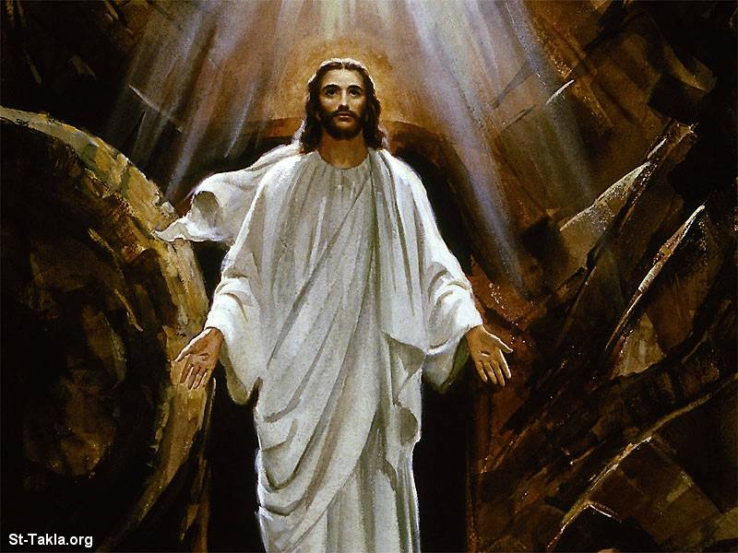
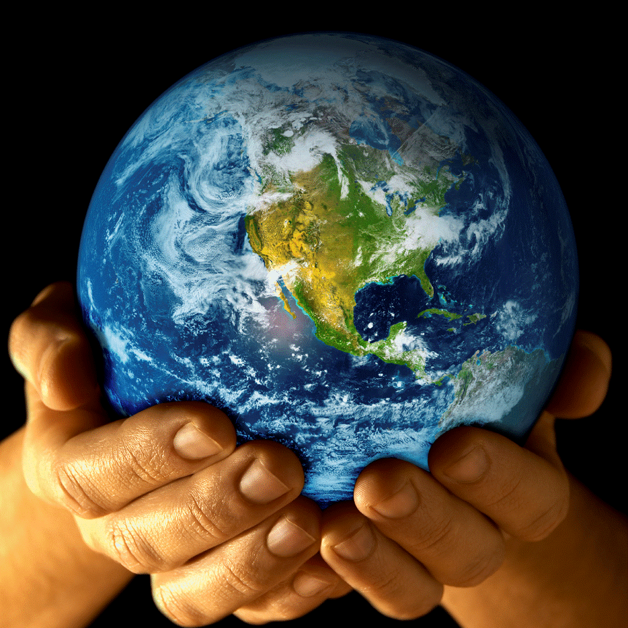
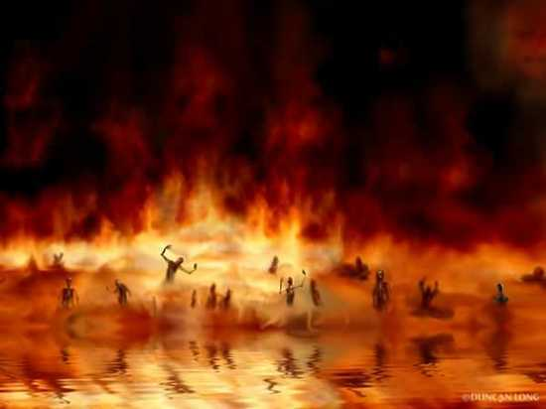
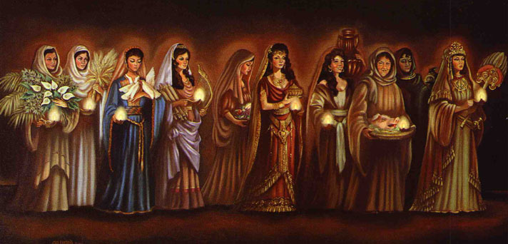
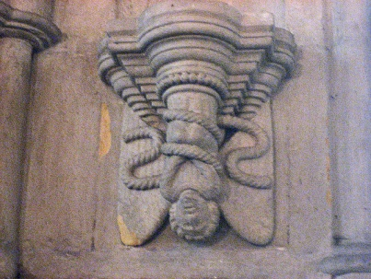
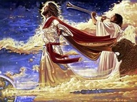
The Second Coming---Read D&C 45:47-59
v.48
v. 50
v. 51-54
V. 58
v.55
V. 56
V. 59

Slide 34
A Thief in the Night
“unexpectedly and without warning”
Paul taught that if the followers of Jesus Christ “are not in darkness” they will not be caught off guard by the Lord’s return.
Children of the Night = These are the people of the world who dwell in darkness. Therefore they will not “see” the signs which herald the approach of this great event. The “day of the Lord” shall be a dreadful day for them.
Children of the Day = These are those who dwell in light and truth. They “see” the warning signs and therefore are spiritually prepared for the coming of Jesus. For them, the “day of the Lord” shall be a great day.
I, the Lord God, have spoken it; but the hour and the day no man knoweth, neither the angels in heaven, nor shall they know until he comes.
D&C 49:7
1 Thessalonians 5:2
(8)

Slide 35
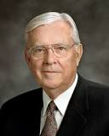
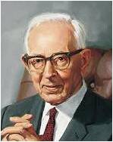

We Do Not Know…
"I am called as one of the Apostles to be a special witness of Christ in these exciting, trying times, and I do not know when He is going to come again. As far as I know, none of my brethren in the Council of the Twelve or even in the First Presidency knows. And I would humbly suggest to you, my young brothers and sisters, that if we do not know, then nobody knows, no matter how compelling their arguments or how reasonable their calculations. . . .
I believe when the Lord says 'no man' knows, it really means that no man knows. You should be extremely wary of anyone who claims to be an exception to divine decree." (5)
“I do not know when he is going to come. No man knows. Even the angels of heaven are in the dark in regard to that great truth.
But this I know, that the signs that have been pointed out are here. The earth is full of calamity, of trouble. The hearts of men are failing them.
We see the signs as we see the fig tree putting forth her leaves; and knowing this time is near, it behooves me and it behooves you, and all men upon the face of the earth, to pay heed to the words of Christ, to his apostles and watch, for we know not the day nor the hour. But I tell you this, it shall come as a thief in the night, when many of us will not be ready for it.” (6)
1 Thessalonians 5:2; Matthew 24:36-37

Slide 36
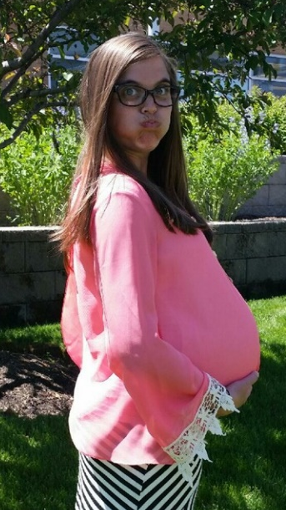
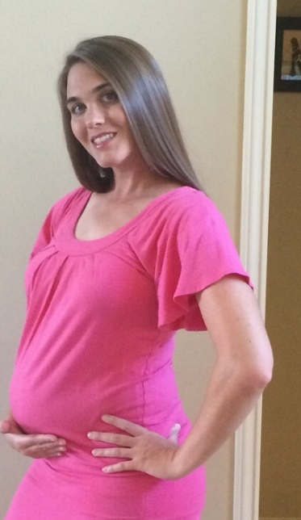
A Woman With Child
“She does not know the hour or the minute of the child’s arrival, but she does know the approximate time.” (6)
Based on this analogy, we might also consider how trials preceding the Second Coming are similar to labor pains.
But just as the arrival of a baby is wonderful, so will the Second Coming be wonderful to the righteous.
If we are faithful and watch for the signs preceding the Second Coming of Jesus Christ, then we will be prepared when He comes again
False
3. The Second Coming will surprise everyone as a thief in the night.
1 Thessalonians 5:3

Slide 37
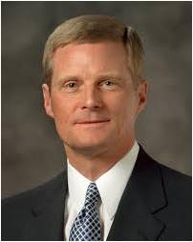
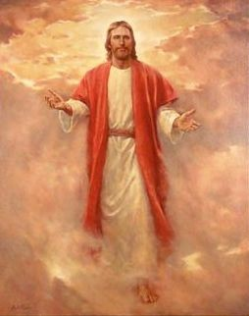
Quench Not The Spirit
To not extinguish or stifle the influence of the Holy Ghost in one’s own life
“If something we think, see, hear, or do distances us from the Holy Ghost, then we should stop thinking, seeing, hearing, or doing that thing.
If that which is intended to entertain, for example, alienates us from the Holy Spirit, then certainly that type of entertainment is not for us.
Because the Spirit cannot abide that which is vulgar, crude, or immodest, then clearly such things are not for us. Because we estrange the Spirit of the Lord when we engage in activities we know we should shun, then such things definitely are not for us…
“… As we become ever more immersed in the Spirit of the Lord, we should strive to recognize impressions when they come and the influences or events that cause us to withdraw ourselves from the Holy Ghost.”
1 Thessalonians 5:19
(9)

Slide 38
Hold Fast To That Which is Good
Paul Speaking to the Thessalonians:
‘Now that you are members of the Church, that you have come in at the gate of repentance and baptism, press forward to the end and do the things that will enable you to be saved in the everlasting kingdom of the Father’” (6)
Pray always
Give Thanks
Utilize the Holy Ghost
Take advice from the Prophets
1 Thessalonians 5:16-21

Slide 39
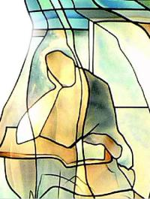
Prove All Things
To examine or test
As members of the Church, we are taught not only to learn the gospel, but to ponder, pray about, and ultimately understand it.
Therefore, go ye unto your homes, and ponder upon the things which I have said, and ask of the Father, in my name, that ye may understand, and prepare your minds for the morrow, and I come unto you again.
1 Thessalonians 5:21; 3 Nephi 17:3

Slide 40
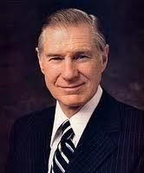
Abstain From the Appearance of Evil
“I strongly urge you that if there is any question in your minds or hearts about whether your personal conduct is right or wrong, don’t do it.
It is the responsibility of the prophets of God to teach the word of God, not to spell out every jot and tittle of human conduct.
If we are conscientiously trying to avoid not only evil but the very appearance of evil, we will act for ourselves and not be acted upon.” (10)
1 Thessalonians 5:22

Slide 41
Paul’s promise is that if we do this, then God will sanctify us. Such sanctification, or cleansing, then makes it possible for our “whole spirit and soul and body [to] be preserved blameless unto the coming of our Lord Jesus Christ.”
1 Thessalonians 5:23
(8)

Slide 42
Sources:
New Testament Institute Student Manual Chapter 46
Elder Neal A. Maxwell (“Premortality, a Glorious Reality,” Ensign, Nov. 1985, 15).
President Spencer W. Kimball (The Teachings of Spencer W. Kimball, edited by Edward L. Kimball [Salt Lake City: Bookcraft, 1982], 265.); (Miracle of Forgiveness, chap. 2)
Elder Bruce D. Porter (“Building the Kingdom,” Ensign, May 2001, 81).
Elder M. Russell Ballard (Leon R. Hartshorn, Dennis A. Wright, and Craig J. Ostler, eds., The Doctrine and Covenants, a Book of Answers: The 25th Annual Sidney B. Sperry Symposium [Salt Lake City: Deseret Book Co., 1996], 207-208.)
Elder Bruce R. McConkie (Doctrinal New Testament Commentary, 3:54). Doctrines of the Restoration: Sermons and Writings of Bruce R. McConkie, ed. Mark L. McConkie [1989], 347
President Joseph Fielding Smith (Doctrines of Salvation, comp. Bruce R. McConkie, 3 vols. [1954–56], 3:52–53).
Life and Teachings of Jesus Christ and His Disciples Chapter 33
Elder David A. Bednar (“That We May Always Have His Spirit to Be with Us,” Ensign or Liahona, May 2006, 30).
President James E. Faust (“The Devil’s Throat,” Ensign or Liahona, May 2003, 51). Paul offered similar counsel in 1 Corinthians 8:9–13.
Presentation by ©http://fashionsbylynda.com/blog/

Slide 43
THE FIRST AND SECOND LETTERS OF PAUL TO THE SAINTS AT THESSALONICA, CA. A.D. 52–53 WRITTEN FROM CORINTH DURING PAUL’S SECOND MISSIONARY JOURNEY (1 THESSALONIANS)
Timothy’s Mission to Thessalonica | 3:1–13
Live in Holiness and Charity | 4:1–12
The Saints Saved at Second Coming | 4:13–18
Saints Know Season of Second Coming | 5:1–11
Be Considerate Saints | 5:12–28
Being Chaste 1 Thessalonians 4:3-5:
“The Church of Jesus Christ of Latter-day Saints has a single, undeviating standard of sexual morality: intimate relations are proper only between a man and a woman in the marriage relationship prescribed in God’s plan. Such relations are not merely a curiosity to be explored, an appetite to be satisfied, or a type of recreation or entertainment to be pursued selfishly. They are not a conquest to be achieved or simply an act to be performed. Rather, they are in mortality one of the ultimate expressions of our divine nature and potential and a way of strengthening emotional and spiritual bonds between husband and wife. We are agents blessed with moral agency and are defined by our divine heritage as children of God—and not by sexual behaviors, contemporary attitudes, or secular philosophies” Elder David A. Bednar (“We Believe in Being Chaste,” Ensign or Liahona, May 2013, 42).
Holiness 1 Thessalonians 4:5-7:
“Holiness … comes by faith and through obedience to God’s laws and ordinances. God then purifies the heart by faith, and the heart becomes purged from that which is profane and unworthy.” President James E. Faust (“Standing in Holy Places,” Ensign or Liahona, May 2005, 62).
Life and Teachings of Jesus and His Apostles Chapter 33
Caught Up 1 Thessalonians 4: 16-17:
The Second Coming of Christ will not be complete until Jesus gathers to himself a celestial gathering. This grand meeting amidst the clouds will involve three different groups of saints. The first group are described as 'all the holy angels' (DC 45:44). They are those who were resurrected at the time of Christ (Matt 27:52-53, 3 Ne. 23:19-13). They are not an assembly of angels which do not belong to this earth, for 'there are no angels who minister to this earth but those who do belong or have belonged to it' (DC 130:5). The second group are those saints who have died since the resurrection of Christ. This group was a concern to the Thessalonian saints (v. 13-14), but Paul promised that they would be caught up as well. The third group are those mortals who are worthy of a celestial glory. The scriptures clearly promise that these three groups will be part of the heavenly throng:
'...behold, I will come; and they shall see me in the clouds of heaven, clothed with power and great glory; with all the holy angels; and he that watches not for me shall be cut off.
But before the arm of the Lord shall fall, an angel shall sound his trump, and the saints that have slept shall come forth to meet me in the cloud.
Wherefore, if ye have slept in peace blessed are you; for as you now behold me and know that I am, even so shall ye come unto me and your souls shall live, and your redemption shall be perfected; and the saints shall come forth from the four quarters of the earth.' (DC 45:44-46)
'And the saints that are upon the earth, who are alive, shall be quickened and be caught up to meet him.
And they who have slept in their graves shall come forth, for their graves shall be opened; and they also shall be caught up to meet him in the midst of the pillar of heaven-
They are Christ's, the first fruits, they who shall descend with him...' (DC 88:96-98)
gospeldoctrine.com
Increase 1 Thessalonians 3:12
“As the forces around us increase in intensity, whatever spiritual strength was once sufficient will not be enough. And whatever growth in spiritual strength we once thought was possible, greater growth will be made available to us. Both the need for spiritual strength and the opportunity to acquire it will increase at rates which we underestimate at our peril” President Henry B. Eyring (“Always,” Ensign, Oct. 1999, 9).
Vessel 1 Thessalonians 4:3-4:
The word vessel in this passage has been interpreted to mean “body.” Men and women are to control their bodies, to respect their bodies as temples of God, and to treat them with honor. They are not to use them as instruments for lustful self-gratification.
“To be sanctified is to become clean, pure, and spotless; to be freed from the blood and sins of the world; to become a new creature of the Holy Ghost, one whose body has been renewed by the rebirth of the Spirit. Sanctification is a state of saintliness, a state attained only by conformity to the laws and ordinances of the gospel. The plan of salvation is the system and means provided whereby men may sanctify their souls and thereby become worthy of a celestial inheritance.” (McConkie, Mormon Doctrine, p. 675.)

Slide 44
“When Christ appears again, will people actually be ‘caught up’ to meet him, actually lifted up from the earth like the people in the city of Enoch?” 1 Thessalonians 4:16-17:
The answer to this question is a simple yes. Let me illustrate it with a few citations from scripture. In the Doctrine and Covenants, in a context dealing with our Lord’s second advent, notice these words:
“And the saints that are upon the earth, who are alive, shall be quickened and be caught up to meet him.” (D&C 88:96. Italics added.)
Notice also these words in Doctrine and Covenants 27:18:
“… and be faithful until I come, and ye shall be caught up, that where I am ye shall be also.” [D&C 27:18] (Italics added.)
In another passage of scripture, in some respects even more remarkable for its clarity, the Apostle Paul makes this observation concerning the second coming of the Savior:
“For the Lord himself shall descend from heaven with a shout, with the voice of the archangel, and with the trump of God: and the dead in Christ shall rise first:
“Then we which are alive and remain shall be caught up together with them in the clouds, to meet the Lord in the air; and so shall we ever be with the Lord.” (1 Thes. 4:16–17. Italics added.)
Although it thus appears perfectly clear that there will be people literally “caught up” to meet the Lord at his coming, it does not follow that all people on the rolls of the Church will have this blessed privilege. Even as those who are heirs of telestial glory “will not be gathered with the saints, to be caught up unto the church of the Firstborn, and received into the cloud” (D&C 76:102), so a large proportion of Church members will not be “caught up.” Such is my opinion and for the following reasons. First of all, notice these scriptures:
“And at that day, when I shall come in my glory, shall the parable be fulfilled which I spake concerning the ten virgins.
“For they that are wise and have received the truth, and have taken the Holy Spirit for their guide, and have not been deceived—verily I say unto you, they shall not be hewn down and cast into the fire, but shall abide the day.” (D&C 45:56–57. Italics added.)
“… in the day of the coming of the Son of Man.
“And until that hour there will be foolish virgins among the wise; and at that hour cometh an entire separation of the righteous and the wicked.” (D&C 63:53–54.)
As the parable of the Ten Virgins (Matt. 25) makes clear, many members on the rolls of the Church will have no oil (or very little) in their lamps when the bridegroom comes, and they will not be in a spiritual condition suitable to be caught up to meet him.
Finally, it should be noticed that the Lord says that those who are of the Church of the Firstborn (D&C 76:54) are “they whom he shall bring with him, when he shall come in the clouds of heaven to reign on the earth over his people” (D&C 76:63). Isn’t it therefore reasonable to believe that only the most spiritual and righteous of the Saints on earth will be worthy to be caught up into the heavens and return to the earth with the Lord’s Church of the Firstborn? As a matter of fact, relatively few Saints have been sealed up unto eternal life, thus to become members of the Church of the Firstborn. Nevertheless, there are many who are keeping holy covenants made with the Lord, Saints who, if they remain faithful, will eventually become members of it. The Lord may permit a goodly number of these to be caught up to meet him. Our knowledge is incomplete in this respect.
Sidney B. Sperry Professor Emeritus of Old Testament Languages and Literature Brigham Young University
Questions and Answers: May 1973 New Era

